Slide 1
Wacissa Springs
Basin Management Action Plan (BMAP)
Celeste Lyon & Terry Hansen P.G.
Basin Coordinators
850-245-8561
Celeste.Lyon @dep.state.fl.us terry.hansen@dep.state.fl.us

Slide 2
Water Quality Framework
Collect data
Analyze and verify
List “impaired” waters
REPEAT
Monitor and report progress annually
Adapt and change – new statewide annual report
Set water quality standards
Monitor water quality
Determine pollution problems
Develop and implement restoration plans (BMAPs)
Establish restoration goals (TMDLs)
Measure success and adapt
Work with community leaders
Excessive nutrients
Bacteria, Metals, and Other Impairments
Allocate responsibilities
Identify projects
  Infrastructure
  Best Management Practices (BMPs)
Establish schedules
Identify success criteria
Gather additional data
Evaluate water quality
Adopt pollutant reduction targets

Slide 3
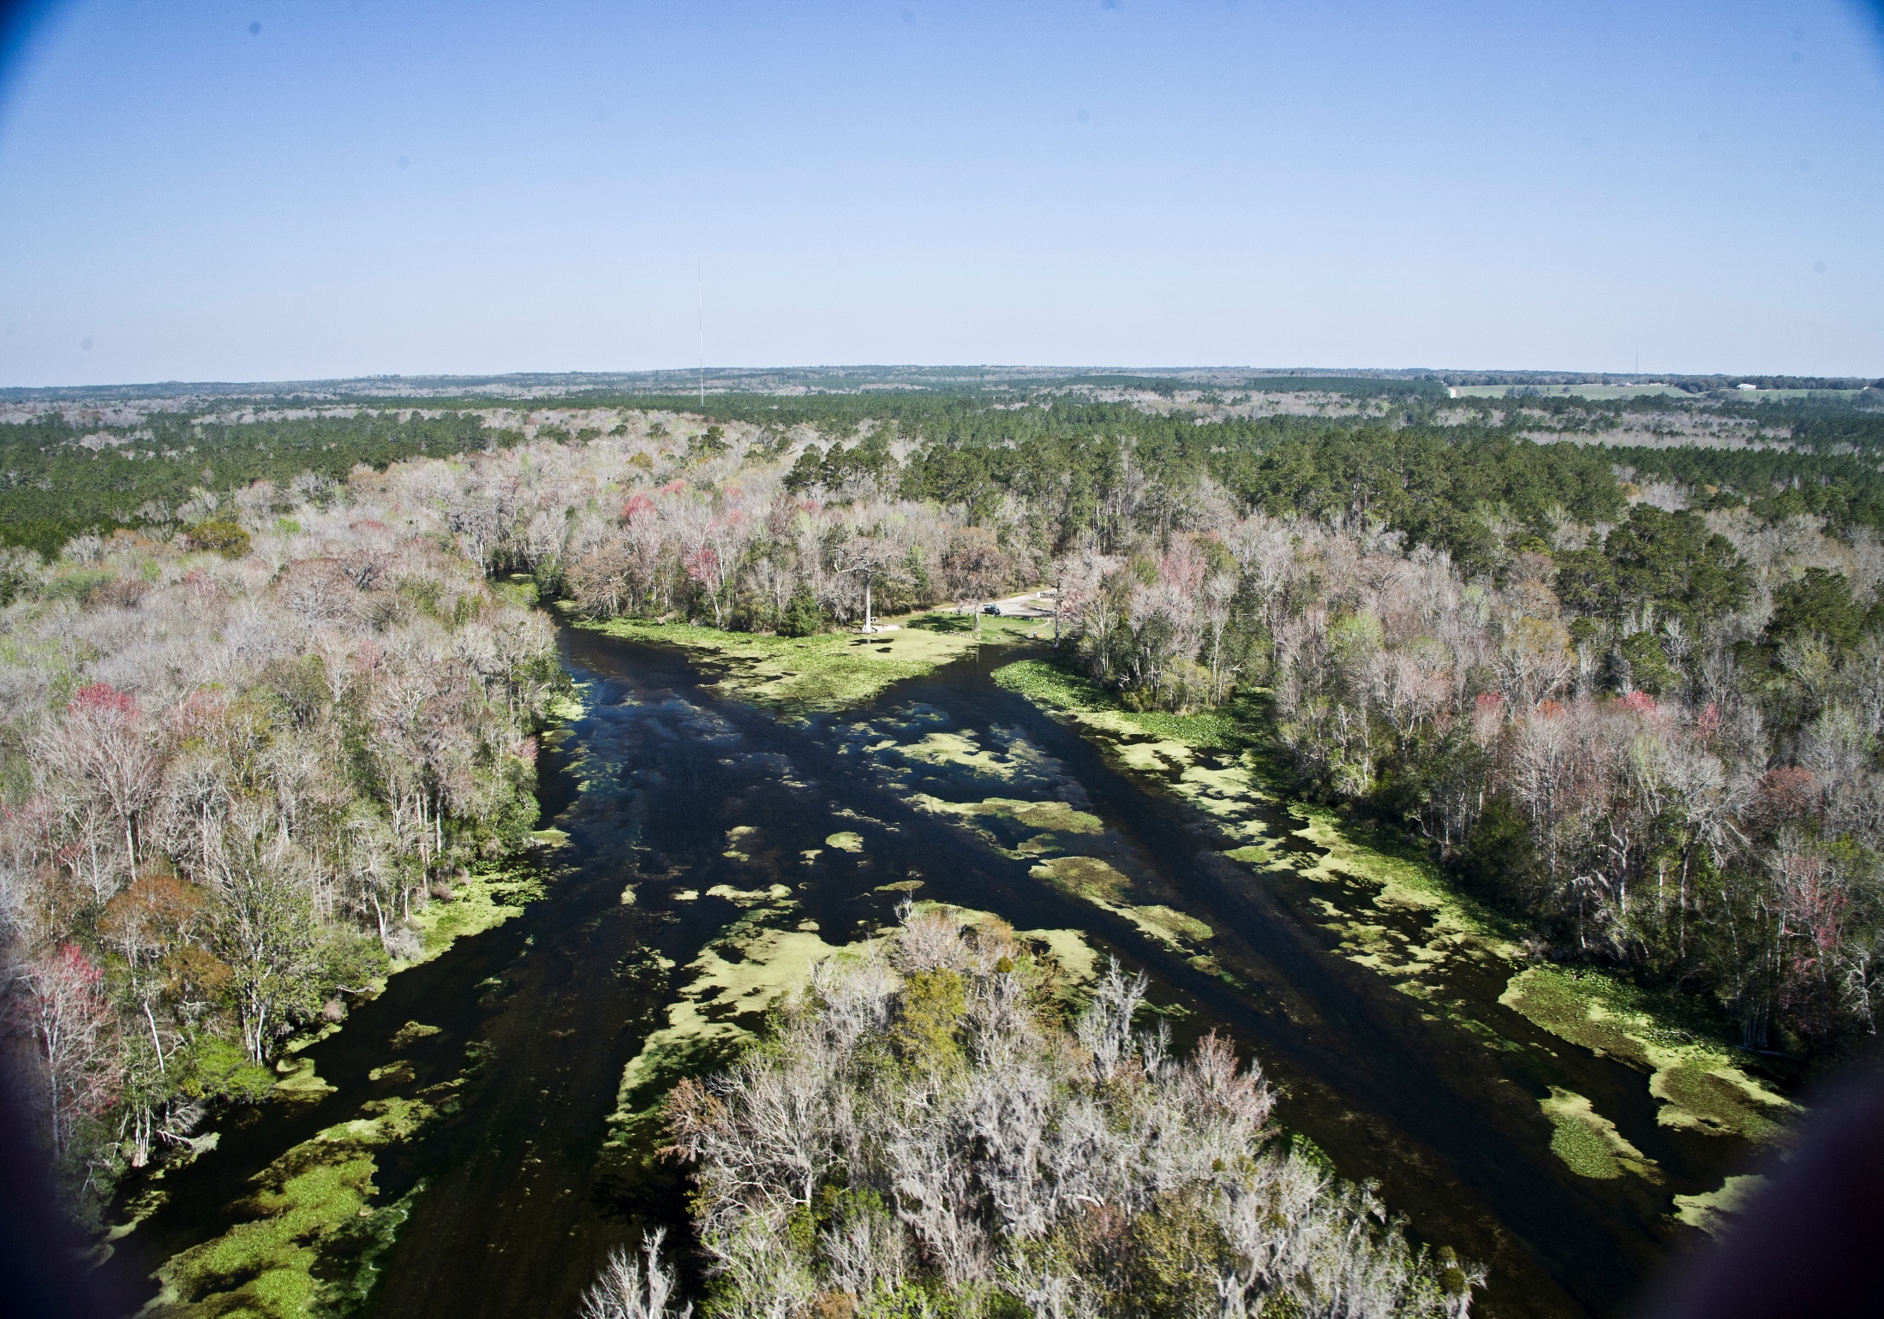

Slide 4
Wacissa River & Springs
Basin Total Maximum Daily Loads (TMDLs)
TMDL
Data Period of Record: January 1, 2005 through June 30, 2012
Adopted June 2016
TMDL Study Results:
  Nitrate shown to be primary factor in causing algal blooms
TMDL:
  Springs - 0.24 milligrams per liter (mg/L) nitrate monthly average concentration (or lower) will
  not cause an imbalance in the flora
  or fauna

Slide 5
Regulatory Framework
The process for preparing BMAPs is found in:
  Section 403.067, Florida Statutes (F.S.), known as the “Florida Watershed Restoration Act”
  The 2016 Florida Springs and Aquifer Protection Act lists requirements for BMAPs for OFS
  Requirement is to achieve TMDL in 20 years
    Plan is to achieve:
      30 % reduction in 5 years
      80 % in 10 years
      100 % in 15 years

Slide 6
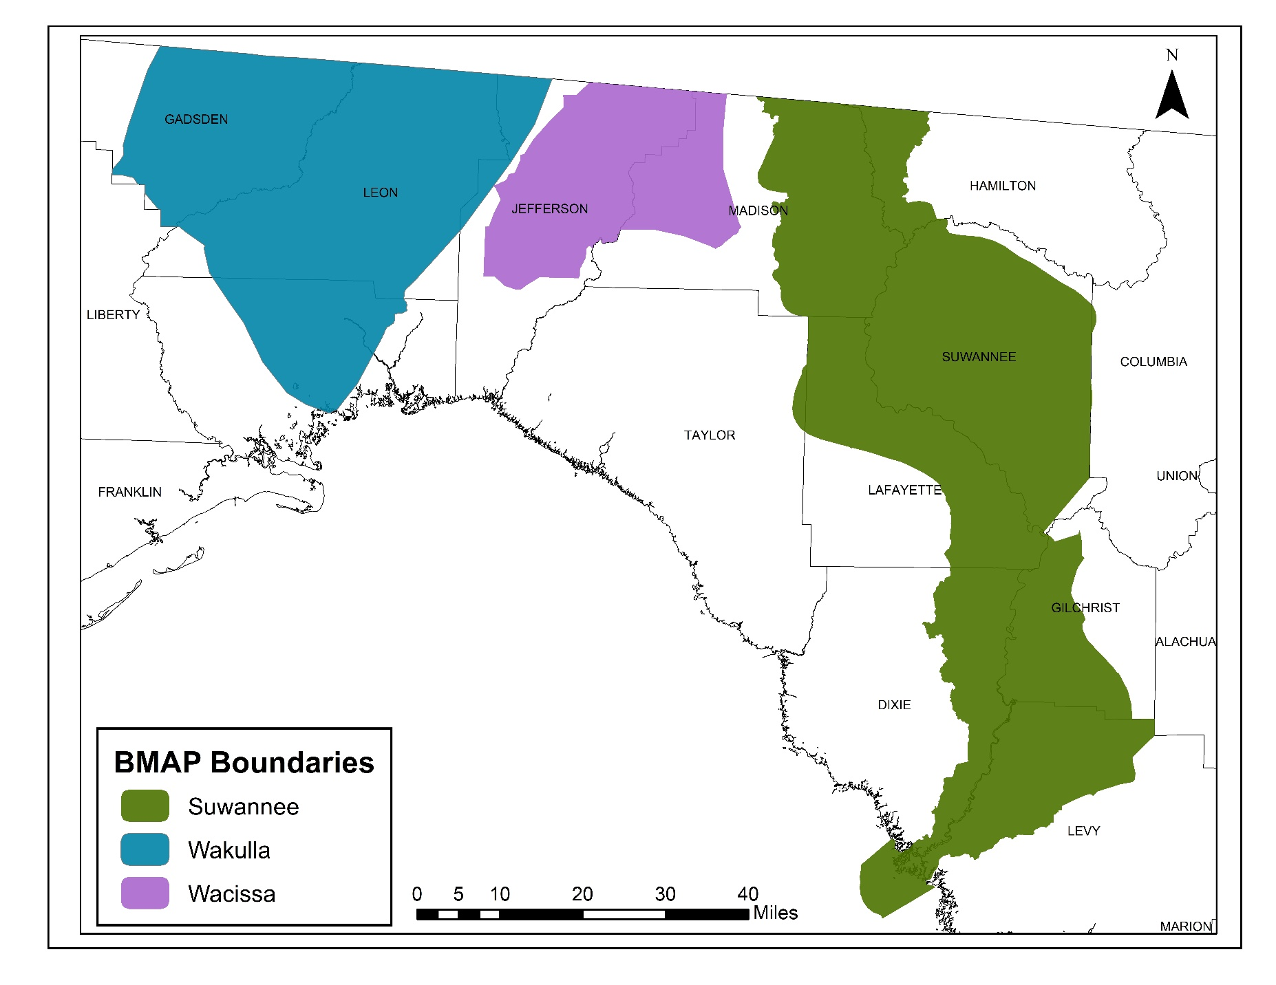
Regional BMAPs

Slide 7
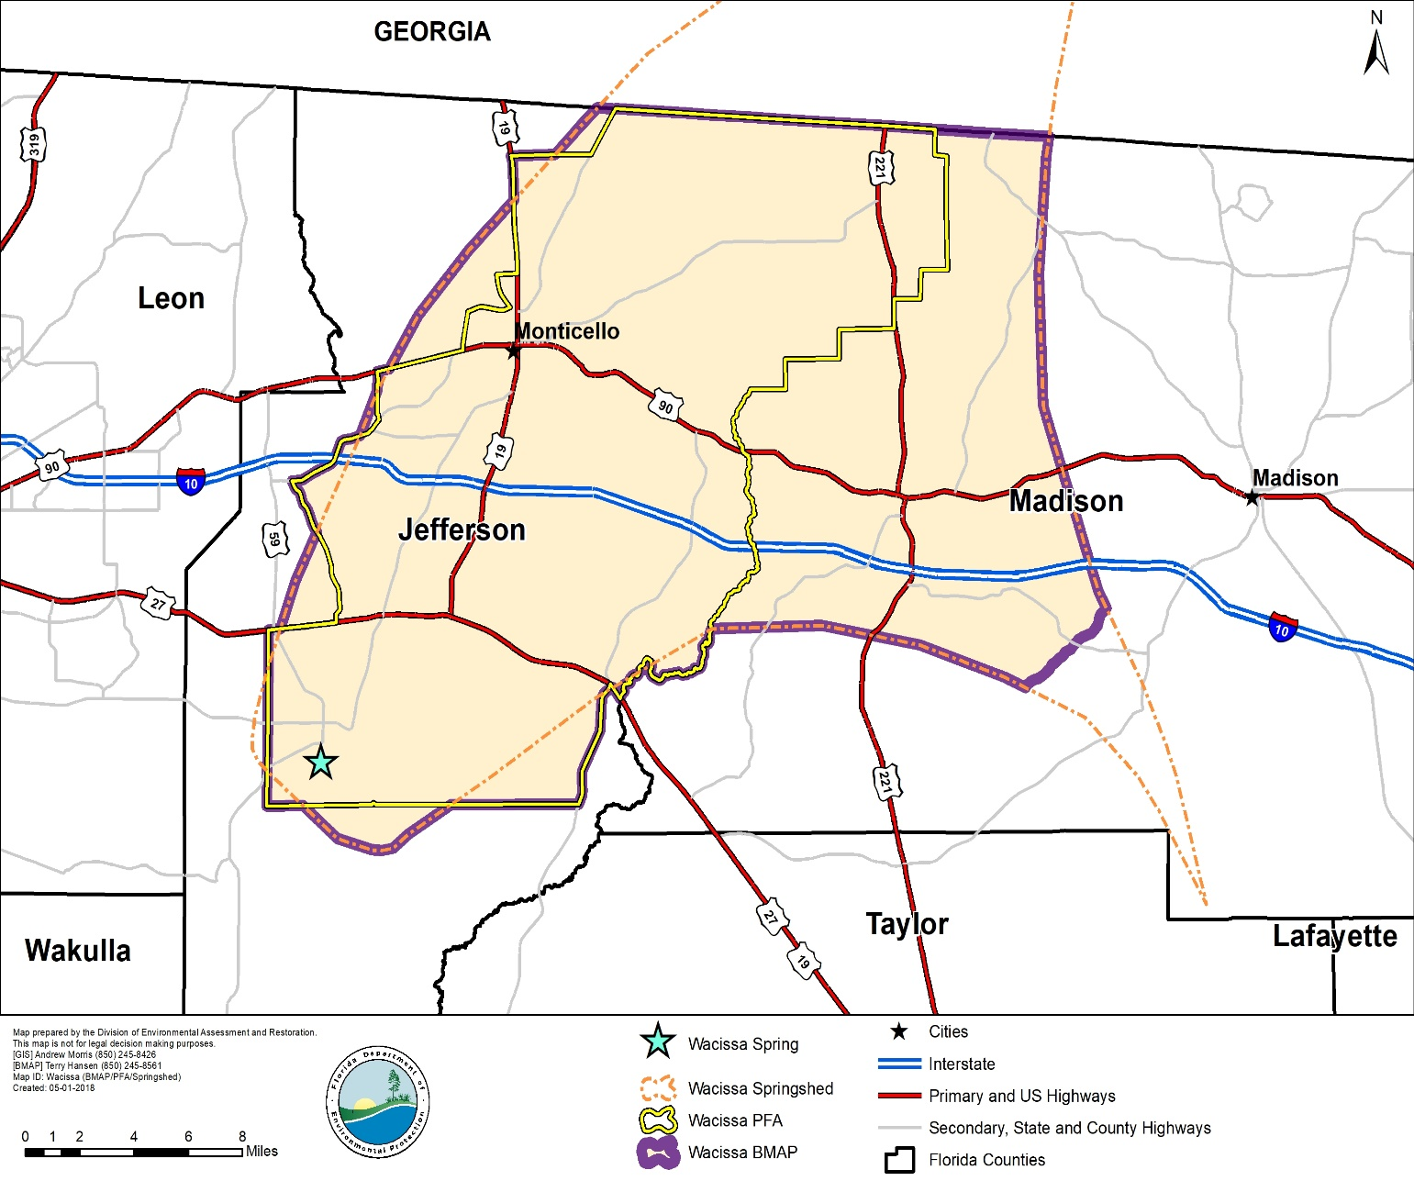
Wacissa BMAP Area
Land Uses:
Upland Forest (43%)
Agricultural (16%)
Wetland/Water (37%)
Urban/Built-Up (3%)
Other (1%)
Both agricultural and urban BMPs are being implemented.

Slide 8
2016-1 Requirements
  INCLUDE:
  Priority Focus Area (PFA) delineation
    Area(s) of basin where Floridan Aquifer is generally most vulnerable
  Identification of point source or category of nonpoint sources with the estimated allocation of the load for each.
    Nitrogen Source Inventory Loading Tool (NSILT)
Notes:
Definition: area or areas of a basin where the Floridan Aquifer is generally most vulnerable to pollutant inputs where there is a known connectivity between ground water pathways and an Outstanding Florida Spring (OFS), as determined by the department in consultation with the appropriate water management districts, and delineated in a BMAP.
Using the best data available from the water management districts and other credible sources, the department, in coordination with the water management districts, shall delineate priority focus areas for each OFS or group of springs that contains one or more OFS and is identified as impaired in accordance with s. 373.807.
PFA and is effective upon incorporation in a basin management action plan.
For ease of implementation delineation Shall use understood and identifiable boundaries such as:
Roads.
Political jurisdictions

Slide 9
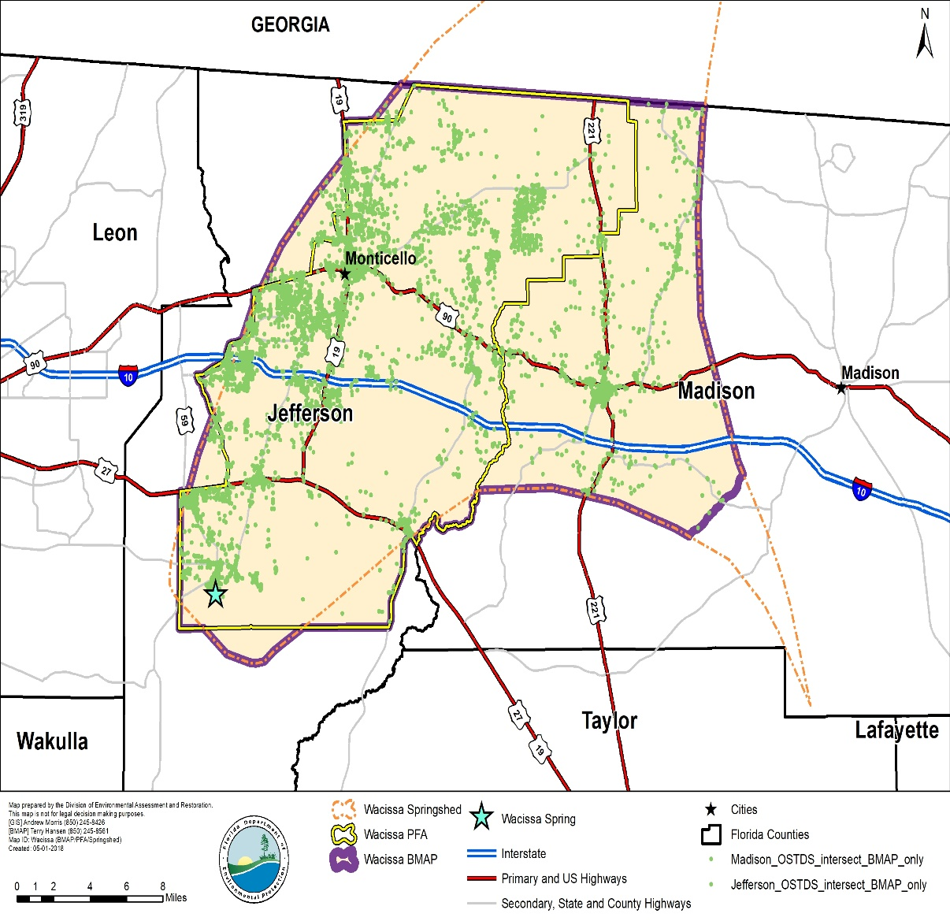
PFA/NSILT Requirement
Priority Focus Area (PFA) – developed for OFS(s) and used to focus restoration efforts
Nitrogen Source Inventory Loading Tool (NSILT) – developed for OFS springsheds to estimate sources of nitrogen to groundwater
  Used to determine if >20% load is from OSTDS

Slide 10
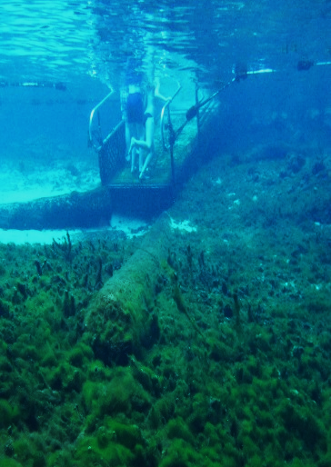
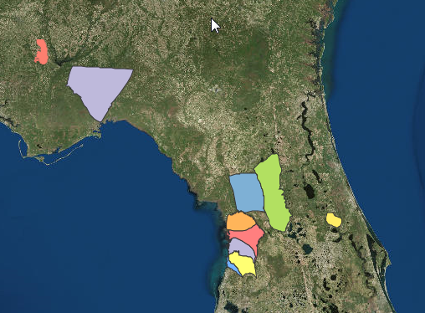
NSILT
Quantifies nitrogen (N) sources and loading to groundwater, and highlights source categories where reductions in N loading could help achieve restoration of impaired waters
Customizes the nitrogen inventory for each spring basin or BMAP area to account for hydrogeologic and land use differences
Uses source category percentages to estimate the necessary and achievable reductions
Fanning Spring

Slide 11

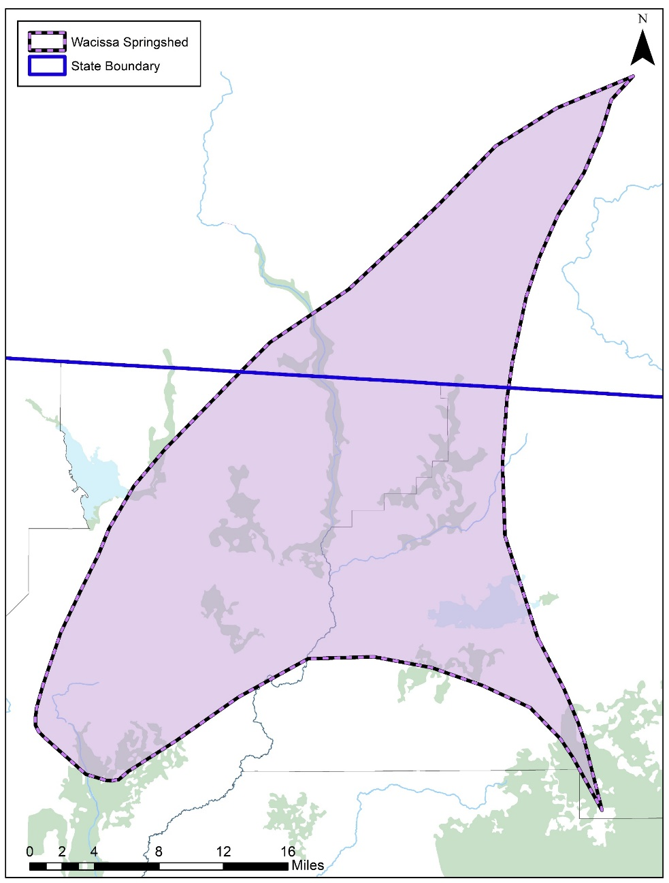
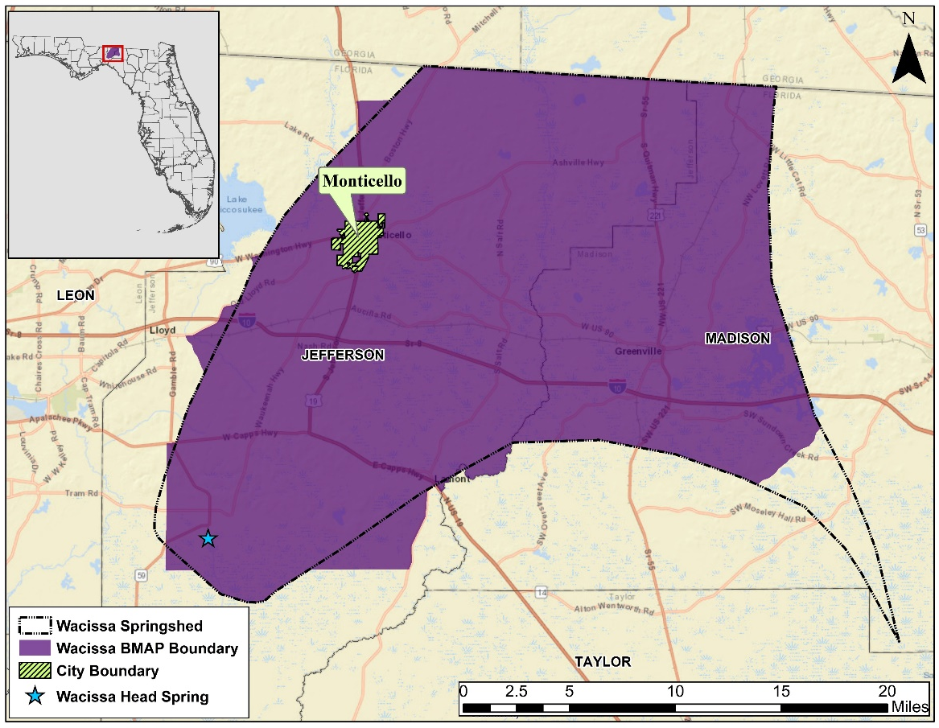
Springshed and BMAP Boundaries
Notes:
The Wacissa springshed extends into Georgia, however only the Florida portion of the springshed was assessed. The image to the right shows the Florida portion of the springshed in relation to the BMAP boundary

Slide 12

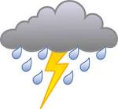
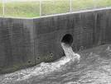




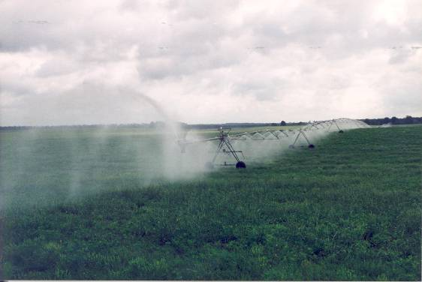
Estimating Nitrogen Loads to Groundwater
Steps:
Estimate the inputs of nitrogen to the land surface from the source inventory information (best available and most current).
Apply attenuation factors based on the various environmental processes that could transform the various forms of nitrogen in the subsurface (such as denitrification, nitrification of ammonia, uptake by plants, mineralization of organic nitrogen).
Apply areal weighting factors that are based on the rate of recharge to groundwater to estimate nitrogen loads to groundwater.
Fine-tune estimates after getting feedback from stakeholders.
Notes:
Our multiple step approach begins with estimating the nitrogen input to the land surface from various sources within the springshed boundary. Next, we estimate the environment’s ability to uptake and utilize this nitrogen which is called attenuation. Then, we evaluate the degree of recharge throughout the BMAP boundary. This will naturally vary with the geological conditions and influences the quantity of water reaching the aquifer. We apply a weighted recharge factor to account for this recharge variation. The final step to this process is reaching out to stakeholder groups and seeking their expertise to help us understand the different nitrogen sources and management practices.

Slide 13
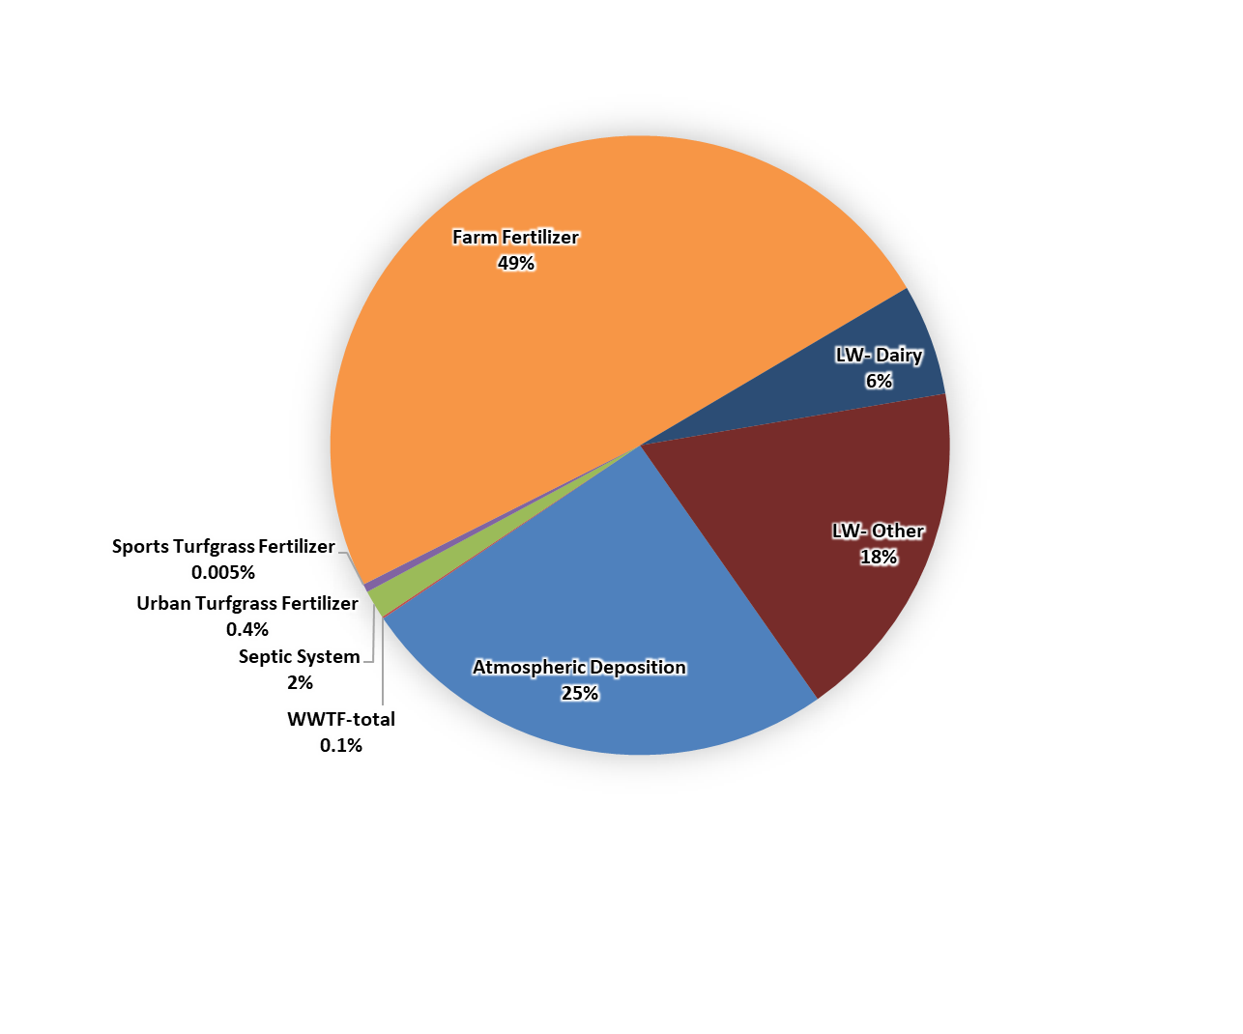
Estimates of Nitrogen Inputs

Slide 14
Source Categories
Land Use evaluation provides potential groundwater sources of nitrate
  Farm Fertilizer (FF)
  Livestock Waste (LW)
  Dairies
  Urban Turfgrass Fertilizer (UTF)
  Sports Turfgrass Fertilizer (STF)
  Atmospheric Deposition (AD)
  Wastewater Treatment Facilities (WWTP)
  Onsite Treatment and Disposal Systems (OSTDS)
Notes:
For atmospheric deposition, we rely on a nationwide model developed by EPA called the TDEP. This approach relies on data from monitoring stations as well as other atmospheric models. At the recommendation of the developers, the model results used included data from 2011 to 2013.

Slide 15
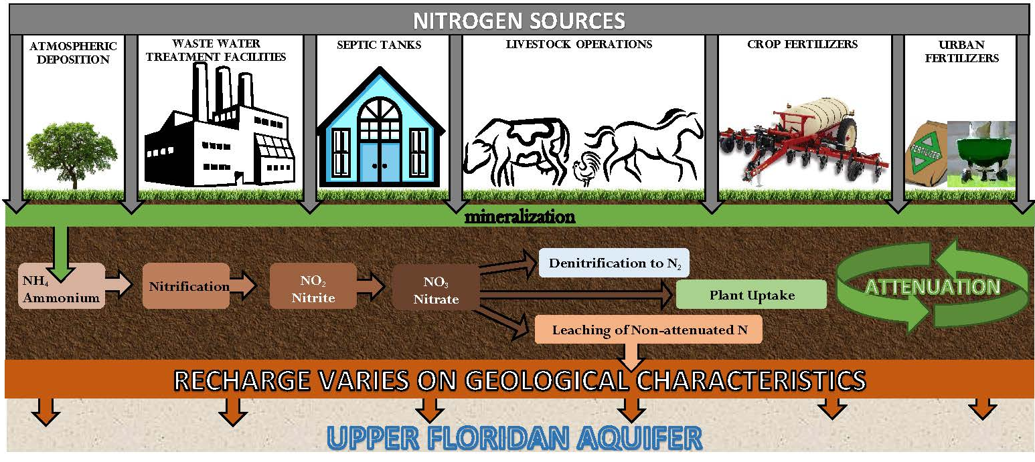
Nitrogen Cycle and Nitrogen Attenuation
LEACHING OF N TO GROUND WATER is related to many factors, such as variable soil conditions, fertilizer material, livestock type, crop types, irrigation, recharge to the aquifer.
Notes:
This cartoon describes the NSILT process. The nitrogen source categories are listed at the top; each with its own input into the environment obtained from current land use and other sources of info. The processes listed in the brown bar describe the attenuation or how different processes uptake, remove or impede the movement of N in the subsurface. We use information from published research investigations in Florida wherever available for the studied BMAP area. If local info is not available we will use published reports from other areas with similar hydrogeologic characteristics. For our estimates of N loading to groundwater, we are interested in the bar labeled “Leaching of Non-attenuated N”. This is the nitrogen which is not utilized by the environment and has the potential to reach ground water.

Slide 16
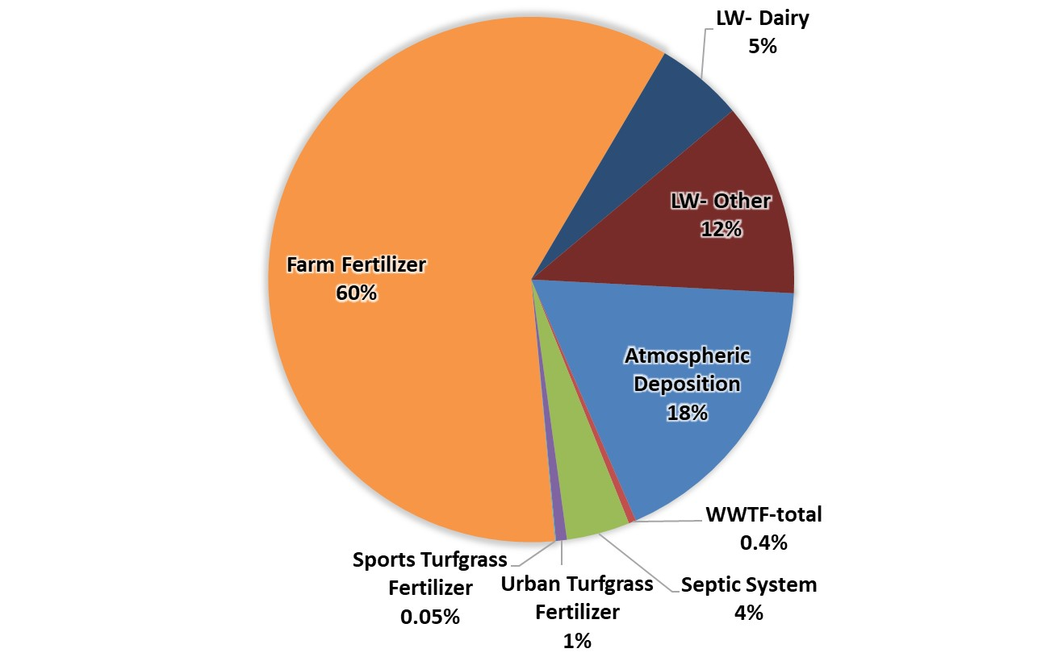
Nitrogen Load to Groundwater

Slide 17
Source Categories
Load to Groundwater evaluation provides comparison of potential groundwater sources of nitrate
  Farm Fertilizer (FF)
  Livestock Waste (LW)
  Dairies
  Urban Turfgrass Fertilizer (UTF)
  Sports Turfgrass Fertilizer (STF)
  Atmospheric Deposition (AD)
  Wastewater Treatment Facilities (WWTP)
  Onsite Treatment and Disposal Systems (OSTDS)
Notes:
For atmospheric deposition, we rely on a nationwide model developed by EPA called the TDEP. This approach relies on data from monitoring stations as well as other atmospheric models. At the recommendation of the developers, the model results used included data from 2011 to 2013.

Slide 18
PFA Delineation
  Sub-Section 373.802, F.S.:
    Definition: Area or areas of a basin where the Floridan Aquifer is generally most vulnerable to pollutant inputs where there is a known connectivity between groundwater pathways and an OFS
  Sub-Section 373.803, F.S.:
    Delineation considers factors that may lead to degradation of an OFS, such as:
        Groundwater travel time to the spring
        Hydrogeology
        Nutrient load, etc.
Notes:
Definition: area or areas of a basin where the Floridan Aquifer is generally most vulnerable to pollutant inputs where there is a known connectivity between ground water pathways and an Outstanding Florida Spring (OFS), as determined by the department in consultation with the appropriate water management districts, and delineated in a BMAP.
Using the best data available from the water management districts and other credible sources, the department, in coordination with the water management districts, shall delineate priority focus areas for each OFS or group of springs that contains one or more OFS and is identified as impaired in accordance with s. 373.807.
PFA and is effective upon incorporation in a basin management action plan.
For ease of implementation delineation Shall use understood and identifiable boundaries such as:
Roads.
Political jurisdictions

Slide 19
PFA Requirements
  Prohibitions
    Wastewater treatment facilities greater than 100,000 gallons per day (GPD), UNLESS advanced wastewater treatment (AWT) is used.
    New conventional OSTDS on less than one-acre lots.
    Ban on land application of Class A or B biosolids w/o approved NMP.
    New Hazardous waste facilities.
  Additional Requirements for Biosolids and Septage Application Practices
    Requirements for newly permitted sites or at renewal
    Verified BMPs for agricultural operations
    Effective nutrient management practices
    Groundwater monitoring requirements

Slide 20
PFA Delineation
  Evaluate
    Aquifer Recharge
    Aquifer Vulnerability
    Soil Leaching Potential
    Land Elevation
    Land Use
    Conservation Lands
    WWTP and OSTDS

Slide 21
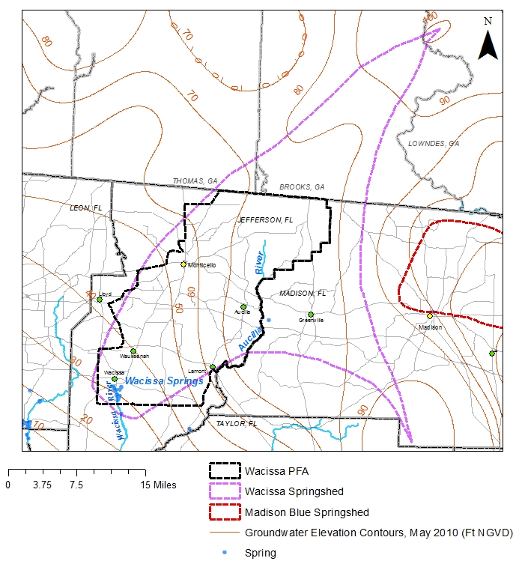
PFA – Boundary

Slide 22
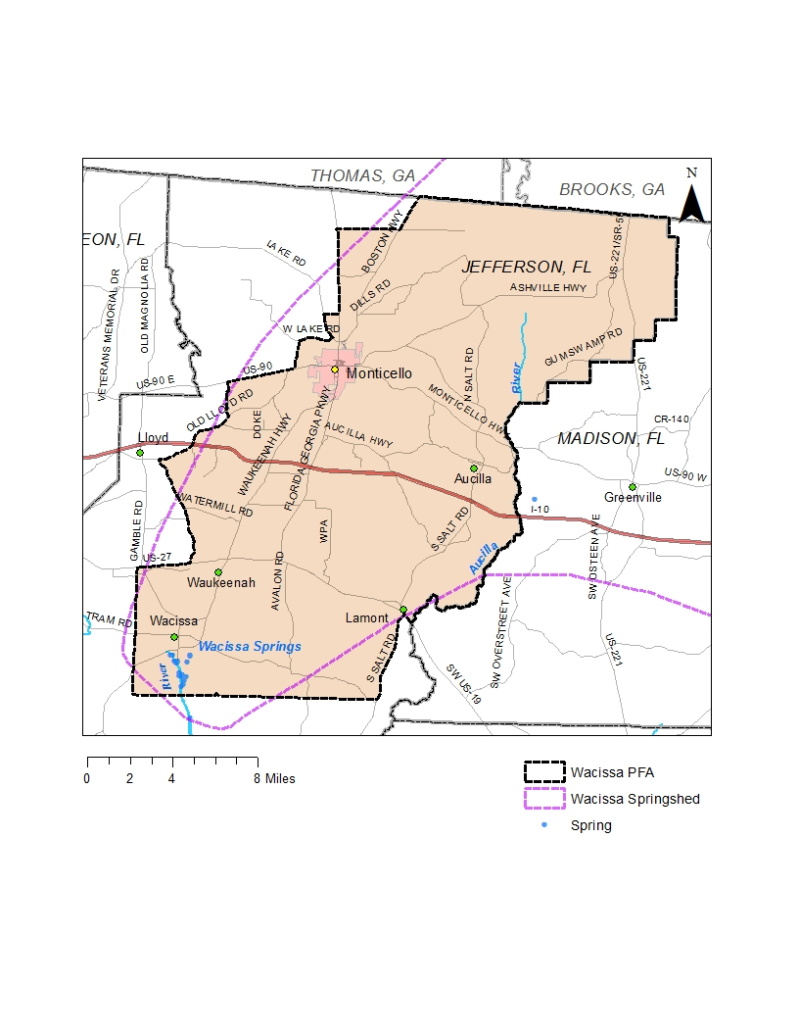
PFA – Boundary

Slide 23
Wacissa
Nitrogen Loads to Groundwater
572,438 lbs-N/yr

Slide 24
Wacissa BMAP Nitrogen Reductions
Determine required reduction to meet TMDL - using most accurate and current data - 2012 to 2018
Calculate spring group vent load
Calculate TMDL load
Determine required reduction to meet TMDL
Total Reduction Required to Meet the TMDL
 | Total Load (lb-N/yr) | TMDL Load (lb-N/yr) | Required Reduction to Meet TMDL (lb-N/yr)
Spring Vent | 193,149 | 114,680 | 78,469
Notes:
9.48M total

Slide 25
Project Credit Analysis
Nitrogen Source | Credits to Load to Groundwater (lb-N/yr) | Description
Onsite Sewage Treatment and Disposal Systems (OSTDS) | TBD | Credits identified for stakeholder OSTDS projects (onsite enhancement or sewer)
Urban Turfgrass Fertilizer (UTF) | 230 | DEP approved credits (up to 6 %) for public education activities as well as credits identified for stakeholder stormwater projects
Atmospheric Deposition (AD) |  | No reduction
Farm Fertilizer Reductions | 51,500 | 15 % BMP credit on FF load to groundwater, assuming 100 % owner-implemented BMPs on all fertilized lands
Sports Turfgrass Fertilizer (STF) | 25 | 6 % BMP credit for sports fields and 10 % BMP credit for golf courses (where applicable) on STF load to groundwater, assuming 100 % BMP implementation on golf courses and sports fields
Livestock Waste | 6,850 | 10 % BMP credit on load to groundwater, assuming 100 % owner-implemented BMPs at all livestock facilities
Livestock Waste Permitted Dairy | 4,650 | 15 % BMP credit on permitted dairy load to groundwater, assuming 100% owner-implemented BMPs at permitted dairies
Wastewater Treatment Facilities (WWTF) | 2,000 | Achieved by BMAP WWTF policy if BMAP-wide (achieving 3 or 6 mg/L total nitrogen concentration at discharge)
Total Credits | 65,250

Slide 26
Wacissa BMAP Nitrogen Reductions
Total Reduction Required to Meet the TMDLs
 | Total Load (lb-N/yr) | TMDL Load (lb-N/yr) | Required Reduction to Meet TMDL (lb-N/yr)
Spring Vent | 193,149 | 114,680 | 78,469
Projects Credits |  |  | 65,250
Additional Project credits needed |  |  | 13,250
Notes:
9.48M total

Slide 27
Additional Potential Reductions
Additional Ag Practices Estimated Reduction Credit (lb-N/yr)
Action | High Recharge Area (100%) | Med. Recharge Area (100%)
Precision Irrigation | 2,021 | 1,123
Precision Fertilization | 24,223 | 13,457
Soil Moisture Probes | 44,334 | 24,630
Controlled Release Fert. | 7,096 | 3,942
Cover crops | 71,345 | 39,636
Fertilizer Banders | 39,172 | 21,762

Slide 28
Additional Potential Reductions
Existing OSTDS in PFA (lb-N/yr)
 | High Recharge Area |  | Med. Recharge Area
 | Tanks | Credit | Tanks | Credit
Parcels <1 ac | 161 | 1,000 lbs. | 74 | 250 lbs.
Parcels >1ac | 728 | 4,400 lbs. | 715 | 2,400 lbs.

Slide 29
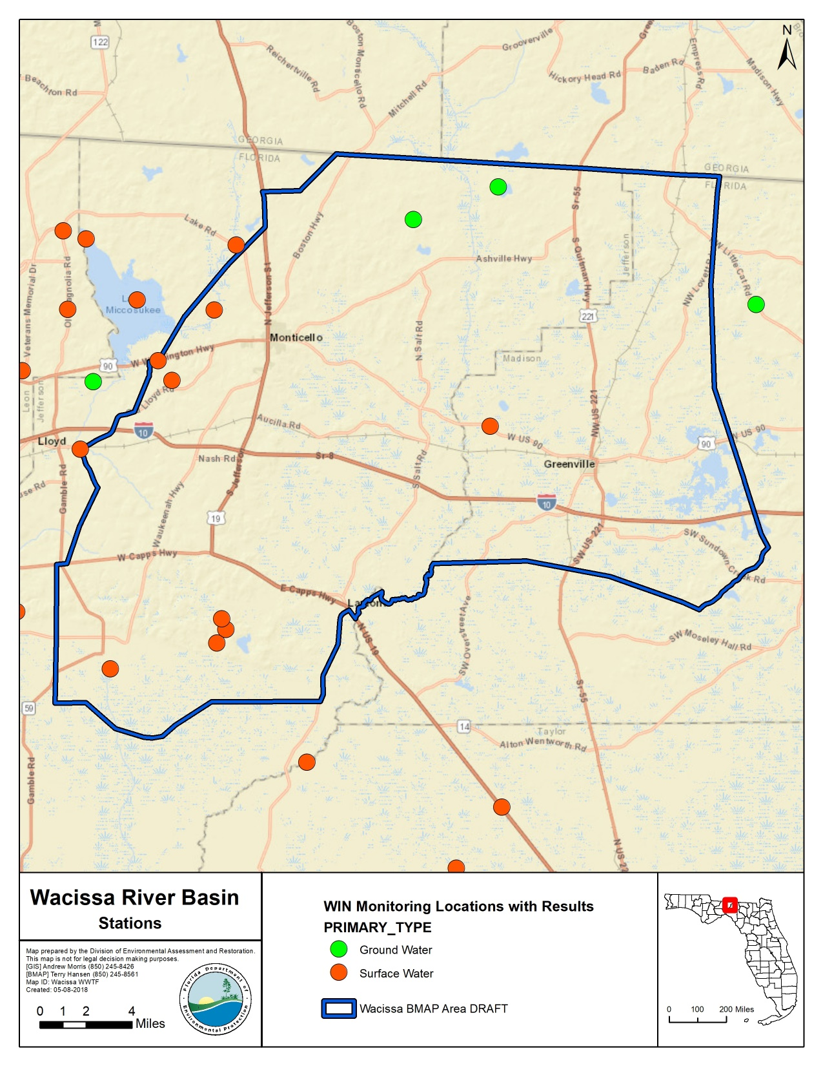
Monitoring

Slide 30
Statewide TMDL, BMAP, Minimum Flows and Levels (MFLs) Annual Report
403.0675(1), F.S. – requires a report that will include status of MFLs, TMDLs, and BMAPs
Replacement of individual BMAP annual progress reports
Annual meetings will continue
Calendar year reporting
Report will contain project information: funding, proposed priority ranking for implementation
Progress made towards restoration goals
Information will be requested in late November, due by the end of January
Info. needed will include: entity activities, compliance, project information, and milestones
Report is due to the Governor and Florida Legislature July 1, 2018 and every year thereafter

Slide 31
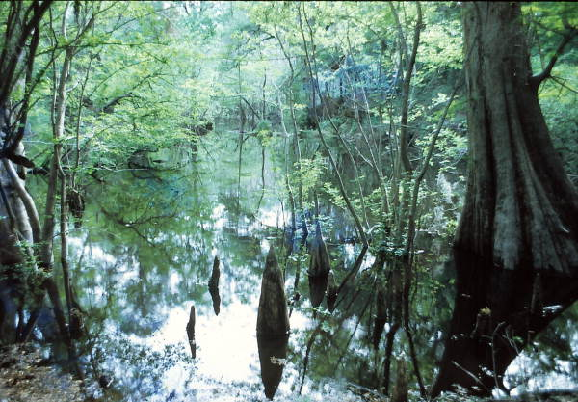
Questions?
http://publicfiles.dep.state.fl.us/DEAR/BMAP/WACISSA/

