Slide 1
Wacissa Springs
Basin Management Action Plan (BMAP)
Celeste Lyon & Terry Hansen P.G.
Basin Coordinators
850-245-8561
Celeste.Lyon @dep.state.fl.us terry.hansen@dep.state.fl.us

Slide 2
Water Quality Framework
Collect data
Analyze and verify
List “impaired” waters
REPEAT
Monitor and report progress annually
Adapt and change – new statewide annual report
Set water quality standards
Monitor water quality
Determine pollution problems
Develop and implement restoration plans (BMAPs)
Establish restoration goals (TMDLs)
Measure success and adapt
Work with community leaders
Excessive nutrients
Bacteria, Metals, and Other Impairments
Allocate responsibilities
Identify projects
  Infrastructure
  Best Management Practices (BMPs)
Establish schedules
Identify success criteria
Gather additional data
Evaluate water quality
Adopt pollutant reduction targets

Slide 3
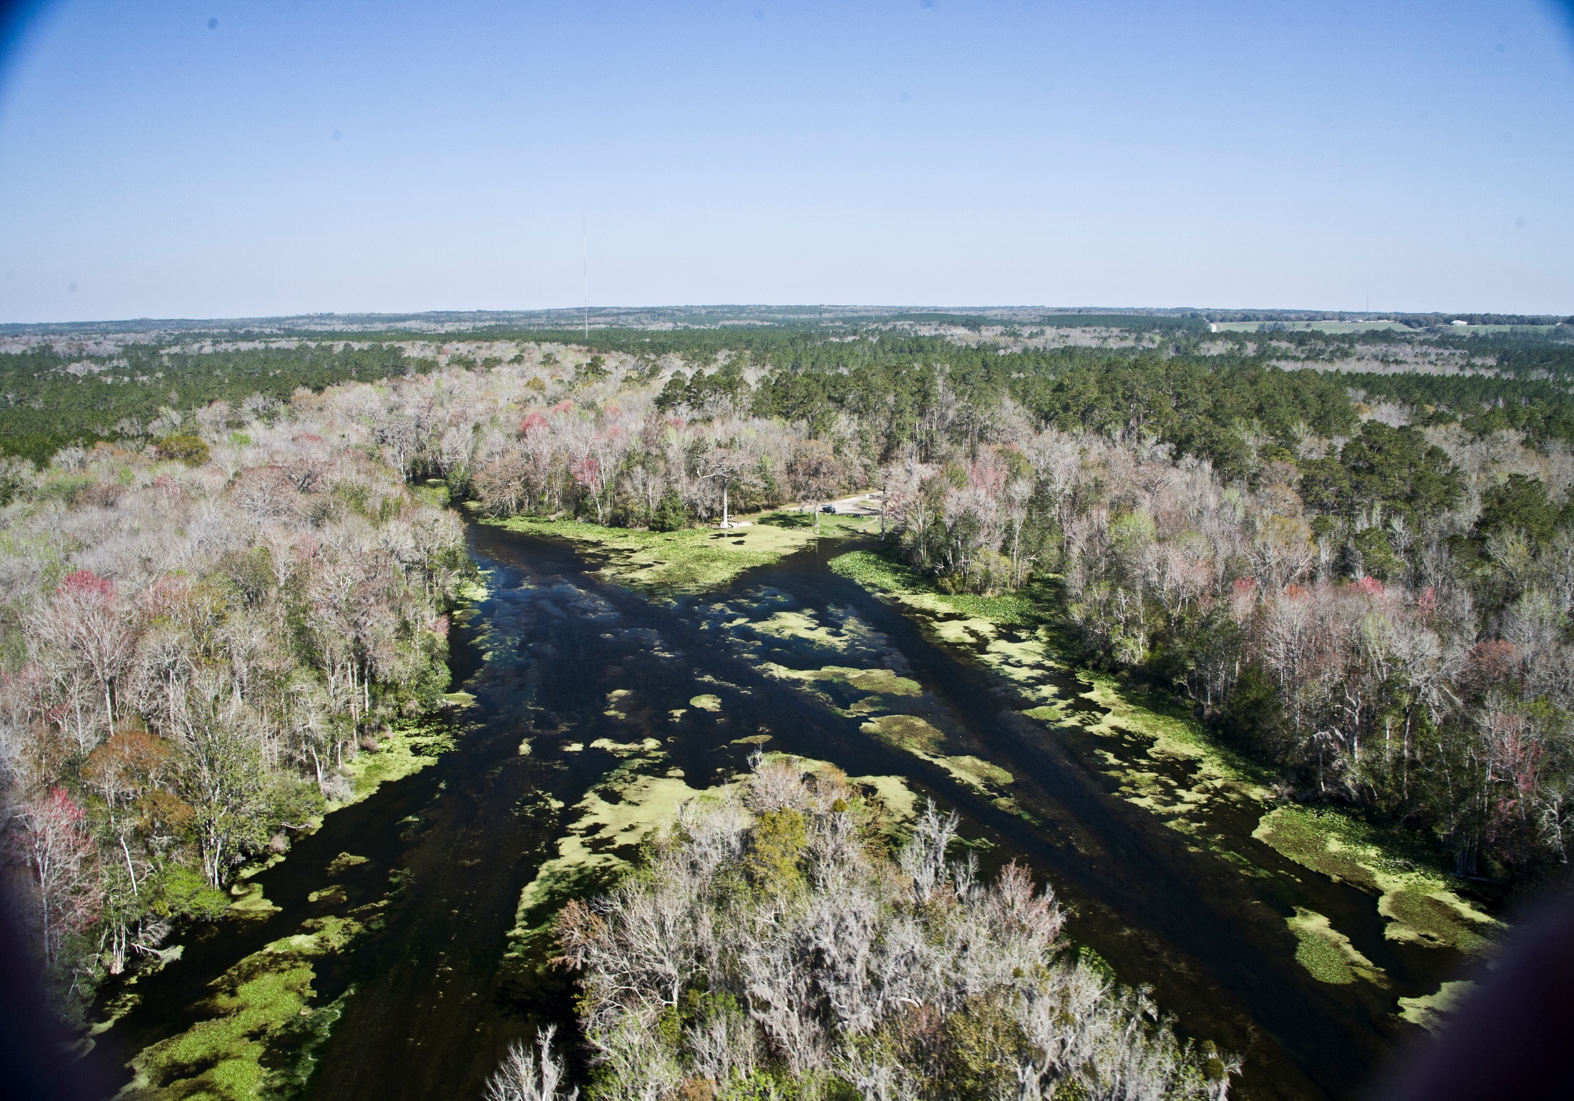

Slide 4
Wacissa River & Springs
Basin Total Maximum Daily Loads (TMDLs)
TMDL
Data Period of Record: January 1, 2005 through June 30, 2012
Adopted June 2016
TMDL Study Results:
  Nitrate shown to be primary factor in causing algal blooms
TMDL:
  Springs - 0.24 milligrams per liter (mg/L) nitrate monthly average concentration (or lower) will
  not cause an imbalance in the flora
  or fauna

Slide 5


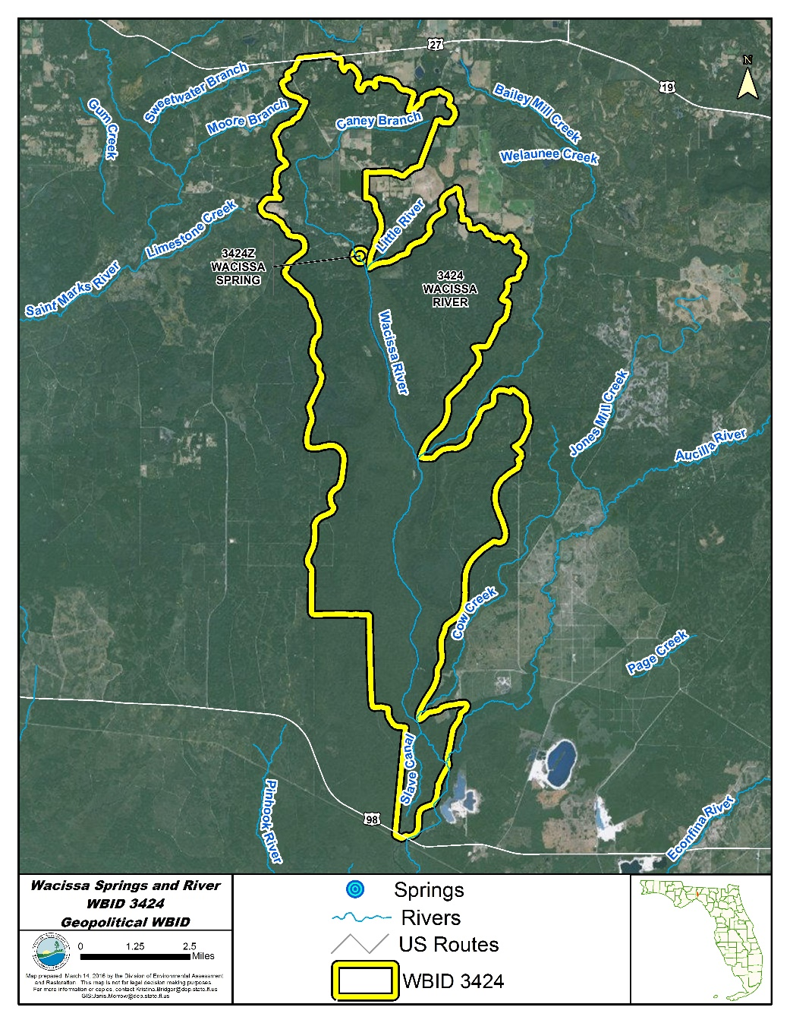
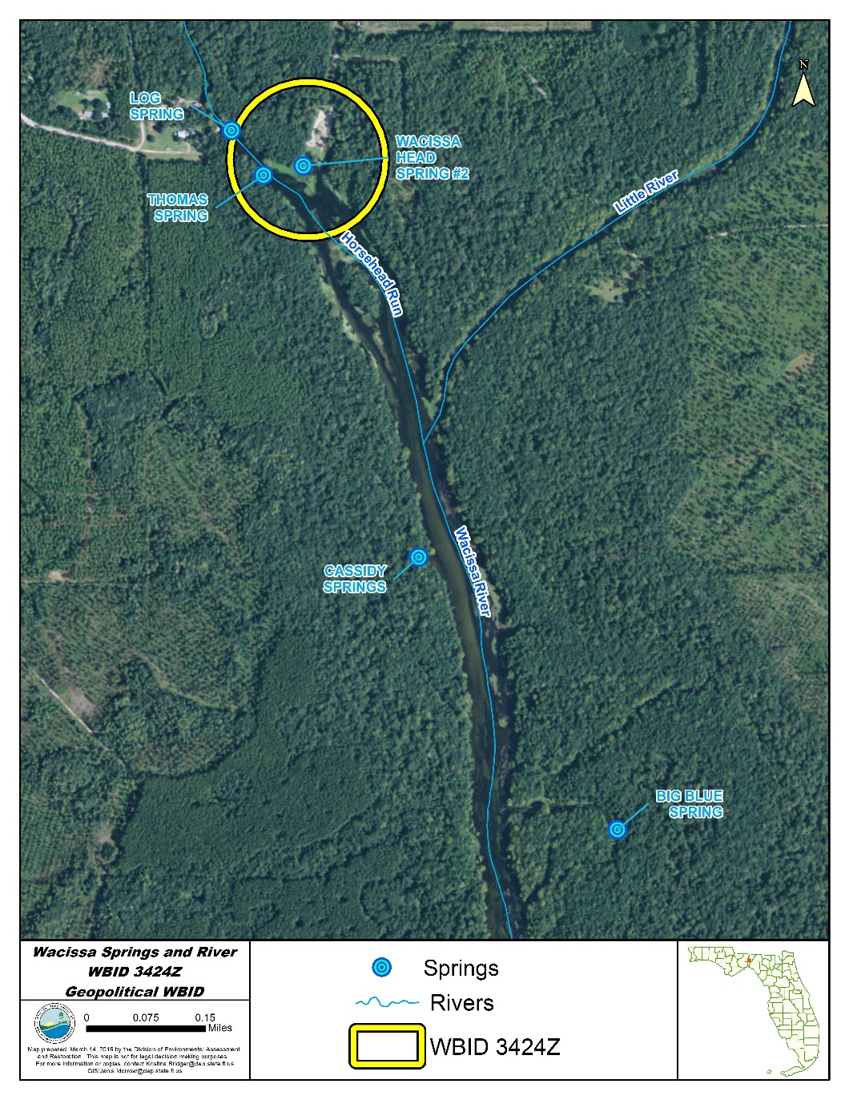
Wacissa
Total Maximum Daily Loads (TMDLs)

Slide 6
Wacissa
Total Maximum Daily Loads (TMDLs)
WBID | Parameter | TMDL (mg/l) | TMDL % Reduction | Wasteload Allocation for Wastewater | Wasteload Allocation for NPDES Stormwater | Load Allocation | MOS
Wacissa River (WBID 3424) | Nutrients (Nitrate) | 0.20 | 39% | N/A | 39% | 39% | Implicit
Wacissa Springs (WBID 3424Z) | Nutrients (Nitrate) | 0.24 | 38% | N/A | 38% | 38% | Implicit
TMDL Table 6.1
WBID: Waterbody identification area.

Slide 7
Regulatory Framework
The process for preparing BMAPs is found in:
  Section 403.067, Florida Statutes (F.S.), known as the “Florida Watershed Restoration Act”
  The 2016 Florida Springs and Aquifer Protection Act lists requirements for BMAPs for OFS
  Requirement is to achieve TMDL in 20 years
    Plan is to achieve:
      30 % reduction in 5 years
      80 % in 10 years
      100 % in 15 years

Slide 8
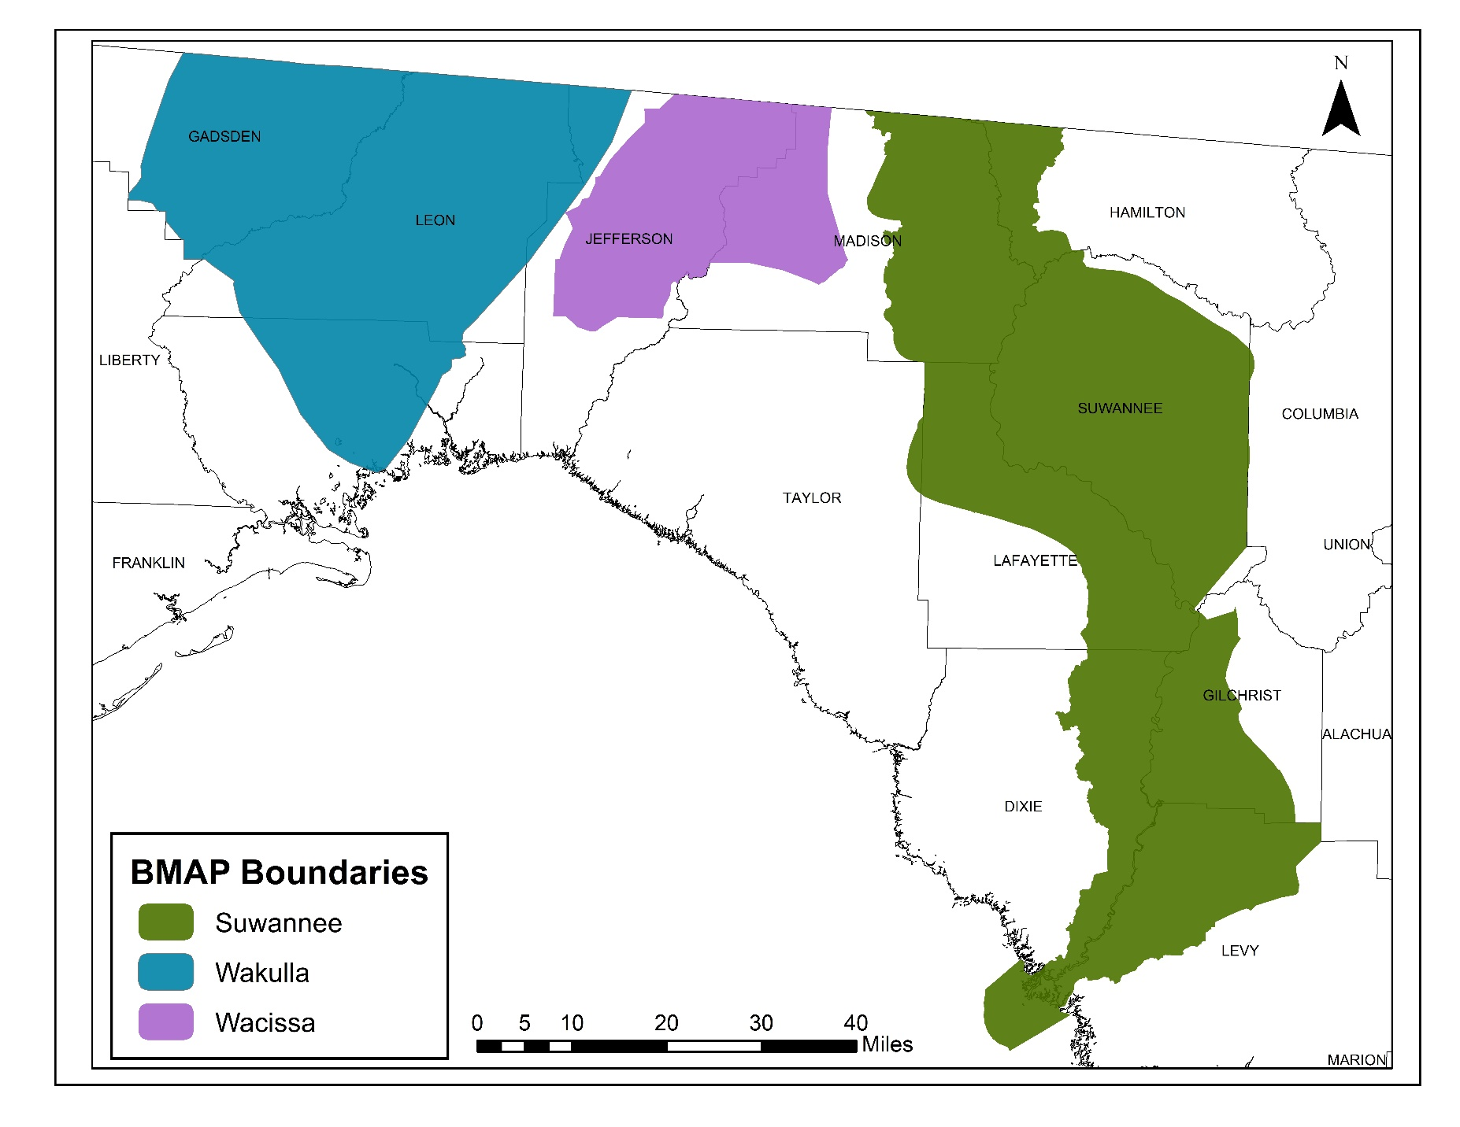
Regional BMAPs

Slide 9
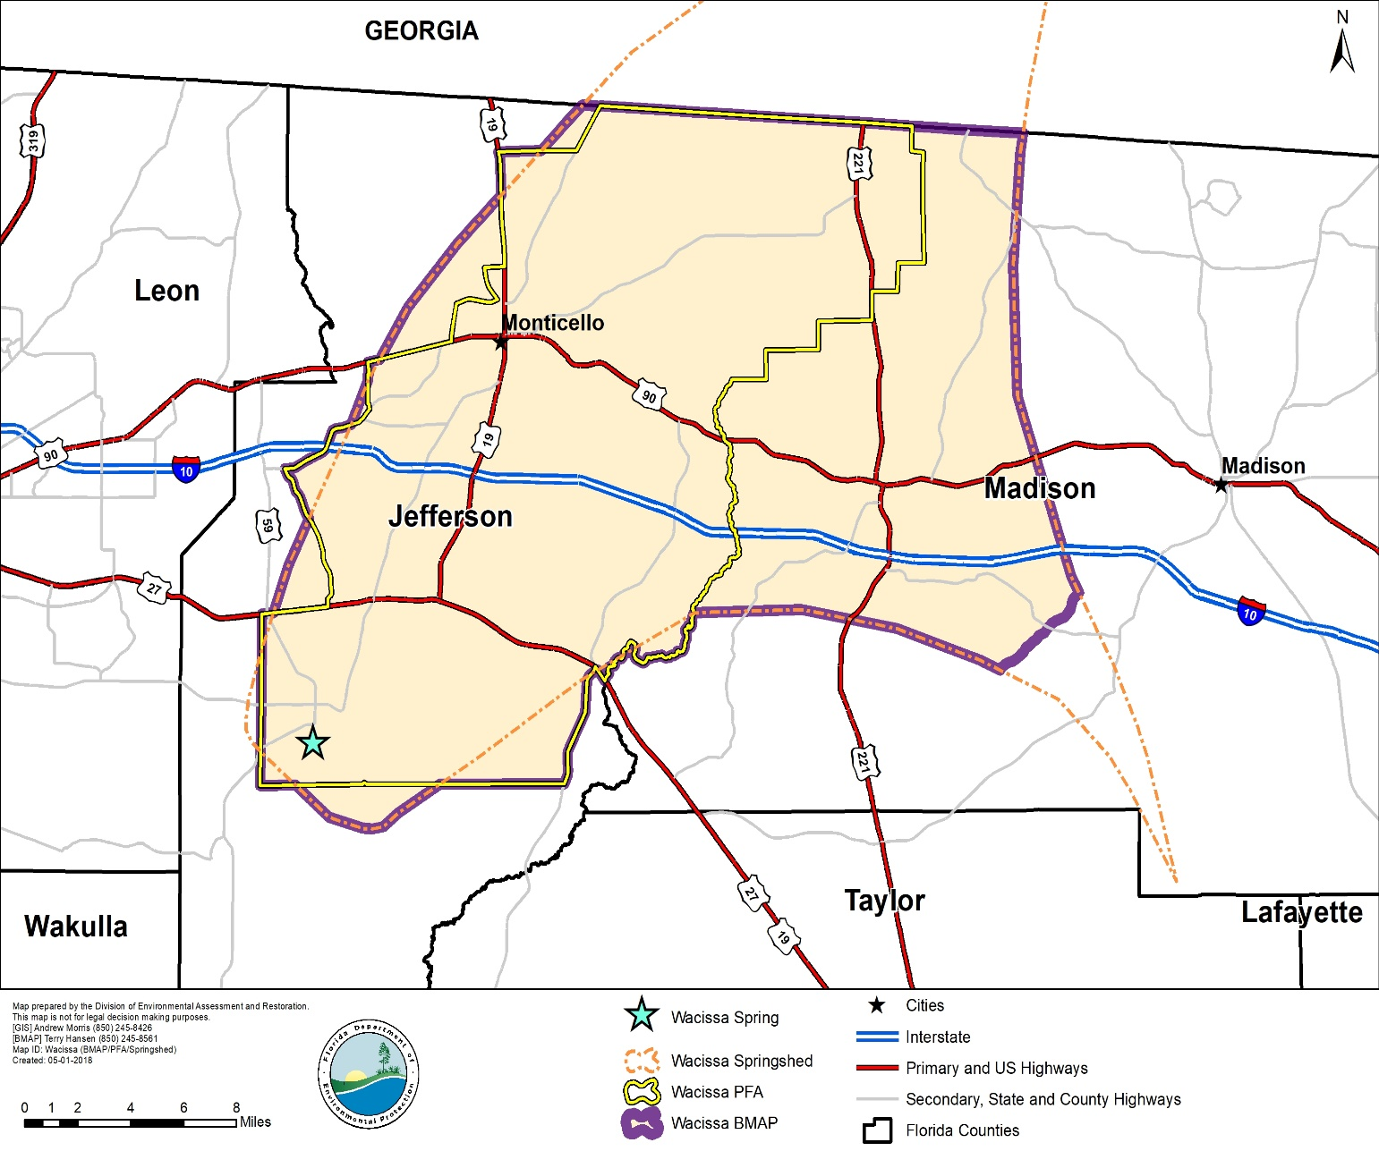
Wacissa BMAP Area
Land Uses:
Upland Forest (43%)
Agricultural (16%)
Wetland/Water (37%)
Urban/Built-Up (3%)
Other (1%)
Both agricultural and urban BMPs are being implemented.

Slide 10
2016-1 Requirements
  INCLUDE:
  Priority Focus Area (PFA) delineation
    Area(s) of basin where Floridan Aquifer is generally most vulnerable
  Identification of point source or category of nonpoint sources with the estimated allocation of the load for each.
    Nitrogen Source Inventory Loading Tool (NSILT)
Notes:
Definition: area or areas of a basin where the Floridan Aquifer is generally most vulnerable to pollutant inputs where there is a known connectivity between ground water pathways and an Outstanding Florida Spring (OFS), as determined by the department in consultation with the appropriate water management districts, and delineated in a BMAP.
Using the best data available from the water management districts and other credible sources, the department, in coordination with the water management districts, shall delineate priority focus areas for each OFS or group of springs that contains one or more OFS and is identified as impaired in accordance with s. 373.807.
PFA and is effective upon incorporation in a basin management action plan.
For ease of implementation delineation Shall use understood and identifiable boundaries such as:
Roads.
Political jurisdictions

Slide 11
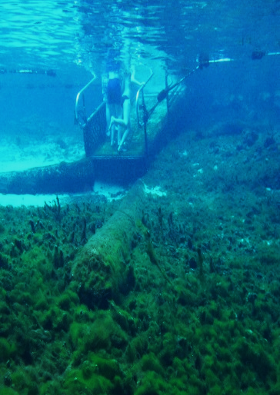
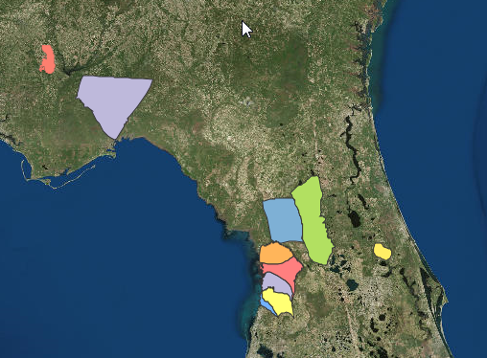
NSILT
Quantifies nitrogen (N) sources and loading to groundwater, and highlights source categories where reductions in N loading could help achieve restoration of impaired waters
Customizes the nitrogen inventory for each spring basin or BMAP area to account for hydrogeologic and land use differences
Uses source category percentages to estimate the necessary and achievable reductions
Fanning Spring

Slide 12


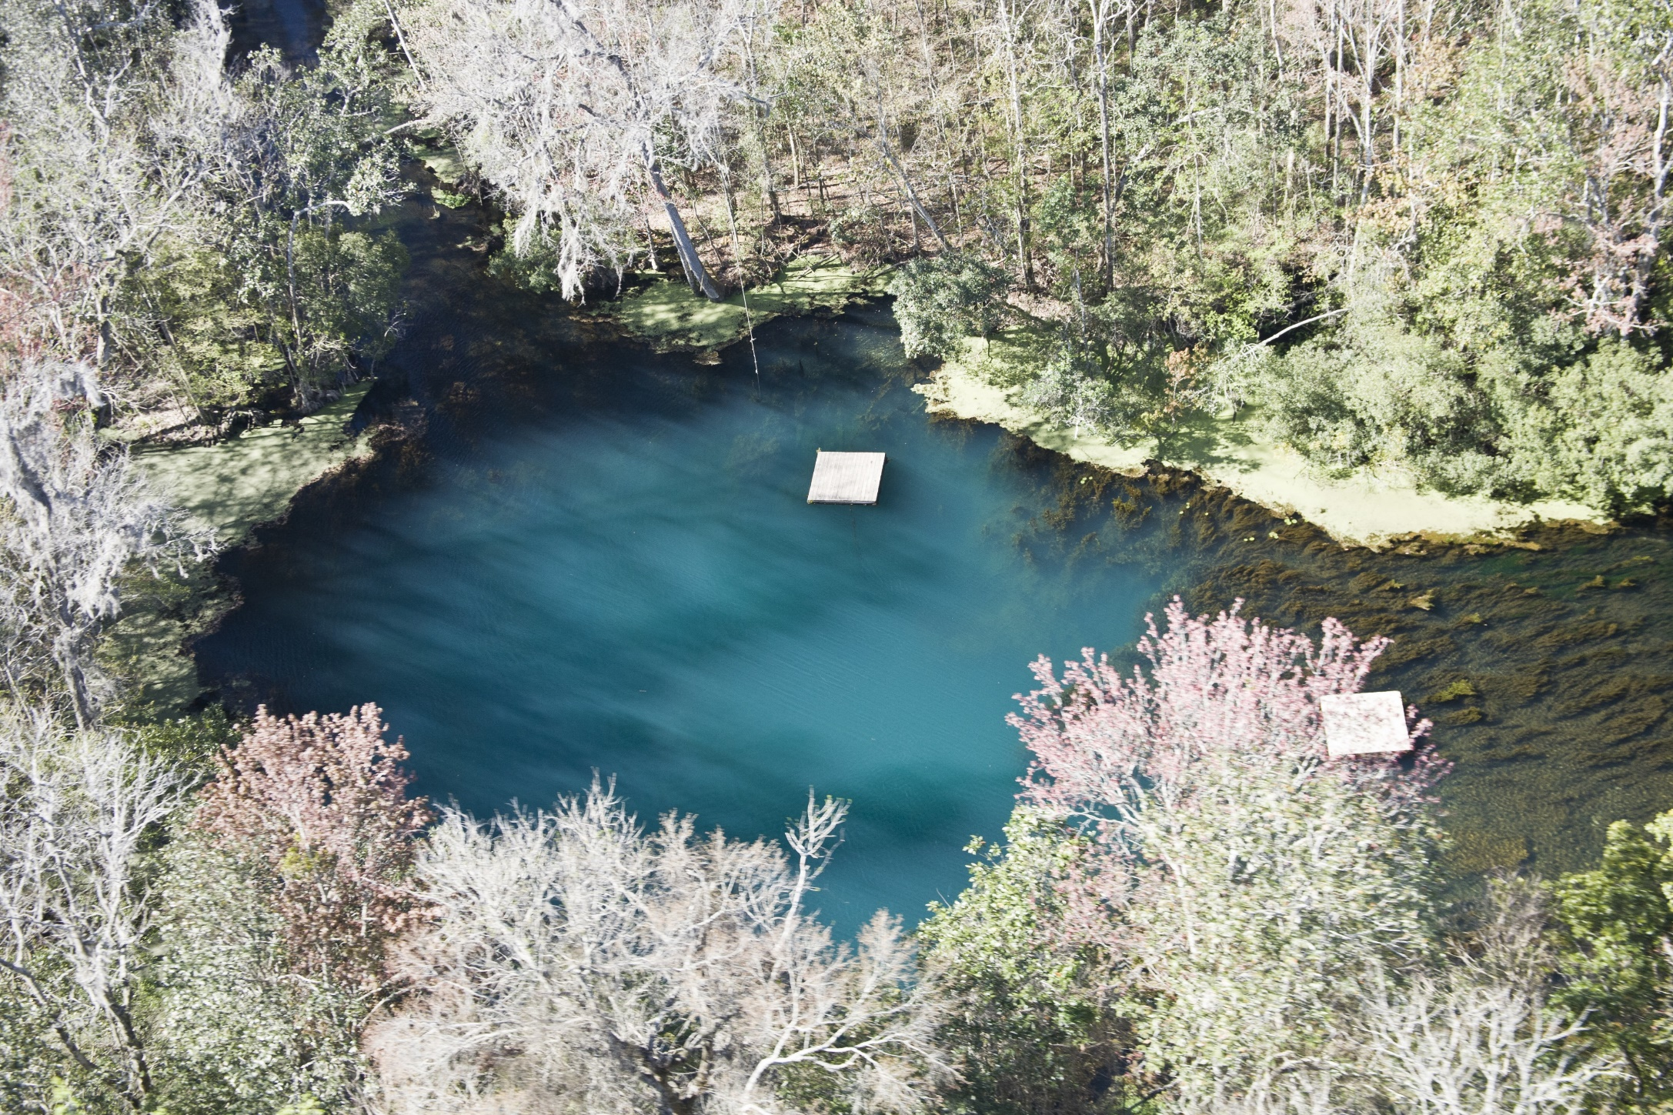
Division of Environmental Assessment and Restoration
Nitrogen Inputs:
Nitrogen Source Inventory and Loading Tool for
Outstanding Florida Springs of the SantaFe River Basin
Celeste Lyon
May 16, 2018

Slide 13
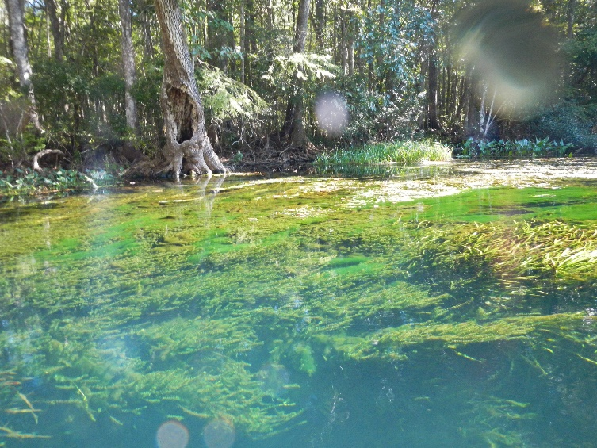
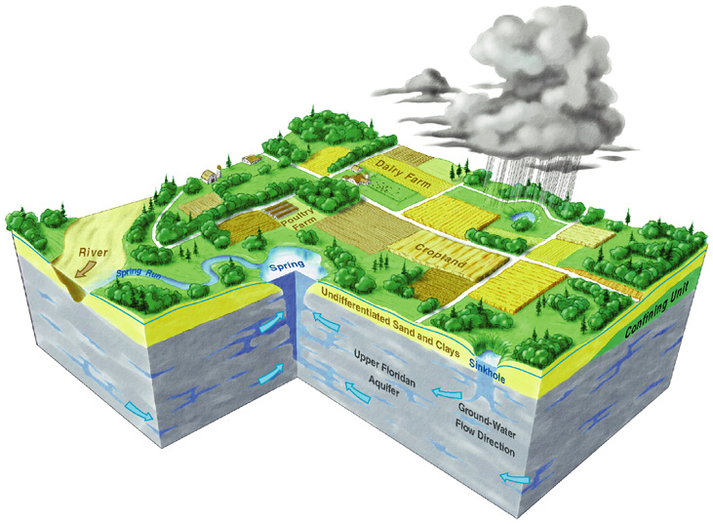
Nitrate-Impaired Spring Waters
The water quality in several Outstanding Florida Springs in the Suwannee River Basin is impaired due to elevated nitrate concentrations
Many sources contribute nitrogen in each springshed:
  atmospheric deposition
  fertilizers (farm and non-farm)
  septic tanks
  land application of wastewater
  livestock manure

Slide 14
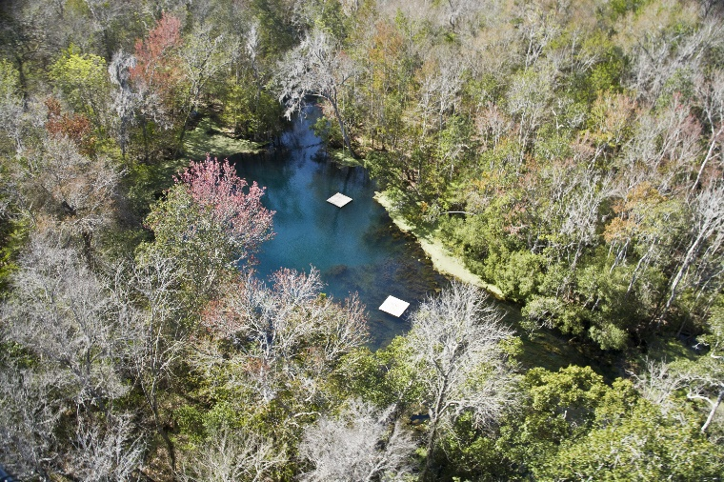
Nitrogen Source Inventory and Loading Tool
Quantifies nitrogen sources and loading to ground water, and highlights source categories where reductions in N loading could help achieve restoration of impaired waters
We customize the inventory for each spring basin or BMAP area to account for hydrogeologic and land use differences
Inventories have been completed for several BMAP areas (Wakulla, Jackson Blue, Silver, Rainbow, Volusia Blue, Springs Coast Springs, Suwannee, Wekiva)

Slide 15

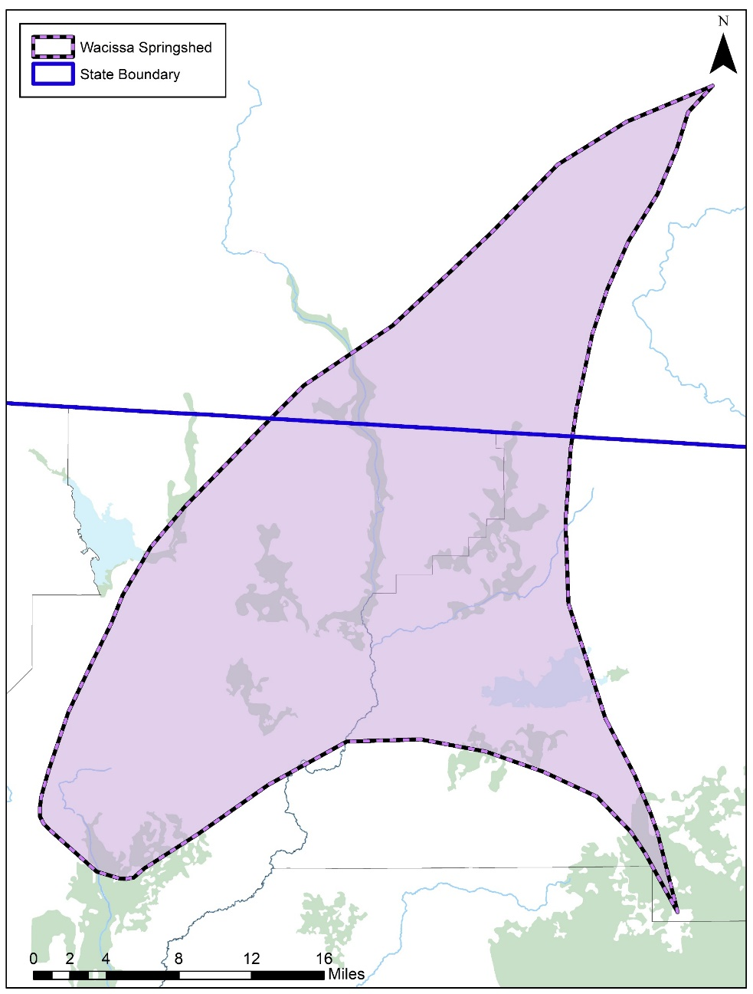
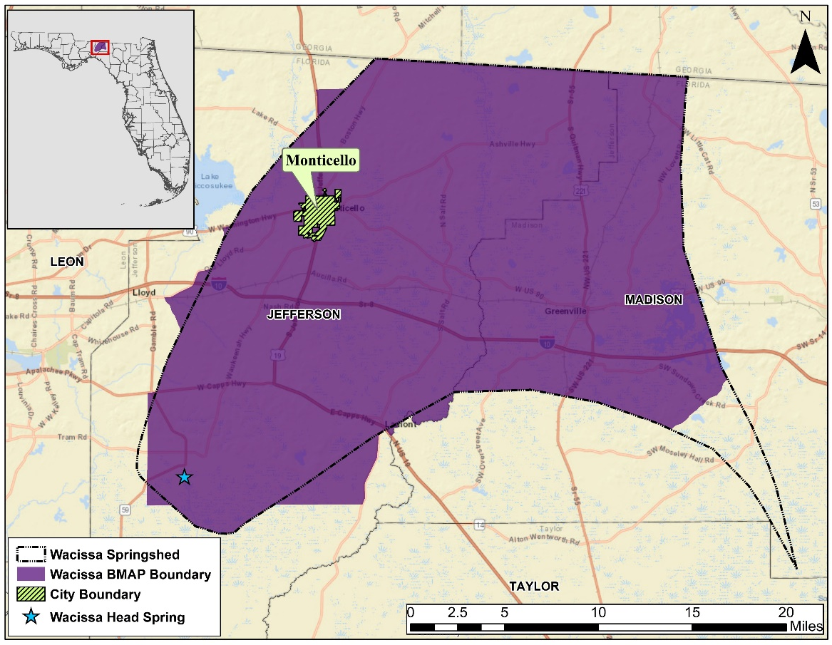
Springshed and BMAP Boundaries
Notes:
The Wacissa springshed extends into Georgia, however only the Florida portion of the springshed was assessed. The image to the right shows the Florida portion of the springshed in relation to the BMAP boundary

Slide 16

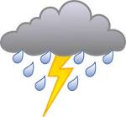
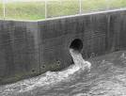

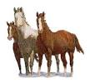

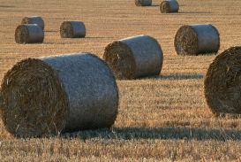
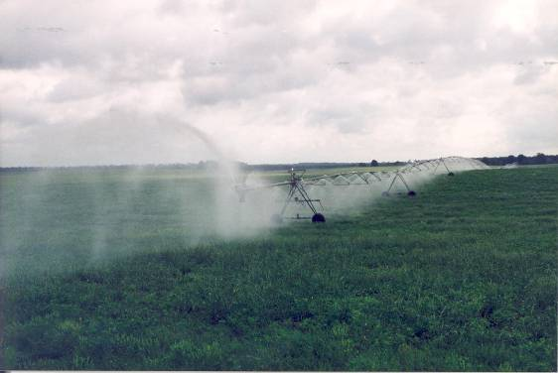
Estimating Nitrogen Loads to Groundwater
Steps:
Estimate the inputs of nitrogen to the land surface from the source inventory information (best available and most current).
Apply attenuation factors based on the various environmental processes that could transform the various forms of nitrogen in the subsurface (such as denitrification, nitrification of ammonia, uptake by plants, mineralization of organic nitrogen).
Apply areal weighting factors that are based on the rate of recharge to groundwater to estimate nitrogen loads to groundwater.
Fine-tune estimates after getting feedback from stakeholders.
Notes:
Our multiple step approach begins with estimating the nitrogen input to the land surface from various sources within the springshed boundary. Next, we estimate the environment’s ability to uptake and utilize this nitrogen which is called attenuation. Then, we evaluate the degree of recharge throughout the BMAP boundary. This will naturally vary with the geological conditions and influences the quantity of water reaching the aquifer. We apply a weighted recharge factor to account for this recharge variation. The final step to this process is reaching out to stakeholder groups and seeking their expertise to help us understand the different nitrogen sources and management practices.

Slide 17
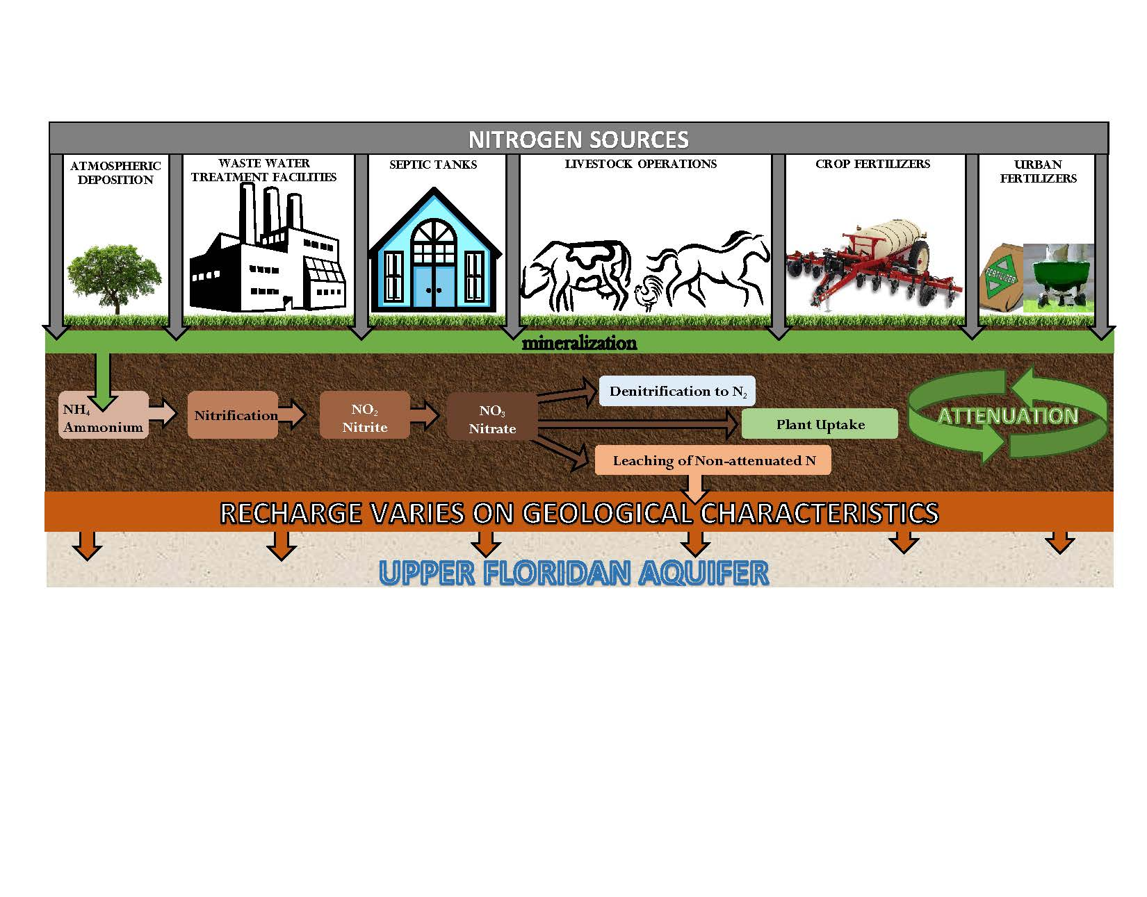
Nitrogen Cycle and Nitrogen Attenuation
LEACHING OF N TO GROUND WATER is related to many factors, such as variable soil conditions, fertilizer material, livestock type, crop types, irrigation, recharge to the aquifer.
Notes:
This cartoon describes the NSILT process. The nitrogen source categories are listed at the top; each with its own input into the environment obtained from current land use and other sources of info. The processes listed in the brown bar describe the attenuation or how different processes uptake, remove or impede the movement of N in the subsurface. We use information from published research investigations in Florida wherever available for the studied BMAP area. If local info is not available we will use published reports from other areas with similar hydrogeologic characteristics. For our estimates of N loading to groundwater, we are interested in the bar labeled “Leaching of Non-attenuated N”. This is the nitrogen which is not utilized by the environment and has the potential to reach ground water.

Slide 18
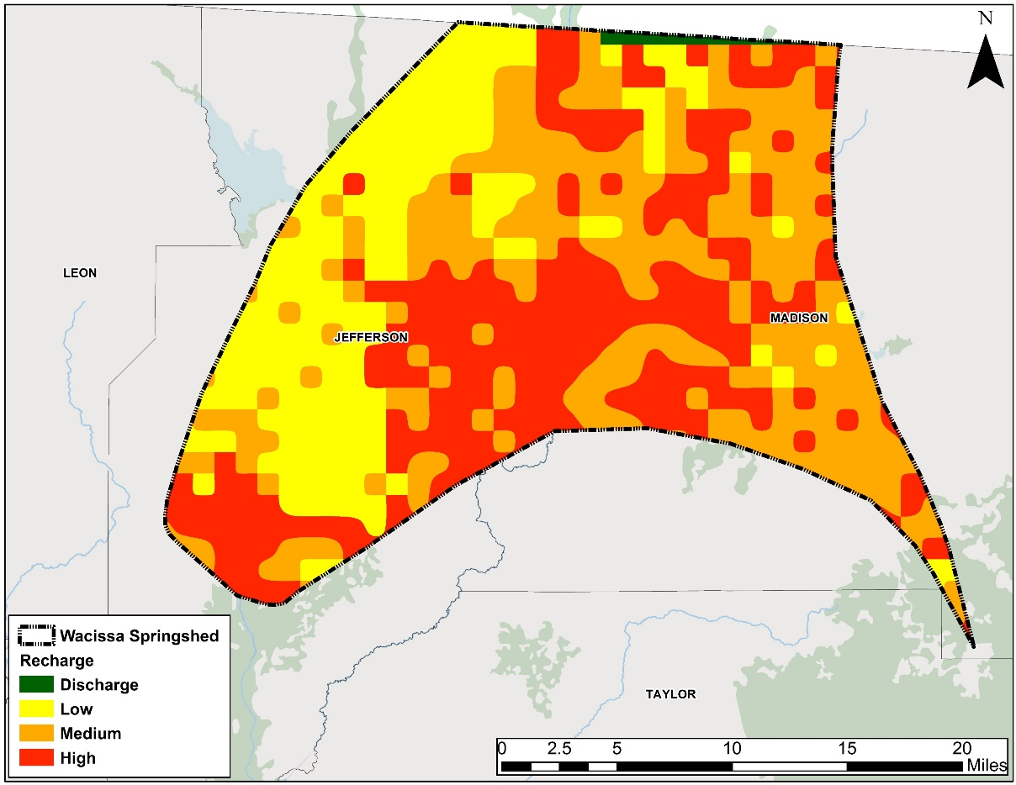
Groundwater Recharge and Nitrogen Attenuation
Inputs to land and loads to groundwater are calculated by recharge region within the springshed
USGS recharge map based on soil properties, hydrogeology, rainfall
  High Recharge: > 10 in/yr
  Medium Recharge: 3-10 in/yr
  Low Recharge: 0-3 in/yr
A weighting factor is assigned to recharge category to account for additional attenuation:
High, 0.9
Medium, 0.5
Low, 0.1
The amount of nitrate that is transported to the UFA in a given year is related to the rate of recharge to the aquifer
Notes:
Here is the BMAP area and associated recharge rates to the Upper Floridan Aquifer.
Recharge layer from USGS 2002 Recharge layer

Slide 19
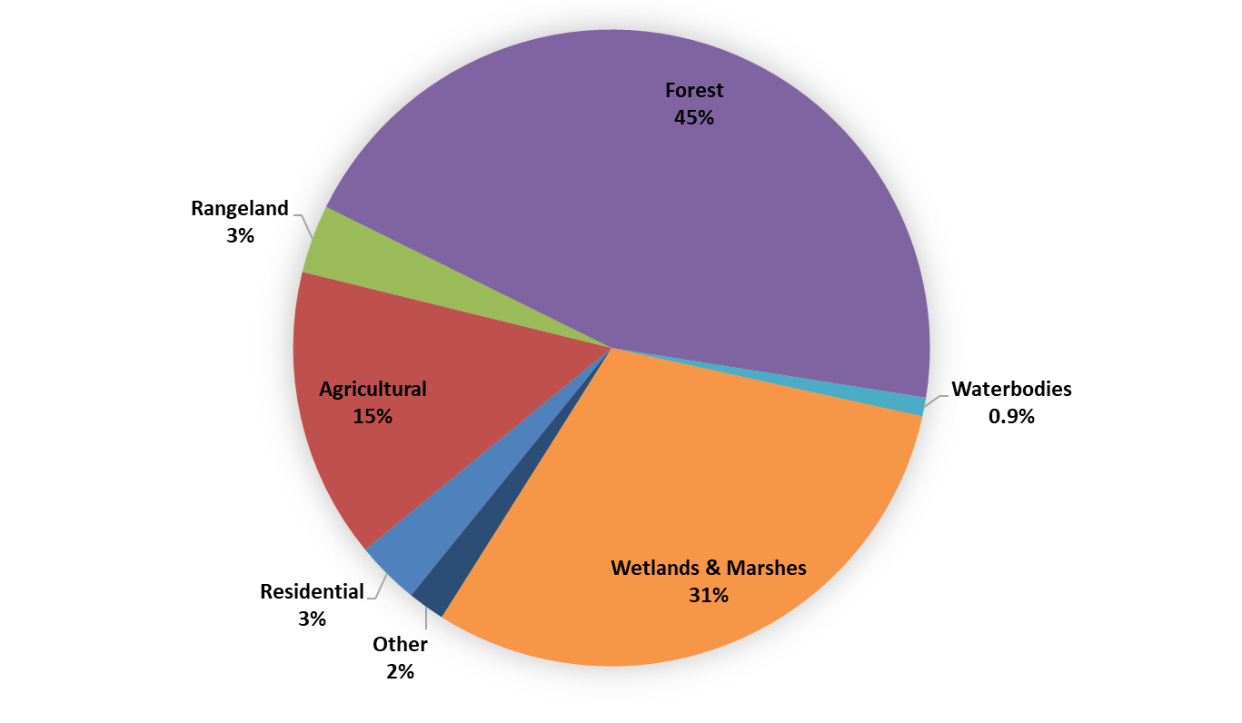
Land Use
Notes:
This chart illustrates the various land uses within the springshed. The majority of nitrogen sources will enter the environment within an urban or agricultural landscape

Slide 20
Source Categories
Land Use evaluation provides potential groundwater sources of nitrate
  Farm Fertilizer (FF)
  Livestock Waste (LW)
  Dairies
  Urban Turfgrass Fertilizer (UTF)
  Sports Turfgrass Fertilizer (STF)
  Atmospheric Deposition (AD)
  Wastewater Treatment Facilities (WWTP)
  Onsite Treatment and Disposal Systems (OSTDS)
Notes:
For atmospheric deposition, we rely on a nationwide model developed by EPA called the TDEP. This approach relies on data from monitoring stations as well as other atmospheric models. At the recommendation of the developers, the model results used included data from 2011 to 2013.

Slide 21
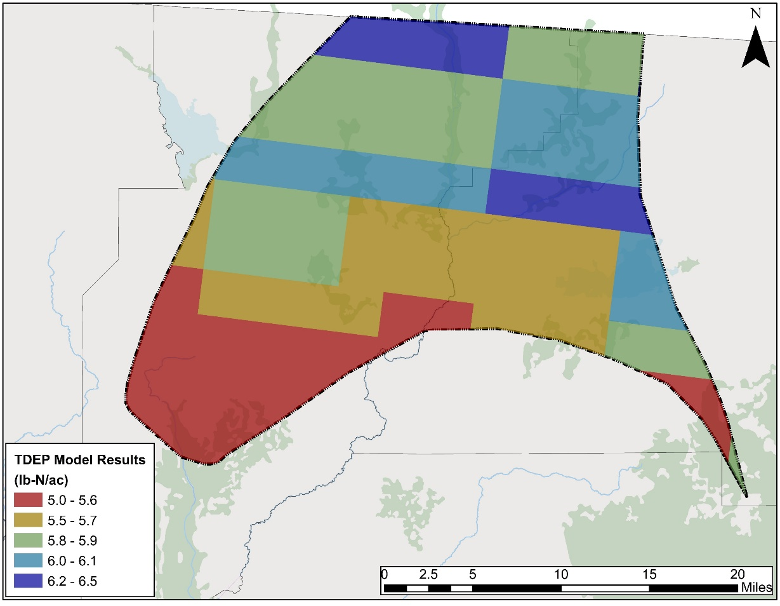
Atmospheric Deposition
TDEP model
  U.S. EPA method to estimate spatially continuous atmospheric deposition
  Nationwide total deposition model for N and S
  Estimated deposition based on monitoring stations and modeled atmospheric concentrations
  Model year is an average from 2011 to 2013
Average TN deposition
  Range 5.0 – 6.5 lb-N/ac/yr
Notes:
For atmospheric deposition, we rely on a nationwide model developed by EPA called the TDEP. This approach relies on data from monitoring stations as well as other atmospheric models. At the recommendation of the developers, the model results used included data from 2011 to 2013.

Slide 22
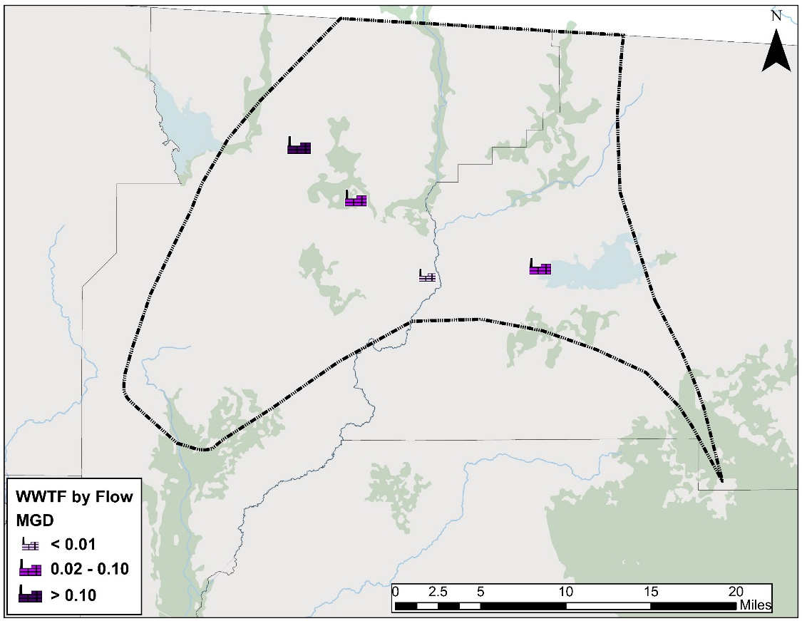
Domestic Wastewater Treatment Facilities
TN effluent concentrations as reported to DEP
NO₃ used to project TN data, if necessary
Effluent data separated based on treatment type
    RIBs, Absorption Fields
    Sprayfields
    Reuse
Notes:
Wastewater treatment facilities are required to report various nutrient and flow data as part of their permits for operating. We use this data to estimate the input from these facilities to the land surface using the total nitrogen in the effluent as well as the actual flow rate from each facility. If nitrate data is available, but not total nitrogen, then the nitrate concentrations are projected to total nitrogen based on a 2009 DEP study. The estimated input to the land surface is separated based on the type of effluent treatment: rapid infiltration basins (RIBs), absorption fields, sprayfield or reuse.
The treated effluent from the City of Monticello WWTF is sent to a local nursery, so the Nitrogen input from this particular facility is incorporated into the farm fertilize category.

Slide 23

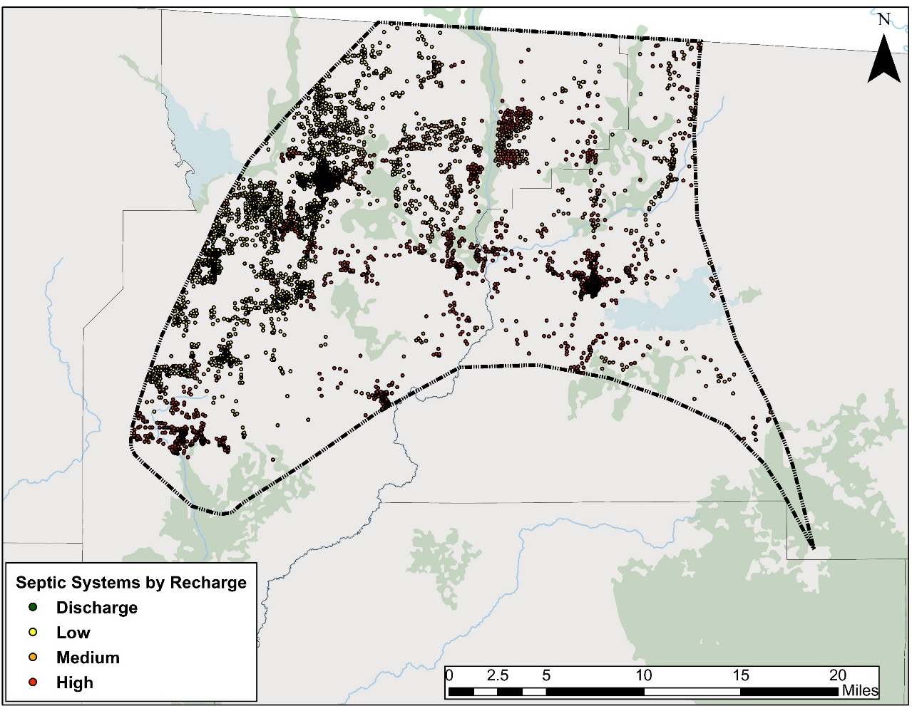
Septic Systems
Septic count taken from DOH’s Florida Water Management Inventory (FLWMI)
Accuracy of this data was verified using an aerial analysis
Calculate # of people relying on septic tanks
Average annual input to septic tank = 9.012 lb-N/person (US EPA)
Notes:
The number of septic tanks within the contributing area is taken from the DOH’s Inventory. The effective population in each county is estimated based on the number of people per occupied household (2010 US Census) and the amount of time an average person will spend at home in a given year (US Labor Statistics). This data allows us to calculate the number of people using septic tanks and apply an annual N factor per person to estimate the input to land surface.

Slide 24


Estimating Livestock Populations and Waste
Livestock | Waste Factor (lb-N/day)
Beef Cows | 0.337
Other Beef Cattle | 0.31
Chicken, broilers | 0.002
Chicken, layers | 0.003
Calves | 0.068
Equine | 0.273
Goats | 0.035
Hogs | 0.19
Sheep | 0.198
Turkeys | 0.006
Literature review provided information on common livestock animals in Florida
Animal waste factors
2012 Census of Agriculture (CoA)
# of livestock (categorized by animal)
Full county data ONLY
2016 USDA Survey
# of beef cattle
Use County-level land use information to estimate livestock population within the springsheds.
Land Use Description
Cattle Feeding Operations*
Feeding Operations*
Horse Farms
Improved Pastures*
Poultry Feeding Operations
Range Land, Herbaceous (Dry Prairie)*
Specialty Farms
Unimproved Pastures*
* Used to determine lands where beef cattle are likely to be present
Notes:
Full county livestock populations are taken from the 2012 Census of Agriculture. We apply relative land use percentages to the full county populations to estimate the livestock populations within the springshed. Once the springshed livestock populations are estimated, a daily waste factor is assigned to each animal type to estimate nitrogen inputs.
Dairy operations were assessed separately because they make up a significant portion of the livestock operations in the area.
*Beef cattle land use is determined using refined categories.

Slide 25
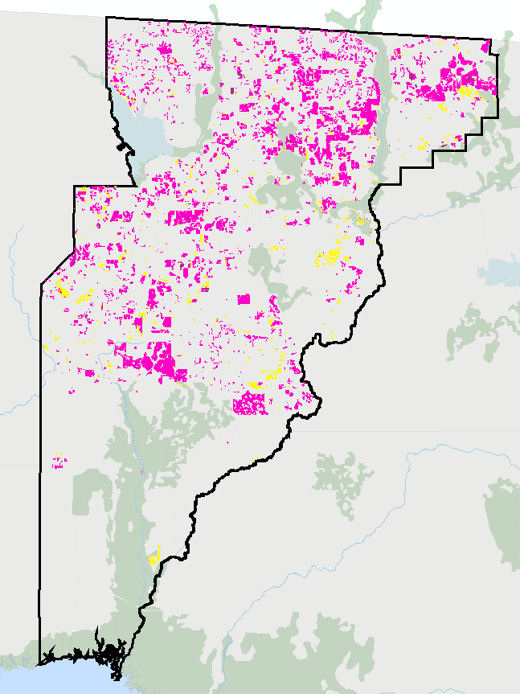
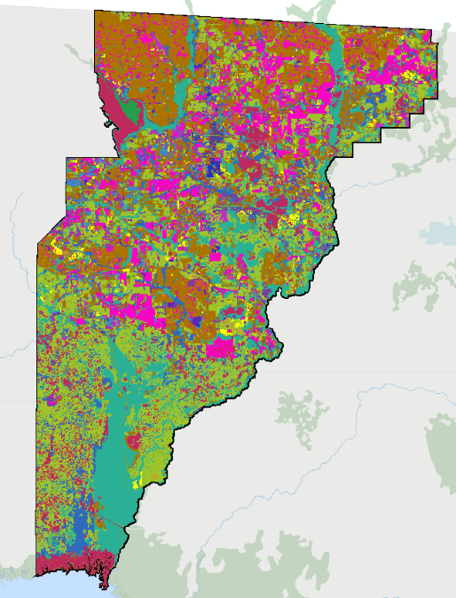
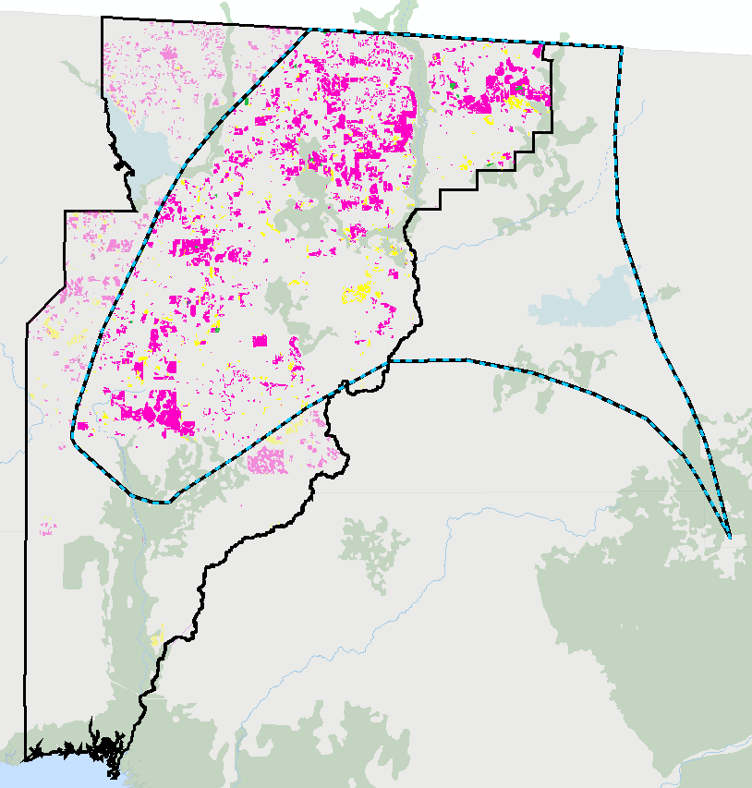
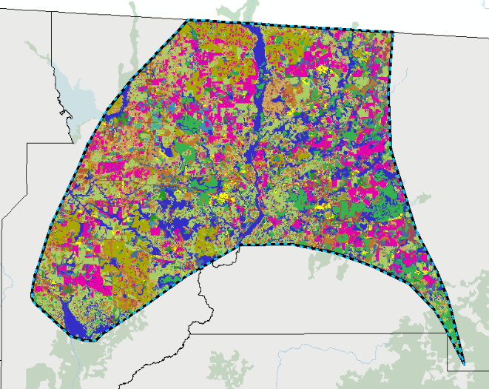
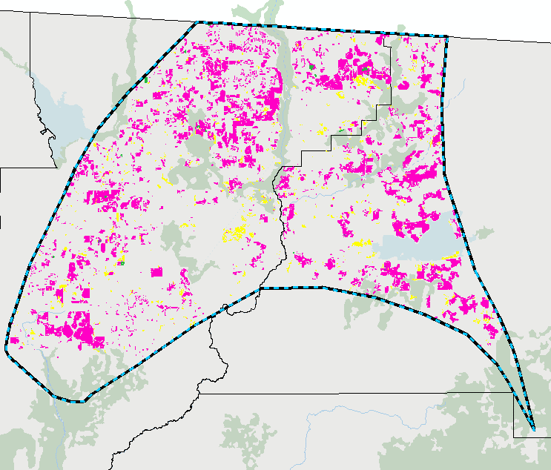
Land Use Percentages: Livestock
73% of land use associated with livestock in Jefferson County falls within the springshed
Land Use Associated with Livestock
Jefferson County
Assumed that 73% of the county livestock population also falls within the springshed
Springshed
Notes:
To calculate the land use percentages, we look at the land use for the entire county.
The land use data for Jefferson County is used as an example. The same calculations were made for the other counties
The total livestock land use acreage is a calculated for the entire county.
The same calculation is made for just the Wacissa sprinsgshed which indicates that 73% of all the livestock lands in Jefferson County are also in the Springshed boundary.
17% of the Jefferson County livestock lands are within the High recharge areas of the boundary.
24% of the Jefferson County livestock lands are within the Medium recharge areas of the boundary, and 32% in the low

Slide 26
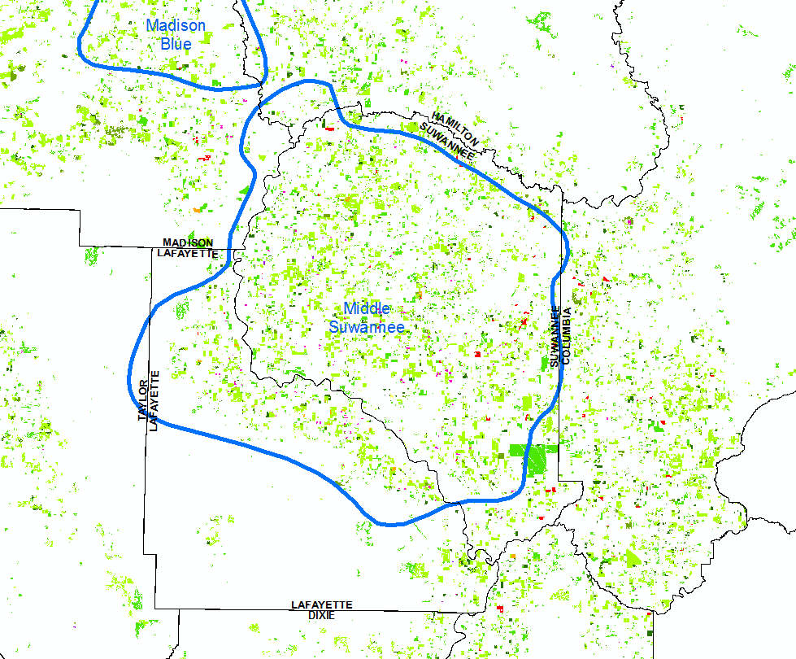
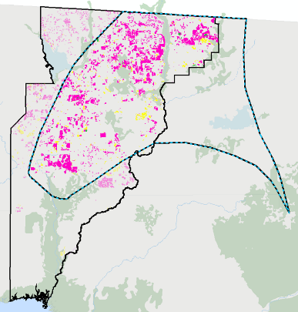
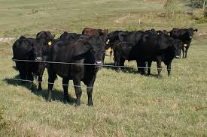
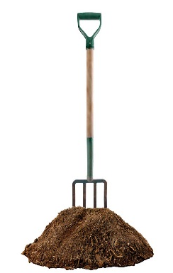
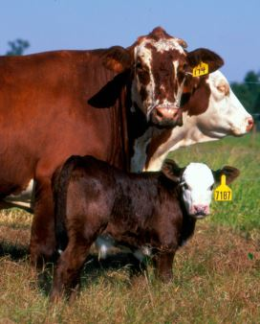

Estimating Beef Cattle (Cow/Calf) Inputs
  County livestock waste
  land use areas
  Identify percentage of livestock waste land use areas that fall within springsheds
USDA 2016 Survey County Total Cattle Population #s
Land Use Description
Cattle Feeding Operations*
Feeding Operations*
Horse Farms
Improved Pastures*
Range Land, Herbaceous (Dry Prairie)*
Specialty Farms
Unimproved Pastures*
35% of Total Beef Cattle population assumed to be calves
Subtract known Dairy population to find Beef Cattle Population #s
Apply daily N waste factors
X 365 days
Total N input from Livestock waste
Calves = Apply daily N waste factors
X 183 days
Notes:
To calculate the total beef cattle and calf populations for the BMAP boundary, we take the total cattle number from the 2016 survey and subtract out the known dairy cattle. This gives us the total beef cattle. From there, we subtract out the beef COW population (given to us in the 2016 survey), in order to identify the remaining, assorted beef cattle. We subtract the calf number (35% of the total beef cattle population) from this remaining cattle category, to end up with the “other” beef cattle population; this includes bulls, steers, and heifers.
The land use percentage is applied to all 3 categories of beef cattle in order to estimate the populations within the BMAP boundary.

Slide 27
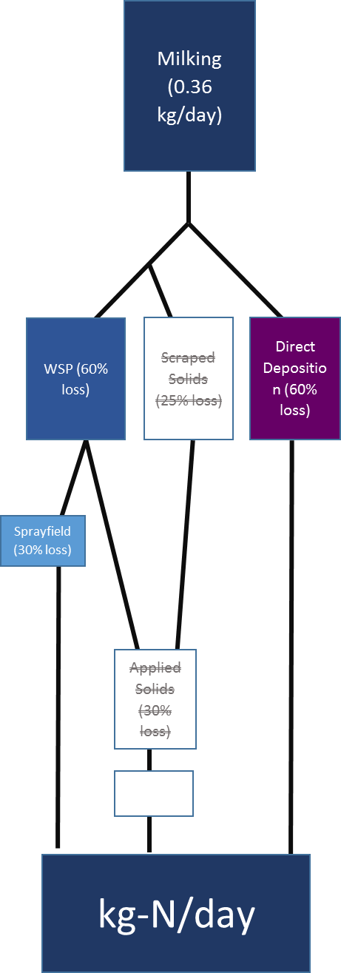

Estimating Dairy Waste Inputs
Permitted Dairy Operations
Detailed information is obtained from the DEP industrial wastewater facility permits on herd sizes, type of cows, confinement and grazing times, and waste management and disposal information
The specific waste handling process was assessed individually for each dairy because of differences in operation from site to site
Notes:
The generalized methodology, seen in the flowchart, for non-permitted dairies, assumes that all small dairies direct the waste water to a waste storage pond. From there, the liquid waste is applied to a sprayfield.

Slide 28
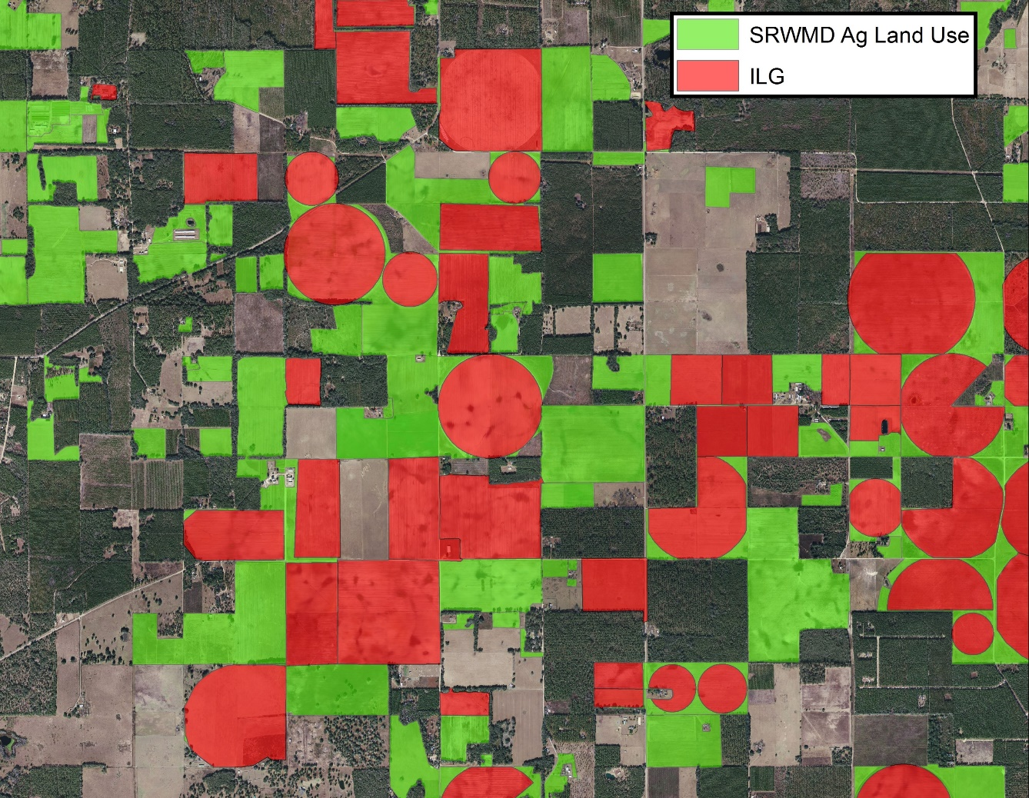
Farm Fertilizer
Irrigated lands and crop type based on FSAID geodatabase.
Crop fertilizer application rates were applied to the acreages identified within springsheds based on crop type.
Application rates based on UF-IFAS recommended rates as well as producer feedback.
Notes:
To identify irrigated acres we utilized FDACS Statewide Agricultural Irrigation Demand Irrigated Lands Geodatabase which is a statewide parcel-level GIS coverage that provides the estimated 2015 irrigated agricultural acreage by crop type - FSAID geodatabase includes crop irrigation and other agricultural water demand projections over the next 25 years, in five-year increments
Water Management District Land Use

Slide 29






Urban Turfgrass Fertilizers
Acreage likely to receive fertilizer estimated from PA data and property values
  Residential
  Non-residential
Maximum fertilizable acreage was capped at 1 acre
Annual Application Rates based on SWFWMD study
Property values used to assess probability of fertilization
Notes:
Urban fertilizers includes fertilizer application for residential purposes, businesses, parks, etc. Golf course and sporting facility fertilizer use is estimated separately. Land areas were estimated based on property appraiser data. The amount of impervious and therefore not fertilized land area was calculated using county zoning laws, when available. The probability of fertilization was also taken into account based on property value which has been identified as an indicator of fertilizer use by socioeconomic studies. The remaining pervious surfaces are assumed to be fertilized at various rates which are derived from multiple SWFWMD studies.
For this analysis, it was assumed that the owners of properties with greater than one acre of pervious land area would regularly apply fertilizer to no more than one acre.

Slide 30

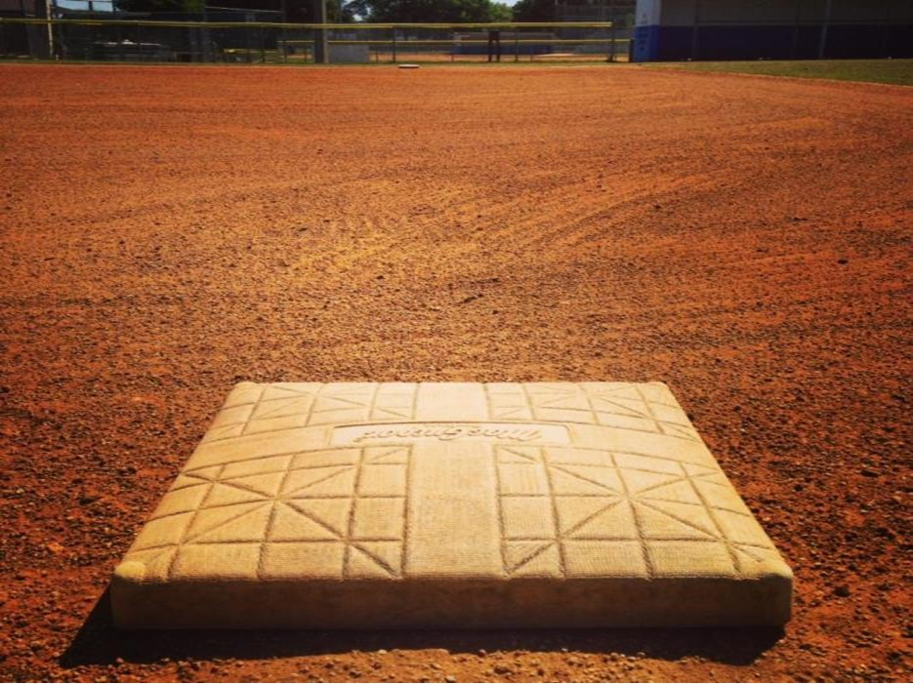

Sports Turfgrass Fertilizers
Sports fields
  Acreage estimates from aerial analysis of PA landuse data
  Application rates based on lawn service company estimates
Golf Courses
  Acreage estimated through PA landuse data
  Annual application rate = 4.5 lb-N/1,000 sq ft
Notes:
Sports turfgrass includes sporting facilities like baseball and football fields as well as golf courses. The acreage associated with sporting facilities was estimated based on an evaluation of PA landuses likely to contain these fields including schools, parks and recreational areas. The nitrogen application rate was estimated using the data for lawn service company fertilization practices (Urban Turfgrass Fertilizers slide).
Golf courses were estimated based on the acreage assessed by the PA offices. The fertilizer application rate is based on voluntary surveys completed by some of the golf course superintendents in the contributing area. For those golf courses which did not complete a survey, an average application rate of 3.24 lb-N/1,000 sq ft was estimated; an average application rate. In total, the average application rate for the contributing area is 4.5 lb-N/1,000 sq ft

Slide 31
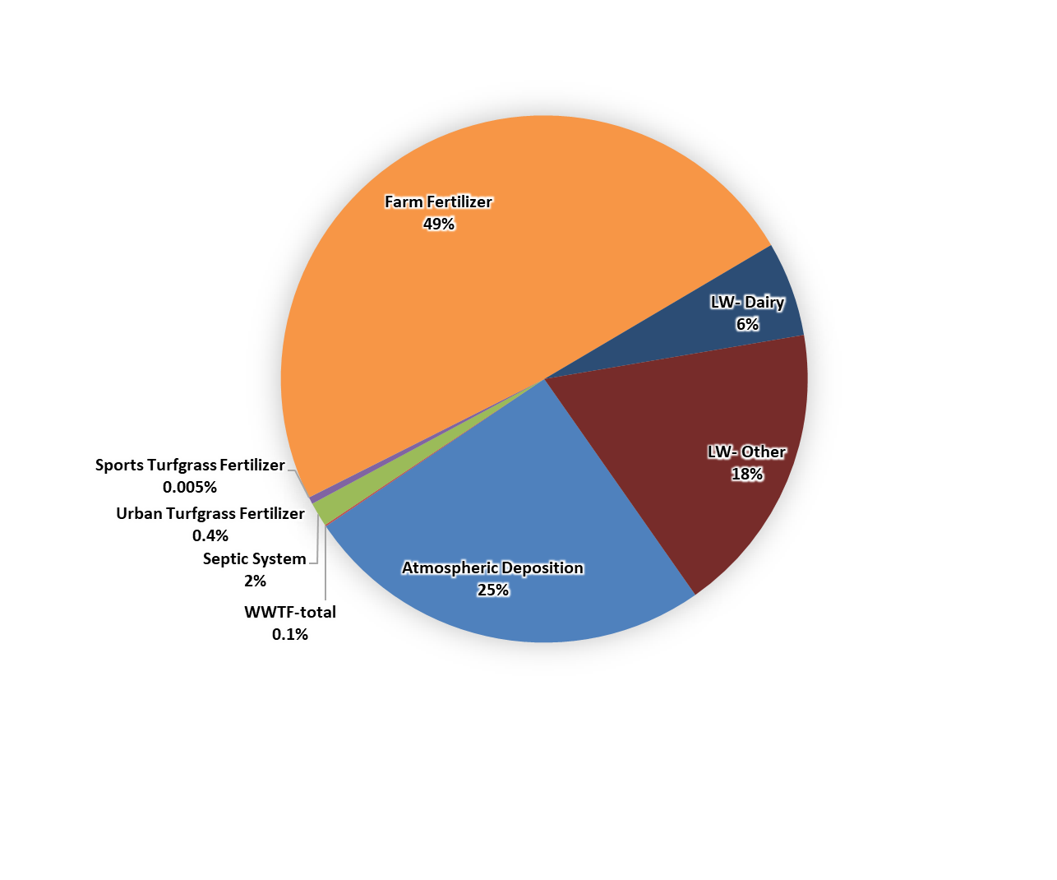
Estimates of Nitrogen Inputs
7,520,879 lb-N/yr

Slide 32

Biochemical Attenuation Factors
Loading Category | N Attenuation Factor | N Leaching
Atmospheric Deposition | 90% | 10%
Septic Systems | 50% | 50%
WWTF-RIB | 25% | 75%
WWTF-Sprayfield | 60% | 40%
WWTF-Reuse | 75% | 25%
Urban Turfgrass Fertilizers | 70% | 30%
Sports Turfgrass Fertilizers | 70% | 30%
Farm Fertilizers | 80% | 20%
Livestock- Dairy | 85% | 15%
Livestock- Other | 90% | 10%
Represent the percentage of N removed and therefore not available for leaching to groundwater
Based on factors used in similar past studies and found in relevant literature
Notes:
After all the nitrogen input to the land surface has been estimated, attenuation factors are applied. This table lists the attenuation factors for each nitrogen source. These factors are the result of an extensive literature and peer review. There is a range for all these factors however, these values represent an average attenuation expected given Florida’s environmental conditions. These factors represent the amount of nitrogen which is taken up by the environment. For example, the 90% attenuation for atmospheric deposition means that 90% of all the nitrogen from atmospheric deposition that falls onto the land surface will be taken up by the environment and will not leach into ground water. This leaves 10% of the atmospheric nitrogen with the potential of leaching to the aquifer.

Slide 33
Hydrogeological Attenuation Factors
Based on Recharge to UFA
Recharge factors are used to estimate the percentage of the non-attenuated nitrogen expected to reach the aquifer in a year
10%
50%
90%
Notes:
Our final step in estimating N loads to ground water is to apply the recharge factor based on where each contributing source is located within the coverage areas. In the high recharge area, we estimate that 90% of all the non-attenuated nitrogen will reach the aquifer, 50% in the medium recharge and 10% in the low recharge.

Slide 34
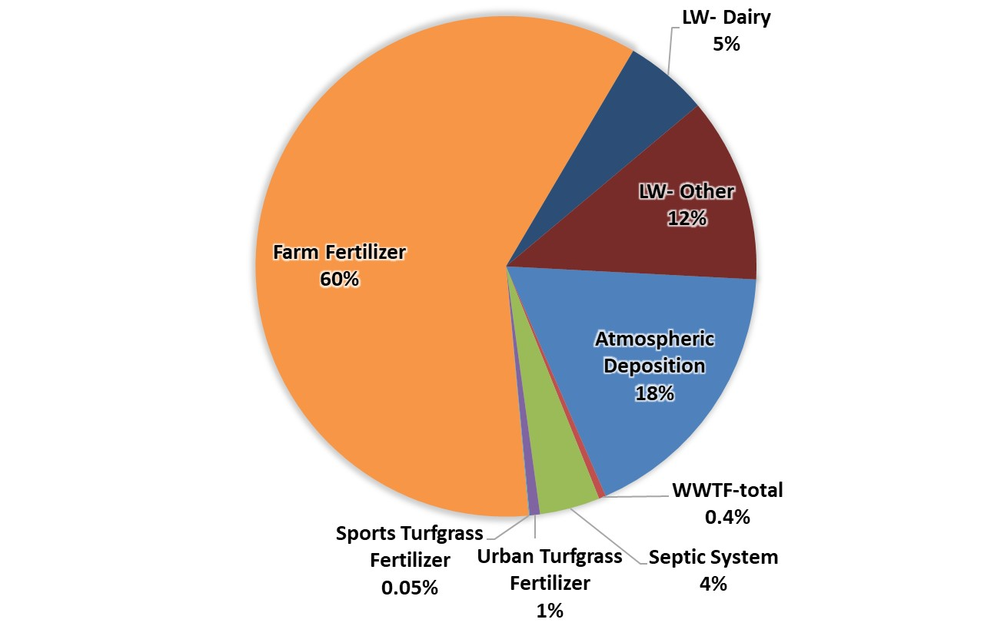
Nitrogen Load to Groundwater
572,439 lb-N/yr

Slide 35
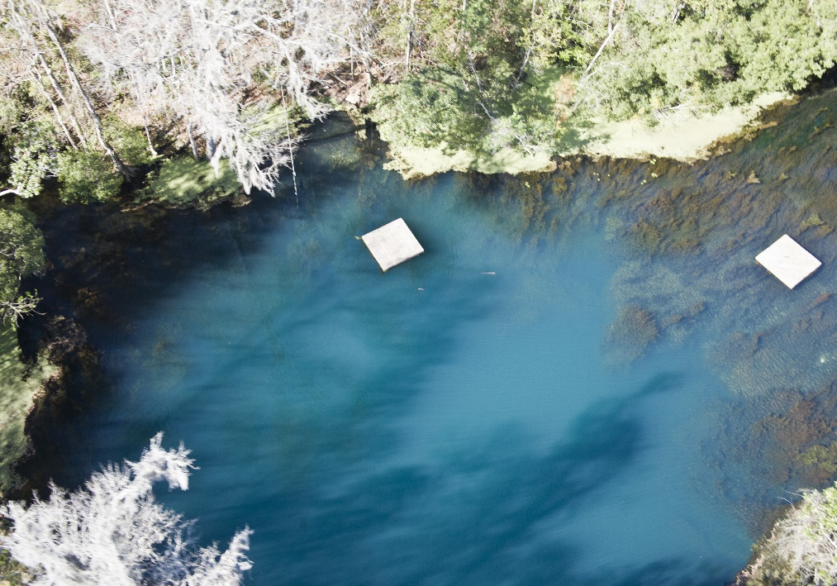
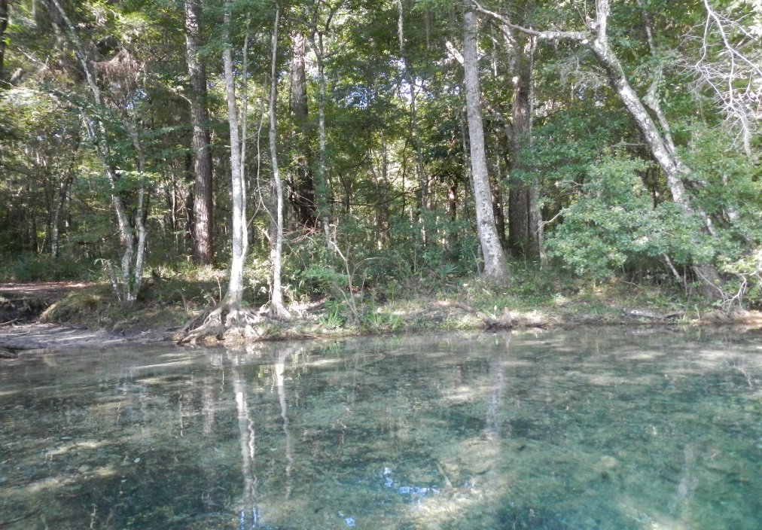
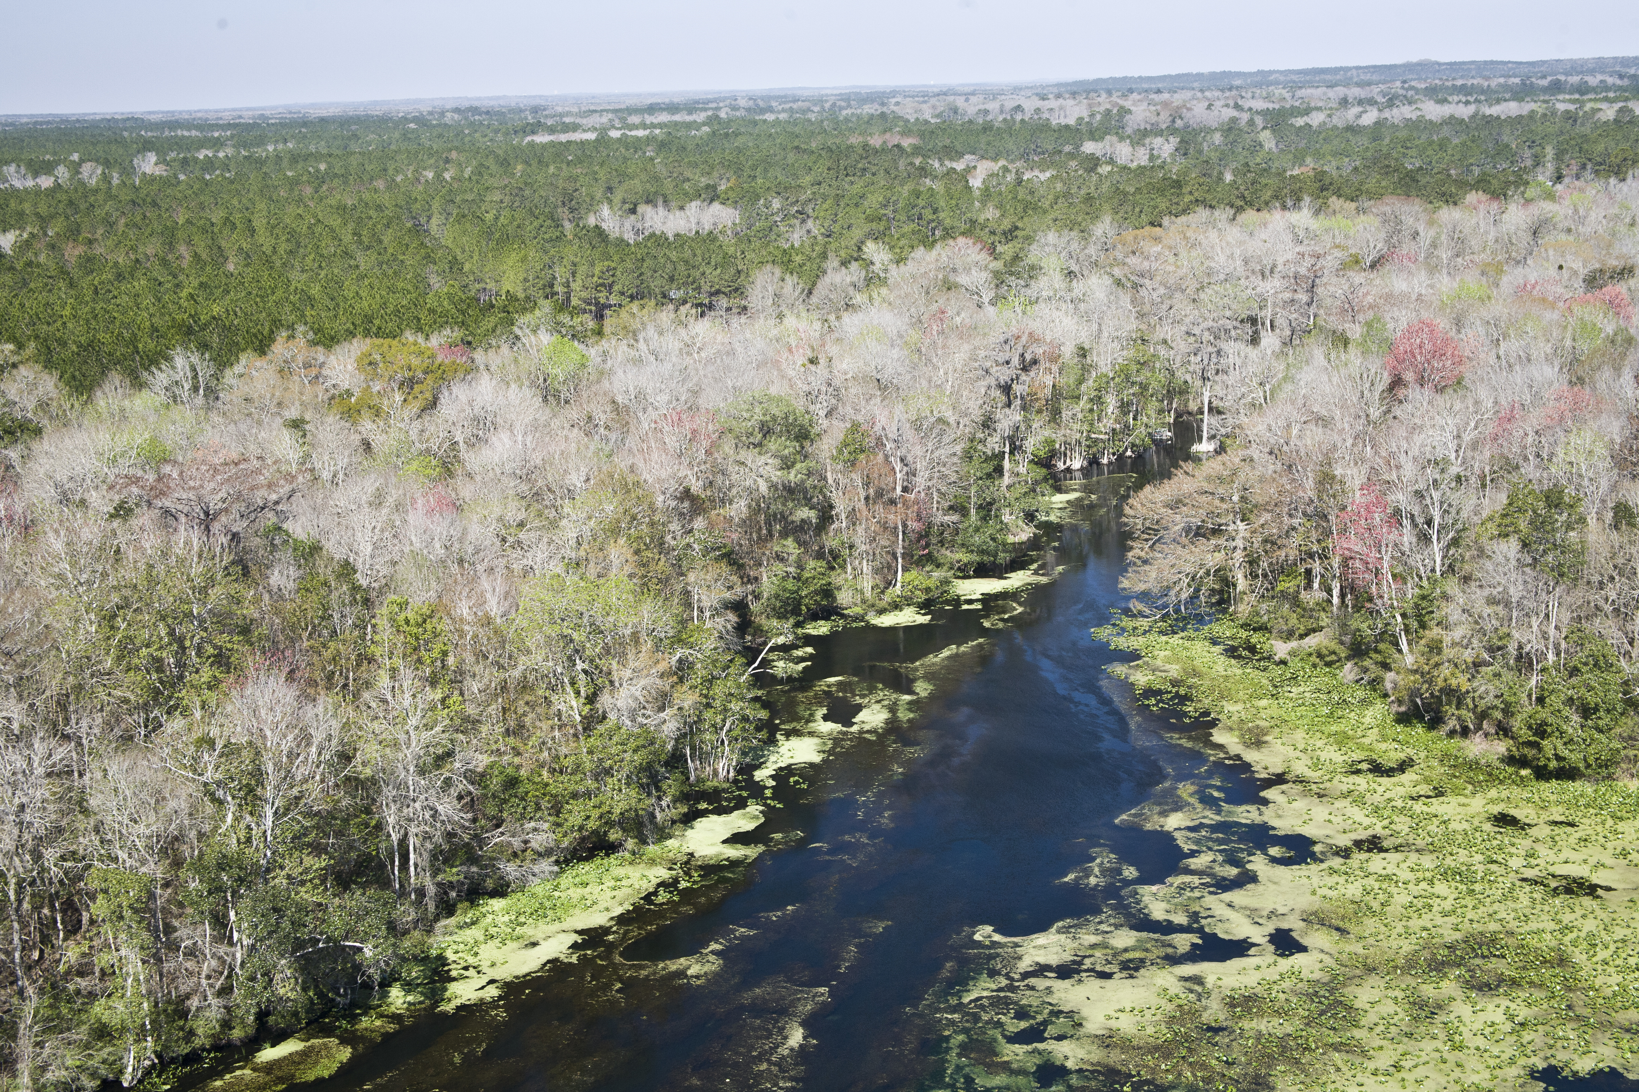
Questions

Slide 36
PFA Delineation
  Sub-Section 373.802, F.S.:
    Definition: Area or areas of a basin where the Floridan Aquifer is generally most vulnerable to pollutant inputs where there is a known connectivity between groundwater pathways and an OFS
  Sub-Section 373.803, F.S.:
    Delineation considers factors that may lead to degradation of an OFS, such as:
        Groundwater travel time to the spring
        Hydrogeology
        Nutrient load, etc.
Notes:
Definition: area or areas of a basin where the Floridan Aquifer is generally most vulnerable to pollutant inputs where there is a known connectivity between ground water pathways and an Outstanding Florida Spring (OFS), as determined by the department in consultation with the appropriate water management districts, and delineated in a BMAP.
Using the best data available from the water management districts and other credible sources, the department, in coordination with the water management districts, shall delineate priority focus areas for each OFS or group of springs that contains one or more OFS and is identified as impaired in accordance with s. 373.807.
PFA and is effective upon incorporation in a basin management action plan.
For ease of implementation delineation Shall use understood and identifiable boundaries such as:
Roads.
Political jurisdictions

Slide 37
PFA Requirements
  Prohibitions
    Wastewater treatment facilities greater than 100,000 gallons per day (GPD), UNLESS advanced wastewater treatment (AWT) is used.
    New OSTDS on less than one-acre lots.
    Ban on land application of Class A or B biosolids w/o approved NMP.
    New Hazardous waste facilities.
  Additional Requirements for Biosolids and Septage Application Practices
    Requirements for newly permitted sites or at renewal
    Verified BMPs for agricultural operations
    Effective nutrient management practices
    Groundwater monitoring requirements

Slide 38
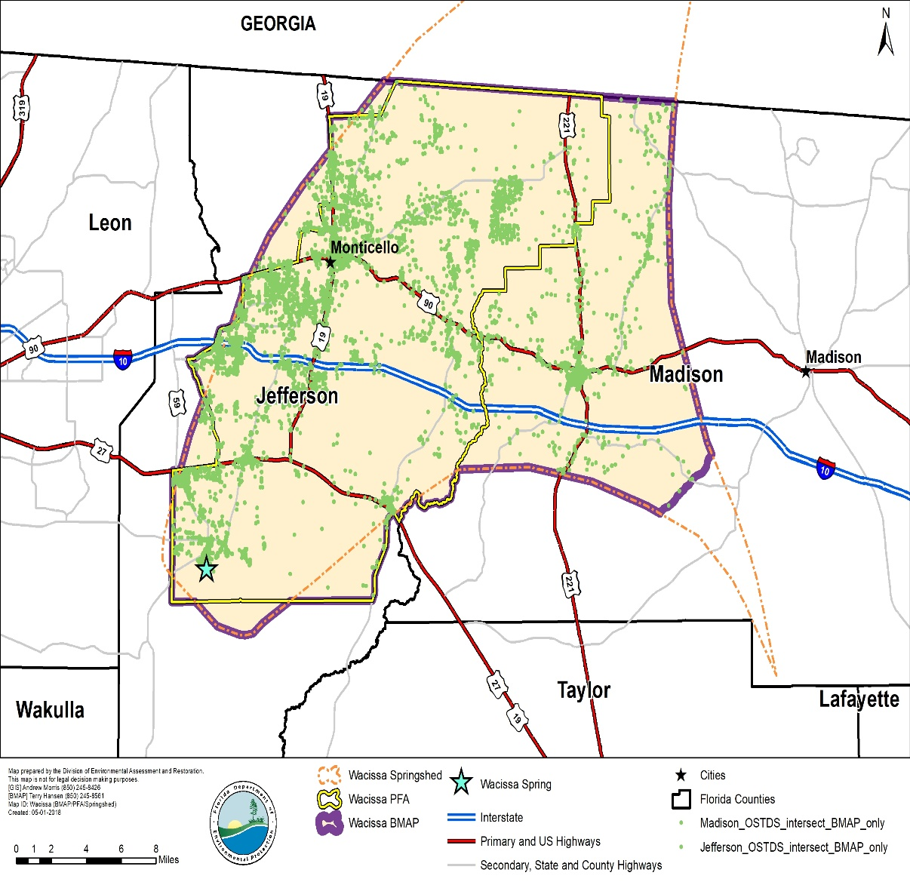
PFA/NSILT Requirement
Priority Focus Area (PFA) – developed for OFS(s) and used to focus restoration efforts
Nitrogen Source Inventory Loading Tool (NSILT) – developed for OFS springsheds to estimate sources of nitrogen to groundwater
  Used to determine if >20% load is from OSTDS

Slide 39
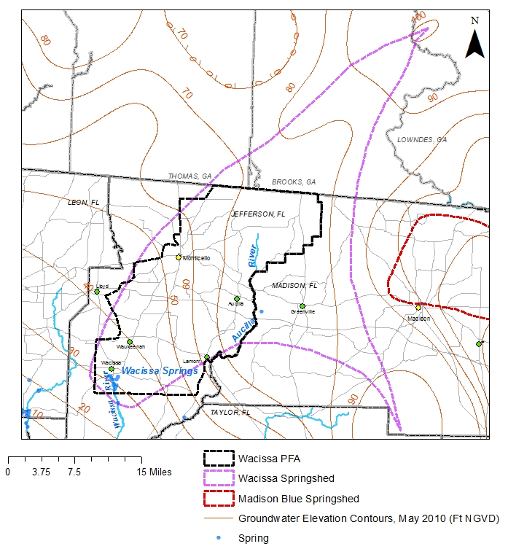
PFA – Boundary

Slide 40
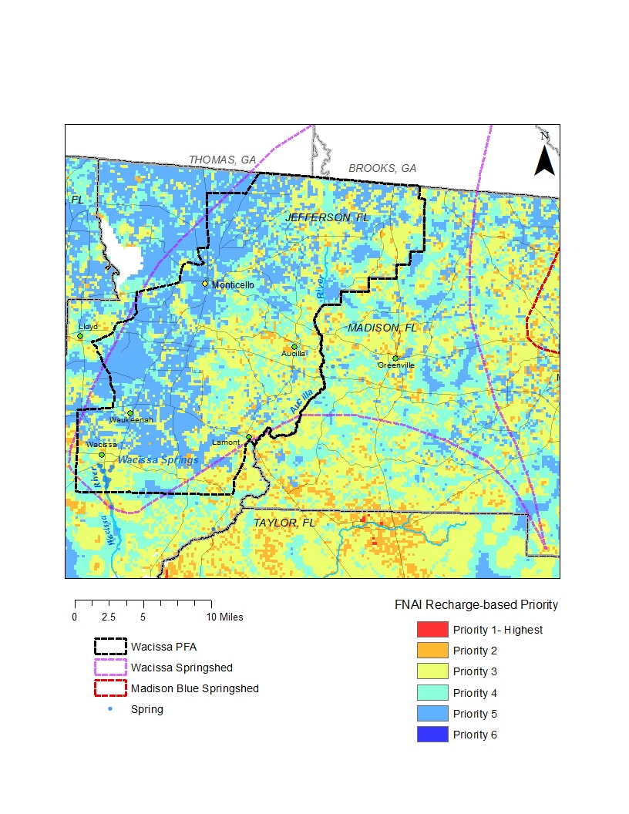
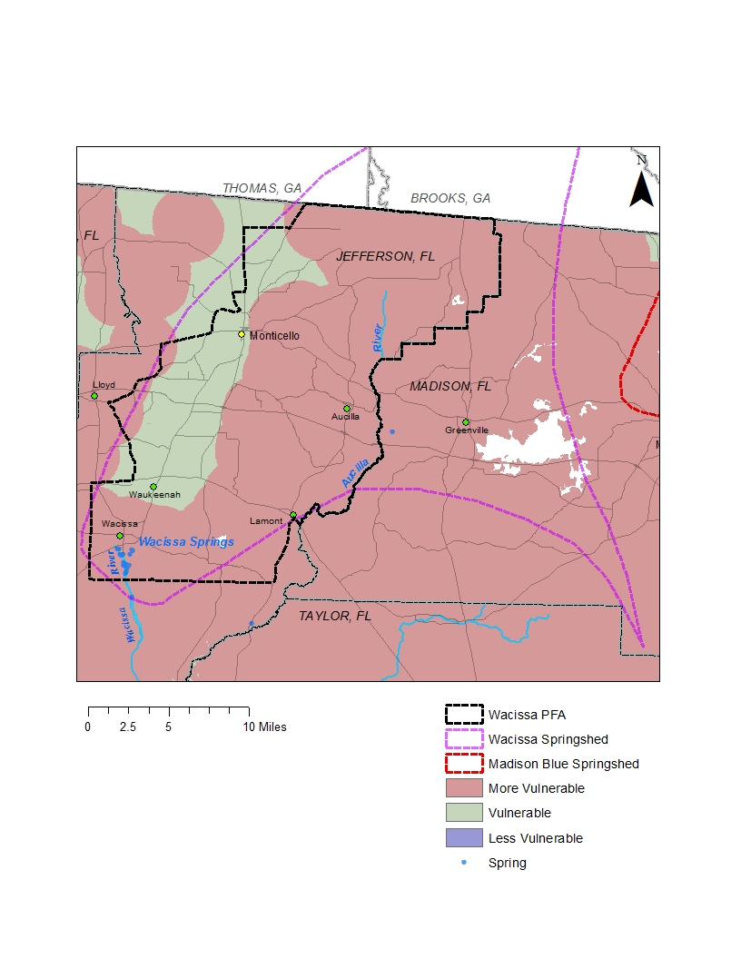
PFA – Recharge and Vulnerability

Slide 41
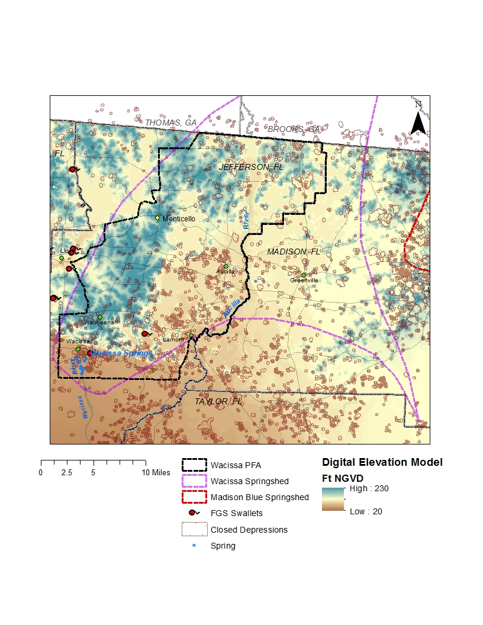
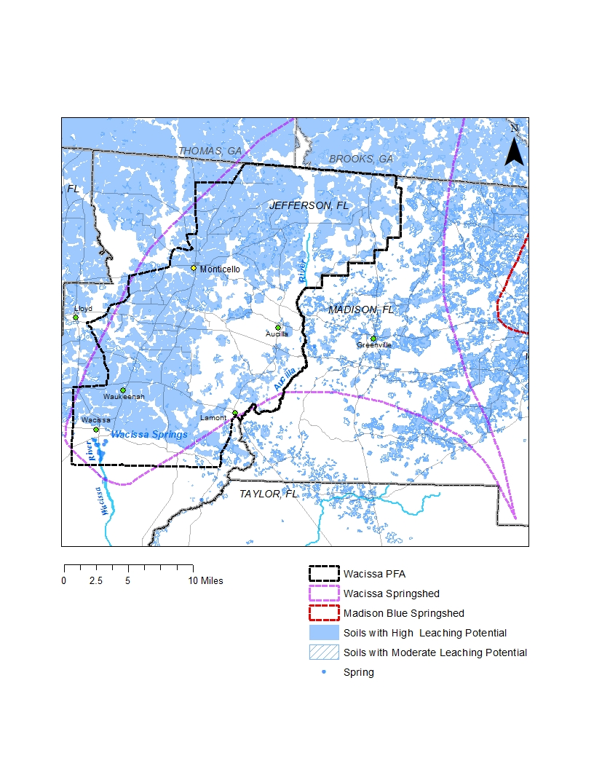
PFA – Elevation & Leaching

Slide 42
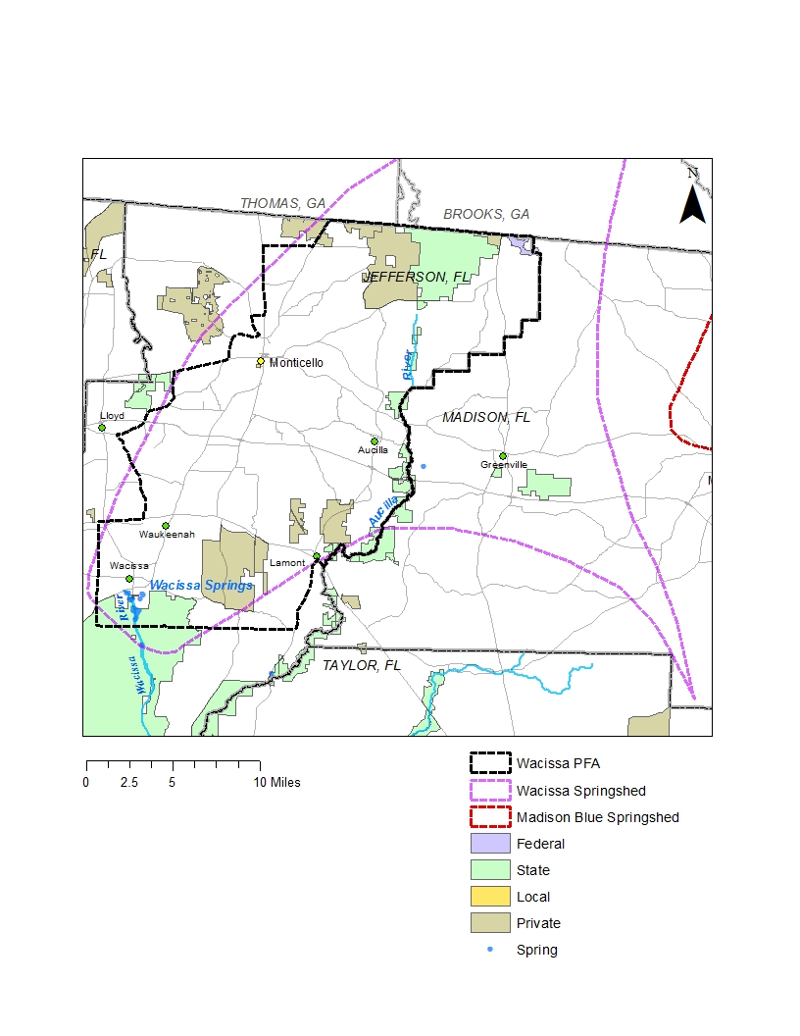
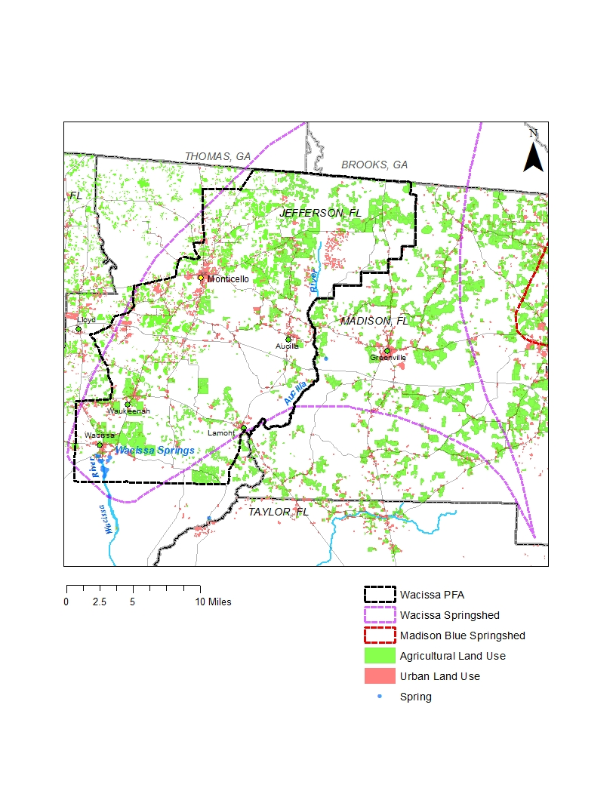
PFA – Conservation Lands & Land Use

Slide 43

PFA – OSTDS & WWTP
  Jefferson County approximately 10,000 OSTDS in BMAP
  Madison County approximately 2,400 OSTDS in BMAP

Slide 44

PFA – Boundary

Slide 45
Wacissa
Nitrogen Loads to Groundwater
572,438 lbs-N/yr

Slide 46
Wacissa BMAP Nitrogen Reductions
Total Reduction Required to Meet the TMDLs
 | Total Load (lb-N/yr) | TMDL Load (lb-N/yr) | Required Reduction to Meet TMDL (lb-N/yr)
Spring Vent | 296,596 | 165,487 | 131,109
Notes:
9.48M total

Slide 47
Project Credit Analysis
Nitrogen Source | Credits to Load to Groundwater (lb-N/yr) | Description
Onsite Sewage Treatment and Disposal Systems (OSTDS) | TBD | Credits identified for stakeholder OSTDS projects (onsite enhancement or sewer)
Urban Turfgrass Fertilizer (UTF) | 200 | DEP approved credits (up to 6 %) for public education activities as well as credits identified for stakeholder stormwater projects
Atmospheric Deposition (AD) |  | No reduction
Farm Fertilizer Reductions | 51,500 | 15 % BMP credit on FF load to groundwater, assuming 100 % owner-implemented BMPs on all fertilized lands
Sports Turfgrass Fertilizer (STF) | 10 | 6 % BMP credit for sports fields and 10 % BMP credit for golf courses (where applicable) on STF load to groundwater, assuming 100 % BMP implementation on golf courses and sports fields
Livestock Waste | 6,800 | 10 % BMP credit on load to groundwater, assuming 100 % owner-implemented BMPs at all livestock facilities
Livestock Waste Permitted Dairy | 4,600 | 15 % BMP credit on permitted dairy load to groundwater, assuming 100% owner-implemented BMPs at permitted dairies
Wastewater Treatment Facilities (WWTF) | 2,000 | Achieved by BMAP WWTF policy if BMAP-wide (achieving 3 or 6 mg/L total nitrogen concentration at discharge)
Total Credits | 71,000

Slide 48
Wacissa BMAP Nitrogen Reductions
Total Reduction Required to Meet the TMDLs
 | Total Load (lb-N/yr) | TMDL Load (lb-N/yr) | Required Reduction to Meet TMDL (lb-N/yr)
Spring Vent | 296,596 | 165,487 | 131,109
Projects Credits |  |  | 71,000
Additional Projects |  |  | 60,000
Notes:
9.48M total

Slide 49
Additional Potential Reductions
Additional Ag Practices Estimated Reduction Credit (lb-N/yr)
Action | High Recharge Area (100%) | Med. Recharge Area (100%)
Precision Irrigation | 2,021 | 1,123
Precision Fertilization | 24,223 | 13,457
Soil Moisture Probes | 44,334 | 24,630
Controlled Release Fert. | 7,096 | 3,942
Cover crops | 71,345 | 39,636
Peanut hay pasture mix | 476,107 | 264,504
Fertilizer Banders | 39,172 | 21,762

Slide 50
Additional Potential Reductions
Existing OSTDS in PFA (lb-N/yr)
 | High Recharge Area |  | Med. Recharge Area
 | Tanks | Credit | Tanks | Credit
Parcels <1 ac | 161 | 1,000 lbs. | 74 | 250 lbs.
Parcels >1ac | 728 | 4,400 lbs. | 715 | 2,400 lbs.

Slide 51

Monitoring

Slide 52
Statewide TMDL, BMAP, Minimum Flows and Levels (MFLs) Annual Report
403.0675(1), F.S. – requires a report that will include status of MFLs, TMDLs, and BMAPs
Replacement of individual BMAP annual progress reports
Annual meetings will continue
Calendar year reporting
Report will contain project information: funding, proposed priority ranking for implementation
Progress made towards restoration goals
Information will be requested in late November, due by the end of January
Info. needed will include: entity activities, compliance, project information, and milestones
Report is due to the Governor and Florida Legislature July 1, 2018 and every year thereafter

Slide 53

Questions?
http://publicfiles.dep.state.fl.us/DEAR/BMAP/WACISSA/

