Slide 1
Wagner Creek Seybold Canal Walk the WBID Summary
September 12, 2011

Slide 2
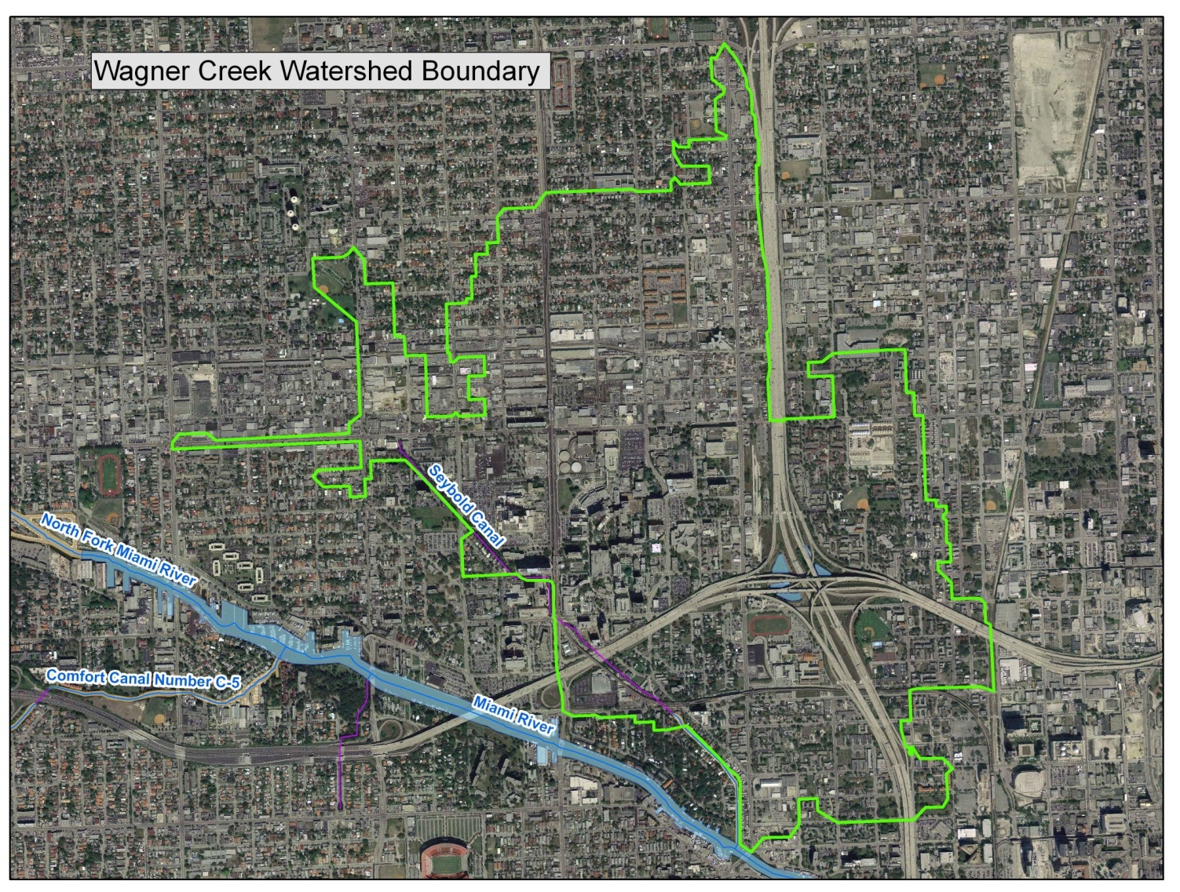
Wagner Creek Watershed

Slide 3
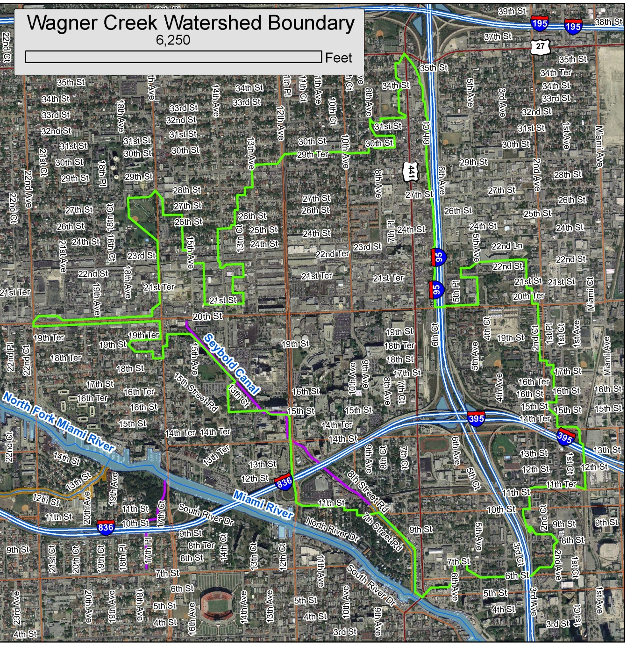
Wagner Creek Watershed
Aerial Base Map with Streets

Slide 4
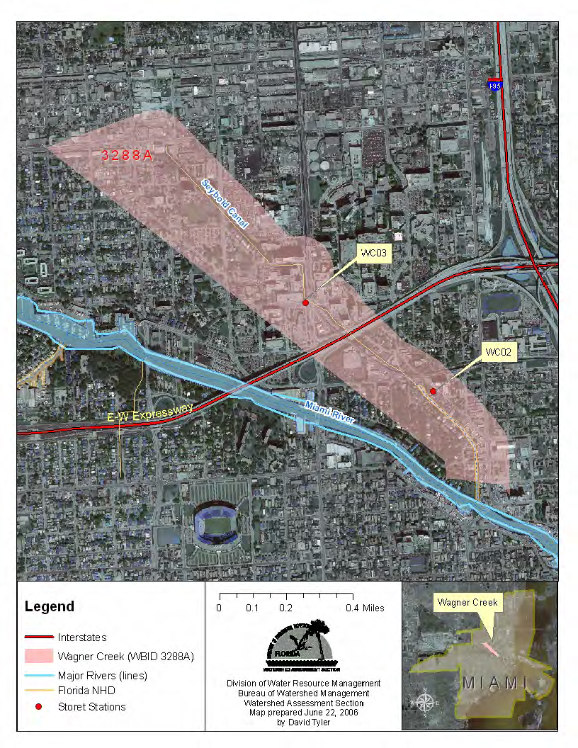
Location of the Water Sampling stations which were used in the TMDL.

Slide 5
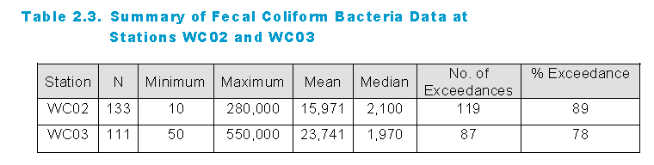
Florida’s Water Quality Standard for Fecal Coliform and the TMDL
Florida’s Water Quality Standard for Fecal Coliform
For determining impairment for fecal coliform bacteria, the IWR states that the most probable number (MPN) or membrane filter (MF) counts (colony-forming units [CFU]) per 100 milliliters (mL) of fecal coliform bacteria shall not exceed a monthly average of 200, nor exceed 400 in 10% of the samples, nor exceed 800 on any one day. The criterion states that monthly averages shall be expressed as geometric means based on a minimum of 10 samples taken over a 30-day period. However, there were insufficient data (fewer than 10 samples in a given month) available to evaluate the geometric mean criterion for fecal coliform bacteria. Therefore, the criterion selected for the TMDLs was not to exceed 400 CFU/100mL in more than 10% of the samples.
From the TMDL

Slide 6
Walk the Waterbody is…
A low-cost, common-sense, effective first step in addressing fecal coliform pollution which often improves communication among entities and divisions who would other wise work independently of one another.

Slide 7
Walk the Waterbody Overview
Maps on the Table review of what we know about potential sources of FC.
Field event to identify potential sources
Plans to address potential sources identified and prevent future potential sources.

Slide 8
Who participates?
All entities with jurisdictional authority in a watershed collaborate simultaneously before, during , and after the field event.

Slide 9
Wagner Creek and Seybold Canal WTW Team members included representatives from:
City of Miami,
City of Miami Public Works,
Miami–Dade County Water and Sewer Department (WASD),
Miami-Dade County Public Works,
Miami–Dade County Department of Environmental Resources Management (DERM),
Miami River Commission (MRC),
Florida Department of Transportation (FDOT),
Miami–Dade (Florida) Department of Health (FDOH),
Florida Department of Environmental Protection (FDEP),
South Florida Water Management District (SFWMD),
and Florida Department of Law Enforcement (FDLE).
Notes:
Kudos and appreciation to all participants!

Slide 10
Team members held the “Maps on the Table” session at the South Florida Water Management District Miami Field Station
Identified areas of concern to visit during the Walk the WBID event, based on field knowledge from staff and a synthesis of the available GIS and other information.
Identified problematic and/or potential contributory facilities and activities
Marked the areas of concern on the maps
  These would further serve as a reference, and as a guide, for the field team during the field exercise.
Notes:
With a representative present from each participating agency, team members held the “Maps on the Table” session at the South Florida Water Management District Miami Field Station, to identify areas of concern to visit during the Walk the WBID event, based on field knowledge from staff and a synthesis of the available information. The team members, facilitated by FDEP, reviewed the information on the maps for completeness, discussed concerns in specific areas, identified problematic and/or potential contributory facilities and activities, and marked the areas of concern on the maps. These would further serve as a reference, and as a guide, for the field team during the field exercise.
Inser date of the ‘table-top’ exercise

Slide 11
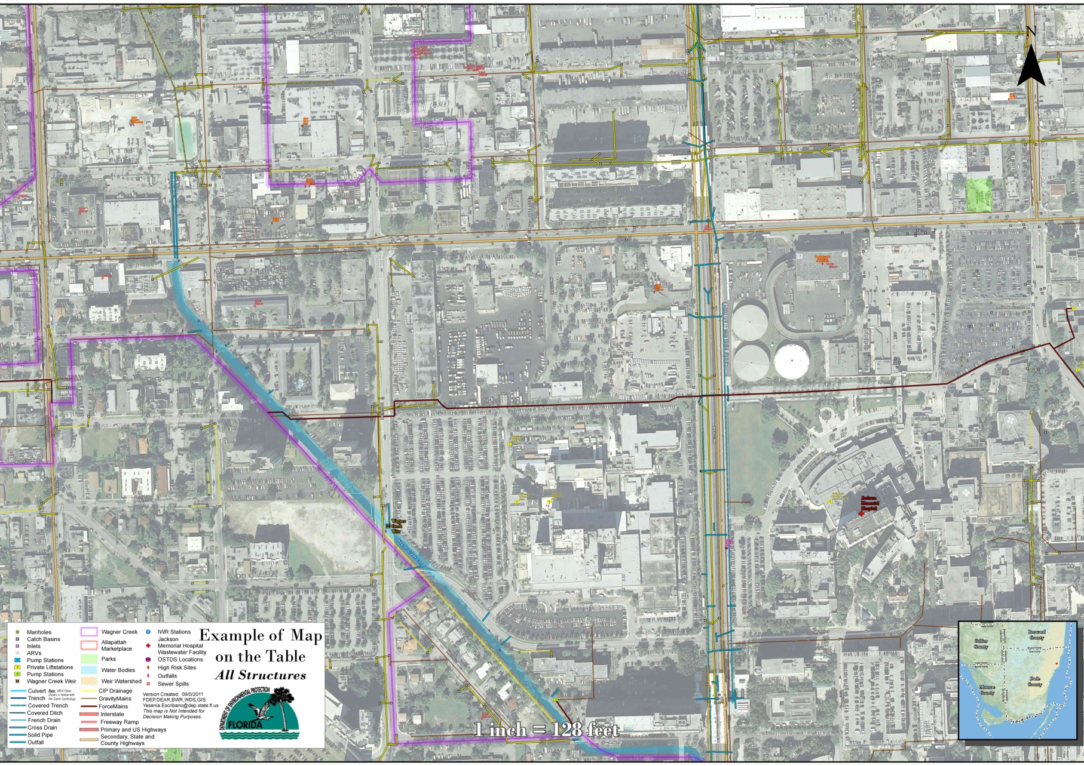
One portion of the MOT map
Showing both the storm sewer and sanitary sewer GIS layers

Slide 12
Potential sources that were investigated included the following:
Potential illicit connections (PICs) or discharges;
Public and private sanitary sewer infrastructure (such as manholes and pump stations);
Package plants (small treatment facilities used to treat wastewater in small communities or on individual properties.);
Signs of recent SSOs, or areas with multiple SSOs;
Wastewater infrastructure located close to surface waters and/or stormwater inlets, including pump stations, manholes, and air release valves (ARVs);
Septic tanks located close to surface waters and/or stormwater inlets;
Failing septic tanks (as indicated by ponding and a strong smell of sewage);
Evidence of homeless populations;
MS4 conveyances requiring cleaning;
Accumulated trash and debris on streets and parking lots;
Accumulated trash and debris near to or inside stormwater drains and catch basins;
Clogged or broken stormwater grates;
Stormwater drains undergoing repairs;
Stormwater outfalls discharging from underground conveyances or into ponds;
Sewage smell from stormwater drains, indicating possible cross-connections;
Unusual odors;
Evidence of illegal dumping or discharge of liquids;
Signs of oil and grease;
Excessive sediments and signs of erosion or wash out;
Stagnant water;
Debris in inlets, or inlets located near wastewater infrastructure;
Exposed pipes of unknown origin;
Flood-prone areas;
Pet waste or evidence of high-traffic pet areas;
Evidence of wildlife such as raccoons and waterfowl;
Evidence of chickens or other hobby animals; and
Areas with heavy tree cover and vegetated ditches preventing ultraviolet (UV) light penetration.

Slide 13
Summary of findings
A summary document has been created noting field day observations
  photos
  field notes
  Post field notes
  contains a table of follow-up actions

Slide 14
Improvements Made
City of Miami has increased the frequency of road and storm system cleaning
  Street sweeping
  Debris and litter removed from stormwater infrastructure traps
The VA Hospital had a full sewer system check resulting in a list of planned improvements
Action Item Completed cooperatively:
  From Juan Pablo Duarte Park to the NW 20th Street Bridge, inspect underground stormwater pipes and ensure they are not clogged.
    Miami–Dade County Public Works cleaned the county storm sewer system along NW 20th Street between NW 15th Avenue and Wagner Creek.
    City of Miami Public Works maintained rights-of- way in this area fall into Public Works Maintenance Grid No. 38. Public Works Operations started cleaning this grid.

Slide 15
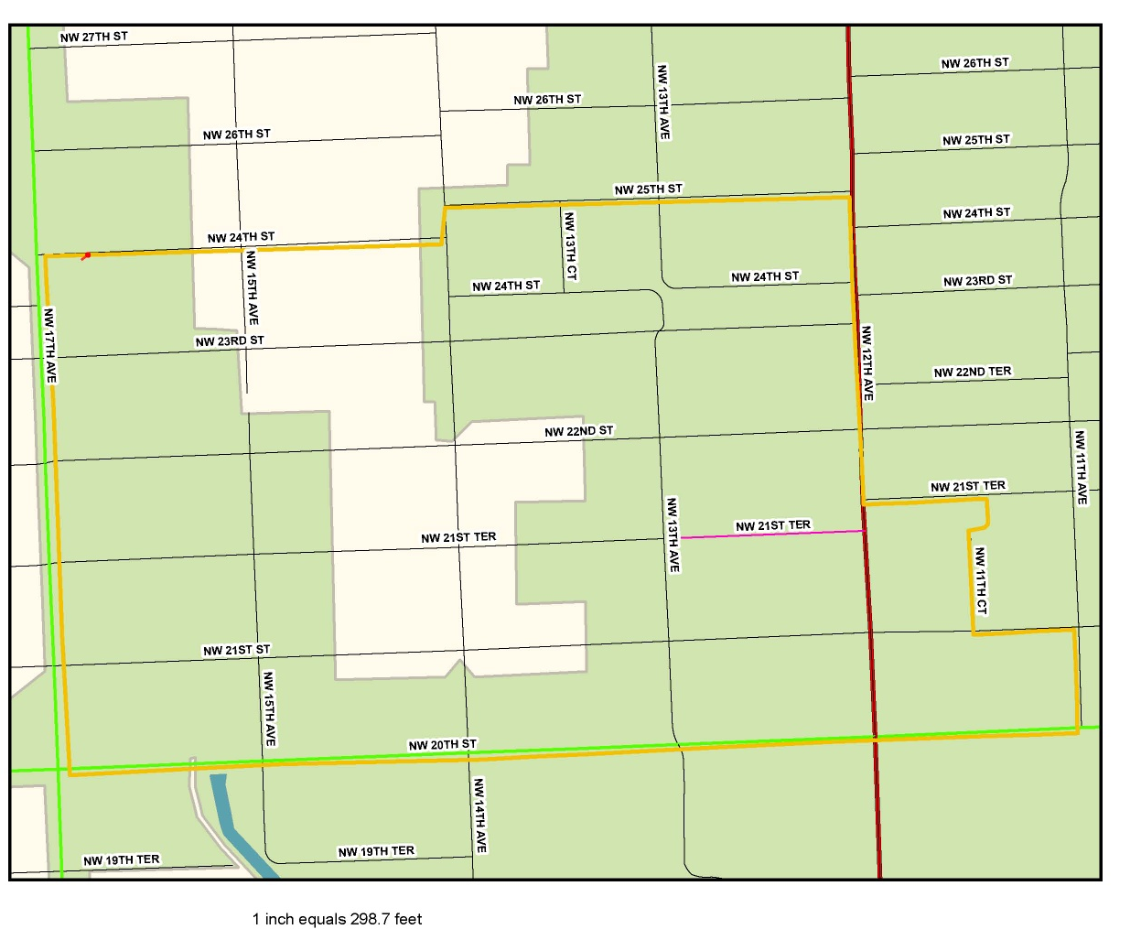

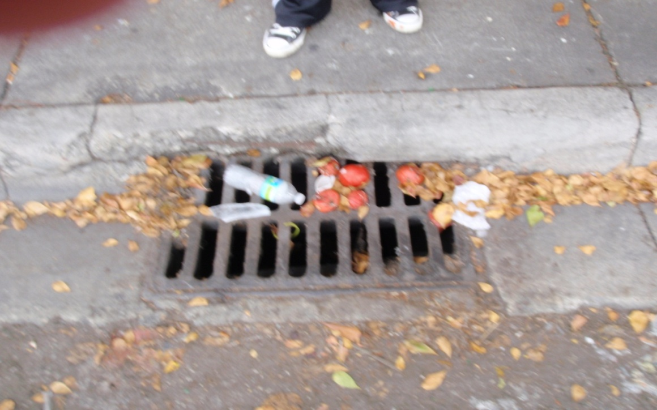
Allapattah Market
As has been consistently revealed during the past 2 decades of environmental action plans and source identification efforts, the Allapattah Market has again been identified as a source of pollution to the system.
There is a need for prolonged improved actions to take place in the market and connecting storm system

Slide 16
Remaining
Investigate PICs found during the boat tour
Investigate to determine whether biowaste dumpsters may be allowing contents to enter stormwater drains to the river
Find solution to free roaming chickens
Prevent fruit and other waste from the Allapattah Market from entering the stormwater system.
Develop sampling plan to immediately follow up on high test results
And more…

Slide 17
Action Items Table
Next Steps and Follow-up Actions
Table 1 lists each follow-up action to be taken to reduce fecal coliform levels in Wagner Creek, the related figure, the entity carrying out the activity, the date of completion or initiation, and the action that was taken. The table serves as a checklist to ensure that all the necessary follow-up actions are taken.
Acronyms used in the table :
COM- City of Miami
PW-Public Works
NET- COM Neighborhood Enhancement Team
MDC-Miami Dade County
PW-Public Works
DERM-Department of Environmental Resources Management
GSA-Miami Dade General Services Administration
MDT- Miami Dade Transit
WASD-Miami Dade Water and Sewer Department
MDHA-Miami Dade Housing Authority
MDX-Miami Dade Expressway
FDEP-Florida Department of Environmental Protection
FDOT-Florida Department of Transportation
DOH- Department of Health
VA-Veterans Affairs Hospital
UM-University of Miami
NTP-Notice to Proceed
TBD-To be determined

Slide 18
Action Items Table Continued
Related Figure(s) | Action Item | Entity | Date Completed/Initiated | Outcome
5, 9, 10, 19, 25, 42 | A:Increase the frequency of stormwater trap cleaning throughout the watershed. B:Each specific point noted by figures to the left to be verified to be on schedules of the respective entity. | Watershed wide, each entity is responsible for their respectively owned stormwater systems: COM, FDOT, MDC, Miami Dade Express Way Authority, VA Hospital | A: Increased frequency: initiated by COM pre 9/2011. B: Verification related figures are on the schedule: initiated by COM 9/8/11, not yet verified.
4, 6, 15, 16, 24, 34, 37, 44, 48, 49, 51 | Carry out additional monitoring of storm drain system discharging to Wagner Creek–Seybold Canal. | COM | NTP issued May 2nd, 2011. Plan is in process as of Sept 2011. Anticipate the plan to be completed within a year. Additional monitoring may be needed. Outfall monitoring planned to take place during the next rainy season following the completion of the strategy plan. | The City of Miami has issued a notice to proceed to a consultant to create a monitoring plan to identify more precisely the source of fecal coliform loading to Seybold Canal and Wagner Creek.
4, 14, 23, 36, 43, 47, 50 | After a high sampling result at any of the sampling stations, go into the field within 24 hours and if possible sample just upstream and downstream of the location to identify the source. | DERM samples monthly, and can cooperate with others to let them know when a follow up sample must be taken. Follow up sampling person TBD | To be initiated no later than March 7, 2012.
4, 5, 6 | From Juan Pablo Duarte Park to the NW 20th Street Bridge, inspect underground stormwater pipes and ensure they are not clogged. | MDCPW | Completed January 31, 2011 | Miami–Dade County Public Works cleaned the county storm sewer system along NW 20th Street between NW 15th Avenue and Wagner Creek.
4, 5, 6 | From Juan Pablo Duarte Park to NW 20th Street Bridge, inspect underground stormwater pipes and ensure they are not clogged. | COMPW | Completed February 14, 2011 | City of Miami–maintained rights-of- way in this area fall into Public Works Maintenance Grid No. 38. Public Works Operations started cleaning this grid.

Slide 19
Action Items Table Continued
Related Figure(s) | Action Item | Entity | Date Completed/Initiated | Outcome
None | Inspect wastewater infrastructure from NW 17th Avenue to 20th Street; multiple SSOs have occurred in this area, and the underground stormwater conveyance is close to the creek and inlets. | WASD | To be initiated no later than March 7, 2012.
9, 10 | A: At the Allapattah Produce Market, increase the frequency of stormwater trap maintenance. B: Each specific point noted by figures to the left to be verified to be on schedules of the respective entity. | Watershed wide, each entity is responsible for their respectively owned stormwater systems: COM, FDOT, MDC | A to be initiated no later than March 7, 2012. B to be verified no later than March 7, 2012.
9, 10 | A: At the Allapattah Produce Market, carry out regular street sweeping. B: Each specific point noted by figures to the left to be verified to be on schedules of the respective entity. | Watershed wide, each entity is responsible for their respectively owned stormwater systems: COM, FDOT, MDC | A to be initiated no later than March 7, 2012. B to be verified no later than March 7, 2012.
9, 10, 11 | At the Allapattah Produce Market, implement public education campaign for businesses in area on stormwater contamination. | NET, Team Metro of MDC, COM MS4 and potentially DERM also. | Choosing flier & passing out fliers to be initiated no later than March 7, 2012.
10, 11, 12 | Increase enforcement of waste disposal codes in Allapattah Produce Market area. | COM, MDC | To be initiated no later than March 7, 2012.

Slide 20
Action Items Table Continued
Related Figure(s) | Action Item | Entity | Date Completed/Initiated | Outcome
11, 12 | At the Allapattah Produce Market, increase and enhance homeless services to reduce the number of homeless in the area who are retrieving fruit from unsecured dumpsters, or obtaining fruit to sell from local merchants who are seeking to avoid disposal costs using less environmentally responsible methods. | COM’s Homeless Assistance Program, “Green Shirts” | To be initiated no later than March 7, 2012.
12 | At the Allapattah Produce Market, determine whether the drainage system at 1265 NW 21st Terrace is located within the 30-foot-wide utility easement or only within the area where the property owner bears maintenance responsibility. | COM/MDC will determine who’s responsibility it is for maintenance of the road. | Determination to be made no later than March 7, 2012.
12 | At the Allapattah Produce Market, encourage local businesses to install locks or otherwise secure dumpsters to prevent the removal of fruit. | COM Solid Waste /MDC Solid waste could include in a letter. | To be initiated no later than March 7, 2012.
17 | Sample the sheen observed on the water’s surface downstream of the 20th Street Bridge. | Walk the WBID team | Sampled November 18, 2010 | The results showed that oil and grease are not a problem at this location.
19 | Fix broken storm drain covers at NW 20th Street. | MDCPW | Around March of 2012 expected completed. | Storm drain covers will be repaired under proposed project, NW 20St & NW 15 Ave. Drainage Improvement Project

Slide 21
Action Items Table Continued
Related Figure(s) | Action Item | Entity | Date Completed/Initiated | Outcome
20 | Investigate and resolve the cause of the trash buildup in the storm drain at NW 15th Avenue south of NW 2oth Street. | NA | NA | Plans show that this is a French drain, and is believed not to be contributing to Wagner Creek. The city has a regular maintenance program in place to clean out the storm drains.
21 | In the area near the 20th Street Bridge, carry out a campaign to educate the public about pet waste. | Team Metro of MDC. MDC owns 20th Street. | To be initiated no later than March 7, 2012.
21 | Install pet waste stations in the area along NW 19th Terrace and NW 19th Street. | COM Solid Waste/ MDC Solid Waste | Discussion to be initiated no later than March 7, 2012.
21 | Increase public education concerning “scoop the poop” campaign. | COM & MDC | To be initiated no later than March 7, 2012.
21, 22 | Identify the owners of the free-ranging chickens or remove free-range chickens from the area. Ask COM Code Enforcement to address the issue of free-roaming pets. Ask County Animal Services to pick up stray chickens. | COM Code Enforcement & MDC Animal Services | Communication between WTW members and animals services to be initiated no later than March 7, 2012.

Slide 22
Action Items Table Continued
Related Figure(s) | Action Item | Entity | Date Completed/Initiated | Outcome
23 | Investigate whether the apartments located just south of 19th Street have a direct connection to Wagner Creek. | COM, MDC, and FDEP | Boat Tour June 9, 2011 | Boat tour revealed several pipes connecting directly to Wagner Creek from these parcels.
24 | Increase sampling frequency at NW 14th Avenue. | DERM | Discussion and planning to be initiated no later than March 7, 2012.
25 | Clean the partially blocked stormwater drain at 1501 to 1511 NW 13th Court. | COMPW | 5/19/2011 | A service request for storm drain cleaning at 1511 NW 13th Court was sent to Public Works Operations under SR # 11-00103962. The city has cleaned the inlet.
28 | Investigate the storm drain outlets that discharge directly to the creek from apartments at 1310 NW 16th Street. | MDHA | To be initiated no later than March 7, 2012.
29 | Investigate PIC #1 on NW 13th Court. | COMPW contractor | Completed November 19, 2010 | The city has removed the pipe sticking out of ground.

Slide 23
Action Items Table Continued
Related Figure(s) | Action Item | Entity | Date Completed/Initiated | Outcome
32, 33, 41, 44 | Investigate solids and oils floating on surface water at the stormwater outfall from the VA Hospital building. | Walk the WBID team | Sampled November 18, 2010 | The results showed fecal coliform levels of 50 CFU/100mL.
33, 34 | Inspect the VA Hospital stormwater outfalls and wastewater pump stations. | COM, FDEP, and DERM, VA Hospital Reps. | June 9, 2011 | Wastewater pump stations were inspected with no obvious issues found. Due to the time constraints of the boat tour, only part of the VA stormwater infrastructure was inspected.
35 | Sample just past the dumpsters at the University of Miami Medical Center after a rain event. | MRC approved up to $1700 in water quality samples (DERM’s contracted private lab-100 samples at $17 each) for this WBID. Leading this action item is COM and DERM, if necessary, ask for trained students from a university to volunteer time to grab samples. | Discussion to be initiated no later than March 7, 2012.
36, 37 | Sample at NW 15th Street upstream of the University of Miami Medical Center. | MRC approved up to $1700 in water quality samples (DERM’s contracted private lab-100 samples at $17 each) for this WBID. Leading this action item is COM and DERM, if necessary, ask for trained student from a university to volunteer time to grab samples. | Discussion to be initiated no later than March 7, 2012.
41 | Launch a boat downstream from NW 14th Avenue to complete the inspection of the creek. | DERM, FDEP, and COM | Completed June 9, 2011 | Results reflected in this report.

Slide 24
Action Items Table Continued
Related Figure(s) | Action Item | Entity | Date Completed/Initiated | Outcome
None | Determine whether Jackson Memorial Hospital has a direct connection to the public storm sewer system that connects to Wagner Creek. | 12th Ave is a DOT road, and FDOT’s storm sewer. | To be initiated no later than March 7, 2012.
42 | Verify the connections between the Metrorail drainage systems to the storm sewer system that leads to Wagner Creek–Seybold Canal, and increase cleaning of Metrorail drainage if connections are verified. | MDCPW and MDT | To be initiated no later than March 7, 2012.
42 | Contact the Miami–Dade County General Services Administration to ask them to clean up litter, debris, and trash in the stormwater drain inside the Miami–Dade Transit Culmer Metrorail Station in the Highland Park area. | MDCPW and MDT | Discussions to be initiated no later than March 7, 2012.
42 | Obtain plans from Miami–Dade County Public Works or Miami–Dade County Transit, or perform a field test to verify connections to the creek from the stormwater drain inside the Miami–Dade Transit Culmer Metrorail Station in the Highland Park area. | MDT and Miami Dade GSA | Planning to be initiated no later than March 7, 2012.
42 | Walk the ditch along State Road 836 to look for potential sources such as PICs, etc. | MDT and Miami Dade GSA | Discussions and planning to be initiated no later than March 7, 2012.

Slide 25
Action Items Table Continued
Related Figure(s) | Action Item | Entity | Date Completed/Initiated | Outcome
43 | Ask the City of Miami Building Department whether the Winn-Dixie Supermarket in this area is directly connected to Wagner Creek. Field testing may be necessary. | COM | March, 2011 | Plans show French drains only, no discharges to creek.
45, 46, 50 | Investigate the hydrology of the area around the City of Miami Overtown stormwater pump station. | FDOT | Aug. 2011 | FDOT is investigating.
None | Ensure that the gate valve at the City of Miami Solid Waste Yard is still properly functioning. | COM GSA & COM Solid Waste | Information pursuit to be initiated no later than March 7, 2012.
None | Ensure that solid waste from the City of Miami Solid Waste vehicles is not entering the French drain system at the Solid Waste Yard. | COM GSA & COM Solid Waste | Information pursuit to be initiated no later than March 7, 2012.
None | Ensure that the sanitary/storm sewer cross-connection (discovered before the walk the waterbody exercise) at the Miami–Dade County Solid Waste Transfer Station has been corrected. | MDC Solid Waste | Information pursuit to be initiated no later than March 7, 2012.

Slide 26
Action Items Table Continued
Related Figure(s) | Action Item | Entity | Date Completed/Initiated | Outcome
None | Verify whether the storm sewer system at the Miami–Dade County Solid Waste Transfer Station connects to the public system that discharges to Wagner Creek. | FDOT- NW 12 Ave, MDC-NW 20th | Information pursuit to be initiated no later than March 7, 2012.
None | Ensure that solid waste leachate from the storage area and trucks at the Miami–Dade County Solid Waste Transfer Station is not entering the storm drain system. | FDOT- NW 12 Ave, MDC-NW 20th | Information pursuit to be initiated no later than March 7, 2012.
None | Implement increased sediment control at the Cemex concrete plant to lessen sedimentation into ditches and waterbodies. | DERM, COM | Information pursuit to be initiated no later than March 7, 2012.
53 | At the VA Hospital, ensure that there is no contamination from biomedical waste bins and roll-off containers entering the curb opening inlet. | VA Hospital, DERM, and COM Code Enforcement. Maybe DOH. | Information pursuit to be initiated no later than March 7, 2012.
58 | Ensure that the pump station near the VA Hospital’s Fisher House is pumped out and the slow leak from the backflow preventer is fixed. | DERM | Information pursuit to be initiated no later than March 7, 2012.

Slide 27
Action Items Table Continued
Related Figure(s) | Action Item | Entity | Date Completed/Initiated | Outcome
62, 63, 64, 65, 66, 67 | Investigate whether the PICs at Creek Club Apartments are discharging to the creek. | DERM and potentially COM Building Department | Information pursuit to be initiated no later than March 7, 2012.
68, 69 | Investigate whether the outfalls near the NW 19th Terrace put-in point is discharging to the creek. | COM | Information pursuit to be initiated no later than March 7, 2012.
71, 72, 73, 74 | Investigate whether the PICs at Campeones Boatyard are discharging to the creek. | DERM, potentially COM Building Department, and FDOT | Information pursuit to be initiated no later than March 7, 2012.
75 | Investigate whether the submerged outfall at 732 NW 7th Avenue is discharging to the creek. | FDOT owns 7th AVE, DERM and potentially COM Building Department | Information pursuit to be initiated no later than March 7, 2012.
76 | Investigate whether the PVC pipe at Florida Precision, 800 NW 7th Avenue, is discharging to the creek. | DERM and potentially COM Building Department, FDOT | Information pursuit to be initiated no later than March 7, 2012.

Slide 28
Action Items Table Continued
Related Figure(s) | Action Item | Entity | Date Completed/Initiated | Outcome
77 | Investigate whether the three rusted pipes at Popeye Marine, 810 NW 8th Street, are discharging to the creek. | DERM and potentially COM Building Department, FDOT | Information pursuit to be initiated no later than March 7, 2012.
78 | Investigate whether the PVC pipe protruding from a private residence at 922 or 938 NW 8th Street is discharging to the creek. | DERM and potentially COM Building Department, FDOT | Information pursuit to be initiated no later than March 7, 2012.
79 | Inspect the history of the capped lateral at the apartment building at 938-942 NW 8th Street to determione if it was a source of fecal coliform to the creek. | COM Building Department | Information pursuit to be initiated no later than March 7, 2012.
81 | Investigate whether the white PVC pipe at 727 NW 7th Street is discharging to the creek. | DERM and potentially COM Building Department, FDOT | Information pursuit to be initiated no later than March 7, 2012.

Slide 29
Future MRC involvement
The monthly meetings of the MRC may act as the forum for continued communications on the status of the action items listed in the summary document.

Slide 30
Many Thanks…
If it were not for the dedicated staff and time allotted by each agency, this collaborative effort would not have been so successful, lines of communication would likely be minimal, and the river system would continue to receive anthropogenic sources of fecal coliforms.

Slide 31
Questions? Feel free to contact:
John Abendroth
2600 Blair Stone Rd., Tallahassee, FL 32399
John.Abendroth@dep.state.fl.us
(850) 245-8555
Anita Nash
Anita.nash@dep.state.fl.us
(850) 245-8545

