Slide 1


Florida Department of
Environmental Protection
Boater Safety Education
Required by DEP Directive 270
Required by State Law if born After 1/1/1988
Prevents Accidents

Slide 2
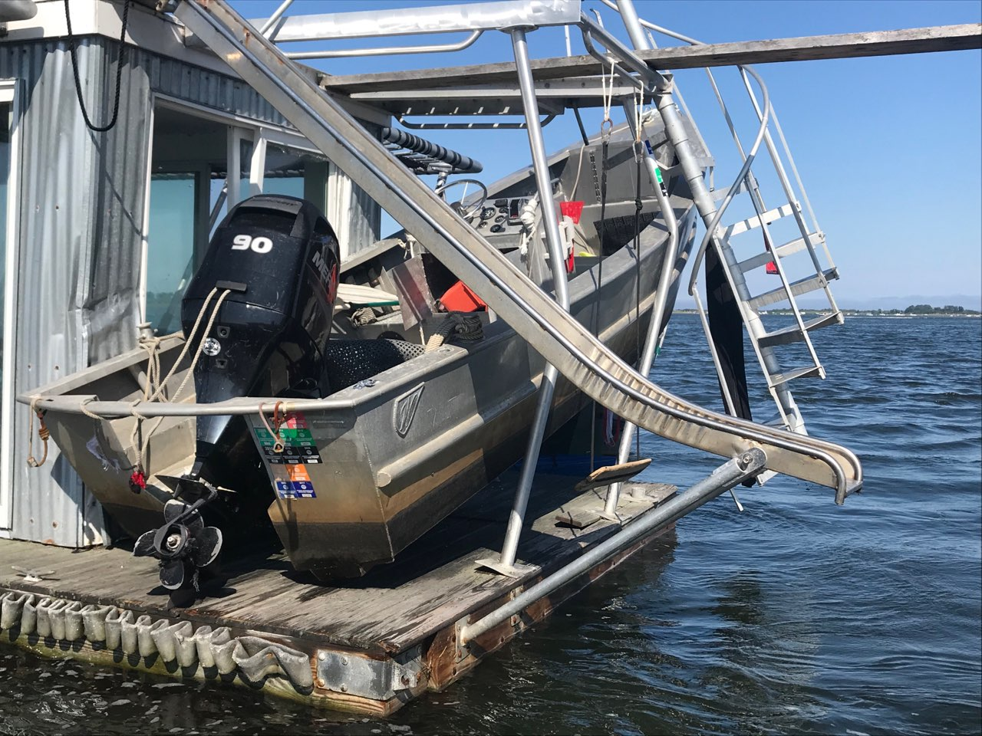
Why is Boater Safety Important?

Slide 3
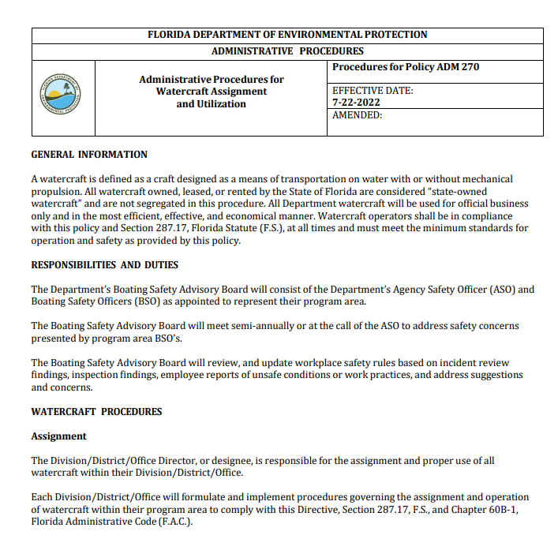
Directive 270

Slide 4
Directive 270
“To operate state-owned watercraft, other than in emergency situations, operators must possess a current and valid department-approved watercraft operator’s certification for the class of watercraft which they are operating and have it recorded in the applicable training tracking program.”

Slide 5
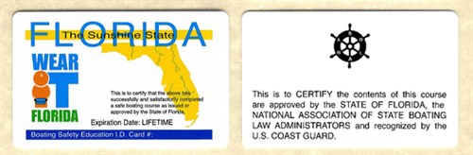
Required for anyone born after January 1, 1988
& all DEP watercraft operators
Boater Safety Education
https://myfwc.com/boating/safety-education/courses/
Notes:
For anyone born on or after January 1, 1988, who will be operating a boat in Florida waters with an engine of ten (10) horsepower or more, the law requires them to complete an approved boating safety course and obtain a Florida Boating Safety ID Card. This card is not a boating license, it is a certification that the person named on the card has successfully completed the required boating safety course. The card does not expire. You can find information on how to obtain the card below.

Slide 6
Boating Basics
      Know Your Boat
      Before Getting Underway
      Trailer Safety
      Boating Operations
      Navigation Rules
      Legal Requirements of Boating
      Boat Emergencies

Slide 7
Boating Basics
Chapter 1
Know Your Boat

Slide 8
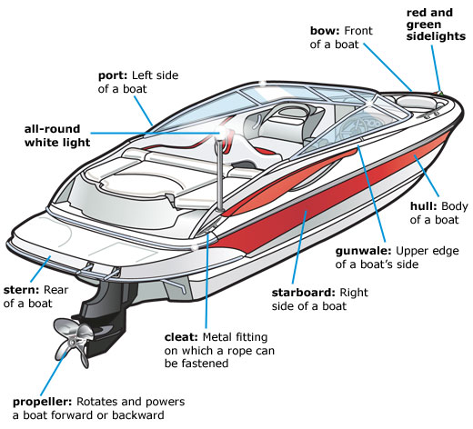
Boat Parts
Notes:
Boats come in many styles and shapes, but the names of the different parts remains consistent. Every boat operator should know the terms and definitions

Slide 9
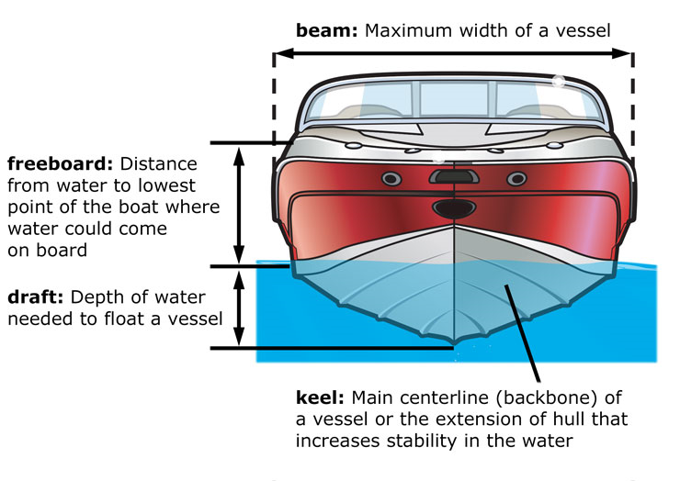

Slide 10
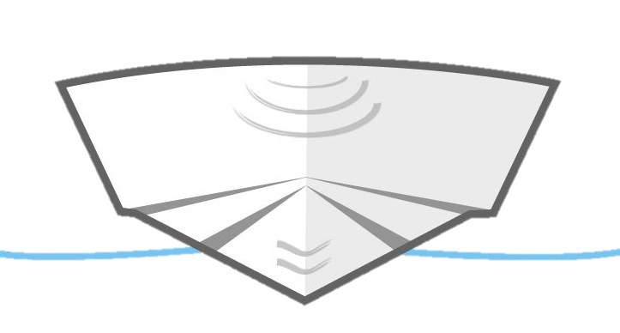
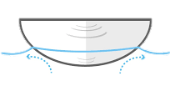
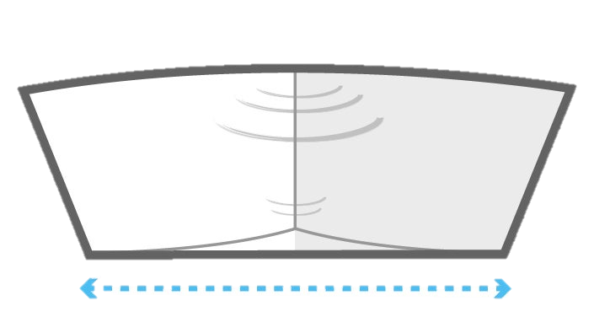
TYPE OF BOAT HULLS
PLANNING
HULL
DISPLACEMENT
HULL
FLAT
BOTTOM
Notes:
Displacement hulls push through the water as they have no hydrodynamic lift, or the boat does not rise out of the water as speed increases. Some general characteristics of a displacement hull are: (1) Rugged construction, (2) Easy to propel through the water at low speeds, and (3) Large interior spaces
Planning hulls are designed to run on top of the water at high speeds and have a very flat stern. The hull design (shape) does not limit the maximum attainable speed but does affect the power required for it to get on plane (on top of the water). Some negative characteristics of a planing hull are: (1) At high speeds in rough water the vessel will have a jarring ride as it pounds into waves and swells, (2) Tends to roll at rest, and (3) Inefficient at low speeds (takes more power to push through the water)
Flat-bottomed boat has a shallow draft which allows it to be used in shallow bodies of water, such as rivers, because it is less likely to ground. The flat hull also makes the boat more stable in calm water. however this design becomes less stable in choppy water. This is because it causes the boat to travel on the water, instead of through it, as a boat with a rounded or V-shaped hull would.

Slide 11
Vessel Classes
Class A-1 Watercraft less than 12 feet, canoes, kayaks, SUPs, or any other manually propelled watercraft
Class A-2 Watercraft 12 feet to less than 16 feet and all powered canoes
Class 1 Watercraft 16 feet to less than 26 feet
Class 2 Watercraft 26 feet to less than 40 feet
Class 3 Watercraft 40 feet to less than 65 feet
Special Class Airboats
Notes:
Class 4 65 to less than 110 feet and
Class 5 greater than 110
(but no current DEP vessels in these categories)

Slide 12
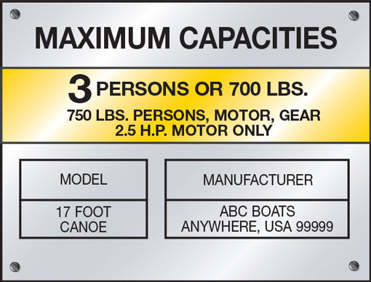
Capacity Rating
Notes:
Capacity plate should be located near the Operator’s station or on the transom of the vessel
Never exceed:
(1) either the maximum weight or maximum number of people or (2) maximum engine horse power rating

Slide 13
Boating Basics
Chapter 2
Before Getting Underway

Slide 14
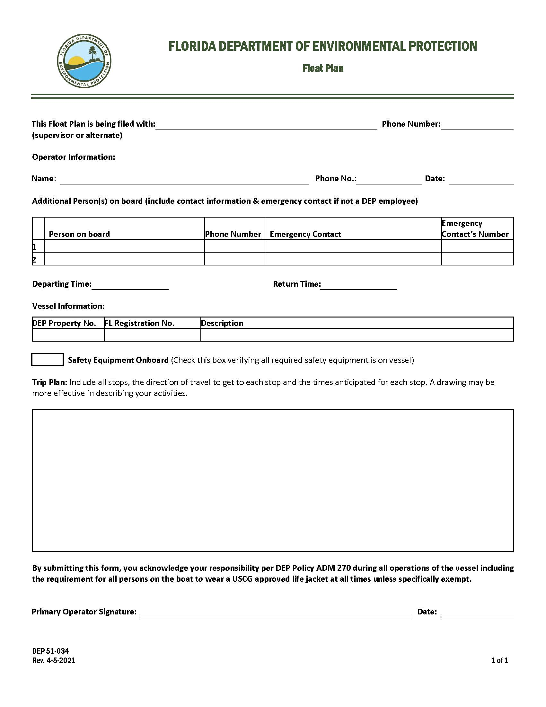
Float Plans
Required by DEP 270
  Where going
  When planned return
  Passengers

Slide 15
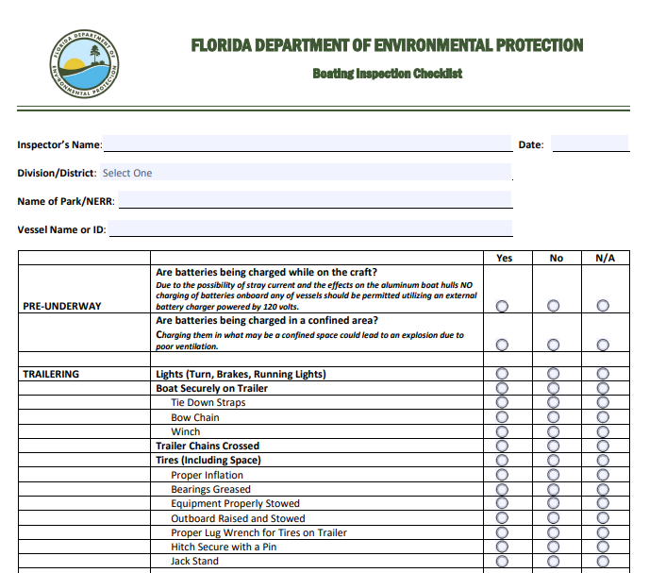
CHECKLIST
Notes:
Prior to the first use of the day of any assigned watercraft, the vessel shall be inspected using the Boating Inspection Checklist, DEP 51-037.

Slide 16
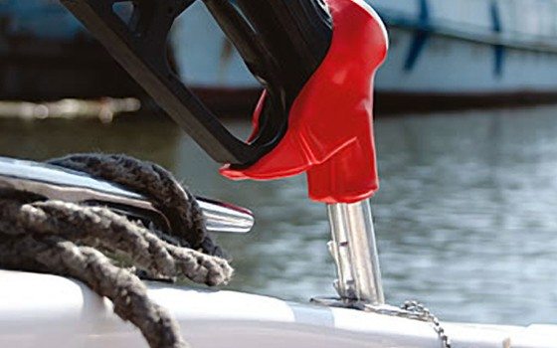
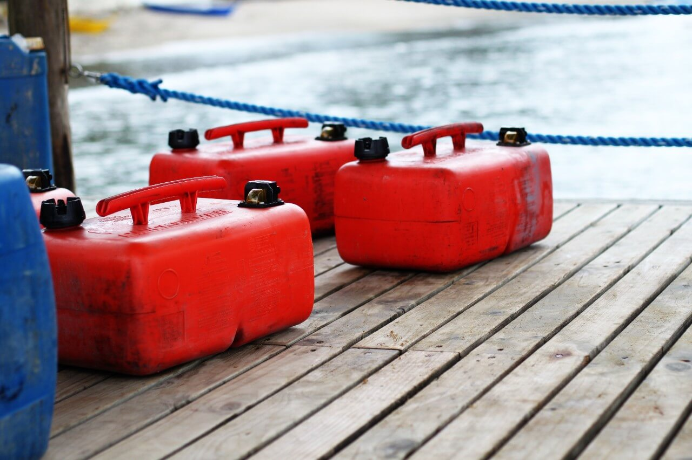
Fueling Vessels
Notes:
Never fuel at night unless emergency. Use electric light if fueling required at night
The proper way to fuel your boat is as follows:
Secure boat to the dock
Switch off engine
Extinguish all open flames
Do not use electrical switches
No smoking
Ports, hatches, and doors closed
Make certain all passengers are ashore
Determine quantity of fuel required and make sure it is the proper type of fuel
Hold hose nozzle firmly against fill pipe opening
Do not overfill
Wipe up all spillage
Open ports, hatches, and doors to ventilate
Turn blower on for four minutes minimum
Do the sniff test
Start engine
Re-board passengers
Untie from dock and cast off

Slide 17
Boating Basics
Chapter 3
Trailer Safety

Slide 18
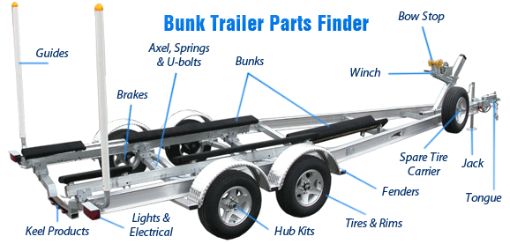
Trailer Anatomy

Slide 19
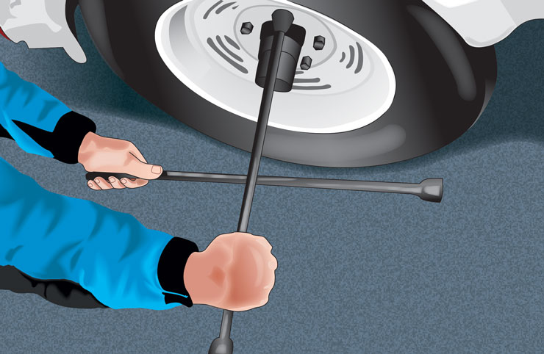
Ongoing Preparation
Notes:
Inspect and maintain trailering equipment.
Check the pressure of all tires on the towing vehicle and the trailer. Make sure you have a spare tire in good condition for both the vehicle and the trailer.
Tighten the lug nuts/bolts on the wheels of both the towing vehicle and the trailer, and grease wheel bearings.
Make sure that all lights and brakes on the towing vehicle and the trailer work properly.
Examine tie-down straps, lines, winch, safety chains, and hitch for signs of wear. Replace or adjust as necessary.
Ensure plug is installed
Use checklist
Secure the vessel on the trailer and the gear within the vessel.
Secure all gear in the vessel firmly to keep it from shifting. Arrange the gear so that its weight is balanced side-to-side and front-to-back.
Secure the vessel to the trailer with several tie-down straps and/or safety lines to prevent the vessel from shifting. Use extra tie-down straps in case one fails. Never trust the bow winch alone to hold your vessel onto the trailer.
Put the engine or drive unit in the raised position and secure it.
Attach the safety chains between the trailer and the towing vehicle, crisscrossing them under the trailer tongue.

Slide 20
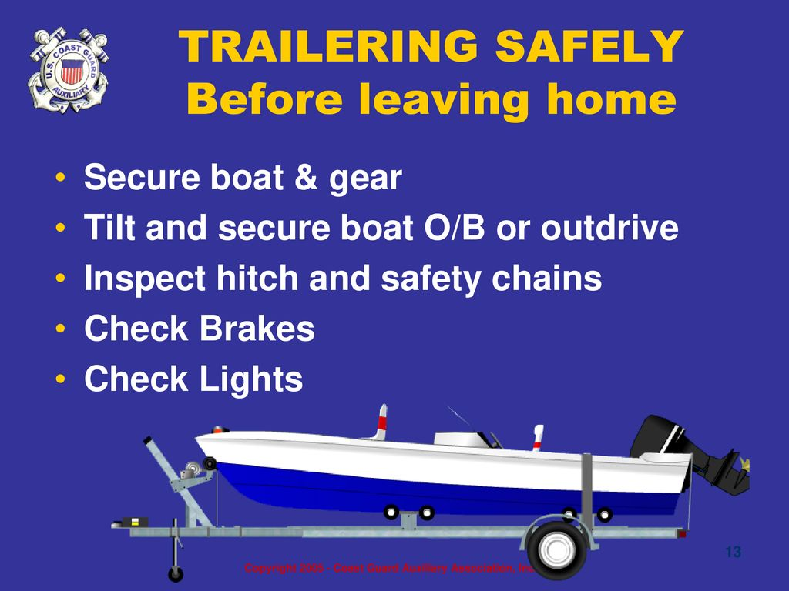
Notes:
Secure the vessel on the trailer and the gear within the vessel.
Secure all gear in the vessel firmly to keep it from shifting. Arrange the gear so that its weight is balanced side-to-side and front-to-back.
Secure the vessel to the trailer with several tie-down straps and/or safety lines to prevent the vessel from shifting. Use extra tie-down straps in case one fails. Never trust the bow winch alone to hold your vessel onto the trailer.
Put the engine or drive unit in the raised position and secure it.
Attach the safety chains between the trailer and the towing vehicle, crisscrossing them under the trailer tongue.

Slide 21
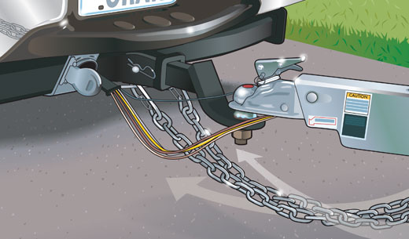
Securing to Vehicle
Notes:
Attachment components: Make sure that all components of your trailer hook-up are properly attached. This includes components like your trailer coupler and ball and safety chains.
Ball: Be certain that you have the correct size ball for your hitch.
Cross the safety chains under the tongue and connect them. The tow chains serve as extra protection in case the trailer does break away. The chains will help keep the trailer from careening off the road or into oncoming traffic. Two strong safety chains should be crisscrossed to support the trailer’s coupler if it becomes disconnected from the towing vehicle. The chains should be strong enough to hold the combined weight of the vessel, engine, and trailer.

Slide 22
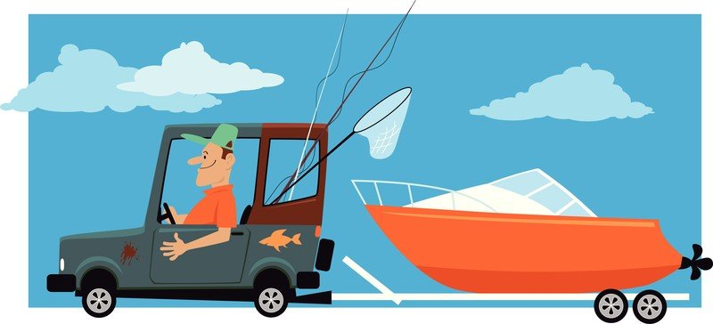
Driving with a Trailer
Notes:
On-The-Road Checklist
After your first 50 miles or so, and at stops along the route, even if everything appears to be going right, take time to check out your rig just to make sure that all is well. Pay special attention to the following areas:
Hitch/ball attachment. Make sure the ball and coupler and tow bar are secure and the safety chains are crossed.
Trailer lights. Ensure the stop and turn signals are working properly.
Trailer wheel lug nuts. Check for tightness.
Trailer wheels' bearing covers. Look for overheating or grease leaks.
Trailer tires. Be alert to overheating or signs of unusual wear.
Boat transom straps. Test for tightness.
Boat interior. Look for signs of load shifting.
Boat engine lower unit. Ensure it has remained in the tilted position and any transom savers are secure.
Remember that your vehicle is longer and heavier than it was before the trailer was attached.
Drive at a slower speed than normal.
Allow for greater braking distance.
Accelerate slowly.
Turn using a wider radius to allow room for the trailer.
Use extra caution if driving in high wind, heavy rain, fog or icy conditions.

Slide 23
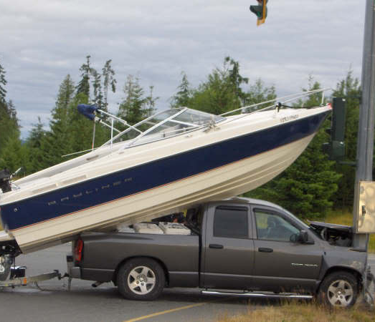
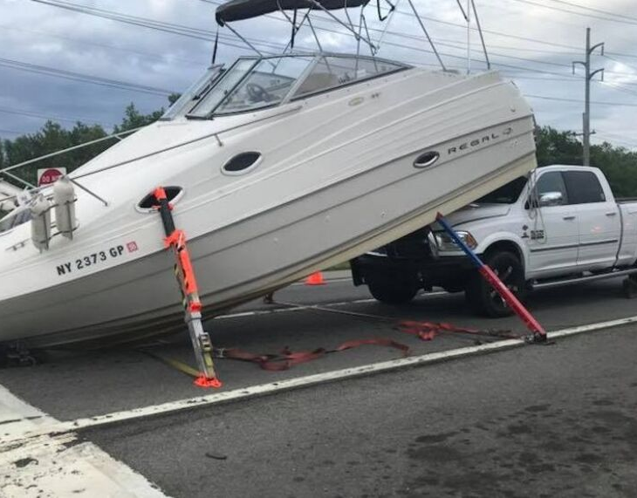
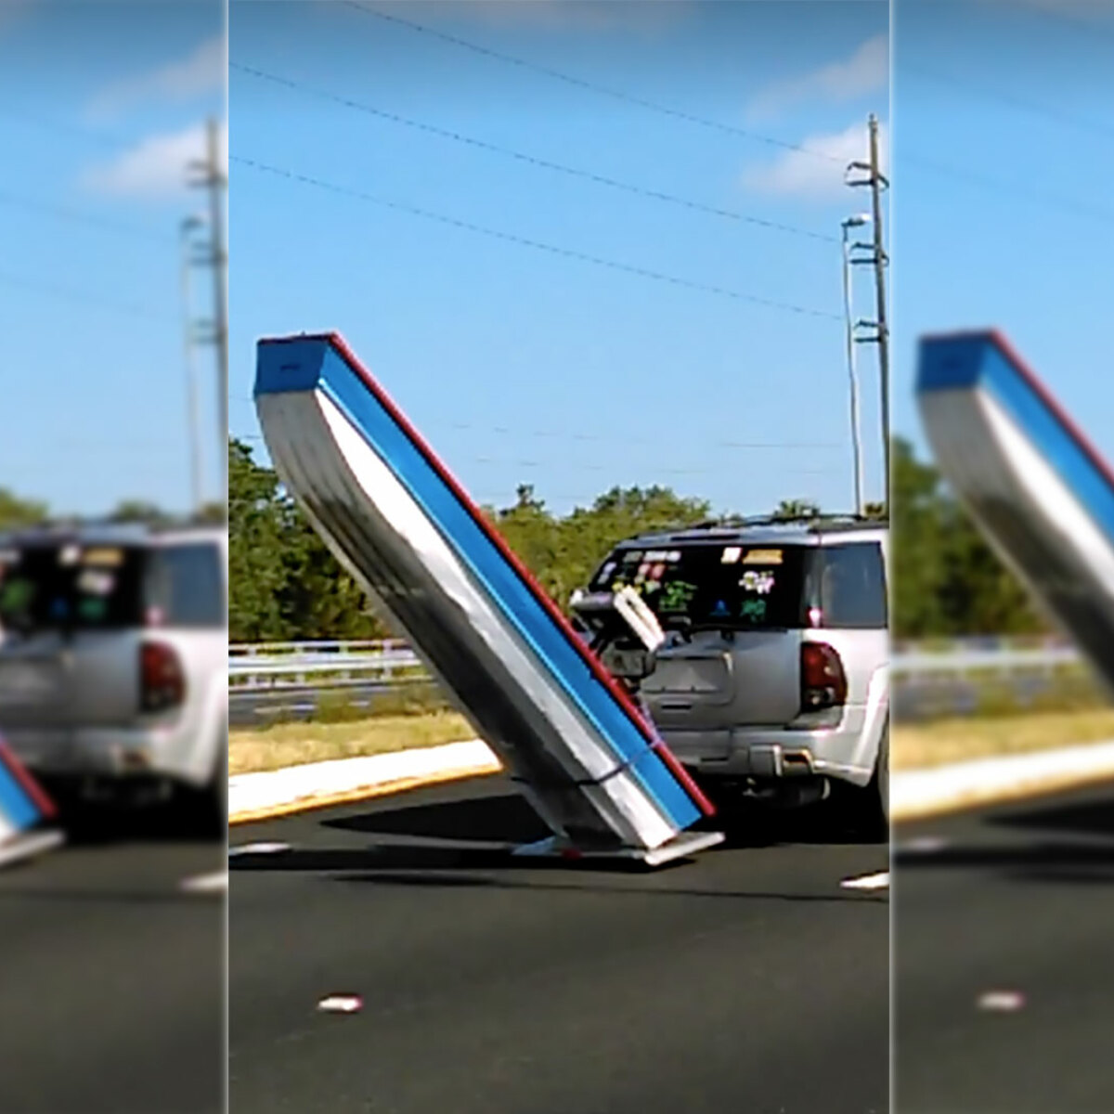
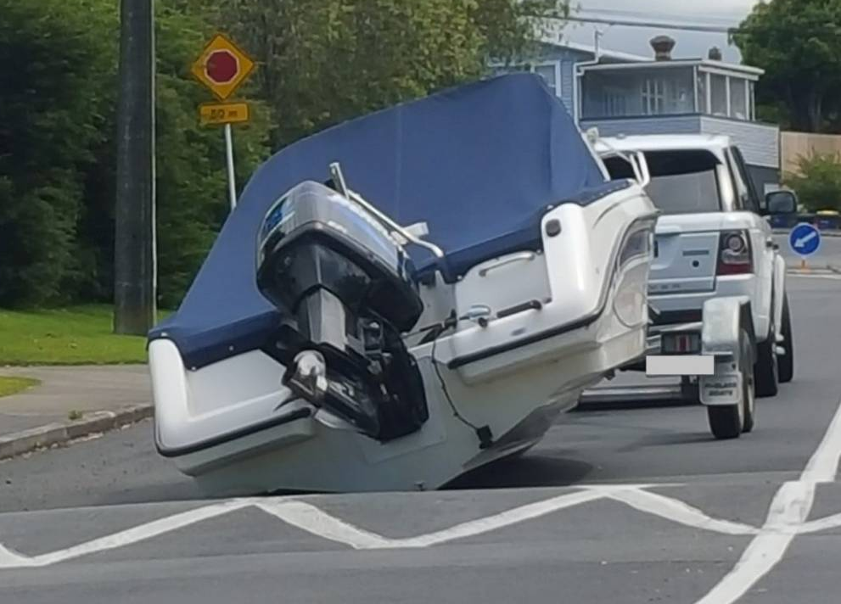
DON’T be like us
Notes:
OOPS

Slide 24
Boating Basics
Chapter 4
Boating Operation

Slide 25
LAUCHING

Slide 26
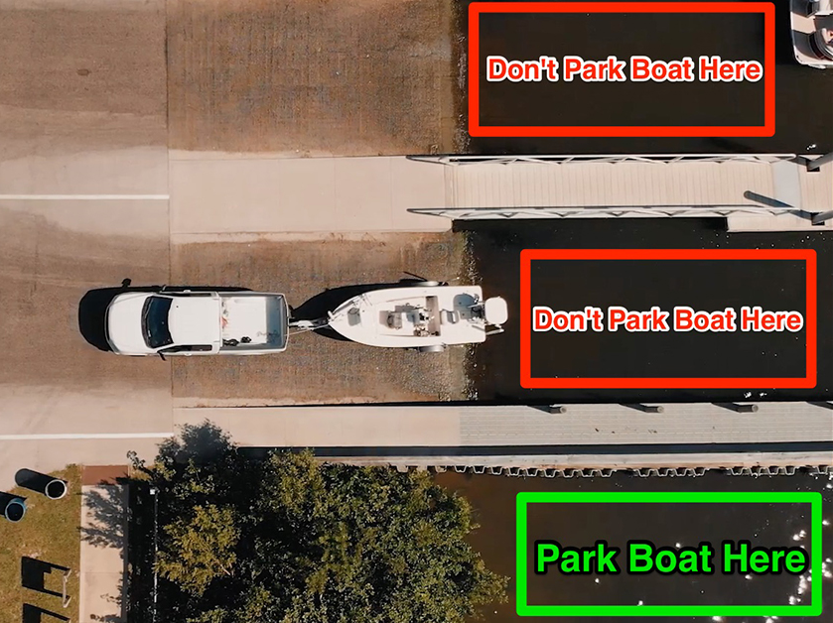
Courtesy on the Boat Ramp
Notes:
DO
Use the staging area. The best way to avoid congestion at the boat ramp is to make all your final preparations before entering the ramp lanes.
mount your navigation lights before approaching the ramp
respect the traffic lines.
bring a friend. Having an extra person who is familiar with the process of launching a boat can make a huge difference at the boat ramp. One person can stay with the boat while the other stays with the vehicle.
Don’ts
load or prep your boat in the ramp lane
socialize while at the ramp
hog the ramp
park your boat in the way of others trying to use the boat ramp
tie-up to other people's boats without first asking for permission.

Slide 27
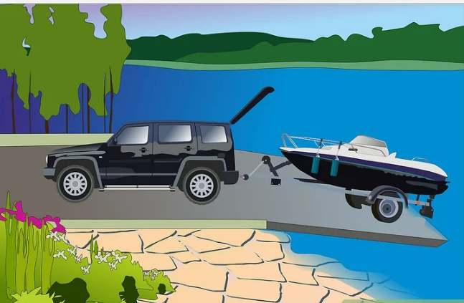
Launching a Vessel
Notes:
Transfer all equipment and supplies to the vessel.
Disconnect trailer lights from the towing vehicle.
Remove all tie-down straps before backing down the ramp but leave the trailer winch line securely attached to the vessel.
Make sure the vessel’s drain plug is in place.
Tie a rope to the vessel’s bow to use to control the vessel if necessary, during launching.
Back the trailer down the ramp. A good rule of thumb is to back in until the water is just above the hubs on the trailer. Be careful about backing in too far otherwise the tow vehicle might become stuck.
Ensure that your tow vehicle has the parking brake set before exiting the vehicle.

Slide 28
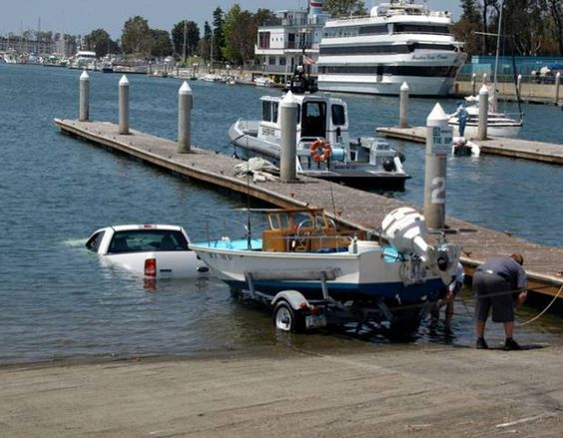
RULE #1
Boat goes in 1st

Slide 29
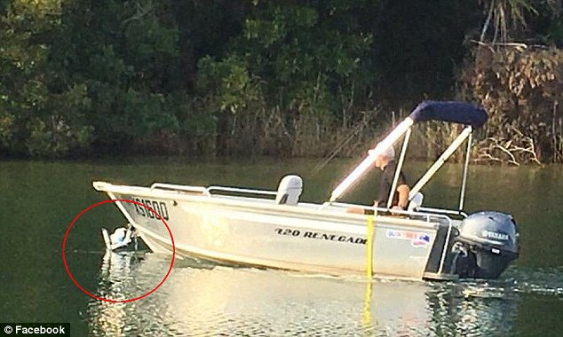
And Finally…
Don’t forget to remove boat from Trailer

Slide 30
CASTING OFF

Slide 31
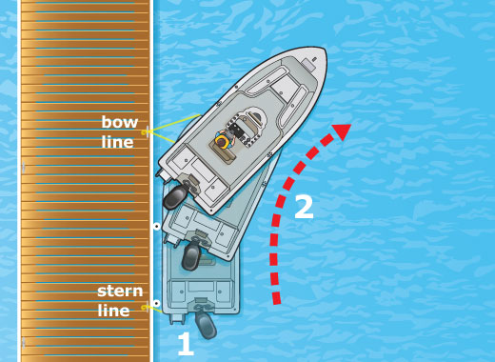
No Wind or Current
Notes:
Before casting off – keep boat tied while warming up engine, all seated with pfd, and check boat is running properly
LOOK for traffic
No current – cast of bow and stern lines. Shift forward and turn boat away from dock

Slide 32
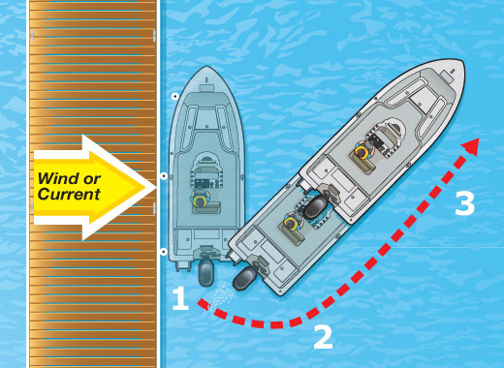
Wind or Current Away from Dock
Notes:
Cast off bow and stern line
Use oar or boat hook to move from dock. Let wind/current carry boat away
Once enough clearance, forward and slowly leave

Slide 33
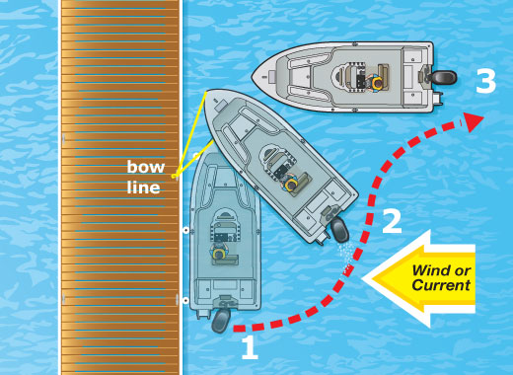
Wind or Current Toward Dock
Notes:
Cast of stern line.
Forward gear, turning hard towards dock until stern clear
Cast off bowline and back out slowly until room to go forward

Slide 34
10 Tips for “Driving” a boat
Surrounding awareness
Slow is pro!
Never under the influence
Tight spaces
Trim motor
Large waves/wakes.
Steering on Plane
Throttle on plane
‘Rules of the road’
Weather and environment
Notes:
Always maintain a good lookout of your surroundings.
When in doubt, slow down. Slow is pro!
Never operate a boat while under the influence of drugs or alcohol.
When driving in tight spaces to maneuver up to a dock or slip, shift into neutral for more precise handling.
Under how to properly trim a boat to improve efficiency and performance.
When approaching a large wave or wake, navigate towards the wake at a 45-degree angle.
When on plane, make slow and steady steering adjustments.
When on plane, avoid fast, sudden changes to the throttle.
Study the ‘rules of the road’ before even leaving the dock.
Always take into account weather and external environment factors like wind, waves and current.

Slide 35
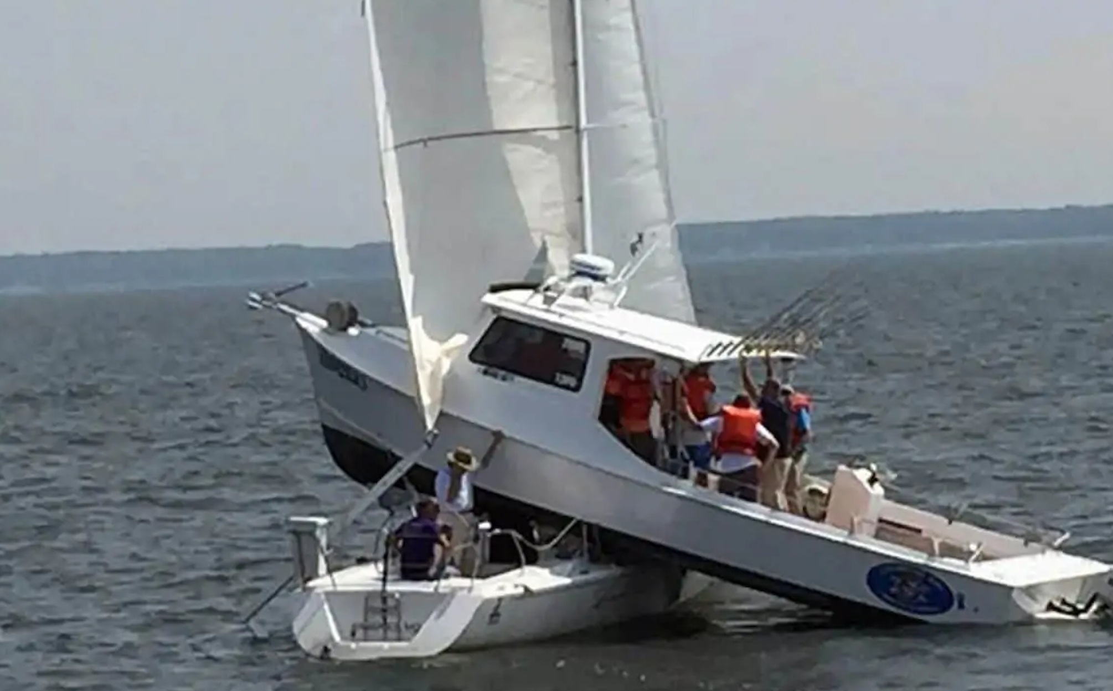
Collision Avoidance
Notes:
What Should You Do to Avoid Colliding with Another Boat?
Always maintain a watch.
Understand marine navigation rules.
Stay clear of shipping lanes.
Understand the implications of speed.
Remain visible at all times.
Keep your VHF radio on underway.
Only boat when well-rested and sober.
Expect the unexpected.
Maintain a speed appropriate to conditions.
Boat smart and use common sense

Slide 36
DOCKING

Slide 37
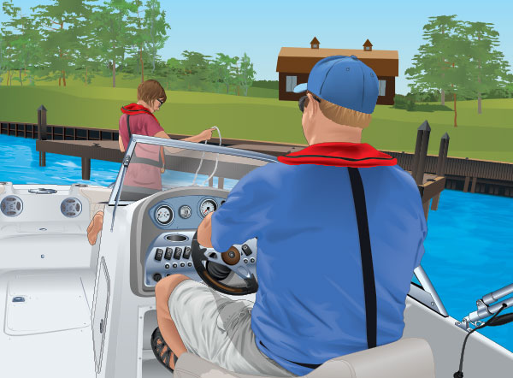
Before Docking
Notes:
Reduce speed to the minimum required to maintain steerage. Use reverse gear to bring the boat to a stop well away from the dock.
Determine the wind and/or current direction while stopped by observing which way your boat drifts. If possible, make your approach into the wind or current, whichever is stronger. This will give you more control.
Have bow and stern lines ready and put boat fenders in place. Never plan to stop a moving boat with your arms or legs.
When the area is clear of traffic, continue your approach.

Slide 38
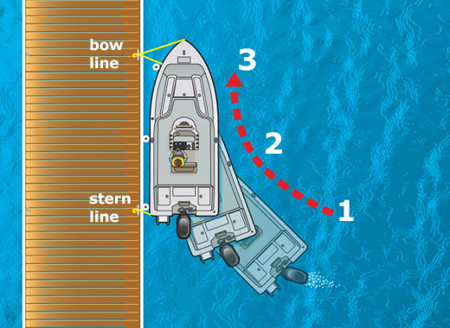
No Wind or Current
Notes:
Approach the dock slowly at a narrow angle (about 20 degrees).
When close enough, have a passenger step on shore and secure the bow line.
Swing the stern in with a line or boat hook and secure it.

Slide 39
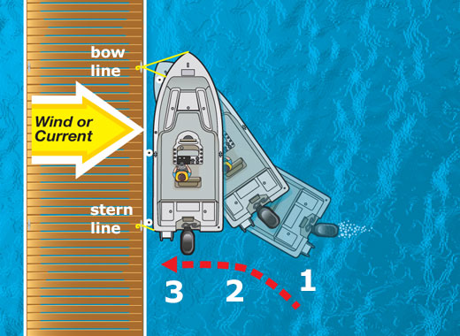
Wind or Current Away from Dock
Notes:
Approach the dock slowly at a sharp angle (about 40 degrees).
Use reverse to stop when close to the dock. Secure the bow line.
Put the boat in forward gear briefly, and slowly turn the steering wheel hard away from the dock—this will swing in the stern. Secure the stern line

Slide 40
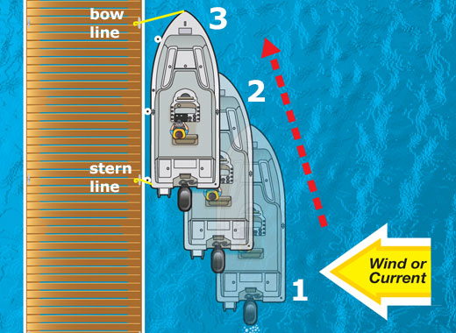
Wind or Current Toward Dock
Notes:
Approach slowly, parallel to the dock.
Let the wind or current carry your boat to the dock. Shift into gear briefly if you need to adjust position.
Secure the bow and stern lines.

Slide 41
RETRIEVING

Slide 42
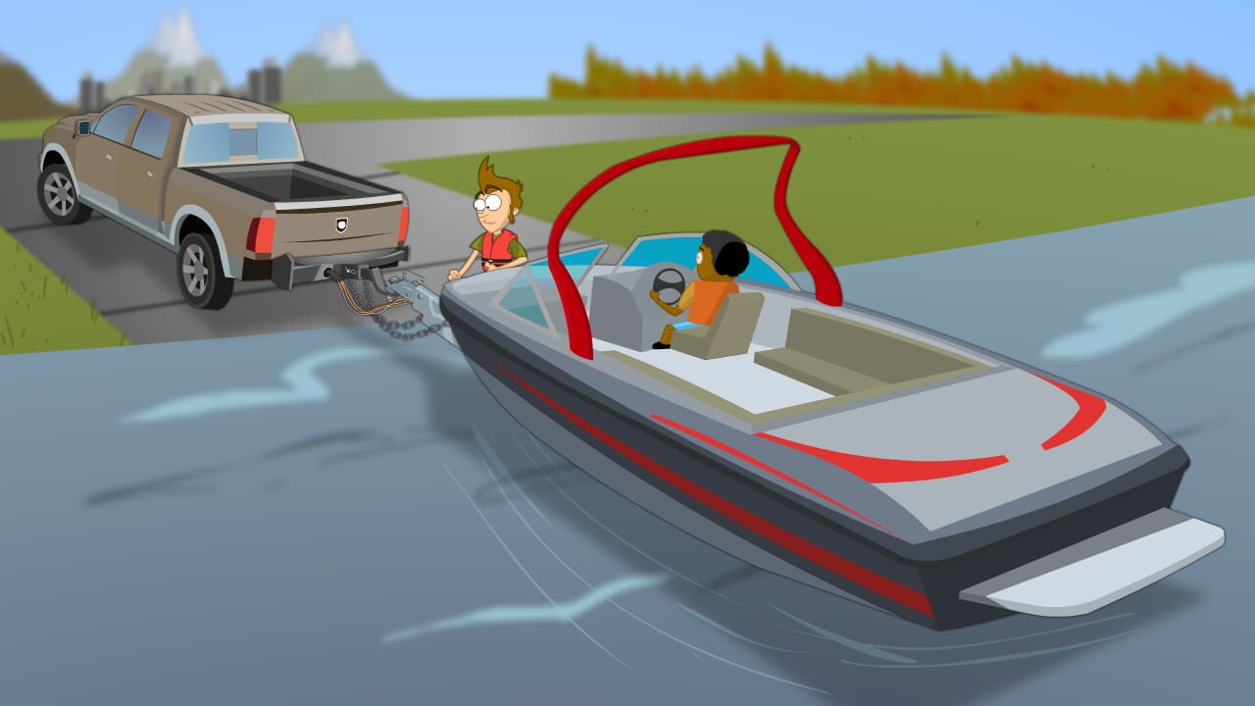
Retrieving a Vessel
Notes:
Here are the steps to take when retrieving a boat:
Backup the trailer, into the water, until two-thirds of its bunks or rollers are submerged.
Attach a bow line to the boat to keep it steady as one retrieves it.
Move the boat close enough to attach a winch line by either maneuvering it or slowly and carefully driving it.
After the winch is attached, shut off the engine and tilt it up.
Crank the winch line to begin retrieving the boat. Steer clear of the winch line during this step-in case it snaps or breaks.
After retrieving the boat from the trailer, ensure that the bow eye is secure.
After securing the boat to the trailer, tow the trailer and attached boat out of the water away from the launch zone, clearing it for others.
Once the boat has been successfully retrieved, it is time to get ready to tow it back home. Remove the drain plug and drain away any water from the bilge. Also, drain any live-wells or bait-wells if applicable.
common practice is to unload all additional fuel and gear away from the launch site itself. This shortens the wait time, for other boaters, by making sure that no one is blocking the launch site while unloading.

Slide 43
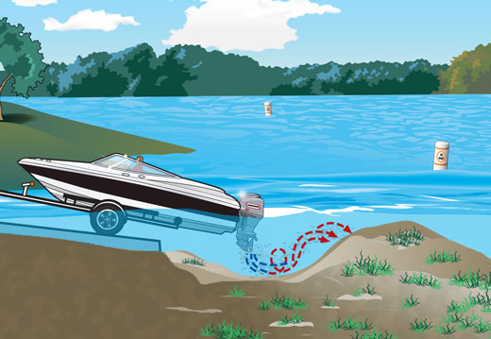
Do Not Power Load
Notes:
Propeller wash can erode the sediment just beyond the ramp surface, creating a large hole. The eroded sediment is deposited behind the propeller, creating a mound. Trailer tires can get stuck in these holes, and boats can run aground on the mound.

Slide 44
Boating Basics
Chapter 5
Navigation Rules

Slide 45
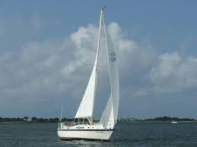
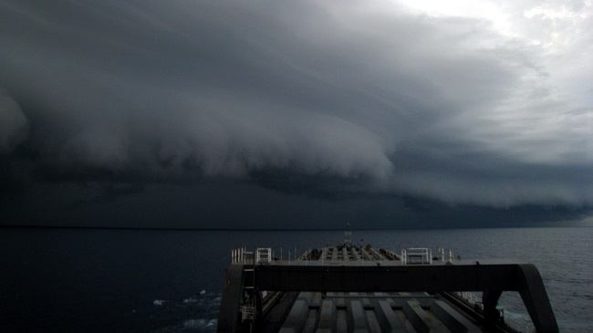
Important Definitions
Vessel Types
Power Driven Vessel
Sailing Vessel
Vessels Engaged in Fishing
Seaplanes
Vessels Constrained by Draft
Vessels Restricted in Their Ability to Maneuver
Vessels not under Command
Restricted Visibility
Notes:
Vessel Types
Power Driven Vessel - Any vessel propelled by machinery. This includes any boat that has an engine. Sailboats are considered powerboats when they are being propelled by a motor - even if the sails are up.
Sailing Vessel - Any vessel under sail alone. Remember, if being propelled by a motor, a sailboat is considered to be a powerboat.
Vessels Engaged in Fishing - Means any vessel fishing with nets, lines, trawls or other fishing apparatus which restrict maneuverability, but does not include a vessel fishing with trolling lines or other fishing gear which doesn't restrict maneuverability. This means a shrimper out of Galveston is "engaged in fishing" Someone out trolling for stripers in their Grady-White is NOT considered to be engaged in fishing under the Rules.
Seaplanes - Are any aircraft designed to operate on the water.
Vessels Constrained by Draft - Means that a vessel can't deviate from a course/channel because they might run aground. A freighter in a narrow channel is an example of this. Note: This is for International waters only, not Inland.
Vessels Restricted in Their Ability to Maneuver - Means a vessel that can't maneuver as required by the rules because of the size or operation of the vessel. A fishing vessel pulling in nets and a buoy tender placing a buoy are both examples of a vessel restricted in their ability to maneuver.
Vessels not under Command - Any vessel that for some exceptional circumstance is unable to maneuver as required by the Rules, and is therefore unable to keep out of the way of another vessel. If Joe boater slips and knocks himself out, and can no longer steer--that's a vessel not under command. If the steering cable goes out, and you can't turn the boat, that's a vessel not under command. If the captain is not paying attention and hits another boat, that's negligence.
Underway - Means that you are not anchored, moored, at the dock, or aground. If you are even drifting along, you are underway.
Restricted Visibility - Means any condition such as fog, mist, falling snow, rain, or other similar causes that make it difficult to see other vessels. Losing your glasses is NOT restricted visibility.

Slide 46
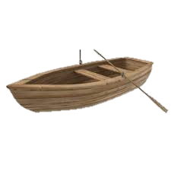
Important Definitions
Give-Way Vessel
Stand-On Vessel

Slide 47
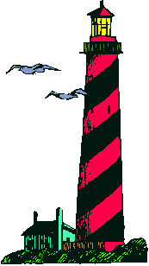
Navigation Rules
Give-way
US Ship: Recommend you divert your course 15 degrees to the
North to avoid a collision.
Canadians: Negative. You will have to divert your course 15
degrees to the South to avoid a collision.
US Ship: This is the Captain of a US Navy ship. I say again,
divert YOUR course.
Canadians: No, I say again, you divert YOUR course.
US Ship: THIS IS THE AIRCRAFT CARRIER USS LINCOLN, THE SECOND
LARGEST SHIP IN THE UNITED STATES' ATLANTIC FLEET. WE ARE
ACCOMPANIED BY THREE DESTROYERS, THREE CRUISERS AND NUMEROUS
SUPPORT VESSELS. I DEMAND THAT YOU CHANGE YOUR COURSE 15 DEGREES
NORTH--I SAY AGAIN, THAT'S ONE FIVE DEGREES NORTH--OR
COUNTER-MEASURES WILL BE UNDERTAKEN TO ENSURE THE SAFETY OF THIS SHIP.
Canadians: This is a Lighthouse. Your call.

Slide 48

Pecking Order
Overtaken
Not under command
Restricted maneuverability
Constrained by draft
Fishing vessels
Sailing vessels
Power driven vessels
Notes:
Overtaken vessel (top priority)
Vessels not under command
Vessels restricted in their ability to maneuver
Vessels constrained by draft
Fishing vessels engaged in fishing, with gear deployed
Sailing vessels
Power driven vessels

Slide 49
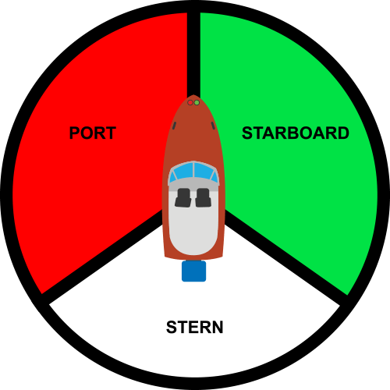
Notes:
Good way to remember “Port wine” – Red is on port (or left) side

Slide 50
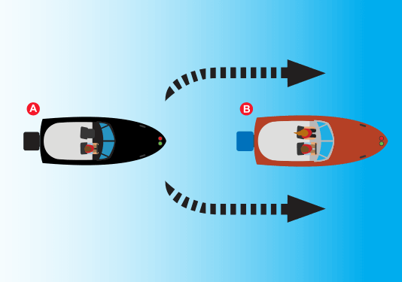
Stern
Notes:
Stern:
In this case, A is the give-way vessel.
If a vessel approaches from this direction, maintain course and speed and be cautious.

Slide 51
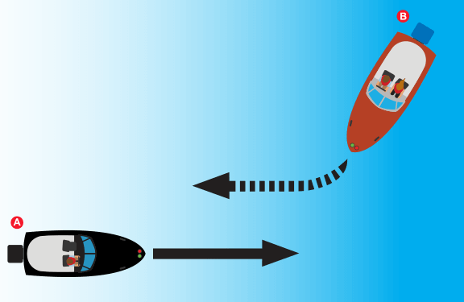
Starboard
Notes:
Starboard:
In this case, A is the stand-on vessel.
If a vessel approaches one from their starboard (right) side, keep out of its way (If one or both vessels are sailboats then this rule may not apply).

Slide 52
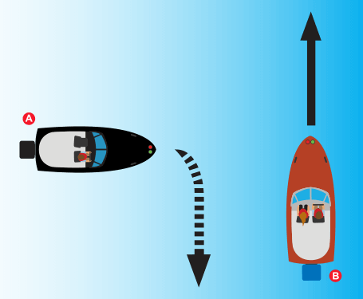
Port
Notes:
Stern:
In this case, A is the give-way vessel.
If a vessel approaches from this direction, maintain course and speed and be cautious.

Slide 53
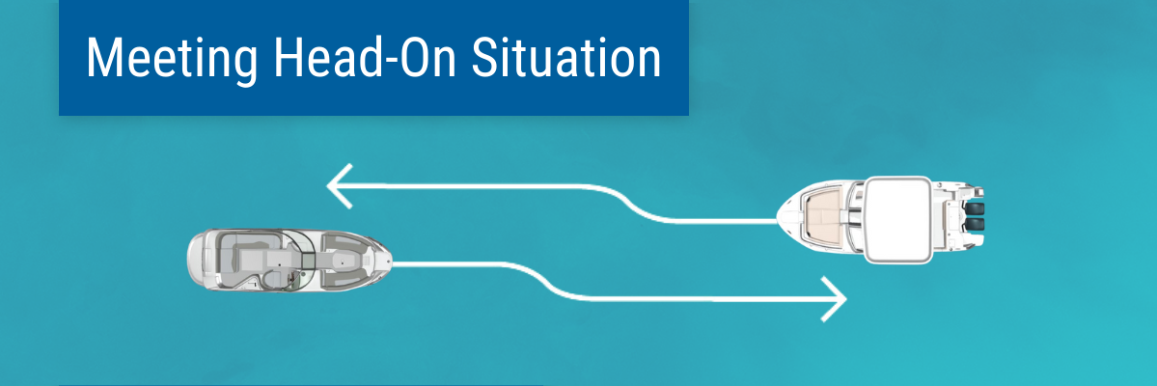
Notes:
Neither vessel is the stand-on vessel. Both vessels should turn to starboard (the right).

Slide 54
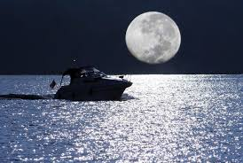
Precautions at Night
Slow down
Lookout duties
Preparations list
Night vision
No spotlights
Look
Listen!!!!
Trust
Towel
Dock
Notes:
Slow down, visibility is reduced at night.
Share the lookout duties.
Tap into your preparations list. Before ever setting out in the dark, you should have refreshed the batteries in your flashlights and headlamps, put binoculars close to the helm and located personal floatation devices (PFDs). You may consider wearing PFDs with an attached strobe light or glow stick in case someone goes overboard.
Preserve your night vision.
Don't use headlights or spotlights. You’re not in a car and the reflective water kills the benefits of bright forward lights. Use docking lights only when arriving at your destination like at a dock or another boat. That’s when spotlights help you see close-up detail like cleats and handholds.
Look for the red and green.
Listen, listen, listen. Turn off the stereo and listen. You may hear fog horns, bells or other boats approaching. Use your hearing, which may seem more acute in the dark when you can’t rely on your eyes.
Trust your navigation instruments.
Bring along a towel—for many uses. A nice beach towel has lots of uses at night. You can drape it over yourself to stay warm and dry, you can toss it over parts of your console to cut down on ambient onboard light, and you can use it wipe a fogged windshield.
Dock with extra caution.

Slide 55
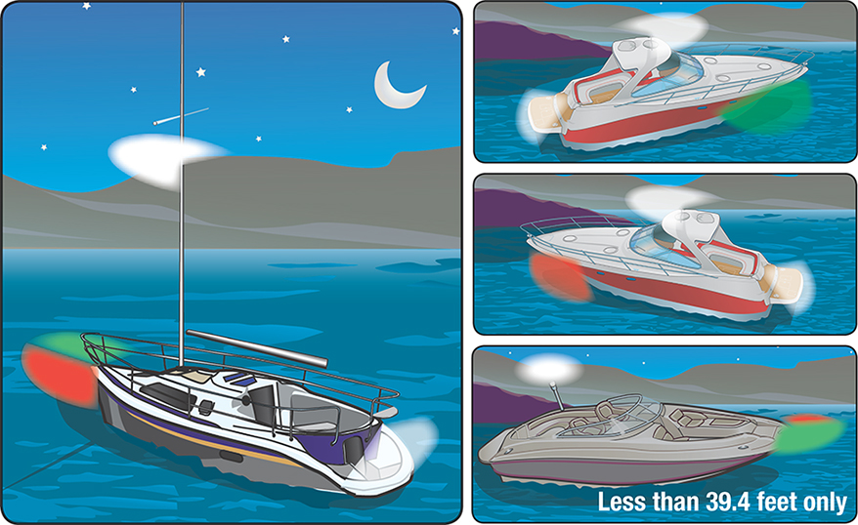
Navigation Lights
Notes:
When underway, all motorboats must exhibit the lights as shown in Figure 1. Remember, motorboats include sailboats operating under power. The required lights are:
Red and green sidelights visible from a distance of at least one mile away on a dark, clear night.
An all-round white light or both a masthead light and a sternlight. These lights must be visible from a distance of at least two miles away on a dark, clear night. The all-round white light (or the masthead light and sternlight) must be visible from all directions in a 360-degree circle.

Slide 56
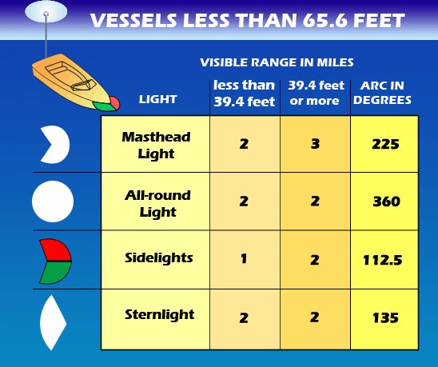

Slide 57
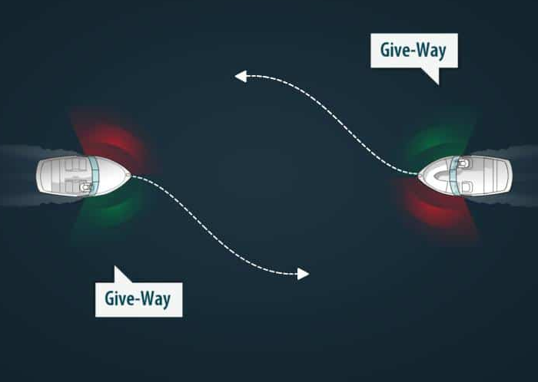

Slide 58
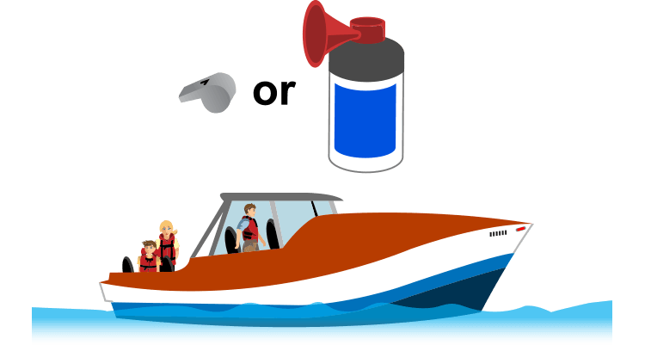

Sound Signals Requirements
Less than 39.4 ft.
39.4 – 65 feet

Slide 59


Slide 60

Aids to Navigation (ATON)
Notes:
The term "aids to navigation" includes buoys, day beacons, lights, lightships, radio beacons, fog signals, marks and other devices used to provide "street" signs on the water. Aids To Navigation include all the visible, audible and electronic symbols that are established by government and private authorities for piloting purposes.
The Coast Guard is the agency responsible for
The term "aids to navigation" encompasses a wide range of floating and fixed objects (fixed meaning attached to the bottom or shore), and consist primarily of:
Buoys - floating objects that are anchored to the bottom. Their distinctive shapes and colors indicate their purpose and how to navigate around them.
Beacons - structures that are permanently fixed to the sea-bed or land. They range from structures such as light houses, to single-pile poles. Most beacons have lateral or non-lateral aids attached to them. Lighted beacons are called "LIGHTS", unlighted beacons are "DAYBEACONS".
These are a few of what is used. Each will be covered in more detail in the next few slides

Slide 61

Nun & Can Buoys
Notes:
Green colors, green lights, and odd numbers mark the edge of a channel on your port (left) side as you enter from open sea or head upstream. Numbers usually will go up as you head upstream. A type of green marker is the cylinder-shaped can buoy.
Red colors, red lights, and even numbers mark the edge of a channel on your starboard (right) side as you enter from open sea or head upstream. Numbers usually will go up as you head upstream. A type of red marker is the cone-shaped nun buoy.
Red and green colors or lights are placed where a channel splits in two. If green is on top, keep the buoy on your left to continue along the preferred channel. If red is on top, keep the buoy on your right. These markers are sometimes called “junction buoys.”

Slide 62


“Red Right Returning”
Notes:
In most circumstances, you can use this phrase as a reminder of the correct course when returning from open waters or heading upstream: “Red Right Returning.”

Slide 63

Regulatory Markers and Other Aids

Slide 64

Mooring Buoy
Notes:
Usually white with a blue band
Only buoys you can legally tie up to

Slide 65

ANCHORING
Notes:
Select an area to anchor with plenty of room. Ideally, it should be a well-protected area with adequate water depth and a sandy or muddy bottom.
Head slowly into the wind or current to a position upwind or upcurrent of where you actually want to end up.
When you are at that position, stop the boat and slowly lower the anchor over the bow to the bottom. Never anchor from the stern as this can cause the boat to swamp. The square stern may be hit by waves, and water will splash into the boat. The motor’s weight will add to this problem.
Slowly back the boat away downwind or downcurrent. Let out about seven to ten times as much anchor line as the depth of the water, depending on the wind strength and wave size. Tie off the line around a bow cleat, and pull on the anchor line to make sure the anchor is set.
After anchoring, take visual sightings of onshore objects or buoys in the water to help you know where your boat is positioned. While at anchor, recheck these sightings frequently to make sure the anchor is not dragging.
Periodically check connecting knots on your anchor line. When possible, use splices instead of knots. Knots weaken a line more than splices.

Slide 66

Anchor Types
Notes:
Mushroom Anchor
Very large mushroom anchors are used for moorings or securing buoys. Small mushroom anchors may be effective in the softest river bottom but have minimal holding power. They should be used only for personal watercrafts, small aluminum fishing boats, or dinghies.
Danforth or Fluke Anchor
This style of anchor is a good choice for smaller boats because it folds flat and is easy to stow, and has great holding power for its weight. Its wide, sharp flukes sink into sand and hard-mud bottoms, but are less effective in deep mud or a grassy bottom. If the wind shifts and boat drifts over the anchor and then in the opposite direction from which it was set, a Danforth anchor can pull free.
Plow Anchor
A plow anchor is a little more cumbersome than a Danforth, and is a good choice if the anchor is secured on a bow roller rather than in an anchor locker in the boat. A plow anchor has a single penetrating point and is more likely to reset itself if boat position changes. It can be more effective than the Danforth in light grass, has the strength to hold in a rocky bottom if it gets a good grip, and does well in soft bottoms.
Claw Anchor
This non-folding anchor is similar to the plow anchor, but has a broader scoop shape that works well in mud, clay or sandy bottoms. These anchors are also strong enough to hold on a rocky bottom. A claw anchor will re-set quickly if the wind changes. It may not work well on a very hard bottom, or in thick vegetation, both challenging for all types of anchors. This anchor is also best-suited to installation with a bow roller or windlass.
Grapnel Anchor
Shaped like a grappling hook, this anchor has multiple tines or points, and is designed to grab onto structure on the bottom—such as rocks or submerged timber—rather than sink into the bottom. The tines usually fold up along the shank so that the anchor is more compact for stowage. On some models the tines are designed to bend to make it easier to retrieve the anchor if it becomes snagged on bottom structure. The tines can them be bent back into shape. Grapnel anchors are available in many sizes, including very small models for jon boats, skiffs or sm

Slide 67

Setting Anchor
Notes:
When it comes to getting the anchor to stick, there are two things to keep in mind:
Always use a chain
Have enough scope
Many inexperienced boaters don’t have a chain on their anchor and wonder why their anchor often doesn’t catch.
The weight of the chain decreases the angle of the anchor relative to the boat.
It lets the anchor lie closer to the bottom, which is what allows it to catch.
If it’s sticking straight up, it will have a much tougher time catching.
Another thing that decreases the angle of the anchor relative to the boat is the scope, or the amount of rope let out.
A good rule of thumb is that for calm conditions, you need to have three feet of rope for every one foot of depth.

Slide 68


Chart and Compass
Notes:
A nautical chart is one of the most fundamental tools available to the mariner. It is a map that depicts the configuration of the shoreline and seafloor. It provides water depths, locations of dangers to navigation, locations and characteristics of aids to navigation, anchorages, and other features.
The nautical chart is essential for safe navigation. Mariners use charts to plan voyages and navigate ships safely and economically. Federal regulations require most commercial vessels to carry electronic or paper nautical charts while they transit U.S. waters. If nautical charts are not available, local knowledge is the key
Every boat needs a magnetic compass. It is still the most reliable means of navigation. It is also the most convenient for long-distance navigation. The best place is to mount the compass at the front of the boat, right in front of the helmsman.

Slide 69
Boating Basics
Chapter 6
Legal Requirement

Slide 70

Vessel Registration
Notes:
All motorized vessels operating on Florida’s public waterways must be titled and registered. Chapter 328, Florida Statutes, designates that FLHSMV is responsible for issuing vessel registrations and titles. Applications for titles and registrations must be filed at a county tax collector or license plate agent office. Owners have the option of registering their vessel for either one year or two years.
A purchaser of a new or used vessel has 30 days to title and register that vessel. During this 30 day period, the owner must have proof of the date of purchase aboard the vessel. Operating an unregistered vessel after 30 days is a second-degree misdemeanor.
exemptions from Titling
Vessels operated, used and stored exclusively on private lakes and ponds.
Vessels owned by the U.S. Government, the State of Florida or its political subdivisions
Registration fees based upon class size

Slide 71

Notes:
he Florida registration number is used for identification purposes and must be painted or permanently attached to both sides of the bow (forward half) in block letters and numbers at least three inches high. The number must read from left to right, contrast in color with the vessel and be maintained in r
Decals
A decal identifying the year that the vessel registration is valid will be issued with each registration certificate. The decal must be displayed on the port (left) side of the vessel, immediately before or after the registration number (see image below). Decals from expired registrations must be removed from the vessel.

Slide 72

Notes:
Hull Identification Numbers
All registered and/or titled vessels operating on Florida waters must display the assigned hull identification number (HIN), which is usually branded into the vessel by the manufacturer.
Vessels without a manufacturer’s HIN and homemade vessels built or assembled by the owner will be assigned a HIN by FLHSMV. The HIN must be permanently affixed to the outboard side of the transom or, if there is no transom, the outermost starboard side at the end of the hull, above the waterline. The characters of the HIN must be of no less than 12 numbers and letters and no less than ¼ inch high (see image below).

Slide 73

Who may Operate a Vessel in FL
Notes:
For anyone born on or after January 1, 1988, who will be operating a boat in Florida waters with an engine of ten (10) horsepower or more, the law requires them to complete an approved boating safety course and obtain a Florida Boating Safety ID Card. This card is not a boating license, it is a certification that the person named on the card has successfully completed the required boating safety course. The card does not expire.
Personal Watercraft (PWCP
A person must be at least 14 years of age to operate a personal watercraft in Florida.
A person must be at least 18 years of age to rent a personal watercraft in Florida.
It is unlawful for a person to knowingly allow a person under 14 years of age to operate a personal watercraft (a second-degree misdemeanor).

Slide 74

Unlawful Operations
Notes:
Chapter 327 Florida Statutes
It is unlawful to operate a vessel in a reckless manner. A person who operates any vessel, or manipulates any water skis, aquaplane, or similar device, in willful or wanton disregard for the safety of persons or property at a speed or in a manner as to endanger, or likely to endanger, life or limb, or damage the property of, or injure a person is guilty of reckless operation of a vessel.
Per FWC
anyone who operates a vessel with willful disregard for the safety of persons or property will be cited for reckless operation (a first-degree misdemeanor).
All operators are responsible for operating their vessel in a reasonable and prudent manner with regard for other vessel traffic, posted restrictions, the presence of a divers-down flag and other circumstances so as not to endanger people outside of the vessel or property. Failure to do so is considered careless operation (a non-criminal infraction).
It is a violation of Florida law and DEP to operate a vessel while impaired by alcohol or other drugs. A vessel operator suspected of boating under the influence must submit to sobriety tests and a physical or chemical test to determine blood- or breath-alcohol content.
In Florida, a vessel operator is presumed to be under the influence if their blood- or breath-alcohol level is at or above .08.
Any person under 21 years of age who is found to have a breath-alcohol level of .02 or higher and operates or is in actual physical control of a vessel is in violation of Florida law.
A violation of the Federal Navigation Rules is also a violation of Florida law.

Slide 75




Regulatory Zones
Notes:
On Florida waterways, there are signs restricting boat speed. Florida regulates boat speeds in certain areas either for protection of manatees or for boating safety purposes. It is important that boat operators look for signs, understand what they mean, and abide by the speed regulations. Here are the most common signs.
Idle Speed, No Wake” Zone: A designated area where vessels must be operated at a speed no greater than that which is necessary to maintain steerage and headway. The vessel should not produce a wake at this speed.
Slow Speed, Minimum Wake” Zone: Areas where vessels must be fully off plane and completely settled in the water. Any wake created by a vessel in one of these zones must be minimal (very small). If your vessel is traveling with the bow even slightly elevated while in one of these zones, it is not proceeding at “Slow Speed” as required by law.
Maximum 25 MPH, 30 MPH, and 35 MPH Speed Zones: Controlled areas within which a vessel must not exceed posted speed.
Vessel Exclusion Area: An area marked with a vertical diamond shape with a cross in the center that indicates all vessels or certain classes of vessels are excluded from the area.

Slide 76

Obstructing Navigation
Notes:
Vessel operators should always be considerate of other vessel operators even when stopping to anchor or moor.
Keep in mind that it is illegal to:
Operate any vessel in such a way that it will interfere unnecessarily with the safe navigation of other vessels on the waterway.
Anchor a vessel in the traveled portion of a river or channel in a way that will prevent or interfere with any other vessel passing through the same area.
Moor or attach a vessel to a buoy (other than a mooring buoy), beacon, light, or any other navigational aid placed on public waters by proper authorities.
Move, displace, tamper with, damage, or destroy any navigational aid.
Obstruct a pier, wharf, boat ramp, or access to any facility.

Slide 77

Types of PFDs
Type II
Type III
Type I
Type V
Type IV
Notes:
(1) Type I Personal Flotation Device
These devices are typically used for higher speeds and rougher waters. With a minimum buoyancy of 22 pounds for adults, Type I personal floatation devices are designed to turn anyone who is unconscious face up in water. While Type I life jackets offer the best protection, they tend to be more uncomfortable for the wearer.
Less buoyant at 15.5 pounds for adults,
(2) Type II Personal Flotation Devices are
better suited for inland boating and boating near the shore. These life jackets aren’t designed for rougher waters and wearers will have to do some treading of water to keep their heads above the surface.
(3)Type III Personal Flotation Device
More comfortable than Type I or Type II PFDs, Type III PFDs are best for boaters and passengers who are boating near shore. These types of life jackets are not designed for extended use or use in rough waters.
(4) Type IV Thowable Device
Type IV devices aren’t traditional life jackets, but rather throwable devices designed to help an individual who has gone overboard. These can be rings or a cushion style, the second of which provides a little additional buoyancy.
These types of devices must be readily available for use at all times while the boat is in motion. A device in storage or under a seat is not considered readily available.
It’s important to note that there are also inflatable flotation devices, and this blog only covers inherently buoyant PFDs. Always make sure you understand your state-specific regulations as it relates to PFDs on your boat.
(5) Type V: Special-Use Devices
These are often developed and customized specifically for specific sports such as kayaking, wakeboarding, or windsurfing.
To be acceptable, Type V PFDs must be used in accordance with their label.

Slide 78

Boat Requirements - FL
Notes:
Minimum Florida Boat Safety Equipment Requirements
In Florida the following minimum boat safety equipment is required on all Class A recreational boats (less than 16 feet in length), canoes and kayaks:
One Coast Guard-approved Type I, II or III Personal Flotation Device (PFD) for each person on board or being towed on water skis etc.
Fire extinguisher(s) of the appropriate size and type for your boat
Visual Distress Signals (on high sea, and coastal waters)
Sound-producing device (horn, whistle or bell etc.)
Backfire flame control
Ventilation system
Boat lighting equipment

Slide 79

PFD Requirements

Slide 80

The Captain is Responsible!
No One Else.
Notes:
The rules for the waterways in Florida are different than the rules of the road for driving. Under international maritime law, a boat captain of any size vessel on the ocean or inland waterways has ultimate responsibility for protecting passengers from injury.
The Rule of Responsibility
The vessel operator is responsible for acting in a prudent and reasonable manner consistent with the ordinary practices of boating.
Stay active.
Stay alert.
Respect the weather, the water, your passengers, fellow boaters, divers, swimmers, and property owners.
Crusoe the Celebrity Dachshund pictured

Slide 81

Fire Extinguisher Types

Slide 82

Vessel Fire Extinguishers
Vessel Length | No Fixed System | With approved Fixed Systems
Less than 26' | One 5-B or One 10-B | 0
26' to less than 40' | Two 5-B or Two 10-B or One 20-B | One 5-B or One-10-B
40' to 65' | Three 5-B or Three 10-B or One 20-B and One 5-B or One 10-B | Two 5-B or Two 10-B or One 20-B
Notes:
All non-exempt vessels, including PWCs, are required to have a Type B, USCG-approved fire extinguisher(s) on board. While a vessel may be exempt from the fire extinguisher requirement, all vessel operators are strongly encouraged to carry a fire extinguisher on board.
Approved types of fire extinguishers are identified by the following marking on the label—"Marine Type USCG Approved"—followed by the size and type symbols and the approval number. Only USCG–approved fire extinguishers are legal for use on vessels.
Extinguishers should be placed in an accessible area away from the engine. Be sure you know how to operate them, and check all extinguishers regularly.
extinguishers labeled with B-I or B-II only are no longer acceptable.

Slide 83


Slide 84

Visual Distress Signals
Notes:
A Visual Distress Signal (VDS) is any device you can use to help others locate your boat quickly in the case of an emergency. Visual distress signals include day signals that are visible in sunlight, night signals that are visible in the dark, and anytime signals that can be used both day and night. VDS are either pyrotechnic, which use smoke and flame, or non-pyrotechnic, which are non-combustible. There are a wide variety of signals that can be carried to meet federal boating regulations.
The law states that no person may use a distress signal under any circumstances unless assistance is needed because of immediate or potential danger to the persons onboard.
In other words, never use a VDS unless it's an emergency. Breaking the law can come with serious penalties!
There are some exceptions. During daytime hours the following boats are not required to carry visual distress signals:
Boats less than 16 feet in length;
Boats participating in organized events, such as regattas;
Open sailboats that are less than 26 feet in length and not equipped with an engine;
And manually propelled boats, such as canoes.
These boats are only required to carry visual distress signals approved for nighttime use when operating at night in the above listed waters.
U.S. Coast Guard-approved pyrotechnic VDS include:
Hand-held or aerial red flares;
Hand-held or aerial orange smoke flares;
Parachute flares or red meteor flares;
And any associated launchers of these signals.

Slide 85

Sound Producing Devices
Notes:
In periods of reduced visibility or whenever a vessel operator needs to signal his or her intentions or position, a sound-producing device is essential. The navigation rules for meeting head-on, crossing, and overtaking situations are examples of when sound signals are required.
Vessels less than 26 feet long, which includes PWC, are required to carry a whistle, horn, or some other mechanical sound device.
Vessels 26 feet long or longer are required to carry a whistle, horn, or some other mechanical sound device and a bell.
These requirements apply to vessels operating on waters under USCG jurisdiction (federally controlled waters).
Vessels less than 39.4 feet (12 meters) in length, which includes PWC, must have some way of making an efficient sound signal. Examples are a handheld air horn, an athletic whistle, an installed horn, etc. A human voice is not acceptable.
Vessels that are 39.4 feet (12 meters) or more in length must have a sound-producing device that can produce an efficient sound signal. The sound signal should be audible for one-half mile and should last for 4 to 6 seconds.

Slide 86



Divers Down
Notes:
A diver down flag, or scuba flag, is a flag used on the water to indicate that there is a diver below. Two styles of flag are in use. Internationally, the code flag alfa/alpha, which is white and blue, is used to signal that the vessel has a diver down and other vessels should keep well clear at slow speed. In North America it is conventionally red with a white stripe from the upper left corner to the lower right corner.
Boaters must make reasonable efforts to stay at least 300 feet away from divers-down warning devices in open water and at least 100 feet away in rivers, inlets, or navigation channels. Boaters approaching divers-down warning devices closer than 300 feet in open water and 100 feet in rivers, inlets, or navigation channels must slow down to idle speed.
Divers must stay within 100 feet of a divers-down flag or a buoy within rivers, inlets, or navigation channels and within 300 feet on open water.
On a vessel, the divers-down flag must be at least 20 x 24 inches in size. And the flag must be displayed at the highest point of the vessel so that its visibility is not obstructed in any direction.
On the water, the divers-down symbol must be at least a 12 x 12 inch flag on a float. If the divers-down symbol is a buoy, the buoy must have three or four sides with the divers-down symbol displayed on each of the flat sides. The buoy must be prominently visible on the water’s surface and can’t be displayed on the vessel.
If the divers-down warning device is a flag, the divers-down symbol must be on each face and have a wire stiffener or be otherwise constructed to ensure it remains fully unfurled and extended, even when there is no wind or breeze.
A divers-down warning device may not be displayed when divers are out of the water.

Slide 87



Environmental Concerns
Seagrass
Manatees
Invasive Aquatic Plants

Slide 88

Seagrass
Notes:
Seagrasses are submerged flowering plants found in shallow marine waters, such as bays and lagoons and along the continental shelf in the Gulf of Mexico. A vital part of the marine ecosystem due to their productivity level, seagrasses provide food, habitat, and nursery areas for numerous vertebrate and invertebrate species. The vast biodiversity and sensitivity to changes in water quality inherent in seagrass communities makes seagrasses an important species to help determine the overall health of coastal ecosystems. Seagrasses perform numerous functions:
Stabilizing the sea bottom
Providing food and habitat for other marine organisms
Maintaining water quality
Supporting local economies

Slide 89

Notes:
Scarring (shown) is caused primarily by large numbers of small boats, although larger boats cause a much greater impact when they run aground. Damage occurs when boats enter shallow waters, causing the propeller to come into contact with seagrasses. This creates damage as the propeller slashes into the bottom substrate. Recovery and growth of seagrasses in these scarred areas takes years, and if the damage is repeated, the seagrass bed may never completely recover. Scarring also leaves seagrass beds vulnerable to storms and other forms of erosion.
The easiest way to protect seagrasses is by preventing damage in the first place.
Read the Waters: Wear polarized sunglasses when boating to reduce the surface glare to help you see shallow areas and seagrass beds. Polarized sunglasses can also help you see and avoid manatees and underwater hazards.
Know Your Boating Signs and Markers: Operate your boat in marked channels to prevent running aground and damaging your boat and seagrass beds. Know the correct side to stay on when approaching channel markers. Learn the shapes and markings of signs warning boaters of dangerous shallows and areas where boats are prohibited by law.
Know Your Depth and Draft: When in doubt about the depth, slow down and idle. If you are leaving a muddy trail behind your boat, you are probably cutting seagrass. Tilt or stop your engine if necessary. If you run aground, pole or walk your boat to deeper water. Never try to motor your way out. This will cause extensive damage to seagrass and may harm your motor. Know the times for your low and high tides.
Study Your Charts: Use navigational charts, fishing maps, or local boating guides to become familiar with waterways. These nautical charts alert you to shallow areas so you don't run aground and damage seagrass. Know before you go.

Slide 90

Manatees
Notes:
West Indian manatees are large, gray aquatic mammals with bodies that taper to a flat, paddle-shaped tail.
Manatees are gentle and slow-moving animals. Most of their time is spent eating, resting, and traveling. Manatee are mostly herbivorous, however small fish and invertebrates can sometimes be ingested along with a manatee’s normal vegetation diet.
Protect manatees while boating
Abide by the posted speed zone signs while in areas known to be used by manatees or when observations indicate manatees might be present.
Wear polarized sunglasses to reduce glare on the surface of the water, which will enable you to see manatees more easily.
Try to stay in deep-water channels whenever possible.
Avoid boating over seagrass beds and shallow areas. Manatees are often found in shallow, slow-moving rivers, estuaries, lagoons, and coastal areas.
Remain at least 50 feet away from a manatee when operating a powerboat.
Please don't discard monofilament line, hooks, or any other litter into the water. Manatees and other wildlife may ingest or become entangled in this debris and can become injured or even die.

Slide 91

Don’t Spread Invasive Aquatic Plants
Notes:
Non-native aquatic plants, such as hydrilla, water lettuce, and water hyacinth, are invasive weeds that can cause significant environmental harm.
Edge out beneficial native submersed plants and lower oxygen levels resulting in fish kills.
Threaten human health by creating ideal mosquito breeding habitats.
Restrict water flow, resulting in flooding.
Increase the sedimentation of waterways
Help slow the spread of these species and prevent additional invasive aquatic species from becoming established.
Clean all aquatic plants (even small fragments) and mud from your boat and trailer before leaving a waterway.

Slide 92
Boating Basics
Chapter 7
Boating Emergencies

Slide 93

Boating Emergencies
Notes:
Most accidents are preventable. Even accidents attributed to the environment most likely could have been prevented if the operator had not overlooked the warning signals, had not made poor decisions, or had the proper boating skills. Many accidents attributed to equipment also could have been prevented if proper maintenance and defect detection had taken place.
Statistics from US Coast Guard

Slide 94

Accident Avoidance
Notes:
Avoiding Accidents
The best way to minimize damage from a grounding is, of course, NOT TO GROUND YOUR BOAT. Here are a few tips to help make the topic of grounding not apply to you.
Know where you are - Sounds easy enough, but things happen. A weather front or fog comes through making it difficult to see. You decide to travel to new places. Many things can put your boat where it doesn't belong. Having an UP TO DATE chart and compass, a navigation system such as a GPS, and a good dose of common sense will help you avoid putting your boat on the ground.
Be observant - Part of knowing where you are is to observe the waters that you are on. Do the buoys you just passed match the ones on the chart? Is the tide high or low? Does your crew know what to look for and what to avoid?
Be smart - The key to avoiding any unpleasant situation in life is to be careful and to be prepared. When you are on your boat, always operate in a manner that is safe for the conditions you are encountering. If you are in a new area, slow down--it will give you time to orient yourself, and it will give you time to react. Best of all, hitting something at low speed is usually less painful than hitting something at high speed. Get as much information as you can about where you are going. What's the weather like? What are the water conditions? Will there be many boats on the water with you? Knowledge is power - and safety.

Slide 95

Boating Stressors
Notes:
Knowing the stressors involved with boating can help keep you safe on the water. Many people mistakenly think that boating is no different than driving. Unfortunately, they quickly find out that it is much different indeed. While driving great distances can encourage fatigue, there are more stressors on a boat than in a car such
Sun Glare
The sun bouncing off of the water and into your eyes is tiring. Think of driving into the sun for hours on end with no visor to help you. Anyone driving a boat is encouraged to wear a pair of sunglasses that blocks the sun’s rays from the front and the sides to help reduce glare and fatigue.
Motion
You have seen mothers rocking babies to put them to sleep. Imagine what driving a boat all afternoon can do to you. The persistent rocking of a boat can cause you to become drowsy quickly. For some people, this rocking can cause motion sickness, a problem in and of itself.
Vibration
Feeling a constant vibration under your feet and beneath your hands can make you tired. It is suggested that you stand on a shock-absorbing mat or take frequent breaks from standing still at the helm. Turn the controls over to someone else from time to time if it is safe to do so.
Noise
Many people use white noise to fall asleep at night. Falling asleep is not what you want to do when you are piloting a boat, but the consistent humming of the engine can make your eyes heavy. If the noise gets to you, pop in your ear buds and listen to some of your favorite tunes to break up the monotony.

Slide 96

Dehydration
Notes:
A typical boating day in the summer causes your body to generate a large amount of heat. Sitting exposed in the sun increases your body heat. As you ride in a boat, your body automatically adjusts to the changing position of the boat. The exertion of this constant adjustment increases body heat.
The way the body rids itself of increased heat is by sweating. Increased sweating will cause dehydration if fluids are not replaced. Dehydration will make you more fatigued and more at risk for a boating accident.
The best way to minimize the risk of dehydration is to drink plenty of water—before, during, and after any water activities. A good rule of thumb while you are boating in warm weather is to drink some water every 15–20 minutes.
Besides thirst, other signs of dehydration are a dry mouth, sleepiness, irritability, weakness, dizziness, and a headache. The first thing you should do if you experience any of these symptoms is to drink plenty of water. If possible, get out of the sun and rest. Serious dehydration may require medical attention.

Slide 97

Capsizing
Notes:
Did you know that the major cause of fatalities in small boats is from drowning after a fall overboard or a capsizing? And according to the U.S. Coast Guard, eighty-five percent of people who drown while boating are not wearing a lifejacket.
So the number one way you can be prepared for these potentially deadly emergencies is to always wear your lifejacket.
Prevention of Boat Capsizing and Falls Overboard
First, stay low and centered in your boat, and always maintain three points of contact when moving about your boat.
Second, take corners at a safe speed and angle.
Third, watch for other boats' wake and take that wake head-on from the bow.
Don’t overload vessel
If your vessel does capsize, make sure everyone is accounted for and stays with the boat. Don’t panic and try to swim for shore. A capsized vessel may recover on its own and most trailer-sized vessels will remain afloat, even when flooded or over-turned.

Slide 98

Passenger Overboard
6 Steps
Slow down & Stop
Throw
Keep in sight
Position
Throw line
Pull aboard
Notes:
If you're operating a boat and a passenger falls overboard, here's what to do:
Step 1: Immediately slow down and stop the boat.
Step 2: Quickly throw something buoyant, like a life buoy or a lifejacket, to the person overboard. This will help them stay afloat and mark their location in the water if they go under.
Step 3: Assign someone in your boat to keep the overboard person in sight at all times. Have them continually point to the person's location in the water.
Step 4: Carefully position the boat close enough to make contact with the overboard person. Keep them on the operator side of the boat.
Step 5: Throw a buoyant heaving line, or a life buoy attached to your boat, to the person overboard.
Step 6: Pull the overboard person to your boat and get them back on board using the boat's boarding ladder. If your boat doesn't have a ladder, you can drape a heavy rope or chain across the stern to use as a makeshift step.

Slide 99

Boating Emergencies
Running Aground
Notes:
Take time to review a nautical chart when boating in unfamiliar waters. Try and speak with any local boaters or marinas about the hazards inherent to the local area. If using a depth finder, set a shallow alarm. This will alert the operator if moving towards water that is dangerously shallow for the boat. Do not fully rely on a depth finder. Stay alert and keep an eye out for hazards, even when using one.
Always be vigilant and keep a constant lookout for hazards when boating. Negligence can cause an accident even on a clear, calm day. Look for any buoys or markers that warn of shallow water and try to locate any shoals or sandbars that will run one aground. These can be hard to spot. So, stay alert.
Finally, keep to a safe speed at all times. If traveling too quickly it will be more difficult to react to any hazard which presents itself, even if one is able to spot it in time.
If you run aground, make sure no one is injured and then check for leaks.
If the impact did not cause a leak, follow these steps to try to get loose.
Don’t put the boat in reverse. Instead, stop the engine and lift the outdrive.
Shift the weight to the area farthest away from the point of impact.
Try to shove off from the rock, bottom, or reef with a paddle or boathook.
Check to make sure your boat is not taking on water.
If you can’t get loose, summon help using your visual distress signals. Call for assistance using your VHF marine radio.

Slide 100

Hypothermia
Notes:
Hypothermia is a drop in core body temperature, caused by prolonged exposure to abnormally low temperatures, such as immersion into cold water.
Hypothermia can be caused by:
Immersion in cold water
Exposure to cold air and wind while in water-soaked clothing
Prolonged exposure to low water and air temperatures
Hypothermia sets in when core body temperature drops below 35.0° Celsius
1-10-1
1-10-1 is a simple way to remember the first three phases of cold water immersion and the approximate time each phase takes.
1- Cold shock: An initial deep and sudden gasp followed by hyperventilation and a rise in heart rate. Cold shock will pass in about one minute. During that time concentrate on avoiding panic and getting control of your breathing. Wearing a life jacket during this phase is critically important to keep you afloat and breathing.
10 – Cold incapacitation: Over approximately the next ten minutes, you will lose the effective use of your fingers, arms and legs for any meaningful movement. Swim failure will occur within these critical minutes and if you are in the water without a life jacket, drowning will likely occur.
1- Hypothermia: Even in ice water, it could take approximately one hour before becoming unconscious due to hypothermia. You should understand the techniques of how to delay hypothermia, self-rescue and calling for help in order to increase your chances of survival.

Slide 101

Hypothermia
H.E.L.P.
Huddle
Notes:
H.E.L.P.
Use the Heat Escape Lessening Posture (or H.E.L.P.) to conserve heat. This is done by bringing the knees up to the chest and wrapping arms around them. Curling up in this position will lessen the amount of heat which escapes the body. This posture is most effective while wearing a lifejacket as it would be difficult to tread water and keep this position. This further highlights the importance of wearing a PFD.
Huddle
If immersed in the water with other passengers, huddle together to conserve heat. Bring the sides of everyone's chests together and wrap arms around each other's backs, intertwining legs to stay close. This technique is also most effective if everyone is wearing a PFD.

Slide 102

Boating Emergencies
First Aid Kit
Always have
one handy!
Notes:
First Aid Guide
Storage Containe
Eye Wash
Burn Cream
Cotton Swabs Or Pads
Bandages
Antiseptic Spray And/Or Ointment
Sterile Absorbent Pads
Rolled Gauze
Foil Blanket
Tweezers
Scissors
Alcohol Wipes
Disposable Gloves

Slide 103





Summoning Help
Notes:
Visual Distress Signals: It is recommended that you have and know how to use visual distress signals. Carry extras. Always respond immediately to other boaters displaying a distress signal.
VHF Marine Radio: Consider purchasing a Very High Frequency (VHF) marine radio. VHF marine radios have channels that are reserved for distress calls and are monitored continuously by the USCG.
Mobile Phone: If you own a mobile telephone, include it as part of your standard boating gear. It may be useful for contacting local law enforcement agencies. However, they have serious limitations and should not be used as a substitute for a VHF radio.
Emergency Position Indicating Radio Beacon (EPIRB): If you operate far from shore, you should seriously consider carrying appropriate communications gear. A satellite EPIRB is designed to quickly and reliably alert rescue forces, indicate an accurate distress position, and guide rescue units to the distress scene, even when all other communications fail.
Personal Locator Beacon (PLB): A less expensive alternative to an EPIRB, the PLB sends out a personalized emergency distress signal to a monitored satellite system. It is waterproof and light enough for you to keep it attached to your PFD at all times.

Slide 104

VHF Marine Radio Use
Notes:
There are three phrases that you might hear on a VHF radio, and they all relate to safety.
In emergency situations, there are certain procedures to follow to ensure prompt response to your need for help. There are three phrases that you might hear on a VHF radio, and they all relate to safety.
MAYDAY - distress signal, requires the most urgent response. This signal is only to be used when a person, or boat is threatened by grave or imminent danger, and requires assistance.
PAN-PAN - (pronounced “pawn-pawn”) used to signal urgent information, like when someone has fallen overboard, or a boat is drifting into shore or a busy shipping channel. If your emergency isn't immediately life threatening, say Pan-Pan instead of Mayday, for example if you have a controllable leak, and you want help standing by in case it gets worse.
SECURITE - (pronounced sea-cur-i-tay) is the safety signal. This is used to transmit information about the safety of navigation. For instance, if a large commercial vessel is coming through a narrow channel, this signal would be used. Can also be used to transmit weather information, such as when a powerful storm system is approaching.
If lives are in danger transmit “Mayday Mayday Mayday” and your vessel name.
Wait for the Coast Guard to respond and be ready to reply with your location, ideally with latitude and longitude from GPS.
If your situation is bad but not life-threatening, use the call “pan-pan.”
Report:
-Location
-Nature of Emergency
-Type of Assistance Needed
-Number of People onboard
-Condition of Vessels Seaworthiness
Wait for response and repeat if needed

Slide 105
TRAILER TRAINING FIELD COURSE
Trailer Components Review
Controlled Braking
Forward Serpentine
Left Hand Turn
Right Hand Turn
Backing Intersection

Slide 106

Trailer Components Review

Slide 107
Controlled Braking
Must stop in a safe and controlled manner
Brake
Enter at 30 MPH

Slide 108
Forward Serpentine
Enter at 15 to 20 MPH & Maintain Speed

Slide 109
Left Hand Turn

Slide 110
Right Hand Turn

Slide 111
Backing Intersection
Paths:
A to C, to back to A
Forward into D back to C
Return to A, Back to B
Exit through A
C
(1)
B
D
(2)
(3)
A
ENTER

Slide 112
Boater Safety Education
Questions?

