Slide 1

LVI Calculator User Guide
DRAFT
Water Quality Standards Program
Florida Department of Environmental Protection
7/8/2024

Slide 2
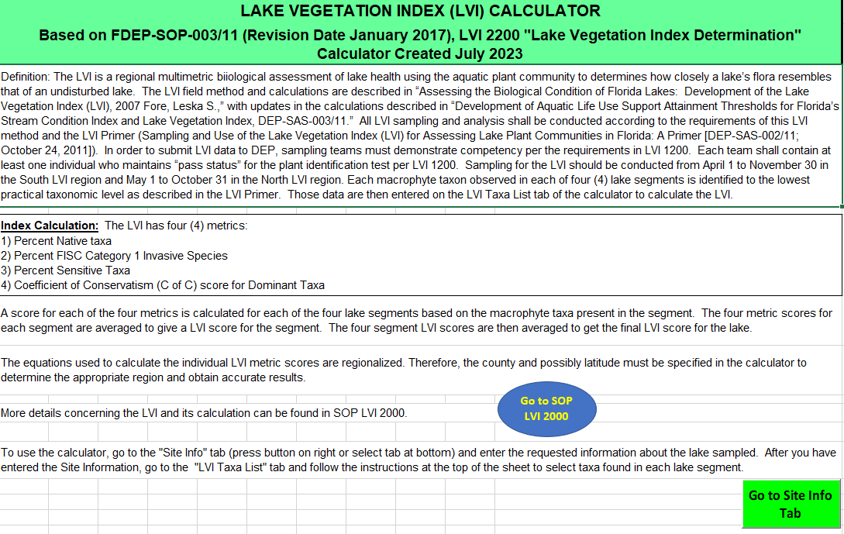
Open LVI Calculator in Excel.
If the file opens as a read me only, click the “Enable Content” button at the top near the Security Warning.
Calculator will open to Read Me sheet.
Please make sure to read this page and the DEP SOP LVI 2000 (via the Blue Oval button) to understand the LVI and its calculation before starting.
Click on the green “Go to Site Info Tab” button to get started.
Further guidance is provided on each sheet as necessary.
Read Me Sheet

Slide 3
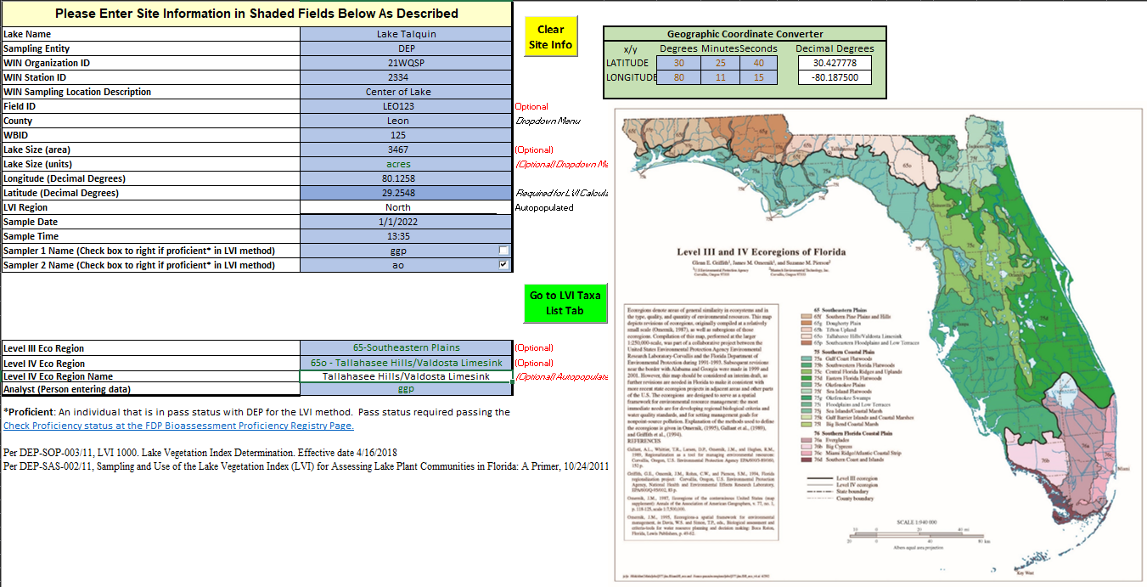
Site Info Tab (fill all blue cells)
Follow numbered steps below (Cells without shading are protected from change and will be auto-populated as appropriate)
Enter Site Info
Convert Coordinate to Decimal Degrees
Enter Ecoregion info, map is provided
Click on the “Go to LVI Taxa List tab” once completed
2)
1)
4)
3)
Link to full map

Slide 4
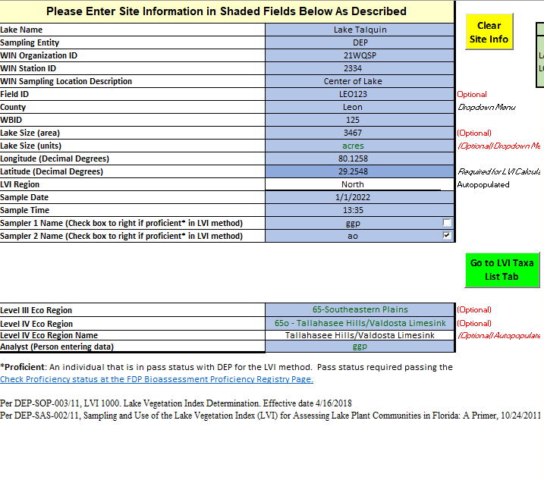
Site Info details
Information entered in the blue shaded cells will be saved when you save the calculator spreadsheet.
Values entered in the Site Info worksheet will be used to auto populate the other worksheets in the calculator to avoid the need to re-enter information.
Cells without shading are protected from change and will be auto-populated as appropriate.

Slide 5
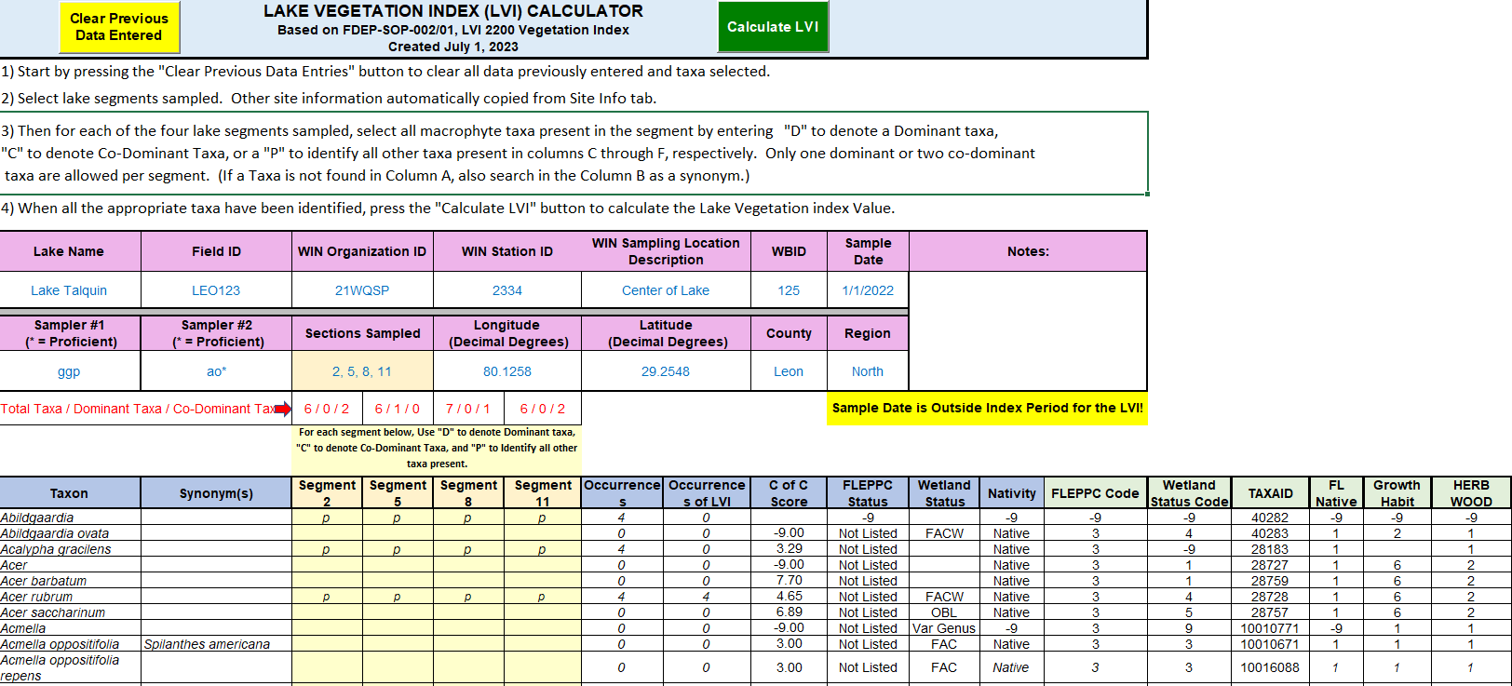
LVI Taxa List sheet Overview
(Follow numbered steps indicated in red)
1)
4)
To clear any previous data, press the “Clear Previous Data Entered” button.
Select lake segments sampled using drop down.
For each taxon found in each segment enter whether it was dominant (D), Co-dominant (C), or present (P) in the pale-yellow shaded cells.
Note: For taxon without observations, leave the columns blank. These will not be counted.
Once all taxa found in each segment have been entered, press the “Calculate LVI” Green button.
If there are any changes to the LVI taxon numbers on this sheet, make sure to click the Calculate LVI button again to calculate the new results on the next sheet.
2)
3)

Slide 6
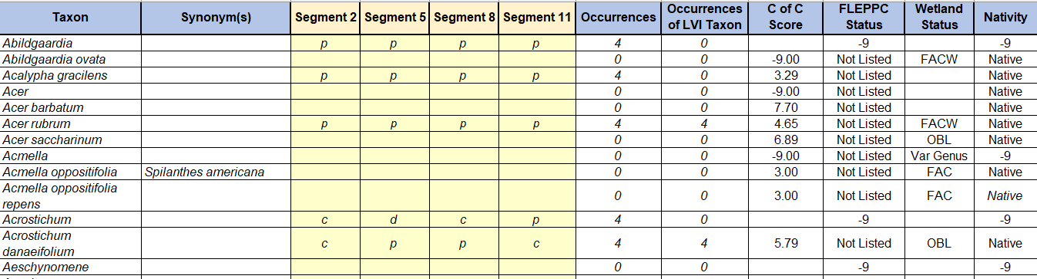
LVI Taxa List
The C of C Scores, FLEPPC Status, Wetland Status, and Nativity associated with each taxa as well as the total number of LVI taxon present as provided on the “LVI Taxa List” tab are used to calculate the metrics for each lake segment.
The taxa included on the “LVI Taxa List” tab were derived from the FDEP Statewide Biological Database (SBIO) and represent the taxa typically found in Florida Lakes.
If a taxon recorded at a lake is not included in the calculator taxa list, please contact Ashley O’Neal at Ashley.ONeal@FloridaDEP.gov to have it added.

Slide 7
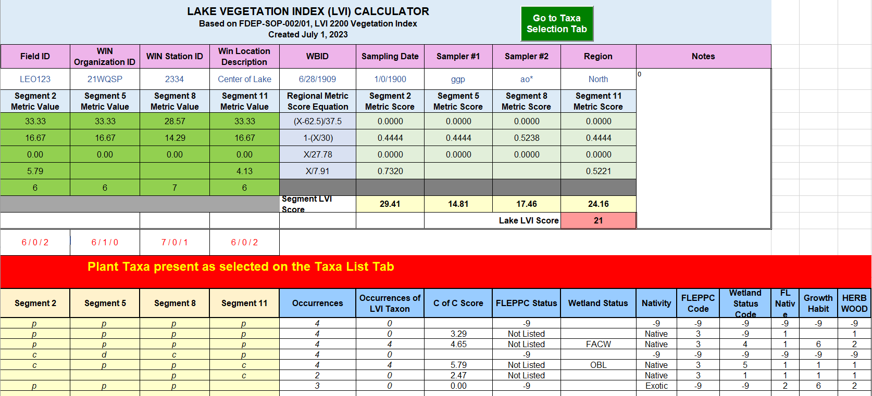
LVI Calculator Overview
Pressing the “Calculate LVI” button, you are taken to the LVI Calculator tab of the calculator, where all the necessary information has been automatically copied and the final LVI score for the lake is calculated.
The bottom portion of the sheet provides a list of all taxa entered on the previous tab and allows you to double check your data entry.
If any errors are found, press the green “Go to Taxa Selection Tab” Button at top to go back to the taxa list and make the necessary edits and re-run the calculation.
This is the final LVI score for the lake
These are the taxa selected

Slide 8
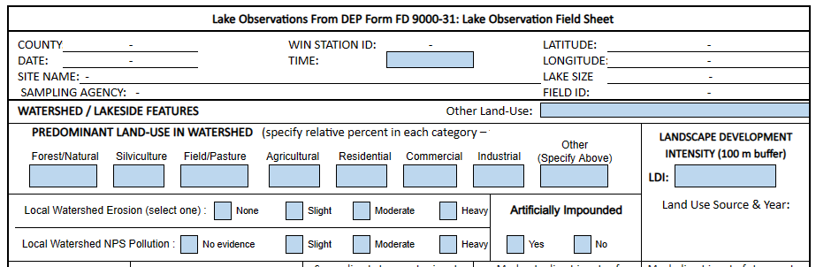
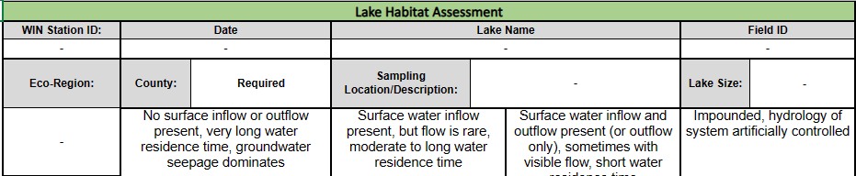
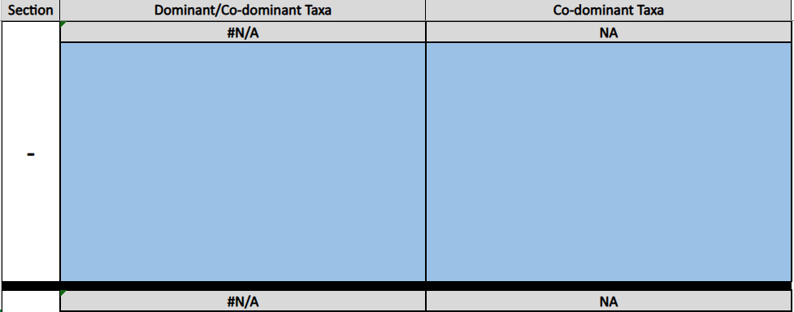
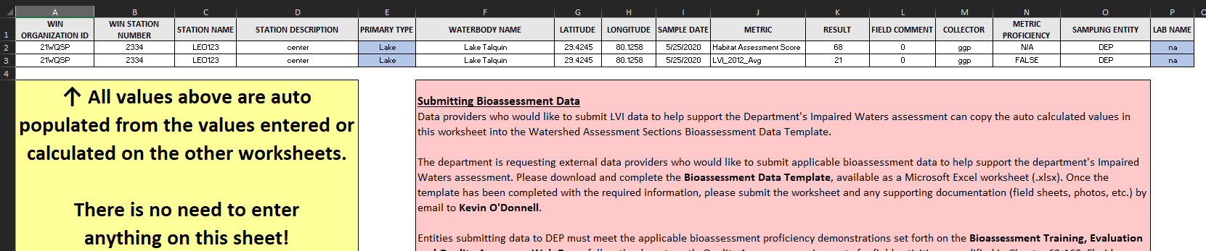
Extra information sheets - Optional
Extra Field Data sheets are provided to record extra information to support the LVI
(these do not affect the LVI calculations within the calculator)
Lake and Sample information are auto-populated using the values entered in the Site Info sheet.
1. Lake Observation sheet (FD 9000-31)
2. Lake Habitat Assessment (HA) sheet (FD 9000-6)
3. Dominant Taxon Photos sheet
Lake sections and dominant and co-dominant taxa are auto populated from the LVI calculator sheet.
Samplers can submit their photographs of dominant and co-dominant taxon for verification.
4. ExternalBioFormat sheet
This sheet is for submitting bioassessment data to the Watershed Assessment Section at DEP
1)
2)
3)
4)

Slide 9

Please contact us if you have any additional questions about the LVI calculator or user guide
Ashley.ONeal@FloridaDEP.gov
Grover.Payne@FloridaDEP.gov

