Slide 1
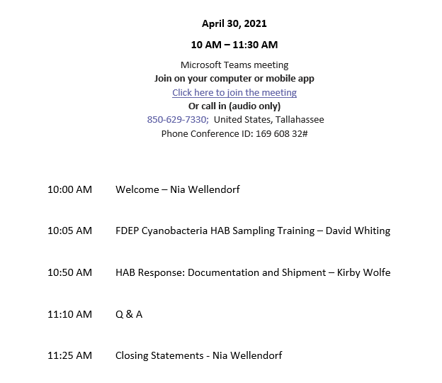

Slide 2
DEP Regional Contacts
Kalina Warren - Administrator for Southern ROCs
Central ROC (Orlando) – Leif Boman (interim contact)
SW ROC (Tampa) – Matt Bearden
SO ROC (Ft. Myers ) - Kirby Wolfe
SE ROC (Ft. Pierce) – Jordan Skaggs
Alicia Hogue – Administrator for Northern ROCs
NW ROC (Pensacola) - Mike King
TLH ROC (Tallahassee) – Mike Eckles
NE ROC (Jacksonville) – Jeremy Parrish

Slide 3
Bloom Response Partners
DEP Aquatic Preserves
Alachua County
Broward County
City of Cape Coral
City of Orlando
Collier County
Escambia County
FWC
Highlands County
Lake County
Lee County
Orange County
Osceola County
Palm Beach County
Pinellas County
Polk County
Sanibel Captiva Conservation Foundation
Santa Rosa County
Seminole County
SFWMD
SJRWMD
SWFWMD

