Slide 1
FDEP Cyanobacteria HAB
Sampling Training
Dave Whiting, Deputy Director
Division of Environmental Assessment and Restoration
Florida Department of Environmental Protection
April 30, 2021

Slide 2
CyanoHAB Surveillance
Agency Staff Coordination
Bloom reports are reviewed daily
Sampling locations are prioritized based on potential for human exposure/harm, representativeness of multiple reports, previous sampling history and analysis results, personnel
Emails and phone calls are made to coordinate sampling among DEP, WMDs, FWCC, and participating county field staff

Slide 3
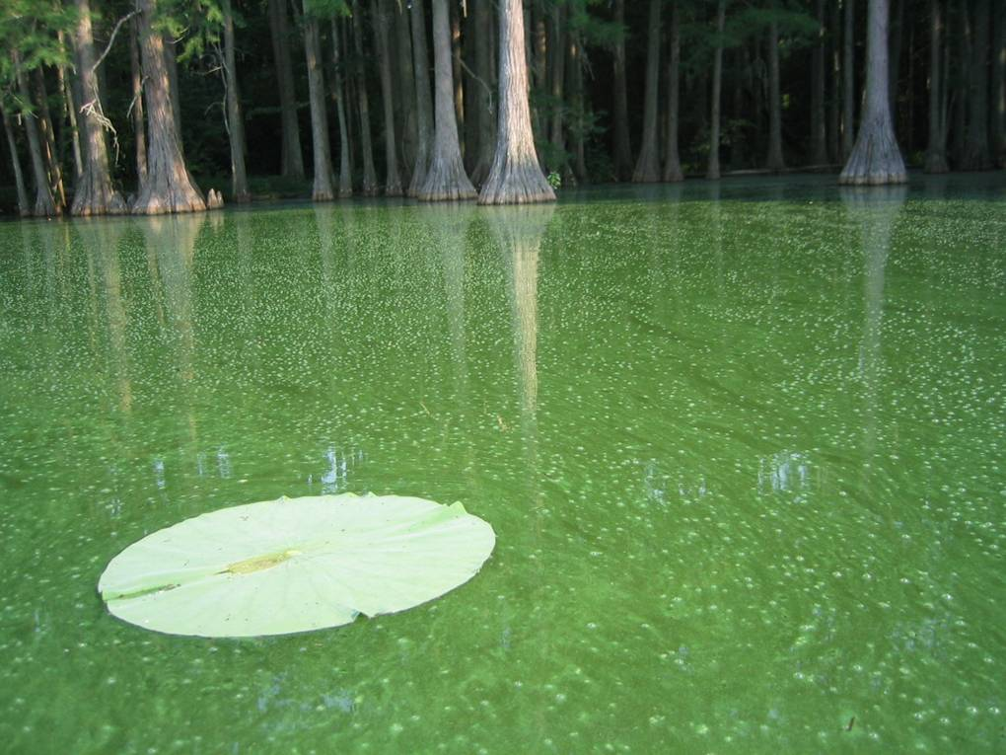
CyanoHAB Sampling
The where, when, and whys of the State’s cyanoHAB sampling strategy

Slide 4
CyanoHAB Sampling
Water, water everywhere
Florida’s total water area covers 4,308 square miles and ranks third in the nation [AK and MI]
The state has more than 11,000 miles of rivers, streams, and waterways
Florida has about 7,700 lakes that are larger than 10 acres
Florida’s coastline stretches 1,197 miles with 663 miles of beaches
http://www.psc.state.fl.us/Files/PDF/Publications/Consumer/Brochure/WMF.pdf
https://www.stateofflorida.com/facts.aspx

Slide 5
CyanoHAB Sampling
Water, water everywhere
Large number/area of Florida’s aquatic resources makes intensive statewide HAB monitoring efforts cost prohibitive
Without intensive sampling, we can never say with high confidence, what is happening in everyone’s backyard due to the heterogeneity of our cyanobacteria HABs

Slide 6
CyanoHAB Sampling
Why do we sample HABs?
Public health protection
Aquatic resource protection/management
To try to understand the factors that contribute to occurrence, persistence, severity, and decline of HABs
To determine if there are ways to effectively mitigate HABs when they occur
To be able to predict when HABs will occur

Slide 7
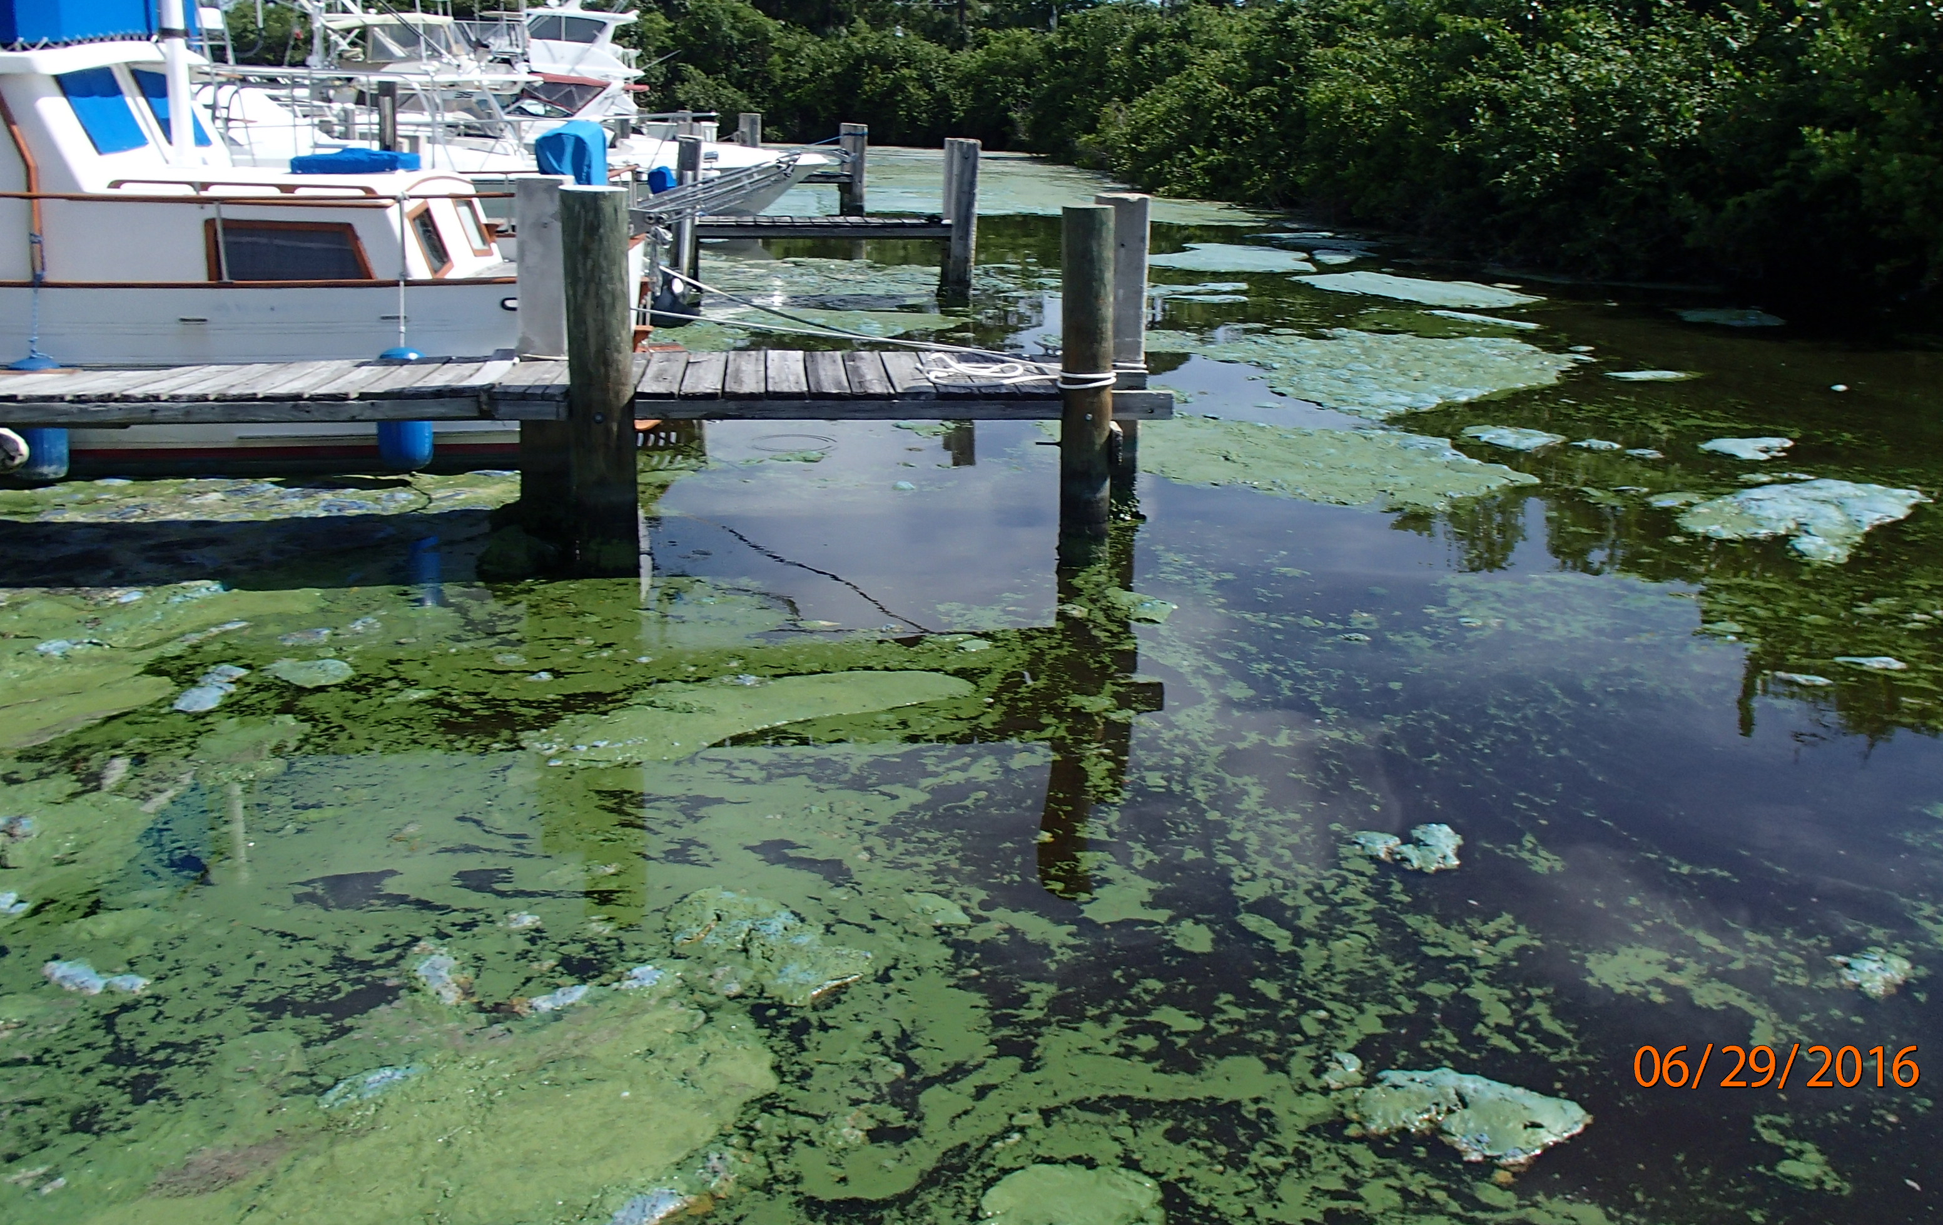
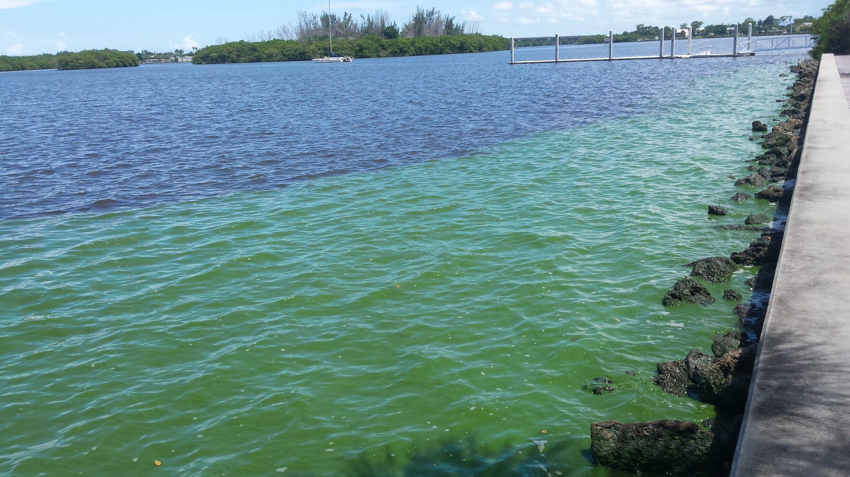
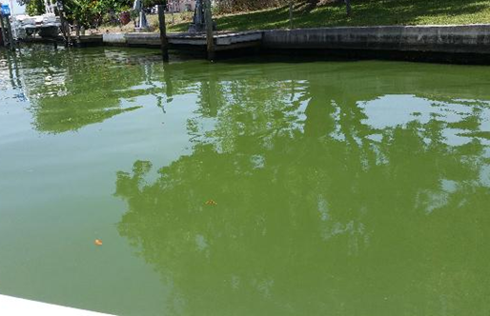
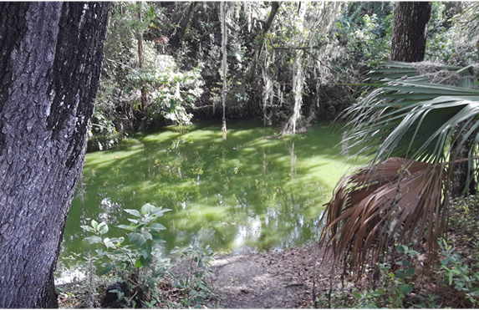
CyanoHAB Sampling
What gets collected?
Representative water samples
Occasionally, scum samples are collected when cyanobacterial scum is dominant in the waterbody being sampled
Photo by FDEP, June 29, 2016, St. Lucie River
Photo by FDEP, June 23, 2016, Leighton Park
Photo by FDEP, June 24, 2019, Manatee River
Photo by FDEP, June 12, 2019 Flint Creek

Slide 8
CyanoHAB Sampling
Why collect “representative” rather than “worst case” samples?

Slide 9
CyanoHAB Thresholds
How much is too much?
EPA’s 2018 and World Health Organizations 2020 recommended cyanotoxin thresholds are based solely on incidental ingestion by children during normal recreational activity (i.e., swimming pool study) and only use toxicological data for MC-LR
Do not account for any other exposure routes (i.e., inhalation, dermal, fish/shellfish consumption)

Slide 10
CyanoHAB Thresholds
EPA recommended Criteria
World Health Organization thresholds
Calculation of provisional recreational water GV for MC-LR: = NOAEL ∗ bw UF ∗ C = 40 ∗ 15 100 ∗ 0.25 µg/L =
24 µg/L
where GVrecreation = guideline value for recreational exposure NOAEL = no-observed-adverse-effect level (40 μg/kg bw/day, based on Fawell et al., 1999) bw = body weight (default = 15 kg for a child) UF = uncertainty factor (100 = 10 for interspecies variation × 10 for intraspecies variation) C = daily incidental water consumption (default = 250 mL for a child)

Slide 11
Cyanotoxins

Slide 12
CyanoHAB Thresholds
The Precautionary Principle
Florida Department of Health does not use a numeric toxin threshold value for advisories
  Presence/Absence of Cyanobacteria bloom or toxins
Advise the public to avoid recreating and allowing pets or livestock in waters with visible algae present
Cyanobacteria bloom conditions change rapidly
Unable to sample, ship, analyze, and disseminate results rapidly enough to accurately inform the public about the risk of recreating in a water at the time of use
Usually takes 3 – 4 days from sampling to posting of results

Slide 13
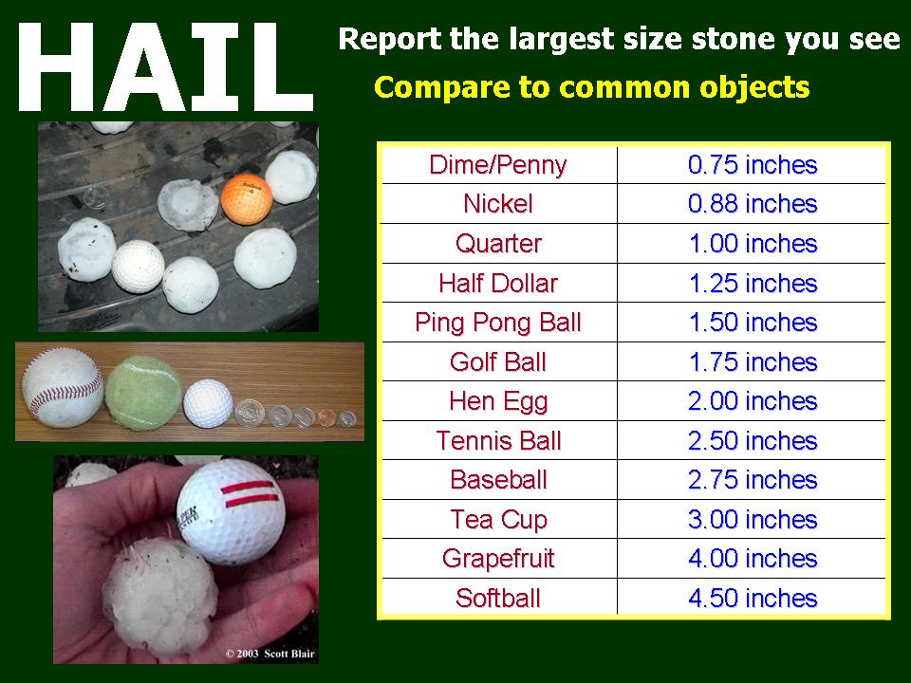
CyanoHAB Thresholds
Sampling a bloom doesn’t change the nature of the bloom, anymore than measuring the size of hailstones changes a storm event
Sampling does tell us something about the relative risk of a bloom, the same as knowing the size of hailstones tells us about the relative risk of the storm event

Slide 14
CyanoHAB Sampling
Why not collect
“representative” and “worst case”
all the time?

Slide 15
CyanoHAB Sampling
Presence of scum can be very ephemeral and change concentration by orders of magnitude within minutes or a few meters
Recreational advisory thresholds are based on concentration of toxin in water, not scum
Workload, cost, and speed of analytical turnaround a factor as well

Slide 16
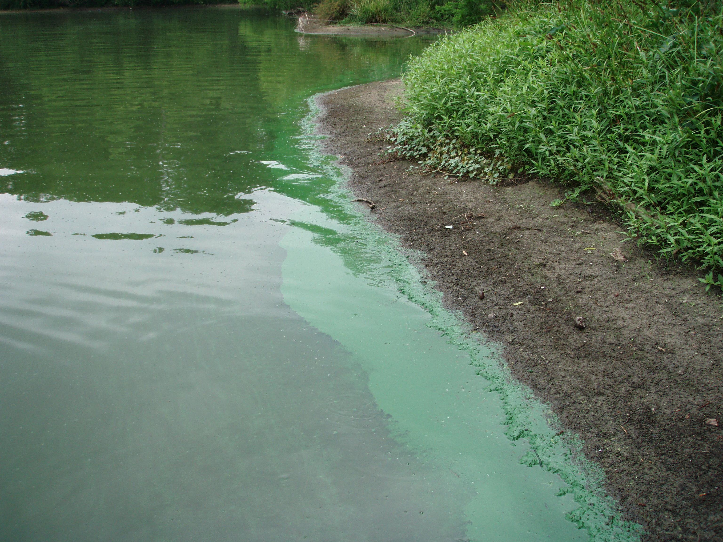
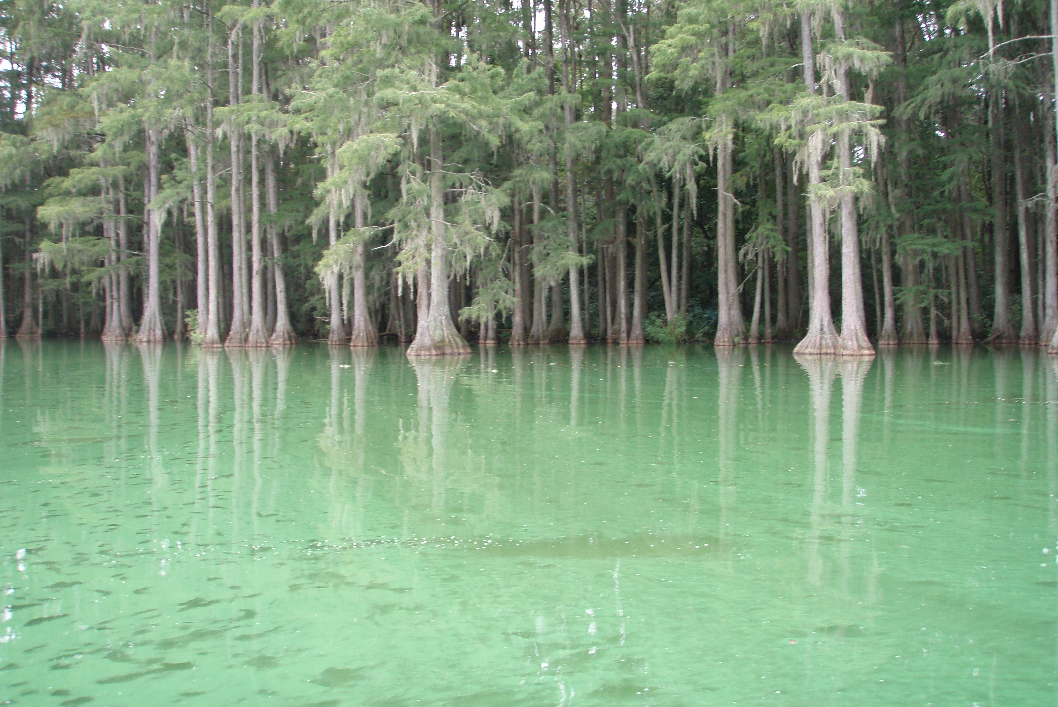
CyanoHAB Sampling
We collect water samples at the edge of scum when it is present and represents a small area of the sampling location (sort of worst case of representative condition)
We collect homogenized scum when it is dominant and representative of the sampling location
Photo by FDEP, Lake Munson, Leon County

Slide 17
CyanoHAB Sampling
What gets analyzed?
Cyanotoxins
  Microcystins (LR, RR, YR, LA, LF, LY, LW, WR, desmethyl LR, HilR and HtyR)
  Anatoxin-a
  Cylindrospermopsin
  Saxitoxins (in some waters)
Algal Identification
Chlorophyll a
Nutrients

Slide 18
CyanoHAB Sampling
What Standard Operating Procedures
Are Used?
FS 7000. GENERAL BIOLOGICAL COMMUNITY SAMPLING
  FS 7110. PHYTOPLANKTON BLOOM SAMPLING
  FS 7240. ALGAL MAT SAMPLING FOR TAXONOMIC IDENTIFICATION OR TOXIN ANALYSIS
  FS 7230 RAPID PERIPHYTON SURVEY
AB-17 Algal Bloom Response
AB-FIELD Cyanobacteria Bloom Response Field Data Sheet
AB-NOTIFY Algal Bloom Notification Form

Slide 19
CyanoHAB Sampling
Which waterbodies do we sample?
Private Ponds and Lakes?
Municipal stormwater ponds?
Residential development retention ponds?
Rivers and streams?
Public lakes?
Waters of the State?
Estuaries, Intercoastal waterways, and beaches?
We have occasionally sampled waterbodies that are not known to be Waters of the State if there is high potential for significant public exposure
NO
NO
NO
YES
YES
YES
Sometimes

Slide 20
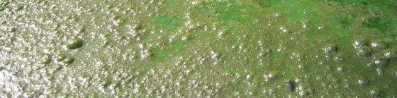
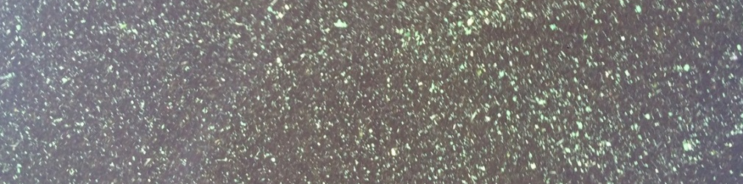
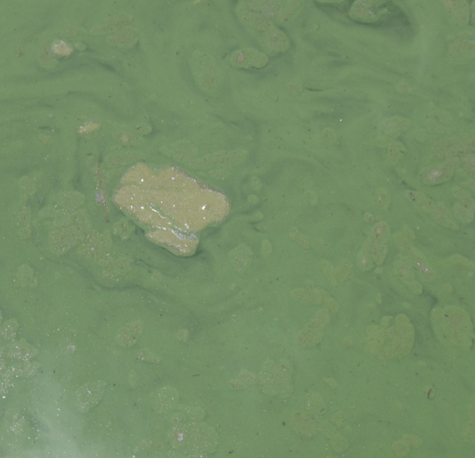
Bloom Sample Types:
20
Surface Scum
First, what is Scum?
A scum is a consolidated layer of algae floating on the water’s surface.
It is not streaks or specks.
It is not thick, green “soup”.

Slide 21
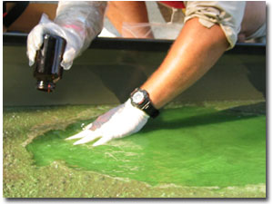
Bloom Sample Types:
21
Surface Scum
Mix the surface scum of a 0.5 m area with the underlying water to mimic recreational exposure.
  For example, swimming or jet skiing would mix the upper scum layer into the underlying water
Collected in the top 5-10 centimeters of the water column.
Do not collect the sample by skimming the surface.
DEP bloom response does include this method, if appropriate to do so. (Refer to representative sampling).

Slide 22
Scum Sampling
22
Requires some judgement
Consolidated surface scum
Whole water column bloom or disturbed surface scum?

Slide 23
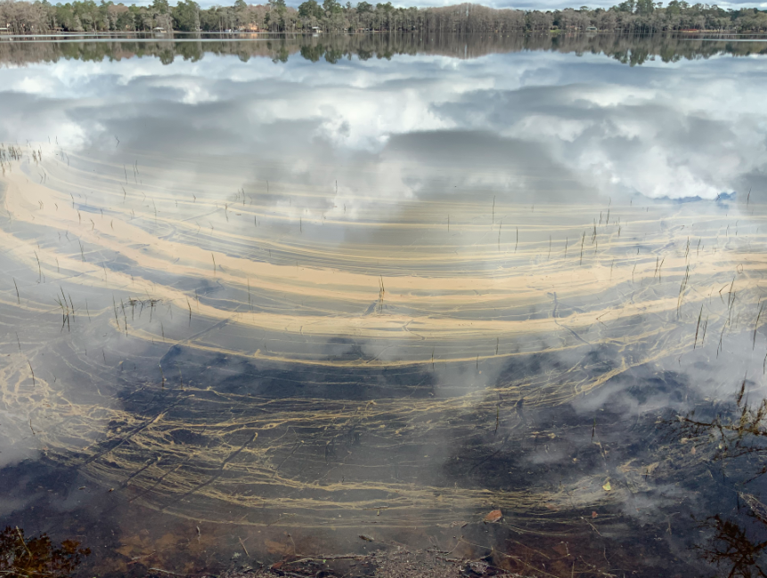
Bloom Sample Types:
23
Surface Scum
We sometimes get HAB reports that turn out to be pollen rather than cyanobacteria or algae.
Lake Bradford, Tallahassee, Florida February 12. 2021

Slide 24
CyanoHAB Sampling
Let’s play “Where do we sample?”
Bloom reported to Hotline
No bloom observed upon visit
Sample/Not Sample?

Slide 25
CyanoHAB Sampling
Let’s play “Where do we sample?”
Take a representative sample

Slide 26
CyanoHAB Sampling
Let’s play “Where do we sample?”
What if there was an area of scum along a portion of the shoreline?

Slide 27
CyanoHAB Sampling
Let’s play “Where do we sample?”
Collect a grab sample of water at edge of scum

Slide 28
CyanoHAB Sampling
Let’s play “Where do we sample?”
What if there was a boat ramp, designated beach area, or other point of high recreational use?
Beach

Slide 29
CyanoHAB Sampling
Let’s play “Where do we sample?”
Sample at edge of scum and at recreational area
Beach

Slide 30
CyanoHAB Sampling
Let’s play “Where do we sample?”
What if a sizable portion of the lake was covered in scum?

Slide 31
CyanoHAB Sampling
Let’s play “Where do we sample?”
What if a sizable portion of the lake was covered in scum?
Collect a grab sample at edge of scum AND a scum sample

Slide 32
CyanoHAB Sampling
Let’s play “Where do we sample?”
What if the scum was affecting a portion or all of the recreational area?

Slide 33
CyanoHAB Sampling
Let’s play “Where do we sample?”
Collect a grab sample at the edge of the scum AND a scum sample within the recreational area

Slide 34
CyanoHAB Sampling
Let’s play “Where do we sample?”
What if the scum is much worst outside of the recreational area?

Slide 35
CyanoHAB Sampling
Let’s play “Where do we sample?”
Remember, DOH only uses the presence of toxin for their Health Alerts, not the amount
Collect scum within the recreational area

Slide 36

CyanoHAB Sampling
Let’s play “Where do we sample?”
Residential Canal in a development with scum present
Canal does not connect to Waters of the State
We don’t sample, refer to county or local government agency

Slide 37
CyanoHAB Sampling
Let’s play “Where do we sample?”
Residential Canal in a development with scum present
Canal does connect to Waters of the State

Slide 38
CyanoHAB Sampling
Let’s play “Where do we sample?”
Residential Canal in a development with scum present
Canal does connect to Waters of the State
Collect Grab sample at edge of Scum

Slide 39
CyanoHAB Sampling
Let’s play “Where do we sample?”
Residential Canal in a development with scum present
Canal does connect to Waters of the State

Slide 40
CyanoHAB Sampling
Let’s play “Where do we sample?”
Residential Canal in a development
Canal does connect to Waters of the State
Collect both a Scum and Grab sample

Slide 41
CyanoHAB Sampling
Let’s play “Where do we sample?”
Flowing waters with streaks of cyanobacteria at the surface and within the water column

Slide 42
CyanoHAB Sampling
Let’s play “Where do we sample?”
Flowing waters with streaks of cyanobacteria at the surface and within the water column
Collect a grab sample in the area with streaks present
Grab taken from streak is fine so long as it’s a streak and not a scum

Slide 43
CyanoHAB Sampling
Let’s play “Where do we sample?”
Flowing waters with streaks of cyanobacteria at the surface and within the water column
Scum accumulated along the shoreline

Slide 44
CyanoHAB Sampling
Let’s play “Where do we sample?”
Flowing waters with streaks of cyanobacteria at the surface and within the water column
Scum accumulated along the shoreline
Collect grab in area of streaks and edge of scum

Slide 45
CyanoHAB Sampling
Let’s play “Where do we sample?”
Flowing waters with streaks of cyanobacteria at the surface and within the water column
Scum accumulated along the shoreline

Slide 46

CyanoHAB Sampling
Let’s play “Where do we sample?”
Flowing waters with streaks of cyanobacteria at the surface and within the water column
Scum accumulated along the shoreline
Scale Matters

Slide 47
CyanoHAB Sampling
Let’s play “Where do we sample?”
Flowing waters with streaks of cyanobacteria at the surface and within the water column
Scum accumulated along the shoreline
Collect grab in area of streaks and edge of scum

Slide 48

CyanoHAB Sampling
Let’s play “Where do we sample?”
Flowing waters with streaks of cyanobacteria at the surface and within the water column
Scum accumulated along the shoreline

Slide 49
CyanoHAB Sampling
Let’s play “Where do we sample?”
Flowing waters with streaks of cyanobacteria at the surface and within the water column
Scum accumulated along the shoreline
Collect Grab in area of streaks and Scum sample (possibly Grab edge of scum)

Slide 50
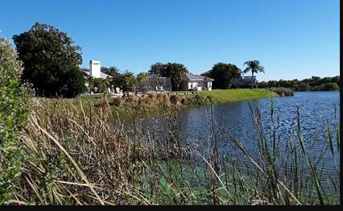
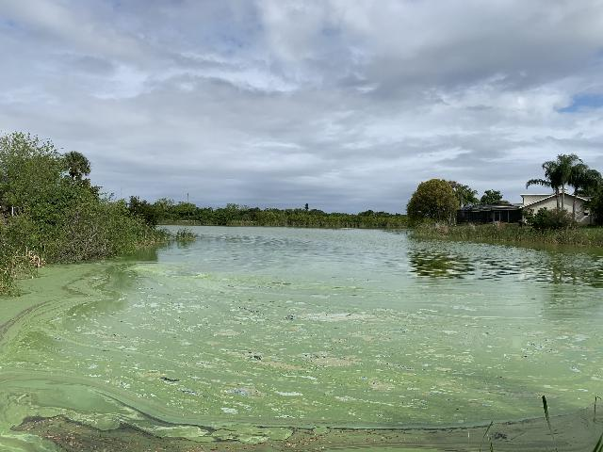
Recent Examples
50
Harbor Isle Lake
NW Lobe South Lobe

Slide 51
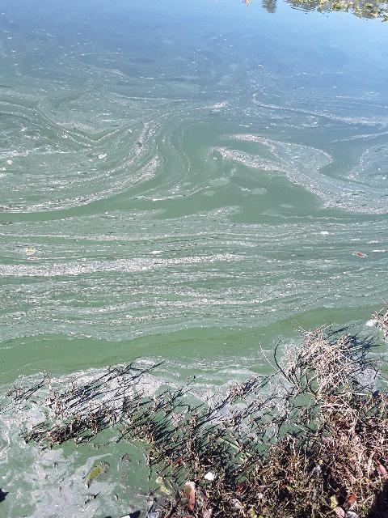
Recent Examples
51
Lake Montgomery

Slide 52
Resampling Frequency
52
Lake | Sampling Date | Microcystin Result (µg/L) | Keep Sampling?
Anderson | 2/17/2020 | 34 | ?
 | 3/9/2020 | 4.7
 | 11/19/2020 | 1.2
 | 12/10/2020 | 2
Jennie Jewel | 2/17/2020 | 150 | ?
 | 2/26/2020 | 2.4
 | 3/9/2020 | 8.5
 | 5/18/2020 | not detected
Arnold | 2/25/2020 | 1.6 I (I) | ?
 | 3/3/2020 | 1.8 I (I)
 | 3/10/2020 | 0.74 I (I)
 | 4/15/2020 | not detected

Slide 53
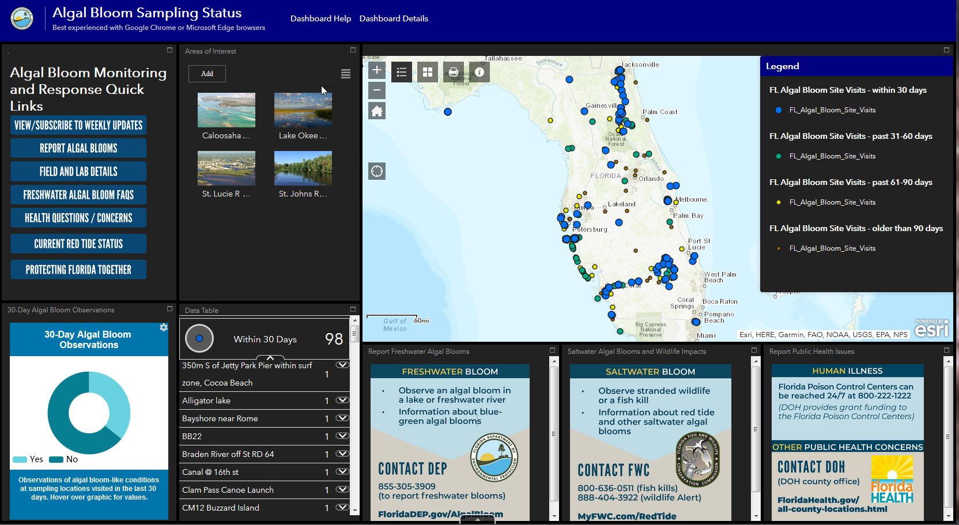
What happens with the Results?
Results are posted to the DEP Algal Bloom Dashboard
DOH reviews daily and contacts local county health departments

Slide 54
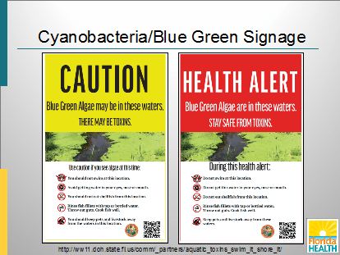
DOH CyanoHAB Signage
Caution sign used when cyanobacteria present but toxins not detected
Health Alert sign used when cyanotoxins detected

Slide 55
DOH CyanoHAB Signage
Daily email from DOH regarding cyanobacteria results includes a table to help local health departments with decisions regarding the need for signage
DOH Blue-Green Algae Daily Update for Florida February 19, 2021 Listings below based on information downloaded 2/19/2021 7:40:51 AM
County | Sites with Bloom Present | Sites with Toxins Detected | Follow-up Sample Found No Toxins | Pending Toxin Results | No Longer Pending No Toxins Detected | Point Map Photo
Brevard | - | - | - | Lake Washington - Center (LWC) | Lake Washington - Center (LWC) | Point Map Photo
Leon | - | - | - | - | Lake Bradford - Western Shore | Point Map Photo
Okeechobee | - | - | - | Lake Okeechobee - LZ2 | - | Point Map No Photo
Orange | - | Lake Conway @ SW Shore | - | - | - | Point Map Photo
Orange | - | Lake Holden 90m S of Lake Holden Point | - | - | - | Point Map Photo
Orange | - | Lake Anderson - NW Corner | - | - | - | Point Map No Photo
Pinellas | - | - | - | - | Round Lake | Point Map Photo
Putnam | - | - | - | Crescent Lake-mouth of Dunns Creek (CRESLM) | - | Point Map No Photo
Putnam | - | - | - | Crescent Lake - mouth of Dunns Creek (CRESLM) | - | Point Map No Photo
Volusia | - | - | - | Lake George - Center (LEO) | Lake George - Center (LEO) | Point Map No Photo

Slide 56
DOH CyanoHAB Signage
Caution signs may stay out until cyanobacteria not observed or until the end of the normal recreational season depending on county
Health Alert sign may stay out until cyanotoxins are no longer detected
When only trace levels detected for extended period of time (6 sampling events), the county may remove the Health Alert sign

Slide 57
Summary
Collaborative effort to respond to bloom reports
Collection and analysis of representative samples (which may include scum samples) to provide information on the risk to public health
Scale of bloom matters as to how you sample
DEP posts results to the Algal Bloom Dashboard to disseminate results to DOH and the public, usually within 3-4 days of sample being collected
County DOH staff post signage

Slide 58
Thank you
ROC Teams
Lab Staff
SJRWMD
SFWMD
Division Office
FWRI
DOH
Communications
County and local
GIS Staff
Public Services

