Slide 1
FDEP ALGAE BLOOM RESPONSE
Documentation, Sample Collection and Shipment
March 10, 2022
FDEP Algae Bloom Response Standard Operating Procedures
https://floridadep.gov/dear/quality-assurance/content/dep-sops

Slide 2
Communication
Before sampling:
  Communicate with your local ROC office or FDEP contact person before collecting any FDEP HAB Kits. HAB kits should only be collected with the approval of FDEP staff.
After sampling:
  Inform your local ROC office or FDEP contact person ASAP so that the algae dashboard map can be updated with the sampling date, time and field observations.
    If your agency updates the algae dashboard directly via Survey123, please email David Whiting, Cheryl Swanson, your local ROC team lead, and Kalina Warren or Alicia Hogue stating that samples have been collected and shipped.
FDEP Algae Bloom Response Standard Operating Procedures
https://floridadep.gov/dear/quality-assurance/content/dep-sops

Slide 3
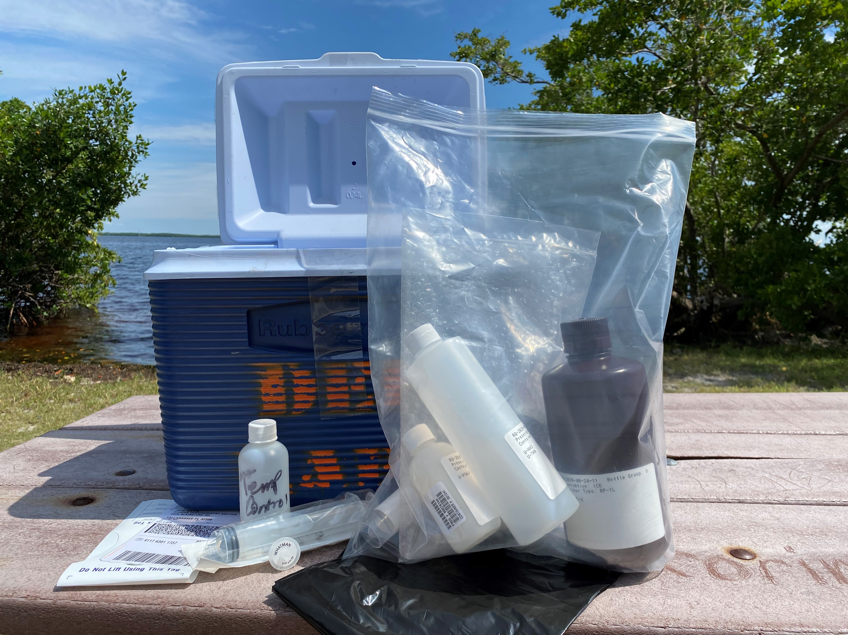
BLOOM RESPONSE COOLER CONTENTS
Bloom Response Bottle Kit
Lab Submittal Form (CoC)
Field Data Sheet (PDF we provide)
  The Bloom Response Field Data Sheet also acts as the Chain of Custody (CoC). It is not necessary to complete the Lab Submittal Form CoC included with the kit.
Packing List
H₂SO₄ preservative
Temperature Control Bottle (TCB)
Shipping label
Zip tie
Ziplock bag
Black trash bag

Slide 4
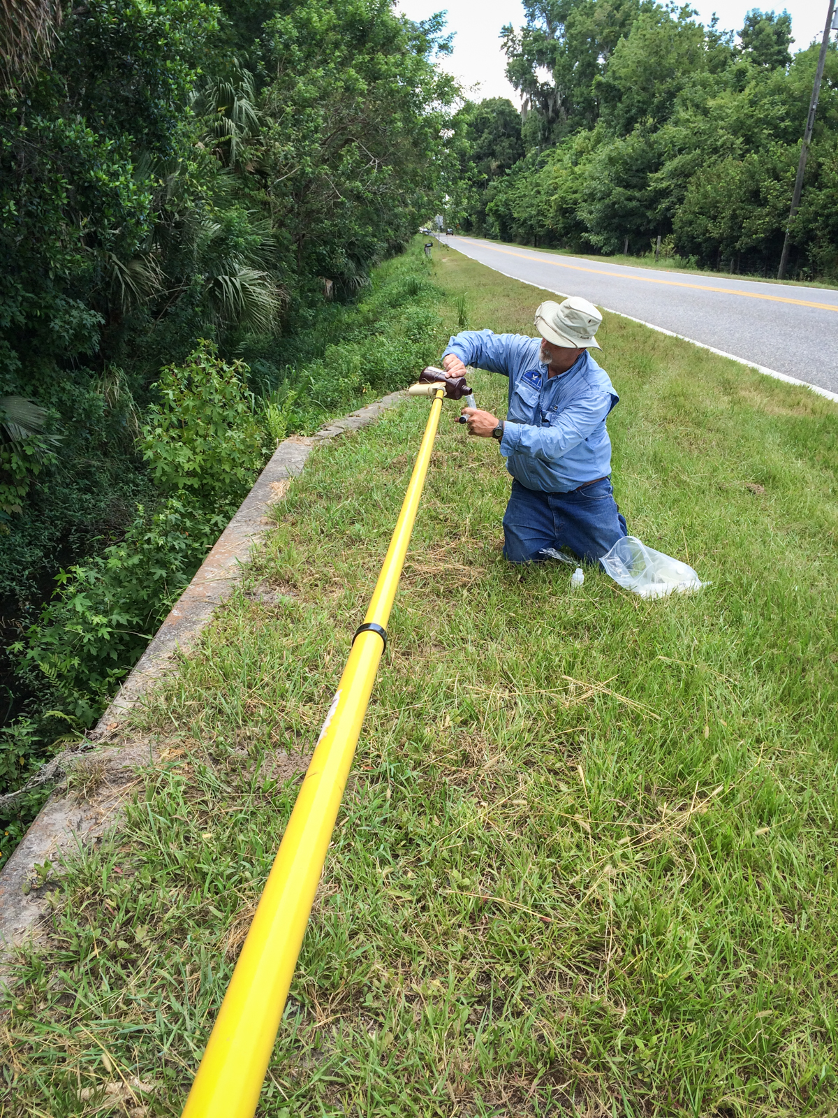
Things you may need to bring.
Calibrated water meter
Sampling pole
Gloves
Face mask
Camera/phone
Syringe/filter

Slide 5
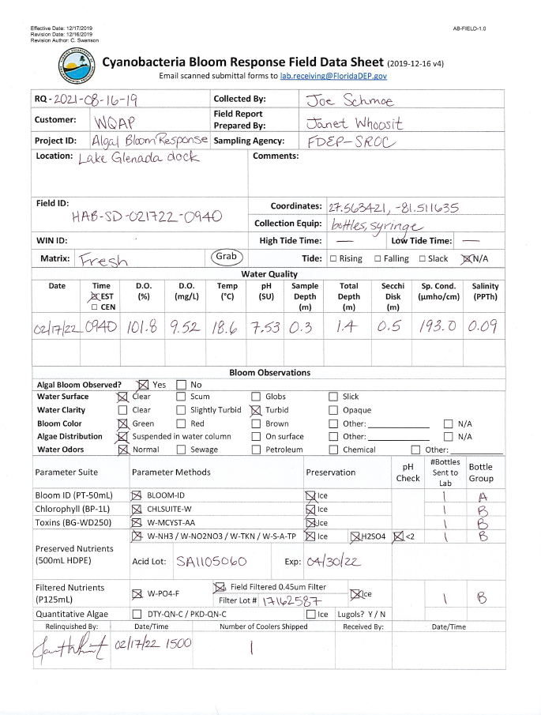
BLOOM RESPONSE FIELD DATA SHEET
AB-FIELD-1.0
We can email it to you.
https://floridadep.gov/dear/florida-dep-laboratory/content/dep-laboratory-quality-assurance-manual-and-sops

Slide 6
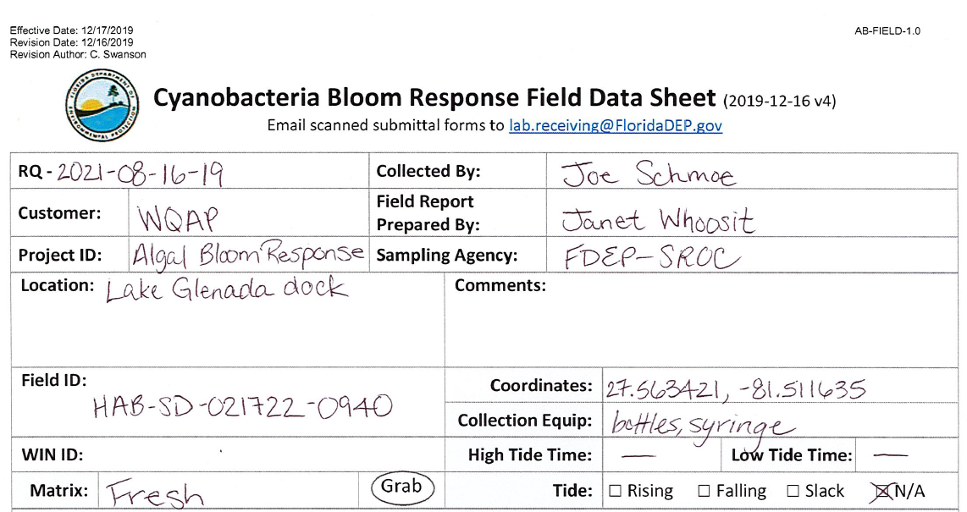
FIELDSHEET – TOP PORTION
RQ – Should match bottles
Customer - WQAP
Project ID – BLOOM-RESP
Location – Include waterbody and general
location information
Field ID – HAB+[AgencyCode]+[UniqueID]
WIN ID – if existing WIN Station known
Matrix – Marine if SpCond > 5000 µmhos/cm
fresh if SpCond < 5000 µmhos/cm
Collected By – person collecting samples
Field Report Prepared By – person completing fieldsheet
Sampling Agency – your agency
Comments – any pertinent comments about the sample,
site, weather, or bloom
Coordinates – dms or dd
Collection Equipment – bottles, filter, syringe,
Van Dorn? pole?
Tides – current tide info, NA if non-tidal

Slide 7
A NOTE ABOUT FIELD-ID
The naming convention for Field ID consists of 3 parameters
Project (HAB or BLOOM)
Agency Code
Some unique ID
AGENCY CODES
Example: If the City of Cape Coral sampled 2 algae blooms on 9/29/20, the Field ID
For the second site would be: HAB-CC092920-02

Slide 8
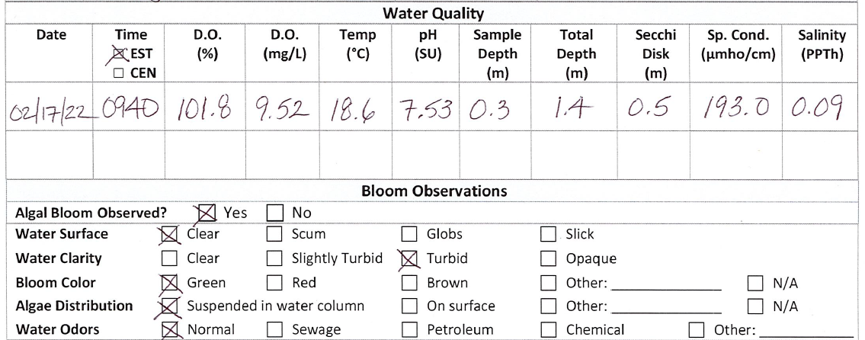
FIELDSHEET – Water Quality and Bloom
SAMPLE DEPTH = 0.3m if TOTAL DEPTH ≥ 0.6m
SAMPLE DEPTH = ½ TOTAL DEPTH if TOTAL DEPTH < 0.6m
(Eg. TOTAL DEPTH = 0.4m, SAMPLE DEPTH = 0.2m)
Bottom reads are not necessary for Bloom Response
Samples should not be collected if DEPTH < 10cm

Slide 9
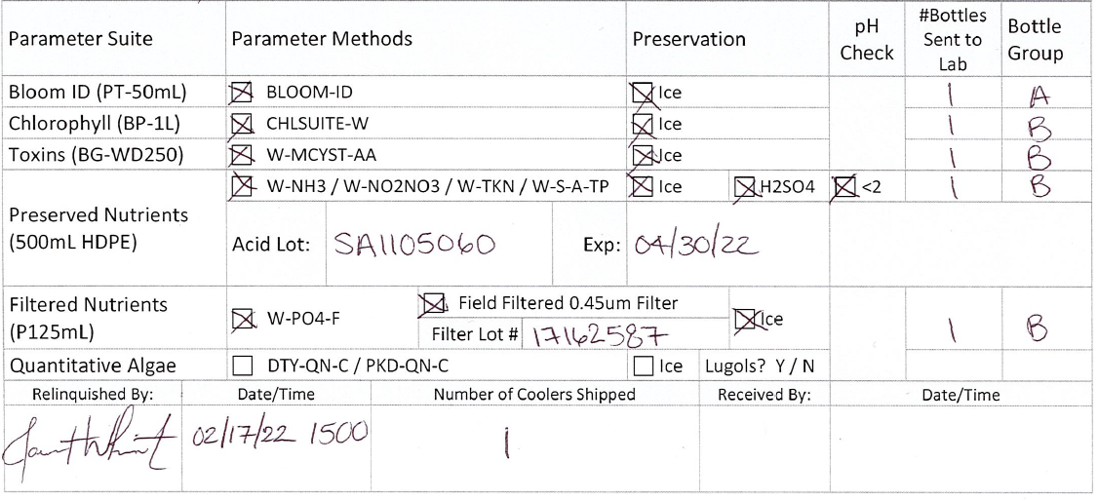
FIELDSHEET – Parameters and Preservation
Select bottle types/parameters which you are collecting (Typically it is the entire kit, but you may be asked to collect BLOOM-ID and TOXINS only)
Be sure to indicate that you filtered PO₄, preserved/checked NUTRIENTS, and iced everything down
Fill in appropriate lot information

Slide 10
FIELDSHEET – Chain of Custody Information
The Bloom Response Field Data Sheet also acts as the Chain of Custody (CoC)
It is not necessary to complete the Lab Submittal Form CoC included with the kit
Complete the CoC portion of each fieldsheet before submitting to lab
#Bottles Sent to Lab – write ‘0’ if none sent (explain in comments)
Bottle Group – enter corresponding group located on bottle
Relinquished By and associated Date/Time – who and time dropped off at FedEx
Number of Coolers Shipped – total number that day
Received By and associated Date/Time – to be completed by lab

Slide 11
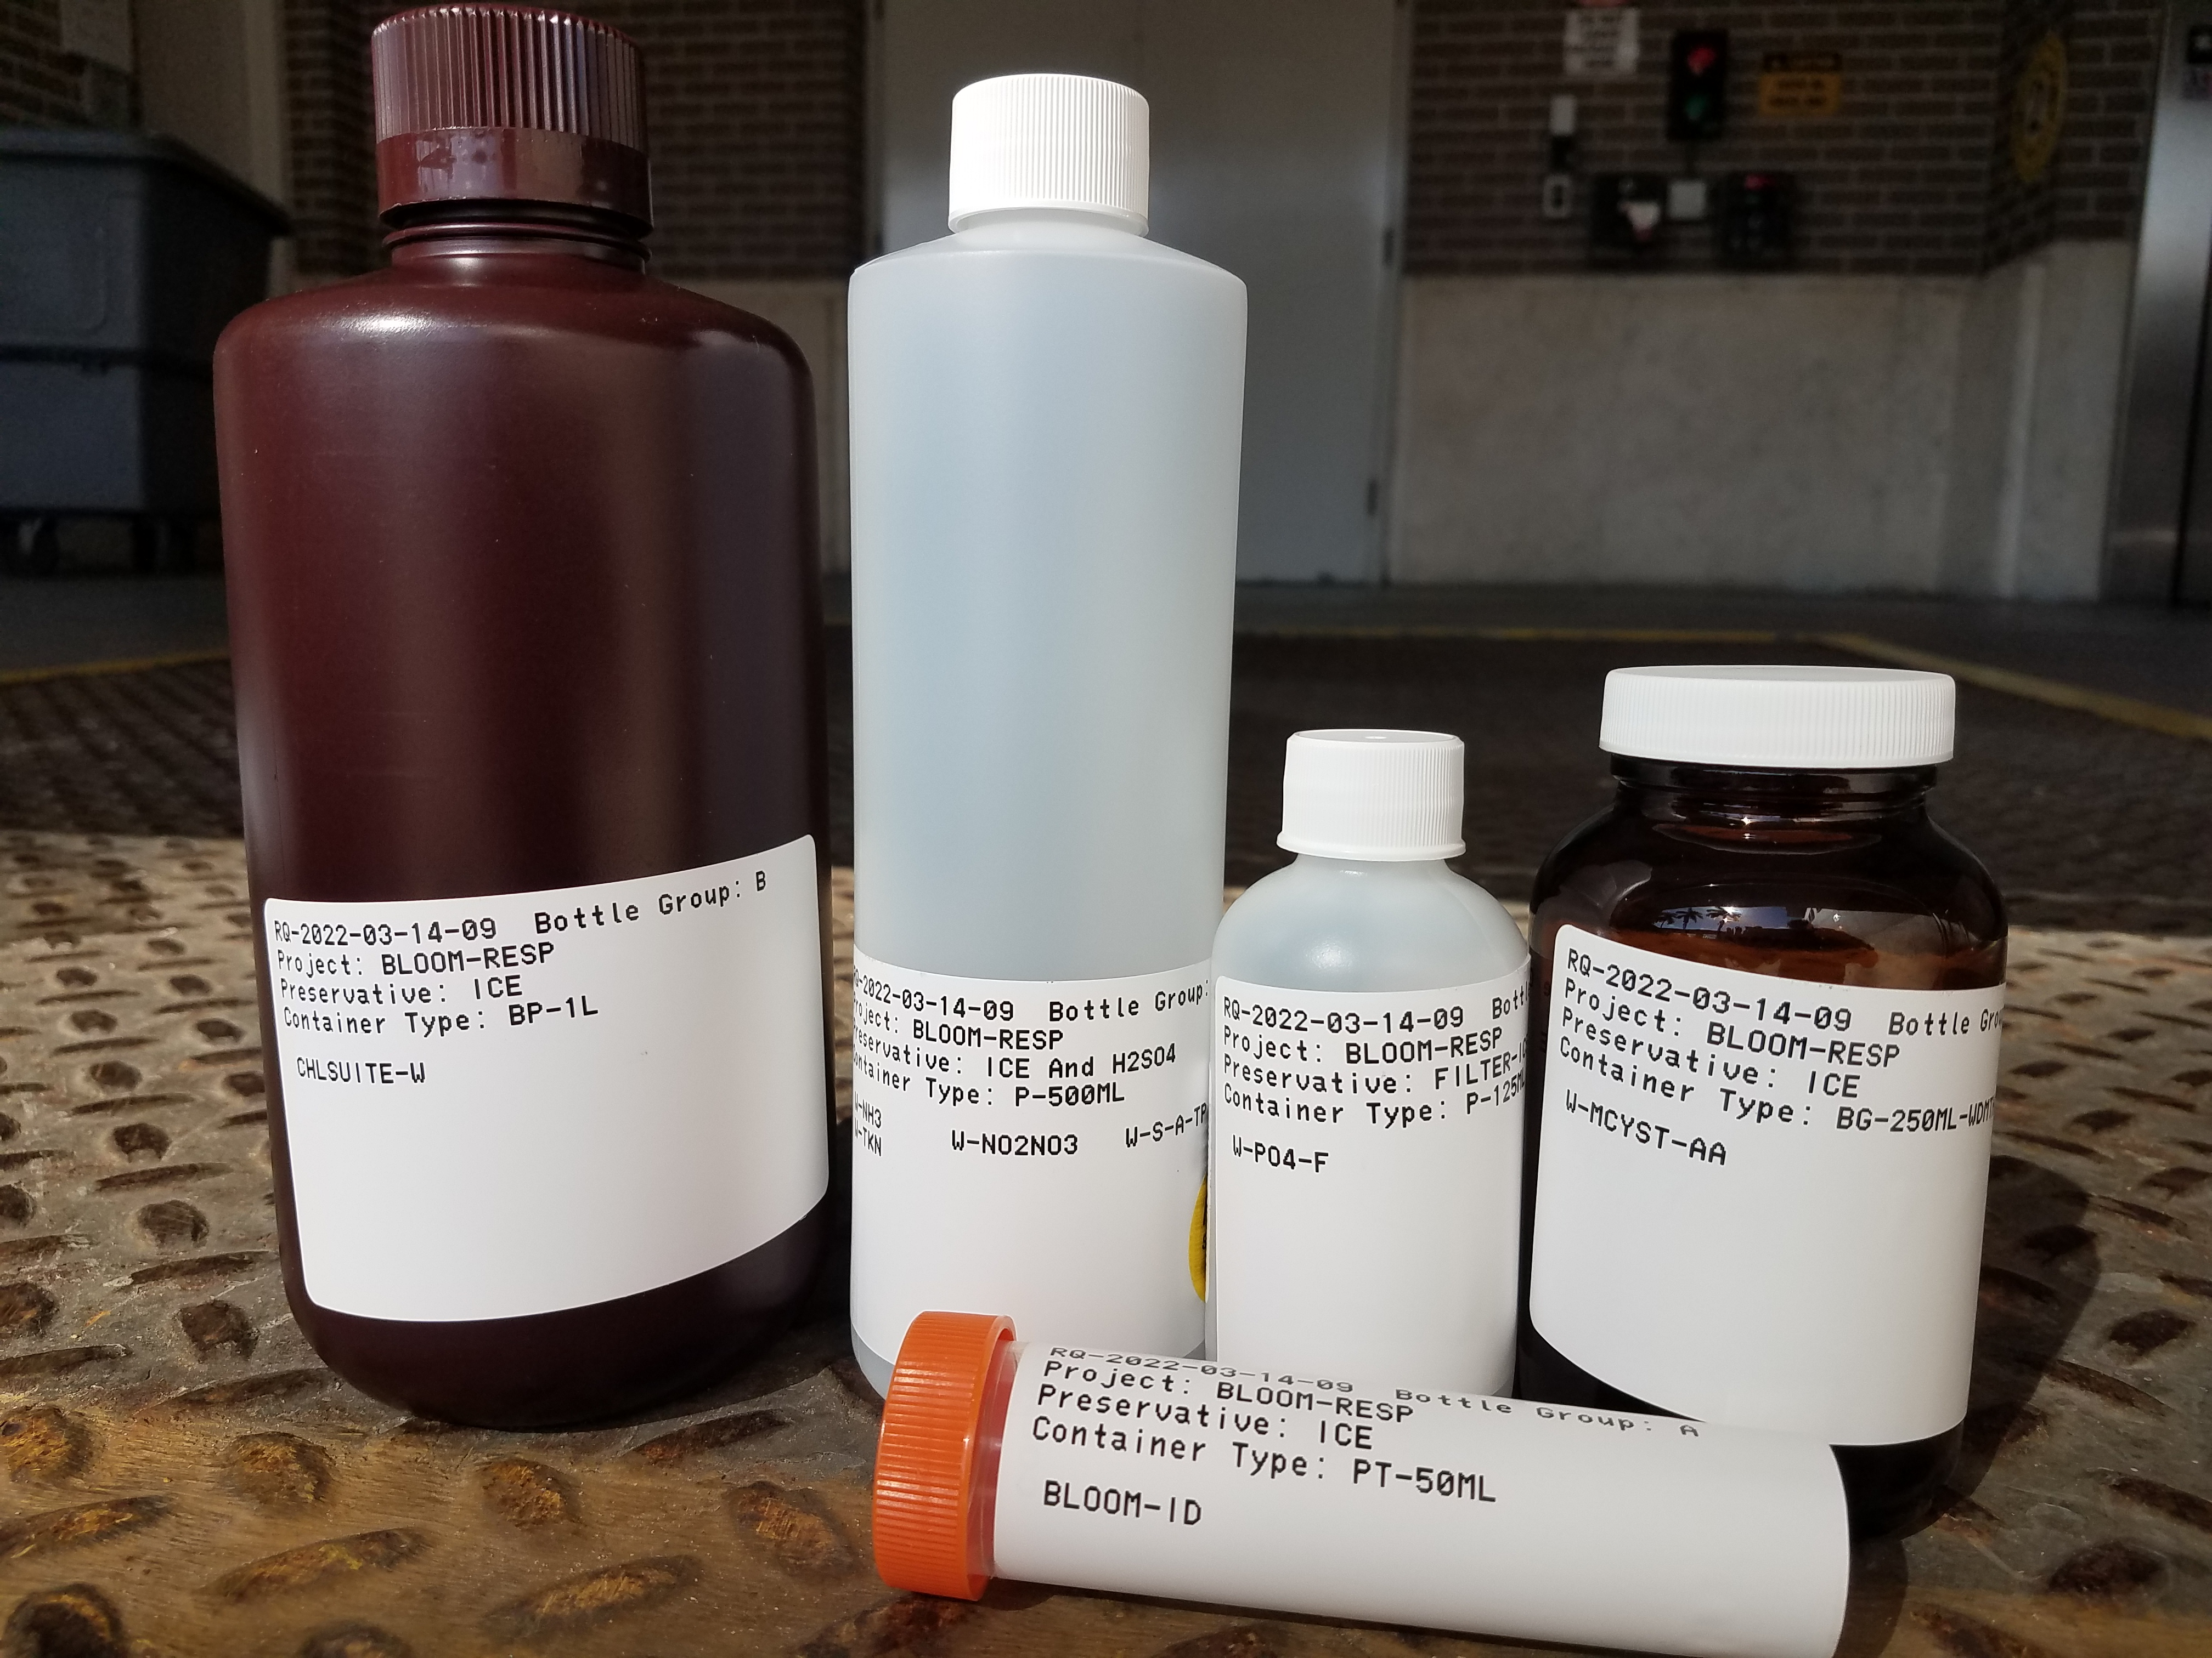
BLOOM RESPONSE BOTTLE KIT
CHLOROPHYLL
CHLSUITE-W
DOMINANT ALGAE TAXA
BLOOM-ID
TOXINS
W-MCYST-AA
NUTRIENTS (preserved)
W-NH3, W-NO2NO3, W-S-A-TP, W-TKN (H2SO4 yellow sticker)
ORTHO-PHOSPHATE (filtered)
W-PO4-F

Slide 12
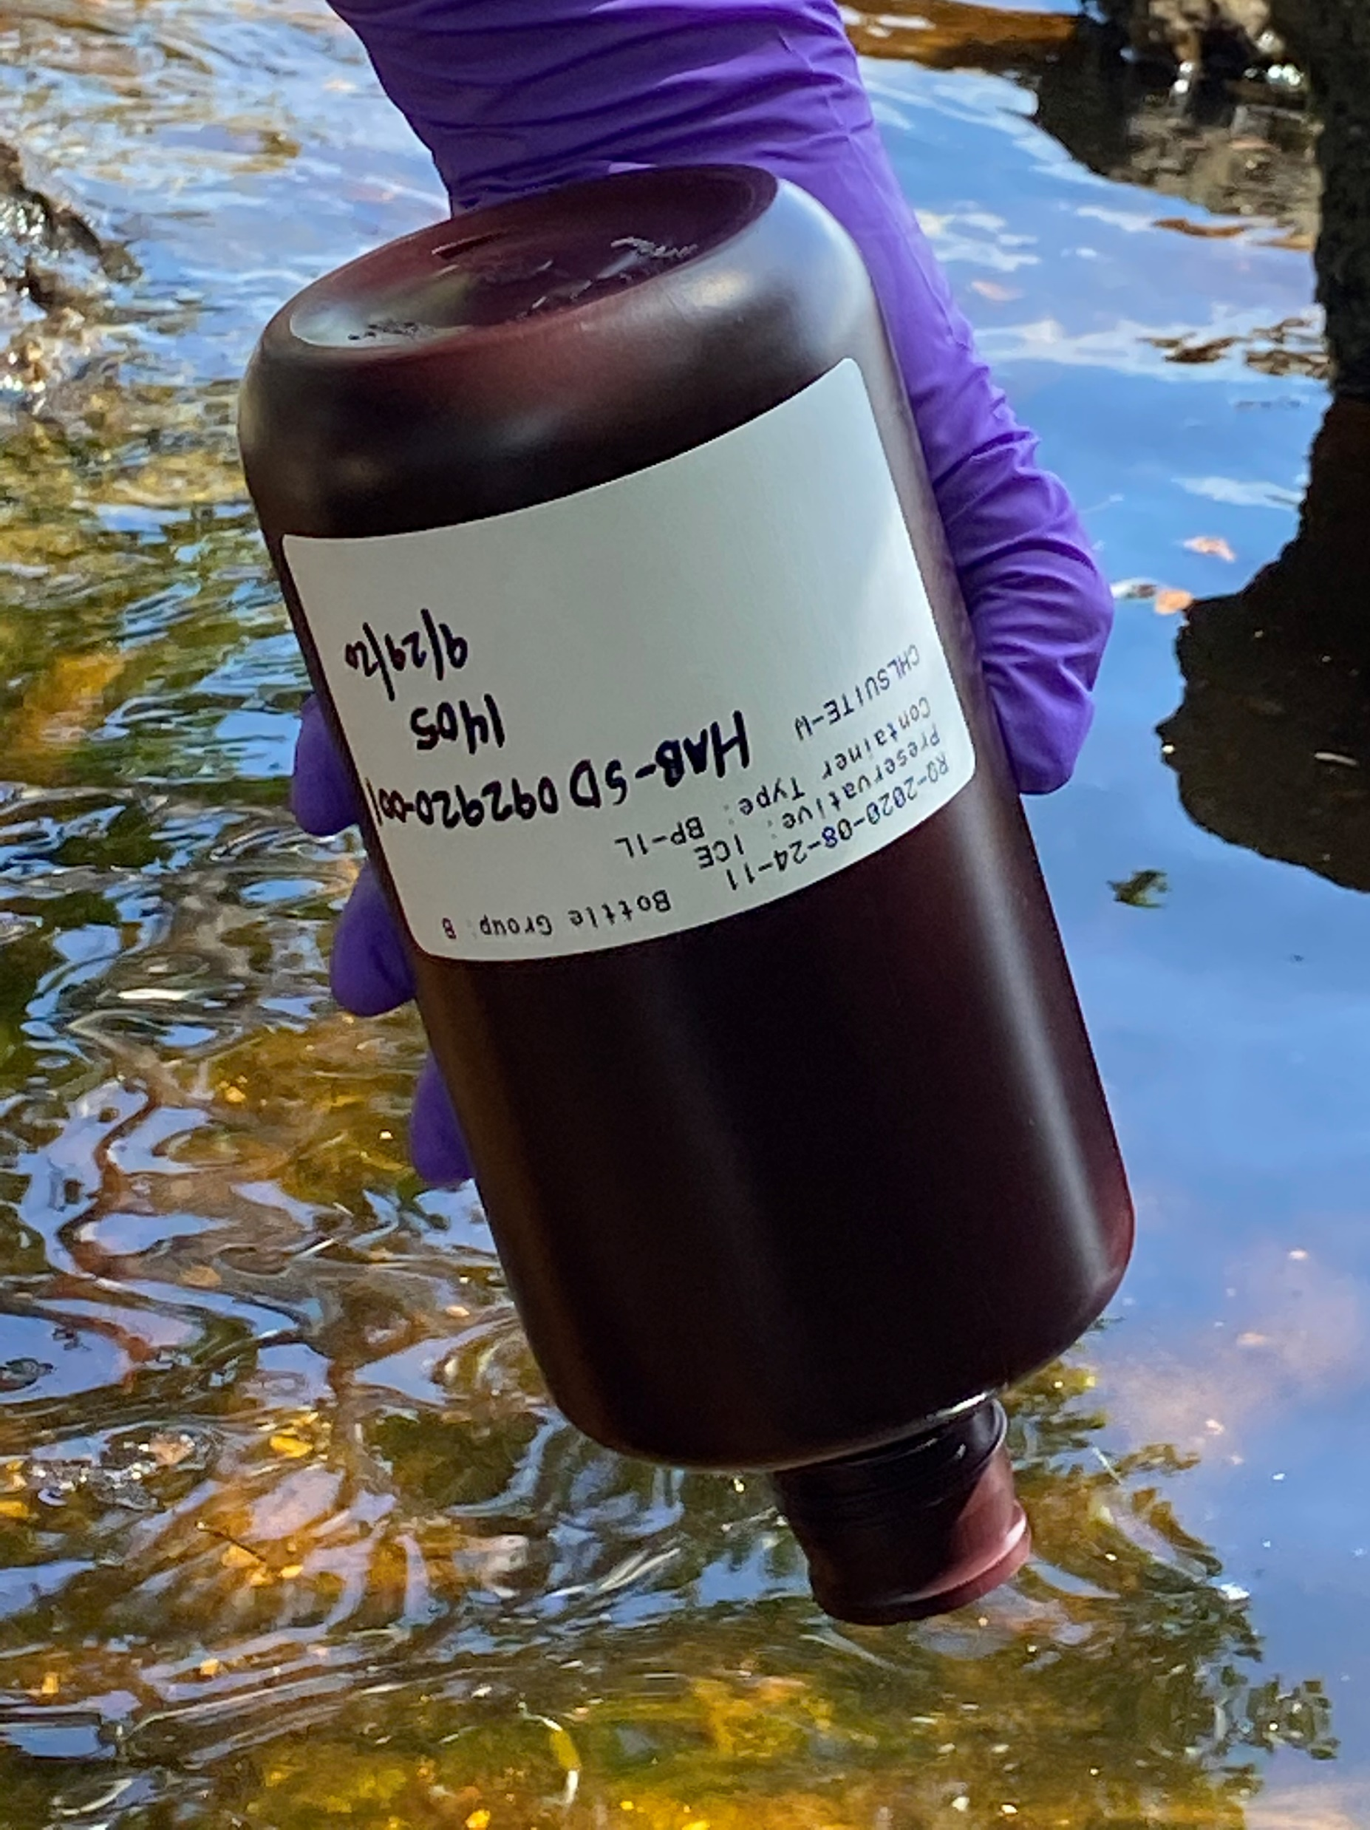
GENERAL COLLECTION PROCEDURES
Note: The more detailed guidance presented by David Whiting should be followed. The guidance below is a general summary of our sampling protocols.
Choose a representative sample location and method
Label each bottle with sampler initials, Field ID, time, and date (Time should match sample time on field sheet)
Prevent interior bottle contamination and wear powder-free gloves
Fill bottle in a single grab when possible and fill to shoulder of bottle
Submerge bottle upside-down to prevent surface scum from entering bottle
Preserve samples within 15 minutes of collection (Lugols applied by lab)
DEP SOP FS 7000 covers biological sampling; subsection FS 7110 applies to algae blooms
FDEP Water Sampling Standard Operating Procedures
https://floridadep.gov/dear/quality-assurance/content/dep-sops

Slide 13
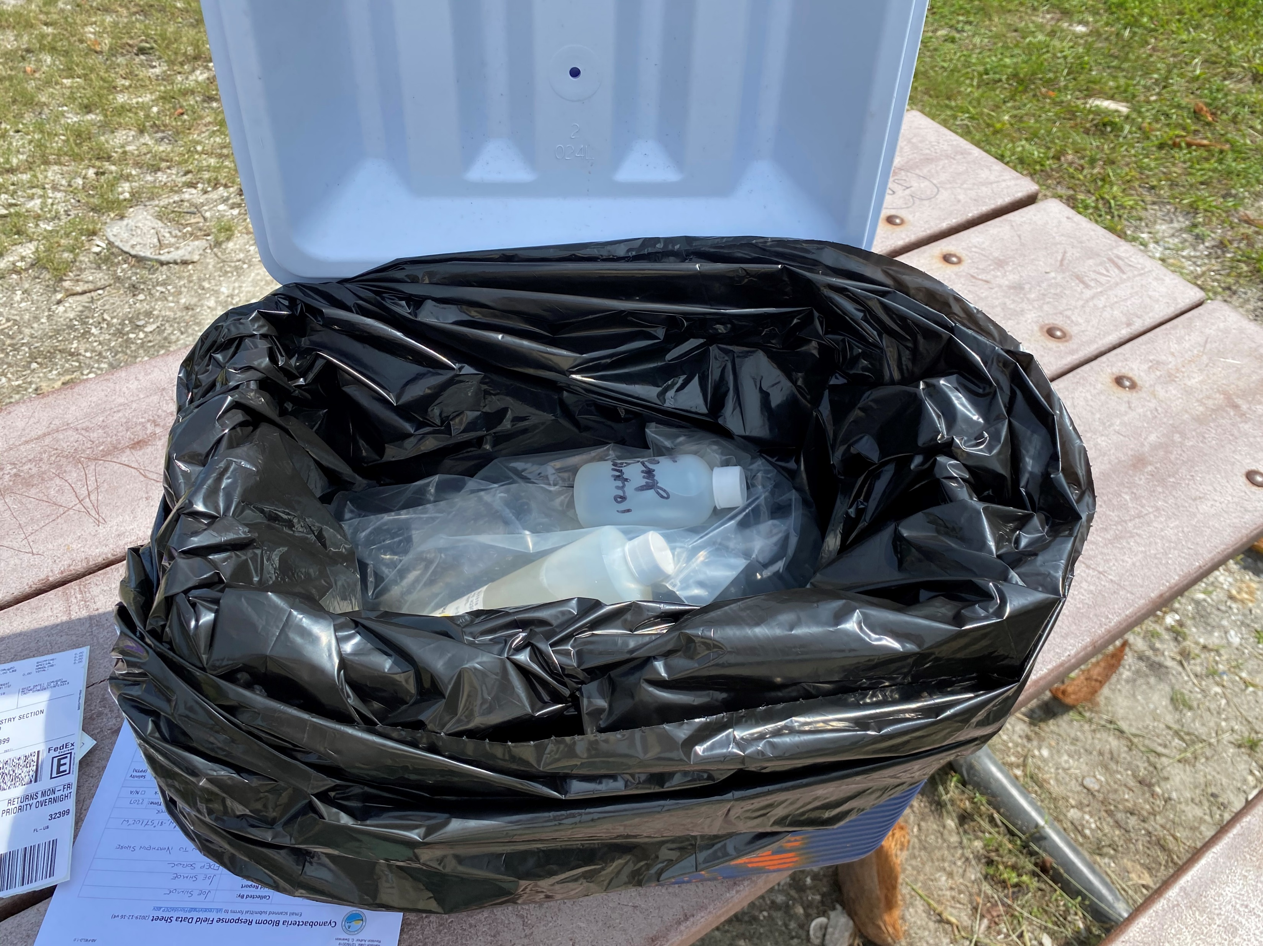
PREPARING COOLER FOR SHIPMENT
Line cooler with black trash bag
Place Temperature Control Bottle (TCB) and samples in trash bag
Fill cooler completely and surround samples and TCB with wet ice
Tie trash bag closed or use zip tie
Take photo or scan fieldsheet
Place completed fieldsheets inside sealed ziplock bag and tape to underside of lid
Wrap cooler shut with packing tape
Fix shipping label to cooler
Send email to FDEP with field sheets, photos, location name, date, time, and GPS coordinates
  If your agency updates the algae dashboard directly via Survey123, email David Whiting, Cheryl Swanson, your local ROC team lead, and Kalina Warren or Mike King stating that samples have been collected and shipped.
FDEP Water Sampling Standard Operating Procedures
https://floridadep.gov/dear/quality-assurance/content/dep-sops

Slide 14
Thank You
Questions?

