Slide 1
Linear Vegetation Survey (LVS) Procedure
2018
Aquatic Ecology and Quality Assurance

Slide 2
Linear Vegetation Survey (LVS)
The Stream and River Linear Vegetation Survey (LVS) is a rapid tool to document the plant community in a 100m stream reach.
DEP SOP FS 7320
Conduct LVS in conjunction with Stream and River Habitat Assessment (SOP FT 3100) and Rapid Periphyton Survey (RPS; SOP FS 7230)

Slide 3
LVS Method Overview
Establish 100m reach of stream
Place flags every 10 m to create 10 sections
100
90
80
70
60
50
40
30
20
10
0
Upstream
10
9
8
7
6
5
4
3
2
1
Downstream
100m

Slide 4
LVS Method Overview
For each section, record:
  Plant taxa presence. Include submersed, floating, emergent plants within the wetted area of stream.
  Note dominant or co-dominant taxa if any single taxon is present with ≥ 1 m² coverage (can be in patches).
  Estimate total area of plant coverage (see back of field sheet).
  Collect unknown taxa for ID in lab or by expert.

Slide 5
LVS Datasheet – FD 9000-32

Slide 6
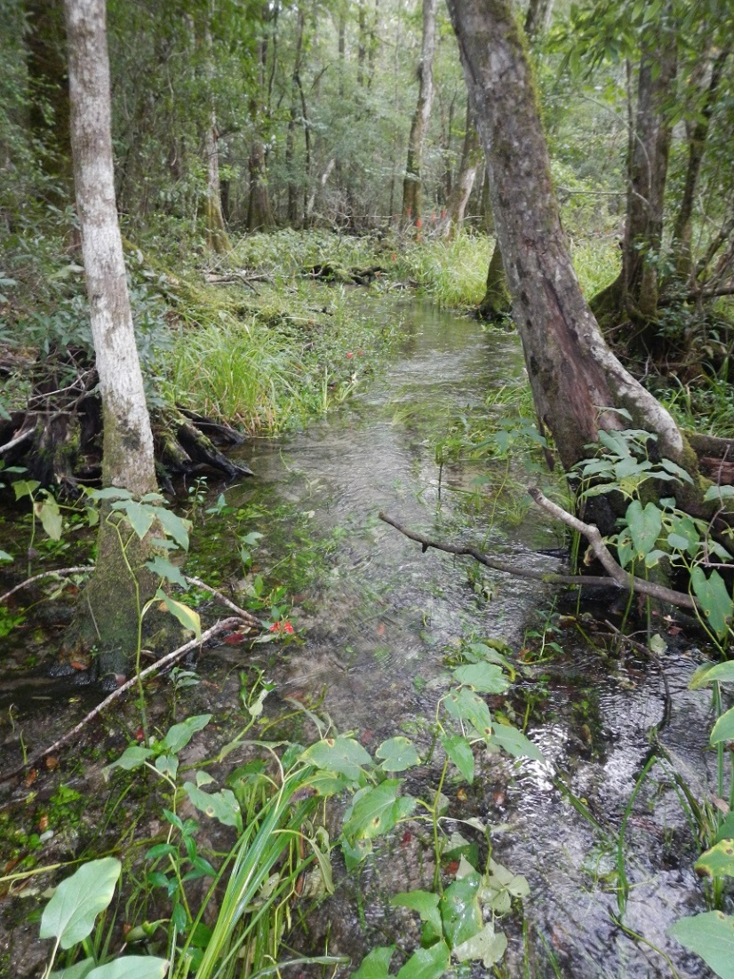
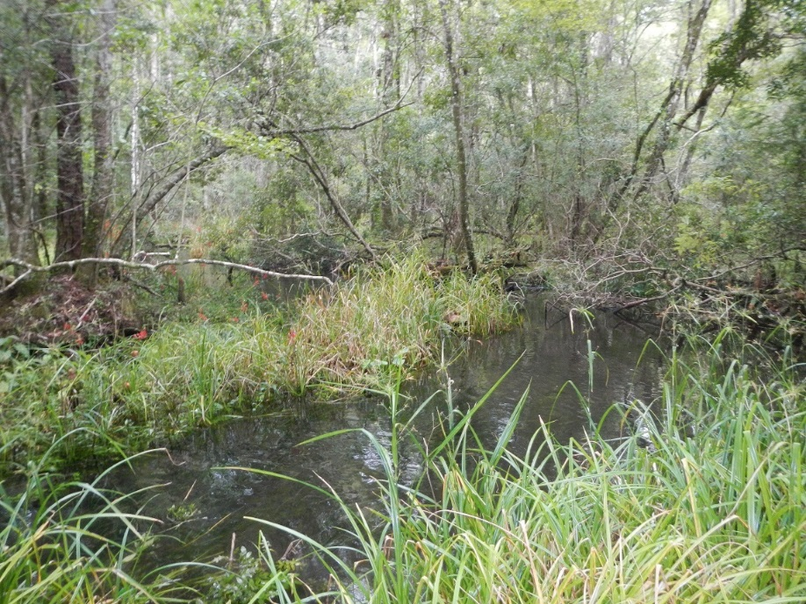
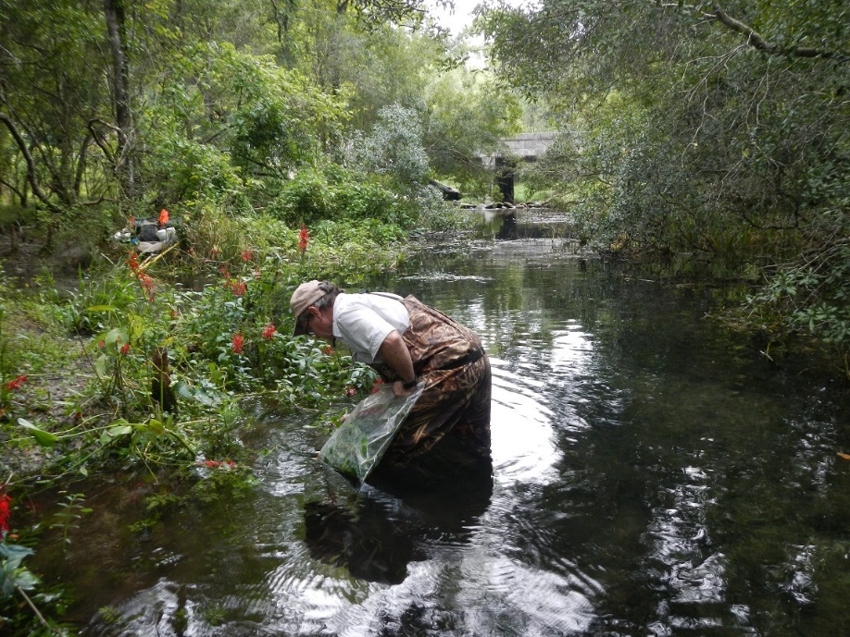
Small spring run
All submersed and emergents in the wetted area of the stream included in LVS

Slide 7
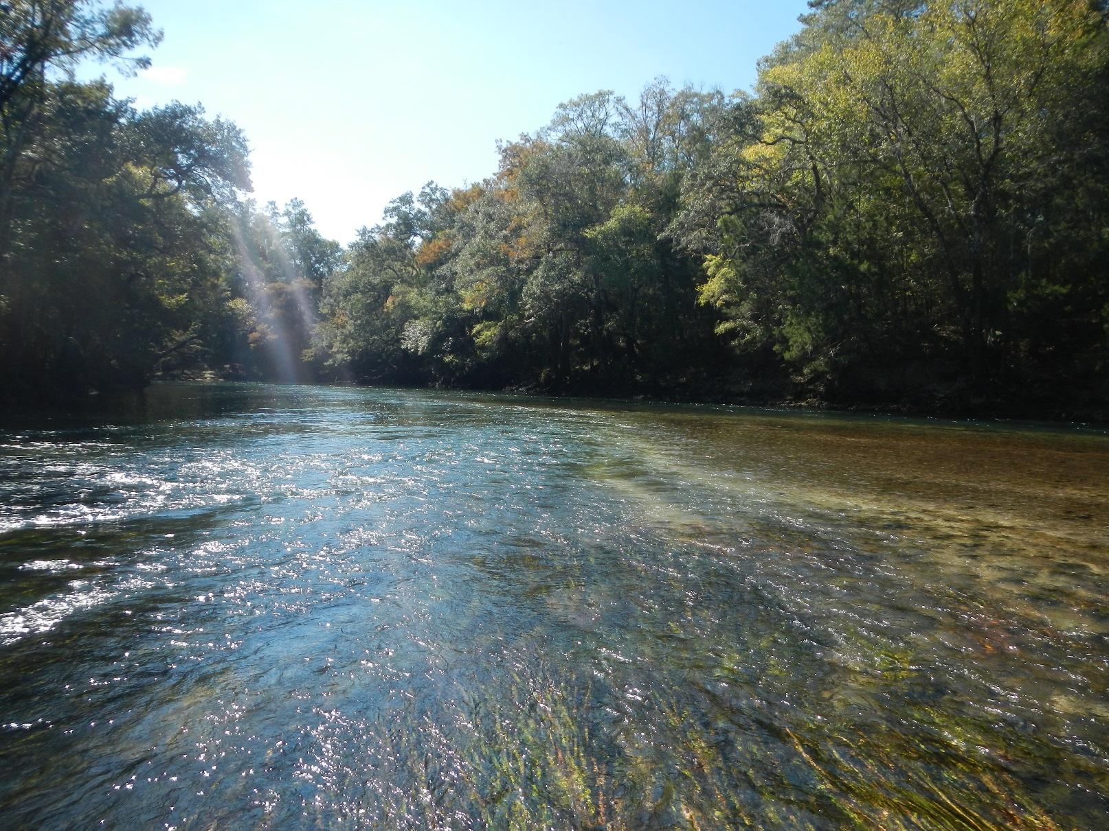
Large river with considerable spring input
All of the Vallisneria (eelgrass) would be included in the LVS
Notes:
Mixed delivery river with a lot of springs and a lot of vegetation—Chipola River.

Slide 8
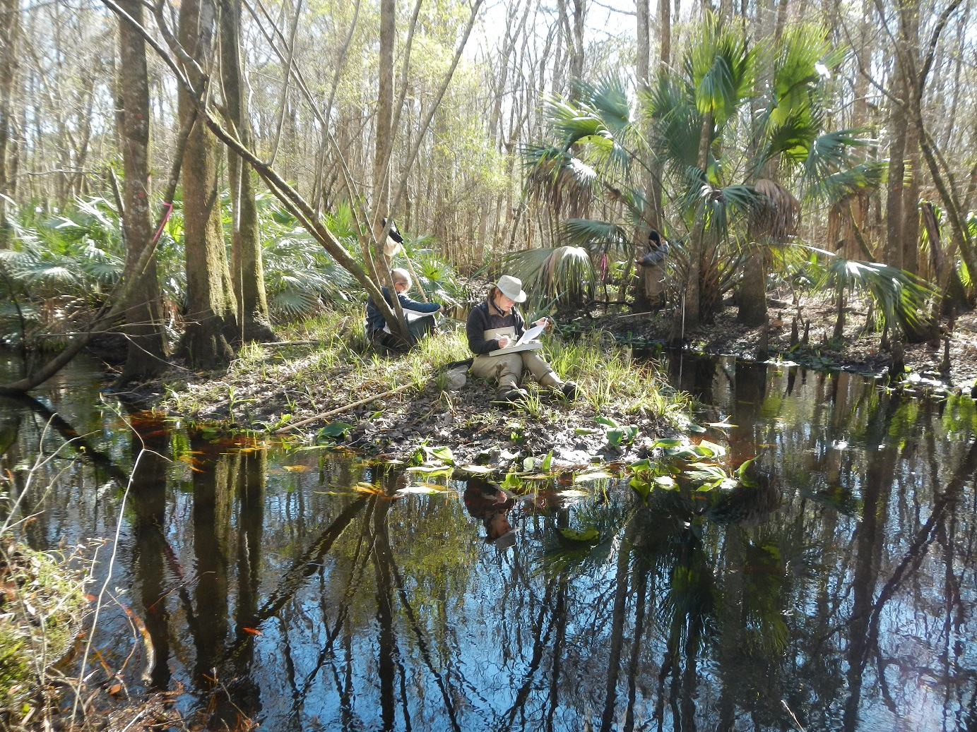
Small dark water stream in NE Florida
Include the floater Nuphar pictured)

Slide 9
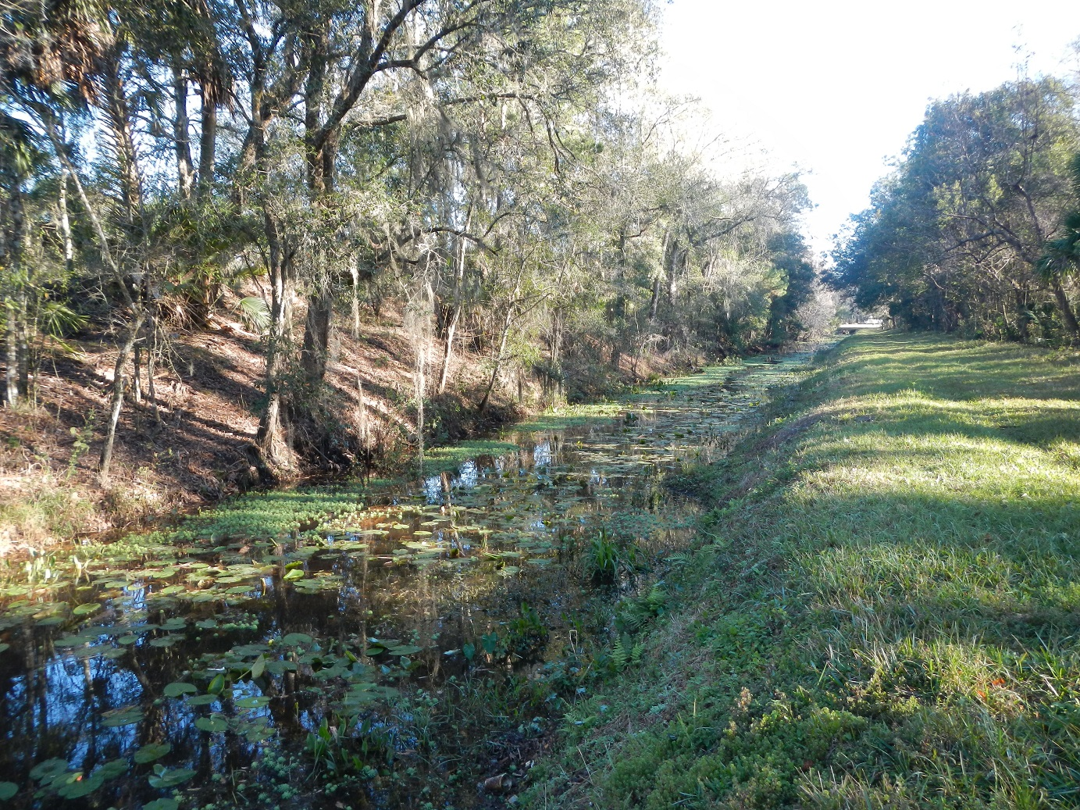
Canal that receives wastewater discharge
All aquatic macrophytes included in LVS

Slide 10
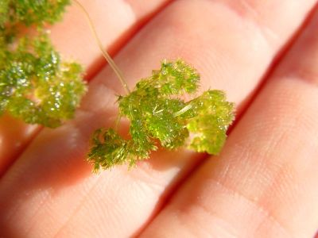
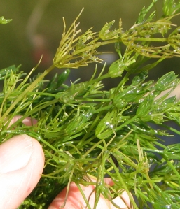
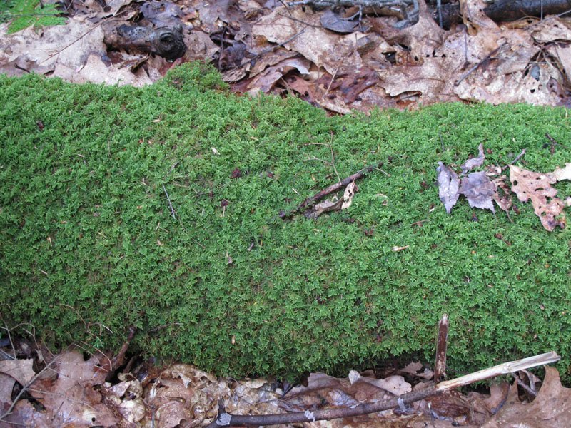
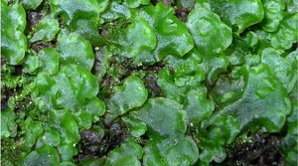
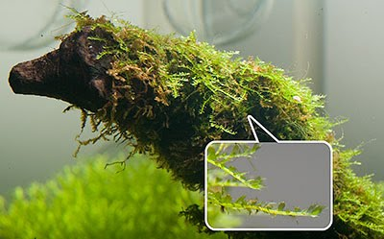
Include Macroalgae in LVS
Macroalgae:
Nitella
Chara
Include mosses if they are structurally similar to macrophytes (2017 SOP change). Note mosses and liverworts.
Liverworts
Sphagnum moss
Fontinalis

Slide 11
Use of LVS for Numeric Nutrient Criteria
When used to determine floral health associated with Ch. 62-302.531, F.A.C.:
  Perform the method only when the total area of macrophytes = or > 2m² within the wetted area of the 100 m sampling reach.
  Do not include trees or shrubs
  Calculate the mean Coefficient of Conservatism (C of C) and % FLEPPC taxa occurrences

Slide 12
Coefficient of Conservatism (C of C)
Score of 0-10 assigned to a plant species based on its ecological tolerances/fidelity to pre-settlement condition
Subjective assignment of scores by regional botanists with many years of experience with plants in their habitats
Establishment of scores creates an objective, repeatable tool to assess the floristic condition; works to compare sites or monitor over time

Slide 13
Use for Numeric Nutrient Criteria
Mean Coefficient of Conservatism (C of C)
  Mean C of C for LVS is weighted by taxon occurrence
  Presence of a taxon in a 10m segment is one occurrence; max. # of occurrences for a taxon within the 100m reach is ten
  For each taxon, multiply the C of C score by the number of occurrences
  Calculate the Mean C of C as the sum of these products divided by the total number of taxa occurrences in the 100 m reach.
  C of C scores found in Table LT 7600

Slide 14
Use for Numeric Nutrient Criteria
FLEPPC Exotics
  FLEPPC is the Florida Exotic Pest Plant Council
  Track and manage invasive exotic plants
  Keep lists of invasives that are displacing native species, and changing community structure and ecological function
  Categories 1 and 2 reflect the extent of the ecological damage caused

Slide 15
Use for Numeric Nutrient Criteria
Percent FLEPPC exotics
  Calculate the percent invasive exotics as the number of occurrences of FLEPPC Category 1 or 2 in the 100 m reach divided by the total number of taxa occurrences in the 100 m reach.
  Calculations detailed in the SOP
  LT 7600 table contains nativity status; FLEPPC website has Cat 1 and 2 lists: http://www.fleppc.org/list/11list.html

Slide 16
Guidance for Level of ID
Species Level ID needed in most cases
LVI Primer contains guidance on which genera really need to be identified/ verified in the lab
Genus level C of C scores
  Hydrocotyle
  Lemna
  Nuphar
  Peltandra
  Typha

Slide 17
Resources
Use in support of numeric nutrient criteria implementation described in “Implementation of Florida’s Numeric Nutrient Standard.”
http://dep.state.fl.us/water/wqssp/nutrients/docs/NNC_Implementation.pdf
SOP is available on DEP website here: http://www.dep.state.fl.us/water/sas/sop/sops.htm
Field form (FD 9000-32) is available on DEP website here:
http://www.dep.state.fl.us/water/sas/qa/forms.htm

