Slide 1
Sampling and Application of the Stream Condition Index
Aquatic Ecology and Quality Assurance
2018

Slide 2
SCI and Accompanying Protocols
Stream Condition Index
  Collection of organisms to be identified in the lab, metrics calculated from taxa list
Habitat Assessment
  Information critical to explaining SCI failures
Companion biological assessments
  Rapid Periphyton Survey
  Linear Vegetation Survey

Slide 3
Course Overview
Provide conceptual information on the SCI and its development
Define expectations for samplers
  Site selection
  Habitats
  Water level issues
  Sampling techniques
Provide hands-on training
  Sweep and sort in field
  Habitat assessment

Slide 4
History of Bioassessment in Florida
Beck’s Biotic Index, 1950s
Shannon-Weaver diversity, 1970s
  Biological integrity (Rule 62-302.500 FAC)
EPA Rapid Bioassessment using multi-metric index (Jim Karr approach), 1992
  Original Stream Condition Index, 1996
    Reference vs. test
  Current Revised SCI, 2007
    Human Disturbance Gradient
    Biological Condition Gradient

Slide 5
Typical Macroinvertebrate Response to Organic Loading Associated with Primary Wastewater Treatment, Typical in the 1950s and 1960s.
100
Point Source Discharge
20
Beck’s Biotic Index
(# Pollution Sensitive Taxa)
Percent Pollution
Tolerant Chironomids
50
10
0
0
Upstream
Downstream

Slide 6
Hester-Dendy samplers used for determining the Shannon-Weaver diversity index.

Slide 7
Bioassessment Theory
Biota respond to a wide variety of cumulative factors, both natural and anthropogenic.
As the organisms integrate factors over time, a characteristic community structure emerges.
When human actions adversely affect a system, the biological population will change, leading to an impaired or imbalanced community.

Slide 8
Human Stressors &Natural Factors Shape Biota
Introduction of exotics,
Harvesting game species
Hydrology/flow
Hydrological modifications
2°
Consumptive use
Desiccation
Consumers:
Impounding
Fish, wildlife, humans
Ditching/draining
Habitat structure
Physical factors
1° Consumers:
Habitat disruption:
Benthic invertebrates, zooplankton,
Human factors
Physical destruction
Sediment/substrate
Biota
some fish
Siltation/Sedimentation
Light penetration
Degradation of water quality:
Toxic substances
Temperature
Producers: Algae, macrophytes, terrestrial
Organic enrichment
plant leaf litter, bacteria/detritus
Nutrient enrichment
Water quality factors
Conductivity/Salinity
pH
Major ions
Dissolved Oxygen
Organic carbon
Nutrients

Slide 9
Adverse Human Factors
Hydrologic modifications
  Consumptive use, impounding, ditching/draining
Habitat disturbance
  Physical removal, sedimentation
Degradation of water quality
  Toxic substances, nutrient and organic enrichment
Introduction of invasive exotic taxa
  Displaces natives
Harvesting biomass
  Disturbing predator-prey relationships

Slide 10
Interpreting Bioassessment Results
Measures of ecosystem health that respond predictably to human influence = metrics.
Comparing reference to "test" sites allows determination of unacceptable departures from the expected condition.
The systems being compared should be similar except for potential human influences.
Natural stressors (e.g., flood vs. drought) should be understood, and controlled for in the sampling design, to determine when human actions cause biological degradation.

Slide 11
Using the Human Disturbance Gradient to
Develop SCI Metrics
Objectively quantify relative level of human influence based on four factors:
Landscape disturbance
  Landscape Development Intensity Index
Habitat alteration
  Habitat assessment data
Hydrologic modification
  Hydrologic scoring process
Chemical Pollution
  Ammonia, etc.

Slide 12
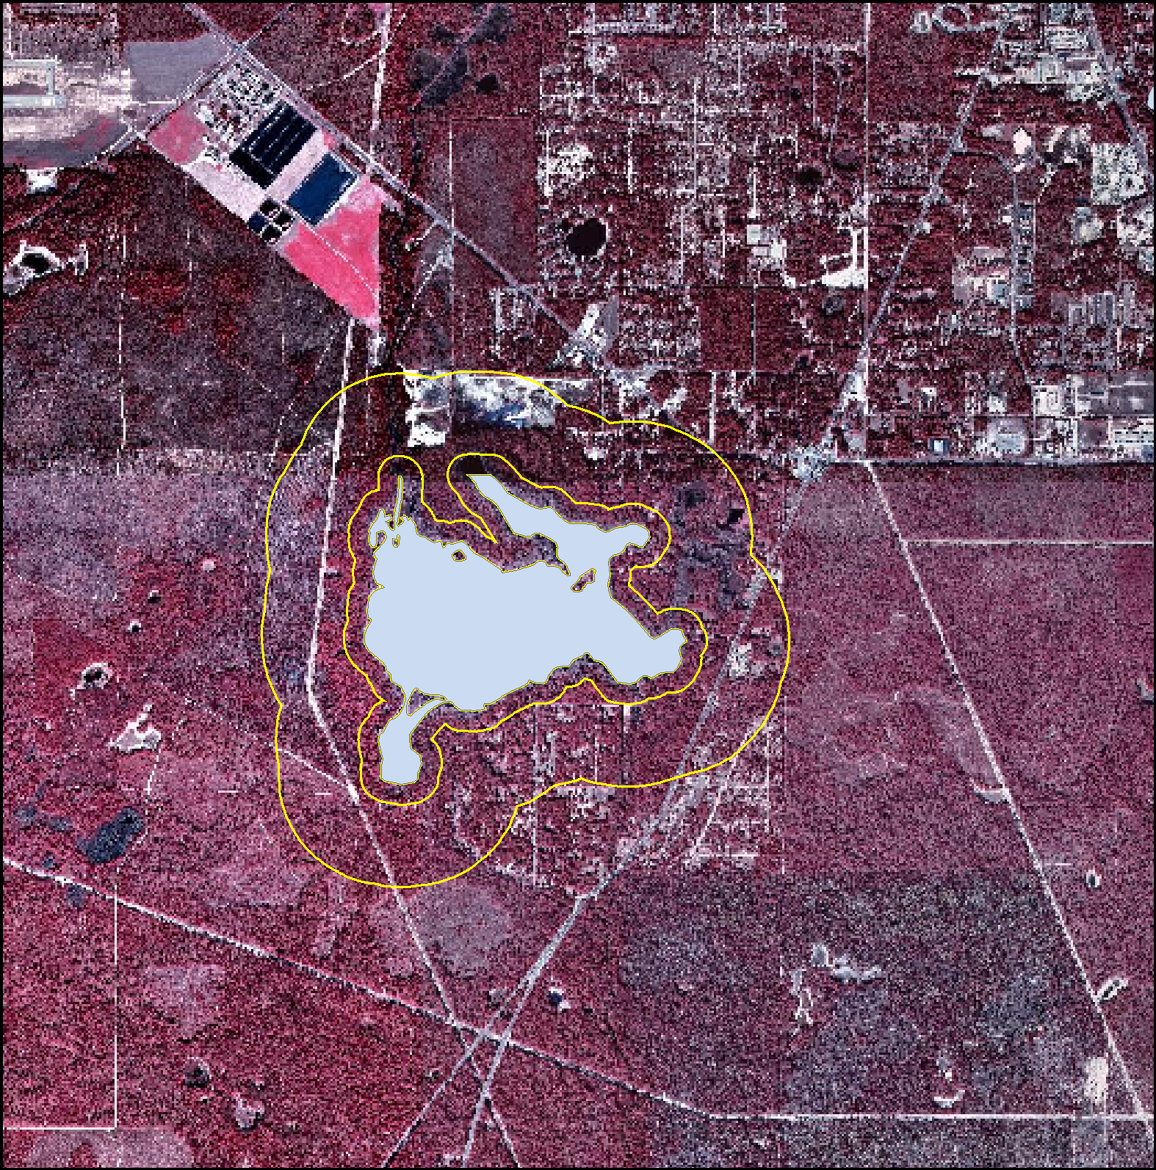
Landscape Development Intensity Index (Brown and Vivas 2004, UF Center for Wetlands)
Specific landuse near a waterbody receives a score from good (1) to bad (10). Based on non-renewable human energy inputs.

Slide 13
Summary of the Landscape Development Intensity Coefficients
Category Coefficient
Natural System 1
Pine Plantation 1.6
Pasture 3.4
Row Crops 4.5
Residential (low) 6.8
Residential (high) 7.6
Commercial 8.0
Industrial 8.3
Commercial (high) 9.2
Business District 10.0
  Based on non-renewable Energy inputs, Odom’s “Embodied Energy” concept.
Notes:
Pass out complete table of coefficients.
Ranking of land use comes from the literature reviews primarily Harper (1994) and Beaulac and Reckhow (1982)

Slide 14
Habitat Assessment Components
Substrate Types
Substrate Availability
Water Velocity
Artificial Channelization
Habitat Smothering
Bank Stability
Riparian Zone Buffer Width
Riparian Zone Vegetation Quality
Optimal
Poor
20 points
1 point

Slide 15
HDG as the x- axis
These components were converted into a dimensionless index, with low values denoting low disturbance, and increasing values associated with more intense human influences.
The index was subsequently used as the x-axis for testing a wide variety of biological attributes associated with the measurement of ecological integrity

Slide 16
Major Attribute Categories for Determining Biological Integrity
INDIVIDUAL
CONDITION
TAXONOMIC
COMPOSITION
COMMUNITY
STRUCTURE
LIFE HISTORY
ATTRIBUTES
SYSTEM
PROCESSES
DISEASE
ANOMALIES
CONTAMINANT
LEVELS
DEATH
METABOLIC
RATE
TROPHIC
DYNAMICS
PRODUCTIVITY
MATERIAL:
CYCLES
PREDATION
RECRUITMENT
IDENTITY
TOLERANCE
RARE OR ENDANGERED KEY TAXA
TAXA
RICHNESS
RELATIVE
ABUNDANCE
DOMINANCE
FEEDING
GROUPS
HABIT
VOLTINISM
INTEGRATED
BIOASSESSMENT
TOXICITY TESTS
INVERTEBRATE SCI

Slide 17
Metric Selection
The 10 selected metrics were chosen to:
Represent as many attribute categories as possible
Provide meaningful and predictable assessment of human effects
Avoid redundancy if several correlated metrics were providing similar information.

Slide 18
0.90
tolerance
habit
tolerance
0.80
richness
0.70
richness
structure
0.60
composition
feeding
voltinism
0.50
0.40
Absolute Spearmans r
0.30
0.20
0.10
0.00
EPT taxa
Eph taxa
Clinger %
Eph %
Trichop %
Clinger taxa
Trichop taxa
Total Taxa
Dominant %
Diptera taxa
Long lived %
Sensitive taxa
Florida Index
All Tolerant %
Tanytarsini %
Tanytarsini %
Very Tolerant %
Very tolerant taxa
Filter-feeder %
Tanytarsini taxa
Filter-feeder no Chuemat.
Correlation between various metrics and the Human Disturbance Gradient. Arrows indicated metrics selected for the SCI, and associated attribute group.

Slide 19
Taxa Richness Metrics
Total taxa richness (the number of different types of organisms present).
Trichoptera richness (caddisflies).
Ephemeroptera richness (mayflies).
These three measures have historically been shown to decrease with human disturbance.
Three richness metrics were chosen since each one may respond differently, depending on the type of disturbance.
Mayflies are more sensitive to metals, certain caddisflies may be more sensitive to flow disruption.

Slide 20
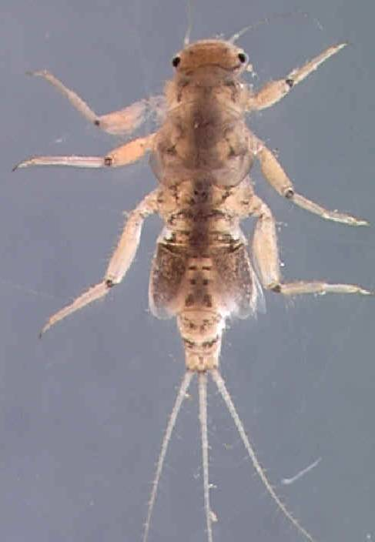
Human disturbance gradient
Ephemeroptera Metric. The photo is of Tricorythodes, a sensitive mayfly.

Slide 21
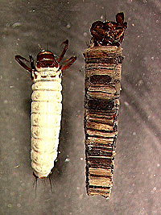
Trichoptera Taxa. The photo is of a caddisfly, Brachycentrus.

Slide 22
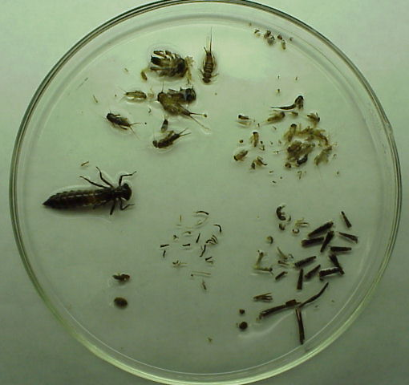
Taxa Richness

Slide 23
Feeding Groups Metric
Disruption of food webs has long been associated with human influence, especially organic pollution.
The relative abundance of filterers (percentage filterer individuals) had the highest correlation and most consistent relationship with the HDG.
Filter feeders extract nutrients by straining food particles from the water column. If the water flow or quality of the organic matter in the water is compromised, a reduction in filter feeders will occur.

Slide 24
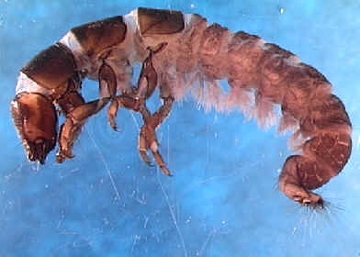
Human disturbance gradient
% Filter-feeders Metric. The photo is of a net-spinning caddisfly.

Slide 25
Voltinism Metric
Voltinism refers to the number of distinct reproductive cycles for a given organism per unit of time.
Long-lived taxa require greater than one year to complete their life cycles.
Long-lived taxa richness would be expected to decrease if a disturbance event (e.g., sporadic illegal dumping, etc.) occurred at a site within a year of sample collection.

Slide 26
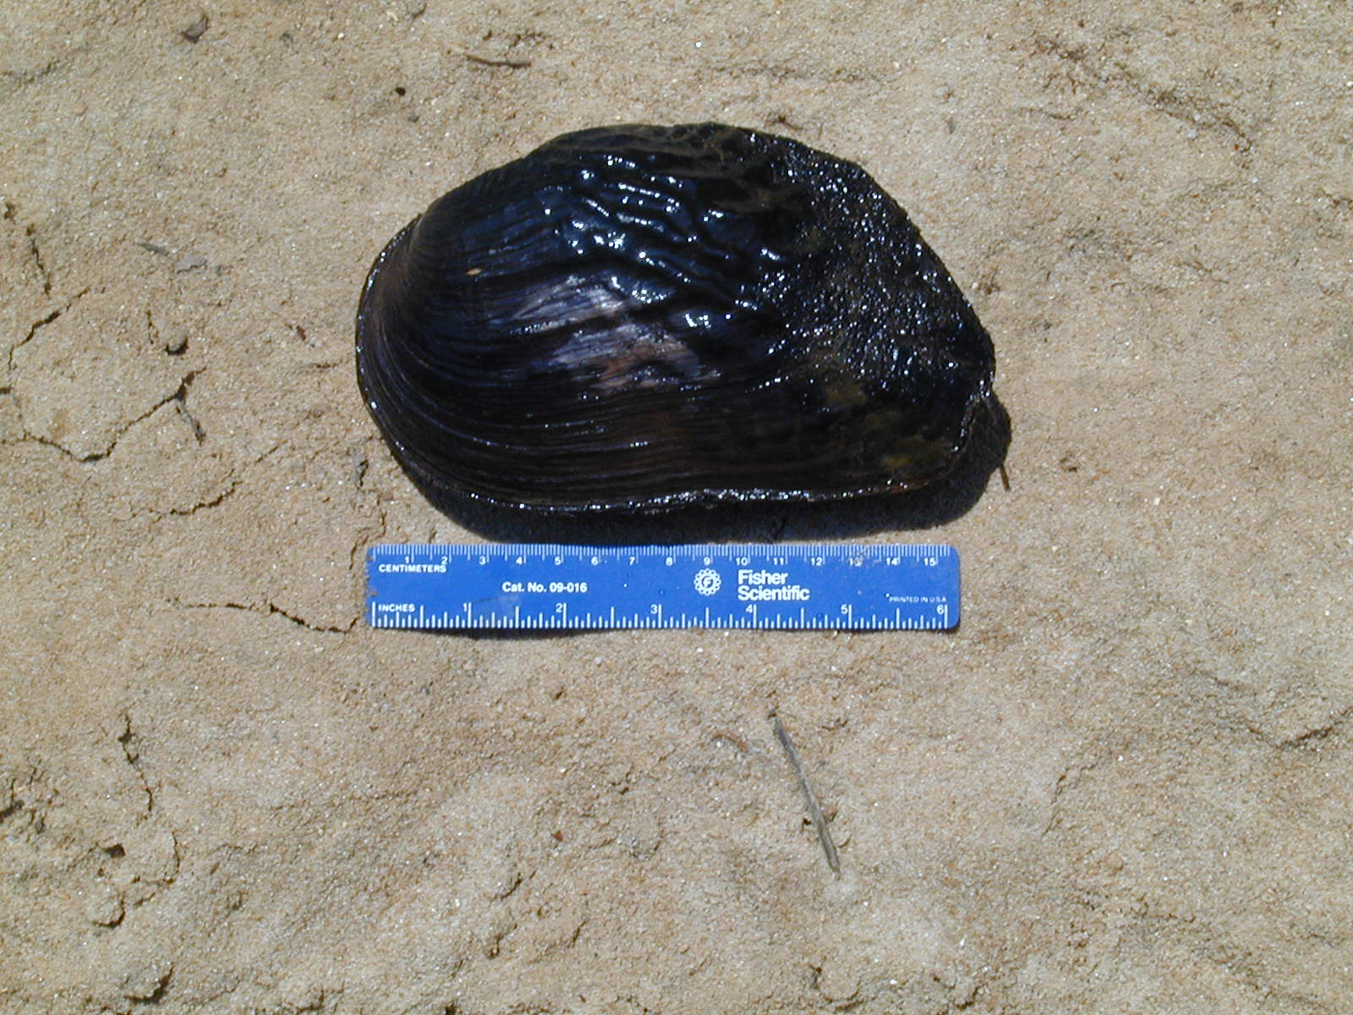
Human disturbance gradient
Long-lived Taxa Metric. The photo is of a mollusk, the threatened “purple bank climber”.

Slide 27
Organism Habit Metric
Clingers are those taxa morphologically adapted to hold onto substrates during routine flow conditions, and would be expected to decline as humans alter a stream’s hydrograph, especially during abrasive events caused by high stormwater inputs from impervious surfaces.

Slide 28
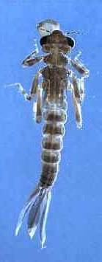
Clinger Taxa Metric. The photo is of a damselfly larvae.

Slide 29
Community Structure Metrics
Substantial shifts in proportions of major groups of organisms, compared to reference conditions, indicate degradation.
The percent dominant taxon, which increases in conditions where a few pollution tolerant organisms are very abundant, to the exclusion of other taxa, was selected as a metric.
Tanytarsini midges are sensitive to disturbance, including toxic metals. % Tanytarsini metric was included in the SCI as the best available measure of the chironomid assemblage.

Slide 30
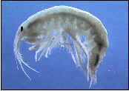
% Dominance Metric. Photo is Hyalla azteca, a tolerant amphipod.
Human disturbance gradient

Slide 31
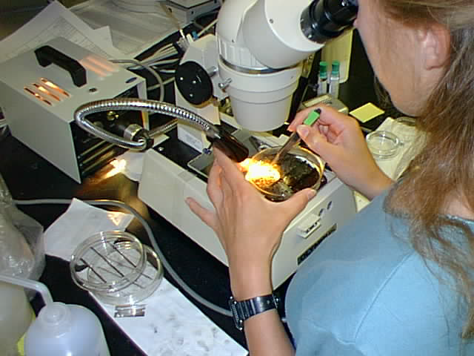
% Tanytarsini (Sensitive midges)

Slide 32
Tolerance Metrics
A list of sensitive and very tolerant invertebrates were established by analyzing the responses of 1,200 individual species to the HDG.
The number of taxa selected as sensitive equaled around 12% of the taxa tested, and the number of very tolerant taxa was approximately 10% of the taxa tested.
Many sensitive taxa belonged to the Ephemeroptera, Trichoptera or Odonata; several chironomids were also included. All the Plecoptera were included as sensitive taxa.
The number of sensitive taxa and the percent very tolerant taxa were highly correlated with the HDG

Slide 33
Sensitive Mayfly (Maccaffertium) vs. HDG
Increasing disturbance →

Slide 34
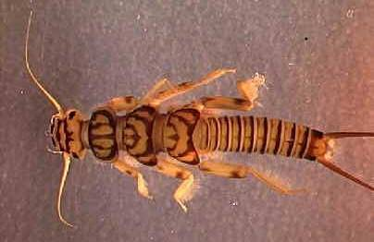
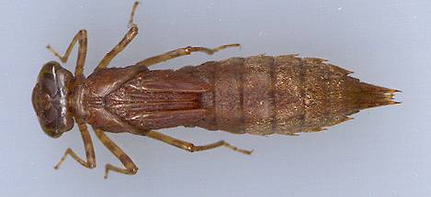
Human disturbance gradient
Sensitive Taxa Metric. The photos include a plecopteran (stonefly) and odonate (dragonfly).

Slide 35
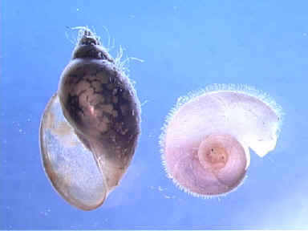
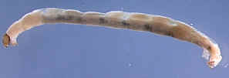
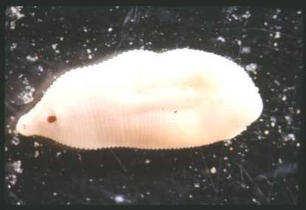
% Very Tolerant Metric. Photos include lunged snails, tolerant midges, and leeches.

Slide 36
Linking the Human Disturbance Gradient to SCI Thresholds
These zero HDG sites were selected by DEP District biologists to represent the very healthiest streams in Florida, experiencing minimal human disturbance. The majority are “healthy”, about 40% are “exceptional”.
“Exceptional”
67
“Healthy”
40
34
“Impaired”

Slide 37
Establishing SCI Thresholds for Impairment
Biological Condition Gradient Approach
Reference Site Approach

Slide 38
The Biological Condition Gradient Concept
Natural structure & function of biotic community maintained
1
2
Minimal changes in structure & function
Evident changes in structure and minimal changes in function
3
Moderate changes in structure & minimal changes in function
4
Biological Condition
Major changes in structure & moderate changes in function
5
6
Severe changes in structure & function
Increasing Effect of Human Activity
Notes:
This figure is a generalized representation of the BCG. In your handout you have the detailed and complete BCG and the HDG. These are the two components of the model that describe the biological response (BCG) to increasing effects of human activity (HDG)..
The gradient of biological responses spans a range of condition - from natural, undisturbed conditions to severely y degraded. There are 6 tiers, or increments of biological change, along the gradient.
Key Points:
1. It is intended to be uses as the starting point for States and Tribes to think about how to more accurately describe the condition of a waterbody and to establish appropriate goals; the 6 tiers represent incremental, measurable changes along this gradient; it is up to the States and Tribes to determine number of tiers and where thresholds established.
2. The model is applicable to different places (geography); different methods; across political boundaries (incorporate into existing State and Tribal programs).

Slide 39
The Biological Condition Gradient: Biological Response to Increasing Levels of Stress
Levels of Biological Condition
Natural structural, functional, and taxonomic integrity is preserved.
Biological Condition
1
Structure & function similar to natural community with some additional taxa & biomass; ecosystem level functions are fully maintained.
2
Evident changes in structure due to loss of some rare native taxa; shifts in relative abundance; ecosystem level functions fully maintained.
3
4
Moderate changes in structure due to replacement of sensitive ubiquitous taxa by more tolerant taxa; ecosystem functions largely maintained.
5
Sensitive taxa markedly diminished; conspicuously unbalanced distribution
of major taxonomic groups; ecosystem function shows reduced complexity & redundancy.
6
Level of Exposure to Stressors
Extreme changes in structure and ecosystem function; wholesale changes
in taxonomic composition; extreme alterations from normal densities.
  Watershed, habitat, flow regime and water chemistry as naturally occurs.
Chemistry, habitat, and/or flow regime severely altered from natural conditions.

Slide 40
10 BCG Attributes Extracted from Site Community Information
Historically documented, sensitive, long-lived or regionally endemic taxa
Sensitive and rare taxa
Sensitive but ubiquitous taxa
Taxa of intermediate tolerance
Tolerant taxa
Non-native taxa
Organism condition
Ecosystem functions
Spatial and temporal extent of detrimental effects
Ecosystem connectance

Slide 41
BCG Ranking Criteria
Natural or native condition
Minimal changes in structure of the biotic community and minimal changes in ecosystem function
Evident changes in structure of the biotic community and minimal changes in ecosystem function
Moderate changes in structure of the biotic community with minimal changes in ecosystem function
Major changes in structure of the biotic community and moderate changes in ecosystem function
Severe changes in structure of the biotic community and major loss of ecosystem function

Slide 42
BCG
Experts
Expert name |  | Affiliation | Years
Jerrell | Daigle | DSA, Inc. | >20
Dana | Denson | FDEP Central District | 10-15
Doug | Durbin | Biological Research Associates | >20
John | Epler | John Epler Consulting | >20
Julie | Espy | FDEP Tallahassee | 5-10
David | Evans | Water and Air Research | >20
Michael | Heyn | FDEP Tallahassee | >20
Joy | Jackson | FDEP Tallahassee | 10-15
Deron | Lawrence | Biological Research Associates | 10-15
Laura | Line | Water and Air Research | 10-15
Rob | Mattson | St. Johns River Water Management District | >20
Peggy | Morgan | FDEP Southwest District | >20
Patrick | O'Connor | FDEP Northeast District | >20
Manuel | Pescador | Florida Agricultural and Mechanical University | >20
Marianne | Pluchino | Reedy Creek Improvement District | >20
Eric | Pluchino | FDEP Orlando District | >20
Donald | Ray | FDEP Northwest District | >20
Johnny | Richardson | Leon County | 10-15
Gitta | Schmitt | FDEP Southwest District | 5-10
Mary | Szafraniec | Southwest Florida Water Management District | 5-10
Albert | Walton | FDEP South District | >20
Gary | Warren | Florida Fish and Wildlife Commission | >20

Slide 43
Proportional Odds Model
Assignment of BCG Category vs. SCI Score

Slide 44
BCG Workshop (October 24, 2006)
Experts independently ranked 30 data sets.
Consistency discussions occurred (Delphi Technique).
Provided expert opinion on where “impairment” line (not meeting interim goal of CWA) existed in rankings.
Later, expert rankings were used to modify the SCI thresholds
  Regression
  Change Point Analysis

Slide 45
Linear Regression Model

Slide 46
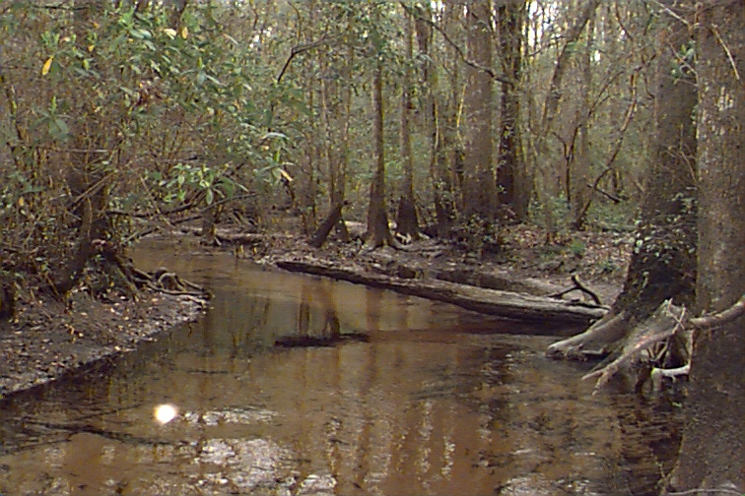
A Tier 1-2 Community
“Minimally disturbed”
1 inch
Notes:
This is an example of what a field biologist will be measuring – who is there, how many and what proportion of the community.
Example of first site – the undisturbed or minimally disturbed site. This represents a tier 1 community.
Blue: Most Sensitive/intolerant organisms
Green: Sensitive, can tolerant some degree of stress
Red: Tolerant

Slide 47
A Tier 1-2 Community
“Minimally disturbed”
Stoneflies
Mayflies
Caddisflies
1 inch
Notes:
This is an example of what a field biologist will be measuring – who is there, how many and what proportion of the community.
Example of first site – the undisturbed or minimally disturbed site. This represents a tier 1 community.
Blue: Most Sensitive/intolerant organisms
Green: Sensitive, can tolerant some degree of stress
Red: Tolerant

Slide 48
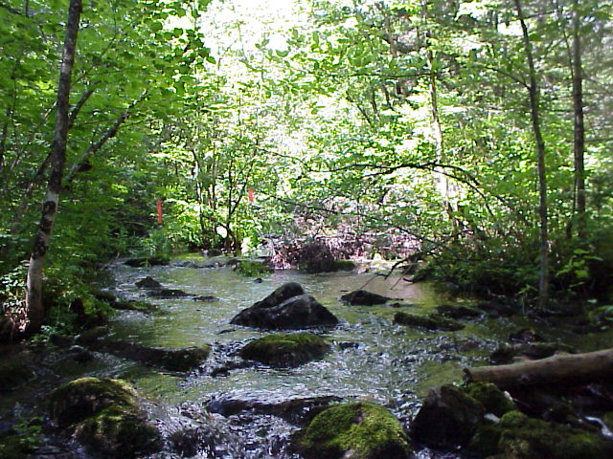
A Tier 1-2 Community
“Minimally disturbed”
Stoneflies
Dragonflies,Damselflies
Mayflies
Beetles
Caddisflies
1 inch
Notes:
This is an example of what a field biologist will be measuring – who is there, how many and what proportion of the community.
Example of first site – the undisturbed or minimally disturbed site. This represents a tier 1 community.
Blue: Most Sensitive/intolerant organisms
Green: Sensitive, can tolerant some degree of stress
Red: Tolerant

Slide 49
A Tier 1-2 Community
“Minimally disturbed”
Stoneflies
Dragonflies, Damselflies
Mayflies
Beetles
Caddisflies
Midges
1 inch
Notes:
This is an example of what a field biologist will be measuring – who is there, how many and what proportion of the community.
Example of first site – the undisturbed or minimally disturbed site. This represents a tier 1 community.
Blue: Most Sensitive/intolerant organisms
Green: Sensitive, can tolerant some degree of stress
Red: Tolerant

Slide 50
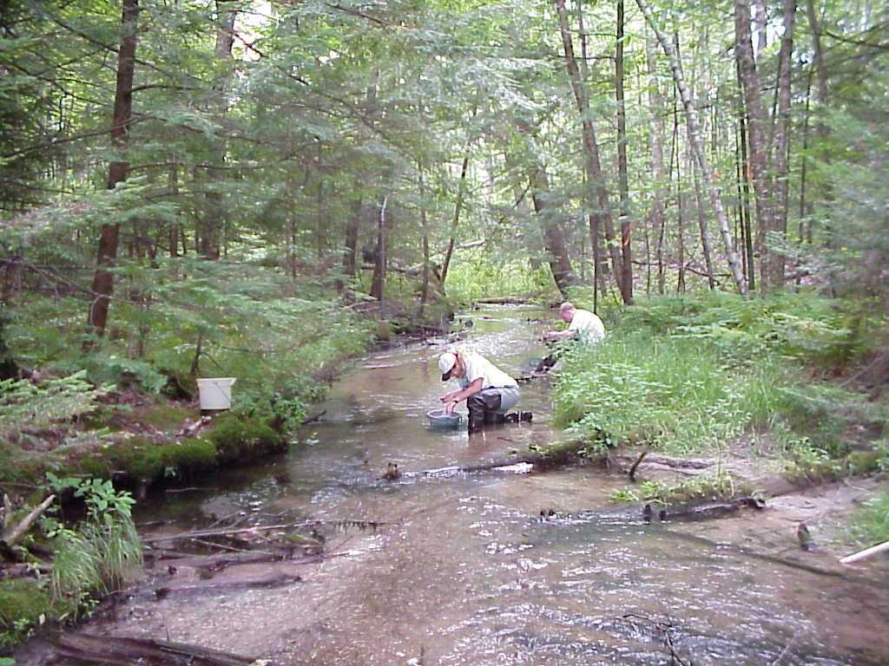
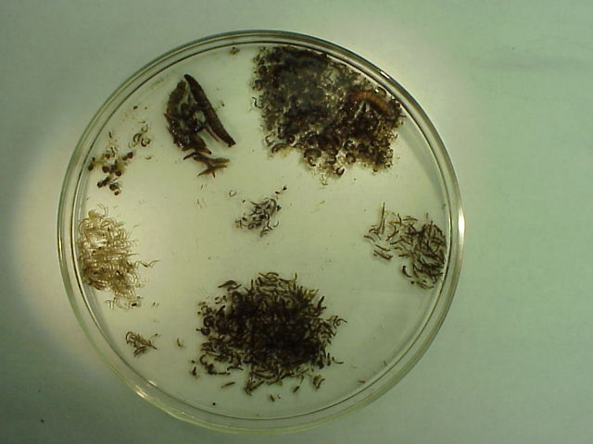
A Tier 3 Community
“evident/moderate disturbance”
Caddisflies
Crane flies
Non-insects
Beetles
Midges
Stoneflies
Blackflies
Mayflies
1 inch
Notes:
Ex of a moderately disturbed site
Nutrient enriched site. You see more of everything – increase in abundance, typical signal of low to moderate nutrient enrichment. Also see a beginning shift in community composition – increase in tolerant species. These changes are visually evident, measurable and statistically significant.

Slide 51
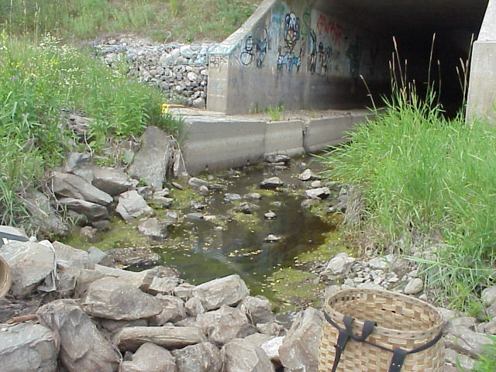
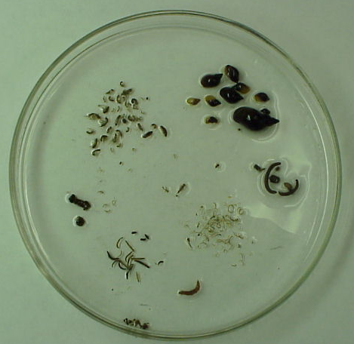
A Tier 5-6 Community
“Highly/Severely Disturbed”
Scuds
Snails
Leeches
Caddisflies
Midges
Beetles
Craneflies
1 inch
Notes:
Downstream of a shopping mall, storm sewer outlet – a representative community where the more tolerant assemblages dominate.
Comtinuing along the gradient – to heavily and severaly disturbed sites, major shift in community composition and function.

Slide 52
Reference Site Approach
Defining reference condition using minimally disturbed sites recognizes that natural stressors can affect the biology of a stream, introducing variability into the reference site data distribution.
Natural drought will cause dry or stagnant flow conditions.
High water, or floods, will limit the effectiveness of the sampling method.
Substrate diversity at some reference sites may be naturally limiting

Slide 53
Reference Selection Criteria
Landscape Development Intensity Index < 2.
Habitat Assessment Index > 75% of total points.
Ammonia < 0.1 mg/L.
Hydrologic Index <6.
Exclude sites with average conductivity > 600 umhos/cm (eliminate “tidal” influence).
Exclude sites receiving NPDES-permitted wastewater treatment facility discharges, based on a review of GIS coverage information from the Water Facilities Regulation (WAFR) database.
Use samples with number of individuals identified ranging from 100-175 (inclusive).

Slide 54
Category III (“Impairment”) Line Based on Reference Sites
Analysis to balance Type I and Type II errors given the inherent statistical error of the method.
The examination of the two most recent visits at 55 reference streams showed that the 2.5th percentile of reference data was in the range of 35-44 points. The middle of this range was 40 points, which represents an impairment threshold that balances Type I and Type II errors.

Slide 55
Establishing SCI Thresholds for Impairment
Biological Condition Gradient Approach
  Workshop in 2006 with Florida experts
  SCI = 35 was the lowest score that still meets CWA (BCG category 4)
Reference Site Approach
  55 reference streams chosen through rigorous selection process
  SCI = 40 determined to be protective

Slide 56
Using Multiples Lines of Evidence to Set the Exceptional Category
Biological Condition Gradient Approach concluded that SCI scores of 64 and above were similar to natural (minimally disturbed).
Reference site approach yielded 70.6.
Averaging these complimentary approaches= 67.

Slide 57
Objectives Affect SCI Sampling Decisions and Interpretation of Results – from SCI PRIMER
Biota respond to natural and human stressors alike.
Study objectives must be clearly articulated, and you must control for confounding factors that may interfere with the appropriate interpretation of the SCI scores.
Especially consider:
  existing and antecedent flow conditions,
  habitat conditions, and
  water quality issues.

Slide 58
Example TMDL Objective
Determine if water quality issues are adversely affecting biological health.
To place a waterbody on the verified list, must reasonably demonstrate the pollutant responsible for poor SCI scores.

Slide 59
Factors to Control For During TMDL Sampling
Current and antecedent flow conditions
  If desiccation or stagnant conditions have occurred, the flow regime, NOT water quality, will be dominant influence
Habitat conditions at sampling site
  By sampling where habitat is NOT limiting, you can emphasize water quality factors

Slide 60
BMP Effectiveness Example
Employed a “Before-After/Control-Impact” study design.
Sites were selected where habitat and water quality were currently acceptable to determine if silviculture practices caused harm.
  Controlled for prior habitat and water quality conditions to emphasize human activities and BMPs.

Slide 61
Experimental Design
1996
1997, 1998
Before
Silviculture
Activities
After
Silviculture
Activities
C
C
Control
Control
B
Site
B
Site
A
A
Flow
Flow
Silviculture
with BMPs
Proposed
C
C
Silviculture
Test Site
Test Site
Area
B
B
A
A

Slide 62
SCI results of a Before-After-Control-Impact study assessing the effectiveness of forestry Best Management Practices.
35
30
Excellent
25
Good
20
Clearcutting (3 & 4-96),
15
Site Prep (6 to 9-96),
Replanting (1-97)
Herbicide
10
Application (5-15-97,
Velpar & Oust)
5
ANOVA: No significant time or
treatment differences
0
C 96
T 96
C
T
C
T
C 98
T 98
2-97
2-97
7-97
7-97

Slide 63
Objectives for Other DEP Programs
BMP Effectiveness Studies
Point Source Studies
Stream Restoration Studies
Minimum Flows and Levels Studies
Status and Trends Monitoring Network

Slide 64
Water Level and the SCI
Method can only effectively capture organisms residing in the top 0.5 m (reachable substrates).
As water level increases, there is a one month lag time for taxa to colonize substrates.
Aquatic organisms die if site goes dry, minimum of 3 month recovery period. Wait 6 months if you do not have information about recovery at that site.

Slide 65
Schematic cross section of a stream showing recent increase in water levels indicating the SCI sampling should not be conducted.
Water level during day of sampling trip.
Substrate which has not yet been colonized by benthos since it was dry 2 weeks ago.
0.8 m
Substrate suitable for sampling, however, not effectively reached with the dip net method. Abort sampling.
Water level 2 weeks ago, which was stable for the previous 6 weeks.

Slide 66
Hydrograph showing the reachable substrates have been inundated more than one month. This is a good time to sample SCI.
1.5
Day of site visit
1.0
Water level (m)
0.5
0
0 7 14 21 28 35 42 49 56 63 70 77 84 91
Days

Slide 67
Recent increase in water level. Reachable substrates have been inundated for less than 2 weeks. Abort sampling.
1.5
Day of site visit
1.0
Water level (m)
0.5
0
0 7 14 21 28 35 42 49 56 63 70 77 84 91
Days

Slide 68
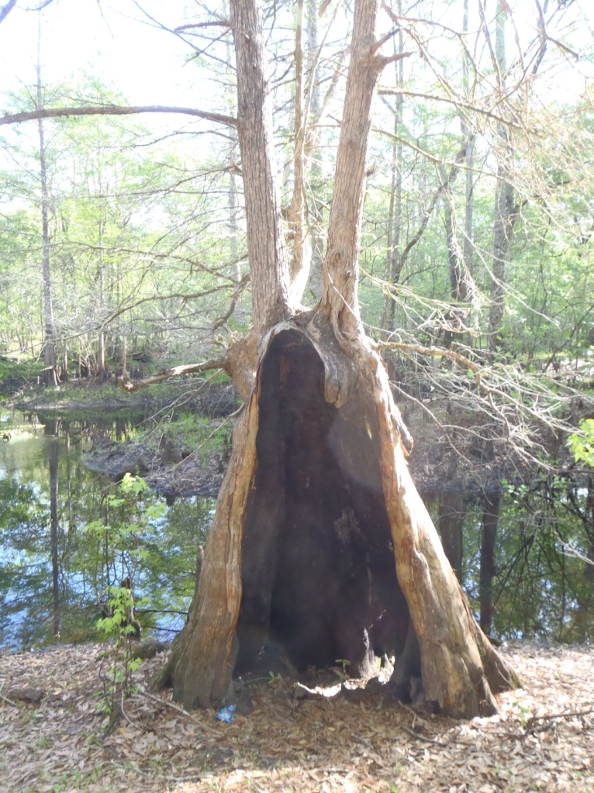
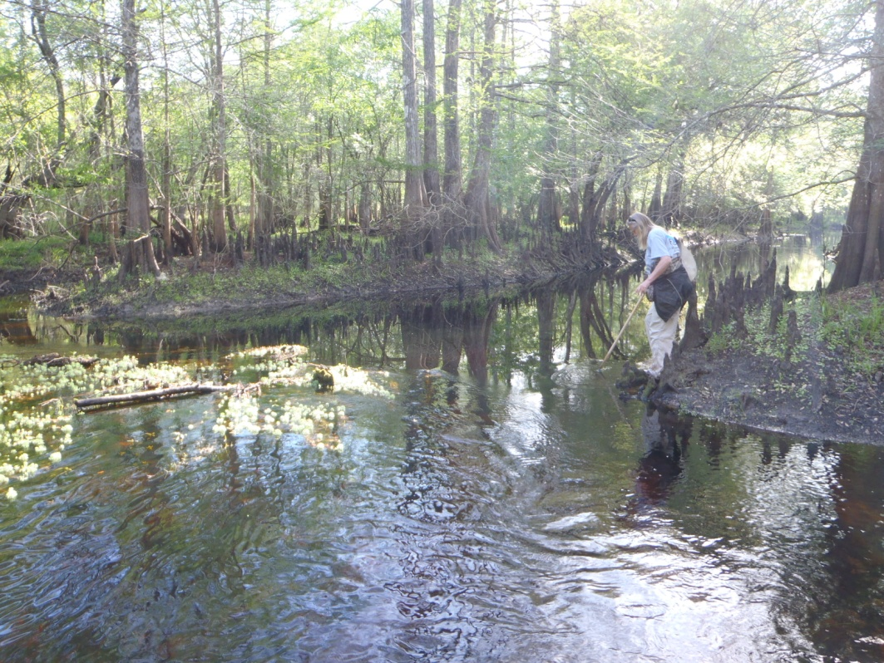
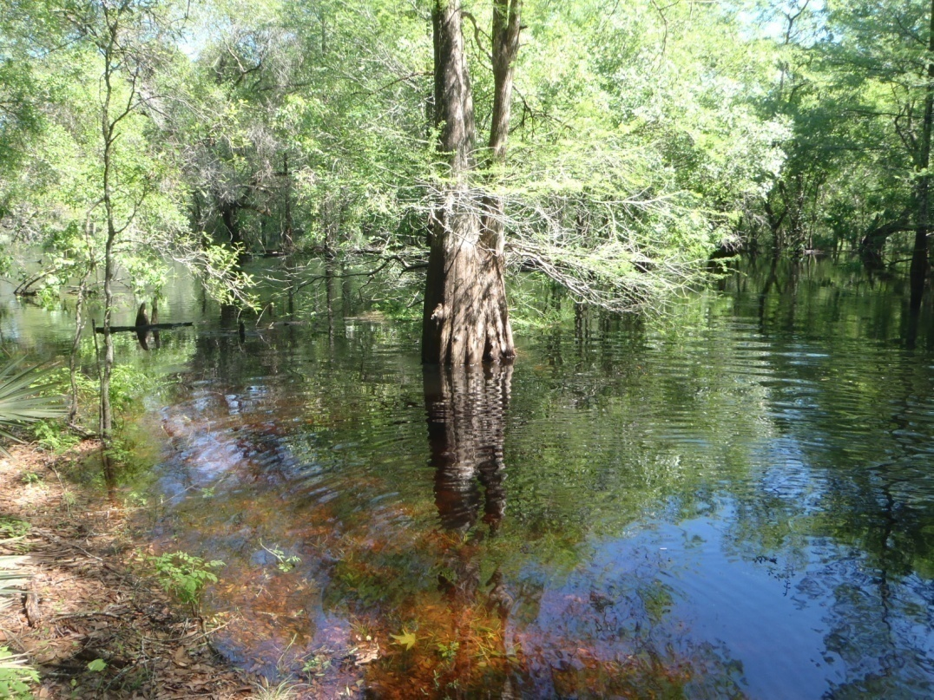
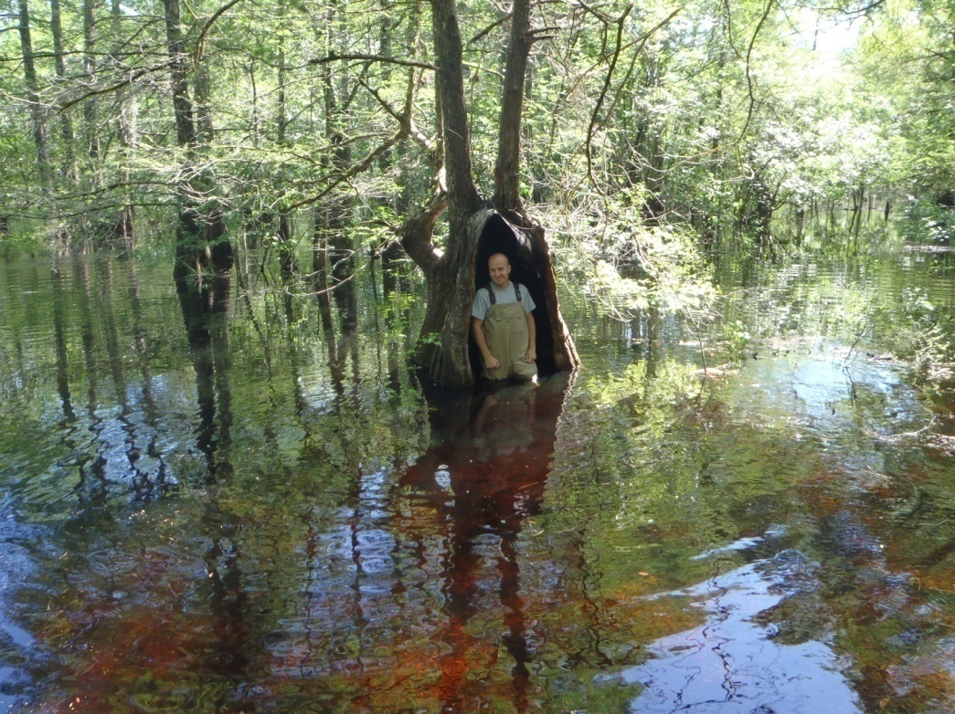
Before
Before
After
After

Slide 69
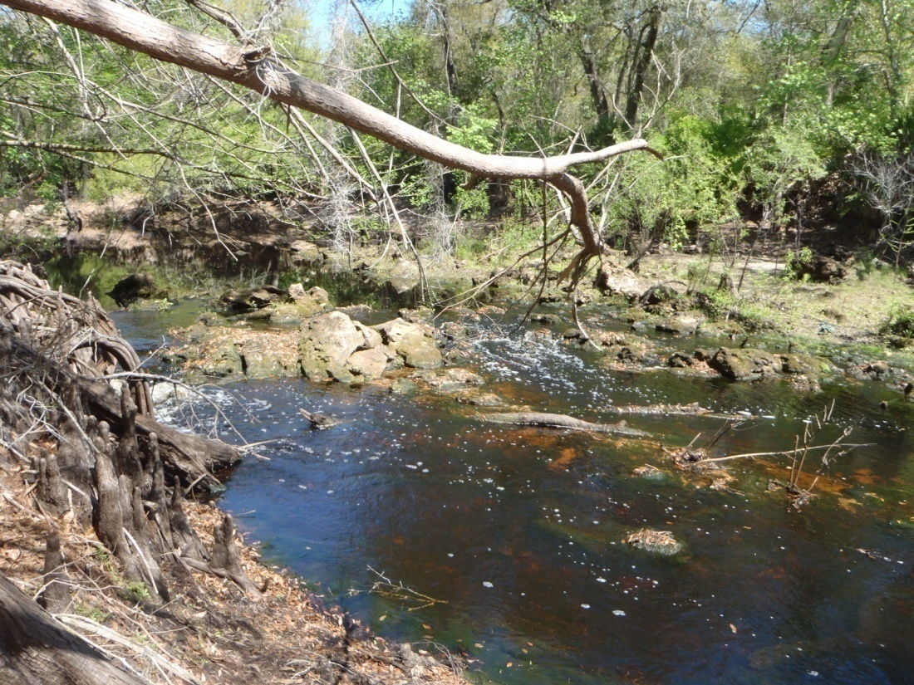
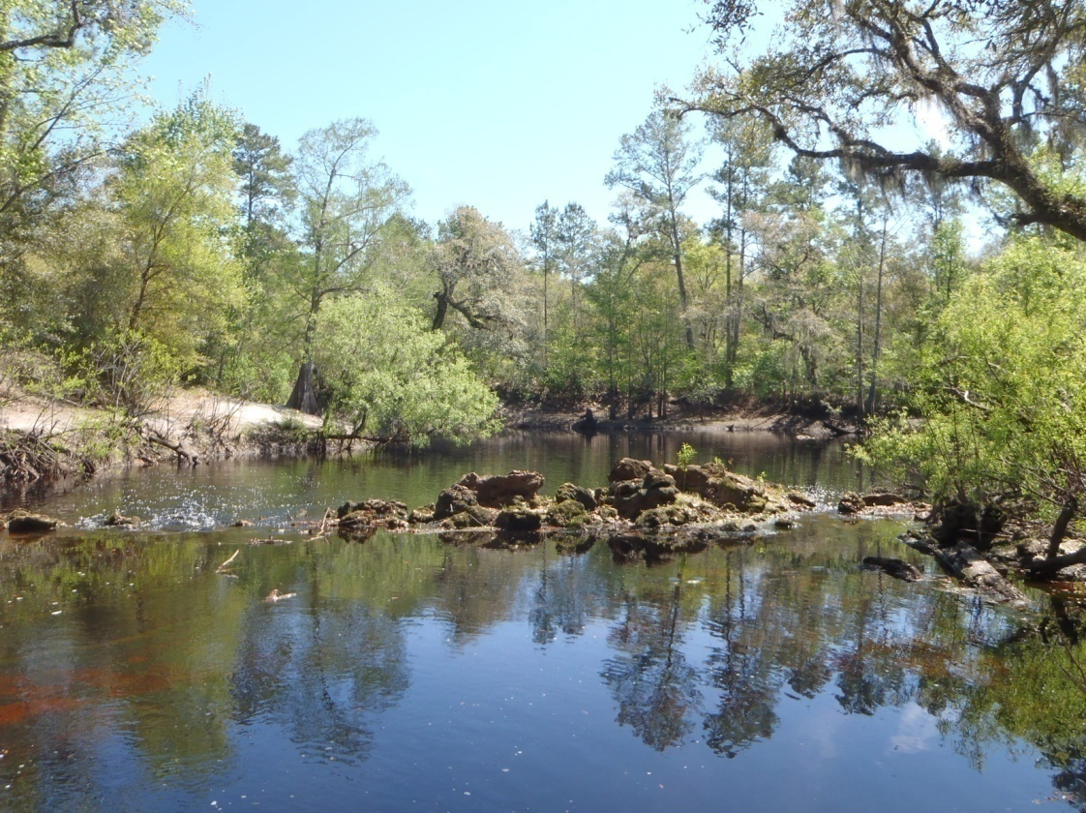
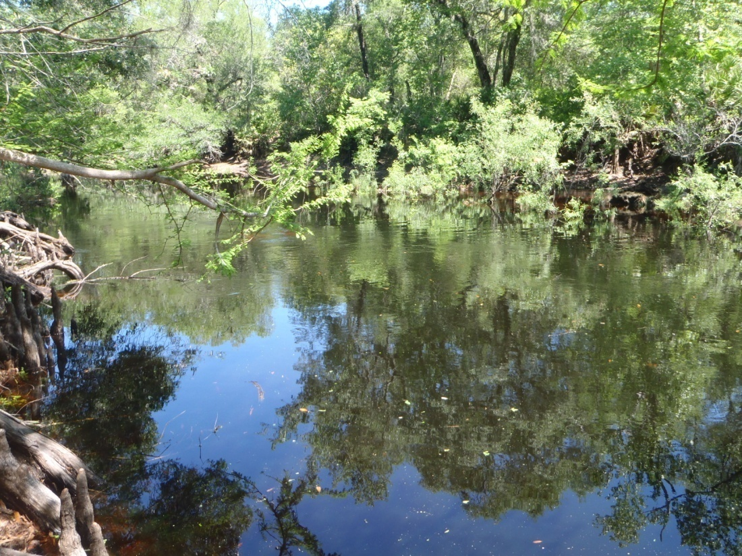
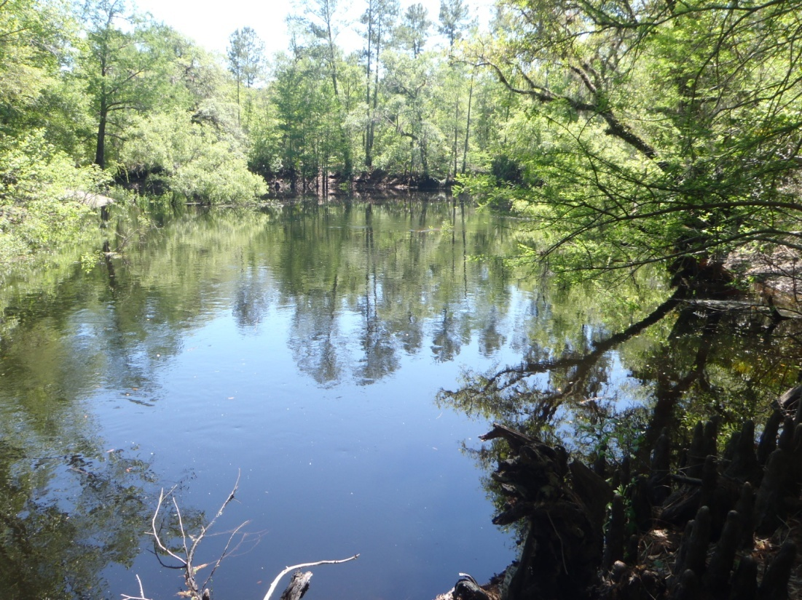
Before
Before
After
After

Slide 70
Hydrograph showing times when substrates are reachable.
1.5
Sampling Windows
1.0
Water level (m)
0.5
0
0 7 14 21 28 35 42 49 56 63 70 77 84 91
Days

Slide 71
SCI Samplers must exercise Best Professional Judgment
Only an experienced, qualified SCI sampler can make the difficult field decisions necessary for proper application of the method.
Samplers MUST understand objectives.
There should be no artificial burdens that prevent samplers from making the correct scientific decision
  Contract issues

Slide 72
Maintaining Linkages between the SCI and Important Associated Data
All associated data (flow conditions, habitat scores, etc.) must be linked to the SCI results, so that a determination may be made that each sample was, or was not, consistent with the study objectives.
Indiscriminate use of SCI scores will likely result in inappropriate or incorrect environmental decisions.
Data analysts and managers have responsibility to fully understand the complexities associated with the SCI scores, and use the data appropriately.

Slide 73
The SCI Sampling Process
Sampling Site Selection and System Classification
Appropriate Antecedent Hydrologic Conditions
Optimal Habitat Selection
Sampling Technique
Field Sorting as a Training Tool
Apprenticeship

Slide 74
Relevant SCI Field SOPs
SCI 1100 (FS 7420) – sampling method
  Assess conditions and appropriateness for sampling, establish 100 m stretch
  Complete phys/chem and HA
  Determine productive habitats and perform 20 dipnet sweeps
  Contain sample in jug and preserve
SCI 1200, 1300 (FA 4310, 5700) contain training and proficiency requirements

Slide 75
Sampling Site Selection and System Classification
Site should be appropriate for sampling objective.
  Compare stream to stream, not stream to swamp-like or lake-like areas.
  Unless MFL study, sample during some (0.05 m/sec) flow.
  Generally sample areas with representative conditions, not atypical areas
    Habitat and flow

Slide 76
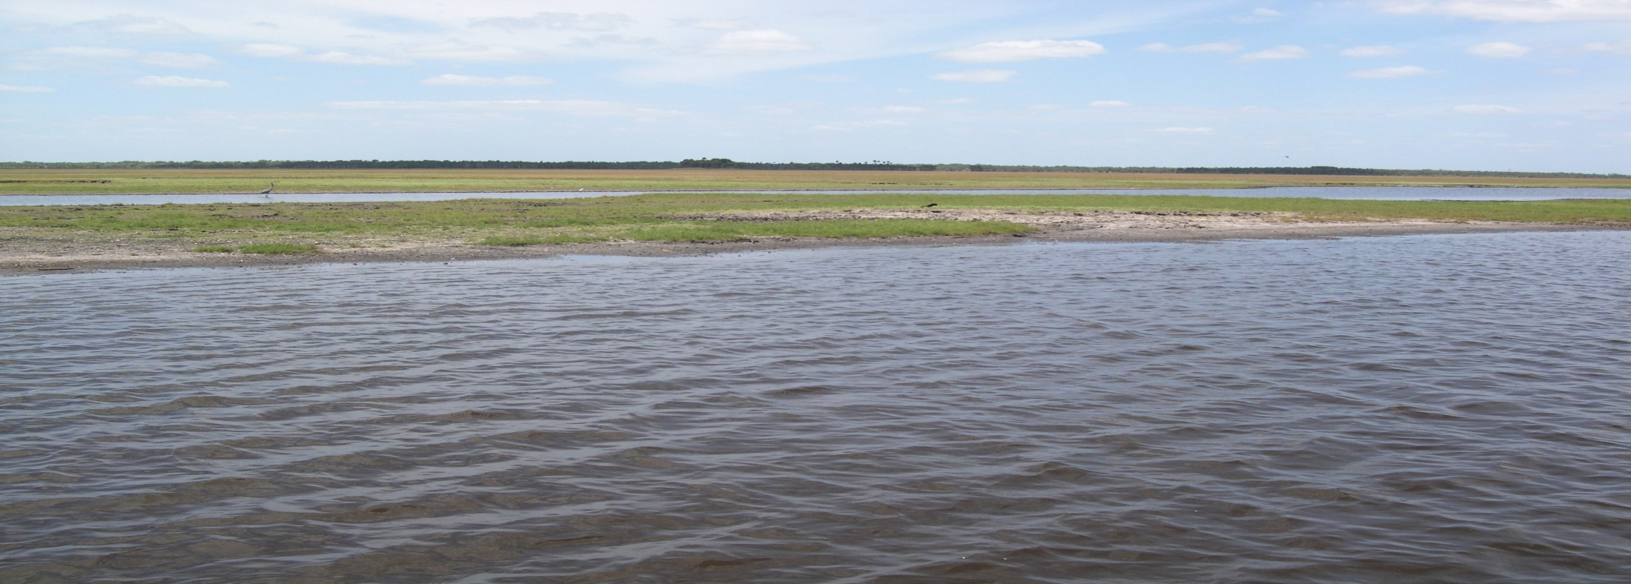
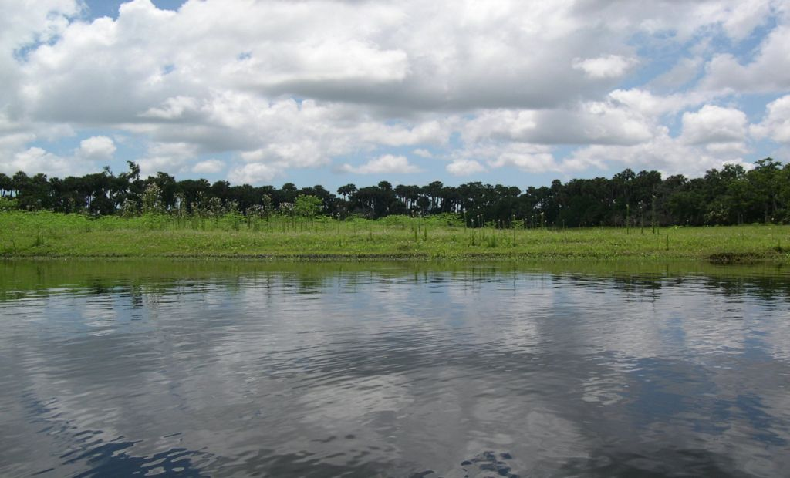

Slide 77
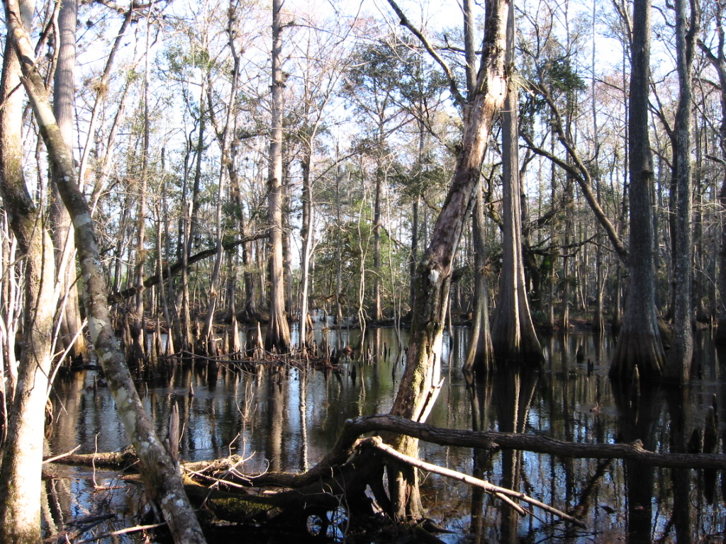

Slide 78
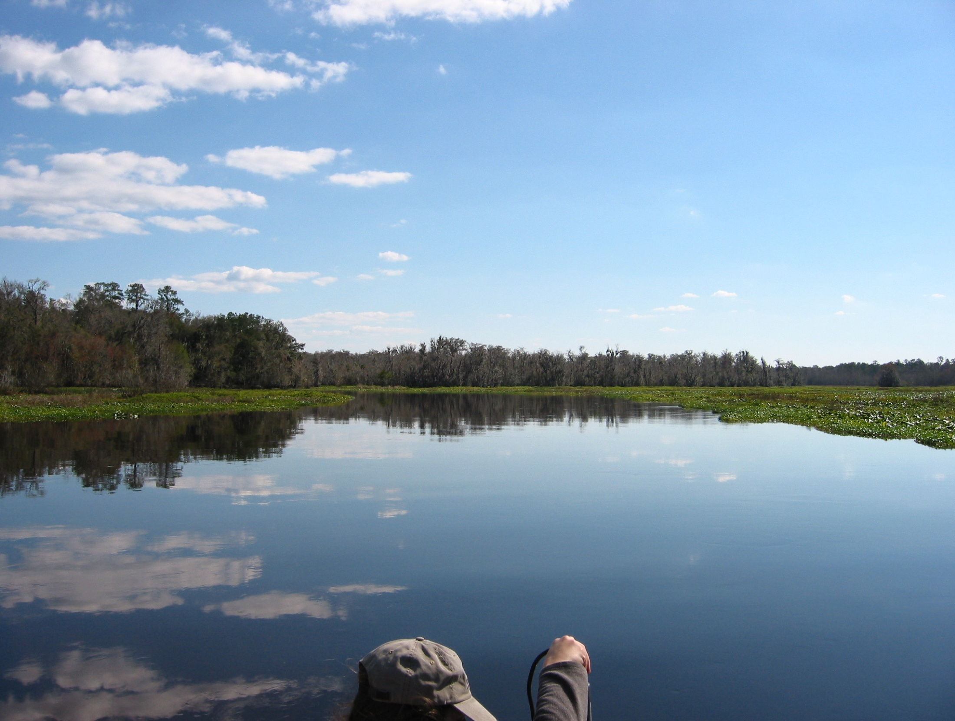

Slide 79
Appropriate Antecedent Hydrologic Conditions
Antecedent hydrologic conditions must be appropriate for the purpose of the study.
How long have habitats in the top 0.5 m of the surface been inundated?
  DO NOT sample recently dry habitats
Hydrographs from area streams should be carefully examined
Samplers need to develop intimate familiarity with the hydrology of streams in their regions.

Slide 80
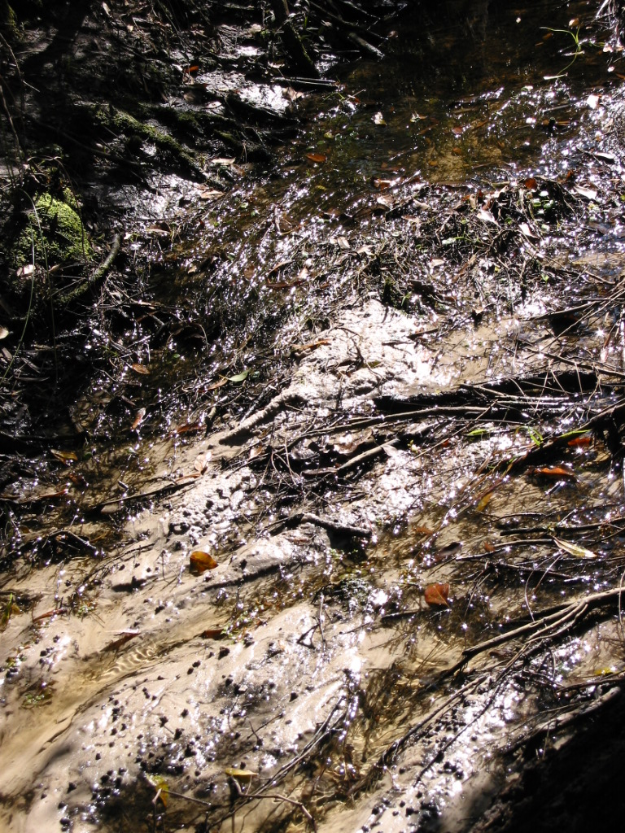
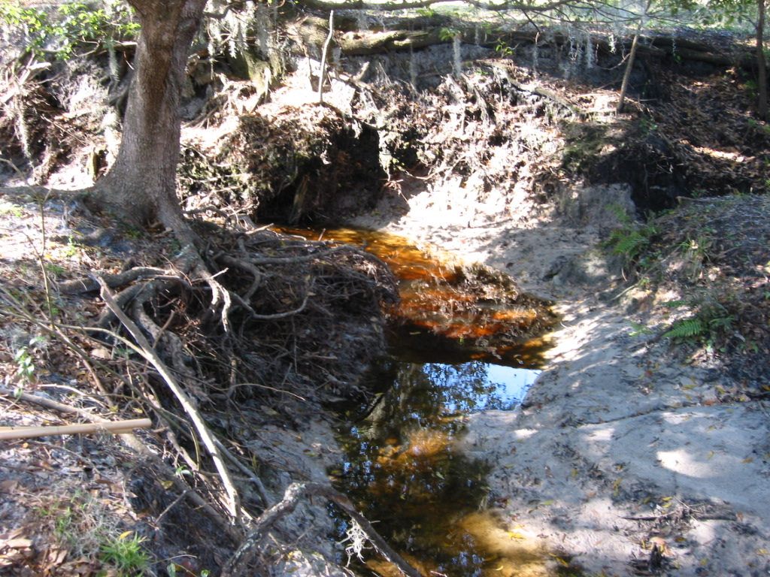
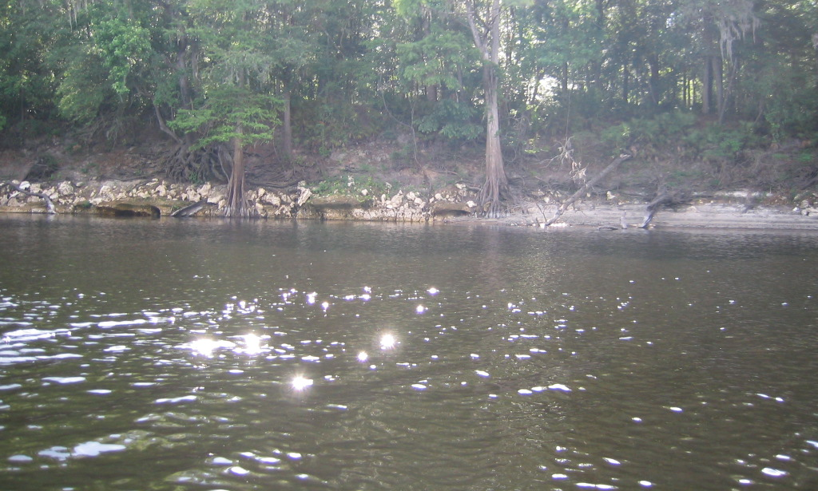

Slide 81
Optimal Habitat Selection
Target productive habitats (roots, woody debris, leaf material, macrophytes and rock)
To be “major”, must have surface area greater than 2 m²
Target optimal flow
Think like a bug

Slide 82
Optimal Habitat Selection (cont.)
Stream taxa are rheophyllic
  Prefer areas with water velocity, which usually have higher DO and food availability
Texture and architecture
  Fine roots, peeling bark, nooks and crannies
Ensure habitats have been inundated

Slide 83
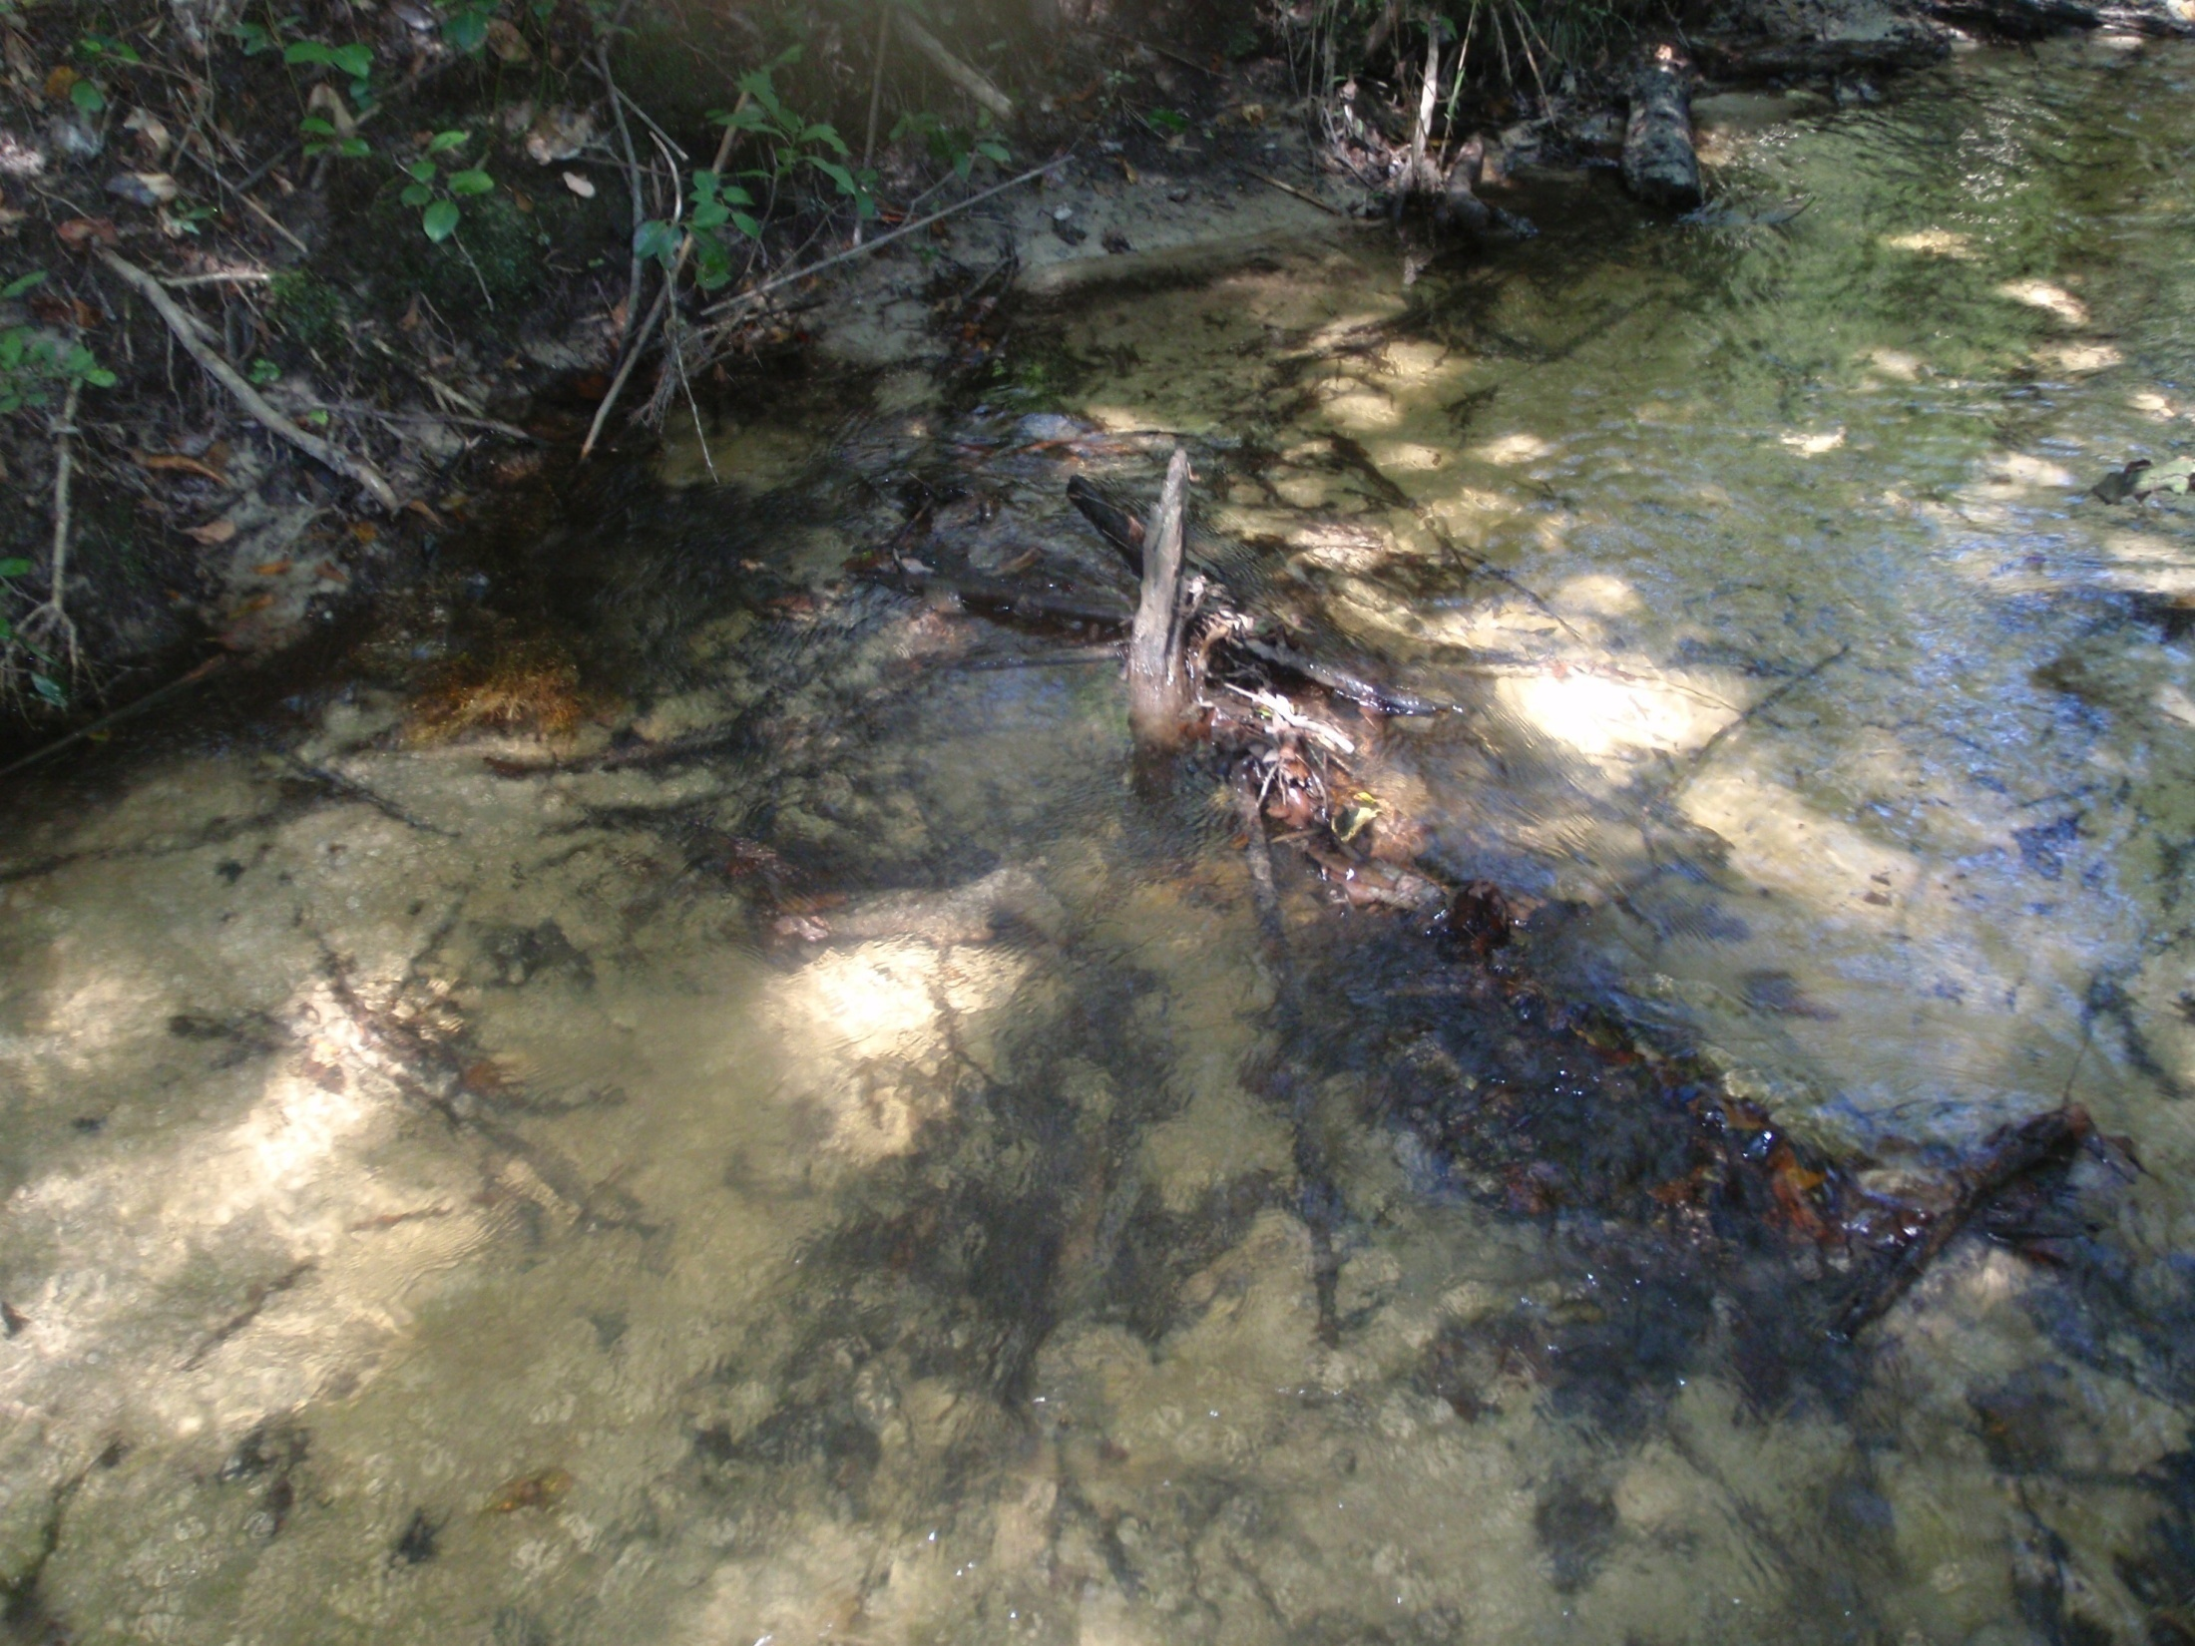
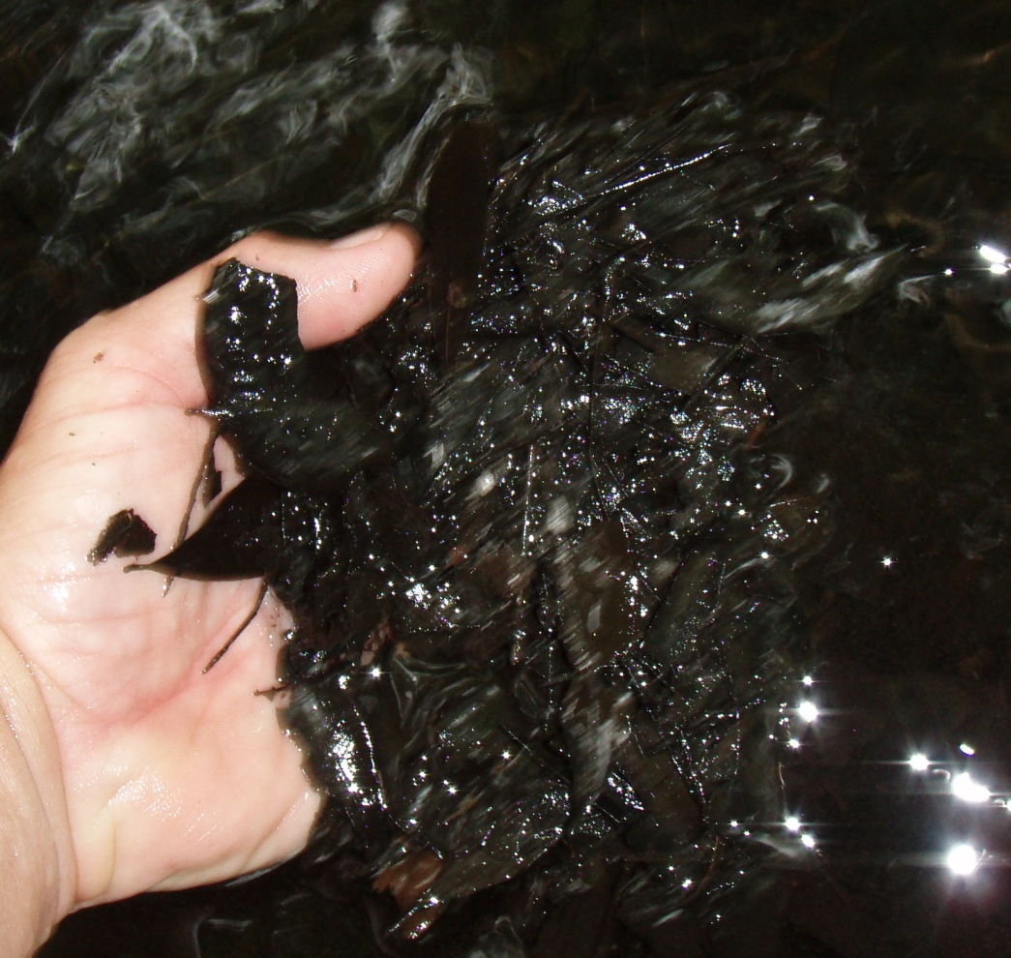
Leaf packs/mats

Slide 84
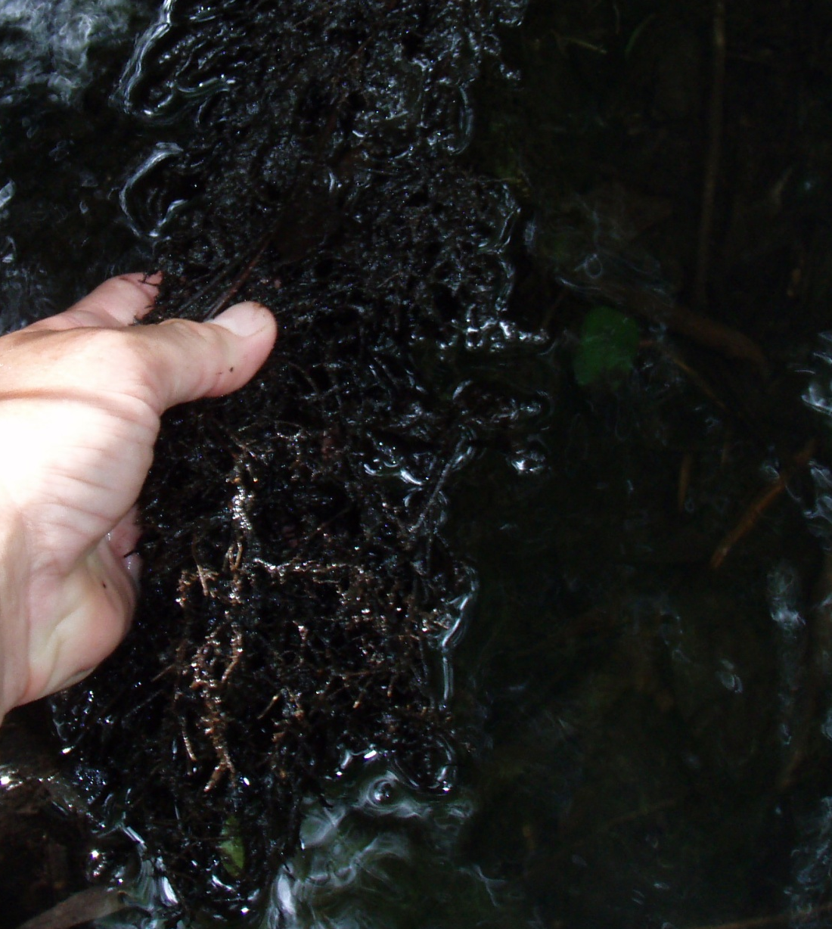
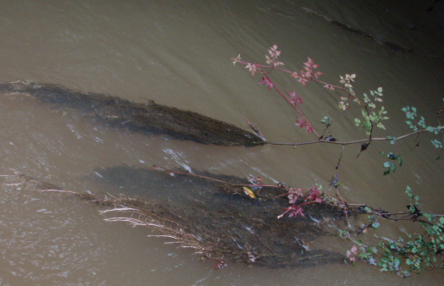
Roots

Slide 85
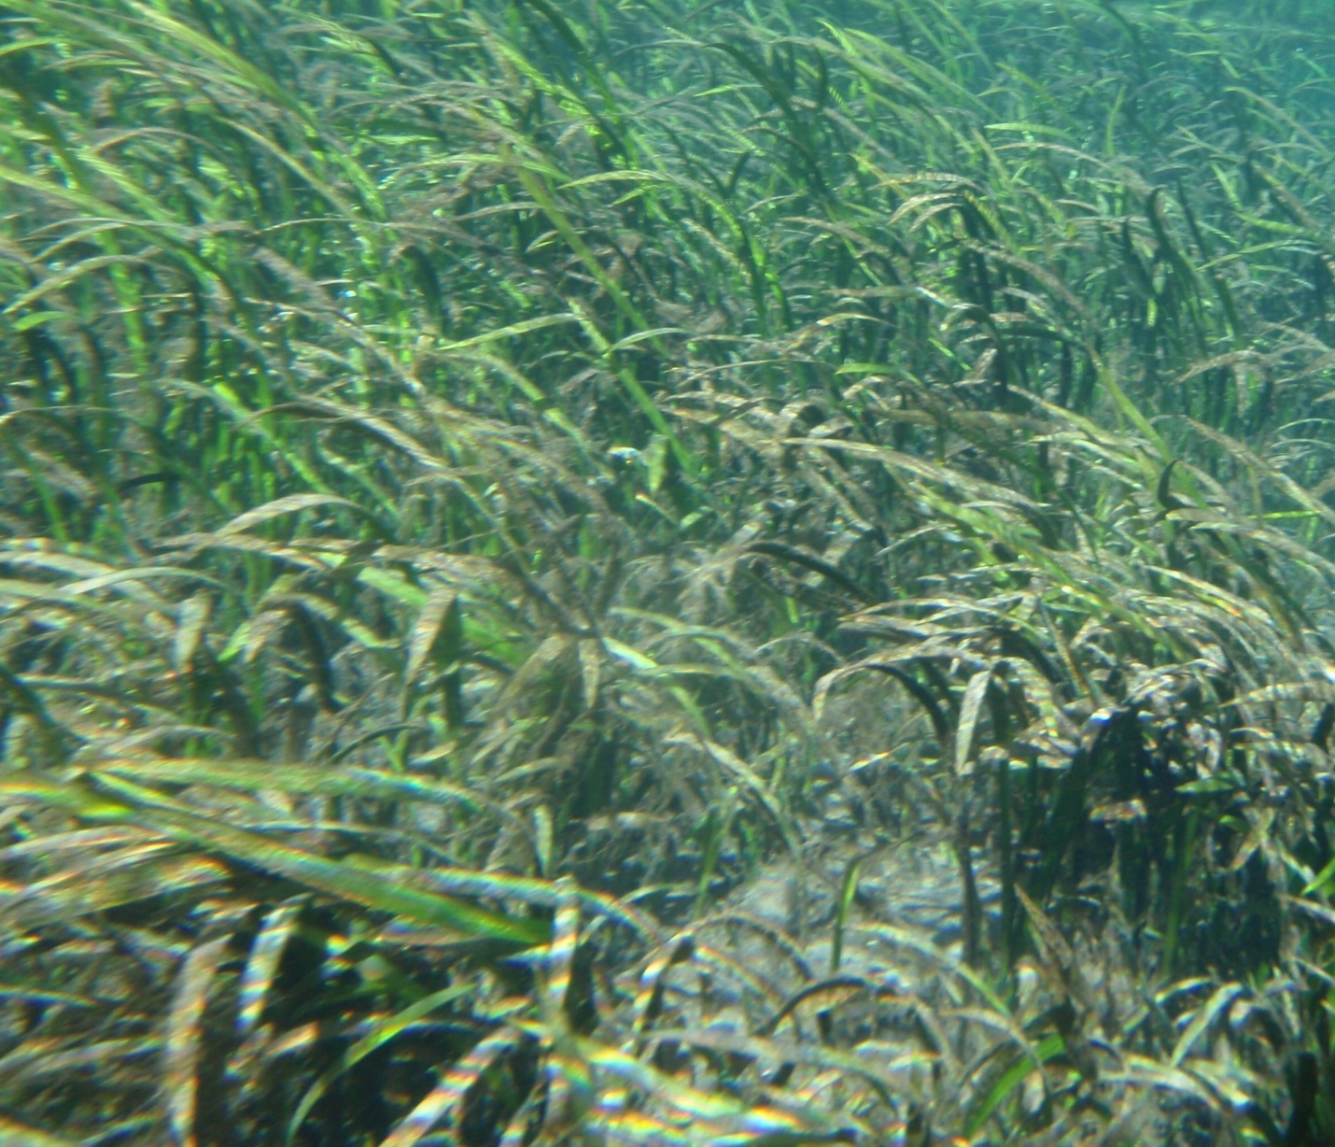
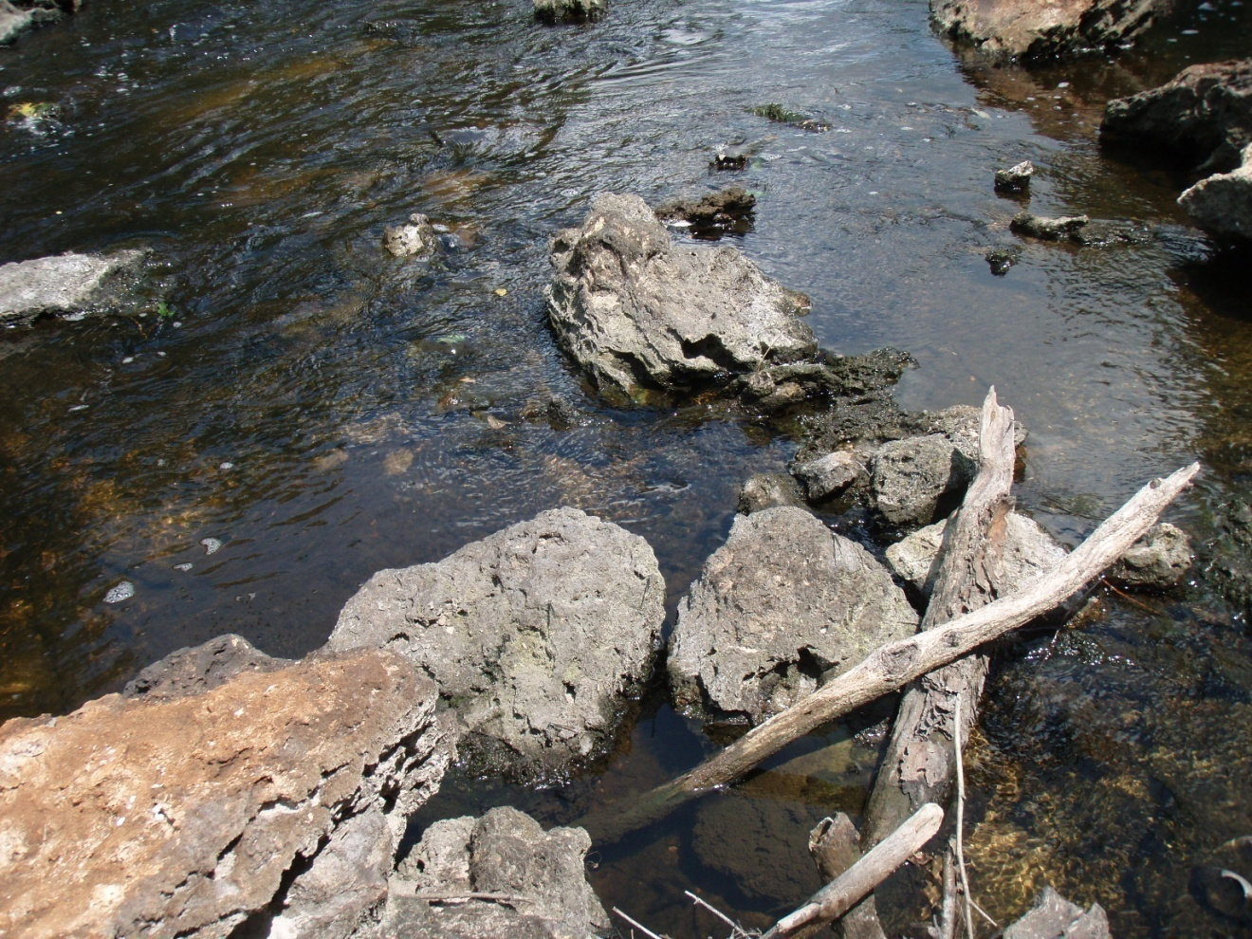
Aquatic vegetation
Rock

Slide 86
Sampling Technique
Samplers absolutely must provide sufficient agitation of substrates to dislodge the organisms, and ensure that all organisms are captured (into the net) without loss.
  Dip net should always be placed perpendicular to the flow
  Agitate substrates with net very close
  Scrub into the net (not parallel)

Slide 87
Sampling Technique (cont.)
  Vigorously shake and scrape all surfaces of the habitats at least 3 times, without organism loss
  Leaf packs are placed directly into the net and the organisms dislodged “one leaf at a time” before discarding excess leaves
    Box technique for measuring packs
  Penetrate sand with fingers, to approximately 2 cm deep, and using a pulling motion, draw the organisms from the sand into the waiting dip net
    Include partially buried bivalves

Slide 88
Sampling Technique (cont.)
  Leaf packs are preferred over leaf mats, unless only mats available
  For leaf mats, only sample the top 1-2 cm to avoid the anoxic layers below
  Large rivers can be sampled from the bow of a boat (best for reachable snags in deep areas) or by wading along the shoreline

Slide 89
20 Dipnet Sweeps for SCI
Productive habitats – snags, roots, leaves, rock, aquatic vegetation (need 2m² for “major”)
“Minor” sweeps are in sand, muck, and in productive habitats with < 2m² cover.
# Major habitats | # Sweeps in Majors | # Sweeps in Minor
1 | 10 | 10
2 | 7,7 | 6
3 | 5,5,5 | 5
4 | 4,4,4,4 | 4
5 | 3,3,3,3,3 | 5

Slide 90
Field Sorting as a Training Tool
Field sorting provides the sampler immediate feedback regarding the degree of success associated with the field decisions and sampling effectiveness.
Sort individual sweeps via white tray, and examine taxa with hand lens.
Field sorting not part of actual SCI (Biorecon only).

Slide 91
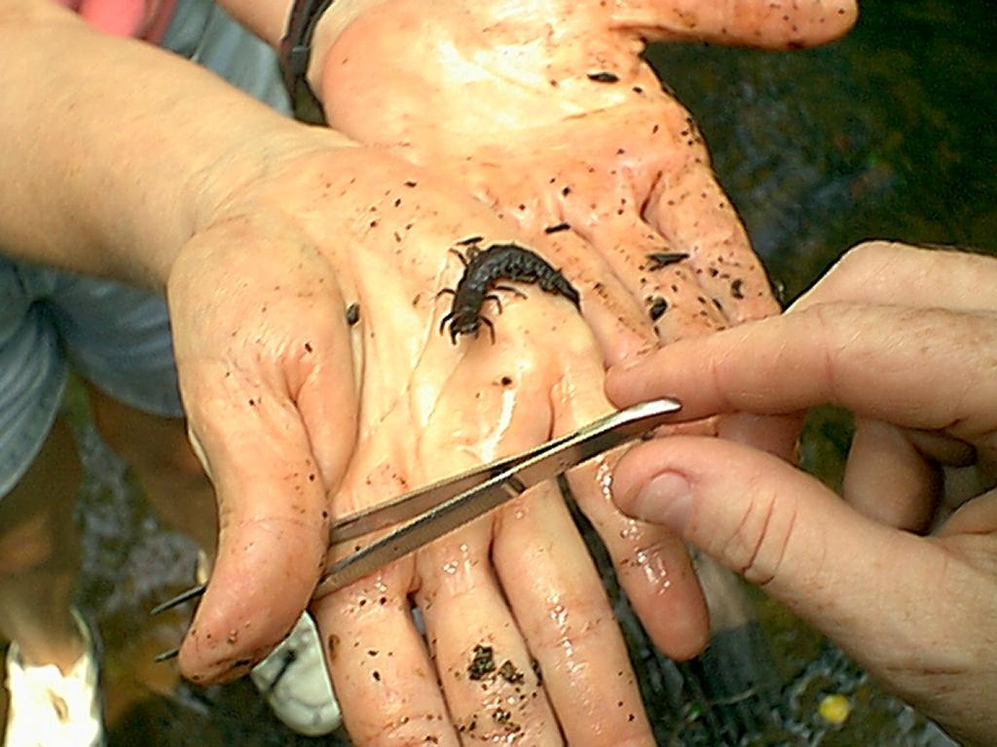
Field Sorting Yields
Megalopteran,“Gator Flea”

Slide 92
Apprenticeship
Experienced SCI samplers must contribute to the training of novice staff.
Goal is to produce SCI samplers with the necessary critical thinking skills and sampling technique required by the SOP.
Training should consist of numerous field visits (minimum of 10), at a variety of sites (starting at reference sites, followed by disturbed sites) and different water levels.

Slide 93
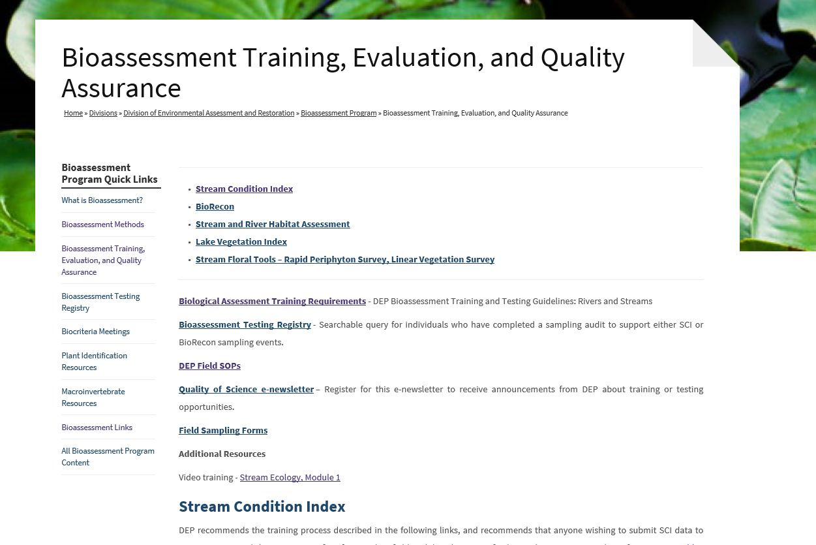
https://floridadep.gov/dear/bioassessment/content/bioassessment-training-evaluation-and-quality-assurance#sci

Slide 94
Training Log
Complete for minimum of 10 practice sites (include 3 low impact sites, 3 high impact sites)
Trainer signs off on training
Evaluator conducts a “mock audit” when training is complete to ensure readiness
Contact DEP for audit
Pass online test and field audit
Online registry of SCI samplers
  http://fldeploc.dep.state.fl.us/sci/query.asp

Slide 95
Auditing
The initial demonstration of capability audit is just a starting point
Samplers should be periodically observed while conducting the entire 20 dip nets to ensure acceptable data.
Refresher audit every 5 years
  On-line test and submitting actual data from a reference site

Slide 96
Conclusions
A scientifically robust SCI requires proper application of the method and correct interpretation of the results
  Clearly defined objectives
  Control of confounding variables
  Post-hoc evaluation of associated data
  Trained professional staff for sampling and analysis

Slide 97
For More Information
https://floridadep.gov/dear/bioassessment/content/bioassessment-training-evaluation-and-quality-assurance

