Slide 1
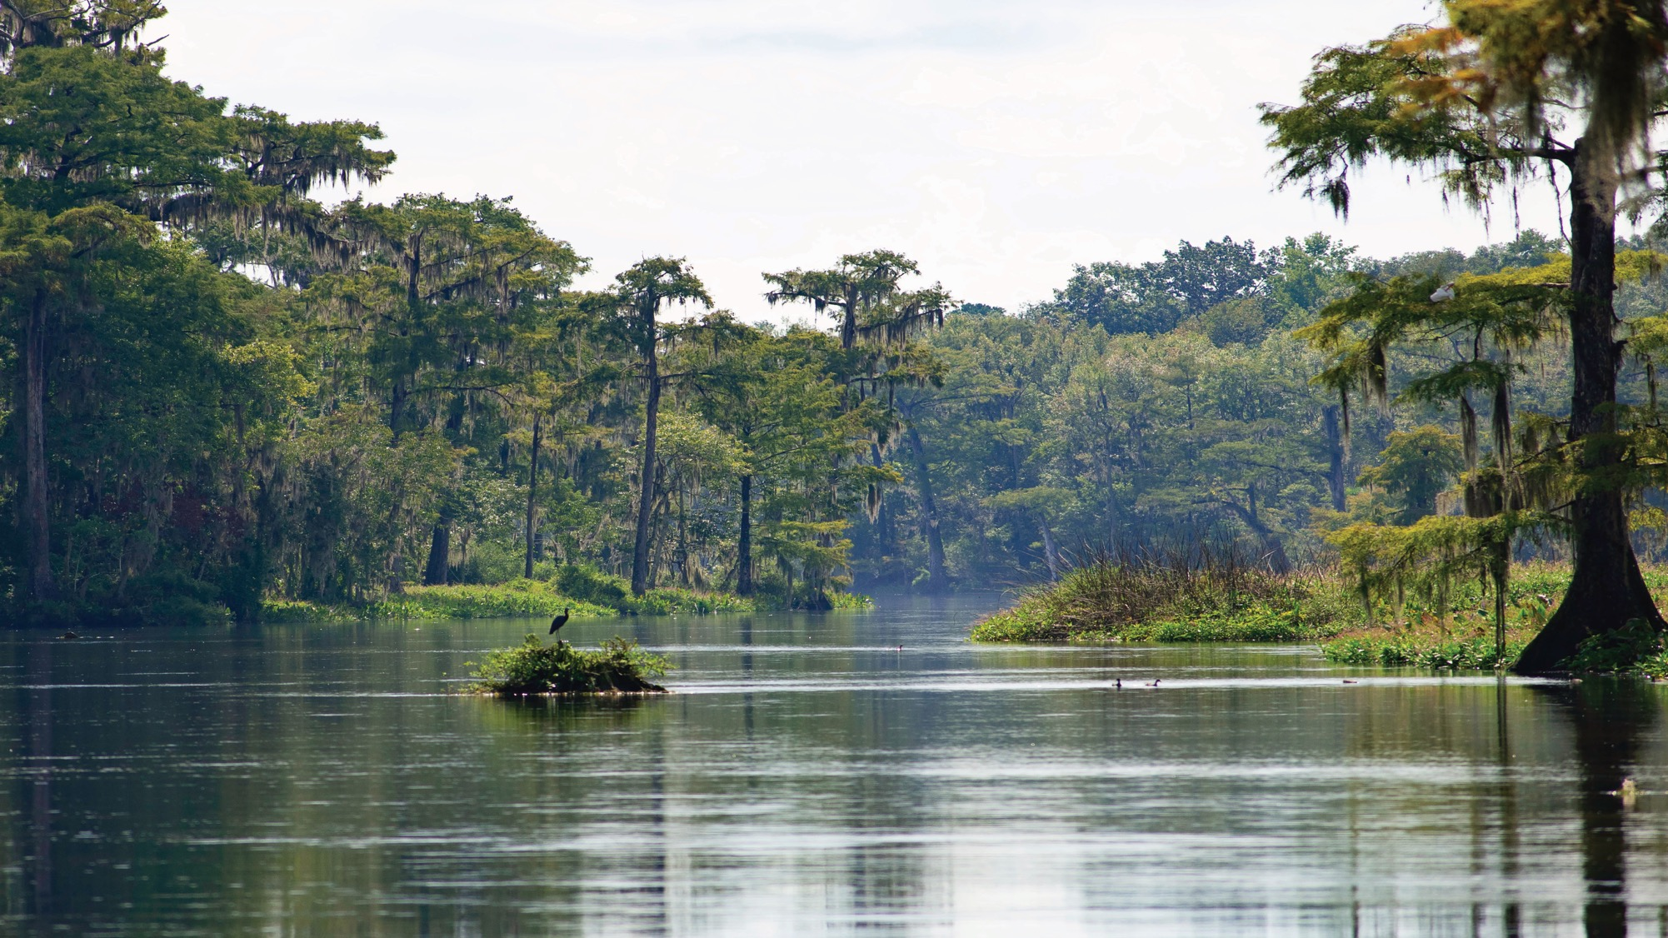


Tampa Bay Reasonable Assurance Plan
Add relevant picture as slide background and include section title, if needed.
FLORIDA DEPARTMENT OF
ENVIRONMENTAL PROTECTION
Ken Weaver
Division of Environmental Assessment and Restoration
October 28, 2021
1

Slide 2
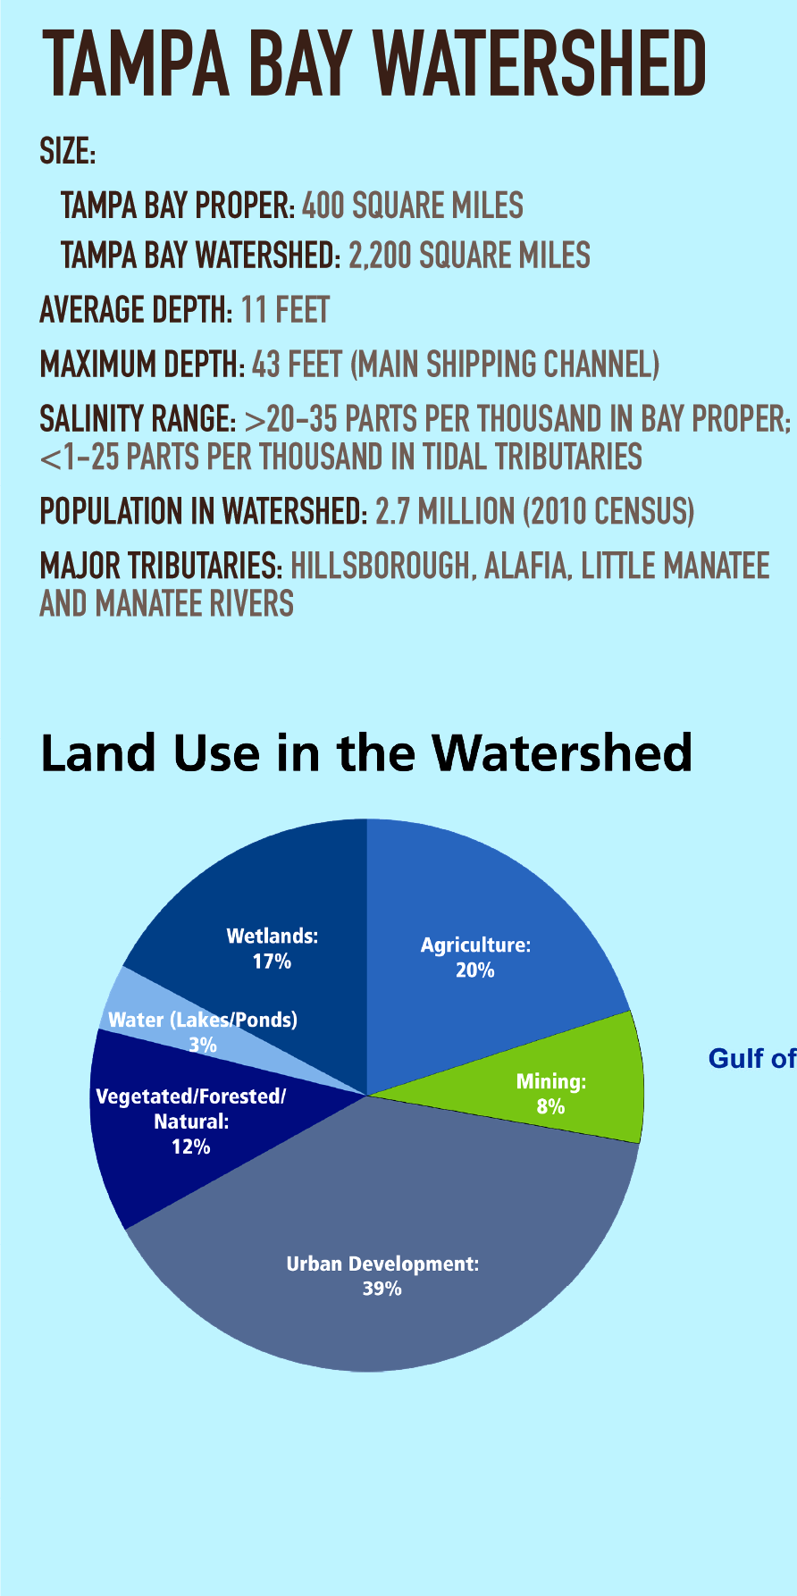
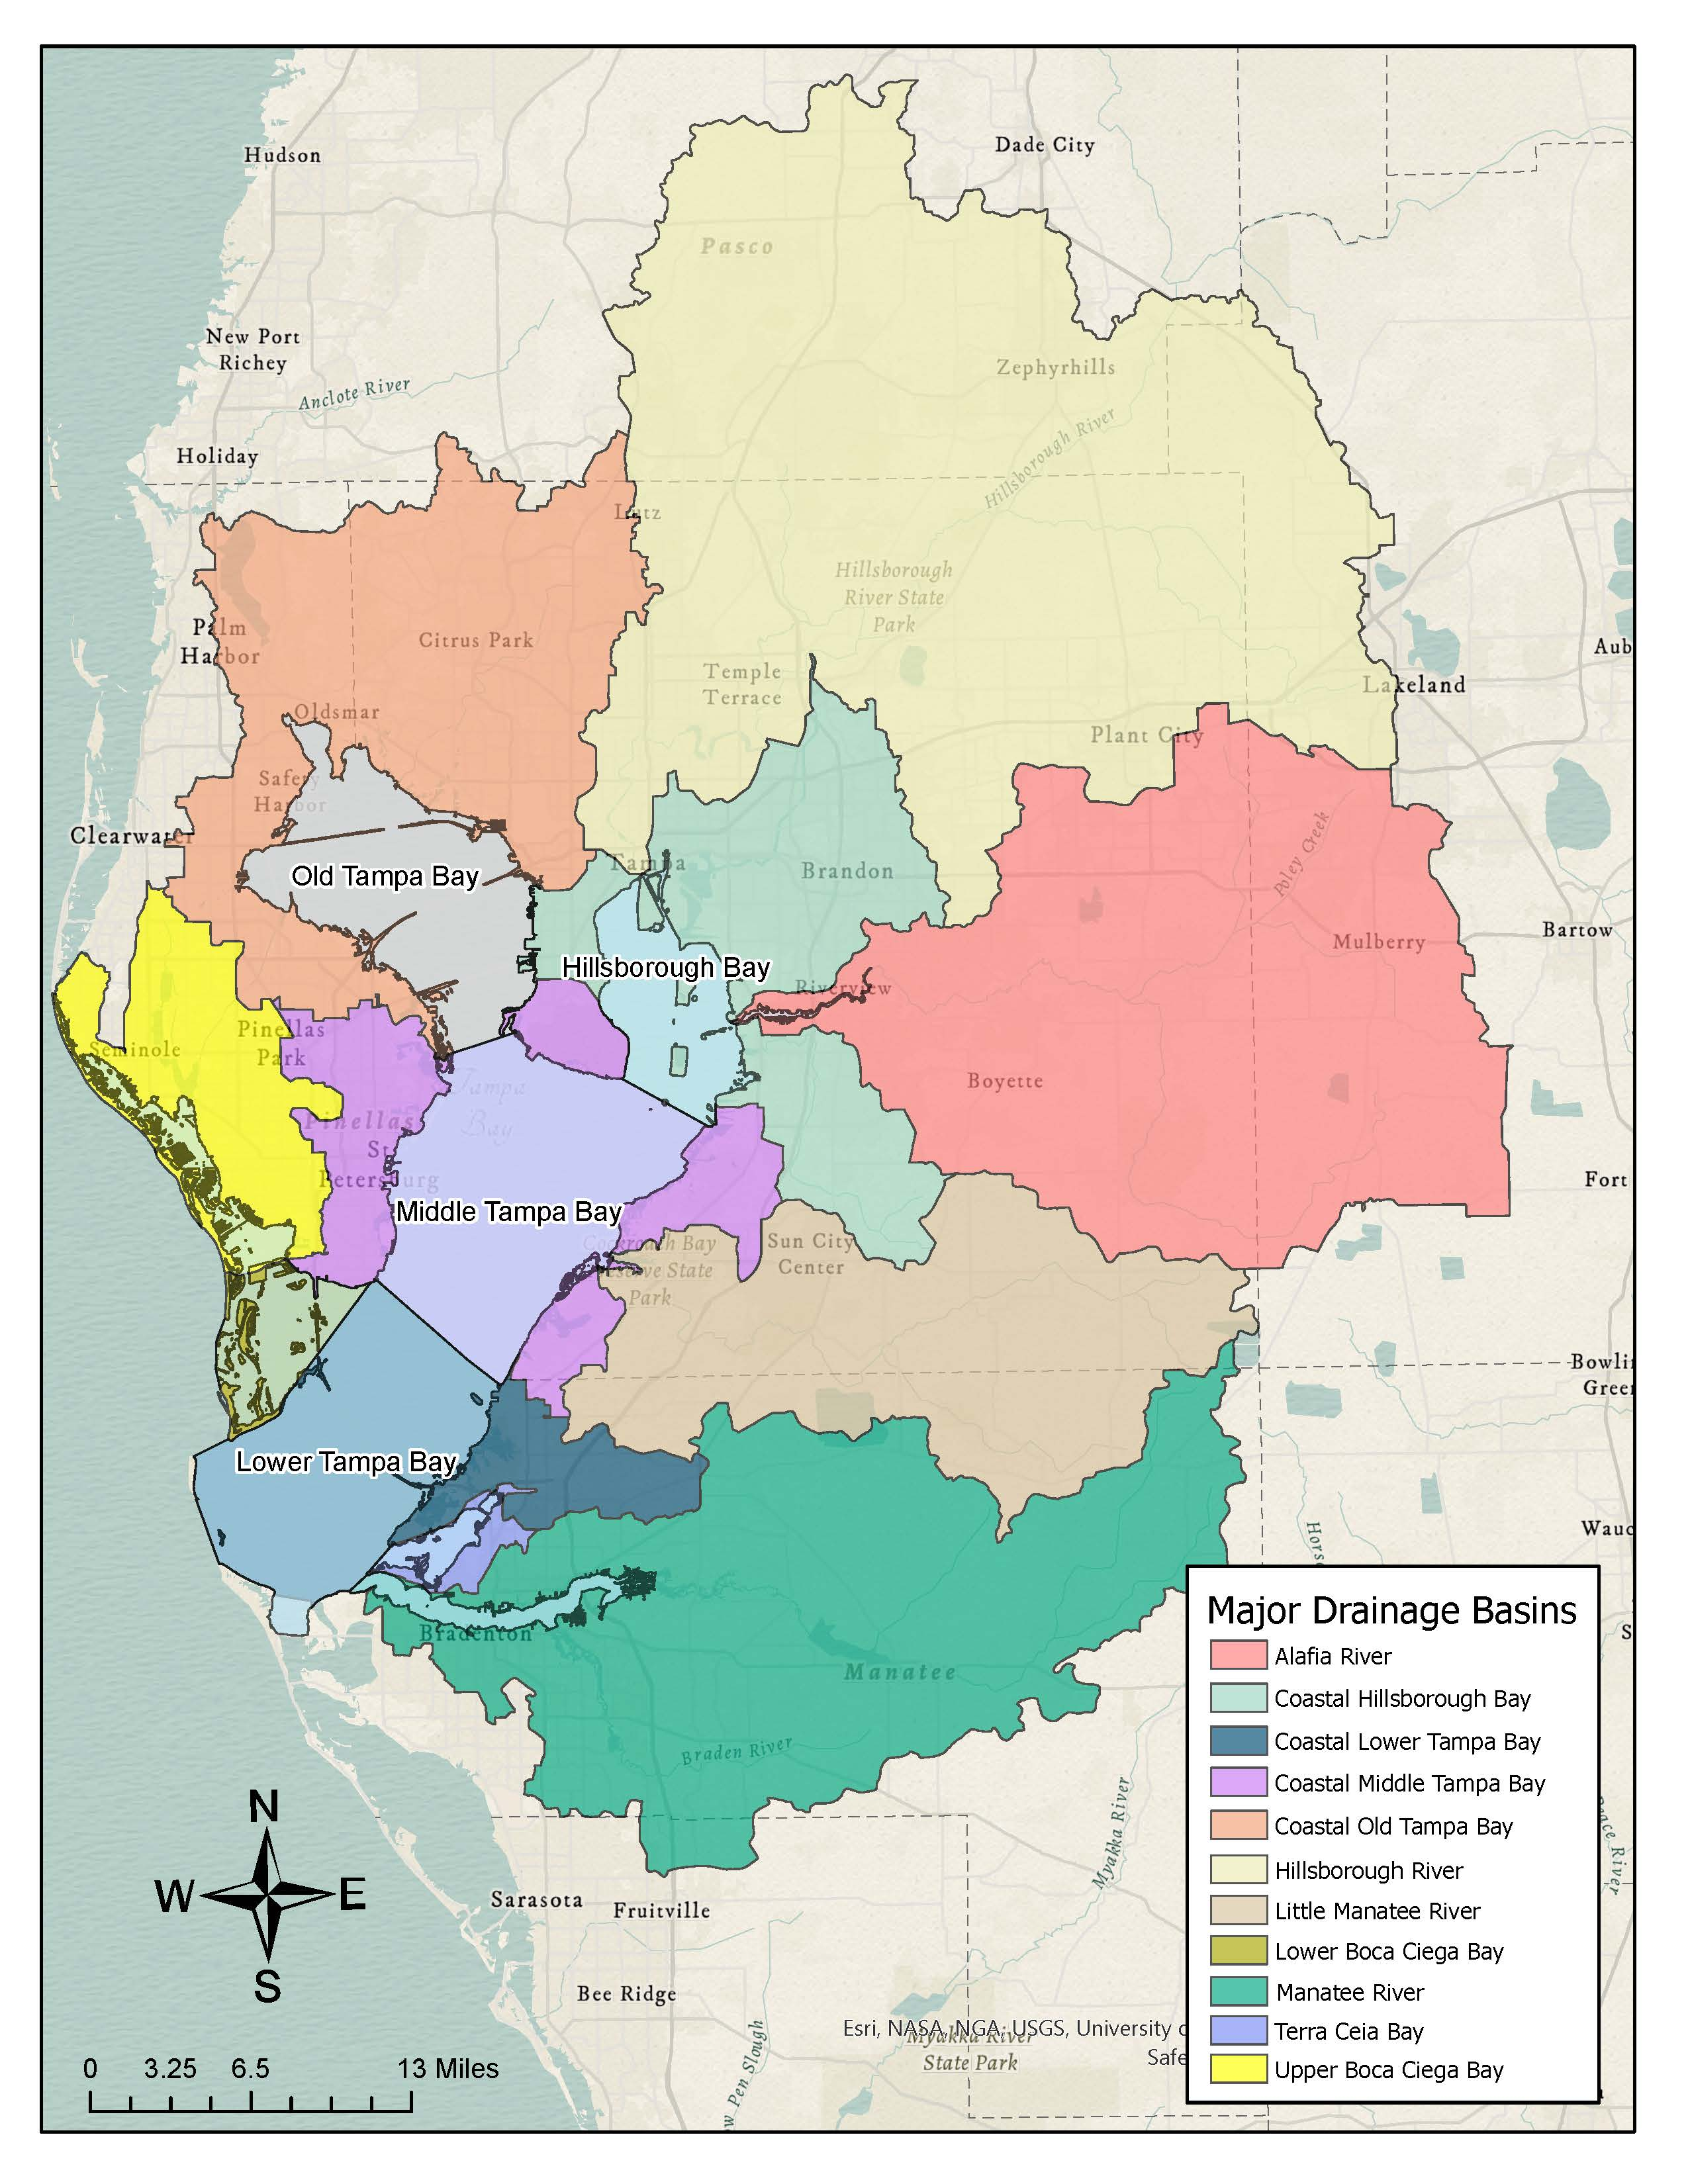
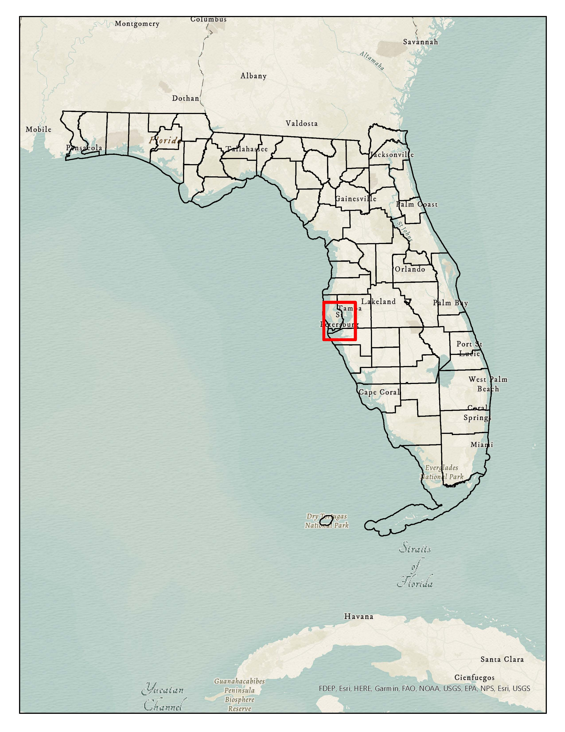
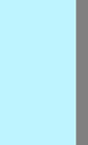

Slide 3
Defining the Problem
Water clarity in Tampa Bay declined markedly in the 1950s, 60s, and 70s as rapid population growth led to increased discharges of partially treated sewage with large amounts of nitrogen.
Algae blooms and fish kills were common and almost 50% of seagrass in the bay died off as a result of insufficient light.
Unregulated dredge and fill operations contributed to the problem by further clouding the water.

Slide 4
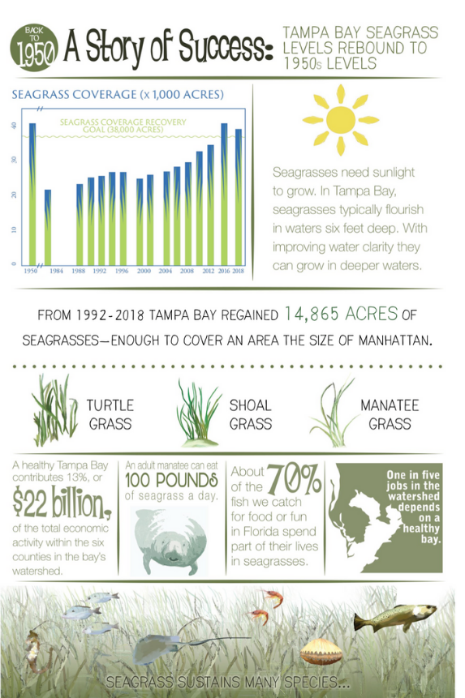
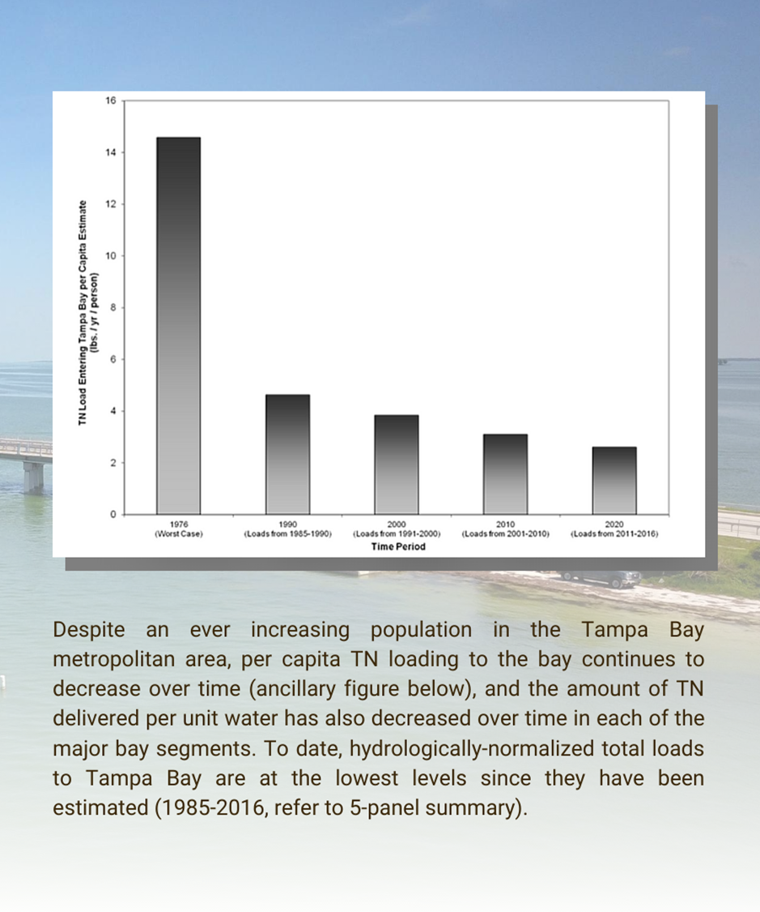
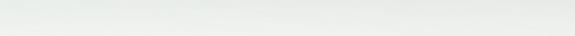

Slide 5
Tampa Bay Estuary Program (TBEP)
Created in 1991.
Intergovernmental partnership coordinating the overall restoration of the bay according to a comprehensive management plan adopted in 1997.
One of 28 National Estuary Programs.
Partnership of Hillsborough, Manatee, Pinellas, and Pasco counties, the cities of Clearwater, St. Petersburg, and Tampa, the Florida Department of Environmental Protection (DEP), the Southwest Florida Water Management District, and U.S. Environmental Protection Agency (EPA).

Slide 6
Tampa Bay Nitrogen Management Consortium (NMC)
Local governments and private industries joined together in 1996 to form the Tampa Bay NMC.
Proactively manages nitrogen loads entering the bay.
Together, these partners implement various projects to “hold-the-line” on nutrient pollution and improve water quality for the benefit of seagrass habitat in Tampa Bay.
https://tbep.org/our-work/boards-committees/nitrogen-management-consortium/

Slide 7
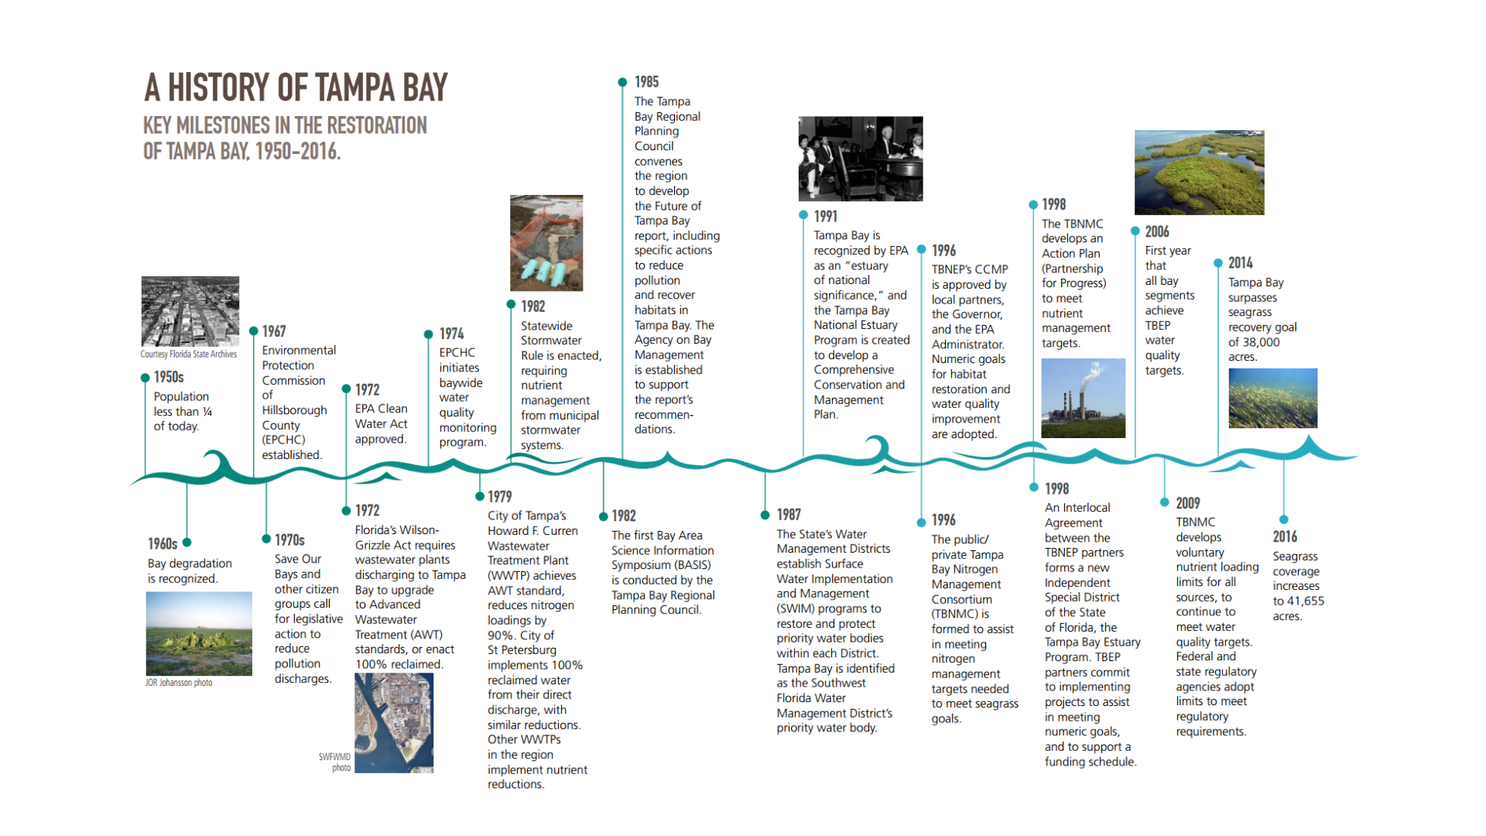

Credit: TPBEP

Slide 8
Tampa Bay TMDL
DEP developed TMDL for Tampa Bay approved in 1998.
  TMDL based on TBEP’s nitrogen targets for each bay segment.
  Goal of “holding the line” on nitrogen loading to the bay at 1992-94 levels to meet seagrass, clarity, and chlorophyll-a targets by offsetting projected increased stormwater loads from growth.
Did not include individual allocations (WQBELs).
The TMDL pre-dated the 1999 Florida Watershed Restoration Act (FWRA) and the TMDL was never adopted into state rule.
  Florida considers it a federal TMDL

Slide 9
Initial Reasonable Assurance (RA) Determination
In November 2002, the DEP approved the Reasonable Assurance plan developed by the NMC.
DEP developed individual WQBELs (allocations) under TMDL.
DEP did not list Tampa Bay as impaired in 2002 because there was Reasonable Assurance that the target loads would be met.
Submitted this position to EPA as part of 2002 303(d) Impaired Waters List.
  EPA did not take a position on RA determination because they said there was already a TMDL.

Slide 10
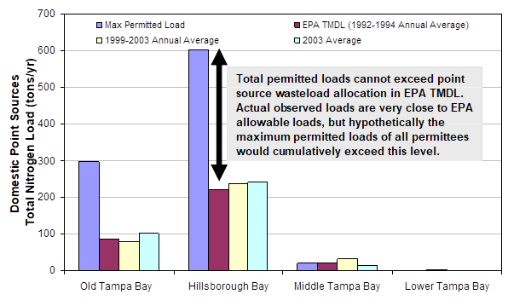
Permitting Concerns - 2004
EPA and DEP advised the NMC that existing and future surface water discharge permit limits must not cumulatively exceed the TMDL.
  Could not issue renewals or new permits.
RA renewal required specific allocations for all permitted sources.

Slide 11
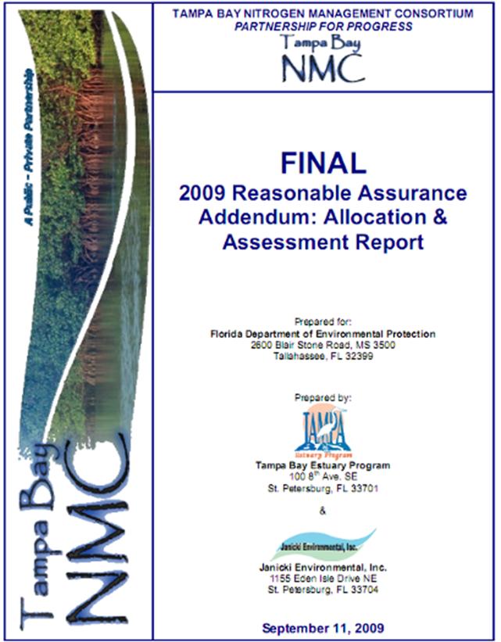
Tampa Bay RA
In December 2007, the NMC submitted to the DEP the “Declaration of Cooperation of the Tampa Bay Nitrogen Management Consortium.”
  Committed an equitable process for the development of load allocations for all sources.
40+ public and private partners throughout watershed.
Consortium developed and agreed to limits on nitrogen loads for 189 sources in September 2009.
Incorporated Load Allocations into permits as WQBEL.
  Florida DEP approved the WQBEL on November 16, 2010.

Slide 12
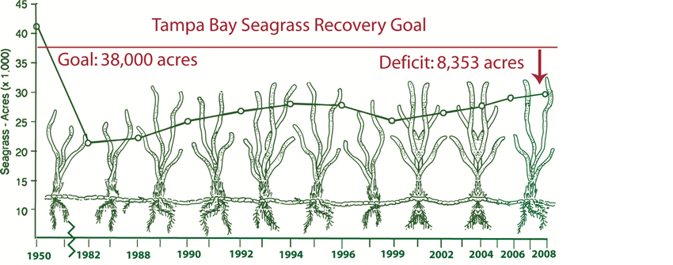
Restoration Targets - Seagrass
A primary goal was to restore seagrass back to estimated 1950s acreage, a total of 38,000 acres across the bay.
  Goal included preservation of the existing acreage, 29,647 acres in 2008, and recovery of an additional 8,353 acres.
TBEP’s and the NMC, adopted a goal of maintaining nitrogen loadings to the bay at the 1992-1994 average annual loads.
This “hold-the-line” approach was expected to be commensurate with water quality conditions sufficient to allow continued recovery of seagrasses.

Slide 13
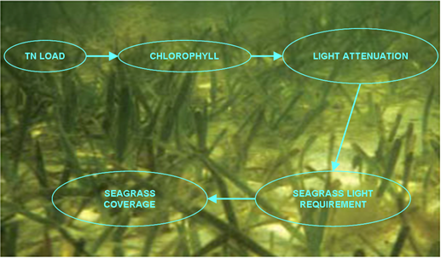
Development of Chlorophyll a Thresholds
Janicki and Wade (1996) developed empirical relationships between:
  External TN loads and resulting average chlorophyll-a concentrations, and
  Chlorophyll-a, turbidity, and color and resulting subsurface light conditions.
Relationships were developed for the Old Tampa Bay, Hillsborough Bay, Middle Tampa Bay, and Lower Tampa Bay segments.

Slide 14
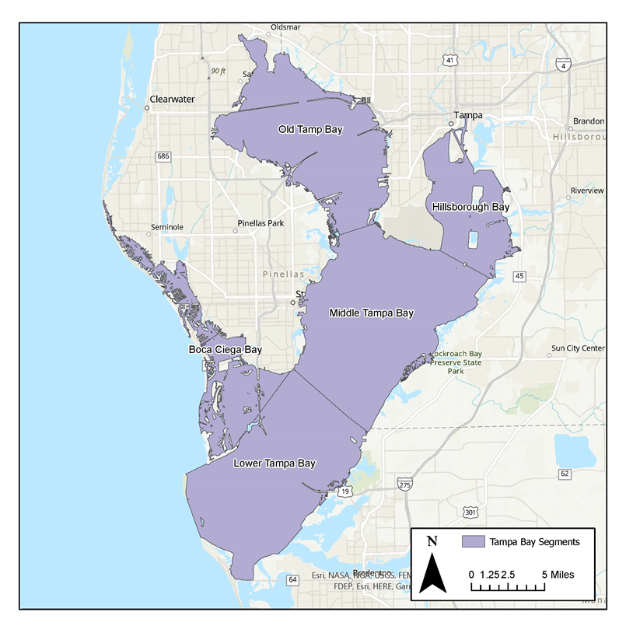
Modeling Results
Seagrass restoration goals could be met by constraining chlorophyll-a concentrations to remain at the estimated average levels of 1992-1994.
Chlorophyll-a targets expressed as annual averages.
Subsequently (2012) adopted as numeric nutrient criteria by DEP.
  Added Boca Ciega Bay.
9.3 µg/L
15.0 µg/L
8.5 µg/L
6.3 µg/L
5.1 µg/L

Slide 15
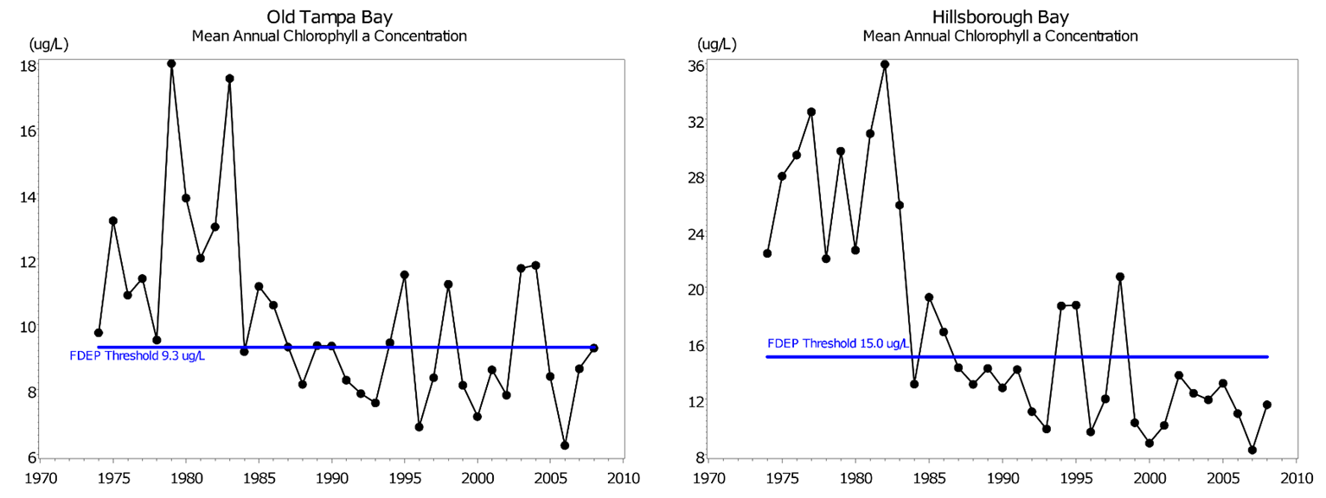
Temporal Trends in Chlorophyll-a
2009 RA Addendum

Slide 16
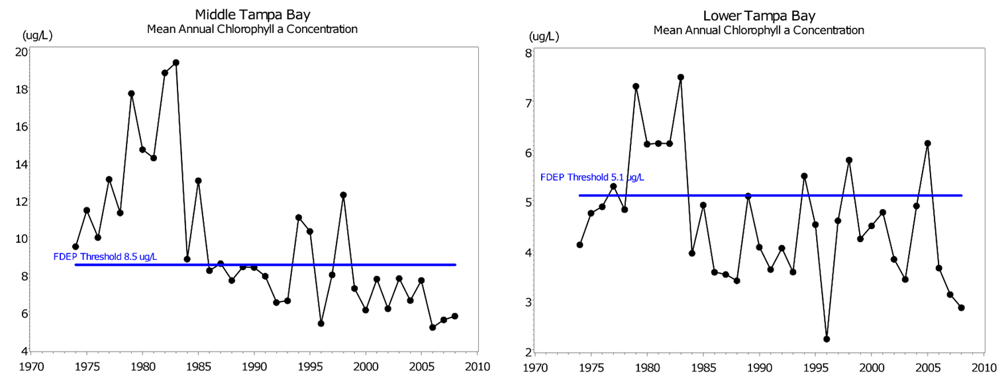
Temporal Trends in Chlorophyll-a
2009 RA Addendum

Slide 17
Nitrogen Loads to Tampa Bay
Estimated TN loads from all major sources to Tampa Bay were developed for 1985-2007.
Loads were developed for each bay segment, and for six source categories within each segment. These source categories include the following:
  Nonpoint Sources (Stormwater).
  Direct Atmospheric Deposition (only that which falls directly on the bay water surface).
  Domestic Wastewater.
  Industrial Wastewater.
  Fertilizer Material Losses.
  Groundwater and Springs.

Slide 18
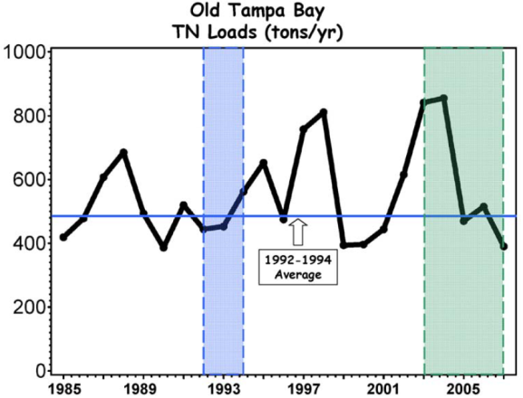
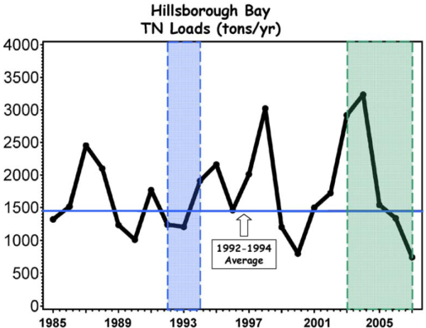
Temporal Trends in TN
486
1451

Slide 19
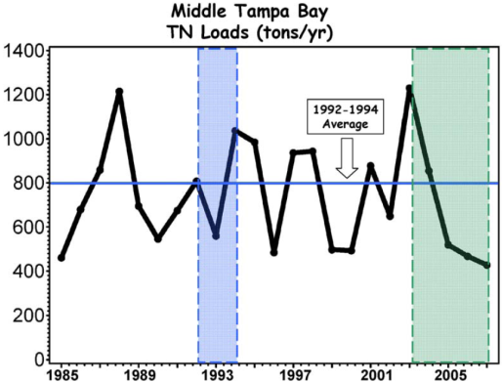
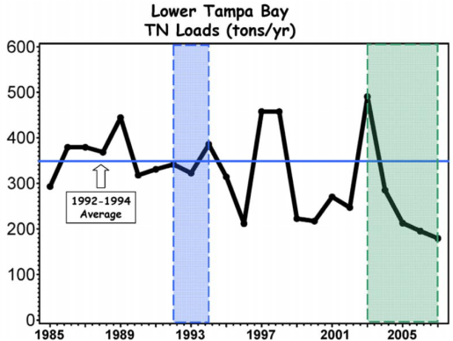
Temporal Trends in TN
799
349

Slide 20
Total Nitrogen Target Loads
Capped the segment TN loads at levels that would ensure adequate water clarity and light to sustain seagrass recovery based on annual average 1992-1994 TN loads by bay segment:
  Old Tampa Bay: 486 tons/year.
  Hillsborough Bay: 1451 tons/year.
  Middle Tampa Bay: 799 tons/year.
  Lower Tampa Bay: 349 tons/year.
Loads were commensurate with good water quality that would promote seagrass recovery.

Slide 21
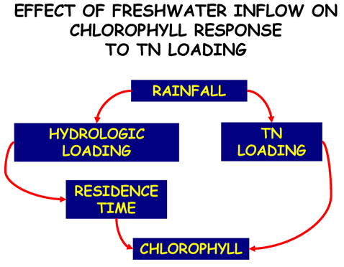
Hydrologic (Residence Time) Adjustment
Residence time was shown to influence the chlorophyll response.
  As residence time shortens, and loadings move more quickly out of the estuary, biological processes have less time to convert nutrients to chlorophyll-a.
  As residence time lengthens, loadings remain within the system longer, and thus more nutrients can be converted to chlorophyll-a.
Given the same nutrient loads, different residence times within the system can result in different chlorophyll-a responses.

Slide 22
Nitrogen Delivery Ratio
The amount of TN delivered per unit water delivered to the bay was determined to be a more reliable predicator of good water quality.
  Denoted as the Nitrogen Delivery Ratio.
  Defined as the amount of TN delivered, in tons, per million m³ of freshwater delivered.
  Units of the Nitrogen Delivery Ratio are tons TN/million m³.
Nitrogen Delivery Ratios:
  Old Tampa Bay: 1.08 tons TN/million m³.
  Hillsborough Bay: 1.62 tons TN/million m³.
  Middle Tampa Bay: 1.24 tons TN/million m³.
  Lower Tampa Bay: 0.97 tons TN/million m³.
  Remainder of Lower Tampa Bay: 1.59 tons TN/million m³.

Slide 23
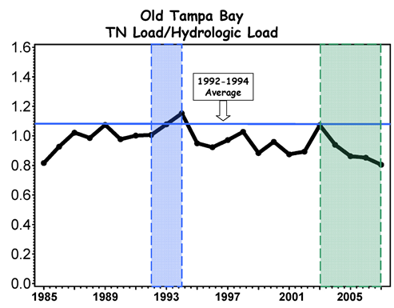
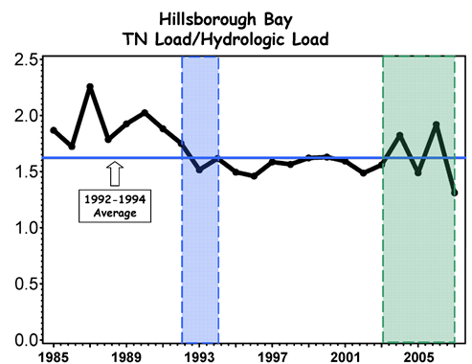
Example Hydrologic Loads

Slide 24
WQBEL Development
The WQBELs were based on nitrogen load allocations developed and approved as part of the 2009 RA Addendum for Tampa Bay.
RA Addendum expressed allocations as:
  Set load for domestic wastewater sources and several industrial wastewater sources.
  Set load for the combined discharge of small source facilities (<0.1 MGD).
  Percentage method was applied to rainfall-driven sources.
    Atmospheric deposition.
    Groundwater and springs.
    Stormwater discharges including Municipal Separate Storm Sewer Systems (“MS4”).
    Any remaining industrial wastewater sources and nonpoint sources.

Slide 25
WBQEL – Allocation Approach
Allocations for a given entity/source within a segment were derived in a 4-step process, as follows:
Estimate mean 2003-2007 bay segment TN load.
Estimate mean 2003-2007 Set Allocations.
Calculate Remaining Load as the difference between the segment TN load and the Set Allocations. This provides the segment TN load remaining after the Set Allocations are removed.
Estimate the percentage contribution for a given entity/source as the ratio of the entity/source 2003-2007 average annual TN load to the Remaining Load for the segment.

Slide 26
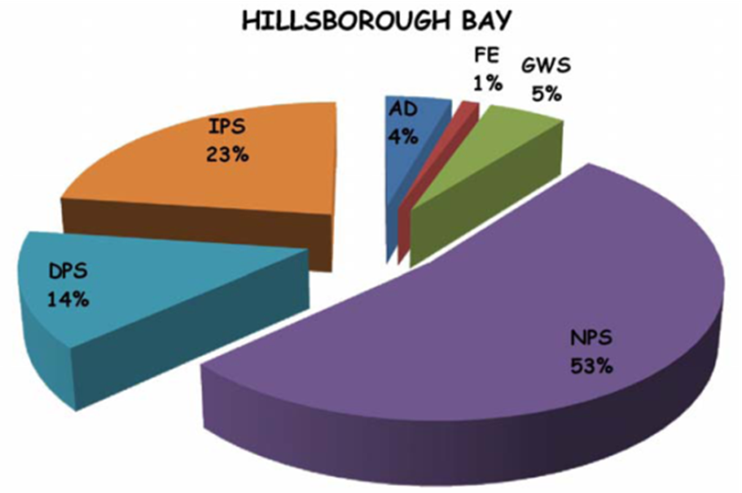
Step 1: Estimate 2003-2007 Segment Loads
2003-2007 loads reduced from baseline.
  TECO installed air pollution controls to reduce nitrogen oxide.
  Surface water withdraws by Tampa Bay Water for drinking water.
  Industrial facility closures.
Segment load estimates were based on six major sources:
  Nonpoint Sources (Stormwater, NPS).
  Direct Atmospheric Deposition (AD).
  Domestic Wastewater (DPS).
  Industrial Wastewater (IPS).
  Fertilizer Material Losses (FE).
  Groundwater and Springs (GWS).
Notes:
The NMC decided that the allocation alternatives dependent upon baseline and future loads were not as useful for this process as those using only the current loads. This was because baseline loads were representative of past conditions which included facilities which have since been closed, and did not include all currently active facilities. Additionally, estimates for future loads were considered to be of varying degrees of confidence, and perhaps not reliable enough as a whole to utilize for this effort. The Consortium thus decided to continue evaluation of the allocation alternative which utilized the proportion of the current load only to derive entity and source allocations, as the current period was most representative of the current distribution of loads.

Slide 27
Step 2: Set Allocations
Sources that have less-rainfall related variability.
Set allocations were primarily for those domestic wastewater facilities which are already at AWT treatment standards and/or discharge for reuse (irrigation).
All domestic point sources facilities discharging >0.1 MGD.
Additional set allocations:
  Material loss facilities (phosphate mines).
  Small point sources received aggregate set allocations as developed by DEP.
Set Allocations were derived as the average annual load for the 2003-2007 period for direct surface water discharge loads and estimated loads associated with reuse discharges.

Slide 28
Step 3: Calculate Remaining Load
Calculated Remaining Load as the difference between the actual bay segment TN load and the Set Allocations for the 2003-2007 period.
Provided the segment TN load remaining after the Set allocations were removed:
Remaining Segment Load = Total Segment Load – Sum (Segment Set Allocations)

Slide 29
Step 4: Estimate Percentage Contributions
Percentage contributions developed for sources with more highly variable rainfall-related loadings.
Sources other than permitted point sources and MS4 sources.
These sources included:
  Atmospheric Deposition.
  Groundwater and Springs.
  Non-MS4/Non-Agricultural Lands.
  Conservation Lands.
  Agricultural Land.

Slide 30
Step 4: Estimate Percentage Contributions
Entity loads were calculated based on land use-specific TN concentrations and areal extent.
Estimate the percentage contribution for a given source as the ratio of the source 2003-2007 average annual TN load to the Remaining Load for the segment:
Percentage Contribution = 100* Entity Load / Remaining Segment Load
Percentage allocations associated with regulated entities were converted to set loads.

Slide 31
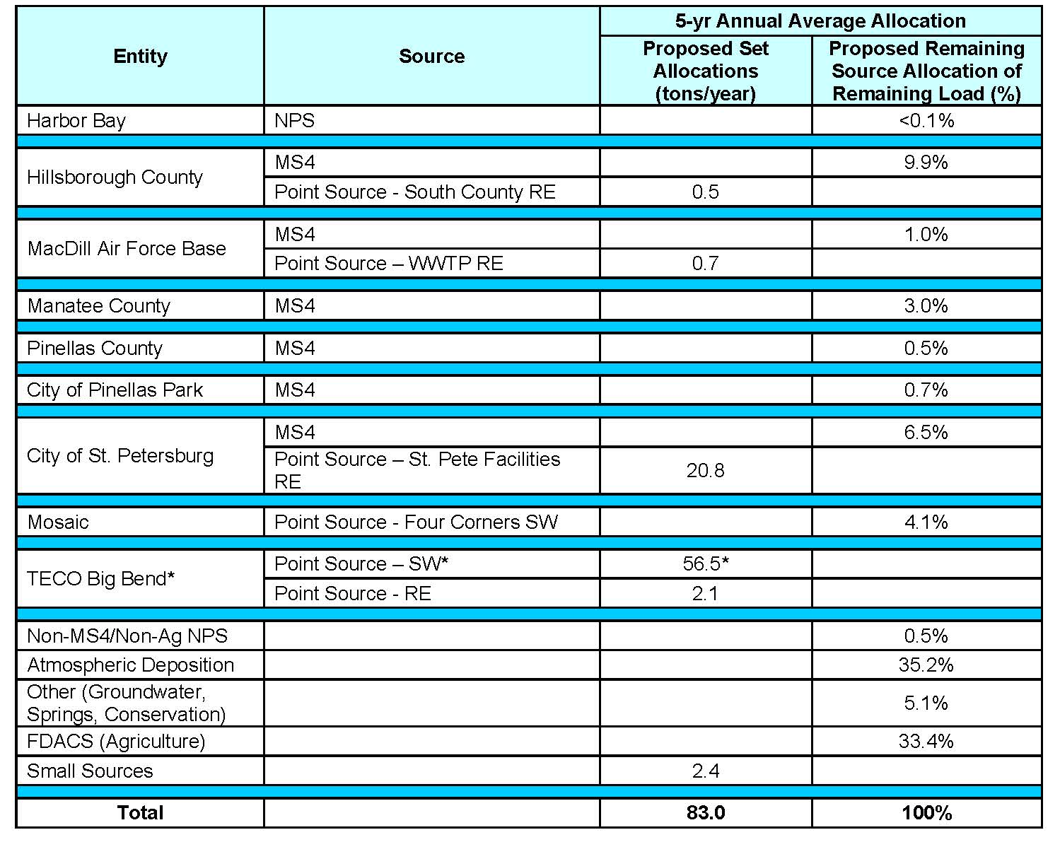

Example Nitrogen Load Allocation Table Middle Tampa Bay
SW=Surface water discharge allocations, RE=Reuse discharge allocations
403 tons/yr remaining for Percent Allocations

Slide 32
WQBEL Compliance Assessment
Rolling 5-year average of annual TN loads is used to demonstrate compliance.
Compliance for percent allocations uses a hydrologic normalization.
  The method is utilized to normalize observed annual TN loads based on differences in observed hydrologic loads from the observed 1992-1994 hydrologic load.

Slide 33
Hydrologic Normalization
TN loads from 1995-2007 exceeded the target loads established in the federally-recognized TMDL in 48% of the bay segment/year combinations.
However, the chlorophyll-a concentration thresholds were met in 81% of the bay segment/year combinations during the same years.
By converting the percentage allocations to set loads and subsequently normalizing the set loads to the hydrologic load observed in 1992-1994, the observed TN load was reconciled with the chlorophyll-a threshold monitoring.
Therefore, percentage allocations were converted to hydrologically-normalized set loads.

Slide 34
Hydrologic Normalized TN Load
For any calendar year, the normalized annual TN load is calculated as follows:
Normalized Annual TN Load =
where:
Observed Annual TN Load = reported calendar year load.
Observed Hydrologic Load = to be calculated by major bay segment.
1992-94 Hydrologic Load by Major Bay Segment=
      Old Tampa Bay = 449.44 million cubic meters/year.
      Hillsborough Bay = 895.62 million cubic meters/year.
      Middle Tampa Bay = 645.25 million cubic meters/year.
      Lower Tampa Bay = 361.19 million cubic meters/year.
      Expanded Lower Tampa Bay = 422.71 million cubic meters/year.

Slide 35
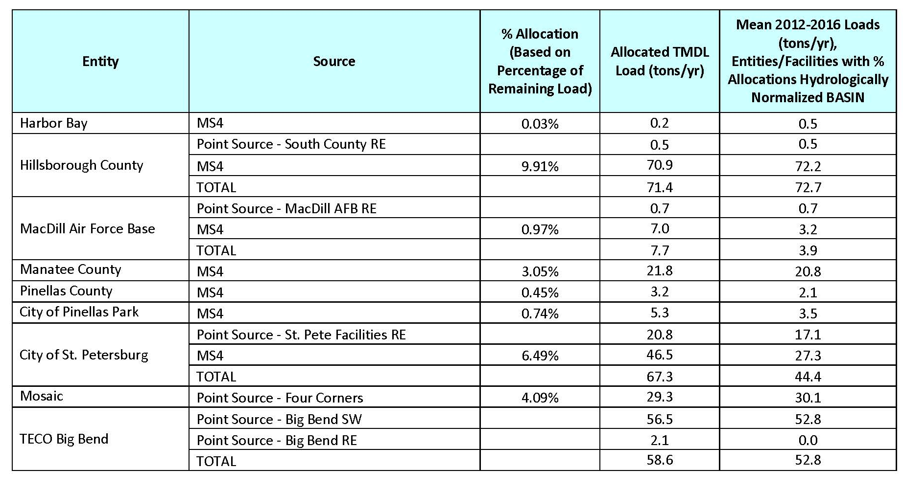
Example WBEL Compliance- Middle Tampa Bay (2012 – 2016)
(SW=Surface water discharge allocations, RE=Reuse discharge allocations)

Slide 36
2017 Reasonable Assurance Update
Hydrologically-normalized total loads to Tampa Bay were at the lowest levels.
Allocations for interim, new and transferred sources were reviewed and updated during the update.
  Led to formal NMC concurrence of allocations assigned to each entity for the 2017-2021 Reasonable Assurance implementation period.
  Total allocations continue to remain within the TMDL limits for the Tampa Bay segments recognized under the 2002-2012 RA periods.
Provided Allocation (WQBEL) assessment for the 2012-2016 period.

Slide 37
2022 RA Update
Old Tampa Bay Working Group Research and Recommendations.
  (Met 1/2020, 6/2020; 11/2020; 8/2021; Complete by Fall 2021 – Summer 2022).
2017-21 Loading Updates.
  (Complete by early 2022).
2017-21 Allocation Assessment.
  (Complete by mid-2022).
Action Plan Projects Update.
  (Complete by late 2022).
Updating 2022-2026 Allocation / Assimilative Capacity Recommendations.
  (Complete by late-2022).
Submit 2022 RA Update to DEP/EPA.
  (Complete by 12/31/2022).

Slide 38
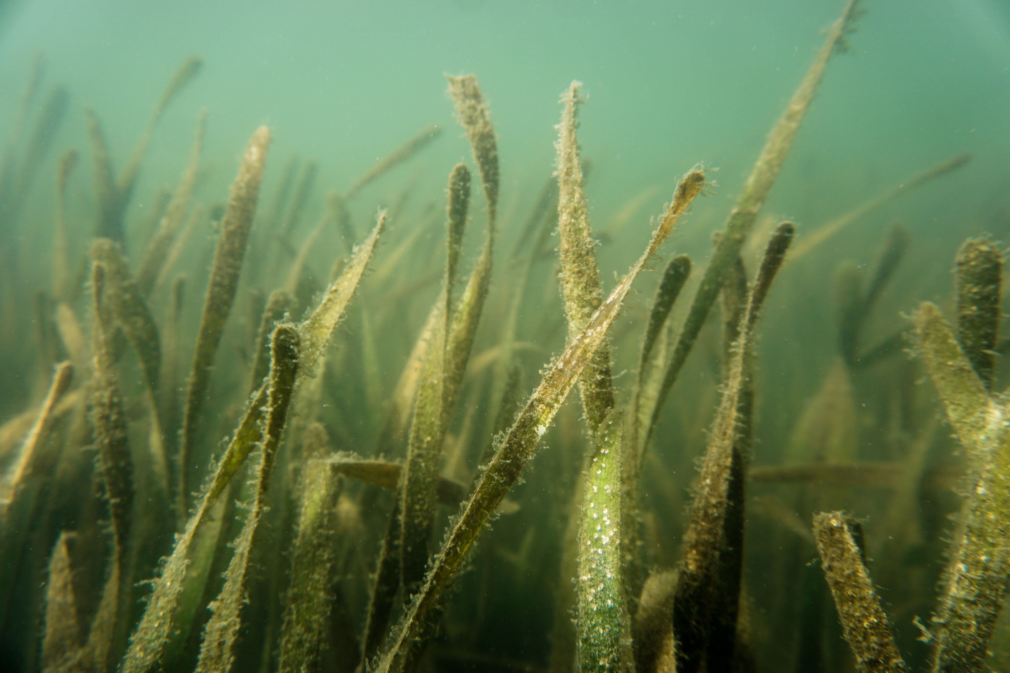
Ken Weaver
Kenneth.Weaver@FloridaDEP.gov
Notes:
This is your closing slide. You may choose to include your contact information where appropriate. If you would like toCustomization: You may choose to use or switch out the photo in the background. To change out the picture, right-click the image and select “Change Picture” from the drop-down menu. From there, browse to select your desired photo replacement. Make sure to select a high-resolution photo that is horizontally oriented. If the photo needs to be resized to fill the PowerPoint frame, adjust the size from the corners of the image so as not to stretch the photo out of proportion. There should be no white frame peeking from behind your selected image.

Slide 39
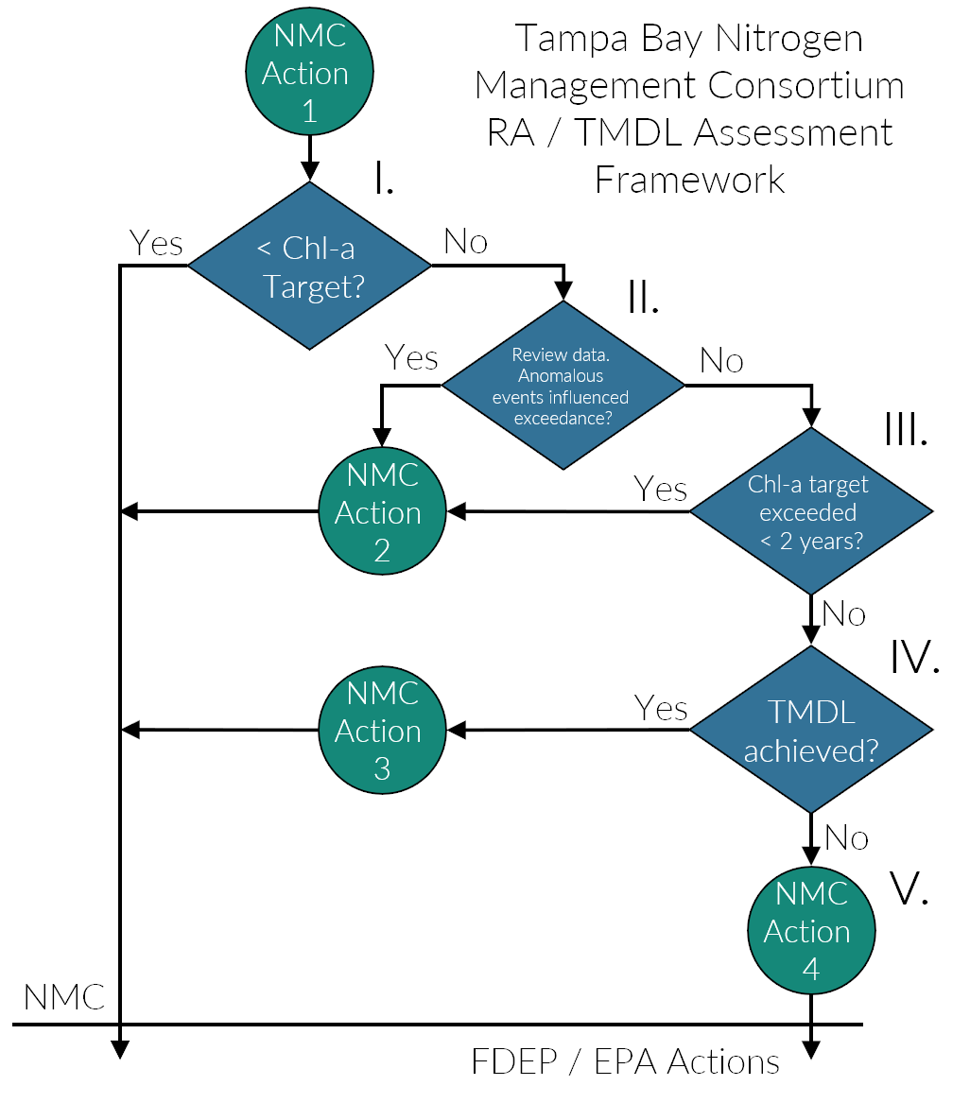
Annual TBNMC RA Assessment

Slide 40
NMC Actions
Action 1: A report assessing attainment of bay segment specific chlorophyll-a thresholds, as traditionally assessed using the Decision Matrix management strategy developed by the TBEP will be delivered to DEP and EPA.
Action 2: A report of the anomalous event(s) or data which influenced the bay segment chlorophyll-a exceedance will be delivered to DEP and EPA, upon review by NMC participants.
Action 3: Consider re-evaluation of the bay segment assimilative capacity based on nonattainment of bay segment chlorophyll-a threshold while meeting federally-recognized TMDL.
Action 4: If federally-recognized TMDL not achieved, compile results of hydrologic evaluation for DEP’s review and identify potential further actions needed to achieve reasonable assurance for bay segment allocations.

Slide 41
2017 - 2021 RA Compliance Period Results
Bay Segment | Chl-a Criteria (μg/L) | 2022 Reasonable Assurance Update Period
 |  | 2017 | 2018 | 2019 | 2020 | 2021
Old Tampa Bay | 9.3 | 9.5 | 9.2 | 9.8 | *9.5 | ?
Hillsborough Bay | 15.0 | 9.7 | 13.9 | 11.0 | *10.5 | ?
Middle Tampa Bay | 8.5 | 5.8 | 7.0 | 5.7 | *5.5 | ?
LTB / Remainder LTB | 5.1 | 3.3 | 4.7 | 3.9 | *3.0 | ?
*April and May 2020 samples were not collected & analyzed due to COVID-19 pandemic
Credit: Ed Sherwood, TBEP Executive Director

Slide 42
Additional RA Assessment Steps for OTB
Bay Segment Reasonable Assurance Assessment Steps | DATA USED TO ASSESS ANNUAL REASONABLE ASSURANCE |  |  |  |  | OUTCOME
 | Year 1 (2017) | Year 2 (2018) | Year 3 (2019) | Year 4 (2020) | Year 5 (2021)
NMC Action 1: Determine if observed chlorophyll-a exceeds FDEP threshold, 9.3 𝜇g/L | 9.5 𝜇g/L (Yes) | 9.2 𝜇g/L (No) | 9.8 𝜇g/L (Yes) | 9.5** 𝜇g/L (Yes**) |  | 2nd concurrent exceedance, but data gaps in 2020 estimate.
NMC Action 2: Determine if any observed chlorophyll-a exceedances occurred for 2 consecutive years, review / report on any anomalous events and data. | No | No | No | Yes** |  | Two month (Apr. - May) gap most likely influenced exceedence. Other data sources have proven to be poor surrogates for those months.
NMC Action 3: Determine if observed hydrologically-normalized total load exceeds federally-recognized TMDL of 486 tons/year | No* (332) | No* (346) | No* (369) | No* (355) |  | Prep. for NMC Action 3: Assemble 2020 loading info; Further scrutinize data; Assess re-evaluation of bay segment assimilative capacity
NMC Action 4: Determine if any entity/source/facility specific exceedances of 5-yr average allocation occurred during implementation period
YES
NO
*Provisional loading data; **April-May data not collected & analyzed due to COVID-19 pandemic

Slide 43
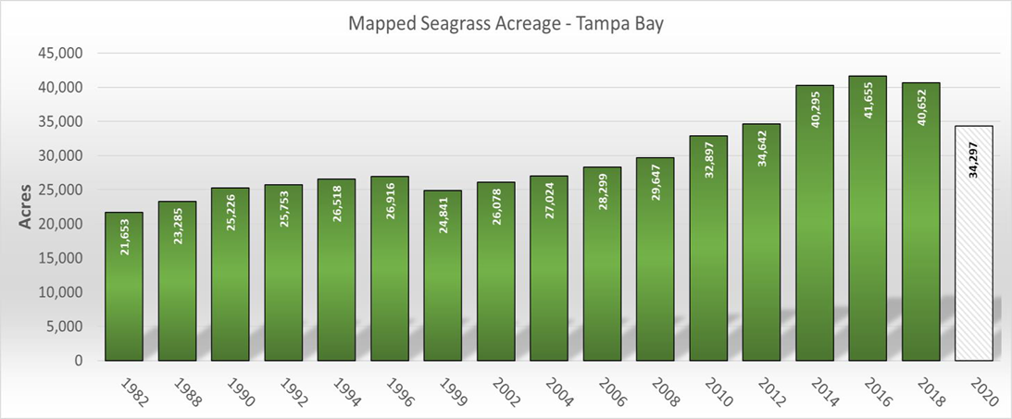
Seagrass Coverage – Recent vs. Goal
Goal: 38,000
Credit: Chris Anastasiou, Southwest Florida Water Management District

Slide 44
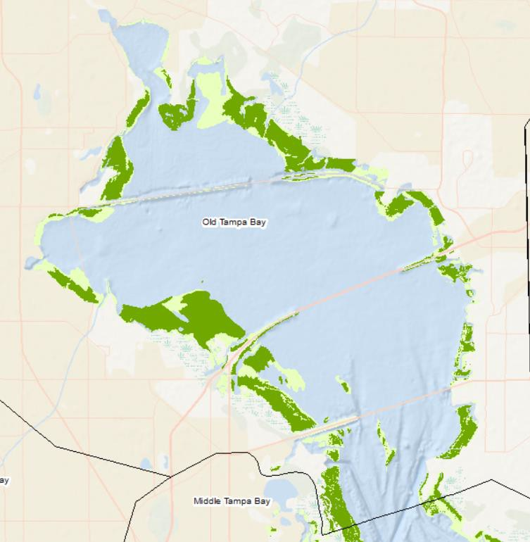
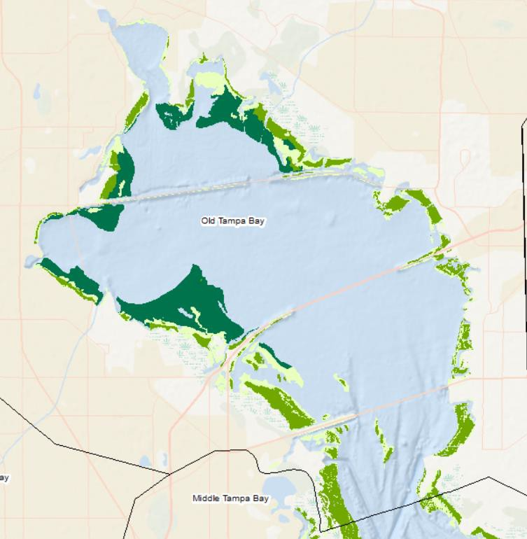
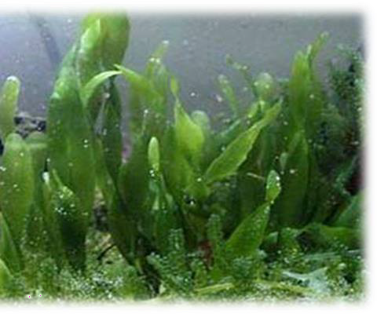
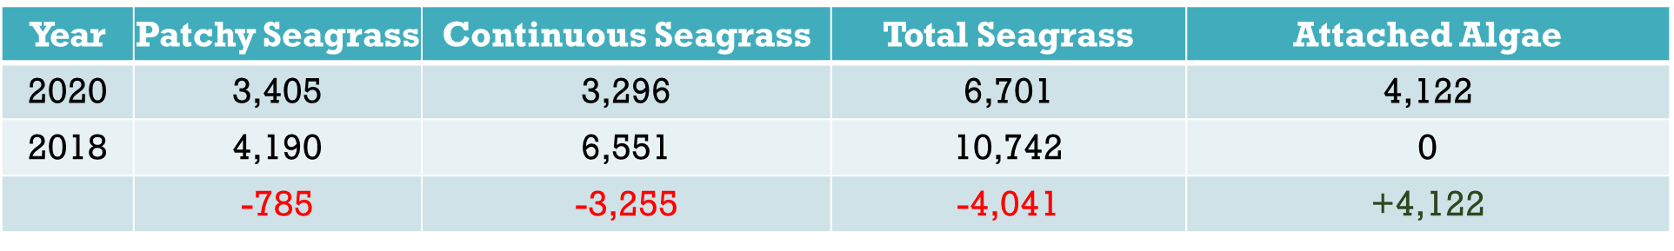
Greatest Loss in Old Tampa Bay

Slide 45
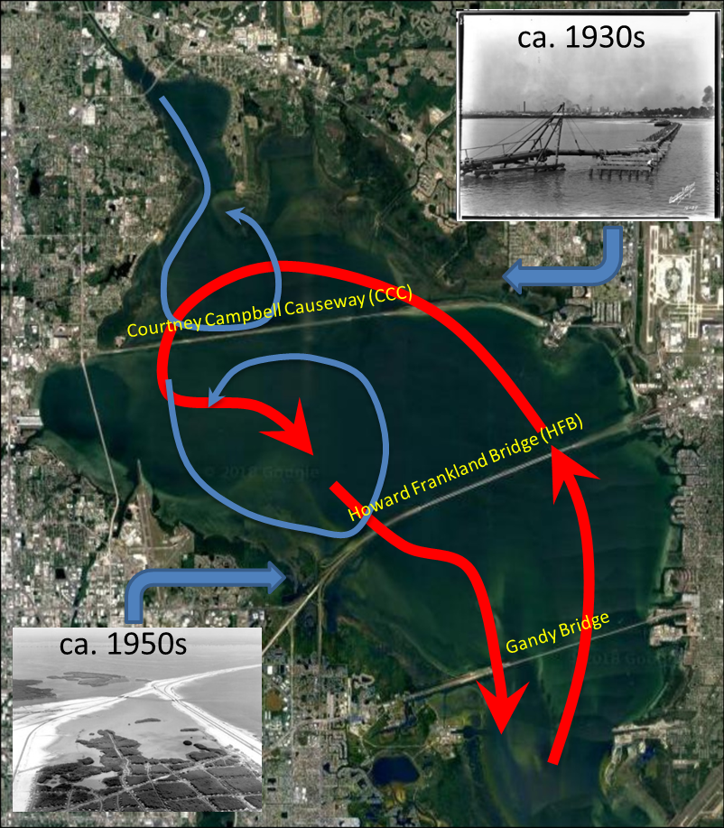
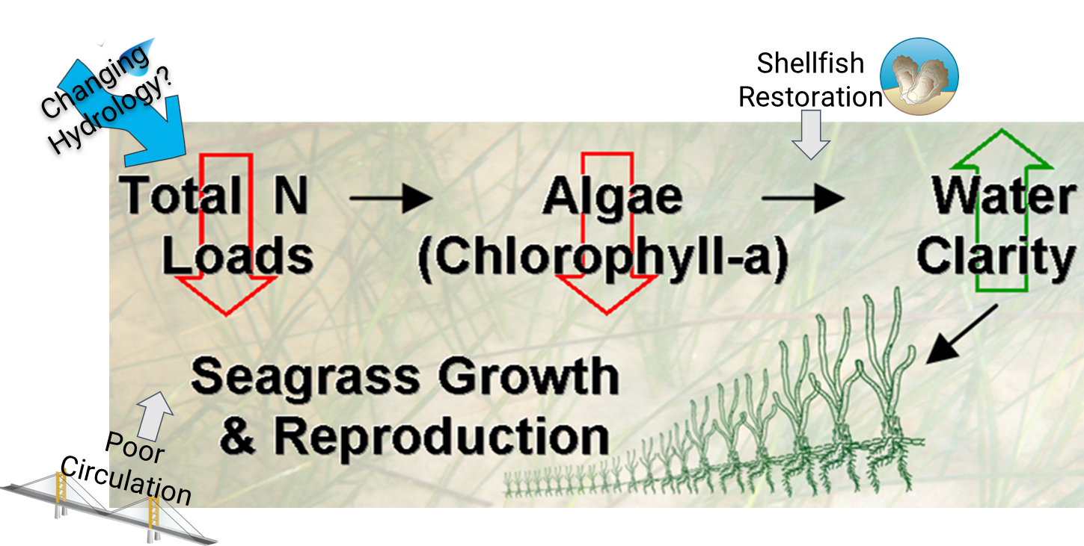
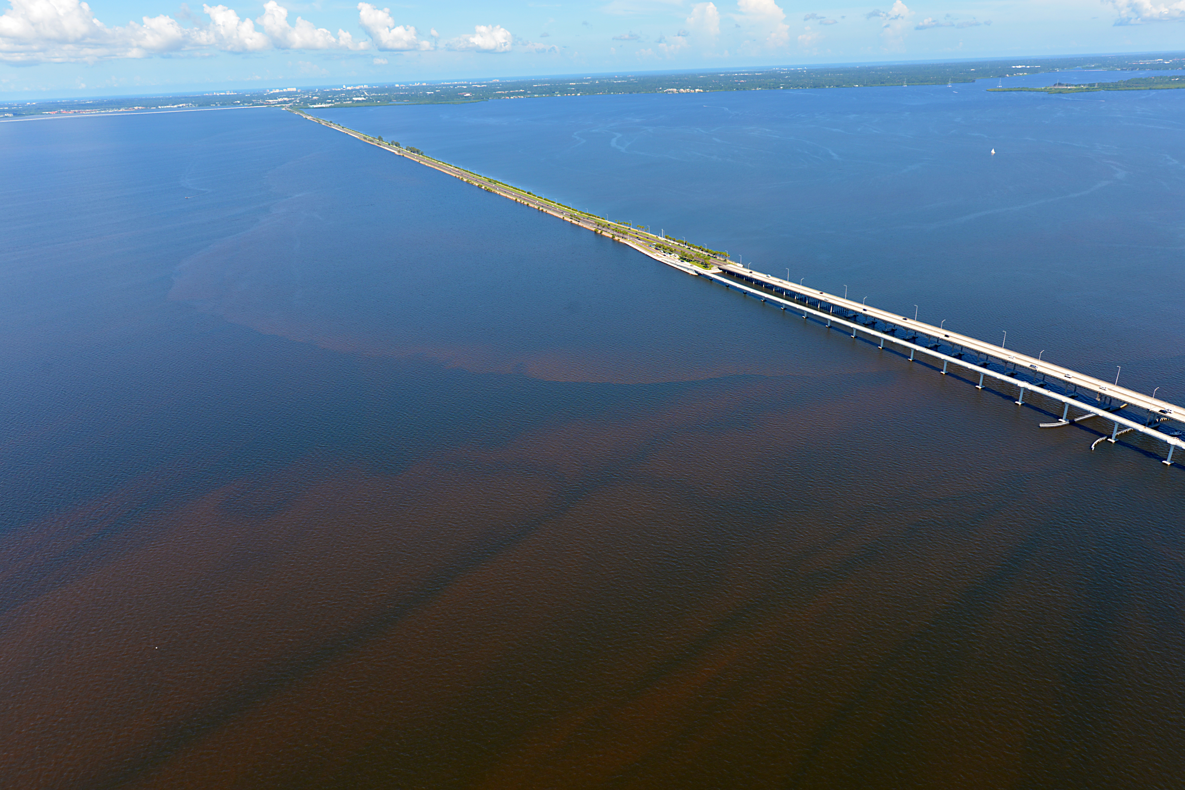
Old Tampa Bay Working Group
Evaluating Conditions and other Drivers
Pyrodinium Bloom, Old Tampa Bay: 7/18/21
Credit: Ed Sherwood, TBEP Executive Director
Dorian Aerial Photographics

