Slide 1
FDEP Pilot Study on the Occurrence of Emerging Substances of Concern (ESOCs) in Florida’s Flowing Waters
Division of Environmental Assessment & Restoration
Florida Department of Environmental Protection

Slide 2

Study Objectives
Determine occurrence of ESOCS at detectable concentrations.
Measure of biological effects, such as hormonal activity, in the water sample.
Determine if the molecule sucralose (Splenda®) is an appropriate tracer for ESOCs in Florida waters.

Slide 3
Questions/Objectives
Are ESOCs occurring at detectable limits in Florida ambient waters? What is DEP doing about it?
What is the appropriate monitoring design?
Do ESOCs have potential biological effects to Florida biota?
  Screen water samples for estrogenic/mutagenic effects.
  Study fish health (vitellogenin, intersex occurrence).
Are we interested in potential health effects from ESOCs bioaccumulation and fish consumption by Floridians?
Can sucralose be used as a reliable tracer compound for ESOCs?

Slide 4
Categories of ESOCs
Organic Waste Water Compounds (OWC)
  Pharmaceuticals and Personal Care Products (PPCP)
  Synthetic Hormones
Current Use Pesticides
Brominated Flame Retardants
Akylphenolic Substances
Perfluorinated Compounds (PFCs)
ESOCs are compounds with a wide array of chemical characteristics that occur at very low levels of detection (parts per trillion or ng/L).

Slide 5
Determining the Analyte List and Sampling Method for Priority ESOCs
Category | Exposure routes | Aquatic life effects | Water Solubility
Brominated fire retardants | House dust, sediment, food web, carcinogen, breast milk | Bioaccumulative, endocrine disrupting, toxic, persistent | Low
Pharmaceuticals & Personal Care Products | Water | Endocrine disrupting | High
Synthetic hormones | Water | Endocrine disrupting | High
Current Use Pesticides | Water, sediment, food web | Toxic | High
Perfluorinated Compounds | Food web, breast milk | Bioaccumulative, Endocrine disrupting | Low
Notes:
Water solubility; need definition of polar and non polar

Slide 6
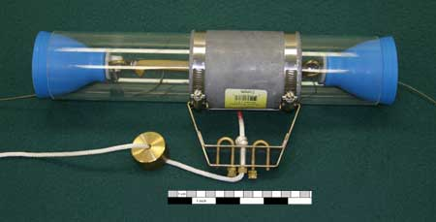
Benefits of Whole Water Grab Samples
Only one sampling trip required.
Quantitative results.
Allows a direct comparison to known sucralose concentrations.
Measure direct biological effects of ESOCs. exposure to aquatic organisms with whole water samples.
Notes:
However, one must keep in mind that whole water sampling will not collect episodic events, is not integrative, there are many non-detects. Which is why we are adding the SPMDs and POCIS.

Slide 7

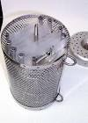
Benefits of Integrative Samplers
Time-Integrated Sample.
Allows for higher number of detected ESOCs based on larger water volumes.
May mimic contaminant accumulation in fish tissue.
Semi Permeable Membrane
Device (SPMD) useful for nonpolar compounds
Polar Organic Compound
Integrative Sampler (POCIS)

Slide 8
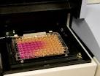
Measuring Biological Effects
Samples are extracted from both POCIS & SPMD and screened for potential estrogenic activity using bioassay techniques such as the yeast estrogen screen (YES) to measure hormonal effects.
Other biological tests of interest:
Oocytes in testes – evaluation of intersex characteristics
Vitellogenin (egg yolk protein) in male fish blood
Human Cell lines – webinar/talk on Wednesday with UF researcher
Mutagenic bioassay (SOS Chromotest)
Notes:
The human estrogen receptor gene is integrated into the main genome and is expressed in a form capable of binding to estrogen response elements (ERE) within a hybrid promoter on the expression plasmid. Activation of the receptor by binding of ligand, causes expression of the reporter gene Lac-Z (4) which produces the enzyme b-galactosidase. This enzyme is secreted into the medium (5) and metabolizes the chromogenic substrate CPRG (normally yellow) into a red product (6), which can be measured by absorbance. (Routeledge, 1996)

Slide 9
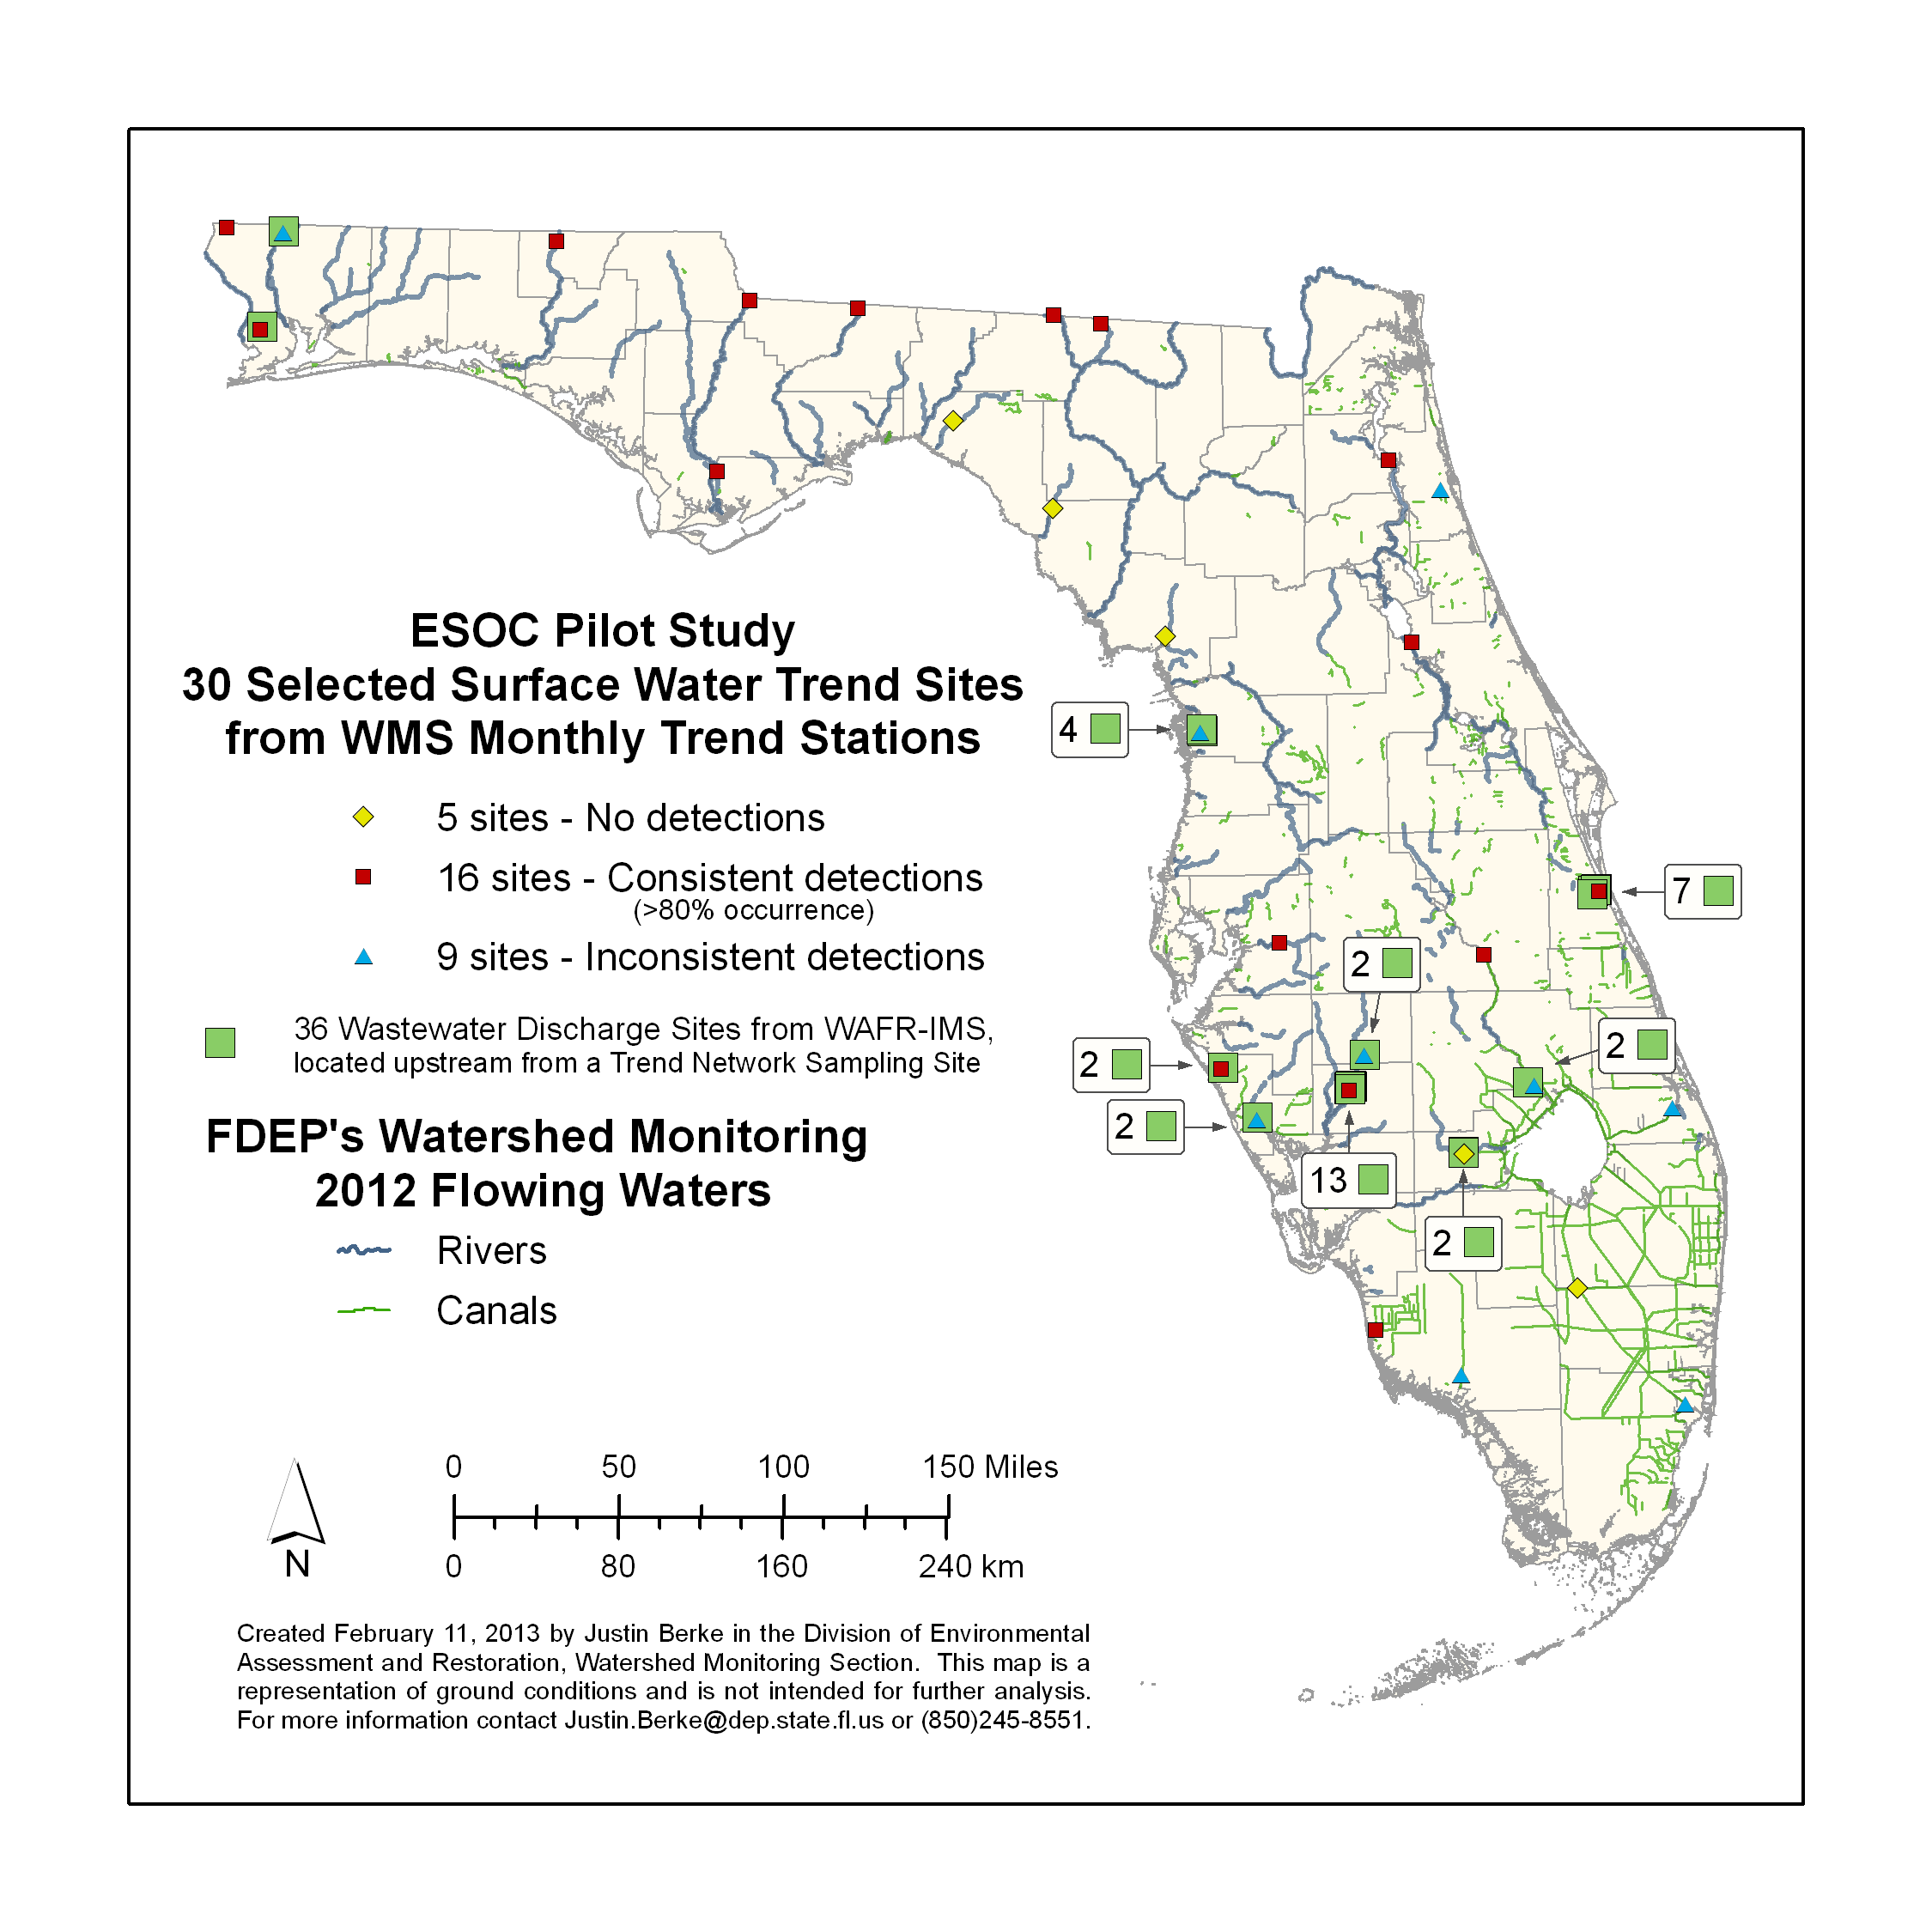

Slide 10
Sucralose as a Tracer for Site Selection
Studies across the nation detect sucralose in surface waters with waste water influence.
Sucralose passes through waste water treatment systems with virtually no degradation, unaffected by chlorination and tertiary-grade treatment.
Therefore FDEP added sucralose to their surface and ground water monitoring networks for the year 2012.

Slide 11
ESOCs Survey Site Evaluation Criteria
WMS monthly trend stations
  One year of sucralose data at each station
Three categories of detection:
  Consistent detections – Occurring > 80% of the time
  Inconsistent detections – Occurring < 80% of the time
  No detections
Within two miles of upstream waste water discharge site(s)
Regional coverage – sites selected in each region of state
Sucralose concentration level taken into consideration
  Concentration ranges from 0.024 ug/L – 2.155 ug/L.
Landscape (LDI) Development Intensity Index taken into account

Slide 12
Cost estimates – Option 1: Whole water, POCIS, and SPMD chemistry analysis with estrogen and mutagen assays
AXYS Chemistry analyses |  |  |  | Whole | POCIS | SPMD | Per site | 30 smpl
Hormones LCMSMS |  |  |  |  | 525 |  | 525 | 15,750
Hormones HR-GCMS |  |  |  | 925 |  |  | 925 | 27,750
PPCP LCMSMS (AXYS List 1-6) |  |  |  | 1,875 | 1,875 |  | 3,750 | 112,500
Pesticides* (whole analyzed by DEP) |  |  |  | - | - | - | - | -
Alkylphenols |  |  |  | 500 | 500 |  | 1,000 | 30,000
PFCs |  |  |  | 385 |  | 385 | 770 | 23,100
PBDEs |  |  |  | 750 |  | 750 | 1,500 | 45,000
Telomers |  |  |  | 375 |  | 375 | 750 | 22,500
HBCDD |  |  |  | 450 |  | 450 | 900 | 27,000
Sum |  |  |  | 5,260 | 2,900 | 1,960 | 10,120 | 303,600
USGS BLYES and SOS Chromotest |  |  |  |  |  |  |  | 90,000
EST-lab POCIS & SPMD sampling devices rental cost** |  |  |  |  |  | $479.10/site |  | 15,061
Total |  |  |  |  |  |  |  | 408,661

Slide 13
Cost estimates – Option 2: Whole water and POCIS chemistry analysis with estrogen assay
AXYS Chemistry analyses |  |  |  | Whole | POCIS | SPMD | Per site | 30 smpl
Hormones LCMSMS |  |  |  |  | 525 |  | 525 | 15,750
Hormones HR-GCMS |  |  |  | 925 |  |  | 925 | 27,750
PPCP LCMSMS (AXYS List 1-6) |  |  |  | 1,875 | 1,875 |  | 3,750 | 112,500
Pesticides* (whole analyzed by DEP) |  |  |  | - | - |  | - | -
Alkylphenols |  |  |  | 500 | 500 |  | 1,000 | 30,000
Sum |  |  |  | 3,300 | 2,900 |  | 6,200 | 186,000
USGS BLYES (Rough estimate) |  |  |  |  |  |  |  | 48,040
EST-lab POCIS only sampling devices rental cost** |  |  |  |  |  | $300.44 per site |  | 9,013
Total |  |  |  |  |  |  |  | $243,053

Slide 14
Cost estimates – Option 2: Whole water and POCIS chemistry analysis with estrogen assay
AXYS Chemistry analyses |  |  |  | Whole | POCIS | SPMD | Per site | 30 smpl
Hormones LCMSMS |  |  |  |  | 525 |  | 525 | 15,750
Hormones HR-GCMS |  |  |  | 925 |  |  | 925 | 27,750
PPCP LCMSMS (AXYS List 1-6) |  |  |  | 1,875 | 1,875 |  | 3,750 | 112,500
Pesticides* (whole analyzed by DEP) |  |  |  | - | - |  | - | -
Sum |  |  |  | 2,800 | 2,400 |  | 5,200 | 156,000
USGS BLYES (Rough estimate) |  |  |  |  |  |  |  | 48,040
EST-lab POCIS only sampling devices rental cost** |  |  |  |  |  | $300.44 per site |  | 9,013
Total |  |  |  |  |  |  |  | $213,053

Slide 15
Study Goals
Are ESOCs occurring at detectable limits Florida ambient waters?
Do ESOCs have potential biological effects to Florida biota?
  One way is to screen the water samples for estrogenic/mutagenic effects with bioassays such as the YES and SOS Chromotest.
  Another is to study fish health (vitellogenin, intersex occurrence).
Can sucralose, common in WWTP discharges, be used as a reliable tracer compound for ESOCs?
The present study plan will answer question 1 and question 2a. Further
evaluation and cost consideration may need to be researched due to new
technology to answer 2a. More research and evaluation is needed to
develop a plan to answer questions 2b through 5.

Slide 16
Project Initiation
The goal of the FDEP WMS staff will be to create agreements with a series of labs, one for whole water chemical analysis and one for bioassay (YES) work.
Pending Division Approval, we hope to kick off by this fiscal year July 2013.
We propose that WMS field team(s) collect the samples to save funding.

