Slide 1

Molecular Approaches to Assessing Contamination and Biological Effects in Aquatic Field Sites
Tara Sabo-Attwood, PhD
Joseph Bisesi, PhD, Nancy Denslow, PhD
University of Florida, USA
Department of Environmental & Global Health
Center for Environmental and Human Toxicology

Slide 2


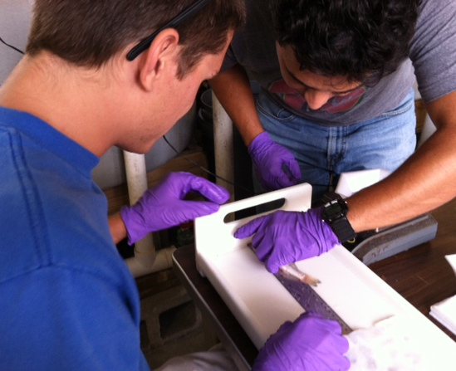
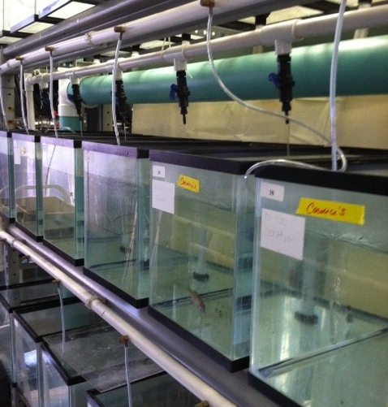
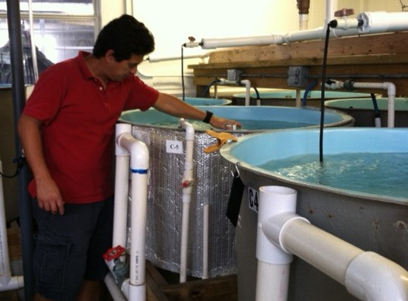
Aquatic Toxicology Facility

Slide 3


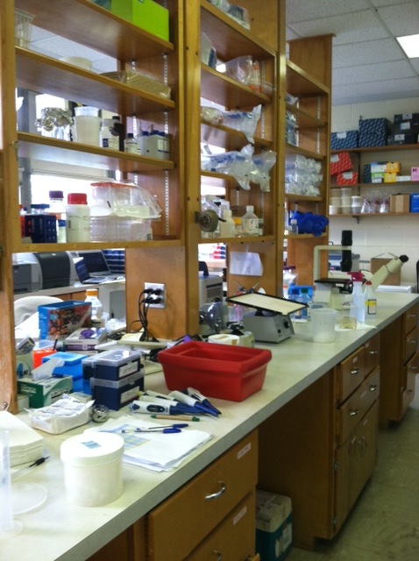

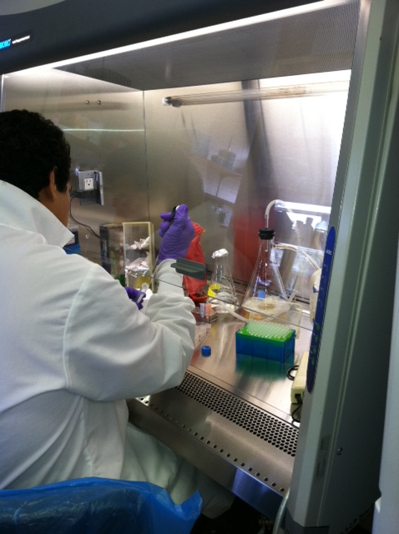
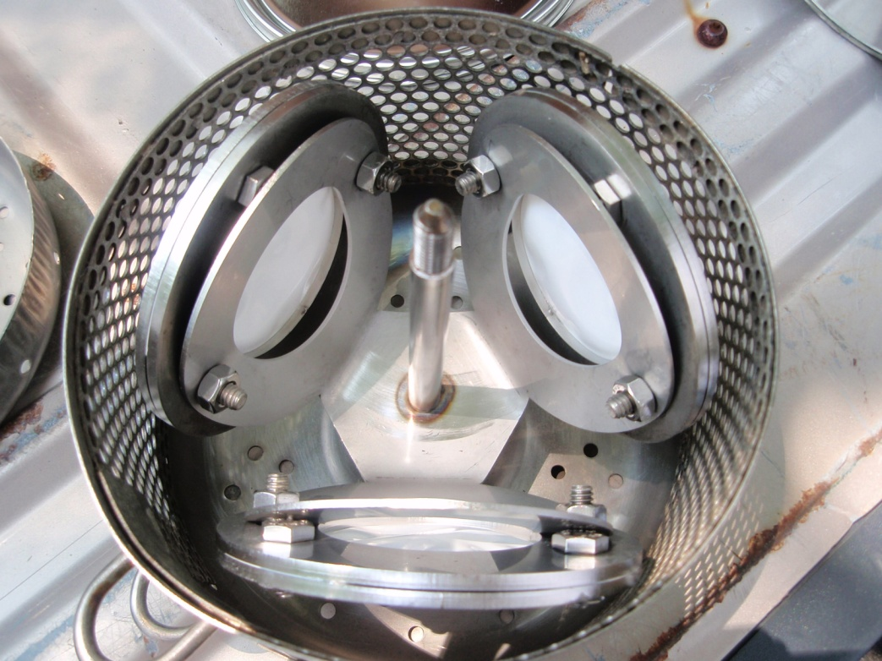
Molecular Toxicology Lab

Slide 4
Outline
Aquatic Contaminants (Hormonally Active Agents)
Focus on 2 molecular assays
  Hormone receptor binding with fluorescence polarization (Bisesi)
  GeneBLAzer hormone receptor activity (Sabo-Attwood)
  Utility in field applications

Slide 5
Hormonally Active Agents (HAAs)
Metals
Personal care products
Industrial
chemicals
SUSPECTED
HAAs
Pesticides
Synthetic & natural hormones
Pharmace-uticals
estrogen, androgen, progesterone, glucocorticoid

Slide 6
Environmental Assays
In vivo fish assays
Plasma Vtg
Plasma hormones
  E2, T, 11-KT
Microarray analysis
In vivo toxicity bioassays
FHM cumulative egg production
High-throughput in vitro assays
ER/AR/PR/GR transactivation assays
ER/AR binding assay

Slide 7
Sensitivity of Molecular Assays
Reversible
Irreversible
100
Tissue
Molecular
50
Population
Percent Measured Effect
0
nM uM mM
Concentration of Toxicant X Time of Exposure

Slide 8
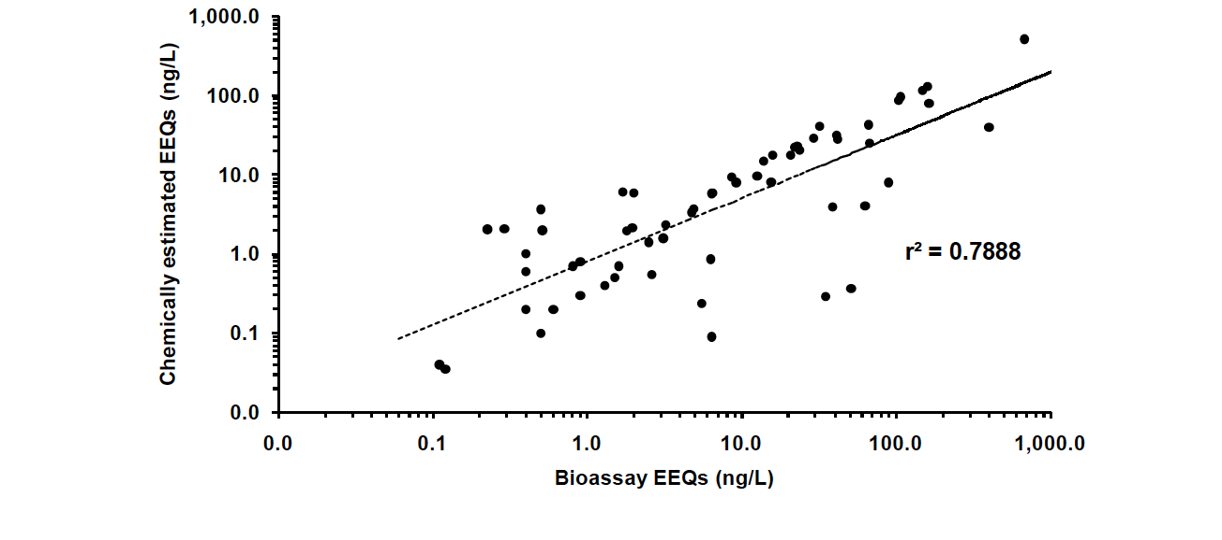
Estrogen Equivalency
Correlation between chemically estimated EEQs and bioassay EEQs (Bulloch et al., 2010).

Slide 9
Hormone-Receptor Mediated
Gene Regulation
xenoestrogen
Receptor binding
E2
ER
Receptor activation
ERE
VTG, ER
mRNA
Hepatocyte nucleus

Slide 10
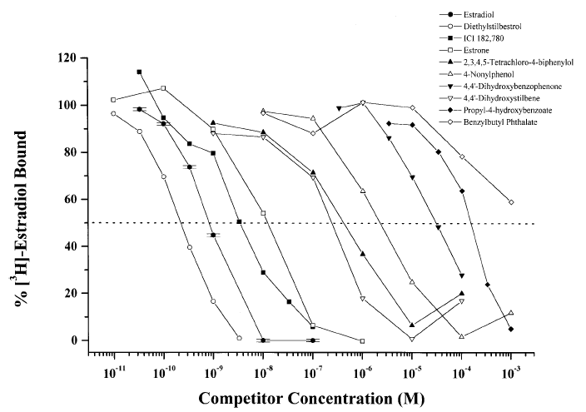
What is currently known about xenoestrogen-ER binding?
Various xenoestrogens (> 188) have been shown to bind the ER through a heterogeneous radioligand competitive binding assay, which measures the ability of compounds to displace [³H]-estradiol from the ER
Major shortcoming:
Time-consuming separations steps are needed to remove unbound probe before performing radioligand measurements
Blair et al., Toxicological Sciences, 2000, 54: 138-54

Slide 11
Fluorescence polarization (FP): a novel approach for probing xenoestrogen-ER interactions in vitro
Fluorescence polarization measures the ability of compounds to competitively displace a high affinity fluorescent-ligand from the ER
Advantages:
Homogeneous, sensitive assay
Non-radioactive
Amenable to view binding events at equilibrium
High-throughput format (96-well plates)
Bolger et al., Environ. Health Perspectives, 1998, 106: 551-57

Slide 12
Fluorescence Polarization -
How it Works
ER ligand binding domain (LBD) with N-terminal thioredoxin and hexahistidine tags

Slide 13
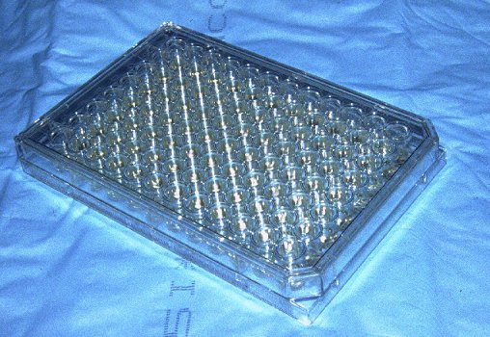
FP – Experimental Methods
Triplicate 12-point serial dilutions of xenoestrogens were prepared in 96-well plates
10 nM recombinant ER-LBD and 0.5 nM fluorescent-estrone probe were added to ligand dilutions and incubated at 25 °C for 1 hour prior to fluorometric measurements (ex λ = 488 nm, em λ = 520 nm)
FP values were converted to % inhibition using the following equation: I% = (A₀ – A)/(A₀ – A₁₀₀) * 100

Slide 14
Results for Single Chemicals
E2
Genistein
Tamoxifen
Nonylphenol
BPA
OH-PCB
DDE
PBDE-100

Slide 15
Results for Single Chemicals

Slide 16
Binding Parameters of
Tested Xenoestrogens
Ligand Calculated IC₅₀ RBA (%)
Estradiol 17.1 nM 100
4-OH-Tamoxifen 5.79 nM 295
4-Nonylphenol 212 nM 8.08
Bisphenol-A 1.48 μM 1.15
OH-PCB 142 nM 12.0
DDE 2.10 μM 0.813
PBDE-100 N.D. N.D..
OPEC N.D. N.D.
RBA = (IC₅₀ E₂)/ (IC₅₀ test cpd) * 100
K_{i} = IC₅₀/[1+(D/K_{d})]

Slide 17
Fluorescence Polarization: Field Example
Notes:
Concentrated extracts from contaminated sites in rural georgia were found to contain low to non-detect levels of estrogens. But the estrogen data alone cannot explain the effects they were seeing in the biota. Other contaminants have been shown to cause endocrine disrupting effects associated with estrogenic exposures but the researchers were unable to measure every chemical in their extracts. They were looking for a method to determine total estrogenicity without trying to measuring every contaminant. Using our fluorescence polarization assay we were able to measure detectable estrogen receptor binding in all sample extracts from the sites they are interested in. These include sites with no measureable estrogen concentrations. The graph on the left shows our repeatable estradiol competitive binding curve that we used to calculate a estradiol binding equivalence. The graph on the right shows the measured estradiol binding equivalence for their sites. We are still in the process of comparing our assay data with measured chemical concentrations and biological impact. It is important to note that this assay only give us information about binding and that bind does not always directly lead to a predictable downstream effect. But it is a starting point for determining total estrogenicity of water samples, or comparing chemical estrogen affinity to known estrogenic contaminants.

Slide 18
Androgen Receptor Binding
Rat androgen receptor ligand binding domain
Commercially available
Potential to build our own to decrease cost

Slide 19
Receptor Activation - Invitrogen GeneBLAzer Assays
Chemicals
Stably Transfected 293T Cells
Division-Arrested
BLA
+
Fluorescent BLA substrate
NHR
GAL4 DBD
Beta-lactamase
Fluorescence measurement
GAL4 site
Individual stable cell lines: ER, AR, PR, p53, PPARγ and GR
High-throughput

Slide 20
Example: Estrogen Receptor Assay
Receptor gene
GAl4-ER LBD = receptor
green
520 nm
Gal 4 DNA
binding sites
Substrate
409 nm
Bla protein
Beta lactamase
FRET, fluorescence resonance
energy transfer
Reporter gene
Hydrolyzed
substrate
blue
Notes:
FRET – fluorescence resonance excitation transfer

Slide 21
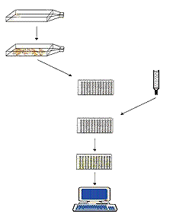
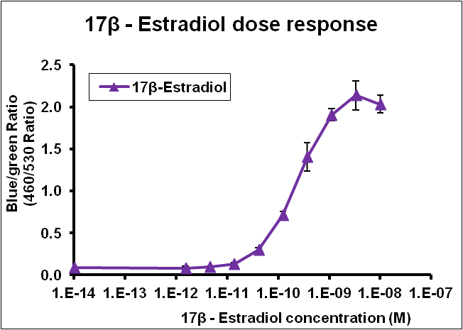
In vitro assay protocol
Cell culture
Seed cells
Chemical exposure
Add assay reagents
and incubation
Fluorescence reading

Slide 22
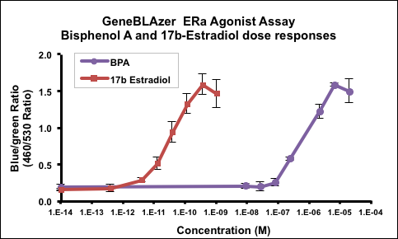
Profiles for Single Chemicals
BPA
E1
NP
Bif

Slide 23
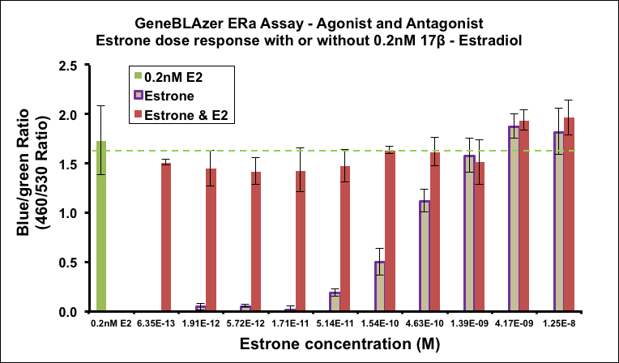
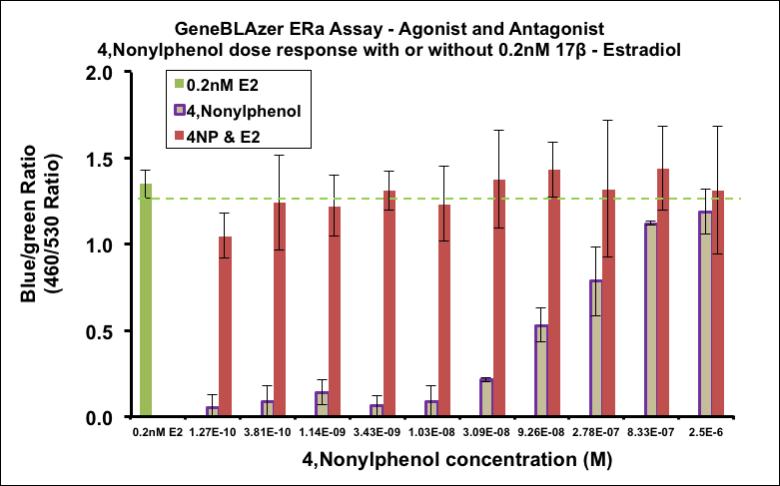
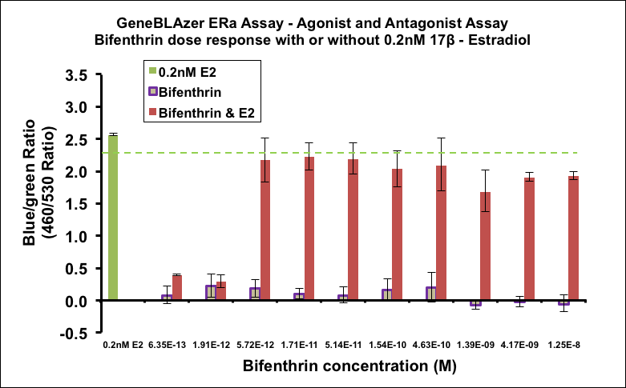
ER Antagonist Profiles
Estrone
Nonylphenol
Bifenthrin

Slide 24
ER Round Robin Results
Legend for samples
A= Effluent 2
B= Effluent 1
C= Ozonation
D= Storm water
E= Membrane
F= RO
G= River Water
H = AO
J= Blank
K= Drinking water
CA= SCCWRP proj
A B C D E F G H J K CA DMSO
Water Samples

Slide 25
Androgen Receptor Assay
Legend for samples
A= Effluent 2
B= Effluent 1
C= Ozonation
D= Storm water
E= Membrane
F= RO
G= River Water
H = AO
J= Blank
K= Drinking water
A B C D E F G H J K DMSO
Water Samples

Slide 26
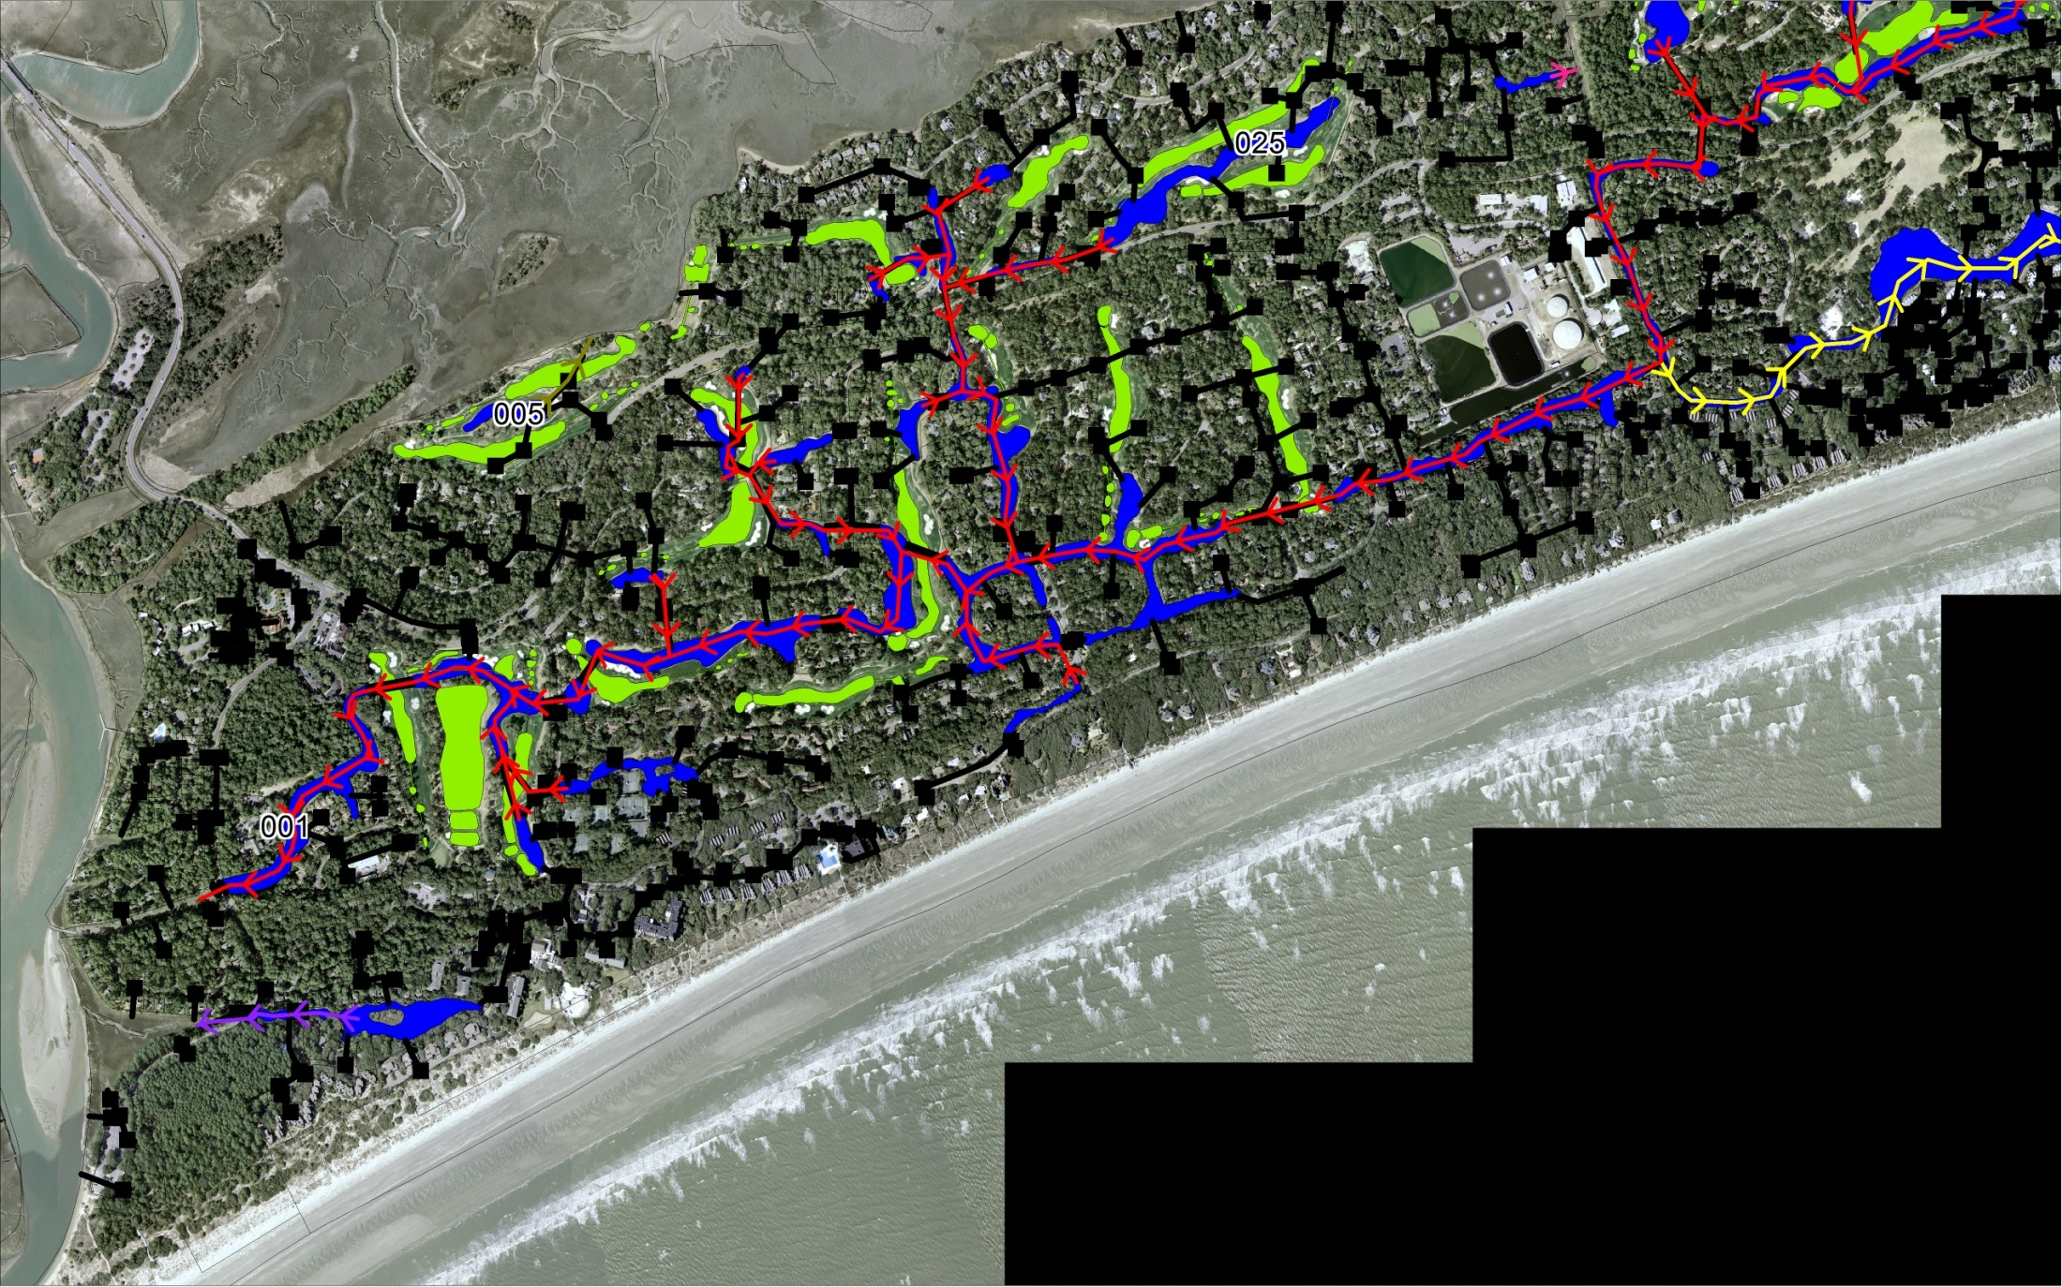
Water Reuse in Turf-Management: Kiawah Island, SC
P43
P25
P5
WWTP

Slide 27
Estrogen and Progesterone Activity of Kiawah Waters
Sample | BEQ using EC₁₀ values (nM)
P5 | 0.9
P25 | 0.3
P43 | 0.6
WWTP | 2.1
C | ND
Sample | BEQ using EC₁₀ values (nM)
P5 | 106.3
P25 | 28.7
P43 | 93.5
WWTP | 45.1
C | ND

Slide 28
Conclusions
Bioanalytical approaches are complementary to analytical chemical approaches and can be used for monitoring – fast, easy, high-throughput
Bioanalytical approaches distinguish the bioactive fraction from the total
Potential to provide information to higher order population level effects

Slide 29
Acknowledgements
Center for Environmental and Human Toxicology
Denslow Lab
Kevin Kroll
Candice Lavelle
Erica Brokemeier
Ignacio Rodriguez
Dr. Reyna Cristinia Colli-Dula
Dr. Sumith Jayasinghe
Dr. Viet Dang
Sabo-Attwood Lab
Dr. Joe Bisesi
Dr. Sumith Jayasinghe
Cody Smith
Lee Ferguson, Duke University
Funding: NIH
EPA
NSF
SFEI
USGS

