Slide 1
Selection of
Sampling Sites
Using the WMS Trend
Monitoring Network
ESOC Workshop
April 29, 2014

Slide 2
Monitoring Questions
Do ESOCs occur in Florida waters?
How/where would we monitor for them?
What analytes would we focus on?
Are there any standards/thresholds?
How to analyze these substances?
What monitoring approach is appropriate?

Slide 3
Building the ESOCs Monitoring Program.…
  Monitoring Design
  Selecting the Sample Sites
  Quality Assurance
  Indicators (chemical/biological/other?)
  Collecting the Samples
  Handling/Shipping
  Analyzing Samples
  Data Management
  Data Analysis
  Reporting
  Next steps?
Notes:
Comp
QA includes training

Slide 4
Considerations for Selecting Sites
We knew that these substances were present in waste water and throughout the US due to other studies and background research
Sampling for these substances would take a well thought out design – consult others!
Analyzing for these substances
would be expensive…needed to determine best approach

Slide 5
Screening Approach
To address the proper monitoring approach, we needed to devise a method that would be both cost effective and still provide good information to inform decisions
Target chemicals are found associated
with human use, as is sucralose
Selected sucralose, as it is found in sewage/septic sources – a good conservative tracer

Slide 6
Screening Approach
Use sucralose as the indicator of choice to select potential sites for further investigation
Use an established ambient network for determining potential monitoring sites
(Helps answer the question of whether these compounds are found throughout Florida waters)
ESOCs are found in many other places, however this would allow us to target sites where they are likely to be present - as a test case

Slide 7
Add Sucralose to Existing Monitoring
  Trend Network:
  Long term trend at fixed stations (surface and ground water
  75 surface water sites; 48 ground water sites
  Status Network:
  Report on statewide condition for surface and ground water using appropriate indicators
  Uses statistical design (random stratified; probabilistic)

Slide 8
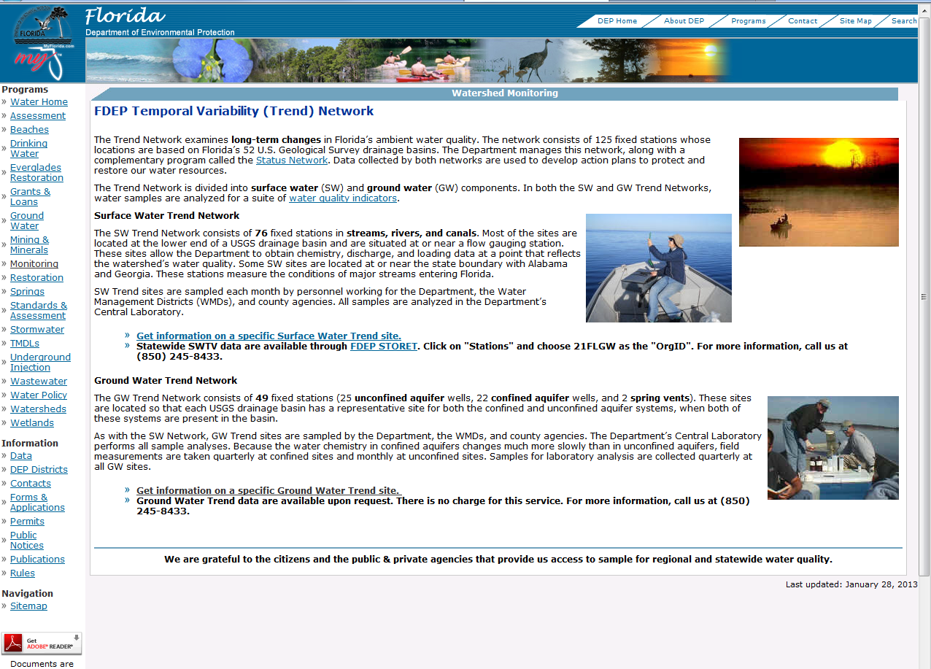
Trend Monitoring Network
http://www.dep.state.fl.us/water/monitoring/trend.htm
Notes:
Both Surface and Ground Water

Slide 9
Trend Monitoring Network
  Make estimates of changes in water quality at set stations over time
  Fixed locations, we return to the same spot at a set interval in time
  Select sampling sites at lower end of watershed
  (“pour point”, basin confluence)
  Sampling stations also located near the state line on major rivers entering Florida from Georgia and Alabama

Slide 10
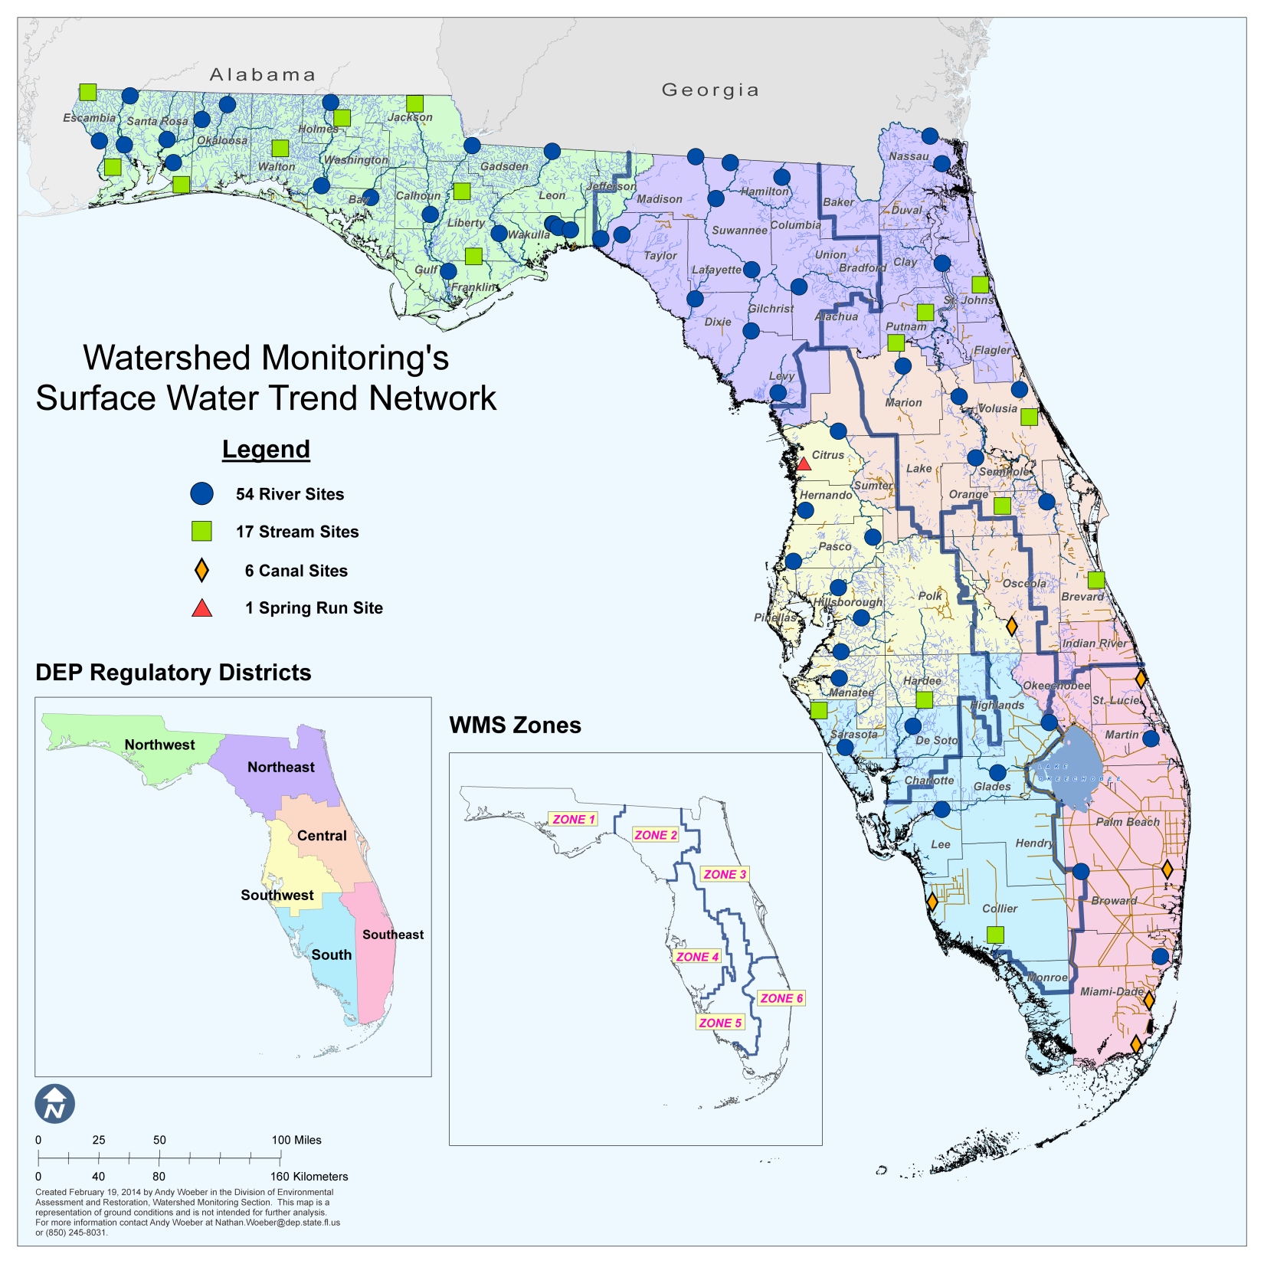
Surface Water Trend Network
75 surface water fixed sites sampled on a monthly basis

Slide 11
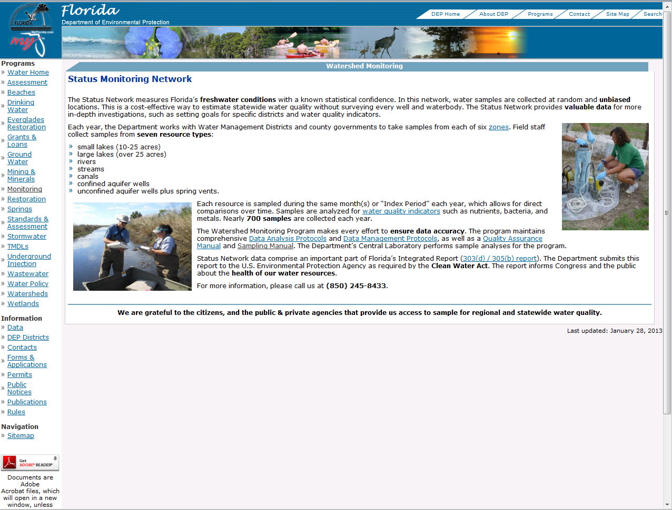
Status Monitoring Network
http://www.dep.state.fl.us/water/monitoring/status.htm

Slide 12
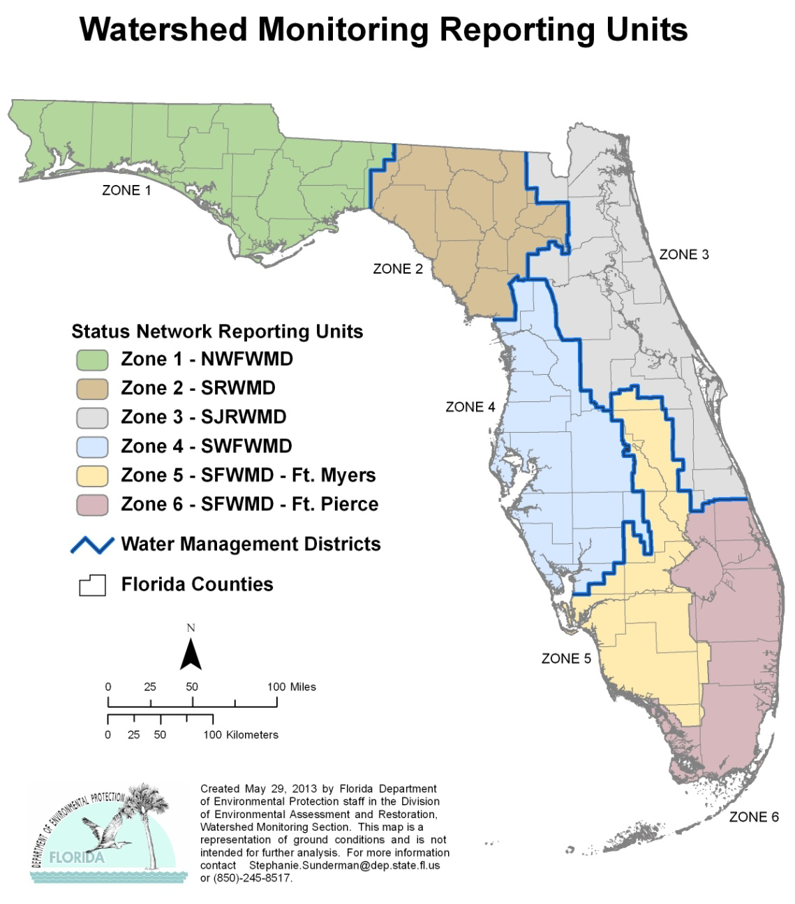
Status Network Sampling Design
6 zones
7 resources
90 samples per sw resource type per year (15 per zone)
60 samples for canals per year (15 per zone)
120 samples for gw resources per year
(20 per zone)

Slide 13
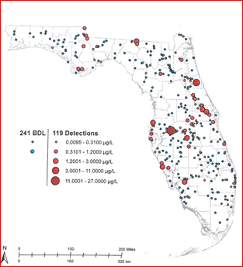
Results from Sucralose Monitoring
Status Network:
Allows unbiased evaluation of distribution across different resource types
Good for determining potential focus areas

Slide 14
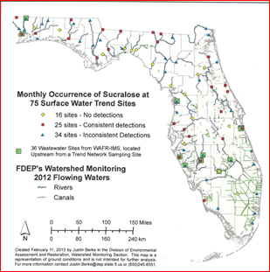
Results from Sucralose Monitoring
Trend Network:
Allows repeat sampling verification
Can review both frequency and magnitude of results

Slide 15
Selecting Sites
Highest values?
Most frequent detections?
Inflows to Florida?
Near facilities?
Away from facilities?
Control sites?
How many?
What can we afford?

Slide 16
The Study Design
Narrow site selections to test the approach
Select sites with highest and most frequent detections of sucralose

Slide 17
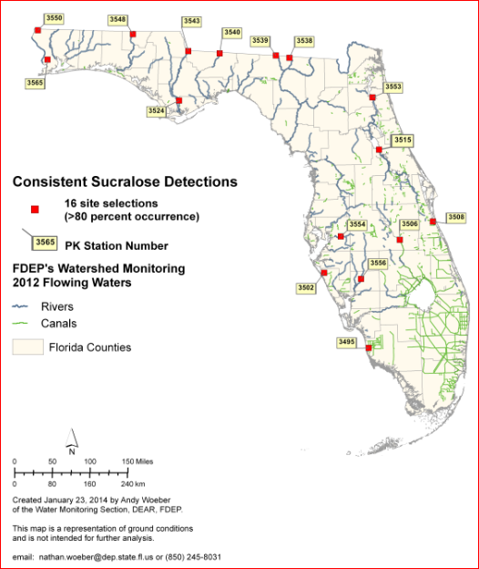
Potential Sites for Pilot Study Design

Slide 18
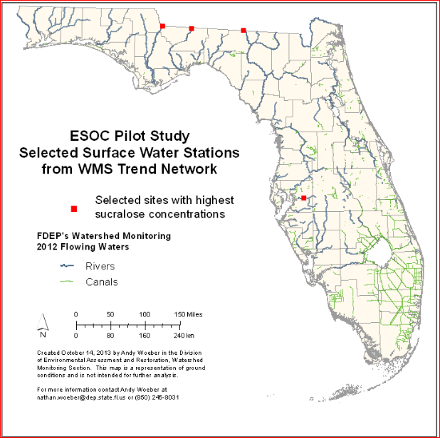
Sites for Pilot Study

Slide 19
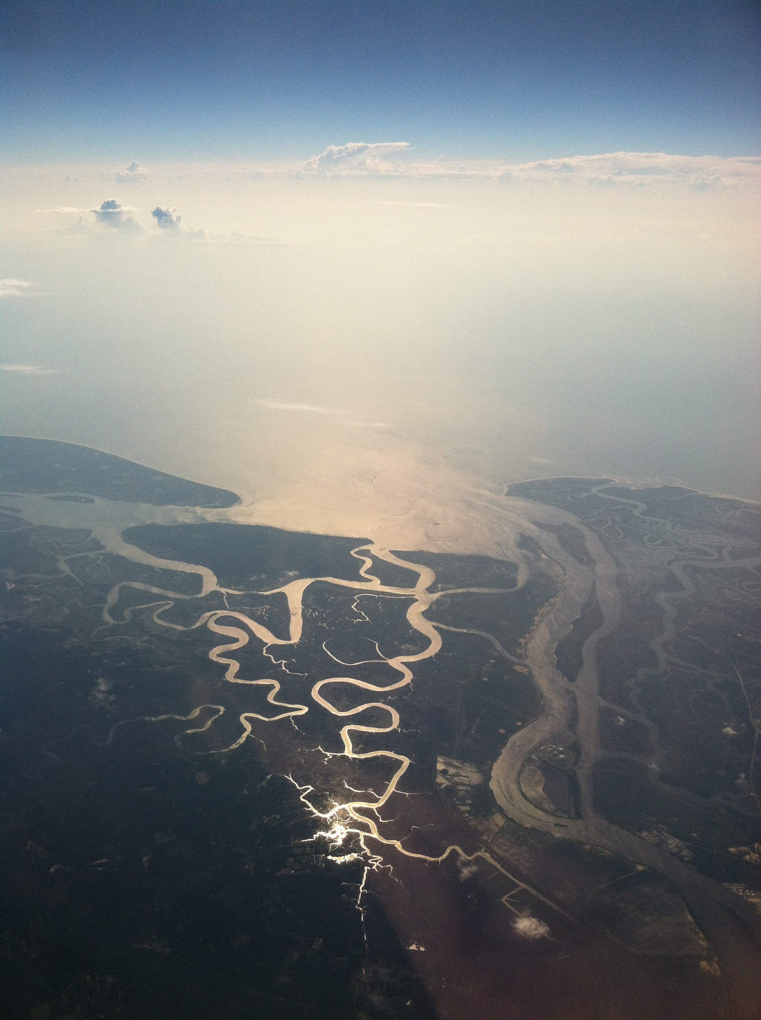
Questions?

Slide 20
Watershed Monitoring Section
Water Quality Assessment Program
Division Of Environmental Assessment and Restoration
2600 Blair Stone Road
Mail Station 3525
Tallahassee, Fl 32399-2400
Gail.Sloane@dep.state.fl.us
850-245-8512

