Slide 1
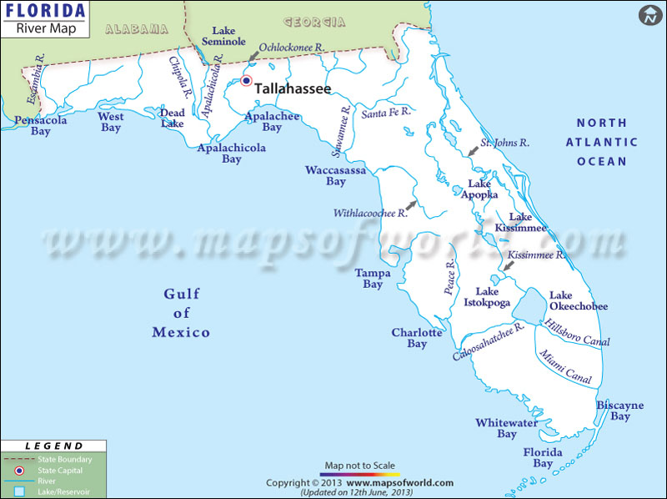
Evaluating ESOCs in Florida Waterbodies
An Effects Based Approach Pilot Study
Study Design Overview

Slide 2
Objective
To evaluate sampling and analytical methods utilizing biomarkers to assess the biological health of waterbodies

Slide 3
Expected Outcome
Better understanding of the effectiveness of the analytical and sampling methods
Build a foundation of knowledge to drive future studies
Be able to better calculate cost efficiency in future studies

Slide 4
Sampling Method Considerations
Compounds with low detection levels (parts per trillion or ng/L)
Compounds with a variety of physical characteristics
  Non-polar
  Polar
  Molecular weight
Estimating potential exposure of aquatic organisms by the utilization of different biological screening tools.

Slide 5
Determining the Collection Method
Whole water grab samples
Integrative Sampling Devices
  Polar Organic Compound Integrative Samplers (POCIS)
  Semi-Permeable Membrane Device (SPMD)

Slide 6
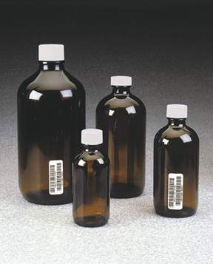
Whole Water Grab Samples
Only one sampling trip required
Quantitative results
Allows a direct comparison to known sucralose concentrations
Will not capture episodic events
Expect non-detections

Slide 7
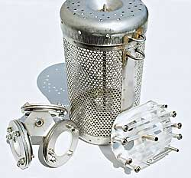
Integrative Sampling Devices
Time-Integrated Sample (30-35 days)
Higher number of detections based on larger water volumes
May mimic contaminant accumulation in fish tissue
Does not result in direct water concentrations

Slide 8
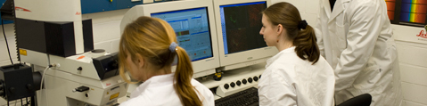
Measuring Biological Effects
Samples are extracted from both POCIS & SPMD and screened for:
Estrogenic and androgenic activity using:
* Bioluminescent yeast estrogen/androgen screen (BLYES/BLYAS)
* Binding and transactivation assays
Genotoxicity using SOS Chromotest

Slide 9
Alicia Wilson
Water Quality Assessment Program
850-245-8553
Alicia.Wilson@dep.state.fl.us

