Slide 1
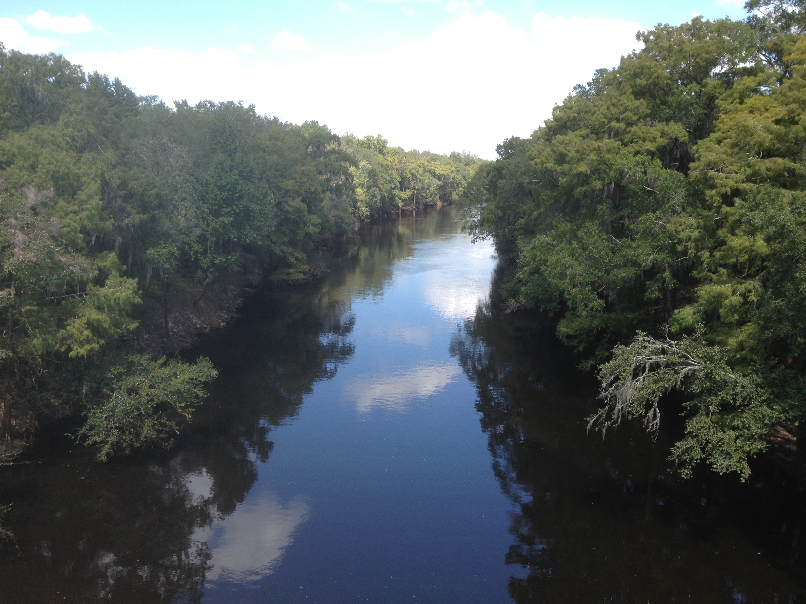
ESOC Pilot Study
Field Sampling Logistics & QA/QC
Stephanie Sunderman-Barnes
Watershed Monitoring Section

Slide 2
Data Collected at Each Site
Passive sampling devices deployed for 30-35 days. Sent to laboratories for extraction and chemical & biological analyses.
Whole water grab samples collected midway through deployment period. Sent to laboratories for chemical & biological analyses.
Water quality field measurements collected during device deployment, midway through deployment period, and during device retrieval.
Minimum of three visits to each site required during deployment period.

Slide 3
General Precautions for Field Sampling
Field personnel should avoid contacting or consuming the following substances on the day of sampling.
Oils, Tars, Fuels, Fumes containing engine exhaust
Paints, Solvents
Tobacco smoke, Caffeine
Fragrances (e.g. perfumes, deodorants, laundry detergent)
Sunscreens, Bug sprays, Pesticides, Herbicides
Soap, Detergents, Antibacterial cleansers
Medications, Hormonal Substances (prescription, over-the-counter)
Urine, Excrement (animal or human)
If contact is unavoidable, details must be documented on field sheet.

Slide 4
General Precautions for Field Sampling
Disposable, powder-free gloves should be worn at all times when handling deployment equipment, sampling equipment, & sampling devices.
Gloves & exposed skin must be free of lotions, insect repellents, and powders.
Change gloves frequently, especially after contacting surfaces that could introduce contamination (e.g. skin, clothing, boat motor).
Do not breathe directly over sampling devices.

Slide 5
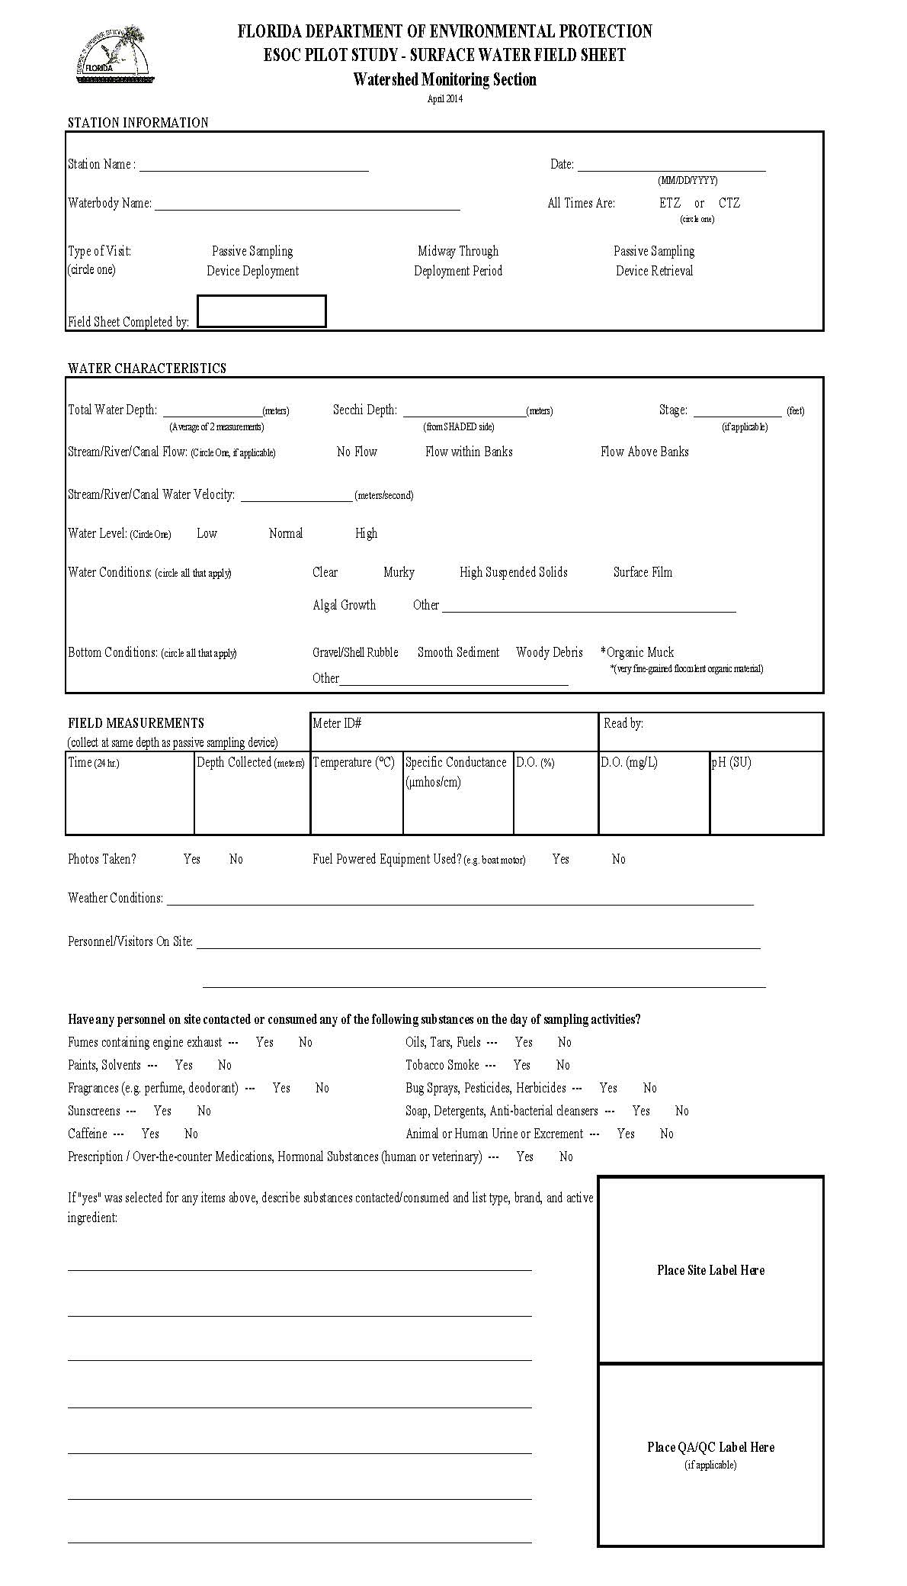
Documentation
Complete one copy of ESOC Field Sheet for each visit to each site.
Do not leave any items blank. If an item is not applicable, draw a single line through it or write “N/A”.

Slide 6
Documentation
Five Custody Sheets will be used throughout the project.
Custody Sheet # | Samples Collected | Goes To | Analytes | Kits Contain
ESOC Custody Record #1 | Midway through deployment period | FDEP Central Lab | Pesticides; Sucralose | 3 – 1L glass amber bottles
ESOC Custody Record #2 | Midway through deployment period | Whole Water Chemistry Lab (TBA) | PPCPs; Hormones; PBDEs; Alkylphenols; PFCs; Pesticides | 1 – 1L glass amber bottle
ESOC Custody Record #3 | Midway through deployment period | USGS | BLYES; BLYAS; SOS Chromotest | 1 – 1L glass amber bottle
ESOC Custody Record #4 | Midway through deployment period | UF – Denslow Lab | ER & AR binding & transactivation assays | 1 – 1L glass amber bottle
ESOC Custody Record #5 | After Passive Sampling Device Retrieval | AXYS | SPMD & POCIS Extraction; AXYS will distribute extracts among designated laboratories for analysis. | 3 - SPMD on spider carriers; 3 – POCIS on metal holders

Slide 7
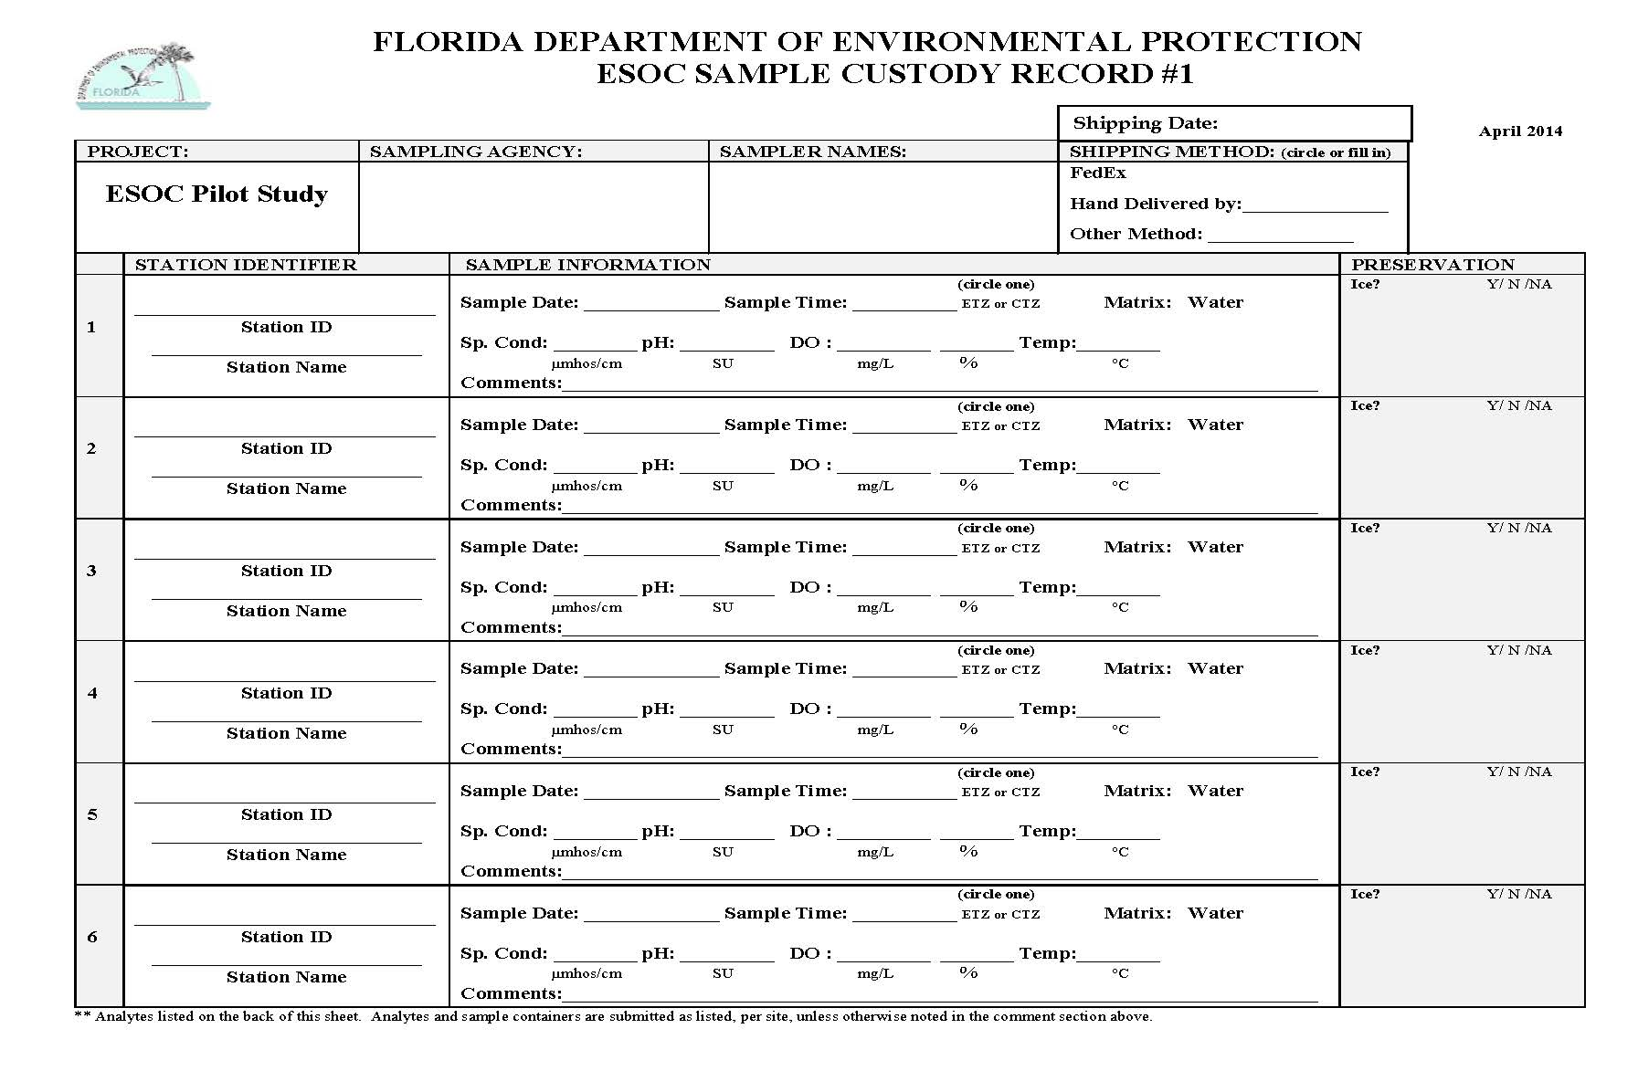
Documentation

Slide 8
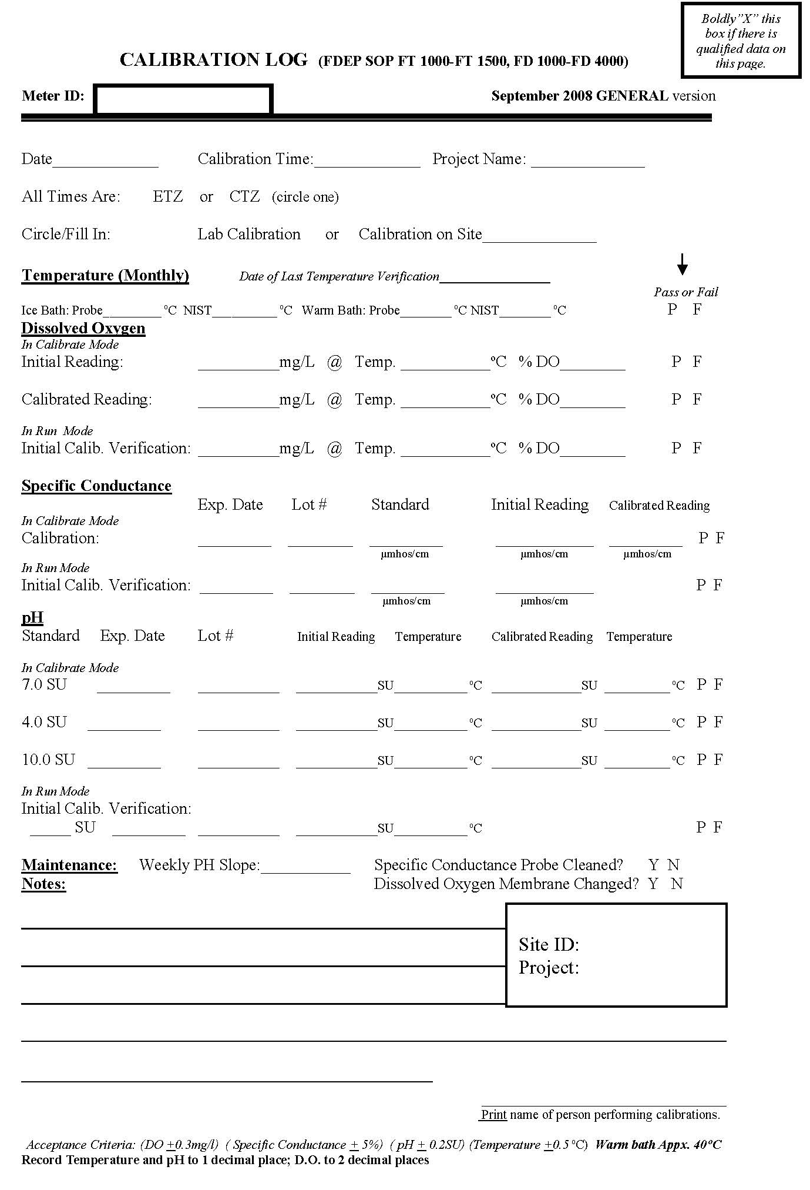
Documentation
Maintain Log Books for:
Calibration Activities
Equipment Cleaning
Equipment Maintenance
Standards / Buffers / Reagents
Details described in October 2013 Status & Trend Networks Sampling Manual (Section 12).

Slide 9
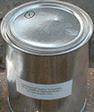
Preparation for Deployment Event
SPMD & POCIS
  Prepared by EST labs, mounted on holders, and
  shipped to DEP in sealed cans (cleaned & solvent rinsed).
  Stored at -20°C until sampling event.
  Transported to field sites in sealed cans, surrounded by wet ice that is packed in separate zip-top bags.
All deployment material (e.g. anchors, wire, hardware) must be cleaned using the following procedure:
  Clean with degreasing solution (if necessary)
  Wash with hot soapy (liqui-nox) water.
  Rinse with dilute HCl (do not use on stainless steel)
  Rinse with isopropyl alcohol or other polar solvent
  Rinse with hexane or other nonpolar solvent.

Slide 10
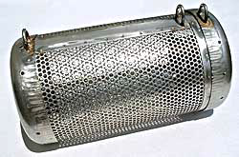
Preparation for Deployment Event
Select deployment location & develop strategy for securing canister.
  Canister & sampling devices must remain submerged for entire 30-35 day deployment period.
  Canister may be secured to a fixed point or suspended above bottom. Targeted sampling depth is top 1m of water column
  Deployment location should be hidden to minimize vandalism.
  Sunshields can be used to reduce exposure to direct sunlight.
  If site has high suspended solids, place canister behind an object that will shield it from debris & orient canister so that fewer openings are pointed upstream.

Slide 11
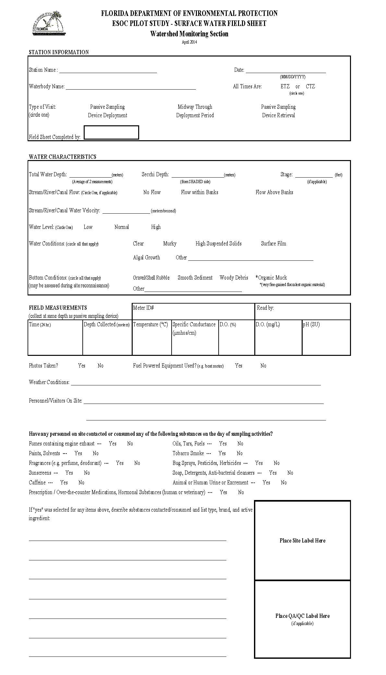
Data Collection Protocols – Deployment Event
Calibrate multi-parameter meter daily (See October 2013 Status & Trend Networks Sampling Manual, Section 3)
Navigate to deployment location. Record coordinates using Trimble GPS unit.
Collect field data before deployment of the passive sampling device.

Slide 12
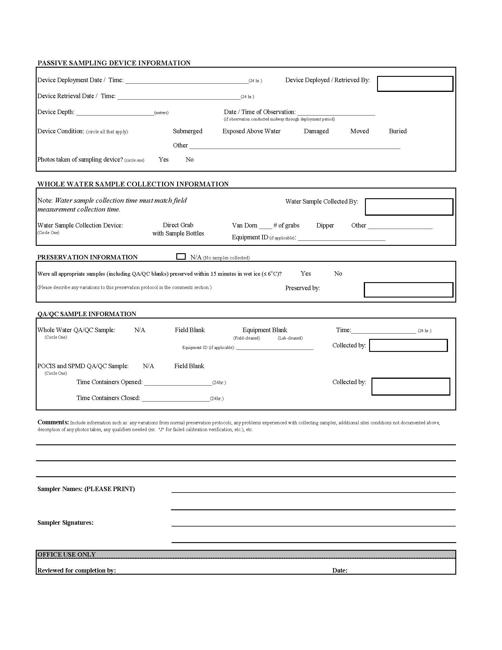
Data Collection Protocols – Deployment Event
Prepare deployment hardware before opening SPMD & POCIS cans. Do not expose sampling devices to air for > 30 min.
Shut off fuel powered equipment before opening cans & disperse any surface film before placing sampling devices in water. Handle sampling devices by holders.
Place 3 POCIS & 3 SPMD (2 pre-spiked) in canister. Secure canister lid & make sure canister is fully submerged.
Do not discard shipping can. Close lid & label can - same cans will be used for shipment following retrieval.
Document deployment time & conditions on field sheet.

Slide 13
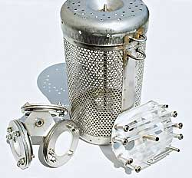
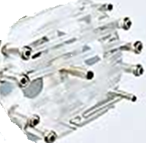
Data Collection Protocols – Deployment Event
Example passive sampling device setup: canister with 3 SPMD (right) and 3 POCIS (left).
Image from EST labs website.

Slide 14
Data Collection Protocols – Mid-Deployment Event
Document condition of passive sampling device.
Collect field data & whole water grab samples at same depth as passive sampling device. Sample collection time must match field data collection time.
Bag sample bottles & immediately place in wet ice.
Document grab sample collection and preservation.

Slide 15
Data Collection Protocols – Mid-Deployment Event
Collect grab samples following order on the back of custody sheets, and order of custody sheets (Custody sheet #1 collected before #2, etc.).
Grab samples must be collected from all 4 sites within a 2 day window.

Slide 16
Data Collection Protocols – Retrieval Event
Devices must be retrieved from all 4 sites within a 2 day window.
Collect field data before retrieving passive sampling device.
Prepare shipping can before removing SPMD & POCIS from canister. Do not expose sampling devices to air for > 30 min.
Shut off fuel powered equipment before opening cans. Handle sampling devices by holders.
Place SPMD & POCIS in shipping cans that they arrived in. Close can lids & surround with wet ice packed in separate zip-top bags.
Document retrieval time & conditions.

Slide 17
Shipping
Prepare five separate coolers, one corresponding to each custody sheet.
Include adequate ice in each cooler to maintain thermal preservation.
Include a white copy of custody sheet in all coolers.
Include a DEP cover letter in all coolers sent to non-DEP labs.
Complete a separate FedEx airway bill for each cooler. Coolers sent to AXYS will require international airway bill & triplicate (original + 2 copies) customs forms.
Custody Sheet # | Samples Collected | Goes To | Delivery Method
ESOC Custody Record #1 | Midway through deployment period | FDEP Central Lab -Tallahassee, FL | Hand Deliver
ESOC Custody Record #2 | Midway through deployment period | Whole Water Chemistry Lab (TBA) | Ship via FedEx (details TBA)
ESOC Custody Record #3 | Midway through deployment period | USGS - Columbia, MO | Ship via FedEx
ESOC Custody Record #4 | Midway through deployment period | UF Denslow Lab - Gainesville, FL | Hand Deliver
ESOC Custody Record #5 | After Passive Sampling Device Retrieval | AXYS Laboratories – Sidney BC | Ship via FedEx International

Slide 18
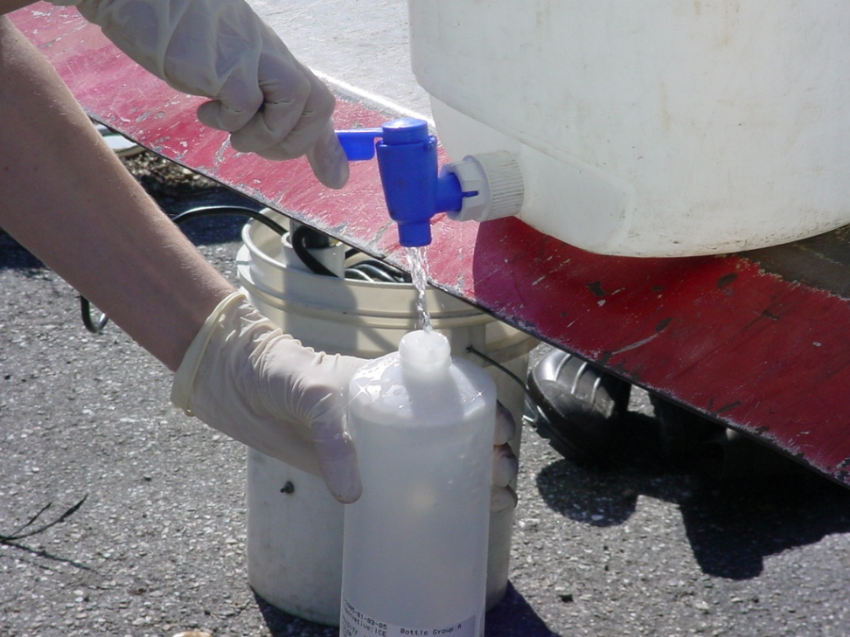
QA/QC – Field Blanks
Collect whole water field blank at one of the four field sites during mid-deployment sampling event.
  Fill sample bottles with DI water under field conditions.

Slide 19
QA/QC – Field Blanks
Collect SPMD & POCIS field blank at one of the four field sites during deployment & retrieval events.
  Transport SPMD & POCIS to field sites in sealed cans, surrounded by wet ice that is packed in separate zip-top bags.
  Open field blank cans at same time as cans for site’s sampling devices are opened.
  Close field blank cans immediately after site’s sampling devices are placed in water.
  Surround sealed field blank cans in ice that is packed in separate zip-top bags. Store field blank cans at DEP lab (-20°C) during 30-35 day deployment period.
  Repeat field blank protocol with same devices at same site when retrieving site’s sampling devices.

Slide 20
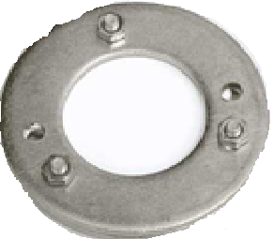
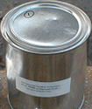
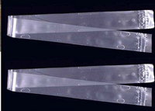
QA/QC – Field Blanks
Example passive sampling device field blank setup: shipping can with 3 SPMD (right) and 3 POCIS (left).
Images from USGS & EST labs websites.

Slide 21
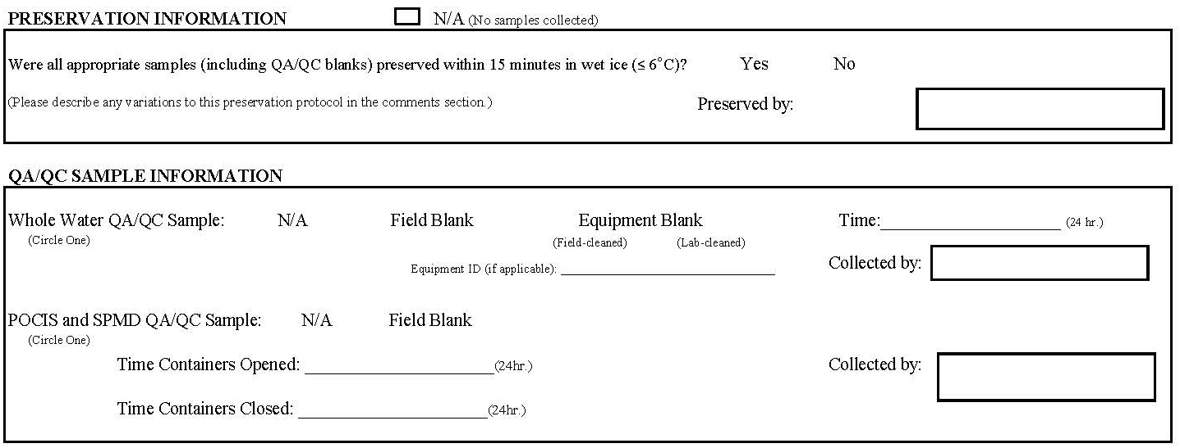
QA/QC – Field Blanks
Document all QA/QC sample collection and preservation information.

Slide 22
References
Alvarez, D.A., 2010, Guidelines for the use of the semipermeable membrane device (SPMD) and the polar organic chemical integrative sampler (POCIS) in environmental monitoring studies: U.S. Geological Survey, Techniques and Methods 1–D4, p 28.
Wilde, F.D., Radtke, D.B., Gibs, Jacob, and Iwatsubo, R.T., eds., 2004 with updates through 2009. U.S. Geological Survey Techniques of Water-Resources Investigations, book 9, April 2004.
FDEP Status & Trend Network Sampling Manual. October 2013 version. available online: http://publicfiles.dep.state.fl.us/dear/watershed%20monitoring/documents/WMS-SamplingManual.pdf.

Slide 23
QUESTIONS?
Stephanie Sunderman-Barnes
Quality Assurance Officer
Watershed Monitoring Section
Florida Department of Environmental Protection
(850) 245-8517
stephanie.sundemranbarnes@dep.state.fl.us

