Slide 1
Analysis of
POCIS and SPMD Extracts
T. M. Chandrasekhar
Bureau of Laboratories

Slide 2
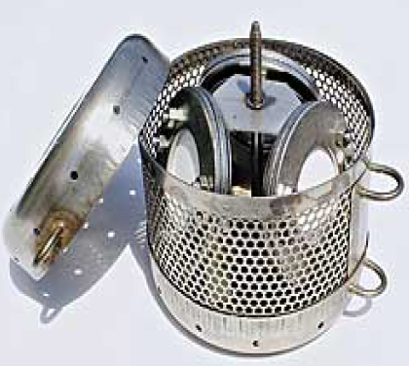
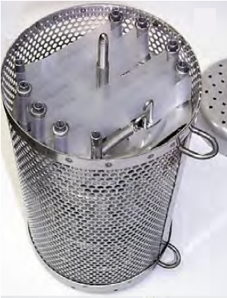
Sampling Canister
One stainless steel sample canister deployed at each of four sites
Each canister has three POCIS membrane disks and three SPMD spiders
One field blank canister to be deployed only at one site

Slide 3
POCIS: Polar Organic Chemical Integrative Sampler
Consists of Oasis HLB media (Waters Corp.) contained between two microporous polyethersulfone membranes
HLB (Hydrophilic Lipophilic Balance) is a water wettable copolymer of Divinylbenzene and N-Vinylpyrrolidone
Enhanced retention of a broad range of polar organic compounds

Slide 4
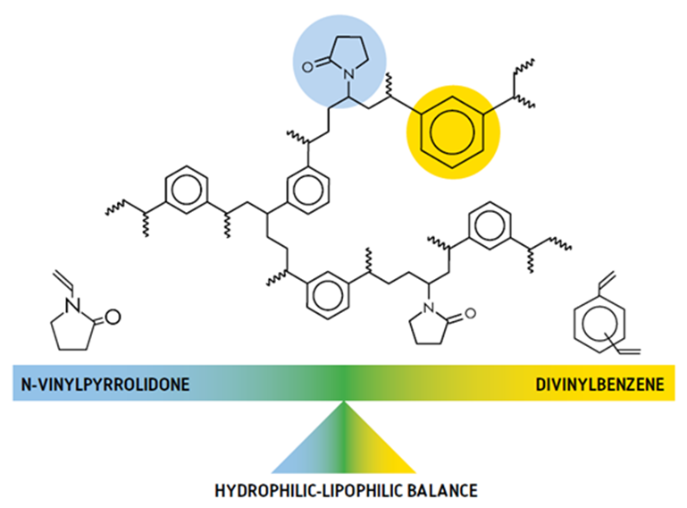
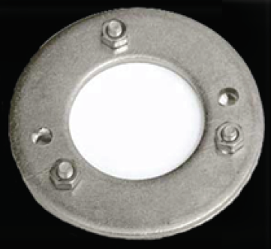
POCIS Membrane Disk

Slide 5
SPMD: Semi Permeable Membrane Device
Consists of a thin layer of Triolein between two semipermeable polyethylene membranes
Triolein (Glyceryl trioleate) is a symmetrical triglyceride - glycerol bound to three units of oleic acid
Enhanced retention of a broad range of nonpolar, lipophilic compounds

Slide 6
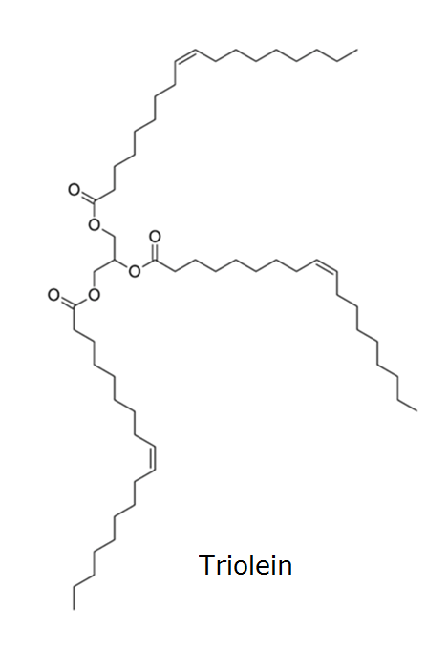
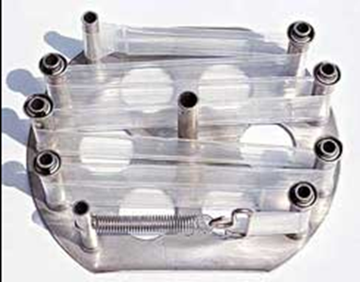
SPMD spider

Slide 7
POCIS Analyses (Polar Analytes)
Pharmaceuticals and Personal Care Products (PPCPs) by LC/MS/MS
Hormones by HR-GC/MS
Perfluorinated Compounds (PFCs) by LC/MS/MS
Pesticides by HR-GC/MS
SPMD Analyses (Nonpolar Analytes)
Poly Brominated Diphenyl Ethers (PBDEs) by HR-GC/MS
Alkylphenols by GC/MS
Pesticides by HR-GC/MS

Slide 8
POCIS Disk 1 (PPCPs and Hormones)
Spiked with labeled surrogates and extracted (MLA-086)
Extract divided in two; one half archived
  PPCPs by LC/MS/MS (EPA 1694)
  Hormones by HR-GC/MS (EPA 1698)
HLB extraction blank split in two
  One half used for method blanks
  Other half spiked for use as LCS
POCIS Field Blank disks treated identically

Slide 9
POCIS Disk 2 (PFCs and Pesticides)
Extracted with methanol and split in two
Labeled surrogates added to splits for two analyses
  PFCs by LC/MS/MS
  Pesticides by HR-GC/MS (EPA 1699)
Methanol blanks for both analyses
Laboratory control samples (LCS) prepared in methanol
POCIS Field Blank disks treated identically

Slide 10
POCIS Disk 3 (Bioassays)
Extracted with methanol and concentrated to 1 ml
No surrogates added; split in two
One half sent to Denslow lab (Univ. of Florida) for Binding and Transactivation assays.
Other half sent to Iwanowicz lab (USGS, Kearneysville) for Bioilluminescent Yeast Estrogen/Androgen (BLYES/BLYAS) and SOS Chromotest genotoxicity assays
POCIS Field Blank disks treated identically

Slide 11
SPMD Spiders 1 & 2 (Chemistry- with PRCs)
Hexane extracts from two spiders combined and split 4 ways
Each of the splits is spiked with respective surrogates
  PBDEs by HR-GC/MS (EPA 1614)
  Alkylphenols by GC/MS
  Pesticides by HR-GC/MS (EPA 1699)
  PRC analysis
Hexane blanks and LCS used for all four analyses
SPMD Field Blank spiders treated identically

Slide 12
SPMD Spider 3 (Bioassays)
Extracted with hexane and concentrated to 1 ml
No surrogates added; split in two
One half sent to Denslow lab (Univ. of Florida) for Binding and Transactivation assays
Other half sent to Iwanowicz lab (USGS, Kearneysville) for Bioilluminescent Yeast Estrogen/Androgen (BLYES/BLYAS) and SOS Chromotest genotoxicity assays
SPMD Field Blank disks treated identically

