Slide 1
Primer on
Bioluminescent Yeast Estrogen/Androgen Assays and SOS Chromotest for Genotoxicity
by
David Whiting
Internal FDEP Workshop on Evaluating ESOCs in Florida Waterbodies: An Effects Based Pilot Study
April 29, 2014

Slide 2
Yeast Assays
Yeast do not normally have estrogen/androgen receptors.
Several traits make yeast a good test organism
  Rapid growth rates
  Ease of plasmid exchange
  Conservation of regulatory mechanisms between mammalian and yeast cells
First recombinant yeast estrogen screening (YES) assay was described by Routledge and Sumpter, 1996, which was preceded by the yeast androgen screening (YAS) assay described by Purvis et al., 1991

Slide 3
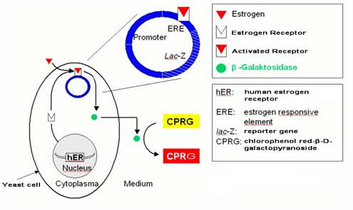
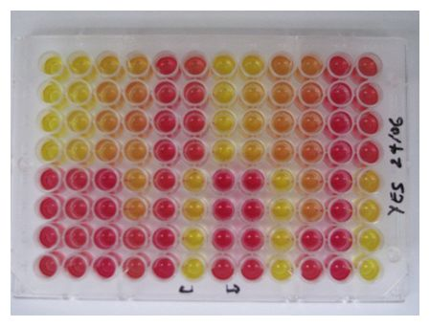
Yeast Assays
Recombinant yeast assays rely on the insertion of mammalian (e.g., human) hormone receptors and reporter genes
  Receptor (hER-α) Reporter (ERE)-lacZ
  When estrogen or estrogen-like compounds bind to the hER-α receptor, it then binds to the ERE reporter inducing transcription of lacZ. β-Galactosidase transforms chlorophenol red- β-D-galactopyranoside from a yellow to red color.
http://www.engineering.auckland.ac.nz/uoa/water-pollution-assessment
http://www.wisdom.caf.dlr.de/en/content/analytics

Slide 4
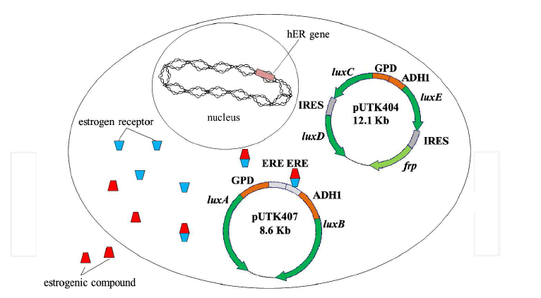
Bioluminescent Yeast Assays
Uses the same hormone receptors, but different reporters.
Instead of lac
  Luc (firefly luciferase gene)
  Lux (Vibrio sp. lux operon)
Eldridge, M. et al., 2011. Analysis of Environmental Samples with Yeast-Based Bioluminescent Bioreporters. Chapter 1. Environmental Monitoring. ISBN 978-953-307-724-6.

Slide 5
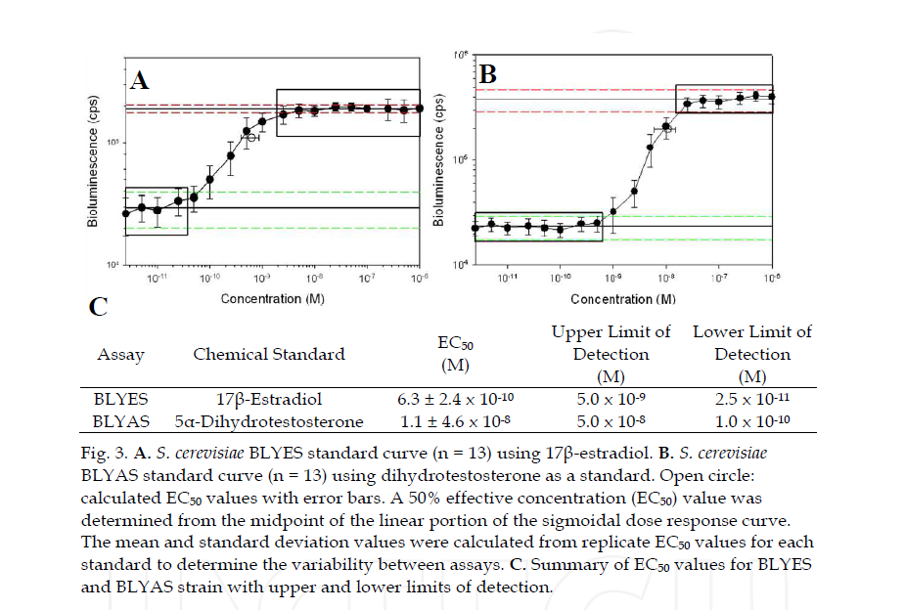
Bioluminescent Yeast Assays
Sanseverino, J. et al., 2005. Use of Saccharomyces cerevisiae BLYES Expressing Bacterial Bioluminescence for Rapid, Sensitive Detection of Estrogenic Compounds. Applied and Environmental Microbiology 77:8 pp4455-4460.

Slide 6
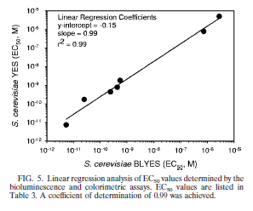
Bioluminescent Yeast Assay
Performance of the BLYES assay to the YES assay are considered to be quite comparable.
Benefits of the BLYES assay over the YES assay are:
  Significant reduction in length of assay (e.g., from days to hours)
  Equal or greater sensitivity
  May be less susceptible to toxic effects than YES assay
Sanseverino, J. et al., 2005. Applied and Environmental Microbiology 77:8 pp4455-4460.

Slide 7
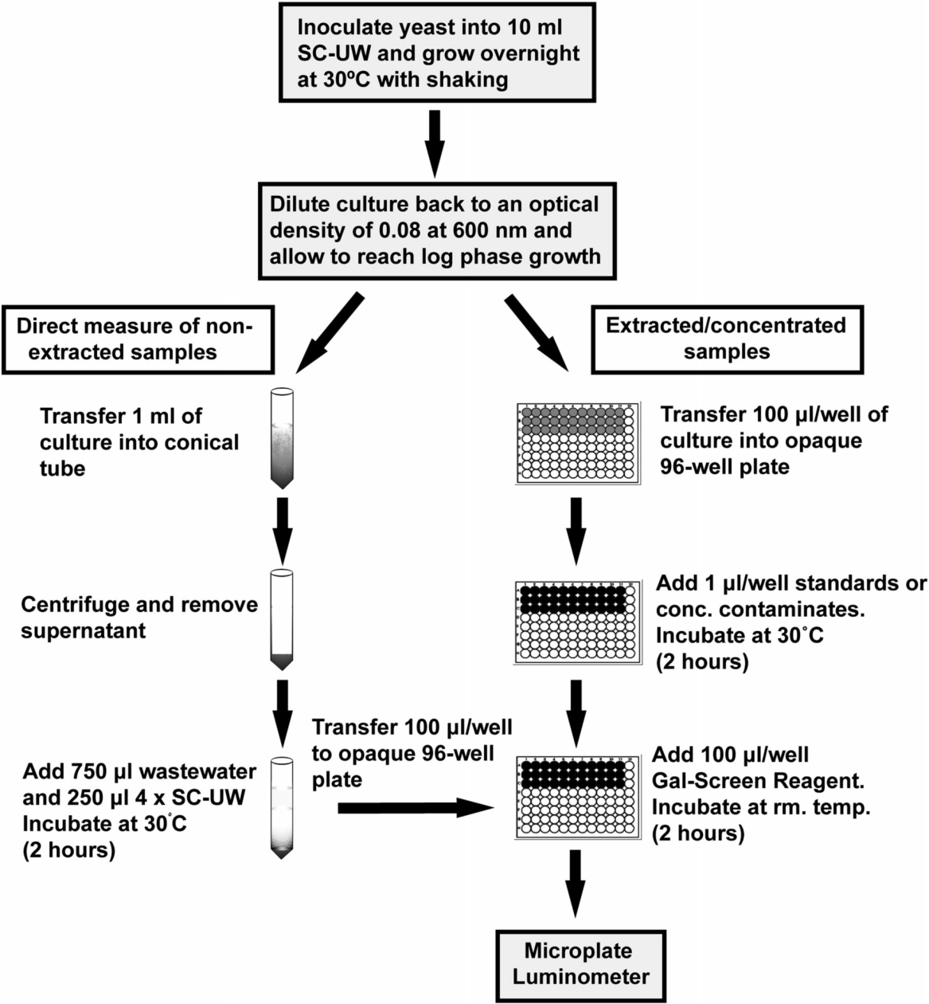
4 Hour BLYES Assay Protocol
Balsiger, H.A., et al.. 2010. Sci. Total Environ. 408(6): 1422-1429.

Slide 8
SOS Response
The SOS response is a cellular response to DNA damage.
Cell division and duplication is stopped and either
  DNA repair is successful,
  the cell survives with minor mutations,
  the cell maintains a senescent state, or
  the cell dies

Slide 9
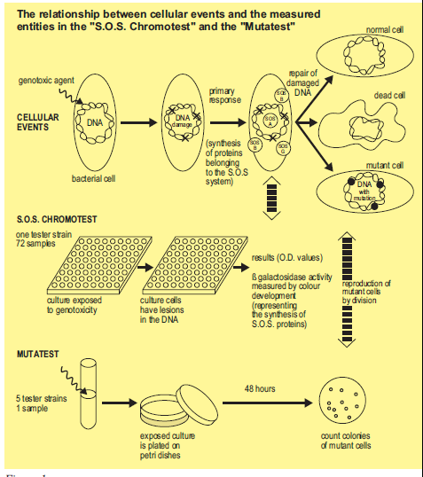
SOS Chromotest
Developed by Quillardet, P. et al., 1982
Uses strain PQ37 E. coli with the operon for lacZ gene for β-Galactosidase production inserted
However, the lacZ gene is under the control of the sfiA gene, which is involved in the SOS response to DNA damage

Slide 10
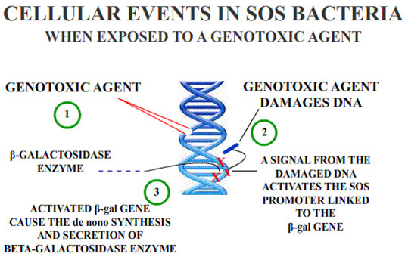
SOS Chromotest
Genotoxic compounds (carcinogens and mutagens) activate the SOS system
Cause the de novo synthesis of β-galactosidase
β-galactosidase produced by the bacteria reacts with X-Gal, (a chromogentic substrate) to produce a color change
http://www.ebpi-kits.com/SOS-ChromoTest.html#

Slide 11
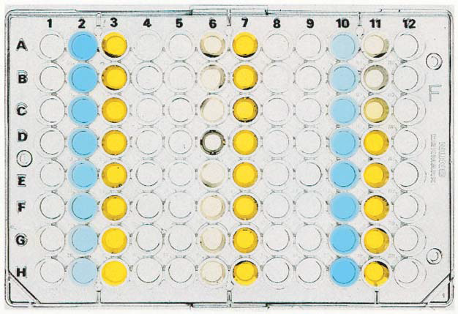
SOS Chromotest
β-galactosidase activity measured colorimetrically
Darker blue – greater possible genotoxicity
Darker yellow – greater alkaline phosphatase activity indicating live cells
Quantification of the response is possible using a spectrophotometer
http://www.ebpi-kits.com/SOS-ChromoTest.html#

Slide 12
SOS Chromotest
Rapid test – completed within a few hours.
Good correlation between Ames mutatest and SOS Chromotest (373 of 452 compounds, 82% yielded similar response) Quillardet and Hofnung, 1993.

