Slide 1
SPMDs and POCIS: Quality Control and Data Interpretation
David Alvarez
US Geological Survey, Columbia Environmental Research Center, Columbia, MO
U.S. Department of the Interior
U.S. Geological Survey

Slide 2
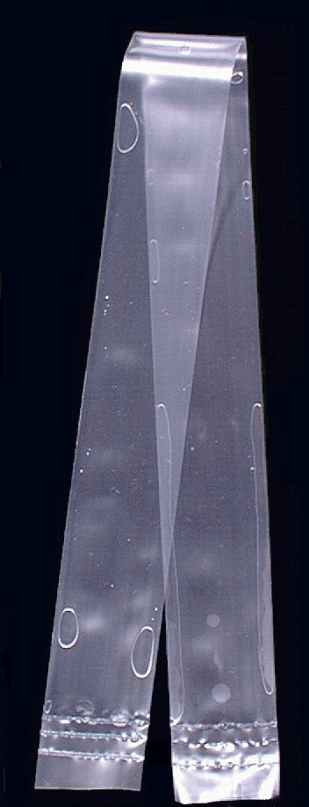
Semipermeable Membrane Device (SPMD)
  Triolein (lipid) filled PE tube
  Lipid soluble, neutral chemicals (log K_{ow} > 3)
  Samples chemicals with molecular weights <600 Daltons and cross-sectional areas < 10Å
  Useful for both water and air sampling
  Used globally since development in early 1990s
SPMD

Slide 3
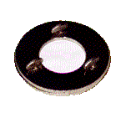
Polar Organic Chemical Integrative Sampler (POCIS)
  Solid resin held between two polyethersulfone membranes (0.1 µm pore size)
  Water soluble chemicals (log K_{ow} < 3)
  Primarily used for surface water but can be adapted for groundwater monitoring
  Used globally since development in late 1990s
POCIS

Slide 4
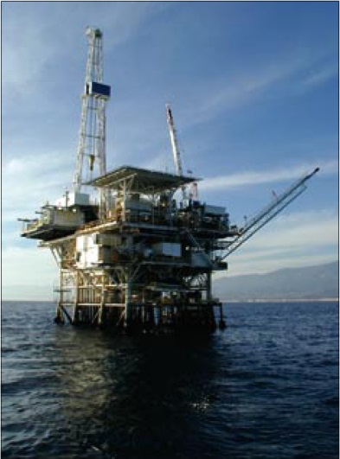
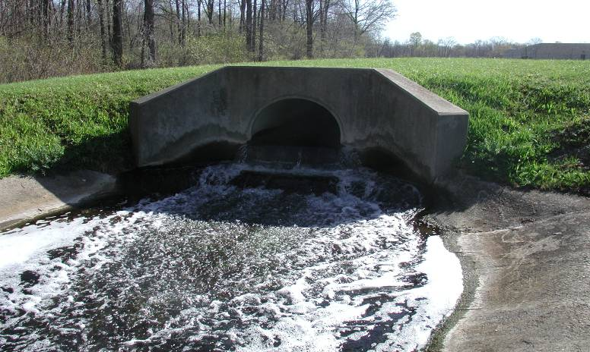
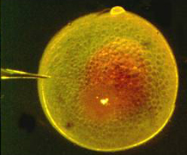
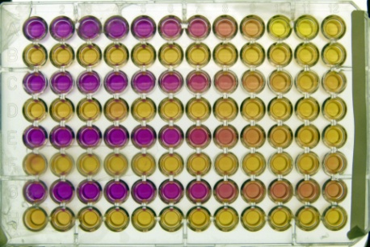
Chemicals commonly sampled by SPMDs
Legacy / regulated contaminants
  Polycyclic aromatic hydrocarbons (PAHs)
  Polychlorinated biphenyls (PCBs)
  Polybrominated diphenyl ethers (PBDEs)
  Chlorinated pesticides (DDT, chlordanes, etc)
  Dioxins and Furans
Emerging Contaminants
  Fragrances
  Phthalate plasticizers
  Antimicrobials (triclosan)
Bioindicator Tests
  In vivo and in vitro assays

Slide 5
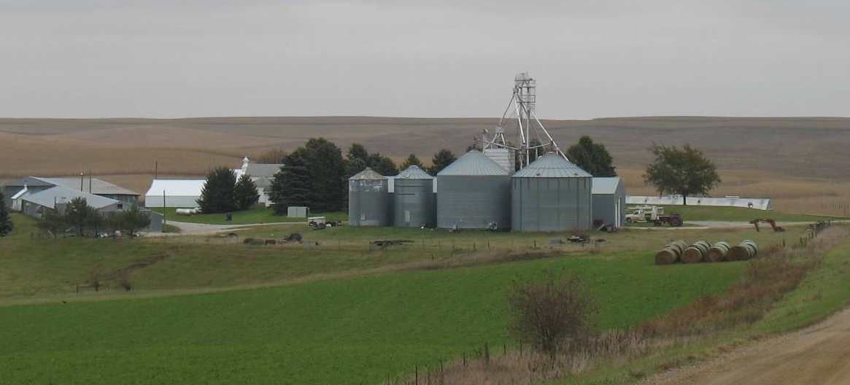
Chemicals commonly sampled by POCIS
Current-Use Pesticides
  Triazines (atrazine)
  Organophosphates
  Fungicides
Emerging Contaminants
  Fragrances
  Pharmaceuticals
  Steroids
  Antimicrobials (triclosan)
  New generation flame retardants
Bioindicator Tests
  In vivo and in vitro assays

Slide 6
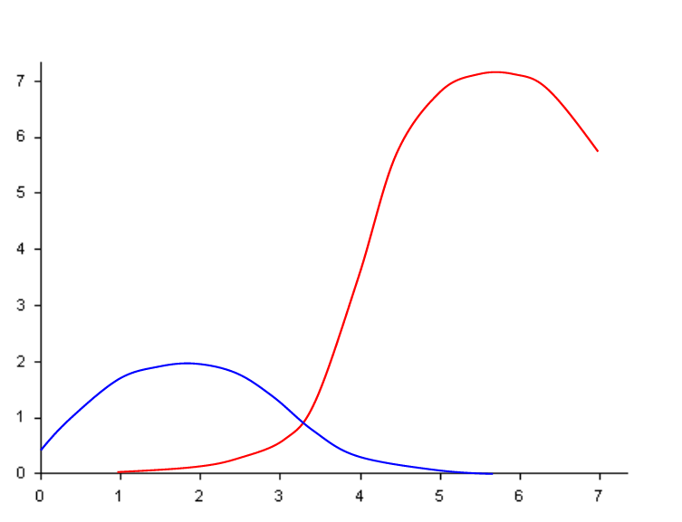
Sampling Characteristics of POCIS and SPMDs
Sampling Rates in L/d (@ <1 cm/sec, 26-28 °C)
Normalized to a Standard SPMD (460 cm²)
SPMD
POCIS
Log K_{OW}

Slide 7
Performance Reference Compounds
(PRCs)
Increasing the Accuracy
of you Data

Slide 8
Performance Reference Compounds (PRCs)
PRCs are added to passive samplers during construction to account for the effect of environmental conditions on sampling
Non-interfering (analytically)
Not present in the environment
Cover a range of fugacities (ability to leave the SPMD)
Preferably compatible with the target analytical method
Common to use multiple PRCs in ensure at least one has usable data
Caution -
PRCs should not be added to samplers which will be used for bioindicator/toxicity determinations.

Slide 9
PRC Approach: Isotropic Exchange
1
Analytes
t_{1/2}
Uptake Rate ≅ Loss Rate
(k_{u} ≅ k_{e})
Currently only applies to SPMDs
C_{s}
0.5
PRCs
0
0
10
20
30
40
50
60
TIME (d)
Figure 1. Illustration of isotropic exchange kinetics.

Slide 10
PRC Approach
Why use PRCs?
R_{s} can increase 10-fold due to water/air velocity
R_{s} can increase 4-fold due to temperature changes
R_{s} can decrease 3 or 4-fold due to biofouling
Photolysis of selected chemical classes (especially PAHs) can occur

Slide 11
PRC Approach: What to Use?
Water: log K_{ow}s 3-6 Air: log K_{oa}s 6-9
Compatibility: PRCs must work with analytical methods used for study
Cost: native and deuterated compounds cost < the ¹³C-labeled PRCs
Site exposure conditions:
high flow/warm temperatures = high K_{ow} and K_{oa} PRCs
low flow/cool temperatures = low K_{ow} and K_{oa} PRCs
Examples (for SPMDs and other hydrophobic samplers):
perdeuterated PAHs (acenaphthene-d₁₀, fluorene-d₁₀, phenanthrene-d₁₀, pyrene-d₁₀)
PCBs (IUPAC 4, 14, 29, 50)

Slide 12
Quality Control and Lab Work
What is needed
and what should I expect?

Slide 13
Quality Control
Blanks –
Blanks are essential to confirm measured levels of contaminants from field deployed samplers were not introduced as “background” from the sampler materials, laboratory processing, storage, shipping, or field handling.
SPMDs readily sample air therefore Field and Laboratory Blanks are necessary.
No amount of precaution can remove all traces of background contamination.

Slide 14
Quality Control
Field Blanks –
Passive sampler exposed to site air during deployment and retrieval operations. Provides a measure of contamination due to the manufacture, shipping, storage, field conditions, and laboratory processing.
Trip Blanks –
Passive sampler shipped along with the field samplers, but is never exposed to the air. Provides a measure of contamination due to the sampler matrix, storage, shipping, and laboratory processing. This type of blank is only needed if air sampling is to performed.

Slide 15
Quality Control
Fabrication (Day 0) Blanks –
Passive sampler constructed at the same time as the field samplers, but is stored frozen until processing. Provides a measure of contamination due to the sampler matrix, storage, and laboratory processing.
Fabrication Blanks are also used to determine the starting PRC concentration (N_{o}) in the SPMD calculations.

Slide 16
Quality Control
Laboratory Blanks –
Solvent blank used to determine potential contamination from a specific step or the full laboratory processing.
Lab Blanks may be less important as the Field Blanks will also pick up contamination from the lab processing; however, you will not be able to determine if the contamination was due to the field or the lab.

Slide 17
Quality Control
Recommended Frequency –
Blanks at all sites is best, but can be very expensive.
10 – 20% of samples for QC is a common practice
Alternative option – use a “cumulative field blank” which is a blank opened at multiple sites.

Slide 18
Quality Control
Analyte Recovery Samples (Spikes) –
Passive sampler spiked with target chemicals should accompany every study set
- especially important for volatile chemicals and non-standard chemicals
  can be difficult to accomplish as the lab extracting the samplers may not be the same as the lab performing the analyses (spiking solutions may not be available)
  Some recovery data can be found in the literature

Slide 19
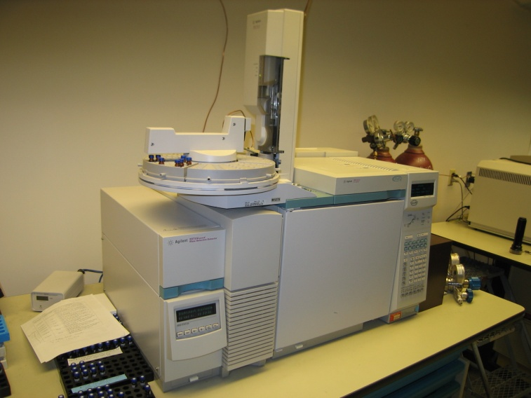
Considerations when choosing a laboratory
Many laboratories do not have experience working with passive samplers, therefore initial contact is important.
Issues to be discussed:
What internal standards / surrogates do they use (may be same as PRCs added to samplers)?
Can they analyze the PRCs as part of their methods and at what concentrations?
How will the data be reported?
ng/sample needed for calculations.

Slide 20
Data Review and Interpretation
What do I do with the data
and what does it mean?

Slide 21
What information can you get from Passive Samplers?
Without sampling rate (R_{s}) data –
  Identification of chemicals (is it there? YES / NO)
  Relative differences between sites
  Semi-quantitative measures of contaminant water concentrations
  Bio-mimic assessment of an organism’s exposure to chemicals
With sampling rate data (and/or use of PRCs) –
  Quantitative measurements of contaminant water concentrations

Slide 22
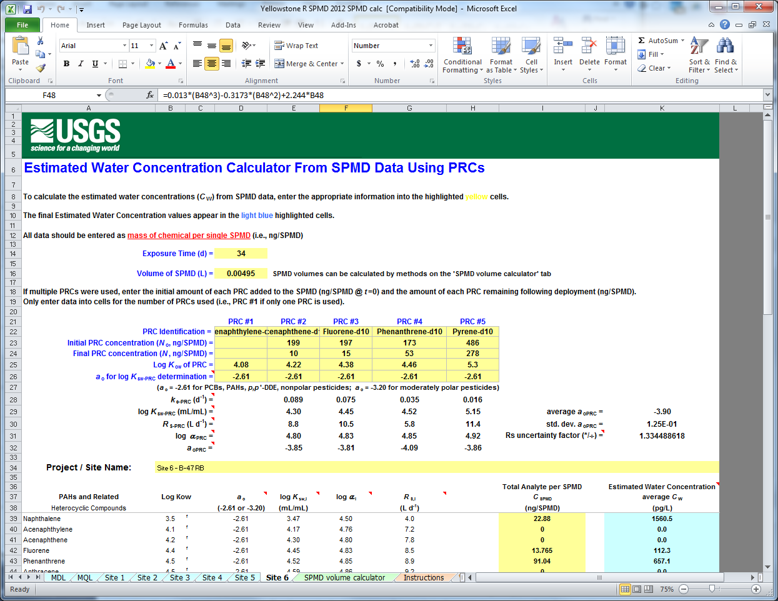
Data Calculations for SPMDs
Uptake models can be complex
Customizable spreadsheets are available to download to aid in SPMD calculations
Two versions available:
If PRCs were used – can be modified to calculate water concentration for nearly any chemical
If no PRCs were used – limited to chemicals for which sampling rates have been experimentally determined
http://www.cerc.usgs.gov/Branches.aspx?BranchID=8

Slide 23
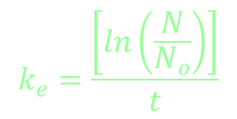

Calculation overview - SPMDs
Site specific R_{s} and C_{w} are based on the log K_{ow} of the chemical, the PRC’s rate loss constant (k_{e}) and the SPMD-water partition coefficient (K_{sw}).

Slide 24
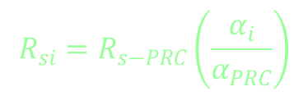
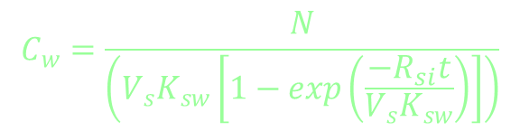
Calculation overview - SPMDs
C_{w} is extrapolated from the site specific sampling rate (R_{si}) which is determined from a third-order polynomial where α_{(i/PRC)} is the compound-specific effect on the sampling rate

Slide 25
SPMD calculation example

Slide 26

Calculation overview - POCIS
Basic linear uptake equation is used where N is the ng of chemical per POCIS, R_{s} is the sampling rate, and t is the deployment time in days.
$$C_{w}= \frac{N}{R_{s} t}$$
PRC approach does not work for POCIS with the exception of a few polar pesticides.

Slide 27
Issues with published POCIS sampling rates (R_{s})
No universal method for determining sampling rates.
  Differences in exposure time, flow, exposure chamber geometry (flow-through, stirred, etc)
  Differences in how sampling rates are calculated
    Atrazine (0.24, 0.21, 0.24, 0.29 L/d)
    Ethynylestradiol (0.24, 0.22, 0.85, 0.34 L/d)
Generally, there is good agreement between studies looking at the same chemical, but there are cases where values can be highly variable.

Slide 28
Recommendations for POCIS selecting R_{s} data
Review article covering these topics –
Harman et al. Environ Toxicol Chem 31 (2012) 2724-2738.
Carefully read and understand the conditions from which R_{s} were derived.
Pick R_{s} data that most closely matches your experimental conditions
If multiple R_{s} data exists, pick a consensus value

Slide 29
POCIS calculation example

Slide 30
Data interpretation
Data is limited to the select list of chemicals in the analytical method and the capabilities of the passive sampler.
A “non-detect” result may not mean the chemical was not present in the water.
An understanding of method performance and ability of the passive sampler to sample the chemical is needed.

Slide 31
Data interpretation
Results represent the average water concentration of a chemical over the deployment period
Timing of episodic events and variability in water concentrations (highs and lows) cannot be determined

Slide 32
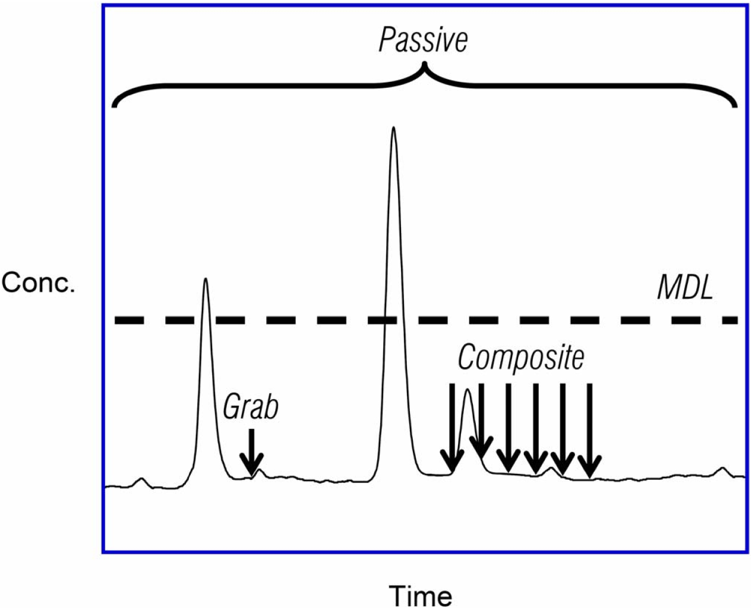
Grab vs. Composite vs. Passive Sampling Techniques
Grab / Discrete Sample
Small vol (1-2 L)
Single point in time
Detection based on conc. and method detection limit
Composite sample
Larger vol. over time
Labor intensive
Improved odds of detecting low conc.
Passive / Integrative sample
Large vol. sampled (10s-100s L)
Time-weighted average conc.
Time-weighted average concentration
MDL

Slide 33
Data interpretation – QC data
Quality control data (blank concentrations and spike recoveries) can be treated in many ways.
The QC guidelines of the study/organization should be followed when interpreting this data.

Slide 34
Data interpretation – Blanks
Subtraction Method
The Blank result is subtracted from the Field result
Best if there is a corresponding FB for each site
Can also subtract the average of all FBs
Comparison Method
Both the Field result and the Blank result are reported, but no correction or censoring of the data is performed based on the Blank data

Slide 35
Data interpretation – Blanks
Detection Limit Elevation Method
Method Detection Limit (MDL) and Method Quantitation Limits (MQL) are elevated by the blanks (Keith, 1991)
MDL = average of blanks + 3 X SD of the blanks
MQL = average of blanks +10 X SD of the blanks
Data is not blank subtracted, instead only values greater than the variability of the blanks are reportable.

Slide 36
Data interpretation – Recovery Spikes
If available, recovery spikes will provide a measure of performance for the laboratory method
Laboratories often will not recovery correct data, but will provide recovery data for the client
Final results to be published or used for regulatory actions should take recovery data into consideration as it might change the data or interpretation

Slide 37
Limitations of using passive samplers
Integrative samplers are designed for long-term sampling periods. Little benefit over grab sampling for durations less than a few days.
It may not be possible to calculate water concentrations for all chemicals measured. Determinations must be made on the importance of water concentrations for these chemicals.

Slide 38
Cautions when comparing data
Beware of dangers when comparing passive sampler data to traditional grab sampling data
Remember passive sampler data is an estimated time-weighted average of the water concentration
There are numerous factors that affect water concentrations that can results in differences in values determined by different techniques

Slide 39
Cautions when comparing data
Unless a rigorous grab sampling program (multiple samples) was used, there is no reason to expect a single data point is representative of the average conditions measured by a passive sampler over weeks or months.
The different techniques should be considered complimentary, but not necessarily interchangeable.

Slide 40
Regulatory acceptance
Samplers as personal dosimeters (human health) for determining occupational exposure is widely accepted.
Use as an environmental monitoring tool is rapidly gaining acceptance.
in US - often viewed as a research tool by federal agencies
a few States are using passive samplers in TMDL and reconnaissance studies
EU is conducting studies to determine the viability for regulatory use

Slide 41
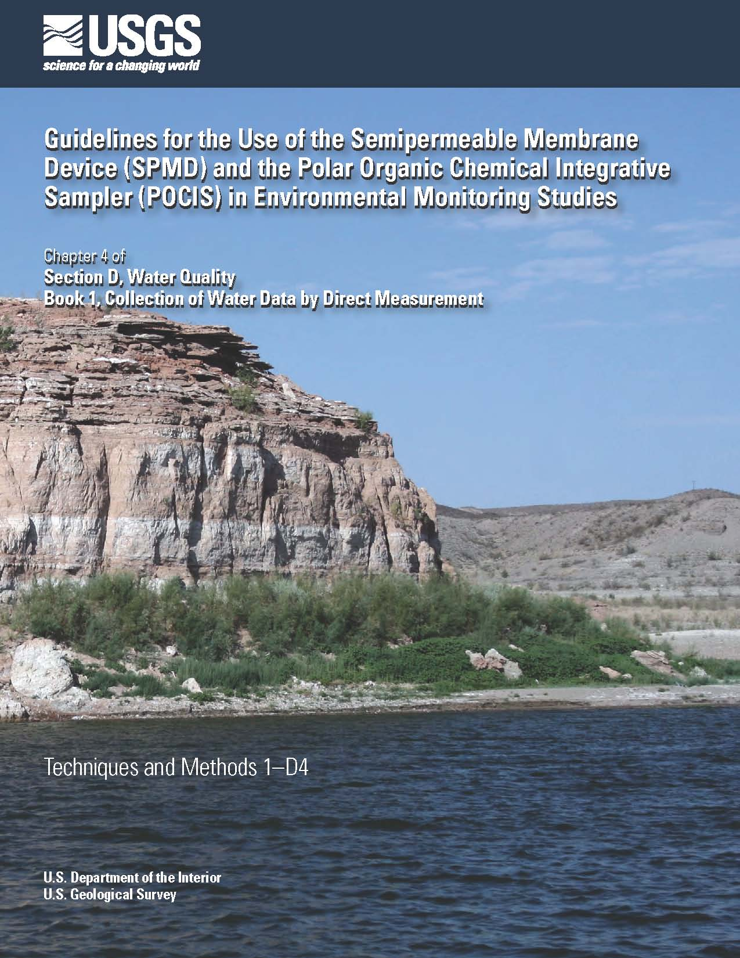
More information
David Alvarez
  dalvarez@usgs.gov
  573-441-2970
SPMD/POCIS “How-To” Guide
  Techniques and Methods Book 1, Section D, Chapter 4
  http://pubs.usgs.gov/tm/tm1d4/
  Covers topics of
    Before heading to the field
    In the field
    Back at the lab
    I have data, now what?

