Slide 1
Passive Samplers: Considerations to Help Make Your Study a Success
David Alvarez
US Geological Survey, Columbia Environmental Research Center, Columbia, MO
U.S. Department of the Interior
U.S. Geological Survey

Slide 2
Passive samplers – What are they?
Abiotic device used to monitor for a chemical(s) in an environmental medium
  Has little or no moving parts
  Doesn’t require power to operate
  Samples over prolonged durations (hours to days to months)

Slide 3
Benefits of Passive Samplers
Allows concentration of trace, yet toxicologically relevant, contaminant mixtures over extended periods of time.
Primarily used for surface water applications, however, air and groundwater use is growing.
Applicable to nearly all environmental conditions, regardless of water quality.

Slide 4
Benefits of Passive Samplers
Concentrate large volumes of water (10s to 100s L) resulting in increased sensitivity and lower detection limits than may be possible with a grab sample of 1 – 2 L of water.
Provide time-weighted average concentrations which are a fundamental part of ecological risk assessment processes for chemical stressors.

Slide 5
Benefits of Passive Samplers
Selectively samples residues from the dissolved (readily bioavailable) phase – mimicking an organism’s exposure.
Detect episodic changes in environmental contaminant concentrations which are often missed with grab samples.
The maximum concentration and the timing of the event is unknown, but presence of the chemical is usually determined

Slide 6
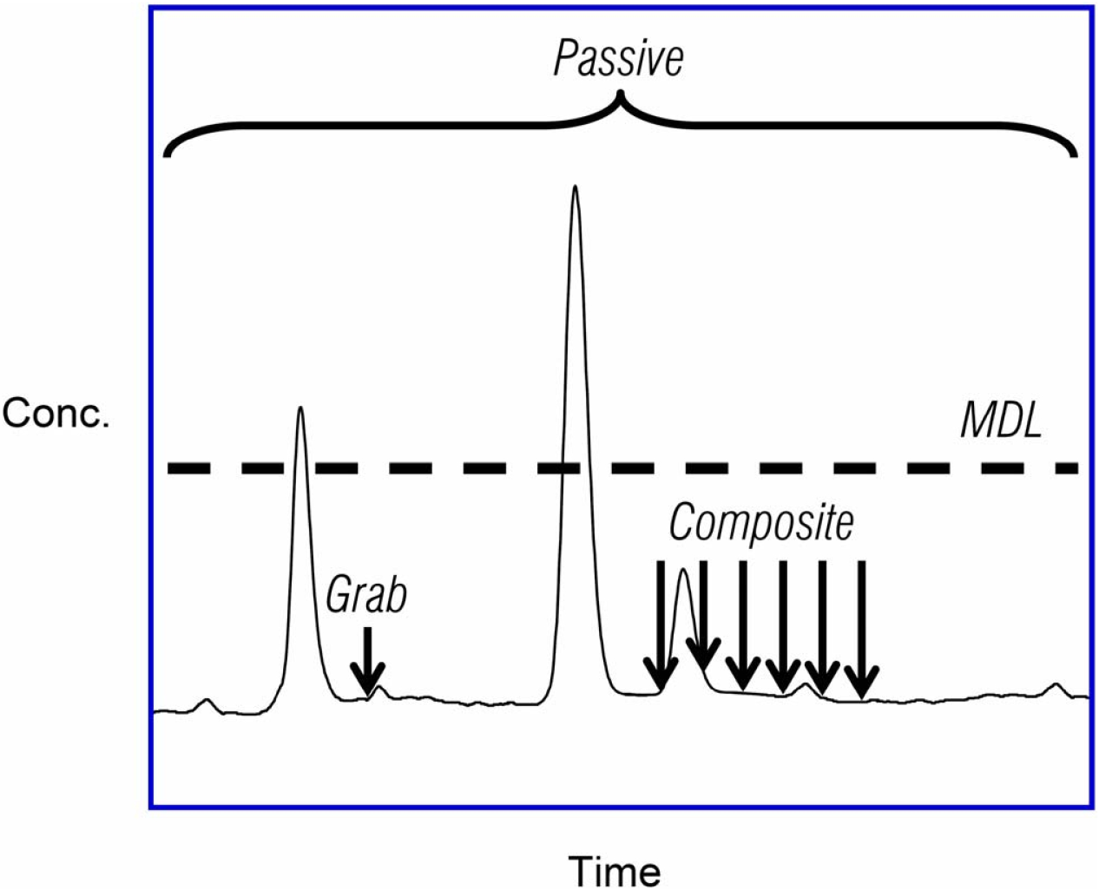
Grab vs. Composite vs. Passive Sampling Techniques
Grab / Discrete Sample
Small vol (1-2 L)
Single point in time
Detection based on conc. and method detection limit
Composite sample
Larger vol. over time
Labor intensive
Improved odds of detecting low conc.
Passive / Integrative sample
Large vol. sampled (10s-100s L)
Time-weighted average conc.
Time-weighted average concentration
MDL

Slide 7
Comparison to Fish Sampling
Passive samplers don’t move.
Metabolism/excretion of sampled chemicals is not an issue.
No need to analyze multiple tissues to obtain the full picture of exposure.

Slide 8
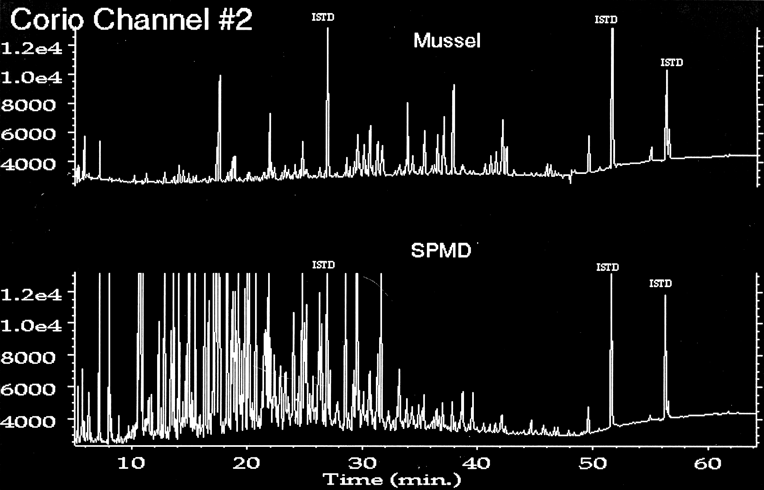
Passive Sampler and Biota Comparison
Sampling of chlorinated organics

Slide 9
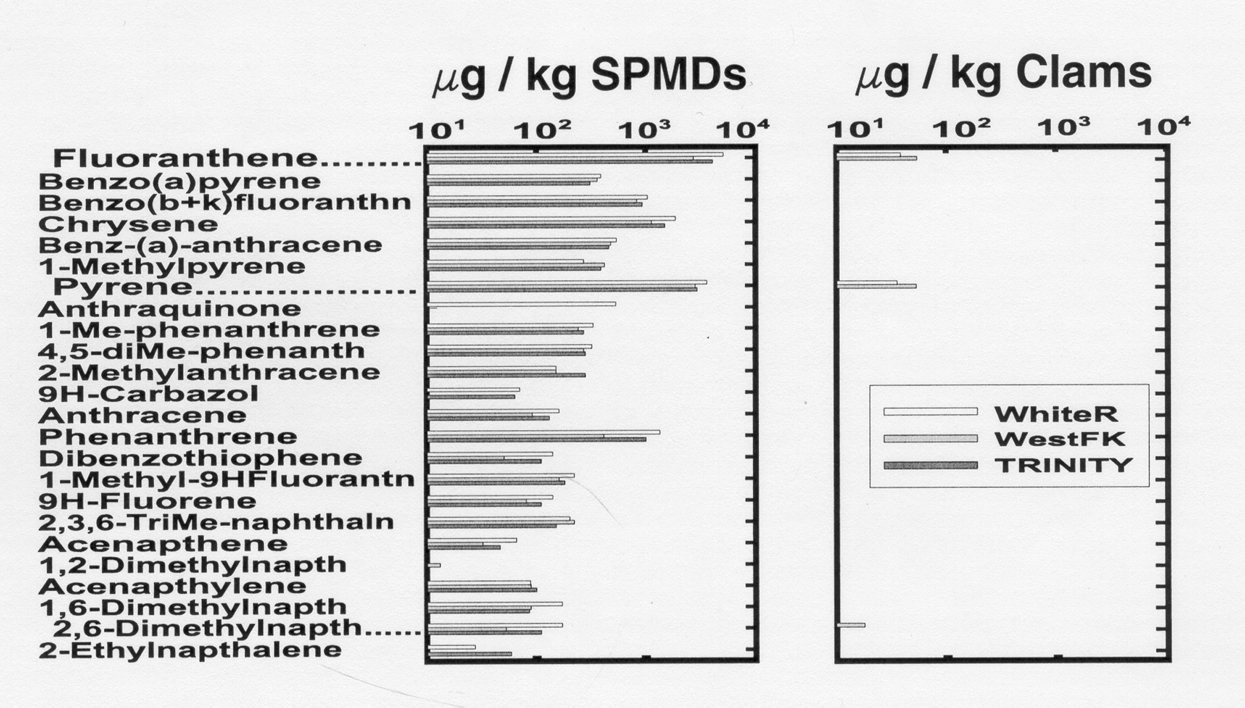
Passive Sampler and Biota Comparison
Sampling of PAHs
Depuration of PAHs: mammals > fishes > crustaceans > bivalves

Slide 10
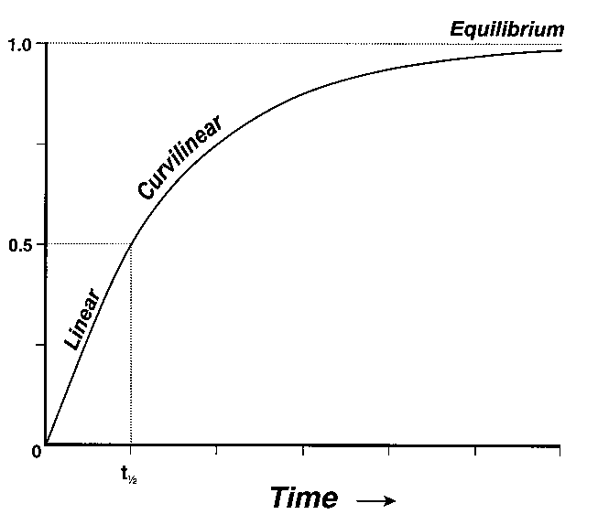
General Types of Passive Samplers
Equilibrium samplers –
  short exposure times (days to weeks)
  low capacity
  data most representative of the latter stages of the deployment
  groundwater, sediment pore water, air, some surface water
  SPME, polymers on glass, diffusion samplers

Slide 11
General Types of Passive Samplers
Integrative samplers –
  long exposure times (weeks to months) – generally 1-2 months
      Short deployments = smaller volumes sampled
      Long deployments = risk of reduction of sampling due to biofilm buildup and change from integrative to equilibrium sampler
  Can act as Integrative and Equilibrium sampler at same time
  high capacity
  provides Time-Weighted Average concentrations over whole deployment
  surface water, air
  SPMD, POCIS, Chemcatcher, PE or Silicone strips

Slide 12
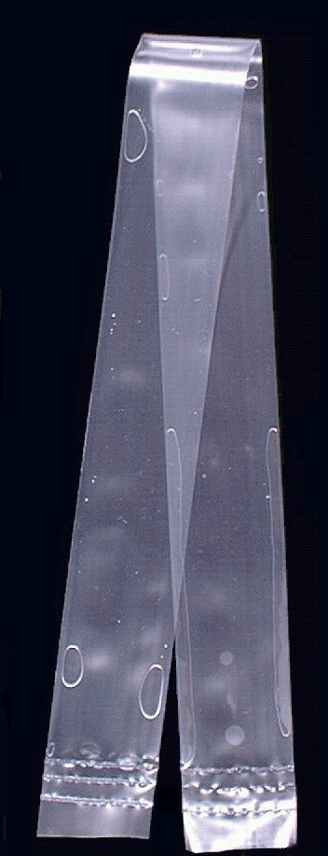
Widely used sampler for organic chemicals
Semipermeable Membrane Device (SPMD)
  Triolein (lipid) filled PE tube
  Lipid soluble, neutral chemicals (log K_{ow} > 3)
  Samples chemicals with molecular weights <600 Daltons and cross-sectional areas < 10Å
  Useful for both water and air sampling
  Used globally since development in early 1990s
SPMD

Slide 13
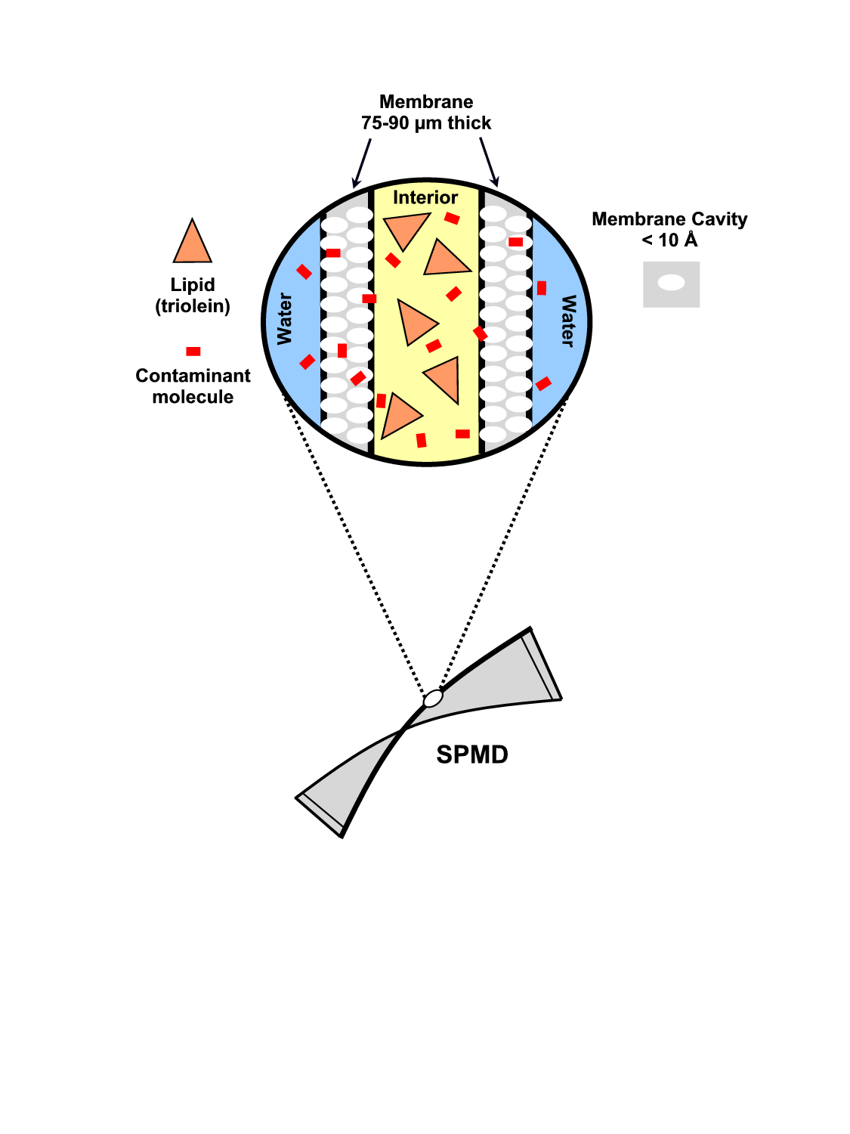
Exploded view of the uptake process in SPMDs

Slide 14
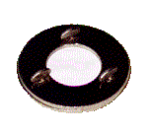
Widely used sampler for organic chemicals
Polar Organic Chemical Integrative Sampler (POCIS)
  Solid resin held between two polyethersulfone membranes (0.1 µm pore size)
  Water soluble chemicals (log K_{ow} < 3)
  Primarily used for surface water but can be adapted for groundwater monitoring
  Used globally since development in late 1990s
POCIS

Slide 15
Exploded view of the uptake process in POCIS
Sorbent particles
Pore Size
0.1 µm
Contaminant molecule
Water
Water
Membrane
~ 130 µm thick

Slide 16
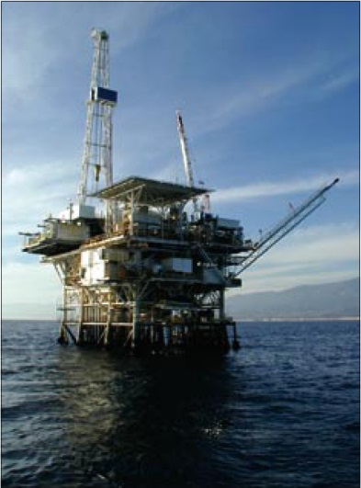
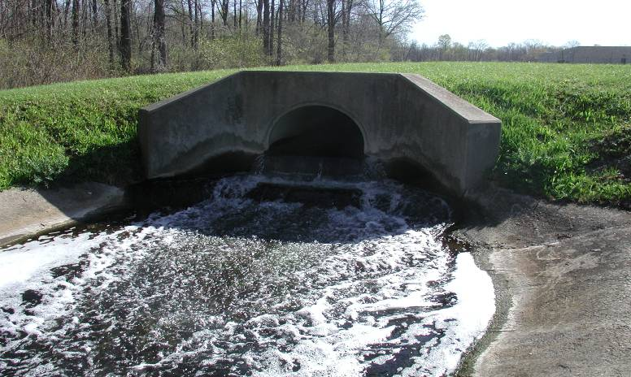
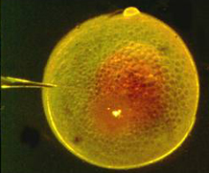
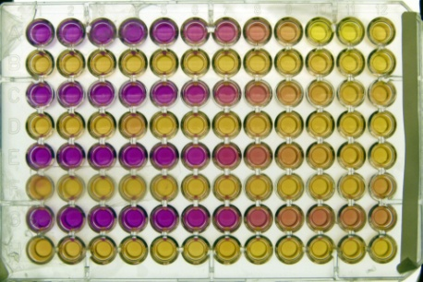
Chemicals commonly sampled by SPMDs
Legacy / regulated contaminants
  Polycyclic aromatic hydrocarbons (PAHs)
  Polychlorinated biphenyls (PCBs)
  Polybrominated diphenyl ethers (PBDEs)
  Chlorinated pesticides (DDT, chlordanes, etc)
  Dioxins and Furans
Emerging Contaminants
  Fragrances
  Phthalate plasticizers
  Antimicrobials (triclosan)
Bioindicator Tests
  In vivo and in vitro assays

Slide 17
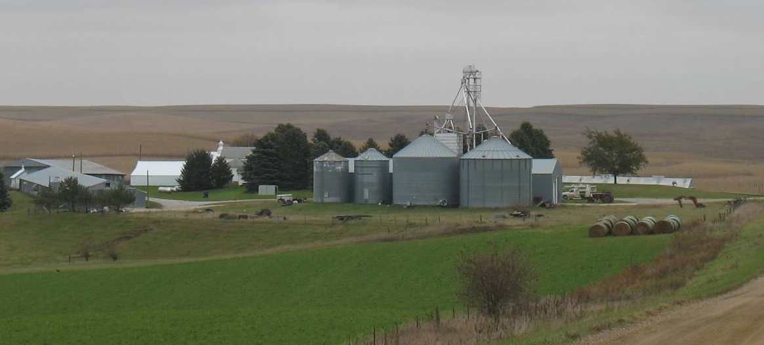
Chemicals commonly sampled by POCIS
Current-Use Pesticides
  Triazines (atrazine)
  Organophosphates
  Fungicides
Emerging Contaminants
  Fragrances
  Pharmaceuticals
  Steroids
  Antimicrobials (triclosan)
  New generation flame retardants
Bioindicator Tests
  In vivo and in vitro assays

Slide 18
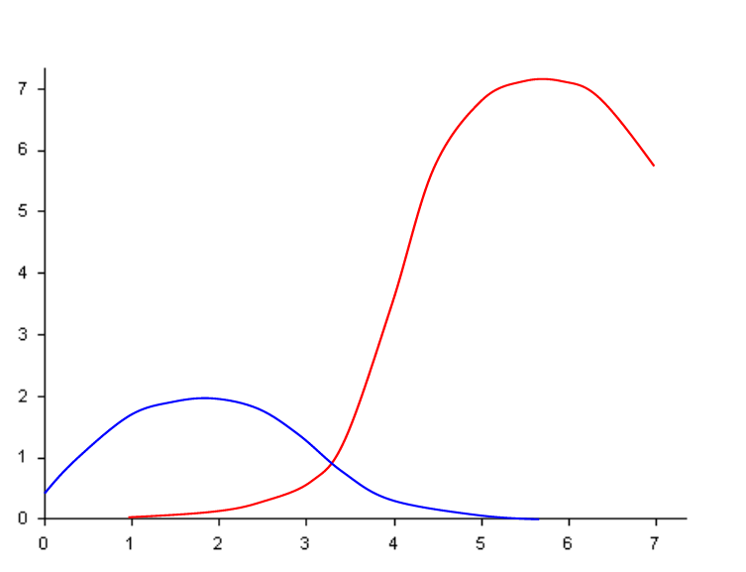
Sampling Characteristics of POCIS and SPMDs
Sampling Rates in L/d (@ <1 cm/sec, 26-28 °C)
Normalized to a Standard SPMD (460 cm²)
SPMD
POCIS
Log K_{OW}

Slide 19
Study Design
1) Are passive samplers the best option to meet study goals?
2) Does the analytical lab have experience with passive samplers?
3) What methods/instrumentation will be used and are they compatible with the passive samplers and PRCs used?
4) How low do you need to measure?
5) What Quality Control (QC) is required?

Slide 20
Performance Reference Compounds
(PRCs)
Increasing the Accuracy
of you Data

Slide 21
Performance Reference Compounds (PRCs)
PRCs are added to passive samplers during construction to account for the effect of environmental conditions on sampling
Non-interfering (analytically)
Not present in the environment
Cover a range of fugacities (ability to leave the SPMD)
Preferably compatible with the target analytical method
Common to use multiple PRCs in ensure at least one has usable data
Caution -
PRCs should not be added to samplers which will be used for bioindicator/toxicity determinations.

Slide 22
PRC Approach: Isotropic Exchange
1
Analytes
t_{1/2}
Uptake Rate ≅ Loss Rate
(k_{u} ≅ k_{e})
Currently only applies to SPMDs
C_{s}
0.5
PRCs
0
0
10
20
30
40
50
60
TIME (d)
Figure 1. Illustration of isotropic exchange kinetics.

Slide 23
PRC Approach
Why use PRCs?
R_{s} can increase 10-fold due to water/air velocity
R_{s} can increase 4-fold due to temperature changes
R_{s} can decrease 3 or 4-fold due to biofouling
Photolysis of selected chemical classes (especially PAHs) can occur

Slide 24
PRC Approach: What to Use?
Water: log K_{ow}s 3-6 Air: log K_{oa}s 6-9
Compatibility: PRCs must work with analytical methods used for study
Cost: native and deuterated compounds cost < the ¹³C-labeled PRCs
Site exposure conditions:
high flow/warm temperatures = high K_{ow} and K_{oa} PRCs
low flow/cool temperatures = low K_{ow} and K_{oa} PRCs
Examples (for SPMDs and other hydrophobic samplers):
perdeuterated PAHs (acenaphthene-d₁₀, fluorene-d₁₀, phenanthrene-d₁₀, pyrene-d₁₀)
PCBs (IUPAC 4, 14, 29, 50)

Slide 25
Field Deployment
Tips and Tricks for Deploying Samplers
(and hopefully getting them back!)

Slide 26
Field Considerations
1) Must remain submerged at all times
2) Keep from getting buried in sediment
3) If photosensitive chemicals are targeted, protect from light (add a photolysis marker as part of PRC mix)
4) Be prepared for flooding and/or floating debris
5) Beware of other people - #1 cause of failed field work

Slide 27
Field Supply Checklist
Passive Samplers and Blanks (if applicable)
Cooler with blue or wet ice for transporting the samplers
Tools
  paint can opener, wrenches, pliers, side cutters, etc.
Cables and/or other anchoring gear
Thermometer (for water temps)
Signage / markings
Gloves
Field log sheets

Slide 28
Field Work – Deployment Summary
Receive samplers in sealed cans at office.
Store samplers (DO NOT open the sealed cans) at <0 °C
Transport samplers in cans to field in a cooler on ice (blue or wet – NOT DRY!)
At site, prepare all deployment hardware prior to opening the shipping cans and removing the samplers
Open the lids to the Field Blank cans (if used at this site)
Open the lids to the deployment canister can

Slide 29
Field Work – Deployment Summary
Quickly remove the deployment canister from the shipping can and secure in the water
Reseal the lids to the Field Blanks and shipping cans
Place the Field Blanks back in the cooler for transport back to office
Fill out Field Log Sheets
At office, store the Field Blanks in freezer at < 0 °C. The empty shipping cans can be stored at room temperature (with lids secured).

Slide 30
Field Work – Retrieval Summary
Transport Field Blanks to field in a cooler on ice, empty shipping cans do not need to be in cooler until the field samplers are placed in them
At site, prepare all gear prior to opening the shipping cans and removing the samplers
Open the lids to the Field Blank cans (if used at this site)
Open the lids to the deployment canister can

Slide 31
Field Work – Retrieval Summary
Quickly remove the deployment canister from the water and return to the shipping can
Reseal the lids to the Field Blanks and shipping cans
Place the Deployment canister (in the shipping can) and Field Blanks back in the cooler for transport
Fill out Field Log Sheets
Ship all deployment canisters, field blanks, and log sheets to CERC via FedEx overnight. If cannot ship immediately, store all cans in freezer at < 0 °C

Slide 32
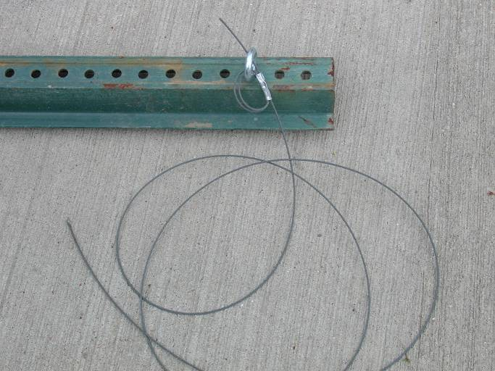
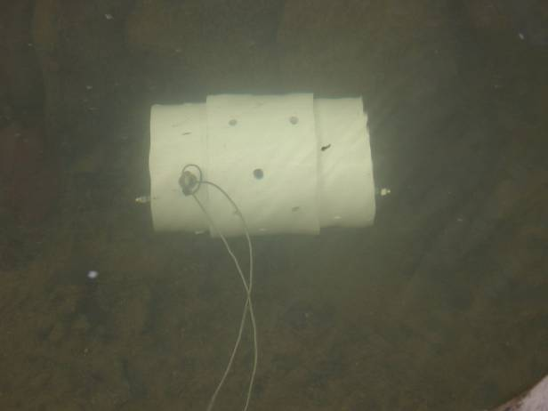
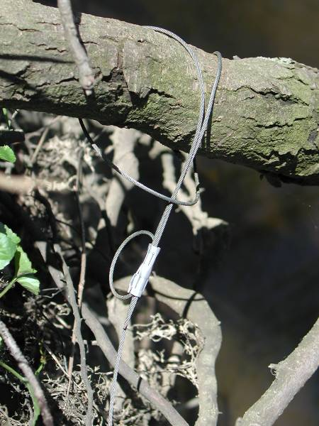
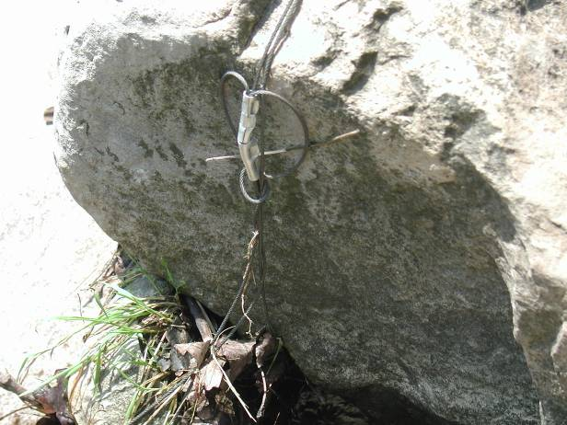
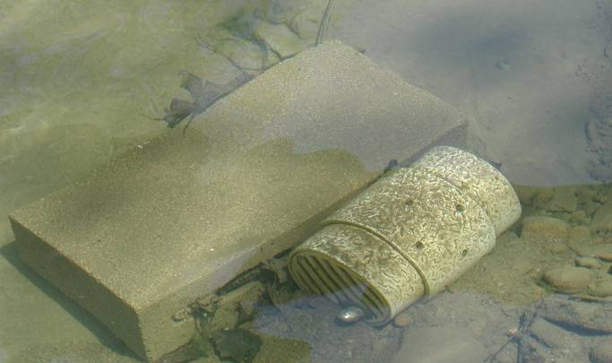
Field Deployment Tips - Anchoring
Trees, rocks, fence posts, etc. offer a solid point to attach cable, but the cable can be a liability during high water; it will pull the device to the bank. A two cable system can keep the canister in place and help if a cable breaks or becomes undone.

Slide 33
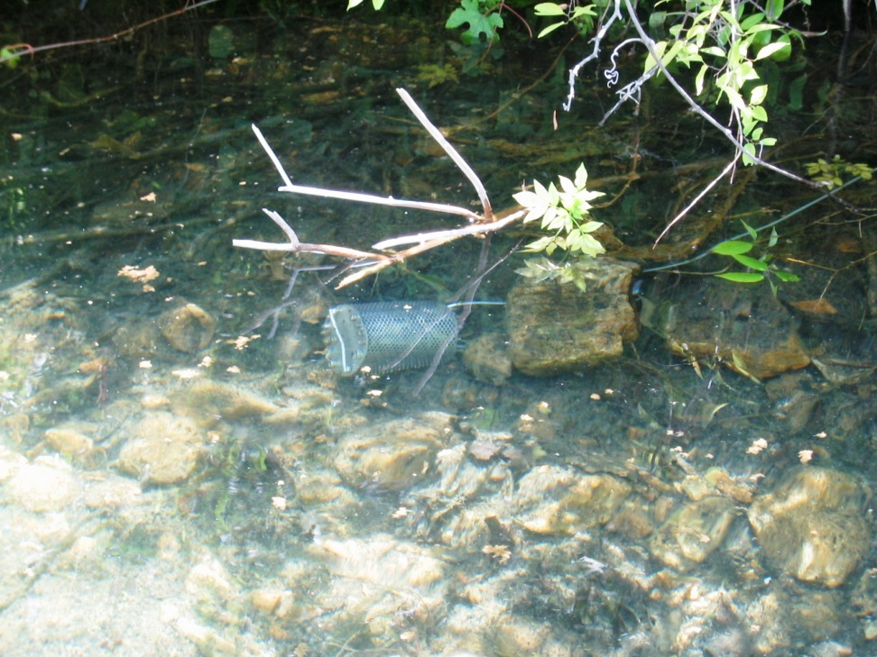
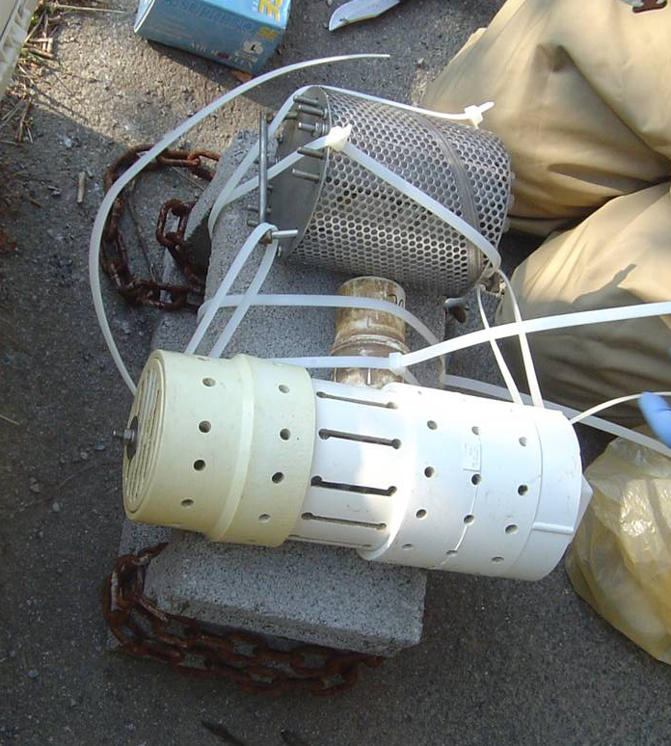
Field Deployment Tips – Bottom Conditions
Rocky Bottom – canister can sit directly on stream bed
Silt/Sand Bottom – canister should be held slightly off the stream bed to prevent getting buried

Slide 34
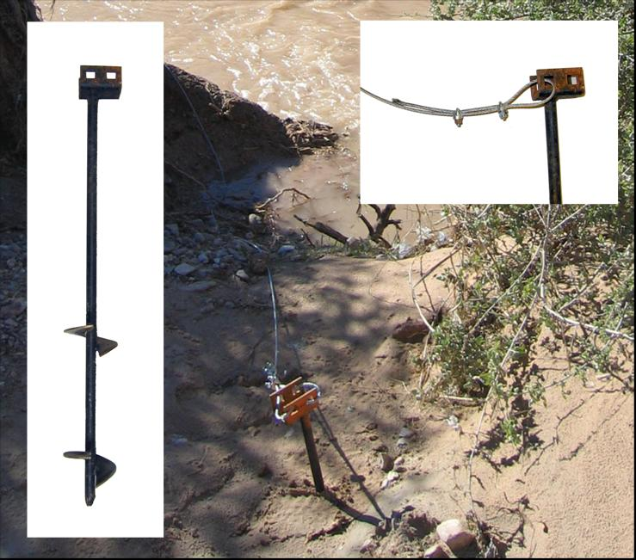
Field Deployment Tips - Anchoring
Ground anchors can be useful for shore deployments when no other structures are available to tie to.
Anchors are strong, but difficult to impossible to use in rocky soils.
A short length of 2X4 works well to twist the anchor in the soil.

Slide 35
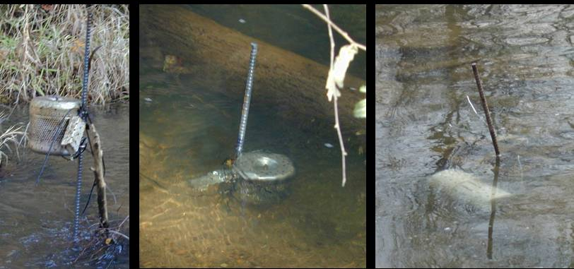
Field Deployment Tips - Anchoring
For mid-channel deployments in wadeable streams, rebar can be driven into the stream bed to tie the deployment canister to.

Slide 36
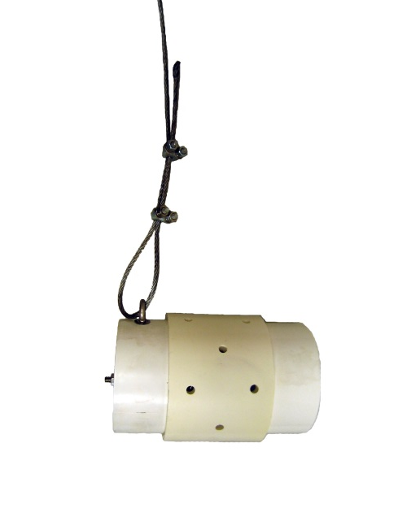
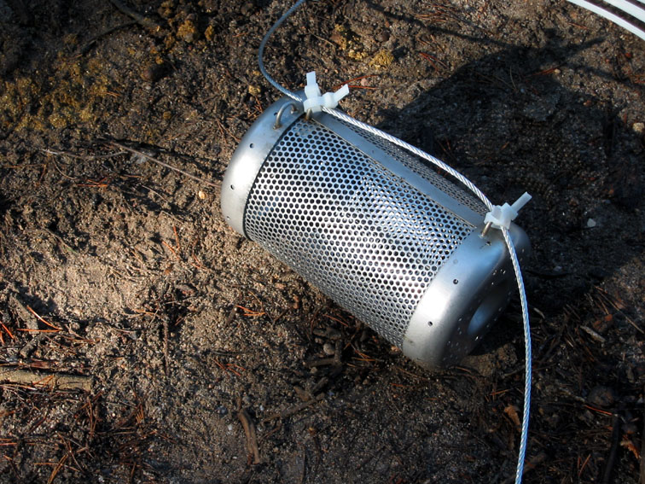
Field Deployment Tips - Hardware
Preferred methods –
1/8” to 3/16” woven cable (non-coated) with cable locks
Thick nylon cable (zip) ties
If using cable, recommend having it precut at the store – very difficult to cut in the field
Rope is not recommended as it can wear thin due to rubbing in moving water and it also can be easily cut by anyone with a pocket knife

Slide 37
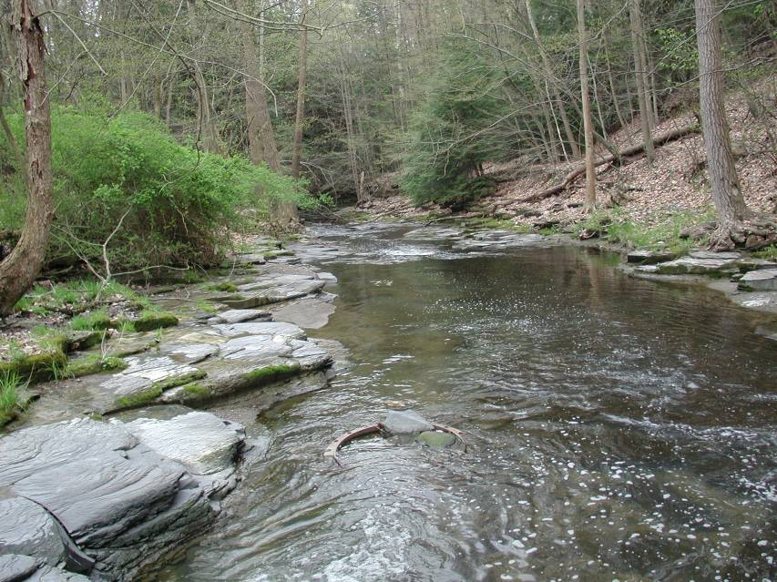
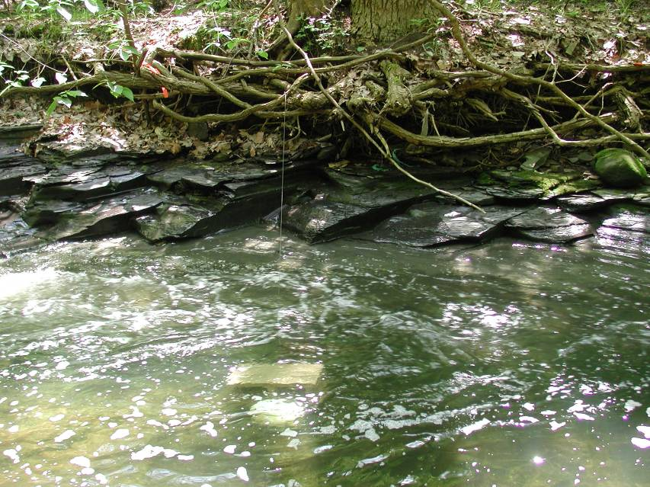
Field Deployment Tips
Bedrock and boulder substrates are the most challenging places to deploy a monitoring device for an extended period
Anchoring is next to impossible
Swift water can be unmanageable, canisters may move to the edge

Slide 38
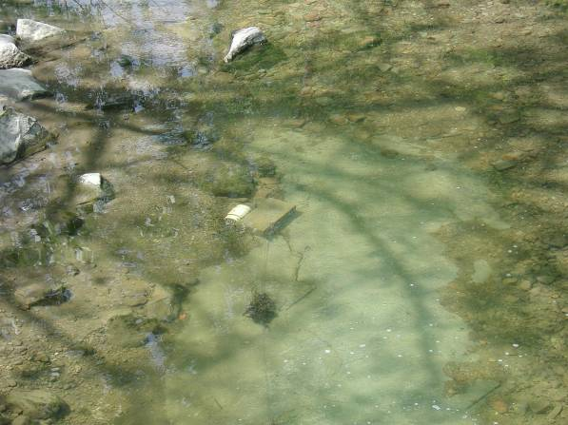
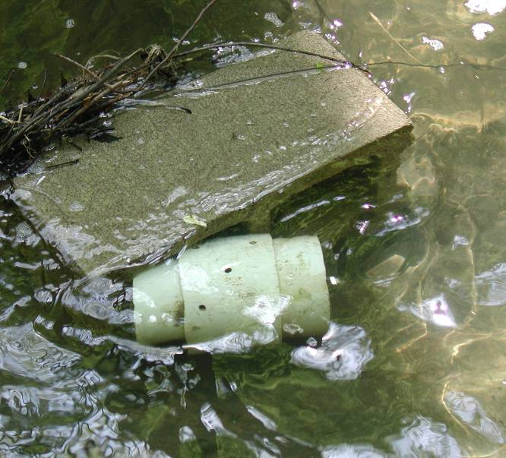
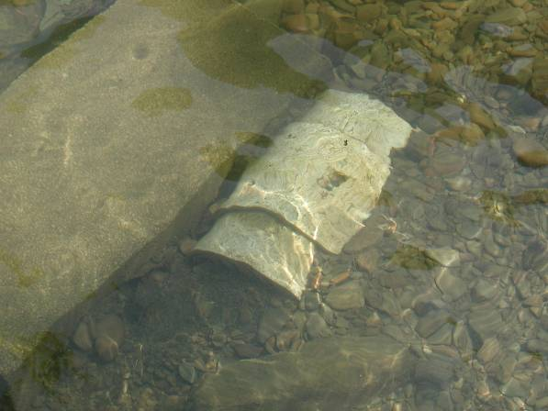
Field Deployment Tips – Depth and Flow
Increased flow can move the canister to the bank
Can limit sampling opportunities
Smaller streams may become too shallow in the summer
Or to the depositional area

Slide 39
Field Deployment Tips – Depth and Flow
Flow is preferred over a still pool if available
  Increased flow = increased volume of water sampled
Samplers must remain submerged for the entire period
  In shallow streams, finding a deep hole, digging out a deeper hole, or creating a temporary dam (generally not a good idea) can help maintain sufficient water depth.
  If water depth drops, samplers can be moved to another nearby location in stream if needed.

Slide 40
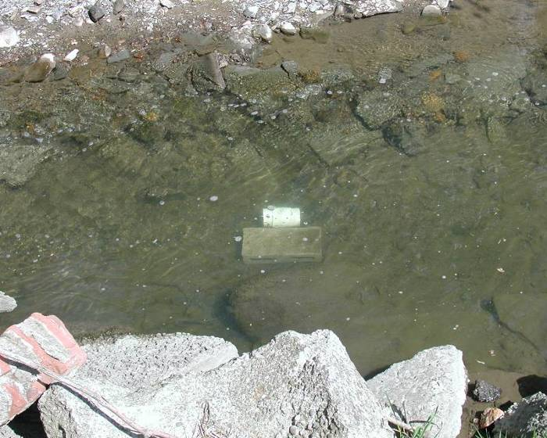
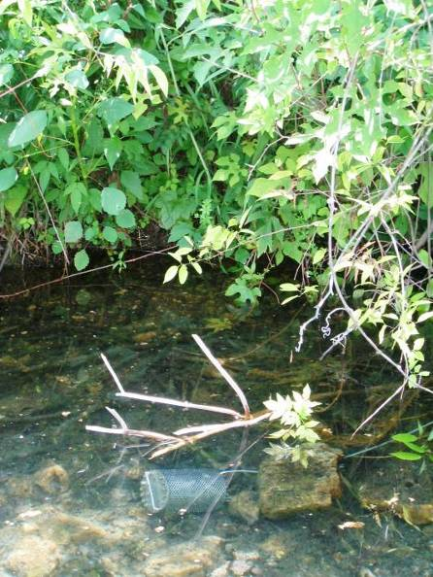
Field Deployment Tips – Vandalism
Avoid public areas
Camouflage as necessary
Beware of fisherman / boaters
Signs / labels may help
Best bet – remain as invisible as possible

Slide 41
Field Deployment Tips – Observations
Bottom Conditions (soft, rocky, etc.)
Water Flow (calm, trickling, rapid, etc.) – flow measurements may be useful in data interpretation, but are not necessary as not part of the passive sampler calculations
Water Conditions (clear, murky, algal growth, surface film on canisters)
Weather / Air quality
Runoff, point sources, other potential chemical inputs

Slide 42
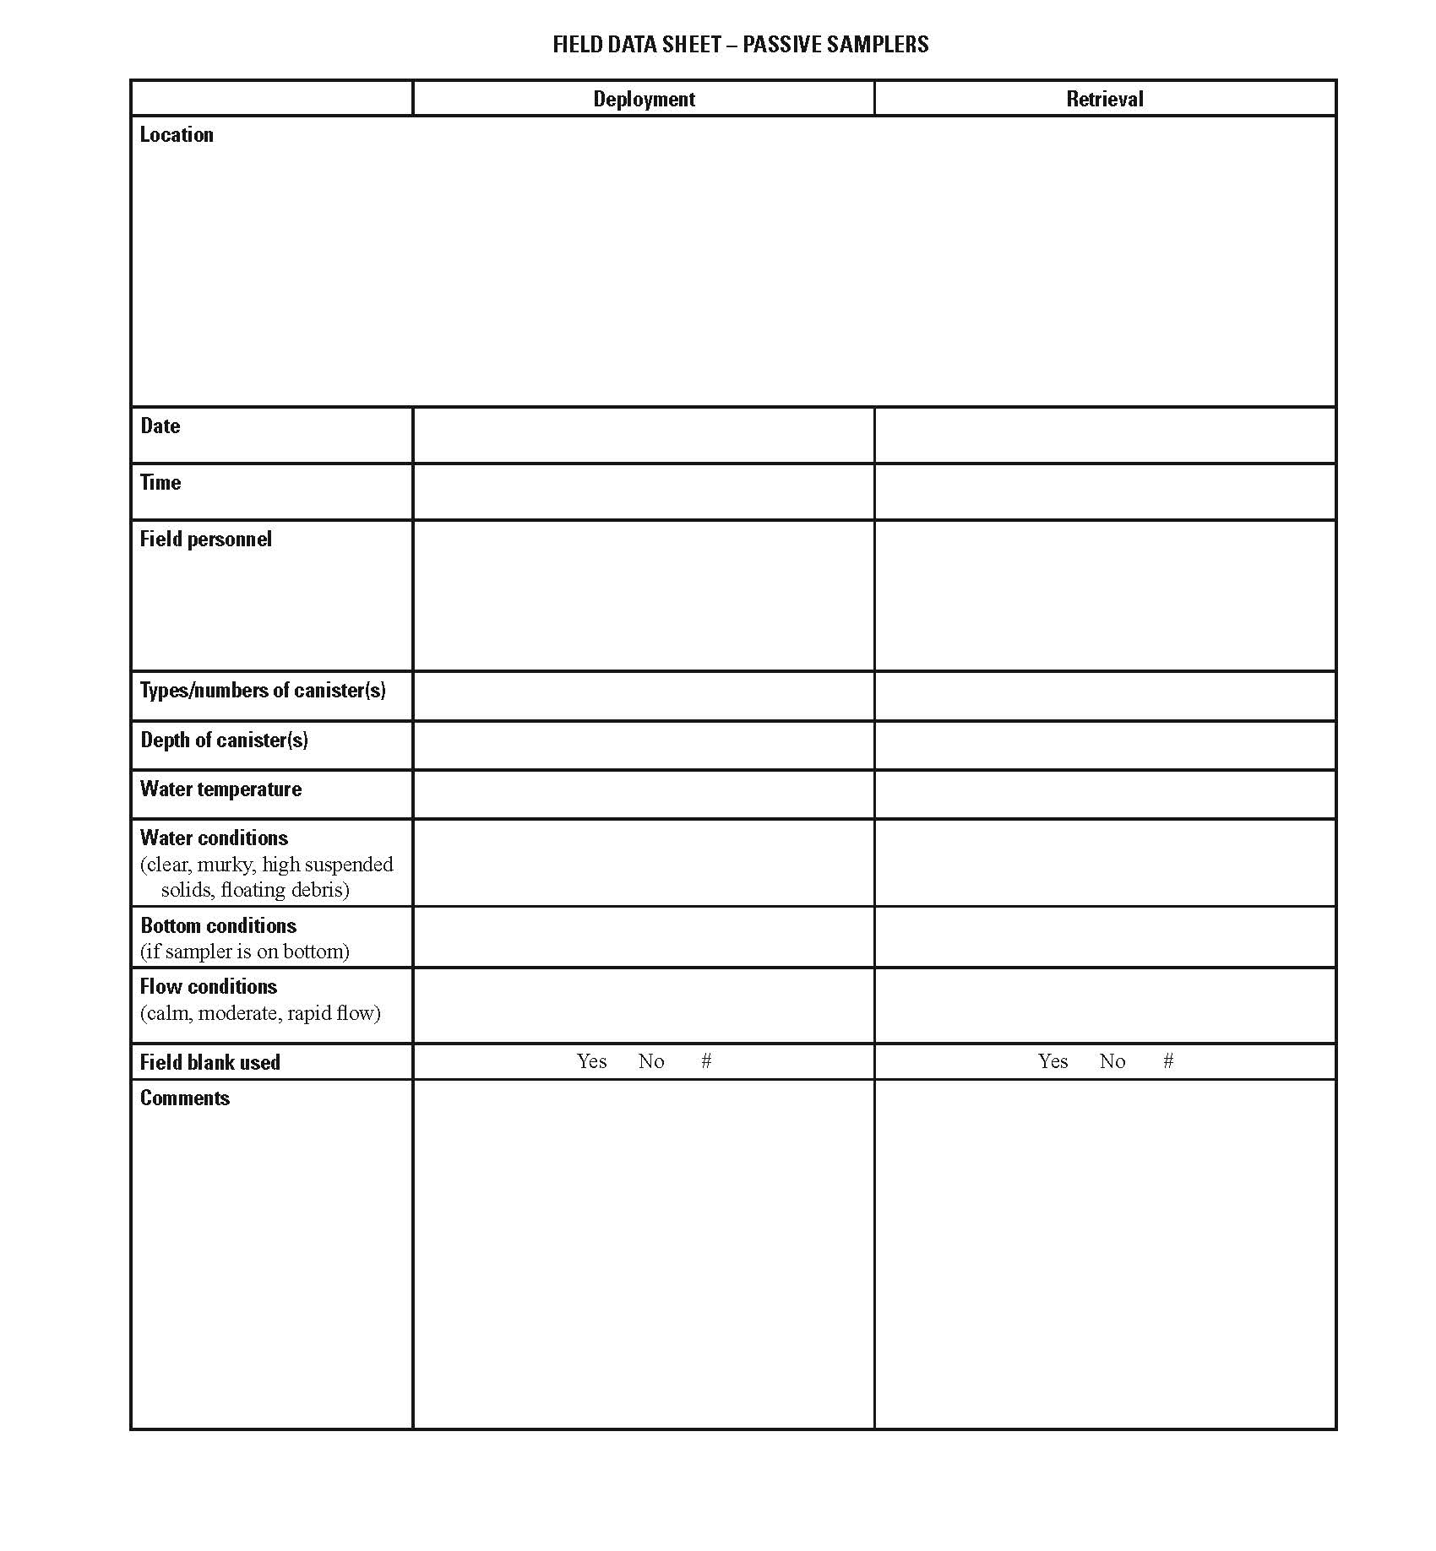
Field Deployment Tips – Observations

Slide 43
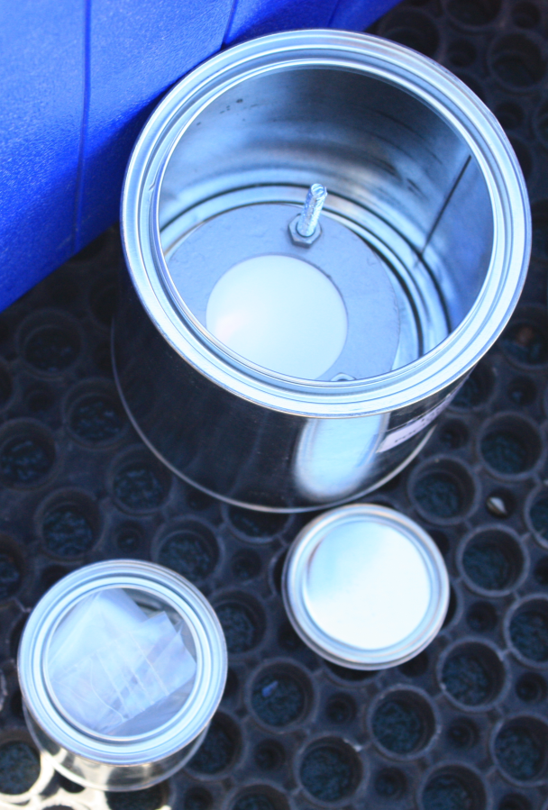
Field Blanks
SPMDs are very good air samplers and POCIS may also sample target or non-target chemicals from the air therefore Field Blanks are essential.

Slide 44
Field Blanks
Field Blanks will be shipped along with field samplers
They should be opened to air during the time the field samplers are exposed to air - BOTH during deployment and retrieval
Do NOT remove the field blanks from their shipping cans
While the samples are deployed, the field blanks need to be kept sealed in their cans in a freezer (-20 °C to 0 °C)

Slide 45
Quality Control and Lab Work
What is needed
and what should I expect?

Slide 46
Quality Control
Blanks –
Blanks are essential to confirm measured levels of contaminants from field deployed samplers were not introduced as “background” from the sampler materials, laboratory processing, storage, shipping, or field handling.
SPMDs readily sample air therefore Field and Laboratory Blanks are necessary.
No amount of precaution can remove all traces of background contamination.

Slide 47
Quality Control
Field Blanks –
Passive sampler exposed to site air during deployment and retrieval operations. Provides a measure of contamination due to the manufacture, shipping, storage, field conditions, and laboratory processing.
Fabrication (Day 0) Blanks –
Passive sampler constructed at the same time as the field samplers, but is stored frozen until processing. Provides a measure of contamination due to the sampler matrix, storage, and laboratory processing.

Slide 48
Quality Control
Laboratory Blanks –
Solvent blank used to determine potential contamination from a specific step or the full laboratory processing.
Lab Blanks may be less important as the Field Blanks will also pick up contamination from the lab processing; however, you will not be able to determine if the contamination was due to the field or the lab.

Slide 49
Quality Control
Recommended Frequency –
Blanks at all sites is best, but can be very expensive.
10 – 20% of samples for QC is a common practice
Alternative option – use a “cumulative field blank” which is a blank opened at multiple sites.

Slide 50
Quality Control
Analyte Recovery Samples (Spikes) –
Passive sampler spiked with target chemicals should accompany every study set
- especially important for volatile chemicals and non-standard chemicals
  can be difficult to accomplish as the lab extracting the samplers may not be the same as the lab performing the analyses (spiking solutions may not be available)
  Some recovery data can be found in the literature

Slide 51
Passive Sampler Processing Scheme
Solvent Extraction & Chemical Recovery
Exterior
Cleaning
Dialysate or Extract
Exterior
Cleaning
Dialytic
Recovery
Enrichment
and
Fractionation
Sealed
in can
Transport
Sealed
in can
Transport
Exposed
SPMD
Exposed POCIS
Chemical Analysis
Bioindicator / Toxicity testing

Slide 52
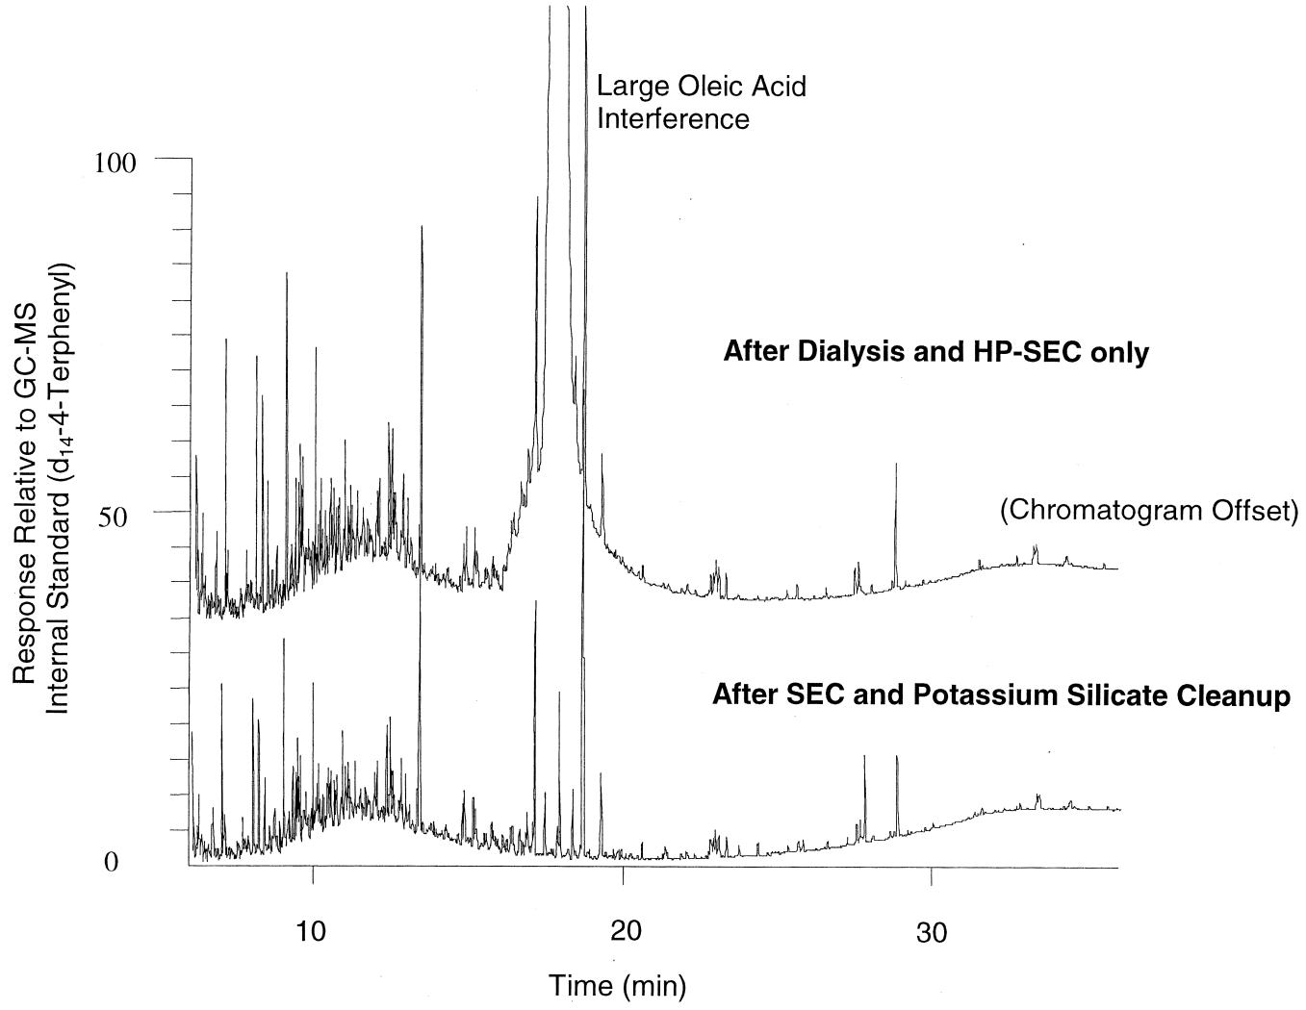
Is Sample Cleanup Necessary?
Targeted contaminants can be masked by co-extracted chemicals which can be natural or biogenic in origin.
  Chemicals in sample can interfere with analysis unless eliminated
  PAHs now detectable following additional cleanup step

Slide 53
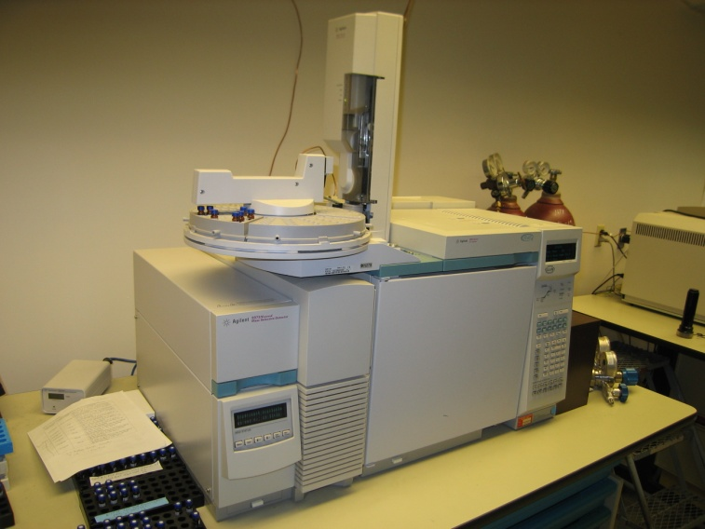
Considerations when choosing a laboratory
Many laboratories do not have experience working with passive samplers, therefore initial contact is important.
Issues to be discussed:
What internal standards / surrogates do they use (may be same as PRCs added to samplers)?
Can they analyze the PRCs as part of their methods and at what concentrations?
How will the data be reported?
ng/sample needed for calculations.

Slide 54
Data Review and Interpretation
What do I do with the data
and what does it mean?

Slide 55
What information can you get from Passive Samplers?
Without sampling rate data –
  Identification of chemicals (is it there? YES / NO)
  Relative differences between sites
  Semi-quantitative measures of contaminant water concentrations
  Bio-mimic assessment of an organism’s exposure to chemicals
With sampling rate data (and/or use of PRCs) –
  Quantitative measurements of contaminant water concentrations

Slide 56
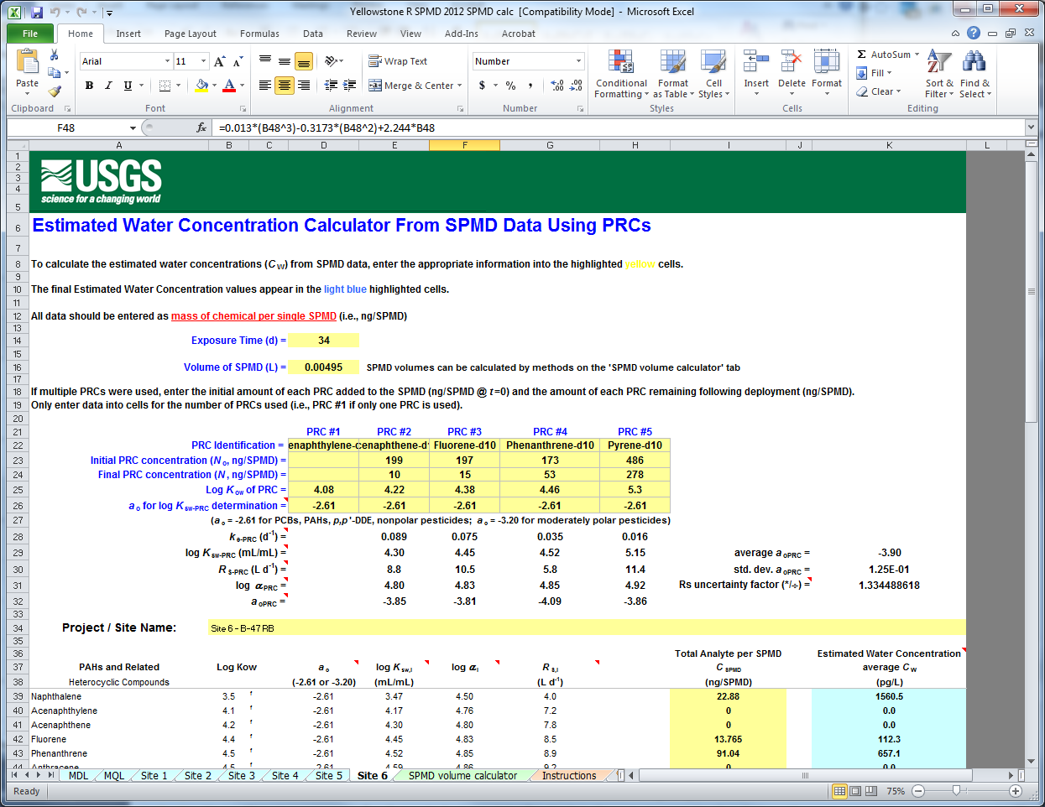
Data Calculations for SPMDs
Uptake models can be complex
Customizable spreadsheets are available to download to aid in SPMD calculations
Two versions available:
If PRCs were used – can be modified to calculate water concentration for nearly any chemical
If no PRCs were used – limited to chemicals for which sampling rates have been experimentally determined
http://www.cerc.usgs.gov/Branches.aspx?BranchID=8

Slide 57
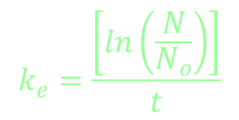

Calculation overview - SPMDs
Site specific R_{s} and C_{w} are based on the log K_{ow} of the chemical, the PRC’s rate loss constant (k_{e}) and the SPMD-water partition coefficient (K_{sw}).

Slide 58
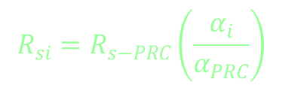
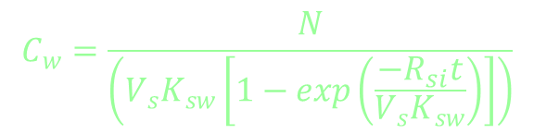
Calculation overview - SPMDs
C_{w} is extrapolated from the site specific sampling rate (R_{si}) which is determined from a third-order polynomial where α_{(i/PRC)} is the compound-specific effect on the sampling rate

Slide 59

Calculation overview - POCIS
Basic linear uptake equation is used where N is the ng of chemical per POCIS, R_{s} is the sampling rate, and t is the deployment time in days.
$$C_{w}= \frac{N}{R_{s} t}$$
PRC approach does not work for POCIS with the exception of a few polar pesticides.

Slide 60
Issues with published POCIS sampling rates (R_{s})
No universal method for determining sampling rates.
  Differences in exposure time, flow, exposure chamber geometry (flow-through, stirred, etc)
  Differences in how sampling rates are calculated
Generally, there is good agreement between studies looking at the same chemical, but there are cases where values can be highly variable.

Slide 61
Recommendations for POCIS selecting R_{s} data
Review article covering these topics –
Harman et al. Environ Toxicol Chem 31 (2012) 2724-2738.
Carefully read and understand the conditions from which R_{s} were derived.
Pick R_{s} data that most closely matches your experimental conditions
If multiple R_{s} data exists, pick a consensus value

Slide 62
Data interpretation
Results represent the average water concentration of a chemical over the deployment period.
Data is limited to the select list of chemicals in the analytical method and the capabilities of the passive sampler.
Quality control data (blank concentrations and spike recoveries) can be treated in many ways. The QC guidelines of the study/organization should be followed when interpreting this data.

Slide 63
Limitations of using passive samplers
Integrative samplers are designed for long-term sampling periods. Little benefit over grab sampling for durations less than a few days.
Although episodic events (storm runoff, spills, etc.) can be captured, impossible to know the maximum concentration or when event occurred.
It may not be possible to calculate water concentrations for all chemicals measured. Determinations must be made on the importance of water concentrations for these chemicals.

Slide 64
Cautions when comparing data
Beware of dangers when comparing passive sampler data to traditional grab sampling data.
Unless a rigorous grab sampling program (multiple samples) was used, there is no reason to expect a single data point is representative of the average conditions measured by a passive sampler over weeks or months.
The different techniques should be considered complimentary, but not necessarily interchangeable.

Slide 65
Regulatory acceptance
Samplers as personal dosimeters (human health) for determining occupational exposure is widely accepted.
Use as an environmental monitoring tool is rapidly gaining acceptance.
in US - often viewed as a research tool by federal agencies
a few States are using passive samplers in TMDL and reconnaissance studies
EU is conducting studies to determine the viability for regulatory use

Slide 66
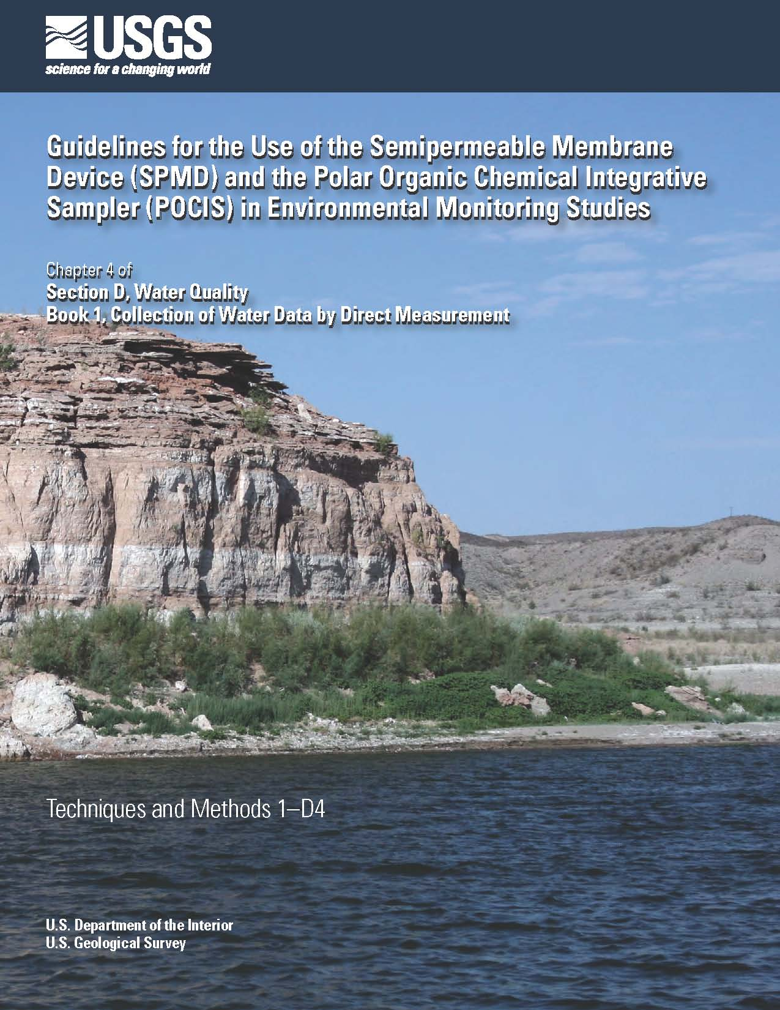
More information
David Alvarez
  dalvarez@usgs.gov
  573-441-2970
SPMD/POCIS “How-To” Guide
  Techniques and Methods Book 1, Section D, Chapter 4
  http://pubs.usgs.gov/tm/tm1d4/
  Covers topics of
    Before heading to the field
    In the field
    Back at the lab
    I have data, now what?

