Slide 1

PASSIVE SAMPLING
- THE NEW BLACK IN GREENTECH
Sorbisense, February 2014

Slide 2
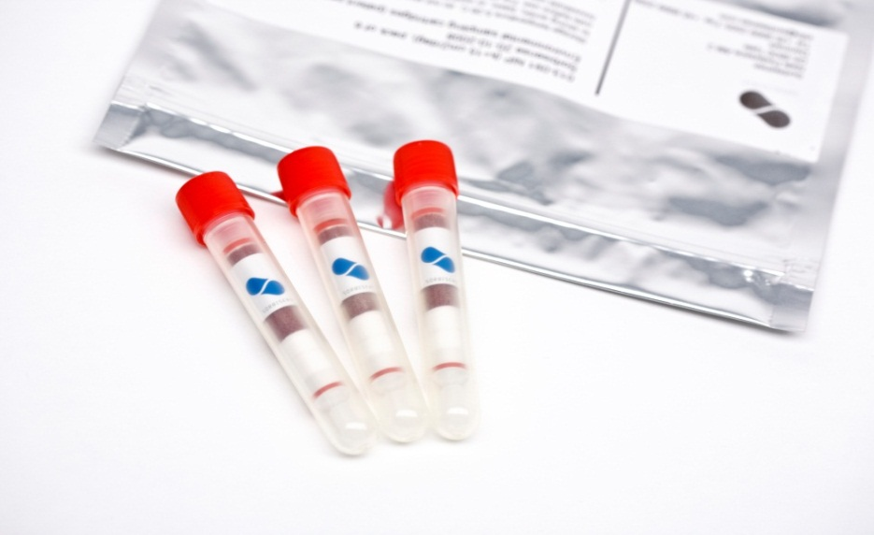

  The Sorbisense method
  - a game changer for research and monitoring of water quality
  Cost-reducing tracking and monitoring of pollutions in
  groundwater and waste water
  Huge savings on sampling
  operations and
  sample handling
  Internationally and
  Accredited laboratory
  network

Slide 3
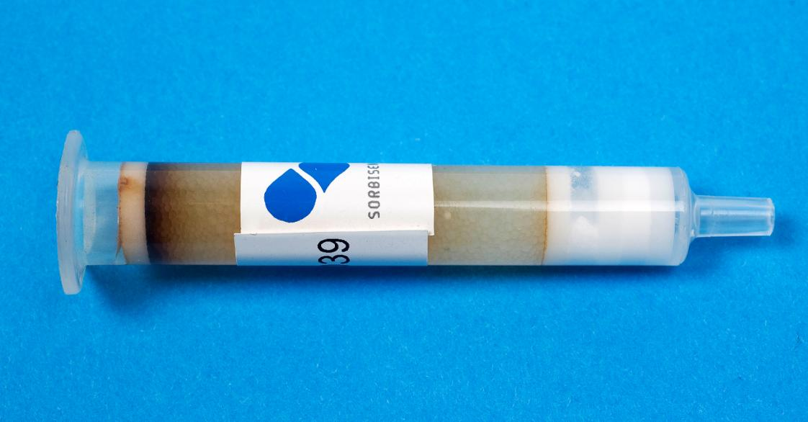
Two types – suitable for classes of solutes
Sorbicells
Sorbicell VOC (organic)
VOCs, fuels, pesticides, PAHs
etc.
Sorbicell CAN (inorganic)
Nitrate, phosphorous, metals

Slide 4
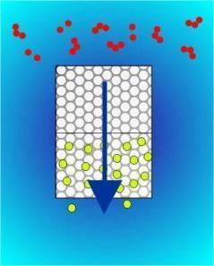
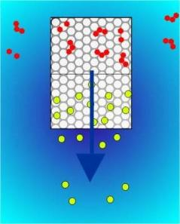
Sorbicell: how it works
Solid phase captures solutes of interest (mass M)
Tracer salt records sample volume (Volume V)
Worldwide patented solution
Laboratory measures compound and tracer salt loss and calculates concentration (M/V)

Slide 5
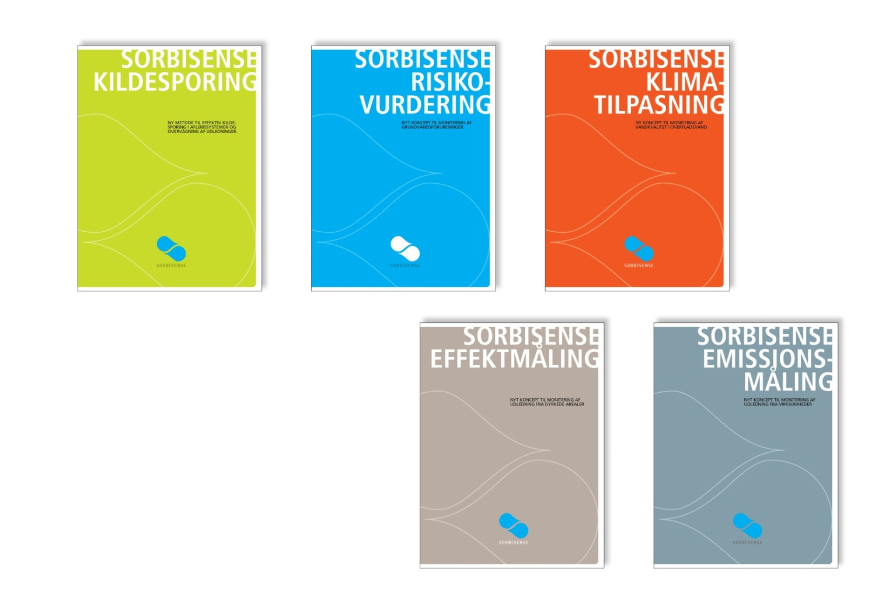
  The Sorbisense method
  - a game-changer for measurring water quality

Slide 6
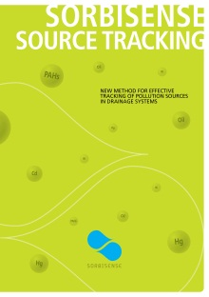
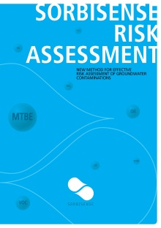
  Sorbisense product-launch 2013-14
  - two groundbraking concepts

Slide 7
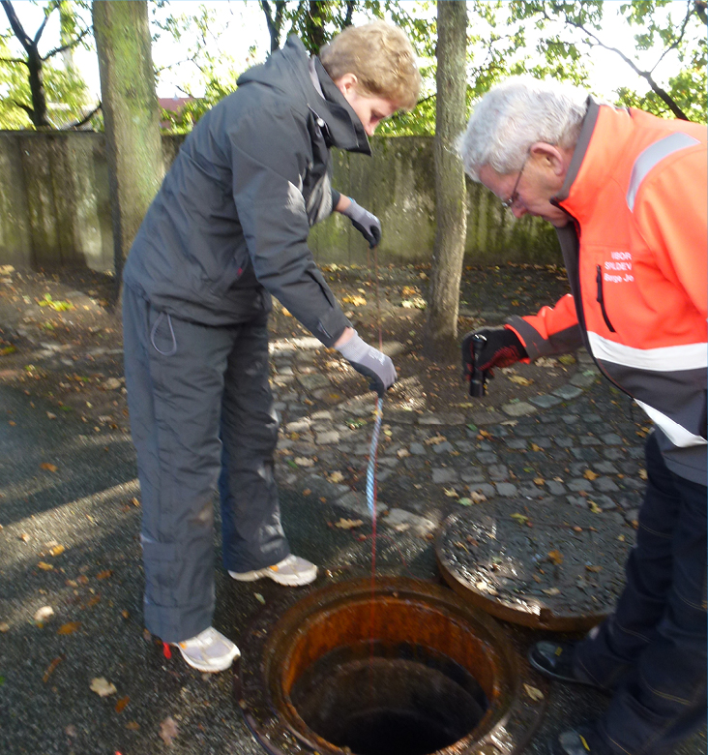
  Sorbisense Source Tracking
  New method for effective tracking of pollution sources in drainage systems
  Reduces cost for disposal of toxic sludge
  Increases opportunities for special contributions
  Reduces capacity requirements from surface water

Slide 8
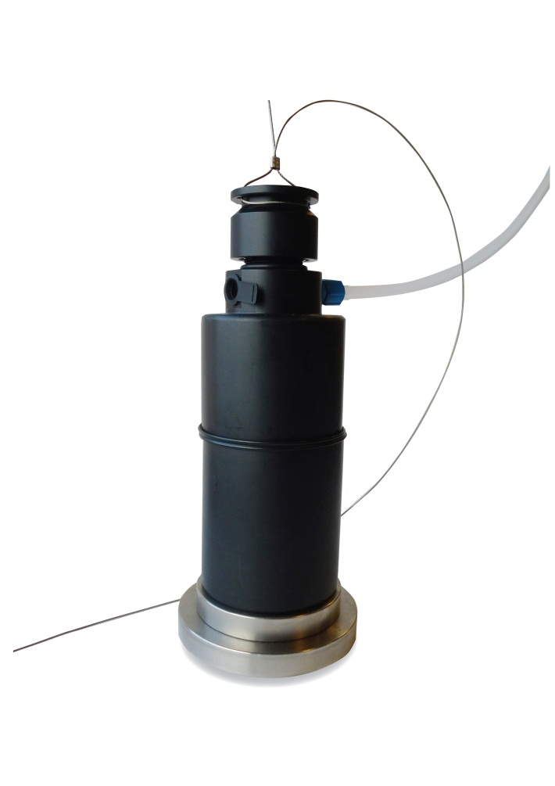
SorbiSystem WW50
Waste water, ponds etc.

Slide 9
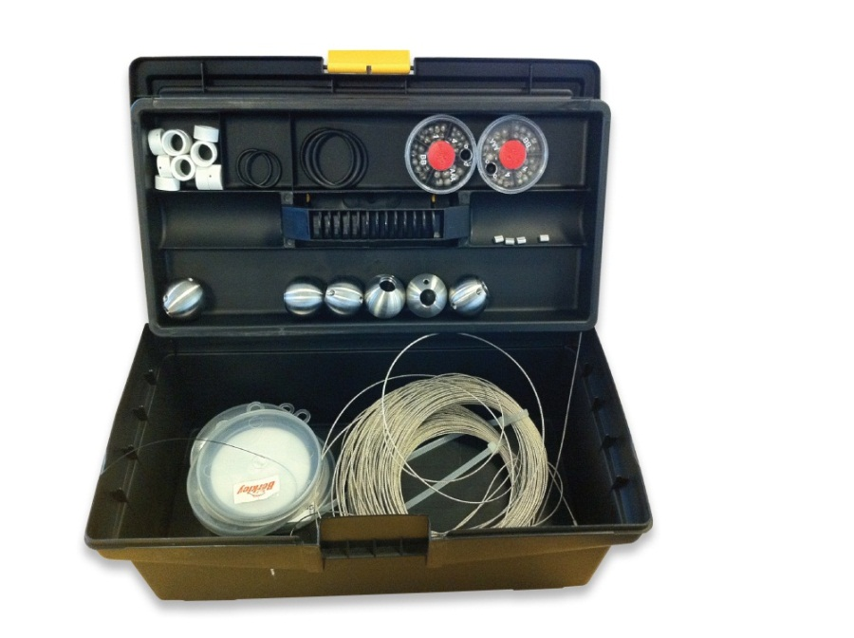
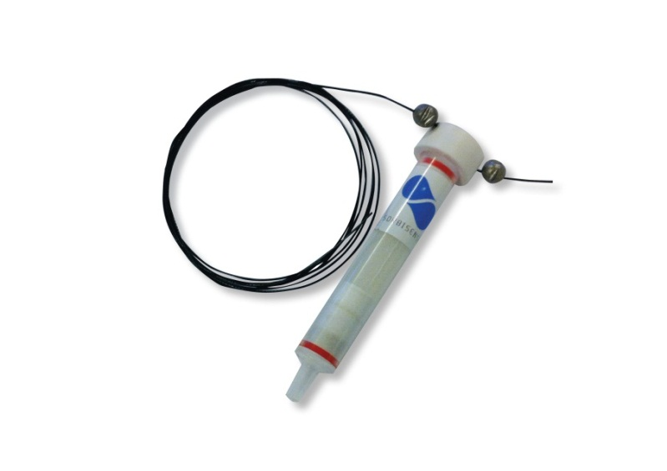
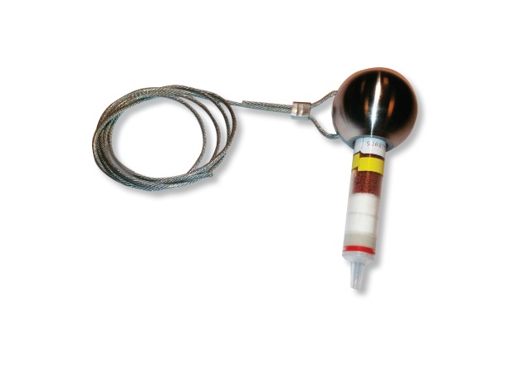
Sorbisense Source Tracking Kit
Steel Ball Mounting
Plastic Mounting

Slide 10
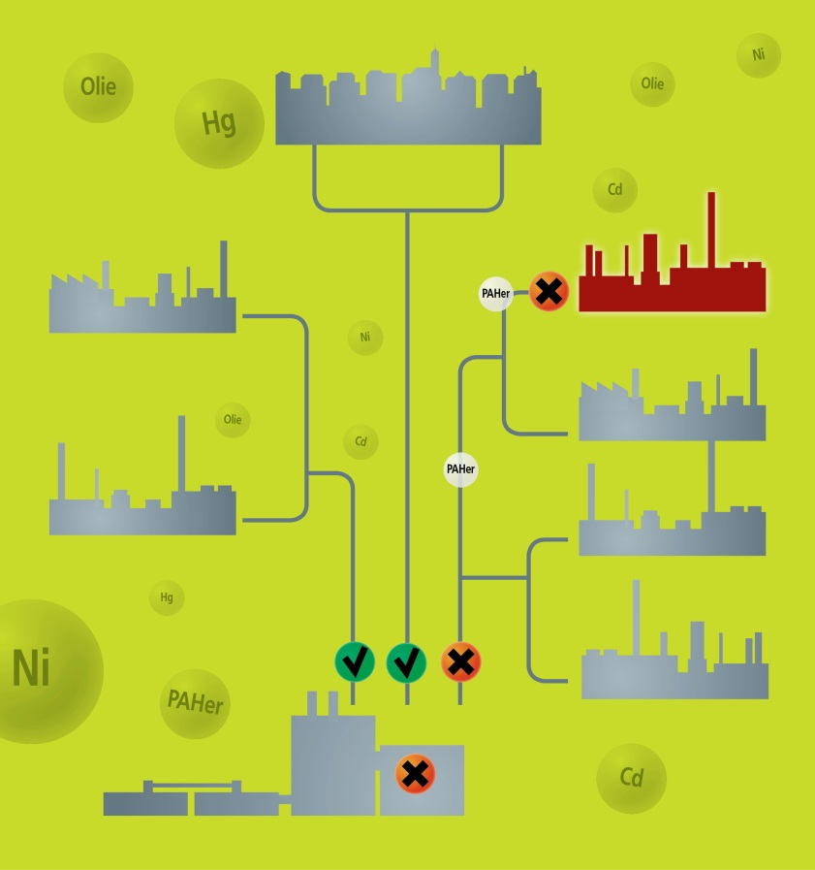
  Sorbisense Source Tracking
  - source screening
  Easy and cost-effective delineation of drainage systems, or for direct measurements at suspected source from individual outlets

Slide 11
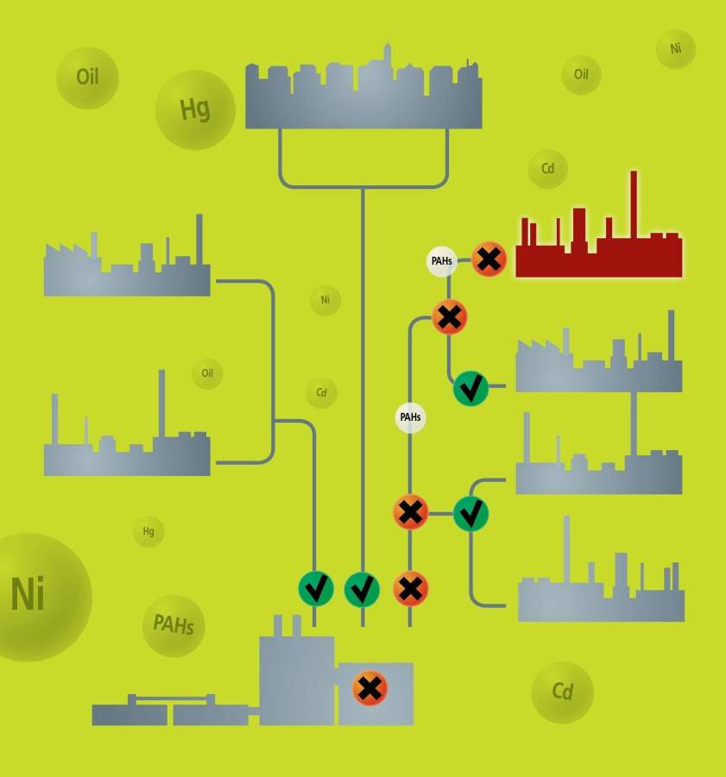
  Sorbisense Source Tracking
  - source tracking
  Efficient monitoring and source tracking in prioritised areas
  Freeze-stored samples allow for long-term sample archive and laboratory analysis on ”need to know” basis

Slide 12

Sorbisense Kildesporing - References
Energi Viborg Spildevand
Challenge: Toxic sludge
History: Periodic discharges, Mercury
Method: Sorbisense Source Screening/ Source Tracking
Result: 3 Sources found within 4-5 months
Finn Køhler,
CEO

Slide 13
Sorbisense Source Tracking - ROI
Sorbisense Source Tracking, Mercury
Investment 1 Sorbisense Source Tracking Kit 3 Sorbisystem WW50 234 pcs. Sorbicell CAN and 96 analyses | DKK 165.443
Labour (Planning, sampling etc.) | ?
Value for utility company– eg. as reduction of costs for disposal of toxic slugde – pr. year | DKK >300.000
Net gain for utility | > DKK 100.000 (pr. year)

Slide 14
  Sorbisense Source Tracking
  - reason why, 5 unique features
Continuous sampling = high rate of succes
Easy establishing of measuring points directly from terrain
Sorbicells can be freeze-stored and analyzed on ”need-to-know” basis
Quick return of investment (ROI)
Easy start-up and can be implemented on demand
Global and accredited laboratory network

Slide 15
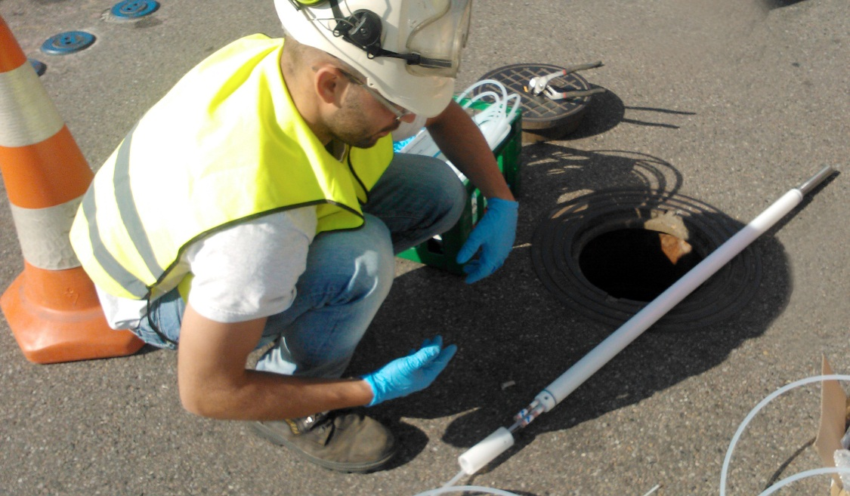
  Sorbisense Risk Assessment
  New method for effective risk assessment of groundwater contaminations creating huge savings on sampling and remediations

Slide 16
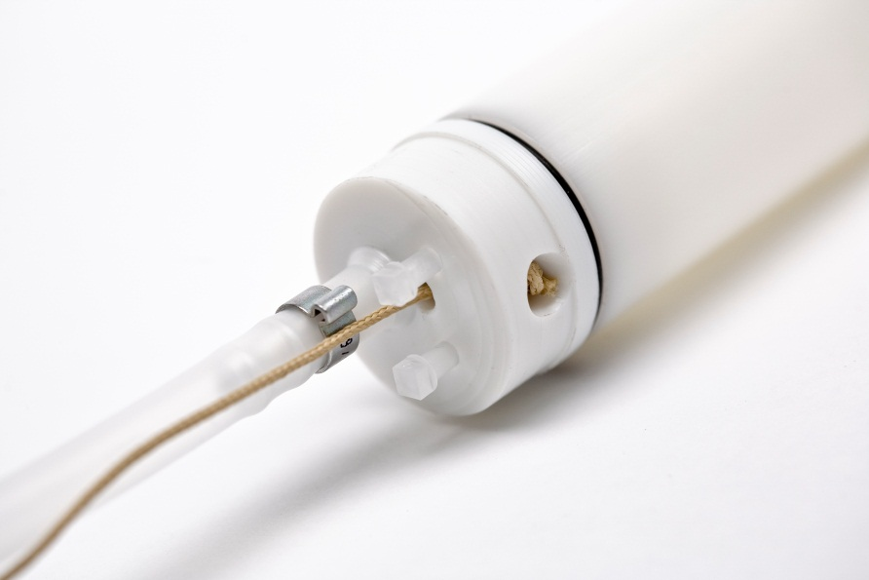
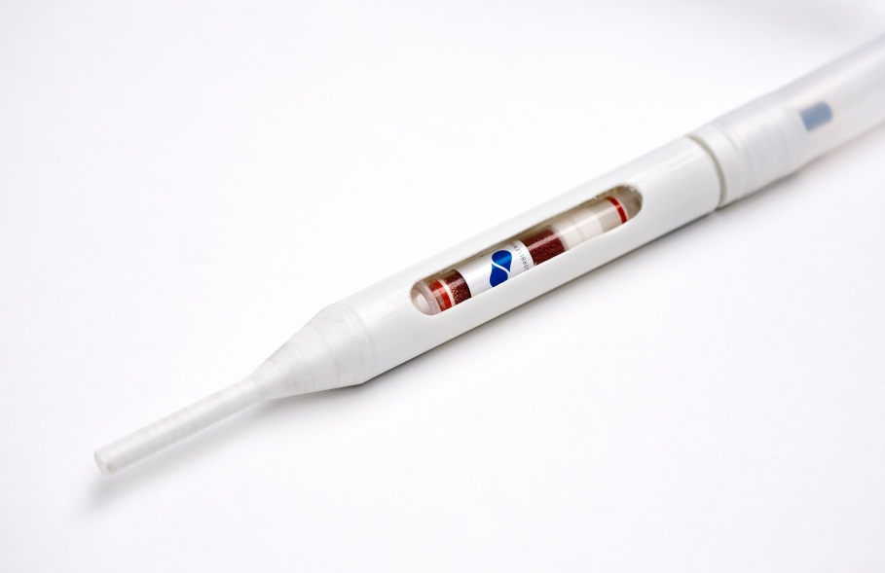
SorbiSystem GWS40/70 and Flex

Slide 17
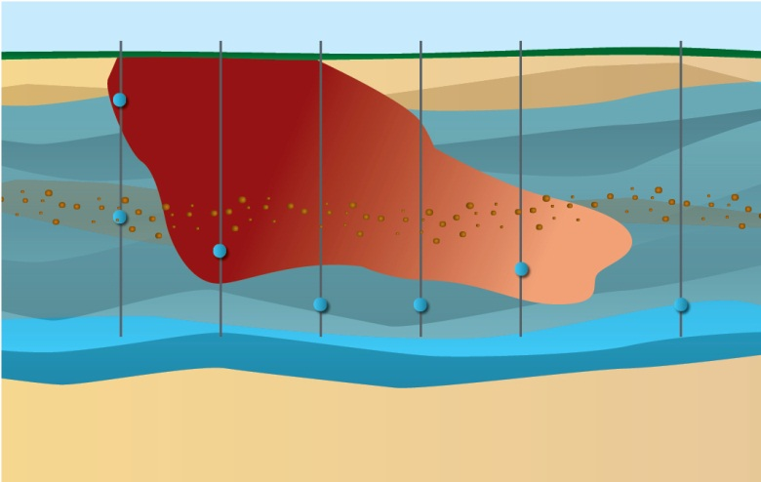
  Sorbisense Risk Assessment
  - risk monitoring
  Up to 80% time savings
  on sampling operations
  and sample handling
  and highly improved
  work environment

Slide 18
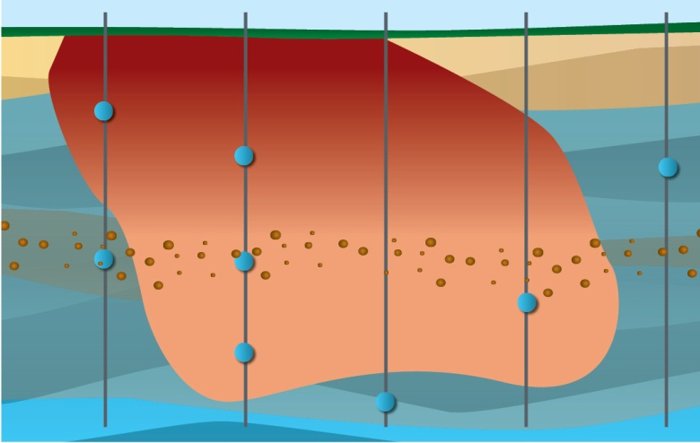
  Sorbisense Risk Assessment
  - risk assessment
  Cost reductions of
  remediations through
  level-specific and
  time-weighted sampling
  of plume development

Slide 19
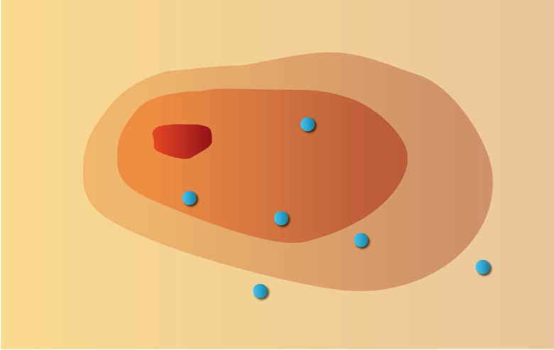
  Sorbisense Risk Assessment
  - risk screening
  Time saving and
  time-weighted
  screening of point sources
  for quick identification of
  need for further
  risk analysis

Slide 20
  Sorbisense Risk Assessment
  - 5 unique features
Sampling tubes instead of water samples and easy mounting allows for huge savings on labour (not operator dependable) and sample handling
Continuous sampling allows for correct measuring of contaminant development and cost savings on remediations (data quality against sampling rounds)
Sorbicells can be freeze-stored and handled through normal mail-services
Patented and robust method for calculating concentrations
Global and accredited laboratory network

Slide 21
SorbiCells: main differences compared to other passive samplers
SorbiCell is and ”active” passive sampler, based on flow of water and solute through sampling unit
Majority of passive samplers are based on diffusion of solute through membrane into sampling unit
Some passive samplers are based on collecting a discrete volume of water into sampling unit

Slide 22
SorbiCell competitive profile: Sampler characteristics
 | Time-weighed Average | Flow-weighed Average | Calibration, n compounds
SorbiCell | Yes | Yes | 1 (Ks)
PDB | ? | No | ÷ (equilibrium time)
SPMD | Yes | No | n parameters (difusivity)
DGT | Yes | No | n parameters (difusivity)
Dosimeter | Yes | No | n parameters (difusivity)
Snap sampler | No | No | ÷
Water sample | No | No | ÷

Slide 23
SorbiCell competitive profile: Testing versatility
 | Ground-water | Surface water | Waste water | Marine | VOCs | NVOCs | Anorganic
SorbiCell | Yes | Yes | Yes | (Yes) | Yes | Yes | Yes
PDB | Yes | Yes | No | ? | Yes | No | No
SPMD | No | Yes | ? | Yes | No | Yes | No
DGT | No | Yes | ? | ? | No | No | Yes
Dosimeter | Yes | Yes | ? | ? | Yes | Yes | No
Snap sampler | Yes | Yes | Yes | Yes | Yes | No | Yes
Water sample | Yes | Yes | Yes | Yes | Yes | Yes | Yes

Slide 24
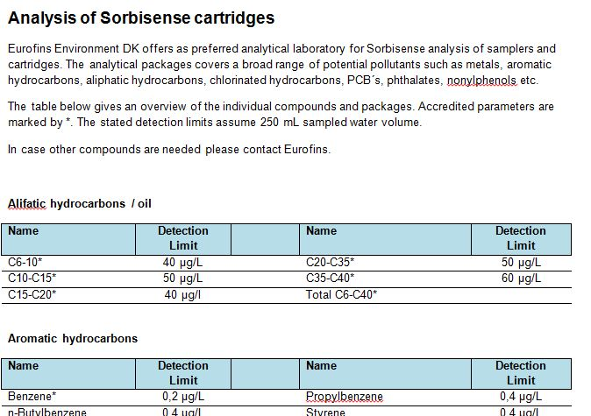

Present list of substances measurable with Sorbicells
Sorbisense supply chain
- analyses performed by Eurofins

Slide 25
Sorbisense supply chain
- and business model
Sorbisense (or dealer)
Consultant
Enduser
Or…
Eurofins

Slide 26
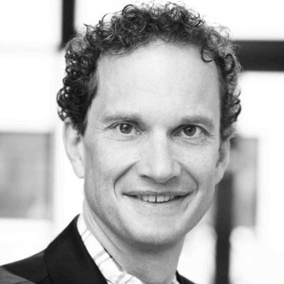
Sales support
Marketing Director
Carsten Frederiksen
+ 45 2925 2505
carsten@sorbisense.com
Visit our webshop: www.sorbisense.com

