Slide 1
Brominated Flame Retardants:
Cause for Concern?
Linda S. Birnbaum, Ph.D., D.A.B.T.
Michael DeVito, Ph.D.
NHEERL/ORD/US EPA

Slide 2
Why BFRs?
Fire Regulations require a high degree of protection
Flame Retardants save lives
  Fires generate PHDDs/PHDFs
75 different BFRs
50% are new substances ( testing required)

Slide 3
BFRs
Large variety of chemicals
  ~75 BFRs – and not all alike!
BFRs may be as common as PCBs
Banned production of PCBs with less information than we currently have on BFRs
Identify data gaps and research agenda
Large variety of issues

Slide 4
Production of BFRs
Worldwide - ~500,000 tons/yr of bromine
  $2 billion/year industry
BFRs- ~ 40% of total bromine usage
Bromine→
  Br-chemicals→Br-polymers→BFRs
Worldwide demand in 2000 for BFRs
  300x10⁶ BFRs kg/year
  Greatest increased use – Asia
  US usage - ~100X10⁶ kg/yr

Slide 5
Why should there be action at international level?
Global, transboundary problem
Persistence
Potential for bioaccumulation
Potential risk for future generations
Very limited knowledge base
Precautionary Principle
  Miminize production, emissions, use, exposure
(Risk/Risk Trade-offs?)

Slide 6
Major BFR Classes
Br-Bisphenols
Br-Diphenyl Ethers
Br-Cyclododecane
Br-phenols
Br-phthallic acid derivatives
+++++others

Slide 7
Global Market Demand for BFRs in 1999 (metric tons)
 | America | Europe | Asia | Total
TBBPA | 21,600 | 3,800 | 85,000 | 121,300
HBCD | 3,100 | 8,900 | 3,900 | 15,900
DBDE | 24,300 | 7,500 | 23,000 | 54,800
OBDE | 1,370 | 450 | 2,000 | 3,820
PeBDE | 8,290 | 210 | ----- | 8,500

Slide 8
Tetrabromobisphenol A
(TBBPA)

Slide 9
TBBPA
(Tetrabromobisphenol A)
Reactive and Additive BFR
Phenolic –OH-→polymerization
Major Use –printed circuit boards
Detected in air, sediment, sewage, sludge
Highly lipophilic, low water solubility
Limited data in biota
Dimethyl-TBBPA metabolite
eliminated in bile
Little retained in tissues

Slide 10
TBBPA (con.)
Acute tox data – oral LD₅₀: 5-10 g/kg
Low chronic toxicity
Not teratogenic or mutagenic
Affects thyroid hormones; estrogenic
Soil Degradation –aerobic and anaerobic
  t_{1/2}~2mos
Photodegradation
  t _{1/2}~<<1day

Slide 11
Health Effects of TBBPA
Immunotoxic
  Inhibits T cell activation : blocks CD25 (<3µM)
Hepatotoxic
  Toxic to primary hepatocytes: destroys mitochondria; membrane dysfunction (inhbits CYP2C9)
Endocrine Disrupting

Slide 12
Health Effects of TBBPA (con)
Endocrine Disruption
AhR Effects
  Not relevant for commercial product
Thyroid
  TBBPA>T4 in relation to binding to transthyretin
  Observed in vivo
Estrogenic
  Inhibits sulfotransferase (decreases estrogen clearance)
  Mostly in vitro data

Slide 13
Hexabromocylododecane
(HBCDD)

Slide 14
HBCDD
(hexabromocyclododecane)
Major use – polystyrene resins>textiles
  ~10,000tons/yr
Highly lipophilic, low water solubility, low vapor pressure, high BCF, persistent
Ecotox –
  Algae, daphnia, NOEC = 3 ug/L
  Fish, LC ₅₀>water solubility; PNEC=.03ug/L

Slide 15
HBCDD (con)
Toxicity
  High absorption; mild irritant and skin sensitizer; liver effects after repeated exposures (LOEL (rats) ~13 mg/kg/day)
    Need more info: repeated dose studies, repro tox
Concern for Occupational Settings
Fulfills POPs Critera
  Persistence, bioaccumulative, toxic, long range transport

Slide 16
PBDEs

Slide 17
Major Industrial Products
(~67 metric tons/year)
DBDE – largest volume (75% in EU)
  97% DBDE; 3% NBDE
  Polymers, electronic equipment>textiles
OBDE
  6%HxBDE; 42%HpBDE; 36% OBDE; 13%NBDE; 2%DBDE – multiple congeners (unclear if any PeBDE)
  Polymers, esp. office equipment
PeBDE
  Textiles – esp. polyurethane foams
  Recommended ban in EU(no production/only import)
  Mainly PeBDE+TeBDE, some HxBDE

Slide 18
Properties
Solids with low solubility (< 1ug/kg), high log K_{ow} (~6.2)
Lower congeners are more bioaccumulative, persistent→Strong adsorption to soil/sediment/sludge;No significant bodegradation in air/water
Bioaccumulation - BCF > 5000, Log K_{ow} >5
Long Range Transport - Evidence of remote contamination (e.g., Arctic)
Persistence- t _{1/2} Atmospheric >2 days;Water >2 mos; Soil, sediment >6 mos

Slide 19
Sources of Environmental Release
Polymer Processing
Formulating/applying to textiles
Volatilization and leaching during use
Particulate losses over use/disposal

Slide 20
PBDEs in Biotic and Abiotic Samples
Air: 47>99>100>153=154
Sediment: 99>47 (pattern reflects commercial PeBDE); also some nona and deca
Sewage Sludge: 1-3mg/kg in US; pattern ~PUFs
  Point sources (~DBDE) --->0.1-5 mg/kg
Biota: 47>99=100 except if near manufacturing site (pattern does NOT reflect commercial PBDEs)
Invertebrates<Fish<<marine mammals

Slide 21
PBDEs (con)
Ecotoxicity
PeBDE>>OBDE>DBDE
  Highly toxic to invertebrates
DBDE/OBDE
  May be low risk to surface water organism and top predators
  Concern for waste water, sediment, and soil organisms
  CONCERNS:
    Presence of lower brominated congeners in OBDE
    Photolytic and/or anaerobic debromination
    Formation of PBDDs/PBDFs

Slide 23
PBDEs (con)
Photolytic Debromination
DBDE-→NBDE+OBDE (t _{½} = 15 hr)
OBDE-→HpBDE+HxBDE (t _{½} = 40 hr)
PeBDE-→lower PBDEs+ PBDFs
Composition of photoproducts is not the same as the commercial PBDE mixtures

Slide 25
PBDEs (con)
Congener Patterns
Commercial Products
Environmental Samples
Human Tissue Samples

Slide 26
Exposure Routes
Fish
Dairy
Meat
OTHER?

Slide 27
Pharmacokinetics of PBDEs
Absorption – DBDE is poorly absorbed
Distribution – lipid binding is important
  Fat: 47>99>>>209
  Liver: covalent binding from 99,209
Metabolism – hydroxylation, debromination, O-methylation
Excretion – feces is major route

Slide 28
Neurotoxic Effects
Developmental Neurotoxicants
  Perinatal; neonatal
  47,99,153,209
  Spontaneous behavior (mice)/hyperactivity
  Permanent changes in brain function
Developmental exposure -→Increased susceptibility of adults exposed to low doses of PBDEs

Slide 29
Endocrine Disrupting Effects
AhR Effects
  not relevant for commercial BFRs
    But combustion can produce PBDDs/PBDFs
Thyroid
  OH-PBDE metabolites bind to transthyretin
  Effects on T4 seen in vivo
Estrogenic
  OH-PBDEs
  Inhibit sulfotransferase (decreases estrogen clearance)
  Mostly in vitro data

Slide 30
Key Issues: PBDEs
Potential adversity to human health and environment
  In vivo and in vitro studies
  Liver effects; Developmental neurotoxicity; Endocrine disruption
Contaminants and Combustion Products –PBDFs/PBDDs (Are they present in the environment and in biota?)
Research Needs
  t _{½} in environment; Remote monitoring data; Chronic health effects
  End of life cycle – release? Breakdown?

Slide 31
PBDEs in Human Samples
Pattern of congeners is different from commercial mixtures (and food)
  47>99 in US and Europe(others: 100,153,183, 209?)
  In Japanese, 99 and 153>47
Large interindividual differences
Increasing time trends – levels doubling every 2-5 years
PBDEs and PCBs levels are not correlated
  In most samples today, PCBs>PBDEs
different sources and/or time sequence

Slide 33
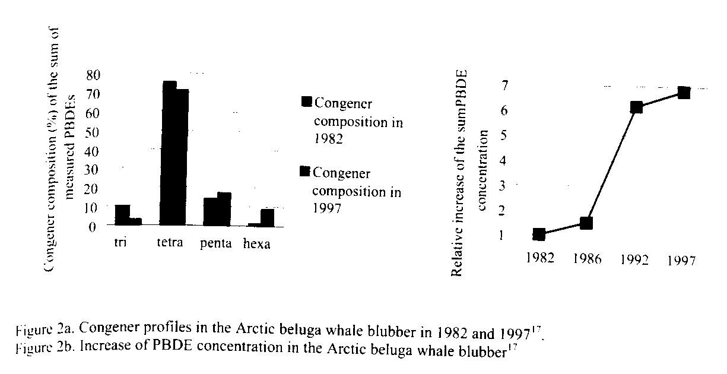

Slide 34
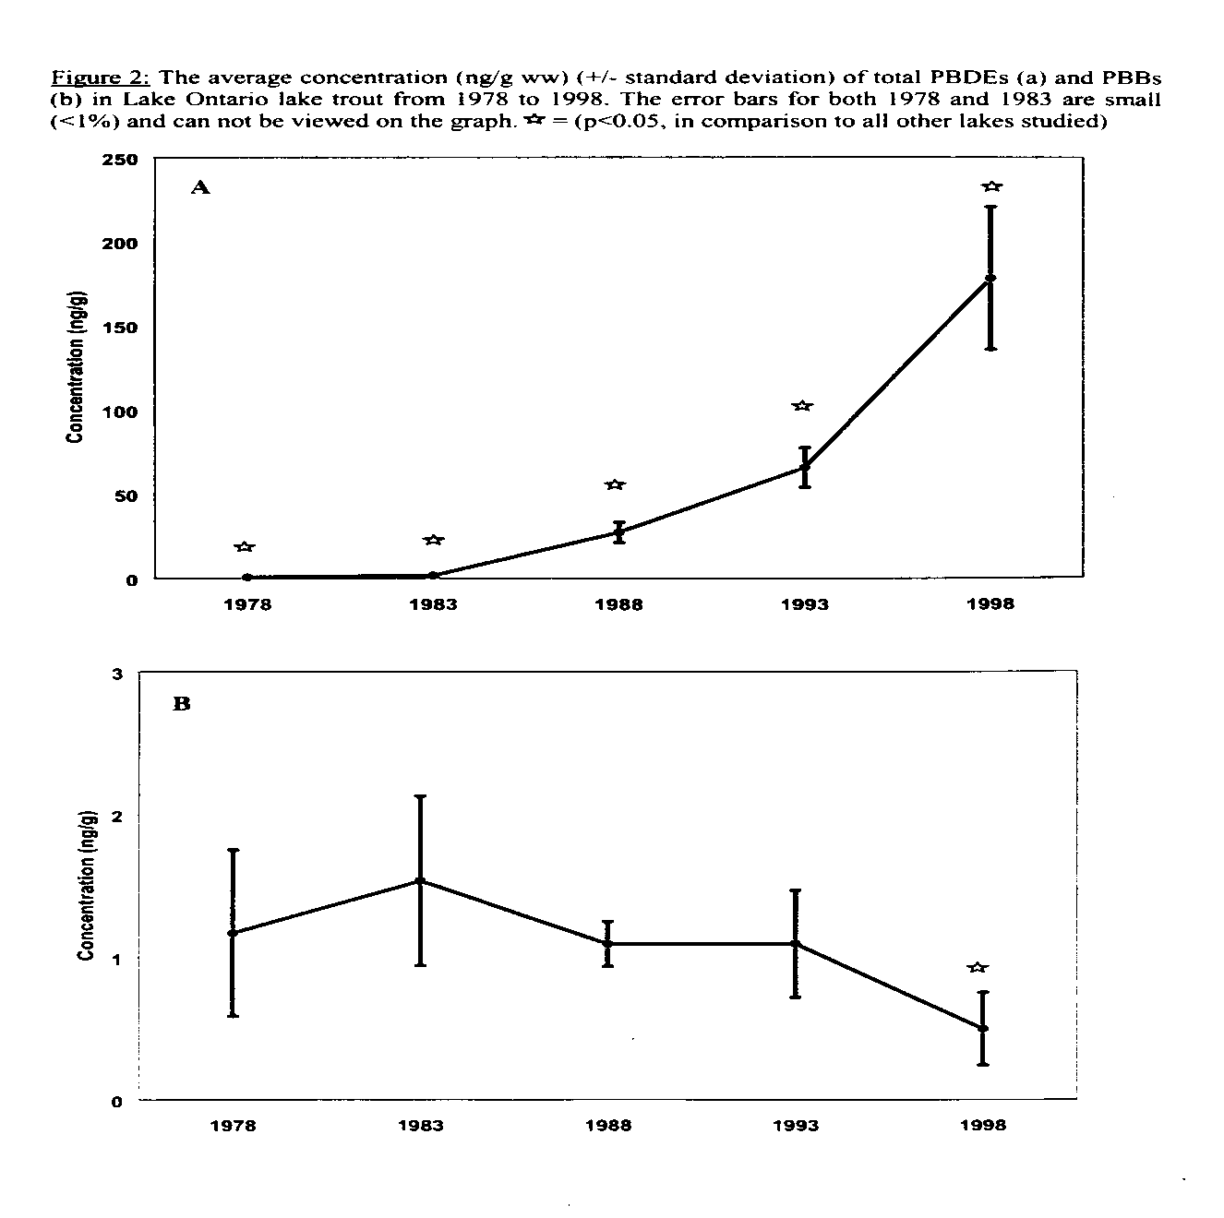

Slide 35
Time Trends of Biotic Levels
Rapid increases from 70s thru 90s
Maybe slight decrease in Sweden
  Ban on use of PeBDE?
Levels still increasing in America
  Continued use of PeBDE?
ARE LEVELS HIGH ENOUGH TO SEE EFFECTS??? NEED MORE TOX DATA!

Slide 36
What next?
More systematic human and environmental monitoring
More tox data
Focus on congeners present in people and wildlife, NOT commercial products since they are altered in the environment

