Slide 1
Pesticide Detections at Alafia River Analyzed by SGS Analytical
Pesticides Detected by Sample Type
No. of Pesticides Detected by Sample Type

Slide 2
Pesticide Detections at Ochlockonee River Analyzed by SGS Analytical
Pesticides Detected by Sample Type
No. of Pesticides Detected by Sample Type

Slide 3
Pesticide Detections at Apalachicola River Analyzed by SGS Analytical
Pesticides Detected by Sample Type
No. of Pesticides Detected by Sample Type

Slide 4
Pesticide Detections at Withlacoochee River Analyzed by SGS Analytical
Pesticides Detected by Sample Type
No. of Pesticides Detected by Sample Type

Slide 5
Pesticides Detections at All Sites by Sample Type
Total No. Undetects, Detects, Not Quantifiable by Sample Type
Pesticides Detected at All Sites by Sample Type
No. Pesticides Detected by Sample Type

Slide 6
PPCPs

Slide 7
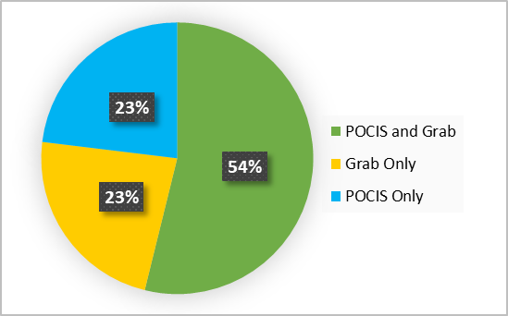
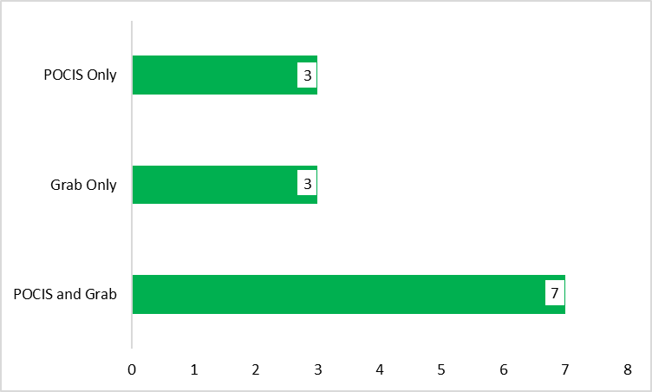
PPCPs Detections at Alafia River Analyzed by SGS Analytical
PPCPs Detected by Sample Type
POCIS Only
Grab Only
Grab & POCIS
Alprazolam
Diatrizoic acid
Amitriptyline
Erythromycin-H2O
Iopamidol
Amphetamine
Hydrocodone
Colchicine
Carbamazepine
Cocaine
DEET
Oxolinic Acid
Sulfamethoxazole
No. of PPCPs Detected by Sample Type
Total No. PPCPs = 127

Slide 8
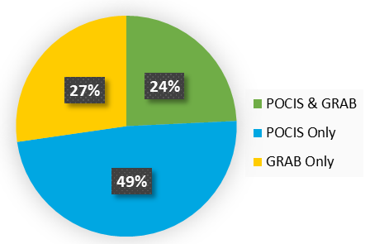
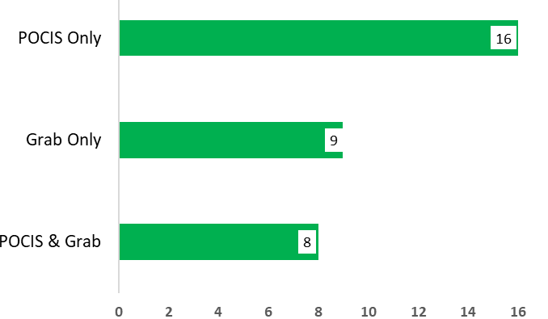
PPCPs Detections at Ochlockonee River Analyzed by SGS Analytical
PPCPs Detected by Sample Type
No. of PPCPs Detected by Sample Type
Total No. PPCPs = 127

Slide 9
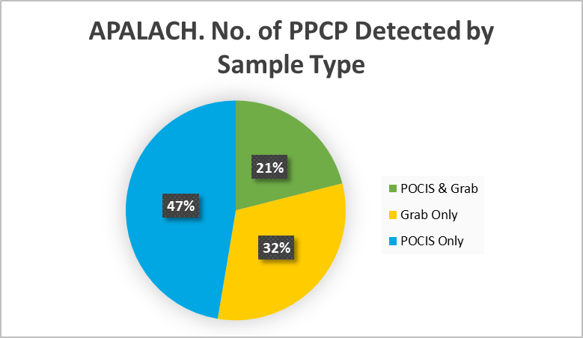
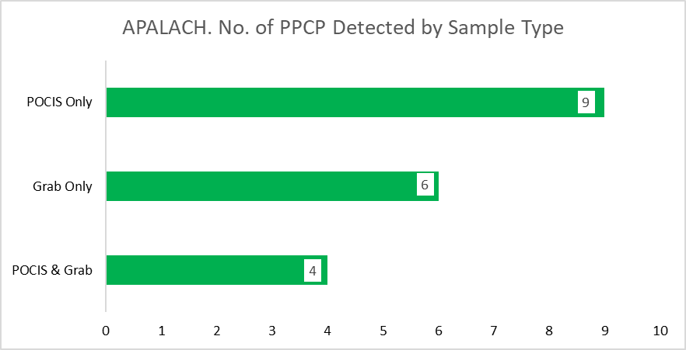
PPCPs Detections at Apalachicola River Analyzed by SGS Analytical
PPCPs Detected by Sample Type
POCIS Only
Grab Only
POCIS & Grab
Alprazolam
Amitriptyline
DEET
Metoprolol
Iopamidol
Sulfamethoxazole
Venlafaxine
Caffeine
Amphetamine
Carbamazepine
Atenolol
Naproxen
Erythromycin-H2O
Cotinine
Trimethoprim
Metformin
Oxycodone
Triamterene
Gemfibrozil
No. of PPCPs Detected by Sample Type
Total No. PPCPs = 127

Slide 10
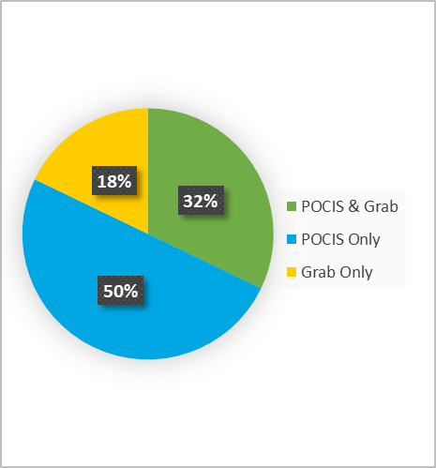
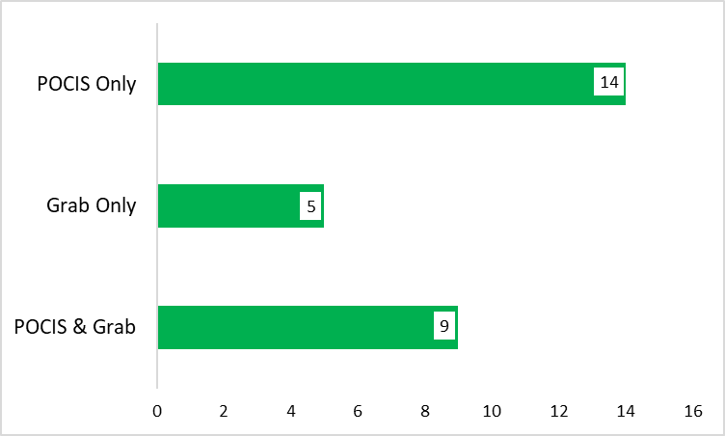
PPCPs Detections at Withlacoochee River Analyzed by SGS Analytical
PPCPs Detected by Sample Type
No. of PPCPs Detected by Sample Type
Total No. PPCPs = 127

Slide 11
PPCPs Detections at All Sites by Sample Type
Total No. Undetects, Detects, Not Quantifiable by Sample Type
Pesticides Detected at All Sites by Sample Type
No. Pesticides Detected by Sample Type

Slide 12
Hormones

Slide 13
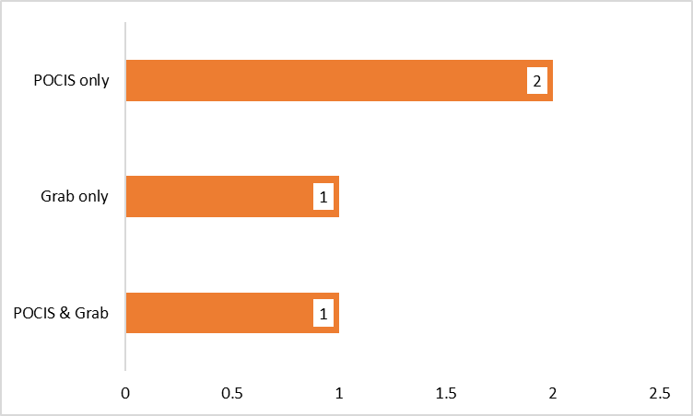
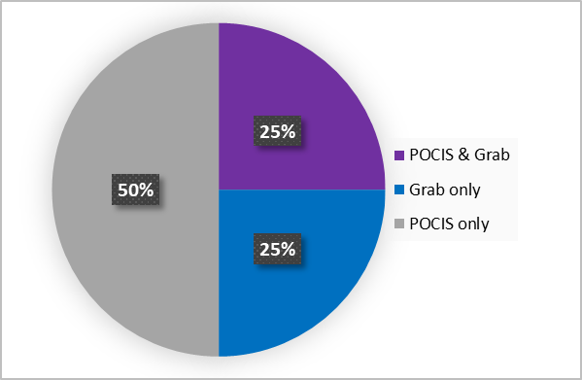
Hormone Detections at Withlacoochee River Analyzed by SGS Analytical
Hormones Detected by Sample Type
No. of Hormones Detected by Sample Type
Total No. Hormones = 17

Slide 14
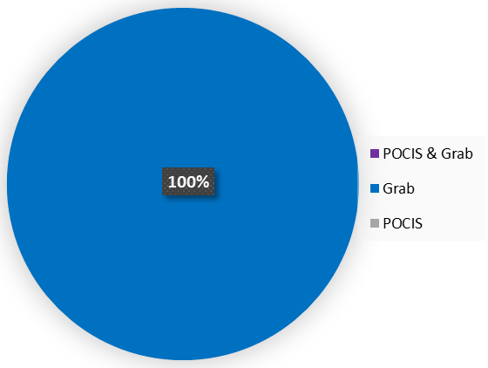
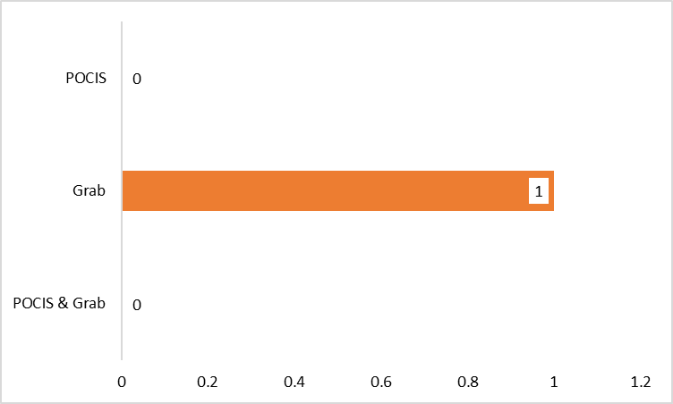
Hormone Detections at Apalachicola River Analyzed by SGS Analytical
Hormones Detected by Sample Type
No. of Hormones Detected by Sample Type
Total No. Hormones = 17

Slide 15
PFCs

Slide 16
PFC Detections at Withlacoochee River Analyzed by SGS Analytical
Hormones Detected by Sample Type

Slide 17
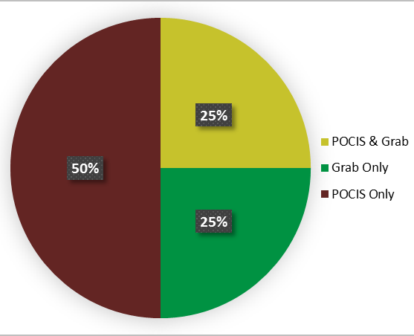
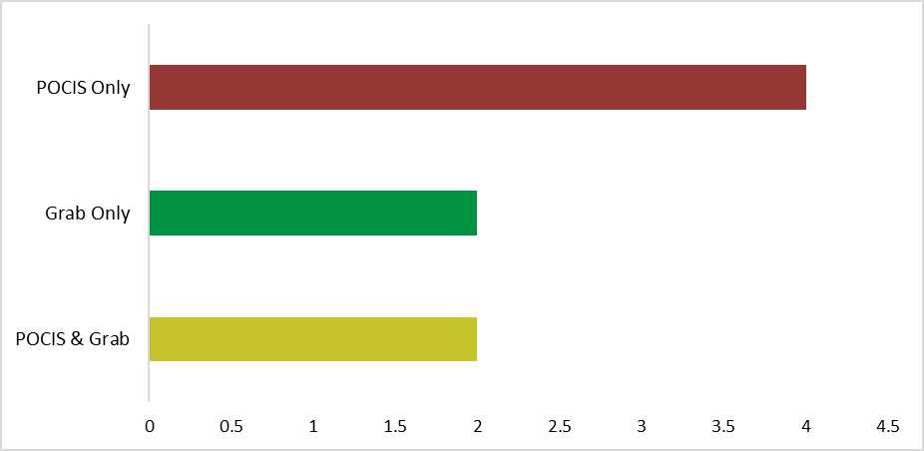
PFC Detections at Apalachicola River Analyzed by SGS Analytical
PFCs Detected by Sample Type
No. of PFCs Detected by Sample Type
Total No. PFCs = 13

Slide 18
PBDEs

Slide 19
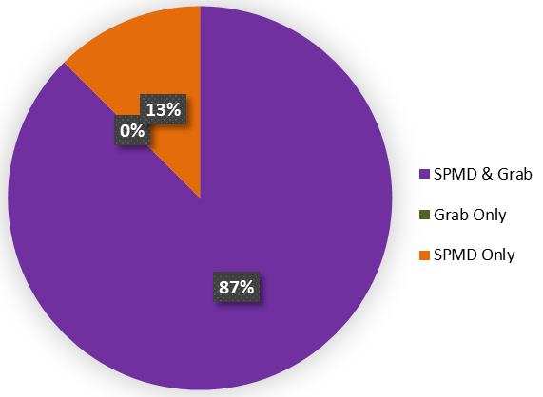
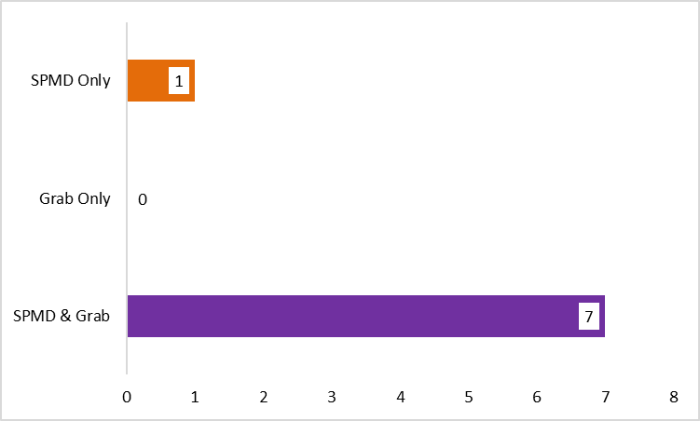
PBDE Detections at Withlacoochee River Analyzed by SGS Analytical
PBDEs Detected by Sample Type
No. of PBDEs Detected by Sample Type
Total No. PBDEs = 9

Slide 20
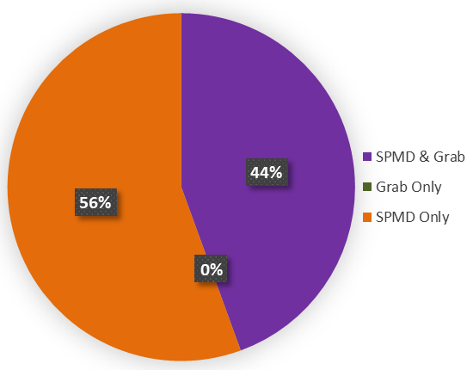
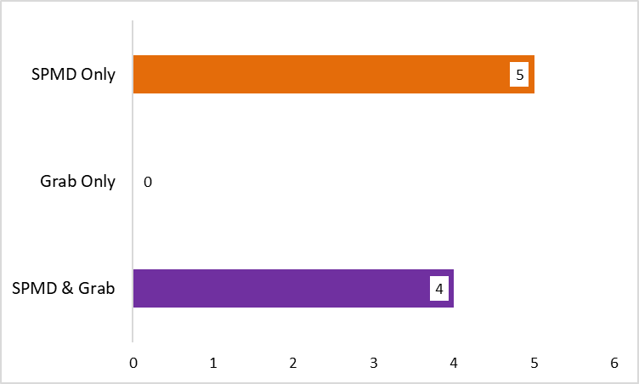
PBDE Detections at Apalachicola River Analyzed by SGS Analytical
PBDEs Detected by Sample Type
No. of PBDEs Detected by Sample Type
Total No. PBDEs = 9

Slide 21
Alkylphenols

Slide 22
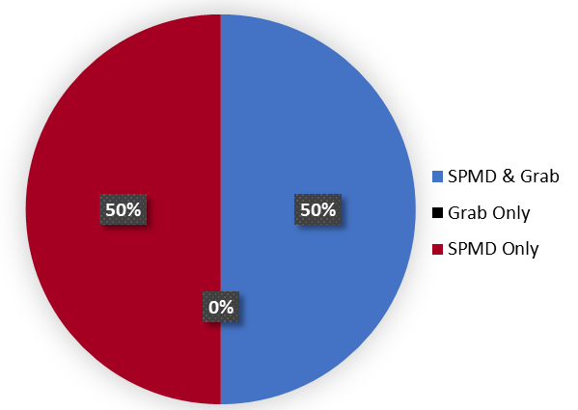
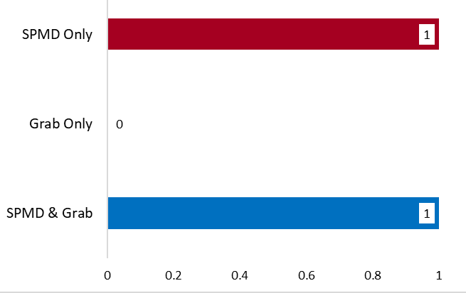
Alkylphenol Detections at Withlacoochee River Analyzed by SGS Analytical
Alkylphenols Detected by Sample Type
No. of Alkylphenols Detected by Sample Type
Total No. Alkylphenols = 4

Slide 23
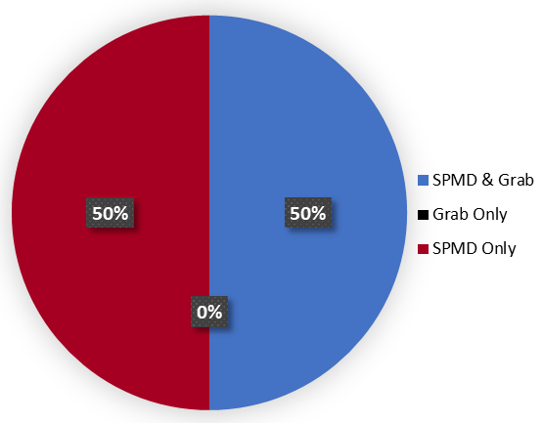

Alkylphenol Detections at Apalachicola River Analyzed by SGS Analytical
Alkylphenols Detected by Sample Type
No. of Alkylphenols Detected by Sample Type
Total No. Alkylphenols = 4

Slide 24
PAHs

Slide 25
PAH Detections at Apalachicola River Analyzed by SGS Analytical
PAHs Detected by Sample Type

