Slide 1
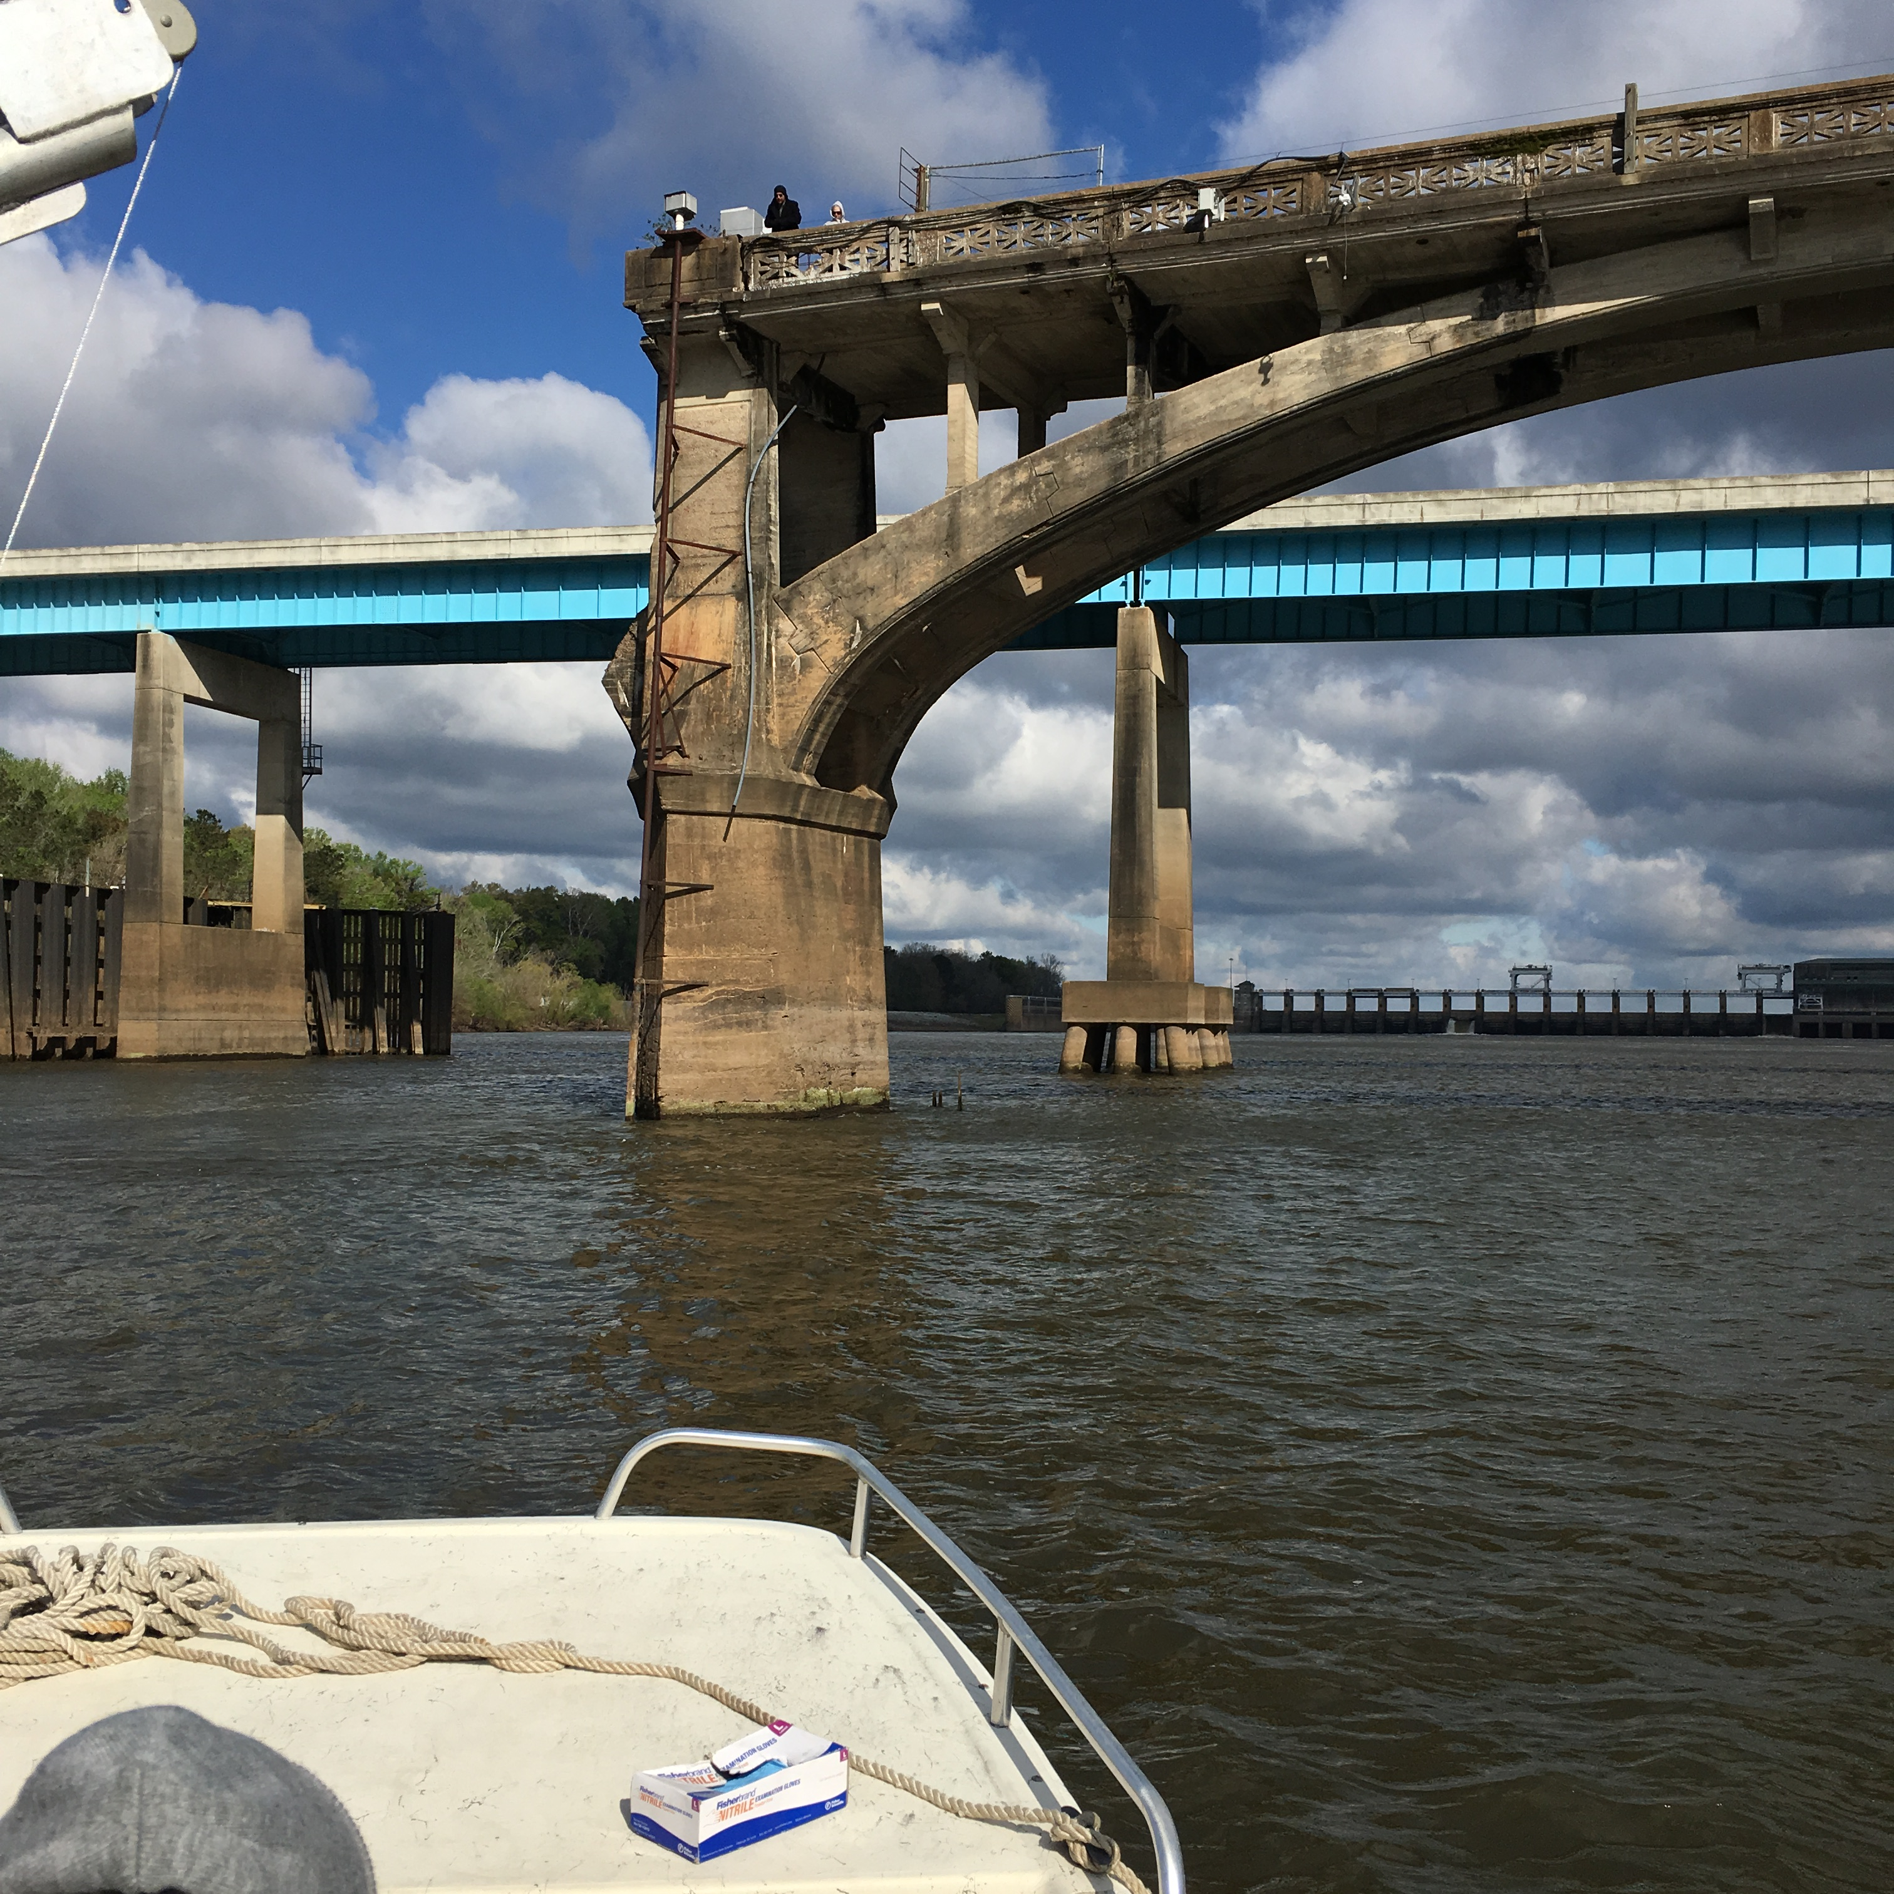
Pesticides

Slide 2
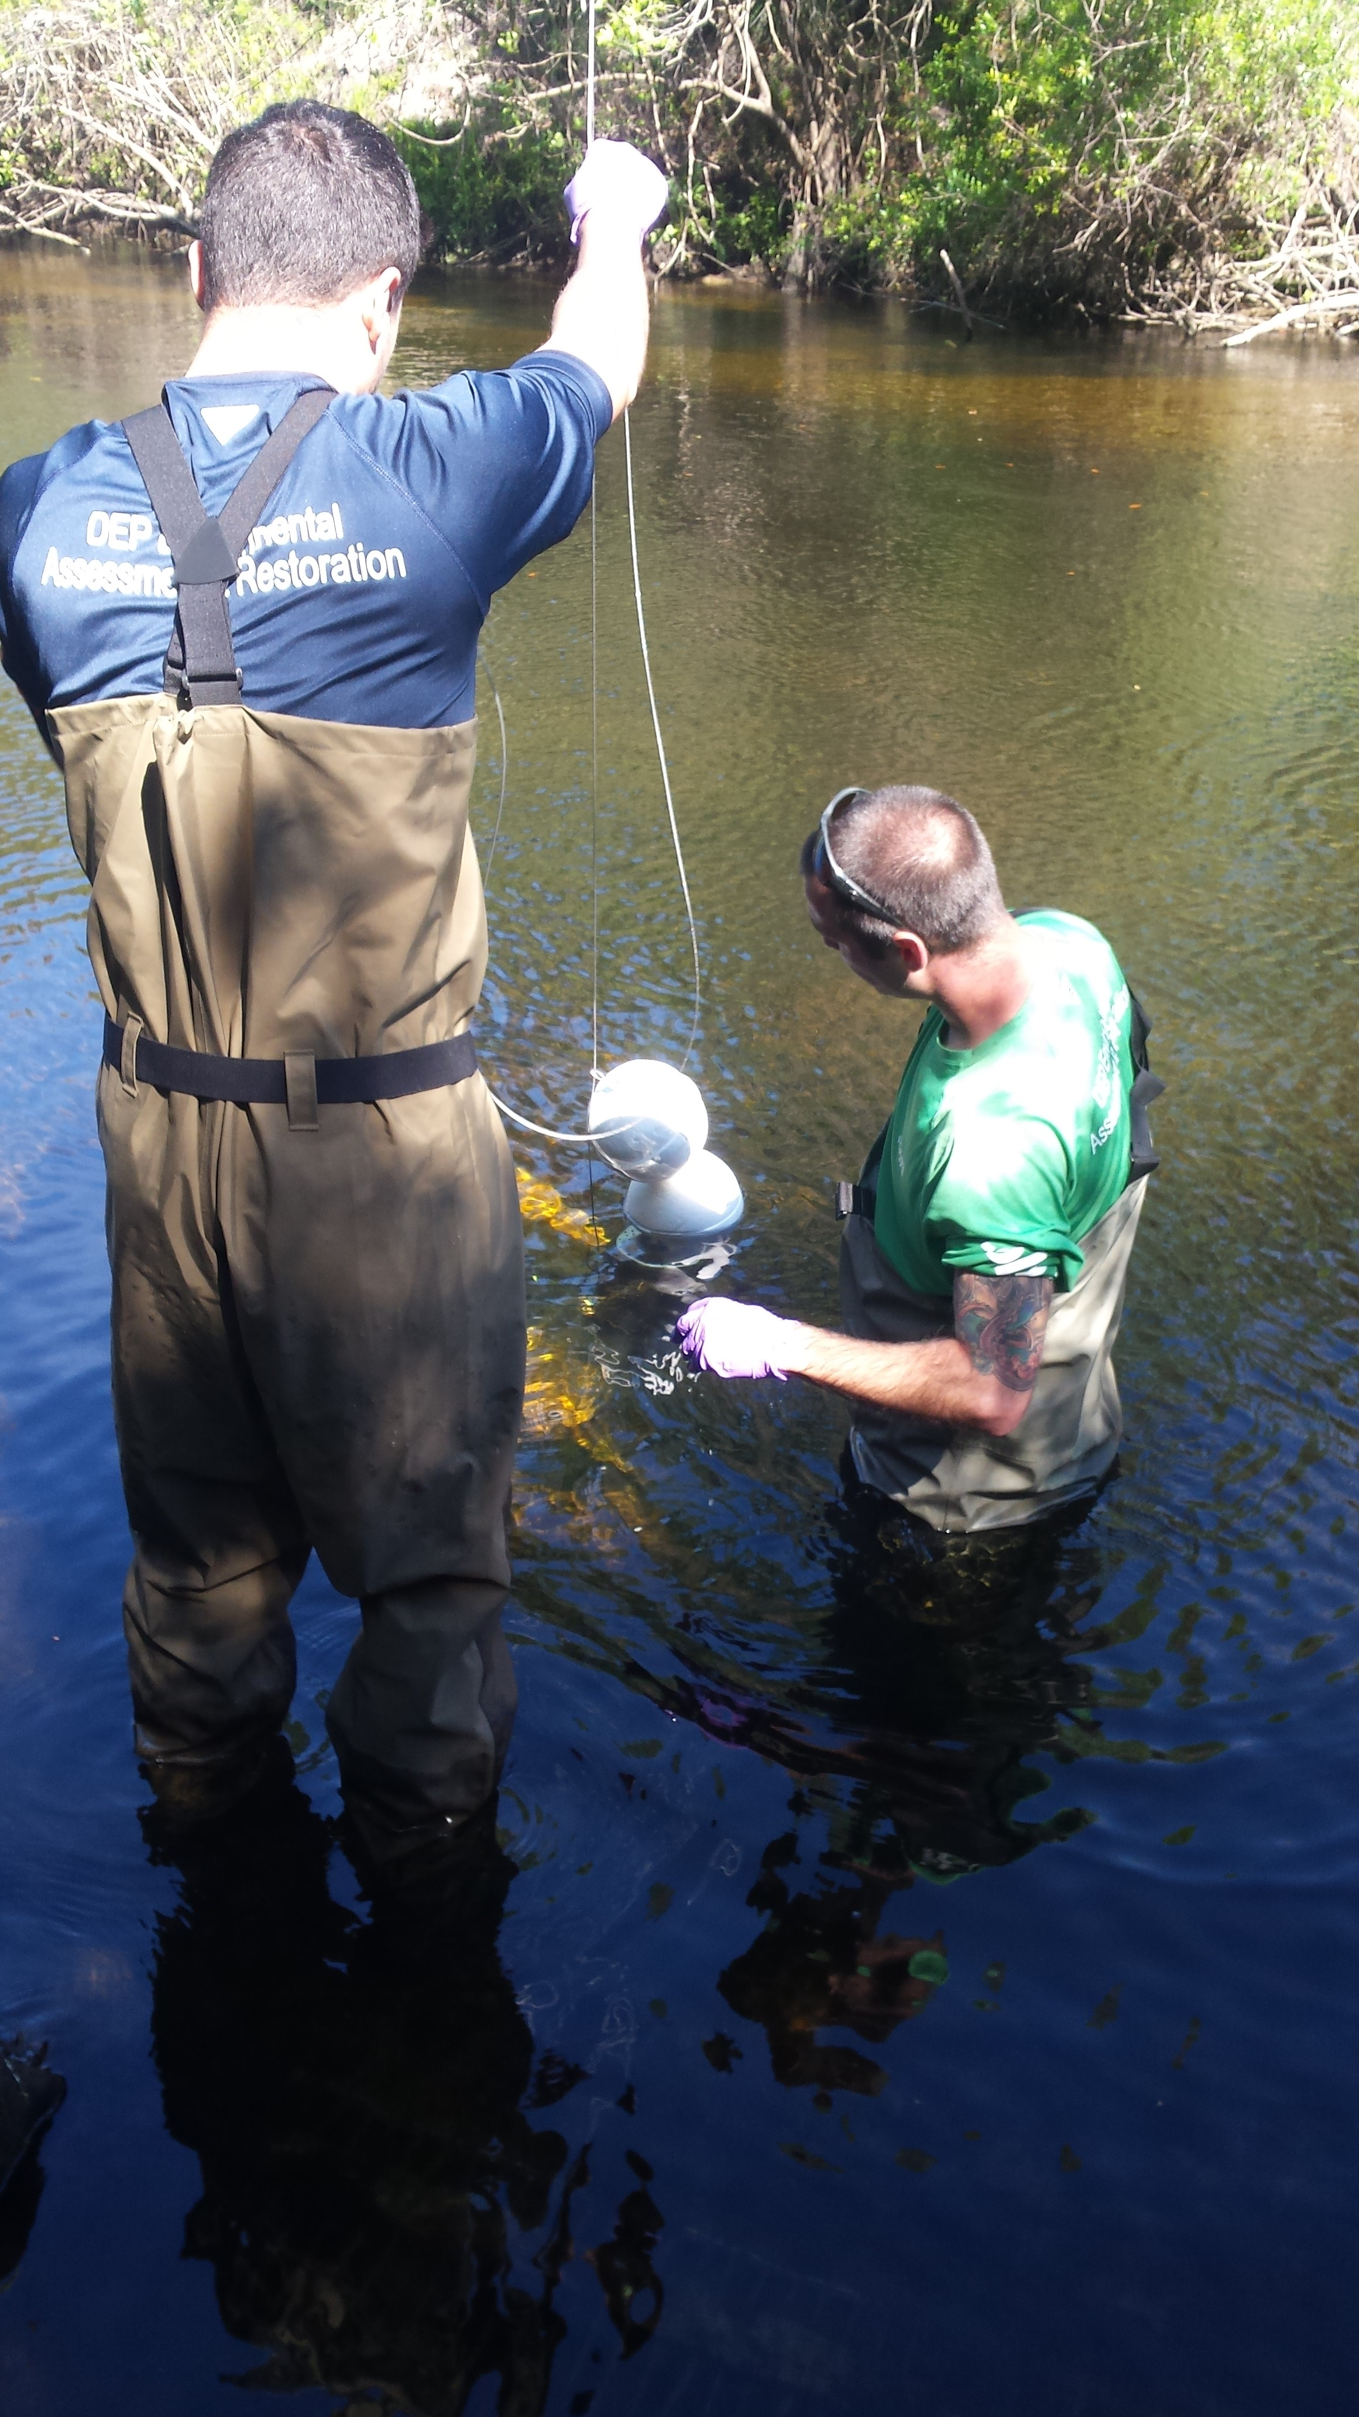
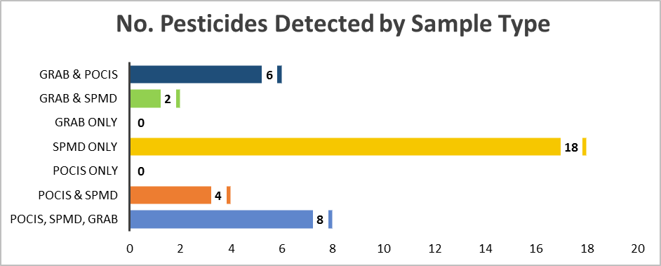
Pesticide Detections at Alafia River Analyzed by SGS Analytical
Pesticides Detected by Sample Type
No. of Pesticides Detected by Sample Type
Total No. Pesticides = 76

Slide 3
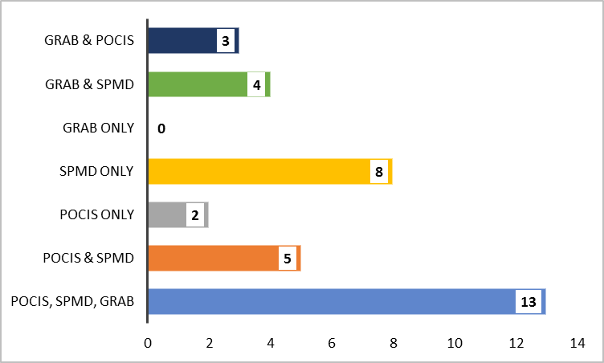
Pesticide Detections at Ochlockonee River Analyzed by SGS Analytical
Pesticides Detected by Sample Type
No. of Pesticides Detected by Sample Type

Slide 4
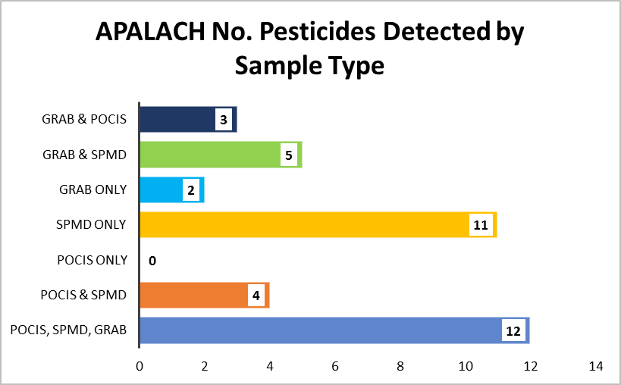

Pesticide Detections at Apalachicola River Analyzed by SGS Analytical
Pesticides Detected by Sample Type
No. of Pesticides Detected by Sample Type

Slide 5
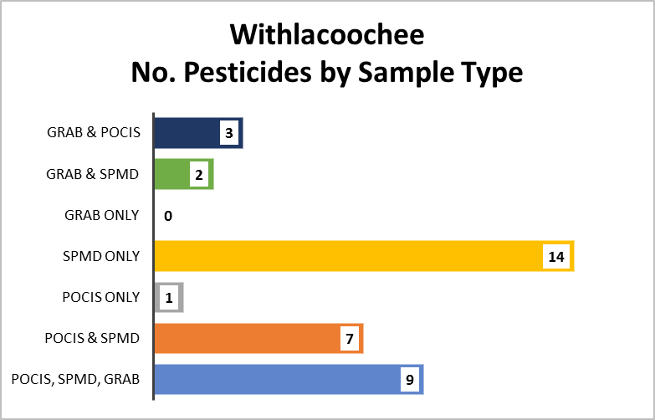
Pesticide Detections at Withlacoochee River Analyzed by SGS Analytical
Pesticides Detected by Sample Type
No. of Pesticides Detected by Sample Type

Slide 6
Pesticides Detections at All Sites by Sample Type
Total No. Undetects, Detects, Not Quantifiable by Sample Type
Pesticides Detected at All Sites by Sample Type
No. Pesticides Detected by Sample Type

Slide 7
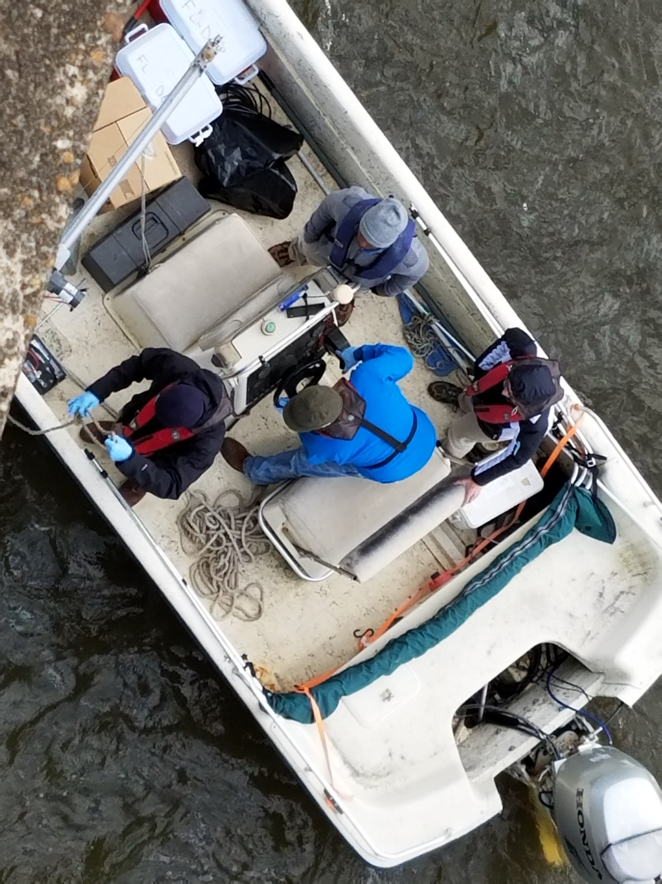
PPCPs

Slide 8
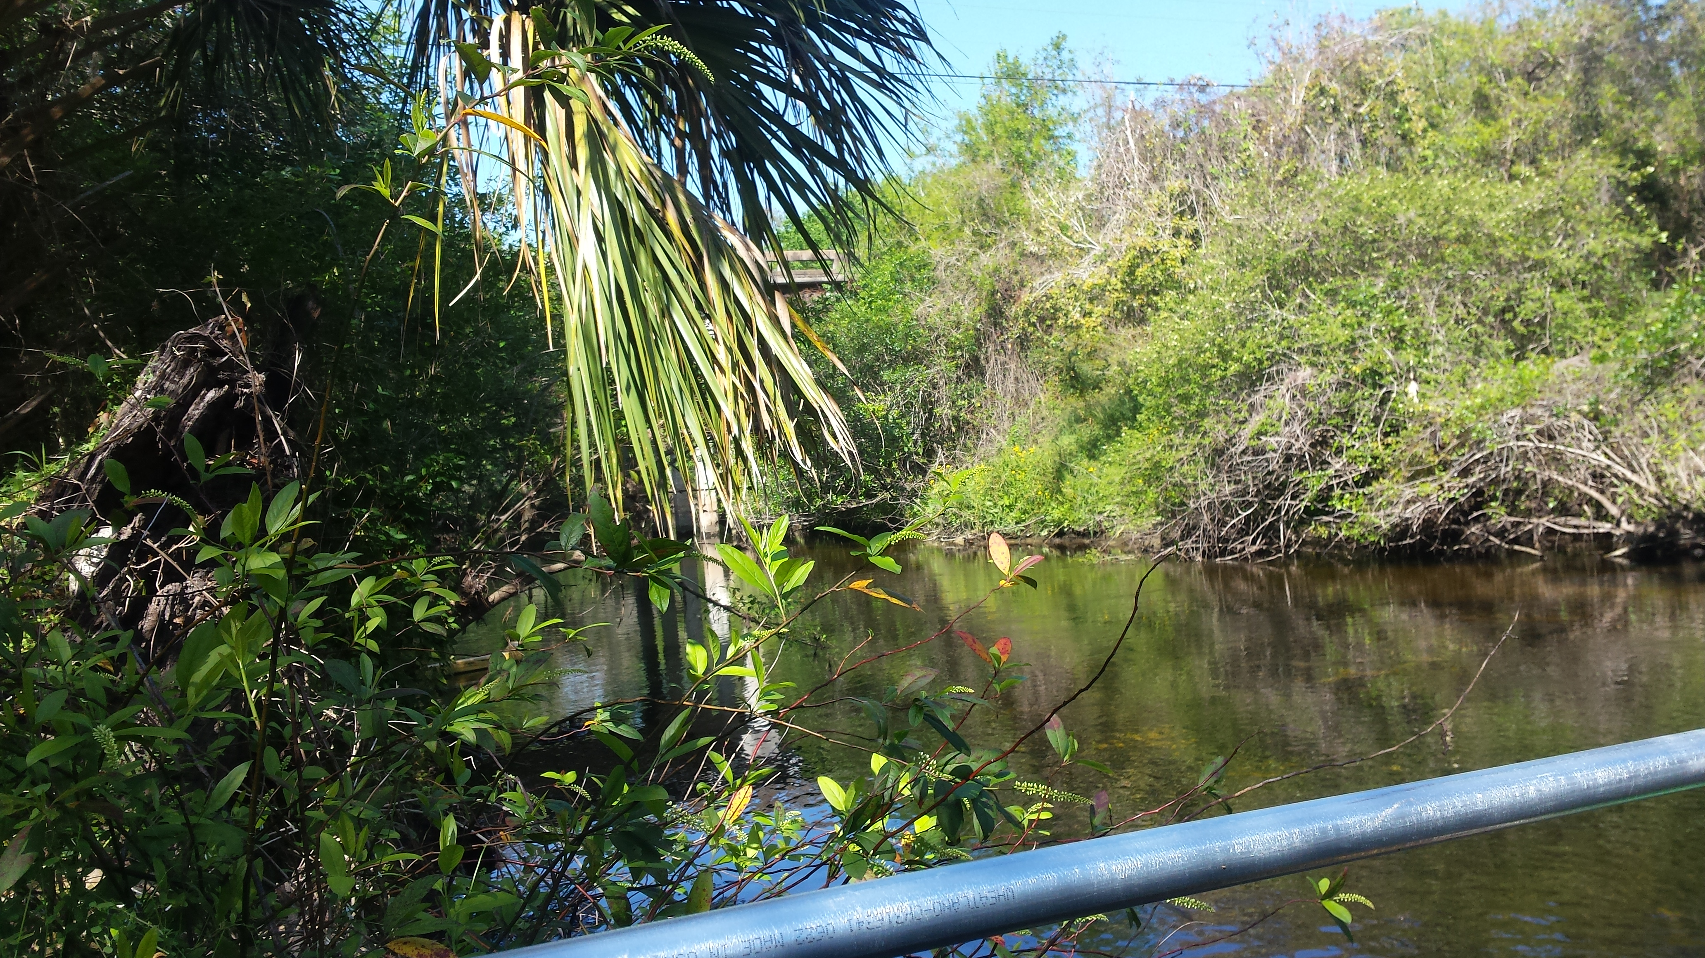
PPCPs Detections at Alafia River Analyzed by SGS Analytical
PPCPs Detected by Sample Type
POCIS Only
Grab Only
Grab & POCIS
Alprazolam
Diatrizoic acid
Amitriptyline
Erythromycin-H2O
Iopamidol
Amphetamine
Hydrocodone
Colchicine
Carbamazepine
Cocaine
DEET
Oxolinic Acid
Sulfamethoxazole
Notes:
Collection methods – Both Grab and POCIS are appropriate for the collection methods of PPCPs.

Slide 9
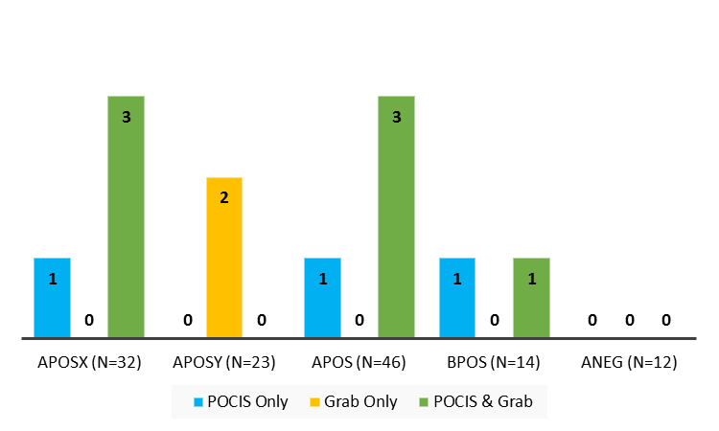
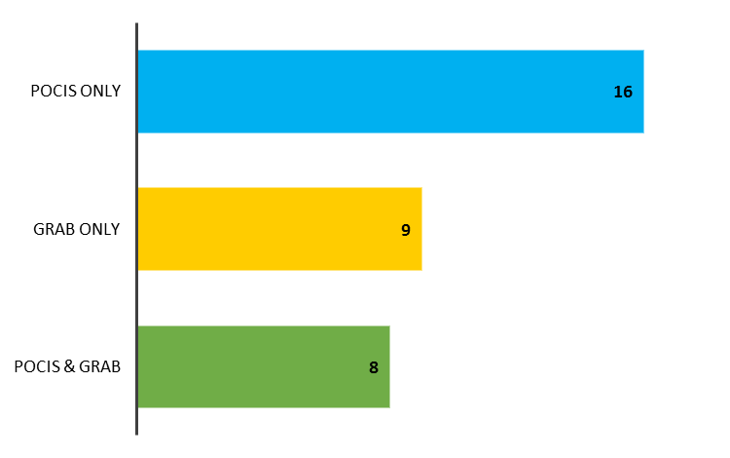
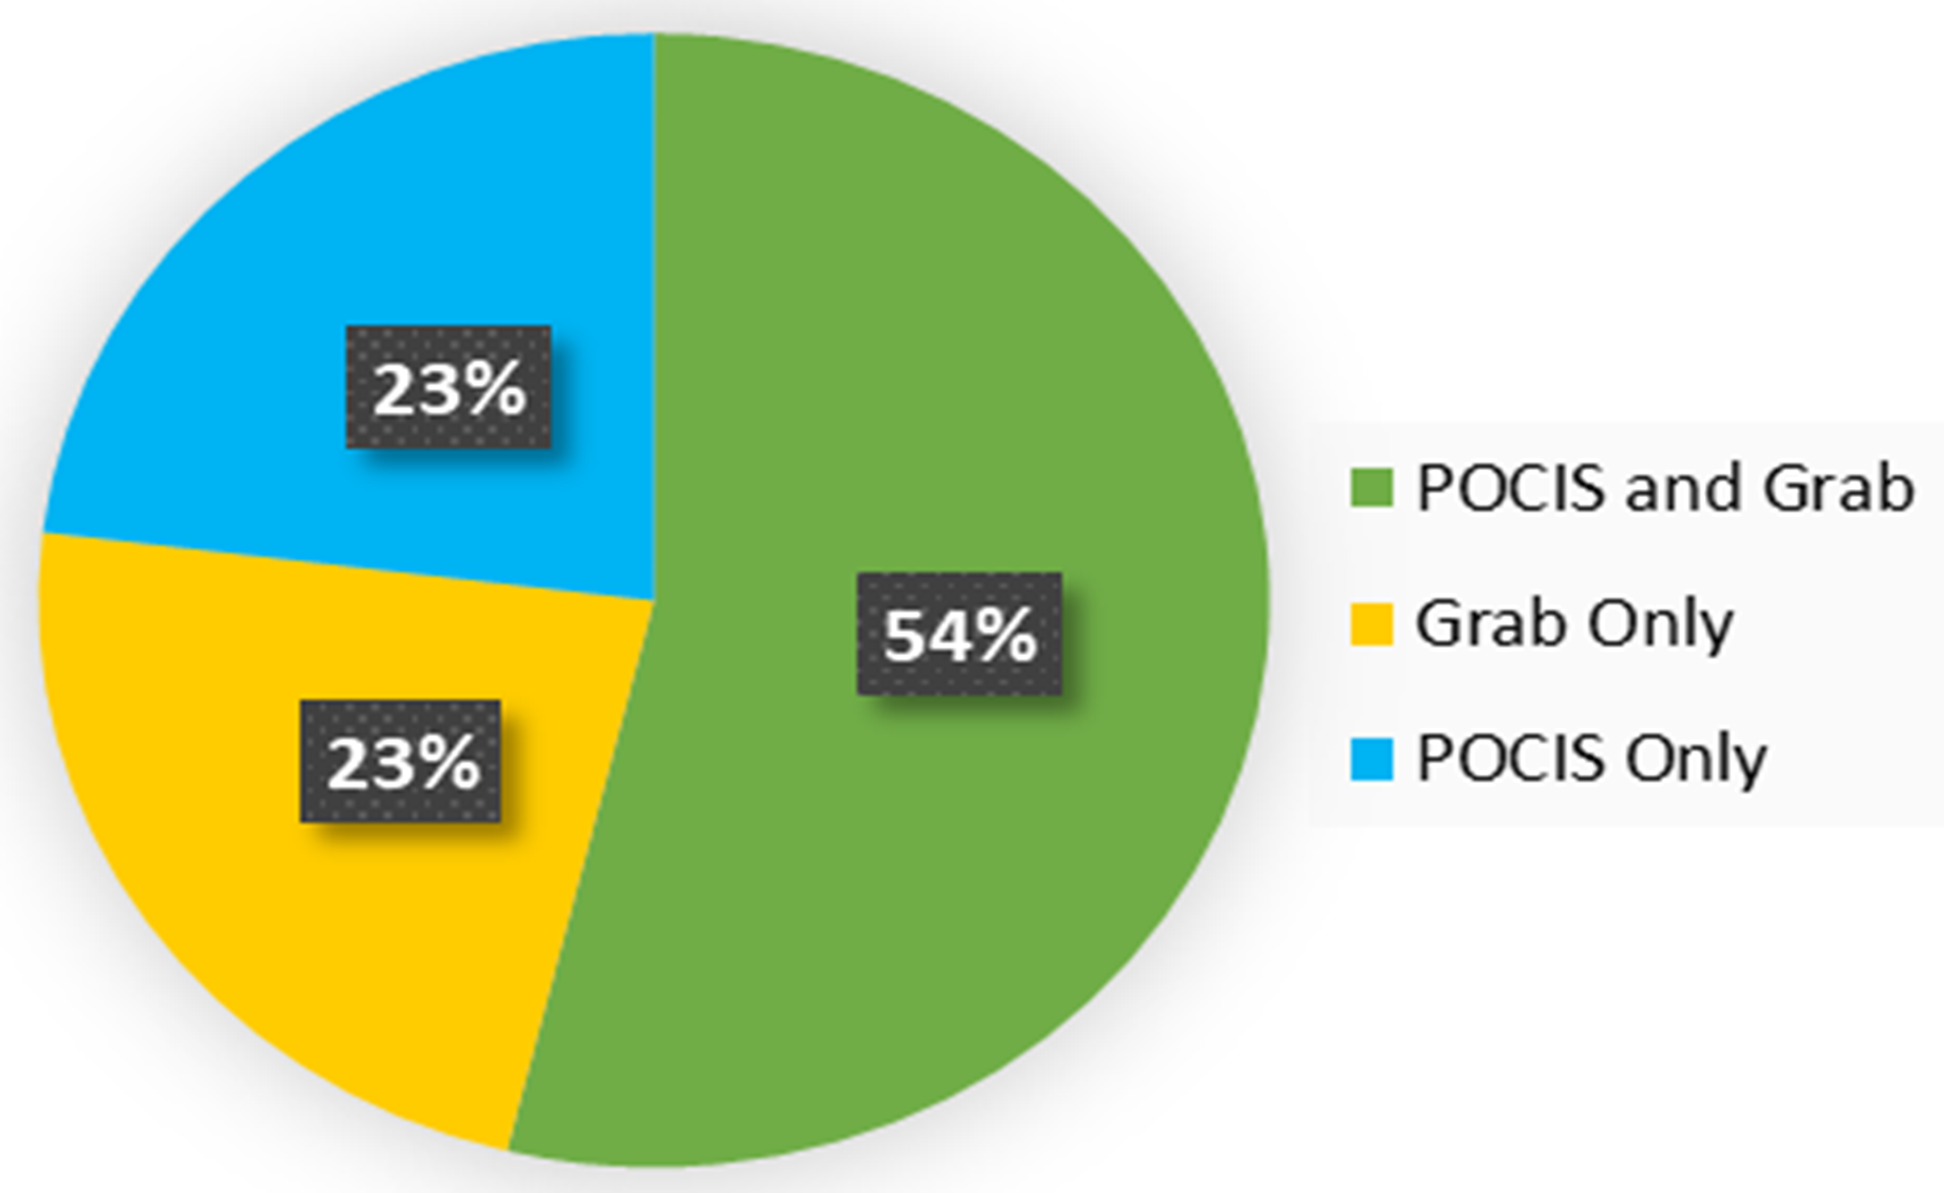
PPCPs Detections at Alafia River Analyzed by SGS Analytical
Detects per Analyte List by Sample Type
Detected by Sample Type
Total No. PPCPs = 127

Slide 10
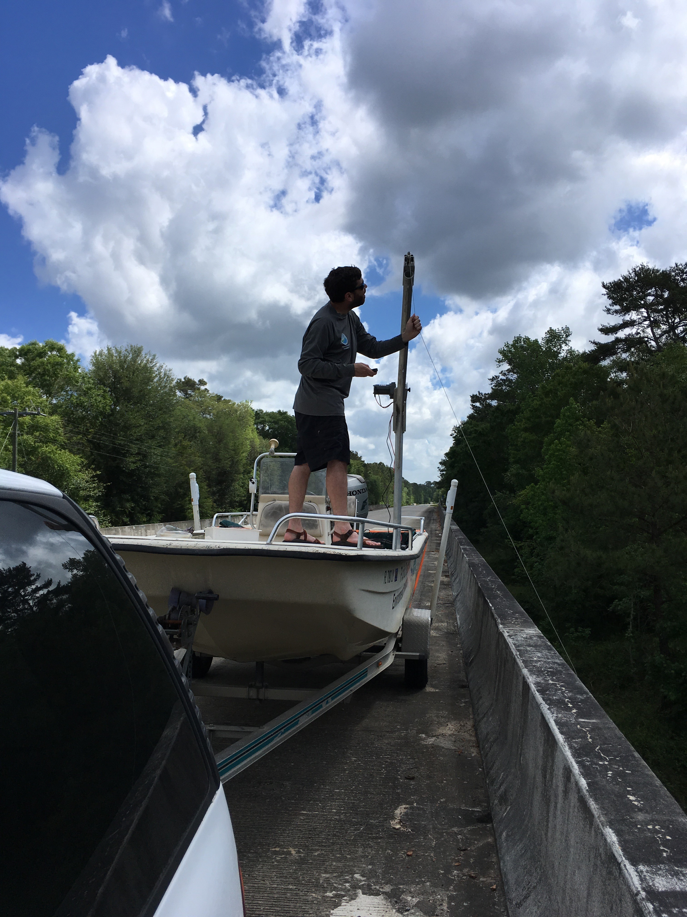
PPCPs Detections at Ochlockonee River Analyzed by SGS Analytical
Detected by Sample Type
Notes:
Collection methods – Both Grab and POCIS are appropriate for the collection methods of PPCPs.

Slide 11
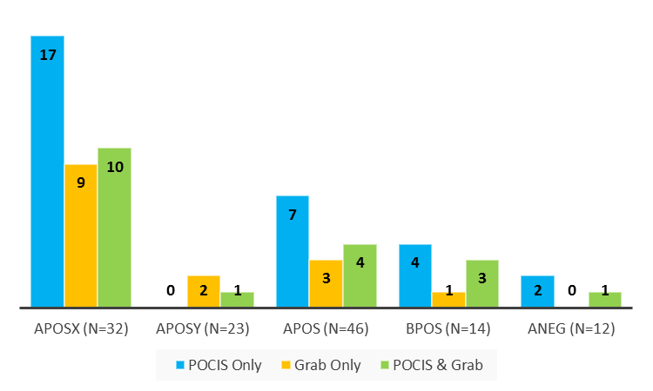

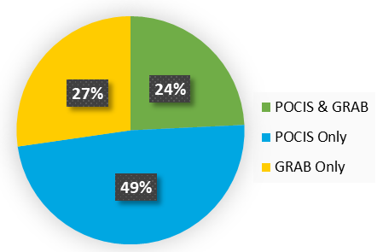
PPCPs Detections at Ochlockonee River Analyzed by SGS Analytical
Detects per Analyte List by Sample Type
Detected by Sample Type
Total No. PPCPs = 127

Slide 12
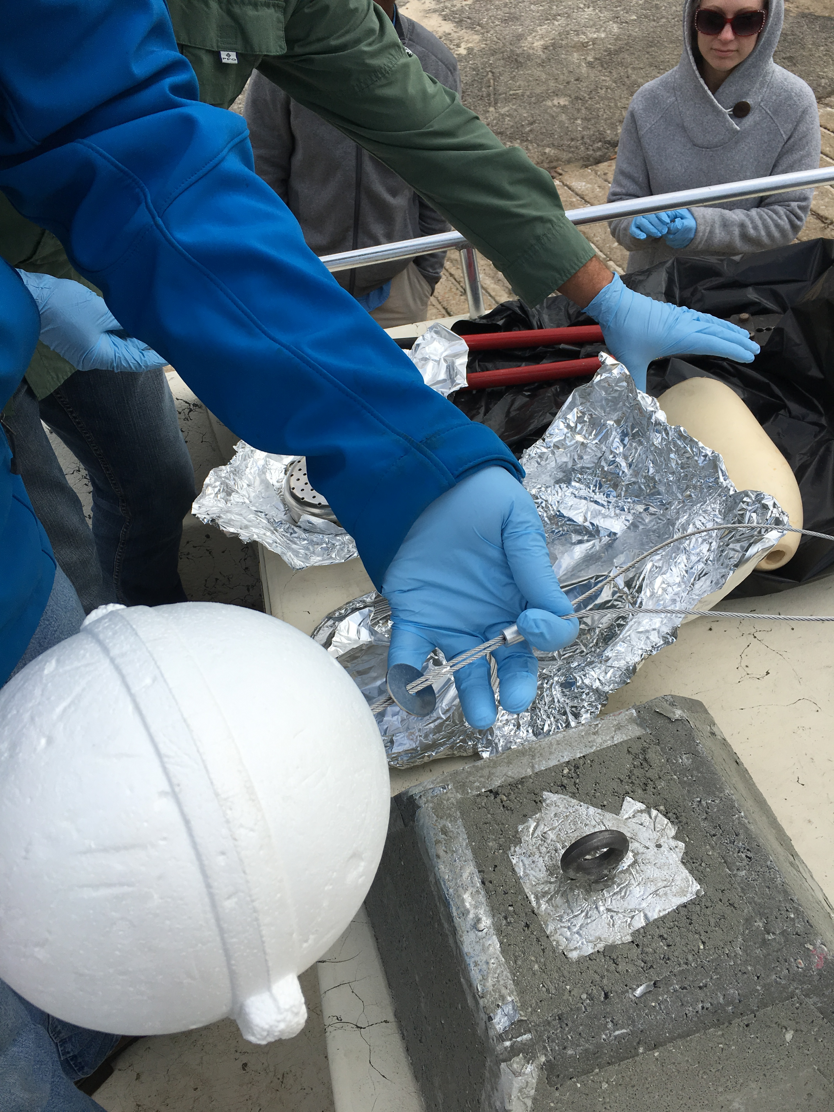
PPCPs Detections at Apalachicola River Analyzed by SGS Analytical
Detected by Sample Type
POCIS Only
Grab Only
POCIS & Grab
Alprazolam
Amitriptyline
DEET
Metoprolol
Iopamidol
Sulfamethoxazole
Venlafaxine
Caffeine
Amphetamine
Carbamazepine
Atenolol
Naproxen
Erythromycin-H2O
Cotinine
Trimethoprim
Metformin
Oxycodone
Triamterene
Gemfibrozil
Notes:
Collection methods – Both Grab and POCIS are appropriate for the collection methods of PPCPs.

Slide 13
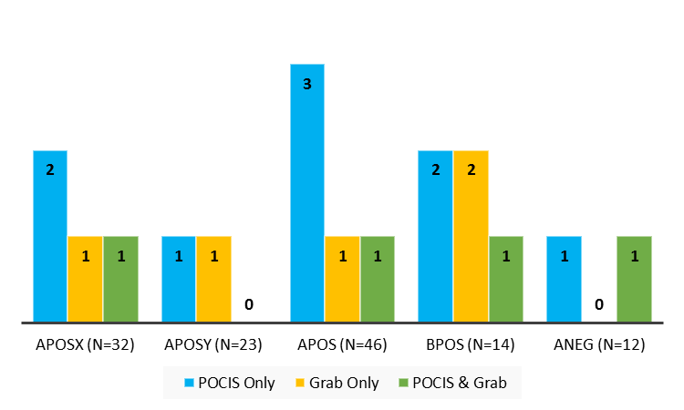
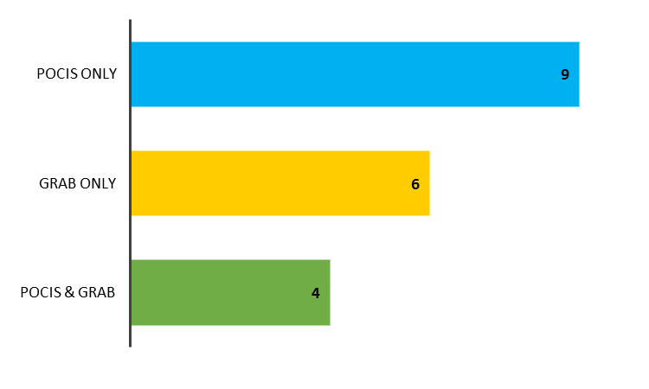
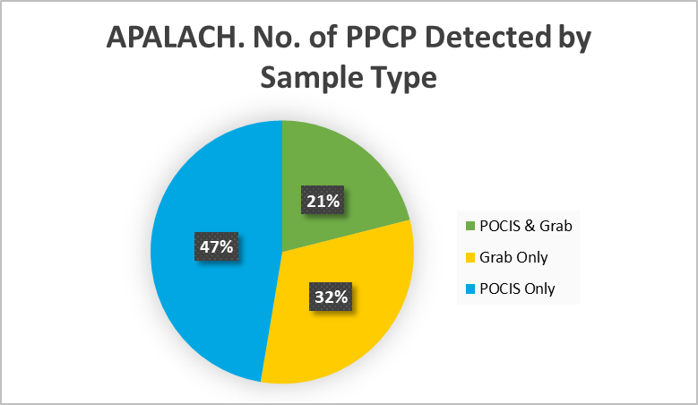
PPCPs Detections at Apalachicola River Analyzed by SGS Analytical
Detects per Analyte List by Sample Type
Detected by Sample Type
Total No. PPCPs = 127

Slide 14
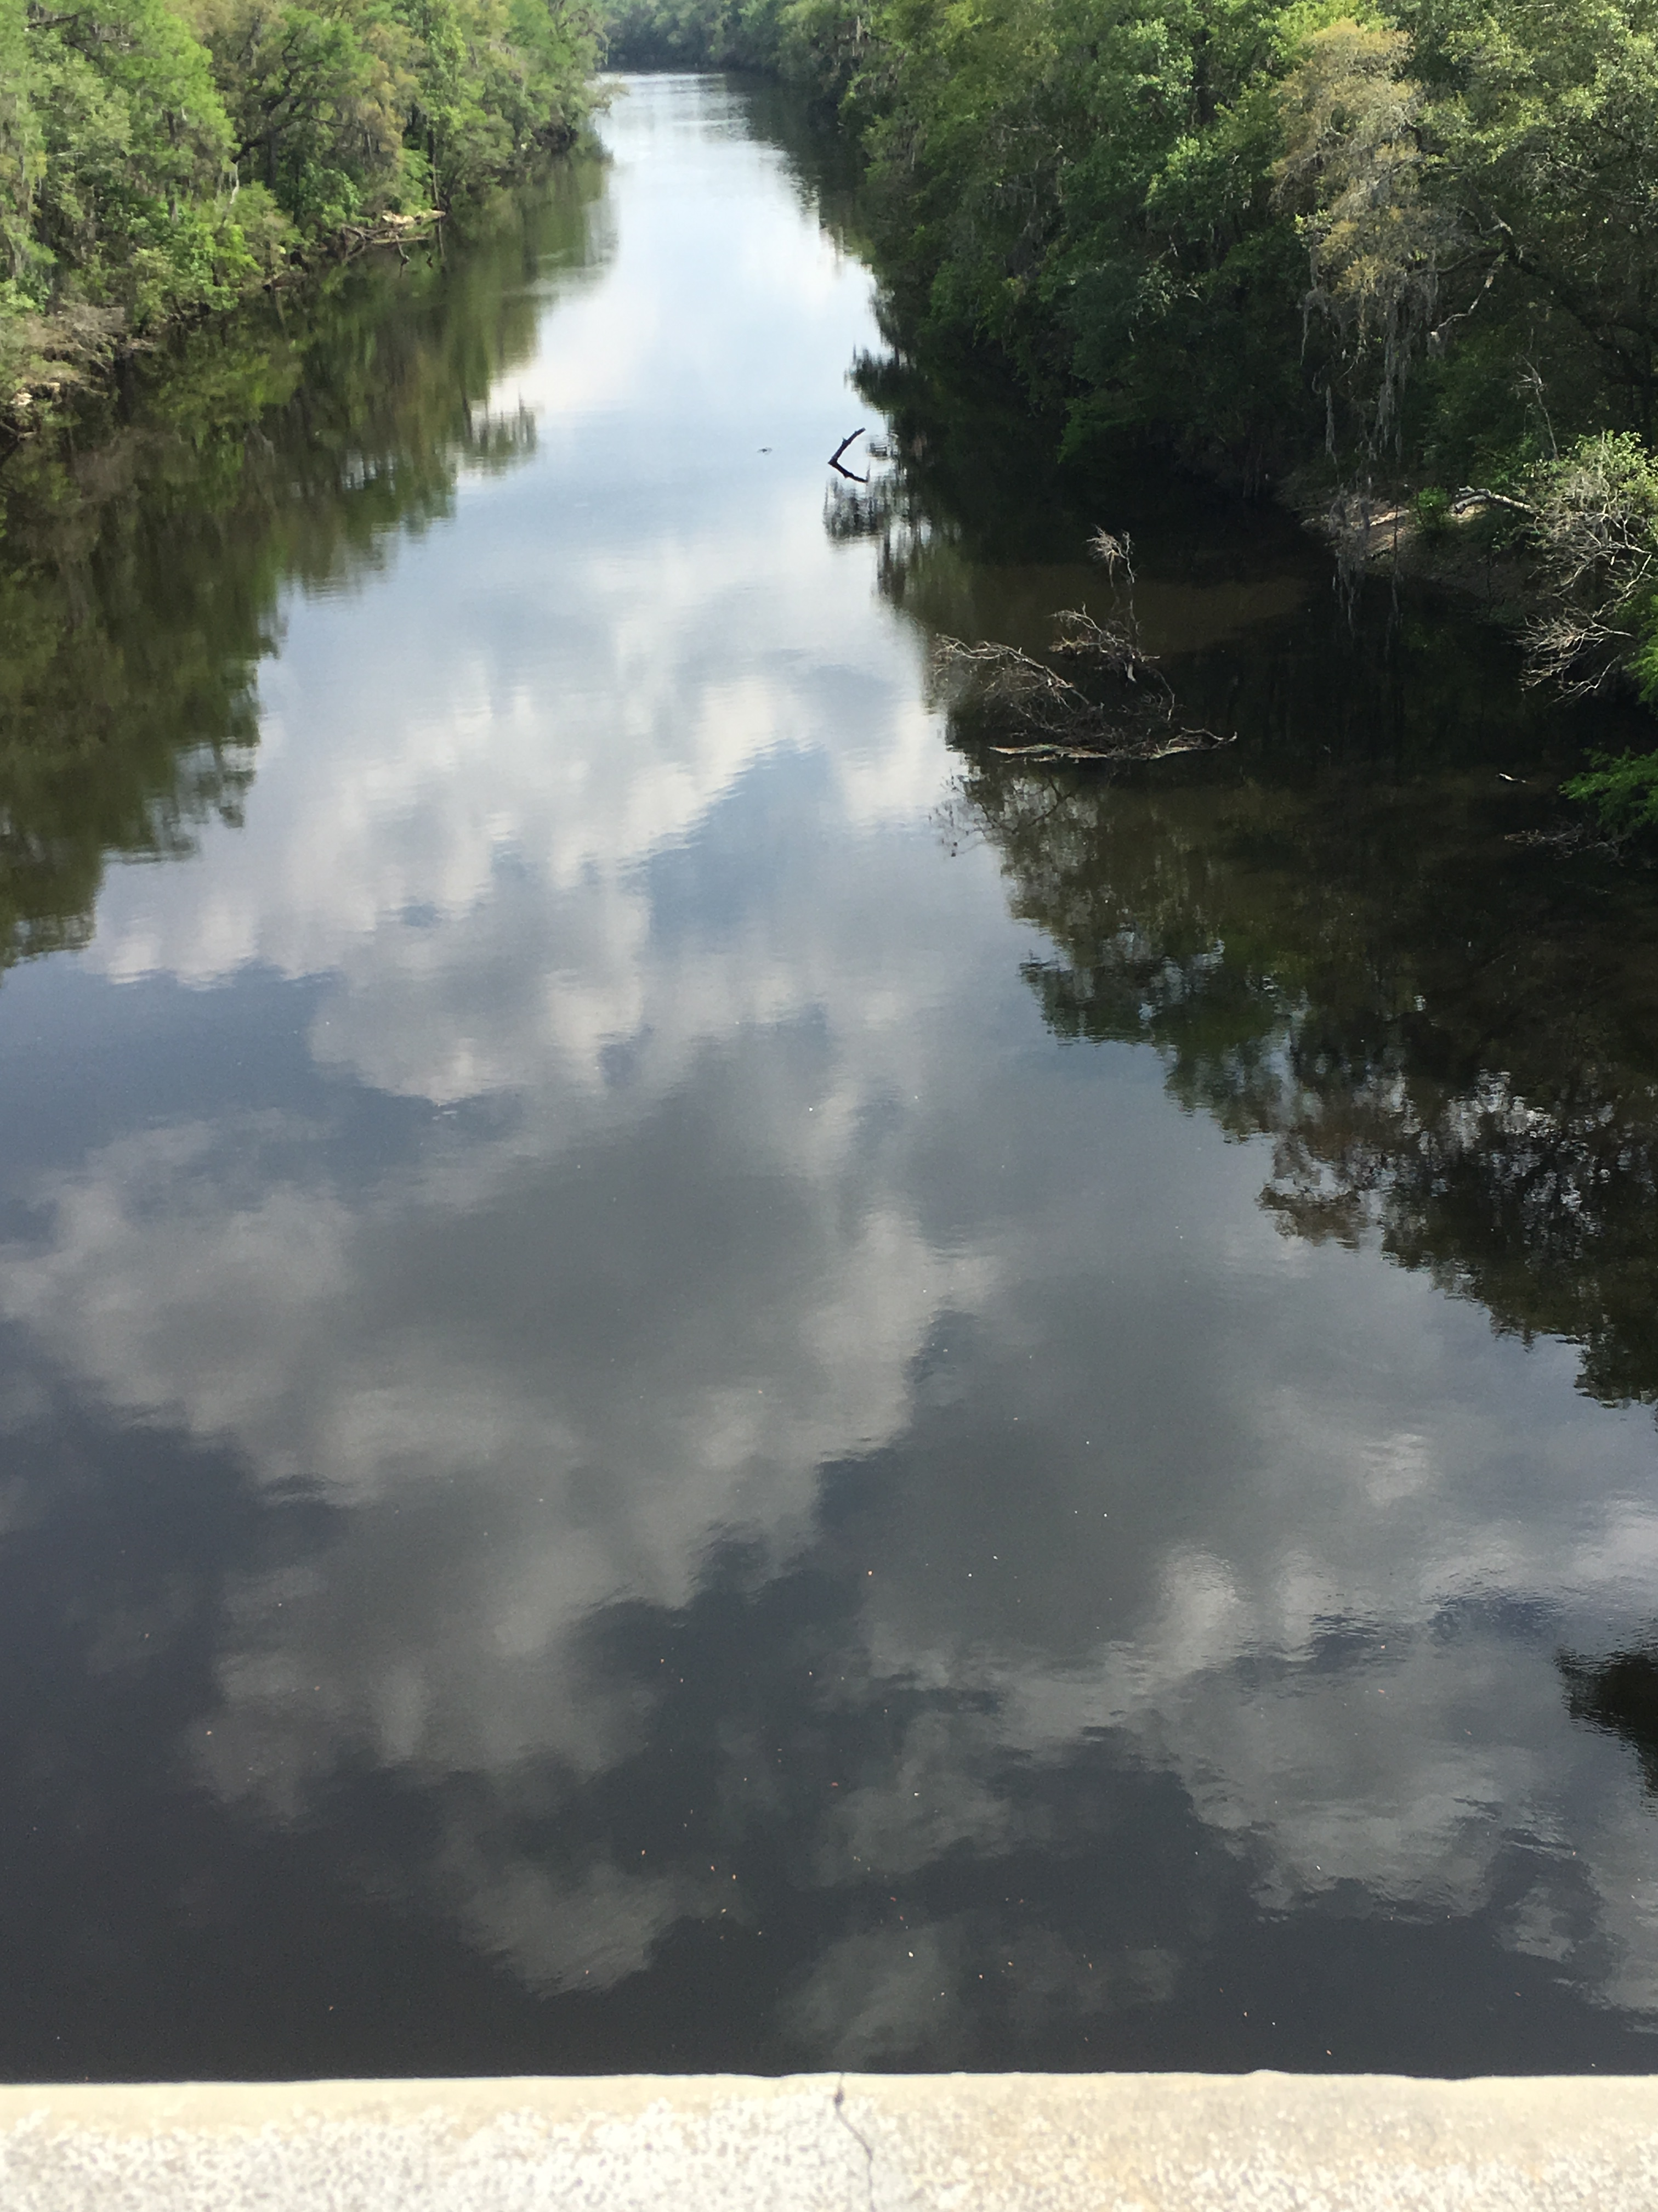
PPCPs Detections at Withlacoochee River Analyzed by SGS Analytical
PPCPs Detected by Sample Type
Notes:
Method – LC-MS/MS
Collection methods – Both Grab and POCIS are appropriate for the collection methods of PPCPs.

Slide 15
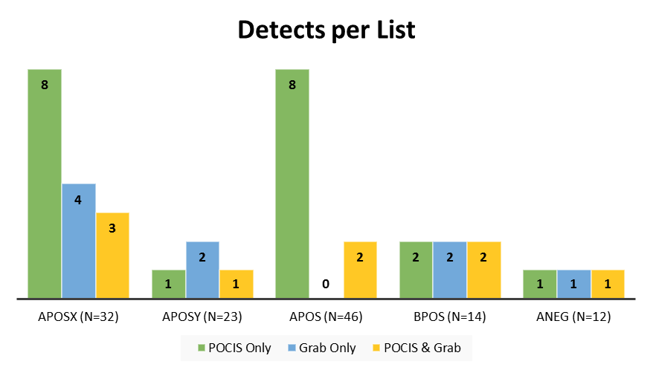
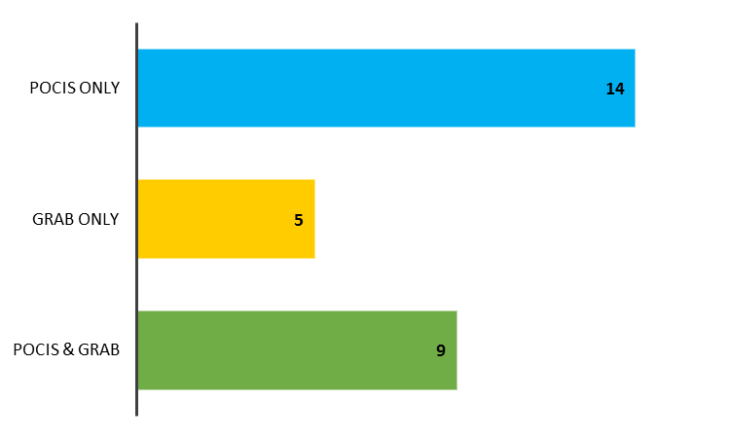
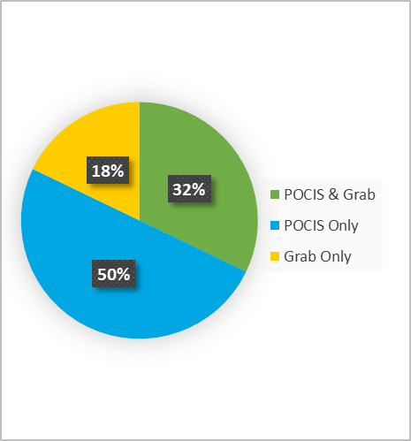
PPCPs Detections at Withlacoochee River Analyzed by SGS Analytical
PPCPs Detected by Sample Type
Total No. PPCPs = 127
Notes:
Method – LC-MS/MS
Collection methods – Both Grab and POCIS are appropriate for the collection methods of PPCPs.

Slide 16
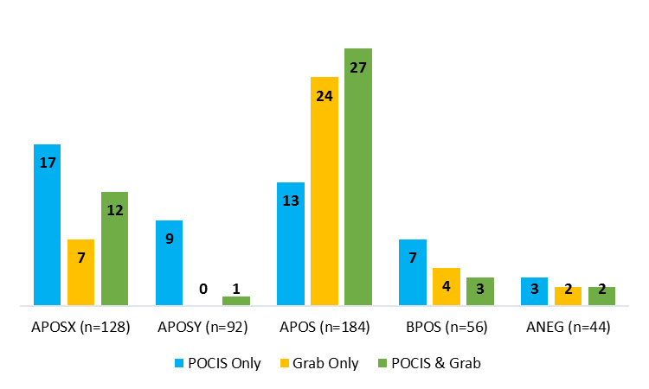
PPCPs Detections at All Sites by Sample Type
Detects per List at All Sites by Sample Type
Notes:
Collection methods – Both Grab and POCIS are appropriate for the collection methods of PPCPs.

Slide 17
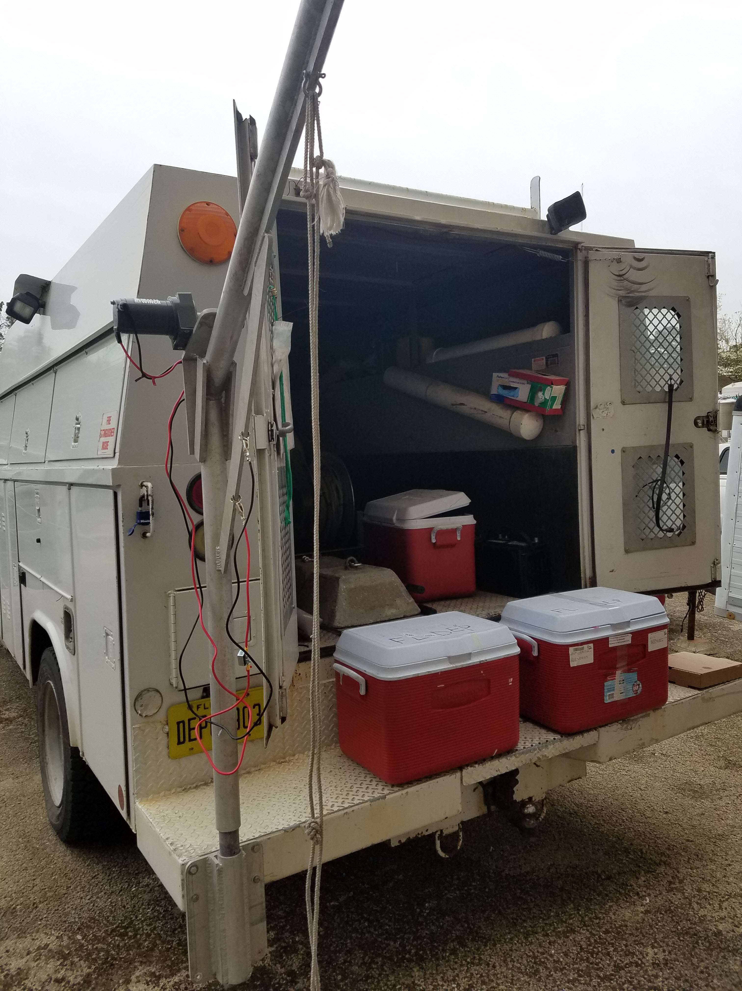

Hormones

Slide 18
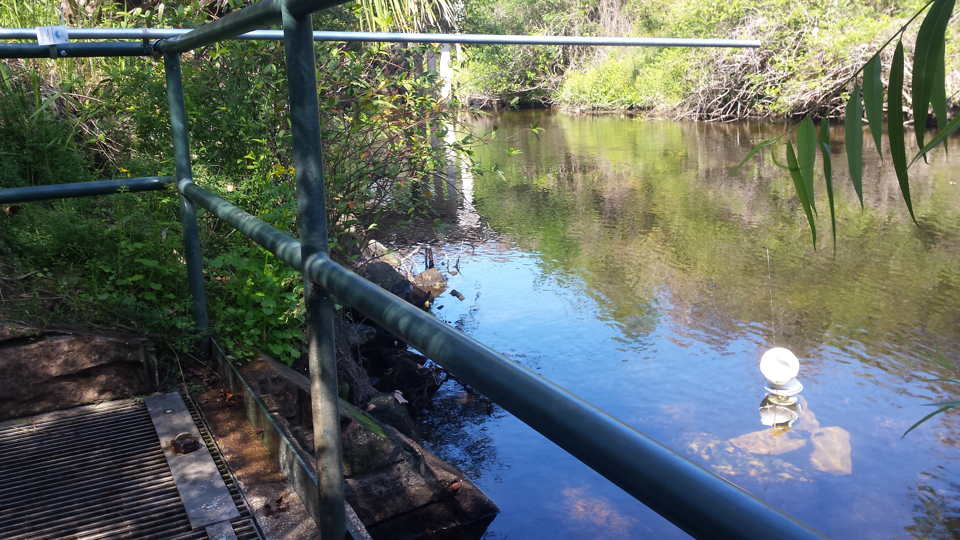
Hormone Detections at Alafia River Analyzed by SGS Analytical
Hormones Detected by Sample Type (n=17)

Slide 19
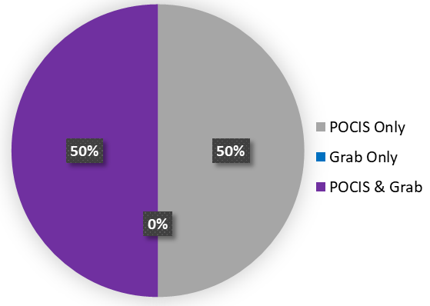
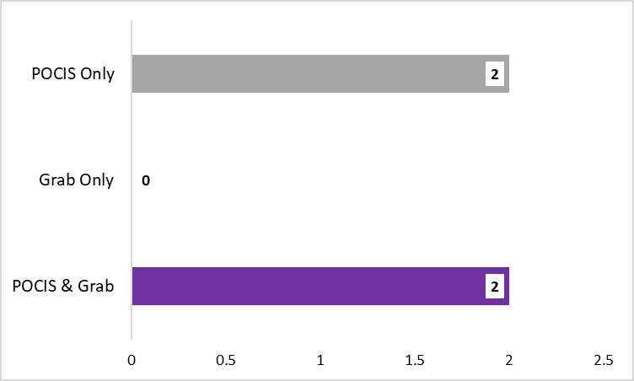
Hormone Detections at Ochlockonee River Analyzed by SGS Analytical
Hormones Detected by Sample Type
No. of Hormones Detected by Sample Type
Total No. Hormones = 17

Slide 20
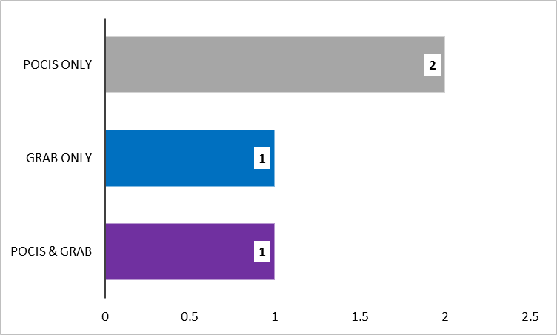
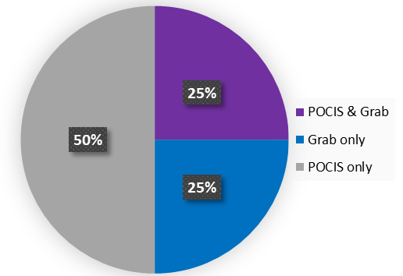
Hormone Detections at Withlacoochee River Analyzed by SGS Analytical
Hormones Detected by Sample Type
No. of Hormones Detected by Sample Type
Total No. Hormones = 17

Slide 21
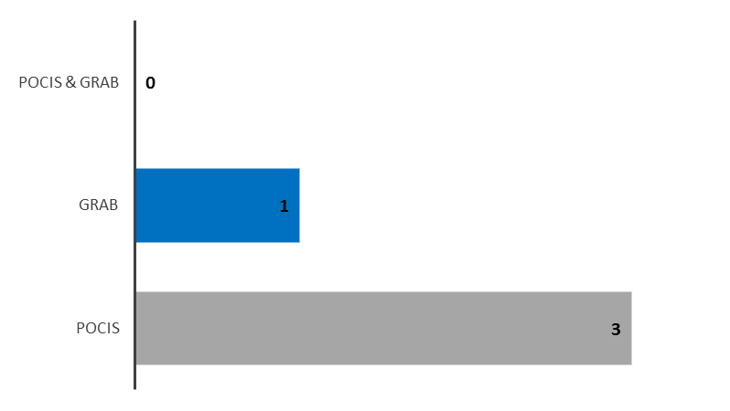
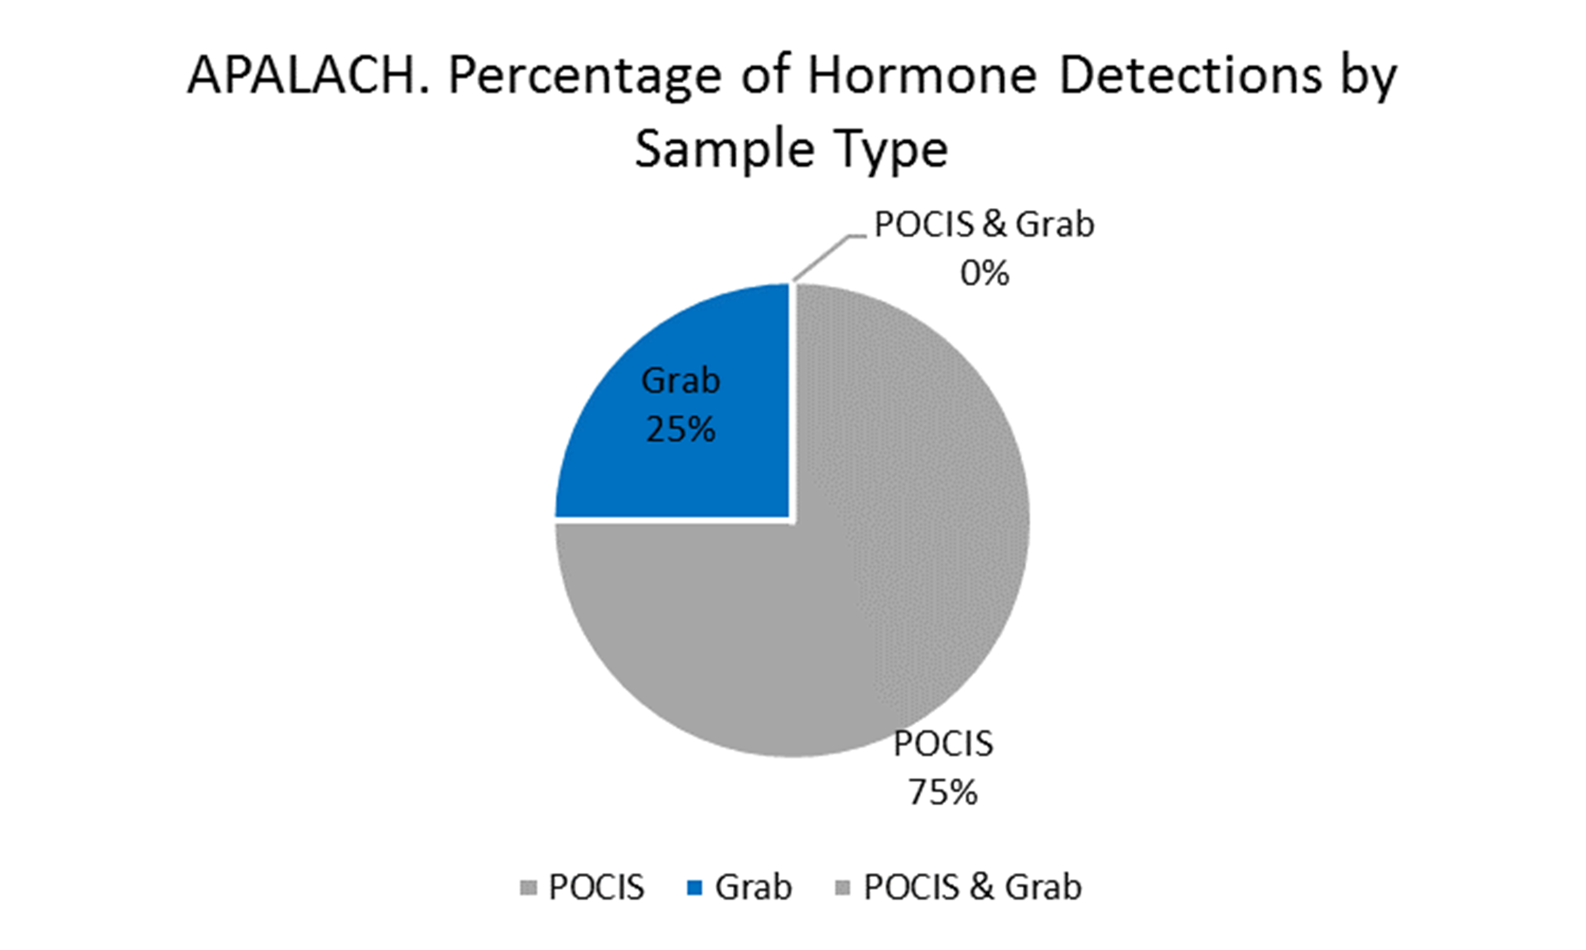
Hormone Detections at Apalachicola River Analyzed by SGS Analytical
Hormones Detected by Sample Type
No. of Hormones Detected by Sample Type

Slide 22
Hormones Detections at All Sites by Sample Type
Total No. Undetects, Detects, Not Quantifiable by Sample Type
Hormones Detected at All Sites by Sample Type
No. Hormones Detected by Sample Type

Slide 23
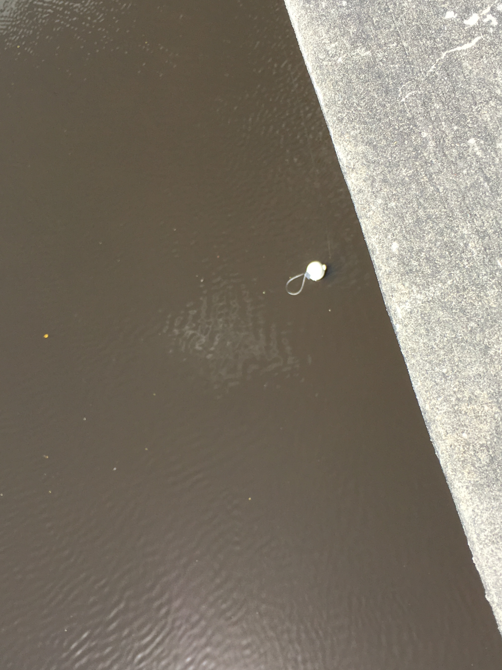
PFCs

Slide 24
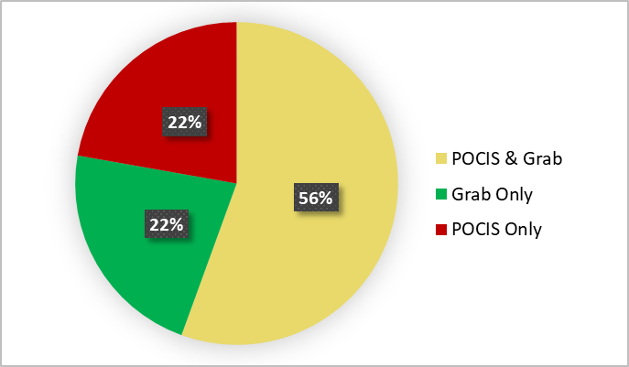
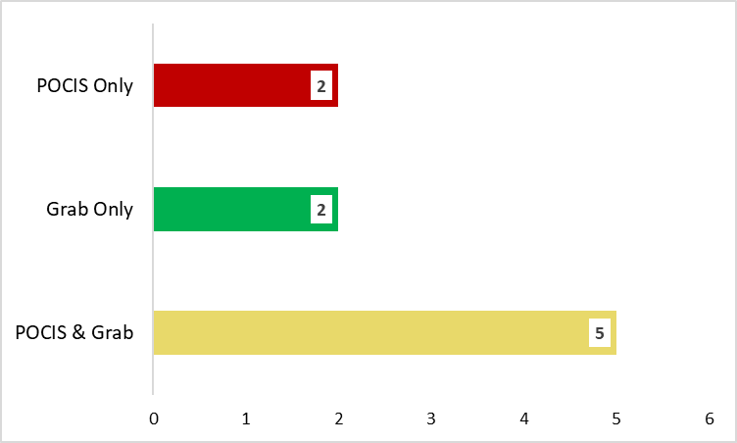
PFC Detections at Alafia River Analyzed by SGS Analytical
PFCs Detected by Sample Type
No. of PFCs Detected by Sample Type
Total No. PFCs = 13

Slide 25
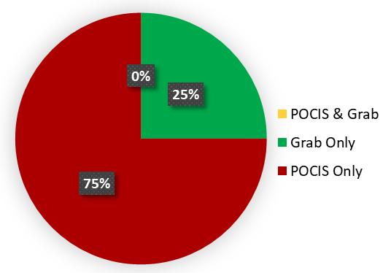
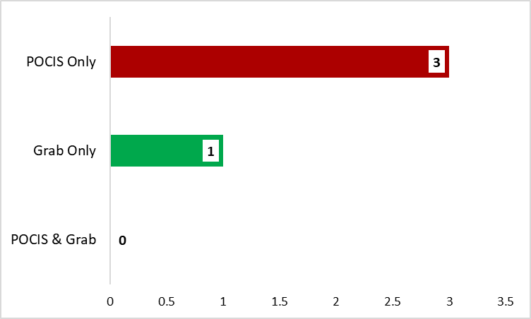
PFC Detections at Ochlockonee River Analyzed by SGS Analytical
PFCs Detected by Sample Type
No. of PFCs Detected by Sample Type
Total No. PFCs = 13

Slide 26
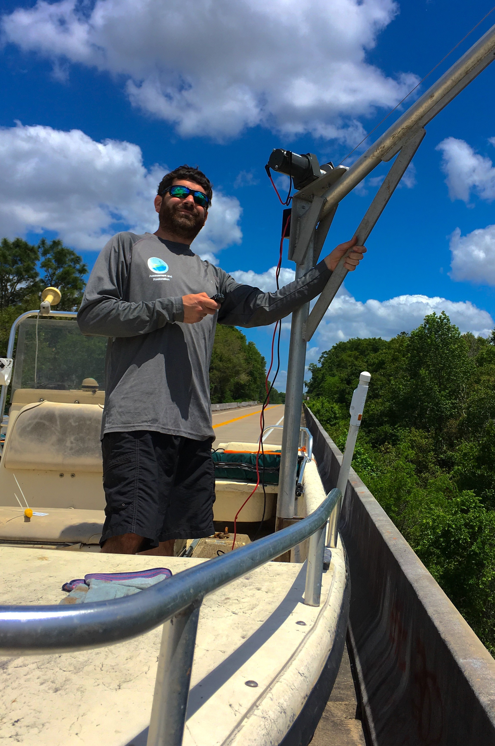
PFC Detections at Withlacoochee River Analyzed by SGS Analytical
PFCs Detected by Sample Type

Slide 27
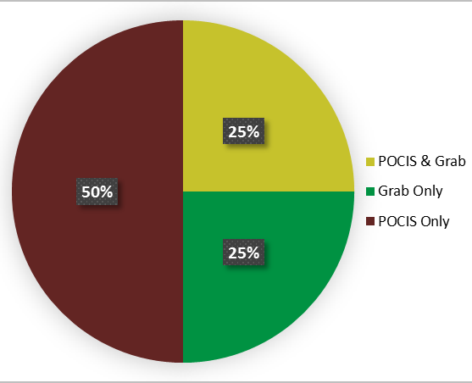
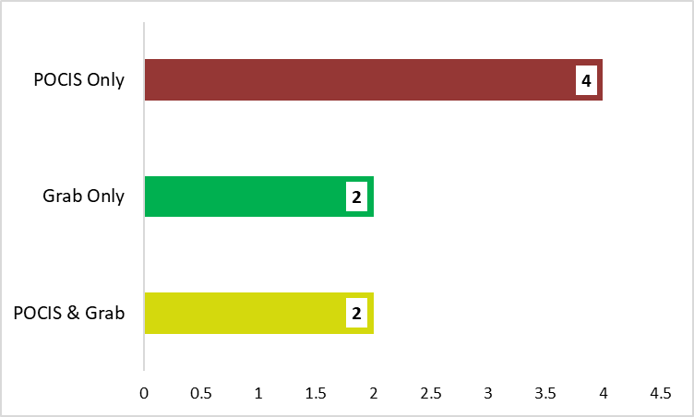
PFC Detections at Apalachicola River Analyzed by SGS Analytical
PFCs Detected by Sample Type
No. of PFCs Detected by Sample Type
Total No. PFCs = 13

Slide 28
PFC Detections at All Sites by Sample Type
Total No. Undetects, Detects, Not Quantifiable by Sample Type
No. PFCs Detected by Sample Type

Slide 29
PBDEs

Slide 30
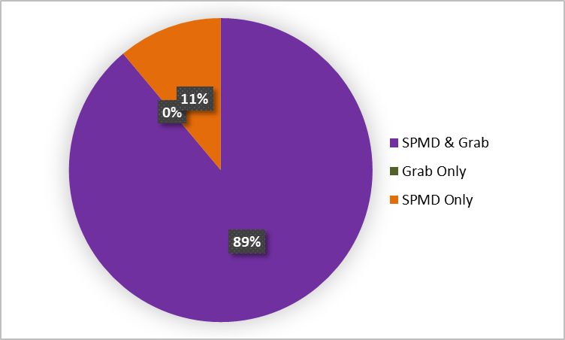
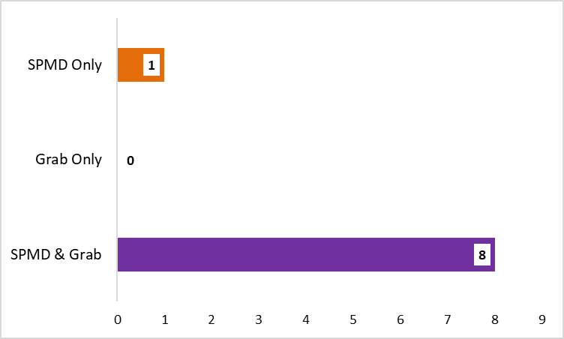
PBDE Detections at Alafia River Analyzed by SGS Analytical
Detected by Sample Type (n=9)
No. of PBDEs Detected by Sample Type

Slide 31
PBDE Detections at Ochlockonee River Analyzed by SGS Analytical
Detected by Sample Type (n=9)

Slide 32
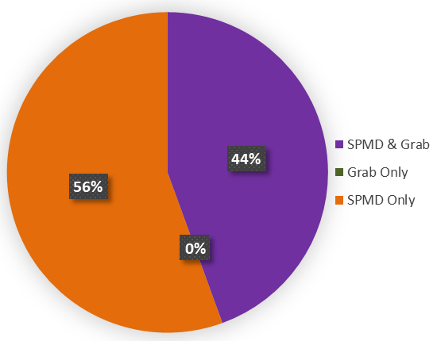
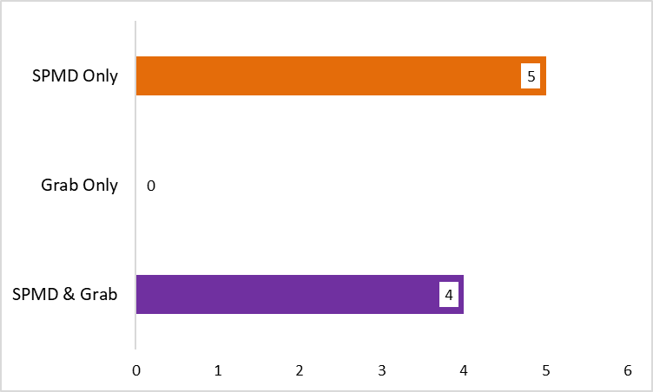
PBDE Detections at Apalachicola River Analyzed by SGS Analytical
Detected by Sample Type (n=9)
No. of PBDEs Detected by Sample Type

Slide 33
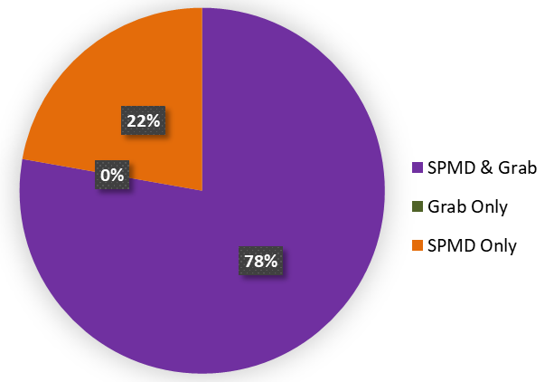
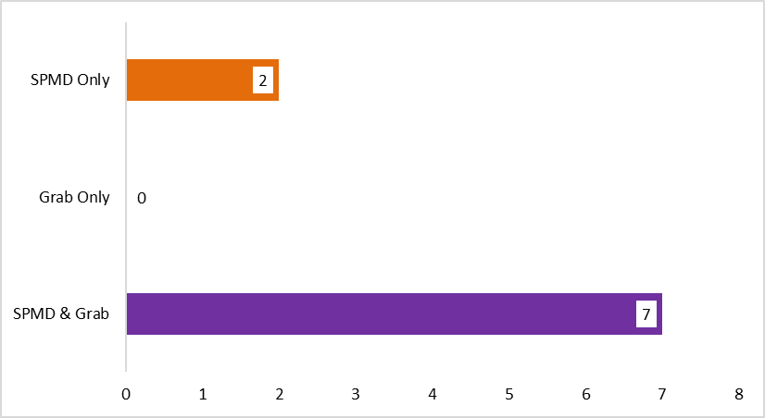
PBDE Detections at Withlacoochee River Analyzed by SGS Analytical
PBDEs Detected by Sample Type
No. of PBDEs Detected by Sample Type
Total No. PBDEs = 9

Slide 34
PBDE Detections at All Sites by Sample Type
Non-detects, Detects, Not Quantifiable by Sample Type
PBDEs Detected at All Sites by Sample Type
No. PBDEs Detected by Sample Type

Slide 35
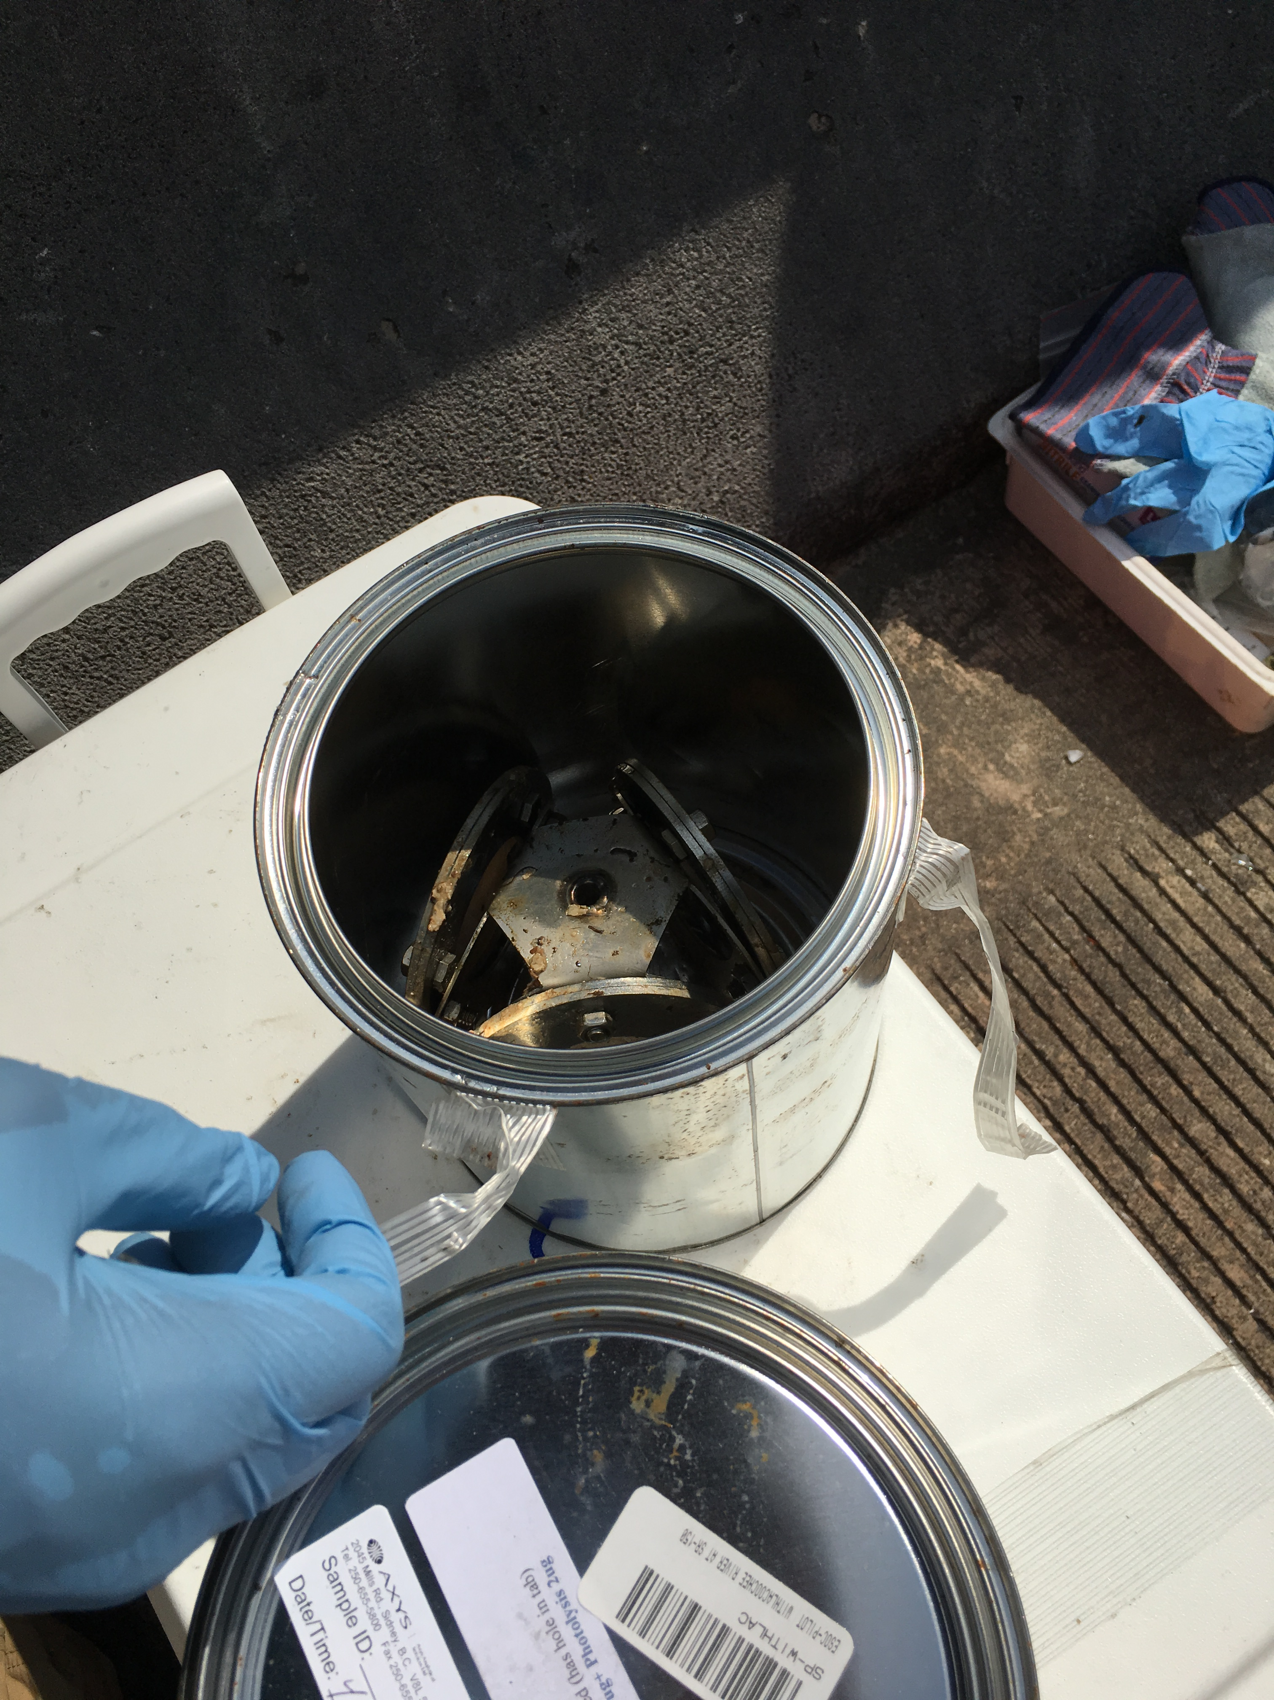
Alkylphenols

Slide 36
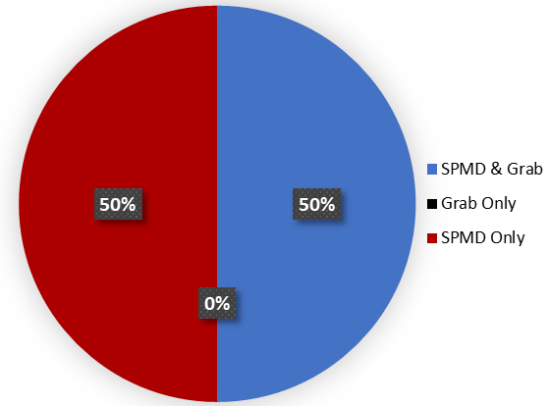
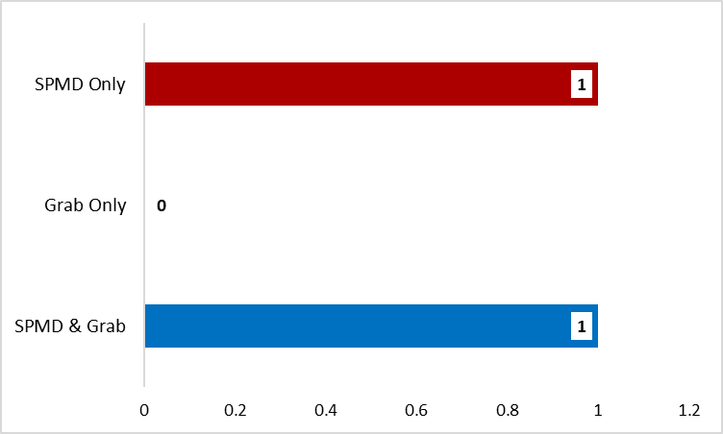
Alkylphenol Detections at Alafia River Analyzed by SGS Analytical
Alkylphenols Detected by Sample Type (n=4)

Slide 37
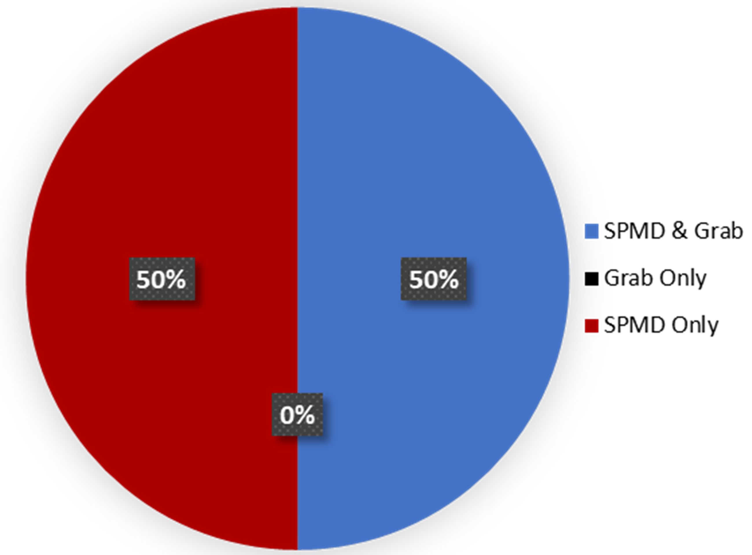
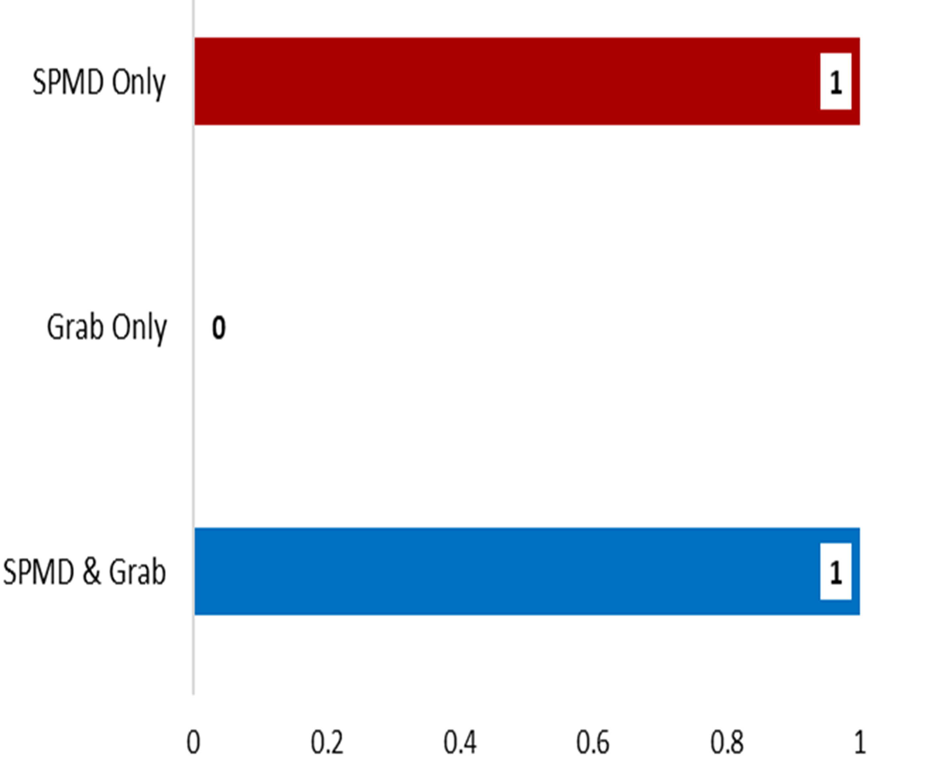
Alkylphenol Detections at Ochlockonee River Analyzed by SGS Analytical
Alkylphenols Detected by Sample Type (n=4)

Slide 38


Alkylphenol Detections at Apalachicola River Analyzed by SGS Analytical
Alkylphenols Detected by Sample Type n=4)

Slide 39


Alkylphenol Detections at Withlacoochee River Analyzed by SGS Analytical
Alkylphenols Detected by Sample Type
No. of Alkylphenols Detected by Sample Type
Total No. Alkylphenols = 4

Slide 40
Alkylphenol Detections at All Sites by Sample Type
Total No. Undetects, Detects, Not Quantifiable by Sample Type
Alkylphenols Detected at All Sites by Sample Type
No. Alkylphenols Detected by Sample Type

Slide 41

PAHs

Slide 42
PAH Detections at Apalachicola River Analyzed by SGS Analytical
PAHs Detected by Sample Type

