Slide 1
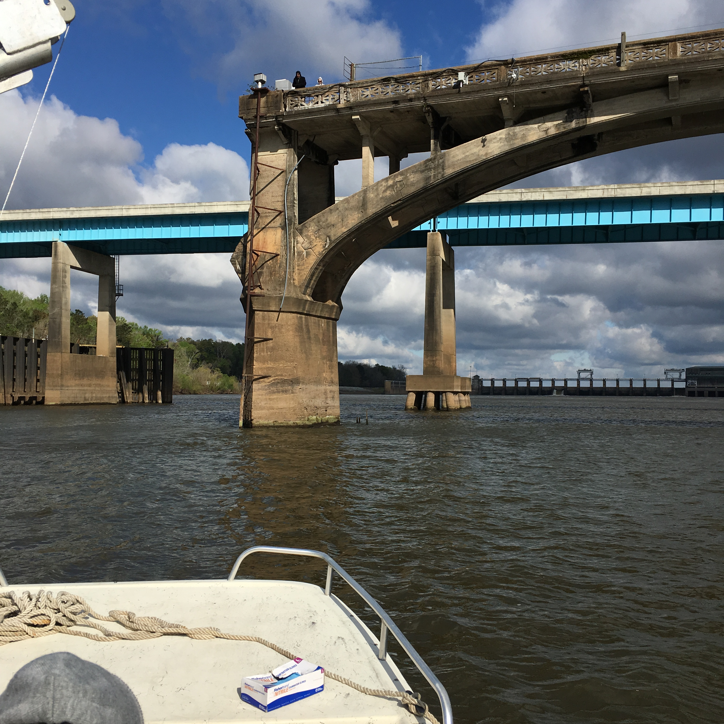
Pesticides

Slide 2
Analyzed Pilot Study Samples for 76 Pesticide Compounds
42 Pesticide Compounds Detected
At one or more sites, in at least one matrix (POCIS, SPMD, or Grab)
2,4'-DDD
4,4'-DDD
2,4'-DDE
4,4'-DDE
4,4'-DDT
Alachlor
Aldrin
alpha-Endosulphan
beta-Endosulphan
Endosulphan Sulphate
Ametryn
Atrazine
Desethylatrazine
Chlordane, alpha (cis)
Chlordane, gamma (trans)
Chlordane, oxy-
Chlorpyriphos
Diazinon
Dieldrin
Dimethenamid
Endrin
Endrin Ketone
Ethalfluralin
Flufenacet
Flutriafol
HCH, alpha
HCH, beta
HCH, delta
HCH, gamma
Heptachlor
Heptachlor Epoxide
Hexachlorobenzene
Hexazinone
Metolachlor
Mirex
Nonachlor, cis-
Nonachlor, trans-
Pendimethalin
Quintozene
Simazine
Tebuconazol
Trifluralin

Slide 3
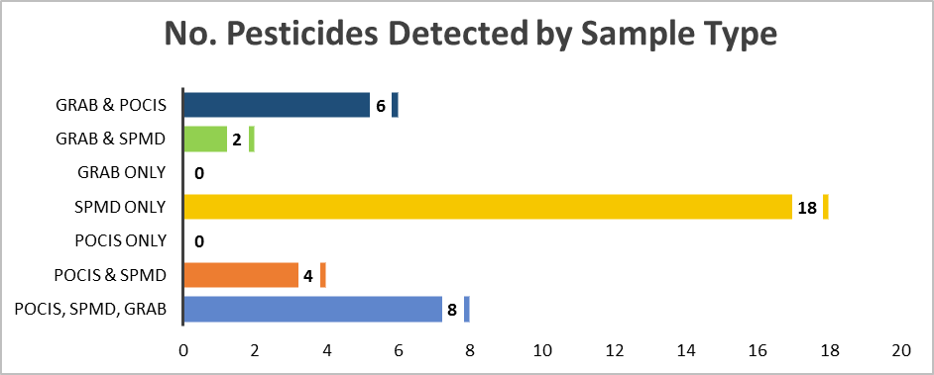
Pesticide Detections at Alafia River Analyzed by SGS Analytical
Pesticides Detected by Sample Type
No. of Pesticides Detected by Sample Type
Total No. Pesticides = 76

Slide 4
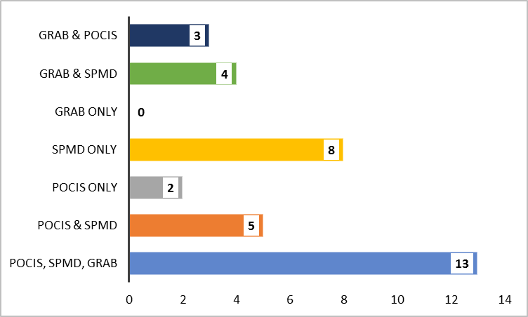
Pesticide Detections at Ochlockonee River Analyzed by SGS Analytical
Pesticides Detected by Sample Type
No. of Pesticides Detected by Sample Type

Slide 5
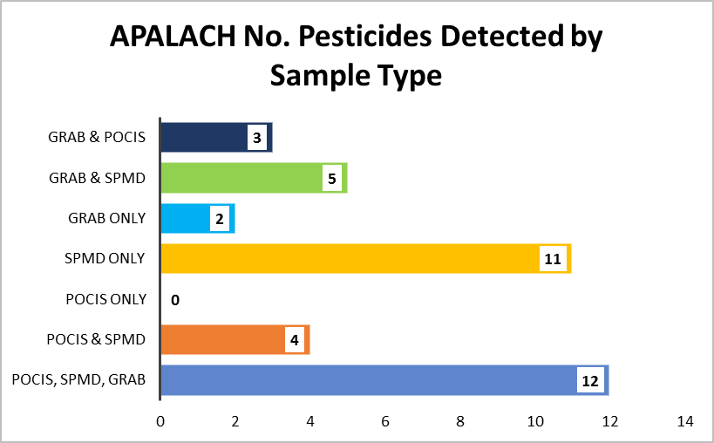

Pesticide Detections at Apalachicola River Analyzed by SGS Analytical
Pesticides Detected by Sample Type
No. of Pesticides Detected by Sample Type

Slide 6
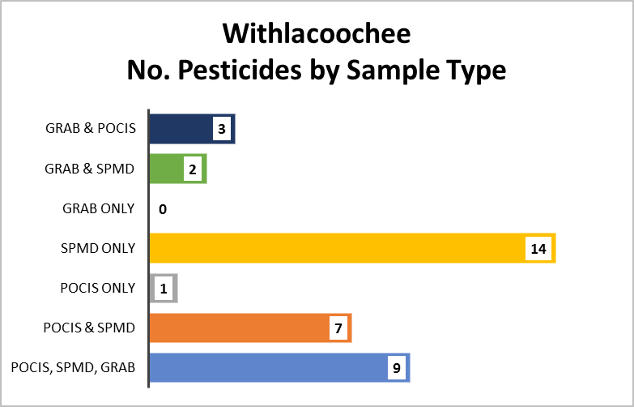
Pesticide Detections at Withlacoochee River Analyzed by SGS Analytical
Pesticides Detected by Sample Type
No. of Pesticides Detected by Sample Type

Slide 7
Pesticides Detections at All Sites by Sample Type
Total No. Undetects, Detects, Not Quantifiable by Sample Type
Pesticides Detected at Every Site (n = 4)
by Matrix
No. Pesticides Detected by Sample Type

Slide 8
Quality Assurance Summary
18 of the 42 pesticide compounds detected were also detected in lab blanks or field blanks at concentrations that required data from at least one site to be qualified.
40% of detections from SPMD samples were qualified due to blank detections.
38% detections from grab samples were qualified due to blank detections.
33% of detections from POCIS samples were qualified due to blank detections.

Slide 9
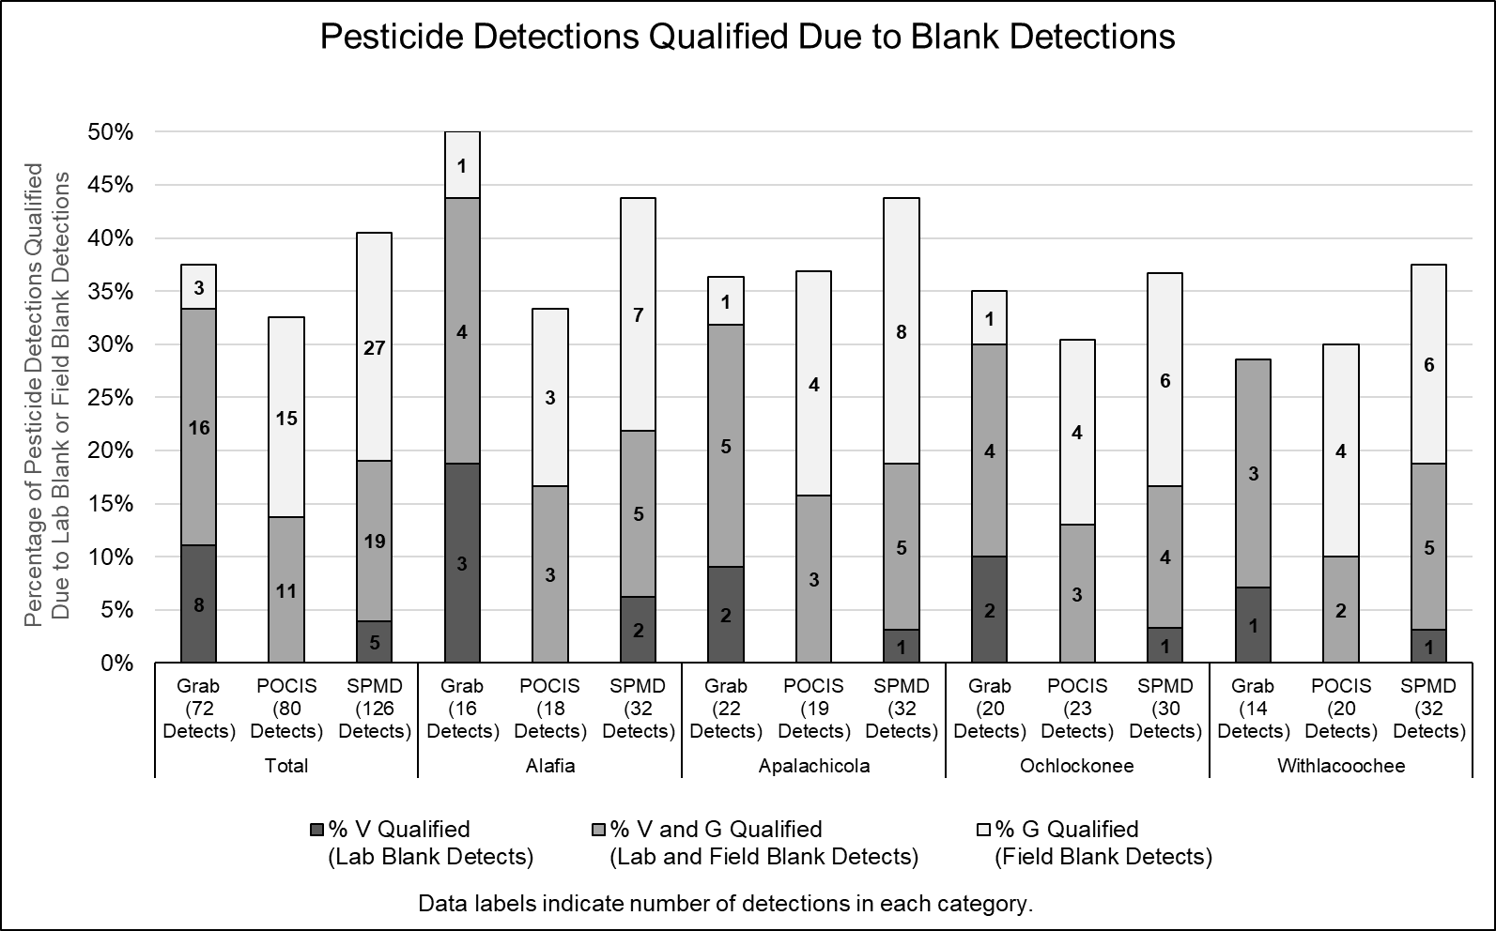

Slide 10
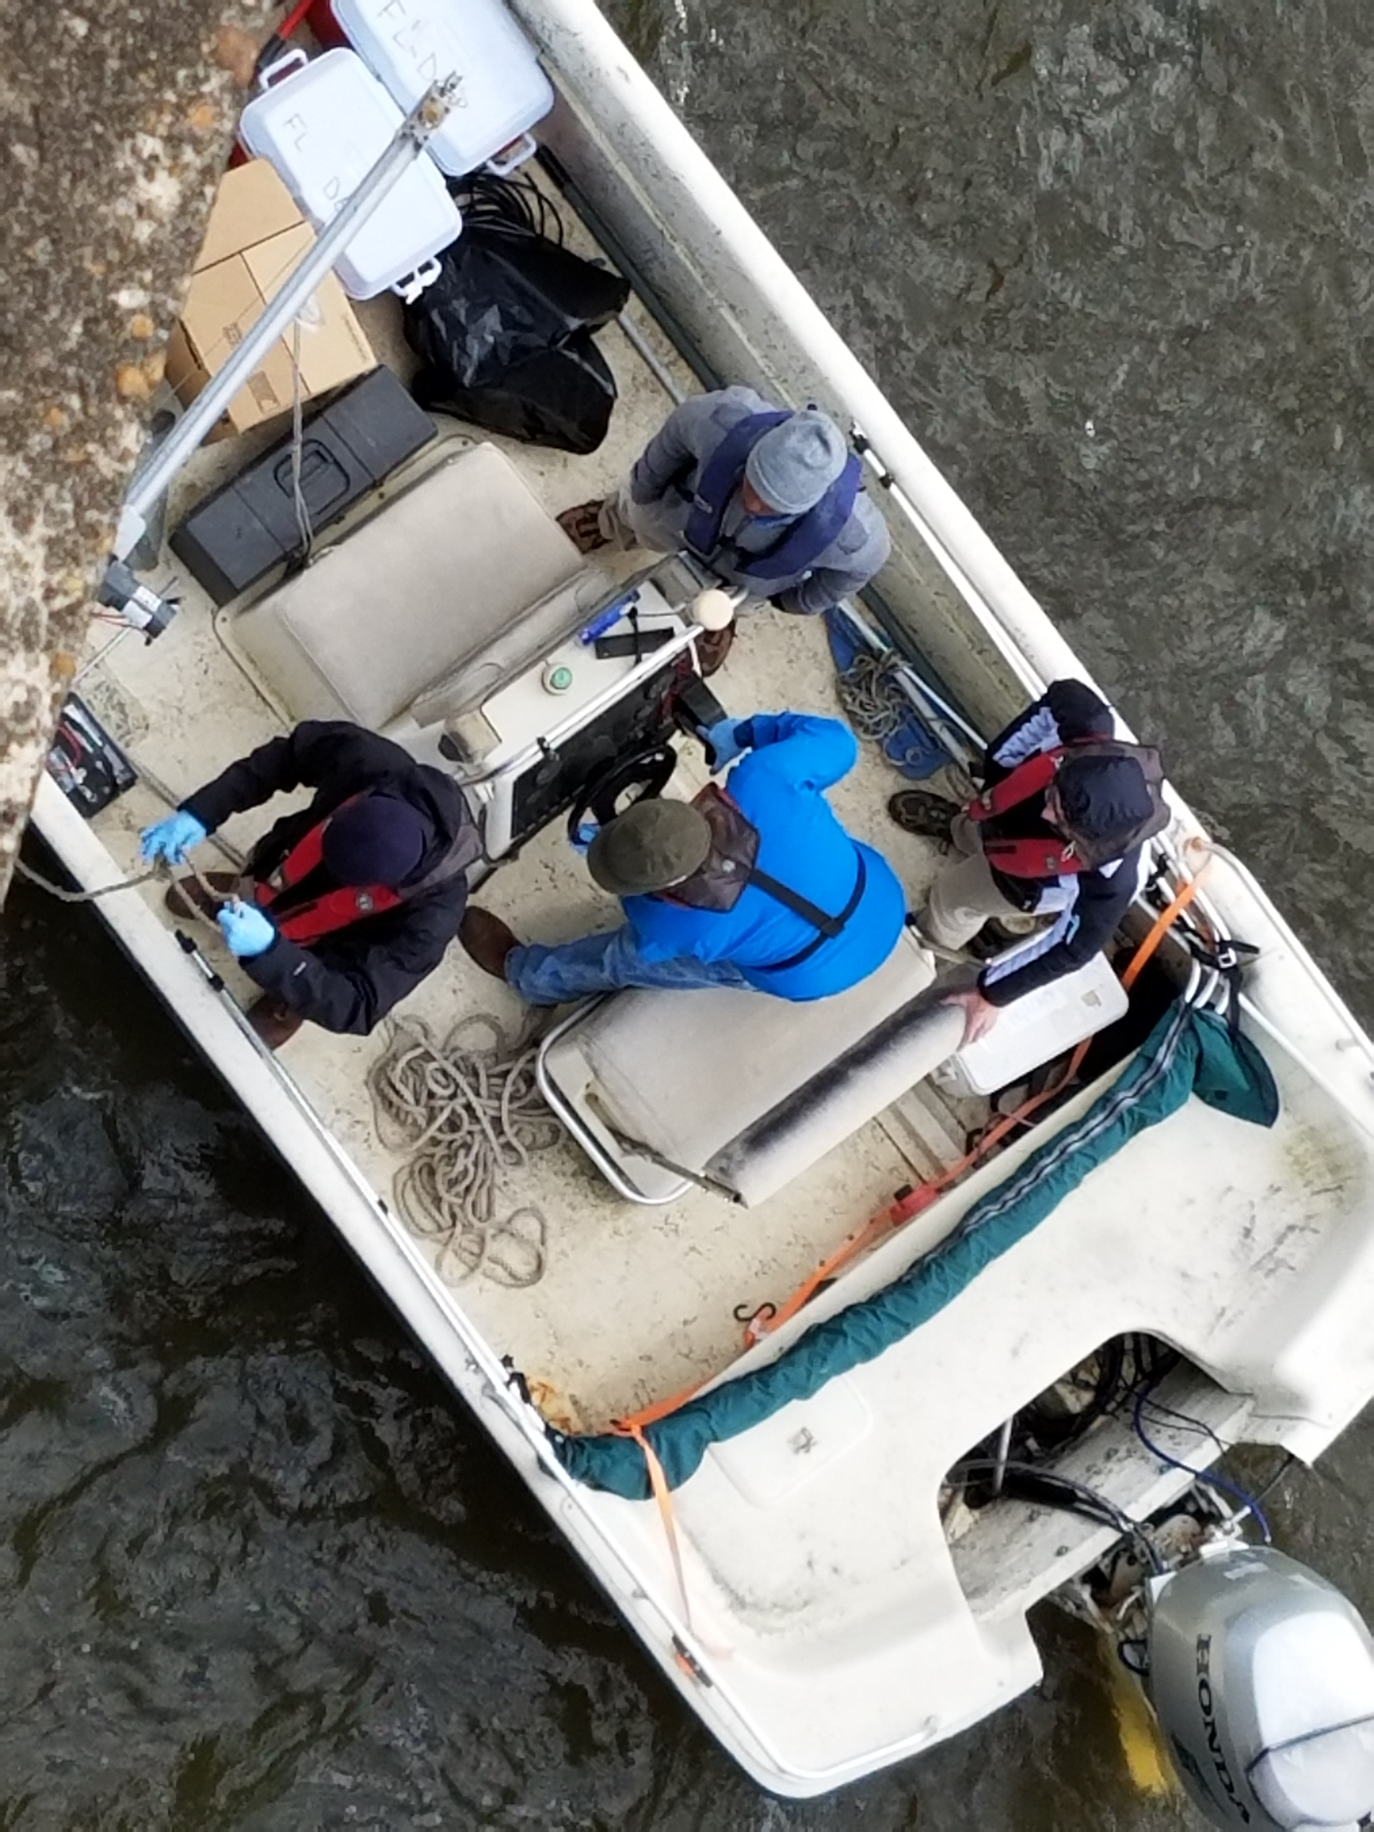
PPCPs

Slide 11
Analyzed Pilot Study Samples for 127 PPCP Compounds
39 PPCP Compounds Detected
At one or more sites, in at least one matrix (POCIS or Grab)
Alprazolam
Amitriptyline
Amphetamine
Atenolol
Azithromycin
Caffeine
Carbamazepine
Clarithromycin
Cocaine
Colchicine
Cotinine
DEET
Dehydronifedipine
Desmethyldiltiazem
Diatrizoic acid
Diazepam
Diltiazem
Diphenhydramine
Erythromycin-H2O
Furosemide
Gemfibrozil
Hydrochlorothiazide
Hydrocodone
Iopamidol
Meprobamate
Metformin
Metoprolol
Naproxen
Oxolinic Acid
Oxycodone
Propoxyphene
Sertraline
Sulfadimethoxine
Sulfamethazine
Sulfamethoxazole
Triamterene
Trimethoprim
Valsartan
Venlafaxine

Slide 12
PPCPs Detections at Alafia River Analyzed by SGS Analytical
PPCPs Detected by Sample Type
POCIS Only
Grab Only
Grab & POCIS
Alprazolam
Diatrizoic acid
Amitriptyline
Erythromycin-H2O
Iopamidol
Amphetamine
Hydrocodone
Colchicine
Carbamazepine
Cocaine
DEET
Oxolinic Acid
Sulfamethoxazole
Notes:
Collection methods – Both Grab and POCIS are appropriate for the collection methods of PPCPs.

Slide 13
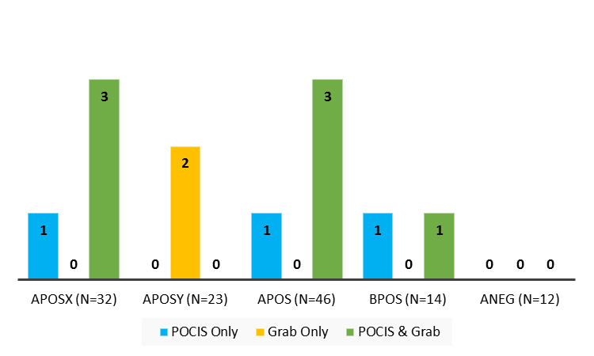
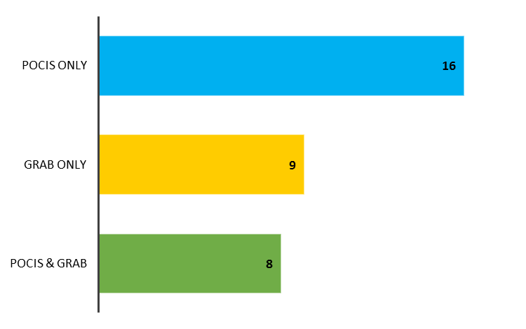
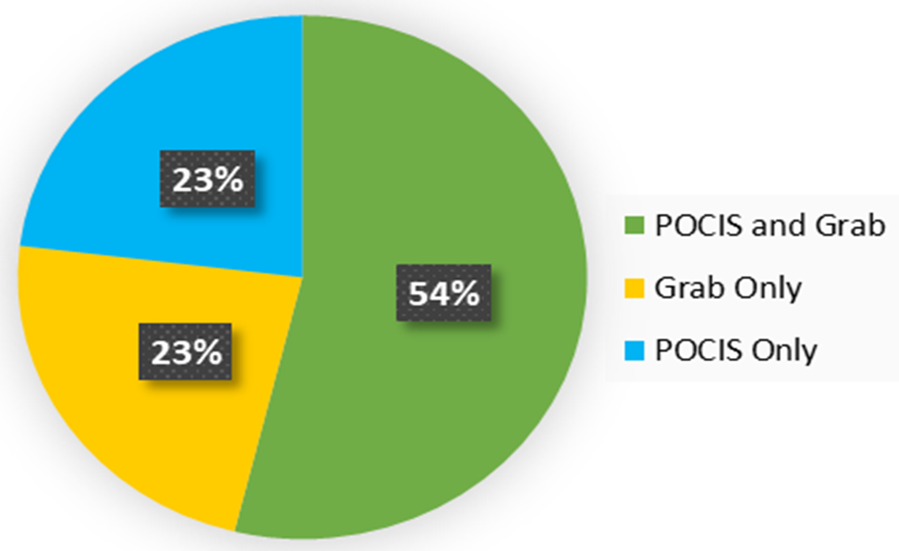
PPCPs Detections at Alafia River Analyzed by SGS Analytical
Detects per Analyte List by Sample Type
Detected by Sample Type
Total No. PPCPs = 127

Slide 14
PPCPs Detections at Ochlockonee River Analyzed by SGS Analytical
Detected by Sample Type
Notes:
Collection methods – Both Grab and POCIS are appropriate for the collection methods of PPCPs.

Slide 15
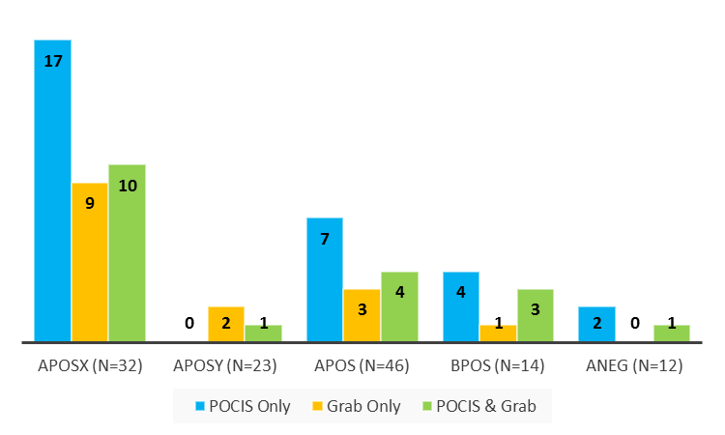

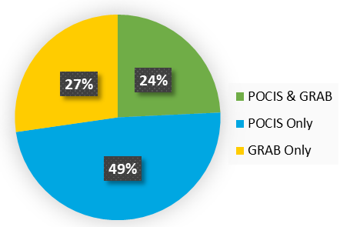
PPCPs Detections at Ochlockonee River Analyzed by SGS Analytical
Detects per Analyte List by Sample Type
Detected by Sample Type
Total No. PPCPs = 127

Slide 16
PPCPs Detections at Apalachicola River Analyzed by SGS Analytical
Detected by Sample Type
POCIS Only
Grab Only
POCIS & Grab
Alprazolam
Amitriptyline
DEET
Metoprolol
Iopamidol
Sulfamethoxazole
Venlafaxine
Caffeine
Amphetamine
Carbamazepine
Atenolol
Naproxen
Erythromycin-H2O
Cotinine
Trimethoprim
Metformin
Oxycodone
Triamterene
Gemfibrozil
Notes:
Collection methods – Both Grab and POCIS are appropriate for the collection methods of PPCPs.

Slide 17
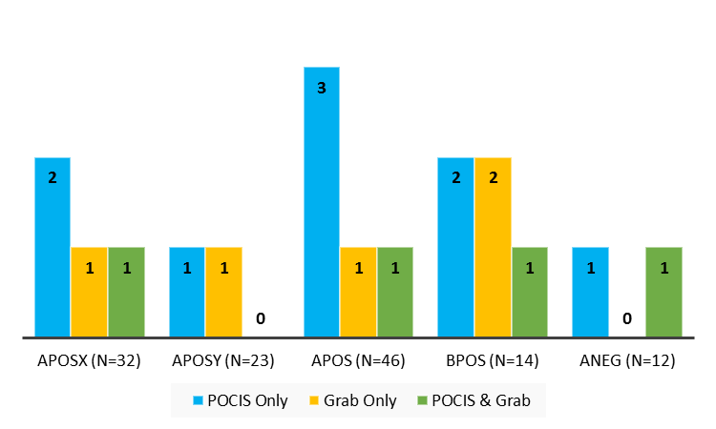
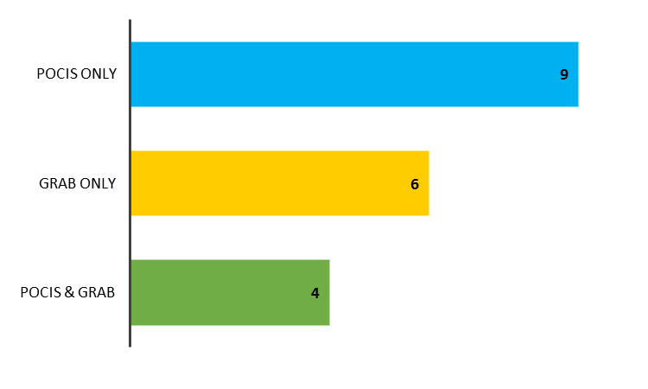
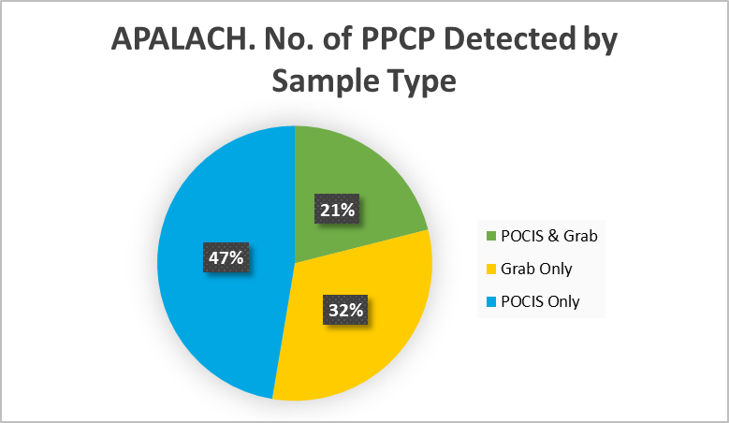
PPCPs Detections at Apalachicola River Analyzed by SGS Analytical
Detects per Analyte List by Sample Type
Detected by Sample Type
Total No. PPCPs = 127

Slide 18
PPCPs Detections at Withlacoochee River Analyzed by SGS Analytical
PPCPs Detected by Sample Type
Notes:
Method – LC-MS/MS
Collection methods – Both Grab and POCIS are appropriate for the collection methods of PPCPs.

Slide 19
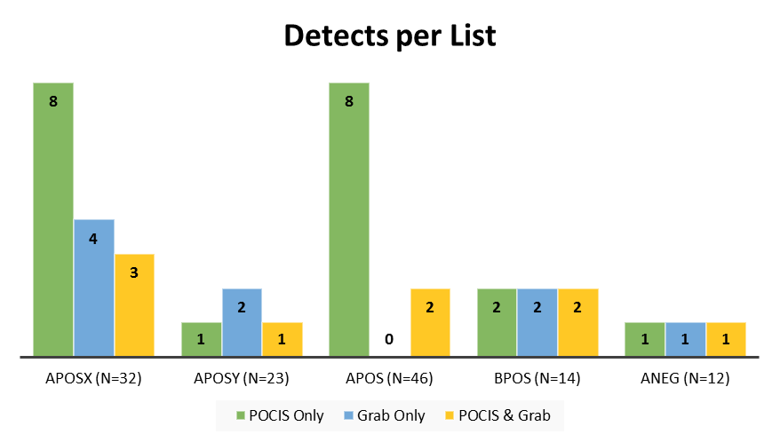
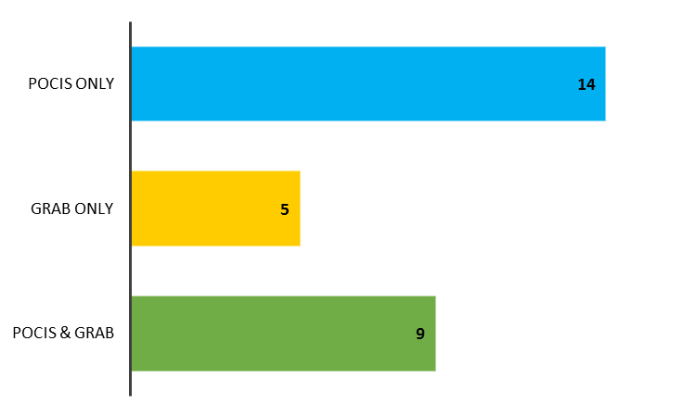
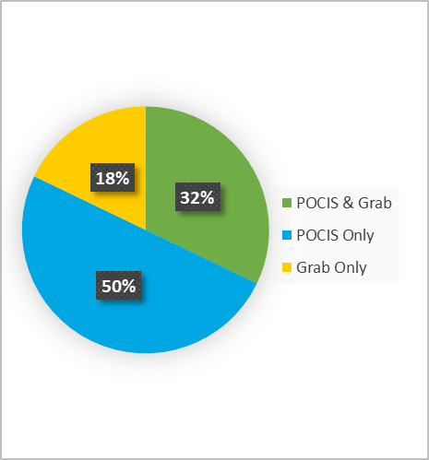
PPCPs Detections at Withlacoochee River Analyzed by SGS Analytical
PPCPs Detected by Sample Type
Total No. PPCPs = 127
Notes:
Method – LC-MS/MS
Collection methods – Both Grab and POCIS are appropriate for the collection methods of PPCPs.

Slide 20
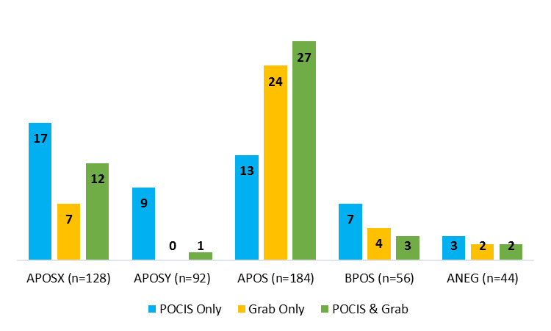
PPCPs Detections at All Sites by Sample Type
Detects per List at All Sites by Sample Type
Notes:
Collection methods – Both Grab and POCIS are appropriate for the collection methods of PPCPs.

Slide 21
Quality Assurance Summary
3 of the 39 PPCP compounds detected were also detected in lab blanks or field blanks at concentrations that required data from at least one site to be qualified.
17% detections from grab samples were qualified due to blank detections.
6% of detections from POCIS samples were qualified due to blank detections.

Slide 22
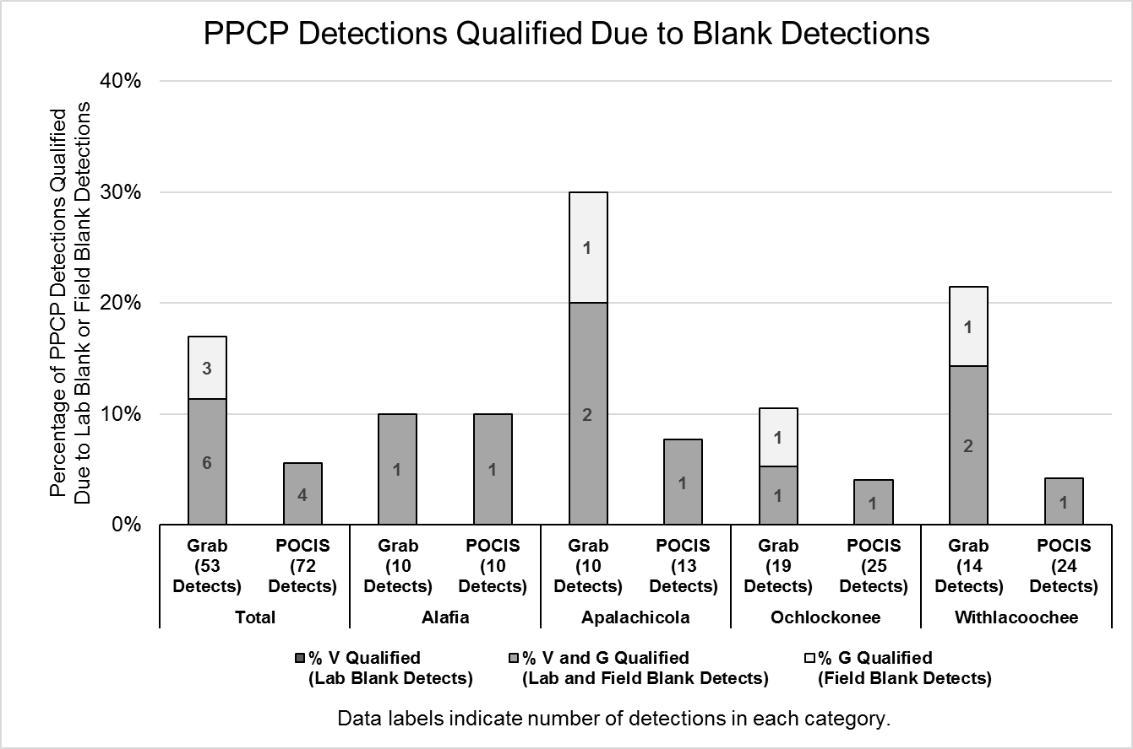

Slide 23
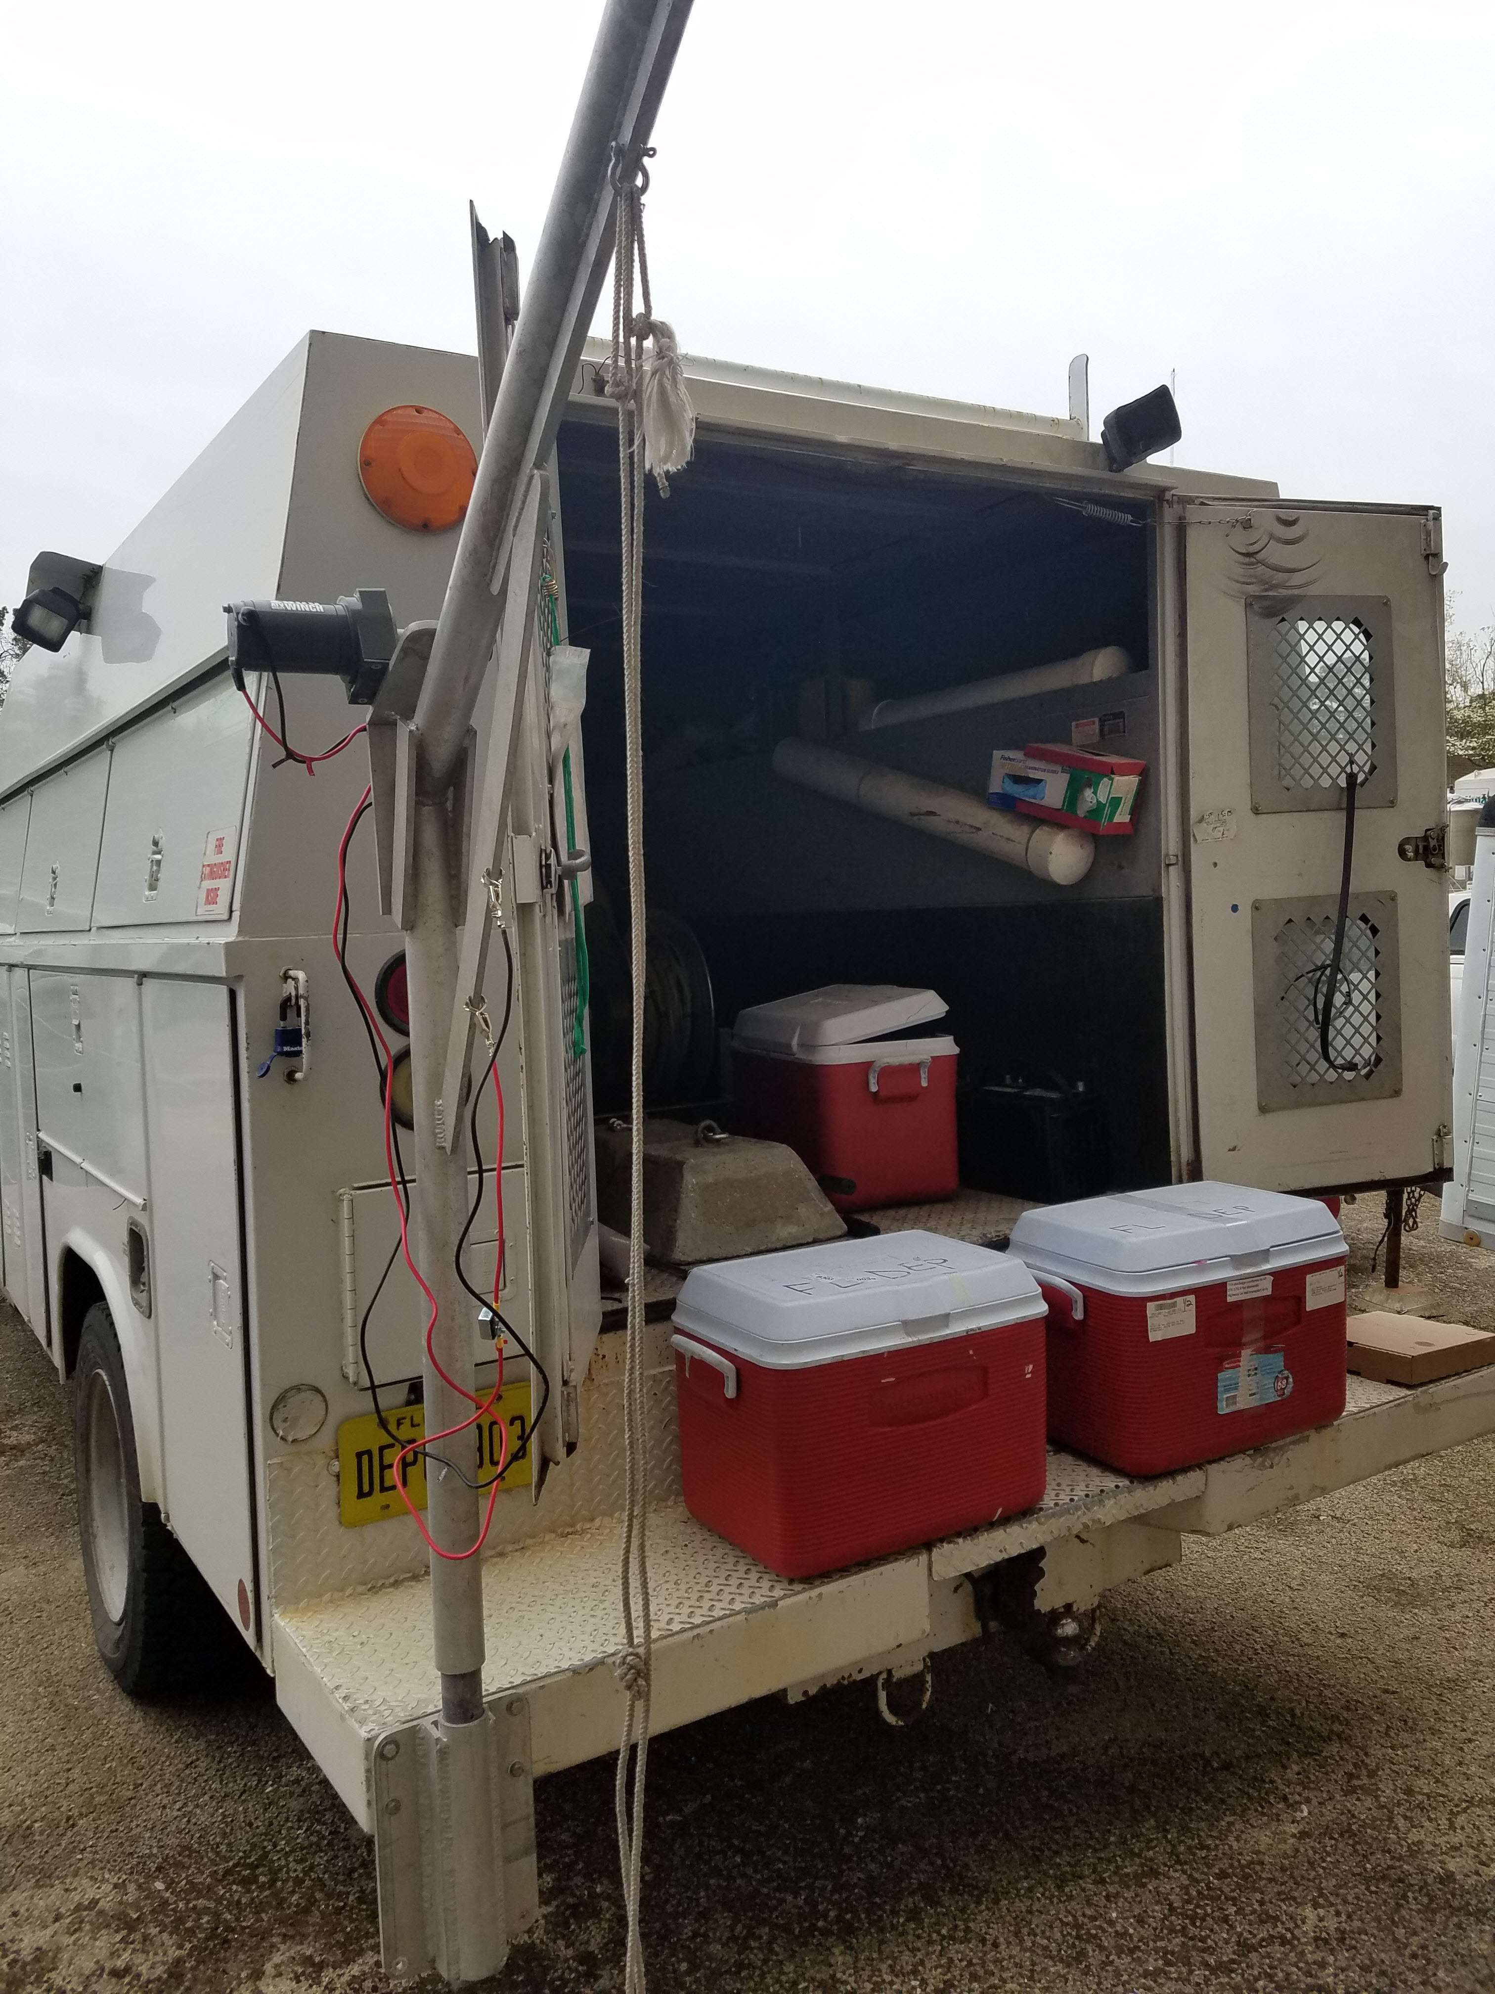

Hormones

Slide 24
Analyzed Pilot Study Samples for 17 Hormone Compounds
5 Hormone Compounds Detected
At one or more sites, in at least one matrix (POCIS or Grab)
Allyl Trenbolone
Androstenedione
Androsterone
Mestranol
Testosterone

Slide 25
Hormone Detections at Alafia River Analyzed by SGS Analytical
Hormones Detected by Sample Type (n=17)

Slide 26
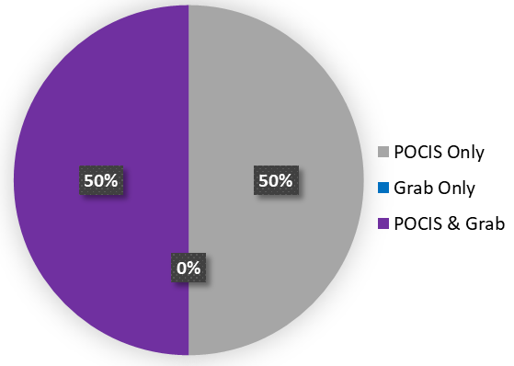
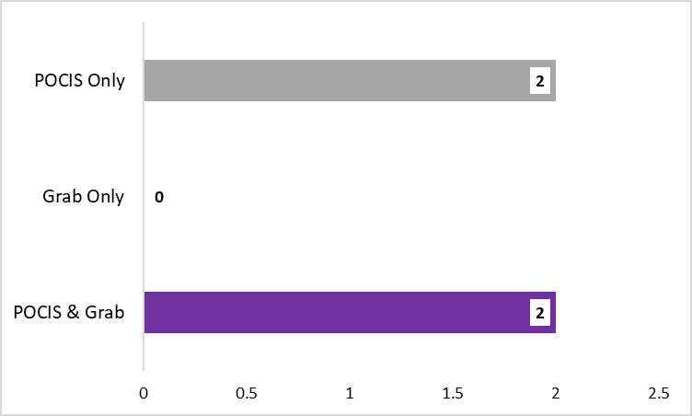
Hormone Detections at Ochlockonee River Analyzed by SGS Analytical
Hormones Detected by Sample Type
No. of Hormones Detected by Sample Type
Total No. Hormones = 17

Slide 27
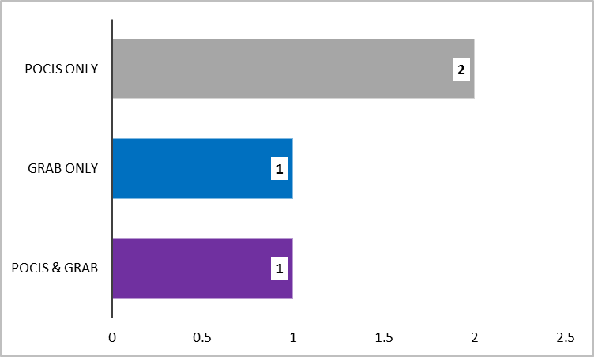
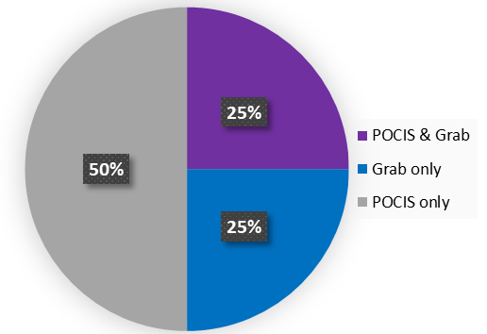
Hormone Detections at Withlacoochee River Analyzed by SGS Analytical
Hormones Detected by Sample Type
No. of Hormones Detected by Sample Type
Total No. Hormones = 17

Slide 28
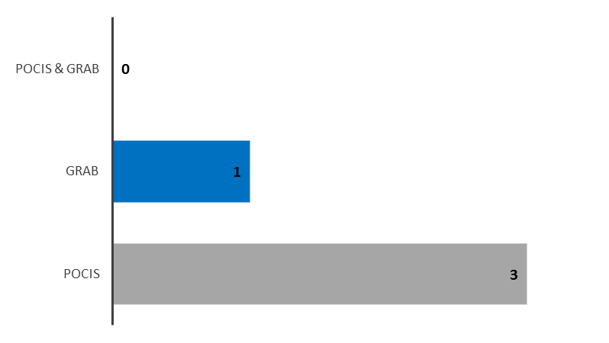
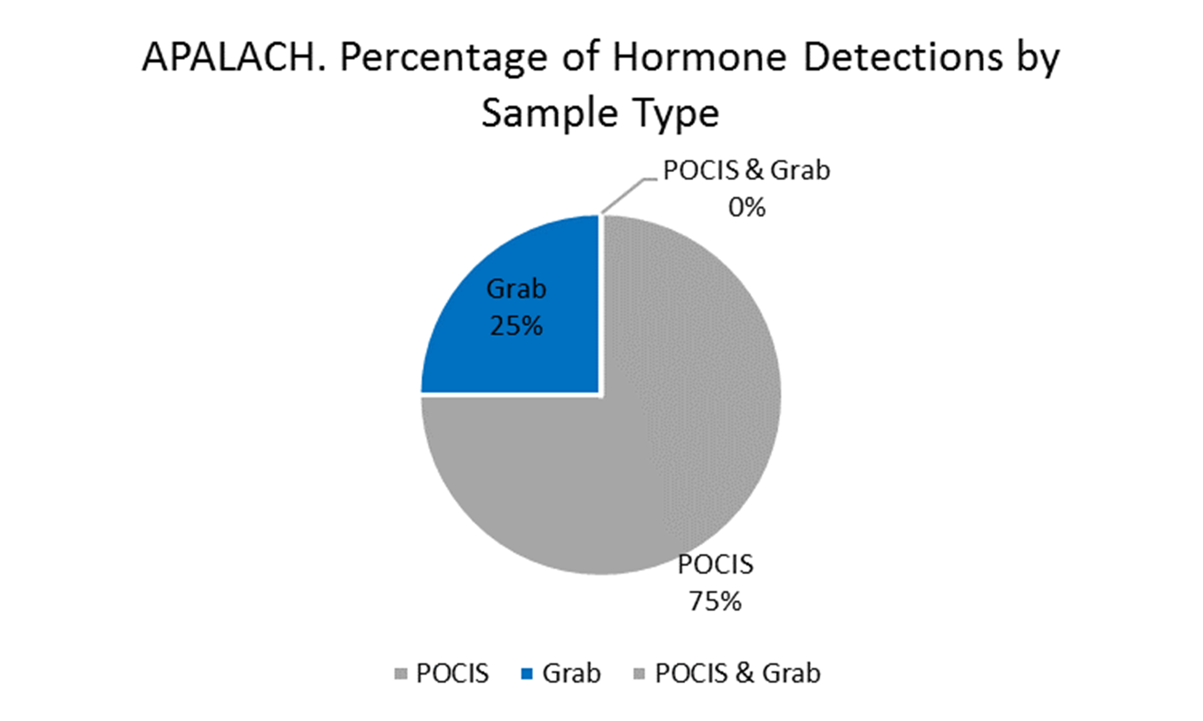
Hormone Detections at Apalachicola River Analyzed by SGS Analytical
Hormones Detected by Sample Type
No. of Hormones Detected by Sample Type

Slide 29
Hormones Detections at All Sites by Sample Type
Total No. Undetects, Detects, Not Quantifiable by Sample Type
Hormones Detected at All Sites by Sample Type
No. Hormones Detected by Sample Type

Slide 30
Quality Assurance Summary
2 of the 5 hormone compounds detected were also detected in lab blanks or field blanks at concentrations that required data from at least one site to be qualified.
All detections from grab samples were qualified due to blank detections.
No detections from POCIS samples were qualified due to blank detections.

Slide 31
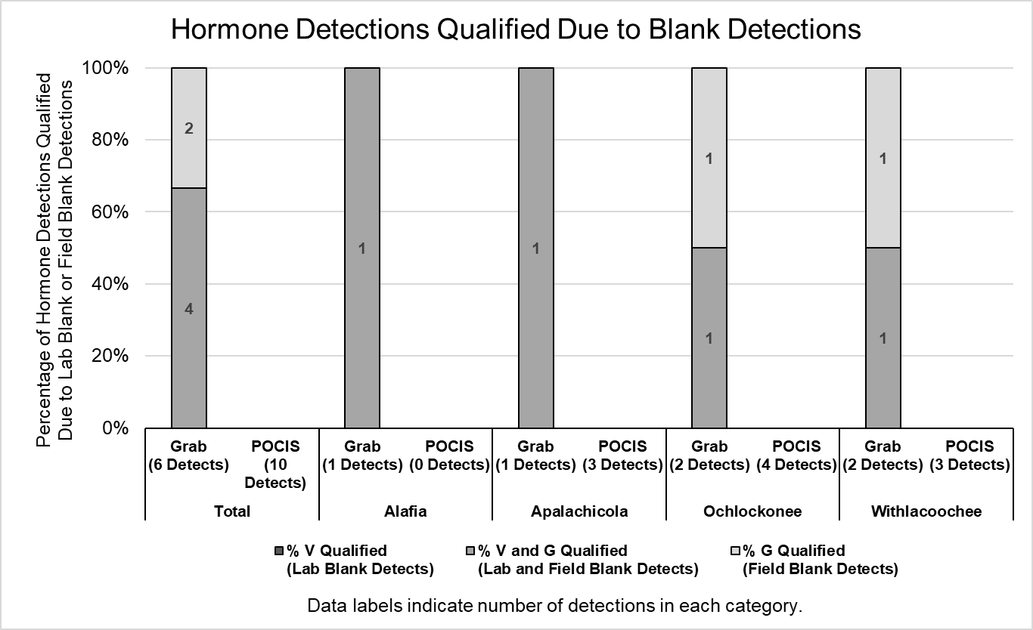

Slide 32
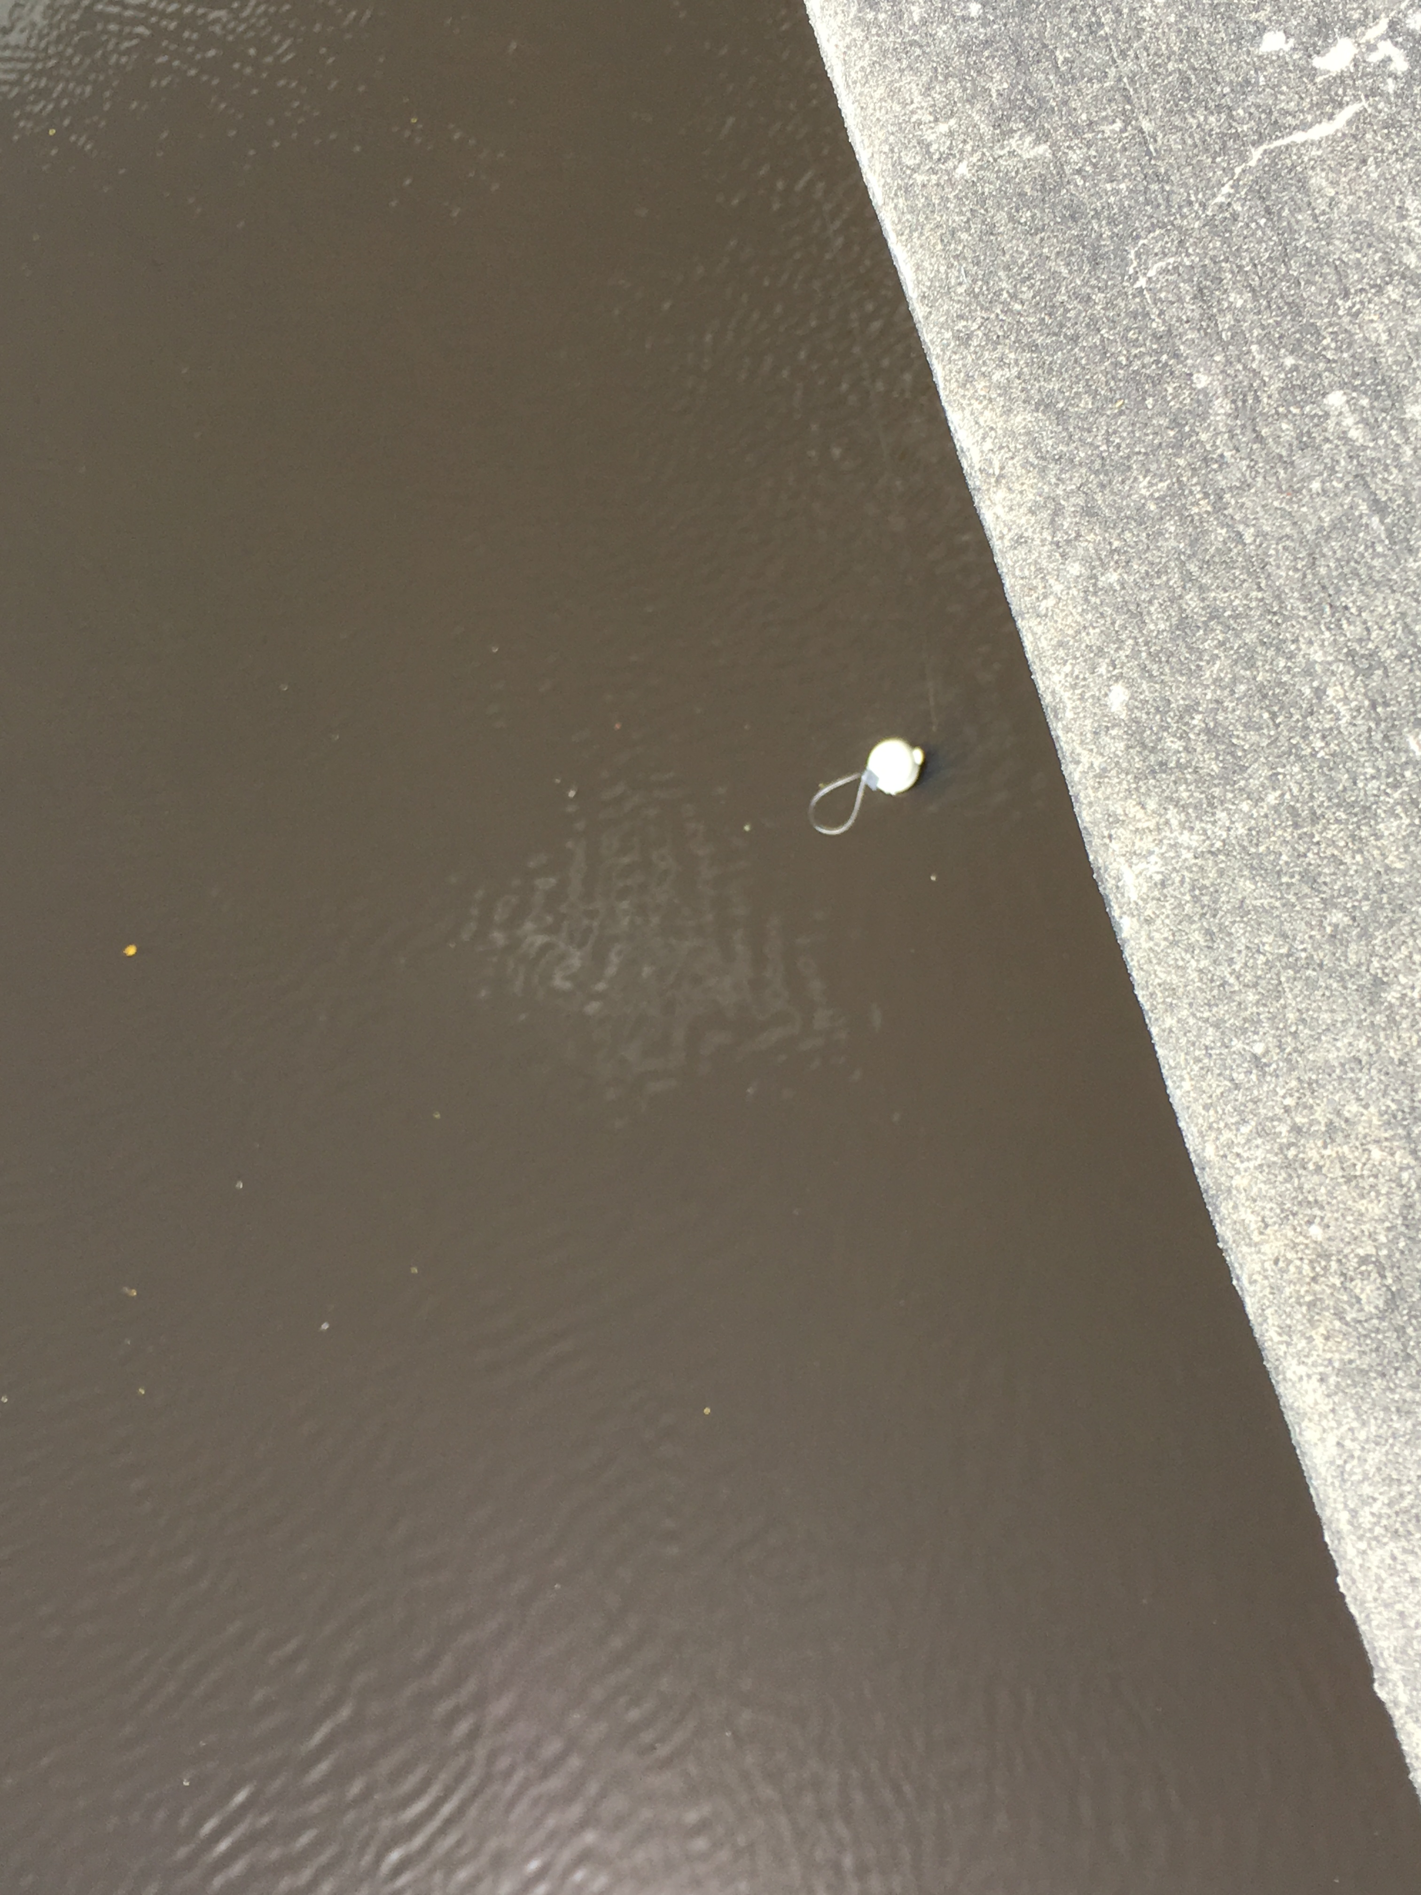
PFCs

Slide 33
Analyzed Pilot Study Samples for 13 PFC Compounds
10 PFC Compounds Detected
At one or more sites, in at least one matrix (POCIS or Grab)
PFBA
PFBS
PFDA
PFHpA
PFHxA
PFHxS
PFNA
PFOA
PFOS
PFPeA

Slide 34
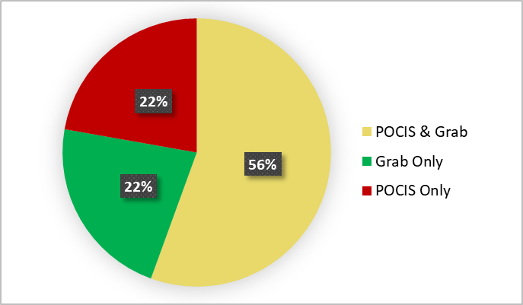
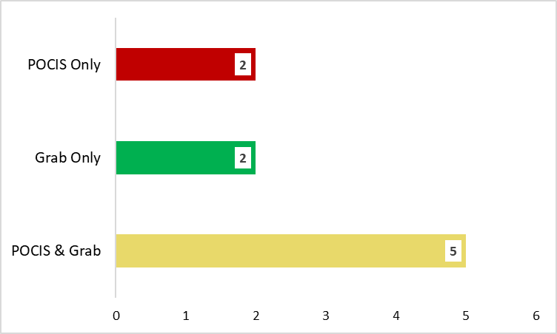
PFC Detections at Alafia River Analyzed by SGS Analytical
PFCs Detected by Sample Type
No. of PFCs Detected by Sample Type
Total No. PFCs = 13

Slide 35
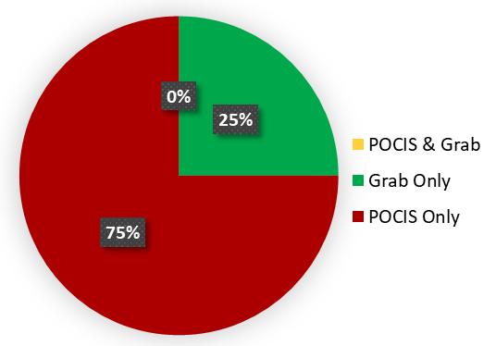
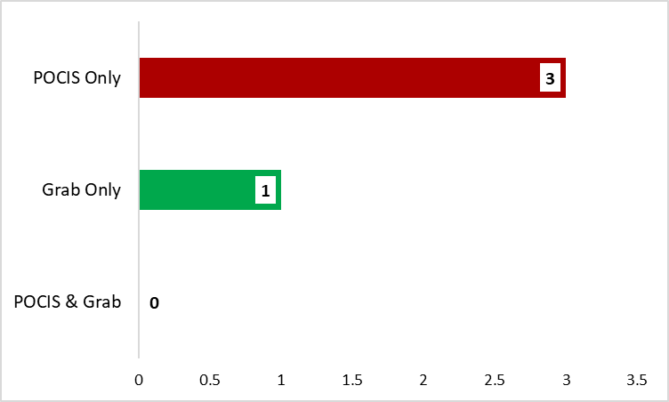
PFC Detections at Ochlockonee River Analyzed by SGS Analytical
PFCs Detected by Sample Type
No. of PFCs Detected by Sample Type
Total No. PFCs = 13

Slide 36
PFC Detections at Withlacoochee River Analyzed by SGS Analytical
PFCs Detected by Sample Type

Slide 37
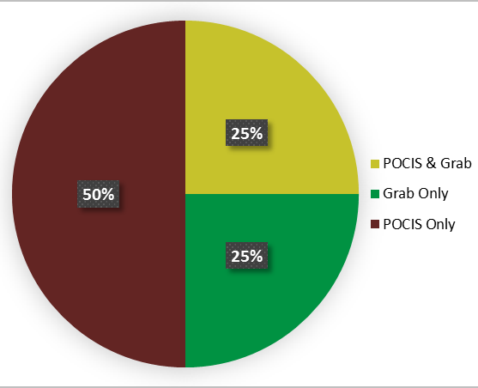
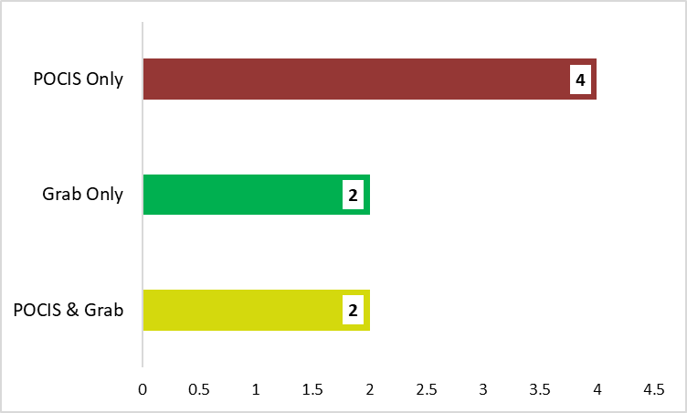
PFC Detections at Apalachicola River Analyzed by SGS Analytical
PFCs Detected by Sample Type
No. of PFCs Detected by Sample Type
Total No. PFCs = 13

Slide 38
PFC Detections at All Sites by Sample Type
Total No. Undetects, Detects, Not Quantifiable by Sample Type
PFCs Detected at Every Site (n = 4) by Matrix
No. PFCs Detected by Sample Type

Slide 39
Quality Assurance Summary
No PFC compounds were detected in lab blanks or field blanks at concentrations that required data from at least one site to be qualified.

Slide 40
PBDEs

Slide 41
Analyzed Pilot Study Samples for 8 PBDE Compounds
8 PBDE Compounds Detected
At one or more sites, in at least one matrix (SPMD or Grab)
2,2',3,3',4,4',5,5',6,6'-DeBDE
2,2',3,4,4',5',6-HpBDE
2,2',4,4',5,5'-HxBDE
2,2',4,4',5,6'-HxBDE
2,2',4,4',5-PeBDE
2,2',4,4',6-PeBDE
2,2',4,4'-TeBDE
2,4,4'-TriBDE

Slide 42
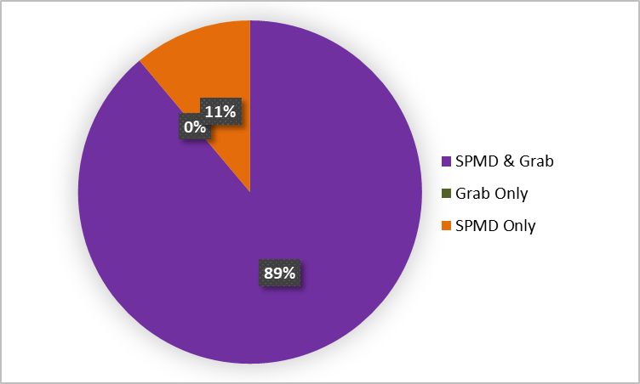
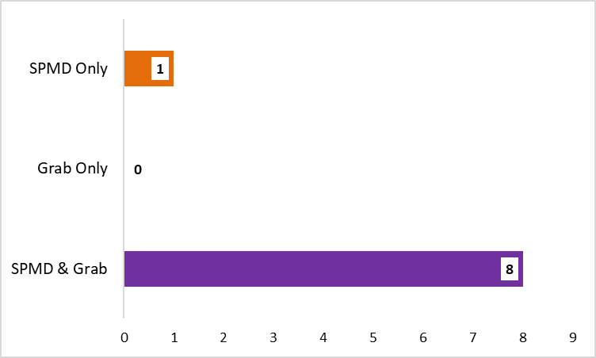
PBDE Detections at Alafia River Analyzed by SGS Analytical
Detected by Sample Type (n=9)
No. of PBDEs Detected by Sample Type

Slide 43
PBDE Detections at Ochlockonee River Analyzed by SGS Analytical
Detected by Sample Type (n=9)

Slide 44
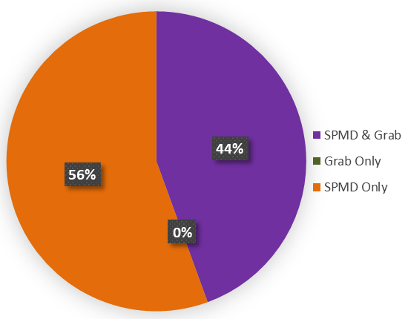
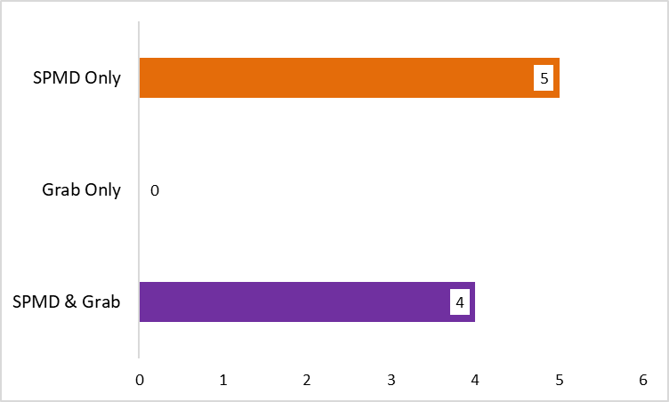
PBDE Detections at Apalachicola River Analyzed by SGS Analytical
Detected by Sample Type (n=9)
No. of PBDEs Detected by Sample Type

Slide 45
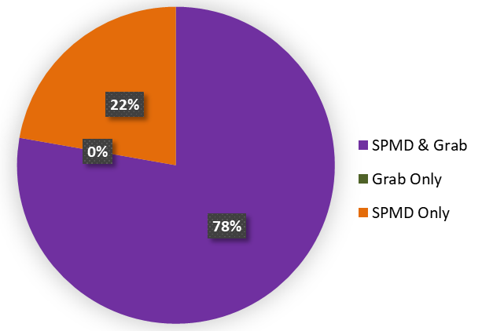
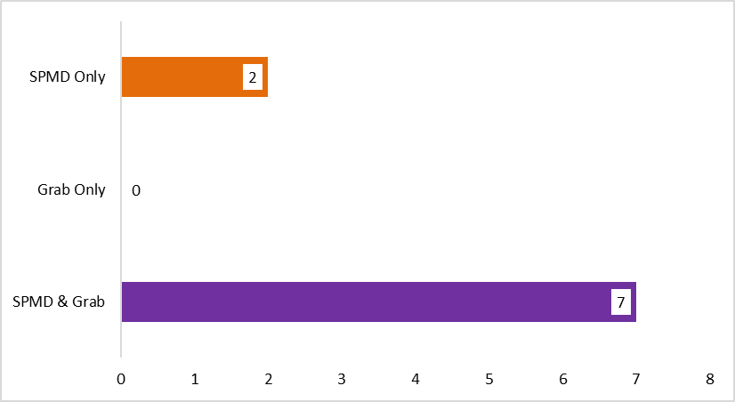
PBDE Detections at Withlacoochee River Analyzed by SGS Analytical
PBDEs Detected by Sample Type
No. of PBDEs Detected by Sample Type
Total No. PBDEs = 9

Slide 46
PBDE Detections at All Sites by Sample Type
Non-detects, Detects, Not Quantifiable by Sample Type
PBDEs Detected at Every Site (n = 4) by Matrix
No. PBDEs Detected by Sample Type

Slide 47
Quality Assurance Summary
All of the PBDE compounds detected, were also detected in lab blanks or field blanks at concentrations that required data from at least one site to be qualified.
All detections from SPMD samples were qualified due to blank detections.
>90% of detections from grab samples were qualified due to blank detections.

Slide 48
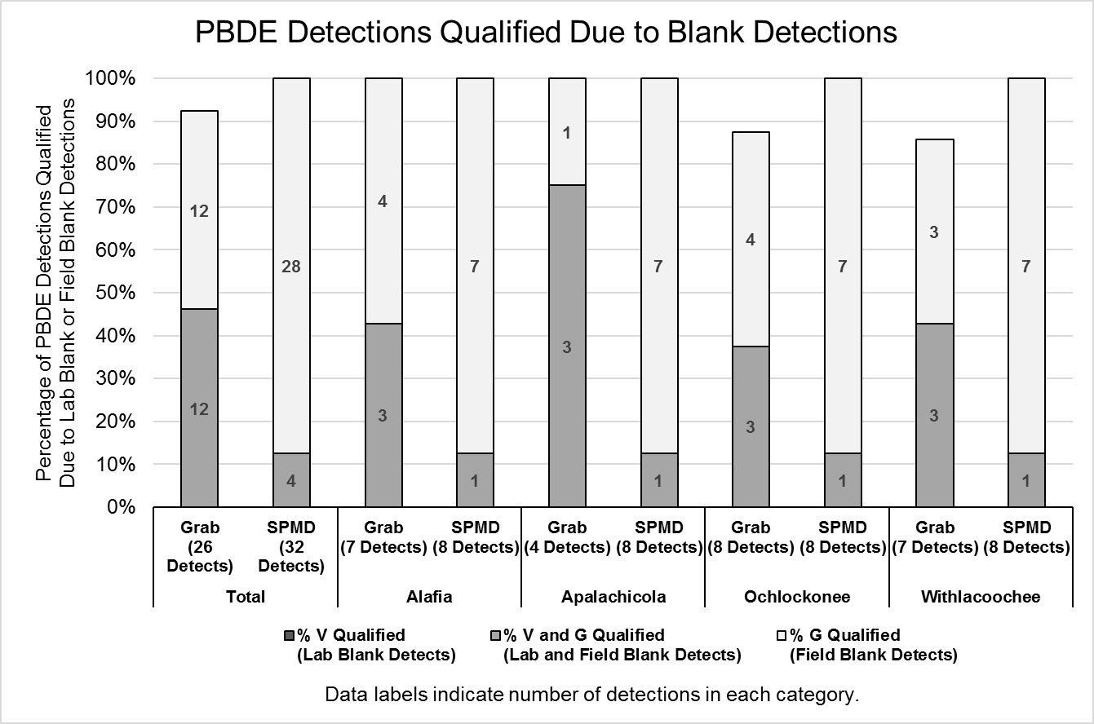

Slide 49
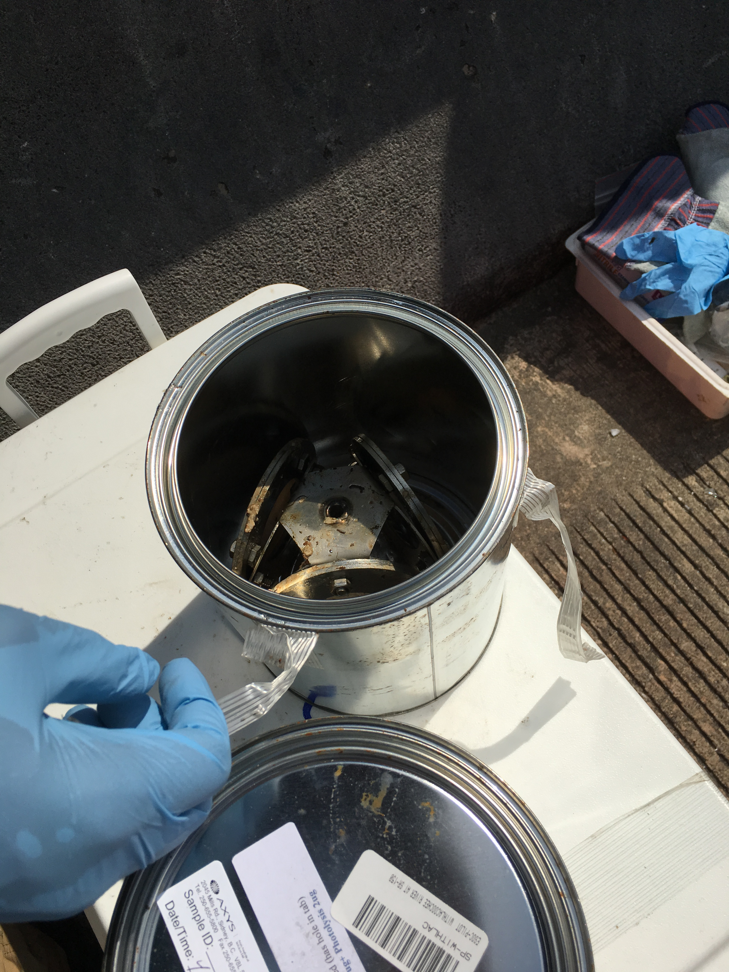
Alkylphenols

Slide 50
Analyzed Pilot Study Samples for 4 Alkylphenol Compounds
2 Alkylphenol Compounds Detected
At one or more sites, in at least one matrix (SPMD or Grab)
4-Nonylphenols
4-Nonylphenol diethoxylates

Slide 51
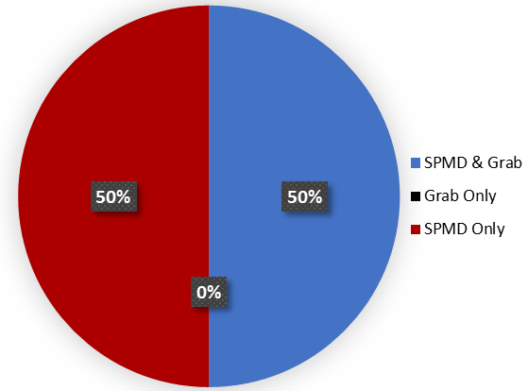
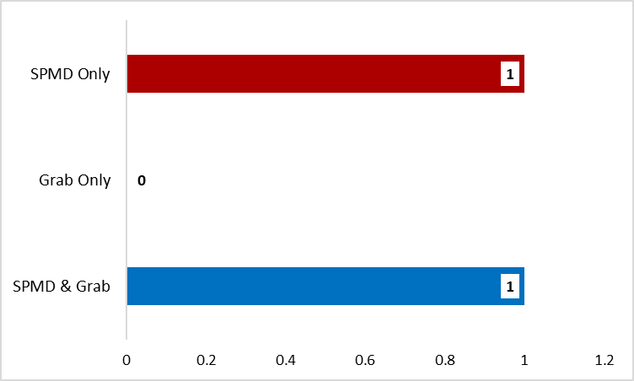
Alkylphenol Detections at Alafia River Analyzed by SGS Analytical
Alkylphenols Detected by Sample Type (n=4)

Slide 52
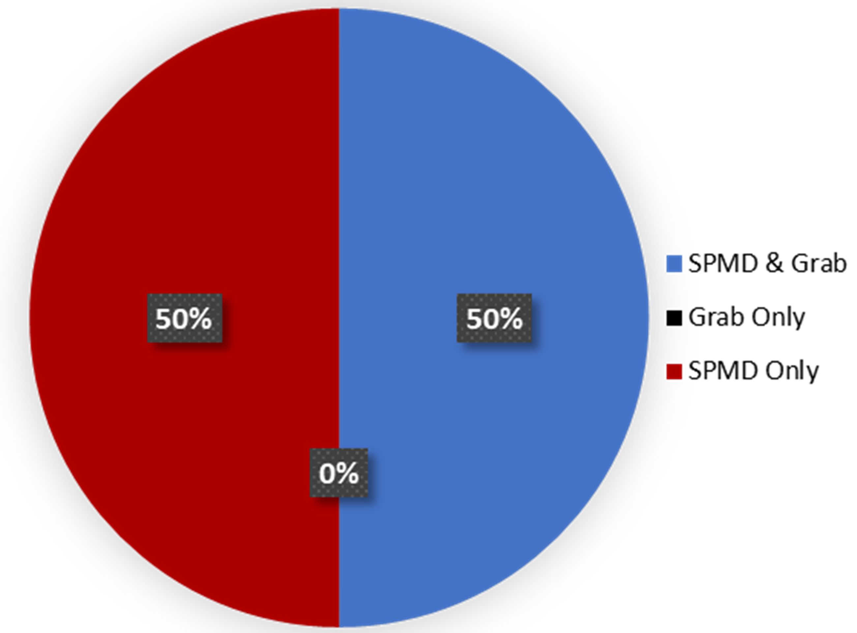
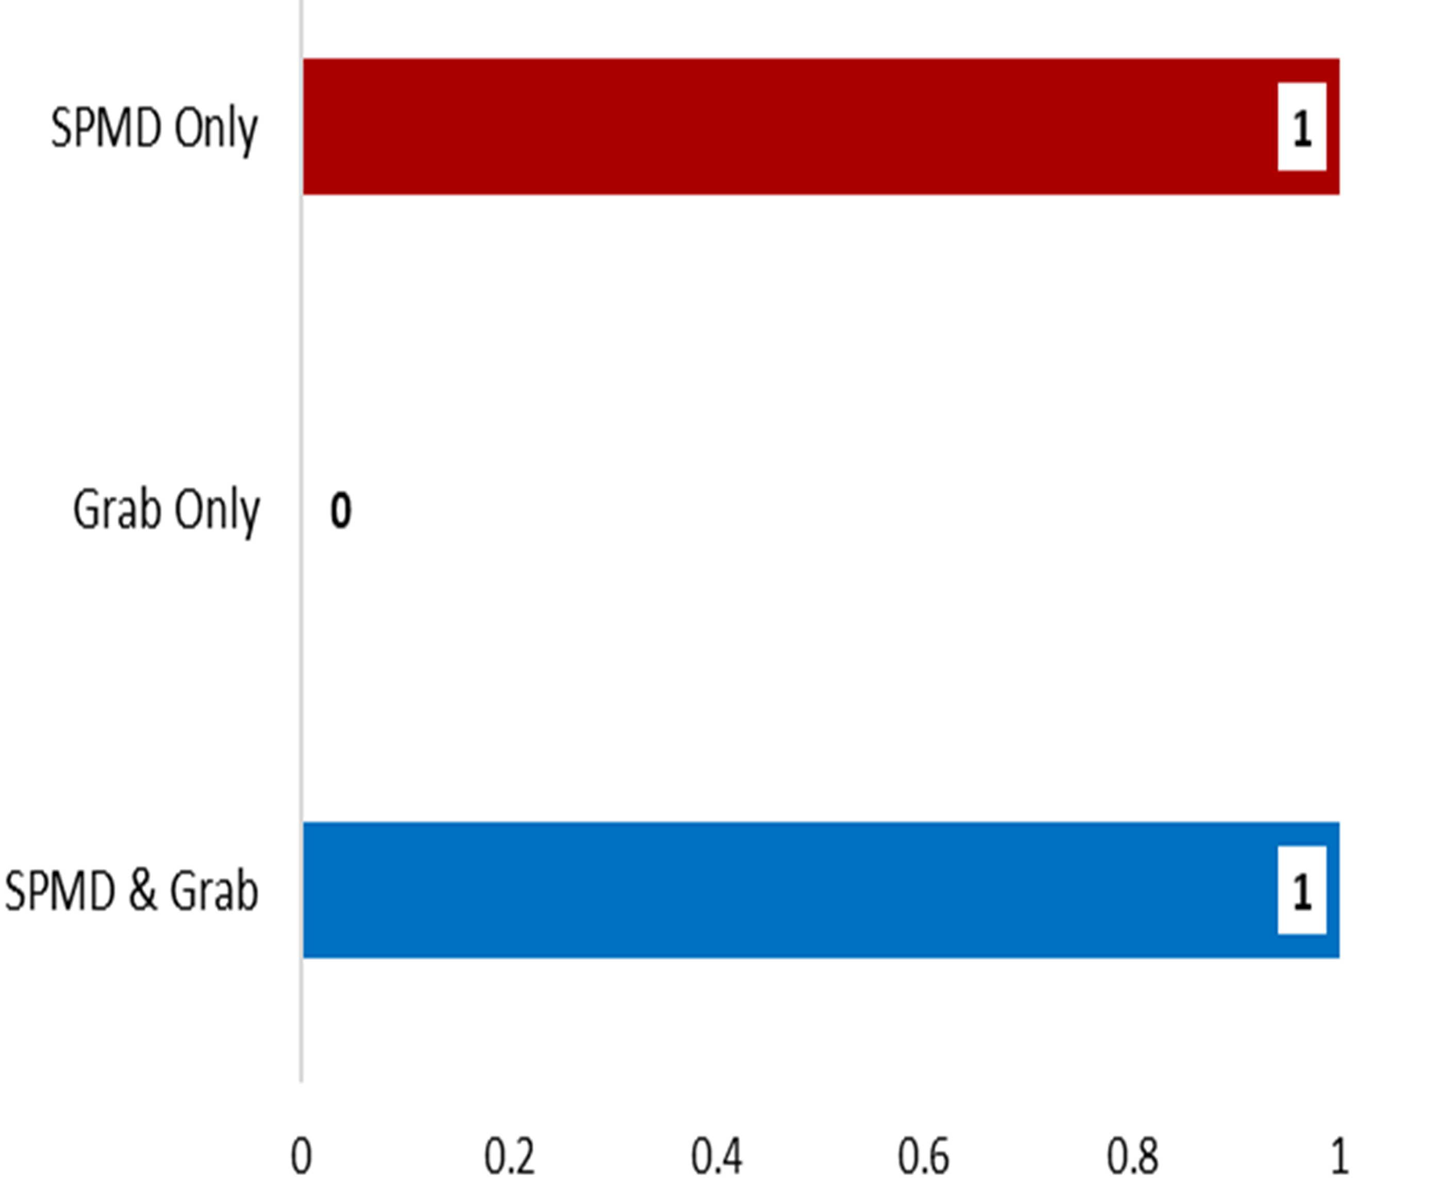
Alkylphenol Detections at Ochlockonee River Analyzed by SGS Analytical
Alkylphenols Detected by Sample Type (n=4)

Slide 53
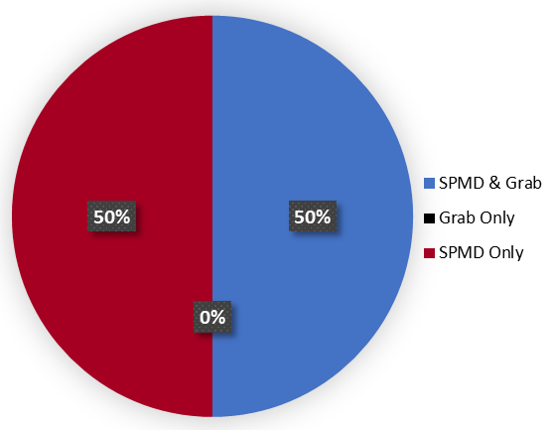
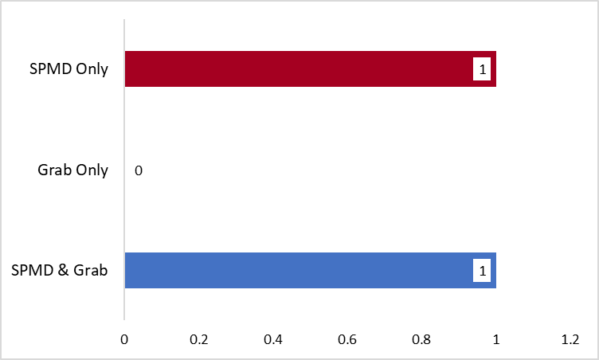
Alkylphenol Detections at Apalachicola River Analyzed by SGS Analytical
Alkylphenols Detected by Sample Type n=4)

Slide 54
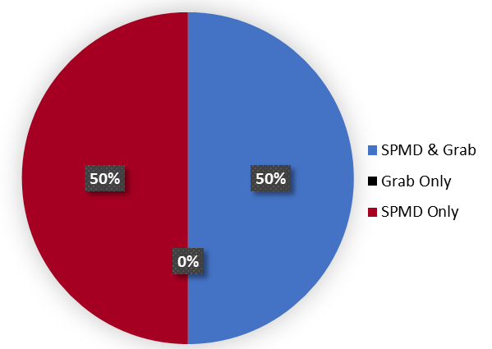

Alkylphenol Detections at Withlacoochee River Analyzed by SGS Analytical
Alkylphenols Detected by Sample Type
No. of Alkylphenols Detected by Sample Type
Total No. Alkylphenols = 4

Slide 55
Alkylphenol Detections at All Sites by Sample Type
Total No. Undetects, Detects, Not Quantifiable by Sample Type
Alkylphenols Detected at All Sites by Sample Type
No. Alkylphenols Detected by Sample Type

Slide 56
Quality Assurance Summary
All alkylphenol compounds detected, were also detected in lab blanks or field blanks at concentrations that required data from all sites to be qualified.
All detections from SPMD & grab samples were qualified due to blank detections.

Slide 57


Slide 58

PAHs

Slide 59
PAH Detections at Apalachicola River Analyzed by SGS Analytical
PAHs Detected by Sample Type

