Slide 1
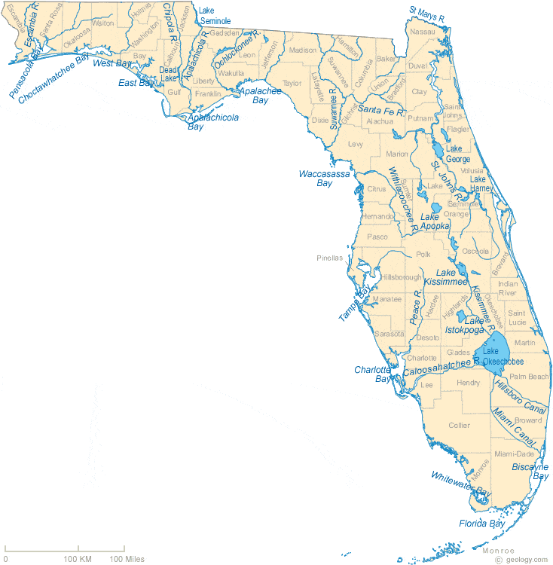
Evaluating ESOC in Florida Waterbodies
Presenter
Author(s)
Funding People/Grant Space

Slide 2
Overview
4 river sites sampled:
  Apalachicola, Ochlockonee, Withlacoochee, and Alafia
Categories of compounds:
  Pesticides, PPCPs, Hormones, PFCs, PBDEs, and Alkylphenols
The matrices (sample collection type) are split into groups.
  SPMD only
  SPMD, POCIS, Grab (Pesticides)
  SPMD & POCIS (Pesticides)
  Grab & SPMD
  Grab & POCIS
  Grab only
  POCIS only
QA is discussed at the end of each category.

Slide 3
Emerging Substances of Concern
(ESOC)
This study separated analytes into 6 main categories:

Slide 4
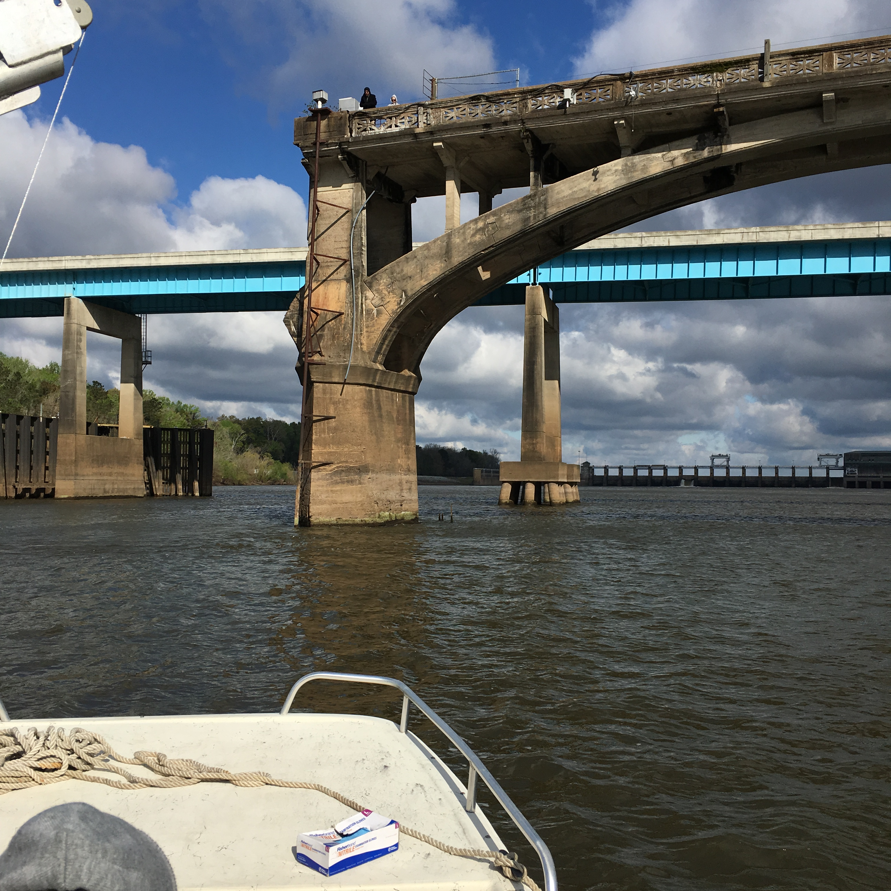
Pesticides

Slide 5
Analyzed Pilot Study Samples for 76 Pesticide Compounds
42 Pesticide Compounds Detected
At one or more sites, in at least one matrix (POCIS, SPMD, or Grab)
2,4'-DDD
4,4'-DDD
2,4'-DDE
4,4'-DDE
4,4'-DDT
Alachlor
Aldrin
alpha-Endosulphan
beta-Endosulphan
Endosulphan Sulphate
Ametryn
Atrazine
Desethylatrazine
Chlordane, alpha (cis)
Chlordane, gamma (trans)
Chlordane, oxy-
Chlorpyriphos
Diazinon
Dieldrin
Dimethenamid
Endrin
Endrin Ketone
Ethalfluralin
Flufenacet
Flutriafol
HCH, alpha
HCH, beta
HCH, delta
HCH, gamma
Heptachlor
Heptachlor Epoxide
Hexachlorobenzene
Hexazinone
Metolachlor
Mirex
Nonachlor, cis-
Nonachlor, trans-
Pendimethalin
Quintozene
Simazine
Tebuconazol
Trifluralin

Slide 6
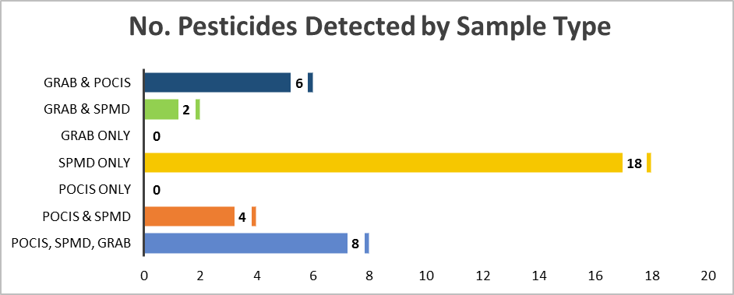
Pesticide Detections at Alafia River Analyzed by SGS Analytical
Pesticides Detected by Sample Type
No. of Pesticides Detected by Sample Type
Total No. Pesticides Analyzed = 76

Slide 7
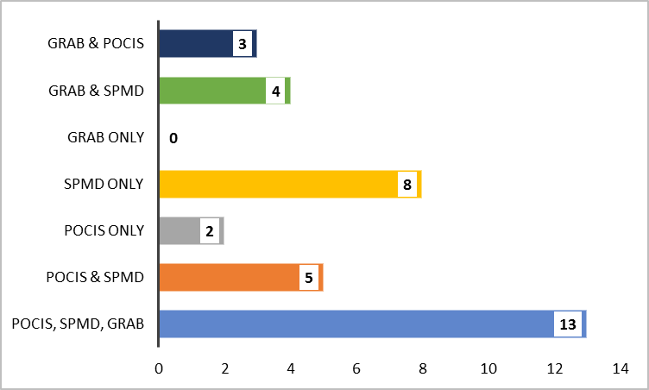
Pesticide Detections at Ochlockonee River Analyzed by SGS Analytical
Pesticides Detected by Sample Type
No. of Pesticides Detected by Sample Type
Total No. Pesticides Analyzed = 76

Slide 8
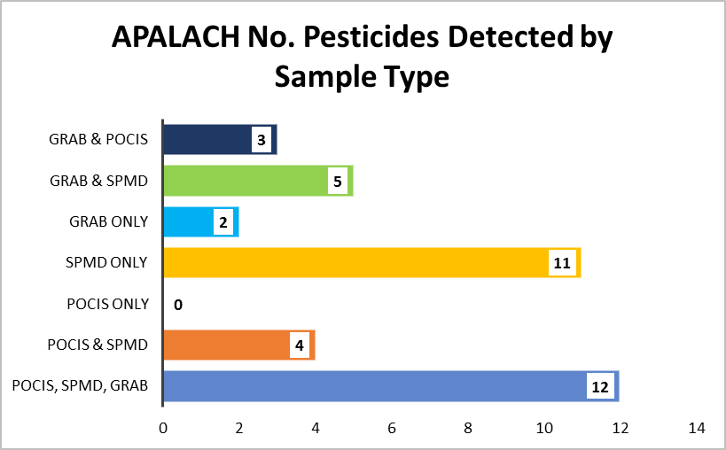
Pesticide Detections at Apalachicola River Analyzed by SGS Analytical
Pesticides Detected by Sample Type
No. of Pesticides Detected by Sample Type

Slide 9
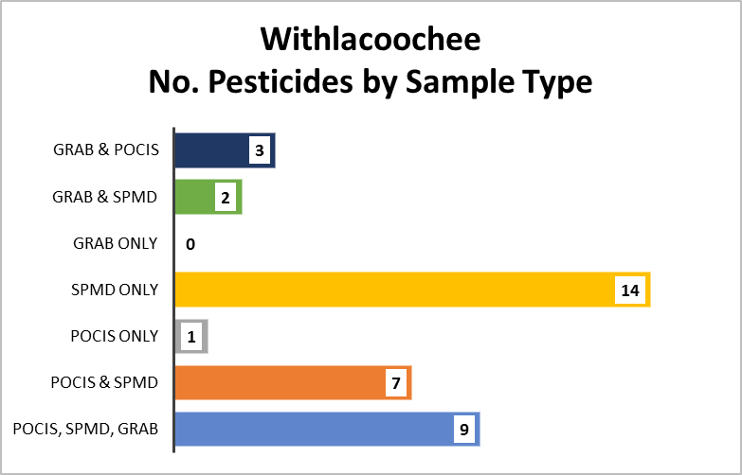
Pesticide Detections at Withlacoochee River Analyzed by SGS Analytical
Pesticides Detected by Sample Type
No. of Pesticides Detected by Sample Type
Total No. Pesticides Analyzed = 76

Slide 10
Pesticides Detections at All Sites by Sample Type
Total No. Undetects, Detects, Not Quantifiable by Sample Type
Pesticides Detected at Every Site (n = 4)
by Matrix
No. Pesticides Detected by Sample Type

Slide 11
Quality Assurance Summary
18 of the 42 pesticide compounds detected were also detected in lab blanks or field blanks at concentrations that required data from at least one site to be qualified.
40% of detections from SPMD samples were qualified due to blank detections.
38% detections from grab samples were qualified due to blank detections.
33% of detections from POCIS samples were qualified due to blank detections.
Notes:
Need to find stephs legend to color code

Slide 12
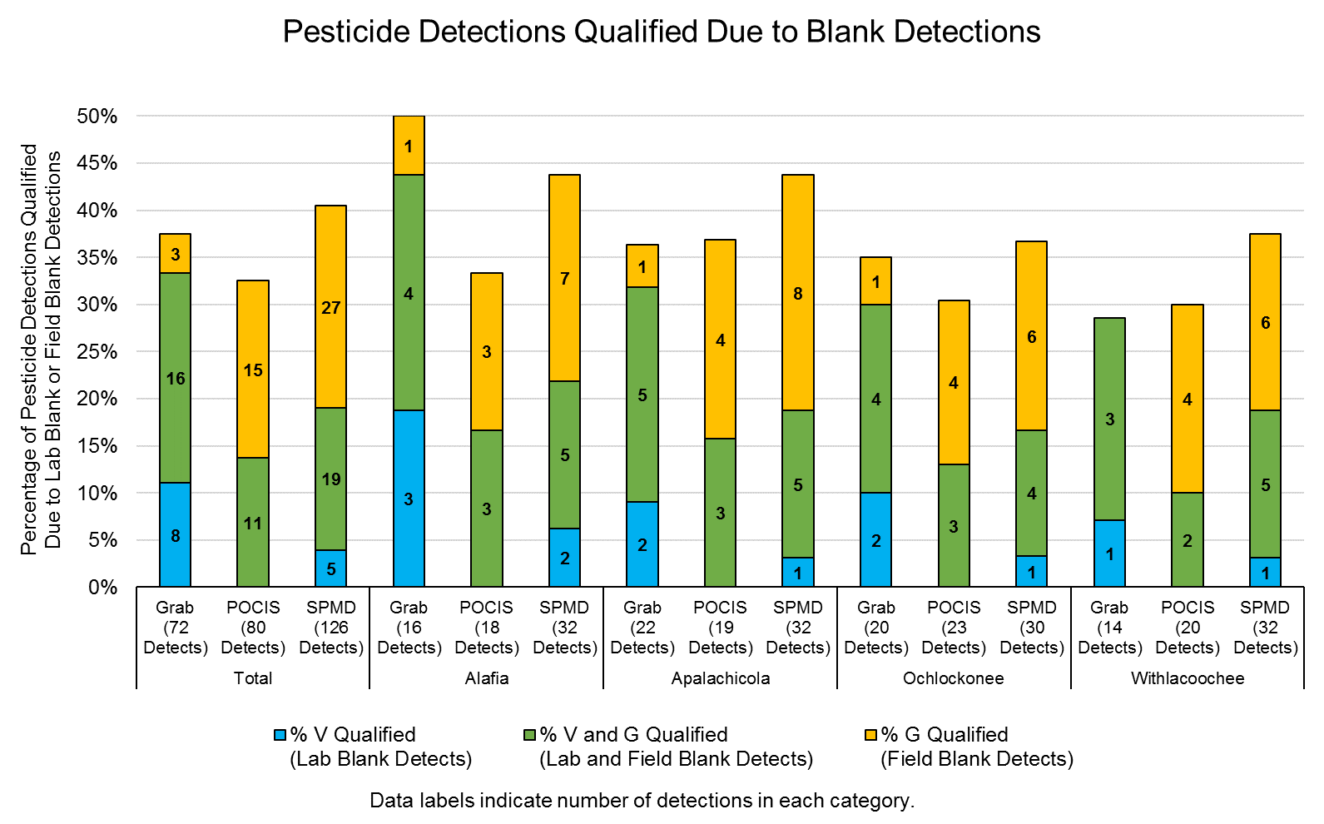

Slide 13
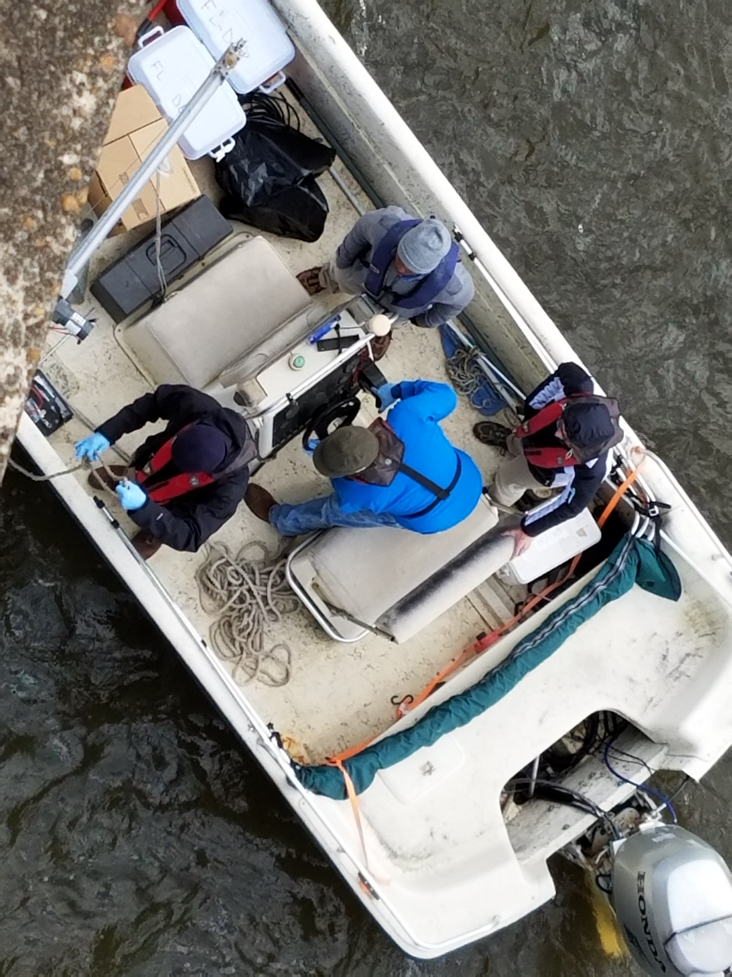
PPCPs

Slide 14
Analyzed Pilot Study Samples for 127 PPCP Compounds
39 PPCP Compounds Detected
At one or more sites, in at least one matrix (POCIS or Grab)
Alprazolam
Amitriptyline
Amphetamine
Atenolol
Azithromycin
Caffeine
Carbamazepine
Clarithromycin
Cocaine
Colchicine
Cotinine
DEET
Dehydronifedipine
Desmethyldiltiazem
Diatrizoic acid
Diazepam
Diltiazem
Diphenhydramine
Erythromycin-H2O
Furosemide
Gemfibrozil
Hydrochlorothiazide
Hydrocodone
Iopamidol
Meprobamate
Metformin
Metoprolol
Naproxen
Oxolinic Acid
Oxycodone
Propoxyphene
Sertraline
Sulfadimethoxine
Sulfamethazine
Sulfamethoxazole
Triamterene
Trimethoprim
Valsartan
Venlafaxine

Slide 15
PPCPs Detections at Alafia River Analyzed by SGS Analytical
Detected by Sample Type
127 Compounds Analyzed
POCIS Only
Grab Only
Grab & POCIS
Alprazolam
Diatrizoic acid
Amitriptyline
Erythromycin-H2O
Iopamidol
Amphetamine
Hydrocodone
Colchicine
Carbamazepine
Cocaine
DEET
Oxolinic Acid
Sulfamethoxazole
Undetects, Detects, Not Quantifiable by Sample Type
Notes:
Collection methods – Both Grab and POCIS are appropriate for the collection methods of PPCPs.

Slide 16
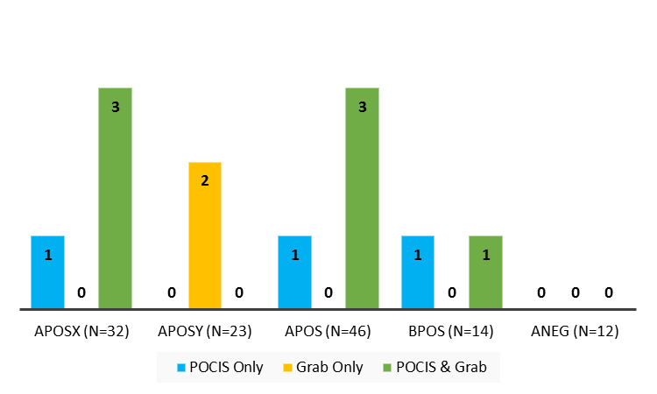
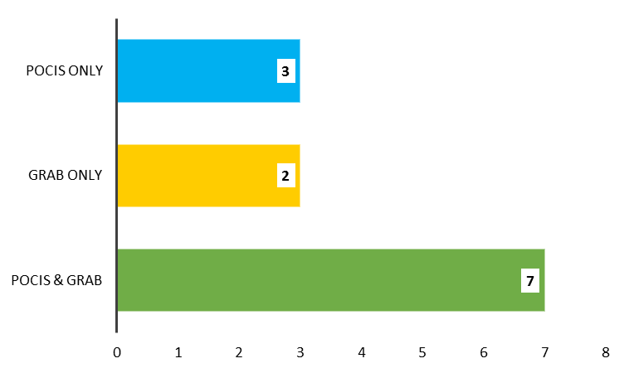
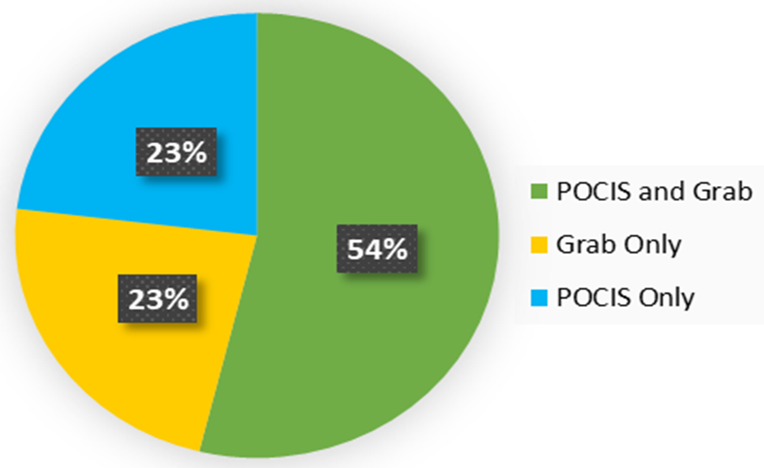
PPCPs Detections at Alafia River Analyzed by SGS Analytical
Detects per Analyte List by Sample Type
Detected by Sample Type
Total No. PPCPs analyzed = 127

Slide 17
PPCPs Detections at Ochlockonee River Analyzed by SGS Analytical
Detected by Sample Type
127 Compounds Analyzed
Undetects, Detects, Not Quantifiable by Sample Type
Notes:
Collection methods – Both Grab and POCIS are appropriate for the collection methods of PPCPs.

Slide 18
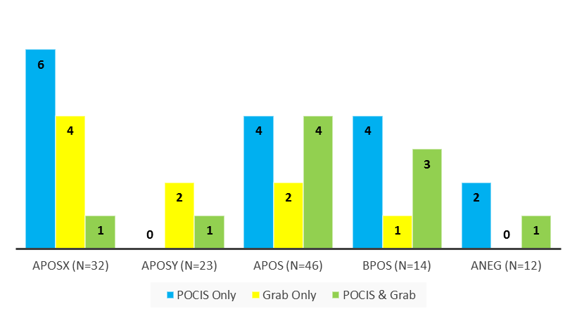
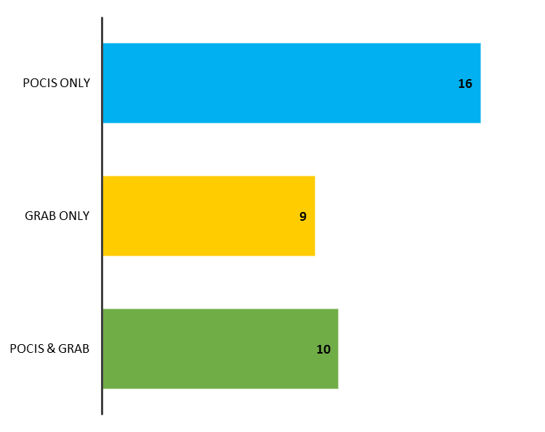
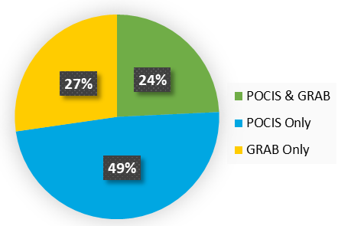
PPCPs Detections at Ochlockonee River Analyzed by SGS Analytical
Detects per Analyte List by Sample Type
Detected by Sample Type
Total No. PPCPs analyzed = 127

Slide 19
PPCPs Detections at Apalachicola River Analyzed by SGS Analytical
Detected by Sample Type
POCIS Only
Grab Only
POCIS & Grab
Alprazolam
Amitriptyline
DEET
Metoprolol
Iopamidol
Sulfamethoxazole
Venlafaxine
Caffeine
Amphetamine
Carbamazepine
Atenolol
Naproxen
Erythromycin-H2O
Cotinine
Trimethoprim
Metformin
Oxycodone
Triamterene
Gemfibrozil
Undetects, Detects, Not Quantifiable by Sample Type
Notes:
Collection methods – Both Grab and POCIS are appropriate for the collection methods of PPCPs.

Slide 20
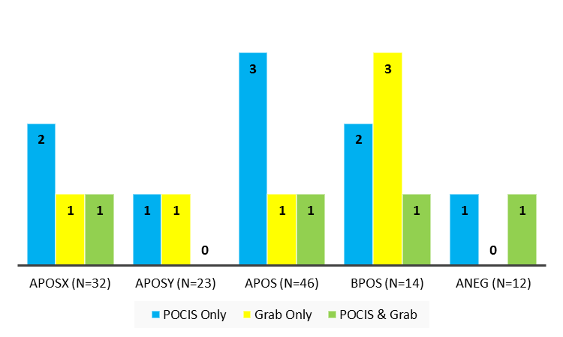
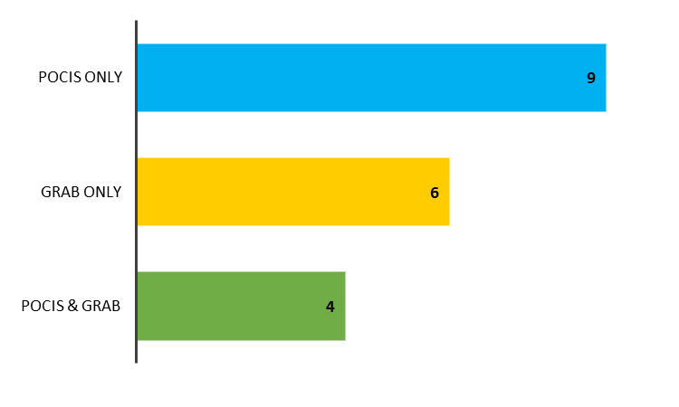
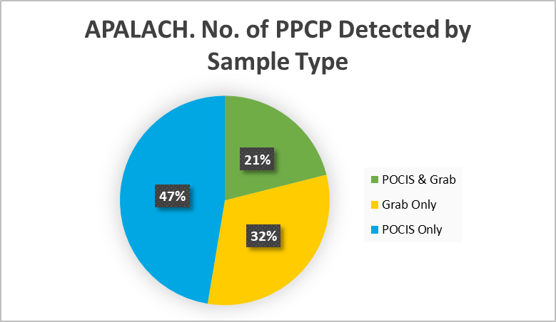
PPCPs Detections at Apalachicola River Analyzed by SGS Analytical
Detects per Analyte List by Sample Type
Detected by Sample Type
Percentage of Detections by Sample Type
127 Compounds nalyzed

Slide 21
PPCPs Detections at Withlacoochee River Analyzed by SGS Analytical
PPCPs Detected by Sample Type
Total No. Analyzed = 127
Undetects, Detects, Not Quantifiable by Sample Type
Notes:
Method – LC-MS/MS
Collection methods – Both Grab and POCIS are appropriate for the collection methods of PPCPs.

Slide 22
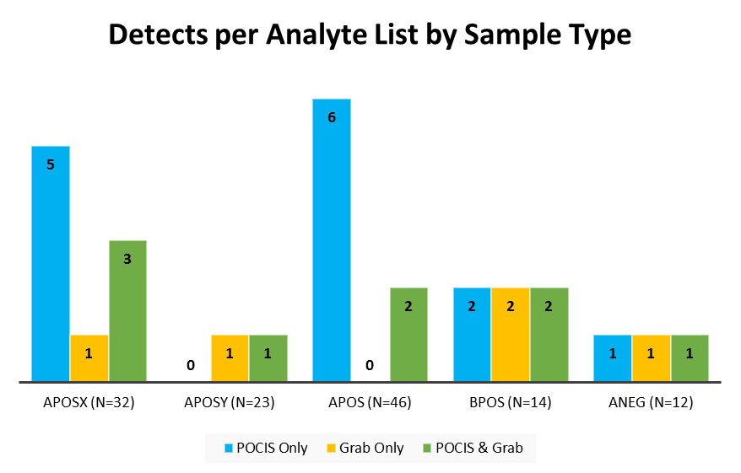
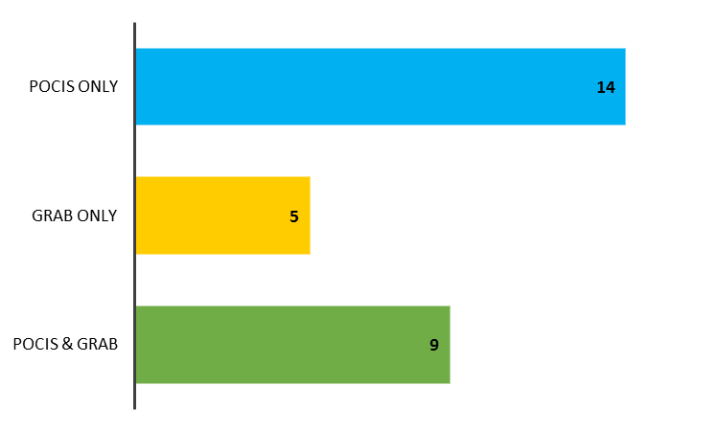
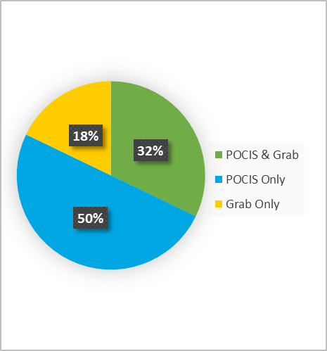
PPCPs Detections at Withlacoochee River Analyzed by SGS Analytical
PPCPs Detected by Sample Type
Detected by Sample Type
Percentage of Detections by Sample Type
Total No. PPCPs analyzed = 127
Notes:
Method – LC-MS/MS
Collection methods – Both Grab and POCIS are appropriate for the collection methods of PPCPs.

Slide 23
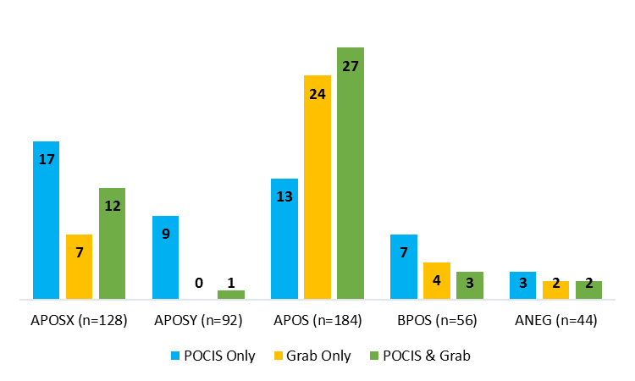
PPCPs Detections at All Sites by Sample Type
Detects per List at All Sites by Sample Type
Notes:
Collection methods – Both Grab and POCIS are appropriate for the collection methods of PPCPs.

Slide 24
Quality Assurance Summary
3 of the 39 PPCP compounds detected were also detected in lab blanks or field blanks at concentrations that required data from at least one site to be qualified.
17% detections from grab samples were qualified due to blank detections.
6% of detections from POCIS samples were qualified due to blank detections.

Slide 25
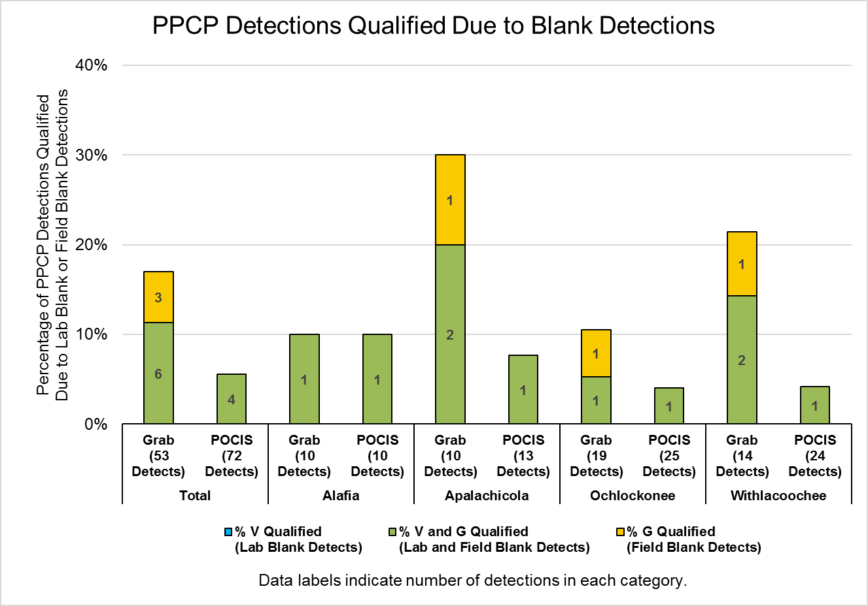

Slide 26
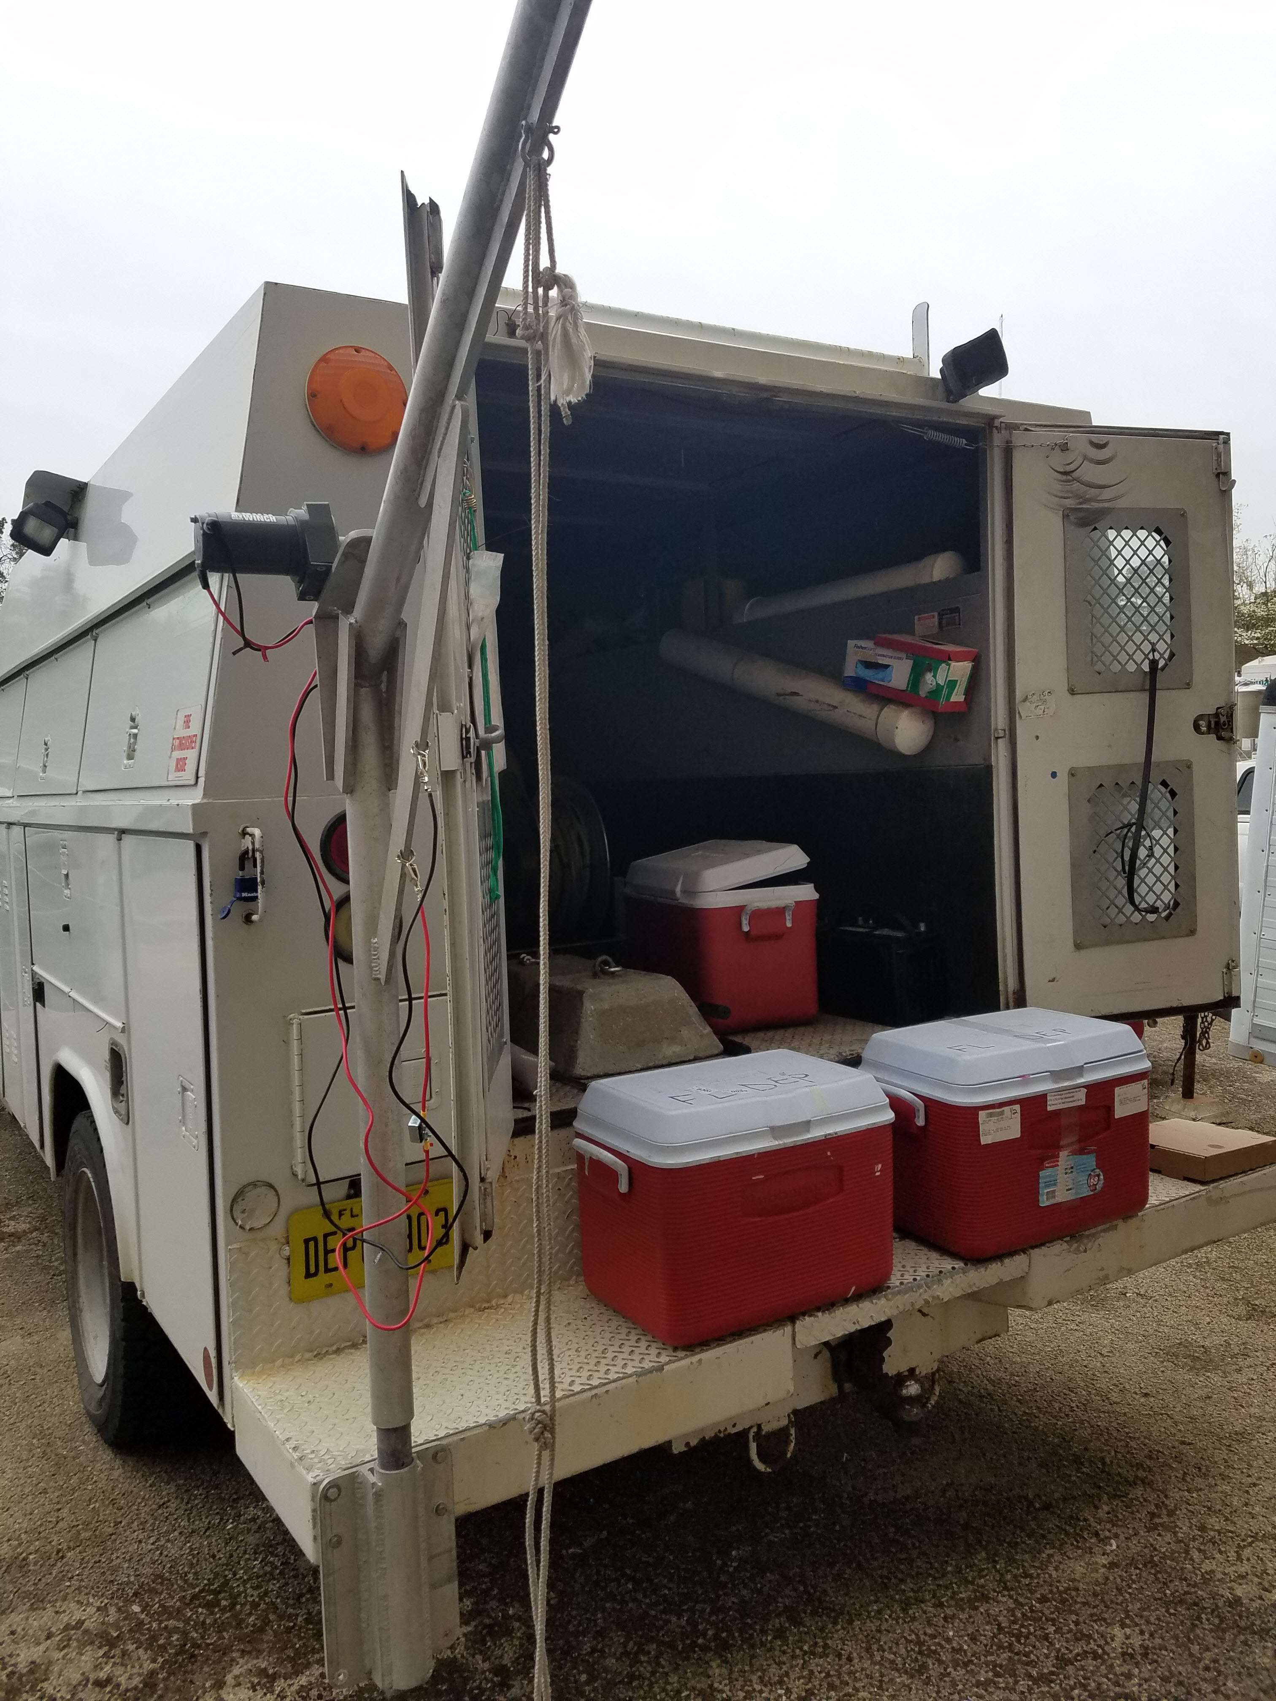

Hormones

Slide 27
Analyzed Pilot Study Samples for 17 Hormone Compounds
5 Hormone Compounds Detected
At one or more sites, in at least one matrix (POCIS or Grab)
Allyl Trenbolone
Androstenedione
Androsterone
Mestranol
Testosterone

Slide 28
Hormone Detections at Alafia River Analyzed by SGS Analytical
Hormones Detected by Sample Type
No. of Hormones Detected by Sample Type
No. of Hormones Analyzed = 17

Slide 29
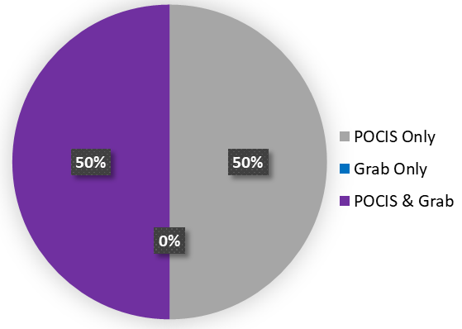
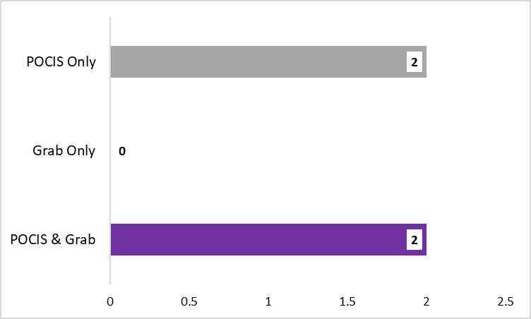
Hormone Detections at Ochlockonee River Analyzed by SGS Analytical
Hormones Detected by Sample Type
No. of Hormones Detected by Sample Type
No. of Hormones Analyzed = 17
Percentage of Hormone Detections by Sample Type

Slide 30
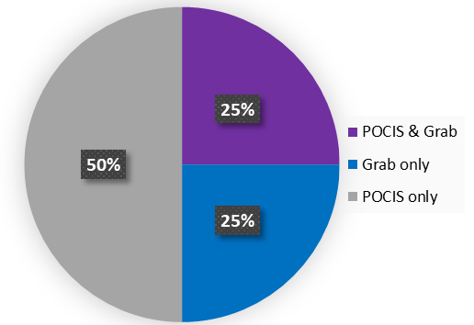
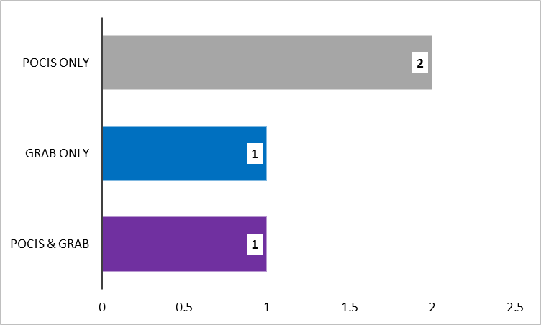
Hormone Detections at Withlacoochee River Analyzed by SGS Analytical
Hormones Detected by Sample Type
No. of Hormones Detected by Sample Type
No. of Hormones Analyzed = 17
Percentage of Hormone Detections by Sample Type

Slide 31
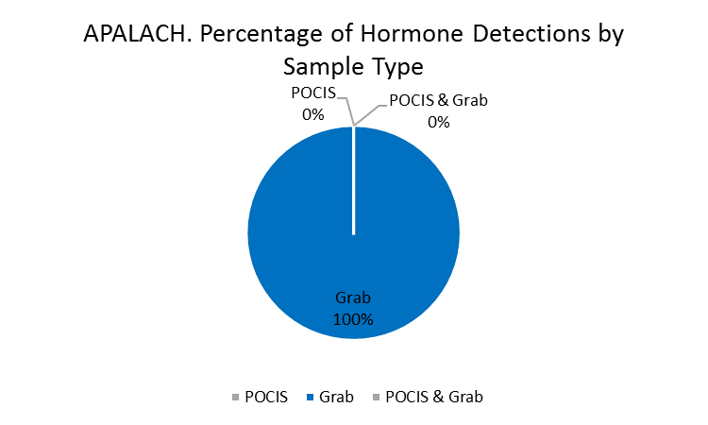
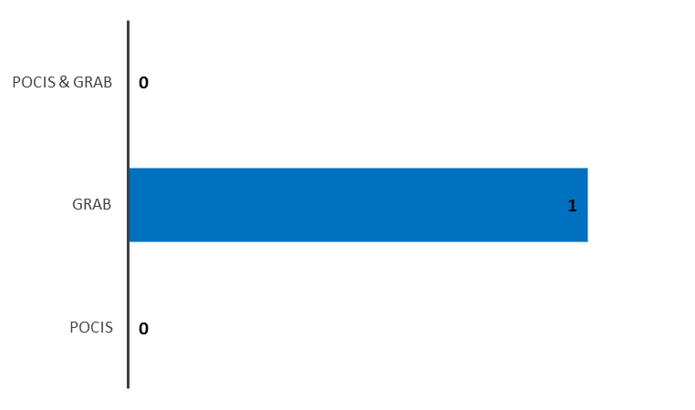
Hormone Detections at Apalachicola River Analyzed by SGS Analytical
Hormones Detected by Sample Type
No. of Hormones Detected by Sample Type
No. of Hormones Analyzed = 17

Slide 32
Hormones Detections at All Sites by Sample Type
Total No. Undetects, Detects, Not Quantifiable by Sample Type
Hormones Detected at All Sites by Sample Type
Detections by Sample Type

Slide 33
Quality Assurance Summary
2 of the 5 hormone compounds detected were also detected in lab blanks or field blanks at concentrations that required data from at least one site to be qualified.
All detections from grab samples were qualified due to blank detections.
No detections from POCIS samples were qualified due to blank detections.

Slide 34
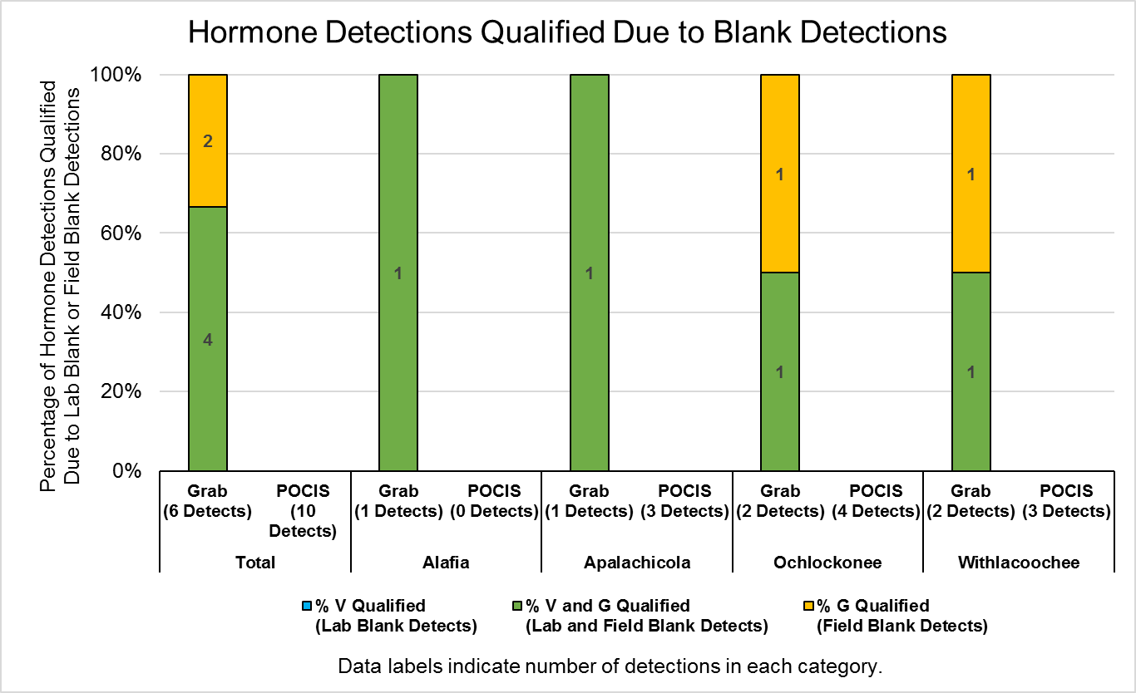

Slide 35
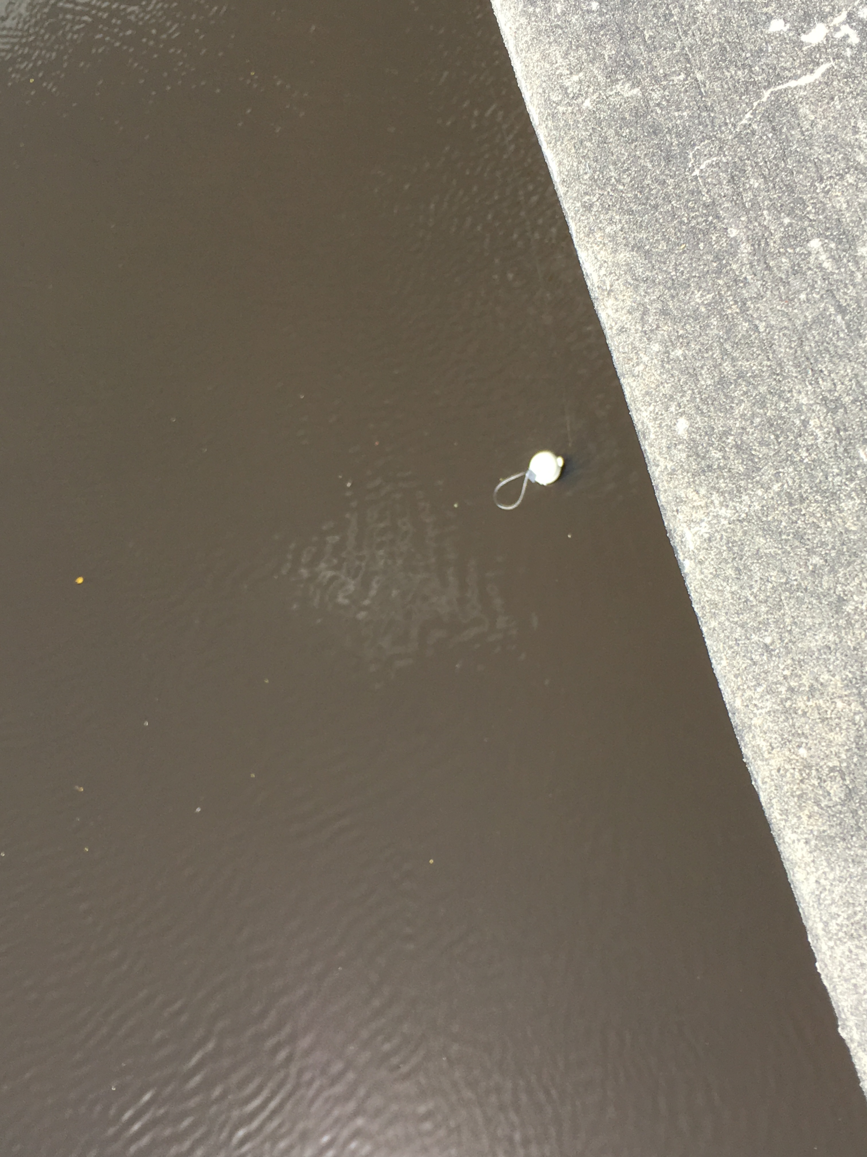
PFCs

Slide 36
Analyzed Pilot Study Samples for 13 PFC Compounds
10 PFC Compounds Detected
At one or more sites, in at least one matrix (POCIS or Grab)
PFBA
PFBS
PFDA
PFHpA
PFHxA
PFHxS
PFNA
PFOA
PFOS
PFPeA

Slide 37
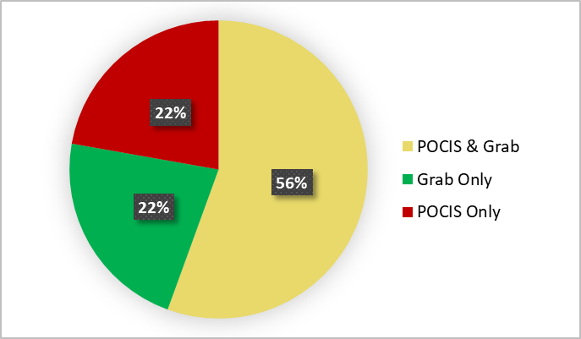
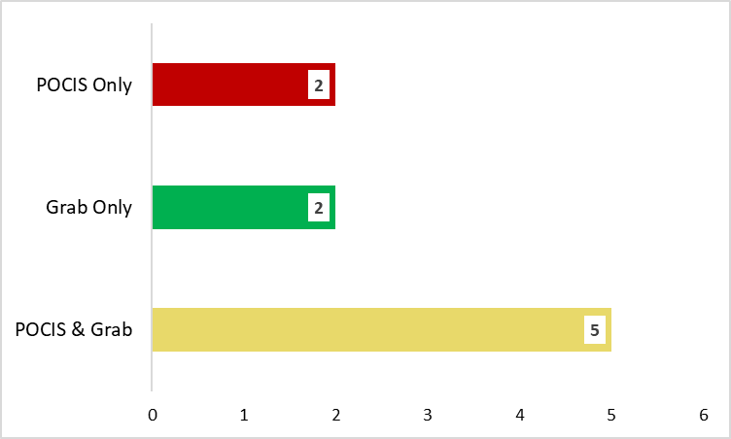
PFC Detections at Alafia River Analyzed by SGS Analytical
PFCs Detected by Sample Type
No. of PFCs Detected by Sample Type
Percentage of Detections by Sample Type
Total No. PFCs Analyzed = 13

Slide 38
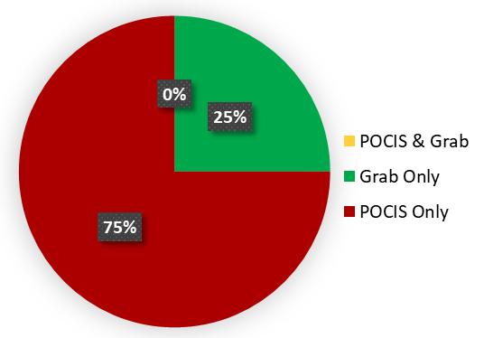
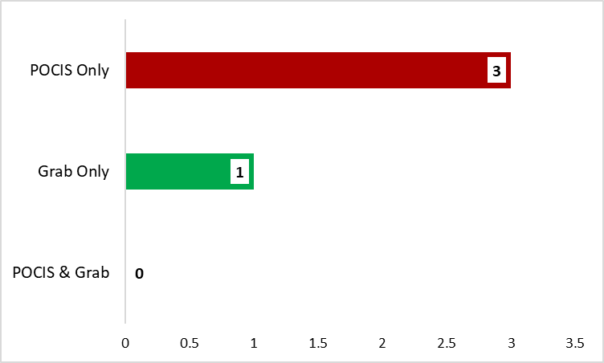
PFC Detections at Ochlockonee River Analyzed by SGS Analytical
PFCs Detected by Sample Type
No. of Detections by Sample Type
Percentage of Detections by Sample Type
Total No. PFCs Analyzed = 13
Undetects, Detects, Not Quantifiable by Sample Type

Slide 39
PFC Detections at Withlacoochee River Analyzed by SGS Analytical
Detections by Sample Type

Slide 40
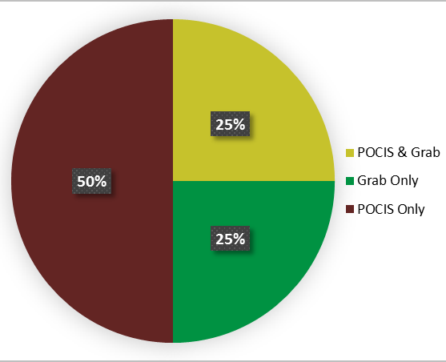
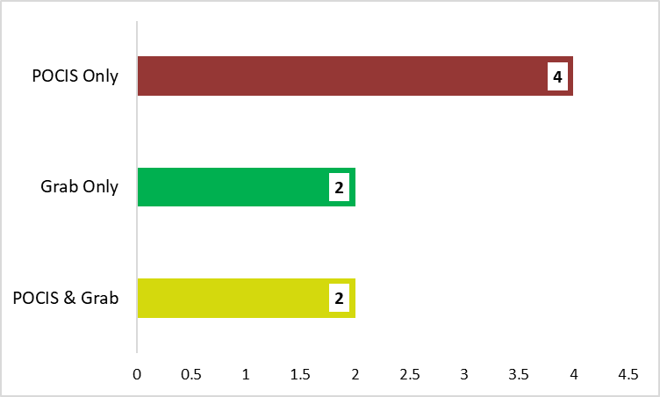
PFC Detections at Apalachicola River Analyzed by SGS Analytical
PFCs Detected by Sample Type
No. of Detections by Sample Type
Percentage of Detections by Sample Type
Total No. PFCs Analyzed = 13

Slide 41
PFC Detections at All Sites by Sample Type
Total No. Undetects, Detects, Not Quantifiable by Sample Type
Detections at Every Site by Matrix
No. of Detections by Sample Type

Slide 42
Quality Assurance Summary
No PFC compounds were detected in lab blanks or field blanks at concentrations that required data from at least one site to be qualified.

Slide 43
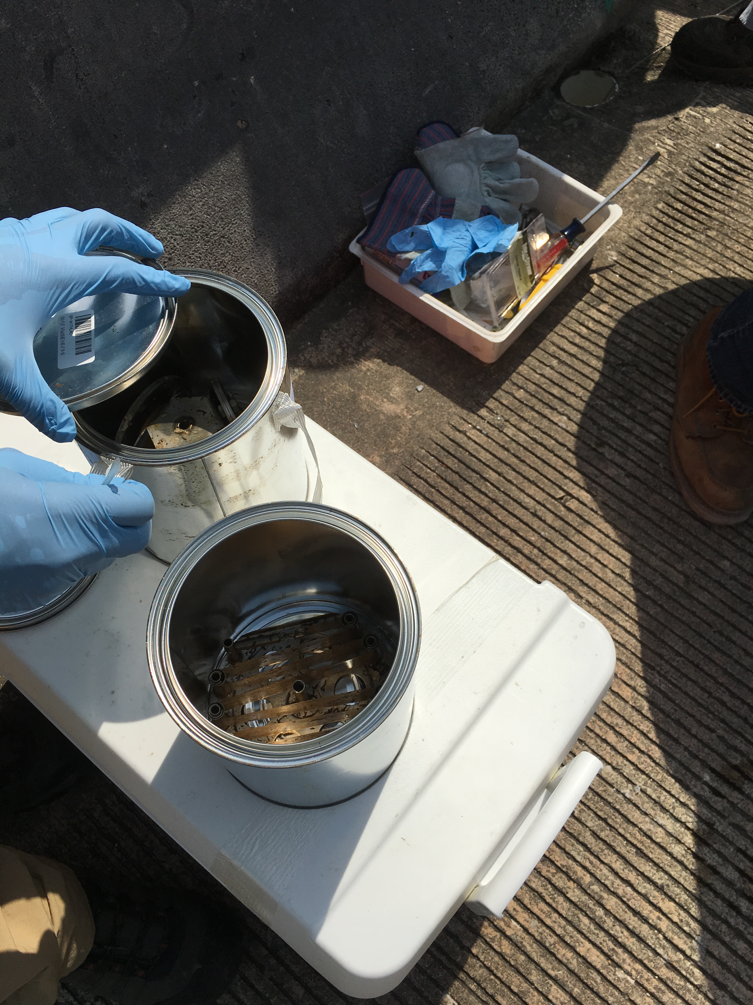
PBDEs

Slide 44
Analyzed Pilot Study Samples for 8 PBDE Compounds
8 PBDE Compounds Detected
At one or more sites, in at least one matrix (SPMD or Grab)
2,2',3,3',4,4',5,5',6,6'-DeBDE
2,2',3,4,4',5',6-HpBDE
2,2',4,4',5,5'-HxBDE
2,2',4,4',5,6'-HxBDE
2,2',4,4',5-PeBDE
2,2',4,4',6-PeBDE
2,2',4,4'-TeBDE
2,4,4'-TriBDE

Slide 45
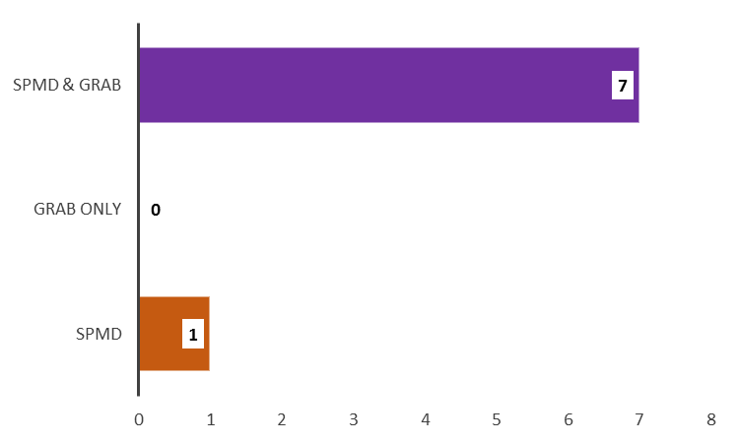
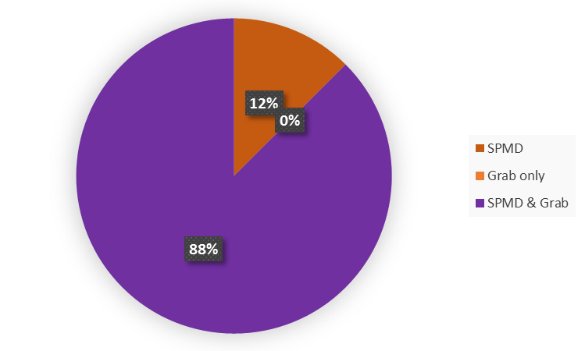
PBDE Detections at Alafia River Analyzed by SGS Analytical
Detections by Sample Type
No. of Detections by Sample Type
Total No. PBDEs Analyzed = 8
Percentage of Detections by Sample Type

Slide 46
PBDE Detections at Ochlockonee River Analyzed by SGS Analytical
Detected by Sample Type
Total No. Analyzed = 8

Slide 47
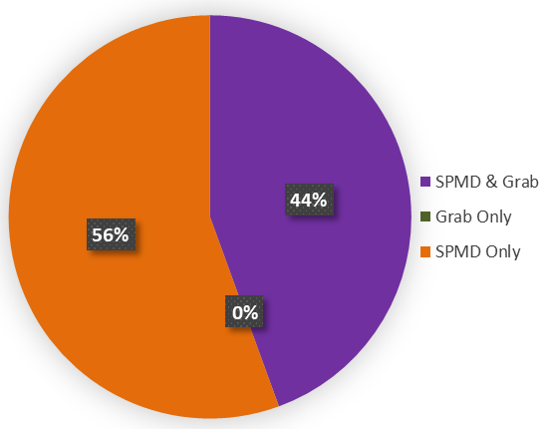
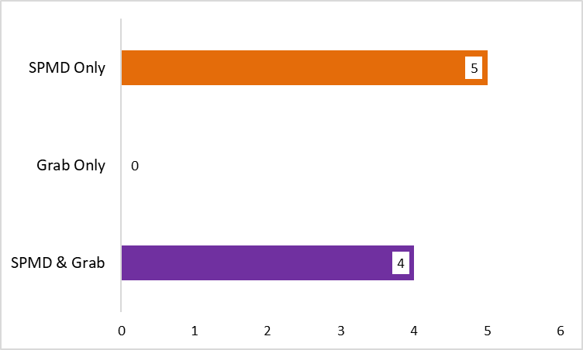
PBDE Detections at Apalachicola River Analyzed by SGS Analytical
Detected by Sample Type (n=9)
No. of Detections by Sample Type
Total No. PBDEs Analyzed = 8
Percentage of Detections by Sample Type

Slide 48
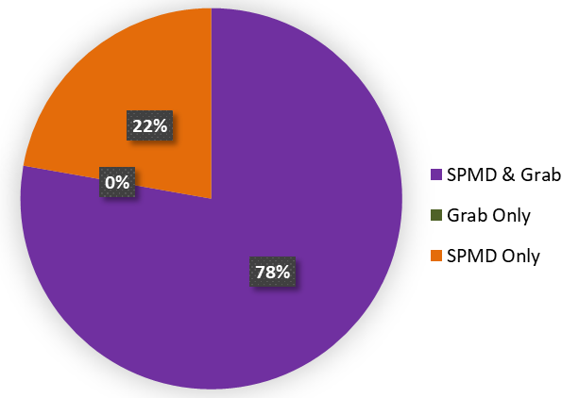
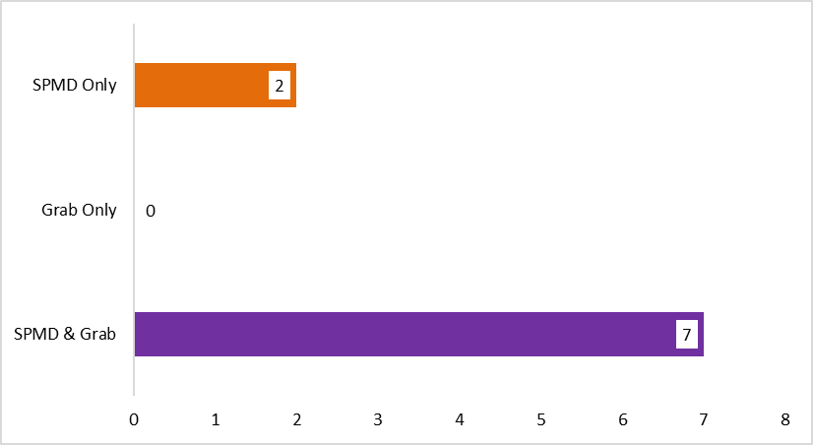
PBDE Detections at Withlacoochee River Analyzed by SGS Analytical
PBDEs Detected by Sample Type
No. of Detections by Sample Type
Total No. PBDEs Analyzed = 8
Percentage of Detections by Sample Type
Total No. Analyzed = 9

Slide 49
PBDE Detections at All Sites by Sample Type
Non-detects, Detects, Not Quantifiable by Sample Type
PBDEs Detected at Every Site (n = 4) by Matrix
No. PBDEs Detected by Sample Type

Slide 50
Quality Assurance Summary
All of the PBDE compounds detected, were also detected in lab blanks or field blanks at concentrations that required data from at least one site to be qualified.
All detections from SPMD samples were qualified due to blank detections.
>90% of detections from grab samples were qualified due to blank detections.

Slide 51
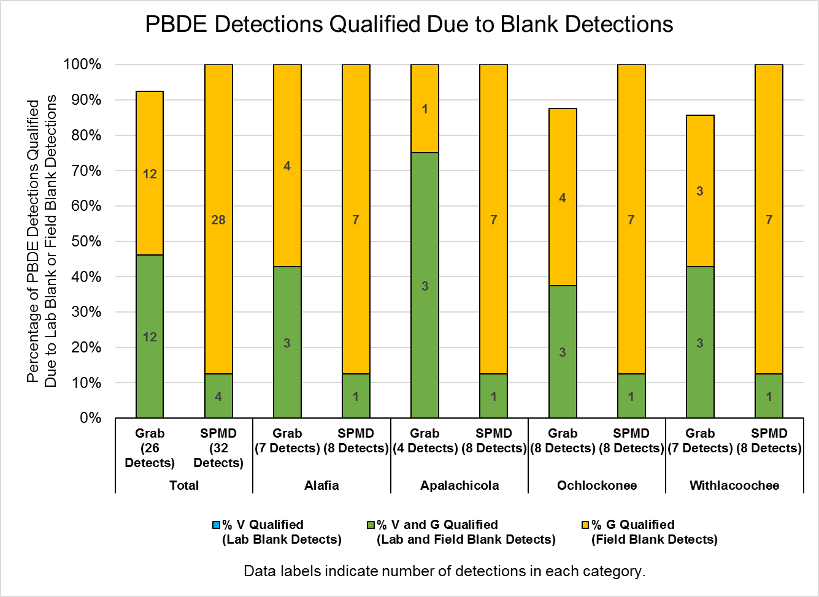

Slide 52
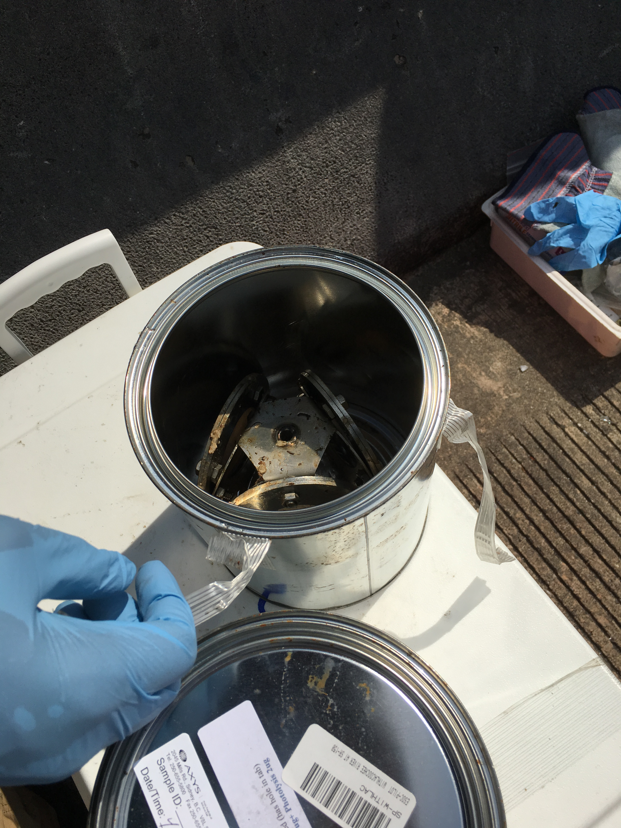
Alkylphenols

Slide 53
Analyzed Pilot Study Samples for 4 Alkylphenol Compounds
2 Alkylphenol Compounds Detected
At one or more sites, in at least one matrix (SPMD or Grab)
4-Nonylphenols
4-Nonylphenol diethoxylates

Slide 54
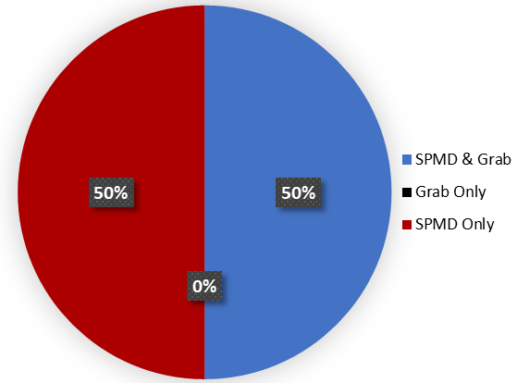
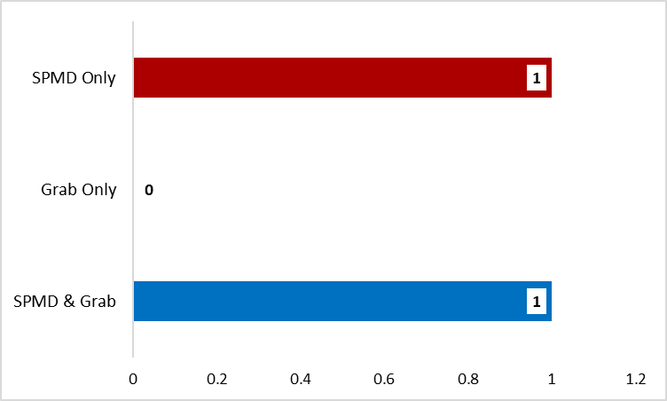
Alkylphenol Detections at All Sites Analyzed by SGS Analytical
Alkylphenols Detected by Sample Type (n=4)

Slide 55
Alkylphenol Detections at All Sites by Sample Type
Total No. Undetects, Detects, Not Quantifiable by Sample Type
Alkylphenols Detected at All Sites by Sample Type
No. Alkylphenols Detected by Sample Type

Slide 56
Compound | SPMD | Grab
4-Nonylphenols | VG | VG
4-Nonylphenol diethoxylates | G
Quality Assurance Summary
All alkylphenol compounds detected, were also detected in lab blanks or field blanks at concentrations that required data from all sites to be qualified.
All detections from SPMD & grab samples were qualified due to blank detections.

Slide 57
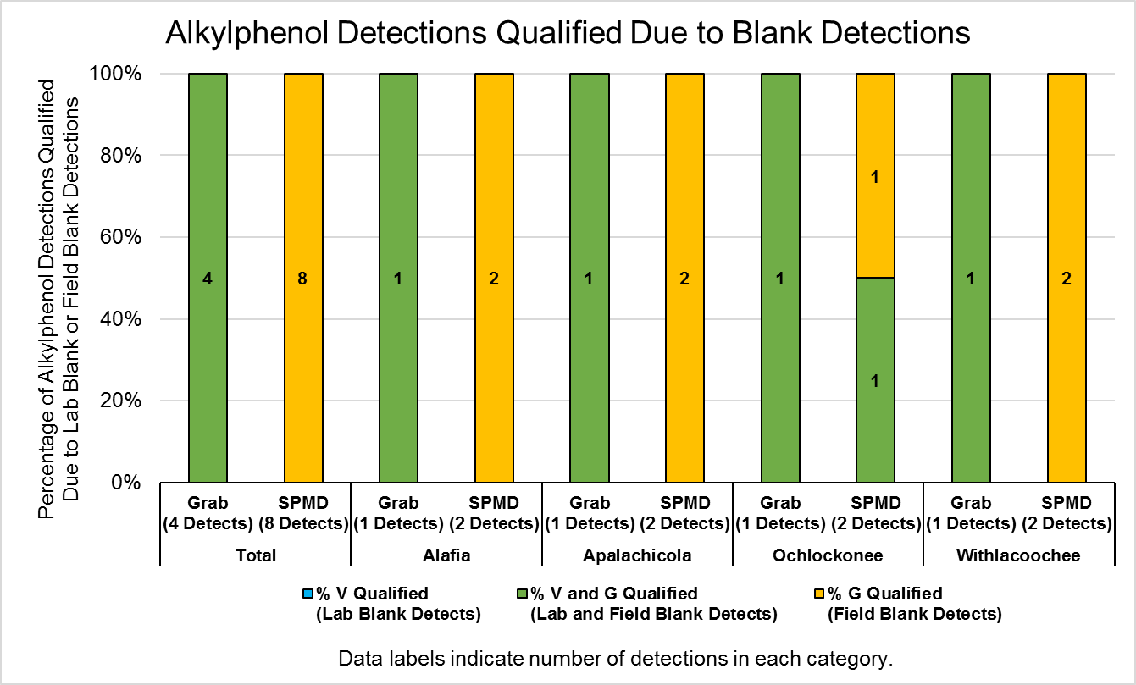

Slide 58
PAHs

Slide 59
PAH Detections at Apalachicola River Analyzed by SGS Analytical
PAHs Detected by Sample Type

Slide 60
Review
Pesticides
  76 total compounds analyzed.
  Most compounds were found in the SPMD only.
PPCPs
  127 compounds analyzed.
  Most compounds were found in POCIS only, there was a widespread distribution of compounds also found in the Grab
Hormones
  Of the 17 total compounds, there was a distribution of 4 to 5 compounds detected in all sample collection methods.
    POCIS only, Grab only, and POCIS & Grab.

Slide 61
Review
PFCs
  10 of the 13 compounds analyzed were detected in each sample collection type at least one or more sites.
  Withlacoochee and Ochlockonee were limited in distribution.
PBDEs
  8 of the 9 compounds were found in both SPMD and Grab.
  Only one compound was missed by Grab, but detected in SPMD.
  All compounds from each site were found to have blank contamination requiring a G qualifier.
Alkylphenols
  2 of the 4 compounds were found in either SPMD and/or Grab.

