Slide 1
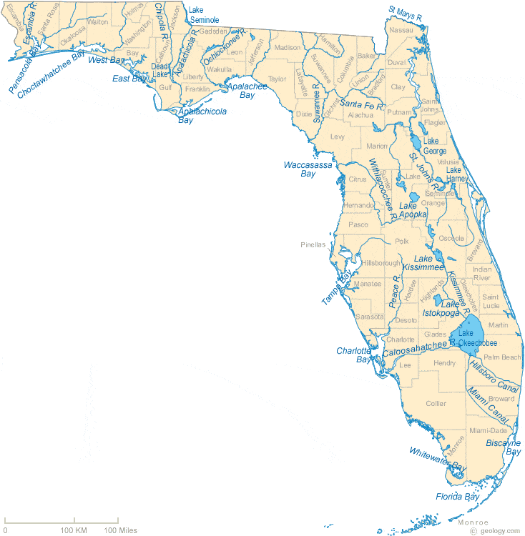
Evaluating ESOC in Florida Waterbodies
Presenter
Author(s)
Funding People/Grant Space

Slide 2
Overview
4 river sites sampled:
  Apalachicola, Ochlockonee, Withlacoochee, and Alafia
Categories of compounds:
  Pesticides, PPCPs, Hormones, PFCs, PBDEs, and Alkylphenols
The matrices (sample collection type) were split into groups.
  SPMD only
  SPMD, POCIS, Grab (Pesticides)
  SPMD & POCIS (Pesticides)
  Grab & SPMD
  Grab & POCIS
  Grab only
  POCIS only
QA is discussed at the end of each category.
SGS/Axys data is presented, then DEP data

Slide 3
Emerging Substances of Concern
(ESOC)
This study separated analytes into 6 main categories:

Slide 4
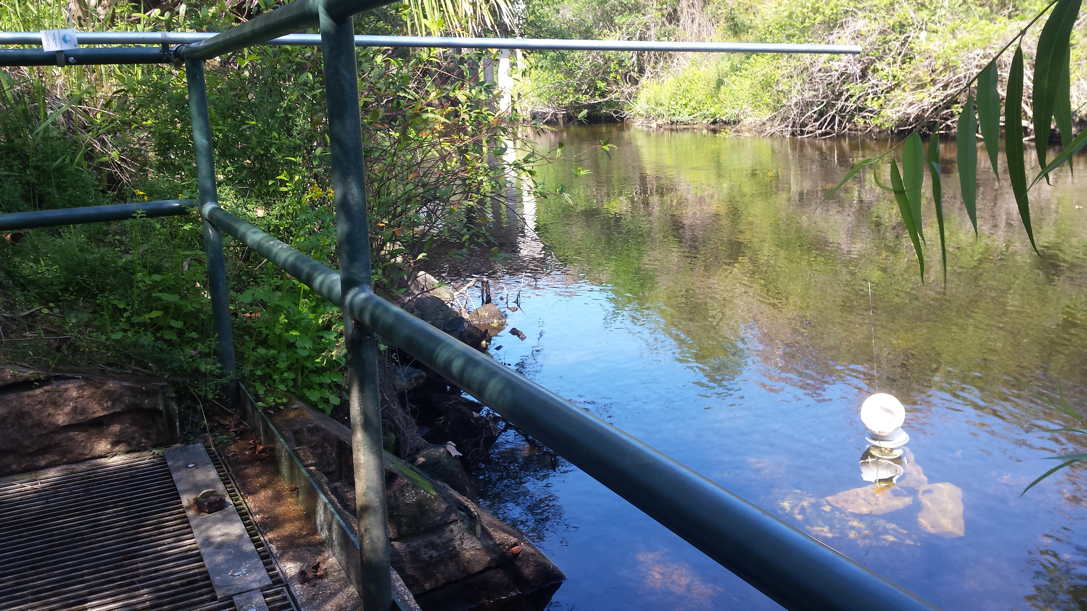
SGS/Axys Data

Slide 5
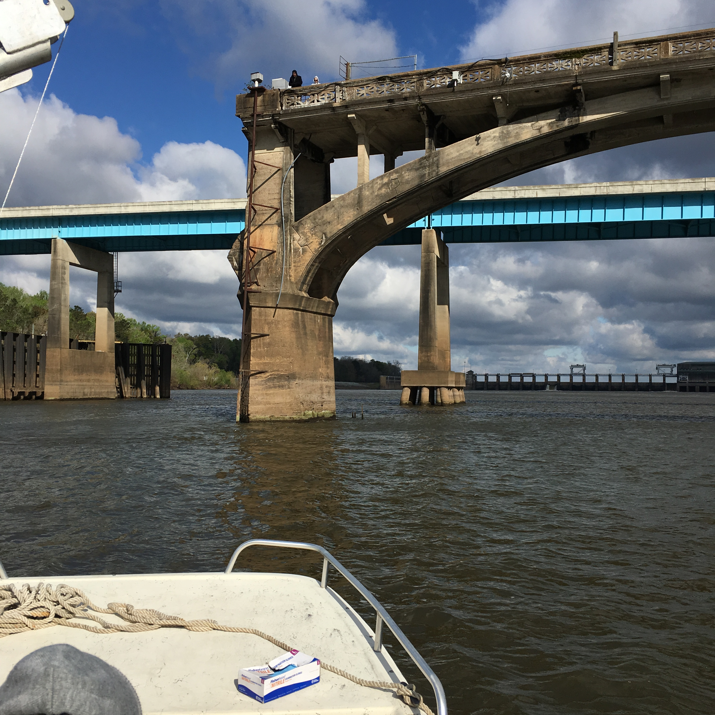
Pesticides

Slide 6
Analyzed Pilot Study Samples for 76 Pesticide Compounds
42 Pesticide Compounds Detected
At one or more sites, in at least one matrix (POCIS, SPMD, or Grab)
2,4'-DDD
4,4'-DDD
2,4'-DDE
4,4'-DDE
4,4'-DDT
Alachlor
Aldrin
alpha-Endosulphan
beta-Endosulphan
Endosulphan Sulphate
Ametryn
Atrazine
Desethylatrazine
Chlordane, alpha (cis)
Chlordane, gamma (trans)
Chlordane, oxy-
Chlorpyriphos
Diazinon
Dieldrin
Dimethenamid
Endrin
Endrin Ketone
Ethalfluralin
Flufenacet
Flutriafol
HCH, alpha
HCH, beta
HCH, delta
HCH, gamma
Heptachlor
Heptachlor Epoxide
Hexachlorobenzene
Hexazinone
Metolachlor
Mirex
Nonachlor, cis-
Nonachlor, trans-
Pendimethalin
Quintozene
Simazine
Tebuconazol
Trifluralin

Slide 7
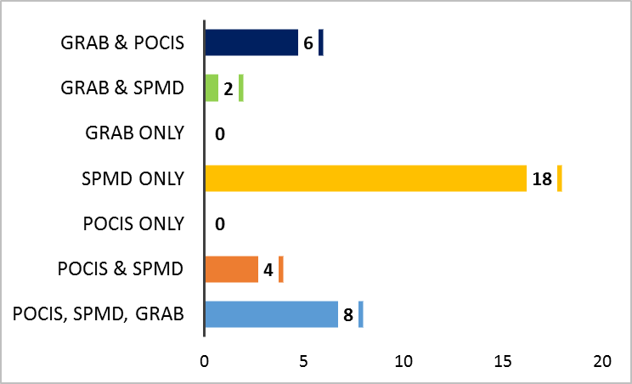
Pesticide Detections at Alafia River Analyzed by SGS Analytical
Pesticides Detected by Sample Type
No. of Pesticides Detected by Sample Type
Percentage of Detections by Sample Type
No. of Pesticides Analyzed = 76

Slide 8
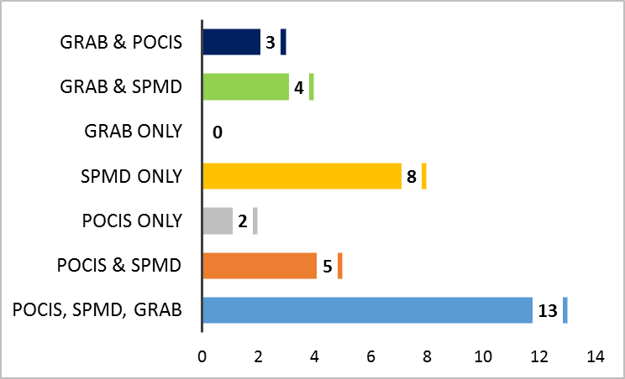
Pesticide Detections at Ochlockonee River Analyzed by SGS Analytical
Pesticides Detected by Sample Type
No. of Pesticides Detected by Sample Type
Percentage of Detections by Sample Type
No. of Pesticides Analyzed = 76

Slide 9
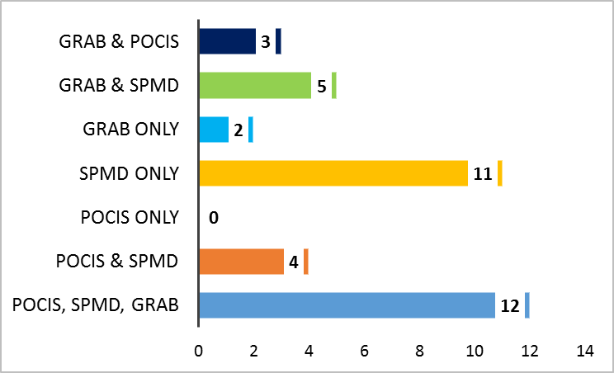
Pesticide Detections at Apalachicola River Analyzed by SGS Analytical
Pesticides Detected by Sample Type
No. of Pesticides Detected by Sample Type
Percentage of Detections by Sample Type
No. of Pesticides Analyzed = 76

Slide 10
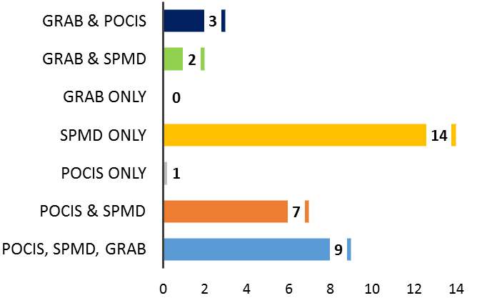
Pesticide Detections at Withlacoochee River Analyzed by SGS Analytical
Pesticides Detected by Sample Type
No. of Pesticides Detected by Sample Type
Percentage of Detections by Sample Type
No. of Pesticides Analyzed = 76

Slide 11
Pesticides Detections at All Sites by Sample Type
Total No. Undetects, Detects, Not Quantifiable by Sample Type
Pesticides Detected at Every Site (n = 4)
by Matrix
No. Pesticides Detected by Sample Type

Slide 12
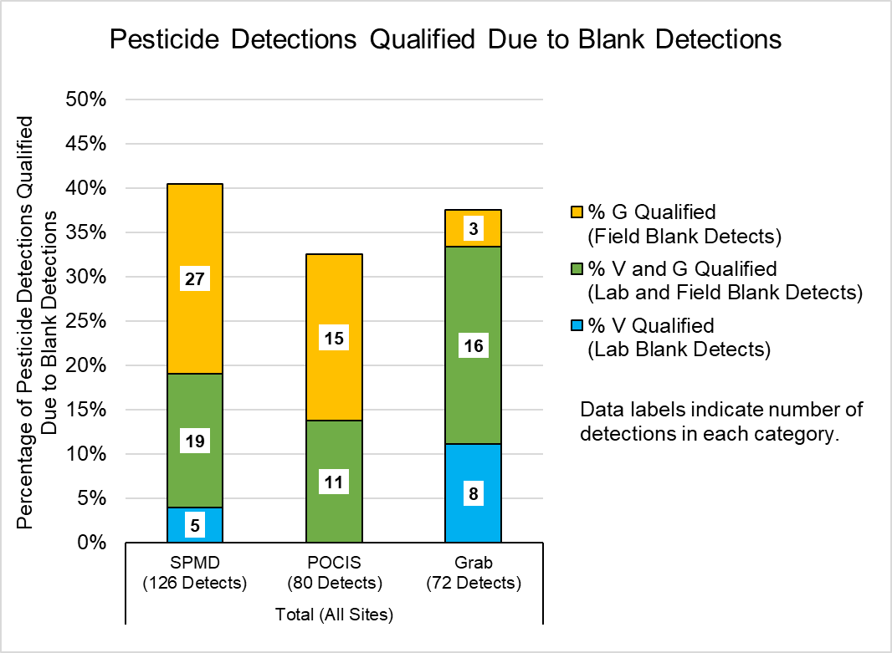
Quality Assurance Summary - Pesticides
33% of detections from POCIS samples were qualified due to blank detections.
40% of detections from SPMD samples were qualified due to blank detections.
38% of detections from grab samples were qualified due to blank detections.
Notes:
Need to find stephs legend to color code

Slide 13
Quality Assurance Summary - Pesticides
18 of the 42 pesticide compounds detected were also detected in lab blanks or field blanks at concentrations that required data from at least one site to be qualified.
Notes:
Need to find stephs legend to color code

Slide 14
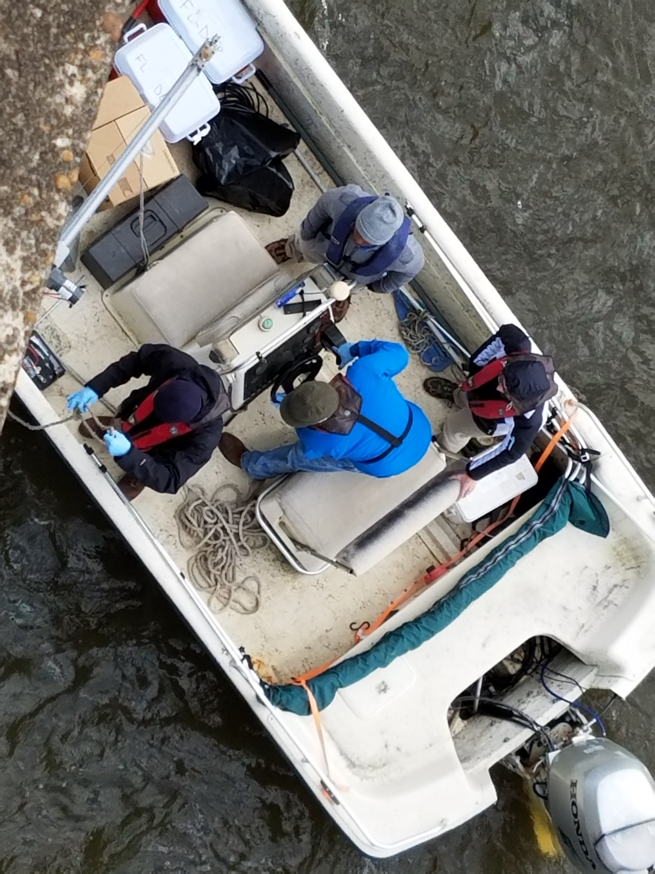
PPCPs

Slide 15
Analyzed Pilot Study Samples for 127 PPCP Compounds
39 PPCP Compounds Detected
At one or more sites, in at least one matrix (POCIS or Grab)
Alprazolam
Amitriptyline
Amphetamine
Atenolol
Azithromycin
Caffeine
Carbamazepine
Clarithromycin
Cocaine
Colchicine
Cotinine
DEET
Dehydronifedipine
Desmethyldiltiazem
Diatrizoic acid
Diazepam
Diltiazem
Diphenhydramine
Erythromycin-H2O
Furosemide
Gemfibrozil
Hydrochlorothiazide
Hydrocodone
Iopamidol
Meprobamate
Metformin
Metoprolol
Naproxen
Oxolinic Acid
Oxycodone
Propoxyphene
Sertraline
Sulfadimethoxine
Sulfamethazine
Sulfamethoxazole
Triamterene
Trimethoprim
Valsartan
Venlafaxine

Slide 16
PPCPs Detections at Alafia River Analyzed by SGS Analytical
Detected by Sample Type
127 Compounds Analyzed
POCIS Only
Grab Only
Grab & POCIS
Alprazolam
Diatrizoic acid
Amitriptyline
Erythromycin-H2O
Iopamidol
Amphetamine
Hydrocodone
Colchicine
Carbamazepine
Cocaine
DEET
Oxolinic Acid
Sulfamethoxazole
Undetects, Detects, Not Quantifiable by Sample Type
Notes:
Collection methods – Both Grab and POCIS are appropriate for the collection methods of PPCPs.

Slide 17
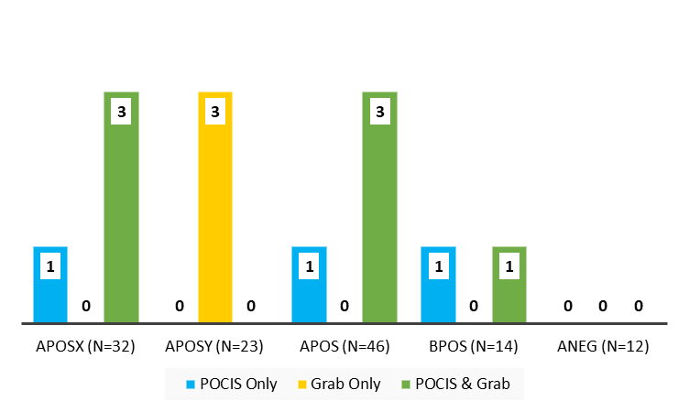
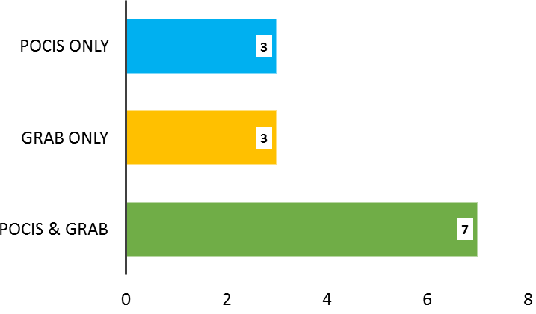
PPCPs Detections at Alafia River Analyzed by SGS Analytical
Detects per Analyte List by Sample Type
No. of PPCPs Detected by Sample Type
Percentage of Detections by Sample Type
No. of PPCPs Analyzed = 127
Total No. PPCPs Analyzed = 127

Slide 18
PPCPs Detections at Ochlockonee River Analyzed by SGS Analytical
Detected by Sample Type
127 Compounds Analyzed
Undetects, Detects, Not Quantifiable by Sample Type
Notes:
Collection methods – Both Grab and POCIS are appropriate for the collection methods of PPCPs.

Slide 19
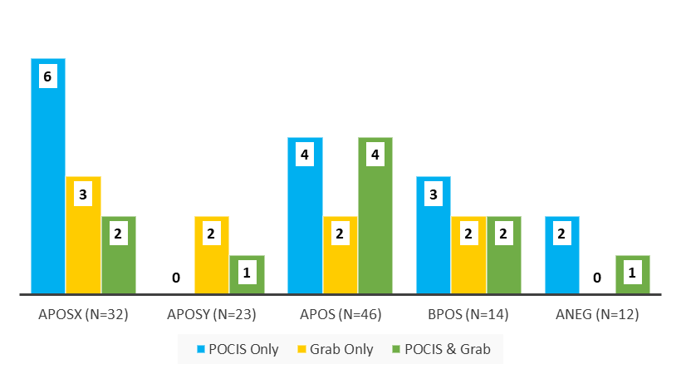
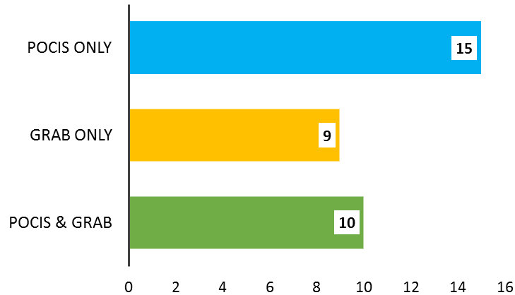
PPCPs Detections at Ochlockonee River Analyzed by SGS Analytical
Detects per Analyte List by Sample Type
No. of PPCPs Detected by Sample Type
Percentage of Detections by Sample Type
No. of PPCPs Analyzed = 127
Total No. PPCPs analyzed = 127

Slide 20
PPCPs Detections at Apalachicola River Analyzed by SGS Analytical
Detected by Sample Type
POCIS Only
Grab Only
POCIS & Grab
Alprazolam
Amitriptyline
DEET
Metoprolol
Iopamidol
Sulfamethoxazole
Venlafaxine
Caffeine
Amphetamine
Carbamazepine
Atenolol
Naproxen
Erythromycin-H2O
Cotinine
Trimethoprim
Metformin
Oxycodone
Triamterene
Gemfibrozil
Undetects, Detects, Not Quantifiable by Sample Type
Notes:
Collection methods – Both Grab and POCIS are appropriate for the collection methods of PPCPs.

Slide 21
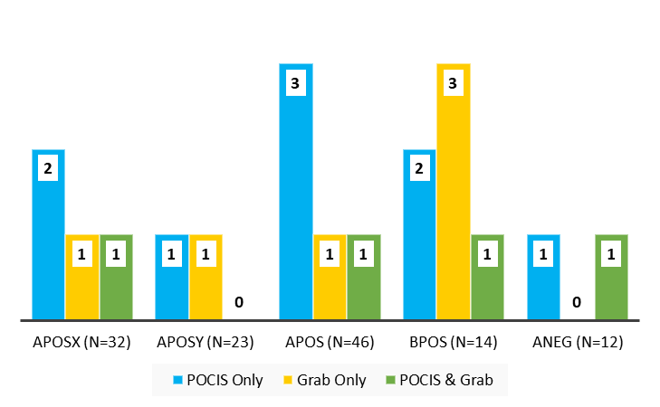
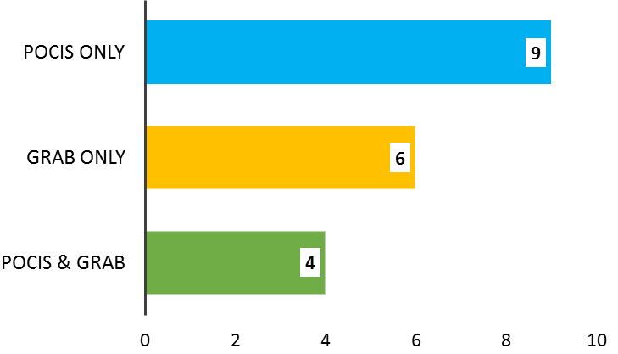
PPCPs Detections at Apalachicola River Analyzed by SGS Analytical
Detects per Analyte List by Sample Type
No. of PPCPs Detected by Sample Type
Percentage of Detections by Sample Type
No. of PPCPs Analyzed = 127

Slide 22
PPCPs Detections at Withlacoochee River Analyzed by SGS Analytical
PPCPs Detected by Sample Type
Total No. Analyzed = 127
Undetects, Detects, Not Quantifiable by Sample Type
Notes:
Method – LC-MS/MS
Collection methods – Both Grab and POCIS are appropriate for the collection methods of PPCPs.

Slide 23
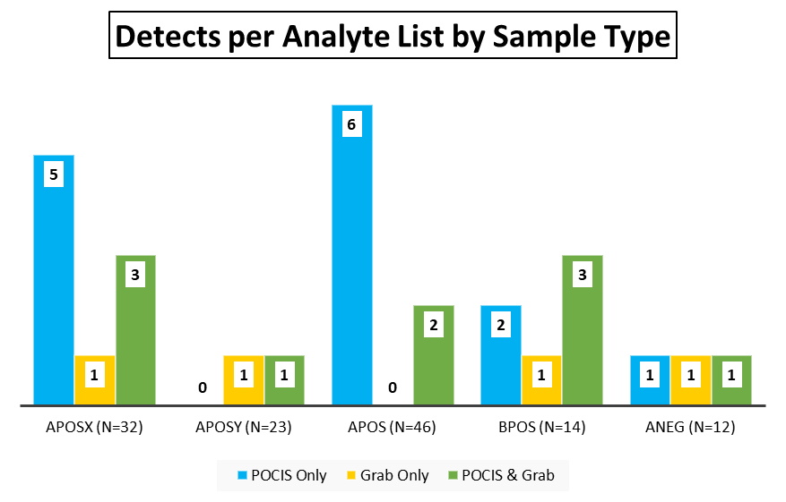
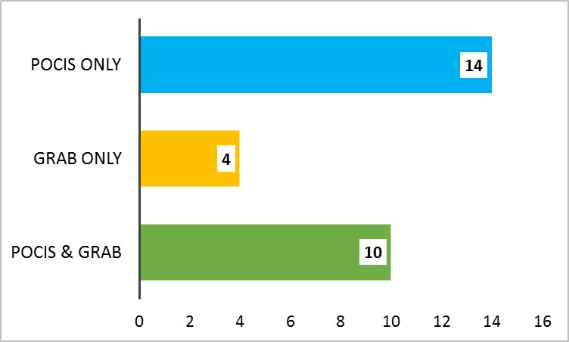
PPCPs Detections at Withlacoochee River Analyzed by SGS Analytical
No. of PPCPs Detected by Sample Type
Percentage of Detections by Sample Type
No. of PPCPs Analyzed = 127
Notes:
Method – LC-MS/MS
Collection methods – Both Grab and POCIS are appropriate for the collection methods of PPCPs.

Slide 24
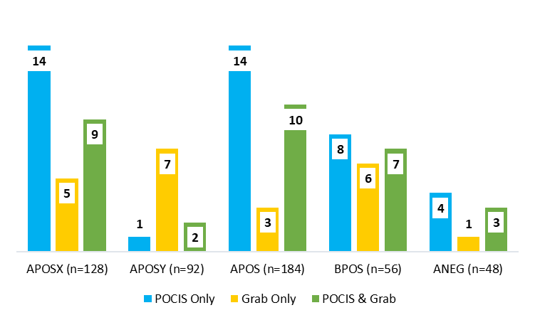
PPCPs Detections at All Sites by Sample Type
Total No. Undetects, Detects, Not Quantifiable
by Sample Type
PPCPs Detected at Every Site (n = 4)
by Matrix
Detects per List at All Sites by Sample Type
No. PPCPs Detected by Sample Type
Notes:
Collection methods – Both Grab and POCIS are appropriate for the collection methods of PPCPs.

Slide 25
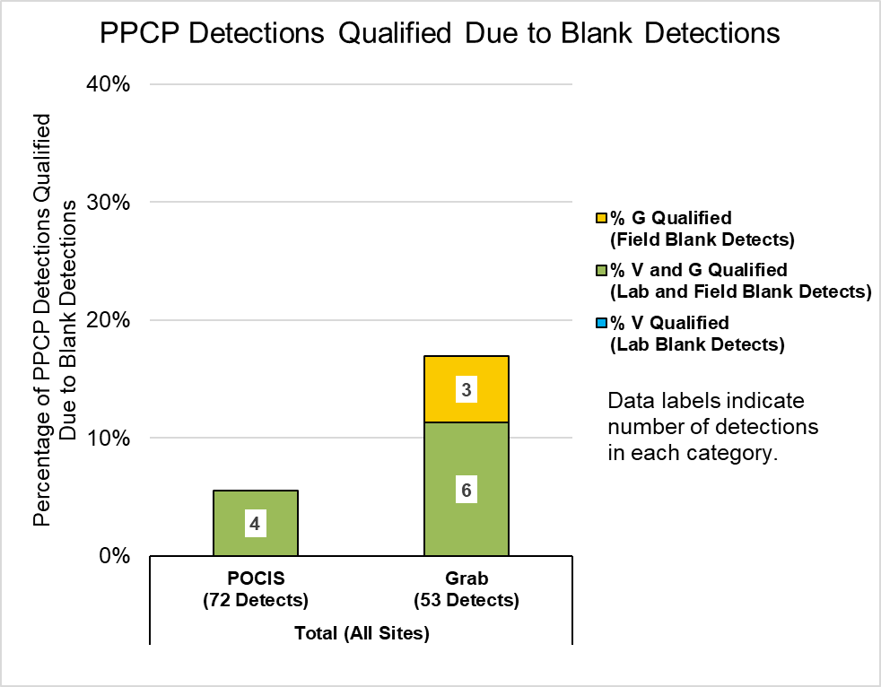
Quality Assurance Summary - PPCPs
6% of detections from POCIS samples were qualified due to blank detections.
17% of detections from grab samples were qualified due to blank detections.

Slide 26
Quality Assurance Summary - PPCPs
3 of the 39 PPCP compounds detected were also detected in lab blanks or field blanks at concentrations that required data from at least one site to be qualified.

Slide 27
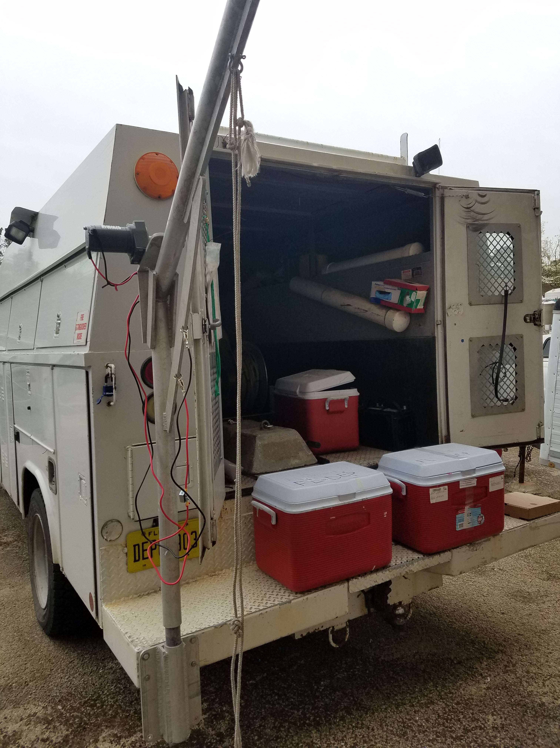

Hormones

Slide 28
Analyzed Pilot Study Samples for 17 Hormone Compounds
5 Hormone Compounds Detected
At one or more sites, in at least one matrix (POCIS or Grab)
Allyl Trenbolone
Androstenedione
Androsterone
Mestranol
Testosterone

Slide 29
Hormone Detections at Alafia River Analyzed by SGS Analytical
Hormones Detected by Sample Type
No. of Hormones Detected by Sample Type
No. of Hormones Analyzed = 17

Slide 30
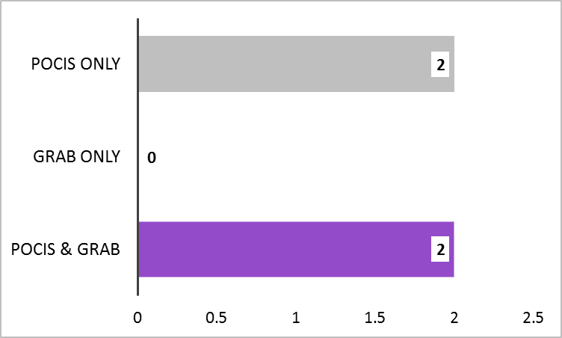
Hormone Detections at Ochlockonee River Analyzed by SGS Analytical
Hormones Detected by Sample Type
No. of Hormones Detected by Sample Type
No. of Hormones Analyzed = 17
Percentage of Hormone Detections by Sample Type

Slide 31
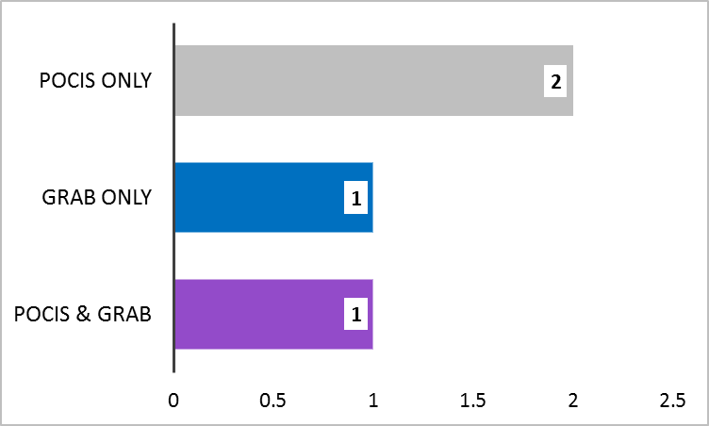
Hormone Detections at Withlacoochee River Analyzed by SGS Analytical
Hormones Detected by Sample Type
No. of Hormones Detected by Sample Type
No. of Hormones Analyzed = 17
Percentage of Hormone Detections by Sample Type

Slide 32
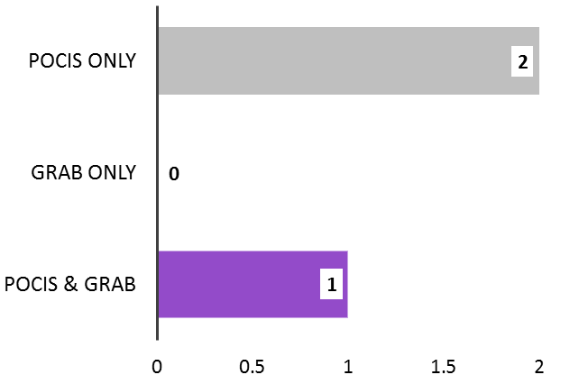
Hormone Detections at Apalachicola River Analyzed by SGS Analytical
Hormones Detected by Sample Type
No. of Hormones Detected by Sample Type
No. of Hormones Analyzed = 17
Percentage of Hormone Detections by Sample Type

Slide 33
Hormones Detections at All Sites by Sample Type
Total No. Undetects, Detects, Not Quantifiable by Sample Type
Hormones Detected at Every Site (n = 4)
by Matrix
No. Hormones Detections by Sample Type

Slide 34
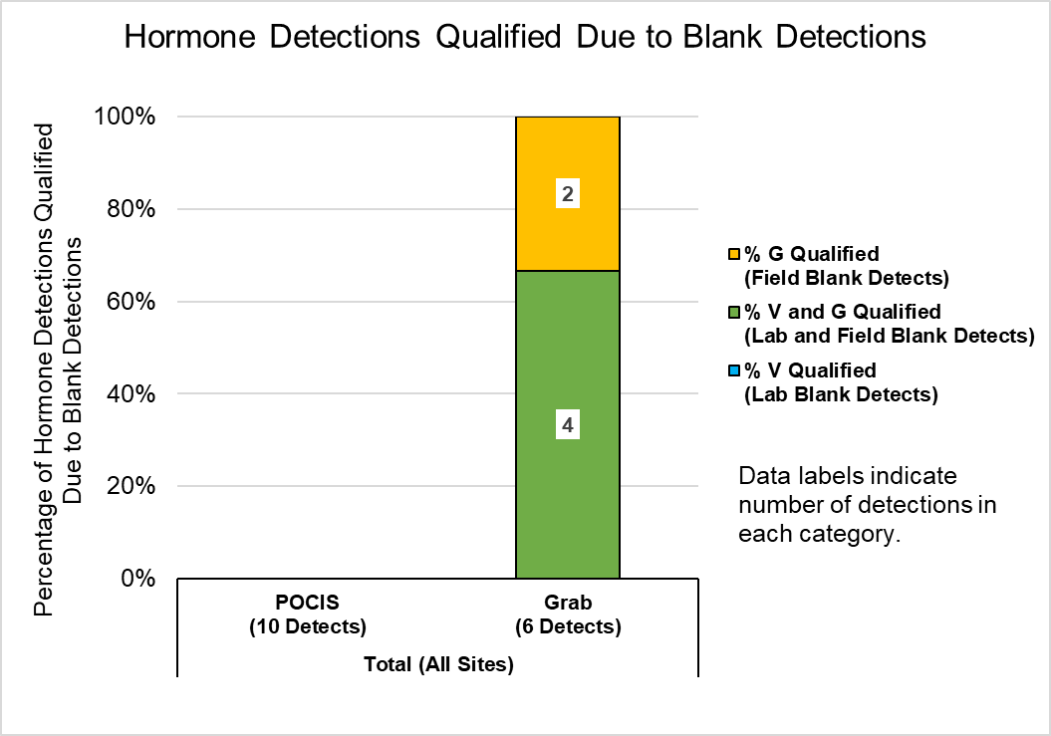
Quality Assurance Summary - Hormones
0% of detections from POCIS samples were qualified due to blank detections.
100% of detections from grab samples were qualified due to blank detections.

Slide 35
Quality Assurance Summary - Hormones
2 of the 5 hormone compounds detected were also detected in lab blanks or field blanks at concentrations that required data from at least one site to be qualified.

Slide 36
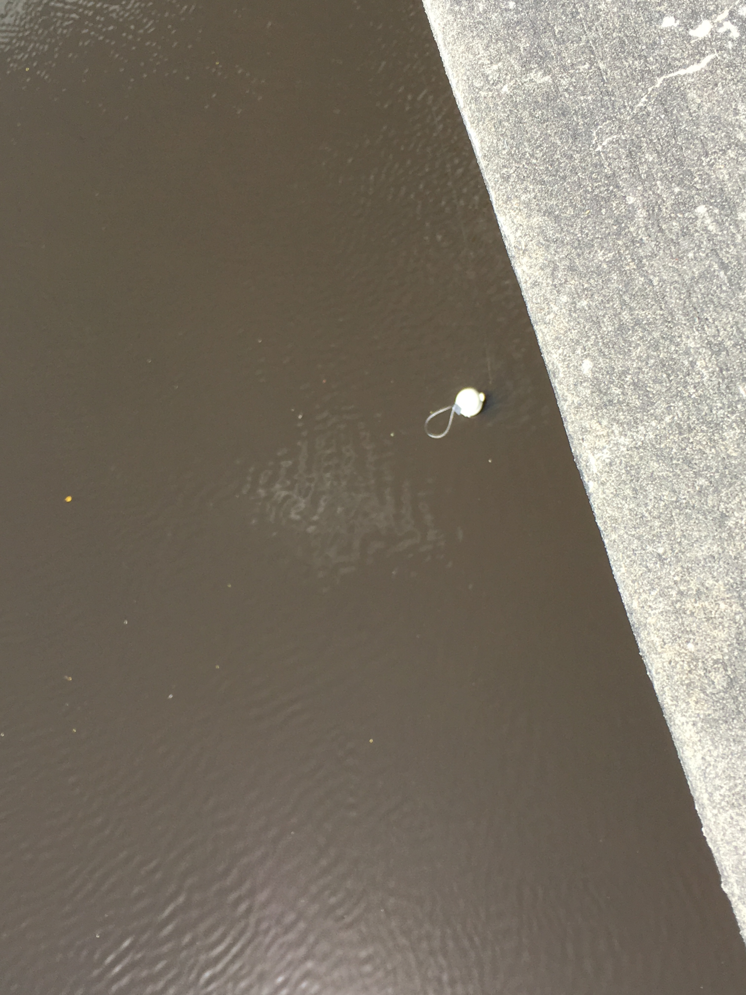
PFCs

Slide 37
Analyzed Pilot Study Samples for 13 PFC Compounds
10 PFC Compounds Detected
At one or more sites, in at least one matrix (POCIS or Grab)
PFBA
PFBS
PFDA
PFHpA
PFHxA
PFHxS
PFNA
PFOA
PFOS
PFPeA

Slide 38
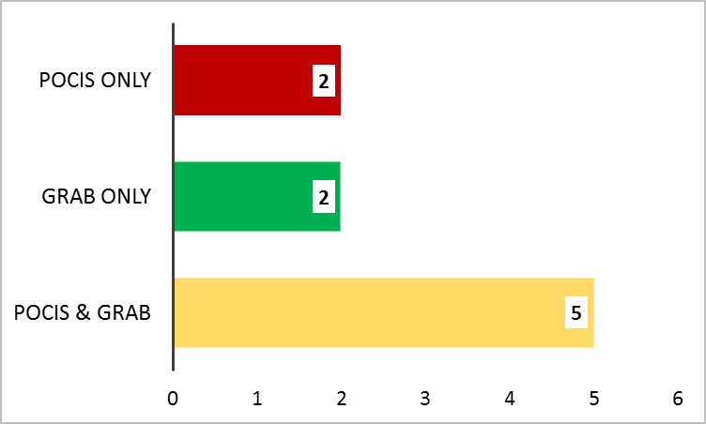
PFC Detections at Alafia River Analyzed by SGS Analytical
PFCs Detected by Sample Type
No. of PFCs Detected by Sample Type
Percentage of Detections by Sample Type
No. of PFCs Analyzed = 13

Slide 39
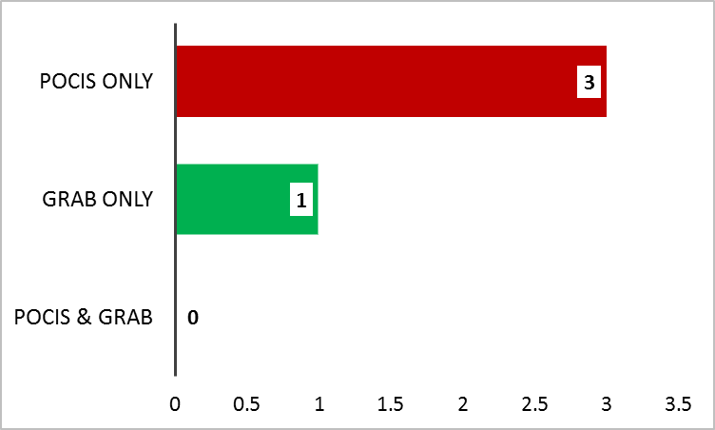
PFC Detections at Ochlockonee River Analyzed by SGS Analytical
PFCs Detected by Sample Type
No. of Detections by Sample Type
Percentage of Detections by Sample Type
No. of PFCs Analyzed = 13

Slide 40
PFC Detections at Withlacoochee River Analyzed by SGS Analytical
Detections by Sample Type

Slide 41
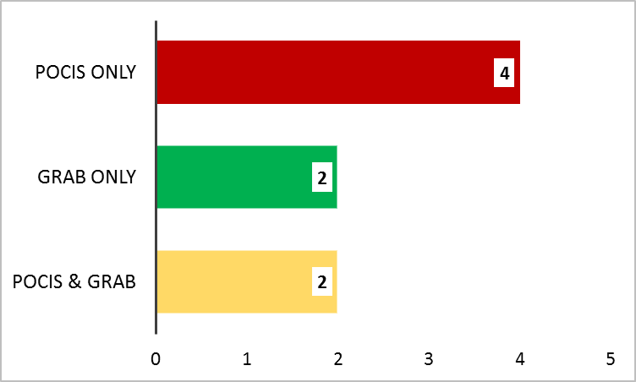
PFC Detections at Apalachicola River Analyzed by SGS Analytical
PFCs Detected by Sample Type
No. of Detections by Sample Type
Percentage of Detections by Sample Type
No. of PFCs Analyzed = 13

Slide 42
PFC Detections at All Sites by Sample Type
Total No. Undetects, Detects, Not Quantifiable by Sample Type
PFCs Detected at Every Site (n = 4)
by Matrix
No. of Detections by Sample Type

Slide 43
Quality Assurance Summary - PFCs
No PFC compounds were detected in lab blanks or field blanks at concentrations that required data from at least one site to be qualified.

Slide 44
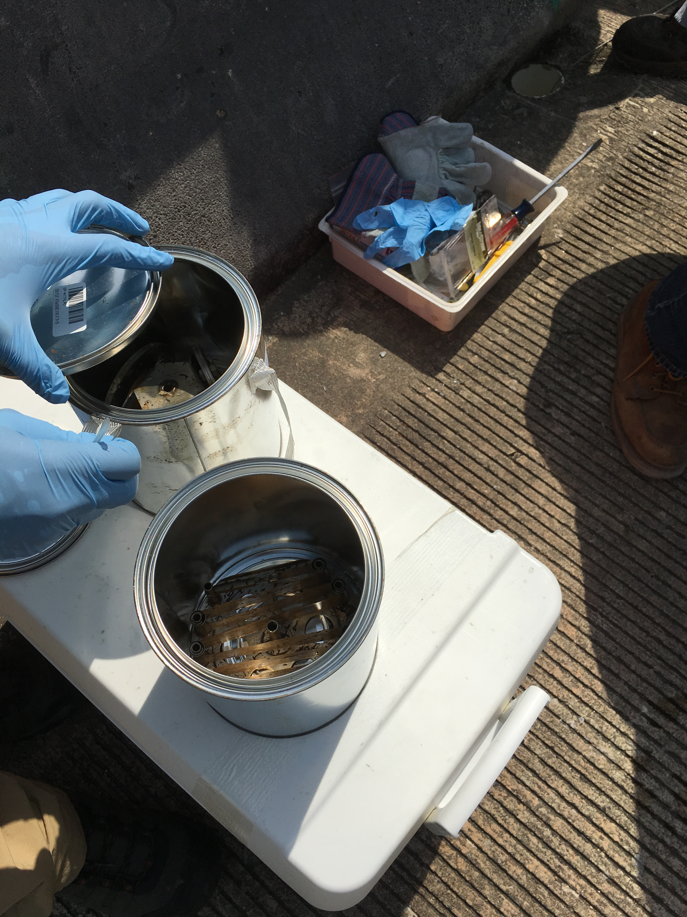
PBDEs

Slide 45
Analyzed Pilot Study Samples for 8 PBDE Compounds
8 PBDE Compounds Detected
At one or more sites, in at least one matrix (SPMD or Grab)
2,2',3,3',4,4',5,5',6,6'-DeBDE
2,2',3,4,4',5',6-HpBDE
2,2',4,4',5,5'-HxBDE
2,2',4,4',5,6'-HxBDE
2,2',4,4',5-PeBDE
2,2',4,4',6-PeBDE
2,2',4,4'-TeBDE
2,4,4'-TriBDE

Slide 46
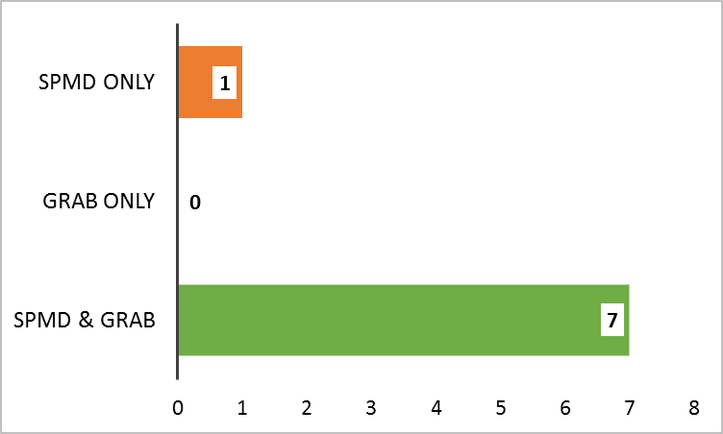
PBDE Detections at Alafia River Analyzed by SGS Analytical
Detections by Sample Type
No. of Detections by Sample Type
Total No. PBDEs Analyzed = 8
Percentage of Detections by Sample Type

Slide 47
PBDE Detections at Ochlockonee River Analyzed by SGS Analytical
Detected by Sample Type
Total No. Analyzed = 8

Slide 48
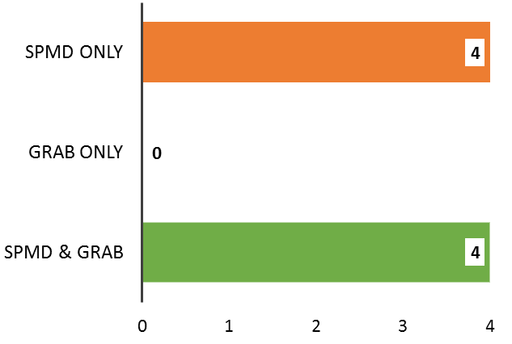
PBDE Detections at Apalachicola River Analyzed by SGS Analytical
PBDEs Detected by Sample Type
No. of Detections by Sample Type
Total No. PBDEs Analyzed = 8
Percentage of Detections by Sample Type

Slide 49
PBDE Detections at Withlacoochee River Analyzed by SGS Analytical
PBDEs Detected by Sample Type
No. of Detections by Sample Type
Total No. PBDEs Analyzed = 8
Percentage of Detections by Sample Type

Slide 50
PBDE Detections at All Sites by Sample Type
Non-detects, Detects, Not Quantifiable by Sample Type
PBDEs Detected at Every Site (n = 4) by Matrix
No. PBDEs Detected by Sample Type

Slide 51
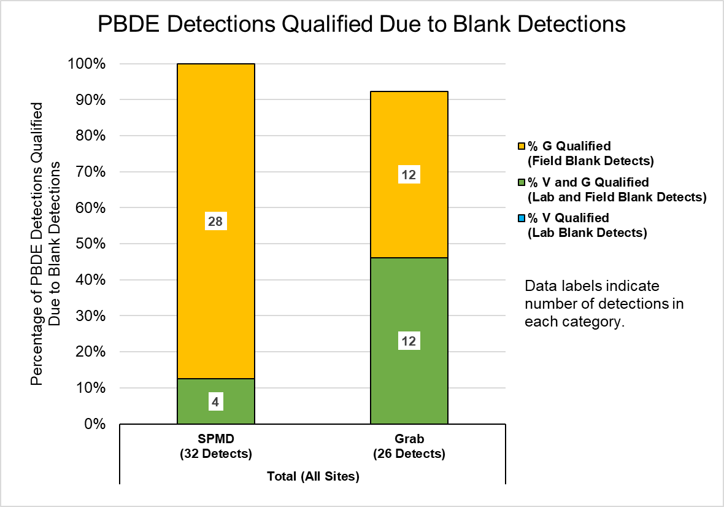
Quality Assurance Summary - PBDEs
100% of detections from SPMD samples were qualified due to blank detections.
92% of detections from grab samples were qualified due to blank detections.

Slide 52
Quality Assurance Summary - PBDEs
All of the PBDE compounds detected, were also detected in lab blanks or field blanks at concentrations that required data from at least one site to be qualified.

Slide 53
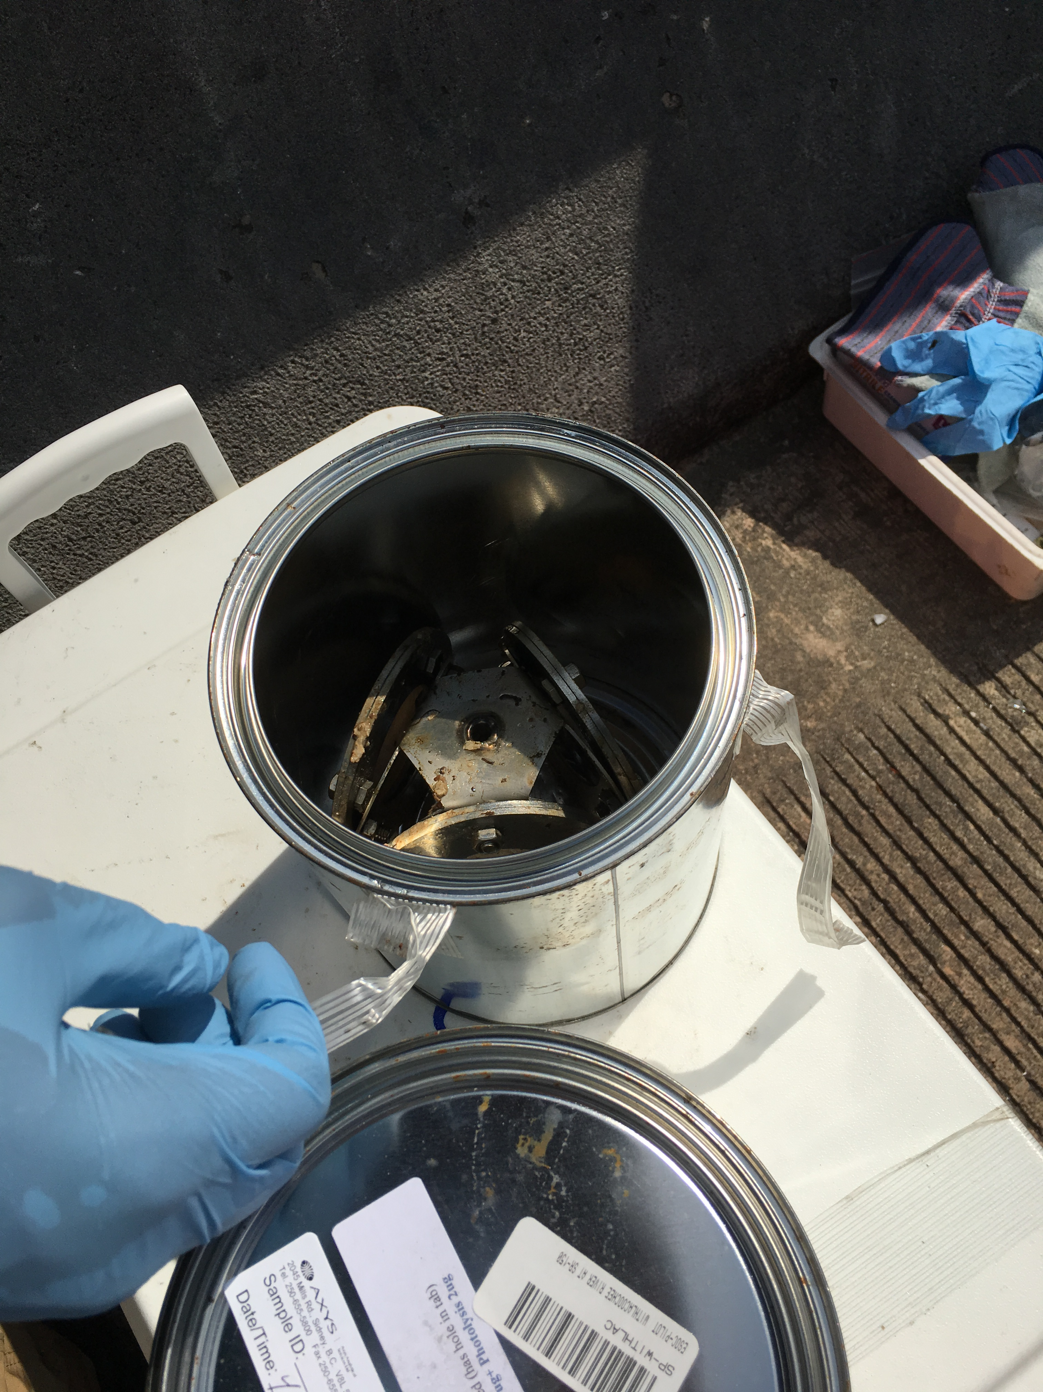
Alkylphenols

Slide 54
Analyzed Pilot Study Samples for 4 Alkylphenol Compounds
2 Alkylphenol Compounds Detected
At one or more sites, in at least one matrix (SPMD or Grab)
4-Nonylphenols
4-Nonylphenol diethoxylates

Slide 55
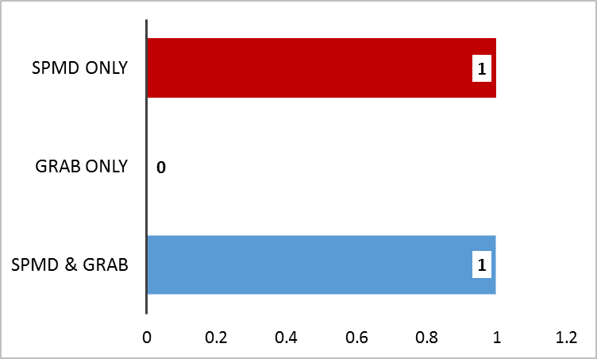
Alkylphenol Detections at All Sites Analyzed by SGS Analytical
Alkylphenols Detected by Sample Type
No. of Detections by Sample Type
No. of Alkylphenols Analyzed = 8
Percentage of Detections by Sample Type
All Sites

Slide 56
Alkylphenol Detections at All Sites by Sample Type
Total No. Undetects, Detects, Not Quantifiable by Sample Type
Alkylphenols Detected at Every Site (n = 4)
by Matrix
No. Alkylphenols Detected by Sample Type

Slide 57
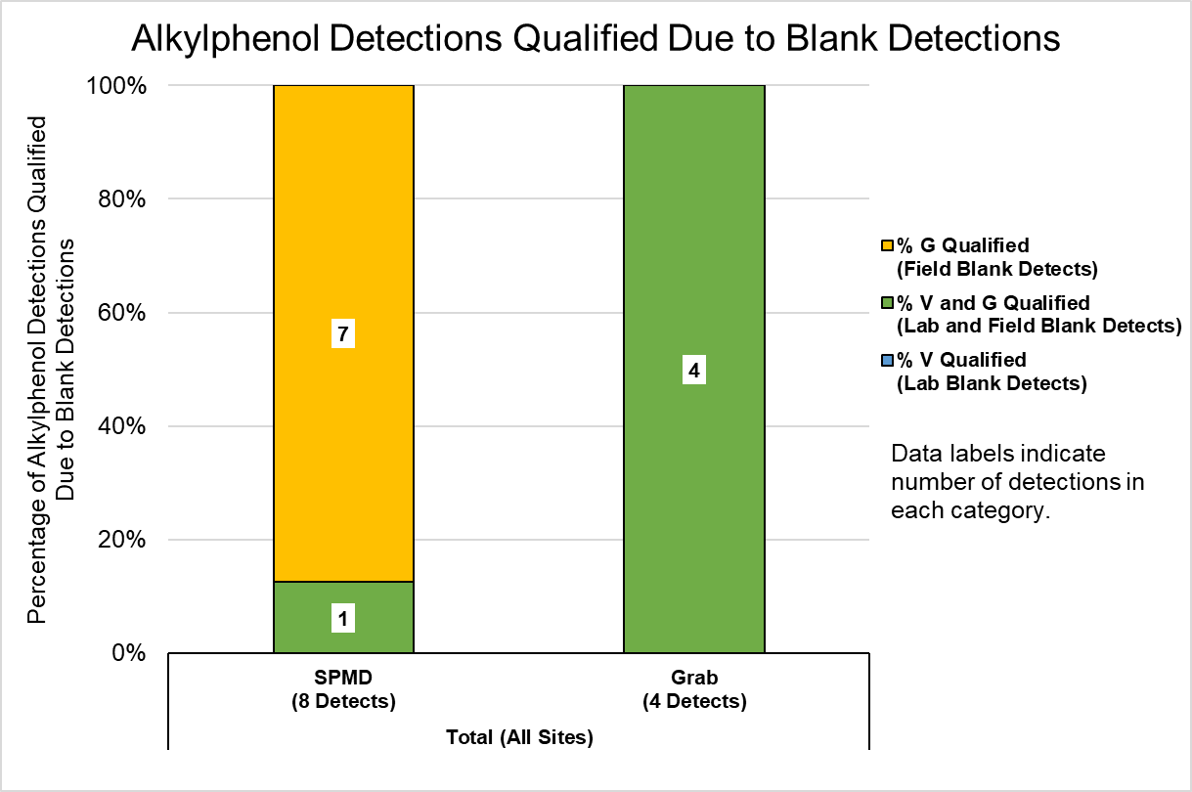
Compound | SPMD | Grab
4-Nonylphenols | VG | VG
4-Nonylphenol diethoxylates | G
Quality Assurance Summary - Alkylphenols
100% of detections from SPMD & grab samples were qualified due to blank detections.

Slide 58
Quality Assurance Summary
All alkylphenol compounds detected, were also detected in lab blanks or field blanks at concentrations that required data from all sites to be qualified.
All detections from SPMD & grab samples were qualified due to blank detections.

Slide 59
PAHs

Slide 60
Review
Pesticides
  42 compounds detected of 76 total compounds analyzed.
  Most compounds were found in the SPMD only.
PPCPs
  39 compounds detected of 127 compounds analyzed.
  Most compounds were found in POCIS only, there was a widespread distribution of compounds also found in the Grab
Hormones
  5 compounds detected of 17 compounds analyzed.
  Blank contamination caused all grab sample data to be qualified, but did not affect POCIS sample data.

Slide 61
Review
PFCs
  10 compounds detected of 13 compounds analyzed.
  Most compounds were found in POCIS only or POCIS & Grab.
PBDEs
  All compounds analyzed (n = 8) were detected in SPMD & Grab samples at one or more sites.
  Blank contamination caused all SPMD data & > 90% of Grab sample data to be qualified.
Alkylphenols
  2 of the 4 compounds analyzed were found SPMD only or SPMD & Grab.
  Blank contamination caused all SPMD and Grab sample data to be qualified.

Slide 62
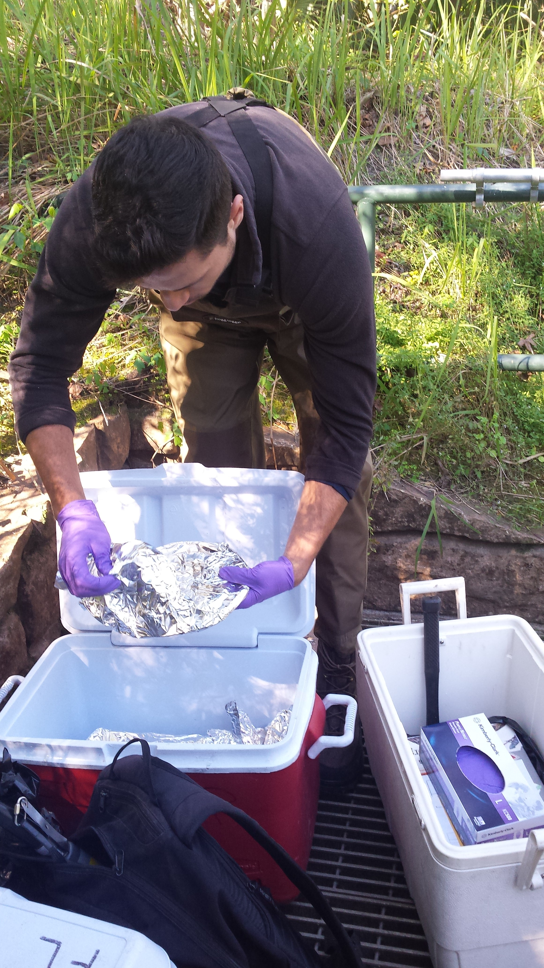
DEP Data

Slide 63
DEP Data
Presented:
  as one analyte list
  per site

Slide 64
Alafia River
Compounds Detected by Sample Type
Number of Undetects and Detects

Slide 65
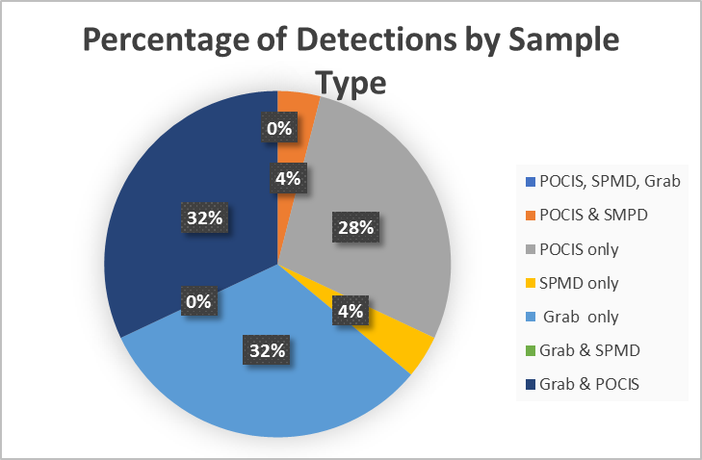
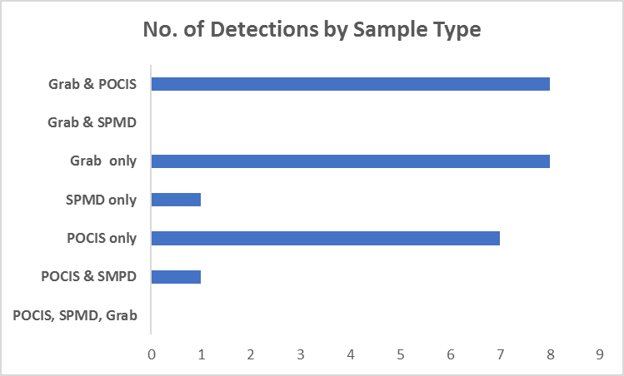
Alafia River

Slide 66
Ochlockonee River
Compounds Detected by Sample Type
Number of Undetects and Detects

Slide 67
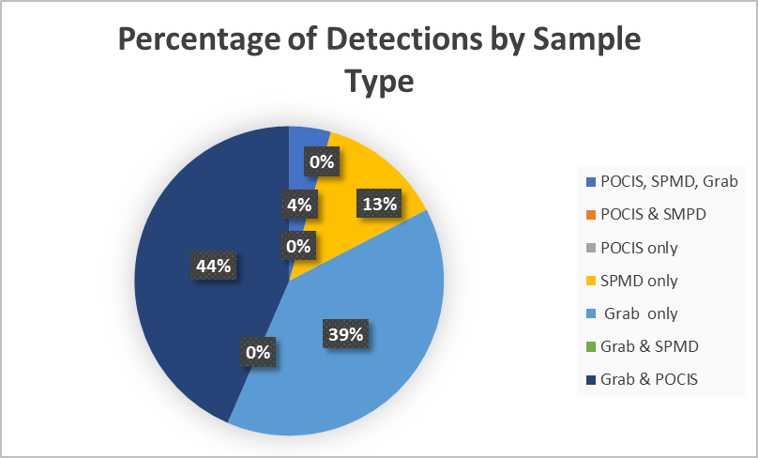
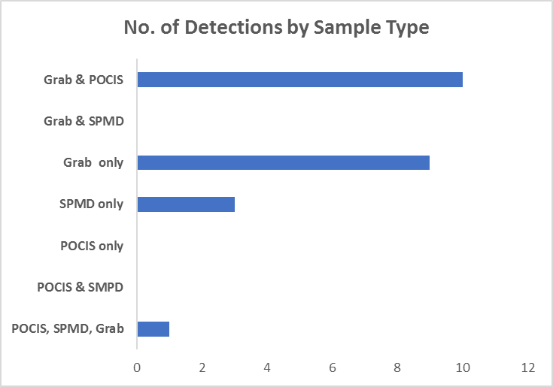
Ochlockonee River

Slide 68
Apalachicola River
Compounds Detected by Sample Type
Number of Undetects and Detects

Slide 69
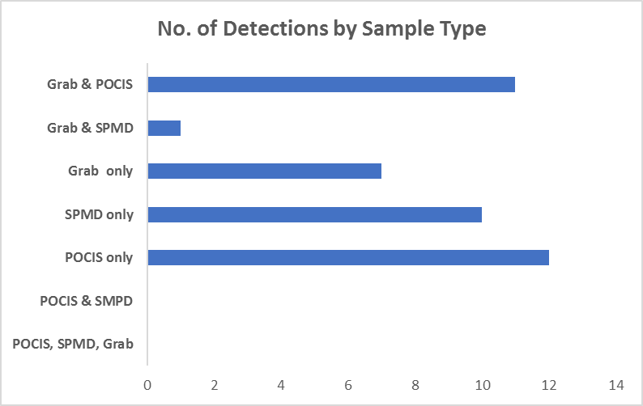
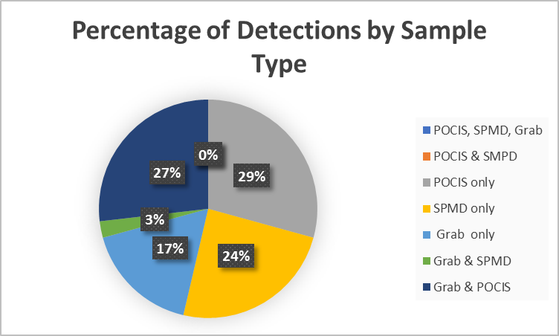
Apalachicola River

Slide 70
Withlacoochee River
Compounds Detected by Sample Type
Number of Undetects and Detects

Slide 71
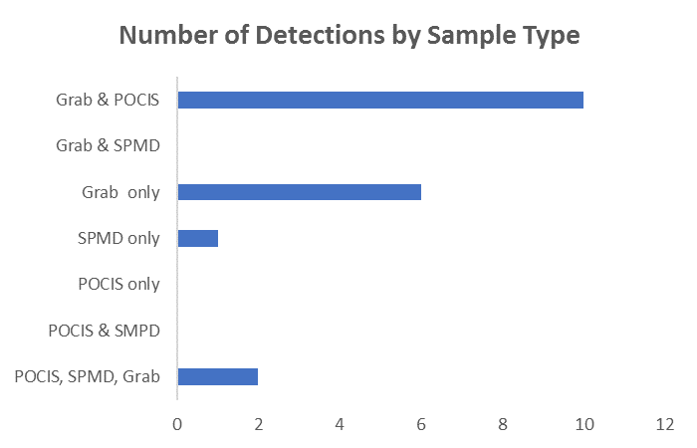
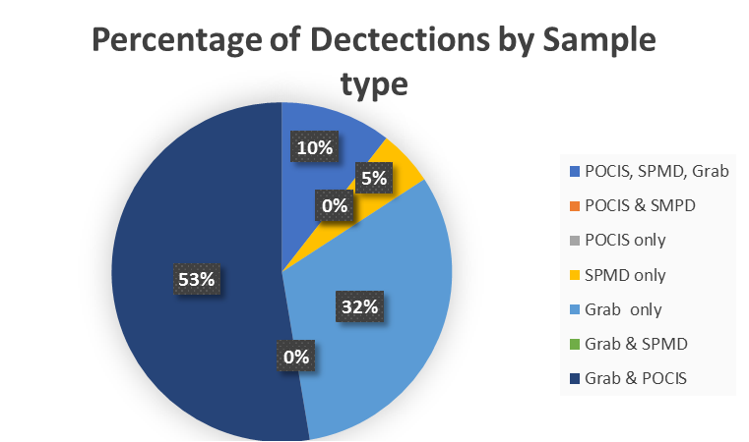
Withlacoochee River

