Slide 1
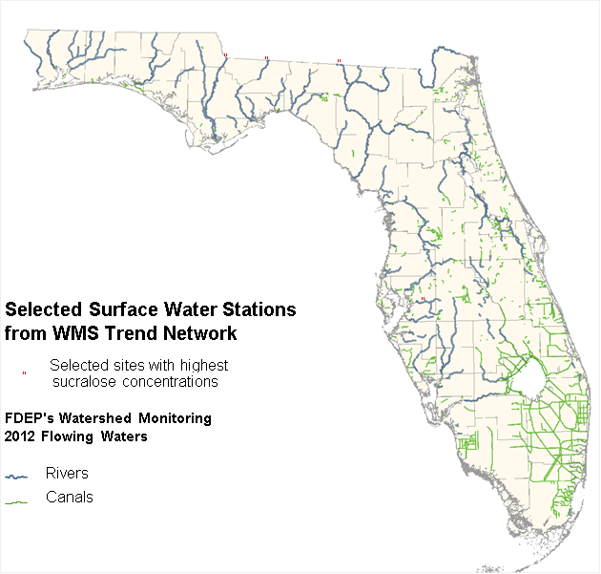

Evaluating ESOC in Florida Waterbodies
Presented by: Alicia Hogue, Tom Seal, Stephanie Sunderman-Barnes & Jade Burtchett

Slide 2
Overview
4 river sites chosen:
  Ochlockonee, Withlacoochee, Apalachicola and Alafia
3 types of sample collection:
  Semi-Permeable Membrane Device (SPMD)
  Polar Organic Chemical Integrative Sampler (POCIS)
  Whole water samples (Grab)
Categories of compounds:
  Pesticides, PPCPs, Hormones, PFCs, PBDEs, and Alkylphenols
The sample collection types were split into 7 categories:
  SPMD, POCIS, Grab (Pesticides)
  SPMD & POCIS (Pesticides)
  Grab & SPMD
  Grab & POCIS
  Grab only
  SPMD only
  POCIS only
QA is discussed at the end of each category.
SGS/Axys data are presented, then DEP data.
Notes:
Thank everyone for attending.
Please feel free to interject and add feedback as we go along.
Talk about how the 4 sites were chosen from the Trend Network highest sucralose concentrations in 2012.

Slide 3
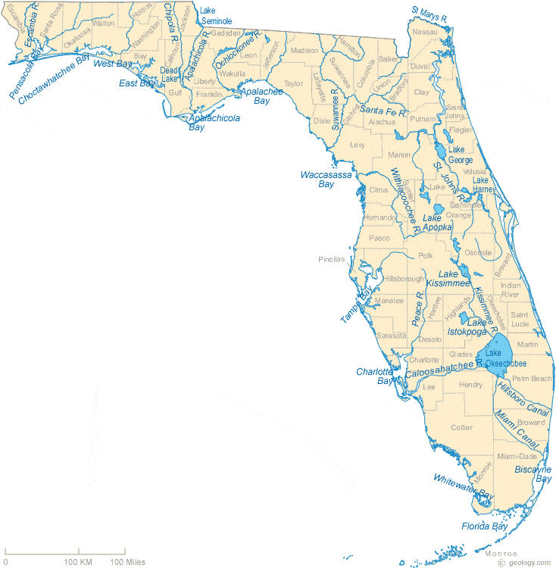
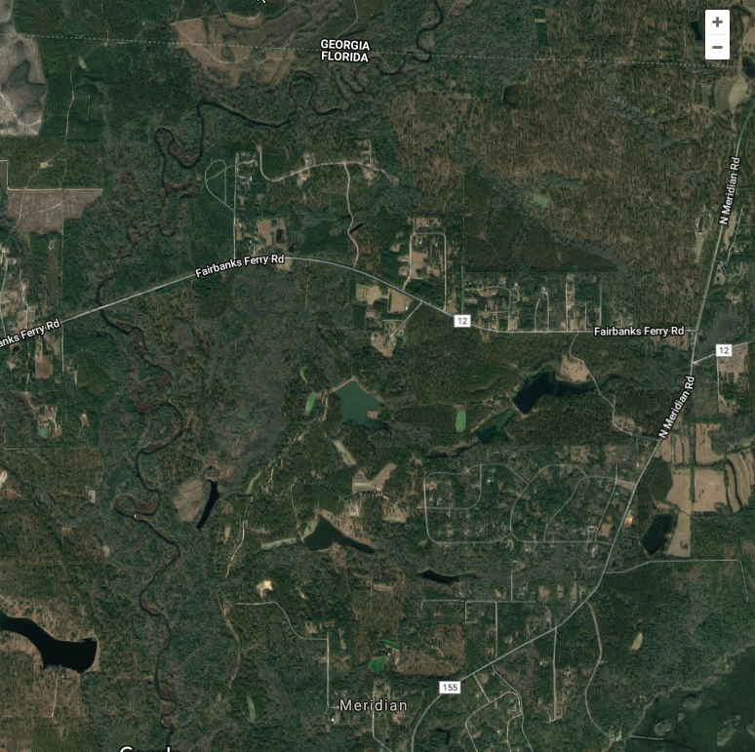
Ochlockonee River
500m

Slide 4
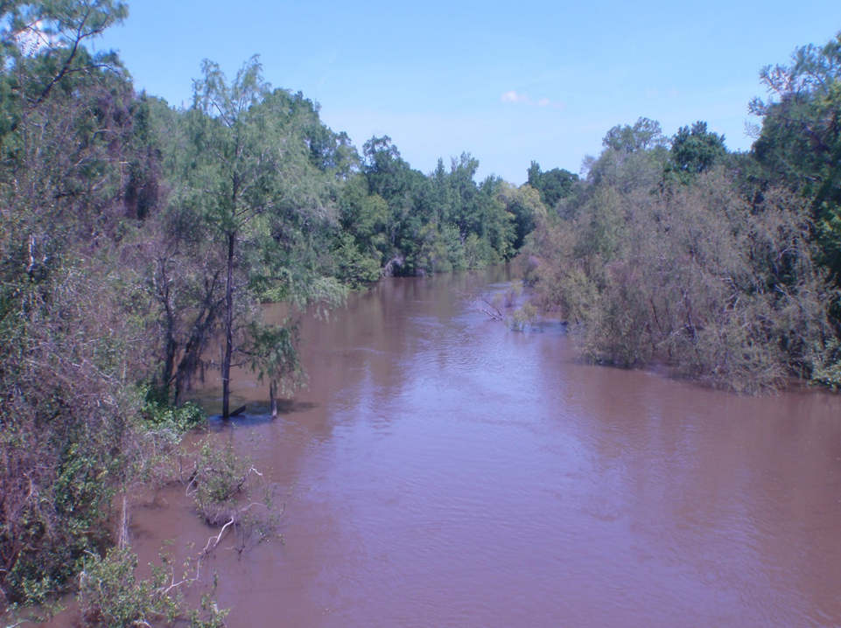
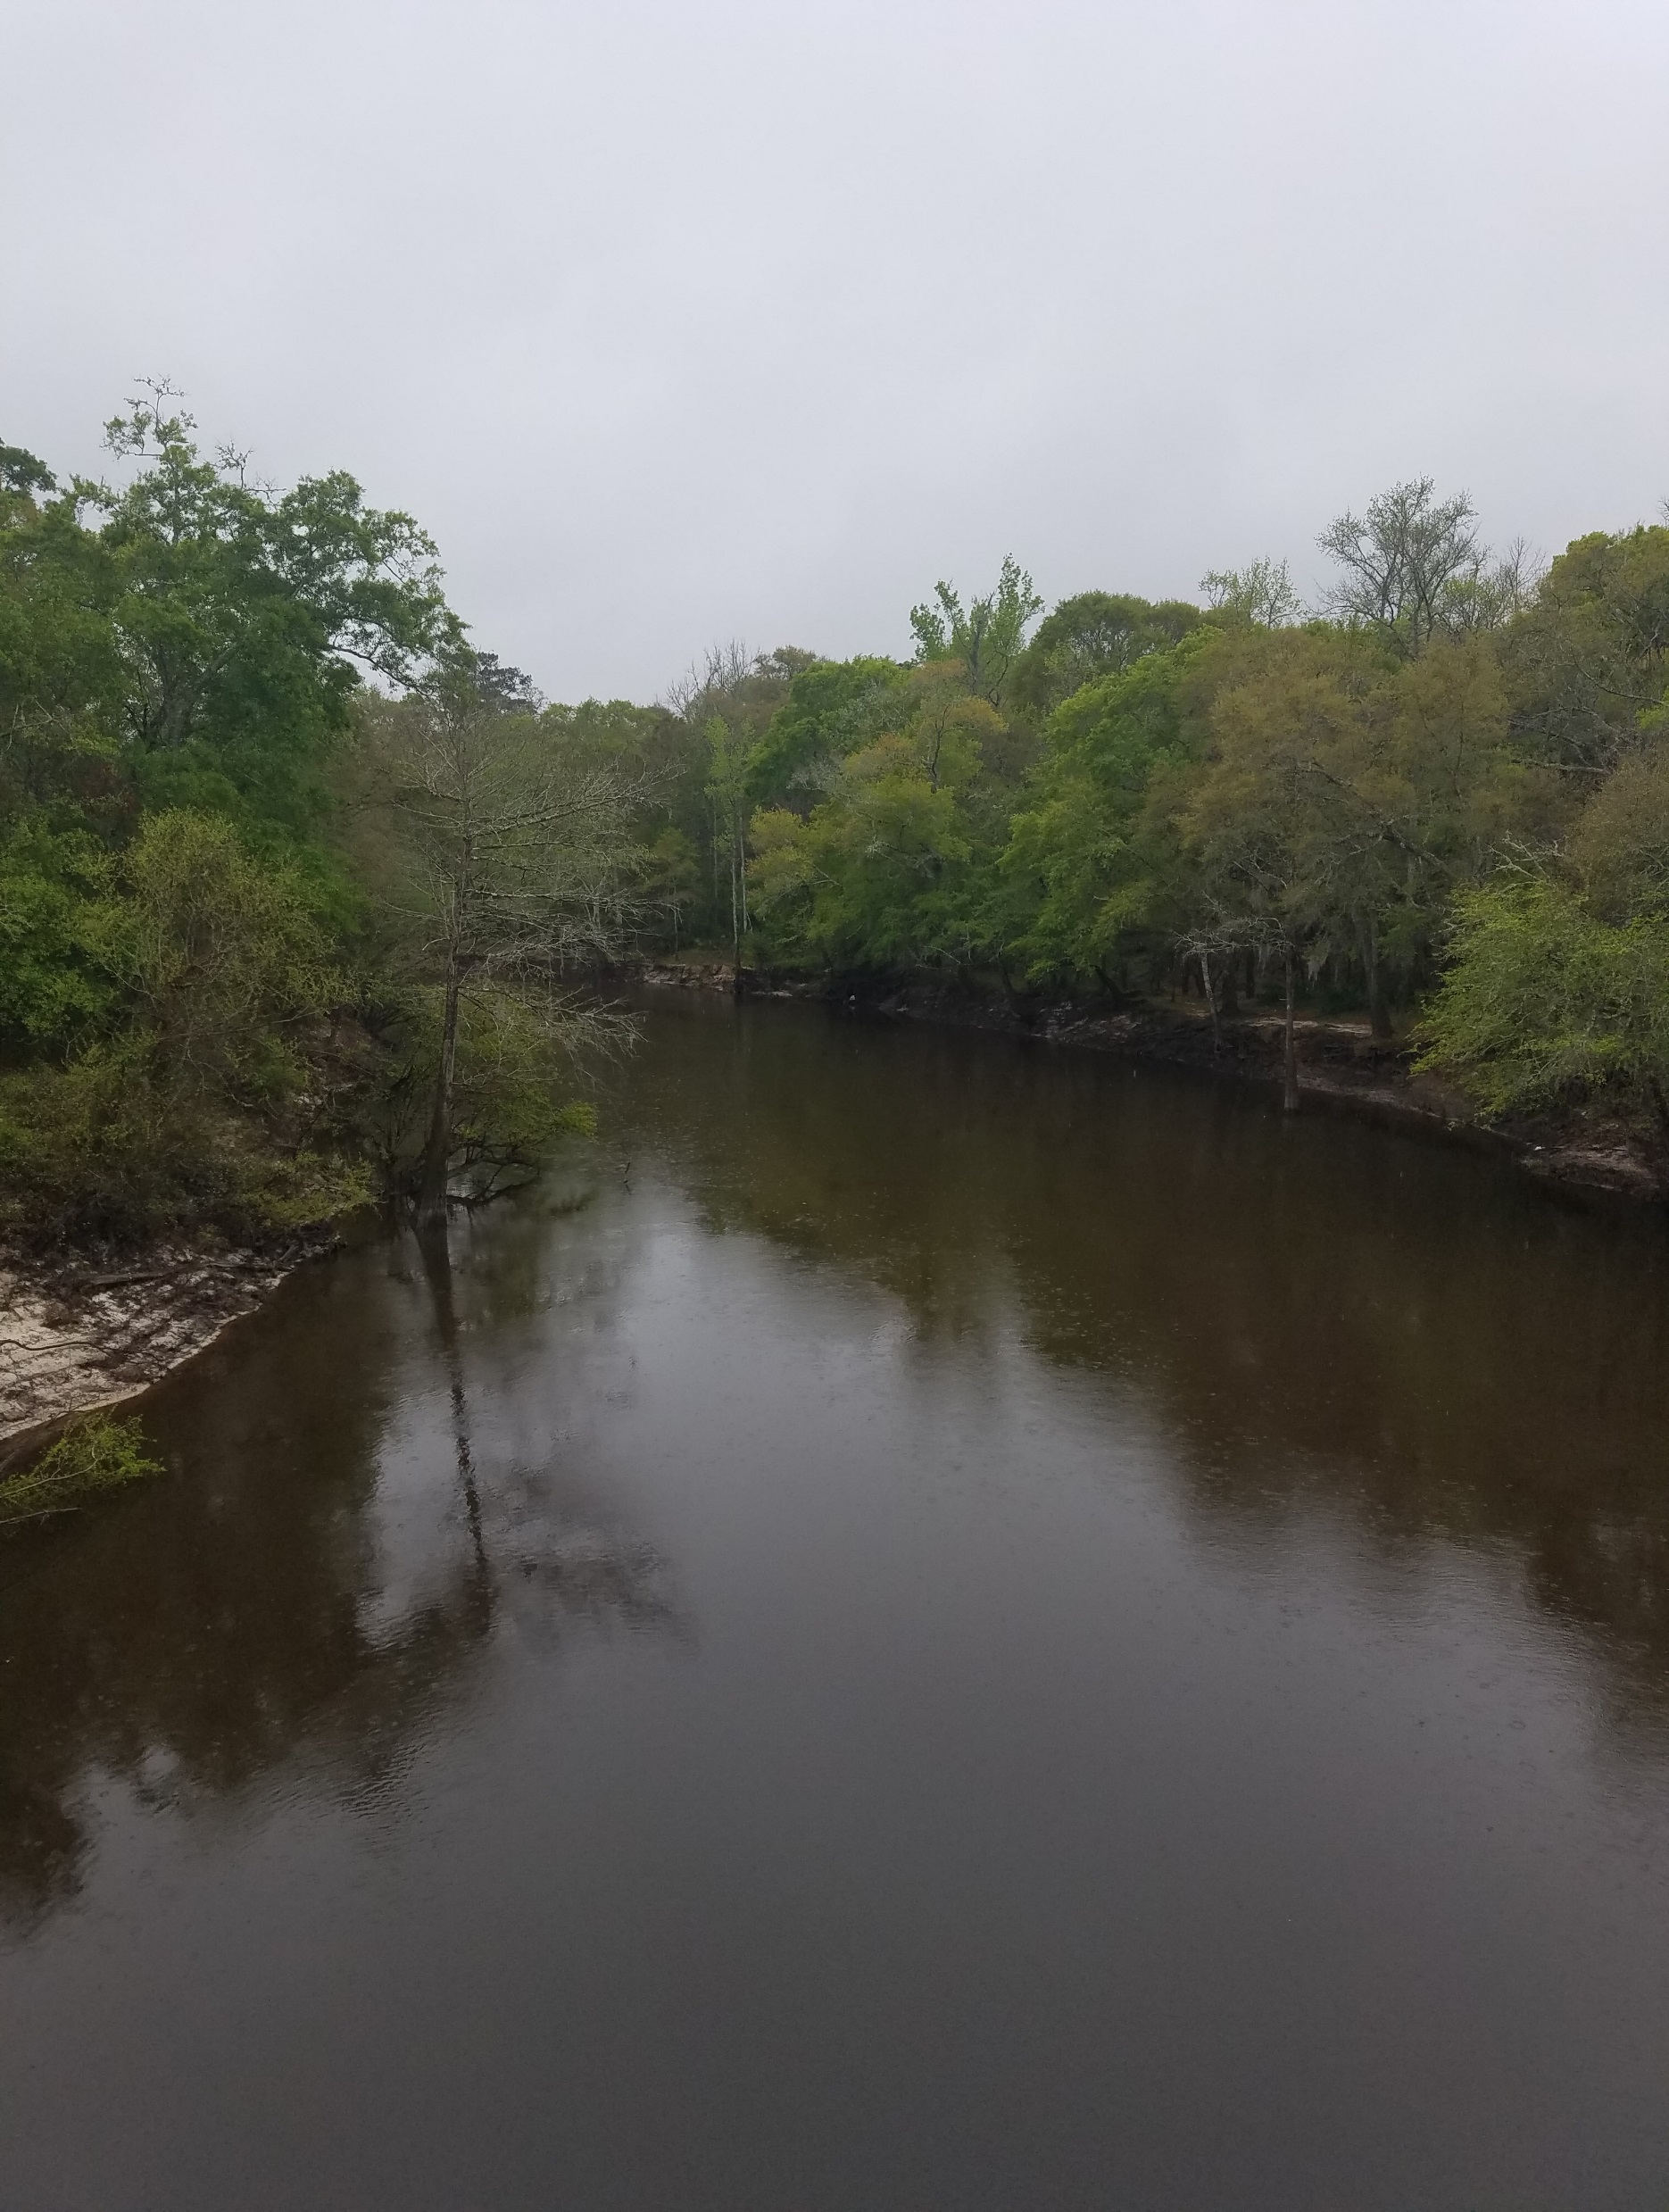
Ochlockonee River
190 miles long
The drainage basin is 1,002 square miles
River discharge averages 1,870 cubic feet/second.
Drainage basin receives sediments from the Coastal Plain province
The river receives effluent from the Georgia cities of Cairo, Thomasville and Moultrie.
Site is located just south of the FL-GA state line.
Sucralose maximum value detected was 2.6 µg/L
Notes:
joins the Gulf of Mexico at Ochlockonee Bay
2. at this sampling site (?)
3. but can range from a minimum of about 100 cfs up to 54,000 cfs

Slide 5
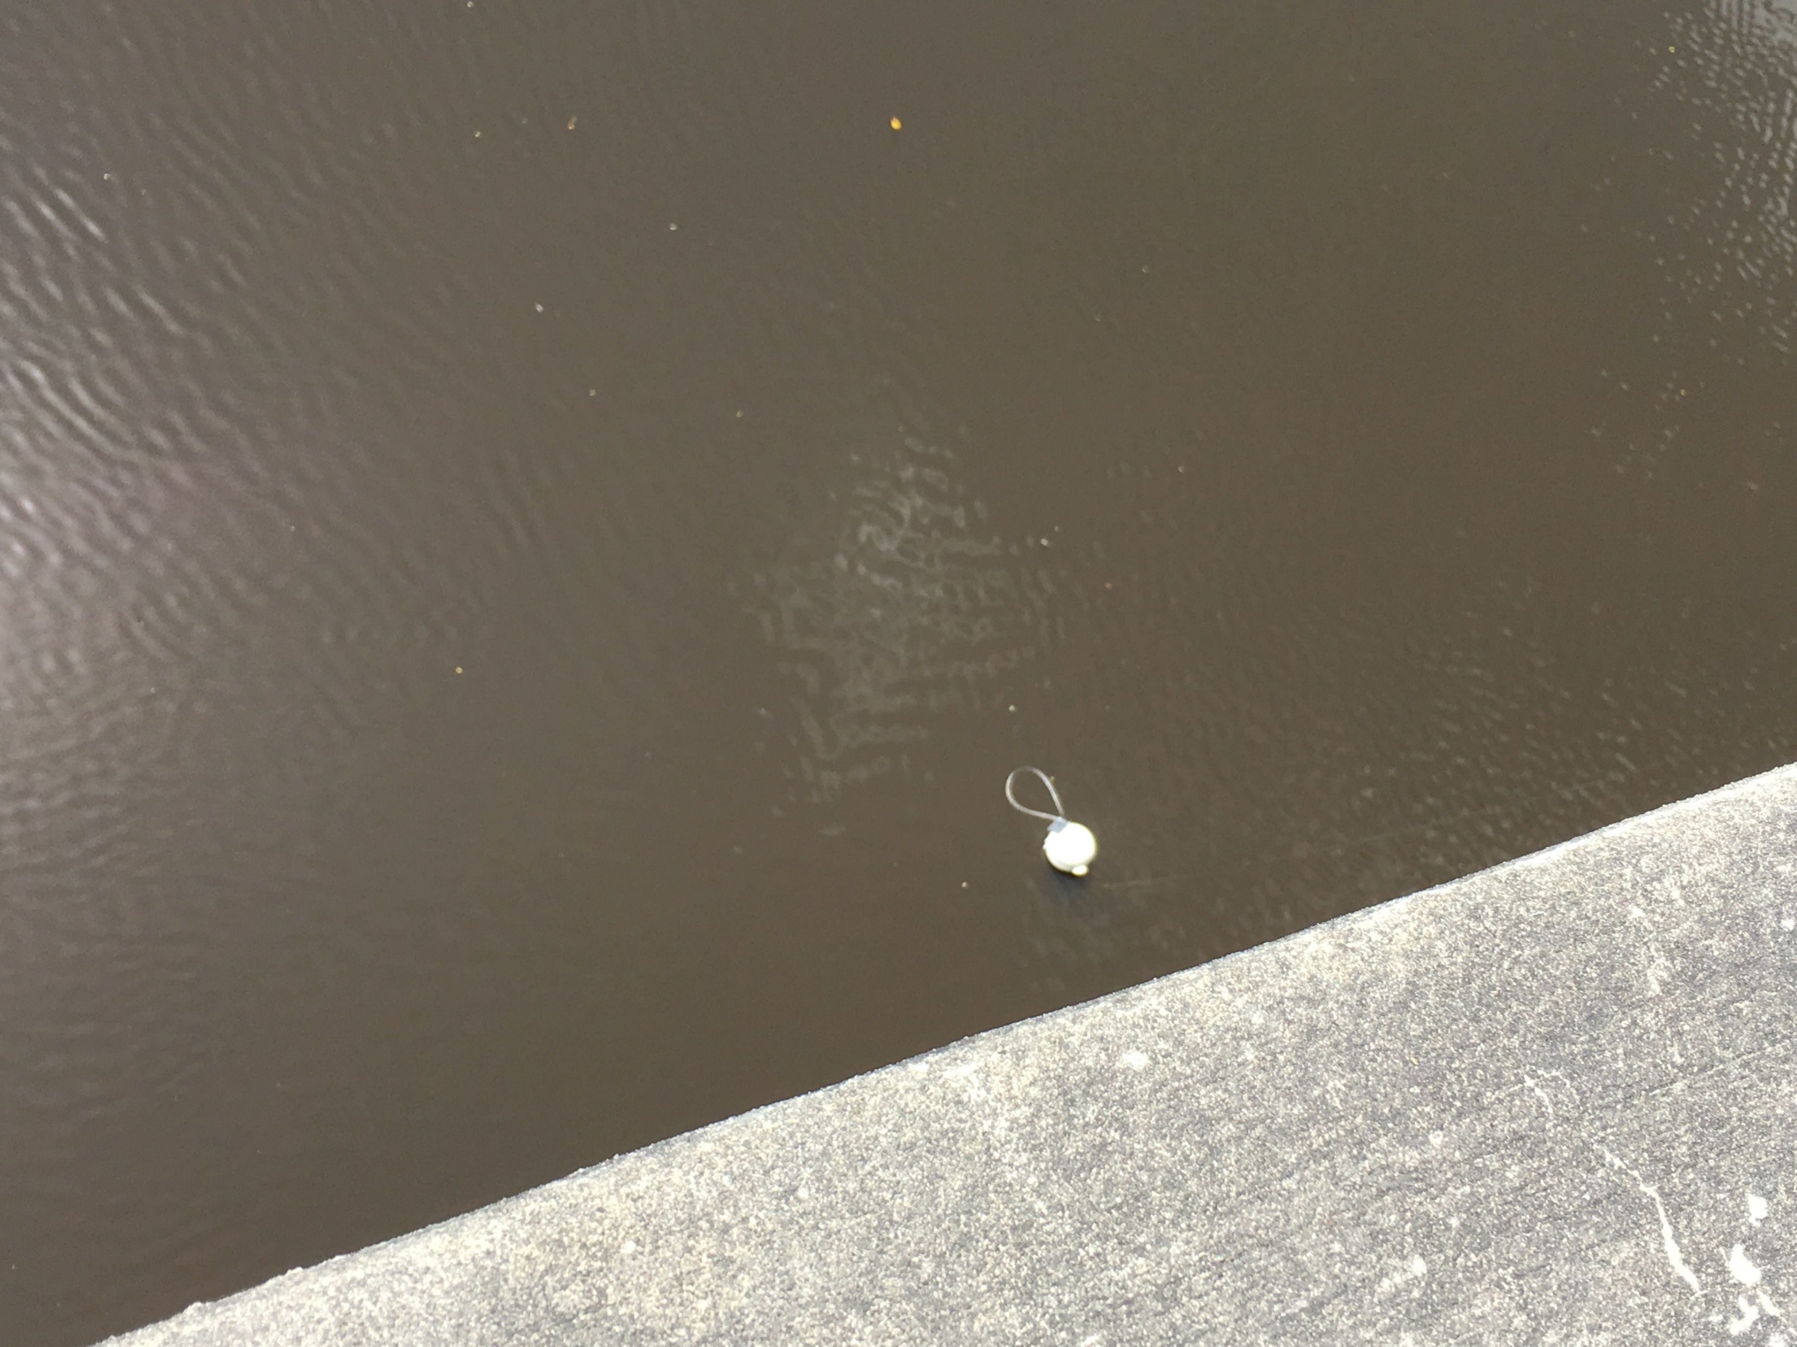
Sampler Location/Deployment

Slide 6
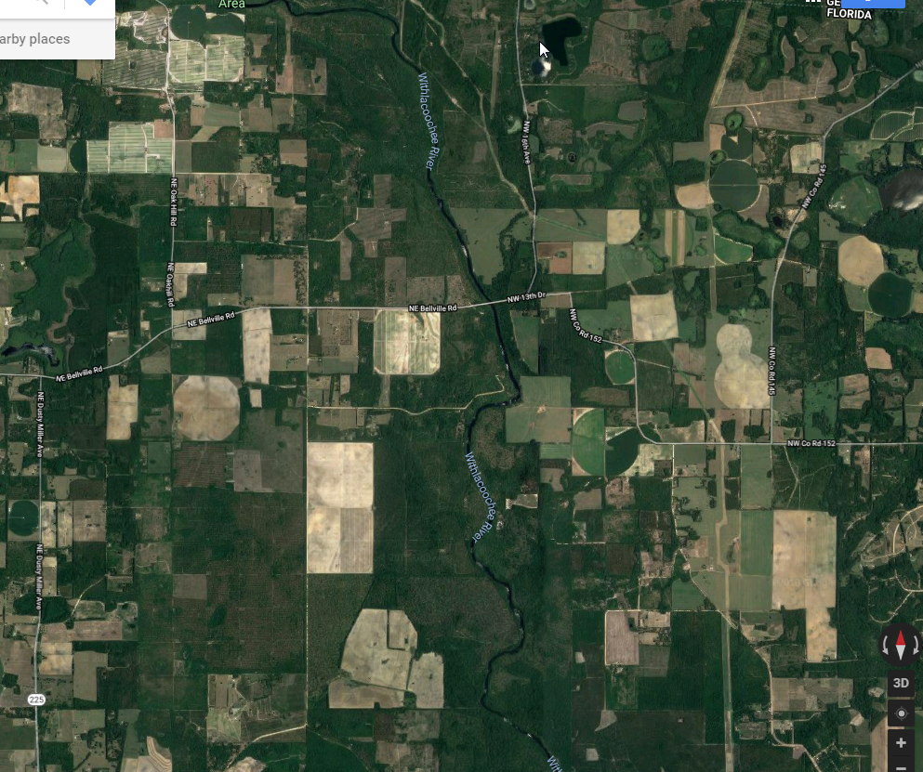
Withlacoochee River
1km

Slide 7
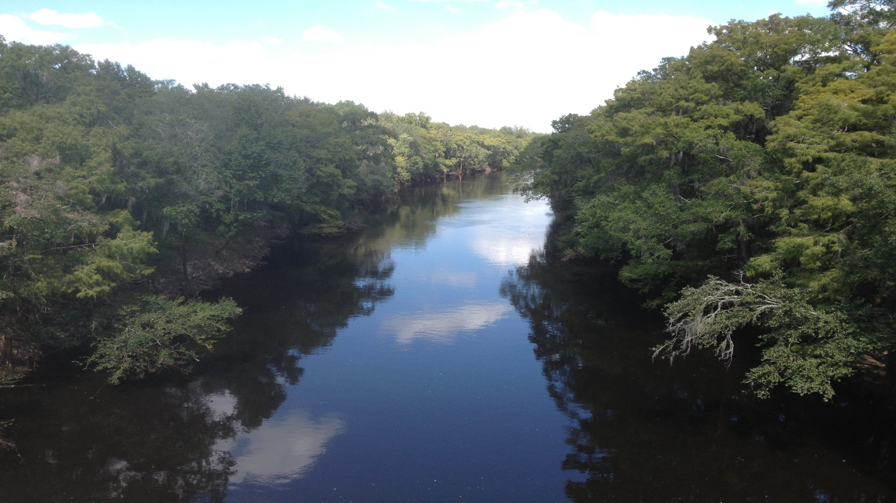
Withlacoochee River
112 miles long.
The drainage basin is 2,120 square miles.
Discharge average 1,870 cubic feet/second.
Drainage basin receives sediments from only the Coastal Plain province.
The river receives effluent from the city of Valdosta about 20 miles upstream of site.
The Withlacoochee River joins with the Suwannee River downstream from the site.
Site is located at state line.
Sucralose maximum value detected was 2.9 µg/L
Notes:
3. but can range from a minimum of 100 cfs up to 78,000 cfs
5. this particular WWTP has a long history of overflows during high rainfall events
6. The Suwannee R has an extra level of protection afforded it by Florida state law.

Slide 8
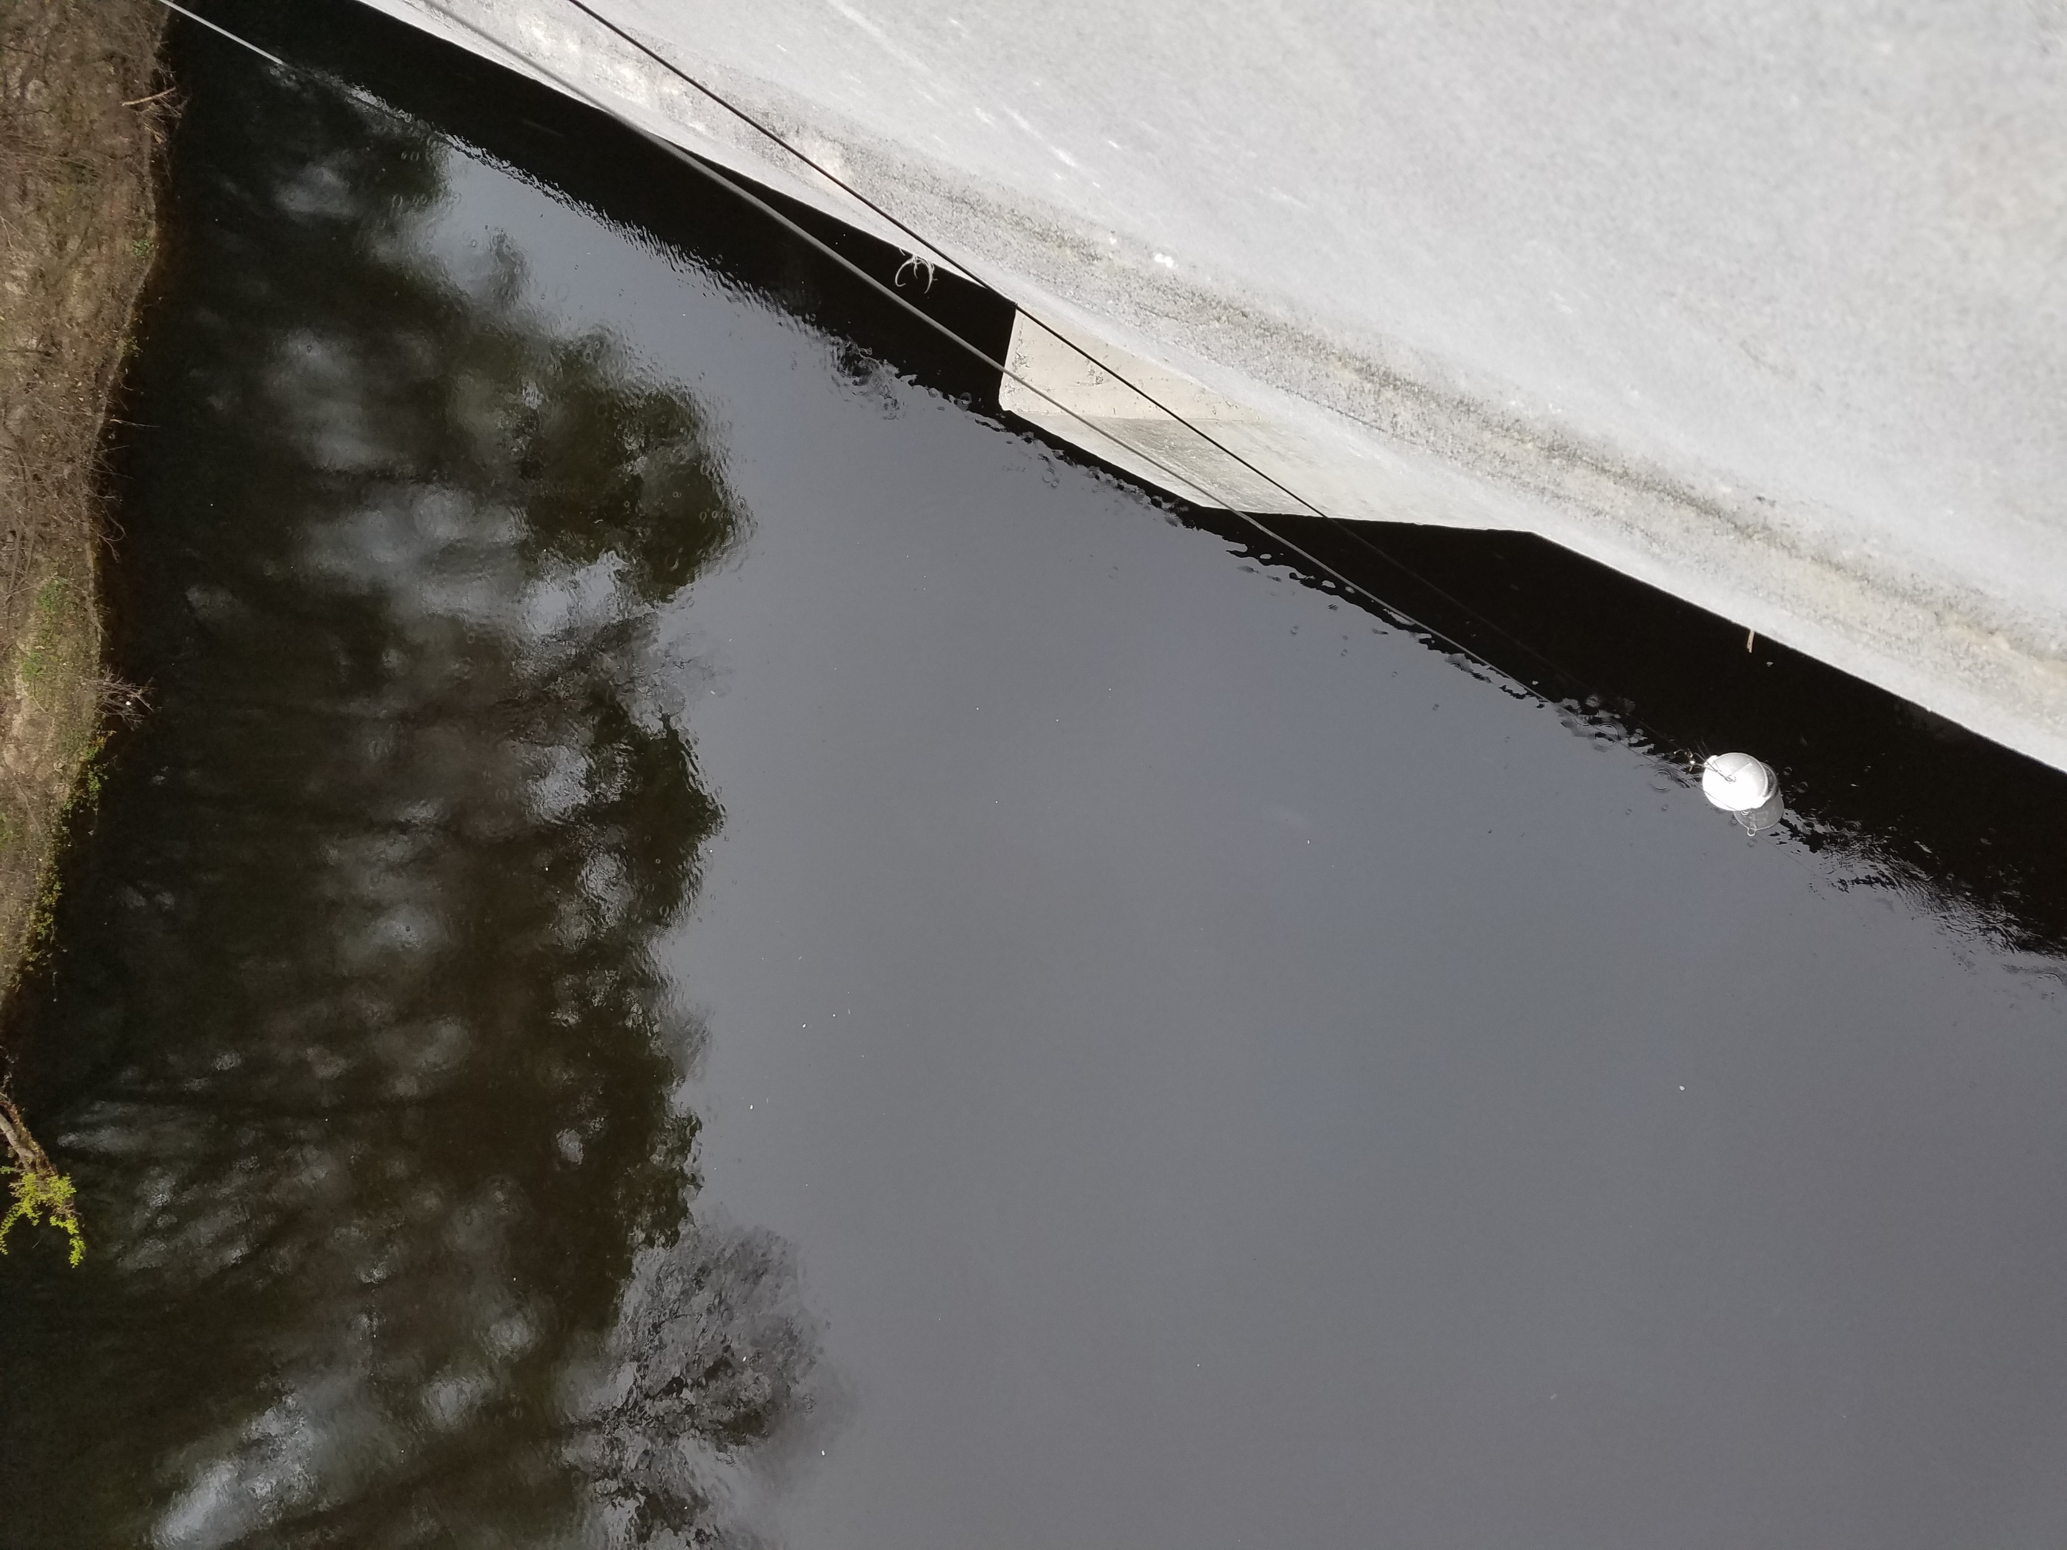
Sampler Location/Deployment

Slide 9
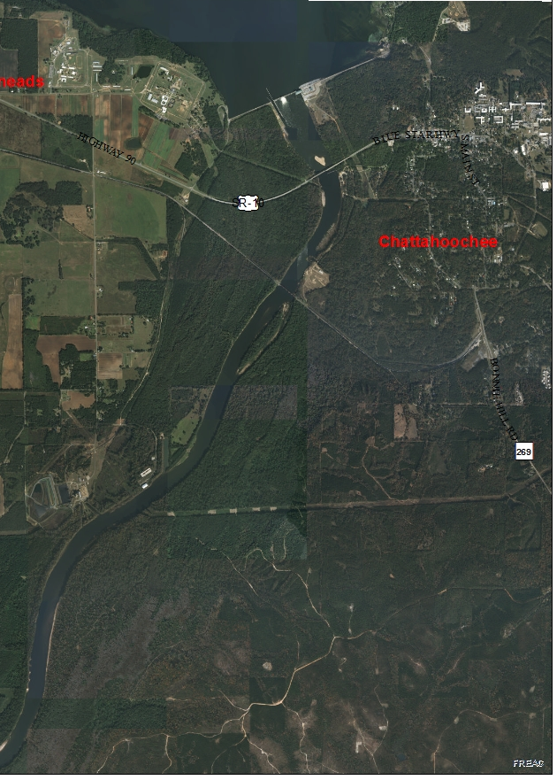
Apalachicola River
1km
SR-10

Slide 10
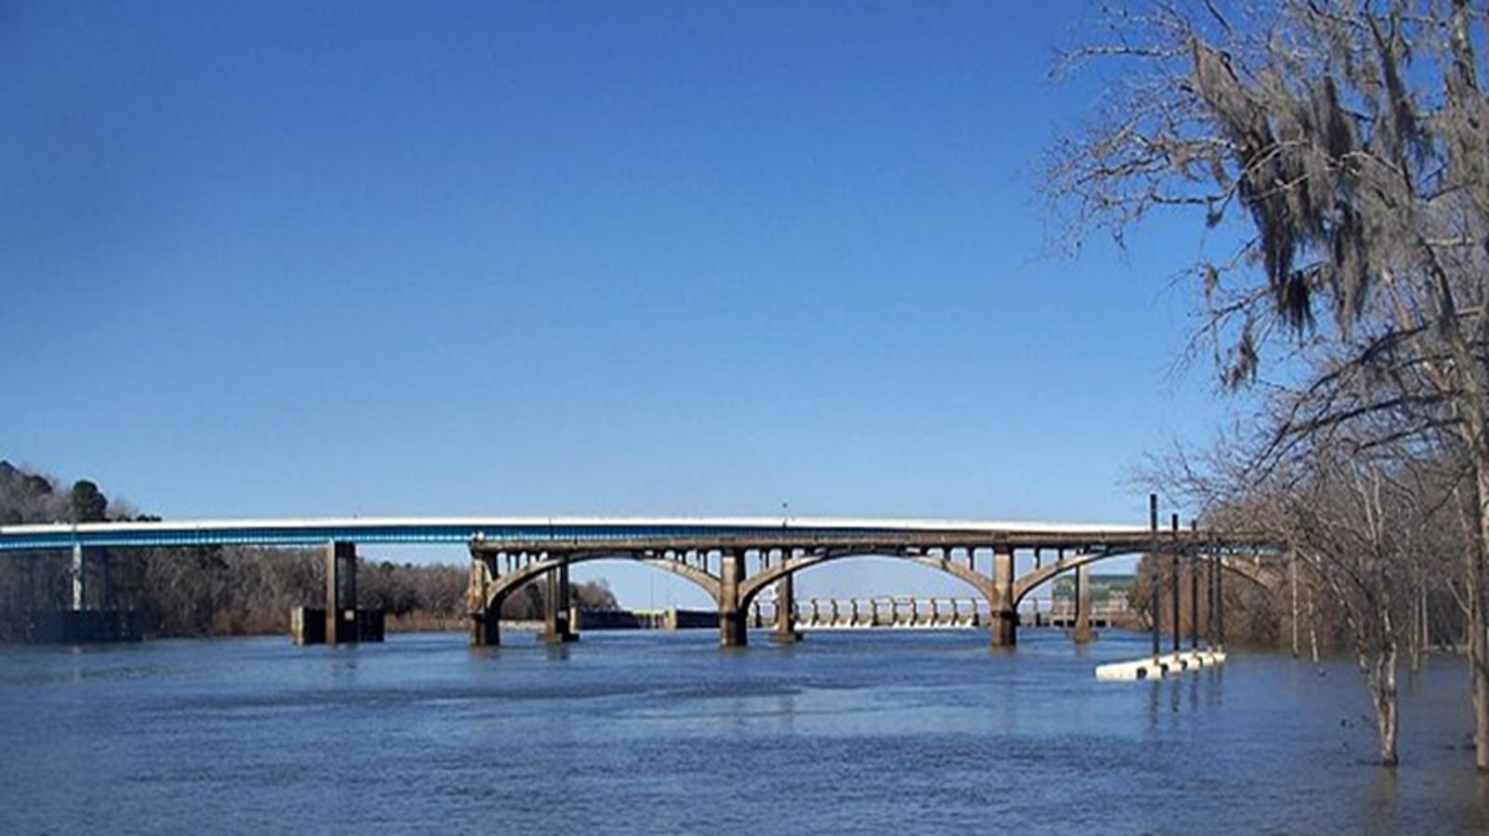
Apalachicola River
Largest river in Florida, based on discharge.
The ACF drainage basin is 17,230 square miles
Discharge averages 16,500 cubic feet/second.
Drainage basin receives sediments from the Blue Ridge, Piedmont and Coastal Plain provinces of Georgia.
Multiple cities use both rivers for effluent discharges (Atlanta metropolitan area, Griffin, Columbus, Bainbridge).
Both basins have significant agriculture presence.
Site located at state line downstream from Woodruff Dam.
Sucralose maximum value detected was 0.95 µg/L.
Notes:
1.Formed by confluence of the Chattahoochee and Flint Rivers, and measures 112 miles long.
2. drainage basin of 430 mile long Chattahoochee is 8,770 square miles; the drainage basin of the 344 mile long Flint River is 8,460 square miles.
3.can range from a minimum of 5,000 cfs (mandated by ACOE) to over 175,000 cfs
4. river sediments still contain visible muscovite mica flakes)
7. forms Lake Seminole, one of the largest lakes in Georgia.

Slide 11
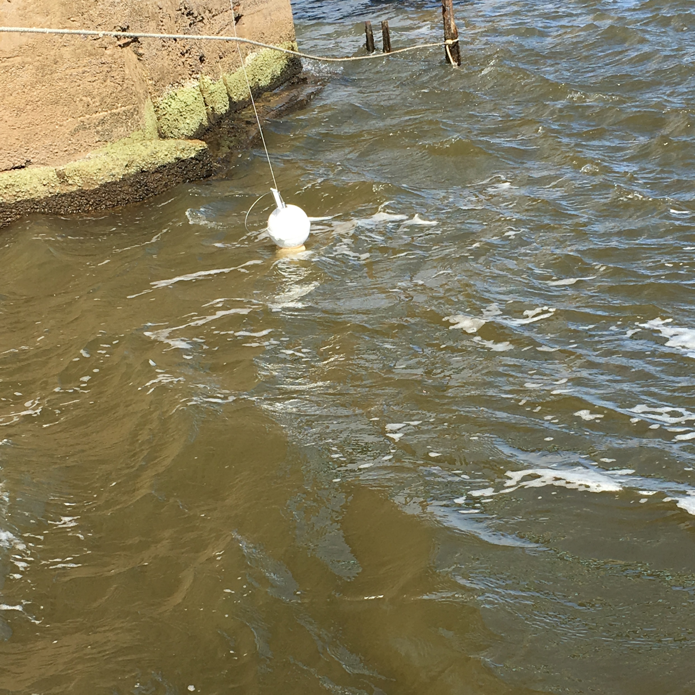
Sampler Location/Deployment

Slide 12
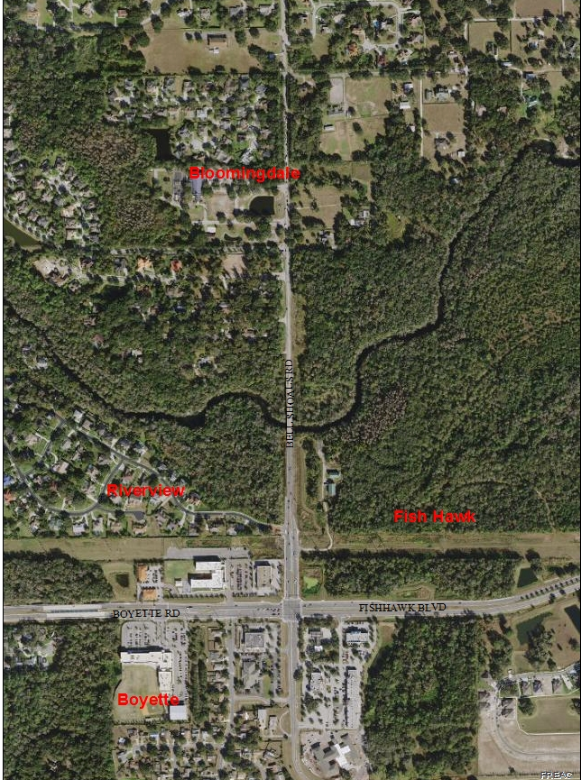
Alafia River
200m

Slide 13
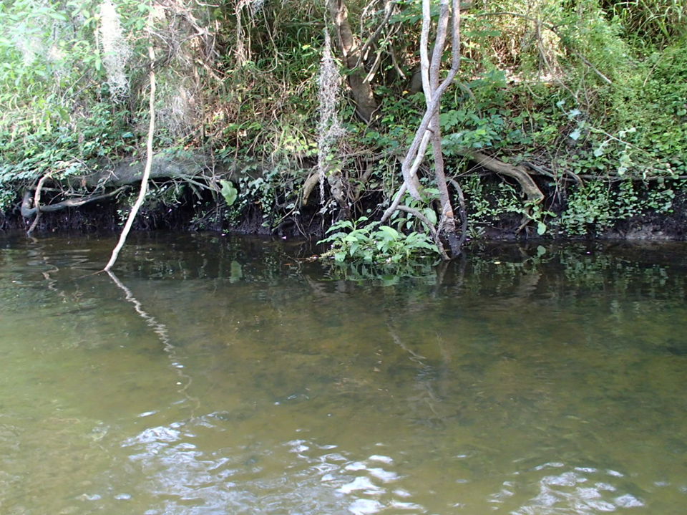
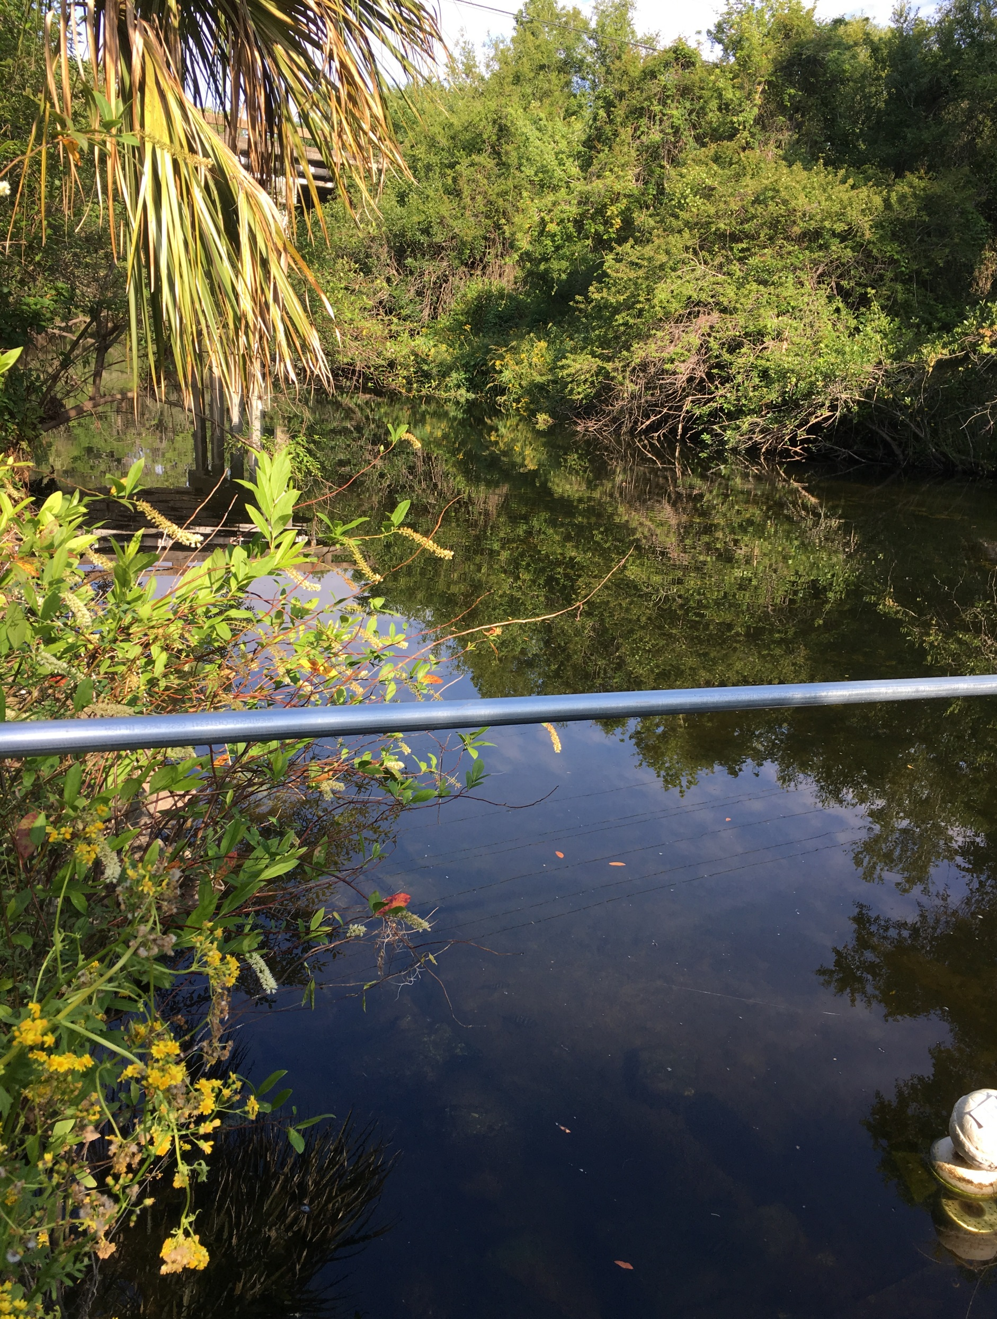
Alafia River
25 miles long, just a few feet above sea level for most of its length.
Watershed is 335 square miles.
Discharges an average of 200 cubic feet/second.
Numerous land uses influence quality of the river, including the City of Lakeland WWTP, phosphate mine sites and phosphate ore processing sites, and agriculture.
Salt water tidal influence occurs upstream from Tampa Bay.
Sampling site is downstream of the confluence of the North & South Prongs of the river at Tampa Bay Water Authority (TBWA) withdrawal point.
Sucralose maximum value detected was 7.3 µg/L
Notes:
2. located entirely in Hillsborough and western Polk County
3. but can range from a minimum of about 40 cfs up to 21,000 cfs
5. indicated by higher specific conductivity in samples
6. near a Tampa Bay Water freshwater withdrawal site.

Slide 14
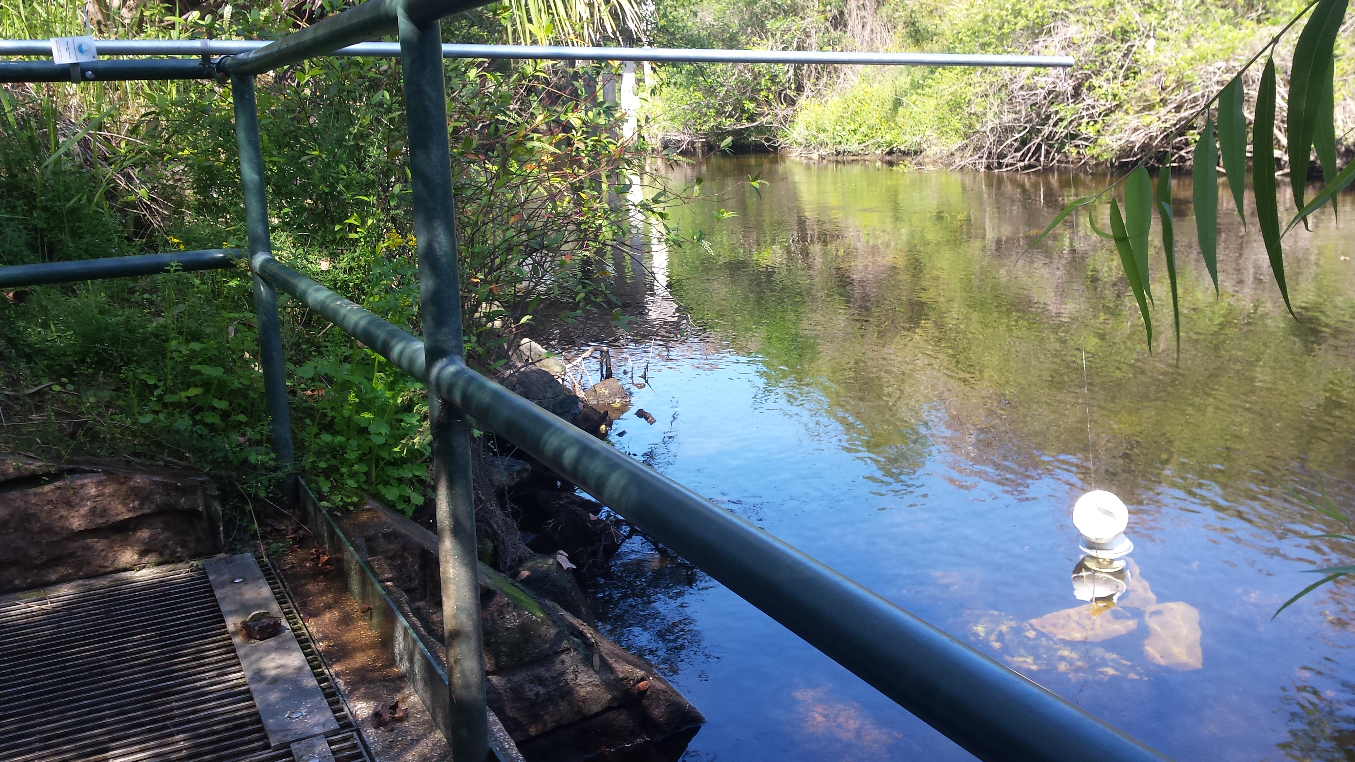
Sampler Location/Deployment

Slide 15
Site Comparisons
Color | Alafia | Apalachicola | Withlacoochee | Ochlockonee
Mean | 79 | 42 | 90 | 108
Median | 60 | 40 | 80 | 100
Min | 15 | 5 | 5 | 15
max | 250 | 160 | 400 | 300
Spec Cond. | Alafia | Apalachicola | Withlacoochee | Ochlockonee
Mean | 477 | 130 | 160 | 134
Median | 465 | 131 | 159 | 114
Min | 184 | 69 | 49 | 37
max | 1052 | 174 | 277 | 386
Notes:
lower color of the Apa due to larger drainage basin diluting black water from riverine wetlands
higher specific conductivity of the Alafia River, indicating human influences upstream as well as possible tidal influence / upwelling

Slide 16
Site Comparisons
Alkalinity (mg/L CaCO₃) | Alafia | Apalachicola | Withlacoochee | Ochlockonee
Mean | 93 | 42 | 54 | 27
Median | 94 | 41 | 53 | 23
Min | 40 | 18 | 4 | 4
max | 163 | 69 | 114 | 81
Nox (mg/L) | Alafia | Apalachicola | Withlacoochee | Ochlockonee
Mean | 0.64 | 0.40 | 0.34 | 0.58
Median | 0.59 | 0.42 | 0.28 | 0.43
Min | 0.06 | 0.31 | 0.02 | 0.03
max | 3.5 | 0.76 | 1.9 | 2.8
Notes:
higher alkalinity of the Alafia River site due to higher calcium in the sediments upstream of site
higher total nitrogen in the Alafia River site, followed by the Ochlockonee River. Likely source is agriculture in both basins.

Slide 17
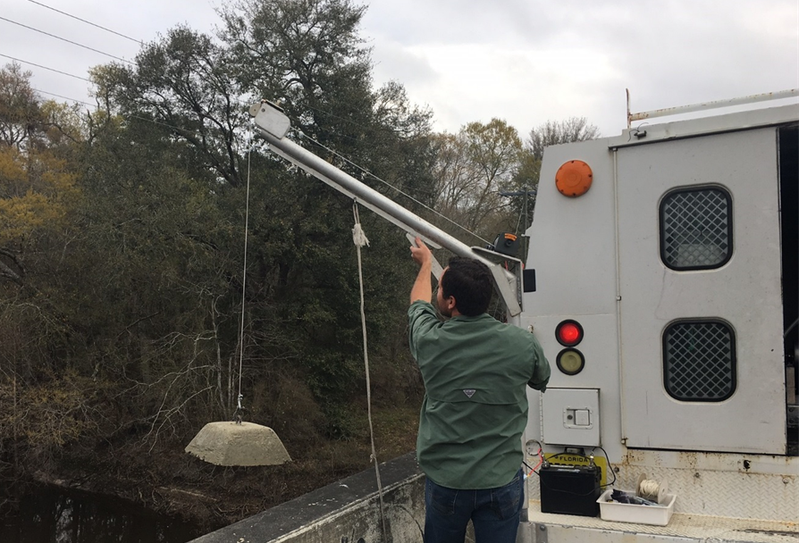
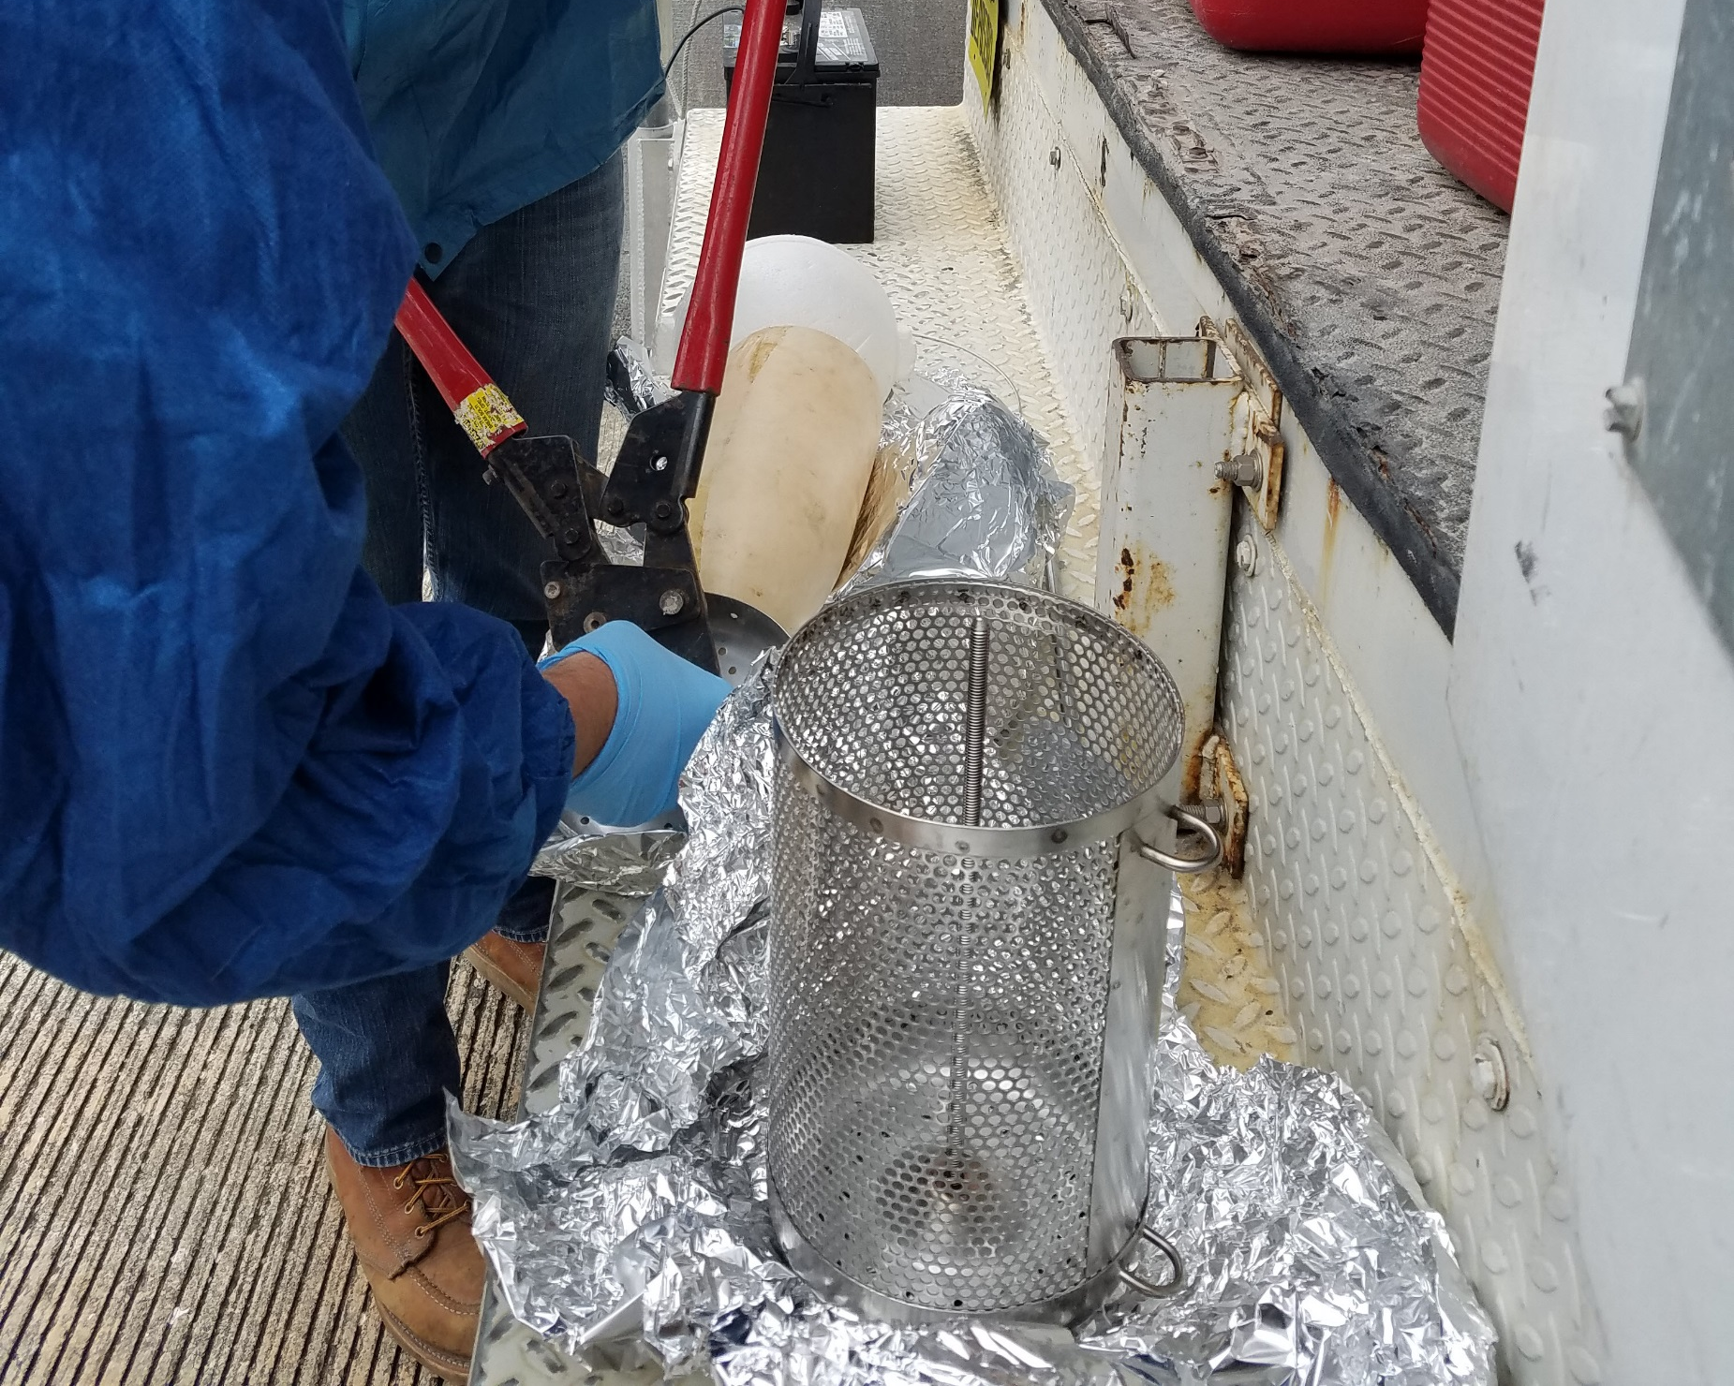
1. 60-80lb weight lowered using a 12volt ATV winch attached to a davit.
Sampler Deployment for
Ochlockonee, Withlacoochee & Apalachicola
2. Buoys were attached to top of canister.
Notes:
Only 30minutes max air time for sampler (including loading/unloading).~10-20mins

Slide 18
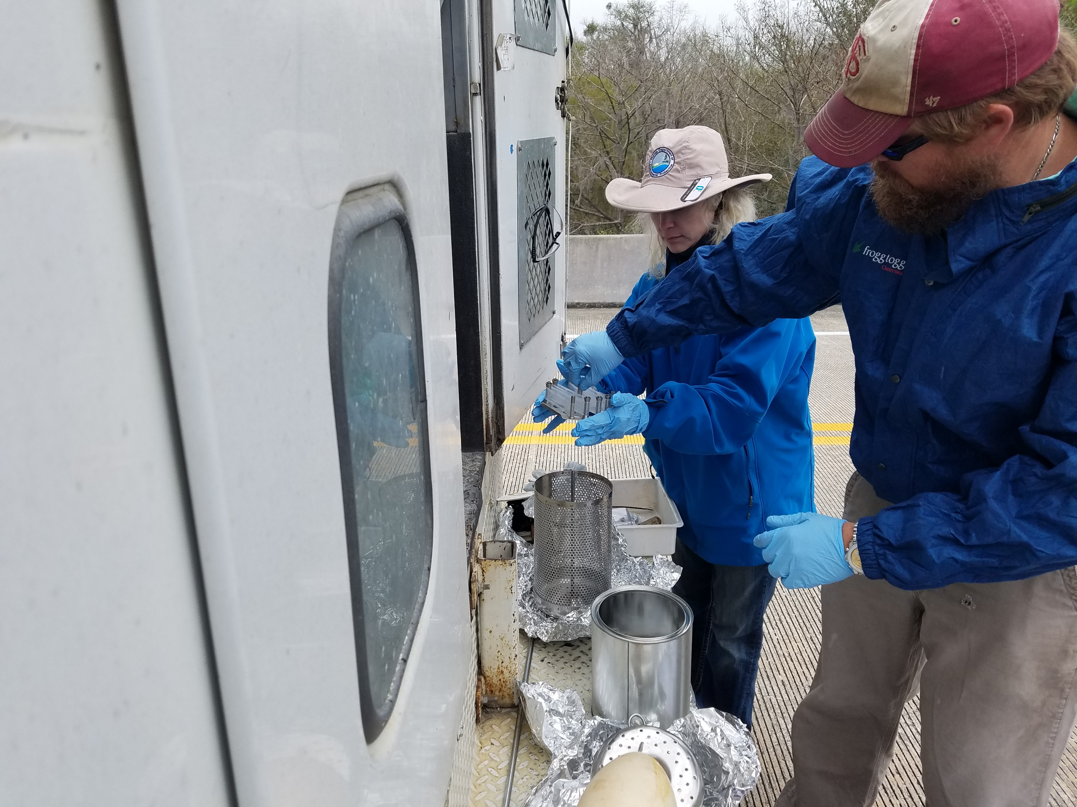
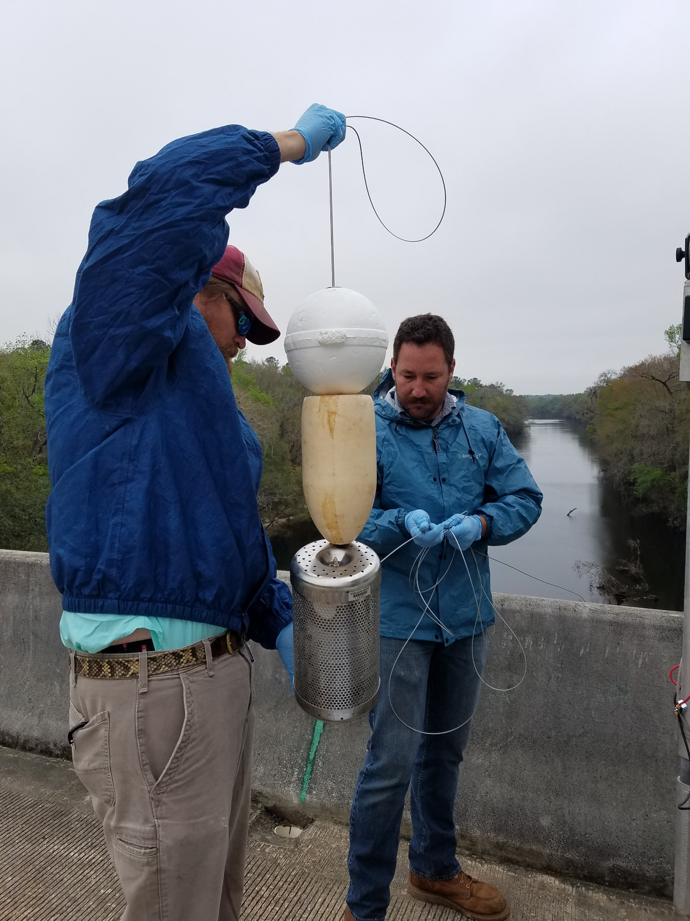
Sampler Deployment for
Ochlockonee, Withlacoochee & Apalachicola
3. Canister was loaded with POCIS and SPMDs.
4. Cable was attached to canister through slip rings.

Slide 19
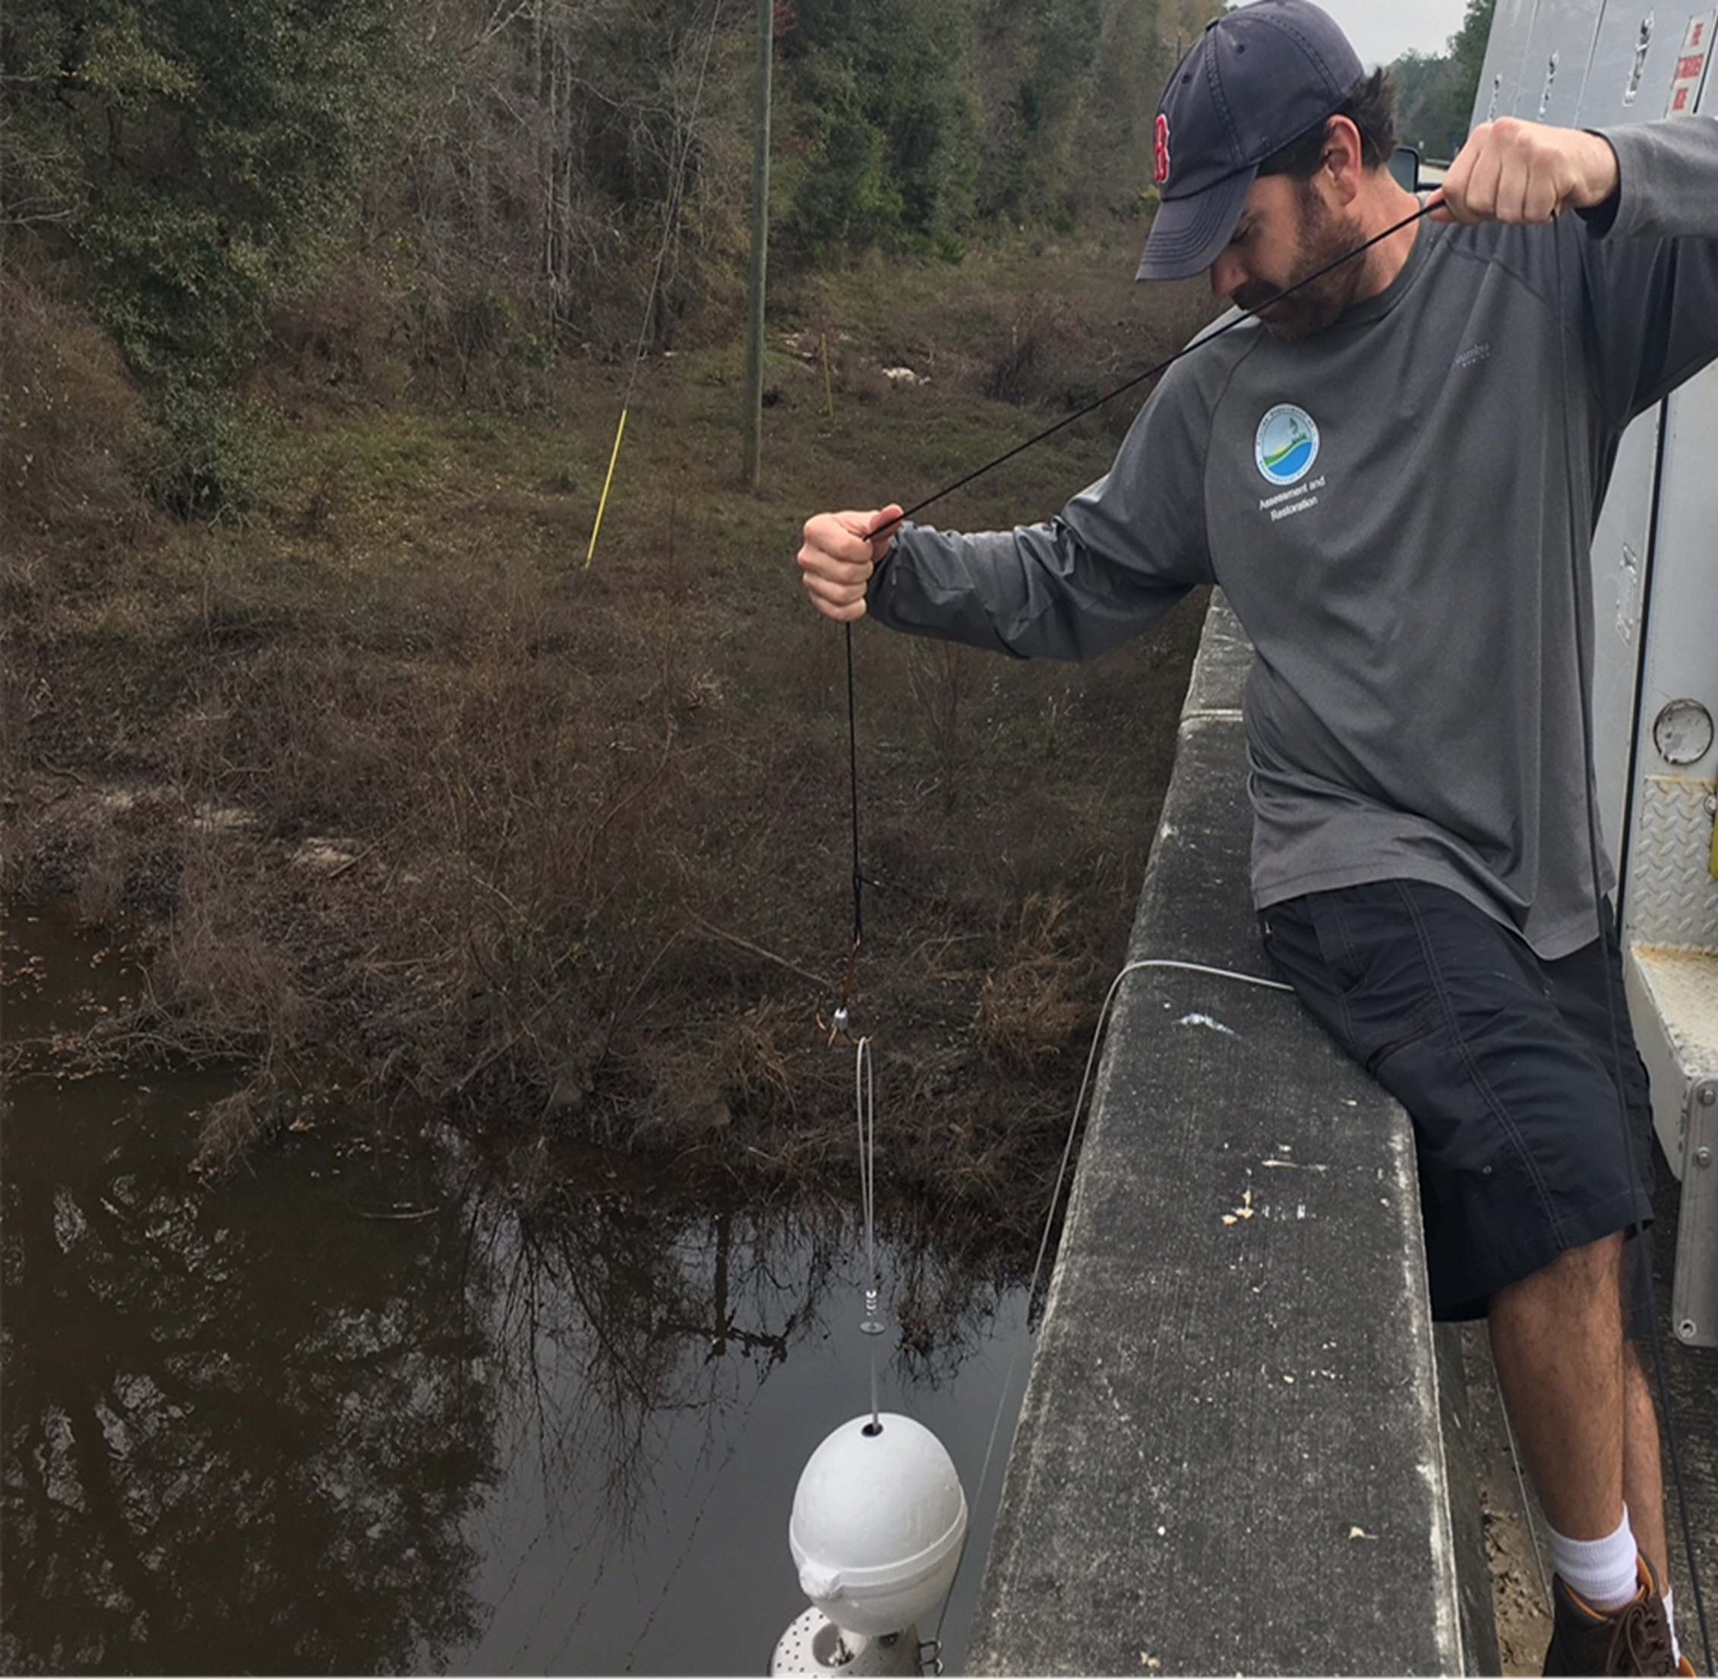
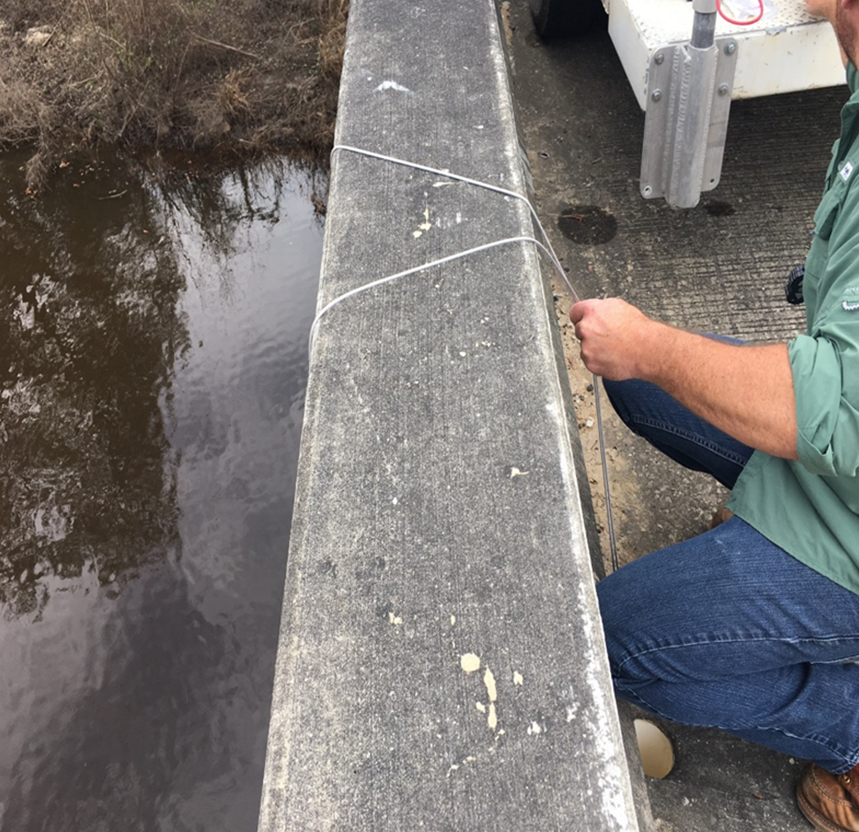
Sampler Deployment for
Ochlockonee, Withlacoochee & Apalachicola
5. Sampler lowered with large weighted treble hook.
6. Looped & attached cable to bridge through drain hole.

Slide 20
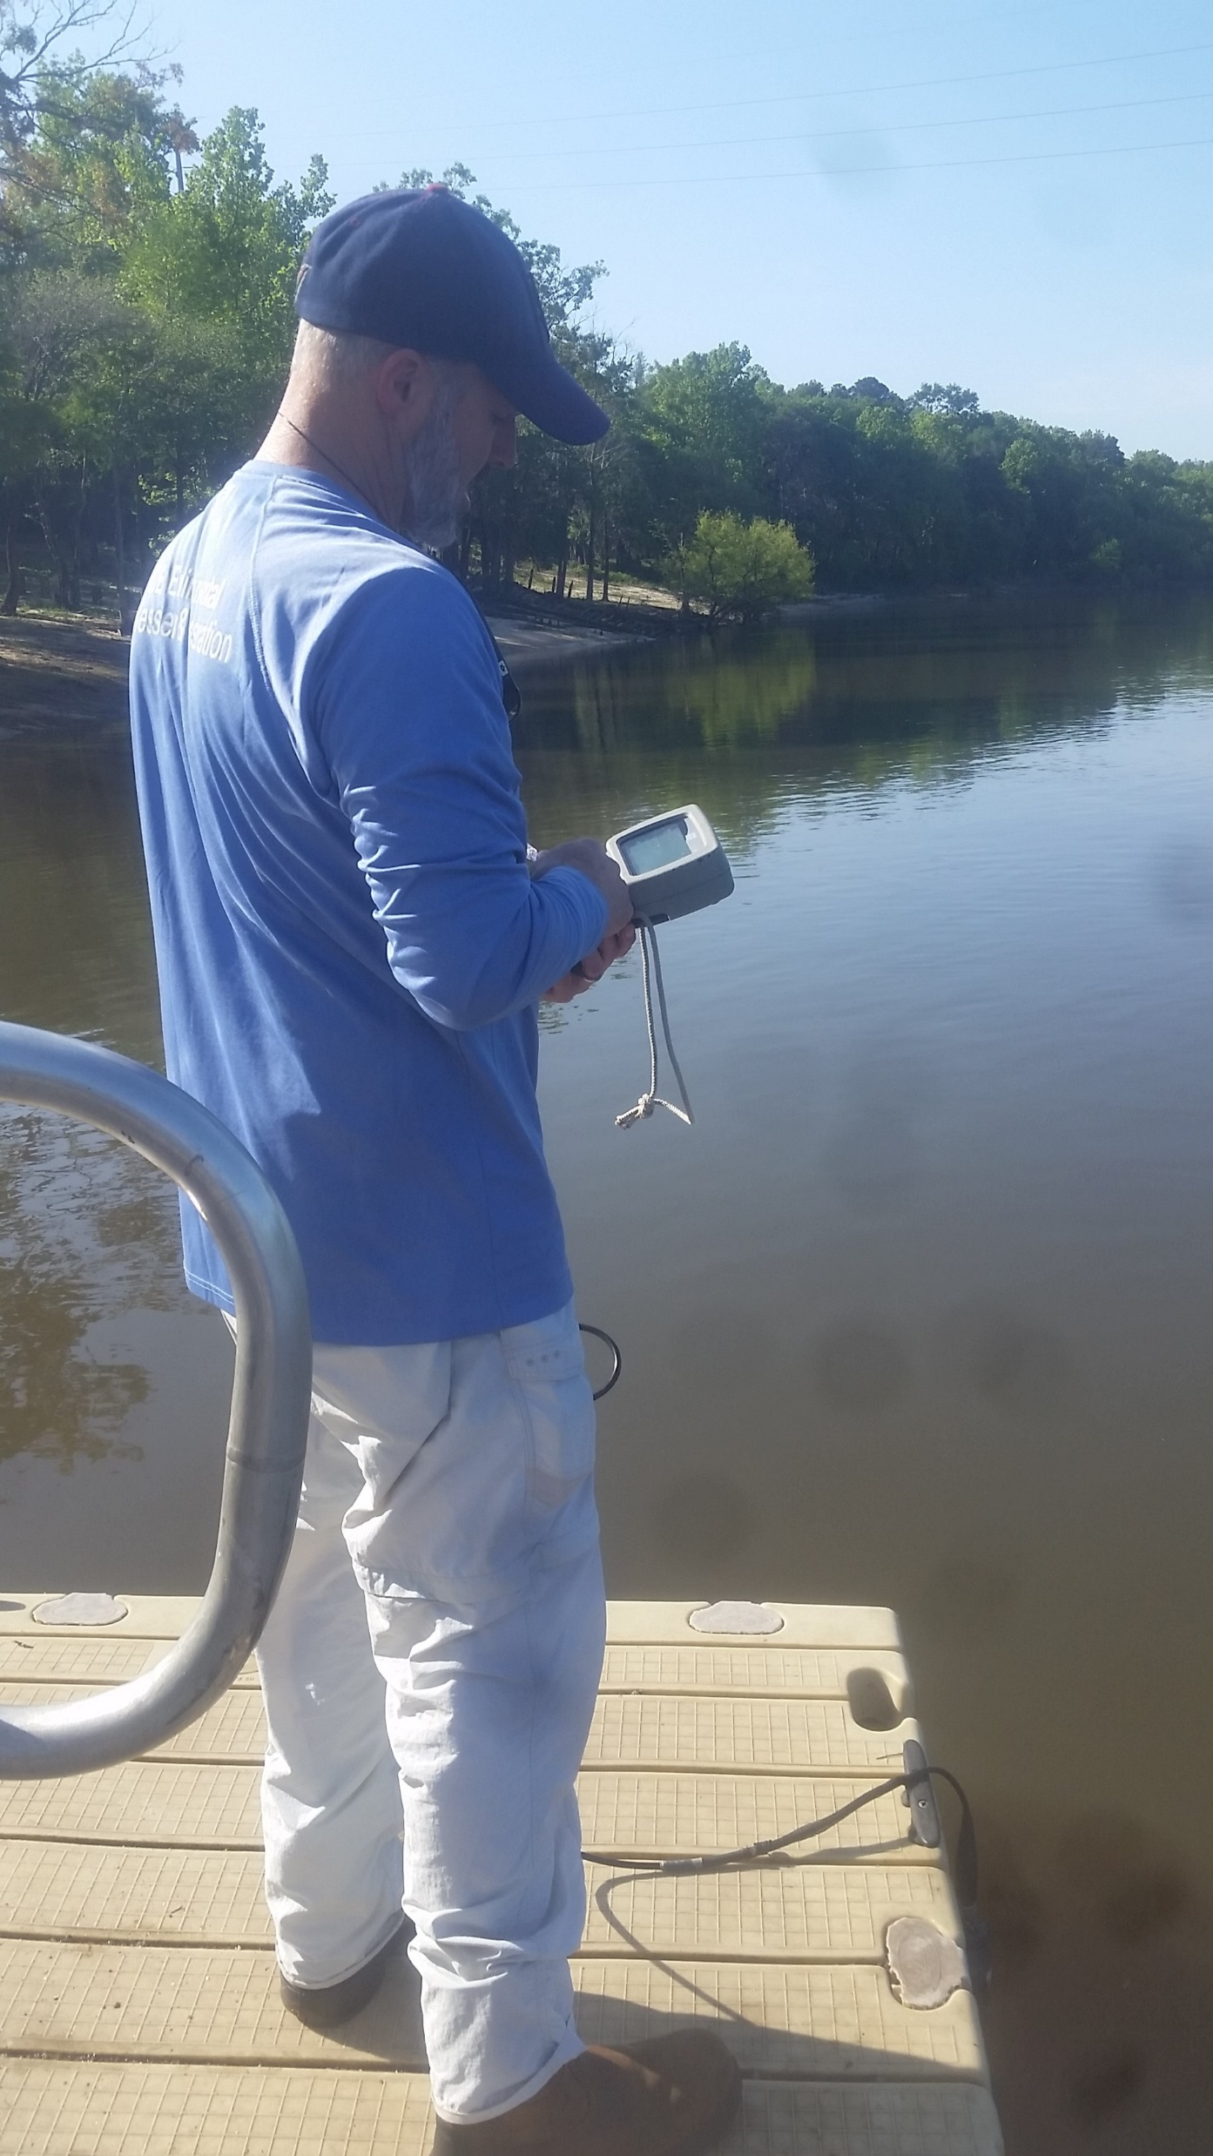
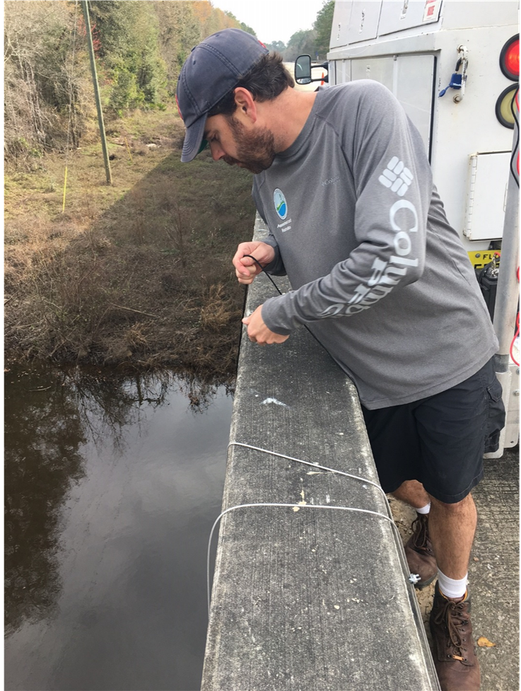
7. Sampler deployed 30 -35 days; Initial water quality parameters collected.
Sampler Deployment for
Ochlockonee, Withlacoochee & Apalachicola
8. Checked equipment & took field measurements halfway through.
Notes:
Water quality field measurements collected during device deployment, midway through deployment period, and during device retrieval
Grab samples collected before container was retrieved at all sites except alafia.. USED glass amber bottles

Slide 21
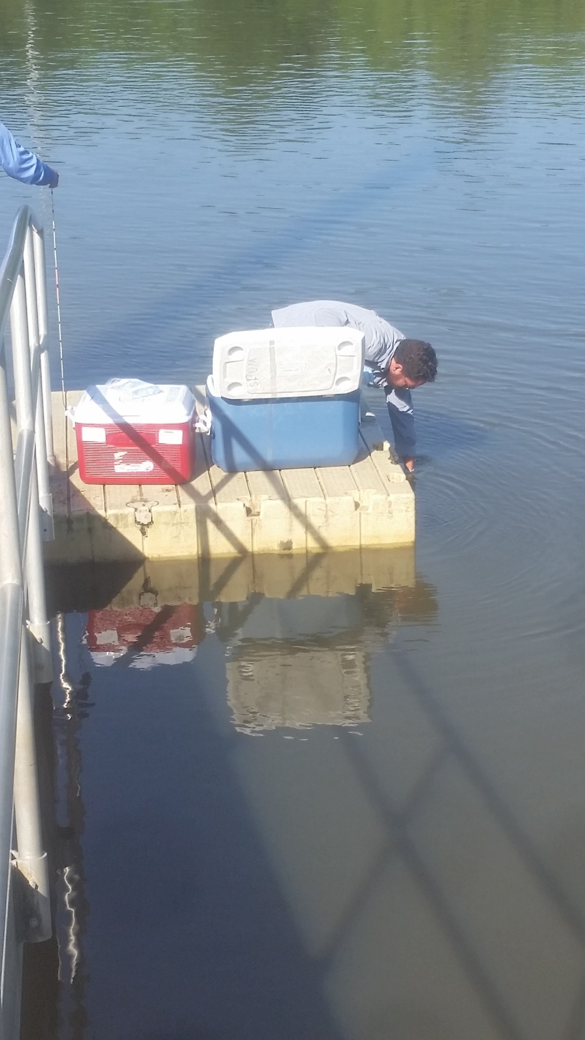
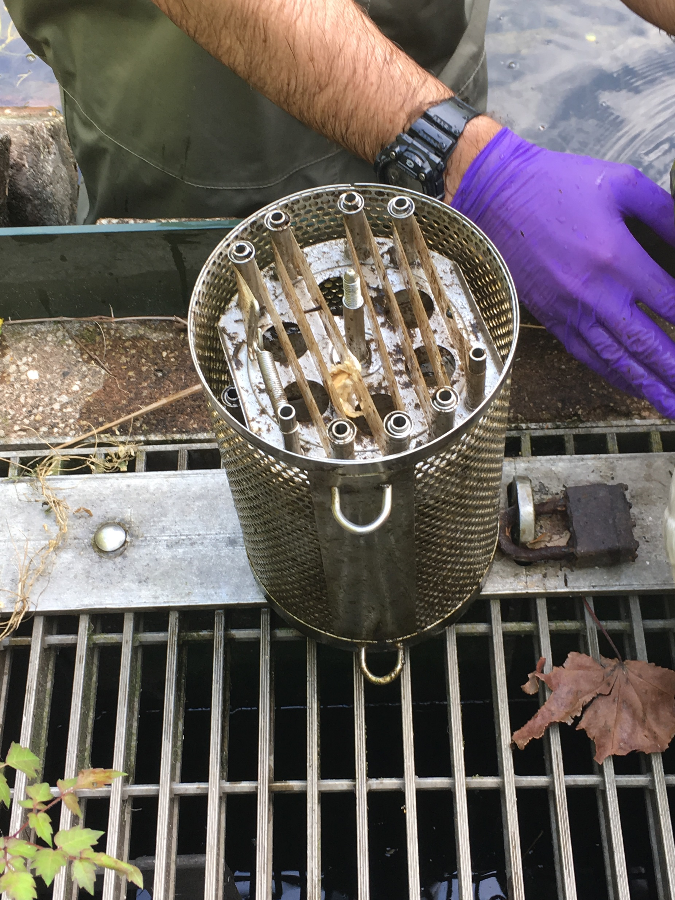
Sampler Deployment for
Ochlockonee, Withlacoochee & Apalachicola
9. Grab samples collected. Sampler retrieved using treble hook. Weight raised using the winch & davit.
10. Canister contents (POCISs, SPMDs) loaded into cans. Cans sealed, stored in ice, and shipped to SGS/Axys for extraction.

Slide 22






Review of Deployment
Ochlockonee, Withlacoochee & Apalachicola
Slip Rings
Cable
Roadway
Buoys
Sampler
Weight

Slide 23
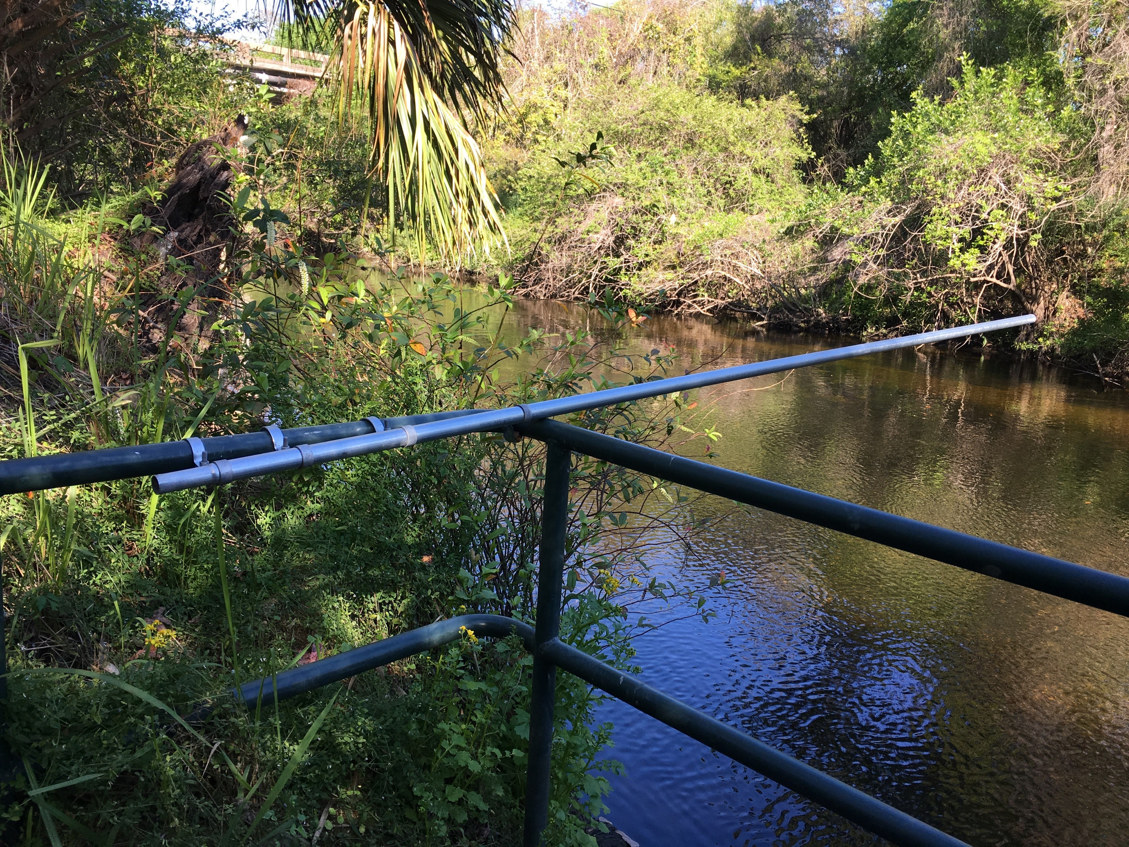
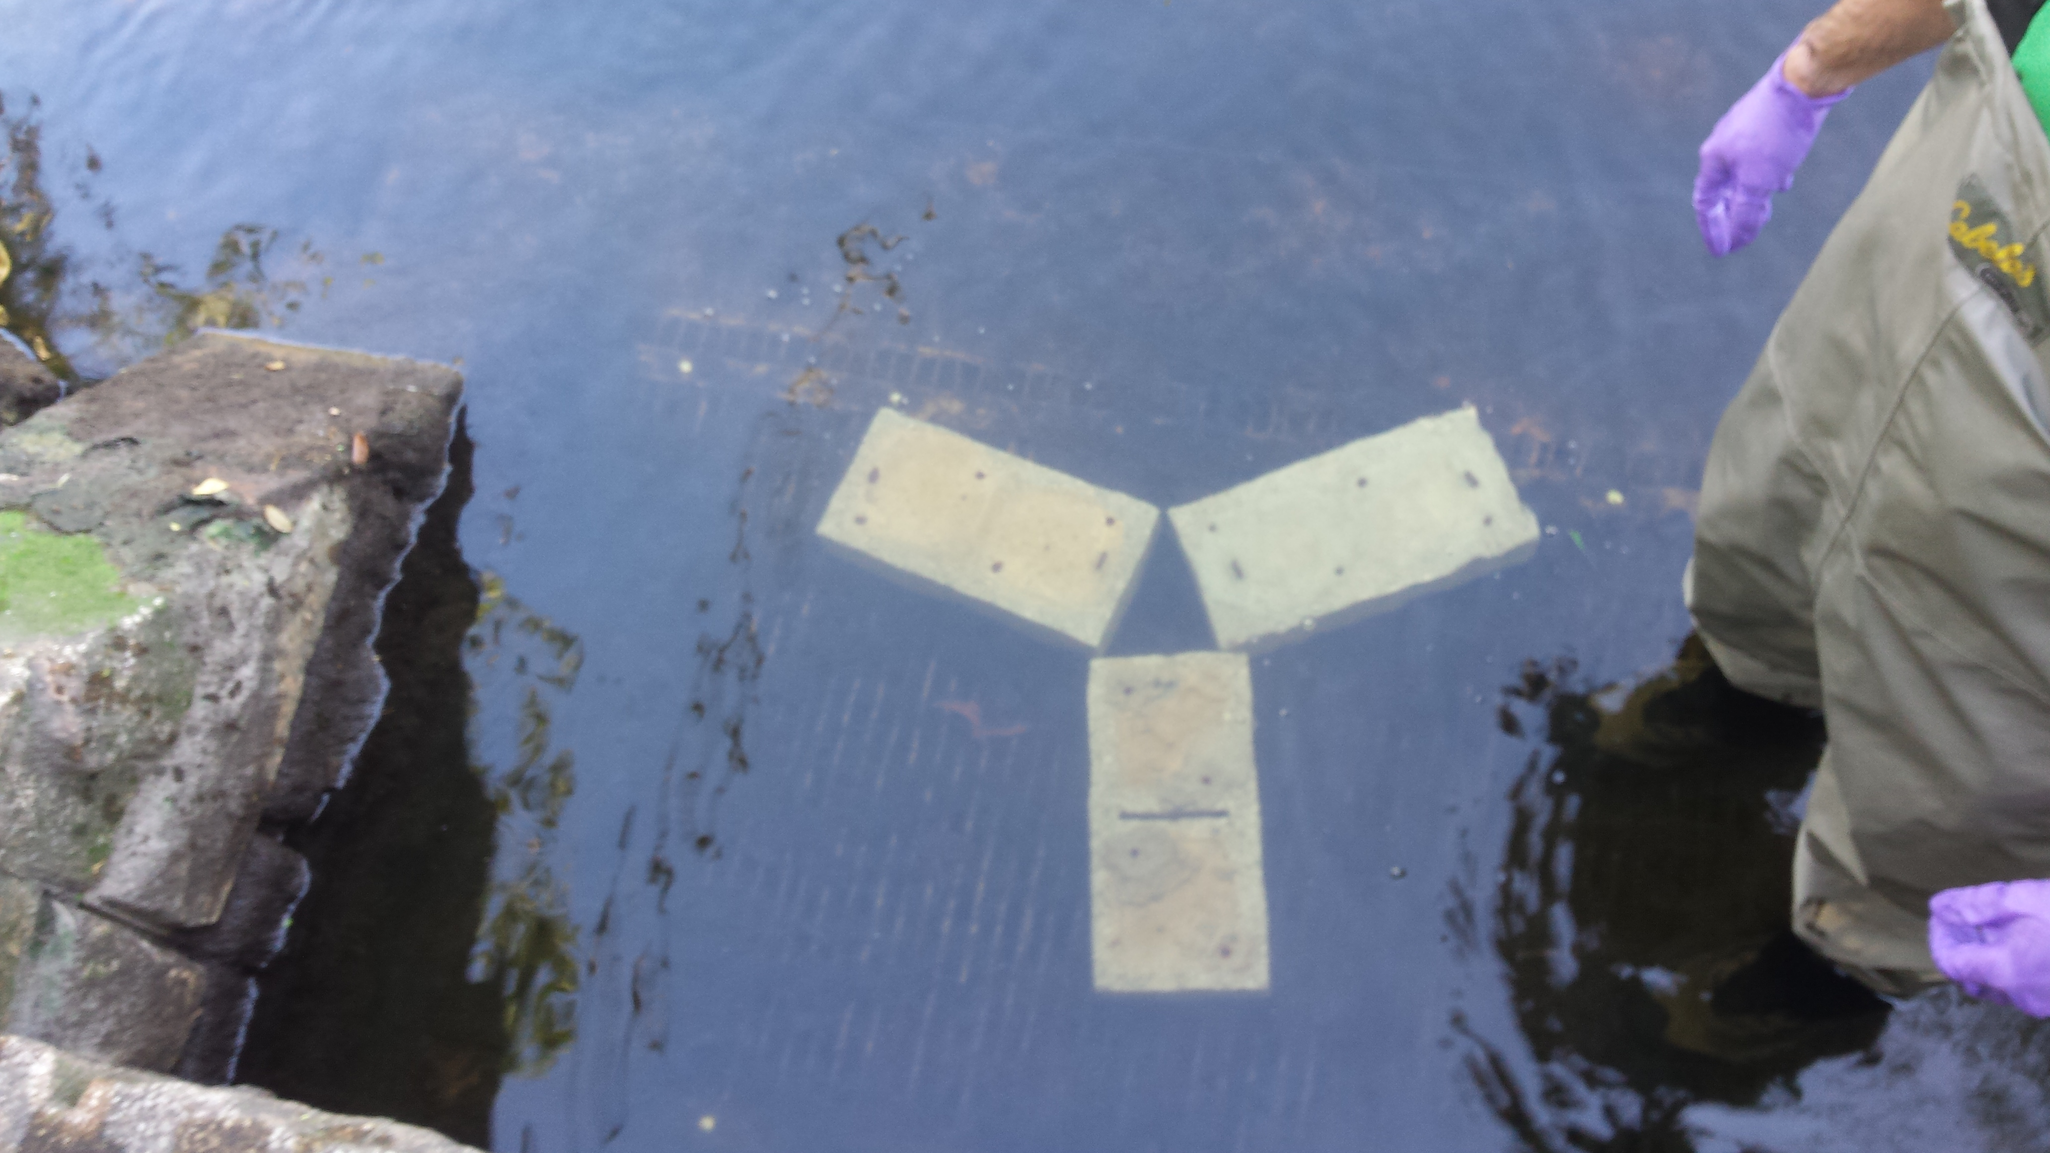
1. Metal pole was attached to TBWA withdrawal point control structure.
Sampler Deployment for
Alafia
2. Concrete blocks placed in front of withdrawal point.
Notes:
Only 30minutes max air time for sampler (including loading/unloading).~10-20mins

Slide 24
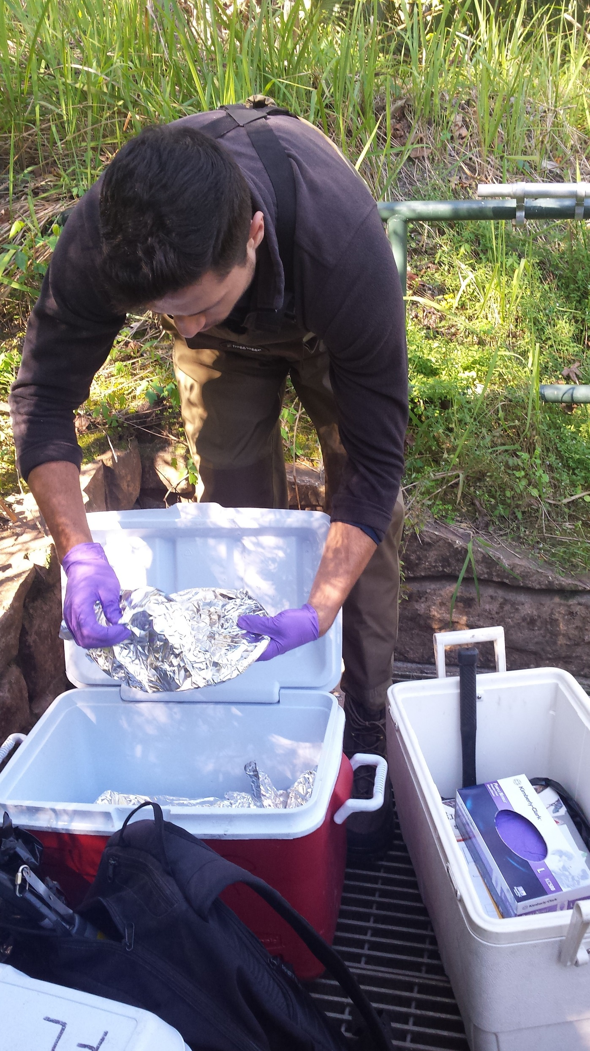
Sampler Deployment for
Alafia
3. Buoys were attached to top of passive sampler.
4. Canister was loaded with POCIS and SPMDs.

Slide 25
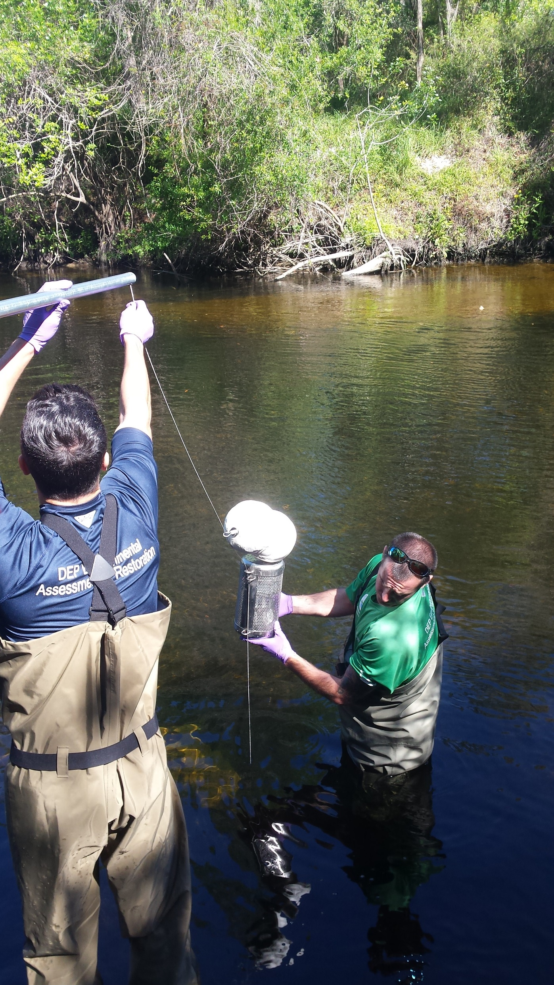
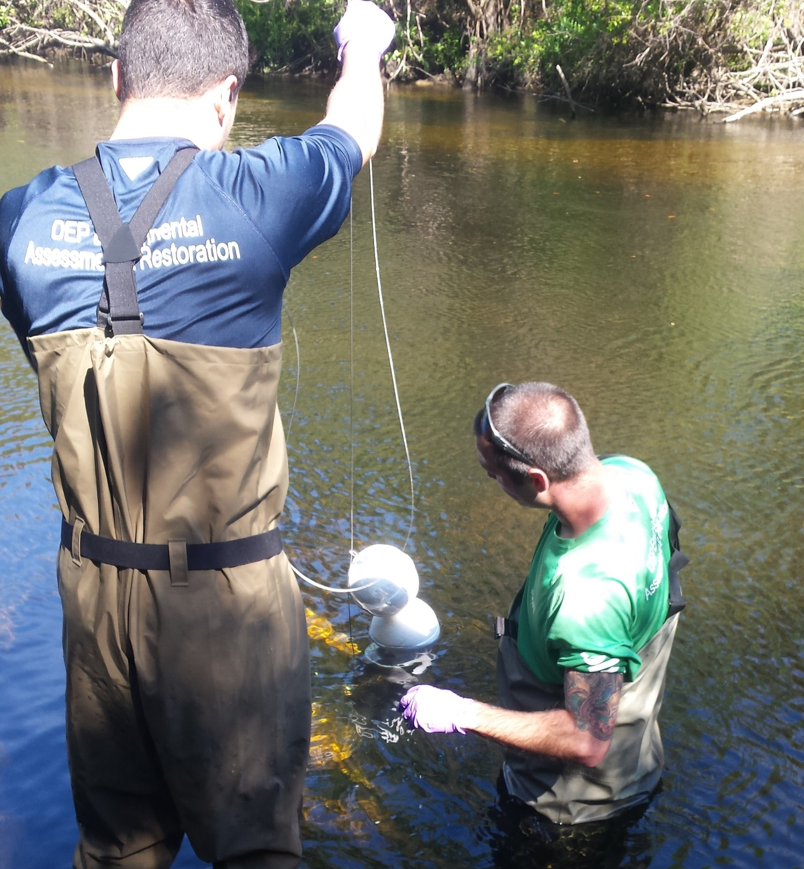
Sampler Deployment for
Alafia
5. Cable was attached to sampler through slip rings.
5. Sampler lowered into water, and positioned into place.

Slide 26
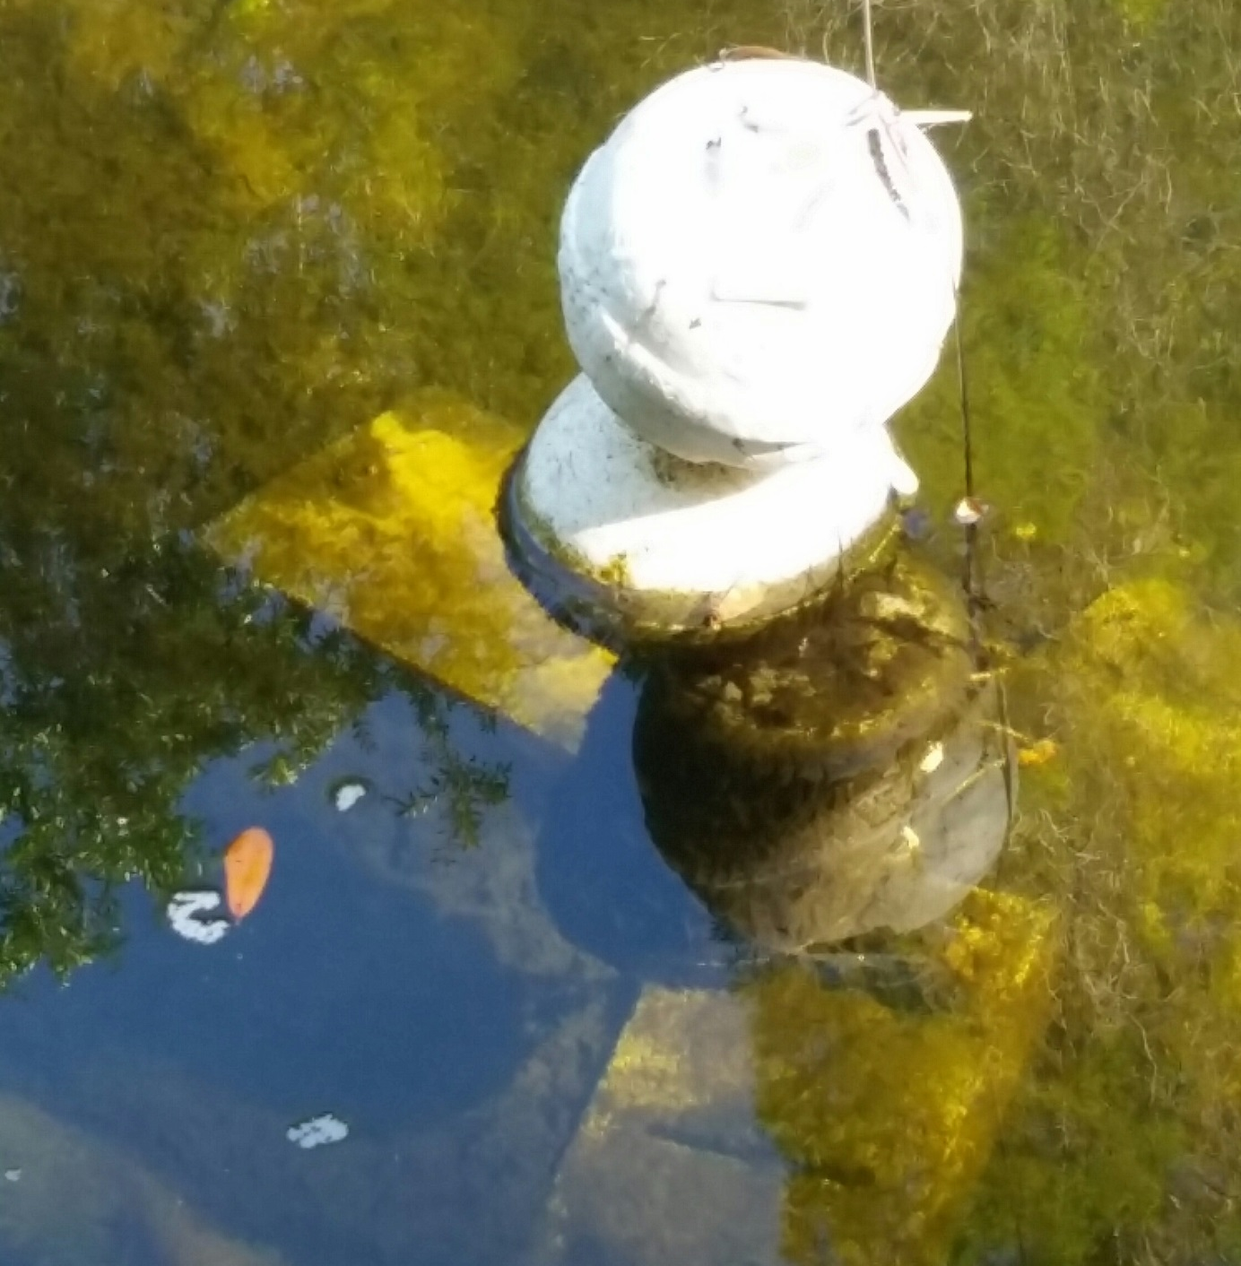
7. Sampler deployed 30 -35 days, Initial water quality parameters were collected.
Sampler Deployment for
Alafia
8. Checked equipment & took field measurements halfway through.
Notes:
Water quality field measurements collected during device deployment, midway through deployment period, and during device retrieval
Grab samples collected before container was retrieved at all sites except alafia.. USED glass amber bottles

Slide 27
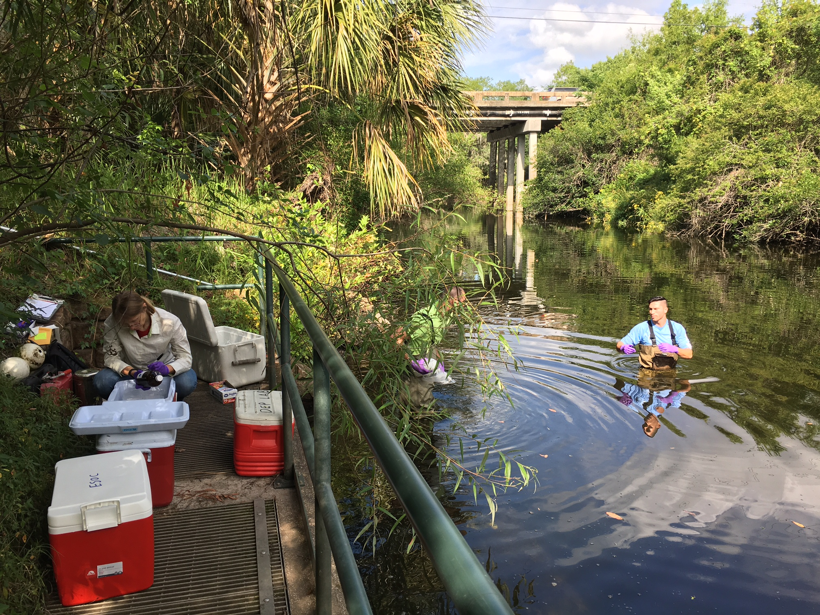
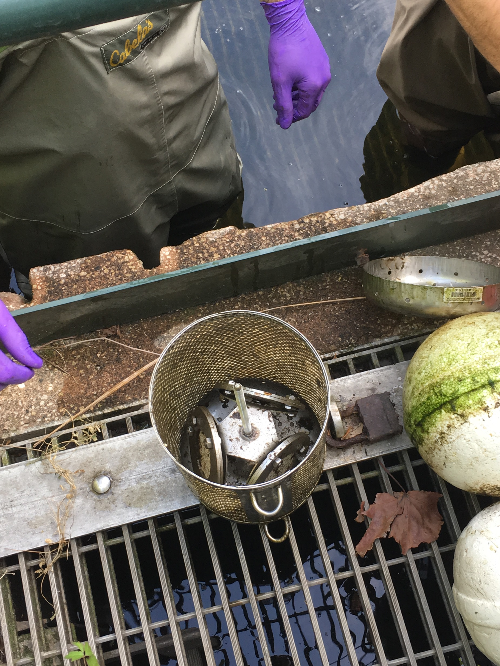
Sampler Deployment for
Alafia
9. Grab samples collected. Passive sampler retrieved.
10. Canister contents (POCISs, SPMDs) loaded into cans. Cans sealed, stored in ice, and shipped to SGS/Axys for extraction.

Slide 28
Review of Deployment
Alafia
Vegetation
Pole
TBWA Control Structure
Cable
Slip Rings
Buoys
Sampler
Concrete blocks
Vegetation
Notes:
Tampa bay water authority

Slide 29
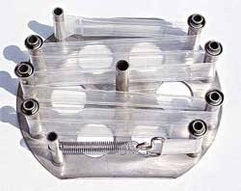
Semi-Permeable Membrane Device (SPMD)
Mimics natural system to collect bioavailable pollutants in water.
Passive transport similar to chemical transport through fish gills.
Doesn’t metabolize sequestered compounds, isn’t affected by poor water quality conditions.
Selective diffusion of hydrophobic organic chemicals through pores & stored in the lipid phase.
http://www.est-lab.com/spmd.php
Notes:
SPMD made of Low density Polyethylene lay-flat tubing containing lipids.
3. Unlike using inverts for quality testing
Bottom pic is used SPMD from Alafia

Slide 30
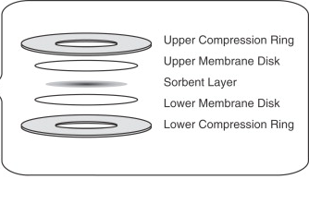
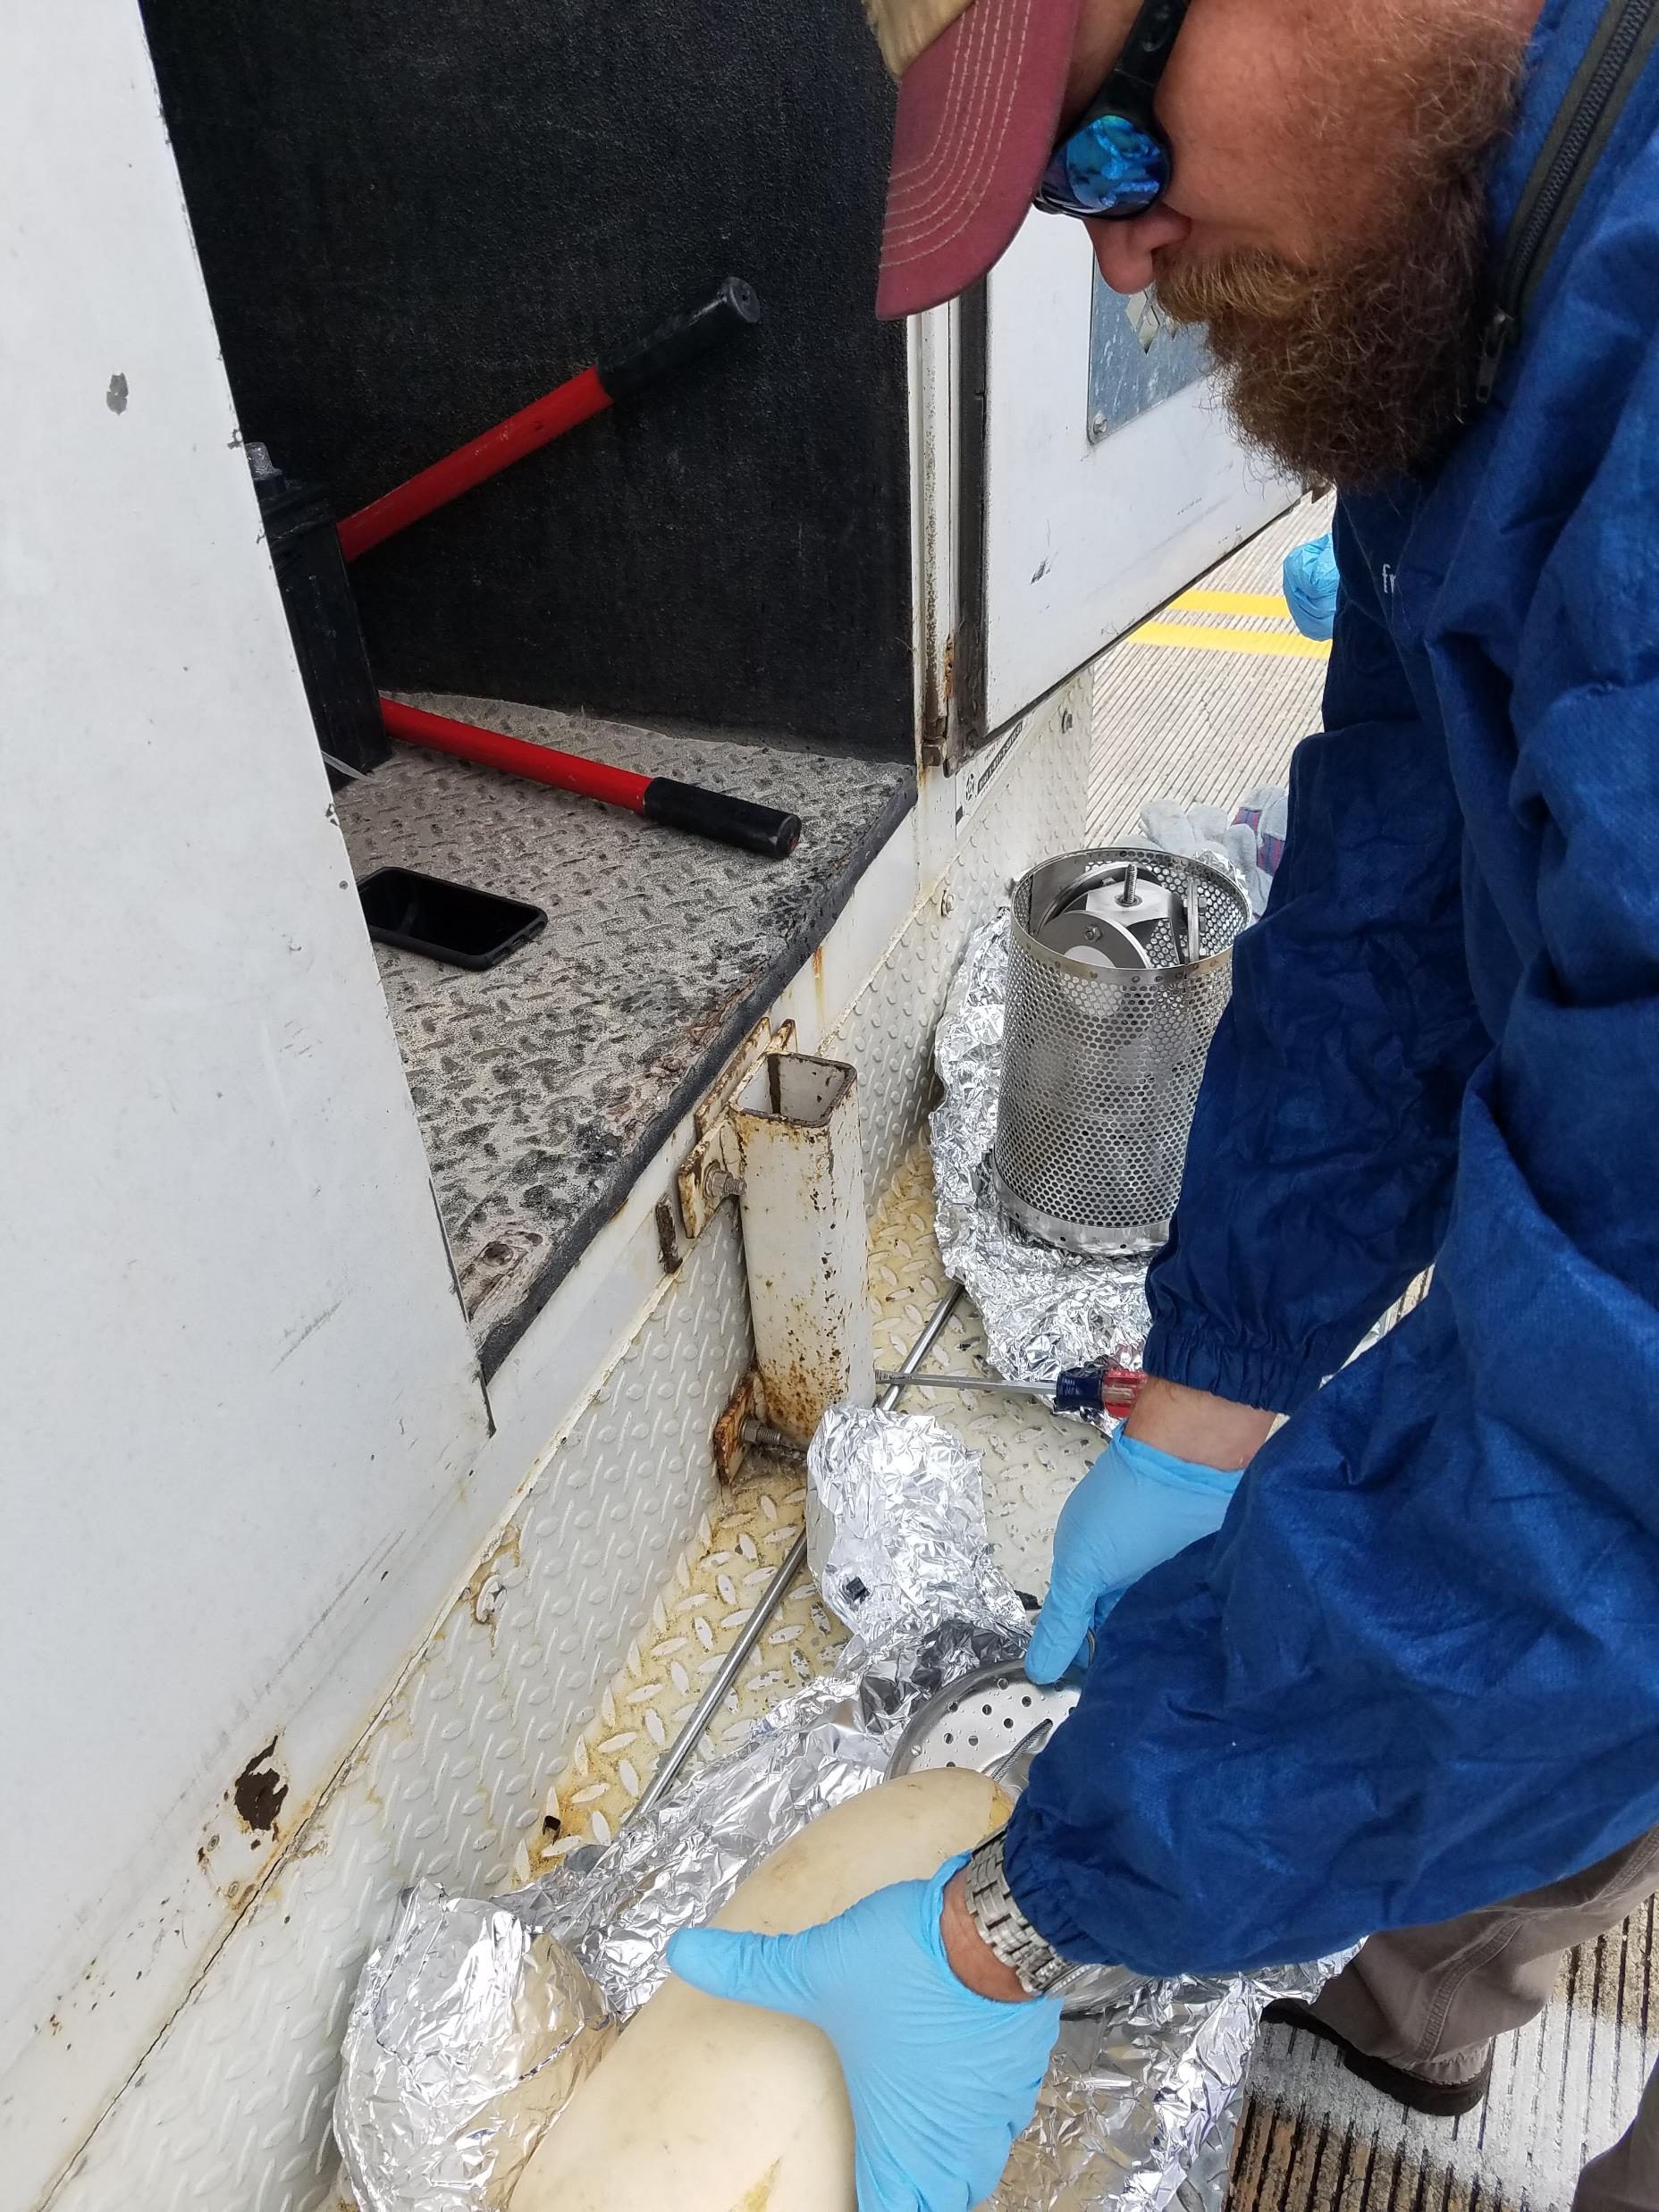
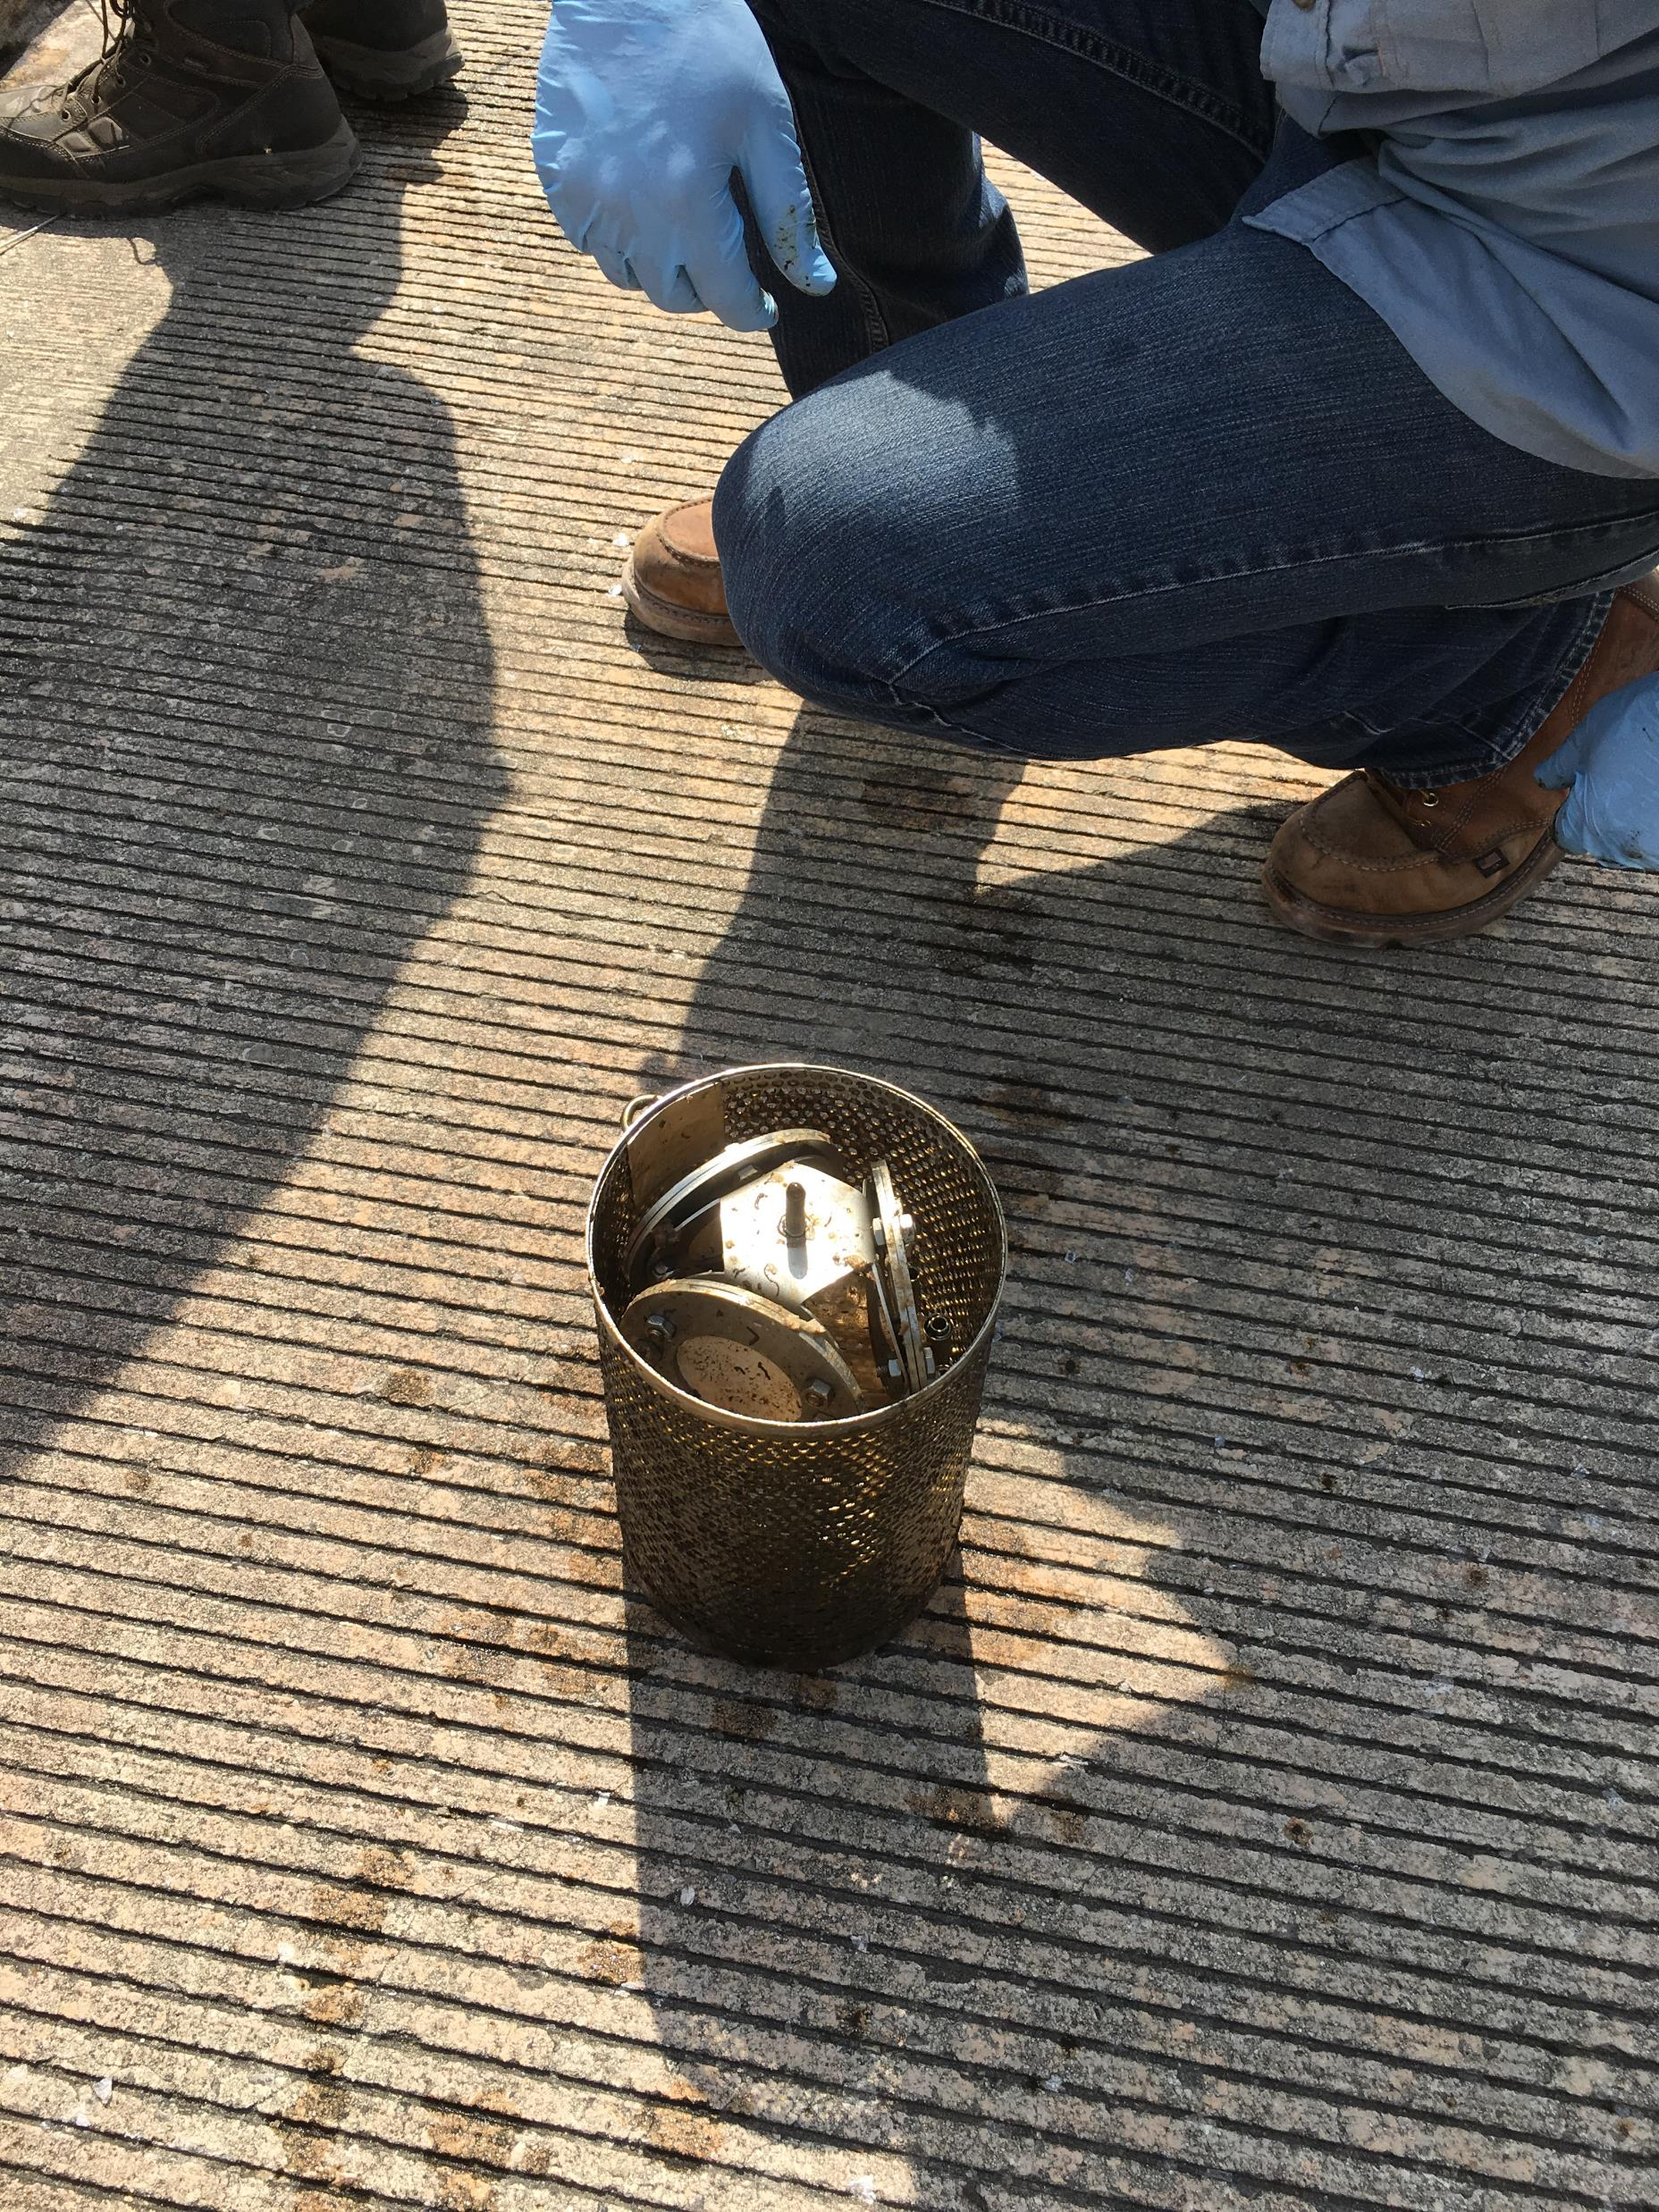
Polar Organic Chemical Integrative Sampler (POCIS)
Monitors hydrophilic contaminants that could be potential endocrine disrupters, or acutely toxic
Composed of 2
sheets of microporous
(0.1µm pore size)
polyethersulfone
membrane encasing
a solid phase sorbent
(Oasis HLB)
https://www.sciencedirect.com/science/article/pii/S0166526X06480089
Notes:
Oasis retains sample chemicals
POCIS before/after deployment in withlacoochee

Slide 31
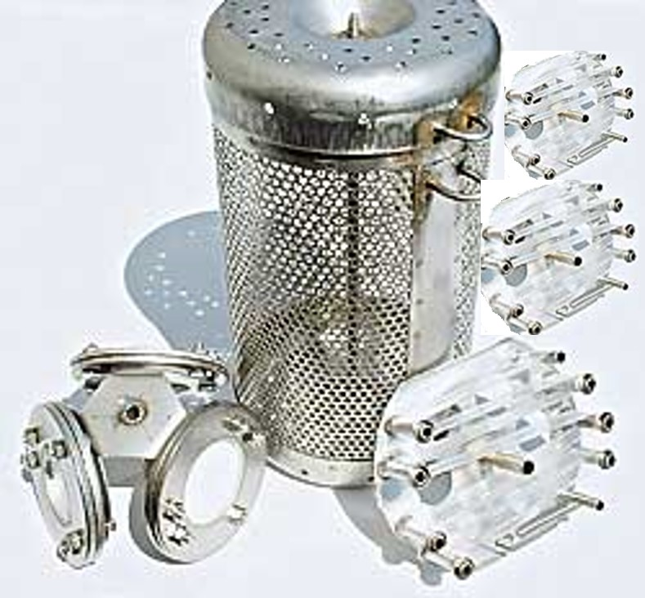
Passive Sampler Collection
SPMD (1)
No PRC addition.
No spike additions.
Extracted separately from the other 2 SPMDs by SGS/Axys.
Extract split 1:3.
  1/3 for BLYES &SOS Chromotest analysis by USGS
  1/3 for ER binding & transactivation assays by UF
  1/3 for pesticide analyses by DEP lab
SGS/Axys ships 1/3 portion of extract concentrated to 0.5 mL to USGS LSC and UF Denslow Lab, 1ml to DEP lab
Canister (1)
Holds 3 POCIS and 3 SPMD in water column during deployment.
SPMD (2)
PRCs added by EST.
Spikes added by SGS/Axys.
Composited & extracted for chemistry analyses.
Extract split 1:5.
  Alkylphenols by SGS/Axys
  MRES w/ ON by SGS/Axys
  PBDEs by SGS/Axys
  PRC analysis by SGS/Axys
  Archive
SGS/Axys performs analyses for chemistry analytes of interest and PRCs.

Slide 32
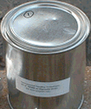
Passive Sampler Collection
POCIS-HLB (2)
Shipped by DEP to SGS/Axys.
Spikes added by SGS/Axys.
Extracted for chemistry analysis by SGS/Axys.
Extract from each disk split 1:4
  MRES w/ ON by SGS/Axys
  PPCP & hormones by SGS/Axys
  PFC by SGS/Axys
  Archive
SGS/Axys performs chemical analysis.
SGS/Axys ships holders back to DEP.
DEP cleans holders and ships them to EST.
POCIS-HLB (1)
No spike additions.
Extracted separate from the other 2 POCIS by SGS/Axys.
Extract split 1:3.
  BLYES &SOS Chromotest analysis by USGS
  ER binding & transactivation assays by UF
  Pesticide analyses by DEP lab
SGS/Axys ships 1/3 portion of extract, concentrated to 0.5 mL to USGS LSC and UF Denslow Lab, 1ml to DEP lab.
Sample Container (Can)(2)
Can #1 contains 3 SPMD (2 w/ PRCs, 1 marked w/ hole has no PRCs)
Can #2 contains 3 POCIS
All POCIS & SPMDs removed & placed in canister during deployment period.
All POCIS & SPMDs placed in cans upon retrieval.
Cans sealed & shipped by DEP to SGS/Axys for extraction.

Slide 33
Blank Collections
2 field blanks were collected at Apalachicola
1. Passive sampling equipment
        The blank sample containers (cans) were opened twice; once when passive sampler was deployed, and again when recovered from the site.
        Blank cans stayed open while passive sampling devices (POCIS & SPMD) were exposed to air.
        Sealed blank cans were stored at -20°C during deployment period.
2. Grab samples
        Blank collected using DI water supplied from SGS/Axys.

Slide 34
Emerging Substances of Concern
(ESOC)
This study separated analytes into 6 main categories
Category | Human exposure route | Aquatic life effects | Water Solubility | Sample device
Polybrominated diphenyl ethers (PBDE) | House dust, sediment, food web, breast milk, surface & ground water. | Bioaccumulative, potential endocrine disruptor (ED), carcinogenic, toxic, persistent | Low | SPMD & Grab
Pharmaceuticals & personal care products (PPCP) | Surface & ground water | Potential ED | High | POCIS & Grab
Synthetic hormones | Surface & ground water | Potential ED | High | POCIS & Grab
Alkylphenols | Surface & ground water | Potential ED | High | SPMD & Grab
Pesticides | Surface & ground water, sediment, food web | Toxic, potential ED | High | POCIS, SPMD & Grab
Perfluorinated compounds (PFC) | Food web, breast milk | Bioaccumulative, potential ED | Low | POCIS & Grab
Notes:
Used table from….(WHERE)……. As guideline for this table
For BFR and pest Aqua life effects, toxic to what? At what conc.?

Slide 35
Analytical Strategy
Targeted analyses based on:
  Occurrence in published literature.
  Occurrence gleaned from an RFI from SGS/Axys.
  Availability of methods.
  Capability of laboratories responding to an RFI.
  Known agricultural use (pesticides/herbicides).
  Observations from existing monitoring programs.
  Potential for adverse environmental effects.

Slide 36
SGS/AXYS Data

Slide 37
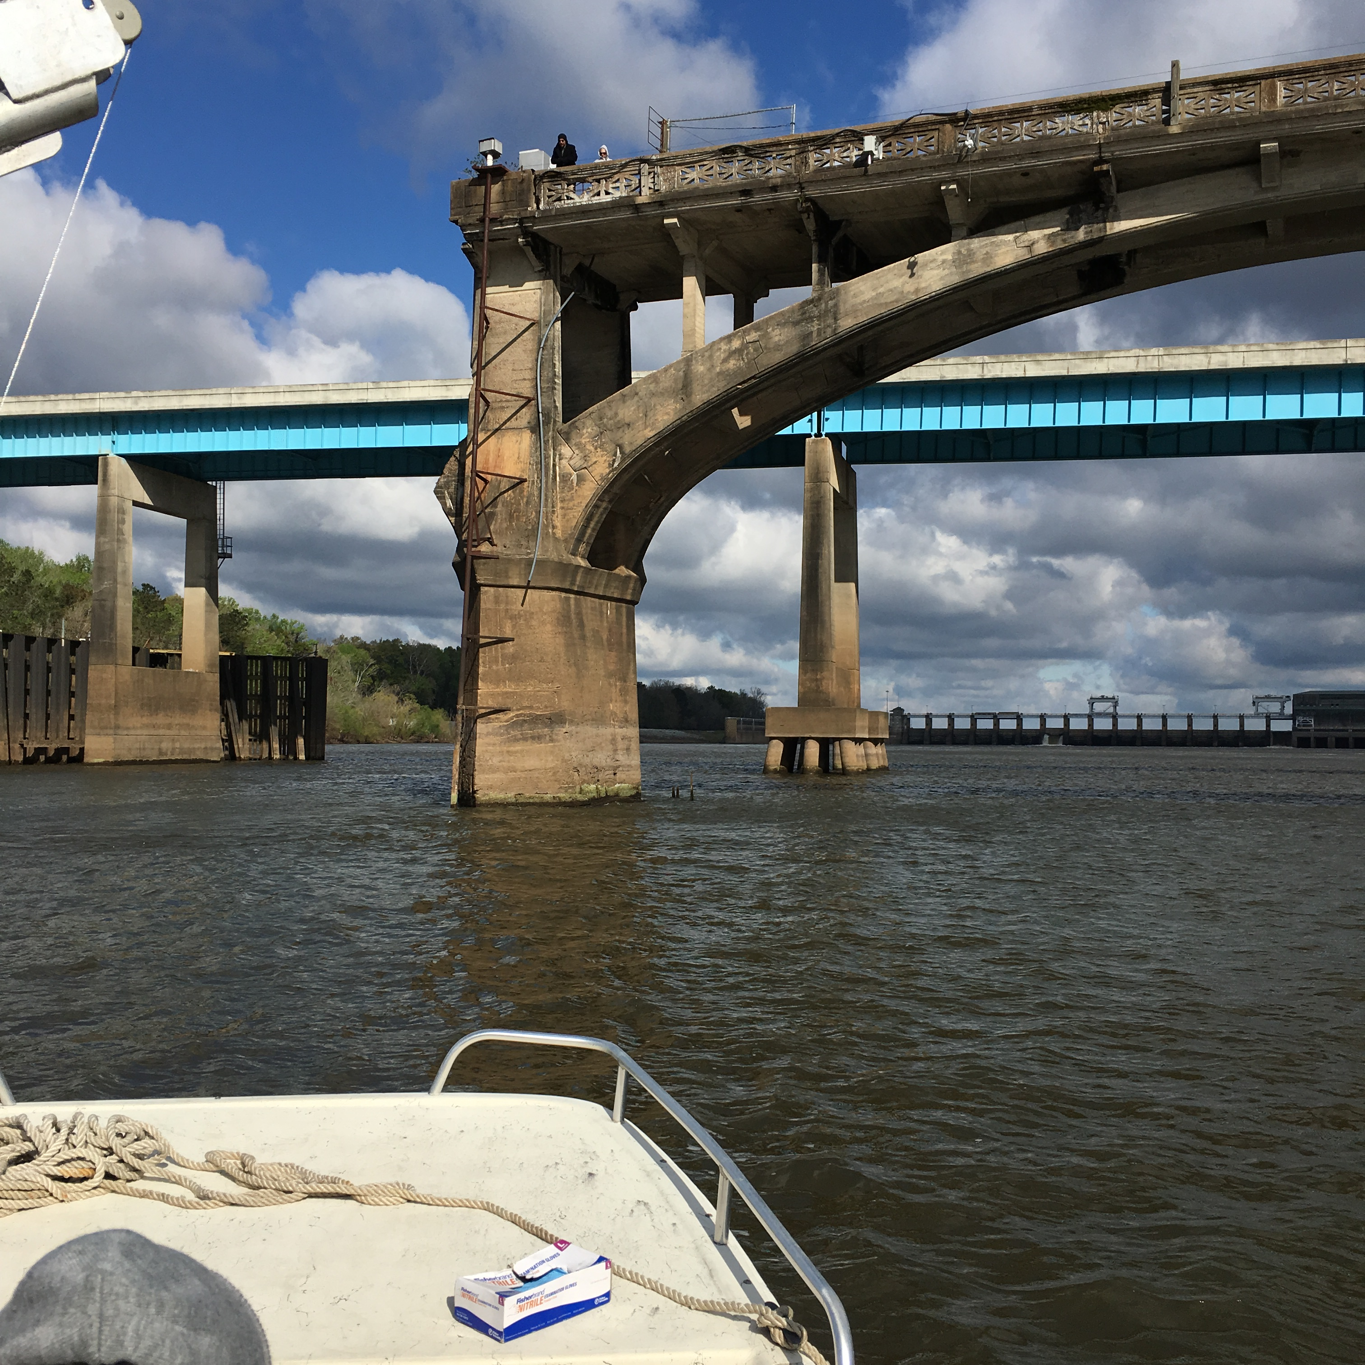
Pesticides

Slide 38
Analyzed Pilot Study Samples for 76 Pesticide Compounds
42 Pesticide Compounds Detected
At one or more sites, in at least one sample type (POCIS, SPMD, or Grab)
2,4'-DDD
4,4'-DDD
2,4'-DDE
4,4'-DDE
4,4'-DDT
Alachlor
Aldrin
alpha-Endosulphan
beta-Endosulphan
Endosulphan Sulphate
Ametryn
Atrazine
Desethylatrazine
Chlordane, alpha (cis)
Chlordane, gamma (trans)
Chlordane, oxy-
Chlorpyriphos
Diazinon
Dieldrin
Dimethenamid
Endrin
Endrin Ketone
Ethalfluralin
Flufenacet
Flutriafol
HCH, alpha
HCH, beta
HCH, delta
HCH, gamma
Heptachlor
Heptachlor Epoxide
Hexachlorobenzene
Hexazinone
Metolachlor
Mirex
Nonachlor, cis-
Nonachlor, trans-
Pendimethalin
Quintozene
Simazine
Tebuconazol
Trifluralin

Slide 39
Pesticides Detections at All Sites by Sample Type
Total No. Undetects, Detects, Not Quantifiable by Sample Type
No. Pesticides Detected by Sample Type

Slide 40
Pesticides Detected at Every Site (n = 4)
by Sample Type
Note: Data in this table corrected 7/30/2018.

Slide 41
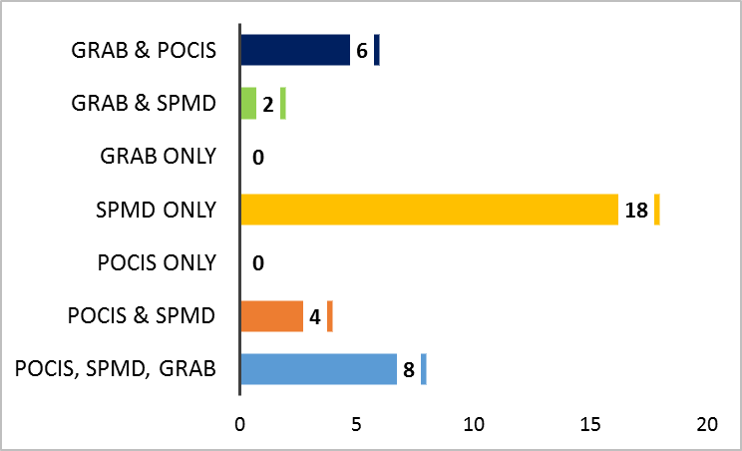
Pesticide Detections at Alafia River Analyzed by SGS Analytical
Pesticides Detected by Sample Type
No. of Pesticides Detected by Sample Type
Percentage of Detections by Sample Type
No. of Pesticides Analyzed = 76

Slide 42
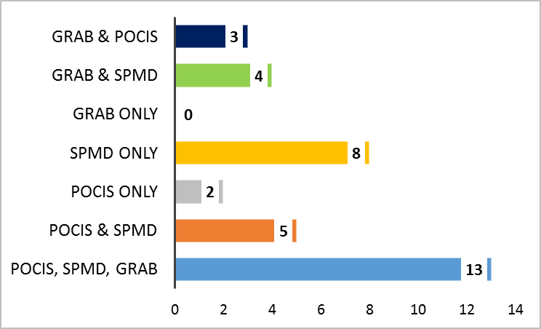
Pesticide Detections at Ochlockonee River Analyzed by SGS Analytical
Pesticides Detected by Sample Type
No. of Pesticides Detected by Sample Type
Percentage of Detections by Sample Type
No. of Pesticides Analyzed = 76

Slide 43
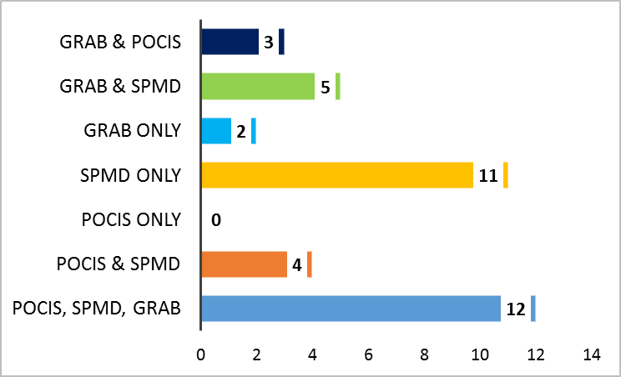
Pesticide Detections at Apalachicola River Analyzed by SGS Analytical
Pesticides Detected by Sample Type
No. of Pesticides Detected by Sample Type
Percentage of Detections by Sample Type
No. of Pesticides Analyzed = 76

Slide 44
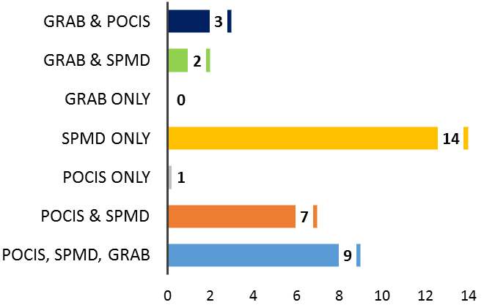
Pesticide Detections at Withlacoochee River Analyzed by SGS Analytical
Pesticides Detected by Sample Type
No. of Pesticides Detected by Sample Type
Percentage of Detections by Sample Type
No. of Pesticides Analyzed = 76

Slide 45
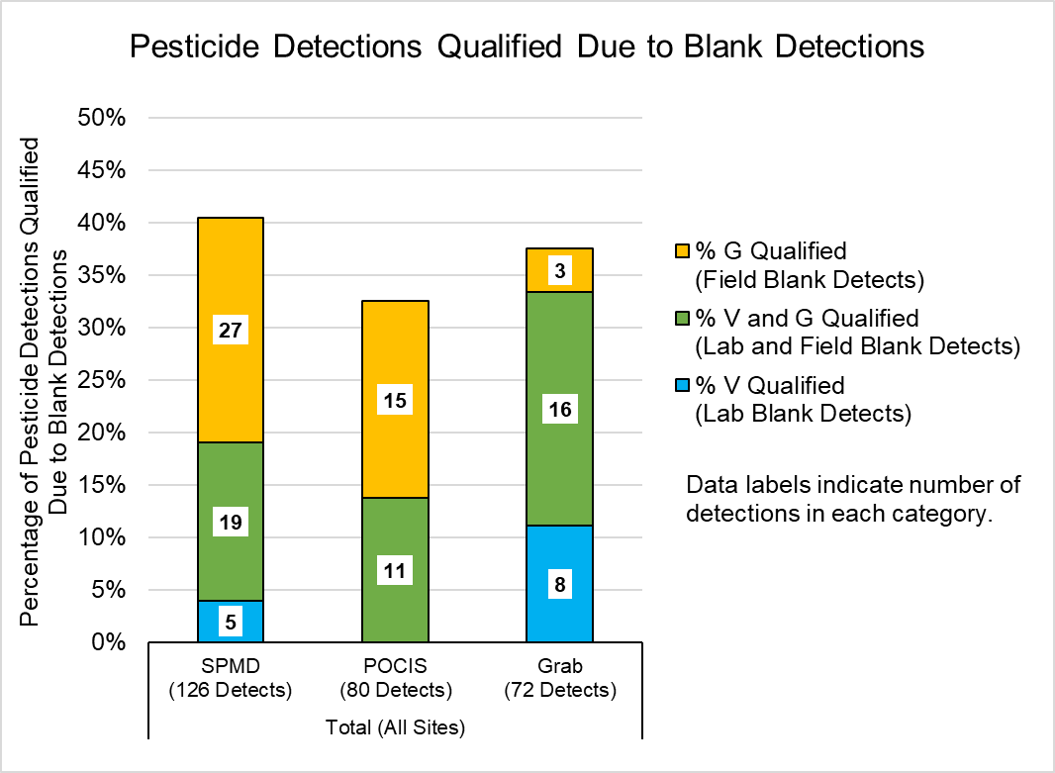
Quality Assurance Summary - Pesticides
33% of detections from POCIS samples were qualified due to blank detections.
40% of detections from SPMD samples were qualified due to blank detections.
38% of detections from grab samples were qualified due to blank detections.
Notes:
Need to find stephs legend to color code

Slide 46
.
Legend
Quality Assurance Summary - Pesticides
18 of the 42 pesticide compounds detected were also detected in lab blanks or field blanks at concentrations that required data from at least one site to be qualified.
Compound detected at one or more sites.
Data not qualified due to blank detections.
V
Compound detected at one or more sites.
Lab blank result > 10% of sample result(s)
Compound detected at one or more sites.
VG
Lab blank and field blank results
> 10% of sample result(s).
G
Compound detected at one or more sites.
Field blank result > 10% of sample result(s).
Compound not detected at any sites.
Notes:
Need to find stephs legend to color code

Slide 47
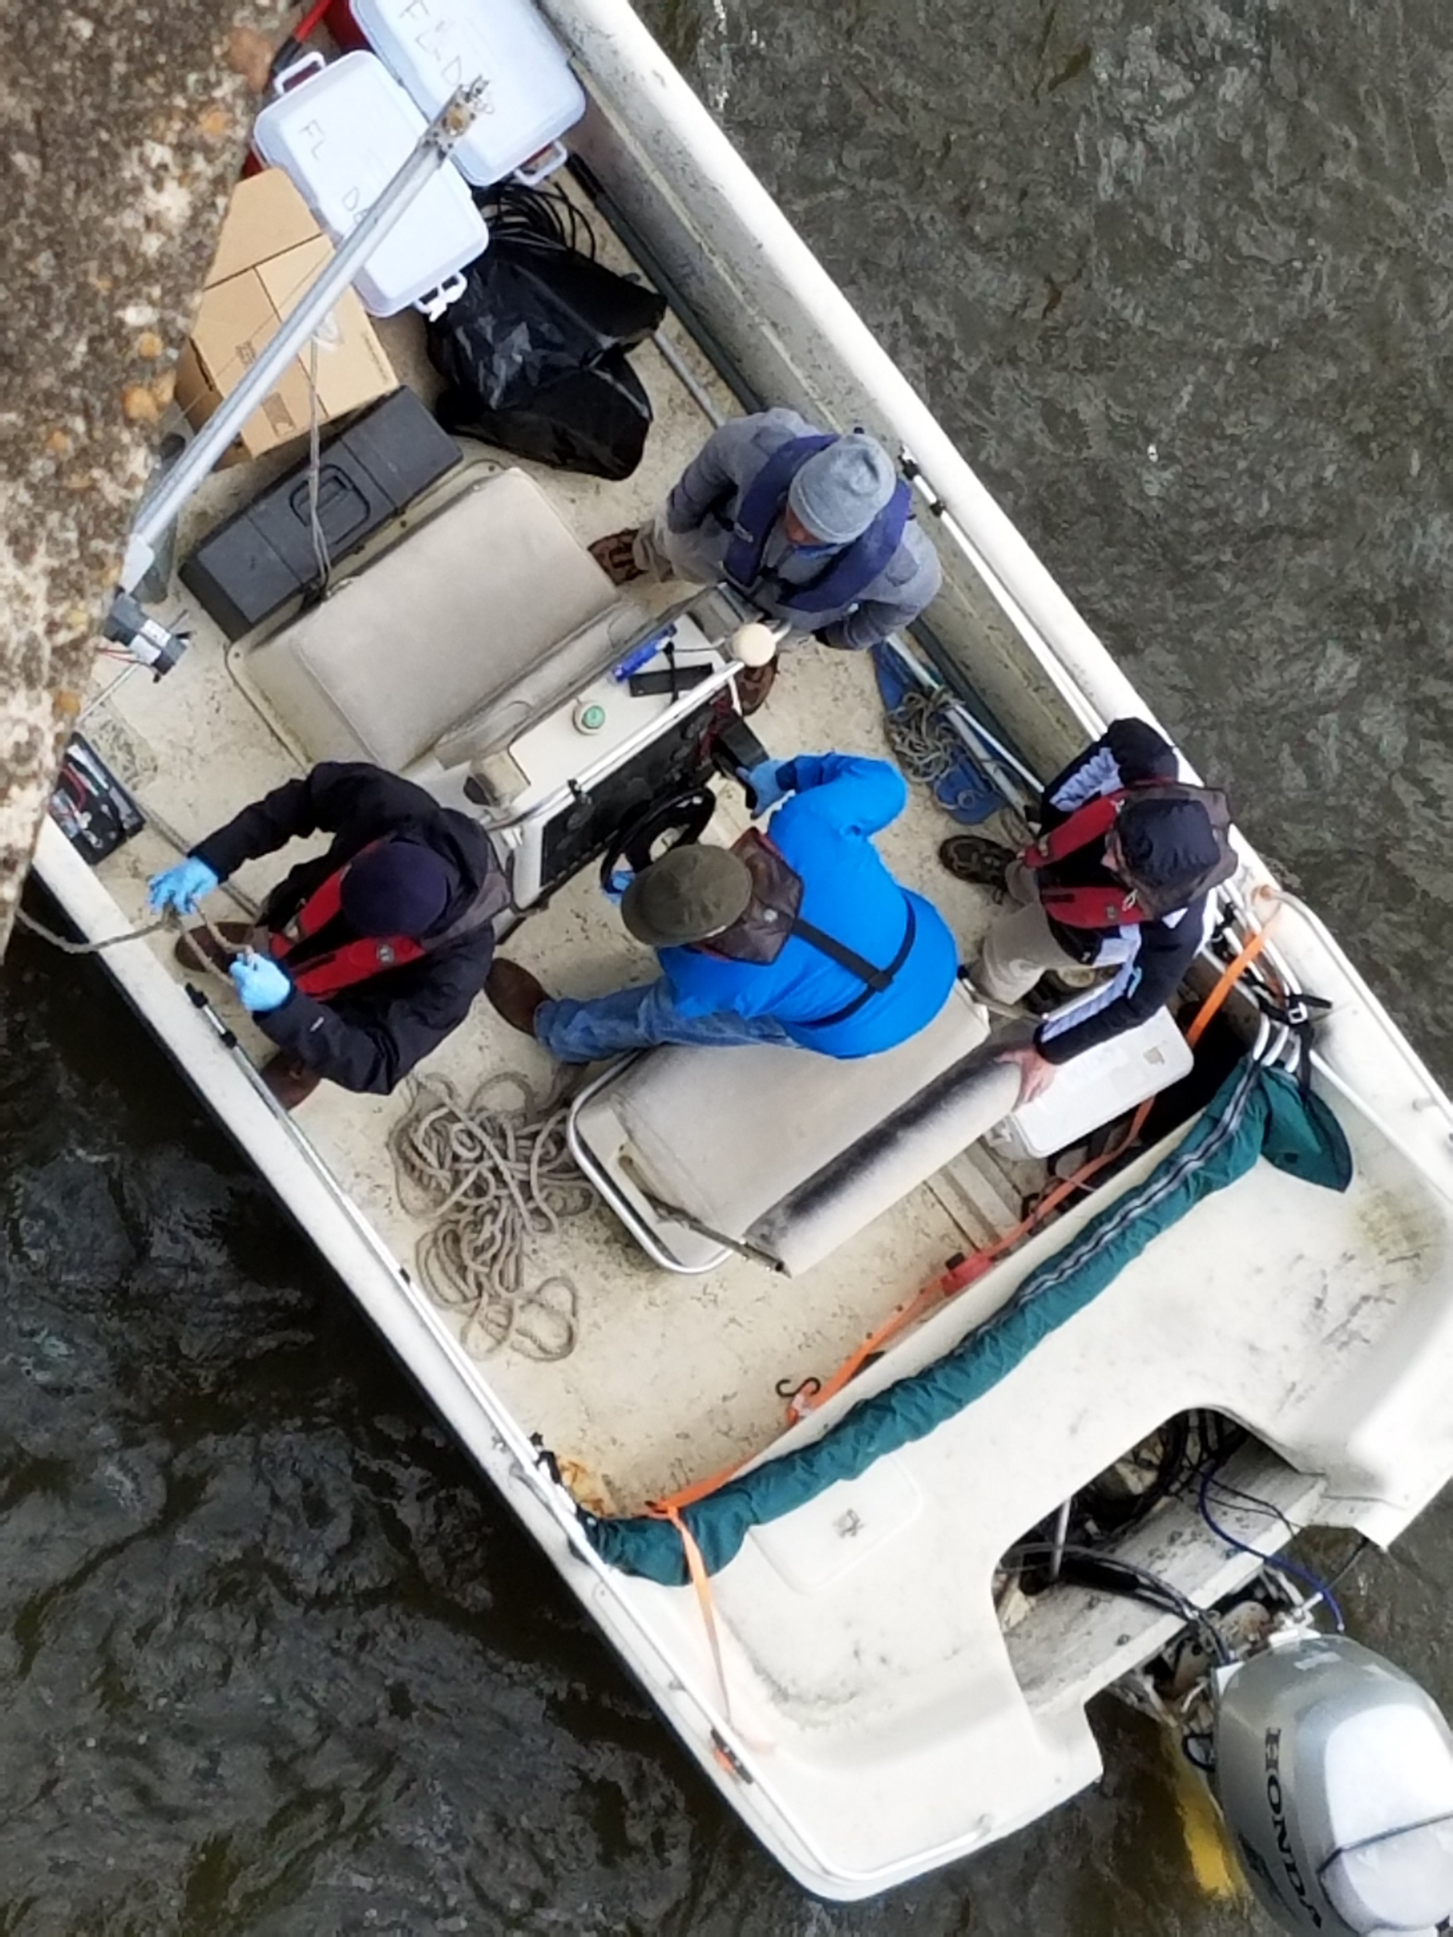
PPCPs

Slide 48
Analyzed Pilot Study Samples for 127 PPCP Compounds
39 PPCP Compounds Detected
At one or more sites, in at least one sample type (POCIS or Grab)
Alprazolam
Amitriptyline
Amphetamine
Atenolol
Azithromycin
Caffeine
Carbamazepine
Clarithromycin
Cocaine
Colchicine
Cotinine
DEET
Dehydronifedipine
Desmethyldiltiazem
Diatrizoic acid
Diazepam
Diltiazem
Diphenhydramine
Erythromycin-H2O
Furosemide
Gemfibrozil
Hydrochlorothiazide
Hydrocodone
Iopamidol
Meprobamate
Metformin
Metoprolol
Naproxen
Oxolinic Acid
Oxycodone
Propoxyphene
Sertraline
Sulfadimethoxine
Sulfamethazine
Sulfamethoxazole
Triamterene
Trimethoprim
Valsartan
Venlafaxine

Slide 49
PPCPs Detections at Alafia River Analyzed by SGS Analytical
Detected by Sample Type
127 Compounds Analyzed
POCIS Only
Grab Only
Grab & POCIS
Alprazolam
Diatrizoic acid
Amitriptyline
Erythromycin-H2O
Iopamidol
Amphetamine
Hydrocodone
Colchicine
Carbamazepine
Cocaine
DEET
Oxolinic Acid
Sulfamethoxazole
Detected, Undetected, Not Quantifiable by Sample Type
Notes:
Collection methods – Both Grab and POCIS are appropriate for the collection methods of PPCPs.

Slide 50
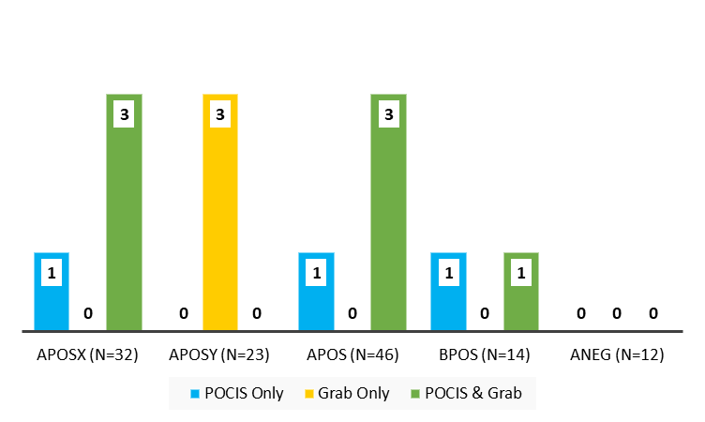
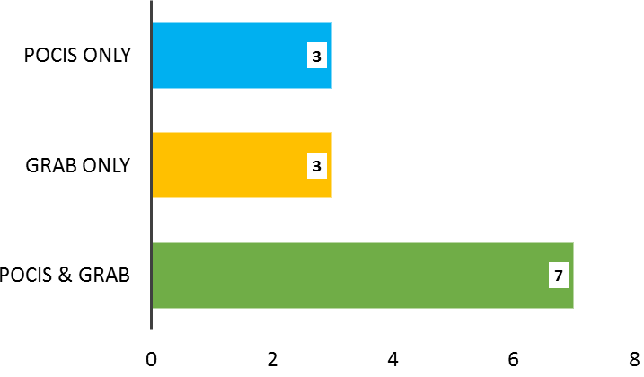
PPCPs Detections at Alafia River Analyzed by SGS Analytical
Detects per Analyte List by Sample Type
No. of PPCPs Detected by Sample Type
Percentage of Detections by Sample Type
No. of PPCPs Analyzed = 127
Total No. PPCPs Analyzed = 127

Slide 51
PPCPs Detections at Ochlockonee River Analyzed by SGS Analytical
Detected by Sample Type
127 Compounds Analyzed
Detected, Undetected, Not Quantifiable by Sample Type
Notes:
Collection methods – Both Grab and POCIS are appropriate for the collection methods of PPCPs.

Slide 52
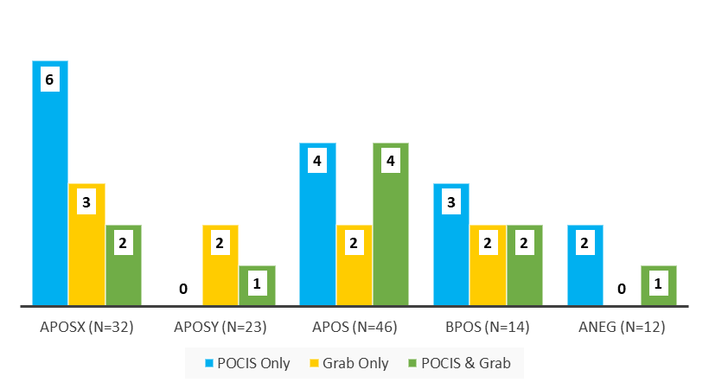

PPCPs Detections at Ochlockonee River Analyzed by SGS Analytical
Detects per Analyte List by Sample Type
No. of PPCPs Detected by Sample Type
Percentage of Detections by Sample Type
No. of PPCPs Analyzed = 127
Total No. PPCPs analyzed = 127

Slide 53
PPCPs Detections at Apalachicola River Analyzed by SGS Analytical
Detected by Sample Type
POCIS Only
Grab Only
POCIS & Grab
Alprazolam
Amitriptyline
DEET
Metoprolol
Iopamidol
Sulfamethoxazole
Venlafaxine
Caffeine
Amphetamine
Carbamazepine
Atenolol
Naproxen
Erythromycin-H2O
Cotinine
Trimethoprim
Metformin
Oxycodone
Triamterene
Gemfibrozil
Detected, Undetected, Not Quantifiable by Sample Type
Notes:
Collection methods – Both Grab and POCIS are appropriate for the collection methods of PPCPs.

Slide 54


PPCPs Detections at Apalachicola River Analyzed by SGS Analytical
Detects per Analyte List by Sample Type
No. of PPCPs Detected by Sample Type
Percentage of Detections by Sample Type
No. of PPCPs Analyzed = 127

Slide 55
PPCPs Detections at Withlacoochee River Analyzed by SGS Analytical
PPCPs Detected by Sample Type
Total No. Analyzed = 127
Detected, Undetected, Not Quantifiable by Sample Type
Notes:
Method – LC-MS/MS
Collection methods – Both Grab and POCIS are appropriate for the collection methods of PPCPs.

Slide 56


PPCPs Detections at Withlacoochee River Analyzed by SGS Analytical
No. of PPCPs Detected by Sample Type
Percentage of Detections by Sample Type
No. of PPCPs Analyzed = 127
Notes:
Method – LC-MS/MS
Collection methods – Both Grab and POCIS are appropriate for the collection methods of PPCPs.

Slide 57

PPCPs Detections at All Sites by Sample Type
Total No. Undetects, Detects, Not Quantifiable
by Sample Type
PPCPs Detected at Every Site (n = 4)
by Matrix
Detects per List at All Sites by Sample Type
No. PPCPs Detected by Sample Type
Notes:
Collection methods – Both Grab and POCIS are appropriate for the collection methods of PPCPs.

Slide 58

Quality Assurance Summary - PPCPs
6% of detections from POCIS samples were qualified due to blank detections.
17% of detections from grab samples were qualified due to blank detections.

Slide 59
.
Legend
Quality Assurance Summary - PPCPs
3 of the 39 PPCP compounds detected were also detected in lab blanks or field blanks at concentrations that required data from at least one site to be qualified.
Compound detected at one or more sites.
Data not qualified due to blank detections.
V
Compound detected at one or more sites.
Lab blank result > 10% of sample result(s)
Compound detected at one or more sites.
VG
Lab blank and field blank results
> 10% of sample result(s).
G
Compound detected at one or more sites.
Field blank result > 10% of sample result(s).
Compound not detected at any sites.

Slide 60

Hormones

Slide 61
Analyzed Pilot Study Samples for 17 Hormone Compounds
5 Hormone Compounds Detected
At one or more sites, in at least one sampling method (POCIS or Grab)
Allyl Trenbolone
Androstenedione
Androsterone
Mestranol
Testosterone

Slide 62
Hormone Detections at Alafia River Analyzed by SGS Analytical
Hormones Detected by Sample Type
No. of Hormones Detected by Sample Type
No. of Hormones Analyzed = 17

Slide 63

Hormone Detections at Ochlockonee River Analyzed by SGS Analytical
Hormones Detected by Sample Type
No. of Hormones Detected by Sample Type
No. of Hormones Analyzed = 17
Percentage of Hormone Detections by Sample Type

Slide 64

Hormone Detections at Withlacoochee River Analyzed by SGS Analytical
Hormones Detected by Sample Type
No. of Hormones Detected by Sample Type
No. of Hormones Analyzed = 17
Percentage of Hormone Detections by Sample Type

Slide 65

Hormone Detections at Apalachicola River Analyzed by SGS Analytical
Hormones Detected by Sample Type
No. of Hormones Detected by Sample Type
No. of Hormones Analyzed = 17
Percentage of Hormone Detections by Sample Type

Slide 66
Hormones Detections at All Sites by Sample Type
Total No. Undetects, Detects, Not Quantifiable by Sample Type
Hormones Detected at Every Site (n = 4)
by Matrix
No. Hormones Detections by Sample Type

Slide 67

Quality Assurance Summary - Hormones
0% of detections from POCIS samples were qualified due to blank detections.
100% of detections from grab samples were qualified due to blank detections.

Slide 68
Quality Assurance Summary - Hormones
2 of the 5 hormone compounds detected were also detected in lab blanks or field blanks at concentrations that required data from at least one site to be qualified.
.
Legend
Compound detected at one or more sites.
Data not qualified due to blank detections.
V
Compound detected at one or more sites.
Lab blank result > 10% of sample result(s)
Compound detected at one or more sites.
VG
Lab blank and field blank results
> 10% of sample result(s).
G
Compound detected at one or more sites.
Field blank result > 10% of sample result(s).
Compound not detected at any sites.

Slide 69

PFCs

Slide 70
Analyzed Pilot Study Samples for 13 PFC Compounds
10 PFC Compounds Detected
At one or more sites, in at least one sampling method (POCIS or Grab)
PFBA
PFBS
PFDA
PFHpA
PFHxA
PFHxS
PFNA
PFOA
PFOS
PFPeA

Slide 71

PFC Detections at Alafia River Analyzed by SGS Analytical
PFCs Detected by Sample Type
No. of PFCs Detected by Sample Type
Percentage of Detections by Sample Type
No. of PFCs Analyzed = 13

Slide 72

PFC Detections at Ochlockonee River Analyzed by SGS Analytical
PFCs Detected by Sample Type
No. of Detections by Sample Type
Percentage of Detections by Sample Type
No. of PFCs Analyzed = 13

Slide 73
PFC Detections at Withlacoochee River Analyzed by SGS Analytical
Detections by Sample Type
Detected, Undetected, Not Quantifiable by Sample Type

Slide 74

PFC Detections at Apalachicola River Analyzed by SGS Analytical
PFCs Detected by Sample Type
No. of Detections by Sample Type
Percentage of Detections by Sample Type
No. of PFCs Analyzed = 13

Slide 75
PFC Detections at All Sites by Sample Type
Total No. Undetects, Detects, Not Quantifiable by Sample Type
PFCs Detected at Every Site (n = 4)
by Matrix
No. of Detections by Sample Type

Slide 76
Quality Assurance Summary - PFCs
No PFC compounds were detected in lab blanks or field blanks at concentrations that required data from at least one site to be qualified.
.
Legend
Compound detected at one or more sites.
Data not qualified due to blank detections.
V
Compound detected at one or more sites.
Lab blank result > 10% of sample result(s)
Compound detected at one or more sites.
VG
Lab blank and field blank results
> 10% of sample result(s).
G
Compound detected at one or more sites.
Field blank result > 10% of sample result(s).
Compound not detected at any sites.

Slide 77

PBDEs

Slide 78
Analyzed Pilot Study Samples for 8 PBDE Compounds
8 PBDE Compounds Detected
At one or more sites, in at least one sampling method (SPMD or Grab)
2,2',3,3',4,4',5,5',6,6'-DeBDE
2,2',3,4,4',5',6-HpBDE
2,2',4,4',5,5'-HxBDE
2,2',4,4',5,6'-HxBDE
2,2',4,4',5-PeBDE
2,2',4,4',6-PeBDE
2,2',4,4'-TeBDE
2,4,4'-TriBDE

Slide 79

PBDE Detections at Alafia River Analyzed by SGS Analytical
Detections by Sample Type
No. of Detections by Sample Type
Total No. PBDEs Analyzed = 8
Percentage of Detections by Sample Type

Slide 80
PBDE Detections at Ochlockonee River Analyzed by SGS Analytical
Detected by Sample Type
Total No. Analyzed = 8
Detected, Undetected, Not Quantifiable by Sample Type

Slide 81

PBDE Detections at Apalachicola River Analyzed by SGS Analytical
PBDEs Detected by Sample Type
No. of Detections by Sample Type
Total No. PBDEs Analyzed = 8
Percentage of Detections by Sample Type

Slide 82
PBDE Detections at Withlacoochee River Analyzed by SGS Analytical
PBDEs Detected by Sample Type
No. of Detections by Sample Type
Total No. PBDEs Analyzed = 8
Percentage of Detections by Sample Type

Slide 83
PBDE Detections at All Sites by Sample Type
Non-detects, Detects, Not Quantifiable by Sample Type
PBDEs Detected at Every Site (n = 4) by Matrix
No. PBDEs Detected by Sample Type

Slide 84

Quality Assurance Summary - PBDEs
100% of detections from SPMD samples were qualified due to blank detections.
92% of detections from grab samples were qualified due to blank detections.

Slide 85
Quality Assurance Summary - PBDEs
All of the PBDE compounds detected, were also detected in lab blanks or field blanks at concentrations that required data from at least one site to be qualified.
.
Legend
Compound detected at one or more sites.
Data not qualified due to blank detections.
V
Compound detected at one or more sites.
Lab blank result > 10% of sample result(s)
Compound detected at one or more sites.
VG
Lab blank and field blank results
> 10% of sample result(s).
G
Compound detected at one or more sites.
Field blank result > 10% of sample result(s).
Compound not detected at any sites.

Slide 86

Alkylphenols

Slide 87
Analyzed Pilot Study Samples for 4 Alkylphenol Compounds
2 Alkylphenol Compounds Detected
At one or more sites, in at least one sampling method (SPMD or Grab)
4-Nonylphenols
4-Nonylphenol diethoxylates

Slide 88

Alkylphenol Detections at All Sites Analyzed by SGS Analytical
Alkylphenols Detected by Sample Type
No. of Detections by Sample Type
No. of Alkylphenols Analyzed = 8
Percentage of Detections by Sample Type

Slide 89
Alkylphenol Detections at All Sites by Sample Type
Total No. Undetects, Detects, Not Quantifiable by Sample Type
Alkylphenols Detected at Every Site (n = 4)
by Matrix
No. Alkylphenols Detected by Sample Type

Slide 90

Quality Assurance Summary - Alkylphenols
100% of detections from SPMD & grab samples were qualified due to blank detections.

Slide 91
Quality Assurance Summary
All alkylphenol compounds detected, were also detected in lab blanks or field blanks at concentrations that required data from all sites to be qualified.
All detections from SPMD & grab samples were qualified due to blank detections.
.
Legend
Compound detected at one or more sites.
Data not qualified due to blank detections.
V
Compound detected at one or more sites.
Lab blank result > 10% of sample result(s)
Compound detected at one or more sites.
VG
Lab blank and field blank results
> 10% of sample result(s).
G
Compound detected at one or more sites.
Field blank result > 10% of sample result(s).
Compound not detected at any sites.

Slide 92

DEP Data

Slide 93
Analyzed Pilot Study Samples for 92 Compounds
32 Compounds Detected
At one or more sites, in at least one sampling method (POCIS, SPMD, or Grab)
* Indicates compounds where analysis not performed on POCIS samples
2,4-D
Acetaminophen
Acetochlor
Alpha-Chlordane*
Ametryn
Atrazine
Atrazine Desethyl
Bentazon
Bromacil
Carbamazepine
Chlordane*
Chlorpyrifos Ethyl
DDD-p,p’*
DDE-p,p’*
Dieldrin*
Diuron
Fipronil
Fipronil Sulfide
Fipronil Sulfone
Fluridone
Gamma-Chlordane*
Hexazinone
Imidacloprid
Metalaxyl
Metolachlor
Norflurazon
Pendimethalin
Prometon
Simazine
Sucralose
Toxaphene*
Trifluralin*

Slide 94
Compound Detections at All Sites by Sample Type
Total No. Undetects & Detects by Sample Type
Compounds Detected at Every Site (n = 4)
by Matrix
No. Compounds Detected by Sample Type

Slide 95
Quality Assurance Summary – DEP Data
No compounds were detected in lab blanks or field blanks at concentrations that required data from at least one site to be qualified.
.
Legend
Compound detected at one or more sites.
Data not qualified due to blank detections.
V
Compound detected at one or more sites.
Lab blank result > 10% of sample result(s)
Compound detected at one or more sites.
VG
Lab blank and field blank results
> 10% of sample result(s).
G
Compound detected at one or more sites.
Field blank result > 10% of sample result(s).
Compound not detected at any sites.

Slide 96
Review
SGS/Axys Data
Pesticides
  42 compounds detected of 76 analyzed.
  Most compounds were found in the SPMD only.
PPCPs
  39 compounds detected of 127 analyzed.
  Most compounds were found in POCIS only; there was a widespread distribution of compounds also found in the Grab.
Hormones
  5 compounds detected of 17 analyzed.
  Blank contamination caused all grab sample data to be qualified, but did not affect POCIS sample data.

Slide 97
Review
SGS/Axys Data
PFCs
  10 compounds detected of 13 analyzed.
  Most compounds were found in POCIS only or POCIS & Grab.
PBDEs
  All compounds analyzed (n = 8) were detected in SPMD & Grab samples at one or more sites.
  Blank contamination caused all SPMD data & > 90% of Grab sample data to be qualified.
Alkylphenols
  2 of the 4 compounds analyzed were found in SPMD only or SPMD & Grab.
  Blank contamination caused all SPMD and Grab sample data to be qualified.

Slide 98
Review
DEP Data
Pesticides
  29 compounds detected of 88 analyzed.
  Most compounds were found in Grab & POCIS.
  Several compounds were found in SPMD only.
PPCPs
  3 compounds detected of 4 analyzed.
  Most compounds were found in Grab and SPMD.
  Acetaminophen was detected in Grab samples analyzed by DEP, but not in those analyzed by SGS/Axys.
Notes:
Chlorpyrifos Ethyl

Slide 99
Biological Assays
The following in Vitro receptor assays were selected for this study based on their sensitivity, simplicity, and rapid results.
Estrogen and androgen receptor (ER and AR) competitive binding assay
Reporter Gene Assays
  Bioluminescent yeast estrogen and androgen screens (BLYES and BLYAS)
  Estrogen and androgen receptor (ER and AR) mammalian cell reporter gene assay
SOS Chromotest

Slide 100

ER and AR Binding Assay Using Fluorescence Polarization (FP)
The diagram shows the principle of how the polarization of the fluorescence is measured.
When there is no competition, the fluorescent labeled derivative remains bound to the receptor resulting in a higher FP signal and vice versus when the estrogen or estrogen like compound displaces the analog (Parker, et. al 2000).
The wavelengths specific to the compound go through the emission filter and those are measured. (www.thesgc.org, accessed 9/5/14; modified from original)

Slide 101

Looking Ahead
Awaiting results from the USGS .
Working with the University of Florida on obtaining final report.
Interpreting results and compiling information to finalize report.

Slide 102
Proposed Questions
Are there any analytes that should be added or removed if this pilot project was expanded? Are there analyte groups that are of higher priority?
Discussion about data and QA/QC.
What are the take home messages that we can glean from this project and how do they inform our path forward?
Discussion about the intensity of sample collection and analysis vs. the results?

Slide 103
References
Alvarez, D et al. (2007) Chapter 8 Tool for monitoring hydrophilic contaminants in water: polar organic chemical integrative sampler (POCIS). Comprehensive Analytical Chemistry. 48, 171-197. doi:10.1016/S0166-526X(06)48008-9
Smith, R. (2018) Product: Semipermeable Membrane Device (SPMD) and its Deployment. http://www.est-lab.com/spmd.php
Notes:
NEED REFERENCE FOR TABLE!!!

Slide 104
Alafia River
Compounds Detected by Sample Type
Data in this slide are incorrect. Revised summary of compounds detected located in \\publicfiles\pubfds\dear\ESOC\ESOC Pilot\2017 Pilot Results\DEP\DEPresults_QA_Check.xlsx.
Detected and Undetected by Sample Type

Slide 105

Alafia River
Percent Detected by Sample Type
No. of Detections by Sample Type
Data in this slide are incorrect. Revised summary of compounds detected located in \\publicfiles\pubfds\dear\ESOC\ESOC Pilot\2017 Pilot Results\DEP\DEPresults_QA_Check.xlsx.

Slide 106
Ochlockonee River
Compounds Detected by Sample Type
Data in this slide are incorrect. Revised summary of compounds detected located in \\publicfiles\pubfds\dear\ESOC\ESOC Pilot\2017 Pilot Results\DEP\DEPresults_QA_Check.xlsx.
Detected and Undetected by Sample Type

Slide 107

Ochlockonee River
Percent Detected by Sample Type
No. of Detections by Sample Type
Data in this slide are incorrect. Revised summary of compounds detected located in \\publicfiles\pubfds\dear\ESOC\ESOC Pilot\2017 Pilot Results\DEP\DEPresults_QA_Check.xlsx.

Slide 108
Apalachicola River
Compounds Detected by Sample Type
Data in this slide are incorrect. Revised summary of compounds detected located in \\publicfiles\pubfds\dear\ESOC\ESOC Pilot\2017 Pilot Results\DEP\DEPresults_QA_Check.xlsx.
Detected and Undetected by Sample Type

Slide 109

Apalachicola River
Percent Detected by Sample Type
No. of Detections by Sample Type
Data in this slide are incorrect. Revised summary of compounds detected located in \\publicfiles\pubfds\dear\ESOC\ESOC Pilot\2017 Pilot Results\DEP\DEPresults_QA_Check.xlsx.

Slide 110
Withlacoochee River
Compounds Detected by Sample Type
Data in this slide are incorrect. Revised summary of compounds detected located in \\publicfiles\pubfds\dear\ESOC\ESOC Pilot\2017 Pilot Results\DEP\DEPresults_QA_Check.xlsx.
Detected and Undetected by Sample Type

Slide 111

Withlacoochee River
Percent Detected by Sample Type
No. of Detections by Sample Type
Data in this slide are incorrect. Revised summary of compounds detected located in \\publicfiles\pubfds\dear\ESOC\ESOC Pilot\2017 Pilot Results\DEP\DEPresults_QA_Check.xlsx.

