Slide 1
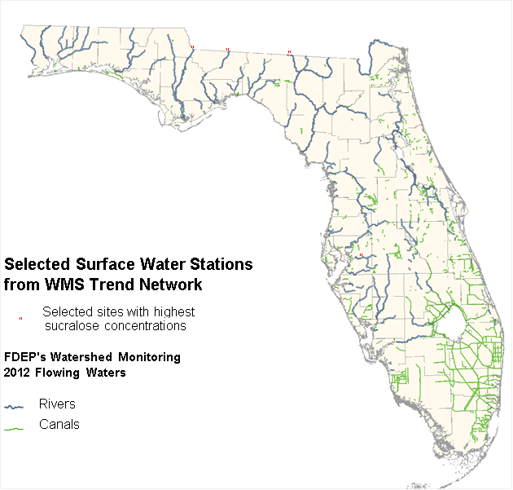


Florida Department of Environmental Protection
Evaluating ECs in Florida Waterbodies
Presented by: Alicia Hogue, Tom Seal, Michael Eckles, Stephanie Sunderman-Barnes & Jade Burtchett

Slide 2
Overview
4 river sites chosen:
  Ochlockonee, Withlacoochee, Apalachicola and Alafia
3 types of sample collection:
  Semi-Permeable Membrane Device (SPMD)
  Polar Organic Chemical Integrative Sampler (POCIS)
  Whole water samples (Grab)
6 Categories of compounds:
  Pesticides, PPCPs, Hormones, PFCs, PBDEs, and Alkylphenols
Sample collection types were considered in up to 7 categories:
  SPMD, POCIS, Grab (Pesticides)
  SPMD & POCIS (Pesticides)
  Grab & SPMD
  Grab & POCIS
  Grab only
  SPMD only
  POCIS only
QA is discussed at the end of each category.
SGS/Axys data are presented, then DEP data.
Notes:
Thank everyone for attending.
Please feel free to interject and add feedback as we go along.
Talk about how the 4 sites were chosen from the Trend Network highest sucralose concentrations in 2012.

Slide 3
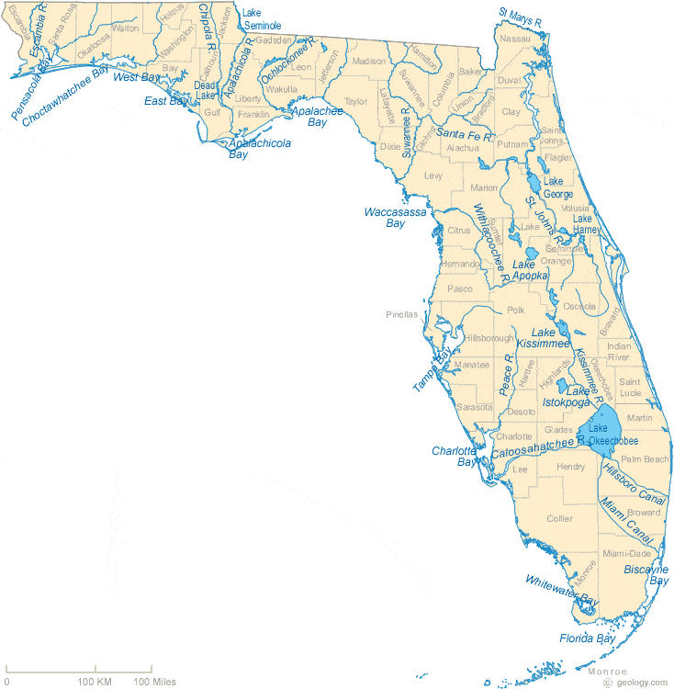
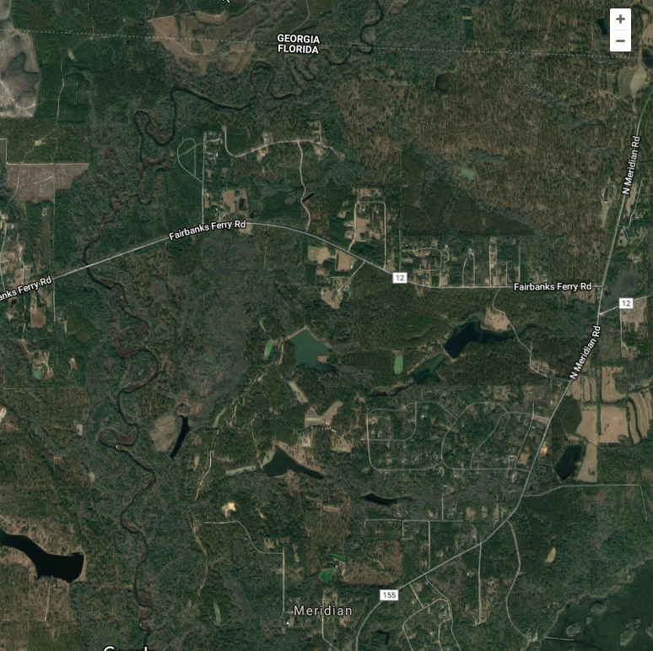
Ochlockonee River
500m

Slide 4
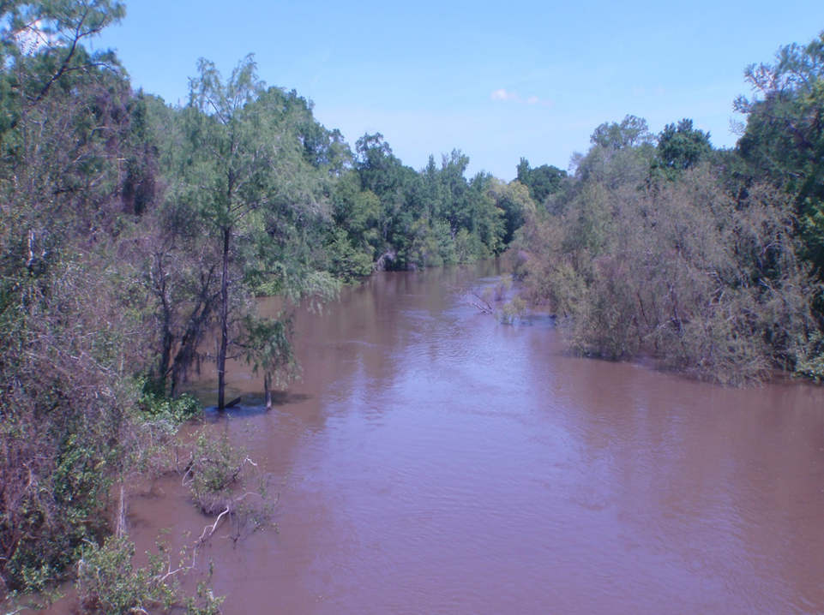
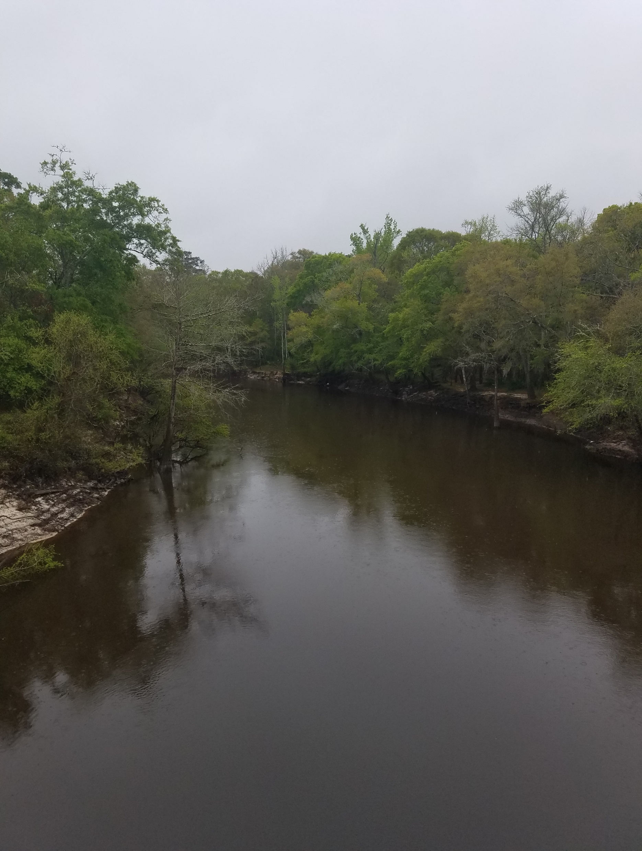
Ochlockonee River
190 miles long
The drainage basin is 1,002 square miles
River discharge averages 1,870 cubic feet/second.
Drainage basin receives sediments from the Coastal Plain province
The river receives effluent from the Georgia cities of Cairo, Thomasville and Moultrie.
Site is located just south of the FL-GA state line.
Sucralose maximum value detected was 2.6 µg/L.
Notes:
joins the Gulf of Mexico at Ochlockonee Bay
2. at this sampling site (?)
3. but can range from a minimum of about 100 cfs up to 54,000 cfs

Slide 5
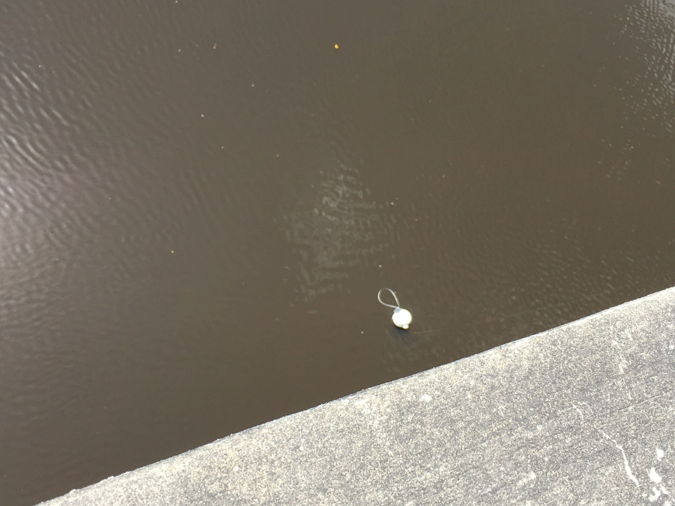
Sampler Location/Deployment

Slide 6
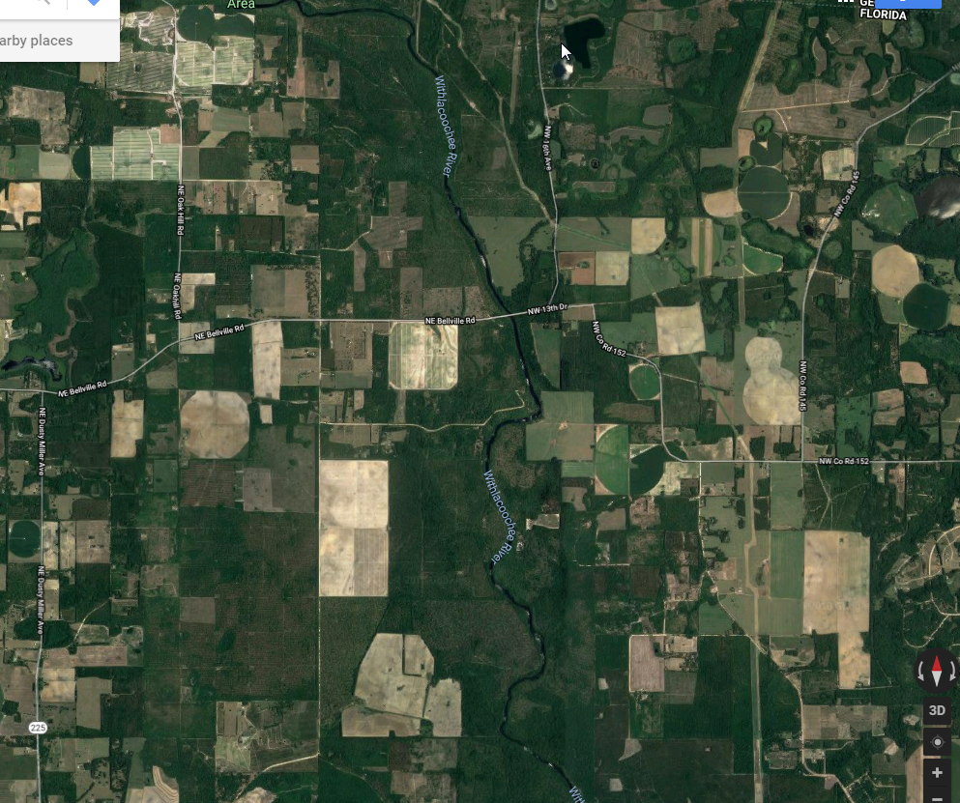
Withlacoochee River
1km

Slide 7
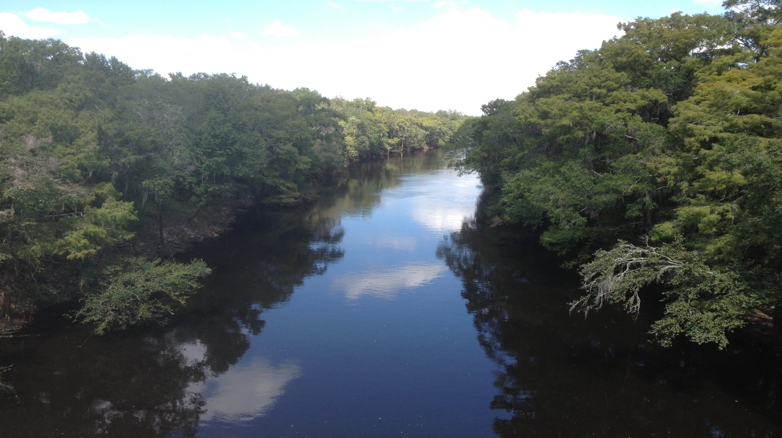
Withlacoochee River
112 miles long.
The drainage basin is 2,120 square miles.
Discharge average 1,870 cubic feet/second.
Drainage basin receives sediments from only the Coastal Plain province.
The river receives effluent from the city of Valdosta about 20 miles upstream of site.
The Withlacoochee River joins with the Suwannee River downstream from the site.
Site is located at state line.
Sucralose maximum value detected was 2.9 µg/L
Notes:
3. but can range from a minimum of 100 cfs up to 78,000 cfs
5. this particular WWTP has a long history of overflows during high rainfall events
6. The Suwannee R has an extra level of protection afforded it by Florida state law.

Slide 8
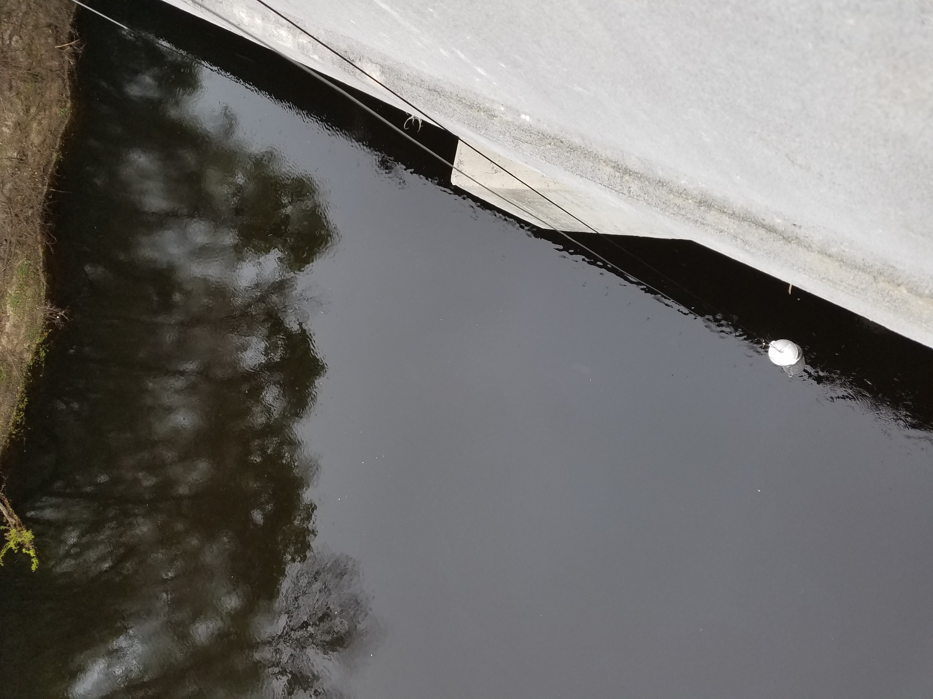
Sampler Location/Deployment

Slide 9
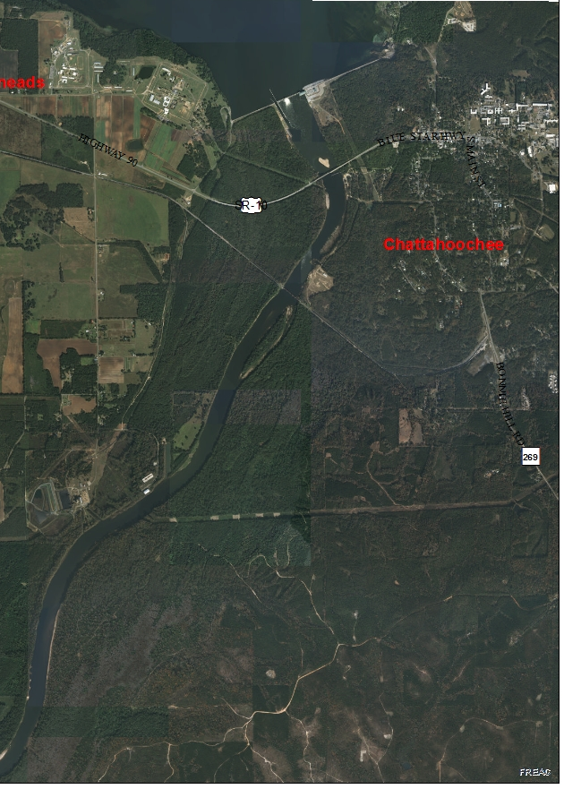
Apalachicola River
1km
SR-10

Slide 10
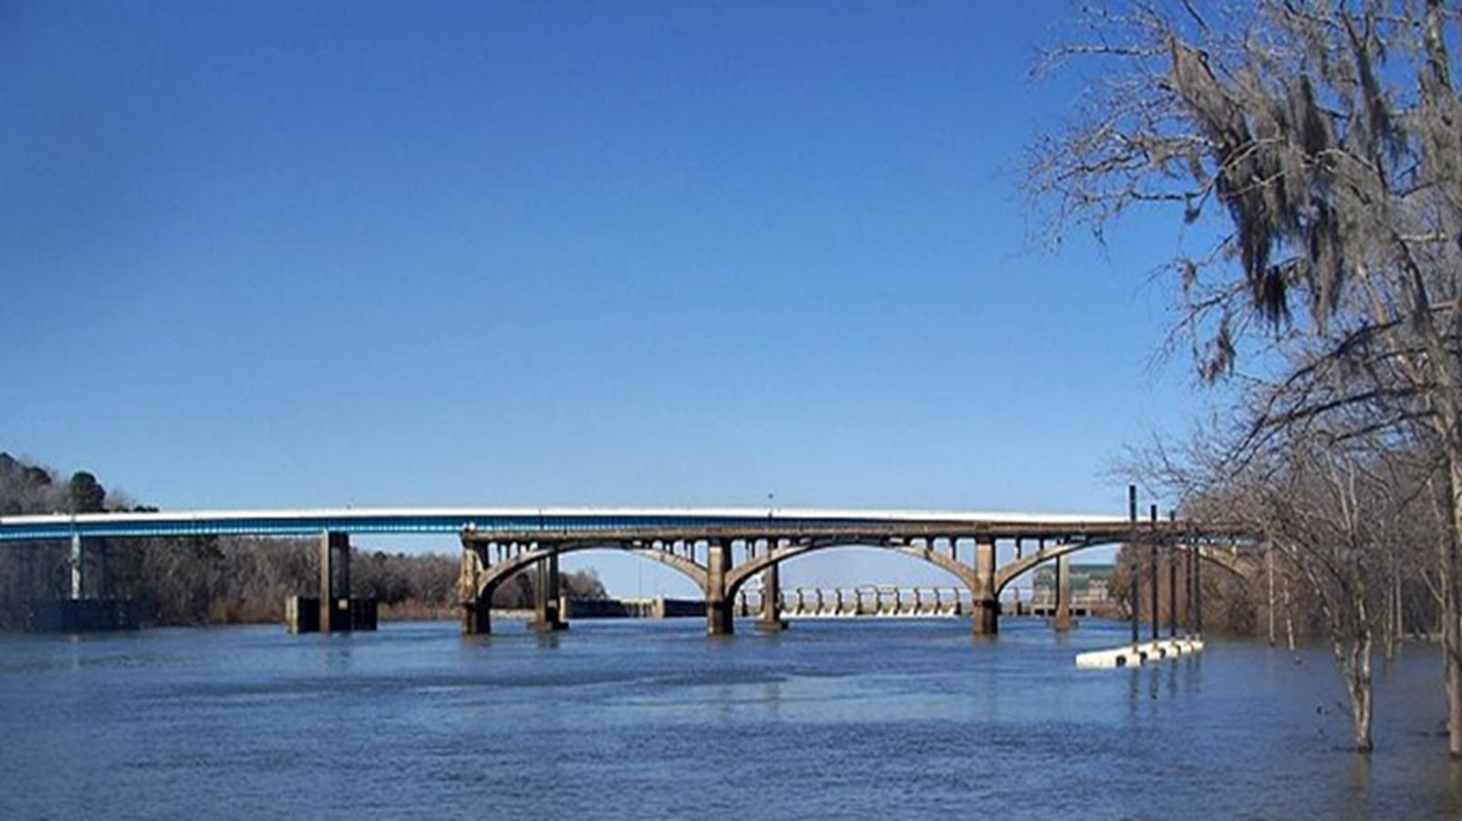
Apalachicola River
Largest river in Florida, based on discharge.
The ACF drainage basin is 17,230 square miles
Discharge averages 16,500 cubic feet/second.
Drainage basin receives sediments from the Blue Ridge, Piedmont and Coastal Plain provinces of Georgia.
Multiple cities use both rivers for effluent discharges (Atlanta metropolitan area, Griffin, Columbus, Bainbridge).
Both basins have significant agriculture presence.
Site located at state line downstream from Woodruff Dam.
Sucralose maximum value detected was 0.95 µg/L.
Notes:
1.Formed by confluence of the Chattahoochee and Flint Rivers, and measures 112 miles long.
2. drainage basin of 430 mile long Chattahoochee is 8,770 square miles; the drainage basin of the 344 mile long Flint River is 8,460 square miles.
3.can range from a minimum of 5,000 cfs (mandated by ACOE) to over 175,000 cfs
4. river sediments still contain visible muscovite mica flakes)
7. forms Lake Seminole, one of the largest lakes in Georgia.

Slide 11
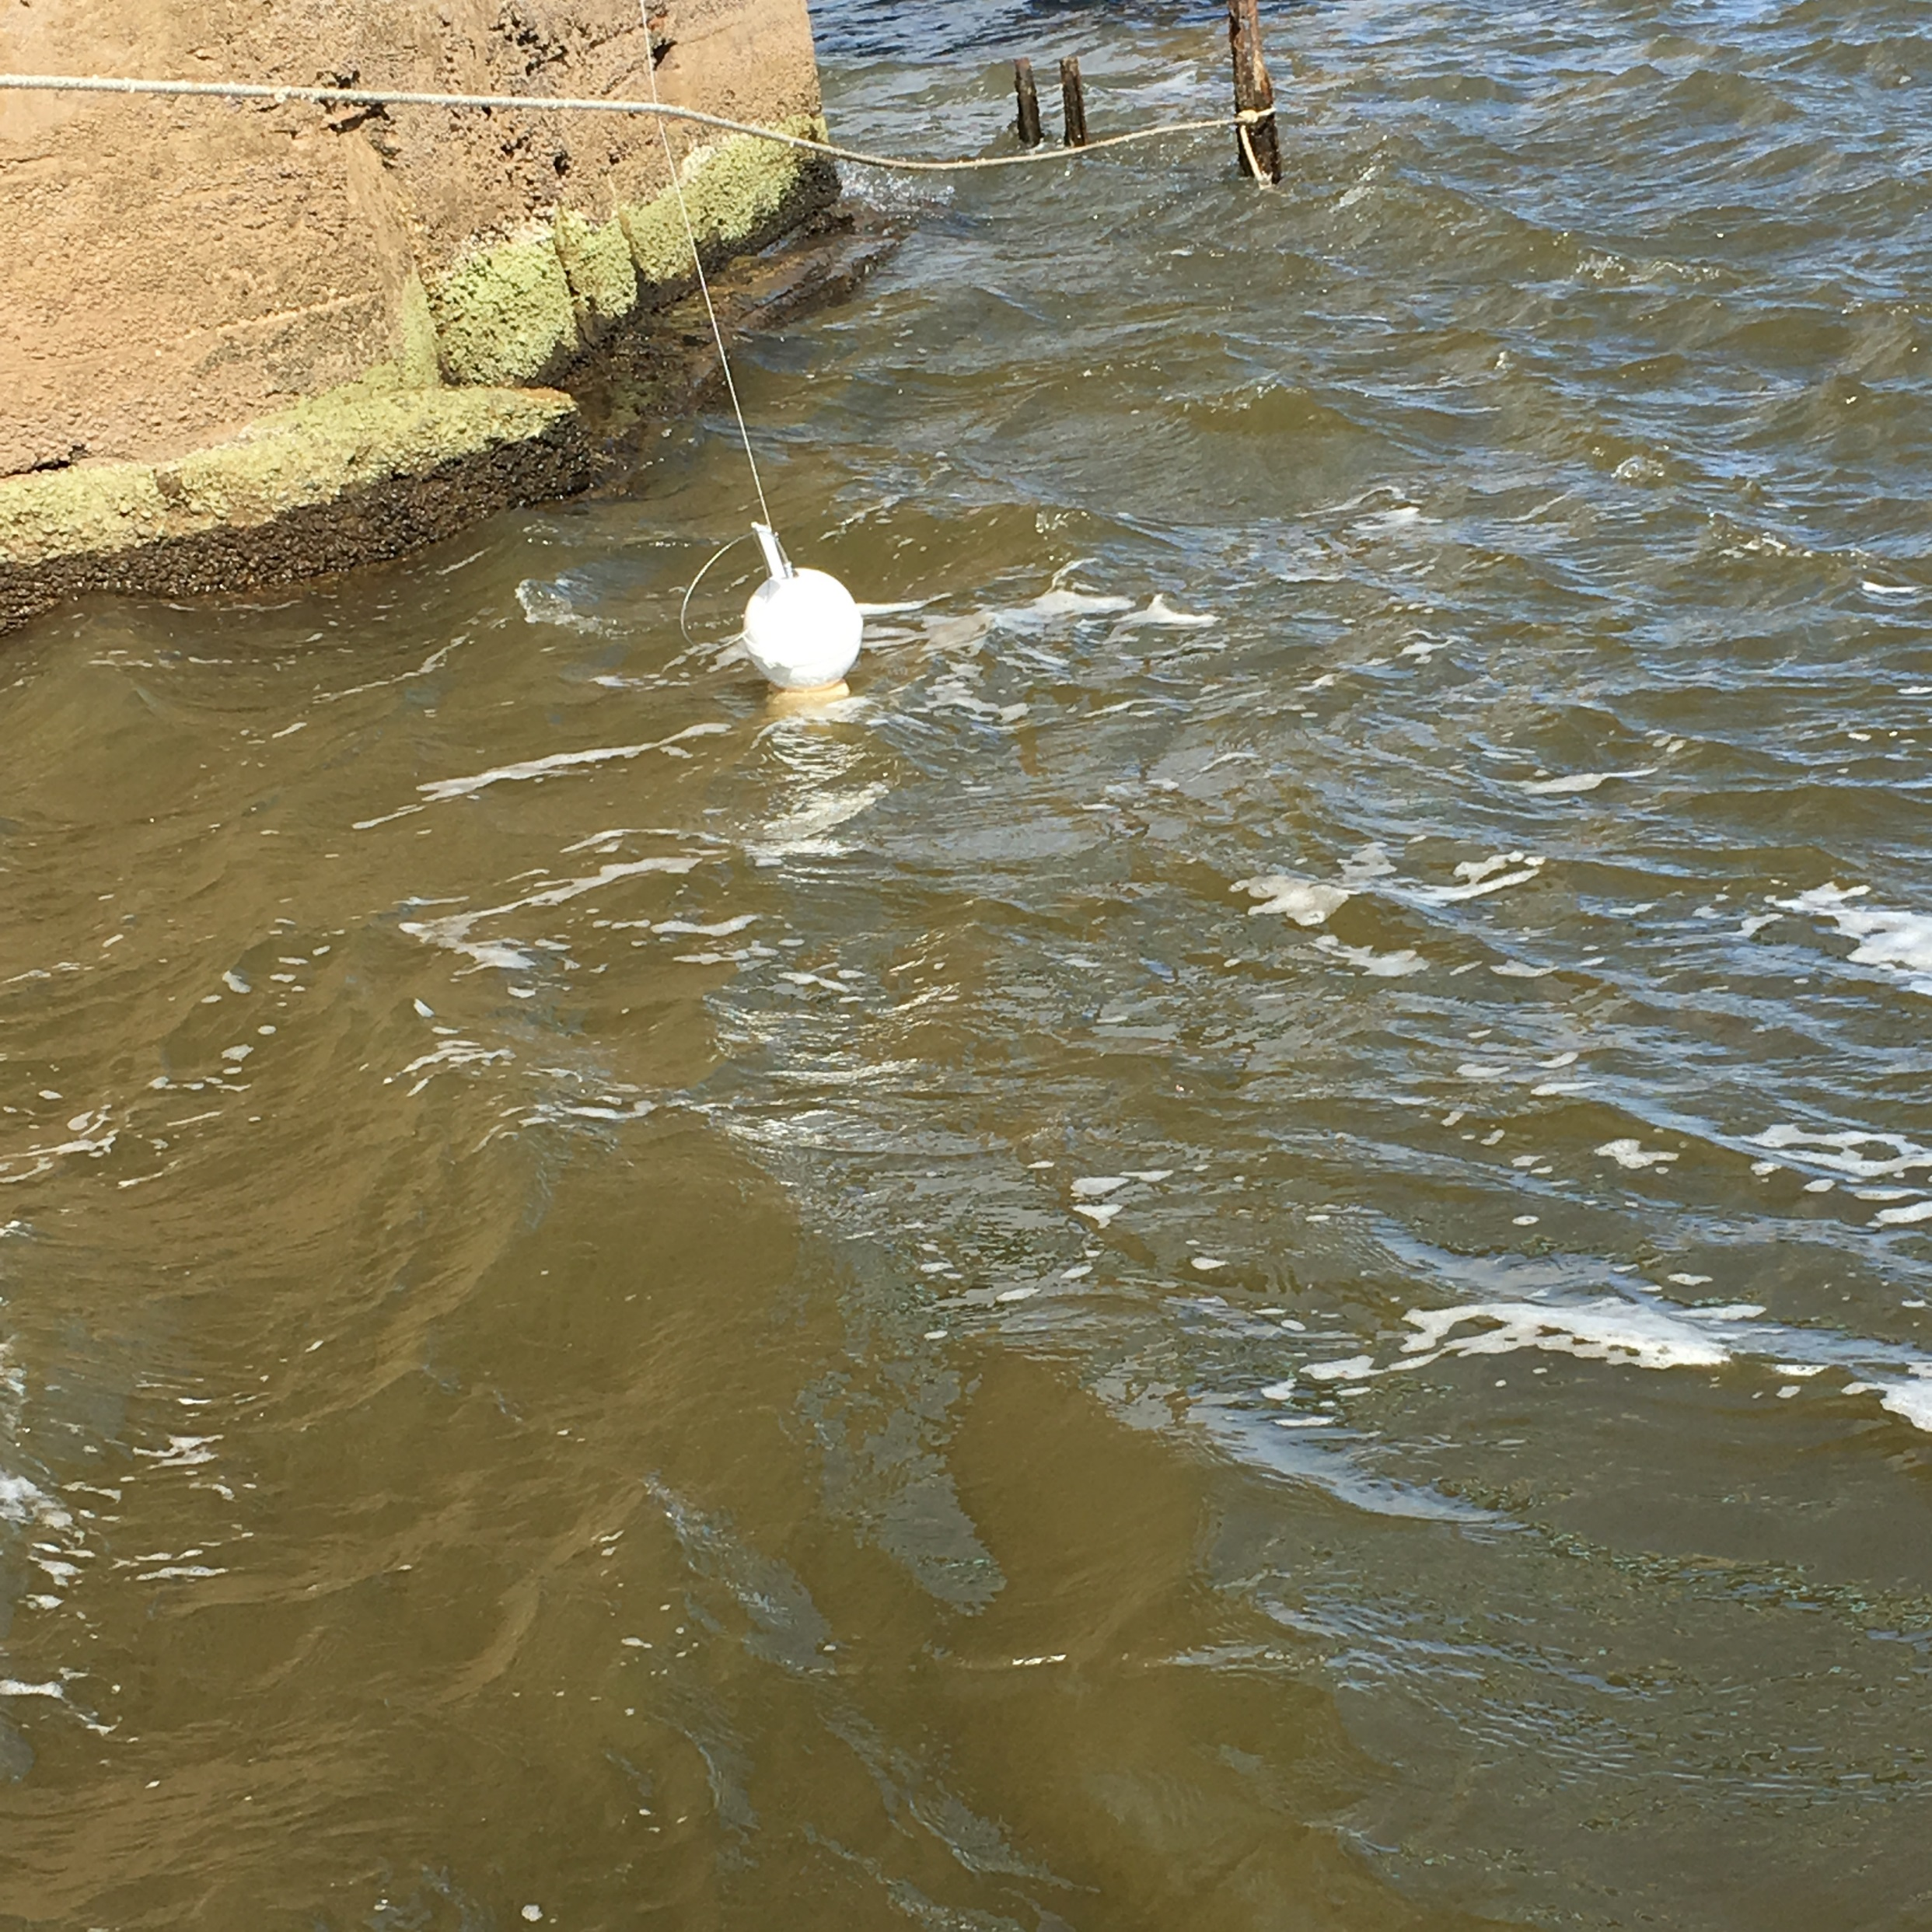
Sampler Location/Deployment

Slide 12
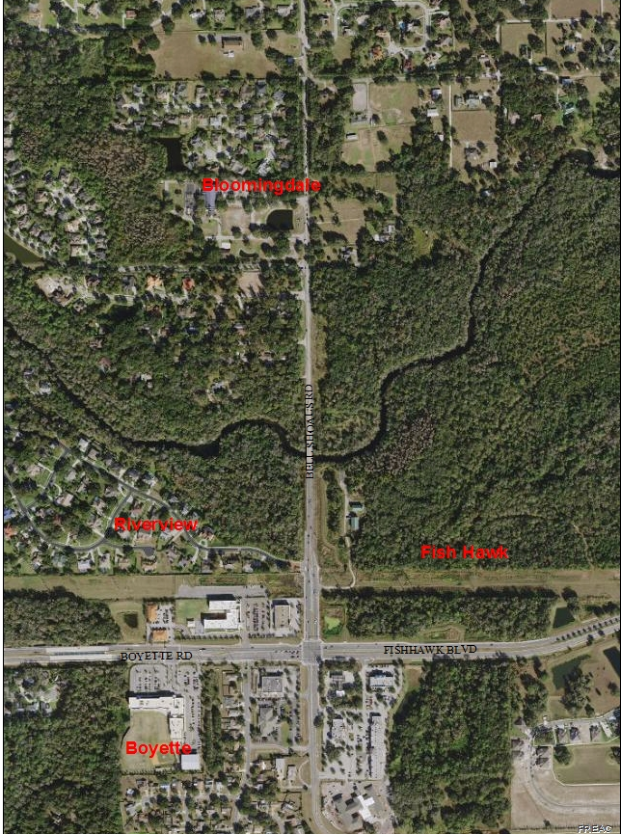
Alafia River
200m

Slide 13
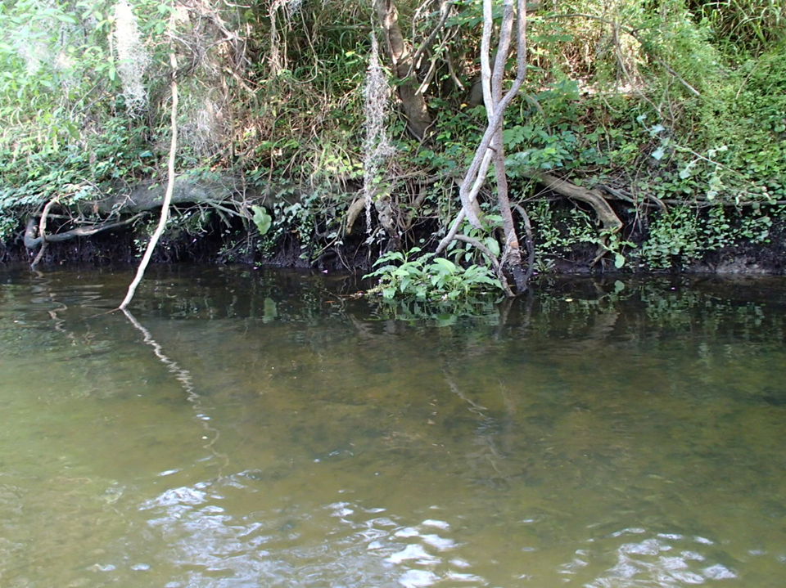
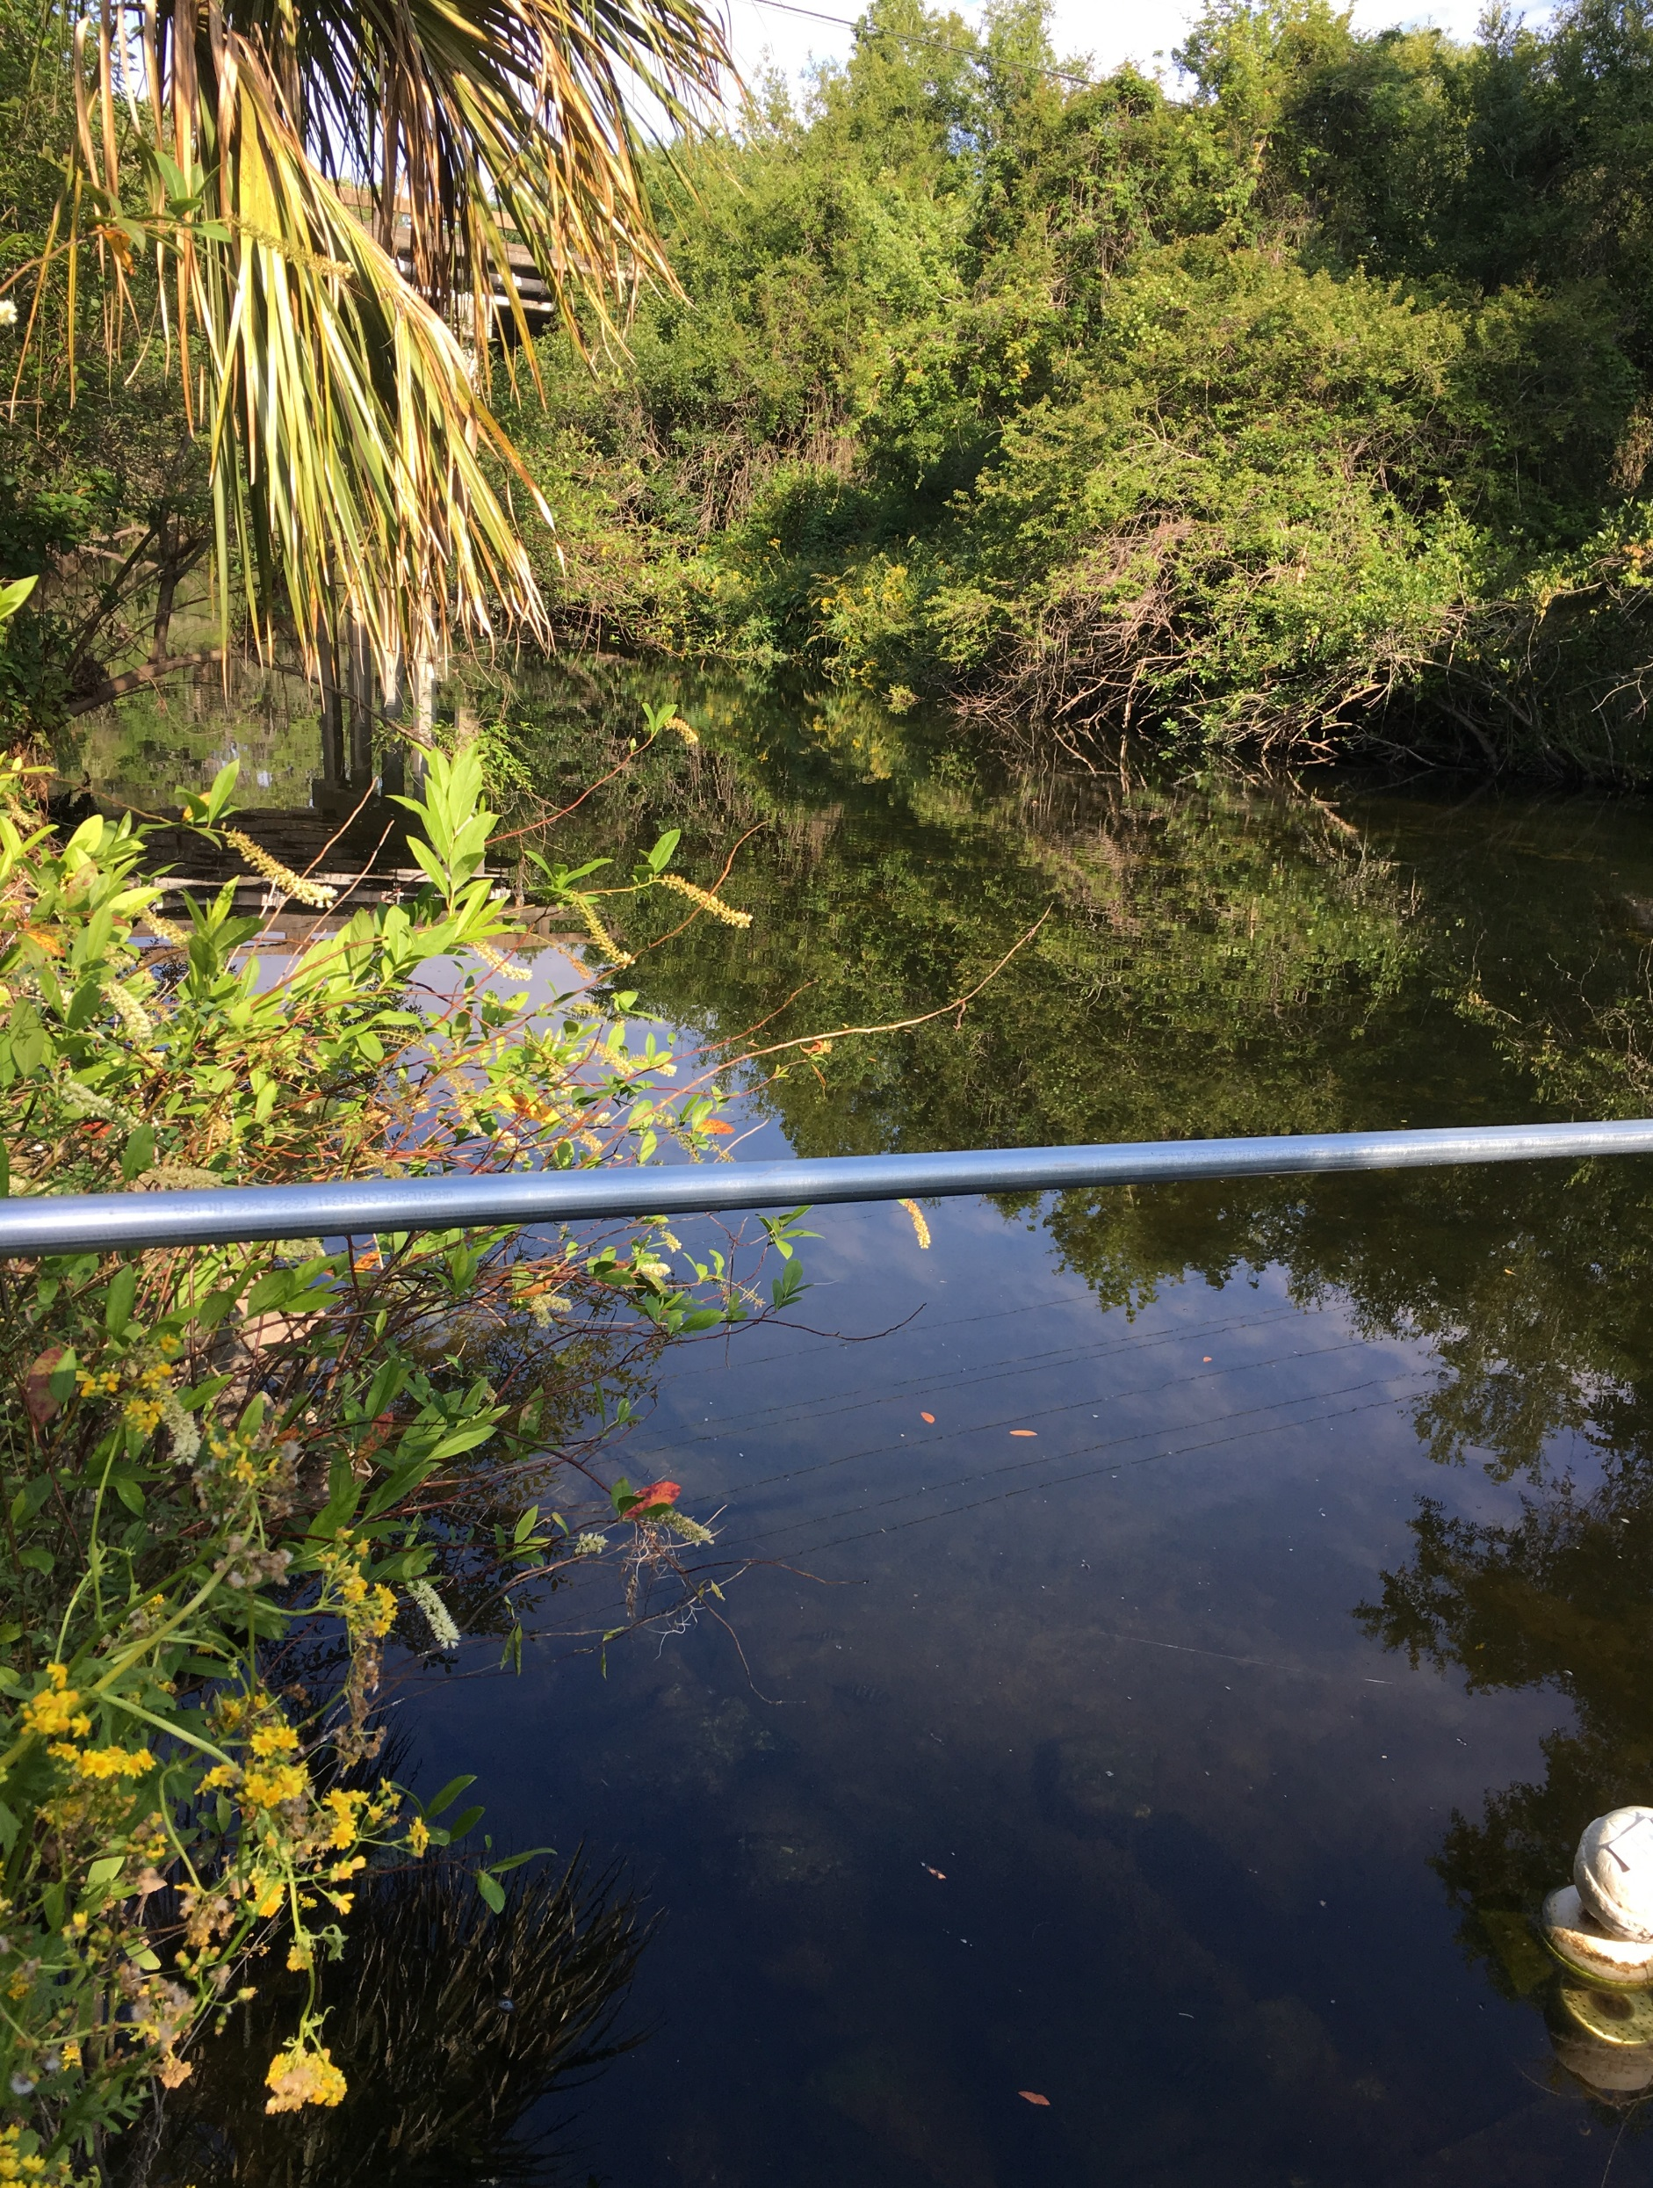
Alafia River
25 miles long, just a few feet above sea level for most of its length.
Watershed is 335 square miles.
Discharges an average of 200 cubic feet/second.
Numerous land uses influence quality of the river, including the City of Lakeland WWTP, phosphate mine sites and phosphate ore processing sites, and agriculture.
Salt water tidal influence occurs upstream from Tampa Bay.
Sampling site is downstream of the confluence of the North & South Prongs of the river at Tampa Bay Water Authority (TBWA) withdrawal point.
Sucralose maximum value detected was 7.3 µg/L
Notes:
2. located entirely in Hillsborough and western Polk County
3. but can range from a minimum of about 40 cfs up to 21,000 cfs
5. indicated by higher specific conductivity in samples
6. near a Tampa Bay Water freshwater withdrawal site.

Slide 14
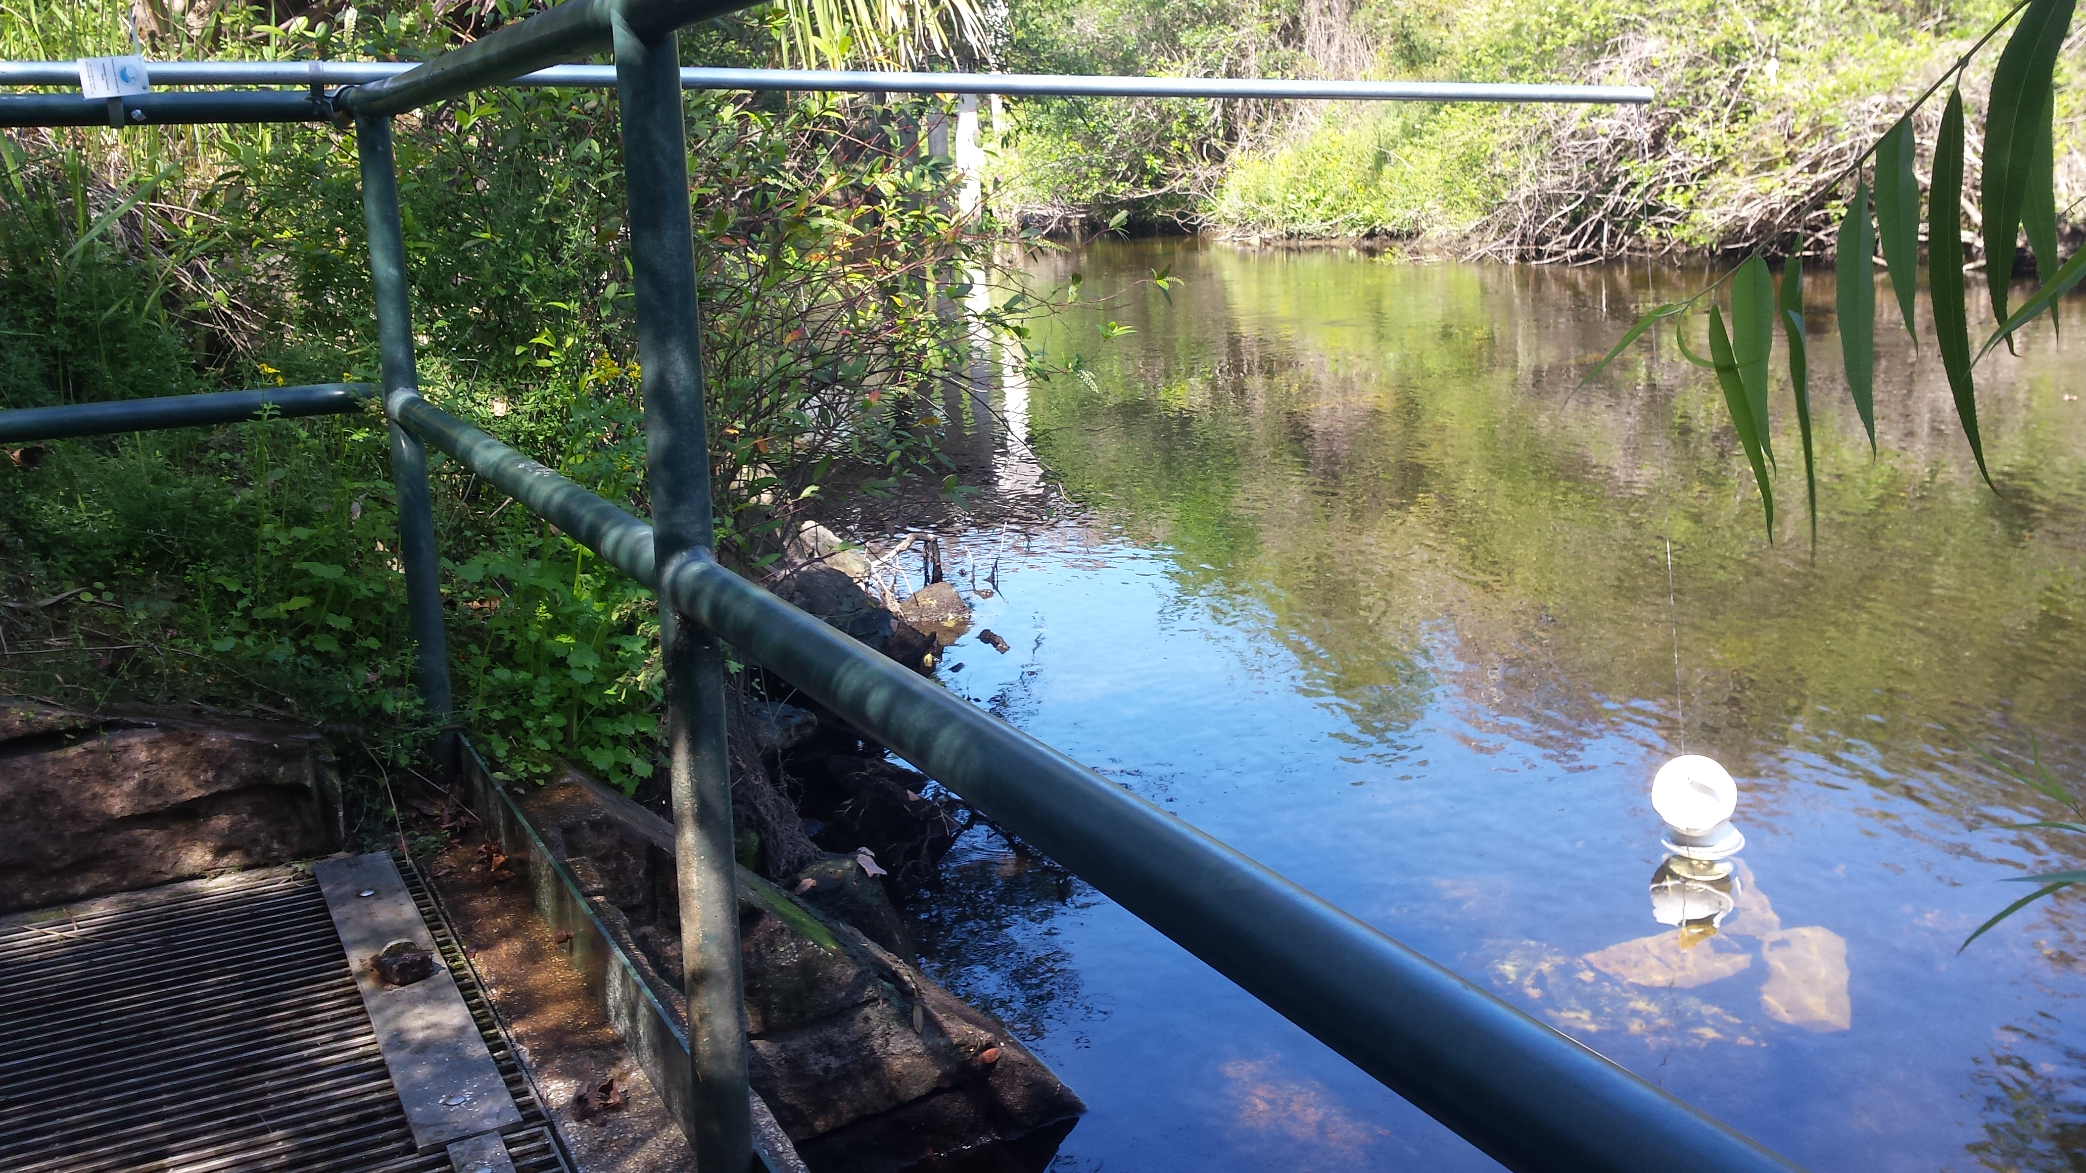
Sampler Location/Deployment

Slide 15
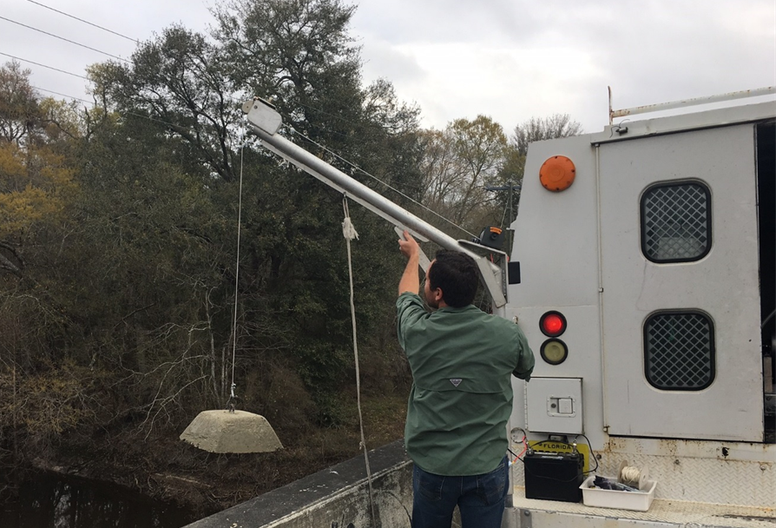
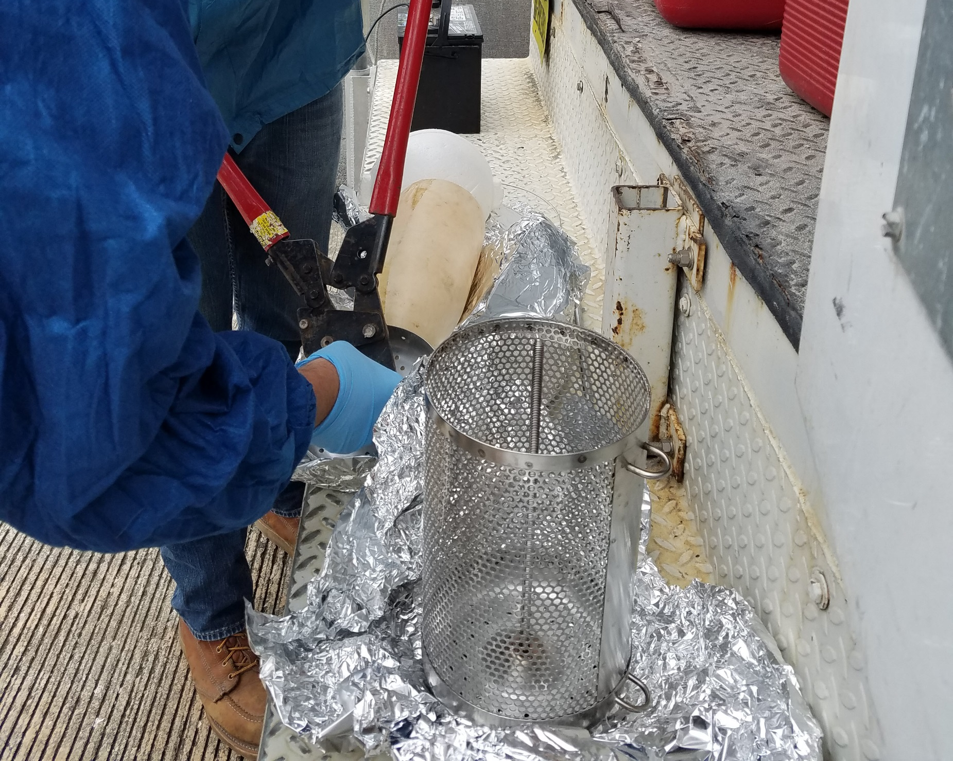
1. 60-80lb weight lowered using a 12volt ATV winch attached to a davit.
Sampler Deployment for
Ochlockonee, Withlacoochee & Apalachicola
2. Buoys were attached to top of canister.
Notes:
Only 30minutes max air time for sampler (including loading/unloading).~10-20mins

Slide 16
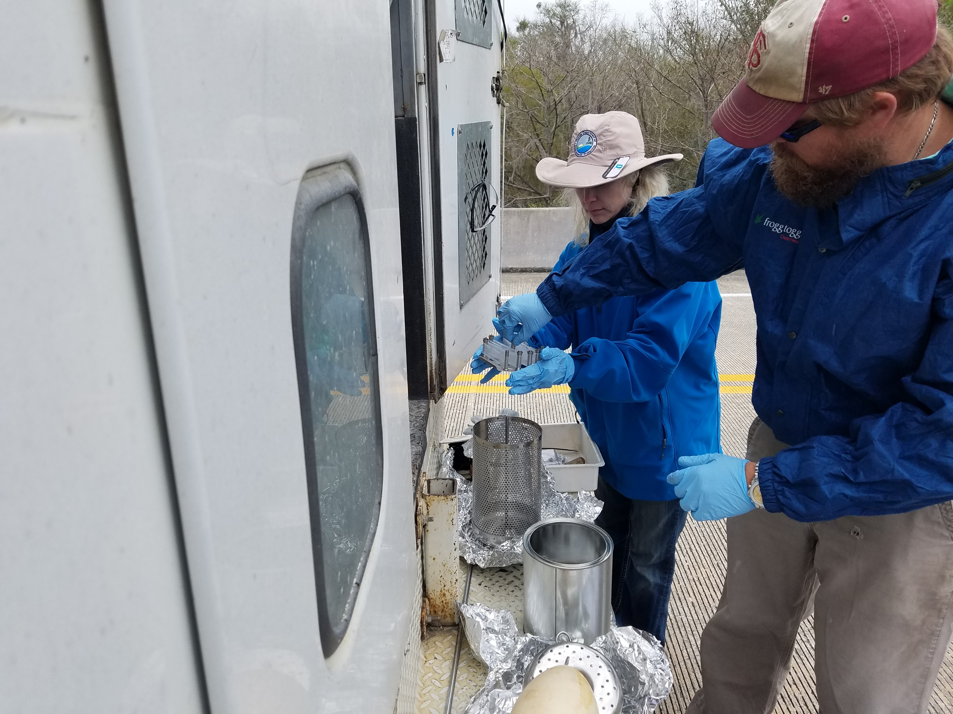
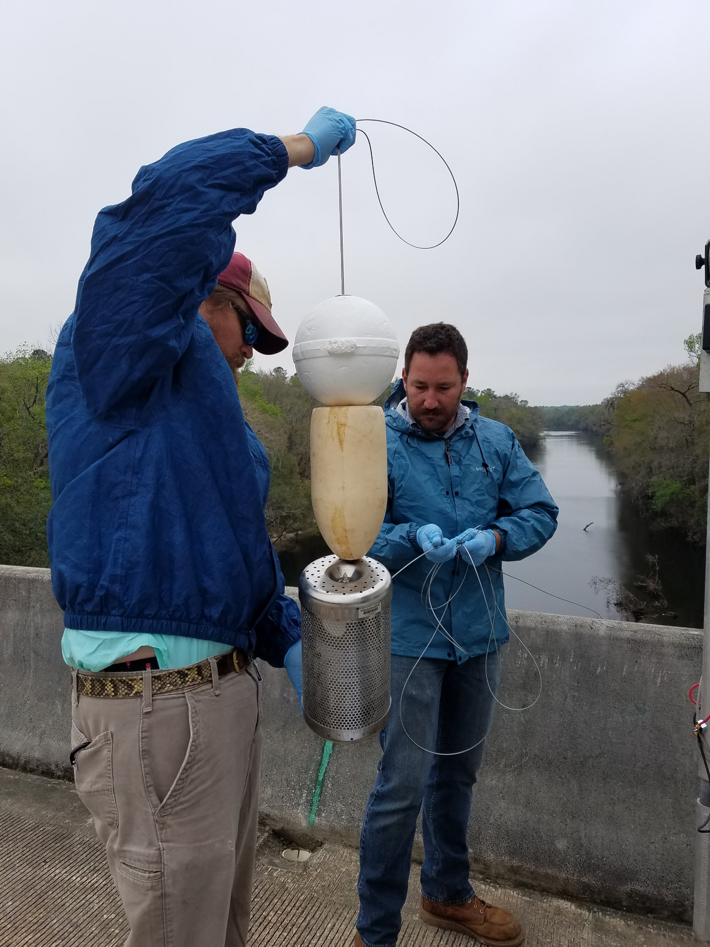
Sampler Deployment for
Ochlockonee, Withlacoochee & Apalachicola
3. Canister was loaded with POCIS and SPMDs.
4. Cable was attached to canister through slip rings.

Slide 17
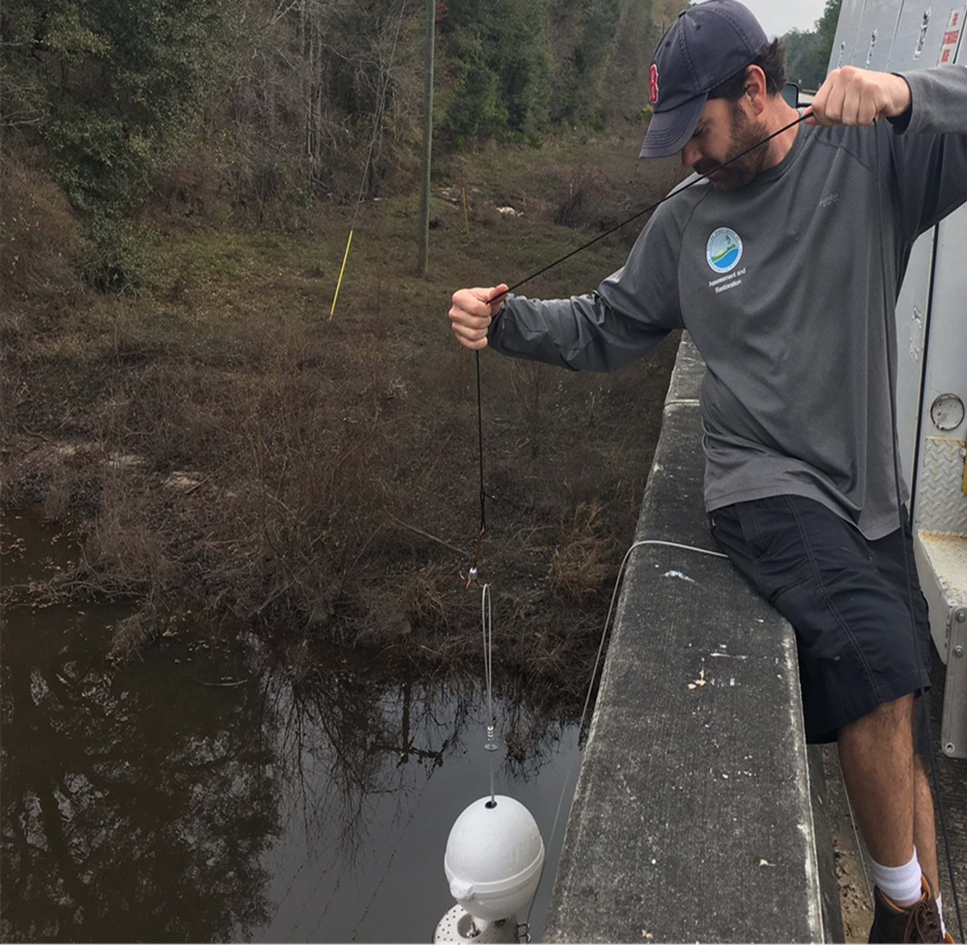
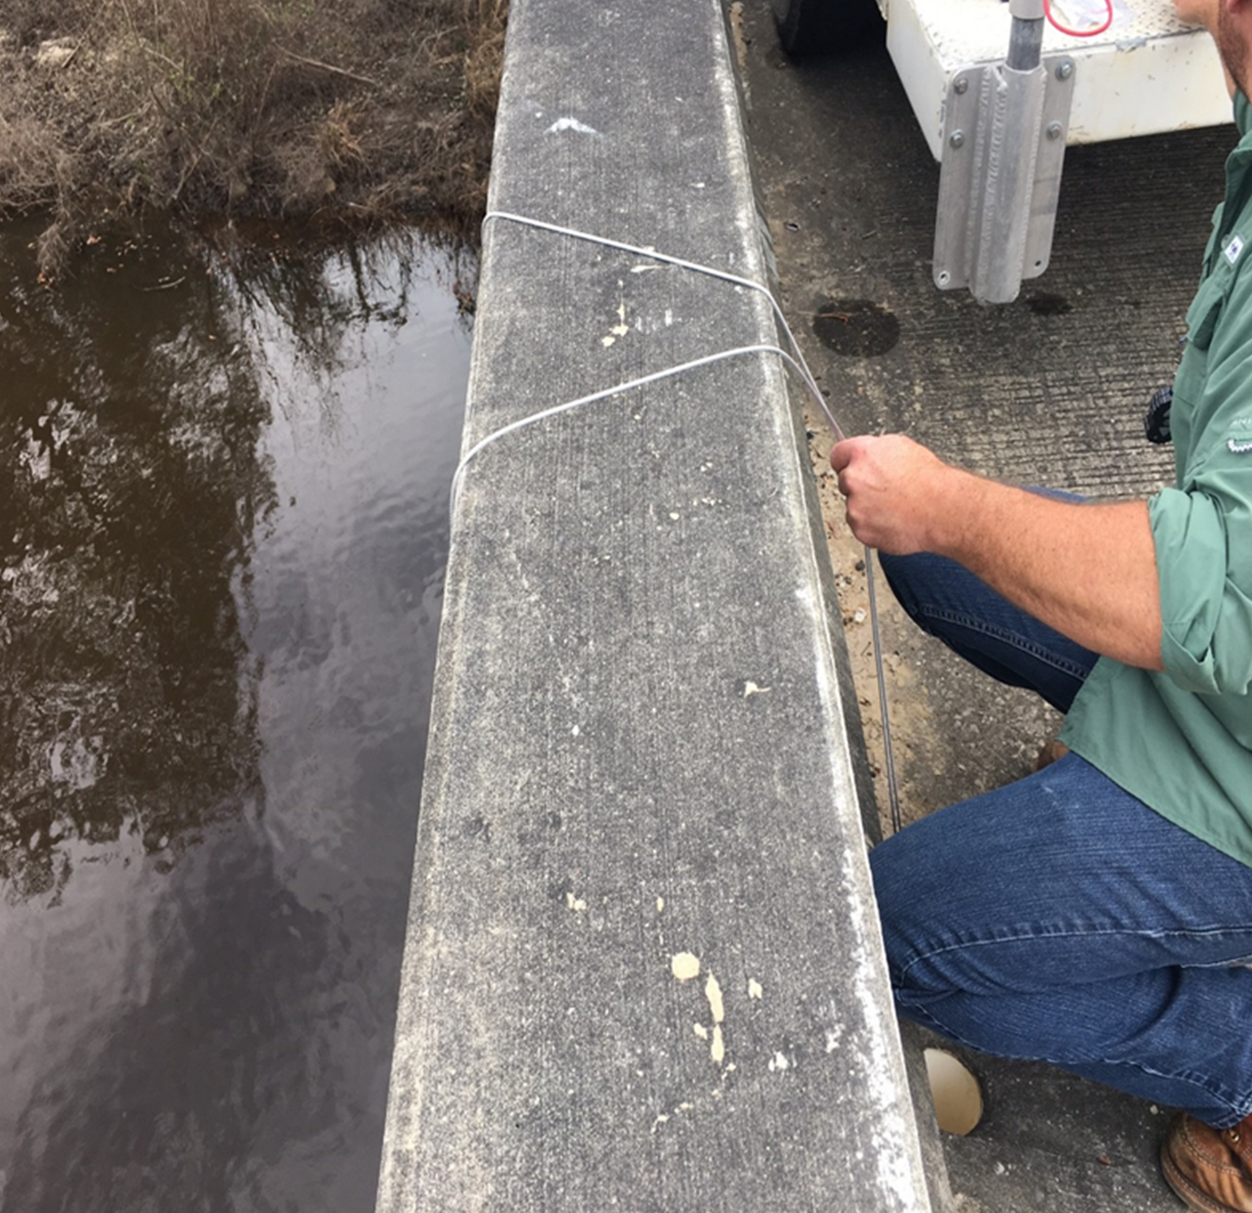
Sampler Deployment for
Ochlockonee, Withlacoochee & Apalachicola
5. Sampler lowered with large weighted treble hook.
6. Looped & attached cable to bridge through drain hole.

Slide 18
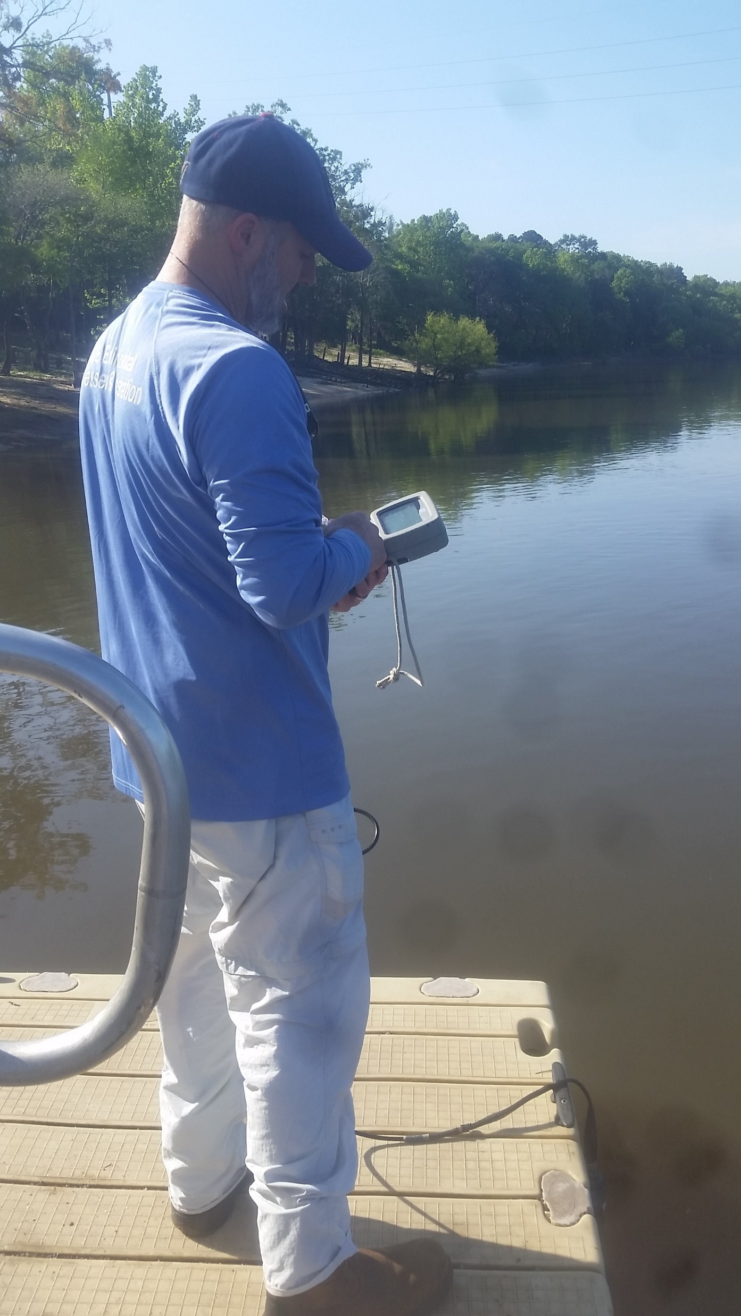
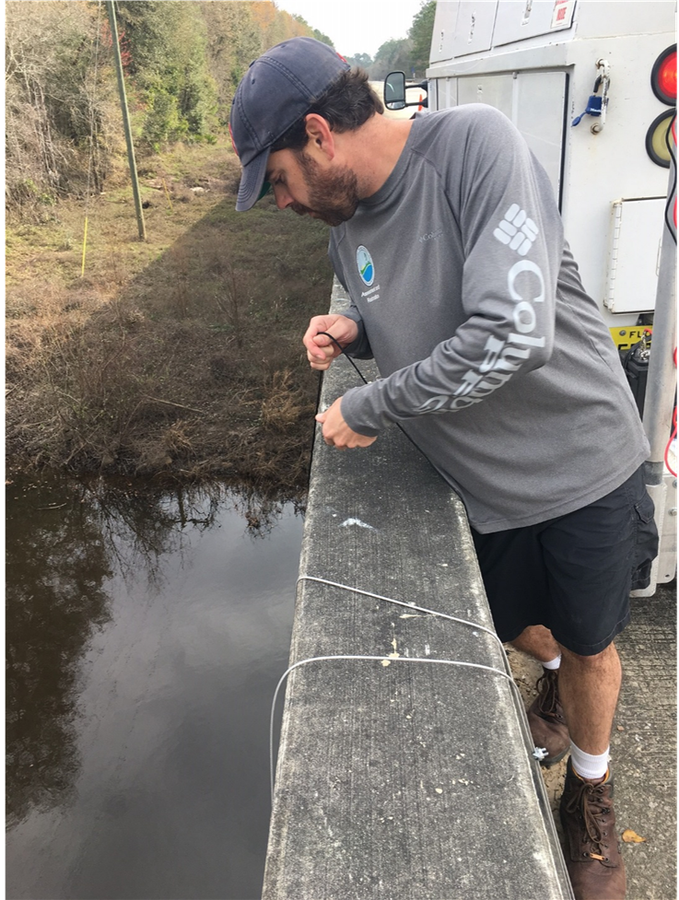
7. Sampler deployed 30 -35 days; Initial water quality parameters collected.
Sampler Deployment for
Ochlockonee, Withlacoochee & Apalachicola
8. Checked equipment & took field measurements halfway through.
Notes:
Water quality field measurements collected during device deployment, midway through deployment period, and during device retrieval
Grab samples collected before container was retrieved at all sites except alafia.. USED glass amber bottles

Slide 19
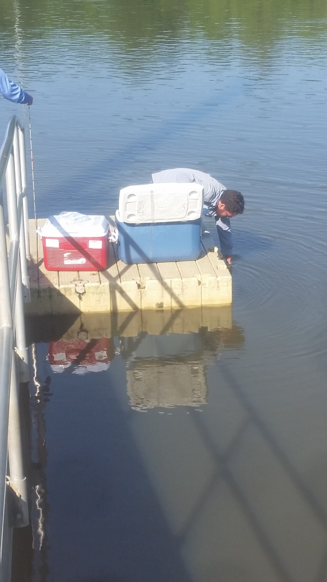
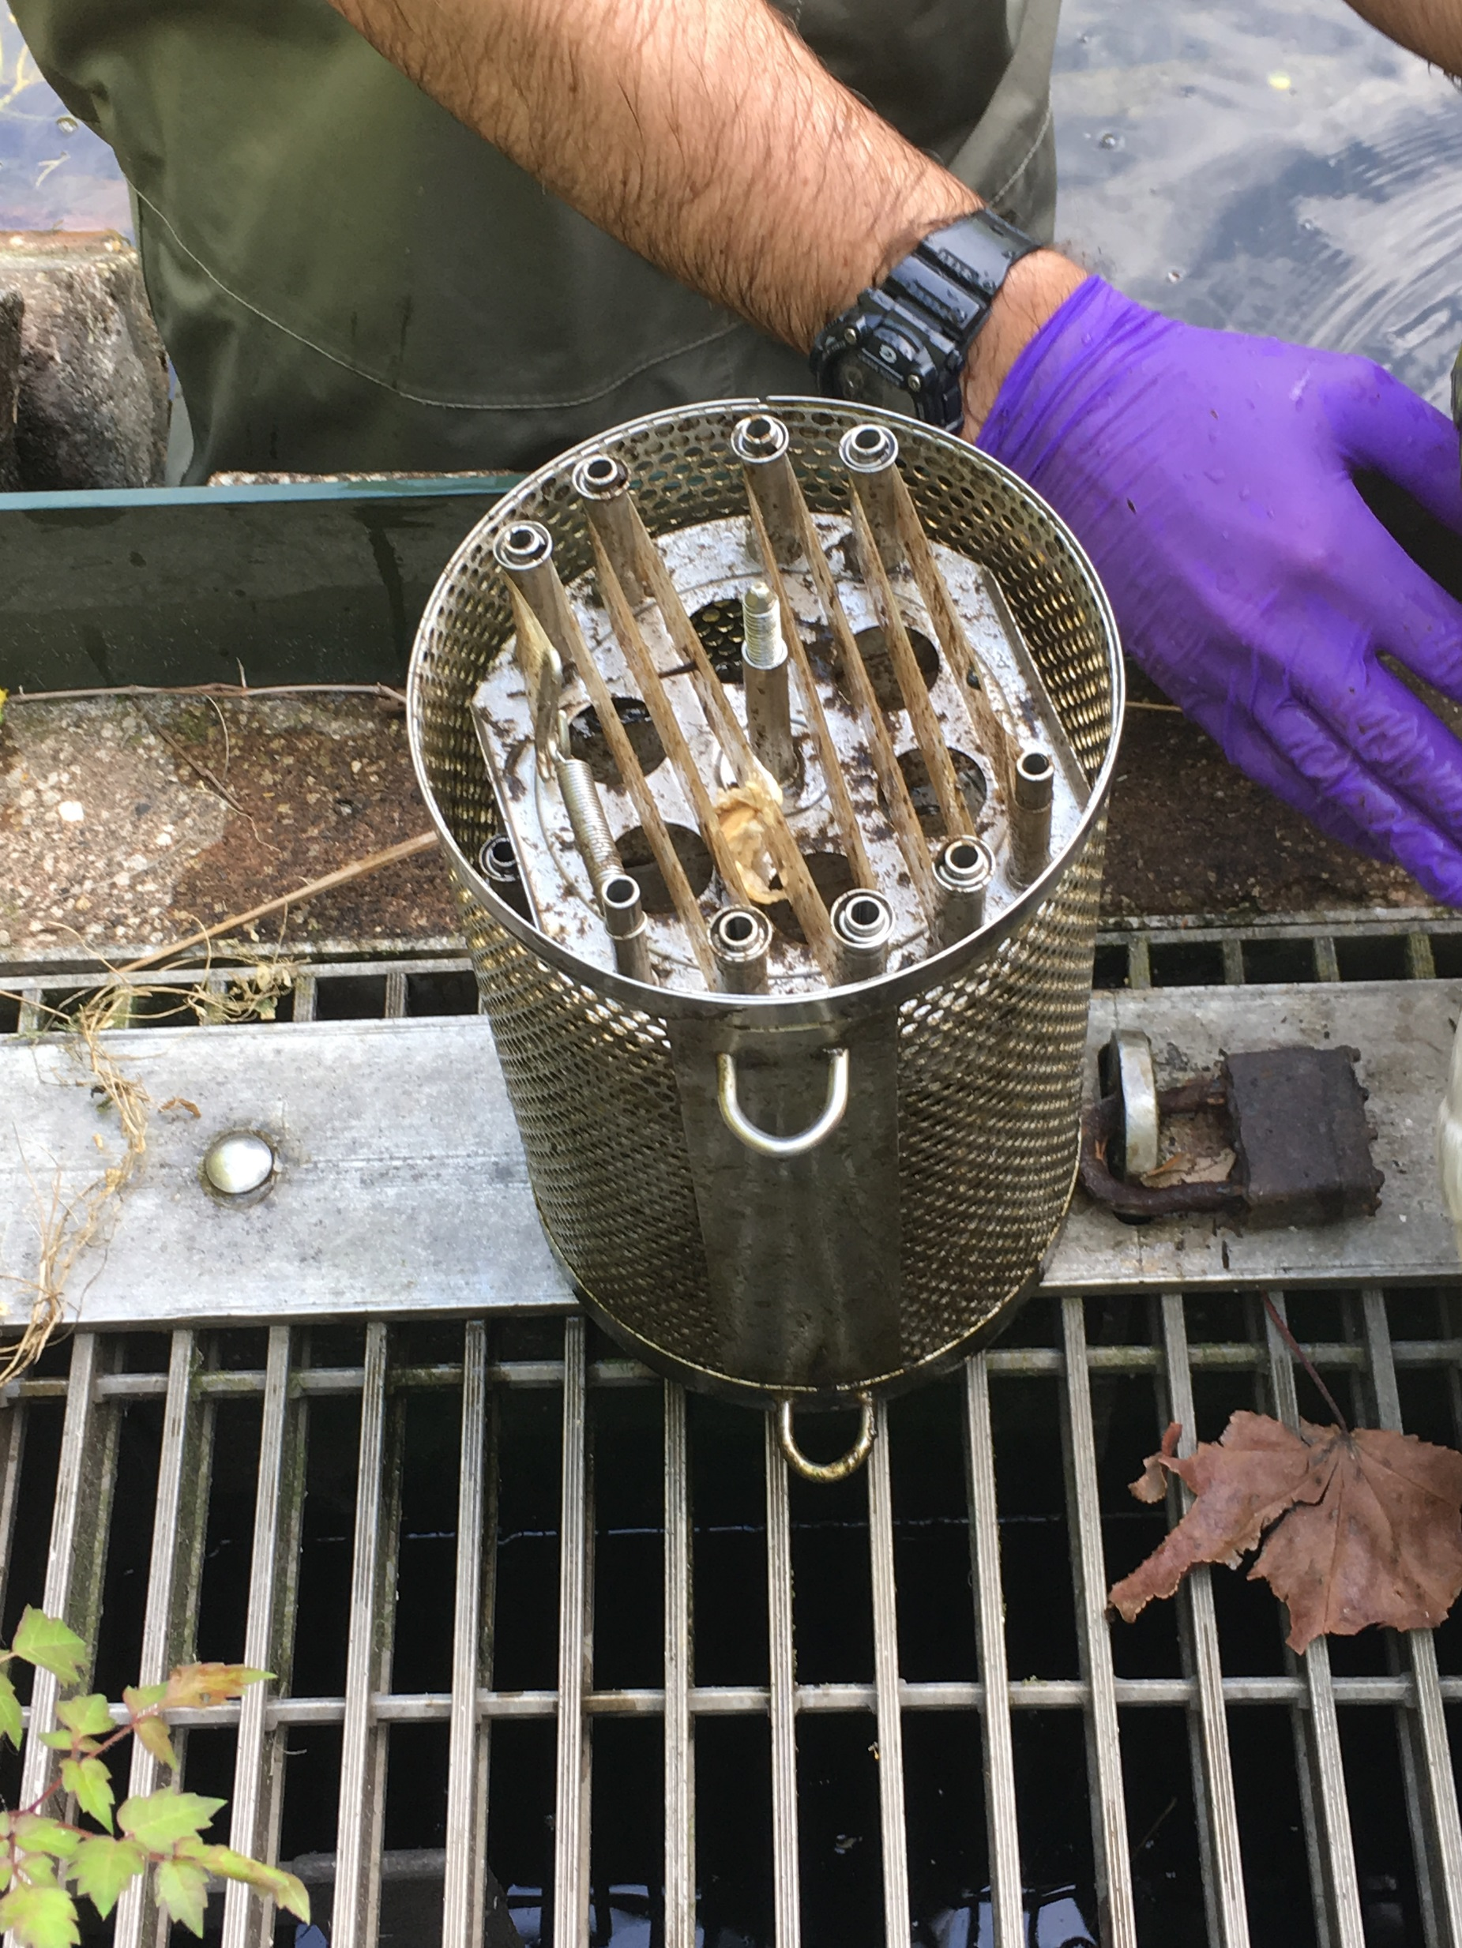
Sampler Deployment for
Ochlockonee, Withlacoochee & Apalachicola
9. Grab samples collected. Sampler retrieved using treble hook. Weight raised using the winch & davit.
10. Canister contents (POCISs, SPMDs) loaded into cans. Cans sealed, stored in ice, and shipped to SGS/Axys for extraction.

Slide 20






Review of Deployment
Ochlockonee, Withlacoochee & Apalachicola
Slip Rings
Cable
Roadway
Buoys
Sampler
Weight

Slide 21
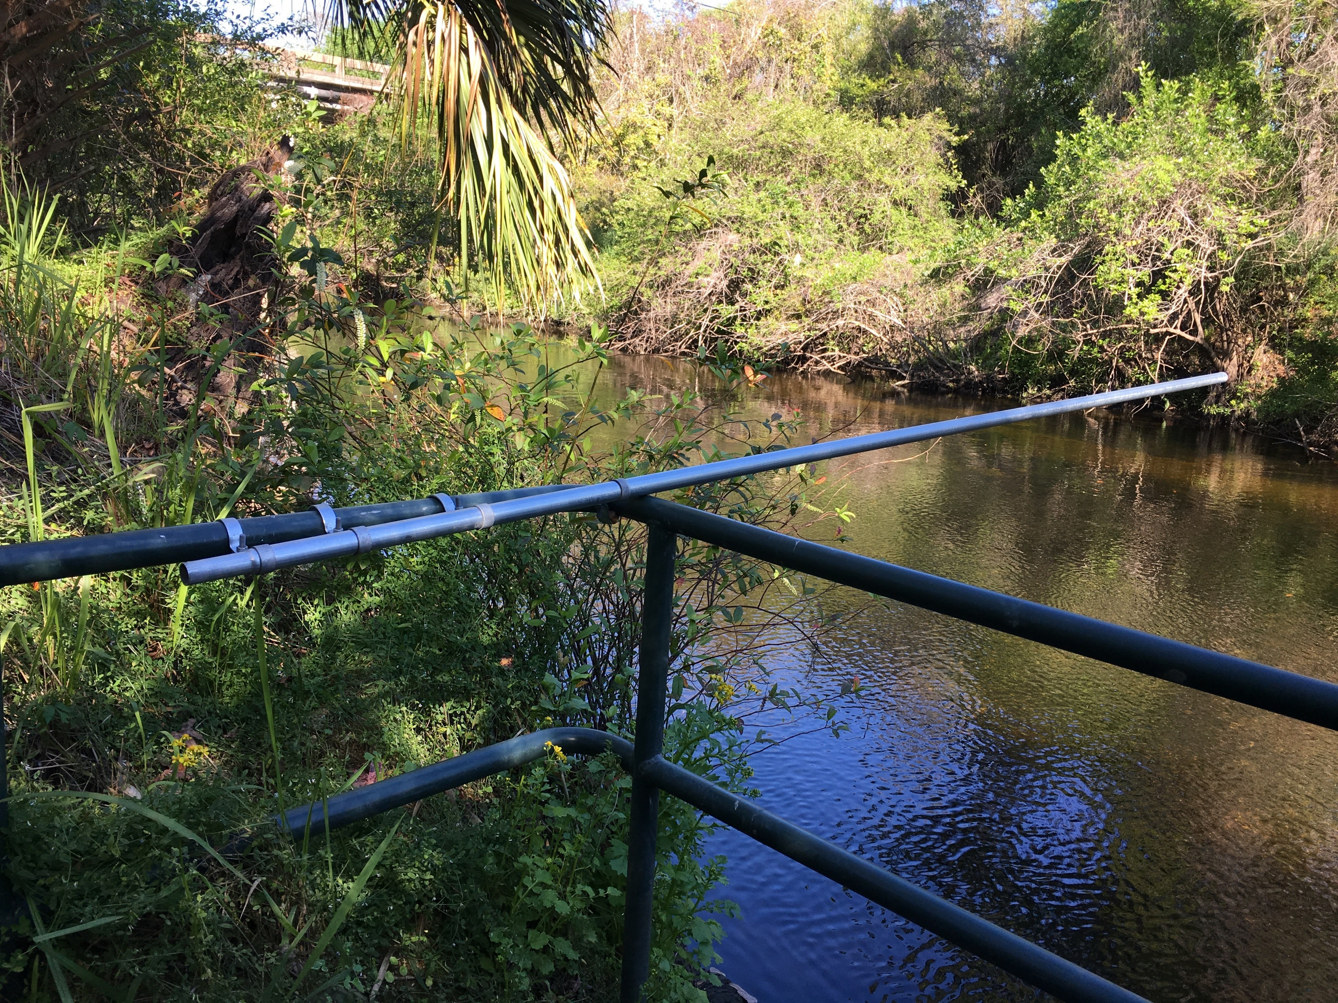
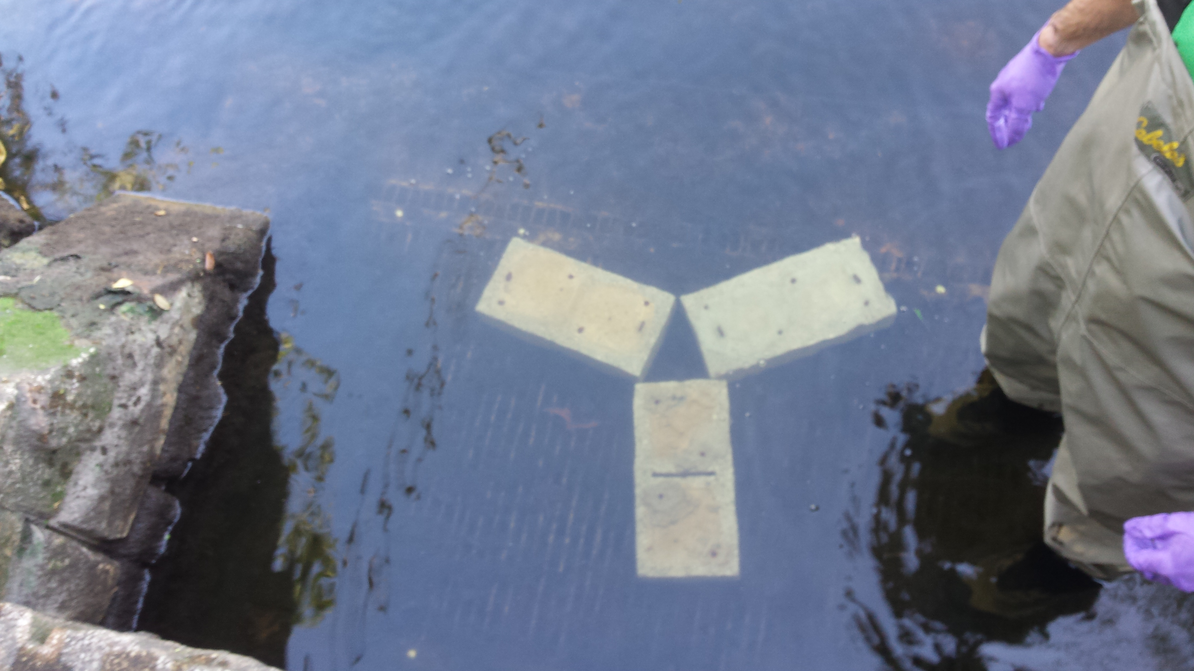
1. Metal pole was attached to TBWA withdrawal point control structure.
Sampler Deployment for
Alafia
2. Concrete blocks placed in front of withdrawal point.
Notes:
Only 30minutes max air time for sampler (including loading/unloading).~10-20mins

Slide 22
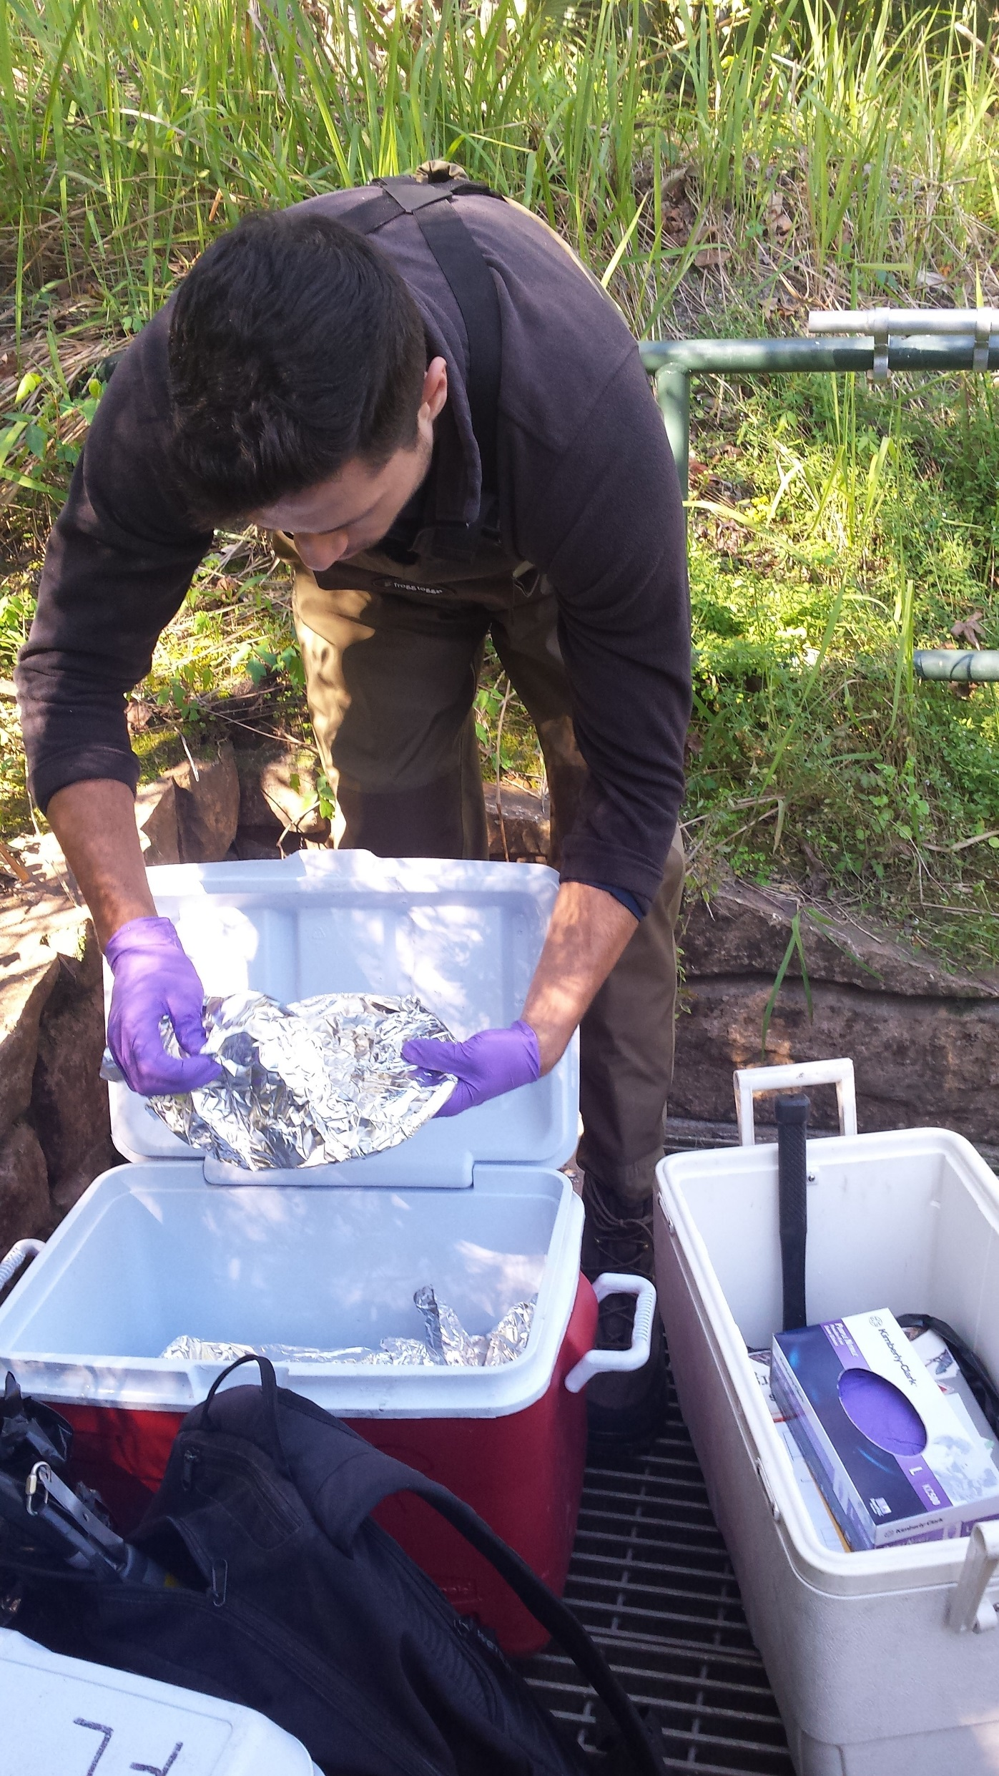
Sampler Deployment for
Alafia
3. Buoys were attached to top of passive sampler.
4. Canister was loaded with POCIS and SPMDs.

Slide 23
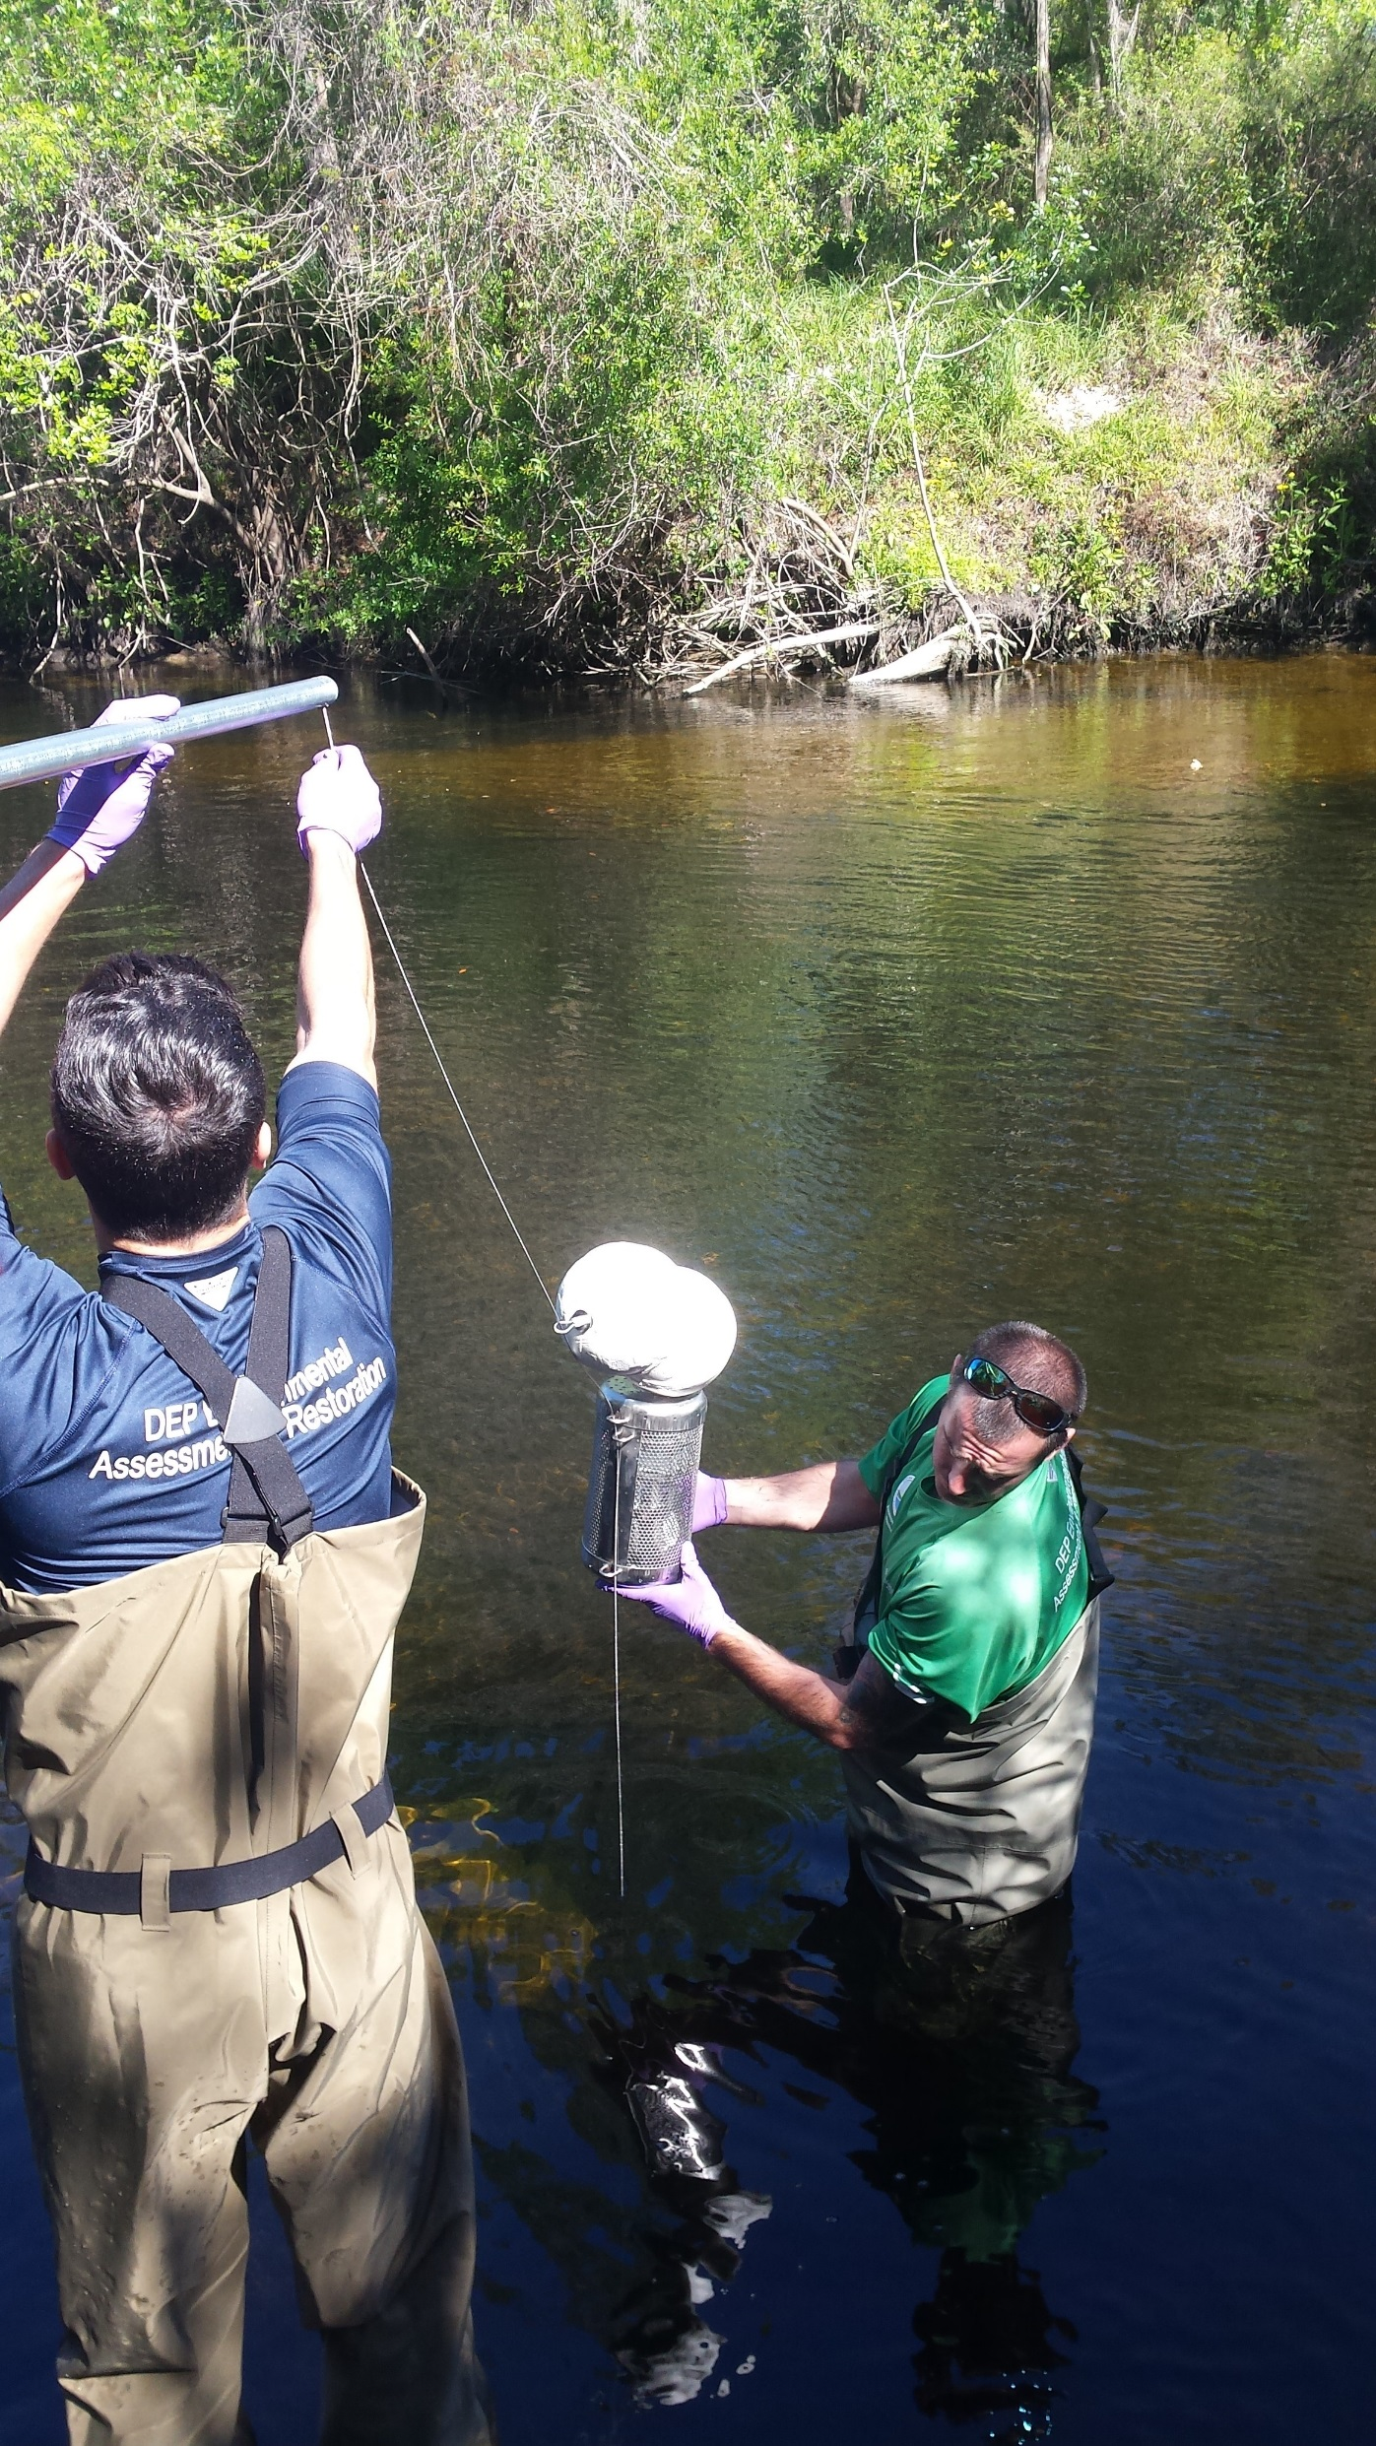
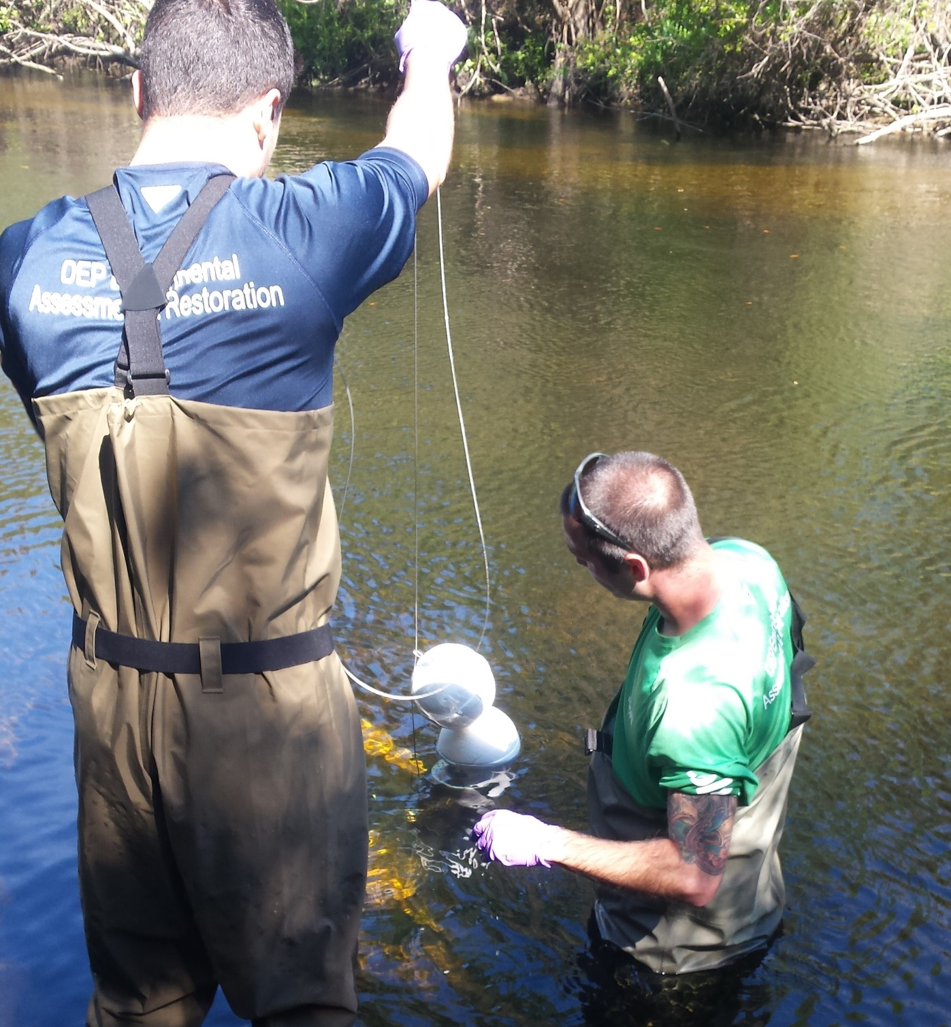
Sampler Deployment for
Alafia
5. Cable was attached to sampler through slip rings.
5. Sampler lowered into water, and positioned into place.

Slide 24
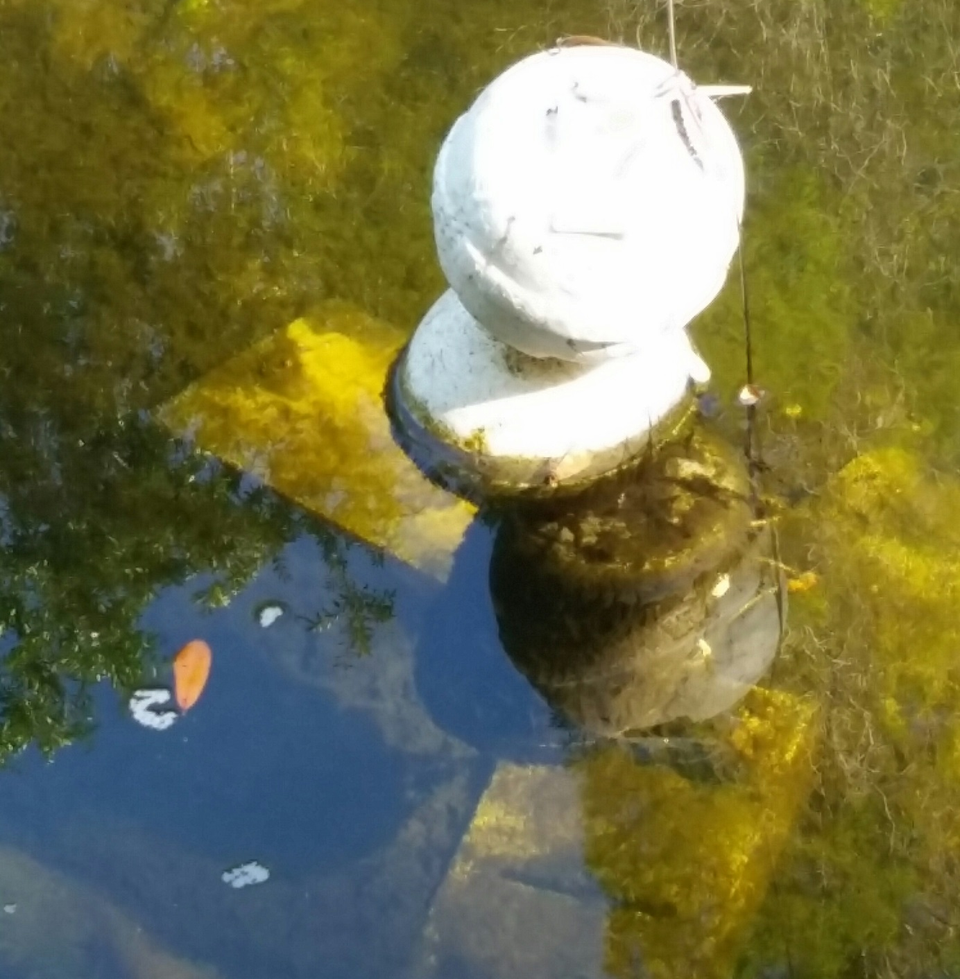
7. Initial water quality parameters were collected. Sampler deployed 30 -35 days.
Sampler Deployment for
Alafia
8. Checked equipment & took field measurements halfway through.
Notes:
Water quality field measurements collected during device deployment, midway through deployment period, and during device retrieval
Grab samples collected before container was retrieved at all sites except alafia.. USED glass amber bottles

Slide 25
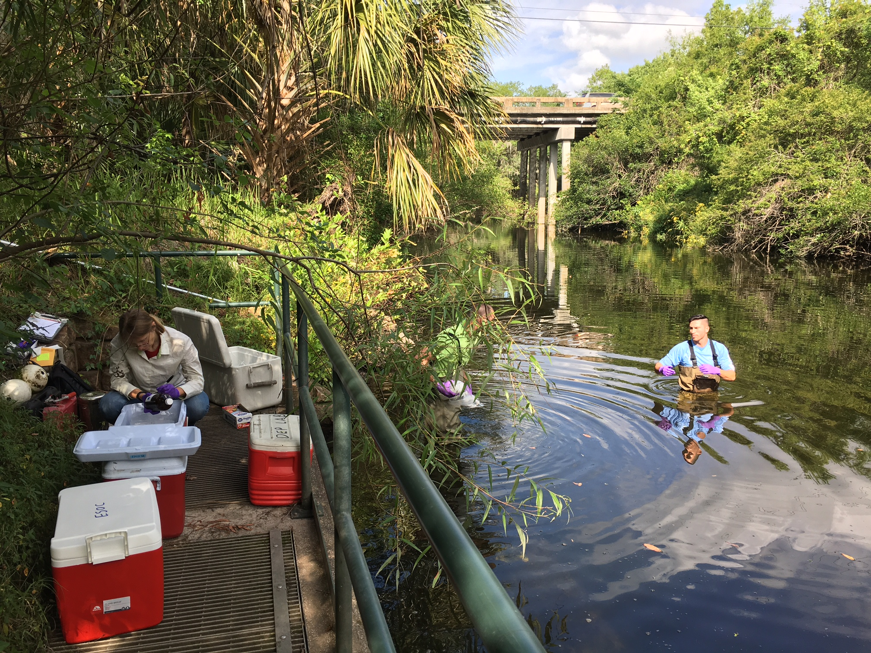
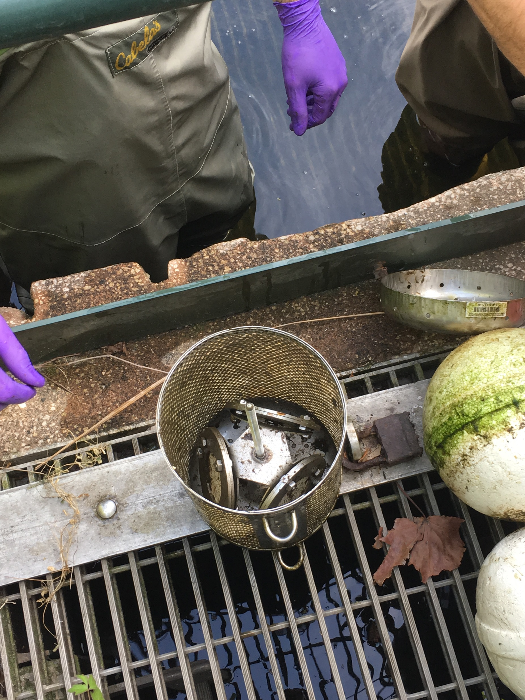
Sampler Deployment for
Alafia
9. Grab samples collected. Passive sampler retrieved.
10. Canister contents (POCISs, SPMDs) loaded into cans. Cans sealed, stored in ice, and shipped to SGS/Axys for extraction.

Slide 26
Review of Deployment
Alafia
Vegetation
Pole
TBWA Control Structure
Cable
Slip Rings
Buoys
Sampler
Concrete blocks
Vegetation
Notes:
Tampa bay water authority

Slide 27
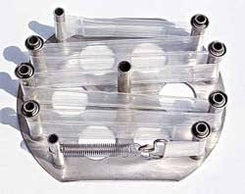
Semi-Permeable Membrane Device (SPMD)
Mimics natural system to collect bioavailable pollutants in water.
Passive transport similar to chemical transport through fish gills.
Doesn’t metabolize sequestered compounds, isn’t affected by poor water quality conditions.
Selective diffusion of hydrophobic organic chemicals through pores & stored in the lipid phase.
http://www.est-lab.com/spmd.php
Notes:
SPMD made of Low density Polyethylene lay-flat tubing containing lipids.
3. Unlike using inverts for quality testing
Bottom pic is used SPMD from Alafia

Slide 28
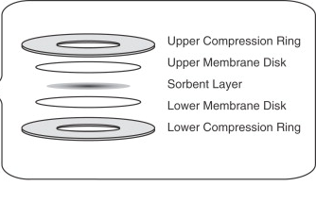
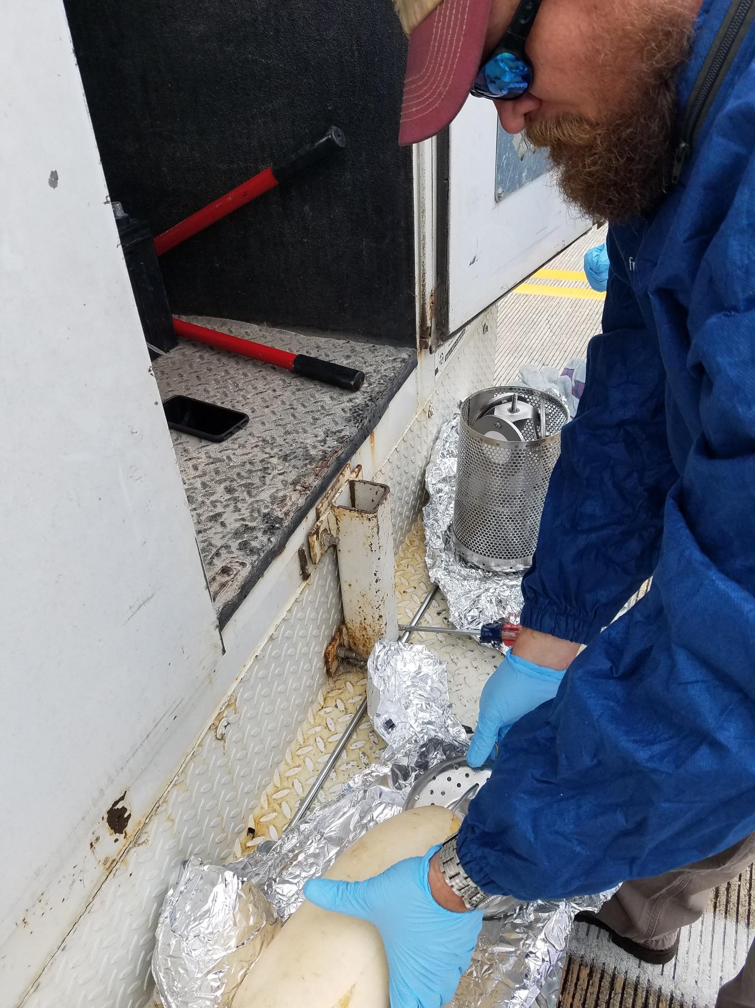
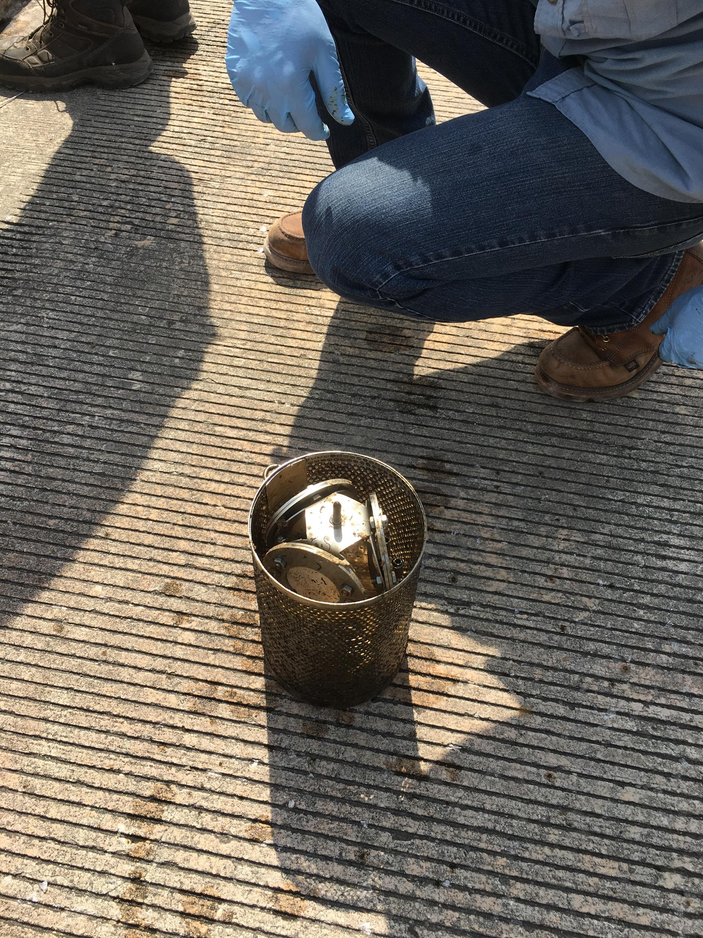
Polar Organic Chemical Integrative Sampler (POCIS)
High water solubility of polar organic chemicals (POCs) makes extraction & detection difficult.
Monitors hydrophilic contaminants that could be potential EDs, or acutely toxic.
POCIS provides reproducible method for the concentration of POCs in the ppt to ppq range
https://www.sciencedirect.com/science/article/pii/S0166526X06480089
Notes:
Composed of 2 sheets of microporous
(0.1µm pore size) polyethersulfone membrane encasing a solid phase sorbent (Oasis HLB).
Oasis retains sample chemicals
POCIS before/after deployment in withlacoochee

Slide 29
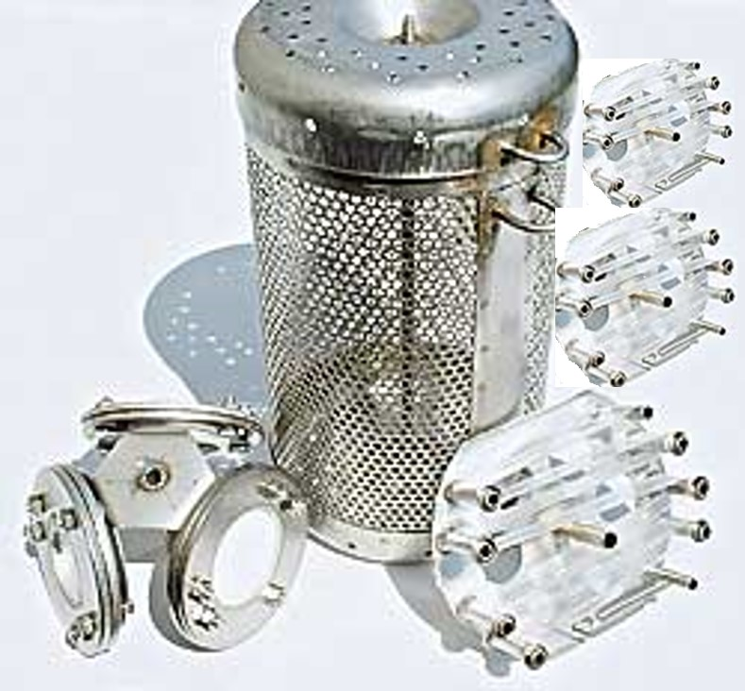
Passive Sampler Collection
Canister (1)
Holds 3 POCIS and 3 SPMD in water column during deployment.
SPMD (1)
No PRC addition.
No spike additions.
Extract split 1:3.
  BLYES &SOS Chromotest analysis by USGS
  ER binding & transactivation assays by UF
  Pesticide analyses by DEP lab
SPMD (2)
PRCs added by EST.
Spikes added by SGS/Axys.
Extract split 1:5.
  Alkylphenols by SGS/Axys
  MRES w/ ON by SGS/Axys
  PBDEs by SGS/Axys
  PRC analysis by SGS/Axys
  Archive

Slide 30
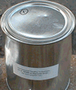
Passive Sampler Collection
POCIS-HLB (1)
No spike additions.
Extract split 1:3.
  BLYES &SOS Chromotest analysis by USGS
  ER binding & transactivation assays by UF
  Pesticide analyses by DEP lab
POCIS-HLB (2)
Spikes added by SGS/Axys.
Extract from each disk split 1:4
  MRES w/ ON by SGS/Axys
  PPCP & hormones by SGS/Axys
  PFC by SGS/Axys
  Archive
Sample Container (Can)(2)
Can #1 contains 3 SPMD (2 plates w/ PRCs or spikes, 1 plate marked w/ notch had no additions)
Can #2 contains 3 POCIS (2 discs w/spikes, 1 marked w/ notch had no additions)

Slide 31
Blank Collections
2 field blanks were collected at Apalachicola
1. Passive sampling equipment
        The blank sample containers (cans) were opened twice; once when passive sampler was deployed, and again when recovered from the site.
        Blank cans stayed open while passive sampling devices (POCIS & SPMD) were exposed to air.
        Sealed blank cans were stored at -20°C during deployment period.
2. Grab samples
        Blank collected using DI water supplied from SGS/Axys.

Slide 32
Category Selection
This study separated analytes into 6 main categories
Category | Human exposure route | Aquatic life effects | Water Solubility | Sample device
Pesticides | Surface & ground water, sediment, food web | Toxic, potential endocrine disruptor (ED) | High | POCIS, SPMD & Grab
Pharmaceuticals & personal care products (PPCP) | Surface & ground water | Potential ED | High | POCIS & Grab
Synthetic hormones | Surface & ground water | Potential ED | High | POCIS & Grab
Perfluorinated compounds (PFC) | Food web, breast milk | Bioaccumulative, potential ED | Low | POCIS & Grab
Polybrominated diphenyl ethers (PBDE) | House dust, sediment, food web, breast milk, surface & ground water. | Bioaccumulative, potential ED, carcinogenic, toxic, persistent | Low | SPMD & Grab
Alkylphenols | Surface & ground water | Potential ED | High | SPMD & Grab
Notes:
Used table from….(WHERE)……. As guideline for this table
For BFR and pest Aqua life effects, toxic to what? At what conc.?

Slide 33
Analytical Strategy
Targeted analyses based on:
  Occurrence in published literature.
  Information gleaned from an RFI from SGS/Axys.
  Potential for adverse environmental effects.
  Availability of sampling methods.
  Capability of laboratories responding to an RFI.

Slide 34
SGS/AXYS Data

Slide 35
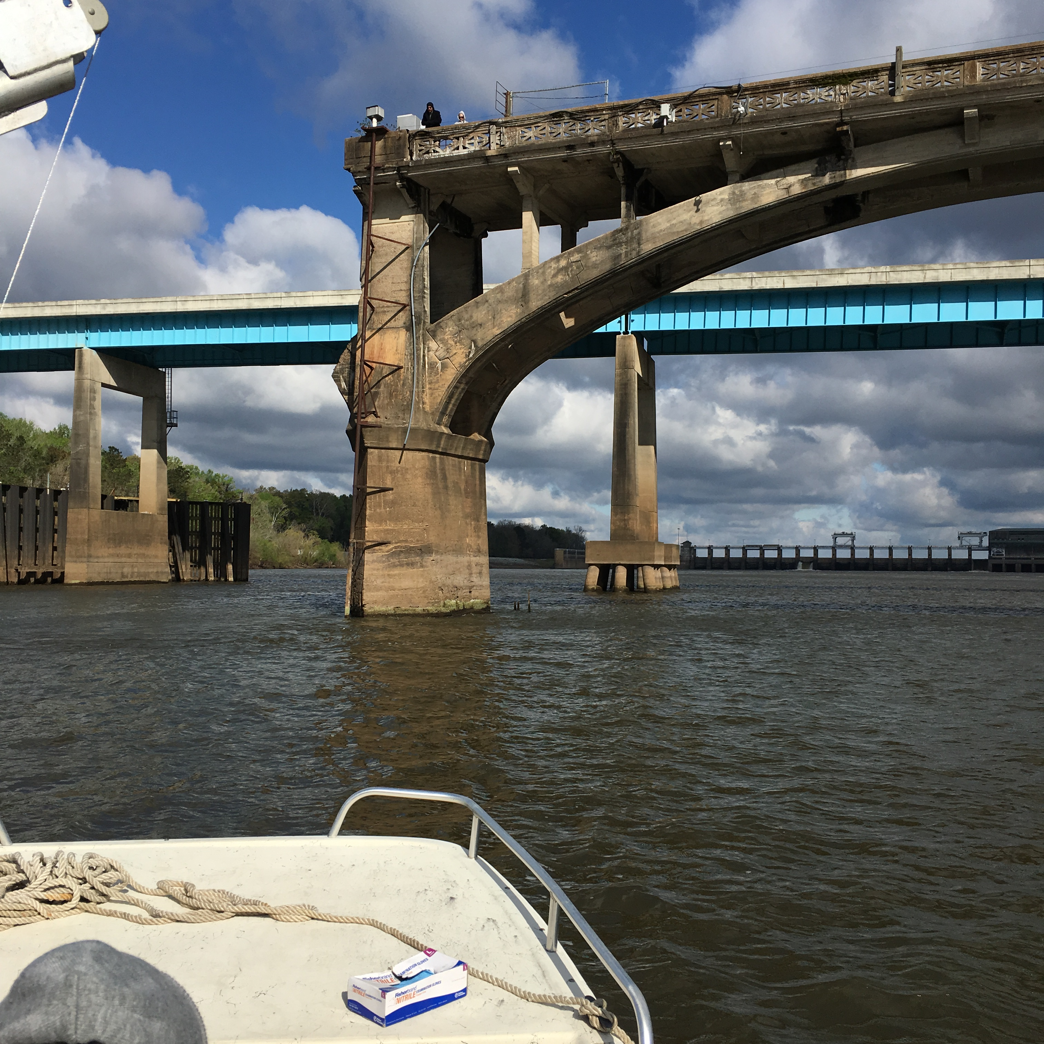
Pesticides

Slide 36
Pesticides
Analyzed samples for 76 pesticide compounds
42 pesticide compounds detected at one or more sites, in at least one sample type (POCIS, SPMD, or Grab)
33% of detections from POCIS samples were qualified due to blank detections.
40% of detections from SPMD samples were qualified due to blank detections.
38% of detections from grab samples were qualified due to blank detections.
https://www.nation.co.ke/business/seedsofgold/Bio-pesticides-in-focus-as-safety-concerns-reshape-export-trade-/2301238-2340128-9n3uwlz/index.html

Slide 37
Pesticides Detections at All Sites by Sample Type
Total No. Detections, Qualified Detections, Non-detects & Not Quantifiable by Sample Type

Slide 38
Pesticides Detected at Every Site (n = 4)
by Sample Type
.
Legend
Compound detected at one or more sites.
Data not qualified due to blank detections.
Compound detected at one or more sites.
V
Lab blank result > 10% of sample result(s)
Compound detected at one or more sites.
VG
Lab blank and field blank results
> 10% of sample result(s).
Compound detected at one or more sites.
G
Field blank result > 10% of sample result(s).
Compound not detected at any sites.

Slide 39
Quality Assurance Summary - Pesticides
Notes:
Total 42 detected 18 qualified in lab, field or both blanks. 11 field, 6 lab, 8 lab & field.

Slide 40
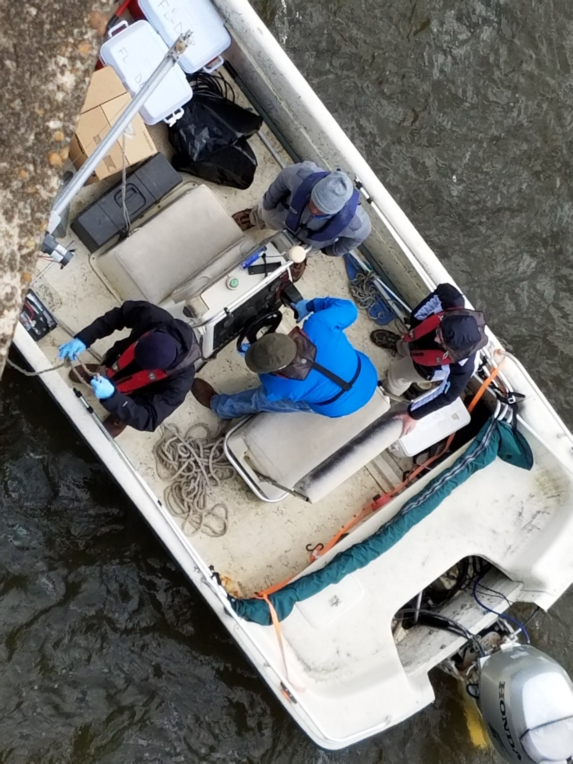
PPCPs

Slide 41
PPCPs
Analyzed samples for 127 PPCP compounds.
39 PPCP compounds detected at one or more sites, in at least one sample type (POCIS or Grab).
6% of detections from POCIS samples were qualified due to blank detections.
17% of detections from grab samples were qualified due to blank detections.
3 of the 39 PPCP compounds detected were qualified.

Slide 42
PPCP Detections at All Sites by Sample Type
Total No. Detections, Qualified Detections, Non-detects & Not Quantifiable by Sample Type

Slide 43
PPCPs Detected at Every Site (n = 4) by Sample Type
.
Legend
Compound detected at one or more sites.
Data not qualified due to blank detections.
Compound detected at one or more sites.
V
Lab blank result > 10% of sample result(s)
Compound detected at one or more sites.
VG
Lab blank and field blank results
> 10% of sample result(s).
Compound detected at one or more sites.
G
Field blank result > 10% of sample result(s).
Compound not detected at any sites.

Slide 44
Quality Assurance Summary - PPCPs

Slide 45
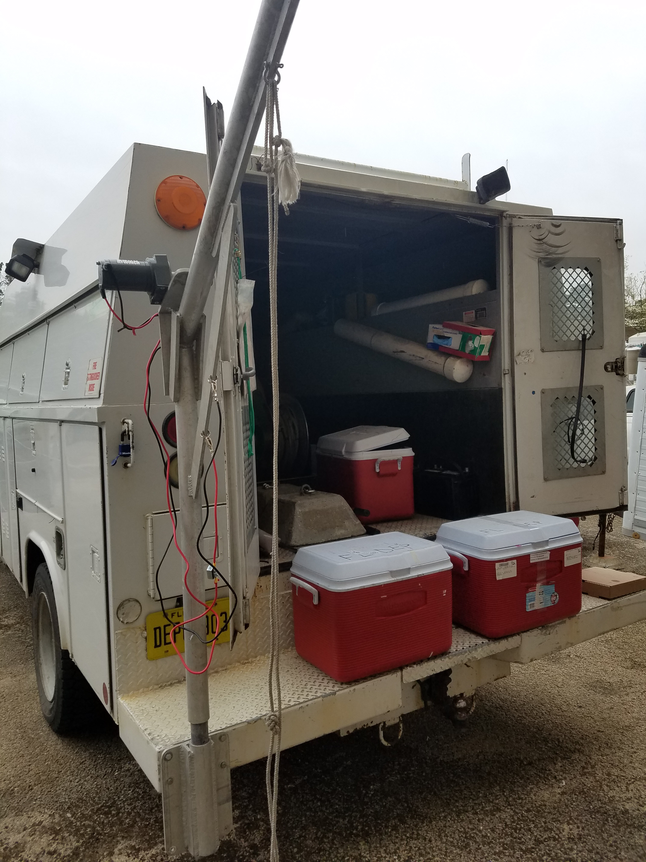
Hormones

Slide 46
Hormones
Analyzed samples for 17 hormone compounds.
5 Hormone compounds detected at one or more sites, in at least one sampling method (POCIS or Grab).
6% of detections from POCIS samples were qualified due to blank detections.
17% of detections from grab samples were qualified due to blank detections.
2 of the 5 hormone compounds detected were qualified.*

Slide 47
Hormone Detections at All Sites by Sample Type
Total No. Detections, Qualified Detections, Non-detects & Not Quantifiable by Sample Type

Slide 48
Hormones Detected at Every Site (n = 4) by Sample Type
.
Legend
Compound detected at one or more sites.
Data not qualified due to blank detections.
Compound detected at one or more sites.
V
Lab blank result > 10% of sample result(s)
Compound detected at one or more sites.
VG
Lab blank and field blank results
> 10% of sample result(s).
Compound detected at one or more sites.
G
Field blank result > 10% of sample result(s).
Compound not detected at any sites.

Slide 49
Quality Assurance Summary - Hormones

Slide 50
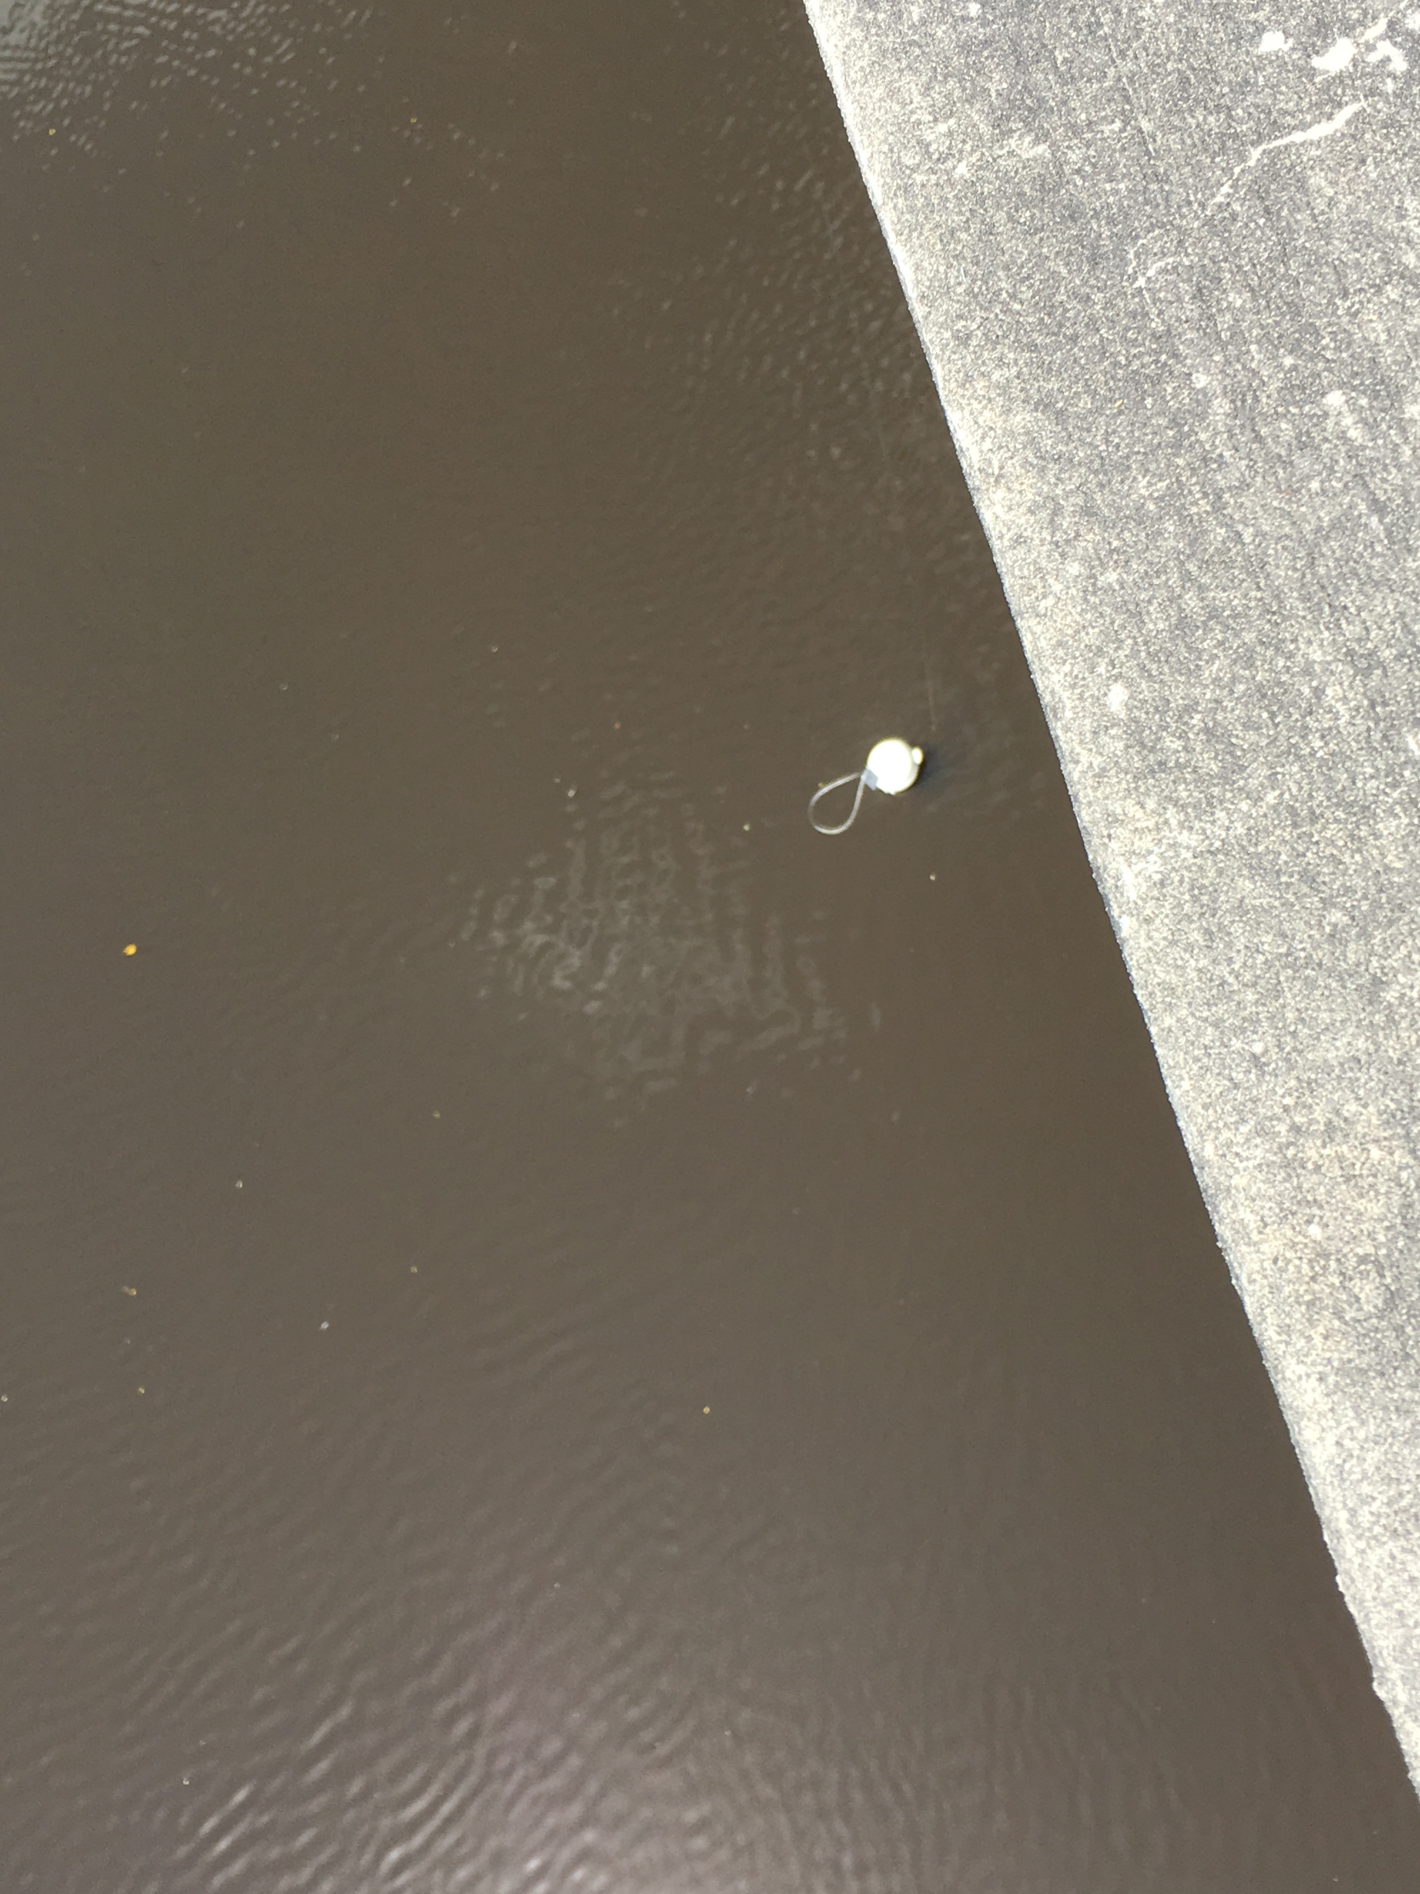
PFCs

Slide 51
Perfluorinated Compounds
PFCs
Analyzed samples for 13 PFC compounds.
10 PFC compounds detected at one or more sites, in at least one sampling method (POCIS or Grab).
0% of detections from POCIS & Grab samples were qualified due to blank detections.
https://www.google.com/search?q=perfluorinated+compounds&source=lnms&tbm=isch&sa=X&ved=0ahUKEwi4hcTa-qTdAhWmq1kKHcy7B0sQ_AUICygC&biw=1366&bih=620#imgrc=-vTOc9wh9VQc8M:

Slide 52
PFCs Detections at All Sites by Sample Type
Total No. Detections, Qualified Detections, Non-detects & Not Quantifiable by Sample Type

Slide 53
PFCs Detected at Every Site (n = 4) by Sample Type
.
Legend
Compound detected at one or more sites.
Data not qualified due to blank detections.
Compound detected at one or more sites.
V
Lab blank result > 10% of sample result(s)
Compound detected at one or more sites.
VG
Lab blank and field blank results
> 10% of sample result(s).
Compound detected at one or more sites.
G
Field blank result > 10% of sample result(s).
Compound not detected at any sites.

Slide 54
Quality Assurance Summary - PFCs

Slide 55
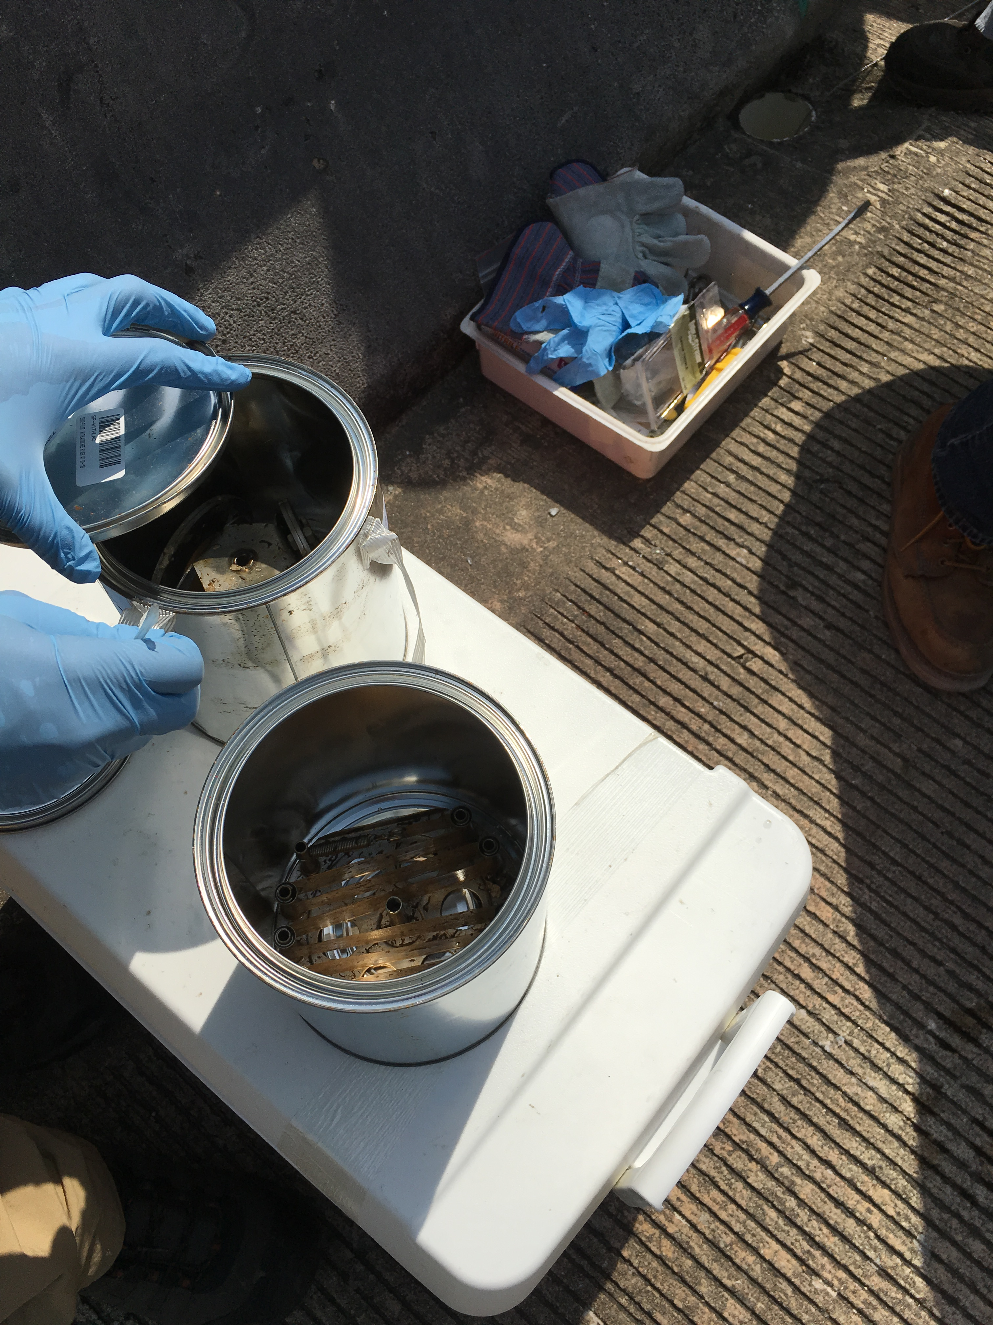
PBDEs

Slide 56
Polybrominated Diphenyl Ethers-PBDEs
Analyzed samples for 8 PBDE compounds.
8 PBDE compounds detected at one or more sites, in at least one sampling method (SPMD or Grab).
100% of detections from SPMD samples were qualified due to blank detections.
92% of detections from grab samples were qualified due to blank detections.
All of the PBDE compounds detected were qualified.

Slide 57
PBDE Detections at All Sites by Sample Type
Total No. Detections, Qualified Detections, Non-detects & Not Quantifiable by Sample Type

Slide 58
PBDEs Detected at Every Site (n = 4) by Sample Type
.
Legend
Compound detected at one or more sites.
Data not qualified due to blank detections.
Compound detected at one or more sites.
V
Lab blank result > 10% of sample result(s)
Compound detected at one or more sites.
VG
Lab blank and field blank results
> 10% of sample result(s).
Compound detected at one or more sites.
G
Field blank result > 10% of sample result(s).
Compound not detected at any sites.

Slide 59
Quality Assurance Summary - PBDEs

Slide 60
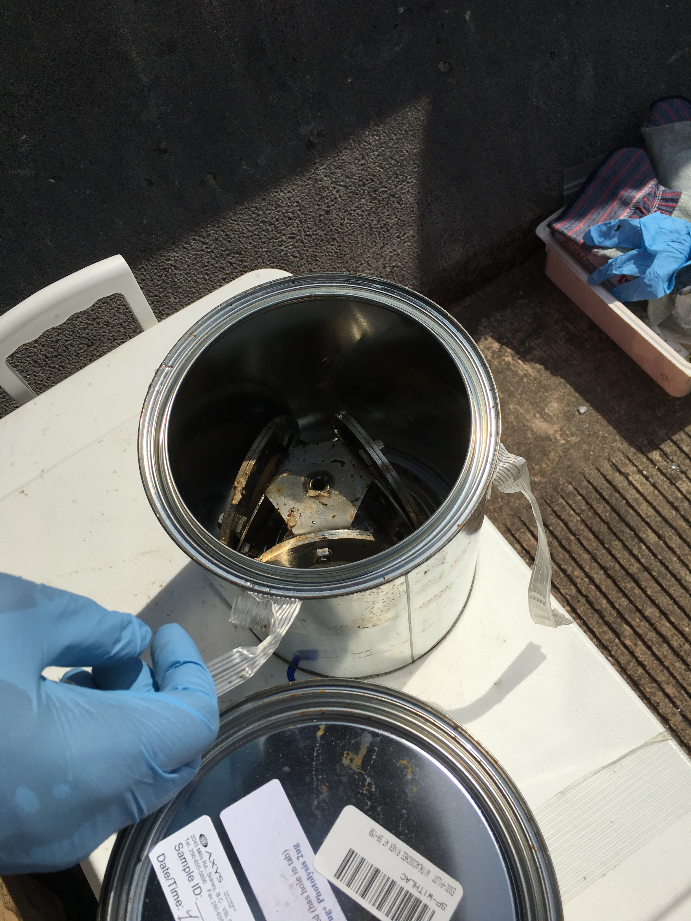
Alkylphenols

Slide 61
Alkylphenols
Analyzed samples for 4 Alkylphenol compounds.
2 Alkylphenol compounds detected at one or more sites, in at least one sampling method (SPMD or Grab).
All alkylphenol compounds detected, were also detected in blanks at concentrations that required data from all sites to be qualified.
All detections from SPMD & grab samples were qualified due to blank detections.
https://www.google.com/search?q=laundry+detergent+alkylphenols&rlz=1C1GCEA_enUS757US757&source=lnms&tbm=isch&sa=X&ved=0ahUKEwjbn86M8bDdAhWJyVMKHfMLCmIQ_AUIDygC&biw=1280&bih=887#imgrc=wdzaBL1XIfCGfM:

Slide 62
Alkylphenol Detections at All Sites by Sample Type
Total No. Detections, Qualified Detections, Non-detects & Not Quantifiable by Sample Type

Slide 63
Alkylphenols Detected at Every Site (n = 4) by Sample Type
.
Legend
Compound detected at one or more sites.
Data not qualified due to blank detections.
Compound detected at one or more sites.
V
Lab blank result > 10% of sample result(s)
Compound detected at one or more sites.
VG
Lab blank and field blank results
> 10% of sample result(s).
Compound detected at one or more sites.
G
Field blank result > 10% of sample result(s).
Compound not detected at any sites.

Slide 64
Quality Assurance Summary - PBDEs

Slide 65

DEP Data

Slide 66
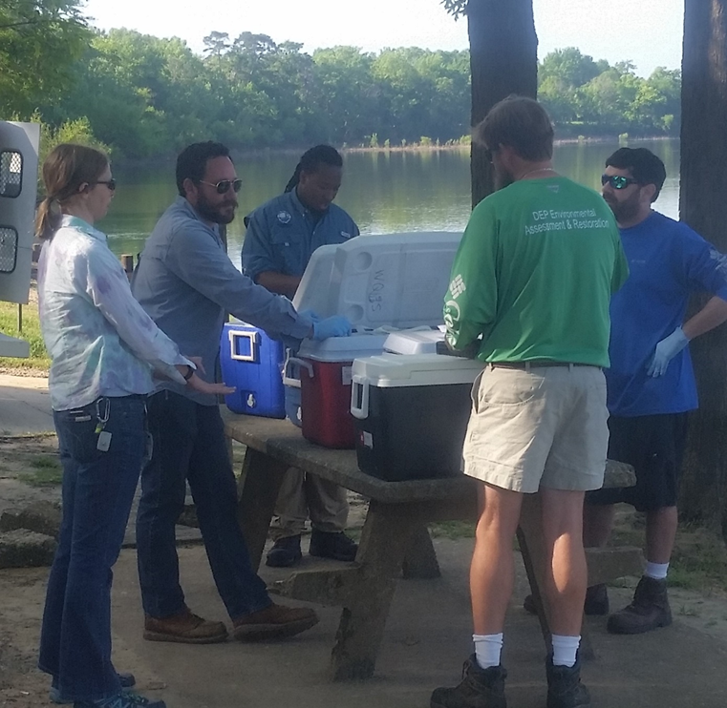
DEP Data
Analyzed Pilot Study Samples for
92 compounds.
32 compounds detected at one or more sites, in at least one sampling method (POCIS, SPMD, or Grab).
0% of detections from POCIS & Grab samples were qualified due to blank detections.

Slide 67
Detections at All Sites by Sample Type
Total No. Detections, Qualified Detections, Non-detects & Not Quantifiable by Sample Type

Slide 68
Compounds Detected at Every Site (n = 4) by Sample Type
.
Legend
Compound detected at one or more sites.
Data not qualified due to blank detections.
Compound detected at one or more sites.
V
Lab blank result > 10% of sample result(s)
Compound detected at one or more sites.
VG
Lab blank and field blank results
> 10% of sample result(s).
G
Compound detected at one or more sites.
Field blank result > 10% of sample result(s).
Compound not detected at any sites.

Slide 69
Quality Assurance Summary – DEP Data
.
Legend
Compound detected at one or more sites.
Data not qualified due to blank detections.
V
Compound detected at one or more sites.
Lab blank result > 10% of sample result(s)
Compound detected at one or more sites.
VG
Lab blank and field blank results
> 10% of sample result(s).
G
Compound detected at one or more sites.
Field blank result > 10% of sample result(s).
Compound not detected at any sites.

Slide 70
Review
SGS/Axys Data
Pesticides
  42 compounds detected of 76 analyzed.
  Most compounds were found in the SPMD only.
PPCPs
  39 compounds detected of 127 analyzed.
  Most compounds were found in POCIS only; there was a widespread distribution of compounds also found in the Grab.
Hormones
  5 compounds detected of 17 analyzed.
  Blank interference caused all grab sample data to be qualified, but did not affect POCIS sample data.

Slide 71
Review
SGS/Axys Data
PFCs
  10 compounds detected of 13 analyzed.
  Most compounds found in POCIS only or POCIS & Grab.
PBDEs
  All compounds analyzed (n = 8) were detected in SPMD & Grab samples at one or more sites.
  Blank interference caused all SPMD data & > 90% of Grab sample data to be qualified.
Alkylphenols
  2 of the 4 compounds analyzed were found in SPMD only or SPMD & Grab.
  Blank interference caused all SPMD and Grab sample data to be qualified.

Slide 72
Review
DEP Data
Pesticides
  29 compounds detected of 88 analyzed.
  Most compounds were found in Grab & POCIS.
  Several compounds were found in SPMD only.
PPCPs
  3 compounds detected of 4 analyzed.
  Most compounds were found in Grab and SPMD.
  Acetaminophen was detected in Grab samples analyzed by DEP, but not in those analyzed by SGS/Axys.
Notes:
Chlorpyrifos Ethyl

Slide 73
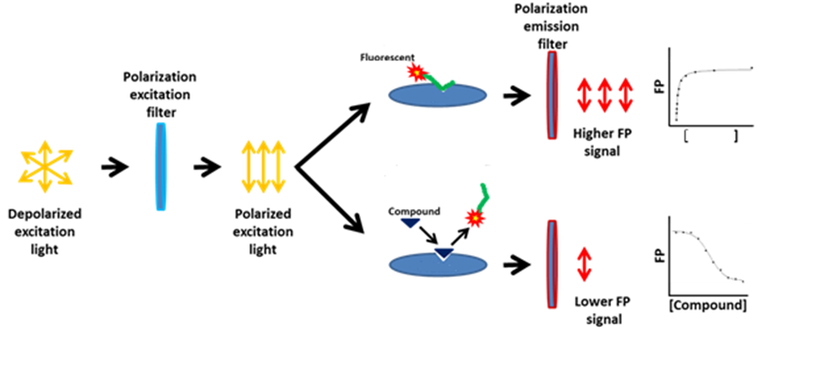
ER and AR Binding Assay Using Fluorescence Polarization (FP)
The diagram shows the principle of how the polarization of the fluorescence is measured.
When there is no competition, the fluorescent labeled derivative remains bound to the receptor resulting in a higher FP signal and vice versus when the estrogen or estrogen like compound displaces the analog (Parker, et. al 2000).
The wavelengths specific to the compound go through the emission filter and those are measured. (www.thesgc.org, accessed 9/5/14; modified from original)

Slide 74

Looking Ahead
Awaiting results from the USGS .
Working with the University of Florida on analyzing final report.
Interpreting results and compiling information to finalize report.

Slide 75
Further Discussion
Analytes that should be added or removed if the project was expanded? Are there analyte groups that are of higher priority?
Intensity of sample collection and analysis vs. the results.
Discussion about data and QA/QC.
Take home messages that can be extracted from this project, and how they construct our path forward.

Slide 76
References
Alvarez, D et al. (2007) Chapter 8 Tool for monitoring hydrophilic contaminants in water: polar organic chemical integrative sampler (POCIS). Comprehensive Analytical Chemistry. 48, 171-197. doi:10.1016/S0166-526X(06)48008-9
Smith, R. (2018) Product: Semipermeable Membrane Device (SPMD) and its Deployment. http://www.est-lab.com/spmd.php
Notes:
NEED REFERENCE FOR TABLE!!!

