Slide 1
Analyzed Pilot Study Samples for 76 Pesticide Compounds
42 Pesticide Compounds Detected
At one or more sites, in at least one matrix (POCIS, SPMD, or Grab)
2,4'-DDD
4,4'-DDD
2,4'-DDE
4,4'-DDE
4,4'-DDT
Alachlor
Aldrin
alpha-Endosulphan
beta-Endosulphan
Endosulphan Sulphate
Ametryn
Atrazine
Desethylatrazine
Chlordane, alpha (cis)
Chlordane, gamma (trans)
Chlordane, oxy-
Chlorpyriphos
Diazinon
Dieldrin
Dimethenamid
Endrin
Endrin Ketone
Ethalfluralin
Flufenacet
Flutriafol
HCH, alpha
HCH, beta
HCH, delta
HCH, gamma
Heptachlor
Heptachlor Epoxide
Hexachlorobenzene
Hexazinone
Metolachlor
Mirex
Nonachlor, cis-
Nonachlor, trans-
Pendimethalin
Quintozene
Simazine
Tebuconazol
Trifluralin

Slide 2
Pesticide Detections at Alafia River Analyzed by SGS Analytical
Pesticides Detected by Sample Type
No. of Pesticides Detected by Sample Type

Slide 3
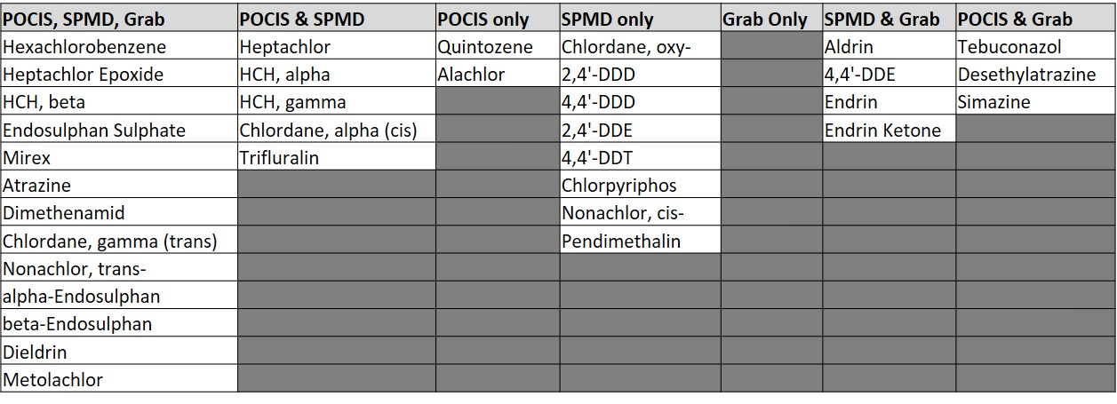
Pesticide Detections at Ochlockonee River Analyzed by SGS Analytical
Pesticides Detected by Sample Type
No. of Pesticides Detected by Sample Type

Slide 4
Pesticide Detections at Apalachicola River Analyzed by SGS Analytical
Pesticides Detected by Sample Type
No. of Pesticides Detected by Sample Type

Slide 5
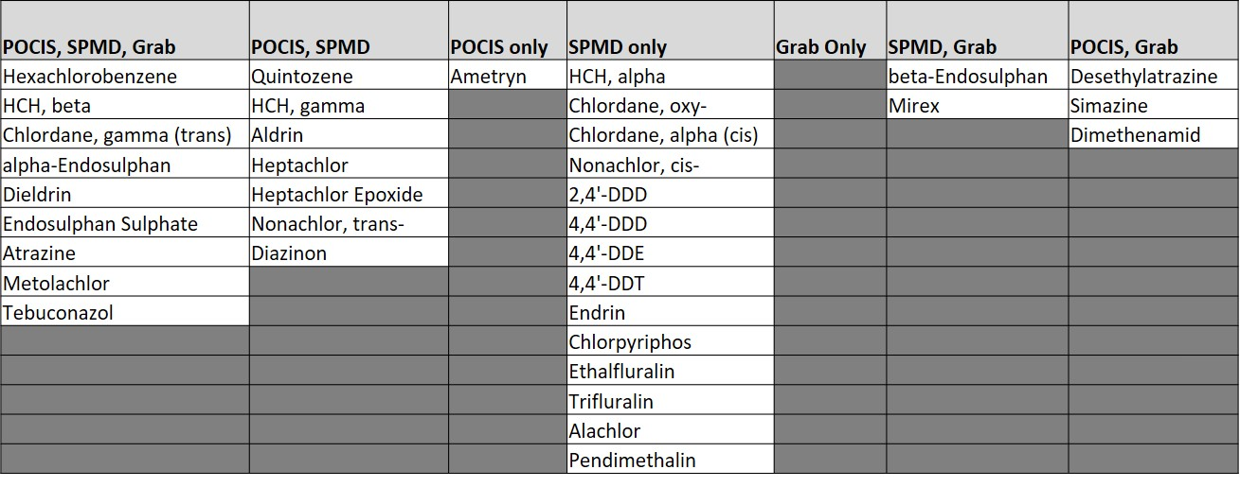
Pesticide Detections at Withlacoochee River Analyzed by SGS Analytical
Pesticides Detected by Sample Type
No. of Pesticides Detected by Sample Type

Slide 6
No. Pesticides Detected by Sample Type At Each Site
Pesticides Detected at Every Site (n = 4) by Matrix
Total No. Undetects, Detects, Not Quantifiable by Matrix

Slide 7
18 of the 42 pesticide compounds detected, were also detected in lab blanks or field blanks at concentrations that required data from at least one site to be qualified.

Slide 8
