Slide 1
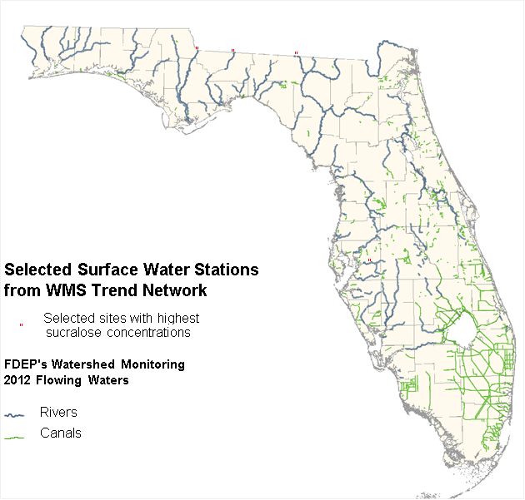
Evaluating
ESOC in Florida Waterbodies
Presented by: Alicia Hogue

Slide 2
Overview
4 river sites chosen:
  Ochlockonee, Withlacoochee, Apalachicola and Alafia
3 types of sample collection:
  Semi-Permeable Membrane Device (SPMD)
  Polar Organic Chemical Integrative Sampler (POCIS)
  Whole water samples (Grab)
6 Categories of compounds:
  Pesticides, PPCPs, Hormones, PFCs, PBDEs, and Alkylphenols
Sample collection types were considered in up to 7 categories:
  SPMD, POCIS, Grab (Pesticides)
  SPMD & POCIS (Pesticides)
  Grab & SPMD
  Grab & POCIS
  Grab only
  SPMD only
  POCIS only
QA is discussed at the end of each category.
SGS/Axys data are presented, then DEP data.

Slide 3
Biological Assays
Transactivation Assays
  Dr. Nancy Denslow, Center for Environmental & Human Toxicology, University of Florida
Binding Assays
  Dr. Joseph Bisessi, Center for Environmental & Human Toxicology, University of Florida
Bioluminescence Yeast Estrogen/Androgen Screen
SOS Chromotest
  Dr. Luke Iwanowicz, Leetown Science Center, USGS

Slide 4
ER and AR Transactivation Assay
Tests for the ability of the activated receptor to turn on gene transcription
Estrogen Receptor Results
Grab
  No estrogenic activity at the Alafia, Withlacoochee, and field blank
  Interference at Apalachicola
  Estrogenic activity found at Ochlockonee
POCIS & SPMD
  Variable results indicated interference with the assay
  POCIS extract from Apalachicola showed no estrogenic activity
Androgen Receptor Results
Grab
  Low level of androgenic activity found in the field blank.
    May be due to androsterone contamination in the sample (analyzed by SGS-Axys)
  Low level of androgenic activity found in the grab sample for Ochlockonee
  Interferences were found in the Apalachicola sample
POCIS & SPMD
  No activity

Slide 5
ER and AR Binding Assay
Tests the ability of estrogen or an estrogen mimic to bind directly to the estrogen receptor, or an androgen mimic to bind directly to the androgen receptor

Slide 6
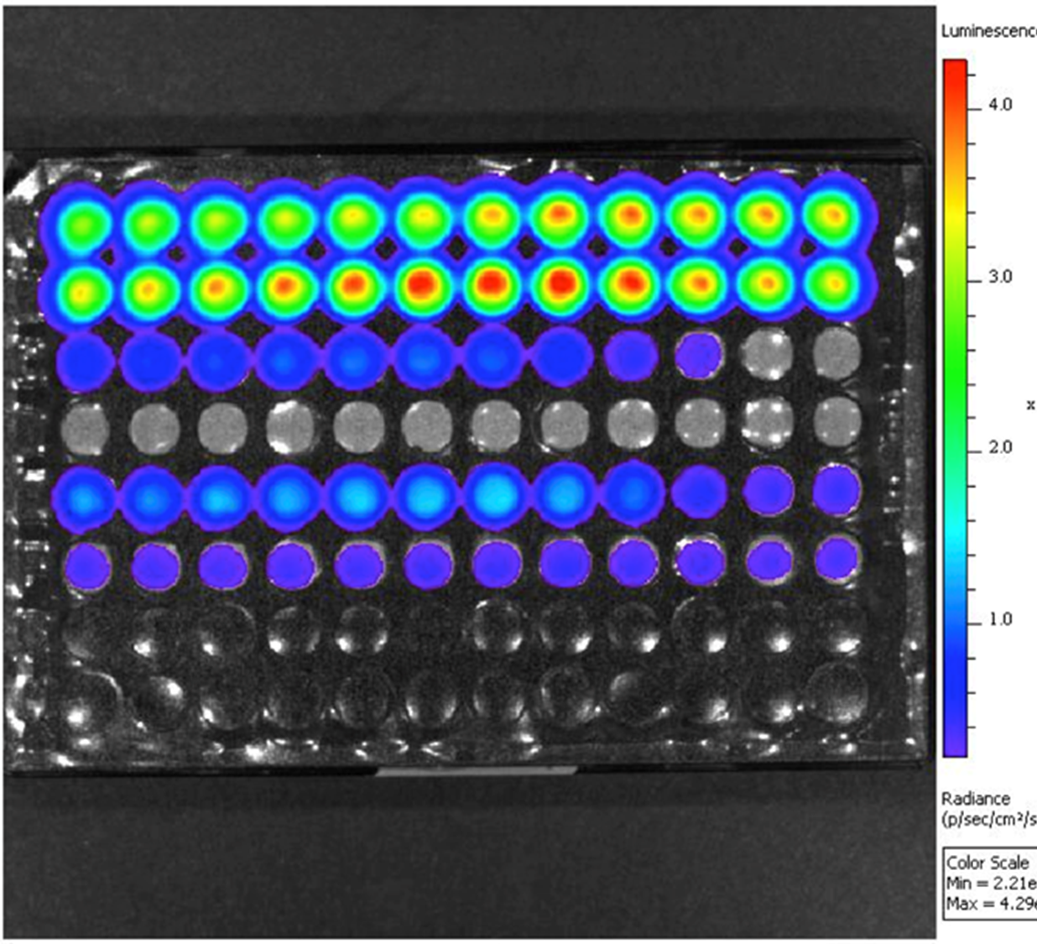
Bioluminescent Yeast Estrogen & Androgen Screen
Used to detect water’s estrogenic and androgenic activity by promoting a light-generating or bioluminescent response in the yeast strain
Source: http://www.490biotech.com.

Slide 7
Bioluminescent Yeast Estrogen & Androgen Screen Results
BLYES Results
Grab
  Alafia, Apalachicola, Withlacoochee Rivers had estrogenic samples
POCIS
  Alafia, Apalachicola, Ochlockonee Withlacoochee Rivers had estrogenic samples
BLYAS results
No androgenic activity

Slide 8
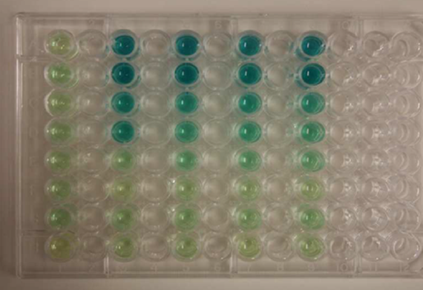
SOS Chromotest
The SOS Chromotest is a colorimetric test that measures the reaction of E. coli bacteria to DNA damaging compounds in water samples.
Results
POCIS & SPMD
  Presence of DNA damaging compounds at the Alafia River site.

