Slide 1
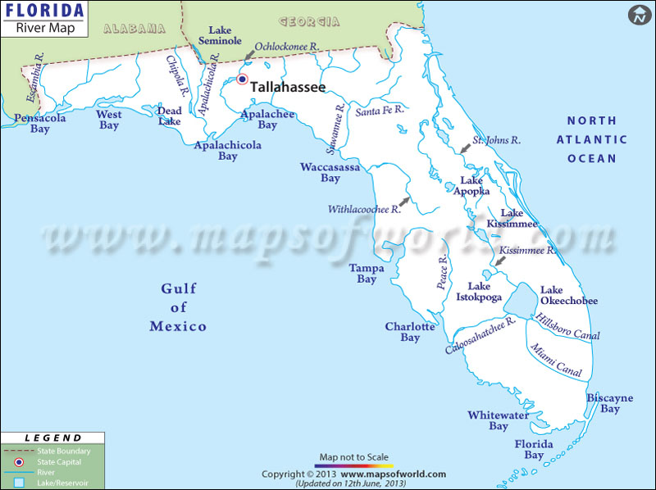
Evaluating ESOCs in Florida Waterbodies
An Effects Based Approach Pilot Study
Study Design Overview

Slide 2
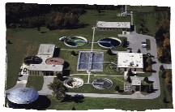
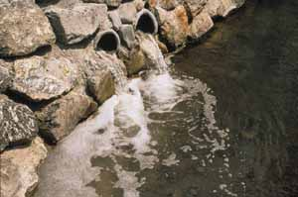
ESOCs are found in waste water effluent
Municipal WWTPs and industrial waste are both sources of ESOCs

Slide 3
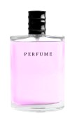

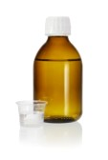
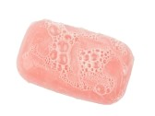
Personal Care Products & Pharmaceuticals
Many induce estrogenic effects in aquatic life.
Notes:
Musks are fragrances that occur in many detergents and personal care products.

Slide 4



Personal Care Products & Pharmaceuticals
Triclosan (since 1972)
Set to be banned in Canada and some European nations, the USEPA recently stated it is safe for use, although it will revisit its decision in 2018.
Notes:
According to EPA, Triclosan attaches to surface sediments and has the tendency to bioaccumulate. When triclosan and its chlorinated derivitive are exposed to sunlight, it forms dioxins.

Slide 5
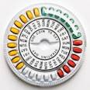

  Synthetic Hormones
Many induce estrogenic effects in aquatic life, especially vertebrates
Municipal WWTP do not remove hormones (i.e. birth
control compounds) completely.
In agricultural situations, such as a feedlot or a dairy, runoff water that may contain hormones is often not treated.
Notes:
17- beta estradiol, estrone, estriol, 17, alpha ethynylestradiol

Slide 6
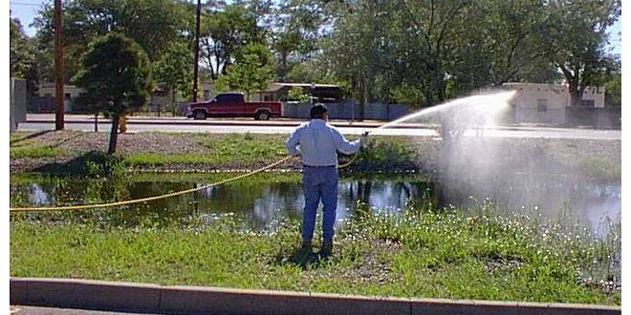
Current Use Pesticides
Many induce estrogenic effects in aquatic life.
Over 20,000 pesticide products are presently registered for use in the United States.

Slide 7
Brominated Flame Retardants
Risk to surface water organisms and top predators
BFRs are found in polyurethane foam in furniture, mattresses, carpet padding, insulation, and automobile seats.
It is everywhere a human population resides.
BFRs have been detected in Florida dolphins.
Notes:
Found in resident dolphin populations in Florida coastlines.

Slide 8

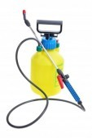
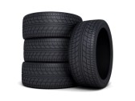
Akylphenolic Substances
Toxic & Estrogenic
Nonylphenols
Industrial and household
cleaning agents
Paints & Plastics
Pesticides
Rubber
Notes:
nonionic surfactants, which are one type of detergent used in industrial and household cleaning agents, in the manufacture of paints and plastics, in pesticide formulations, and in the manufacture of rubber goods.
Nonylphenol (NP) and nonylphenol ethoxylate (NPE) are persistent, bioaccumulative and toxic. NP and NPE are the most widely used members of the larger alkylphenolic family of nonionic surfactants.
NP demonstrates estrogenic and endocrine disrupting characteristics and is toxic to aquatic organisms and moderately persistent in the environment. Metabolites and degradation products of NPE are more toxic than the parent compounds

Slide 9
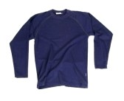
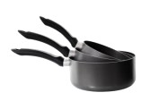
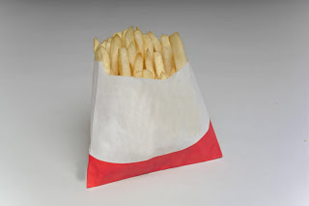

Perfluorinated Compounds (PFCs)
PFOA
PFOS
Many induce estrogenic effects in aquatic life
853 total
Notes:
May be toxic to the maintenance worker in the manufacturing plant, but not to the general population. Long chain PFC have the long half life and tend to “stick” around. Some products are trying to replace the long chain with the short chain PFC due to its shorter half life. PFCs are persistent in the environment, and bioaccumulate in both wildlife and humans worldwide.
To date, adverse effects have not been found in the general human population; however, adverse effects have been identified in laboratory animals and wildlife.
Bioaccumulative, biomagnify, persistent

Slide 10
Determining the Analyte List and Sampling Method for Priority ESOCs
Category | Exposure routes | Aquatic life effects | Water Solubility
Brominated fire retardants | House dust, sediment, food web, carcinogen, breast milk | Bioaccumulative, endocrine disrupting, toxic, persistent | Low
Pharmaceuticals & Personal Care Products | Water | Endocrine disrupting | High
Synthetic hormones | Water | Endocrine disrupting | High
Current Use Pesticides | Water, sediment, food web | Toxic | High
Perfluorinated Compounds | Food web, breast milk | Bioaccumulative, Endocrine disrupting | Low
Notes:
Water solubility; need definition of polar and non polar

Slide 11
Objective
To evaluate sampling and analytical methods utilizing biomarkers to assess the biological health of waterbodies

Slide 12
Expected Outcome
Better understanding of the effectiveness of the analytical and sampling methods
Build a foundation of knowledge to drive future studies
Be able to better calculate cost efficiency in future studies

Slide 13
Sampling Method Considerations
Compounds with low detection levels (parts per trillion or ng/L)
Compounds with a variety of physical characteristics
  Non-polar
  Polar
  Molecular weight
Estimating potential exposure of aquatic organisms by the utilization of different biological screening tools.

Slide 14
Determining the Collection Method
Whole water grab samples
Integrative Sampling Devices
  Polar Organic Compound Integrative Samplers (POCIS)
  Semi-Permeable Membrane Device (SPMD)

Slide 15
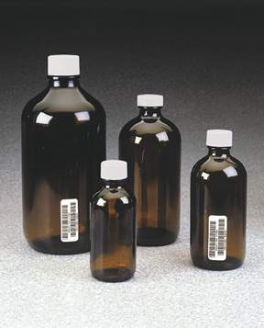
Whole Water Grab Samples
Only one sampling trip required
Quantitative results
Allows a direct comparison to known sucralose concentrations
Will not capture episodic events
Expect non-detections

Slide 16
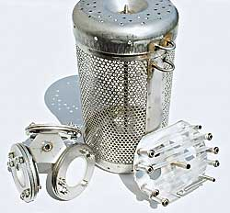
Integrative Sampling Devices
Time-Integrated Sample (30-35 days)
Higher number of detections based on larger water volumes
May mimic contaminant accumulation in fish tissue
Does not result in direct water concentrations

Slide 17
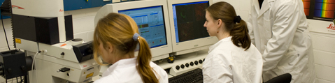
Measuring Biological Effects
Samples are extracted from both POCIS & SPMD and screened for:
Estrogenic and androgenic activity using:
* Bioluminescent yeast estrogen/androgen screen (BLYES/BLYAS)
* Binding and transactivation assays
Genotoxicity using SOS Chromotest

Slide 18
Alicia Wilson
Water Quality Assessment Program
850-245-8553
Alicia.Wilson@dep.state.fl.us

