Slide 1
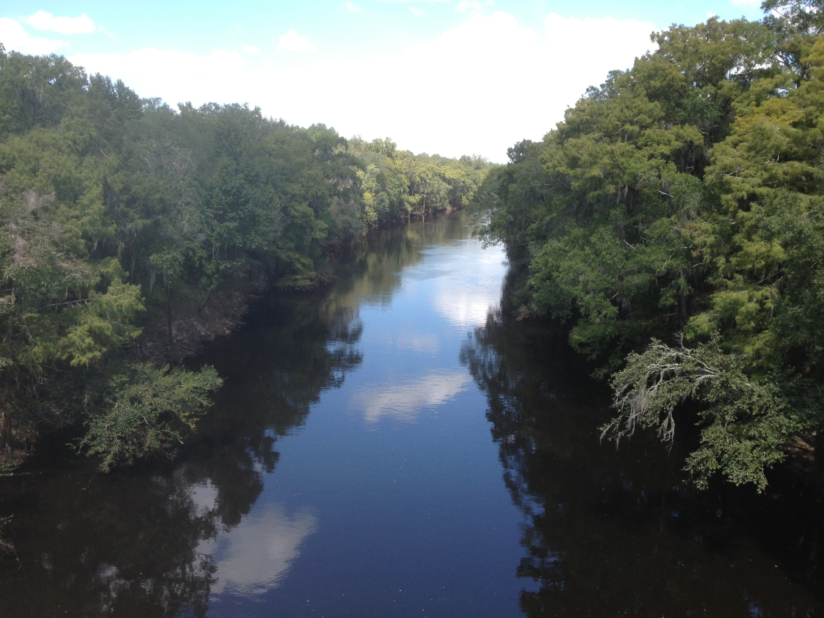
ESOC Pilot Study
Field Sampling Logistics & QA/QC
Stephanie Sunderman-Barnes
Watershed Monitoring Section

Slide 2
Data Collection at Each Site
Deployment period = 30 - 35 days.
Minimum of three visits to each site required during deployment period.
Deployment:
  Collect field measurements.
  Deploy passive sampling devices.
Midway through deployment period:
  Collect field measurements.
  Observe passive sampling device condition.
Retrieval:
  Collect field measurements.
  Collect whole water grab samples.
  Retrieve passive sampling devices.

Slide 3
General Precautions for Field Sampling
Avoid contacting or consuming the following substances on the day of sampling.
Oils, Tars, Fuels, Fumes containing engine exhaust
Paints, Solvents
Tobacco smoke, Caffeine
Fragrances (e.g. perfumes, deodorants, laundry detergent)
Sunscreens, Bug sprays, Insecticides, Herbicides, Fungicides
Soap, Detergents, Antibacterial cleansers
Medications, Hormonal Substances (prescription, over-the-counter)
Urine, Excrement (animal or human)
If contact is unavoidable, details must be documented on field sheet.

Slide 4
General Precautions for Field Sampling
Wear disposable, powder-free gloves when handling deployment equipment, sampling equipment, & sampling devices.
Gloves & exposed skin must be free of lotions, insect repellents, and powders.
Change gloves frequently, especially after contacting surfaces that could introduce contamination (e.g. skin, clothing, boat motor).
Do not breathe directly over sampling devices.

Slide 5
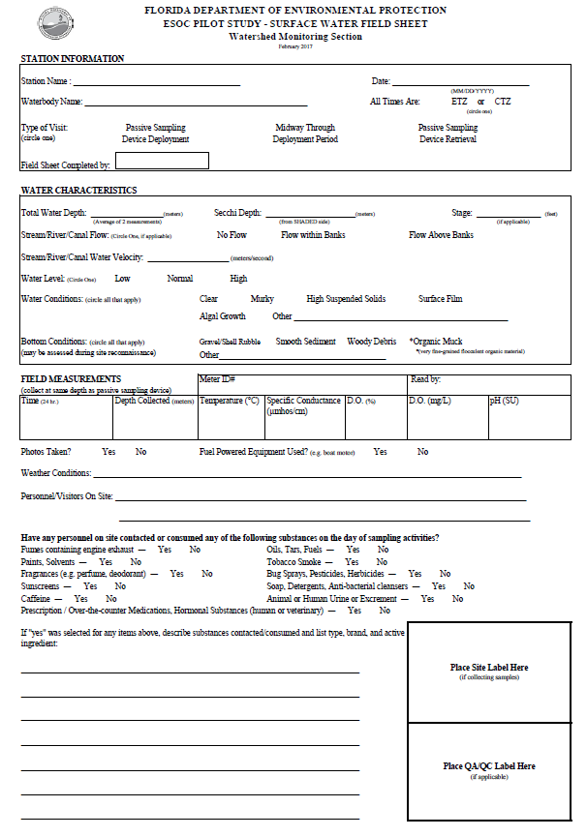
Documentation
Complete new ESOC Field Sheet for each visit to each site.
Do not leave any items blank.
If an item is not applicable, draw a single line through it or write “N/A”.

Slide 6
Documentation
4 Custody Sheets used during retrieval event
Document Name | Delivered To | Analytes | Kits Contain
DEP Custody Sheet #1 | DEP Lab | Pesticides; Sucralose | 3 – 1L glass amber bottles (2 w/ code W-PSNP-TQ, 1 w/ code W-AHERB, W-SUC-AA-R, etc.) 1 – 1L glass amber bottle (pre-preserved w/ chloroacetic acid) 2 – 500 mL amber glass bottles Extra bottles filled at 1 site for lab QC (2 - 1L glass amber bottles & 2 – 500mL glass amber bottles)
DEP Custody Sheet #2 | USGS LSC | BLYES; BLYAS; SOS Chromotest | 1 – 1L glass amber bottle
DEP Custody Sheet #3 | UF – Denslow Lab | ER & AR binding & transactivation assays | 1 – 1L glass amber bottle
AXYS Custody Sheet | AXYS | Whole water: PPCPs; Hormones; PBDEs; Alkylphenols; PFCs; Pesticides SPMD & POCIS Extraction; AXYS will distribute extracts among designated laboratories for analysis. | 8 – 1L Amber glass bottles 4 – 1L HDPE bottles 2 – 500mL HDPE bottles 3 - SPMD on spider carriers in can 3 – POCIS on metal holders in can

Slide 7
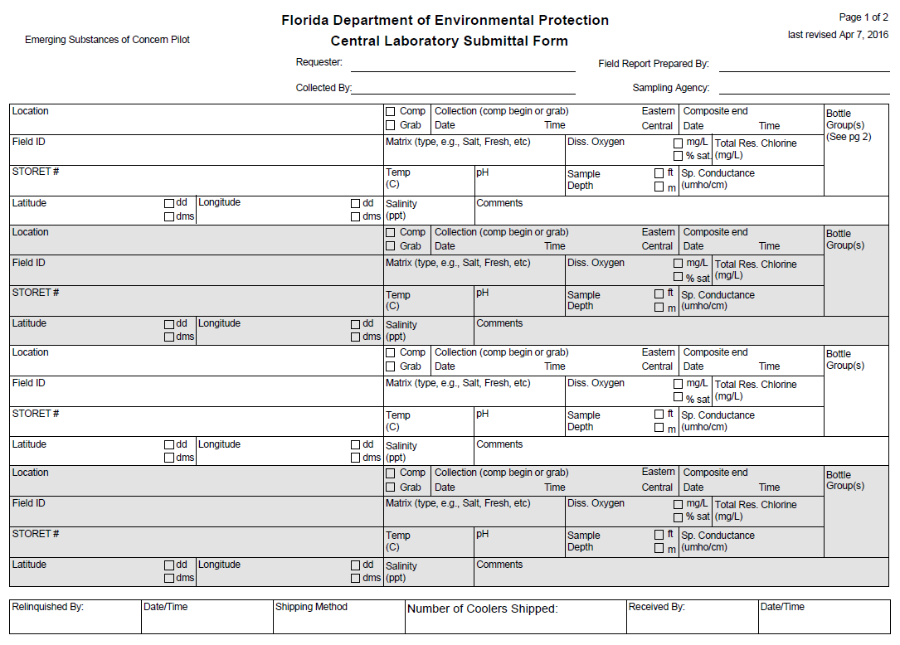
Documentation

Slide 8
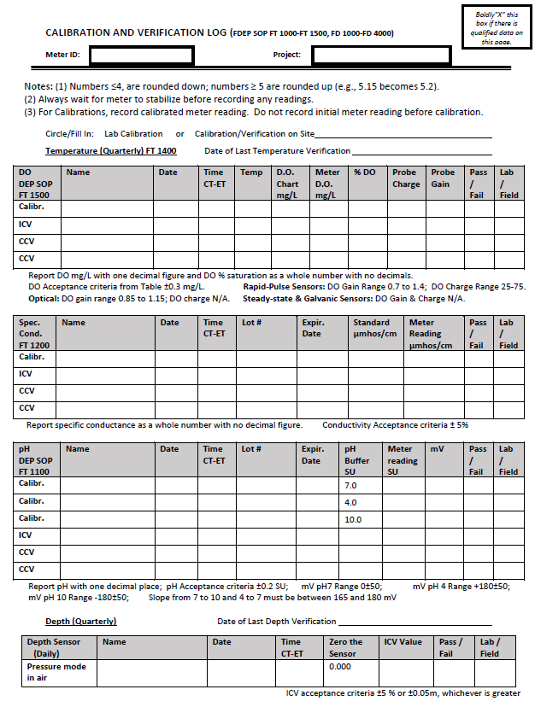
Documentation
Maintain Log Books for:
Calibration Activities
Equipment Cleaning
Equipment Maintenance
Standards / Buffers / Reagents
Details described in Jan. 2016 Status & Trend Networks Sampling Manual (Section 12).

Slide 9
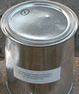
Preparation for Deployment Event
SPMD & POCIS
Prepared by EST labs & mounted on holders.
Shipped to DEP in sealed cans (cleaned & solvent rinsed).
Stored at -20°C until sampling event.
Transported to field sites in sealed cans, surrounded by “blue ice” (frozen bottles of waters) or wet ice that is packed in separate zip-top bags.

Slide 10
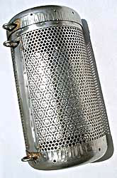
Preparation for Deployment Event
Canister & all deployment material that will contact site water must be cleaned using the following procedure:
Clean with degreasing solution (if necessary)
Soak in hot soapy (liqui-nox) water for several minutes.
Scrub with hot soapy (liqui-nox) water.
Rinse with hot water.
Rinse with nanograde or pesticide grade acetone. (Use Acetone to remove all water.)
Rinse with hexane.
Allow to dry.
Store on clean metal cabinets / container or laminate-free (untreated) Aluminum foil.

Slide 11
Preparation for Deployment Event
Select deployment location & develop strategy for securing canister.
Canister must remain completely submerged for entire 30 - 35 day deployment period.
Canister may be secured to a fixed point or suspended above bottom. Targeted sampling depth is top 1m of water column.
Choose hidden deployment location to minimize vandalism.
Sunshields can be used to reduce exposure to direct sunlight.
If site has high suspended solids, place canister behind an object that will shield it from debris & orient canister so that fewer openings are pointed upstream.

Slide 12
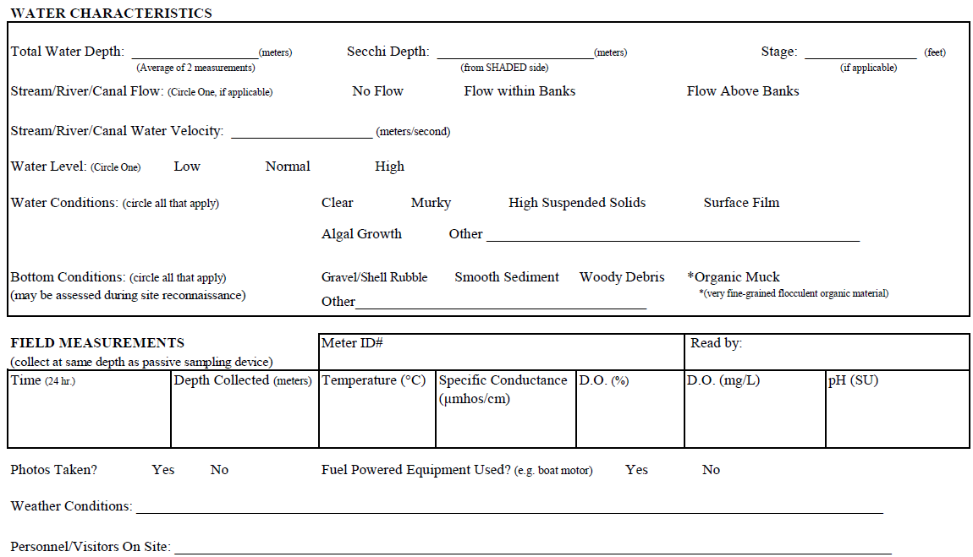
Deployment Event Procedures
Perform daily multi-parameter meter calibration / verification.
Navigate to deployment location. Record location using Trimble GPS unit (generic point).
Document water characteristic before deploying passive sampling device, collect YSI data after.

Slide 13
Deployment Event Procedures

Slide 14
Deployment Event Procedures
Prepare deployment hardware before opening SPMD & POCIS cans. Do not expose sampling devices to air for > 30 min.
Shut off fuel powered equipment before opening cans & disperse any surface film before placing sampling devices in water. Handle sampling devices by holders.
Place 3 POCIS & 3 SPMD (2 pre-spiked w/ PRCs) in canister. Secure canister lid.
Make sure canister is fully submerged & will remain in top 1m of water column.
Do not discard shipping can. Close lid & place site ID label on can - same cans will be used for shipment following retrieval.

Slide 15
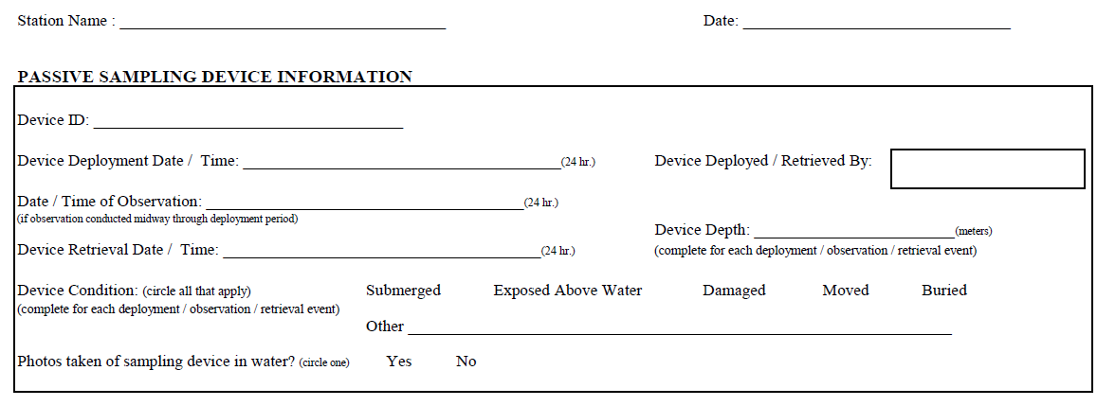
Deployment Event Procedures
Document deployment time & conditions on field sheet.
Take photos of deployment setup & canister in water.
N/A
N/A

Slide 16
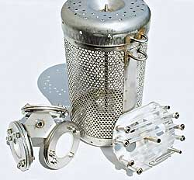
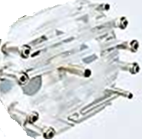
Deployment Event Procedures
Example passive sampling device setup: canister with 3 SPMD (right) and 3 POCIS (left).
Image from EST
labs website.

Slide 17
Mid-Deployment Event Procedures
Document condition of passive sampling device.
Collect field data at same depth as passive sampling device.
N/A
N/A
N/A

Slide 18
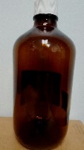

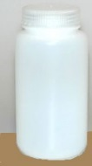


Retrieval Event Procedures
Retrieval events for all 4 sites must be within a 2 day window.
Collect field data and whole water samples before retrieving passive sampling device.
Collect field data & whole water grab samples at same depth as passive sampling device. Sample collection time must match field data collection time.
DEP lab
USGS
UF
AXYS
Fill extra bottles for DEP lab QA/QC at one site

Slide 19
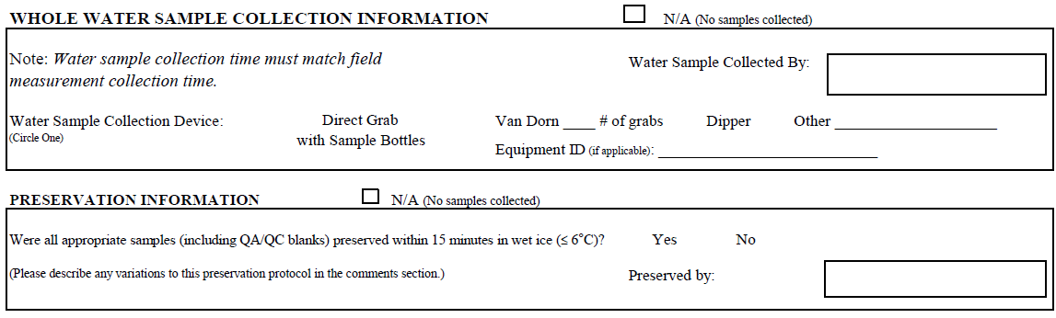
Retrieval Event Procedures
Use logistics diagram to ensure that all required whole water samples are collected.
Place site ID label on each bottle. Record collection date, time, and sampler initials on each bottle label.
Document whole water sample collection information and preservation information on field sheet and custody sheets. Collection times on bottles / field sheet / custody sheet must match.

Slide 20
Retrieval Event Procedures
Prepare shipping can before removing SPMD & POCIS from canister. Do not expose sampling devices to air for > 30 min.
Shut off fuel powered equipment before opening cans. Handle sampling devices by holders.
Place SPMD & POCIS in same cans that they arrived in. Close can lids & surround with “blue ice” or wet ice packed in separate zip-top bags.

Slide 21
Retrieval Event Procedures
Document retrieval time & conditions.
N/A
N/A

Slide 22
QA/QC – Field Blanks
Collect whole water field blank at one of the four field sites during retrieval event.
Fill all sample bottles with analyte-free water under field conditions.
Use only analyte-free water provided by AXYS.
  All glass bottles and 1L HDPE bottles filled with AXYS ultra-pure DI water
  All 500mL HDPE bottles filled with PFC-free spring water provided by AXYS.
DEP lab
USGS
UF
AXYS

Slide 23
QA/QC – Field Blanks
Collect SPMD & POCIS field blank at one of the four field sites during deployment & retrieval events.
Transport SPMD & POCIS to field sites in sealed cans, surrounded by wet ice packed in separate zip-top bags.
Open field blank cans at same time as cans for site’s sampling devices are opened.
Close field blank cans immediately after site’s sampling devices are placed in water.
Surround sealed field blank cans in “blue ice” or wet ice packed in separate zip-top bags. Store field blank cans at DEP lab (-20°C) during 30 - 35 day deployment period.
Repeat field blank protocol with same devices at same site when retrieving site’s sampling devices.

Slide 24
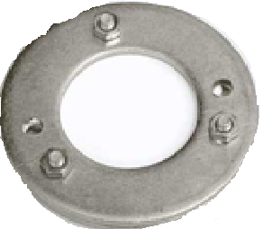
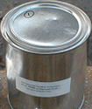
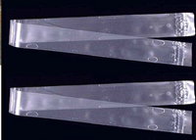
QA/QC – Field Blanks
Example passive sampling device field blank setup: 2 cans with 3 SPMD (right) and 3 POCIS (left).
Images from USGS & EST labs websites.

Slide 25
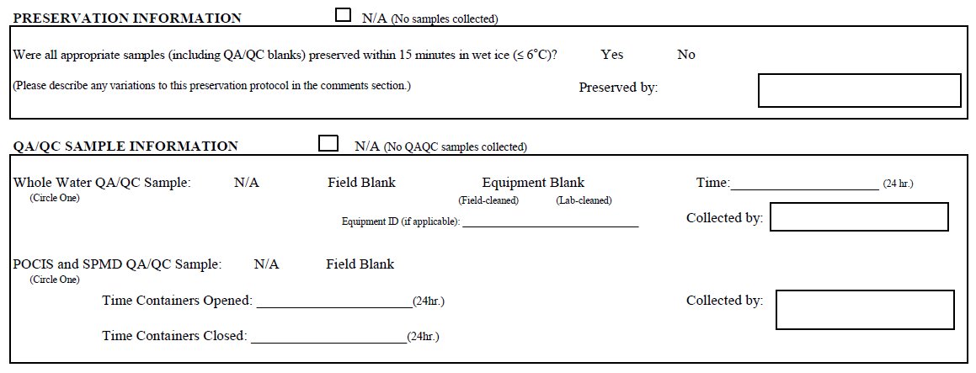
QA/QC – Field Blanks
Document all QA/QC sample collection and preservation information on field sheets for both events (deployment and retrieval).

Slide 26
Shipping
Prepare 4 separate coolers (or groups of coolers), one corresponding to each custody sheet.
Include adequate “blue ice” or wet ice (in separate zip-top bags) in each cooler to maintain thermal preservation.
Include a copy of corresponding custody sheet in all coolers.
Include a DEP cover letter in all coolers sent / delivered to non-DEP labs.
Samples will be shipped to USGS & AXYS, and hand delivered to UF & DEP.
Complete a separate FedEx airway bill for each cooler being shipped. Use DEP WMS FedEx account and select Priority Overnight Shipping.
Coolers sent to AXYS will require international FedEx airway bill & triplicate (original + 2 copies) commercial invoice and customs forms.

Slide 27
Shipping
Document Name | Delivered To | Analytes | Kits Contain
DEP Custody Sheet #1 | DEP Lab | Pesticides; Sucralose | 3 – 1L glass amber bottles (2 w/ code W-PSNP-TQ, 1 w/ code W-AHERB, W-SUC-AA-R, etc.) 1 – 1L glass amber bottle (pre-preserved w/ chloroacetic acid) 2 – 500 mL amber glass bottles Extra bottles filled at 1 site for lab QC (2 - 1L glass amber bottles & 2 – 500mL glass amber bottles)
DEP Custody Sheet #2 | USGS LSC | BLYES; BLYAS; SOS Chromotest | 1 – 1L glass amber bottle
DEP Custody Sheet #3 | UF – Denslow Lab | ER & AR binding & transactivation assays | 1 – 1L glass amber bottle
AXYS Custody Sheet | AXYS | Whole water: PPCPs; Hormones; PBDEs; Alkylphenols; PFCs; Pesticides SPMD & POCIS Extraction; AXYS will distribute extracts among designated laboratories for analysis. | 8 – 1L Amber glass bottles 4 – 1L HDPE bottles 2 – 500mL HDPE bottles 3 - SPMD on spider carriers in can 3 – POCIS on metal holders in can

Slide 28
References
Alvarez, D.A., 2010, Guidelines for the use of the semipermeable membrane device (SPMD) and the polar organic chemical integrative sampler (POCIS) in environmental monitoring studies: U.S. Geological Survey, Techniques and Methods 1–D4, p 28.
Wilde, F.D., Radtke, D.B., Gibs, Jacob, and Iwatsubo, R.T., eds., 2004 with updates through 2009. U.S. Geological Survey Techniques of Water-Resources Investigations, book 9, April 2004.
FDEP Status & Trend Network Sampling Manual. Jan. 2016 version. available online: http://publicfiles.dep.state.fl.us/dear/watershed%20monitoring/documents/WMS-SamplingManual.pdf.

Slide 29
QUESTIONS?
Stephanie Sunderman-Barnes
Quality Assurance Officer
Watershed Monitoring Section
Florida Department of Environmental Protection
(850) 245-8517
stephanie.sundermanbarnes@dep.state.fl.us

