Slide 1
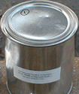
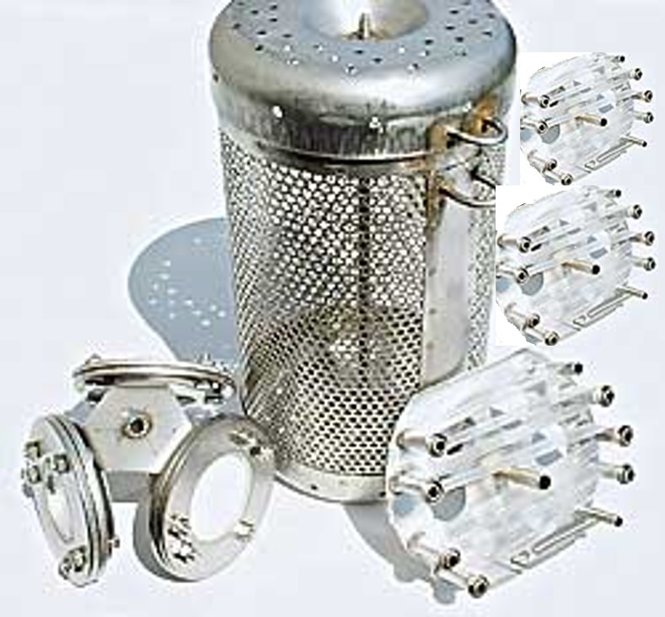
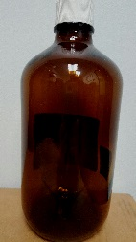



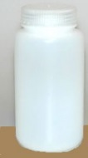

SAMPLES COLLECTED AT EACH SITE
POCIS-HLB (2)
DEP staff place in canister during deployment period.
Shipped by DEP to AXYS.
Spikes added by AXYS.
Extracted for chemistry analysis by AXYS.
Extract from each disk split 1:4
  ¼ for MRES w/ ON by AXYS
  ¼ for PPCP & hormones by AXYS
  ¼ for PFC by AXYS
  ¼ for archive
AXYS performs chemical analysis.
AXYS ships holders back to DEP.
DEP cleans holders and ships them to EST.
Sample Container (Can)(2)
Can #1 contains 3 SPMD (2 w/ PRCs, 1 marked w/ hole has no PRCs)
Can #2 contains 3 POCIS
Cans sealed & chilled during transport.
All POCIS & SPMDs removed & placed in canister during deployment period.
All POCIS & SPMDs placed in cans upon retrieval.
Cans sealed & shipped by DEP to AXYS for extraction.
AXYS ships cans back to DEP.
DEP cleans cans and retains for future use.
SPMD (2)
PRCs added by EST.
DEP staff place in canister during deployment period.
Shipped by DEP to AXYS.
Spikes added by AXYS.
Composited & extracted for chemistry analyses.
Extract split 1:5.
  1/5 for alkylphenols by AXYS
  1/5 for MRES w/ ON by AXYS
  1/5 for PBDEs by AXYS
  1/5 for PRC analysis by AXYS
  1/5 for archive
AXYS performs analyses for chemistry analytes of interest and PRCs.
Canister (1)
Will hold 3 POCIS and 3 SPMD in water column during deployment period.
DEP cleans canister after retrieval and retains for future use.
POCIS-HLB (1)
DEP staff place in canister during deployment period.
Shipped by DEP to AXYS.
No spike additions.
Extracted separate from the other 2 POCIS by AXYS.
Extract split 1:3.
  1/3 for BLYES &SOS Chromotest analysis by USGS
  1/3 for ER binding & transactivation assays by UF
  1/3 for pesticide analyses by DEP lab
AXYS ships 1/3 portion of extract, concentrated to 0.5 mL to USGS LSC.
AXYS ships AXYS ships 1/3 portion of extract, concentrated to 0.5 mL to UF Denslow Lab.
AXYS ships AXYS ships 1/3 portion of extract, concentrated to 1 mL to DEP Lab.
AXYS ships holder back to DEP.
DEP cleans holders and ships them to EST.
SPMD (1)
No PRC addition.
DEP staff place in canister during deployment period.
Shipped by DEP to AXYS.
No spike additions.
Extracted separately from the other 2 SPMDs by AXYS.
Extract split 1:3.
  1/3 for BLYES &SOS Chromotest analysis by USGS
  1/3 for ER binding & transactivation assays by UF
  1/3 for pesticide analyses by DEP lab
AXYS ships 1/3 portion of extract, concentrated to 0.5 mL to USGS LSC.
AXYS ships AXYS ships 1/3 portion of extract, concentrated to 0.5 mL to UF Denslow Lab.
AXYS ships AXYS ships 1/3 portion of extract, concentrated to 1 mL to DEP Lab.
Amber glass bottle 1L (1)
DEP staff fill w/ site water.
Shipped by DEP to USGS LCS.
Amber glass bottle 1L (1)
DEP staff fill w/ site water.
Hand delivered by DEP to UF Denslow Lab
Amber glass bottle 1L (3),
Amber glass bottle 1L (1) pre-preserved w/ chloroacetic acid,
Amber glass bottle 500mL (2), &
DEP staff fill w/ site water.
Hand delivered to DEP
Fill additional Amber bottle 1L (2) & Amber bottle 500mL (2) with site water at one site, for lab QA.
Amber glass bottle 1L (8),
HDPE bottle 1L (4), &
HDPE bottle 500mL (2)
(Note: numbers above reflect 2x required sampling kit. Collecting 2x required sample volume to minimize loss due to container damage during shipping.)
DEP staff fill w/ site water.
Shipped by DEP to AXYS.

Slide 2
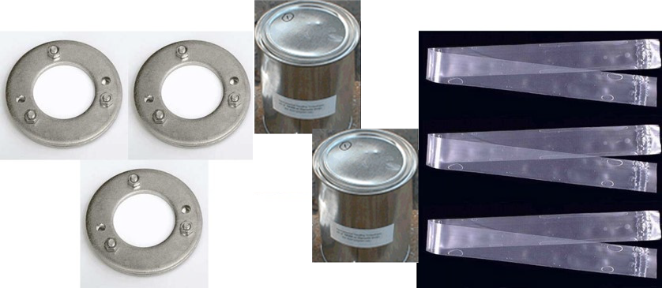
FIELD BLANK
POCIS-HLB (2)
DEP staff do not remove from can.
Shipped by DEP to AXYS.
Spikes added by AXYS.
Extracted for chemistry analysis by AXYS.
Extract from each disk split 1:4
  ¼ for MRES w/ ON by AXYS
  ¼ for PPCP & hormones by AXYS
  ¼ for PFC by AXYS
  ¼ for archive
AXYS performs chemical analysis.
AXYS ships holders back to DEP.
DEP cleans holders and ships them to EST.
Sample Container (Can)(2)
Can #1 contains 3 SPMD (2 w/ PRCs, 1 marked w/ hole has no PRCs)
Can #2 contains 3 POCIS
Can sealed & chilled during transport. Stored at -20°C during deployment period.
Lid opened during setup & retrieval activities at 1 site.
Can sealed & shipped by DEP to AXYS for extraction.
AXYS ships can back to DEP.
DEP cleans cans and retains for future use.
SPMD (2)
PRCs added by EST.
DEP staff do not remove from can.
Shipped by DEP to AXYS.
Spikes added by AXYS.
Extract split 1:5.
  1/5 for alkylphenols by AXYS
  1/5 for MRES w/ ON by AXYS
  1/5 for PBDEs by AXYS
  1/5 for PRC analysis by AXYS
  1/5 for archive
AXYS performs analyses for chemistry analytes of interest and PRCs
POCIS-HLB (1)
DEP staff do not remove from can.
Shipped by DEP to AXYS.
No spike additions.
Extracted separate from the other 2 POCIS by AXYS.
Extract split 1:3.
  1/3 for BLYES &SOS Chromotest analysis by USGS
  1/3 for ER binding & transactivation assays by UF
  1/3 for pesticide analyses by DEP lab
AXYS ships 1/3 portion of extract, concentrated to 0.5 mL to USGS LSC.
AXYS ships AXYS ships 1/3 portion of extract, concentrated to 0.5 mL to UF Denslow Lab.
AXYS ships AXYS ships 1/3 portion of extract, concentrated to 1 mL to DEP Lab.
AXYS ships holder back to DEP.
DEP cleans holders and ships them to EST.
SPMD (1)
No PRC addition.
DEP staff do not remove from can.
Shipped by DEP to AXYS.
No spike additions.
Extracted separately from the other 2 SPMDs by AXYS.
Extract split 1:3.
  1/3 for BLYES &SOS Chromotest analysis by USGS
  1/3 for ER binding & transactivation assays by UF
  1/3 for pesticide analyses by DEP lab
AXYS ships 1/3 portion of extract, concentrated to 0.5 mL to USGS LSC.
AXYS ships AXYS ships 1/3 portion of extract, concentrated to 0.5 mL to UF Denslow Lab.
AXYS ships AXYS ships 1/3 portion of extract, concentrated to 1 mL to DEP Lab.
Amber glass bottle 1L (1)
DEP staff fill w/ AXYS DI water.
Shipped by DEP to USGS LCS.
Amber glass bottle 1L (1)
DEP staff fill w/ AXYS DI water.
Hand delivered by DEP to UF Denslow Lab
Amber glass bottle 1L (3),
Amber glass bottle 1L (1) pre-preserved w/ chloroacetic acid, Amber glass bottle 500mL (2), &
DEP staff fill w/ AXYS DI water.
Hand delivered to DEP
Amber glass bottle 1L (8),
HDPE bottle 1L (4), &
HDPE bottle 500mL (2)
(Note: numbers above reflect 2x required sampling kit. Collecting 2x required sample volume to minimize loss due to container damage during shipping.)
DEP staff fill all 1L bottles (glad & HDPE) w/ AXYS DI water.
DEP staff fill 500mL HDPE bottles with AXYS PFC-free spring water.
Shipped by DEP to AXYS.

