Slide 1
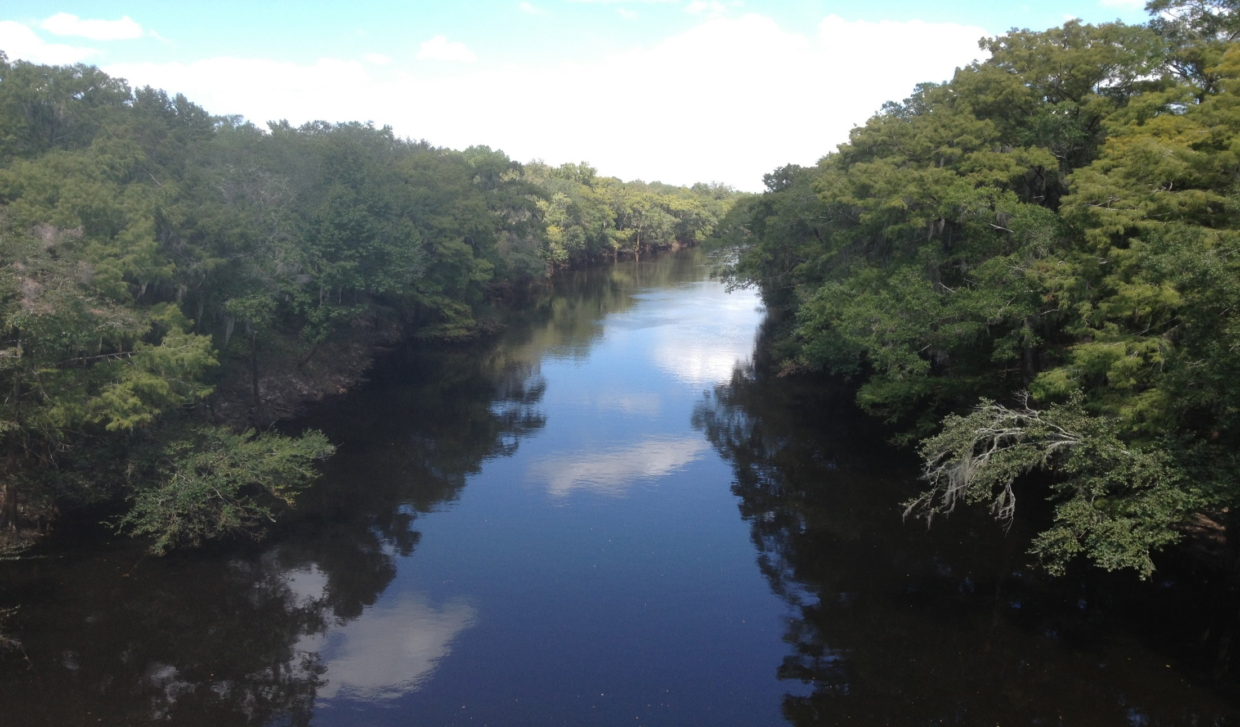
ESOC Site Reconnaissance

Slide 2
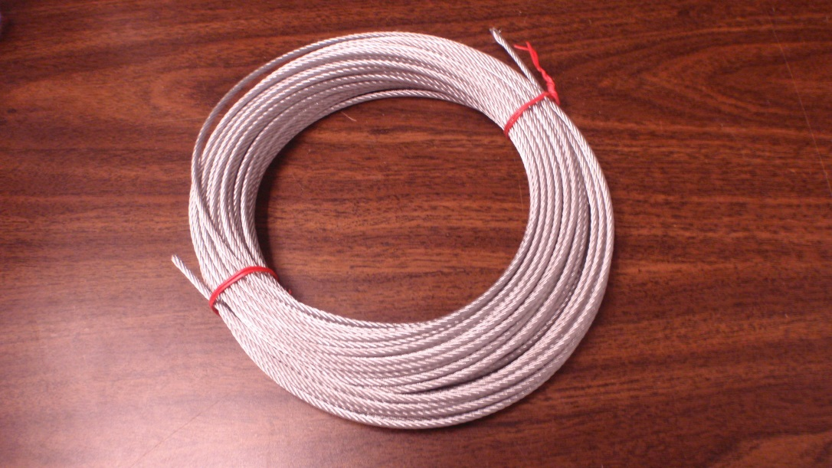
Equipment needs:
Stainless steel cable
Buoys
Weights
Clamps “thimbles”
Slip rings
Anchor

Slide 3
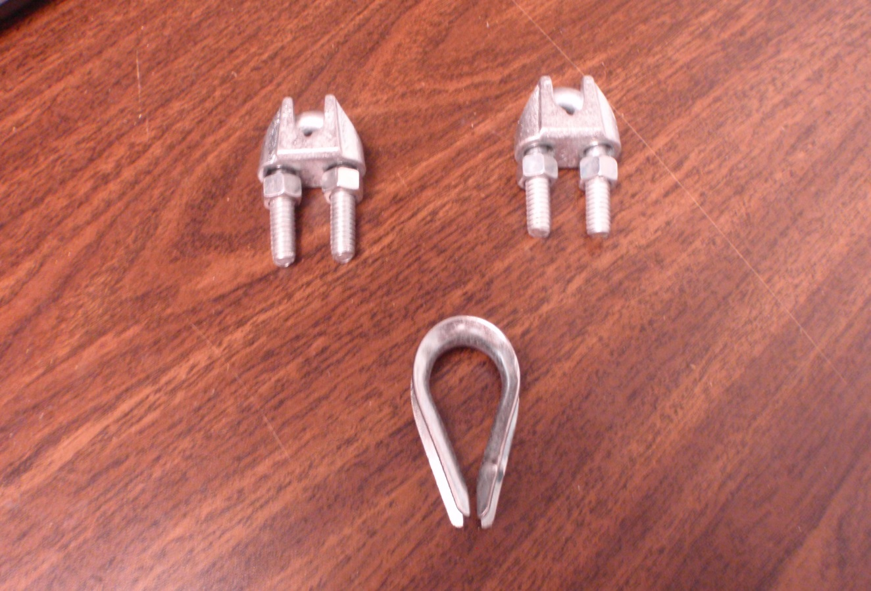
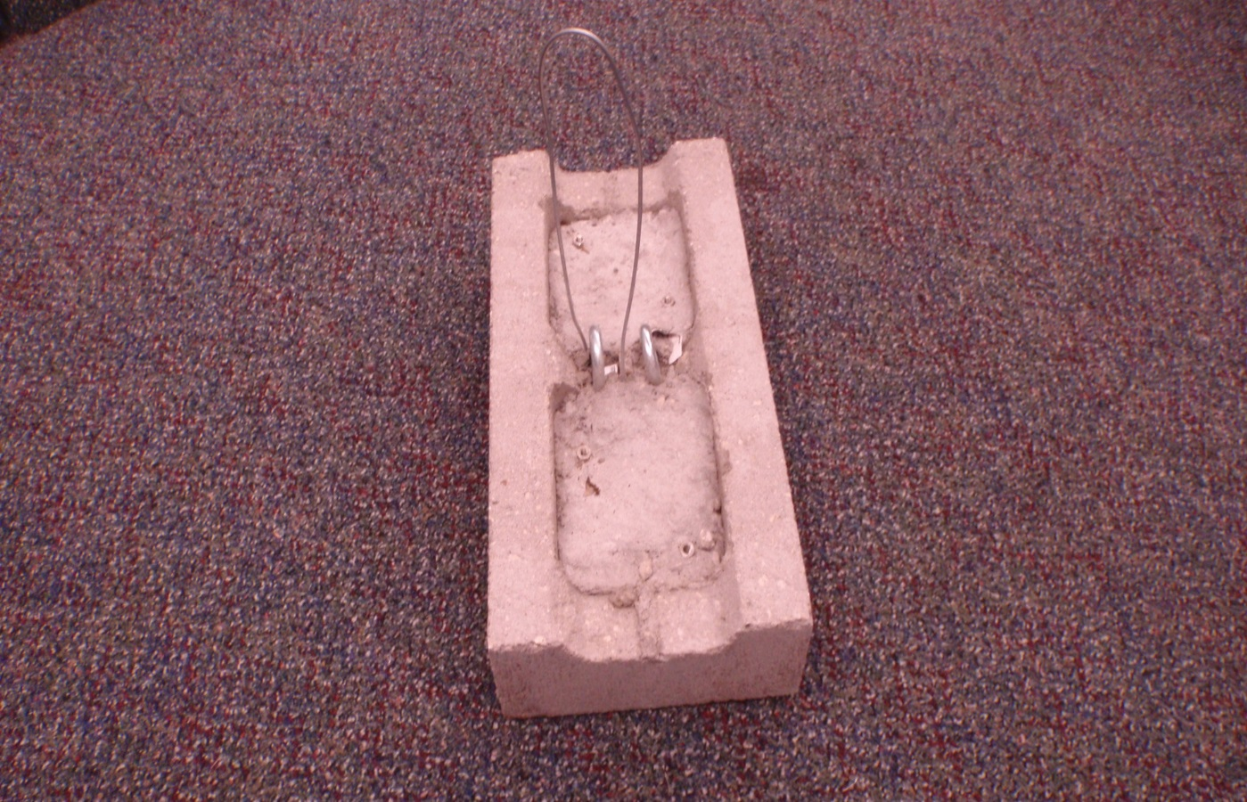
Equipment
Clamps / “Thimbles”
Anchor

Slide 4
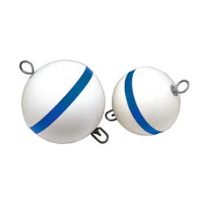
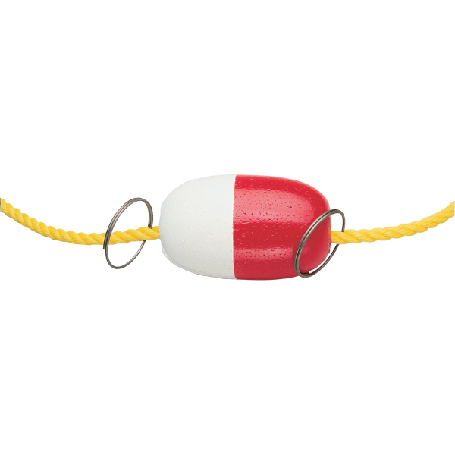
Buoys

Slide 5
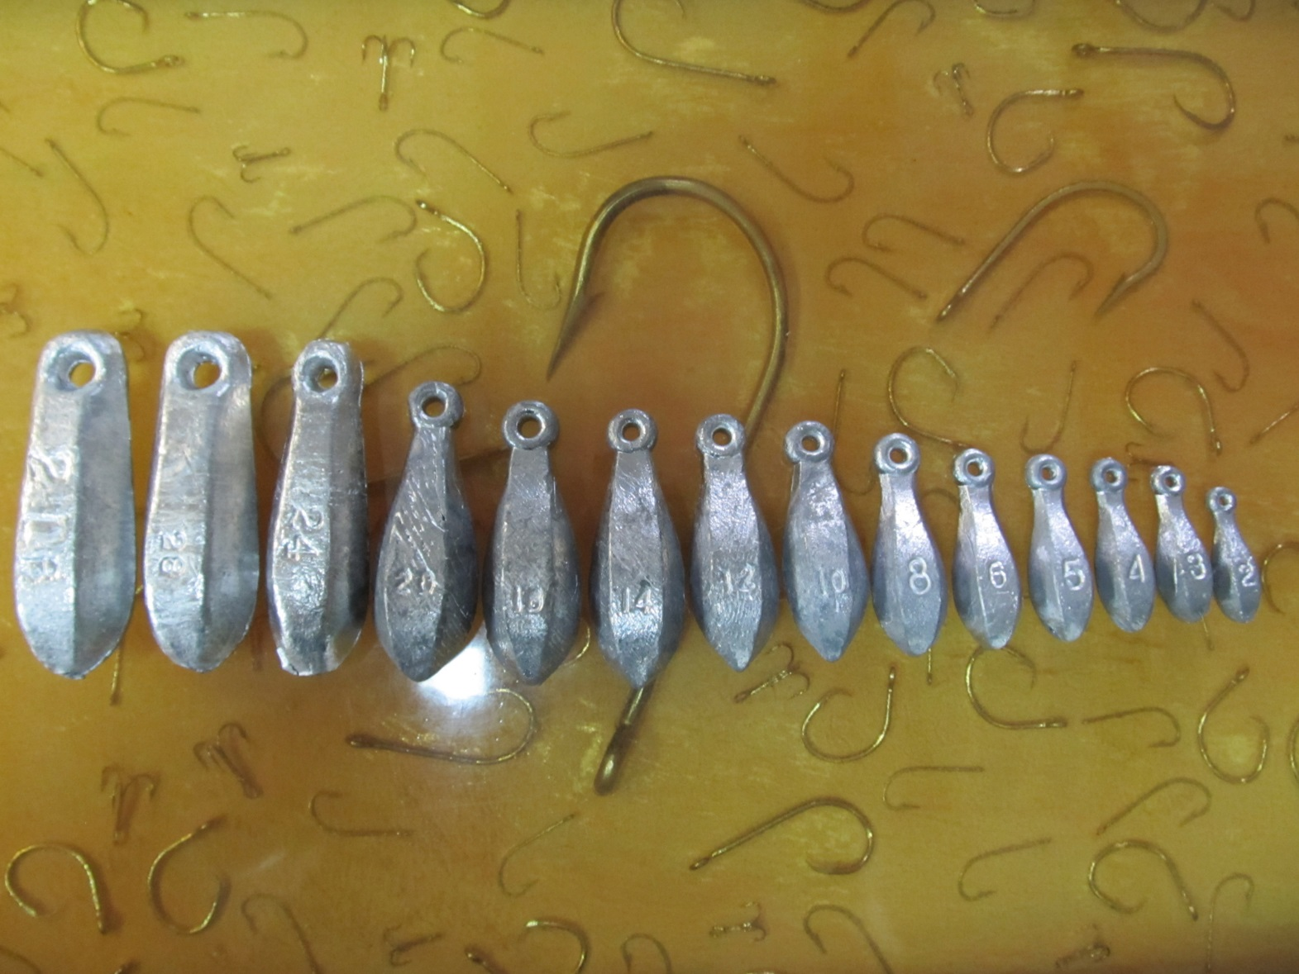
Weights

Slide 6
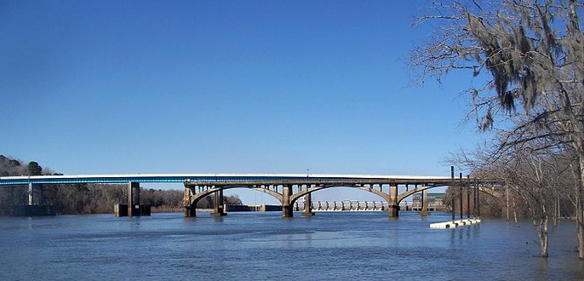
Apalachicola River / US-90 Site

Slide 7
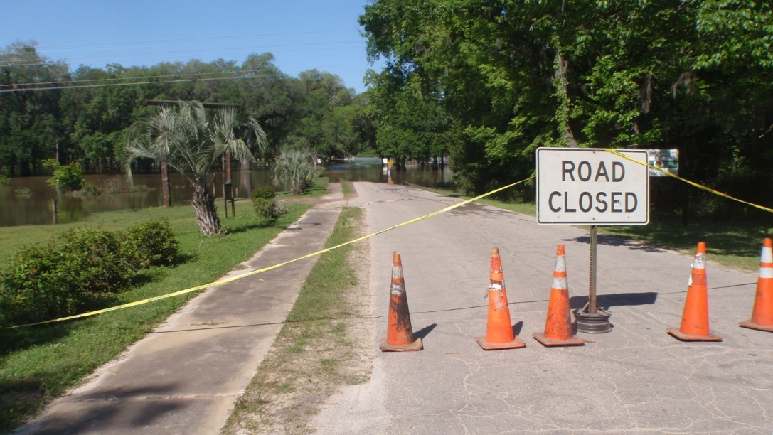
Site Considerations:
Discharge from the dam is not on a set schedule.
Historical water level information has been reviewed.
Tampering with the equipment by the public (this is a concern for all sites).

Slide 8
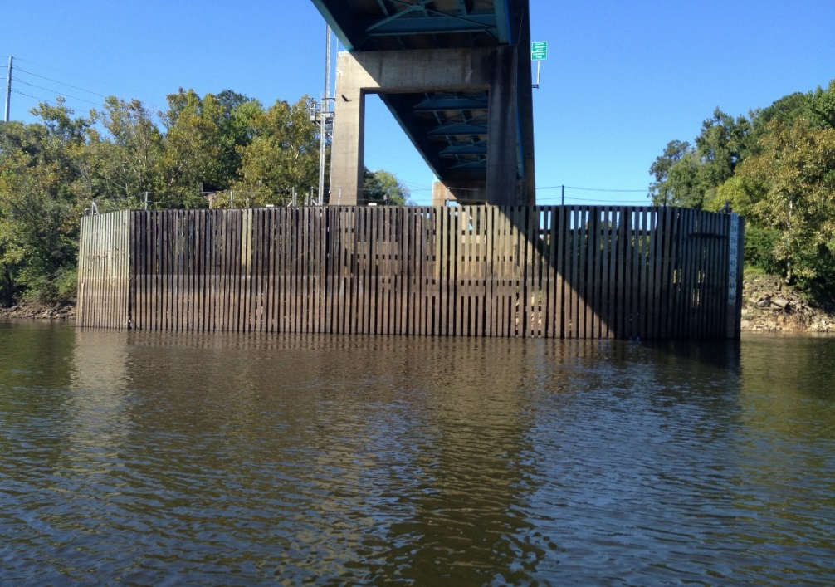
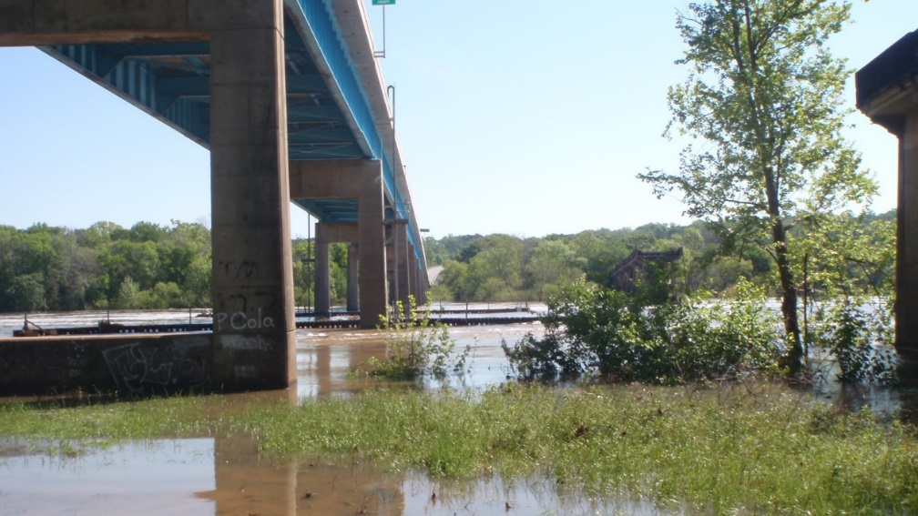
Possible Deployment Points

Slide 9
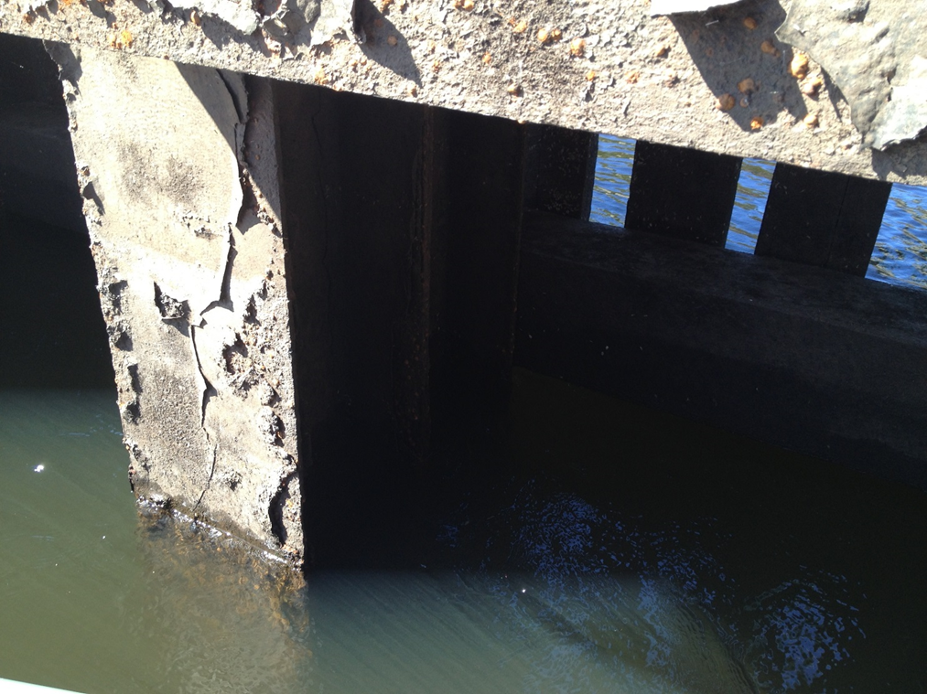
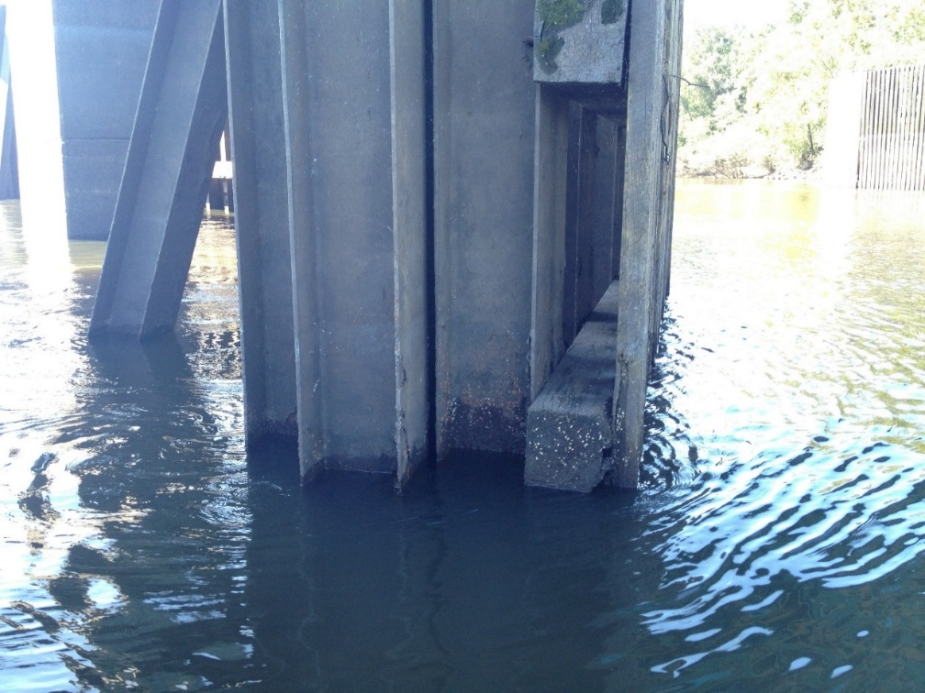
Possible Deployment Points

Slide 10
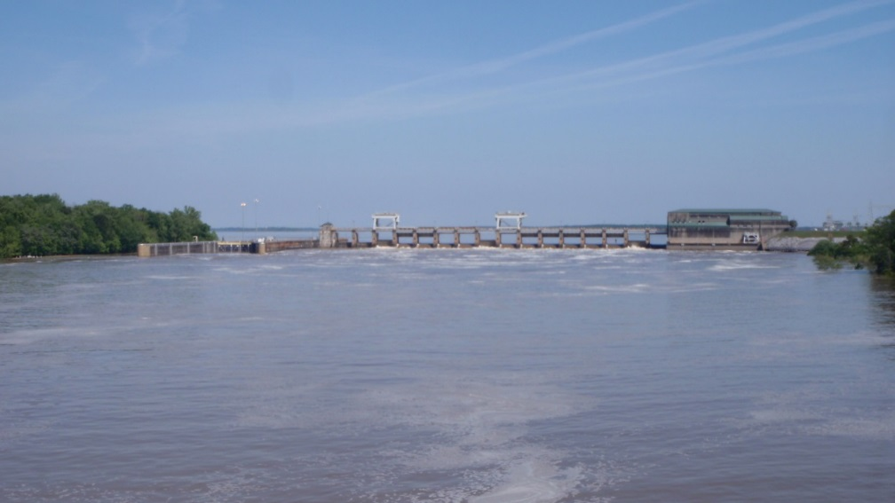
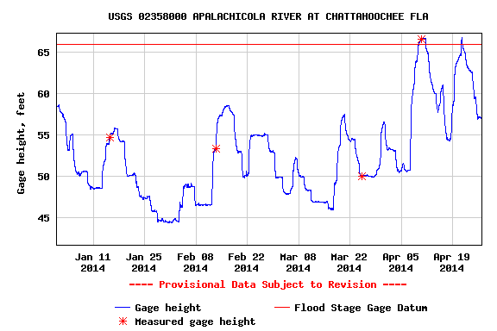
Apalachicola River site on 4/22/14

Slide 11
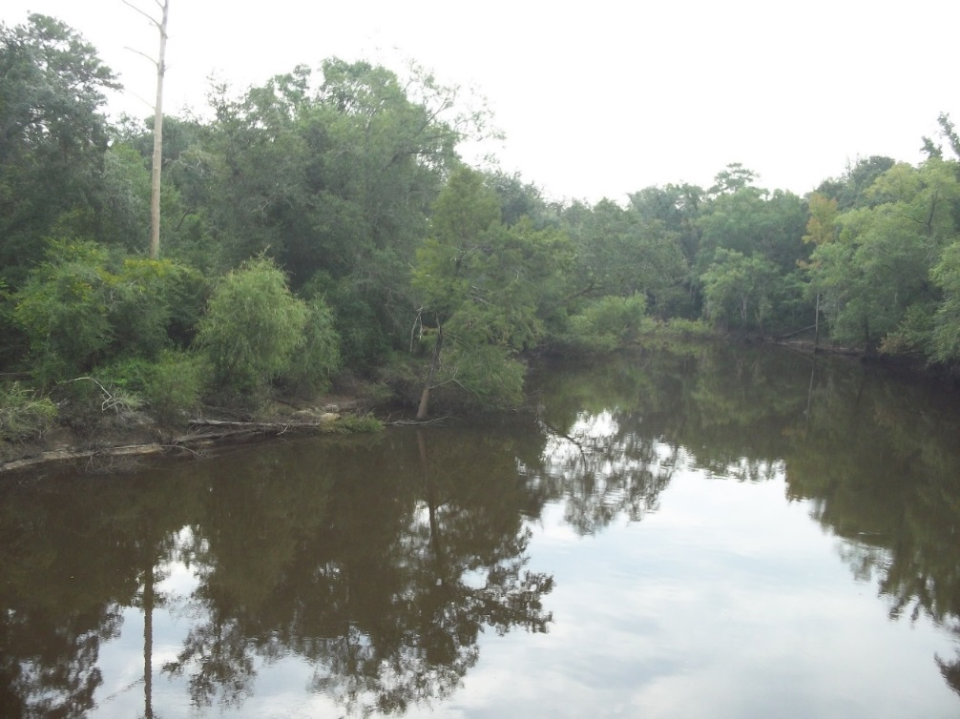
Ochlockonee River / CR-12 Bridge Site

Slide 12
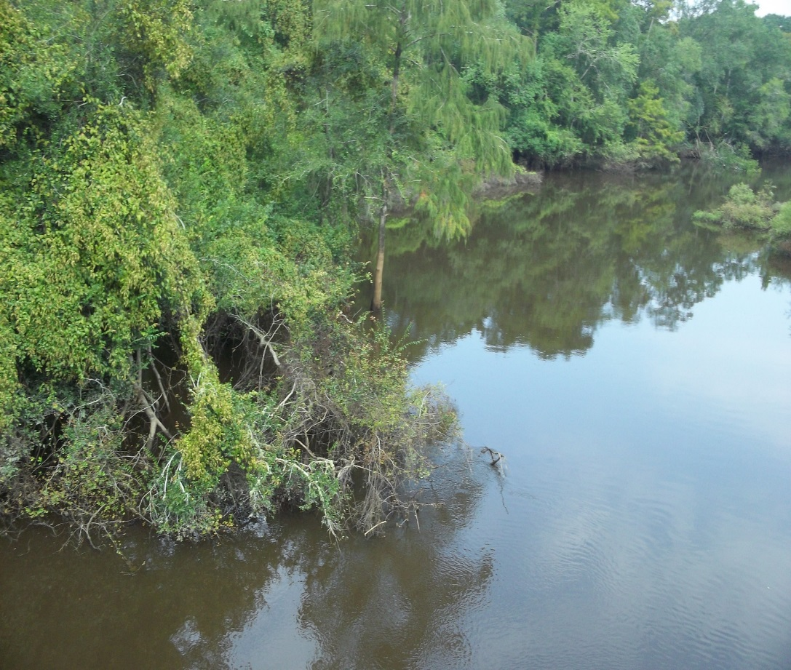
Site Considerations:
As with all our northern sites, the Ochlockonee is currently flooded.
There are several cypress trees along the bank that could be used as attachment points that are currently in the flow, however water level fluctuations in the future might temporarily leave them dry.

Slide 13
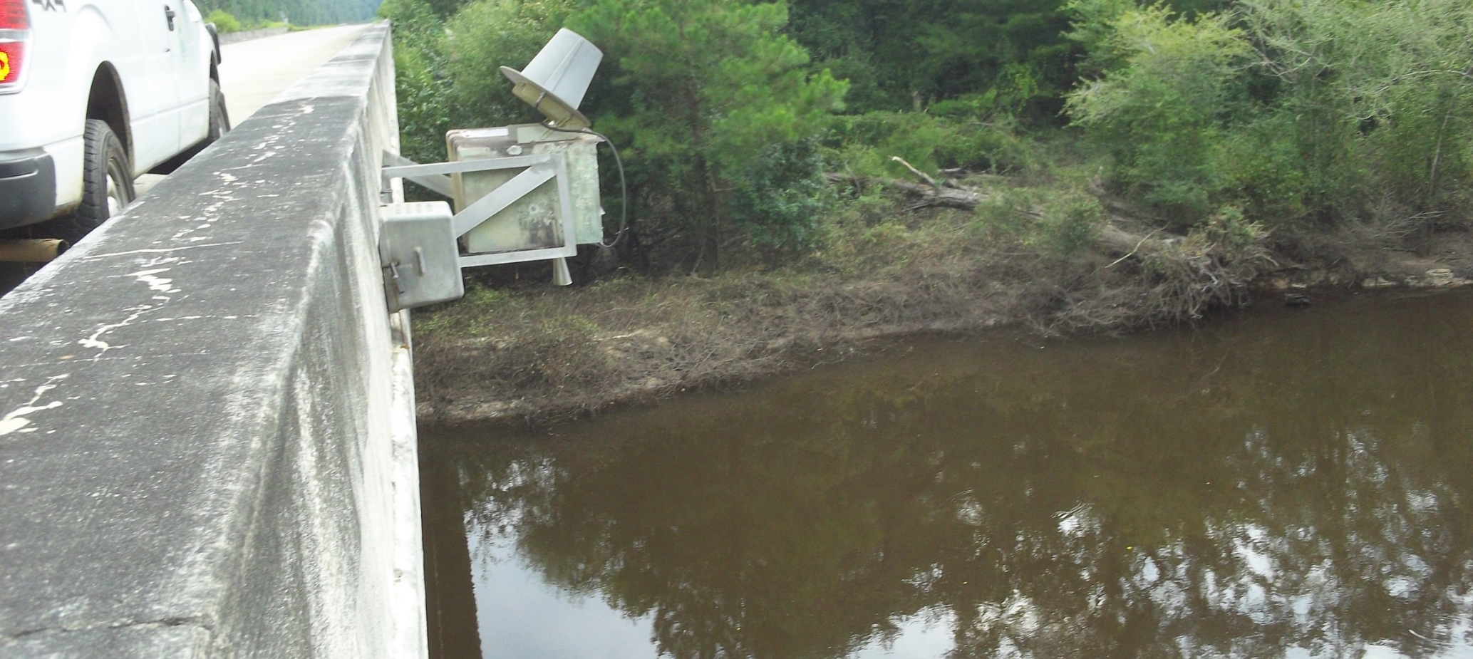
Site considerations:
Without guardrails, the likeliest attachment points are under the bridge.

Slide 14
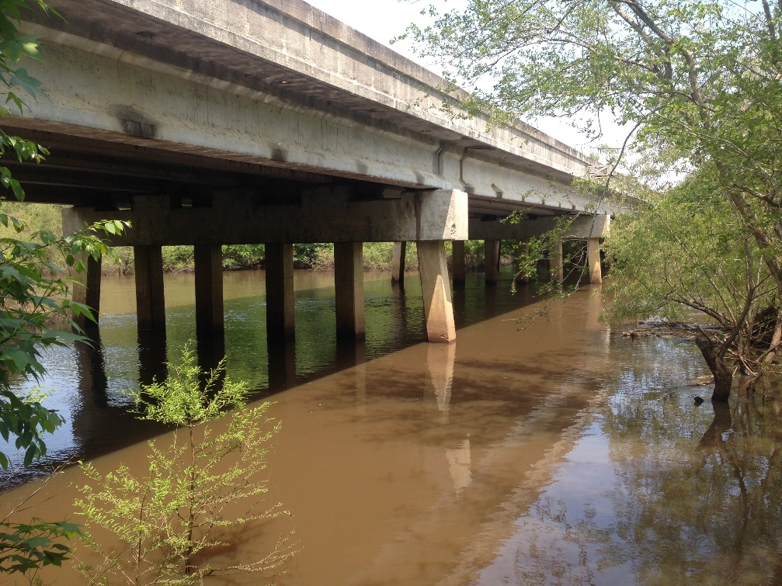
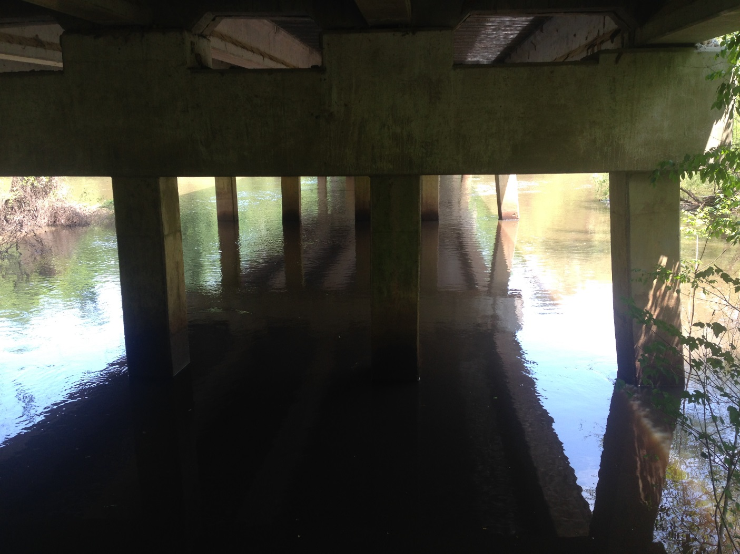
Ochlockonee / CR-12 Bridge

Slide 15
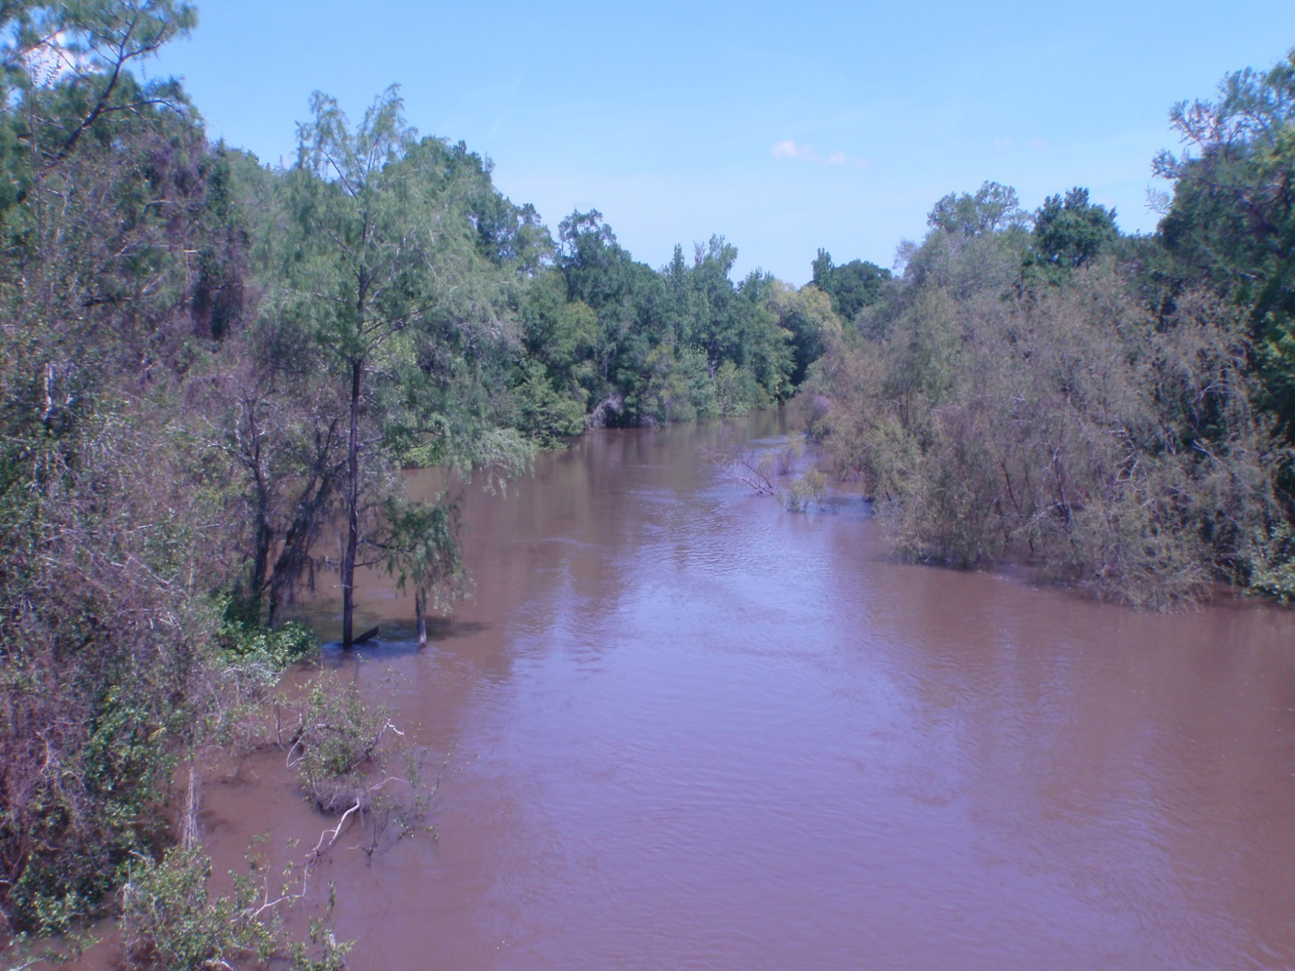
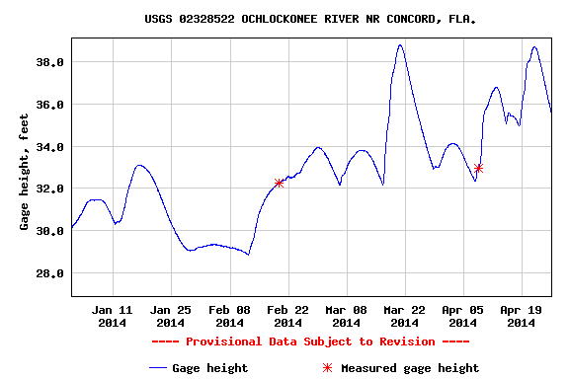
Ochlockonee River site on 4/22/14

Slide 16

Withlacoochee River at SR 150/Bellville Bridge

Slide 17
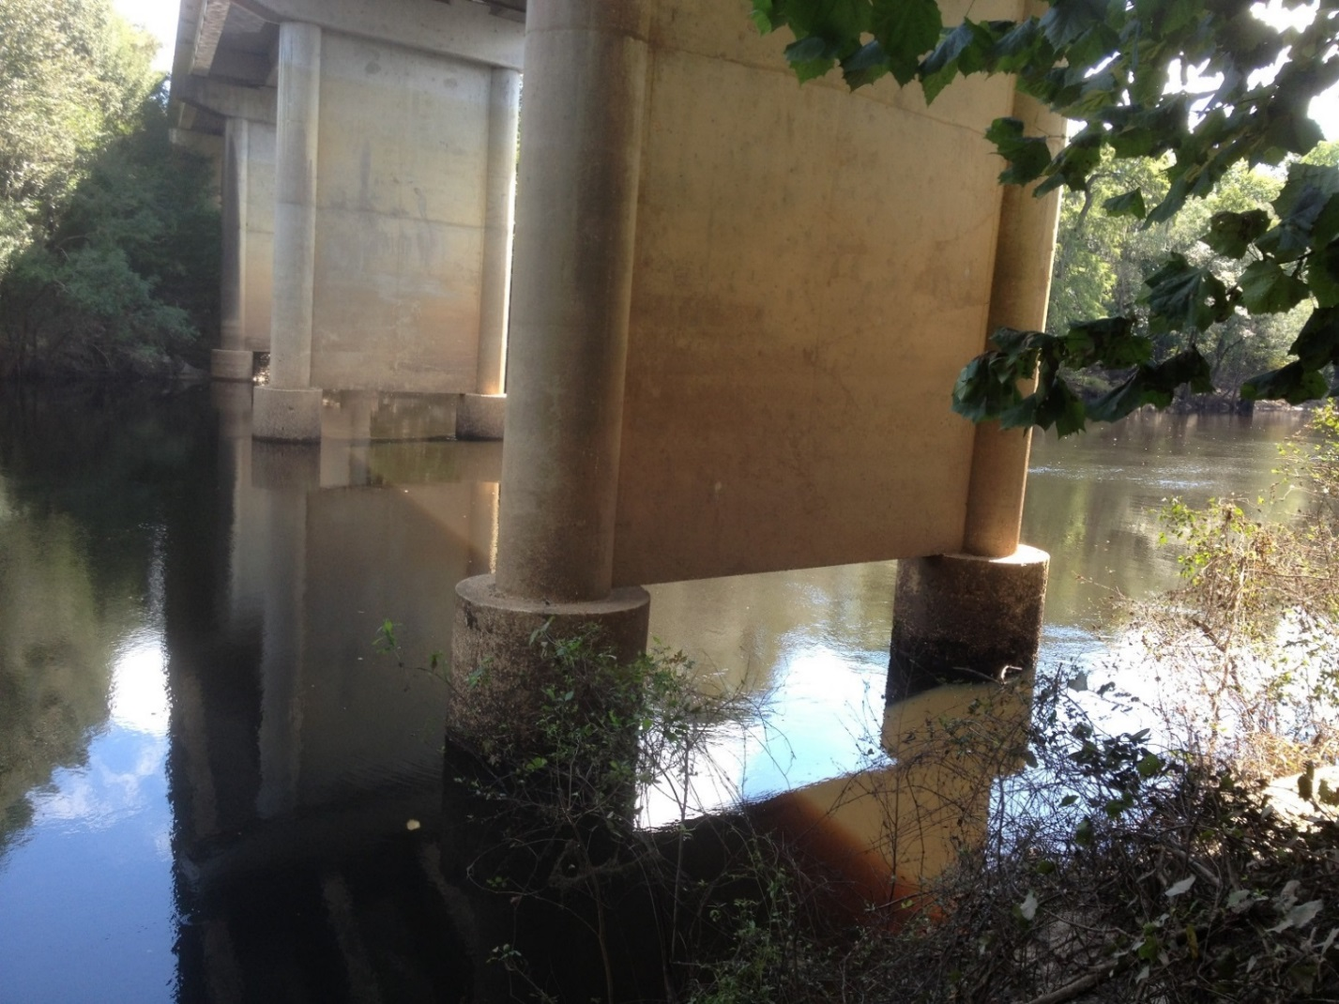
Site Considerations:
Construction of a new bridge upriver at the SR-145 TV site required us to move the location here.
Water level is currently above the base of the pylon.
Considering deploying from the bridge, or possibly running steel cable around the entire column. Water level fluctuations will be a concern.

Slide 18
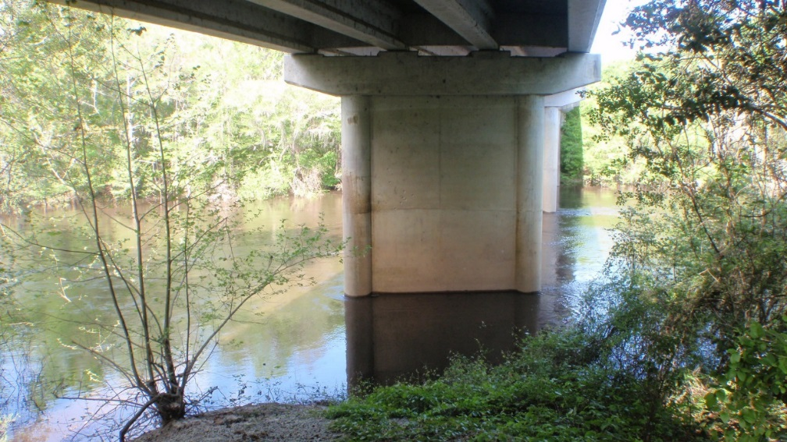
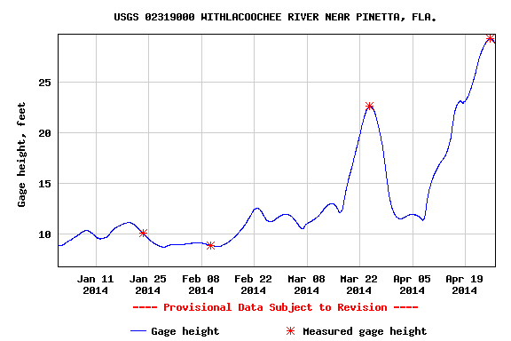
SR-150 / Bellview Bridge 4/16/14

Slide 19
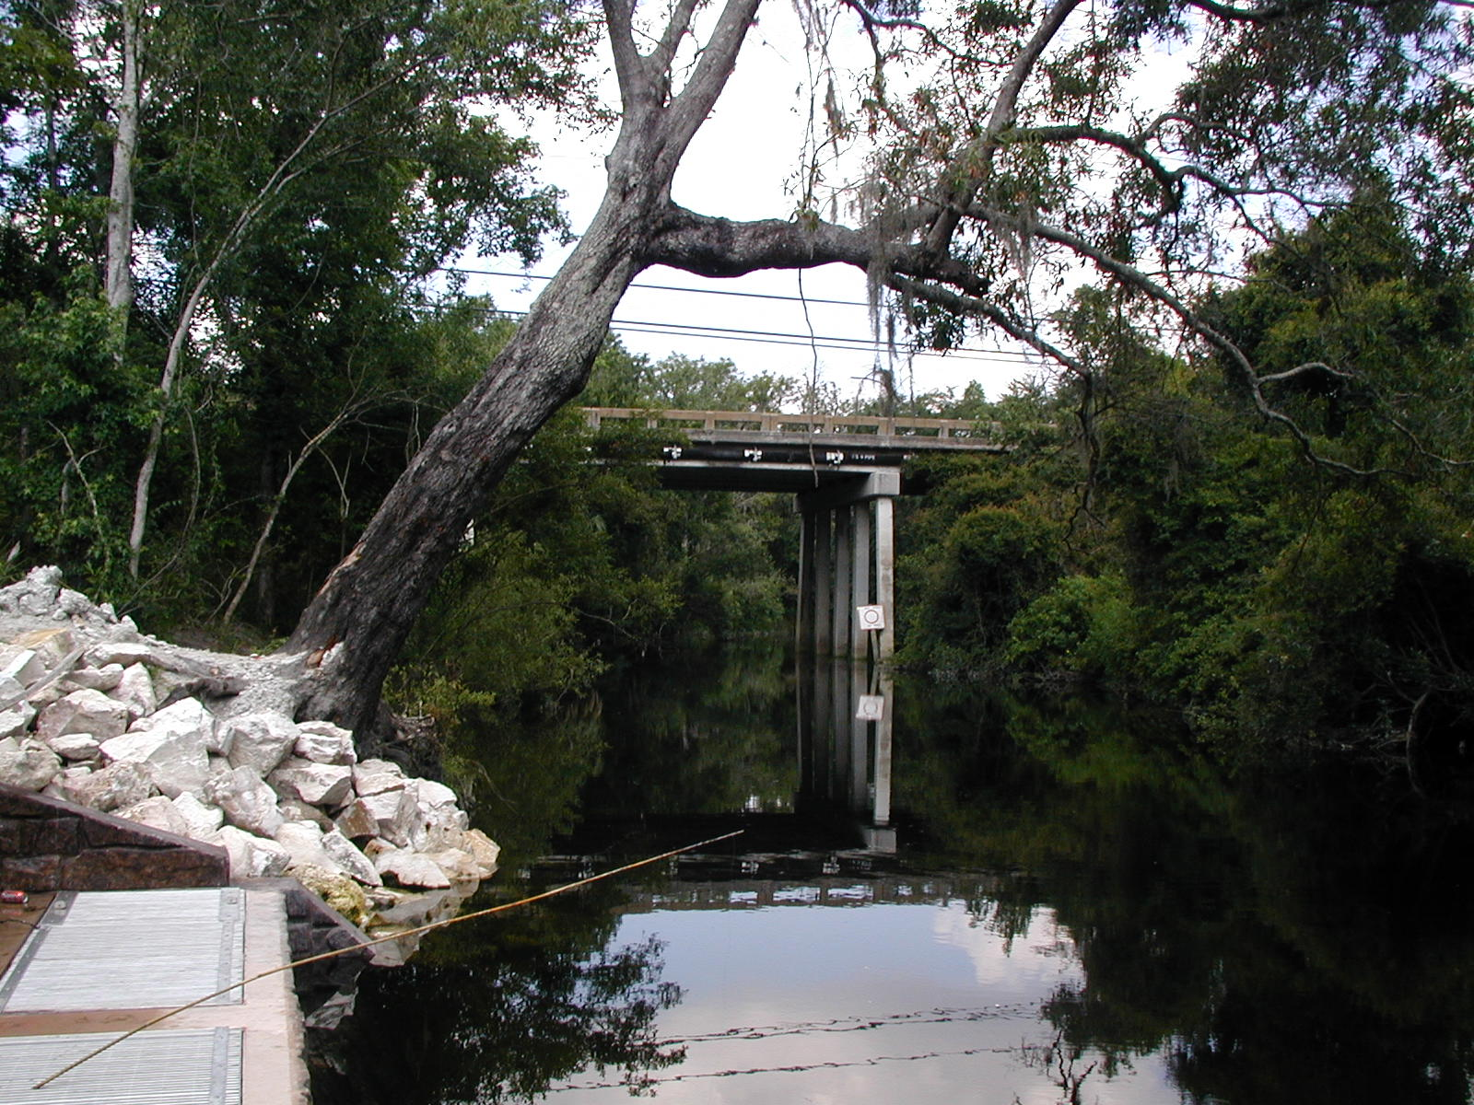
Alafia River / Pump Station at Bell Shoals Rd.

Slide 20
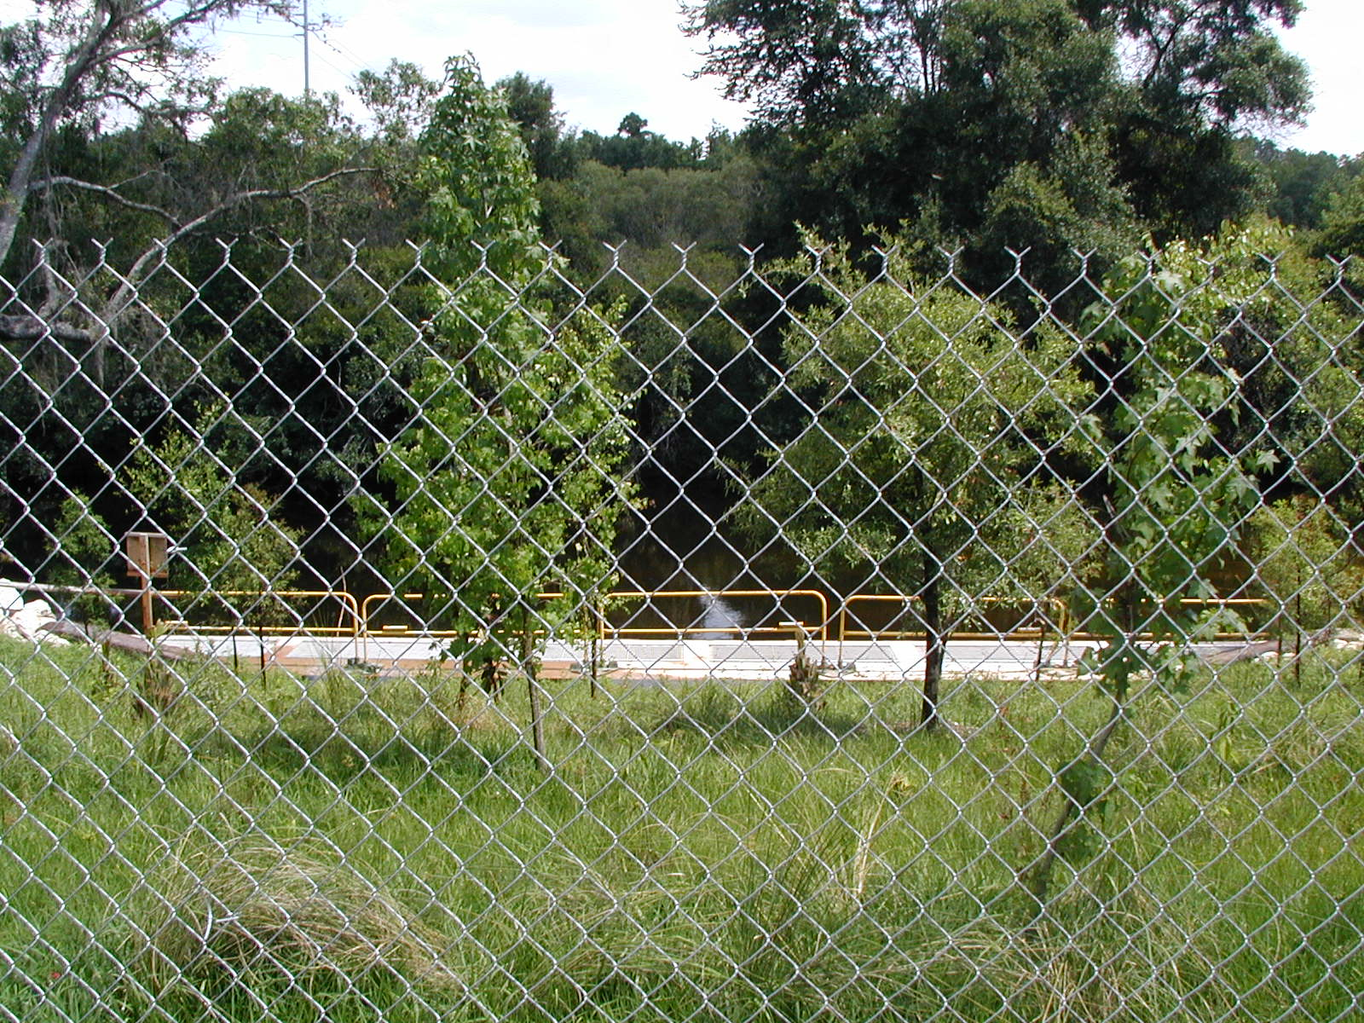
Site Considerations:
The proposed site is fenced in and secure.
This is an intake and pump station supplying drinking water to the Tampa Bay area.

Slide 21
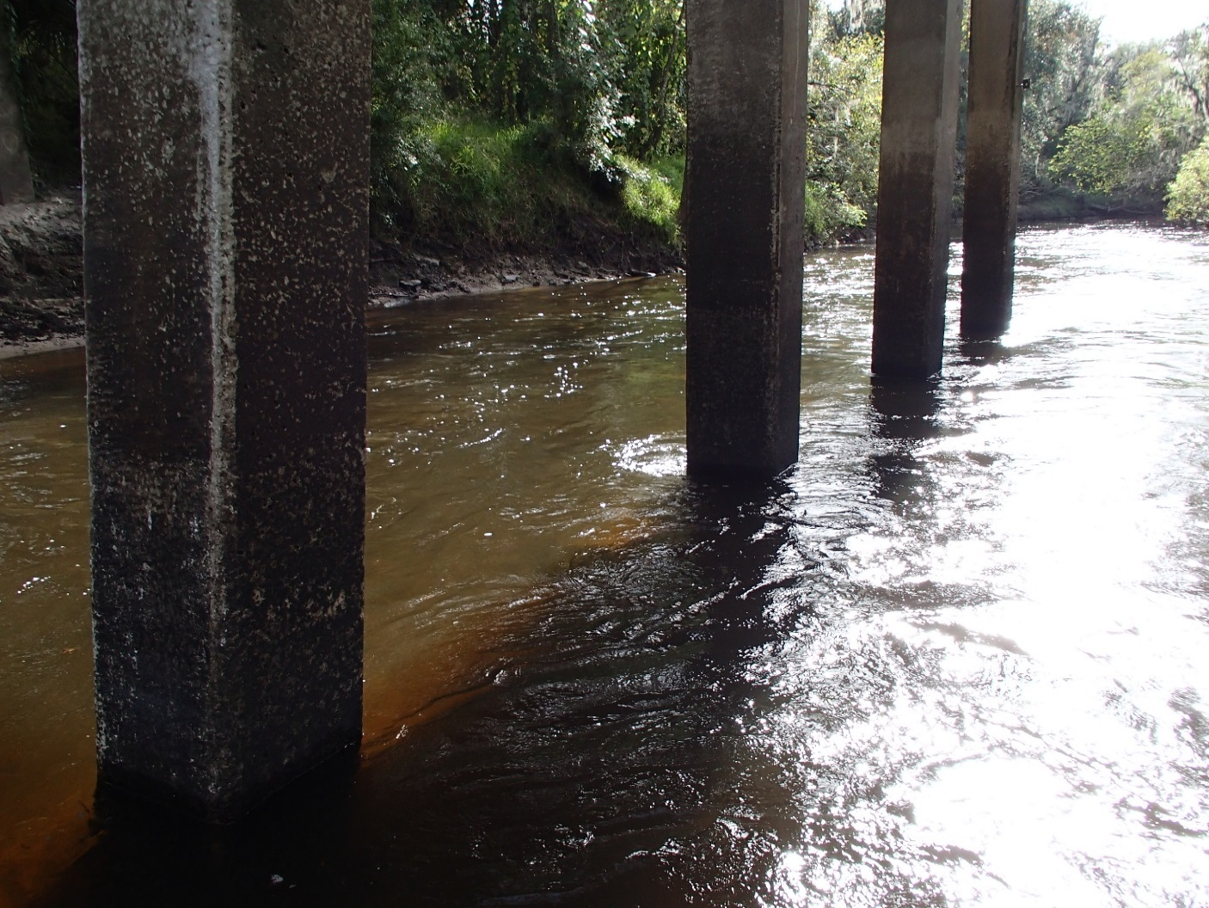
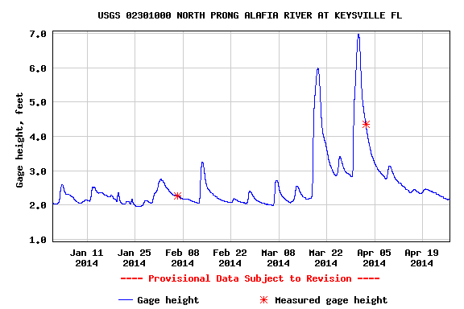
Alafia River Site
From the Bell Shoals Rd. Bridge
Gauging station just North of the facility

Slide 22
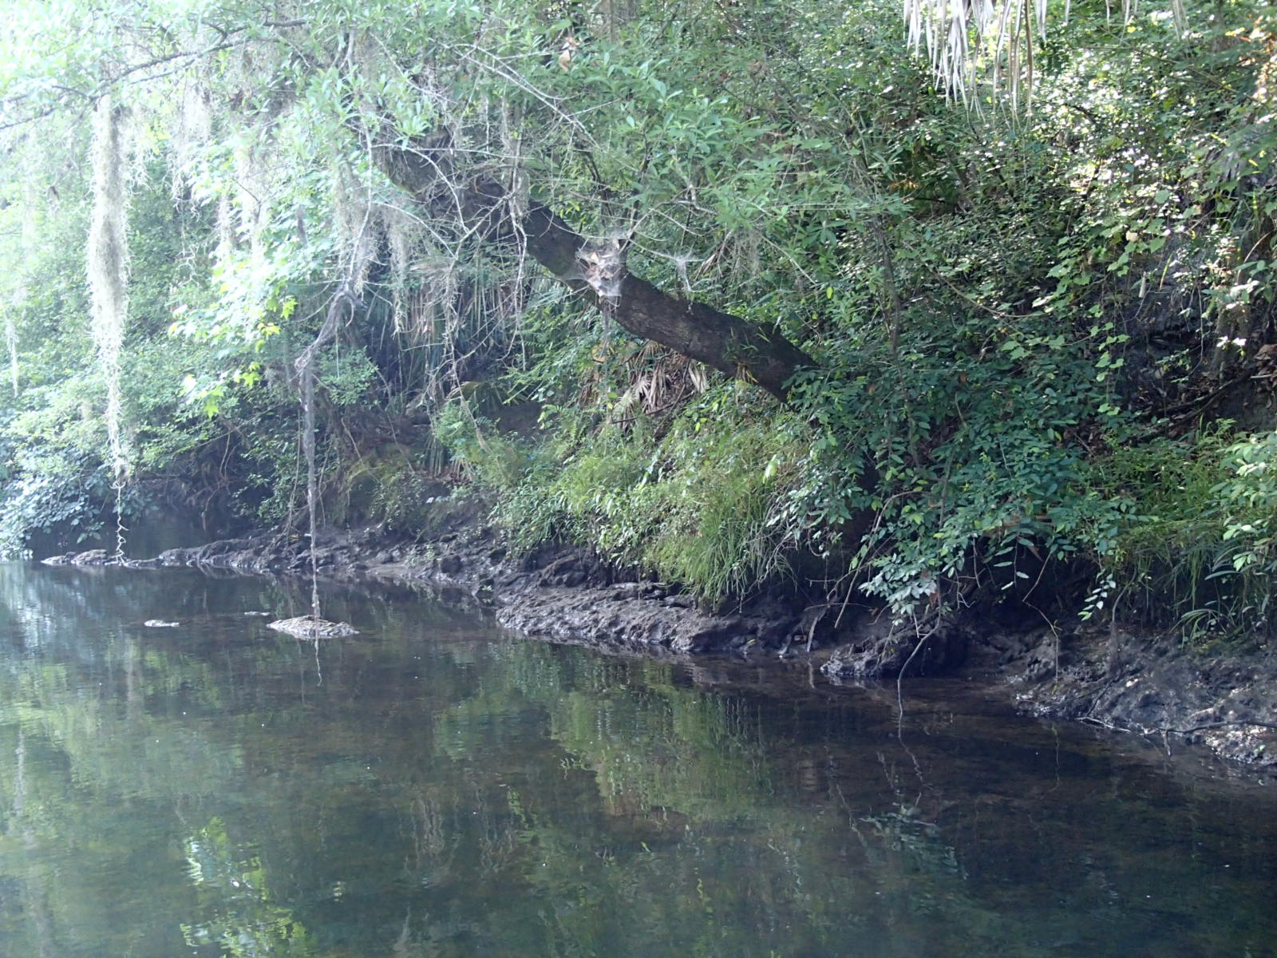
Deployment Possibilities:
The secured site allows more options for deployment. Depending on the strength of the flow, we may anchor the sampling device to the river bed or a nearby tree.

Slide 23
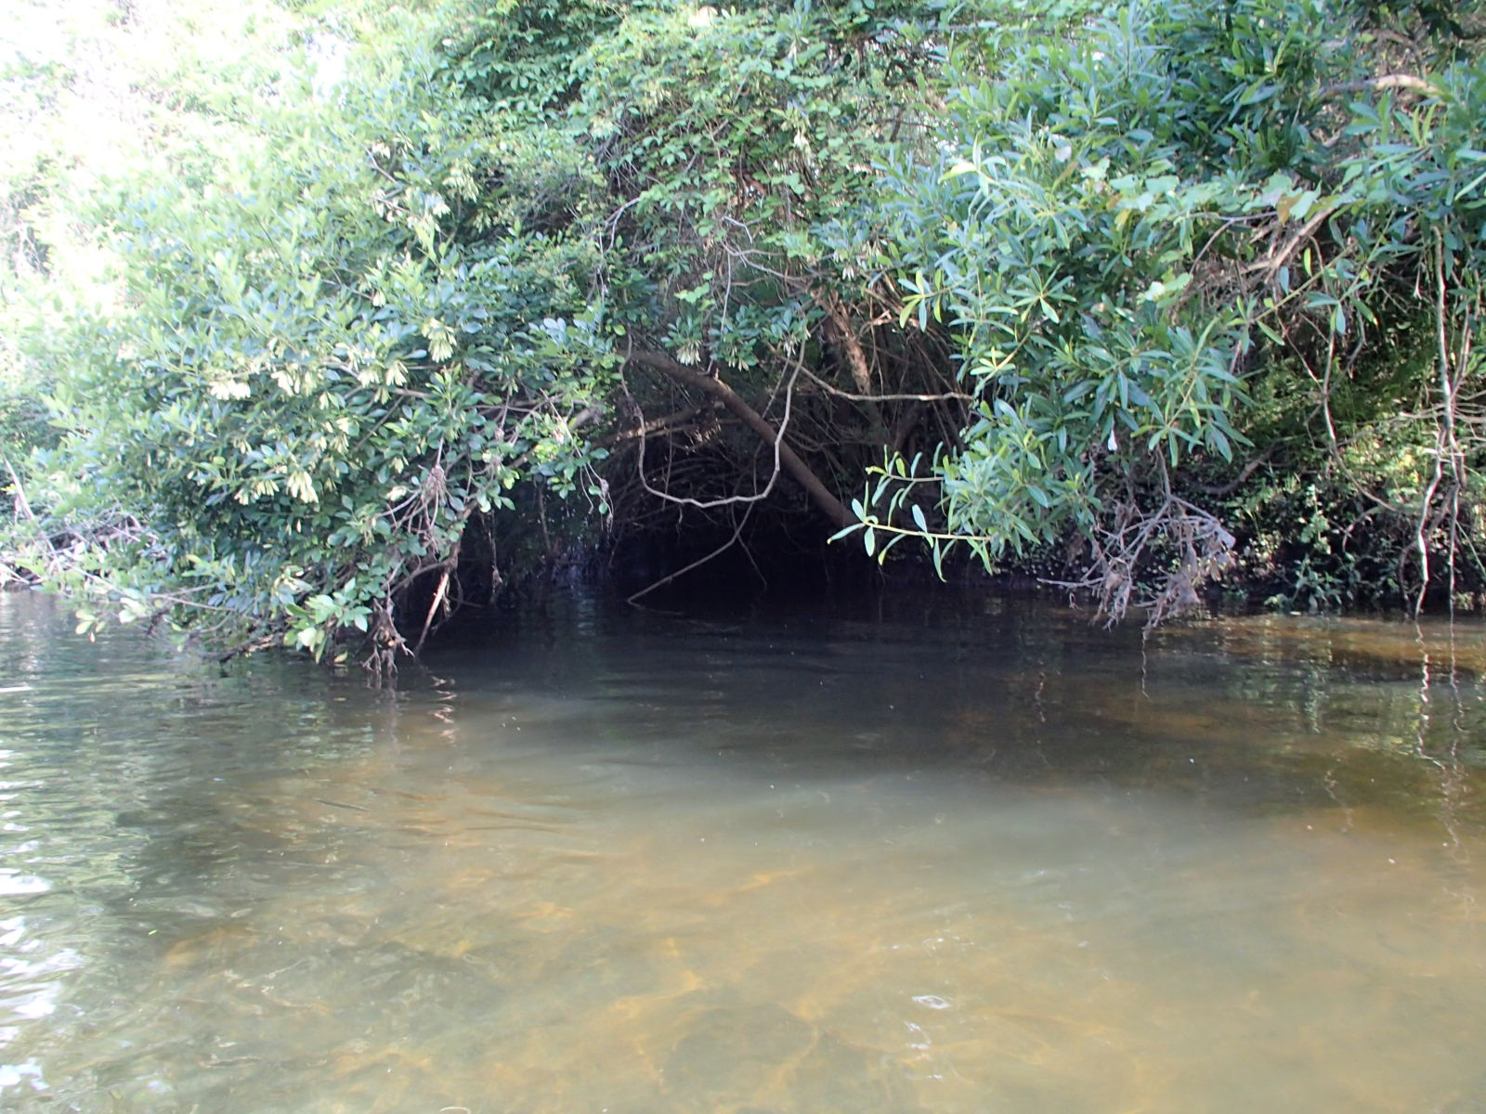
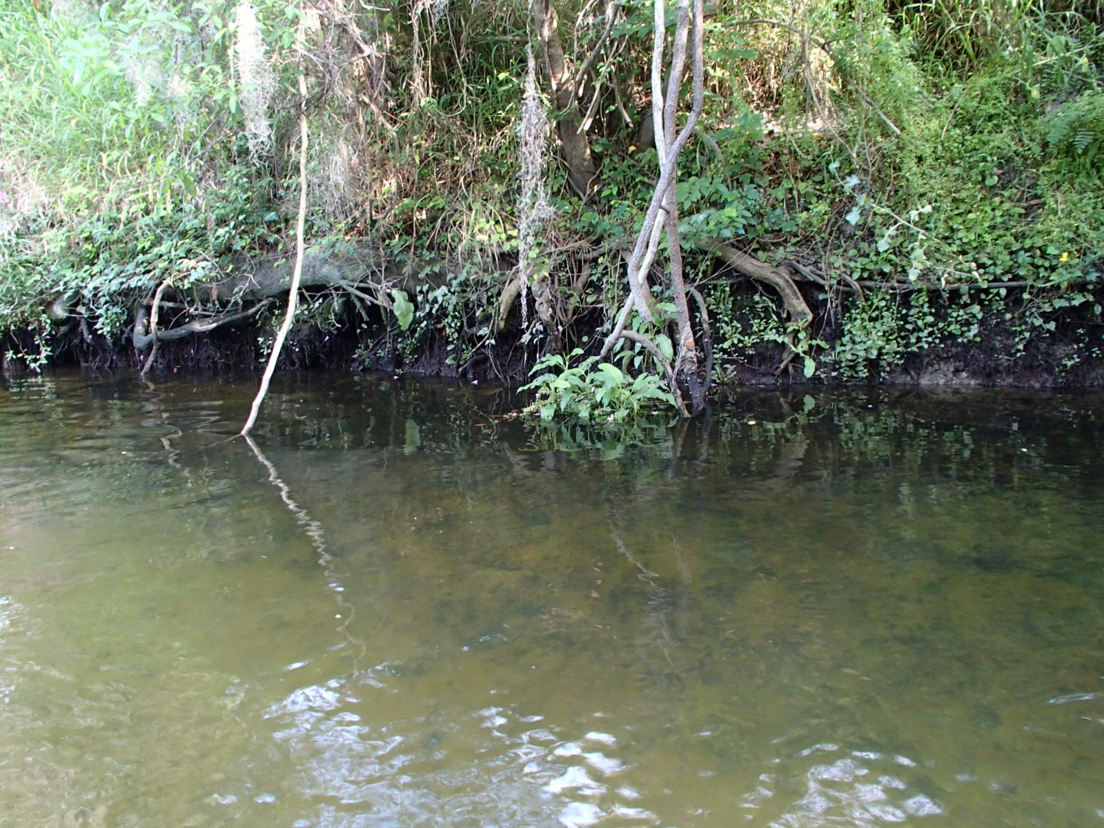
Inside the Facility

Slide 24
Deployment Diagrams

Slide 25
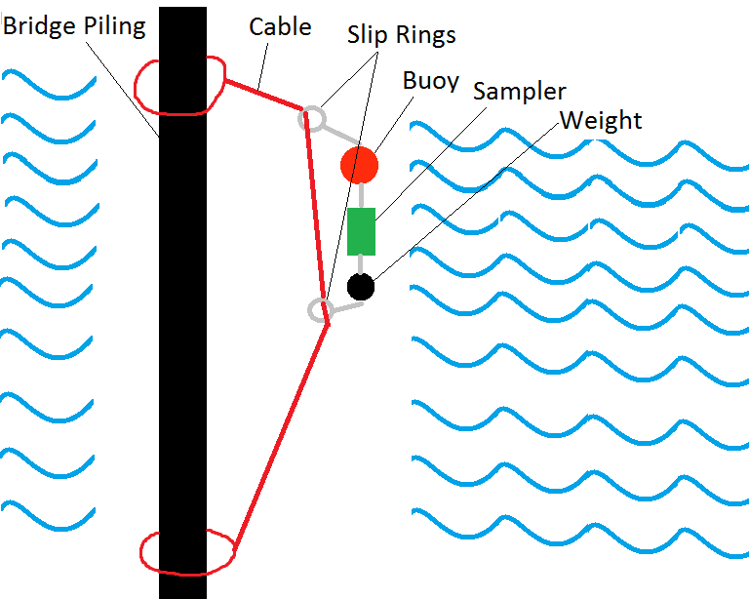

Slide 26
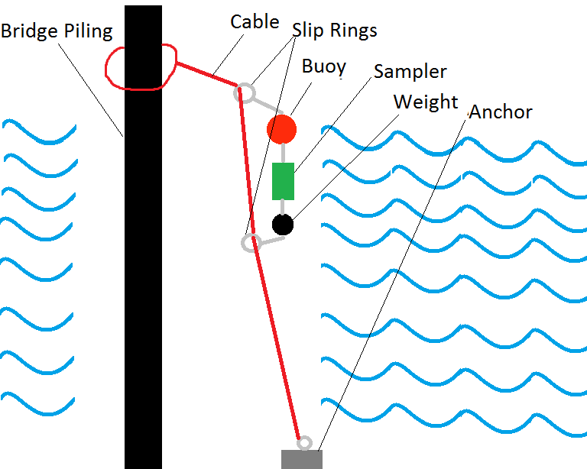

Slide 27
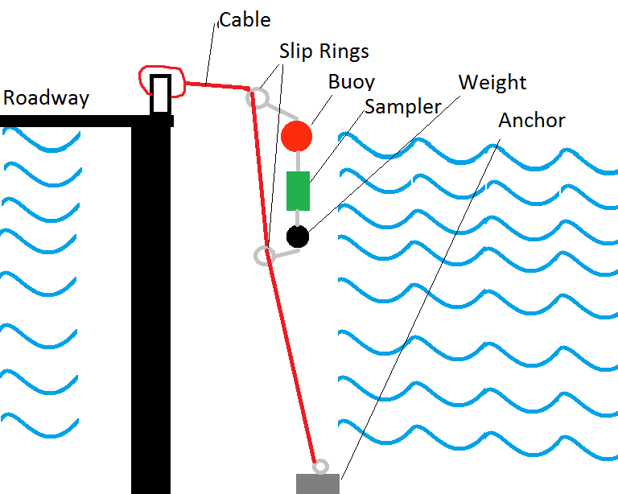

Slide 28
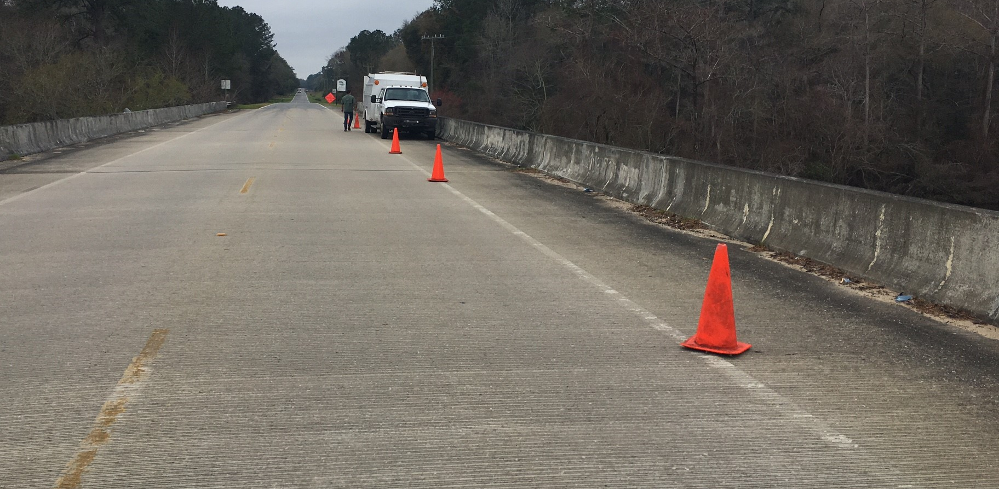
Deployment Photos

Slide 29
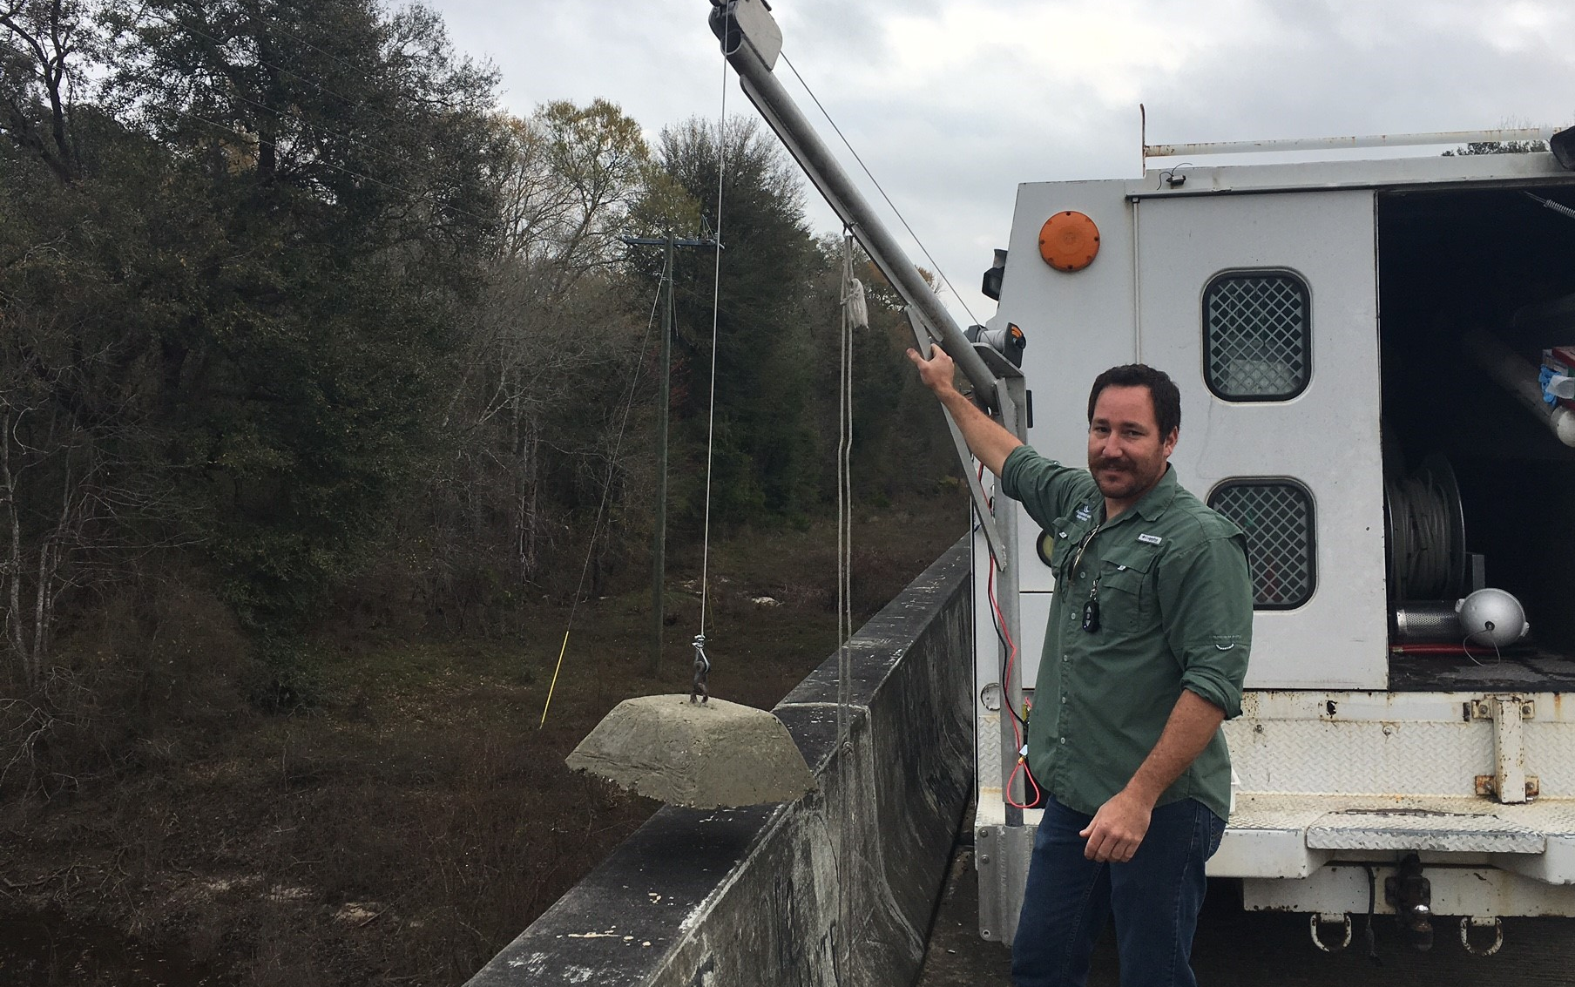
60-80lbs weight lowered using a 12volt ATV winch attached to a davit

Slide 30
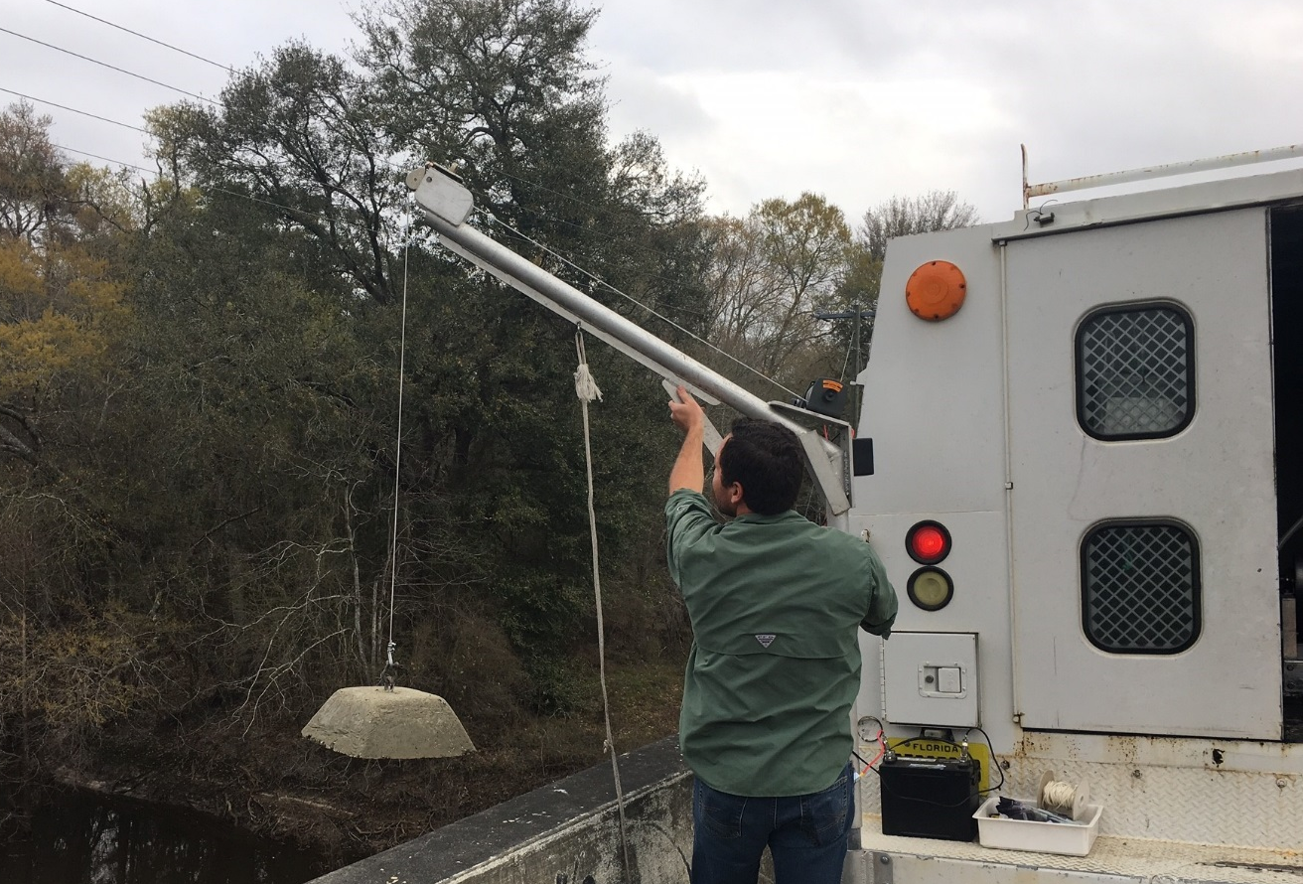
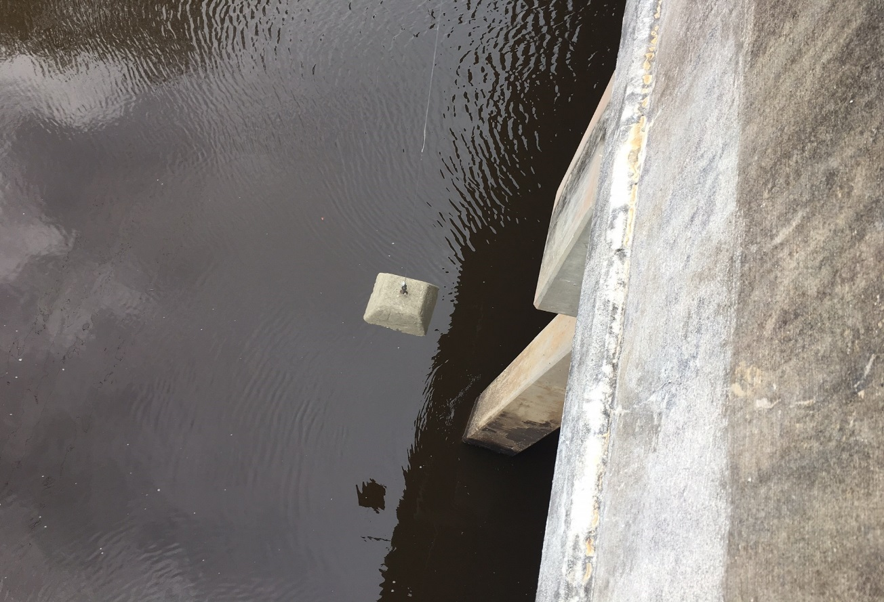
Lowering the weight

Slide 31
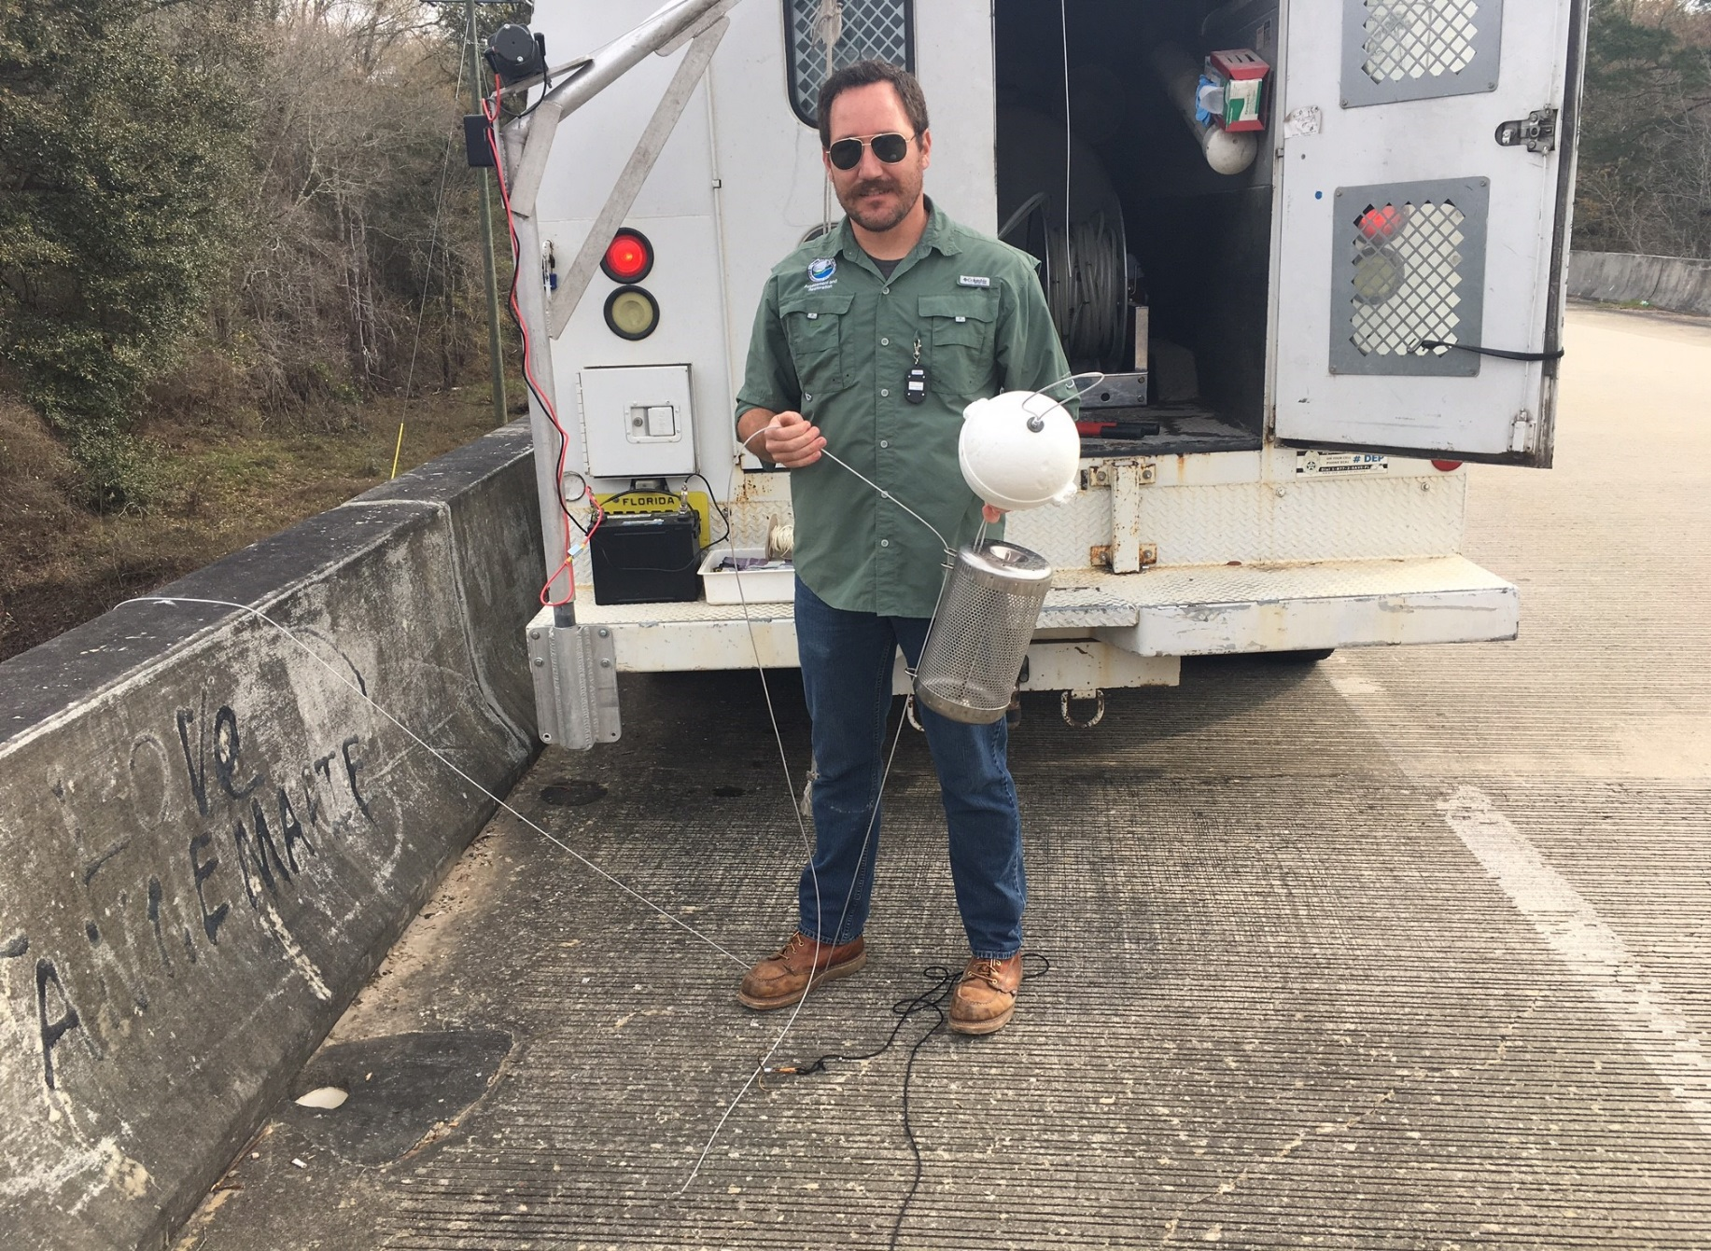
Sliding the basket onto the cable

Slide 32
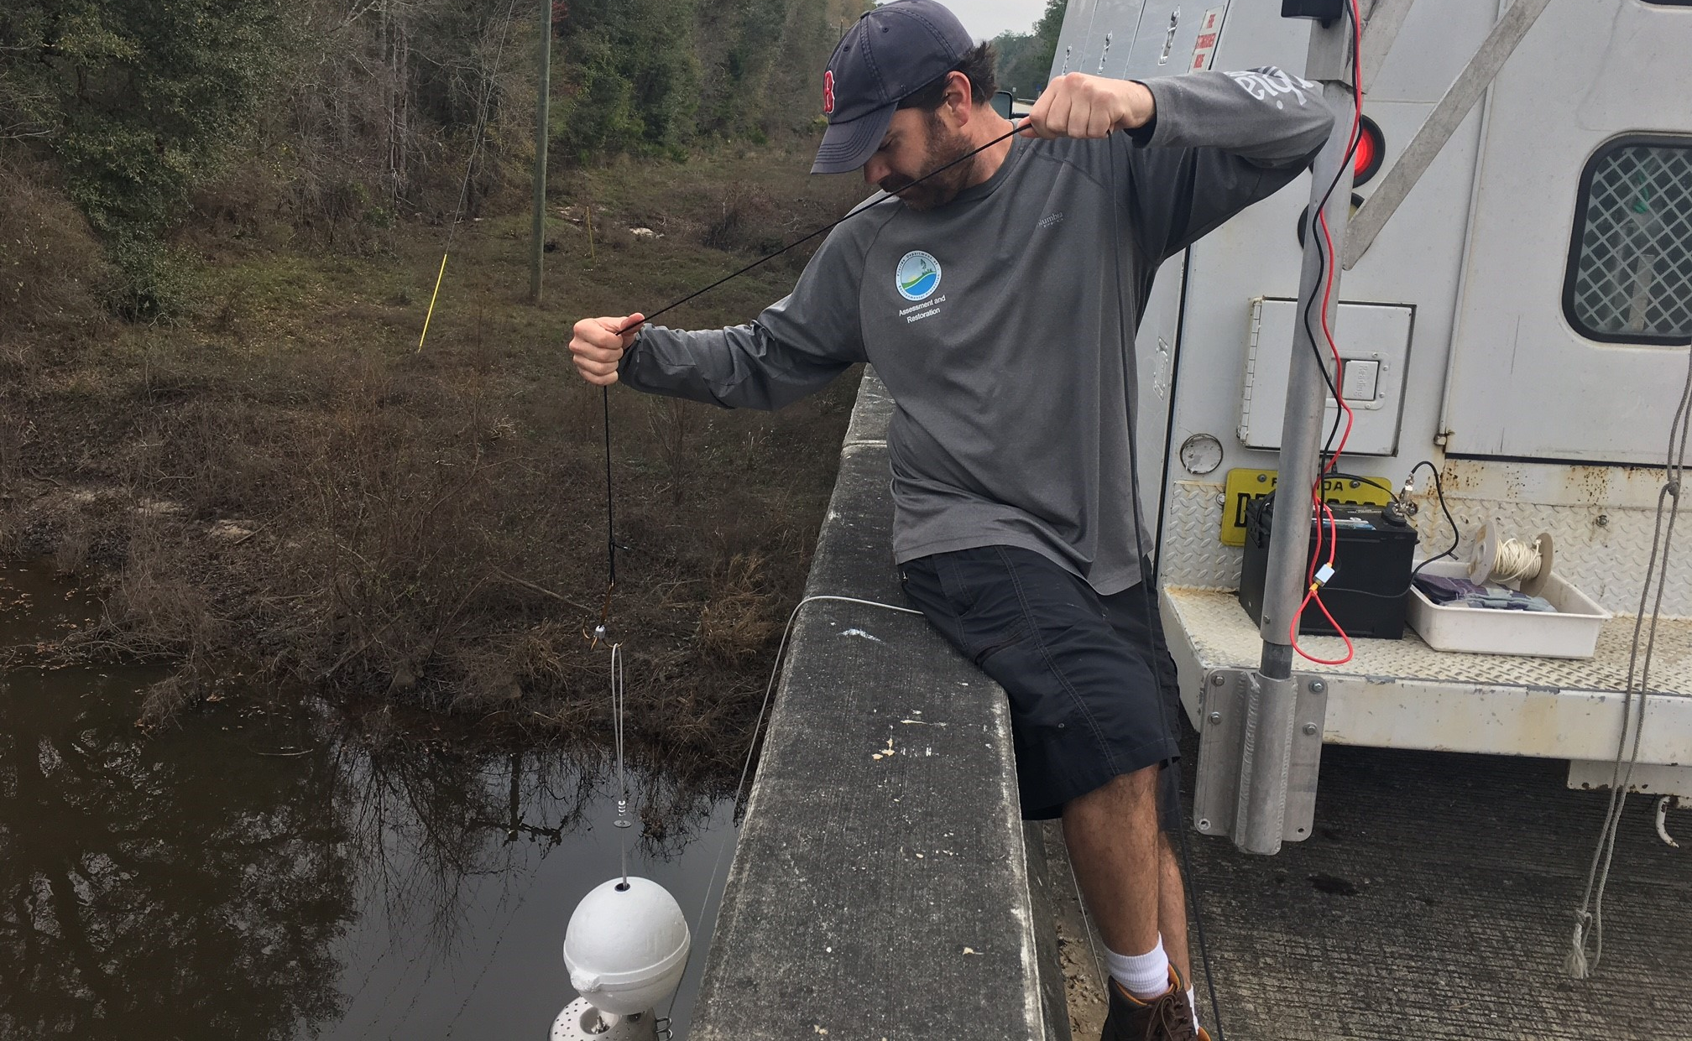
Lowering the basket using a large weighted treble hook

Slide 33
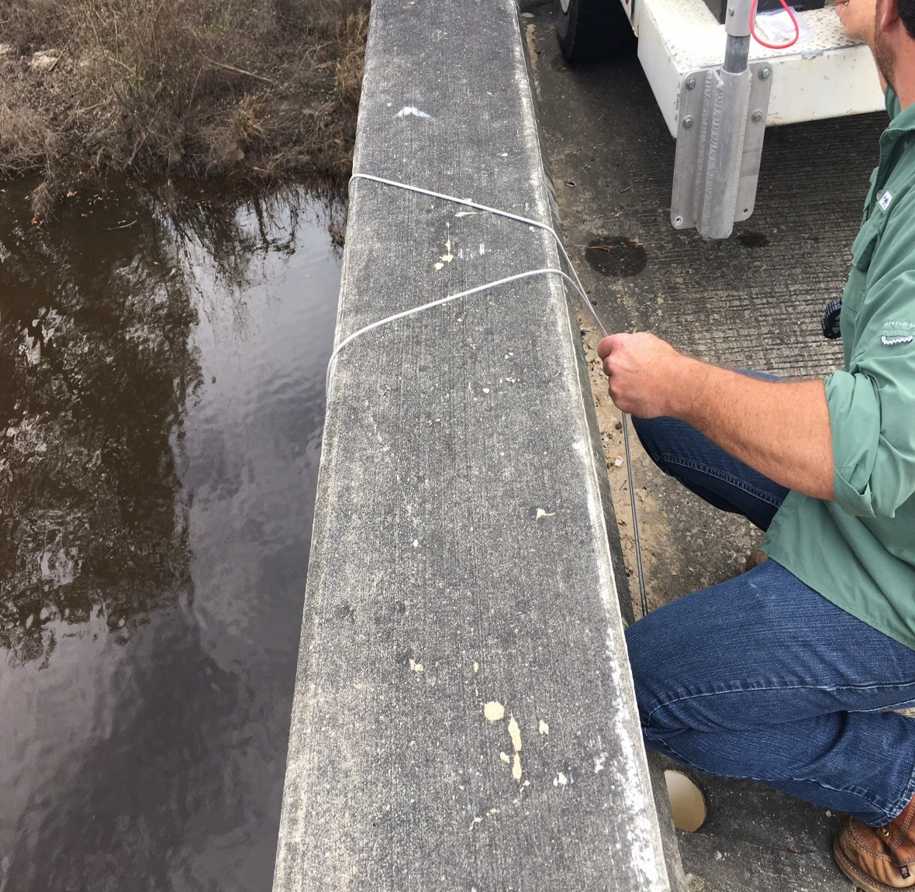
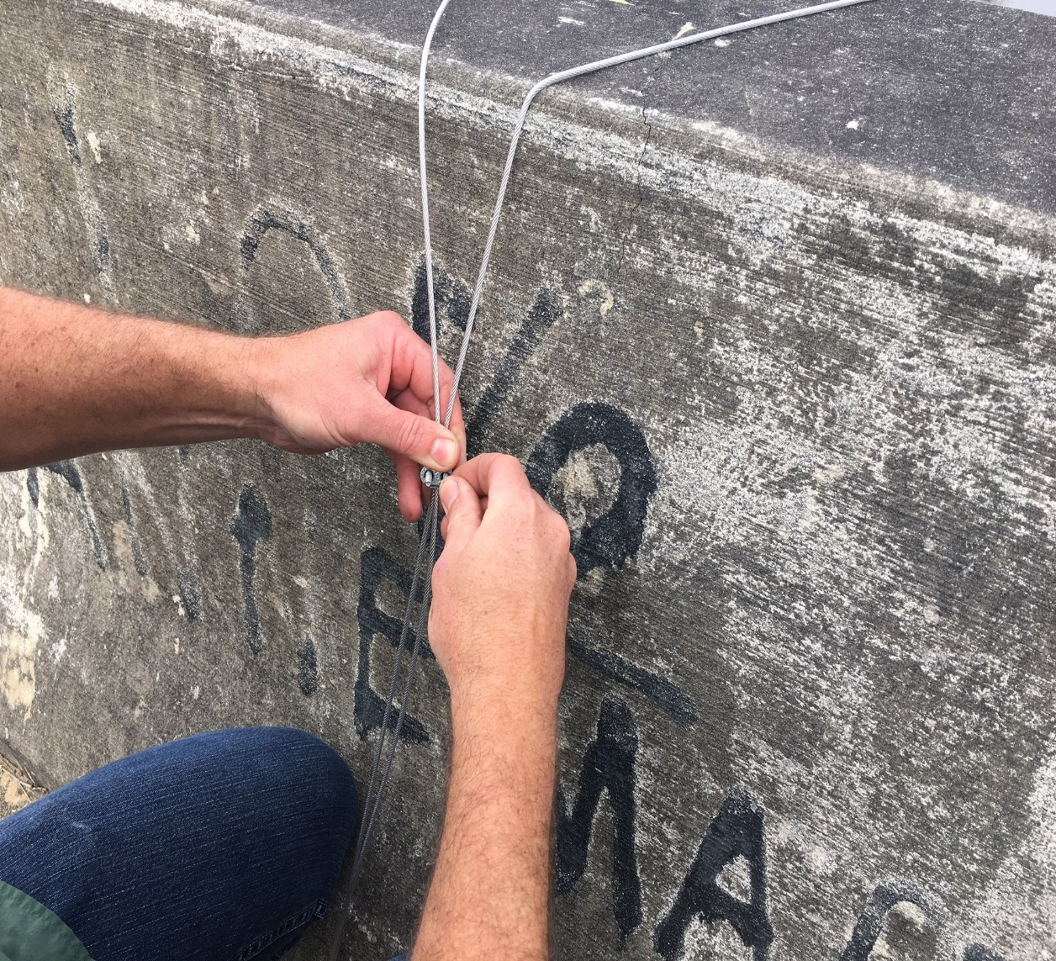
Looping and attaching the cable to the bridge through a drain hole

Slide 34
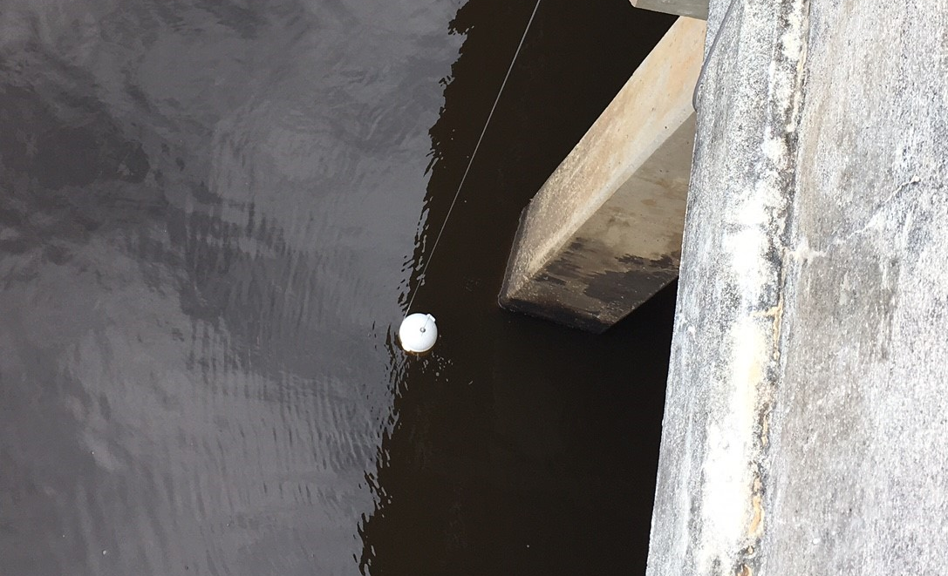
ESOC sampler deployed

Slide 35
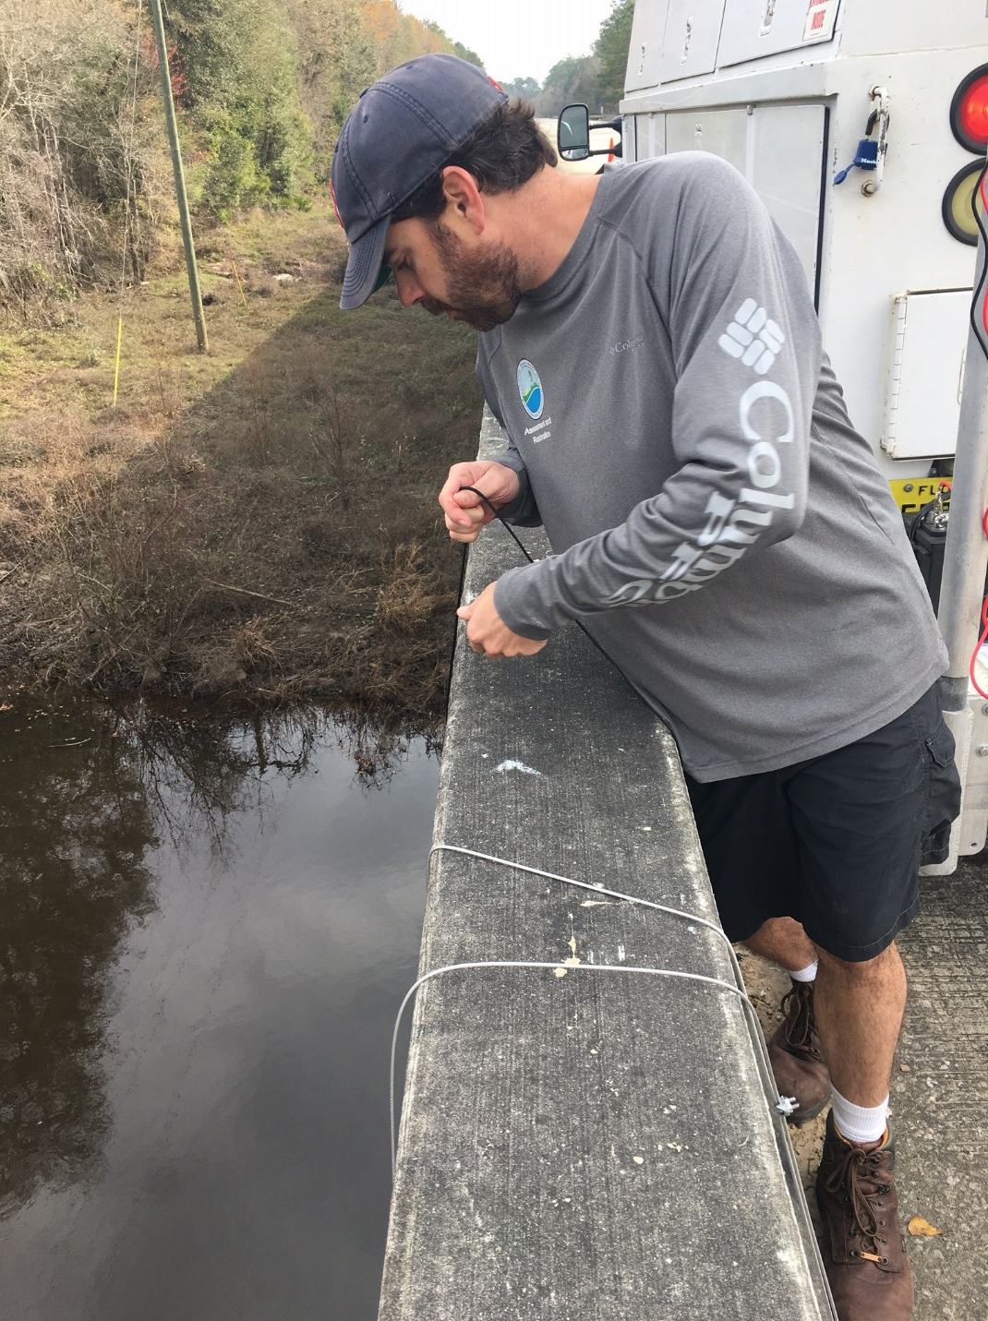
Retrieving basket using treble hook. The weight was raised using the winch and davit.

