Slide 1
Biosolids in Florida
Tom Frick
Division of Environmental Assessment and Restoration
June, 2019

Slide 2
Overview
Biosolids Overview
Biosolids Management in Florida
Septage Management Facilities
Biosolids Technical Advisory Committee
Rule Development

Slide 3
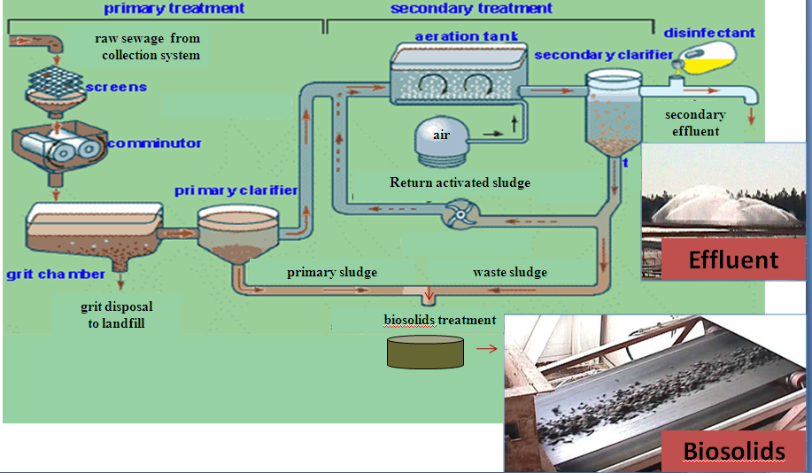
Biosolids Overview
The treatment of domestic wastewater produces two principal end products: effluent and biosolids
Notes:
Biosolids are the solid, semisolid or liquid material produced during the treatment of domestic wastewater.
Biosolids management is regulated by DEP pursuant to s. 403, XX and Ch. 62-640, F.A.C.
Federal – Title 40 CFR Part 503
Local Ordinances
Defined as, “solid organic matter recovered from a sewage treatment process and used especially as fertilizer
Florida regulations more stringent than federal and include: Permits issued addressing biosolids
Setback provisions
Nutrient Management Plan (added in 2010)
Phosphorus provisions
Additional management requirements and site restrictions

Slide 4
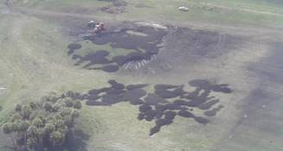
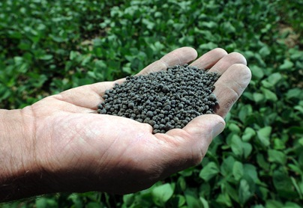
Classes of Biosolids
Two primary uses:
  Land application
    Typically Class B biosolids – minimum quality for beneficial use
  Distribution and marketing as fertilizer
    Class AA biosolids – highest quality for beneficial use
Notes:
Top Picture – land application site Class B
Bottom picture – Class AA pellets
Class B biosolids regulated by DEP
Class AA - classified as fertilizer
Class A- none in Florida

Slide 5
Biosolids and Management in Florida
Estimated Total Production 340,000 dry tons/year.
Approximately two-thirds are beneficially used and one third is landfilled.
Land
Application
(Class B)
Landfill
Distribution and Marketing
(Class AA)
Notes:
“Total” production is raw tonnage
Land application includes Class B biosolids
Distribution and Marking includes class AA biosolids (fertilizer)

Slide 6
Class AA Biosolids - Distribution and Marketing
Distributed and marketed as a fertilizer
Approximately 39 Florida facilities produce Class AA
  192,879 dry tons distributed and marketed in Florida
  26,717 dry tons distributed and marketed outside of Florida

Slide 7
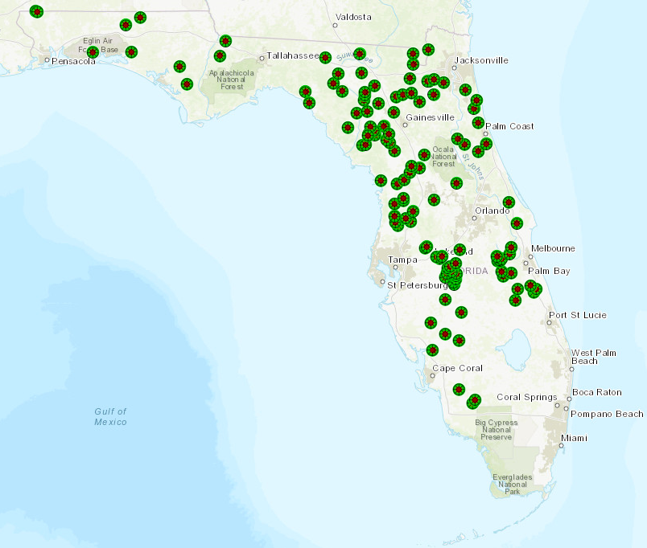
Class B Land Application
Approximately 140 permitted land application sites in Florida
Haulers are the most common site permittees
Utilities commonly contract with haulers/appliers instead of applying the biosolids themselves
Notes:
Only 1 landowner in the state is also site permittee
WWTF’s may also have dedicated sites

Slide 8
Septage Management Facilities
The land application of septage under Florida Department of Health (DOH) regulations was prohibited after June 30, 2016, affecting 80-90 entities regulated by DOH
Under DEP rules, septage is regulated as “biosolids”
Since 2016, DEP has issued 42 septage management facility permits

Slide 9
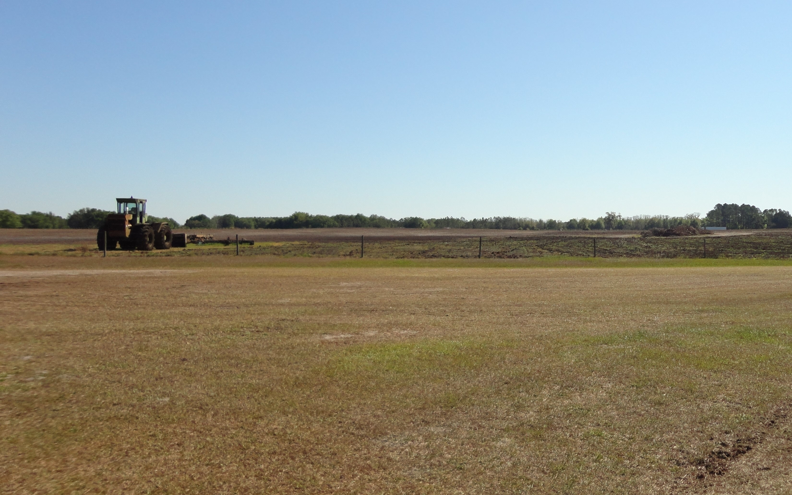
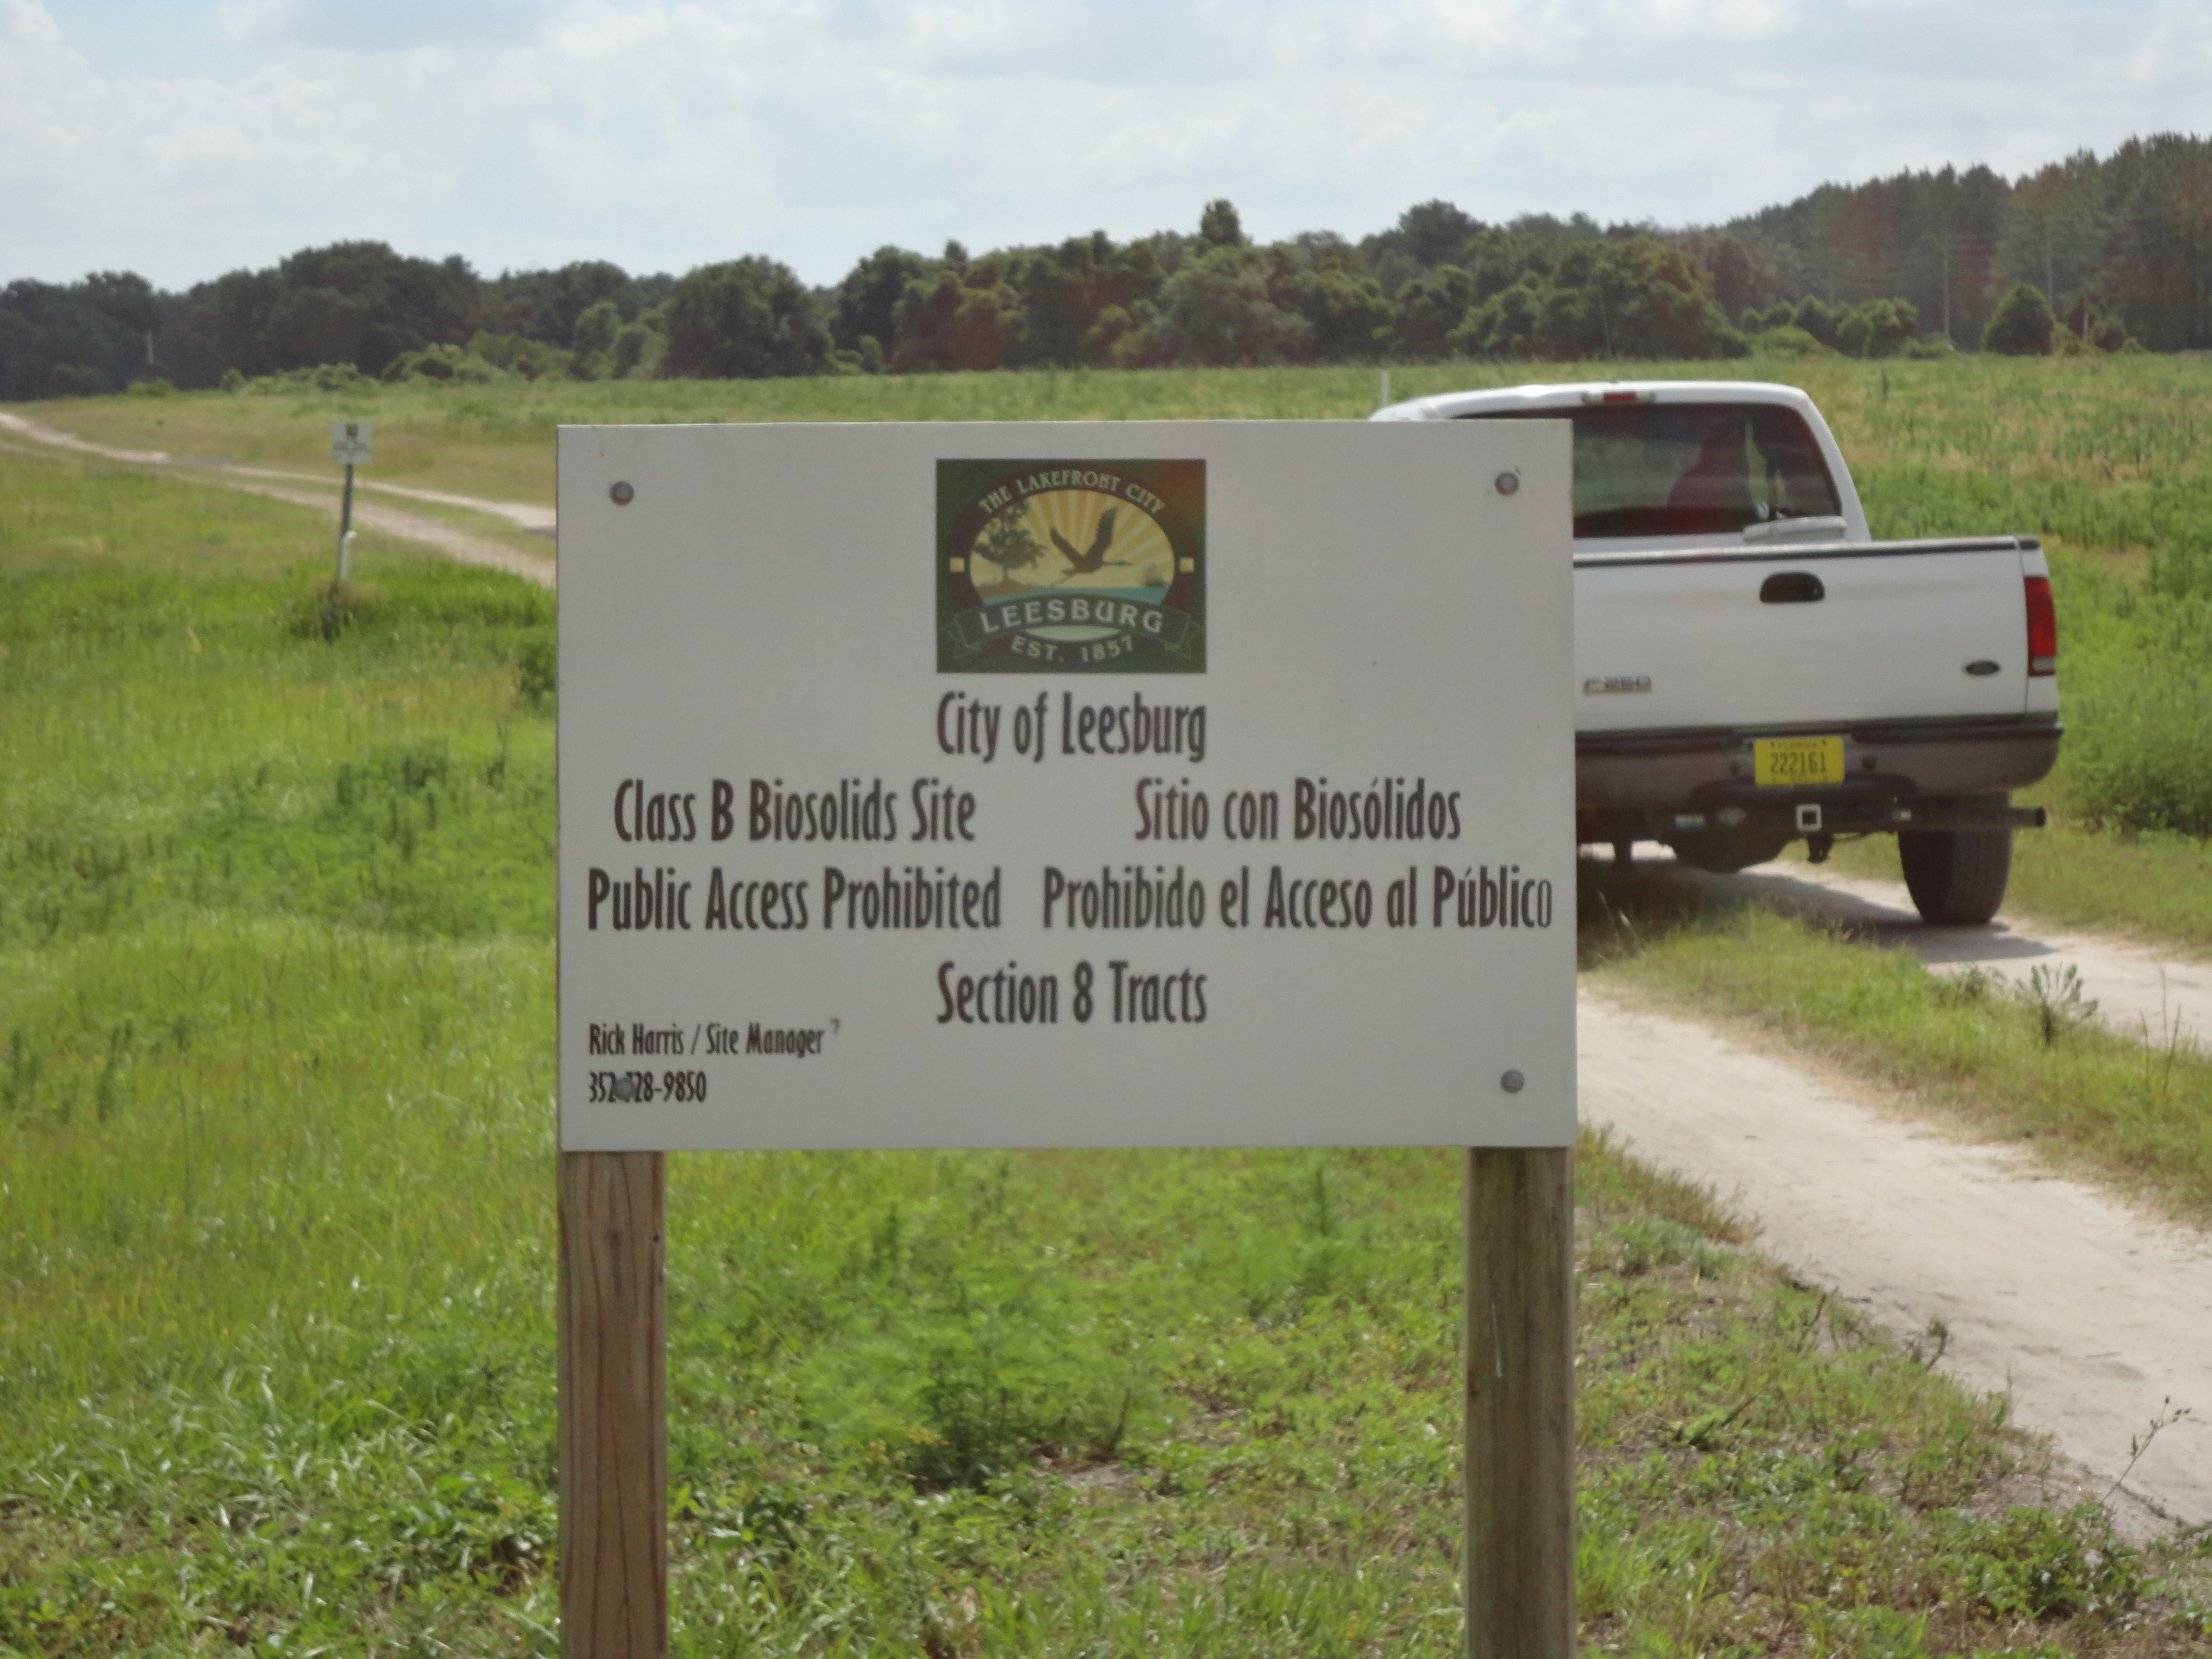
State Regulations
Ch. 62-640, F.A.C.
Land application permits include:
  Nutrient management plan
  Setback provisions
  Ground water depth provision
  Signage Requirements
  Storage requirements
  Public access, grazing, harvesting restrictions
  Runoff provisions
  Record keeping/reporting requirements
Notes:
Nutrient Management Plan
Application Rates
application zones, implementation, site operation and maintenance, and record keeping (for NMP), maps, soil survey, soil fertility testing frequency
Includes any soil, water, plant tissue and biosolids analyses, as applicable
P-Index evaluation (tool to assess the potential risk of phosphorus loss from an agricultural field to surface and ground waters based on the phosphorus source, application rate, site characteristics, soil types, and management practices
SET BACK PROVISIONS
1,000 ft - Class I water, Outstanding Florida Water, or Outstanding National Resource Water
200 ft - Other surface water
100 ft - Other surface water – if biosolids incorporated or injected
200 ft - Subsurface fractures, sinkholes, or other conduits to groundwater
300 ft - Private potable well
500 ft - Public potable well
1,320 ft - **Occupied buildings - biosolids stored or stockpiled for more than 7 days
300 ft - Occupied buildings - Class B only
100 ft - Occupied buildings - Class B only; incorporated or/injected
75 ft- Property lines - Class B only
Signage Requirements
Signage required at the entrance. If there is no fence onsite, then signage required every 500 feet
Storage Requirements
Storage requirements apply if “stored” onsite for more than 7 days. ¼ mile setbacks apply
Public Access, grazing, harvesting restrictions
One year of general public access restriction
Grazing restriction for 30 days
Harvesting restriction – no food crops
Runoff Provisions
Site slope considered
No application during a rain event
SITE RECORDS
Hauling records of deliveries
Site logs for applications to each zone (i.e., field)
Application rates (limited by the NMP)
Cumulative loading tracking/limits
Annual reporting of loadings to each zone

Slide 10
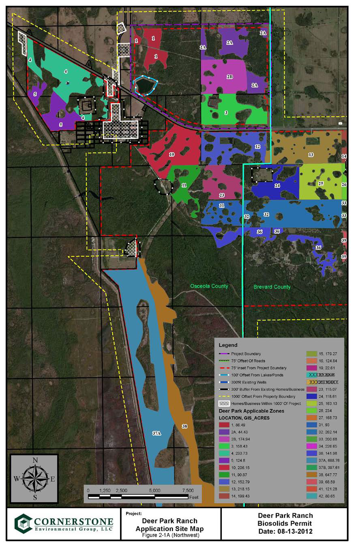
Example Application Site
Site in Osceola and Brevard Counties, shows the application zones, setbacks, etc.
This site has 30 application zones covering 5,736 acres
The odd shapes of the application zones, or fields, primarily result from setback buffers (i.e., wetlands, surface waters, residences, etc.)
Notes:
Site is a cattle ranch – Deer Park Ranch

Slide 11
Biosolids Technical Advisory Committee
The Biosolids Technical Advisory Committee (TAC) convened in September 2018 to evaluate biosolids management and explore opportunities to better protect Florida’s water resources.
The TAC members represented stakeholders from environmental and agricultural industry experts, large and small utilities, waste haulers, consultants and academics.
Each public meeting included an open public comment period, as well as discussion with experts among the TAC members, the audience and the Department
Notes:
The TAC convened on four occasions from September 2018 to January 2019
Public comment included concerns about increased application in St. Johns Basin, concern about increased nutrient loading to water bodies (specifically blue cypress lake), impact to agriculture industry

Slide 12
TAC Recommendations
Permit biosolids in a manner that minimizes migration of nutrients, specifically phosphorus, to prevent impairment to waterbodies.
  Establish the rate of phosphorus application based on site specifics, such as soil characteristics/phosphorus adsorption capacity, water table, hydrogeology, site use, distance to surface water;

Slide 13
TAC Recommendations
Increase DEP inspection rate of land application sites;
Develop monitoring protocols to detect nutrient migration;
Develop and conduct biosolid and nutrient management research on nutrient run-off through surface and groundwater flow; and
Promote innovative technology pilot projects for biosolids processing that could provide a wider range of beneficial end products.

Slide 14
62-640, F.A.C.
Department published notice of rule development to amend Ch. 62-640, F.A.C. on March 22, 2019.
Rule revisions incorporate the recommendations of the TAC
Department will be holding at least three public workshops throughout the state beginning early to mid-summer.

Slide 15
Proposed Revisions
TAC Recommendation – permit biosolids to minimize the migration of nutrients; establish rate of phosphorus application based on site specific characteristics
Proposed revising NMP requirements:
Set application rate based on limiting nutrient
Consider soil capacity to hold phosphorus and the percent water extractable phosphorus (WEP) in biosolids
Comply with applicable BMAPs
Increase soil fertility monitoring frequency
Review NMP annually

Slide 16
Proposed Revisions
Revise monitoring and reporting requirements to include:
  WEP analysis
  Require annual soil fertility testing to include soil phosphorus storage capacity
  Add/revise surface water and groundwater monitoring requirements
  Limit use of sites based on depth to groundwater

Slide 17
Contact Information
Tom Frick
Division of Environmental Assessment and Ecosystem Restoration
Thomas.Frick@floridaDEP.gov
850-245-7518

