Slide 1
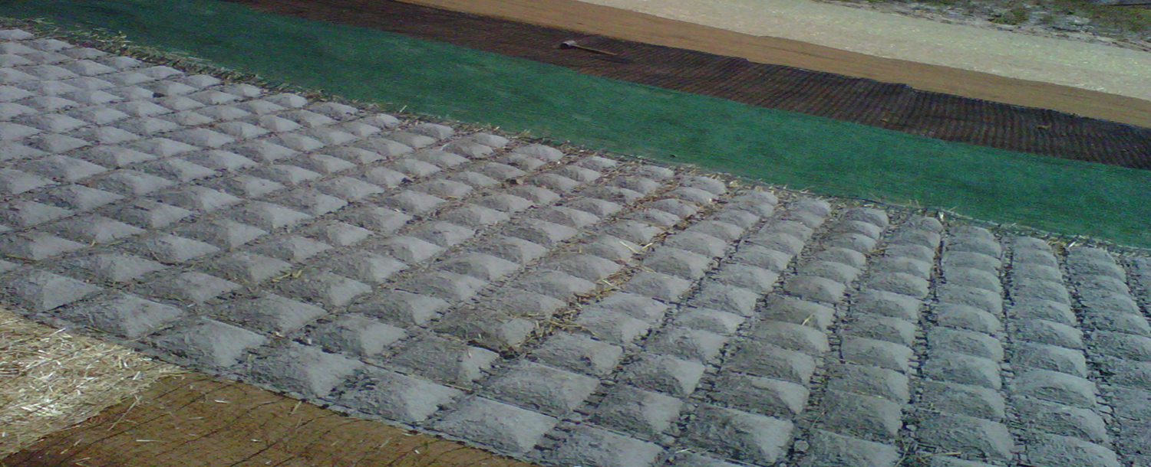
Chapter 7
Stormwater Pollution Prevention Plan (SWPPP)

Slide 2
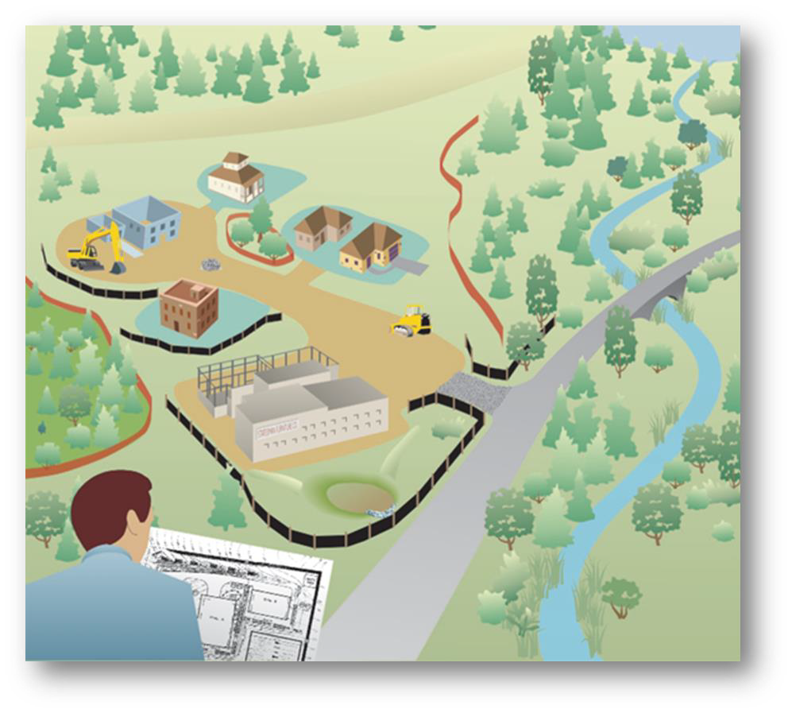
7.1 Purpose of a SWPPP
The SWPPP:
documents how you will comply with the CGP for your site
must be developed prior to submittal of your NOI
must meet or exceed the DEP requirements*
*DEP requirements can be found in the CGP, Part 4: SWPPP. A copy of the CGP can be found in Appendix E of the DEP Manual.

Slide 3
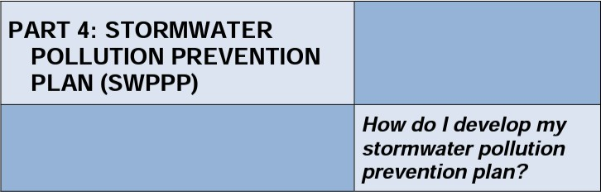
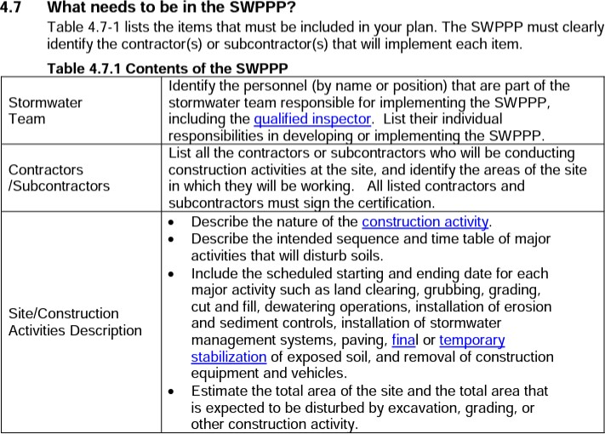
7.1.1 What Must the SWPPP Contain?
CGP Part 4
Contents of the SWPPP

Slide 4


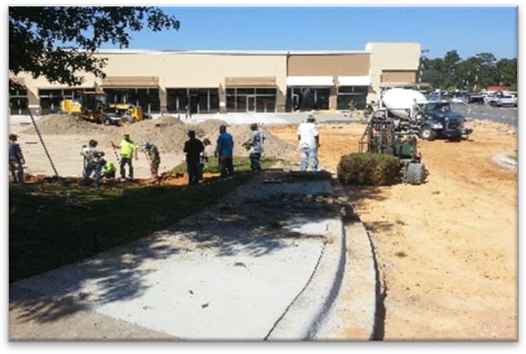
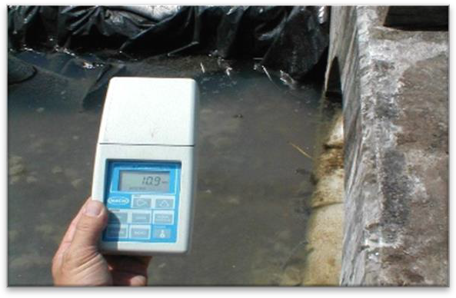

7.1.1 What Must the SWPPP Contain?
Stormwater Team
Contractors/Subcontractors

Slide 5
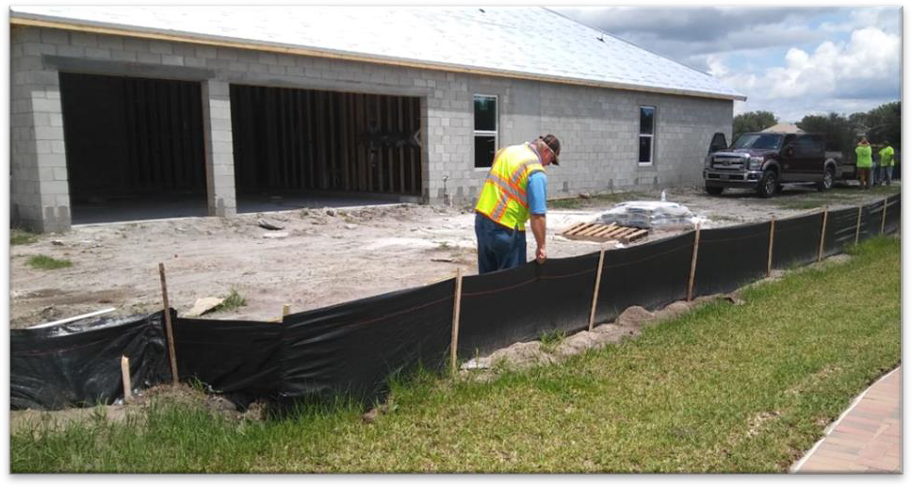
7.1.1 What Must the SWPPP Contain?
Stormwater Team:
Identify the people (Name and Position) responsible for implementing the SWPPP
List their individual responsibilities
(e.g. developing or implementing the SWPPP)
Identify the Qualified Inspector(s) that will be
conducting inspections

Slide 6
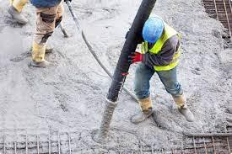
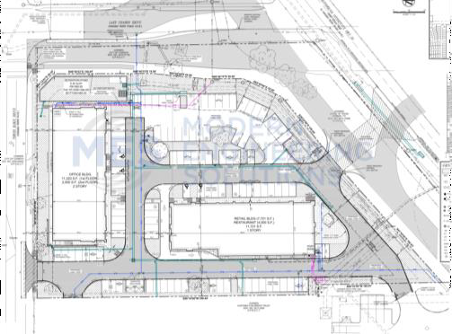

7.1.1 What Must the SWPPP Contain?
7.1.1 What Must the SWPPP Contain?
Contractors and Subcontractors:
List all contractors and subcontractors that will be disturbing the soil during construction activities, or possibly introducing a pollutant that could be picked up in stormwater runoff – Roofers? Probably not. Painters? Maybe!
Identify the area(s) each group will be working in and responsibilities
Obtain Signatures. All the contractors and subcontractors listed must sign the certification in order to be covered under this SWPPP and the CGP NOI (This is an overlooked but important part of your SWPPP)
If a subcontractor isn’t signed on properly, then the signee will be
held responsible!

Slide 7

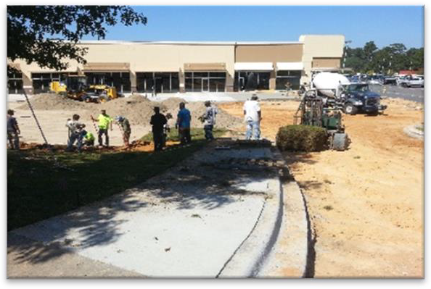
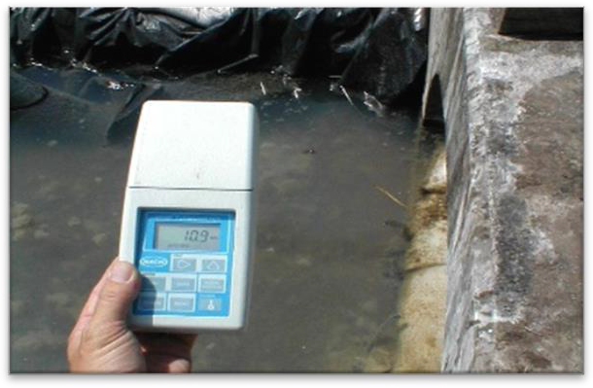
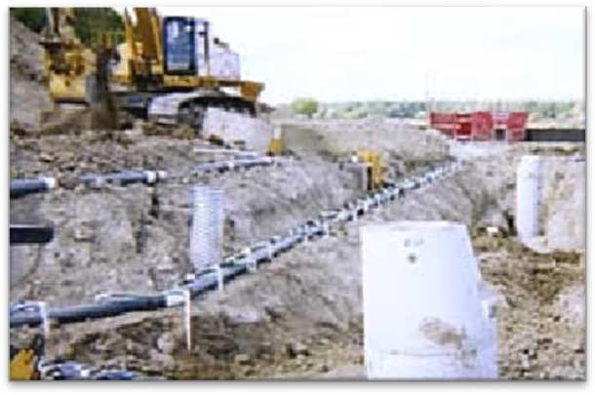
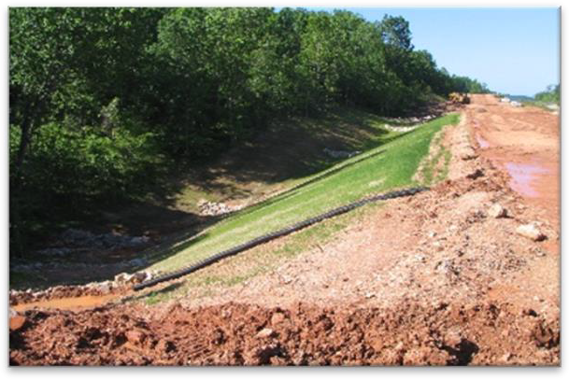
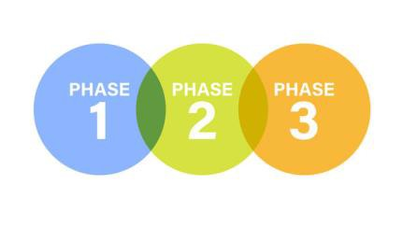
7.1.1 What Must the SWPPP Contain?
Site/Construction Activities Description
Site Map
Non-stormwater Discharges
De-watering controls (if applicable)
Best Management Practices (BMPs)

Slide 8
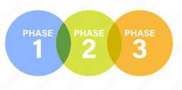
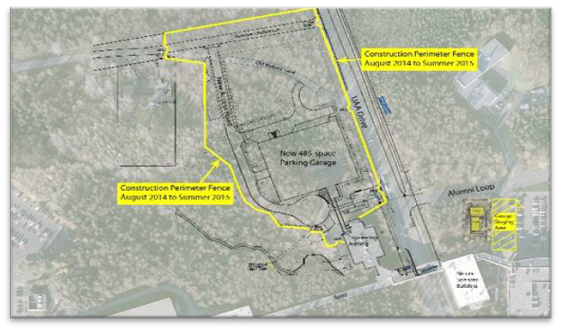
7.1.1 What Must the SWPPP Contain?
Site/Construction and Activities Description:
Describe:
Nature of the construction activity
Sequence and times of major soil disturbing activities
Start and end date for such major activities:
  Land clearing, Grubbing, Grading, Cut and Fill
  Dewatering operations, installation of BMPs
  Installation of stormwater management systems,
  Paving, soil stabilization (temporary, final); removal of equipment and vehicles
Estimate:
Total area of the site and the total expected to be disturbed.
Include existing data on soil types and quality of any existing discharge(s) from the site
and the amount of land to be cleared for each drainage area
For each discharge, provide: Lat. & Long, drainage area, name of the surface waters or system under control of the MS4

Slide 9
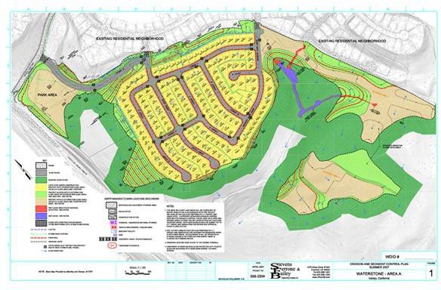
7.1.1 What Must the SWPPP Contain?
Site Map
Include a site map* showing all the following:
Boundaries of the property
Entrance and exit points
Locations where construction activities will occur
Locations where dewatering operations will occur
Drainage patterns and approximate slopes and elevations anticipated after major grading
Areas of soil disturbance and areas to remain undisturbed
Location of major structural and nonstructural controls
Location of areas where stabilization practices are expected to occur
Location of surface waters and wetlands
Location where stormwater is proposed to be discharged
during construction to a surface water or MS4
*You may have to work with the engineer / architect of record to develop a site map or draw from other permit sources for this information!

Slide 10
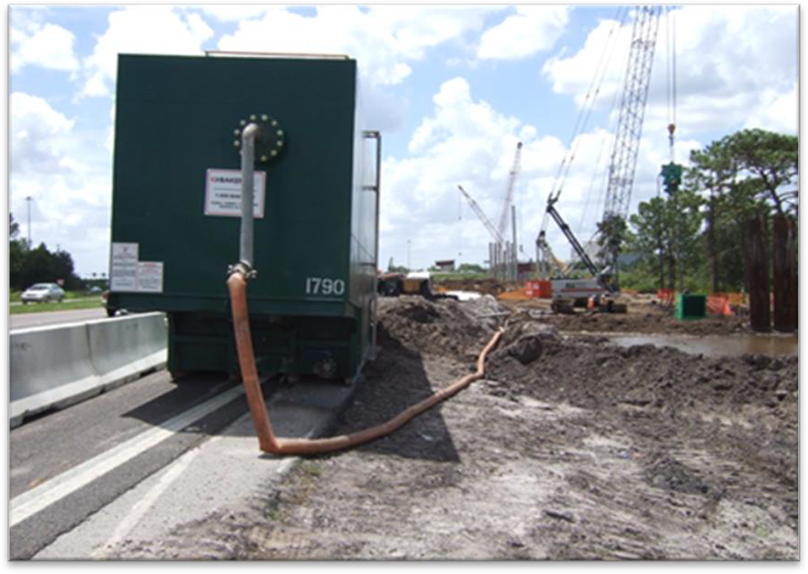
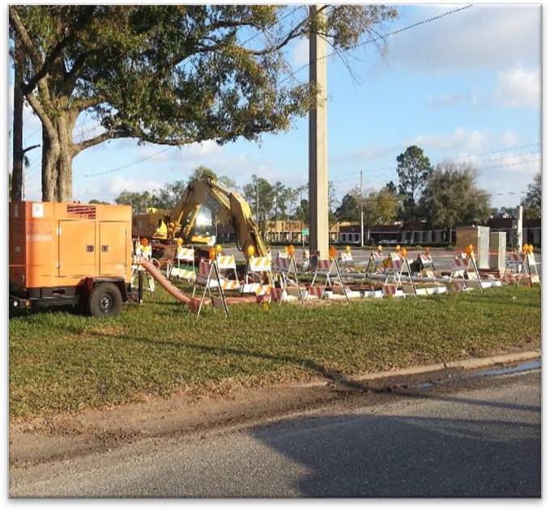
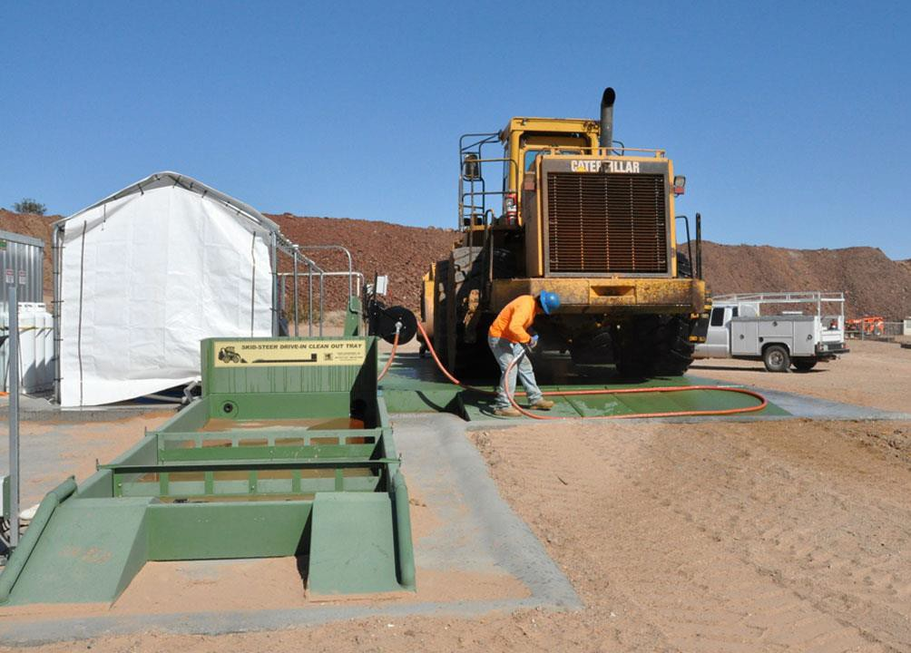
7.1.1 What Must the SWPPP Contain?
Non-stormwater Discharges (i.e., dewatering, vehicle wash)
List all non-stormwater discharges covered under the CGP Permit and the
pollution prevention procedures that will be implemented.

Slide 11
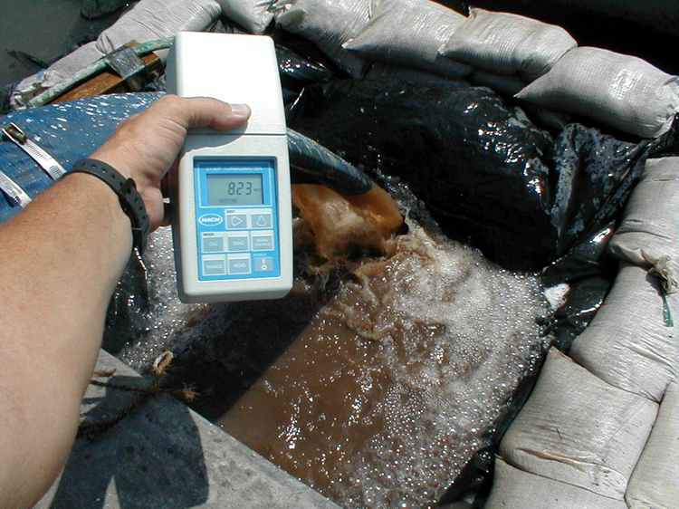
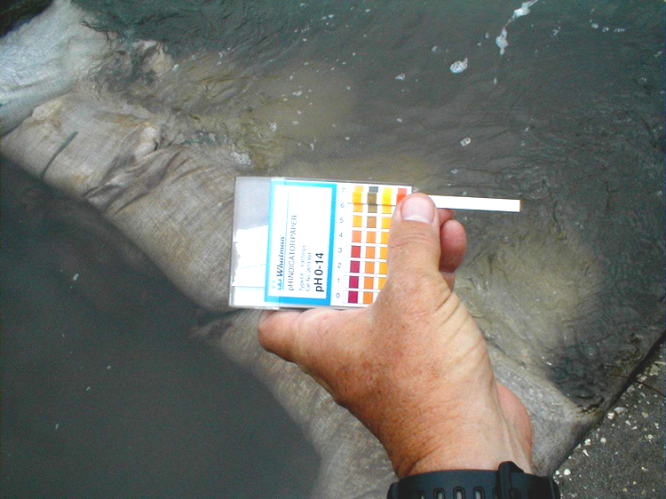
7.1.1 What Must the SWPPP Contain?
Dewatering Controls (If Applicable)
Include a description of the dewatering BMPs that will be used to ensure that discharges of noncontaminated ground water from dewatering operations do not cause or contribute to violations of the State Water Quality Standards (i.e., turbidity and pH).
pH
Turbidity

Slide 12
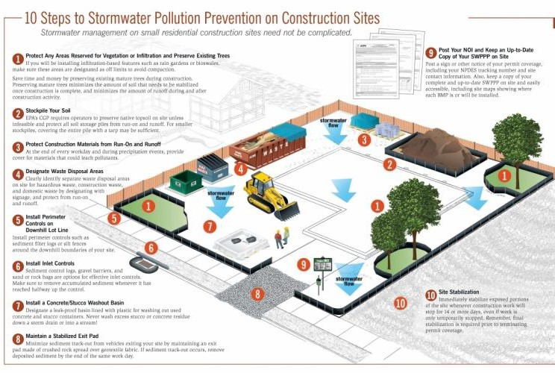
7.1.1 What Must the SWPPP Contain?
Construction Best Management Practices (BMPs)
Source: USEPA

Slide 13

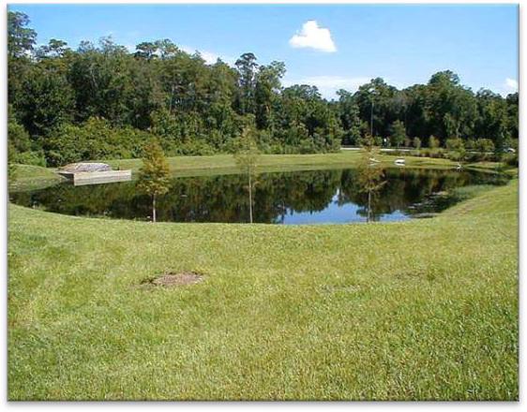
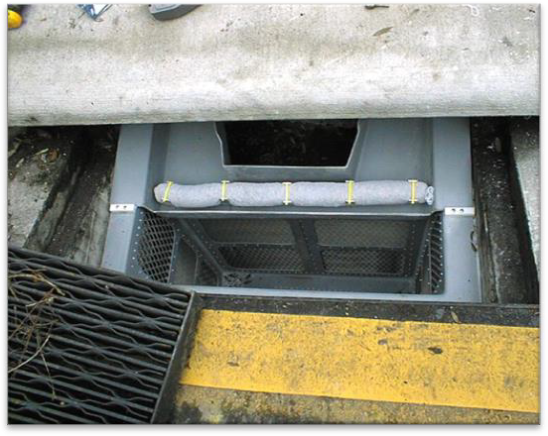
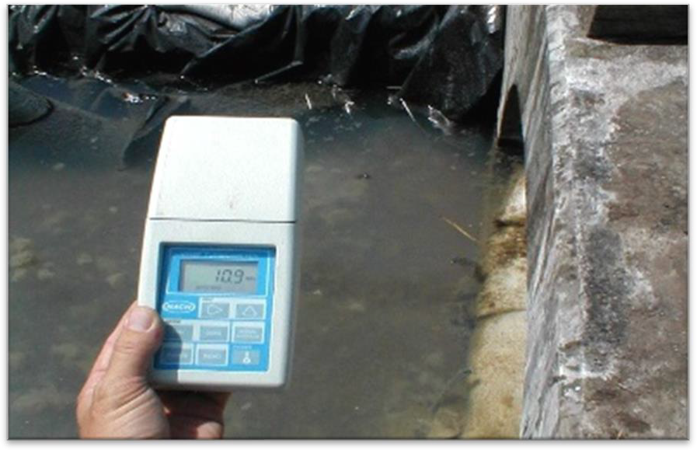
7.1.1 What Must the SWPPP Contain?
Permanent stormwater management controls
Inspections
Maintenance
Signed Certificates (contractors and subs)

Slide 14
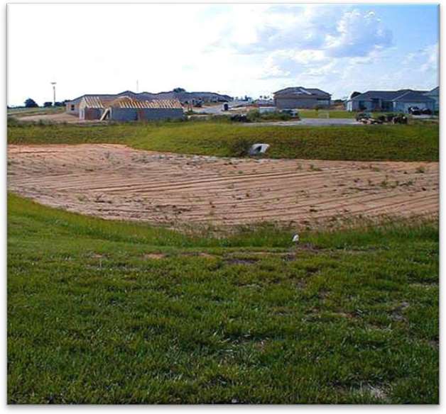

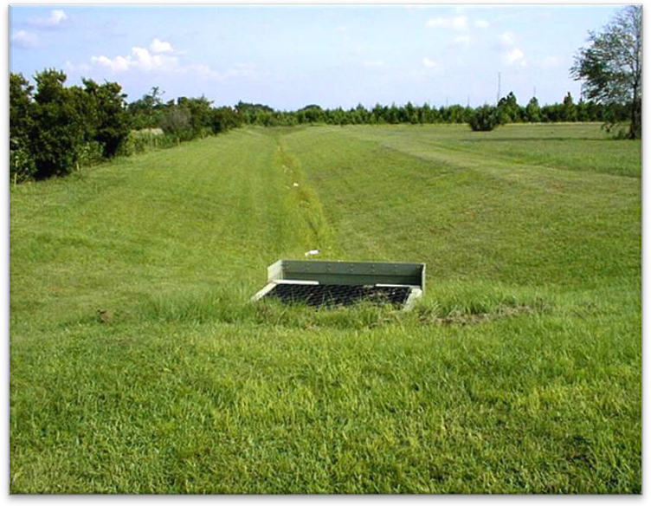
7.1.1 What Must the SWPPP Contain?
Permanent Stormwater Management Controls
Describe stormwater management controls or BMPs
stormwater detention or retention systems
vegetated swales
velocity dissipation devices at discharge points (installed during the construction process to control pollutants in stormwater discharges long after the construction is completed, and site was completely stabilized).

Slide 15
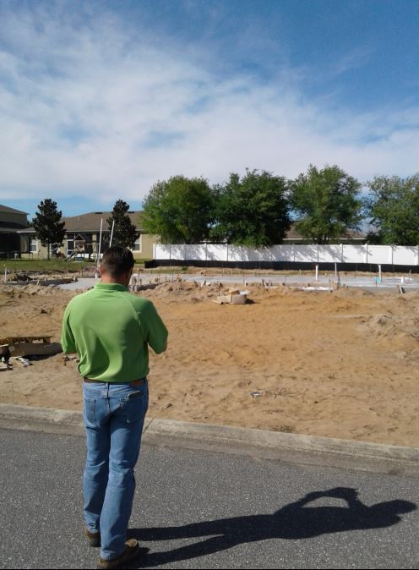
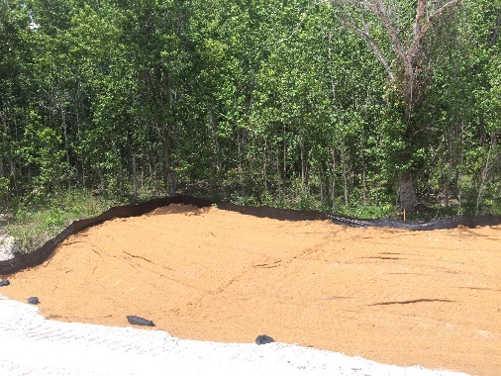
7.1.1 What Must the SWPPP Contain?
Inspections:
Must be at least once every seven calendar days and within 24- hours of the end of a storm event that is 0.50 inches or greater
Yes, even weekends and holidays!
You are responsible for containing erosion at all times for the life of
the project!
Plan for vacations and extended work pauses

Slide 16
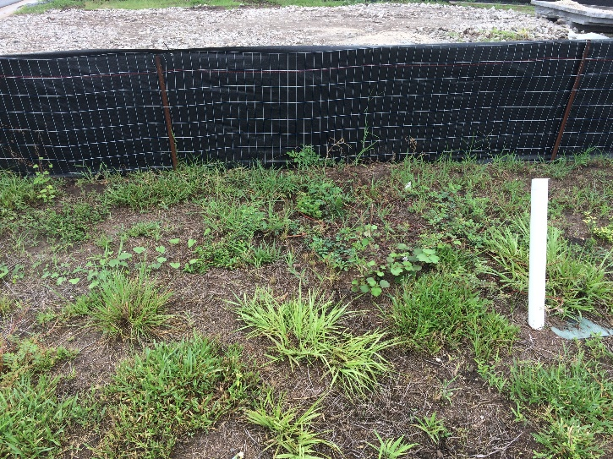
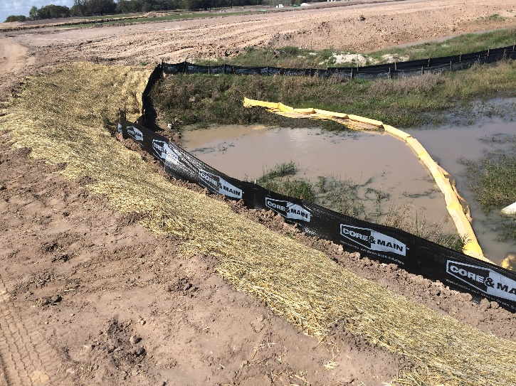
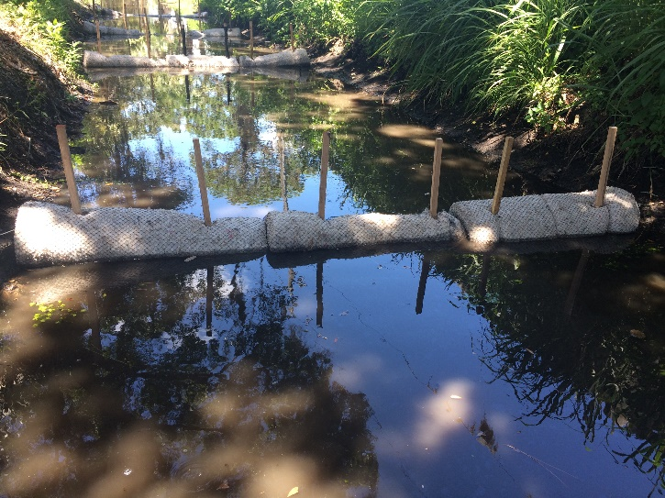
7.1.1 What Must the SWPPP Contain?
Maintenance:
Describe the maintenance activities and schedules that will be followed to keep BMPs in good and effective operating condition. Include material stockpile locations.

Slide 17



7.1.1 What Must the SWPPP Contain?
Signed Certifications
Include all signed contractor and subcontractor certifications in the SWPPP.
*Tip: Include other permits and authorizations as an appendix to your SWPPP for easy reference

Slide 18
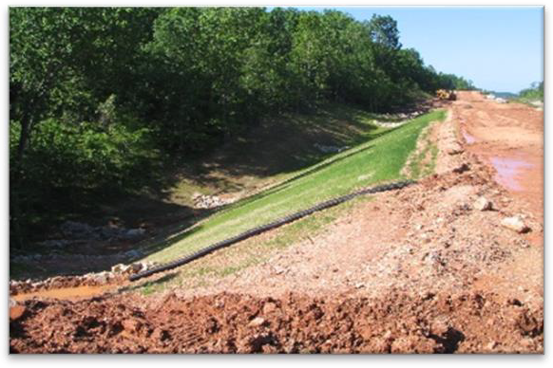


7.1.1 What Must the SWPPP Contain?
Stormwater Team
Contractors/Subcontractors
Site/Construction Activities Description
Site Map
Non-stormwater Discharges
Dewatering Controls (if applicable)
BMPs
Permanent stormwater management controls
Inspections
Maintenance
Signed Certificates (contractors and subs)

Slide 19

7.1.1 What Must the SWPPP Contain?
Did you file your paperwork?

Slide 20
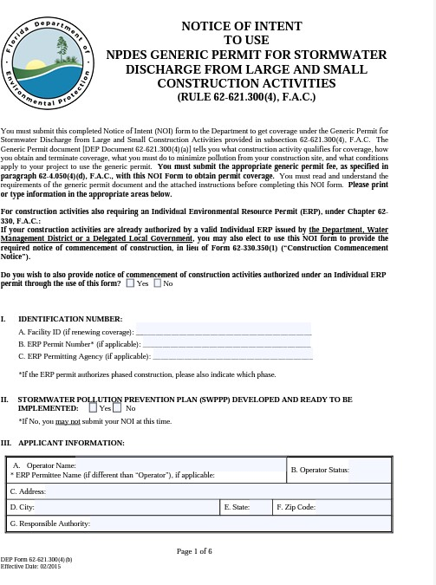
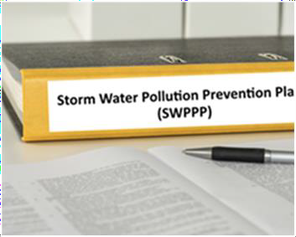
7.1.2 When Must You Start Following the SWPPP?
You must develop the SWPPP before you submit your NOI – most overlooked step!
You must start following your SWPPP when you receive coverage under this permit.
1
2
Develop SWPPP
Submit Notice of Intent (NOI)

Slide 21


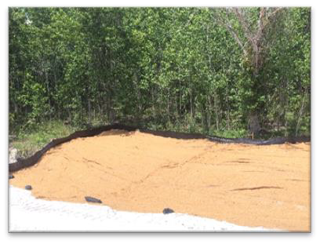

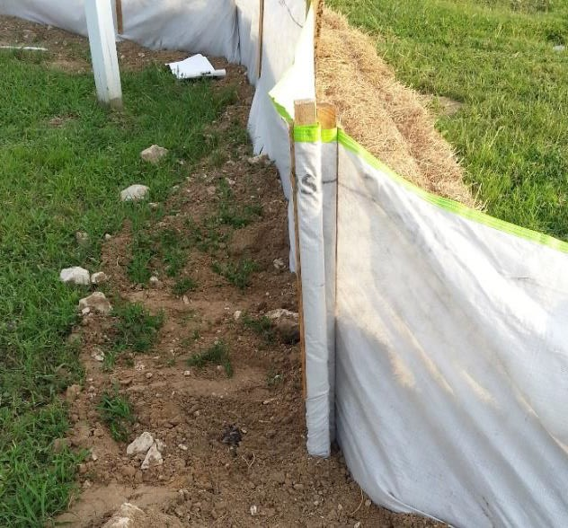
7.1.2 When Must You Start Following the SWPPP?
You must develop the SWPPP before you submit your NOI – most overlooked step!
You must start following your SWPPP when you receive coverage under this permit.
3
If the SWPPP requires perimeter controls, they must be installed before construction activities commence.

Slide 22
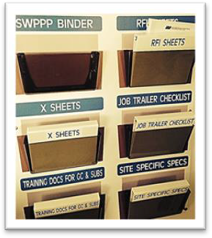


7.1.3 Where to Keep the SWPPP
Keep all records at the construction site, or at an appropriate alternative location as specified in the NOI.
You must maintain a site log notebook or computer file folder that
contains copies of:
the NOI, acknowledgment letter granting coverage
your SWPPP
all your inspection reports and records, and
all notifications from DEP concerning your site.
Keep all records for three years from the date that the site has reached final stabilization and the Notice of Termination (NOT) is submitted.

Slide 23

7.1.4 How Often Must the SWPPP be Updated?
Must keep your SWPPP current. Sign and date revisions, then attach to original.
Whenever any of the following events occur, you have (7) seven
calendar days to update your SWPPP:
Each site is unique with its own soil characteristics, topography, drainage patterns, and
unforeseen issues.
There is a change in design, construction, operation, or
maintenance that effect discharge from your site.
There is a new discharge point, outfall, or change in the location.
An inspection reveals that BMPs are not performing.
A new operator, contractor, or subcontractor has taken over a portion of the project. Update your SWPPP to reflect after changes and make sure they sign on to your coverage or obtain new coverage.
A release containing hazard substance in an amount equal or
greater than a reportable amount during a 24-Hour period.
NO COOKIE CUTTER PLANS !

Slide 24

7.1.5 Who Must Sign the SWPPP?
Who Must Sign……..
All contractors and subcontractors identified in the SWPPP
With their full names and title
Name, address, and telephone of the contracting firm and signature date as well
Sign the Certification statement:
"I certify under penalty of law that I understand, and shall comply with, the terms and conditions of the State of Florida Generic Permit for Stormwater Discharge from Large and Small Construction Activities and this Stormwater Pollution Prevention Plan."
X_____________________________________________

Slide 25
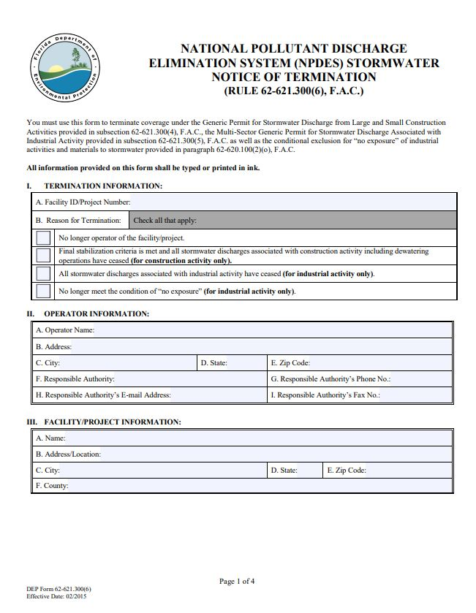
7.2 Submitting the Notice of Termination (NOT)
Within 14 calendar days after your site has achieved “final stabilization” and all discharges eliminated.
All dewatering discharges authorized by this permit have ceased.
All stormwater discharges caused by construction activities have ended.
Any other discharge caused by construction has ended.

Slide 26
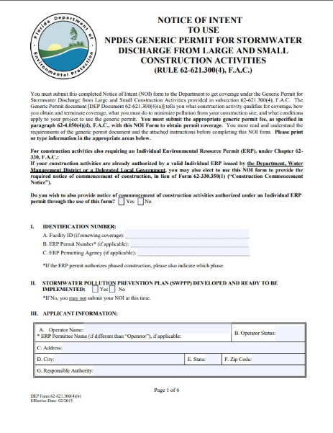
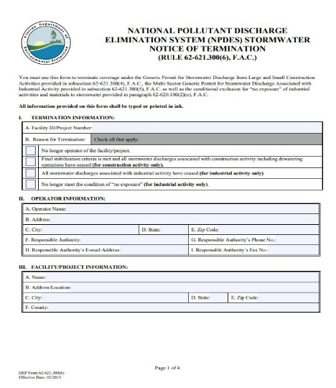
7.2.1 Can a CGP be Transferred?
Coverage is NOT transferable.
New owner/operator will need to develop their own SWPPP and submit their own NOI and fee.
You will need to terminate your coverage by submitting a NOT within 14 calendar days of relinquishing control.
Again, it is the new owner/operator’s responsibility to obtain coverage before your NOT is submitted.
Someone must always be properly permitted – no gaps!

Slide 27
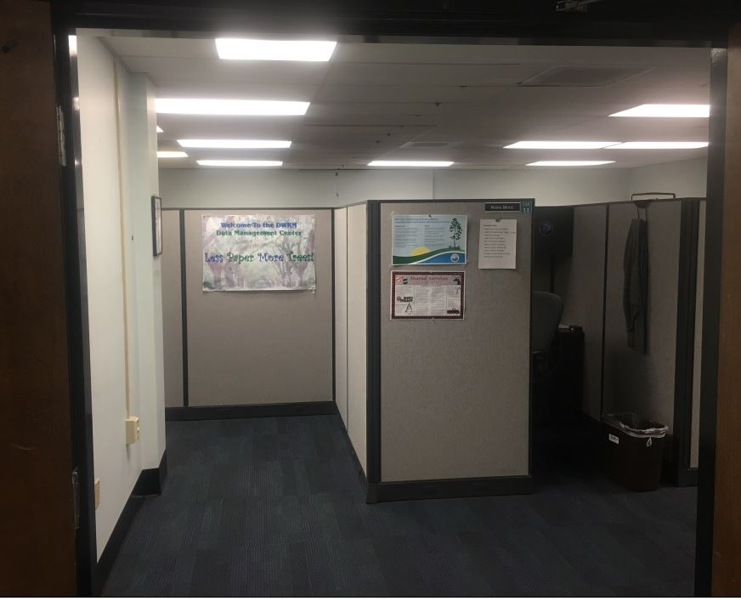

7.2.2 How to Submit a NOT
You can submit the form electronically:
The NOT can be filed online at DEP's Business Portal: http://www.fldepportal.com/go/
Alternatively, you can submit the NOT by email to the Stormwater Notices Center by downloading the NOT at DEP's NPDES Permits and Forms website:
https://floridadep.gov/water/stormwater/content/npdes- permits-and-forms
For additional assistance, contact the Stormwater Notices Center at: (866) 336–6312 (toll-free).
Stormwater Notices Center

