Slide 1
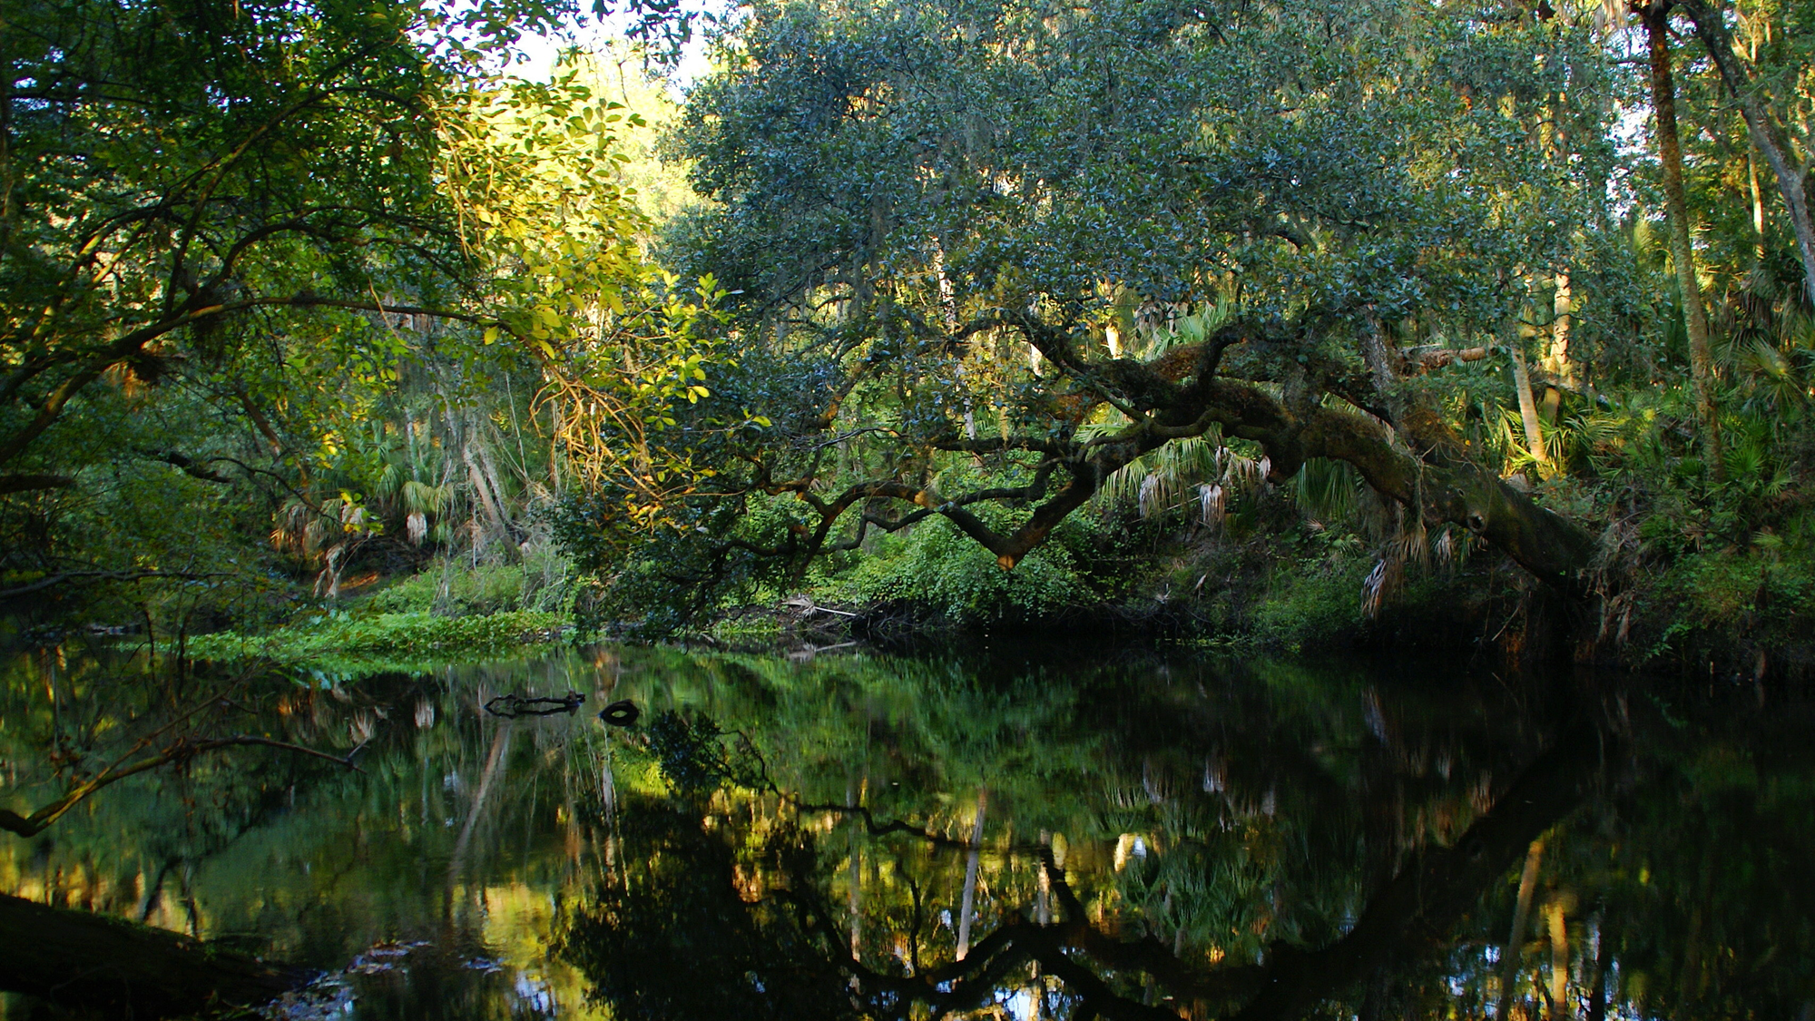

WELCOME TO:
The Florida Stormwater, Erosion, And Sedimentation Control Inspector’s Qualification Course
TIER I – Qualified BMP Installer (QBI), and
TIER II – Qualified Compliance Inspector (QCI)

Slide 2
Introduction
Developed in Cooperation with:
  Florida Department of Environmental Protection
  Florida Department of Transportation
  Other Florida State Agencies, and Colleges
  Florida Towns, Cities, and Counties
  Many of our Private Sector Companies

Slide 3
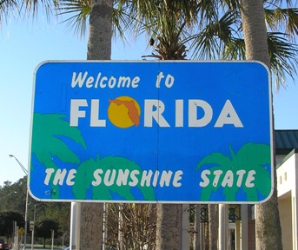
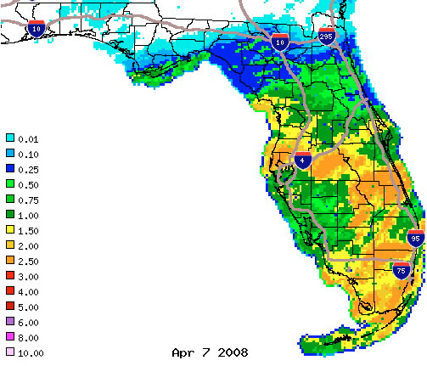
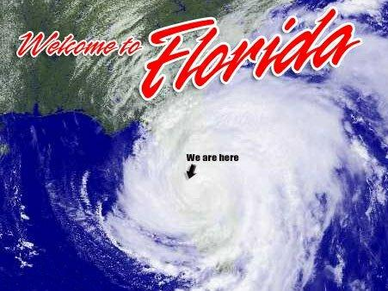
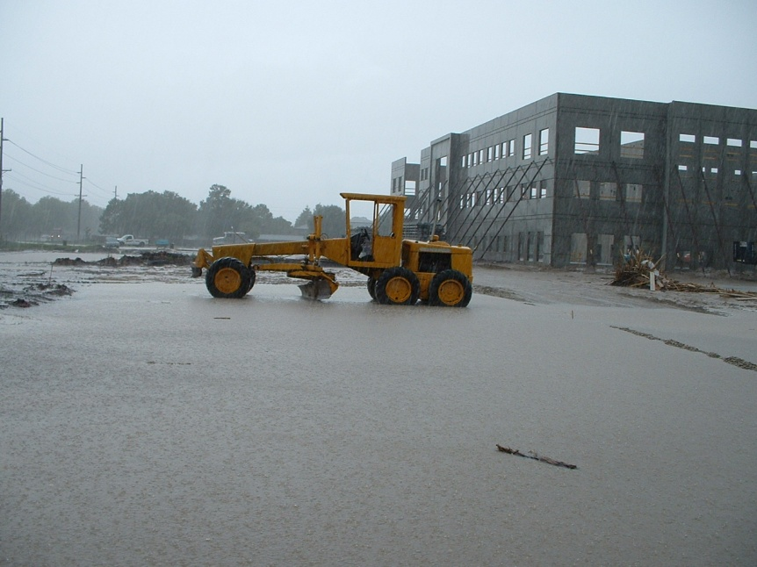
Introduction

Slide 4
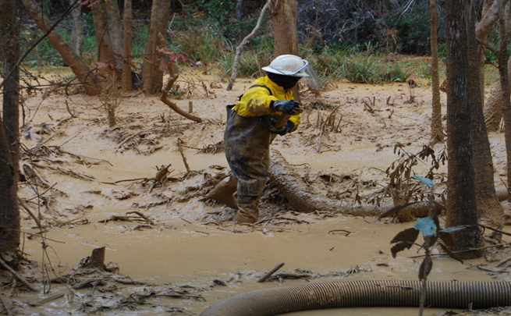
Introduction
Polluted Stormwater Runoff is a Big Messy Problem:
Sediments
Oxygen demanding substances
Nutrients – Such as; nitrogen, phosphorus (in fertilizer)
Pathogenic bacteria
Heavy metals
Oil & grease, hydrocarbons
Fresh water

Slide 5
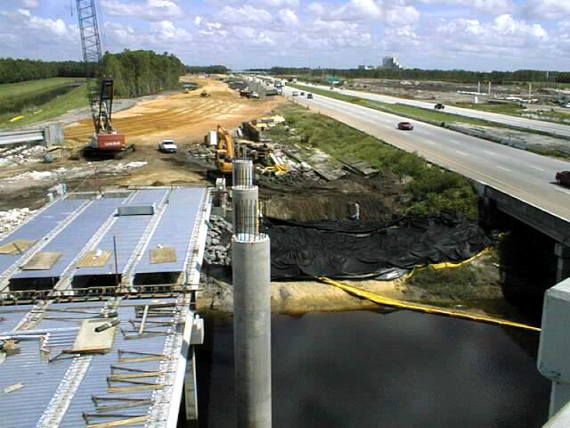
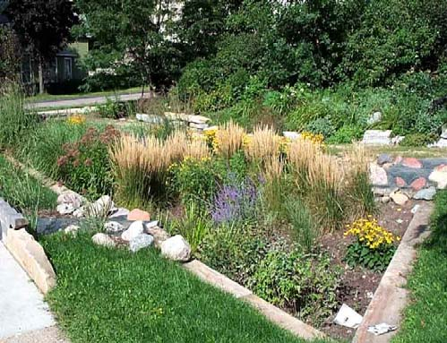
Introduction
Development vs. Environment
Is there a solution?
Does development always have to conflict with nature?
Are there ways to minimize construction impacts on the environment?

Slide 6
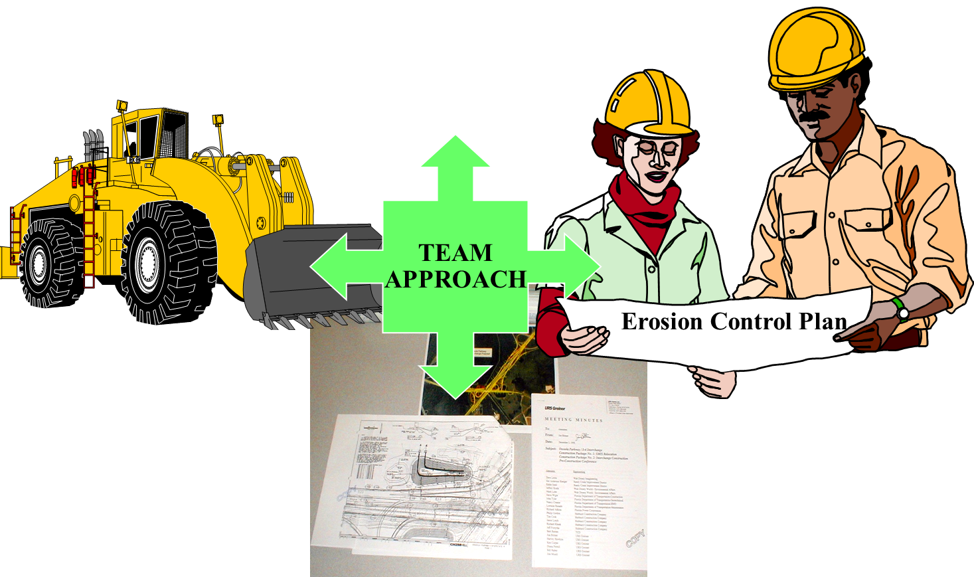
Introduction
Keys for Success
Commitment
Education
Application
Communication

Slide 7
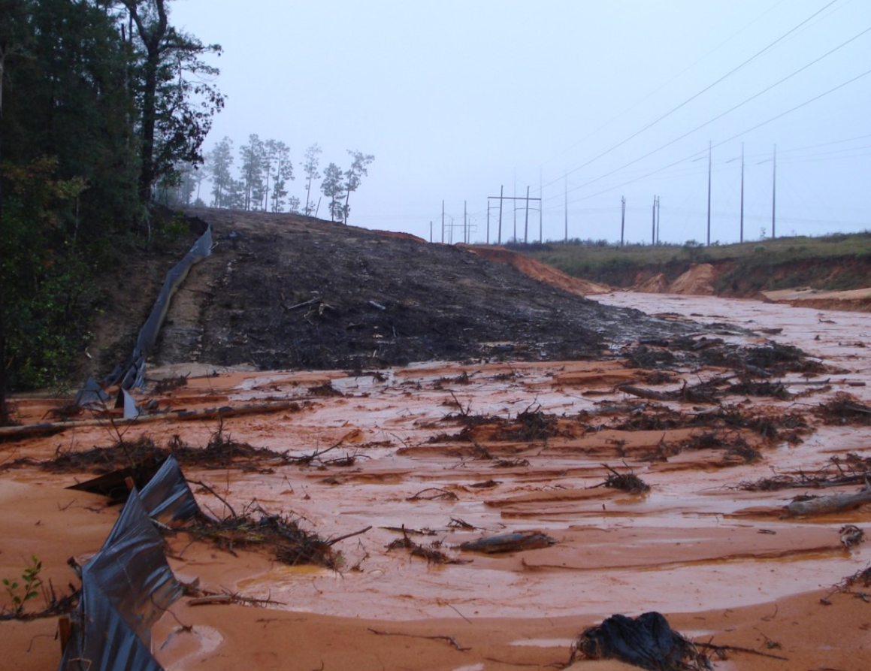
Introduction
Introduction
Learn -
Effective practices to minimize construction impacts on the environment

Slide 8
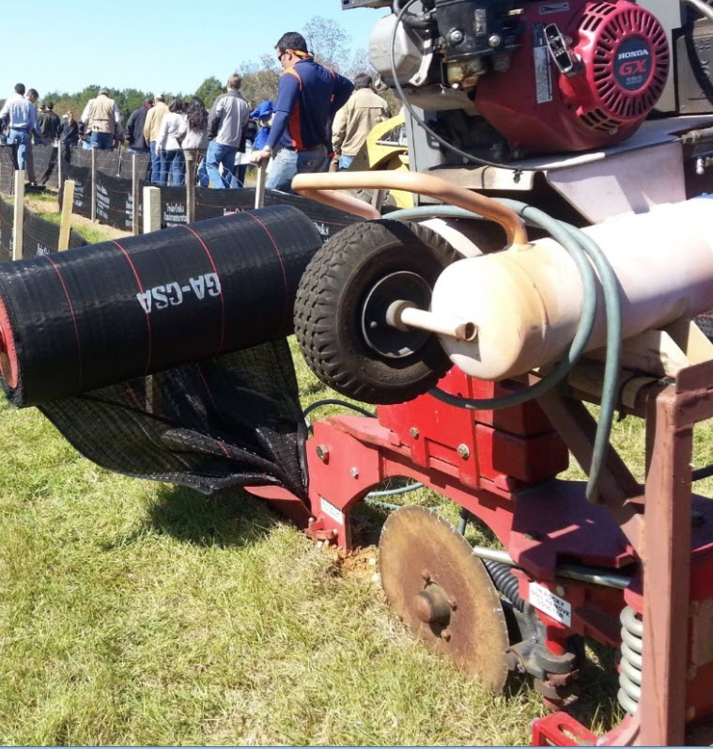
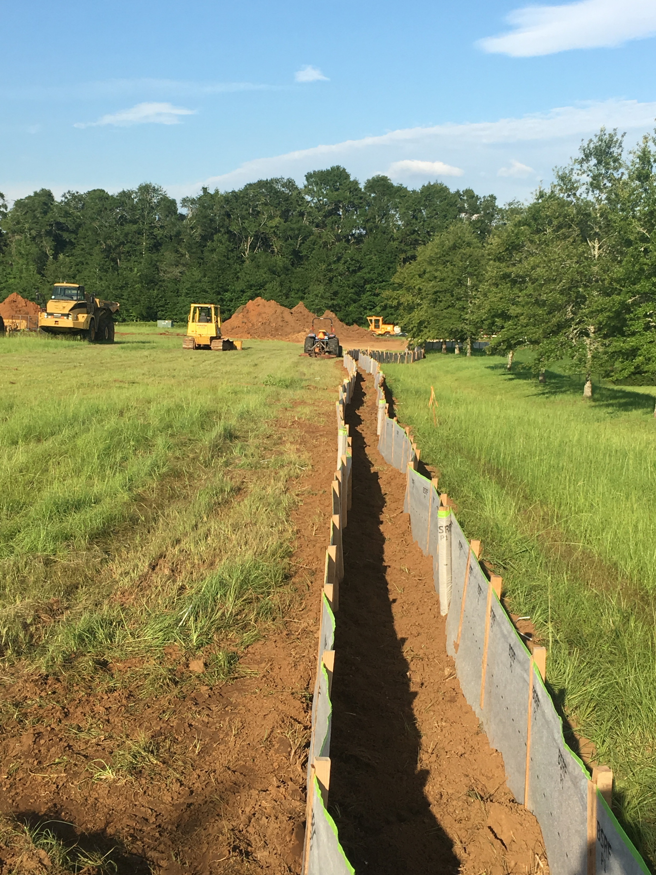
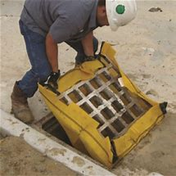
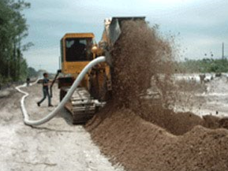
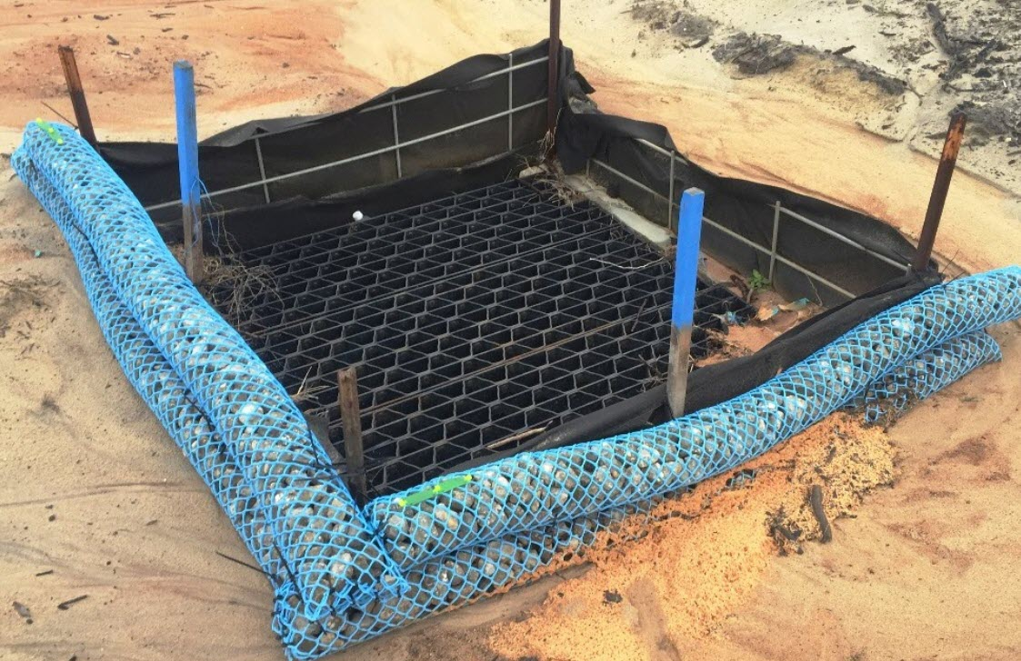
Introduction
Introduction
Best Management Practices:
Perimeter Controls
Phased Development
Dewatering
Inspection and Maintenance
Communication and Training
Notes:
From the first shovel-full of dirt dug to the last square of sod layed

Slide 9
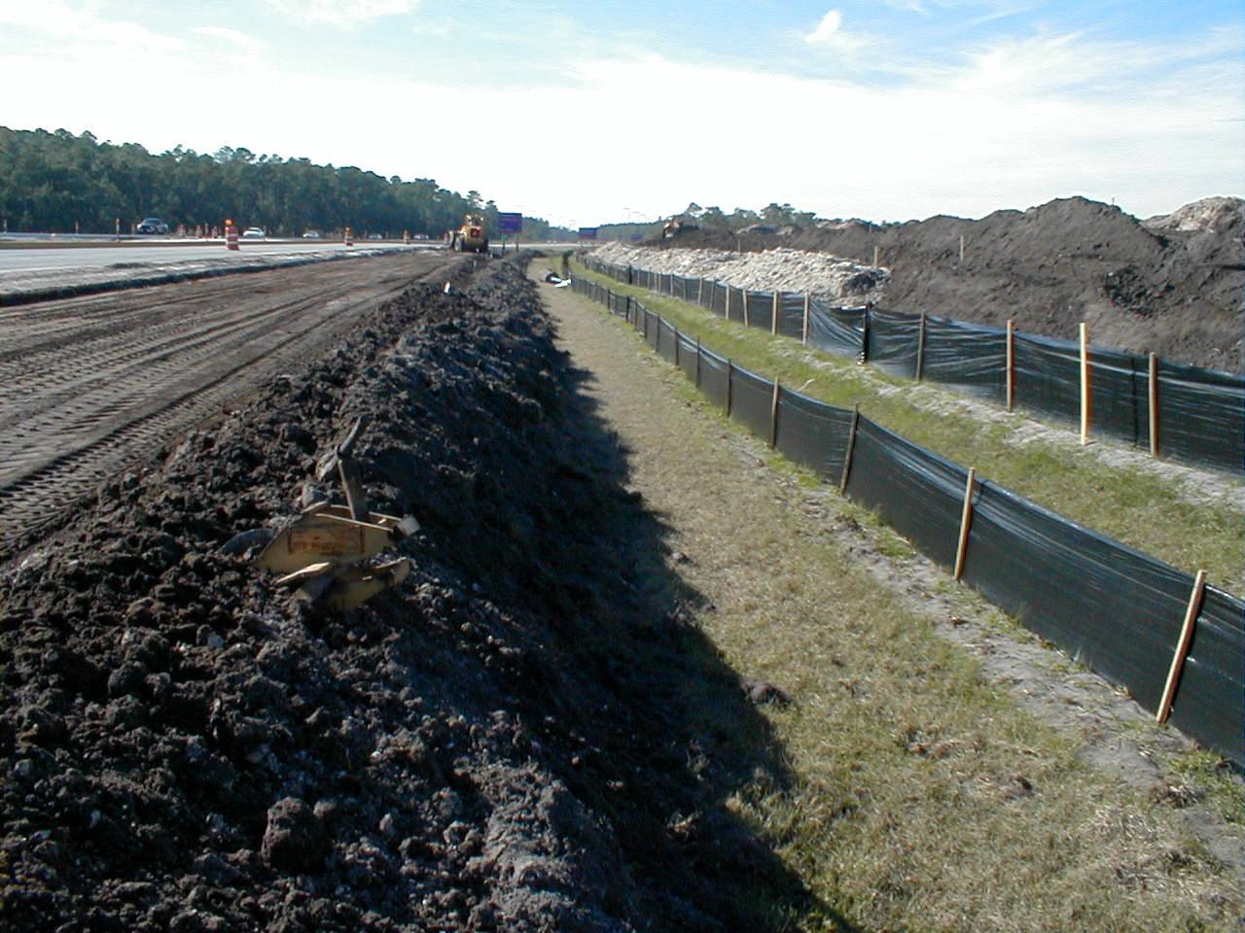
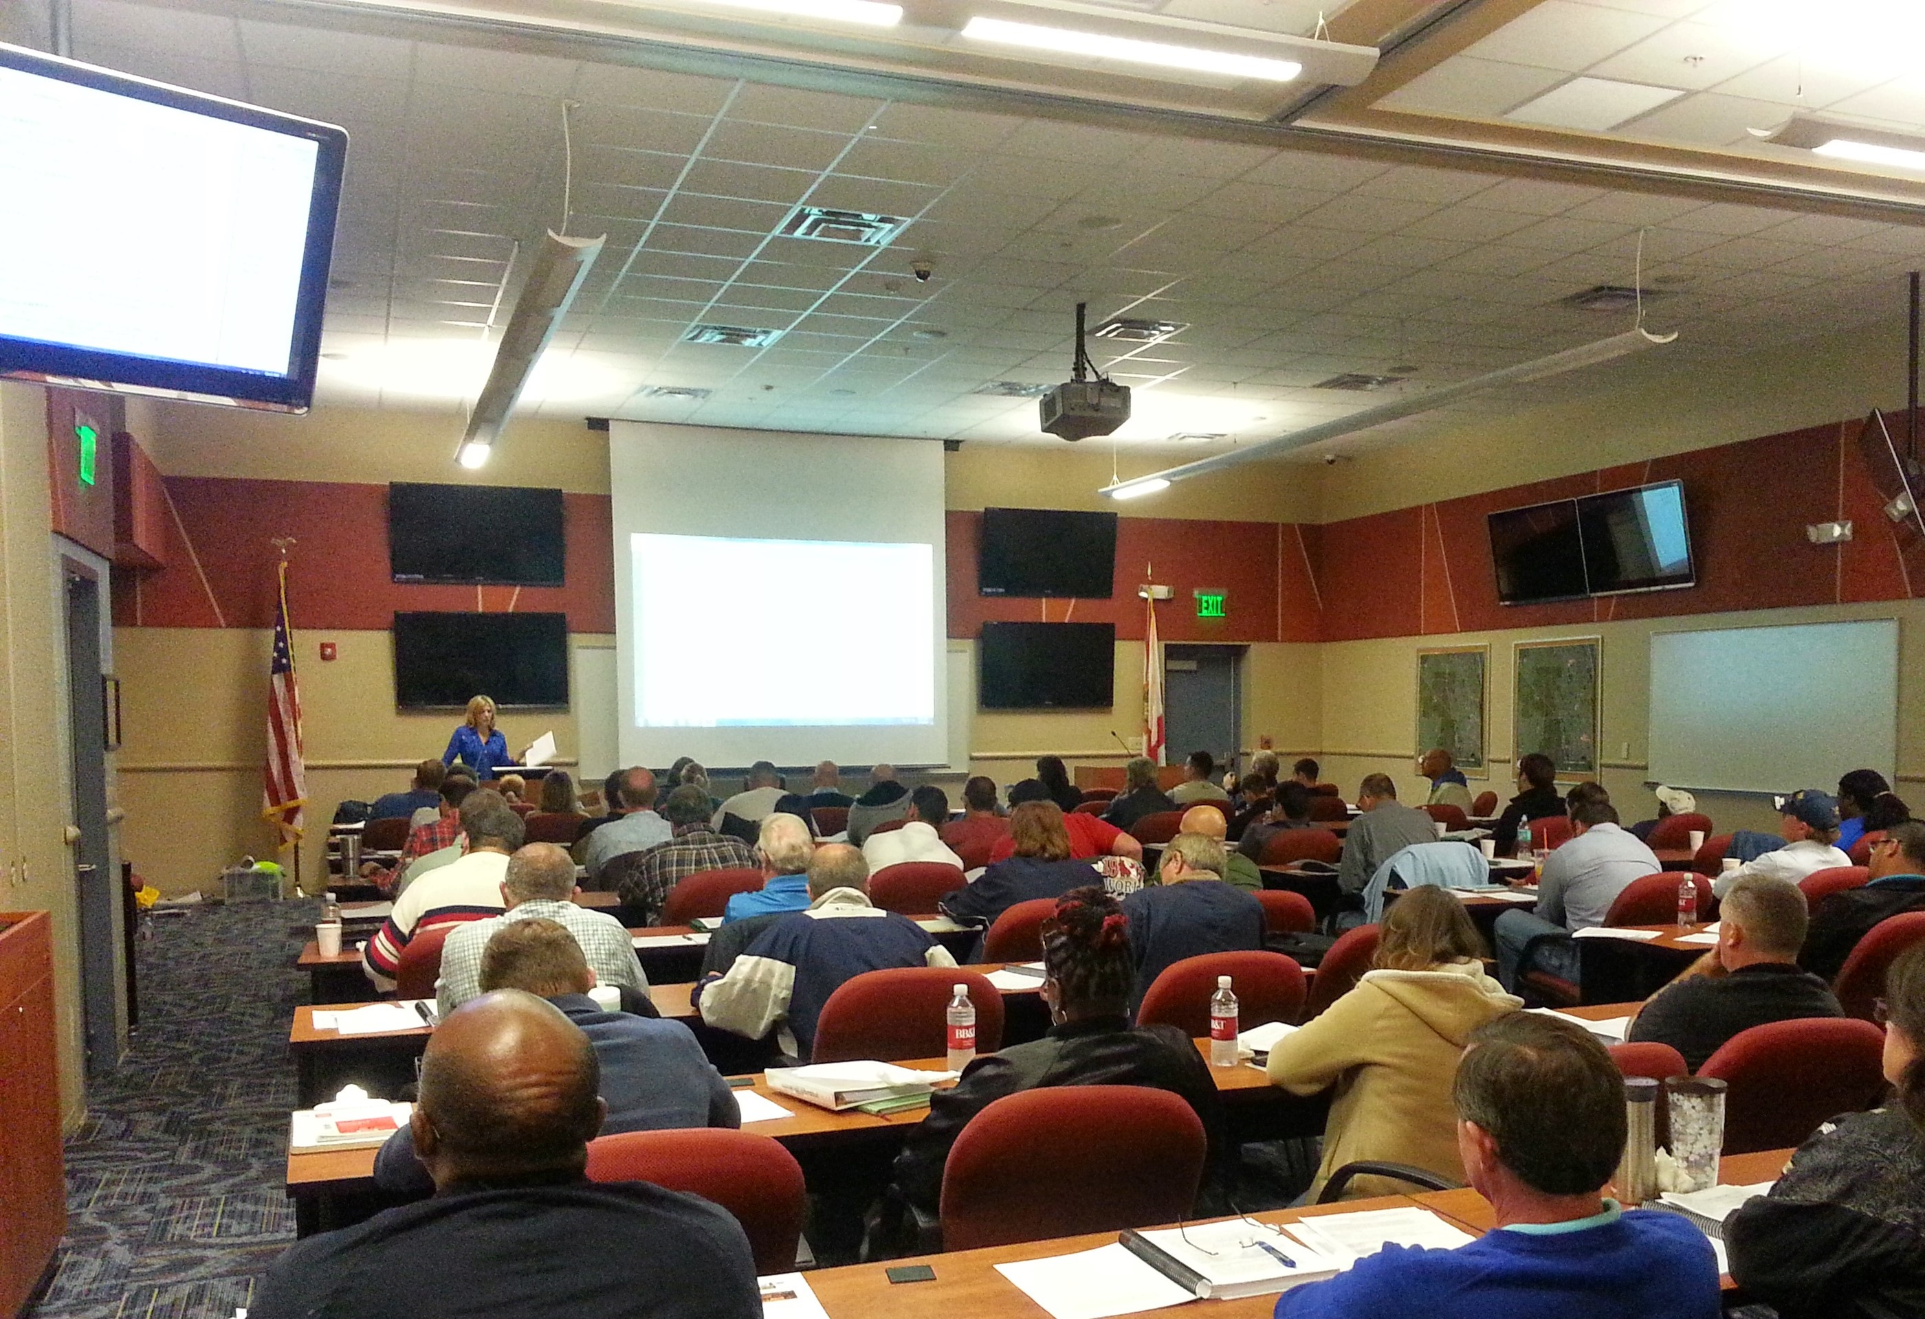
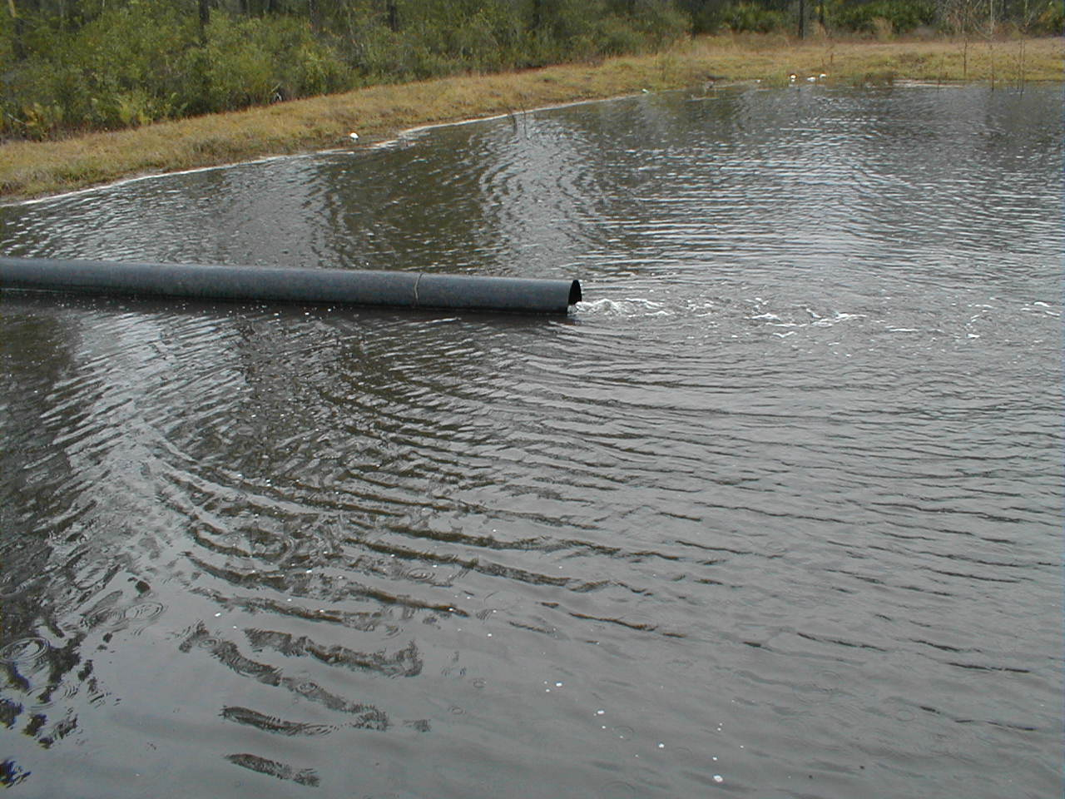
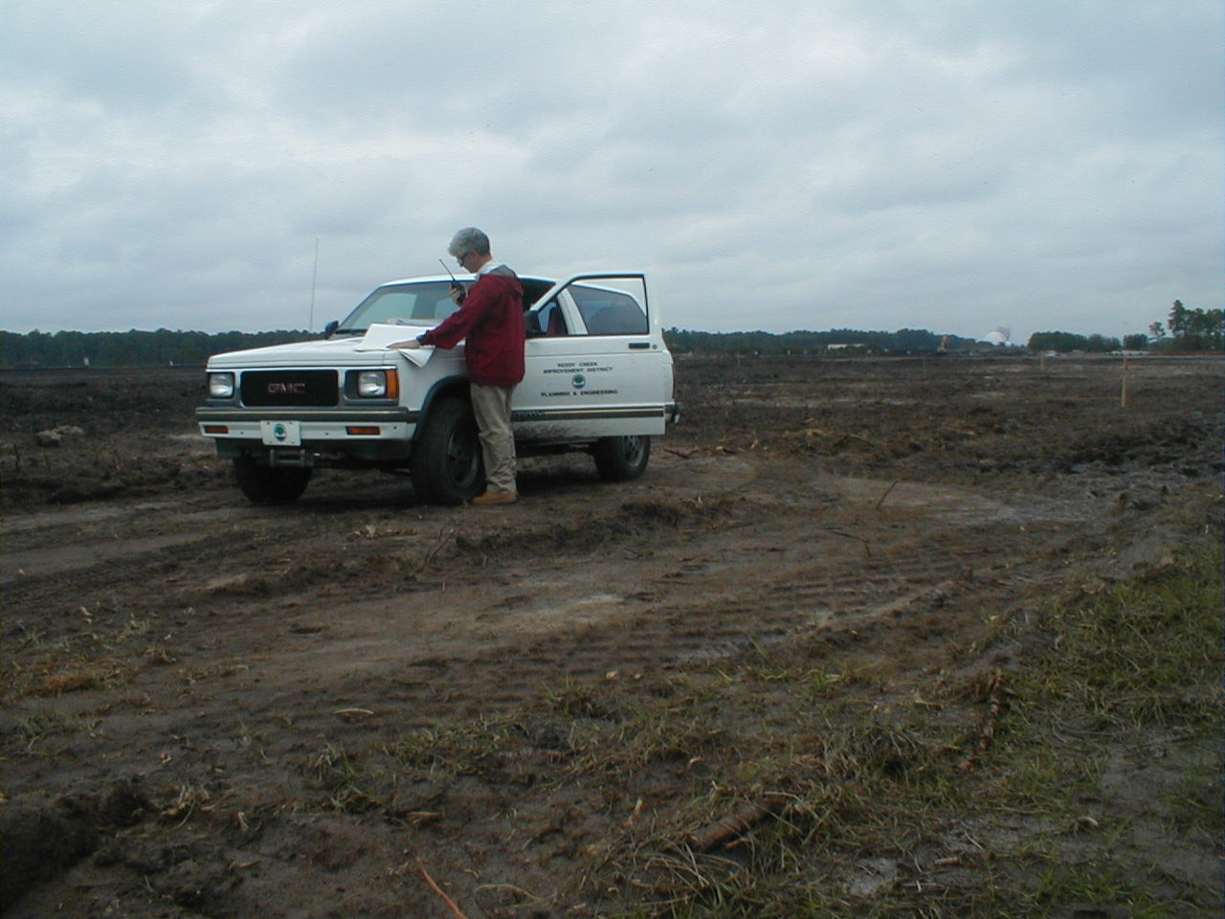
Introduction
Introduction
Perimeter Controls
Training & Education
Dewatering
Inspection & Communication

Slide 10
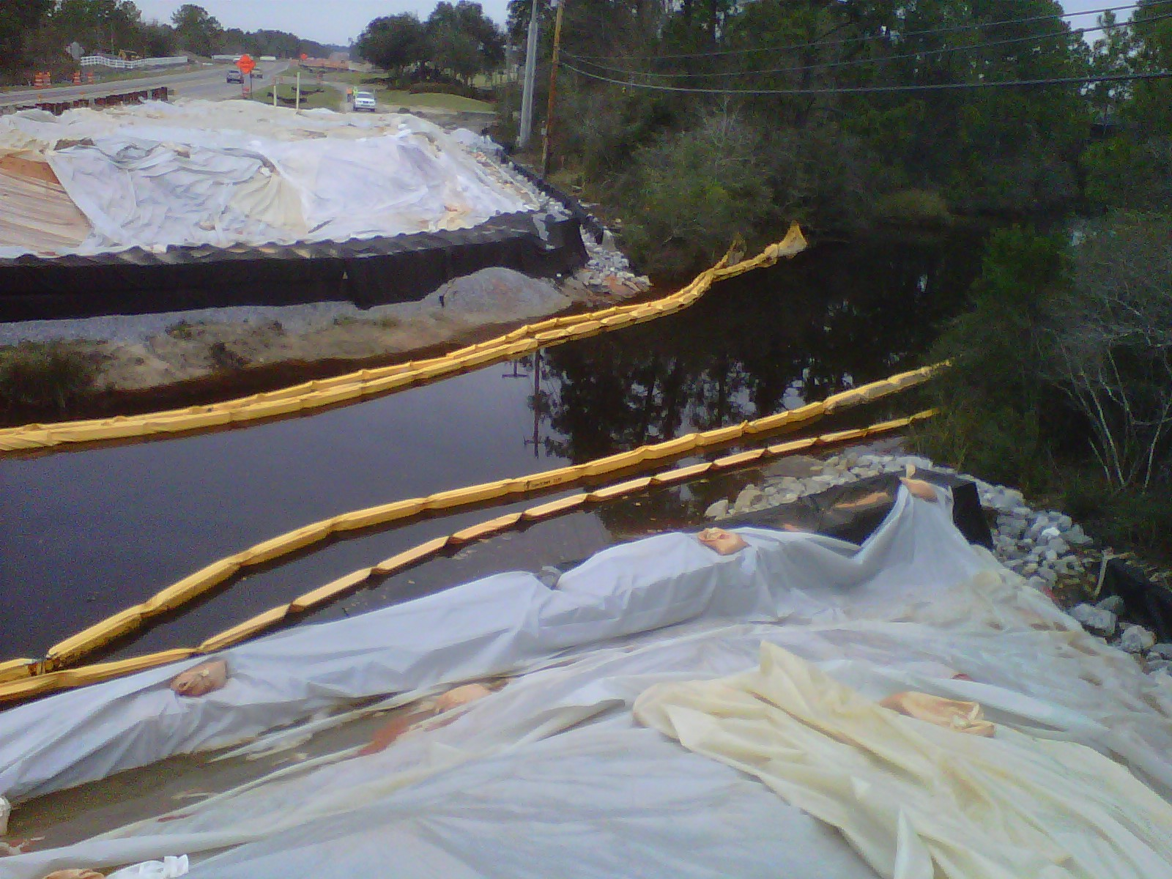
Introduction
Introduction
Erosion control is a balance between science & art:
Technical skills alone will not ensure success
Creative use of appropriate BMP combinations applied correctly in layers will ensure success

Slide 11
Introduction
Introduction
So today, follow along with each slide presentation
You can follow along in your manual
Review the workbook questions with the class
If you don’t understand something
– please ask questions!
Keep an open mind and have fun!

