Slide 1
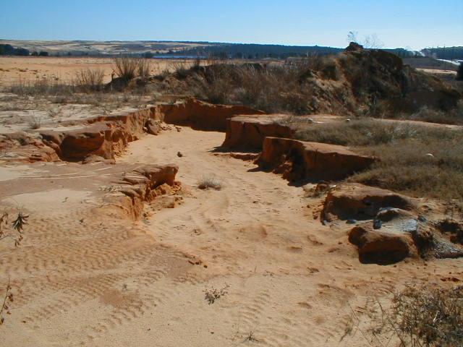
Chapter 1
Erosion and Sedimentation
Notes:
In this Chapter we will be discussing:
Erosion Process
Different Types of Erosion
Physical/Biological effects,
Hazards with Land Development
Principles of E&S Control

Slide 2
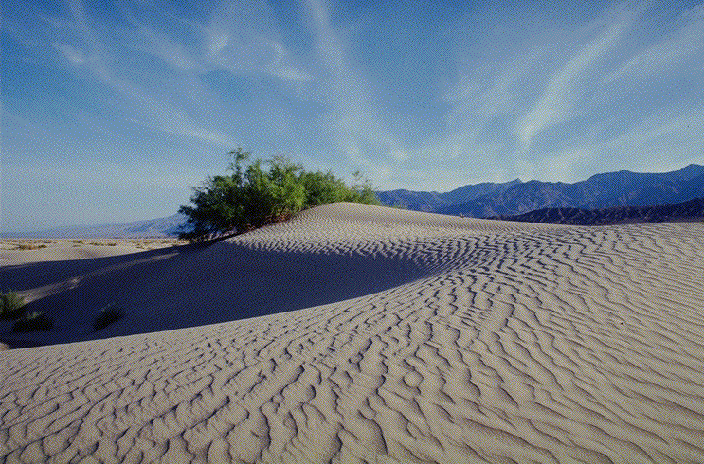
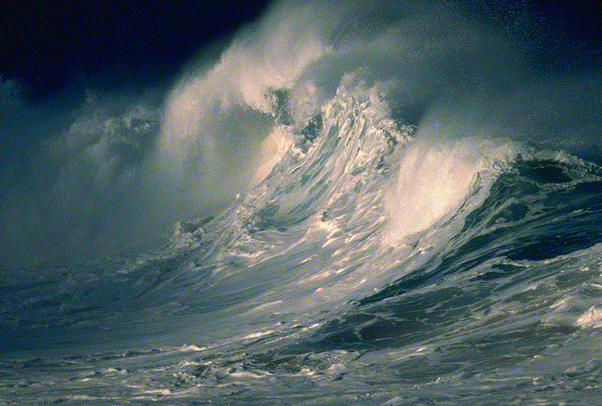
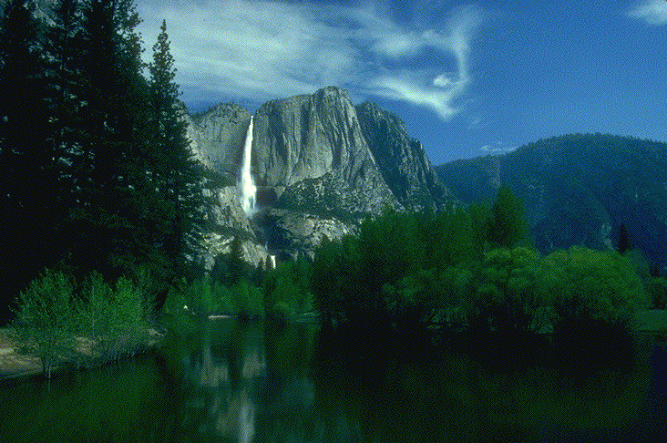
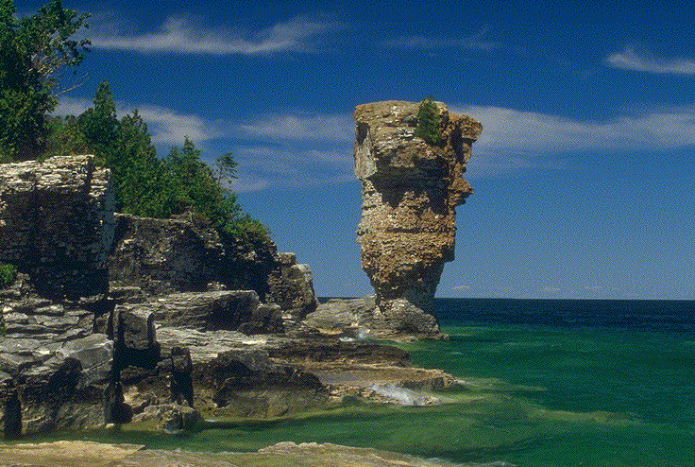
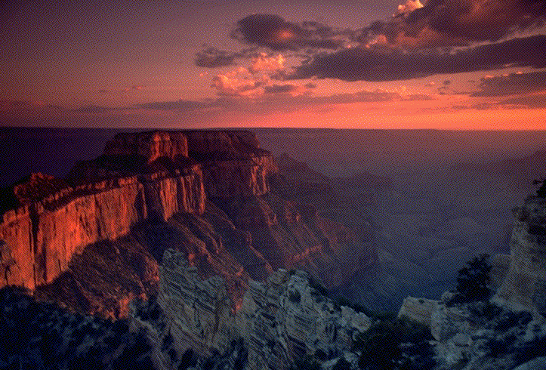
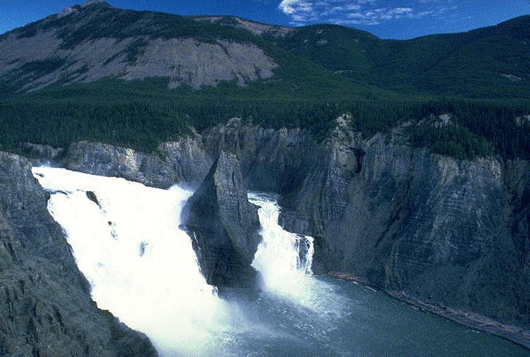
Erosion
Process by which the land surface is worn away by the action of wind, water, and gravity
Notes:
EROSION -----Process by which sediments are detached from soil mass, transported by the means listed WIND, WATER, and GRAVITY.

Slide 3
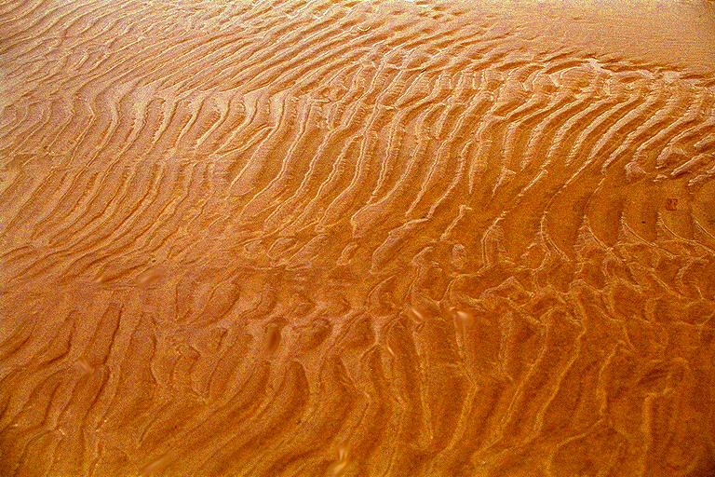
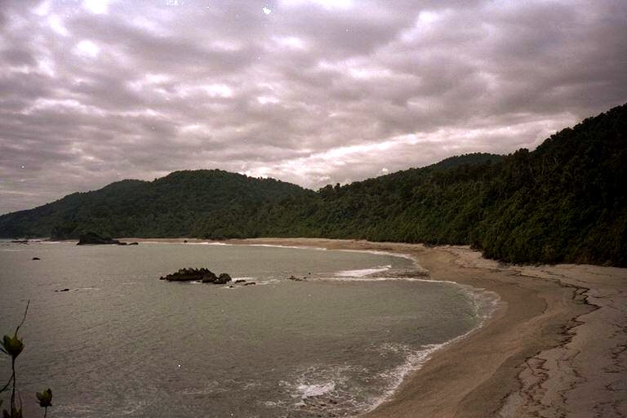
Sedimentation
Settling of soil particles transported by wind and water
Notes:
Erosion leads to sedimentation – occurs when velocity of wind/water carrying the sediment slows to the point at which it settles out of suspension. Heavier particles such as sand and gravel will settle out more rapidly then fine particles such as clay and silt.
Sediment deposition occurs when the velocity (energy) of the transporting stream decreases. Important in FL – streams here have low gradients and low velocities, so, deposition will dominate the transport of soil particles in water.

Slide 4
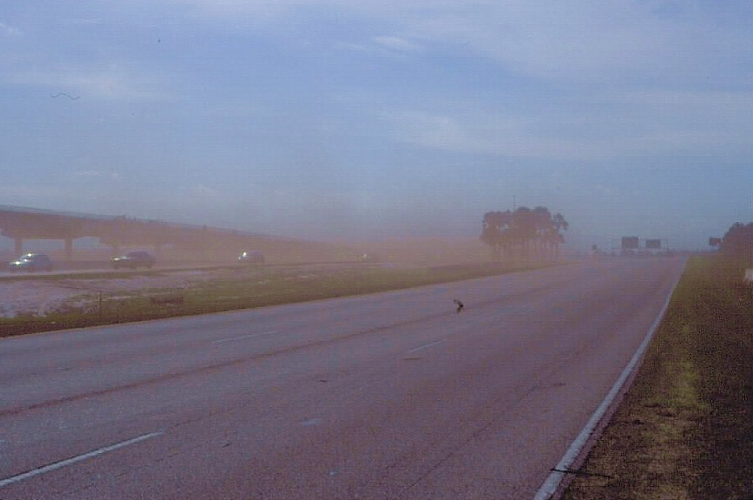
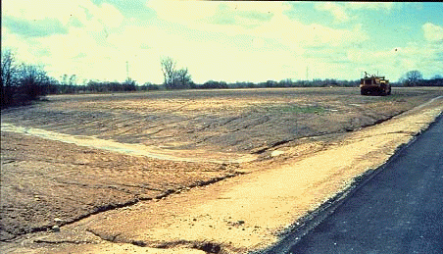
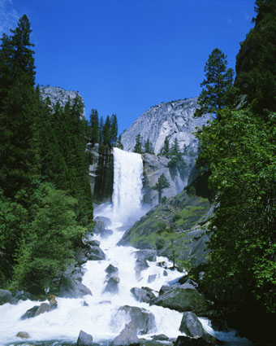
Natural Erosion vs. Accelerated Erosion
Natural Erosion is relatively slow and uniform
Manmade erosion is 10 times greater than natural
Notes:
Natural/geologic erosion – relatively slow rate and uniform rate since the beginning of time and is the major factor in creating the earth as we see today.
Examples of geologic erosion would be: valley’s, rolling farm lands, estuaries and barrier islands along the coast.
Geologic erosion produces about 30% of all sediment in the United States.
Accelerated erosion – increased rate of erosion/removal of vegetative cover or altering contour of ground. Accelerated erosion accounts for 70% of erosion in the US.
Farming and construction are the principal causes of accelerated erosion, although any activity that disturbs land can increase the natural erosion rate.

Slide 5
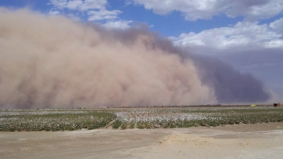
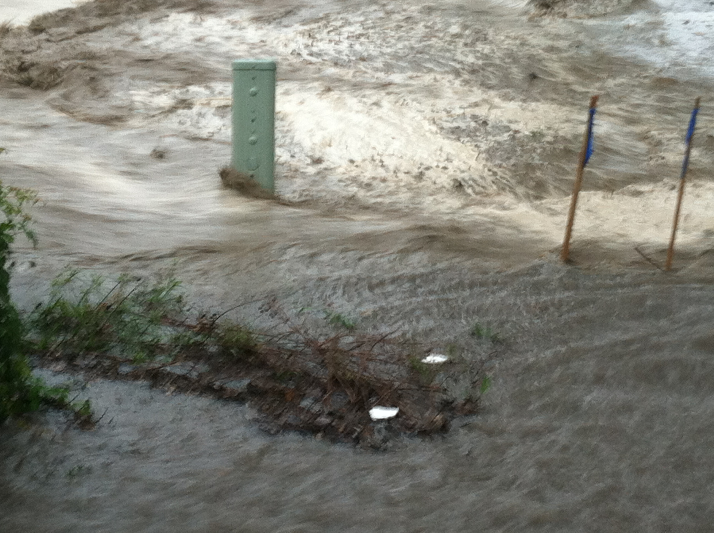
Types of Erosion
Wind Erosion vs. Water Erosion
Annual Loss - 959 million tons and 2.6 tons/acre/year in Florida (NRCS)
Annual Loss - 765 million tons (NRCS)
Notes:
Two different types of erosion previously mentioned.

Slide 6
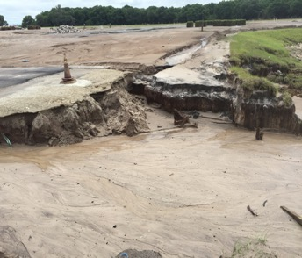
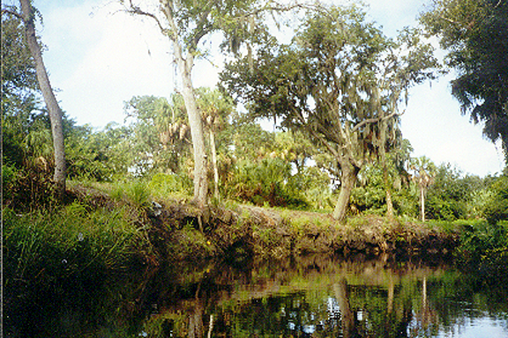
Types of Erosion
Overland erosion
Stream & channel erosion
Notes:
Two types of water erosion – overland and channel
Overland erosion occurs when slopes stripped of cover raindrops hit splash and runoff – largest source of sediment during construction

Slide 7
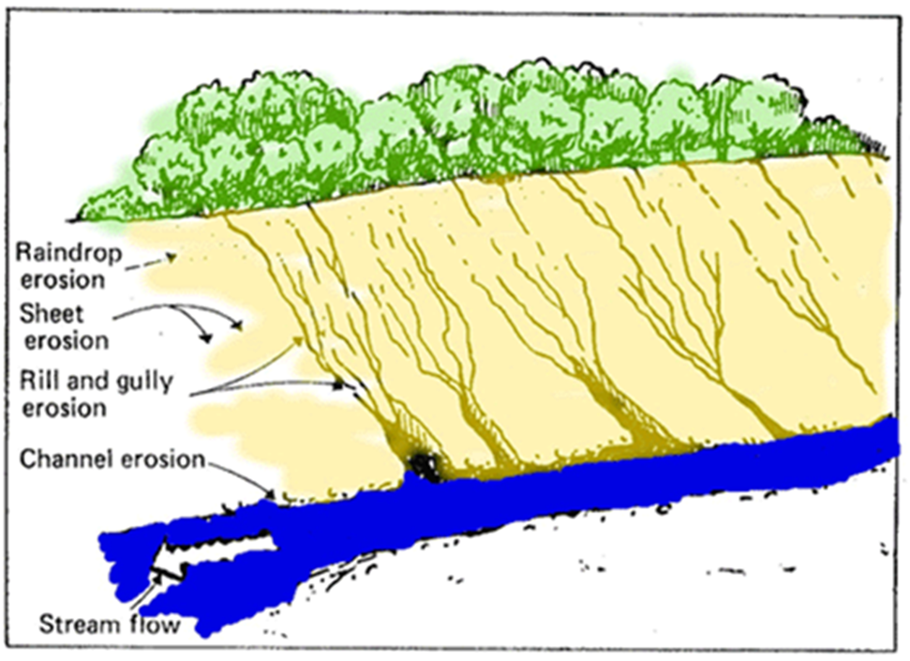
Types of Water Erosion
Notes:
There are two principal types of water erosion: overland erosion and channel erosion. Overland erosion occurs on denuded slopes when raindrops splash and run off.
Overland erosion is the largest source of sediment during construction activities
The 5 types are”

Slide 8
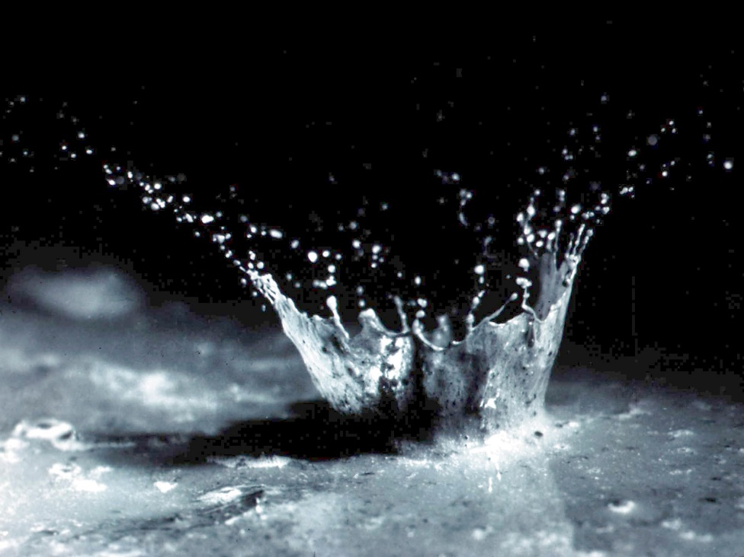
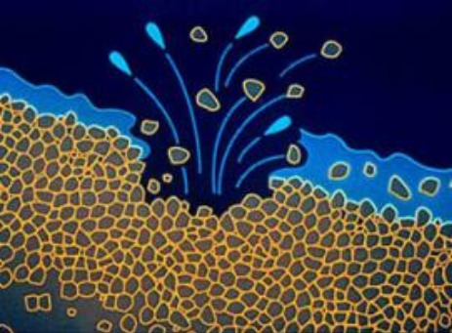
Splash (Raindrop) Erosion
Raindrop impacts on exposed soil surfaces start the erosion process.
Terminal speed of a large raindrop is about 20mph.
Notes:
raindrops will dislodge the soil particles splash them into the air – now vulnerable to sheet erosion

Slide 9
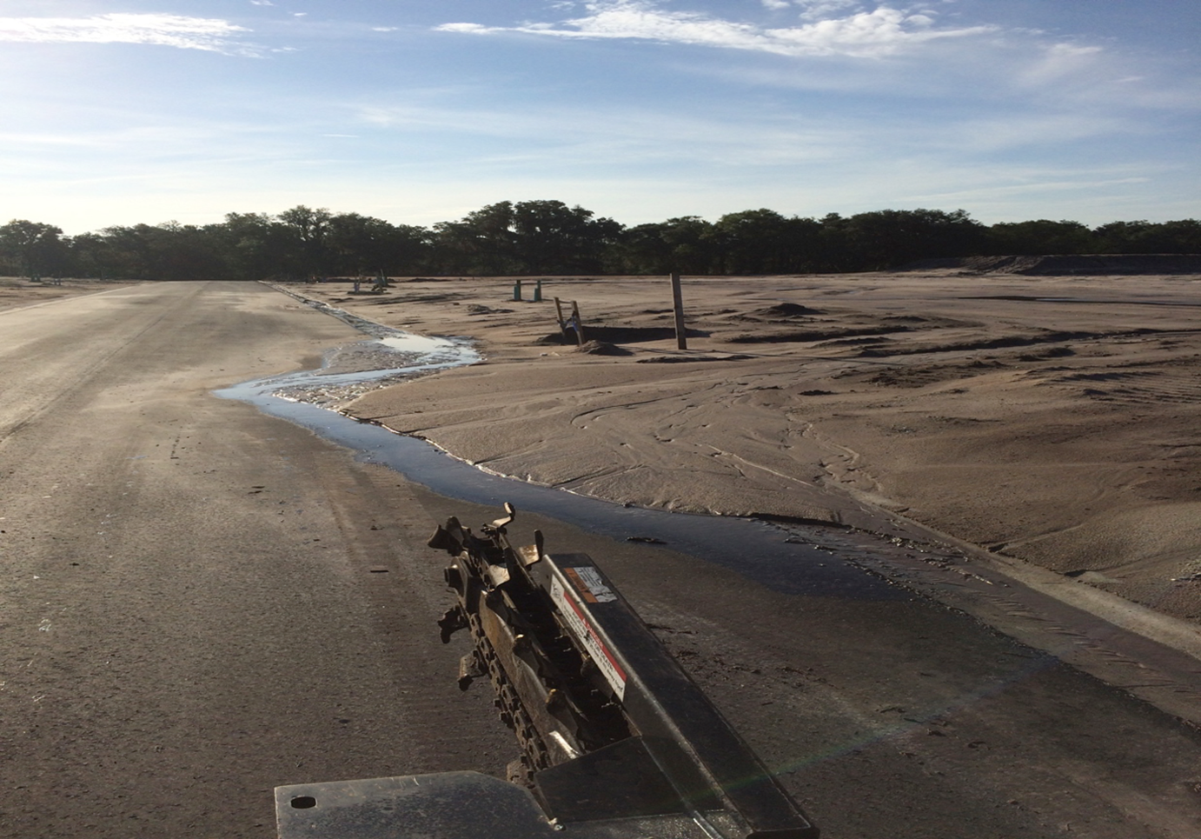
Sheet Flow Erosion
Notes:
Sheet- cause shallow sheets of water rolling across the land – seldom the cause of erosion itself but the flow will move the detached particles caused by splash erosion. Shallow flow will concentrate/collect in low land spots

Slide 10
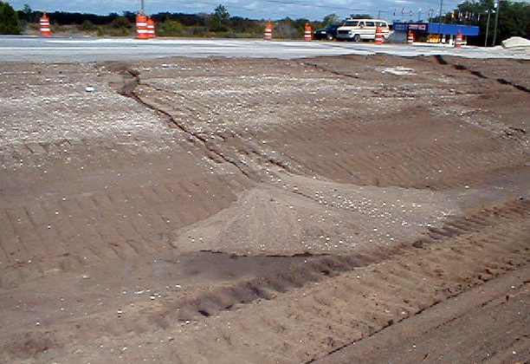
Rill Erosion
Notes:
Rill – shallow surface flow begins to concentrate/collect (yellow arrow) in the low land spots, increases velocity and turbulence in these areas, which causes more detachments and transportation of particles. Cuts tiny channels called a rill.

Slide 11
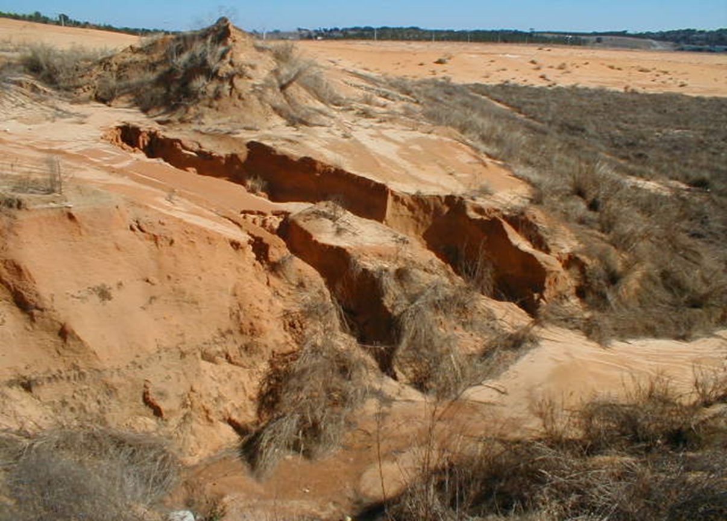
Gully Erosion
Notes:
Gully – Rills come together to form larger and larger channels – difference between a gully and a rill is the size

Slide 12
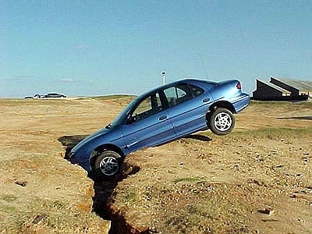
Rill vs. Gully
What is the difference between a rill and a gully?
Rills are small - a few inches wide/deep
Gullies are large and difficult to correct
Given enough time, soil depth, and water flow – rills will become gullies
Notes:
Again size is the difference between a rill and a gully
A rill will become a gully given enough time

Slide 13
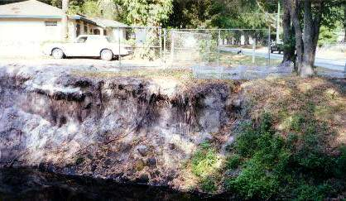
Stream and Channel Erosion (Mass Wasting)
Notes:
Occurs as the volume and velocity of flow increase sufficiently to cause the movement of the stream bed and bank materials to erode

Slide 14
1.4 Four Factors Influencing Erosion
1) Soil characteristics
2) Vegetative cover
EROSION
3) Topography
4) Climate (rainfall)
Notes:
Erosion potential of an area determined by four factors. These will be discussed separately but they are inter-related.

Slide 15
Factors Influencing Erosion
Texture
1) Soil characteristics
2) Vegetative Cover
3) Topography
4) Climate
Organic Matter
SOIL
Structure
Permeability
3
Notes:
Soil properties affect infiltration capacity of a soil and those that affect resistance of the soil to detach and transport by flowing or falling water.
Soils that contain high % of silt and very fine sand are generally the most erodible; as clay and organic matter increases. erodibility decreases. Clay can bind soils keeping erosion from occurring, making it erosion resistant. But if clay detaches it is carried easily by water and hard to settle out.
Organic matter soils – improve permeability, resist raindrop detachment and absorb rainwater which minimizes erosion. Gravels are the least erodible if well drained, graded, and some include larger sand grains. Coarse gravel highly permeable and good adsorption capacity (prevent or delay) reduces surface runoff. Chapter 2 (Soils) provides further explanation.

Slide 16
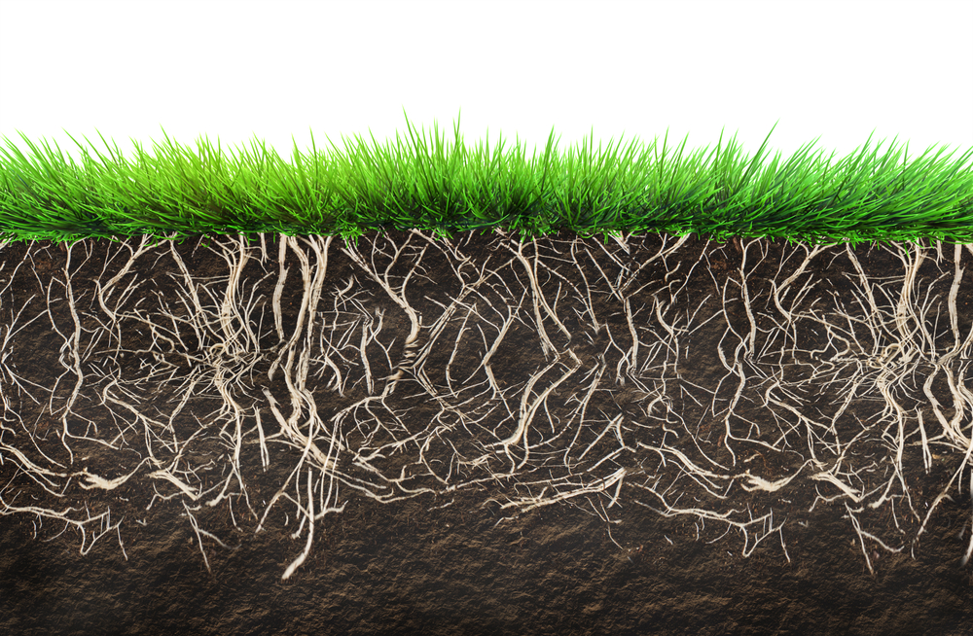
Factors Influencing Erosion
1) Soil characteristics
2) Vegetative Cover
3) Topography
4) Climate
Shields soil from impact of rain
Roots hold soil in place
Maintains soil’s capacity to absorb water
Slows velocity of runoff
Removes water through evapotranspiration
Notes:
Very important – can be controlled by scheduling vegetation removal in stages, decreasing area exposed and duration

Slide 17
Factors Influencing Erosion
1) Soil characteristics
2) Vegetative Cover
3) Topography
4) Climate
Orientation
Slope Gradient
Slope Length
Steeper slope and longer length = Water flows with higher velocity and energy, causing more erosion
vs

Slide 18
Factors Influencing Erosion
1) Soil characteristics
2) Vegetative Cover
3) Topography
4) Climate
Florida’s average wet season: May to Mid-October
Florida’s dry season: November to May
Florida’s average annual rainfall over the last 10 years is 55.85” per year, ranging from 48.99” to 60.52”
Peak Hurricane Season: August to October according to the Nat’l Weather Service
Notes:
Frequency, intensity and duration of rainfall important to determine
Wet season erosion risks are high
Land disturbing activities should be scheduled to take place during periods of low precipitation and low runoff.
Stabilize prior to time of year when high potential will exist.

Slide 19
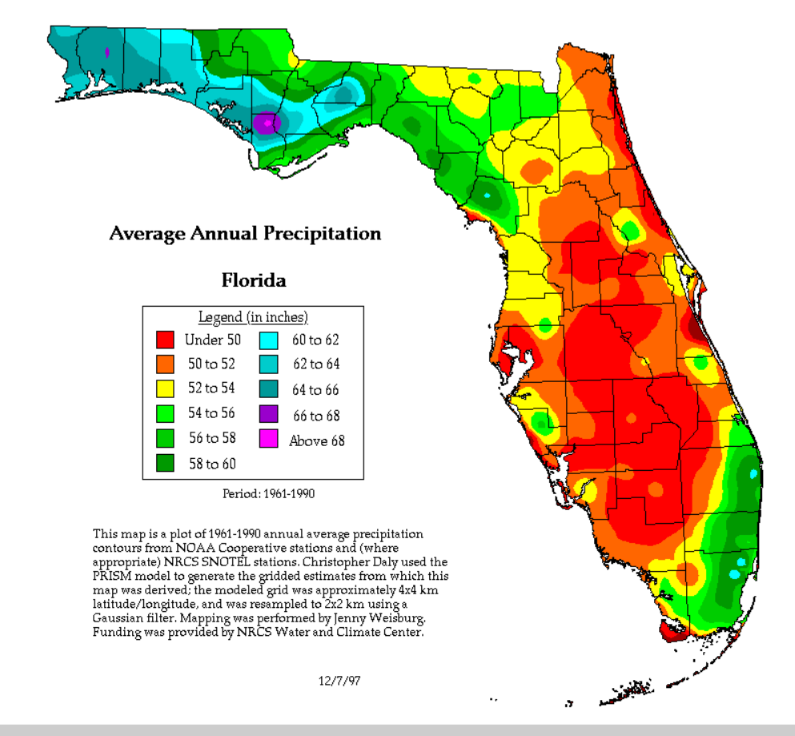
Florida’s Average Annual Precipitation
Highest in Panhandle
Notes:
Depending on where you are working in the state could impact your plans also so take that into consideration.

Slide 20
1.5 Impacts of Sedimentation and Erosion
Four billion tons of material reach water bodies in US
One billion tons of material reach oceans
10% overall due to construction activities
But, this can represent 50% of eroded material in watersheds undergoing development
Notes:
4 Billion tons of sediment are estimated to reach the ponds, rivers, and lake of our country alone.
1 billion tons to our oceans including the Gulf of Mexico.
10% of this sediment amount comes directly from erosion from land undergoing highway construction or land development.
This 10% represents more than half or 50% of the sediment load going into streams in watershed undergoing development.

Slide 21
Sediment Yields to Streams
200 to 500 tons per square mile per year (t/mi²/yr) in stable urban area.
1,000 to 100,000 tons per square mile per year (t/mi²/yr) in active, developing area (5 to 200 times as much).
Cleared land vs. forest: 20,000 to 40,000 times as much.

Slide 22
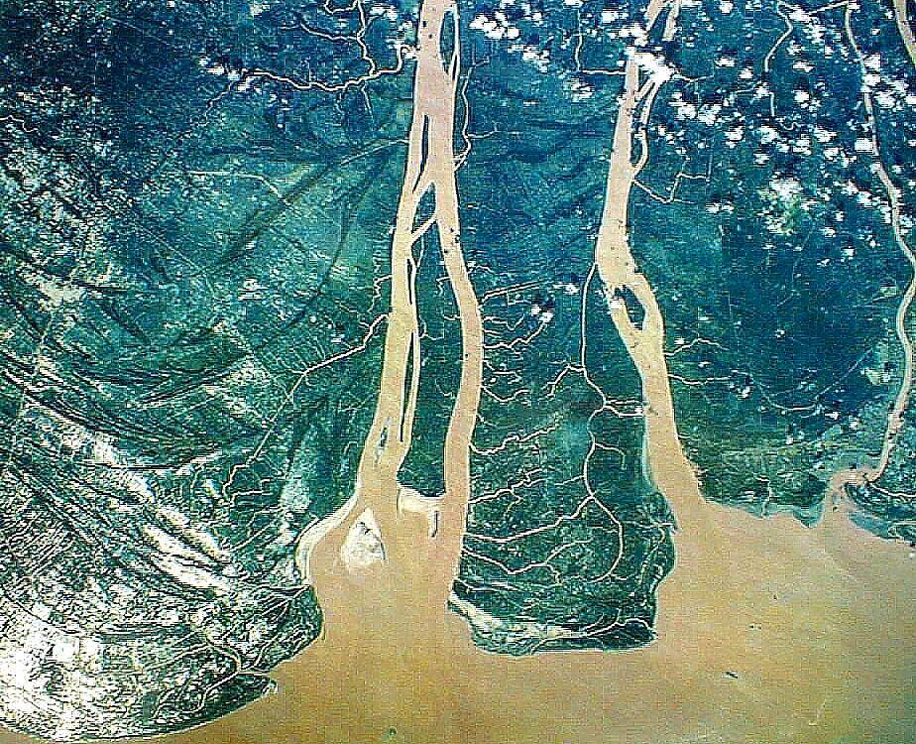
MASSIVE SEDIMENT YIELDS
Notes:
You can see billions of tons of deposits over time in these alluvial fans of this delta region.

Slide 23

Sediment
For every acre under construction without effective erosion control, about one dump truck load of soil per year washes into a nearby lake or water body. This soil contains materials which are toxic when released into water.
Pb – Lead
Cr – Chromium
As – Arsenic
Zn – Zinc
Cd – Cadmium
Cu – Copper
Hg – Mercury
Ni – Nickel
and Others!

Slide 24
Transport vs. Deposition
Deposition is the dominant process here due to the slow speed of Florida’s streams, canals, and lakes.
Heavy particles (sand and silt) settle first, in pipes, ditches, canals, rivers, lakes.
Fine particles (clays and muck) stay in suspension for weeks in rivers, lakes, canals; a.k.a. turbidity.

Slide 25
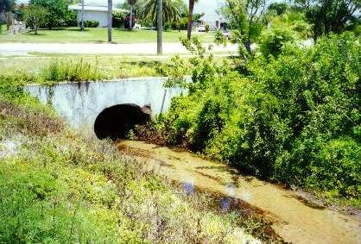
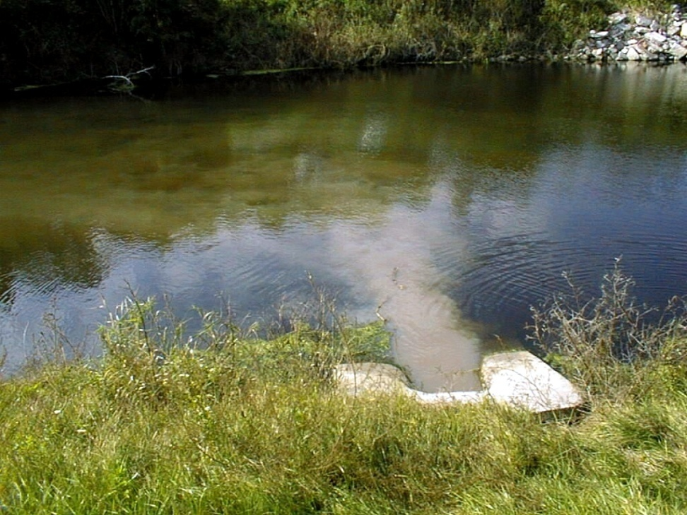
Transport vs. Deposition
Turbidity
Deposition
Notes:
Examples of each impact

Slide 26
Physical Effects of Sedimentation
Reduced hydraulic capacity of rivers and channels
Increased flooding
Increased maintenance costs for stormwater management systems
Lost capacity in water supply reservoirs
Decreased recreational value
Increased dredging of navigable waterways
Increased water treatment costs

Slide 27
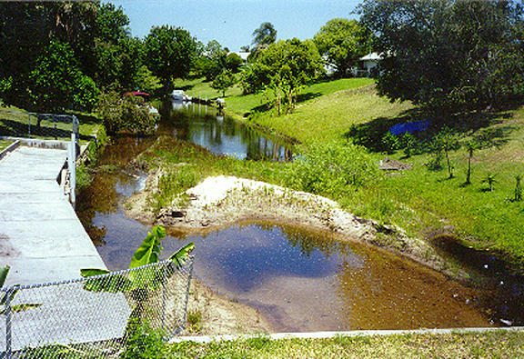
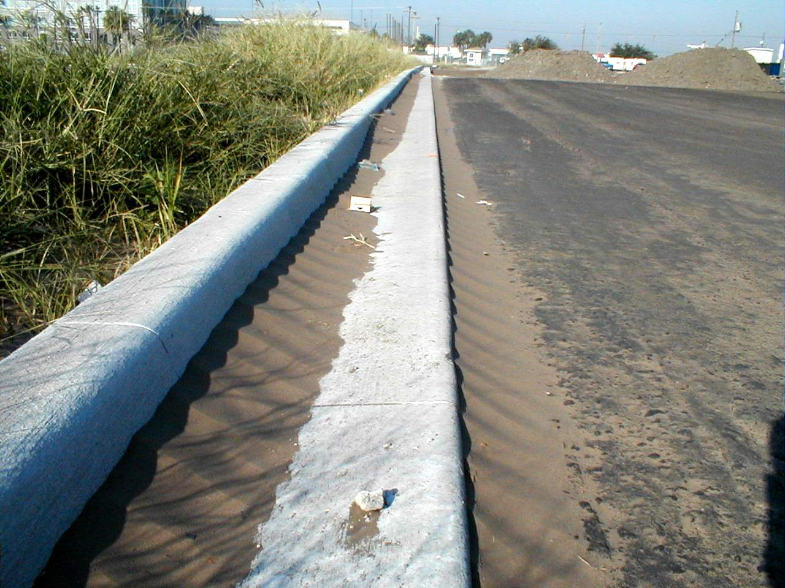
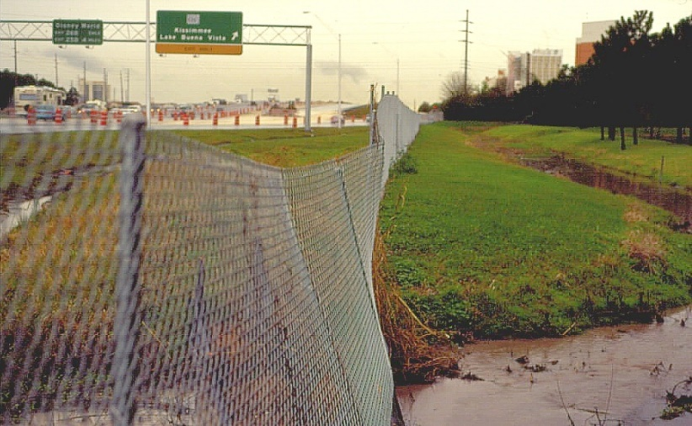
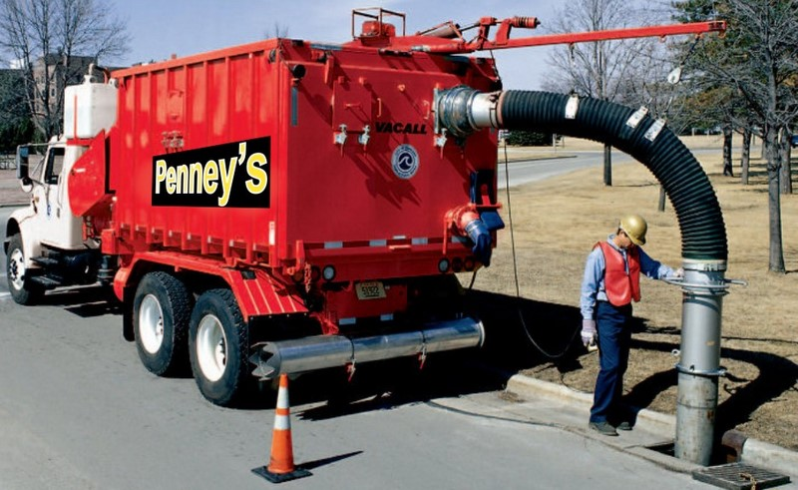
Physical Effects of Sedimentation
Increased dredging
Reduced hydraulic capacity
Increased maintenance
Decreased recreational value
Notes:
Examples of physical effects of sedimentation

Slide 28
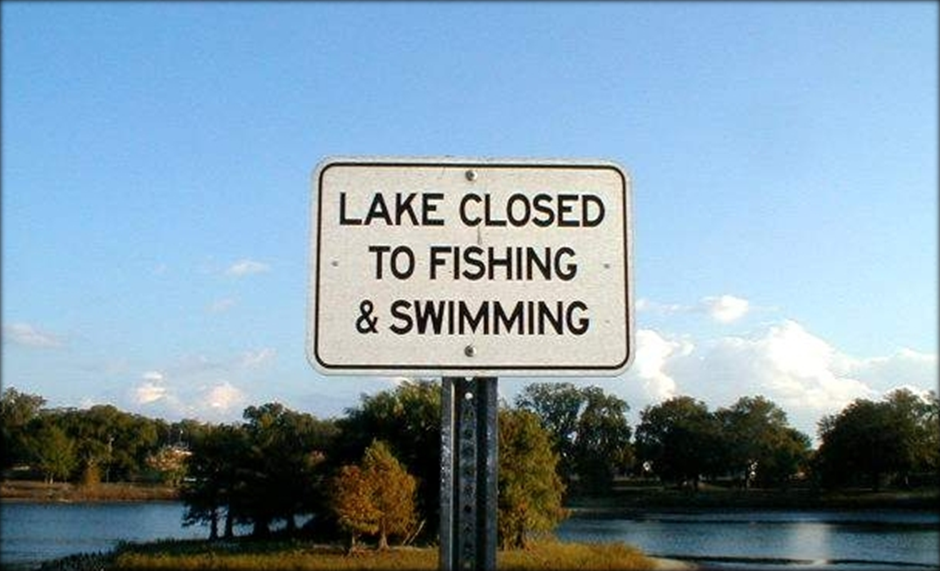
Decreased Recreational Value

Slide 29
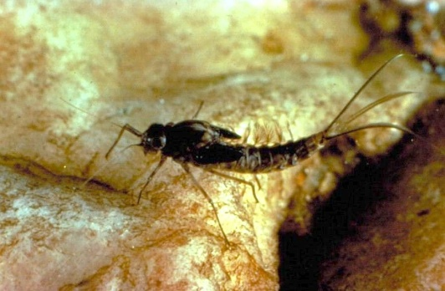
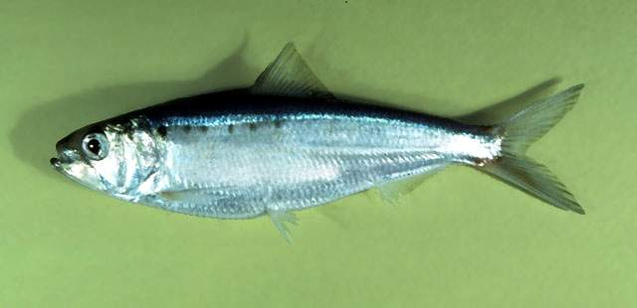
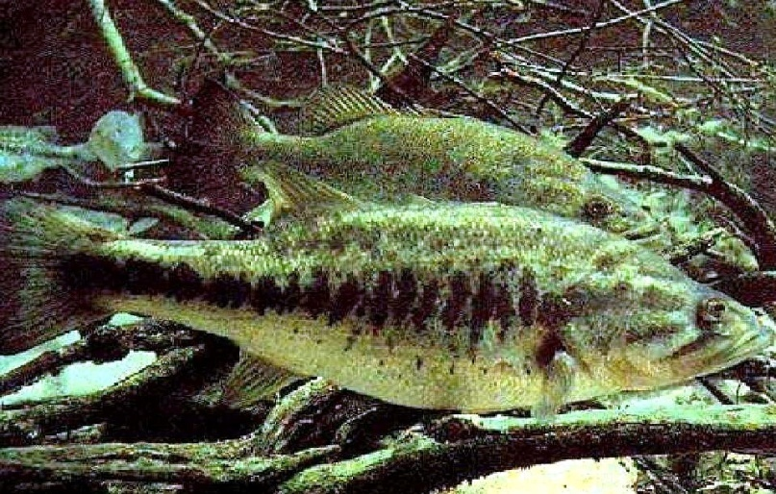
Biological Effects of Sedimentation
Screens out sunlight - decline in plant growth
Disruption of food chain - decline in sport fish and increase in trash fish.
Small amounts impair fish spawning
Large amounts clog gills
Blankets bottom which destroys habitat and suppresses aquatic life

Slide 30
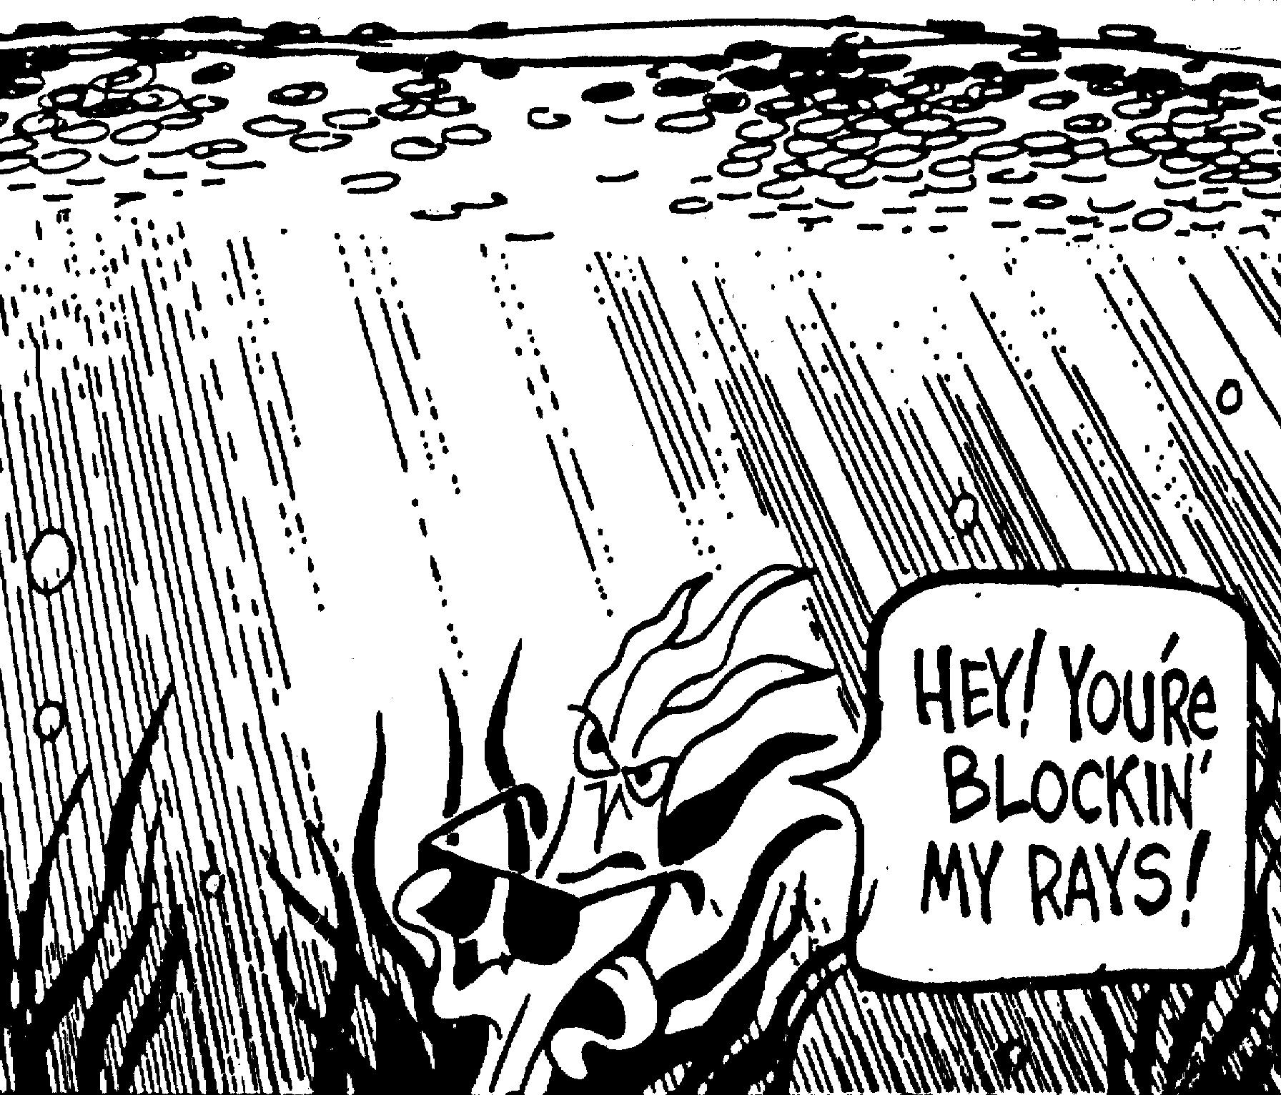
Screens out Sunlight – Decline in Plant Growth

Slide 31
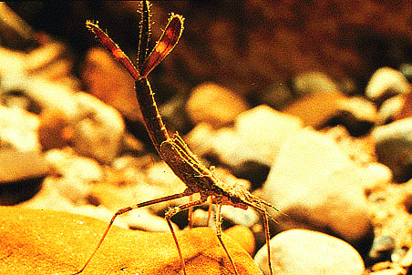
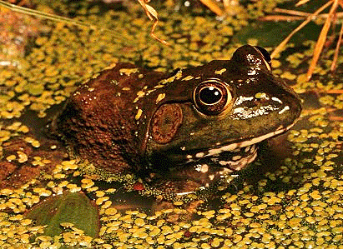
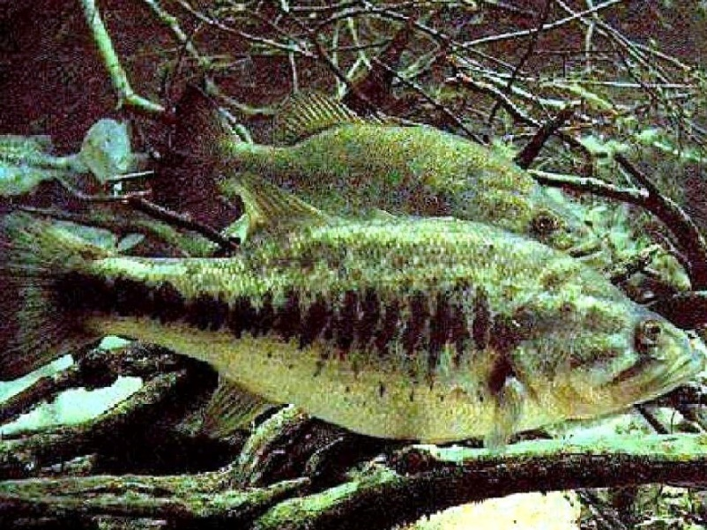
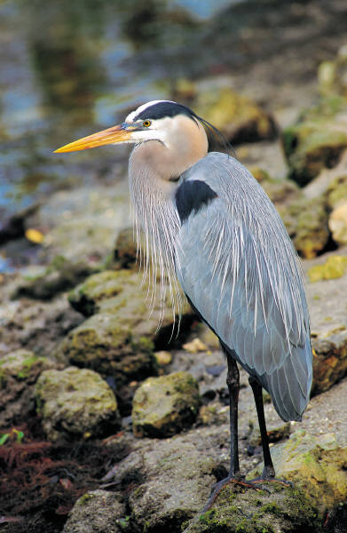
Sedimentation Disrupts Ecosystems
ECOSYSTEM

Slide 32
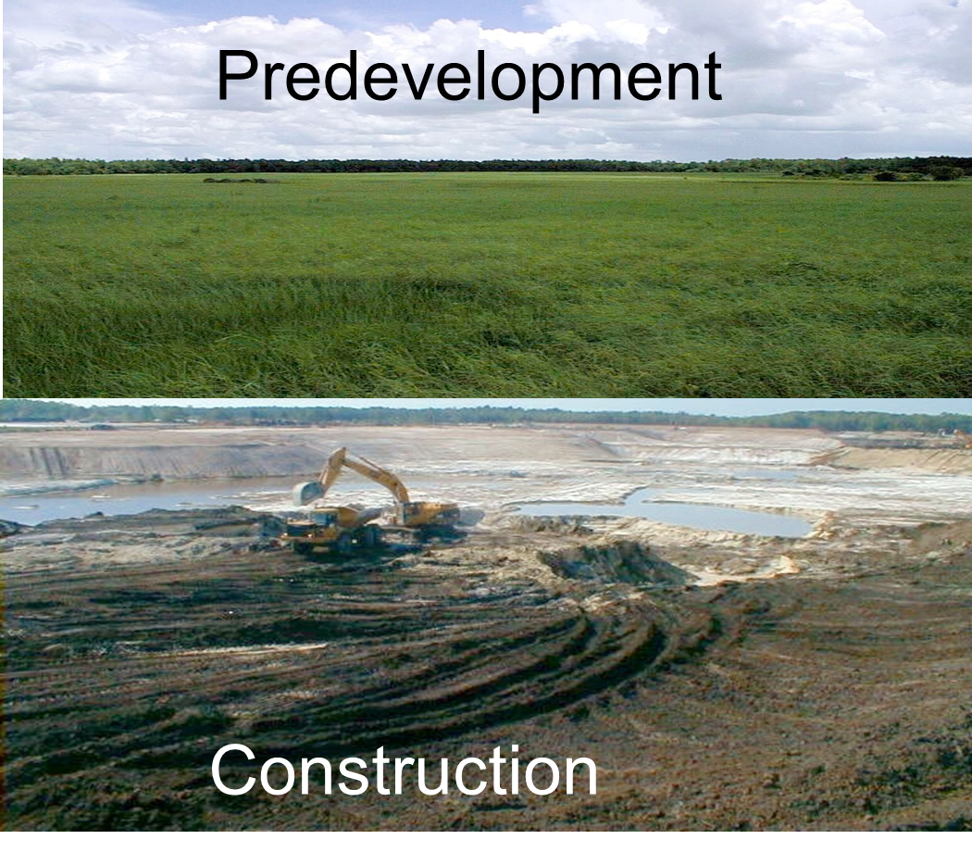
1.6 Erosion and Sedimentation Hazards Associated With Land Development
Increase in area exposed to stormwater and erosion
Alteration of runoff patterns
Alteration of ground water regime
Creation of south or west facing exposures with poor conditions for plant growth
Exposure of subsurface soils unsuitable for plant growth

Slide 33
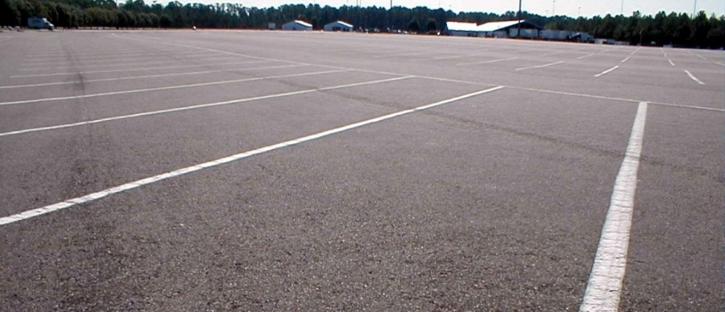
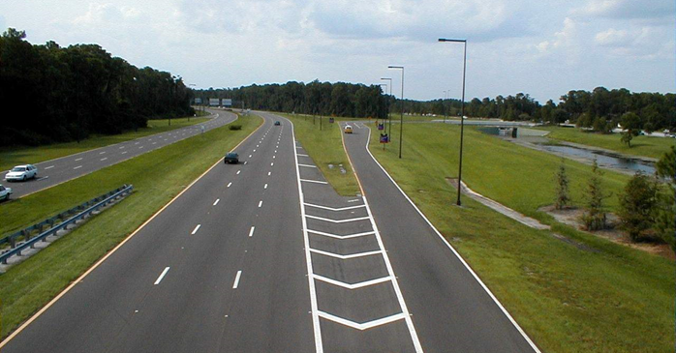
1.6 Erosion and Sedimentation Hazards Associated With Land Development
Increased volume of runoff, accelerated erosion, higher sediment yield, and higher peak flows caused by:
  Removal of existing protective vegetation
  Exposure of more erodible or less pervious subsurface soils
  Reduced permeability due to compaction by heavy equipment
  Enlarged drainage areas created by grading
  Increased impervious areas

Slide 34
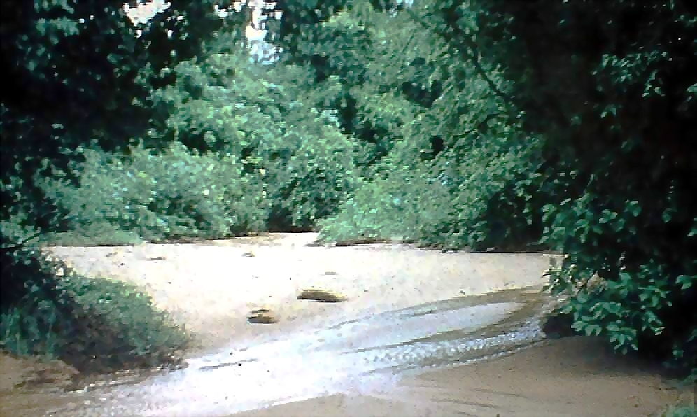
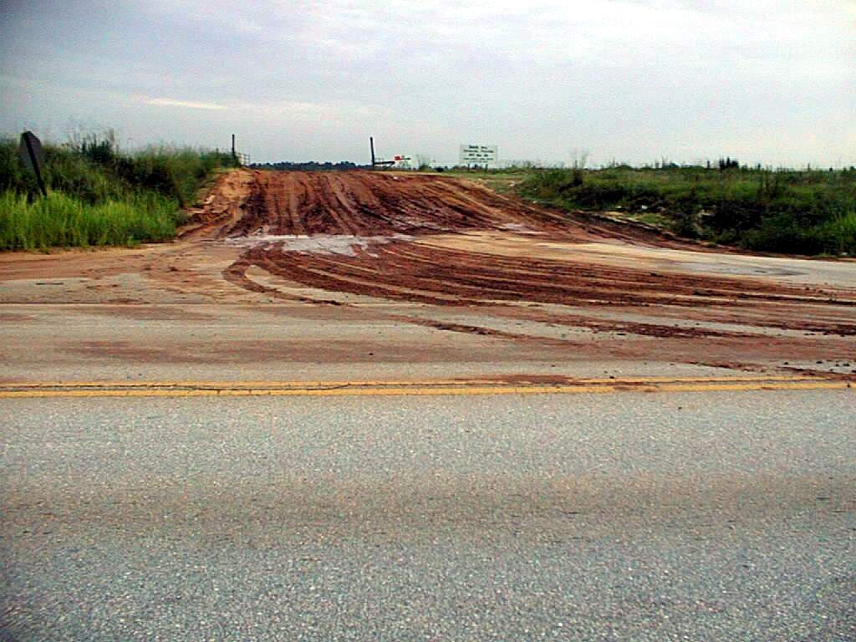
1.6 Erosion and Sedimentation Hazards Associated With Land Development
Offsite Impacts: Breached perimeter controls, mud in roads, damage to surface water and wetlands
Surface Water and Wetlands are damaged
Roadway hazards from tracked mud

Slide 35
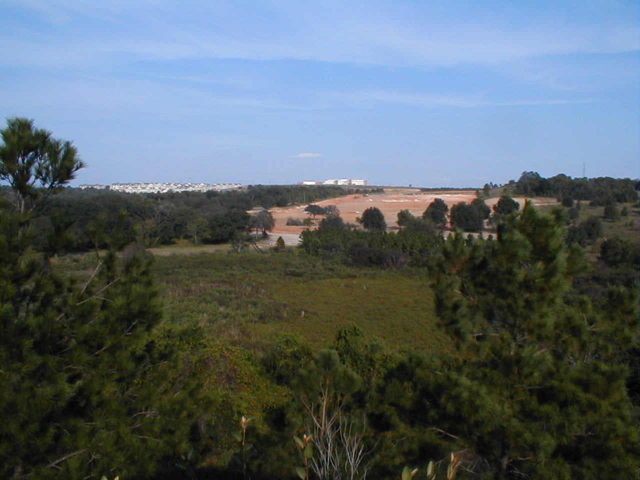
1.7 Principles of Erosion and Sediment Control
Plan the development to fit the particular topography, soils, drainage patterns, and natural vegetation of the site
Slope and clay soils
Wetland area

Slide 36
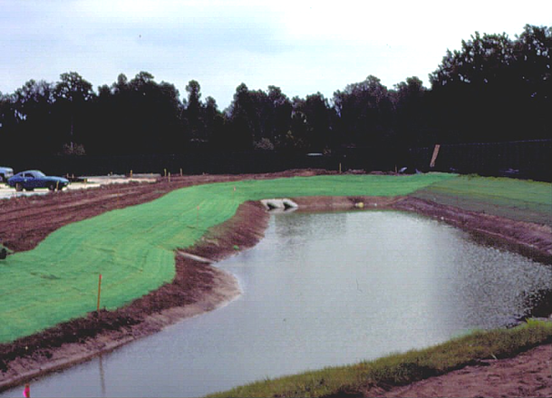
1.7 Principles of Erosion and Sediment Control
Apply erosion control practices to prevent on-site damages
Rolled Erosion Control Product - RECP
Notes:
Rolled Erosion Control Product (RECP) applied around pond with grass seed applied under the RECP.

Slide 37
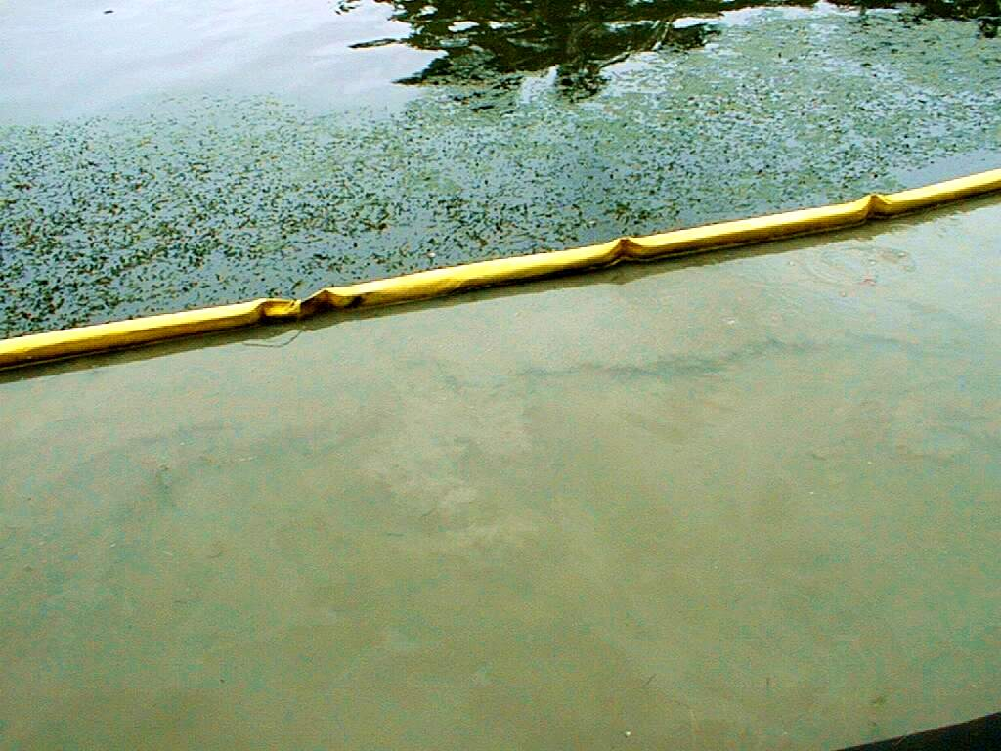


Apply perimeter control practices to protect disturbed areas from off-site runoff, and to prevent sediment damage to areas below the development site
1.7 Principles of Erosion and Sediment Control
Notes:
Isolate the development site from surrounding properties, control sediment once it is produced, preventing transport from site. Diversions, berms, sediment basins …examples

Slide 38

1.7 Principles of Erosion and Sediment Control
Keep runoff velocities low and retain runoff on-site
Stabilize disturbed areas immediately after final grading (i.e., sod), temporary seed area within one week if the final grading is several weeks away
Notes:
Keep slope length short and gradients low…use stable outlets to convey stormwater around the site… these systems should be able to hold peak flows, should be operational ASAP after start of construction.

Slide 39


1.7 Principles of Erosion and Sediment Control
Implement a thorough maintenance and follow-up program (repair, replace, improve, keep records)
Lack of inspection and maintenance
Inspected and maintained

Slide 40

Chapter 1 Review
Notes:
Please open to Chapter 1 of your review workbook. I will give you a 5 minutes to complete and then we will go over them together.

Slide 41
Chapter 1 Review
Erosion
is the process by which the land surface is worn away by the action of wind, water, and gravity.
is the settling out of soil particles transported by water and wind.
Soil erosion can be classified as ______ erosion or _______ erosion, and the sources can be either ________ or __________.
Water erosion can be classified as either _______ erosion or _______ and channel erosion.
Sedimentation
wind
water
natural manmade
overland
stream

Slide 42
Chapter 1 Review
Four processes of overland erosion are:
  Splash or rain drop erosion
  Sheet erosion
  Rill erosion
  Gully erosion
Four principal factors influencing soil erosion are:
  Soil characteristics
  Vegetative cover
  Topography
  Climate
List three physical effects of erosion and sedimentation:
  Increased flooding.
  Reduced hydraulic capacity in rivers, streams, channels, reservoirs.
  Increased maintenance of stormwater systems.
  Increased water treatment costs.
  Decreased recreational value.

Slide 43
Chapter 1 Review
List three biological effects of erosion and sedimentation:
  Reduced light for aquatic plants
  Clogs fish gills
  Impairs spawning
  Disrupts food chain
  Blankets bottom, suppresses aquatic life
  Disrupts ecosystem
Plan the development to fit the terrain using the particular:
  Topography
  Soils
  Drainage patterns
  Natural vegetation of the site
  Minimize the extent of the area exposed at one time and the duration of exposure

Slide 44
Chapter 1 Review
perimeter control
Apply practices to protect the disturbed area from off-site runoff and to protect off-site areas from sediment damage.
Apply practices to prevent excessive on-site damage.
Keep runoff velocities and runoff on the site.
It is very important to Stabilize disturbed areas
after final grading to prevent raindrop impacts from causing erosion.
Implement a thorough and _ (inspection) program as required in the Construction Generic Permit (CGP).
erosion control
low
retain
immediately
maintenance follow up

