Slide 1
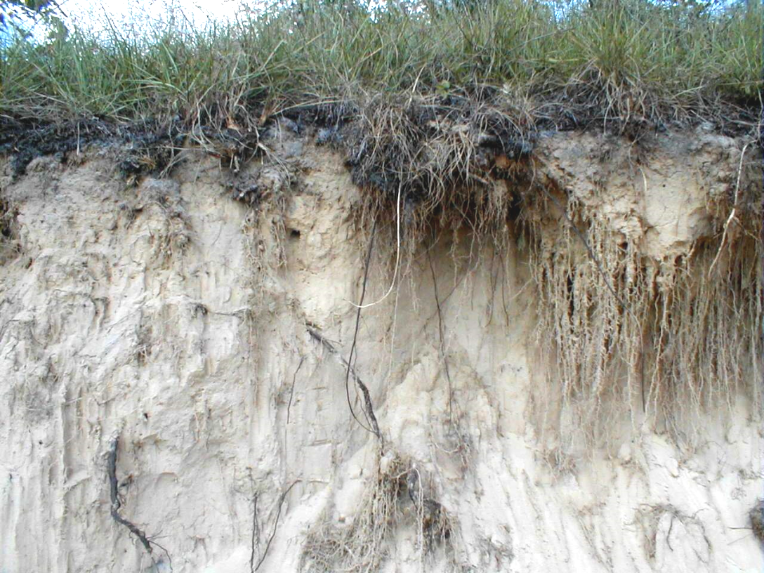
Chapter 2
Soils

Slide 2
2.1 Introduction to Soils
Five Soil Forming Factors
1. Climate
(temperature, rainfall, seasons)
2. Topography
(flatwoods, depressions, ridges)
3. Organisms
(plants, animals, microbes, humans)
4. Parent Material
(marine sand, limestone, organics)
5. Time

Slide 3
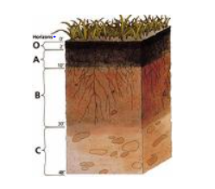
Soil Profile Horizons
O Horizon (organic layer)
A Horizon (mineral topsoil)
E Horizon (mineral)
B Horizon (subsoil)
C Horizon (parent material)
R Horizon (bedrock material)
Real world soils may be missing horizons, include additional horizons, or even repeat sequences of horizons
Notes:
Reference: U.S. Department of Agriculture, UF/IFAS Extension Service, University of Florida, IFAS, Florida A & M University Cooperative Extension Program, and Boards of County Commissioners Cooperating. Nick T. Place, dean for UF/IFAS Extension.

Slide 4
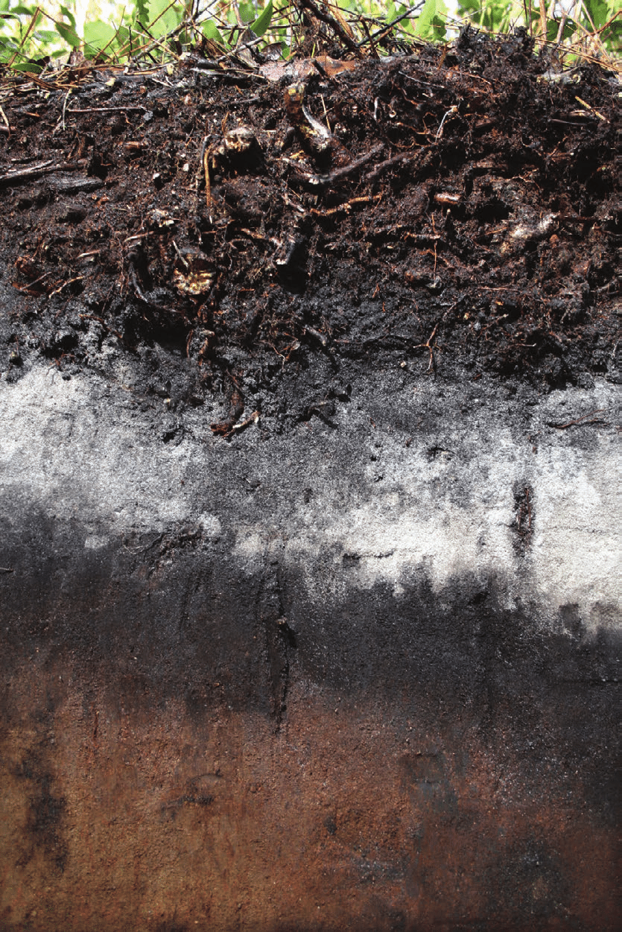
Soil Profiles - Continued
O-horizon – accumulation of plant litter
A-horizon – accumulation of organic matter and hummus
E-horizon – heavily leached, usually by groundwater processes
B-horizon – accumulation of clay/silt and redeposited organics
C-horizon – parent material
Notes:
Here is an example of a soil profile. Point out the different horizons.

Slide 5
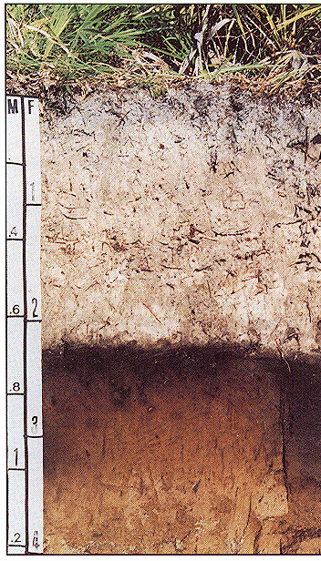
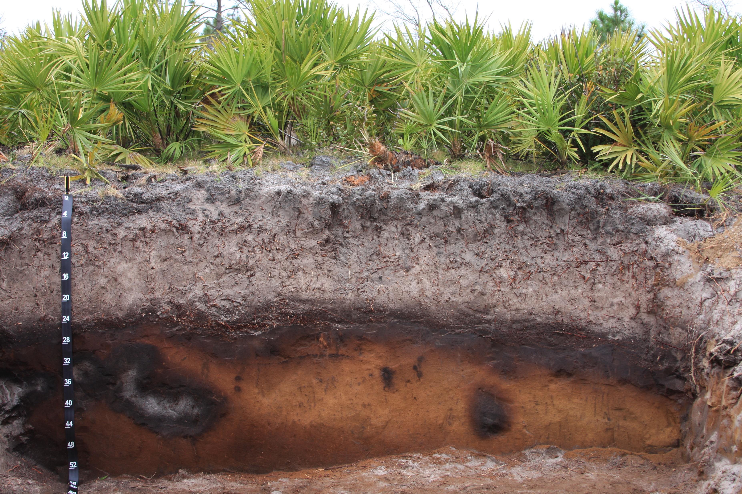
State Soil of Florida
Myakka fine sand
Notes:
MYAKKA SERIES On May 22, 1989, Governor Bob Martinez signed State Senate Bill No. 524 into law, making Myakka fine sand the official state soil of Florida.
You can find more information about Myakka fine sand characteristics in your manual.

Slide 6
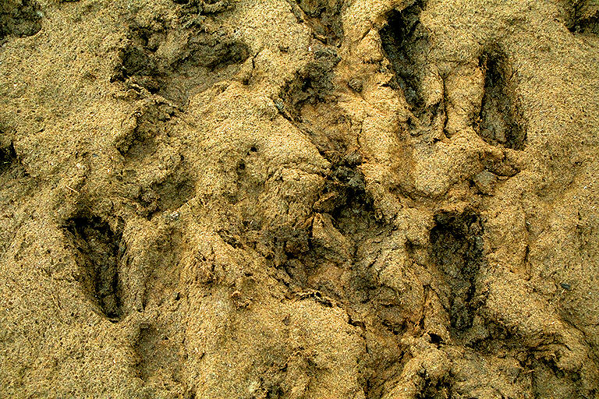
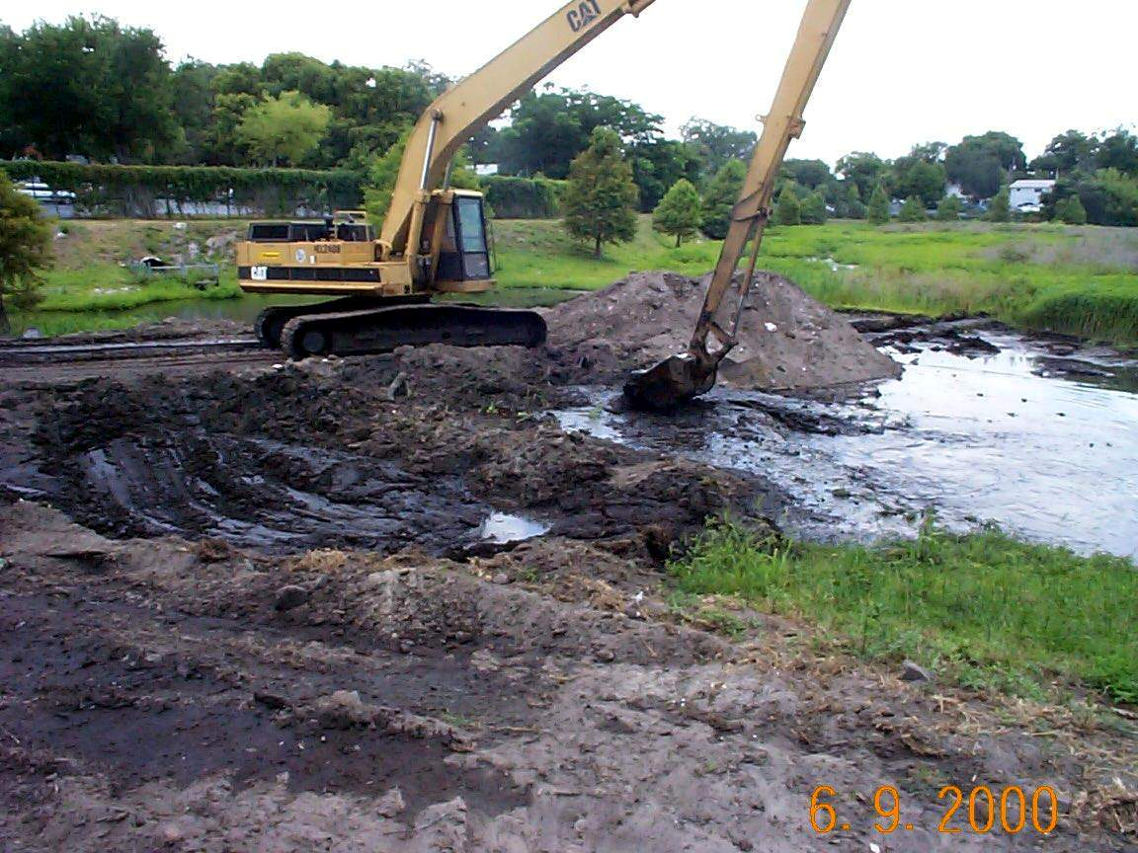
Clay & Muck
Clay & muck soil types cause the most compliance problems with erosion and turbidity control.
Notes:
As you can imagine clay is the 2 soil type that we have the most problems with in Florida. Muck as well can erode and cause major turbidity violation to the surface waters of the state.

Slide 7
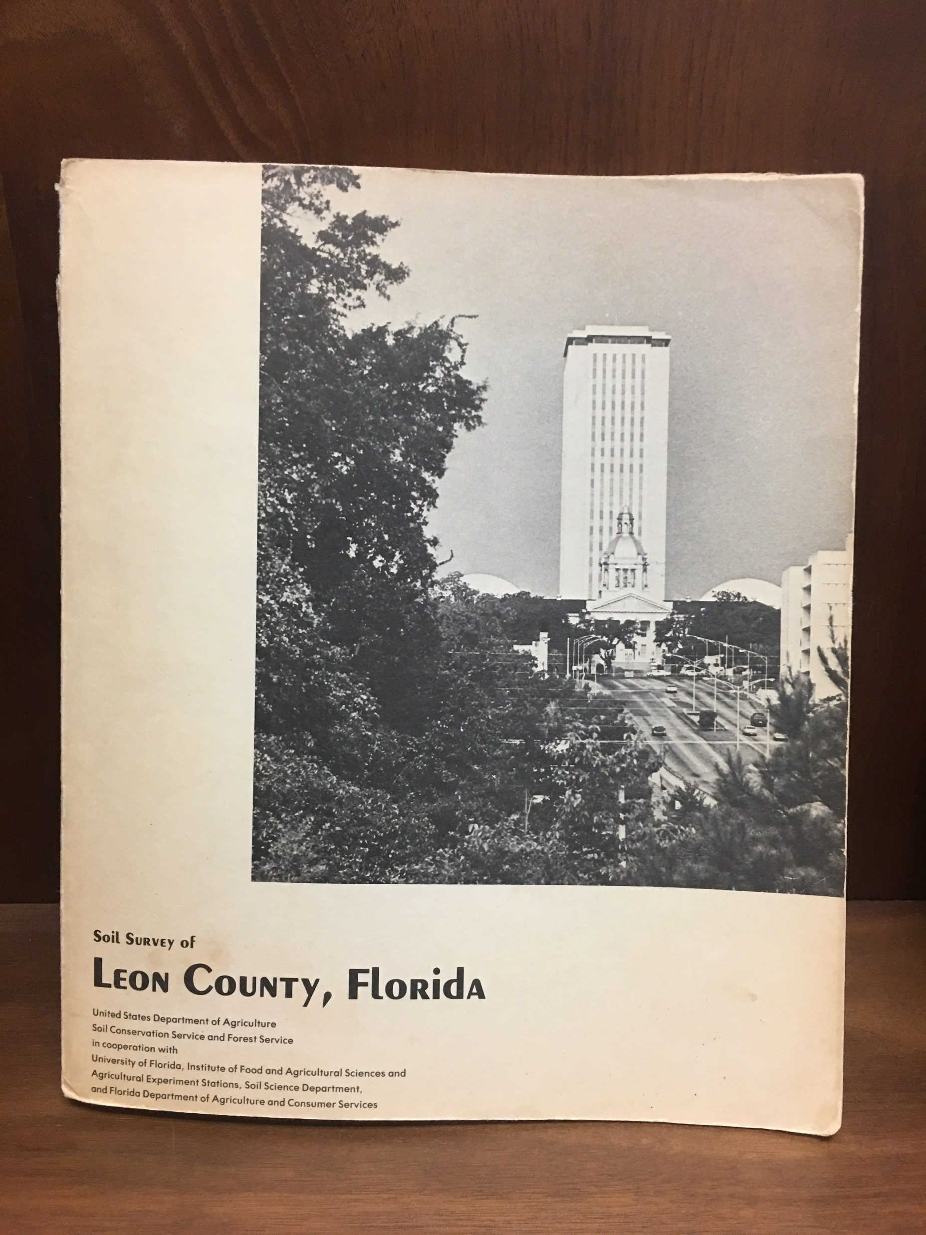
2.2.1 Soil Classification
Soil Texture
Soil Hydrologic Group
USDA
Soil
Classification
Notes:
Soils are classified in 2 groups: texture and hydrologic group. Soil Texture includes particle size, organic matter, soil structure, and soil permeability. The Soil Hydrologic group is a direct reflection of the infiltration rate of the soil.

Slide 8
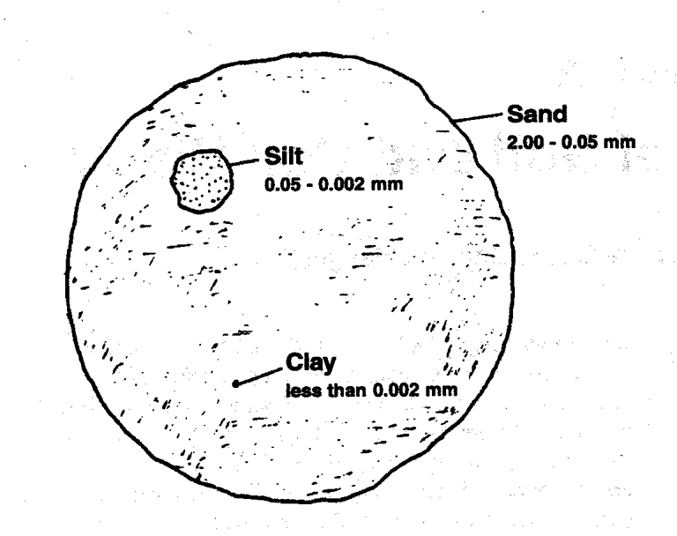
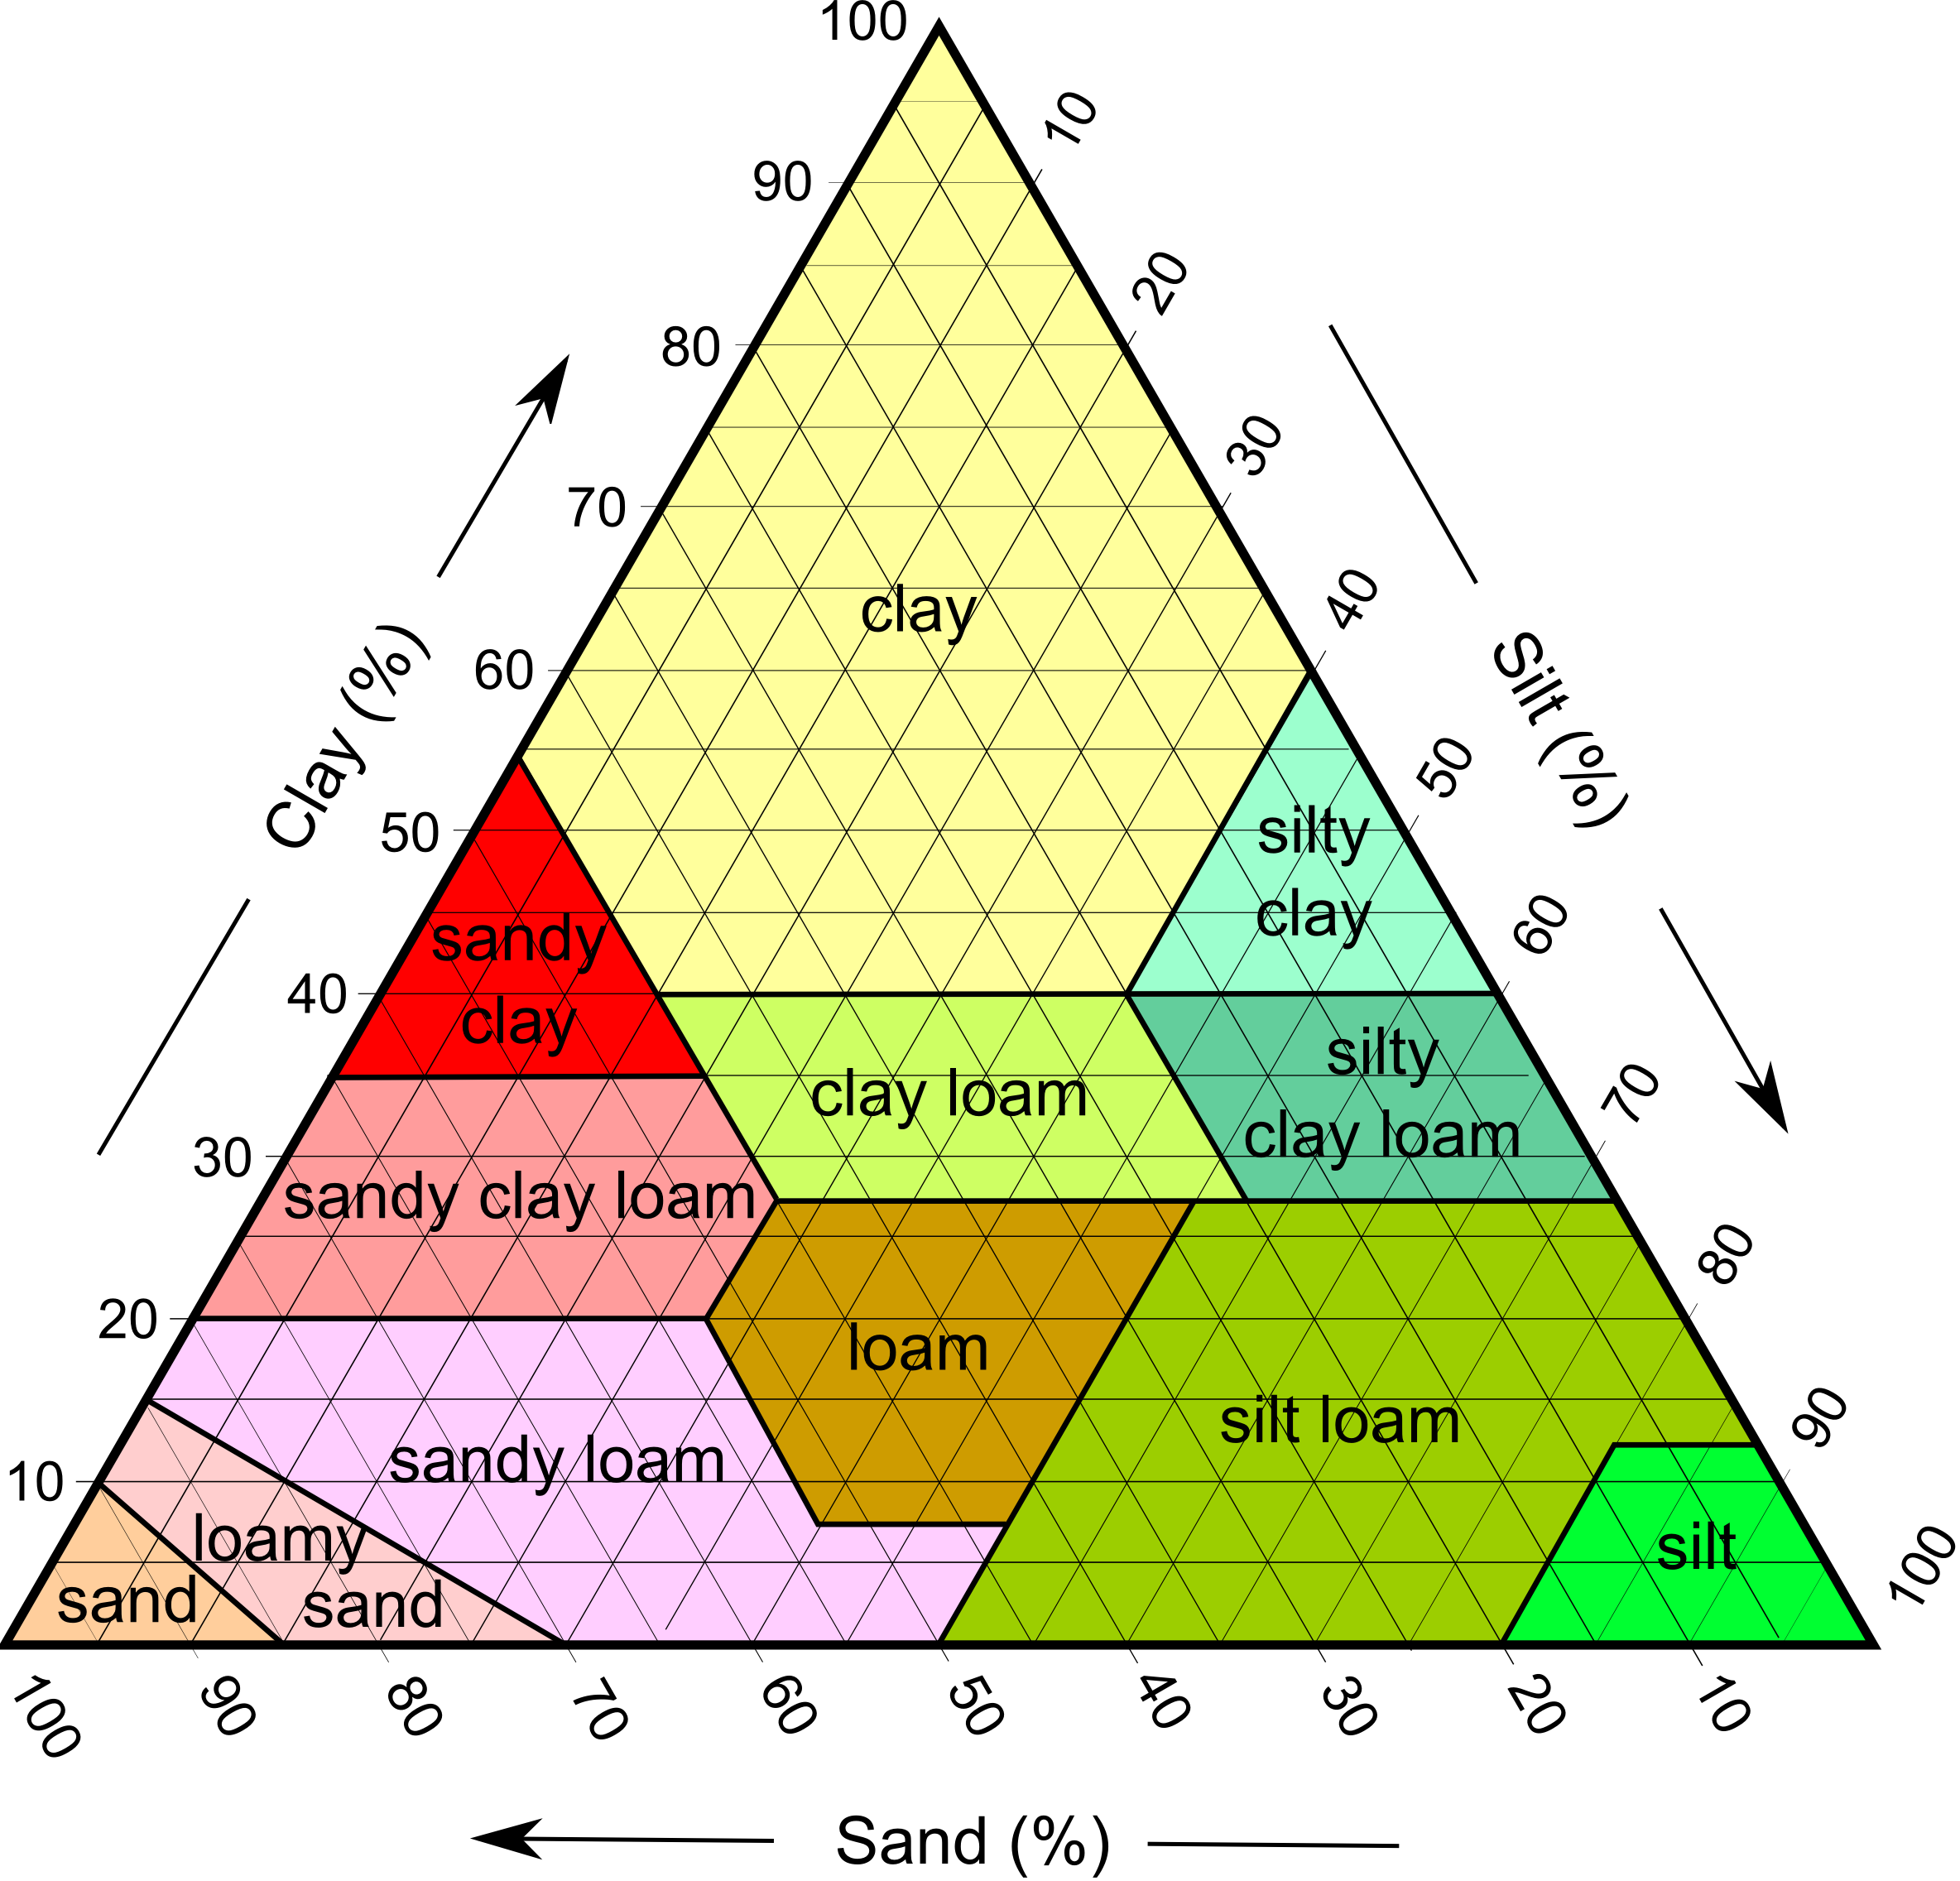
2.2.1 Soil Texture
Depends on proportions (by weight) of sand, silt, and clay
Particle Class Diameter (mm) Feel
Sand 0.05 – 2.00 Gritty
Silt 0.002 – 0.05 Silky
Clay < 0.002 Play dough
Soil Texture Triangle
Notes:
Organic matter is decomposed plant and animal litter. Soils with organic matter are less susceptible to erosion. An example is grassed soil versus bare soil. If the organic layer (the topsoil=O and A horizon) is left undisturbed, then soil erodibility will be much lower.
Soil structure is the arrangement of particles in the soil. You want to try to keep original soil structure. If compaction and grading occur during construction, it will destroy soil structure.
Soil Permeability refers to the ability of the soil to allow air and water through it. Texture, organic matter, and structure all contribute to permeability. For example, larger particles(sand) allow spaces in between the particles, therefore allowing more water to permeate into the soil in between the large particles.
Sand acts like a sponge. As you increase a soil’s permeability, more rainfall can be absorbed and you will decrease runoff potential. Whereas, clay and muck particles are small and can easily bind together leaving very little space between each soil particle. So not a lot of water can penetrate into this soil. As a result, runoff and soil erodibility potential is much higher.

Slide 9
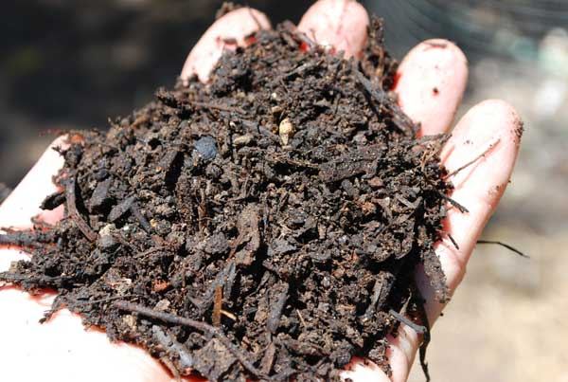
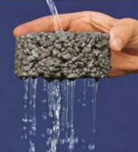
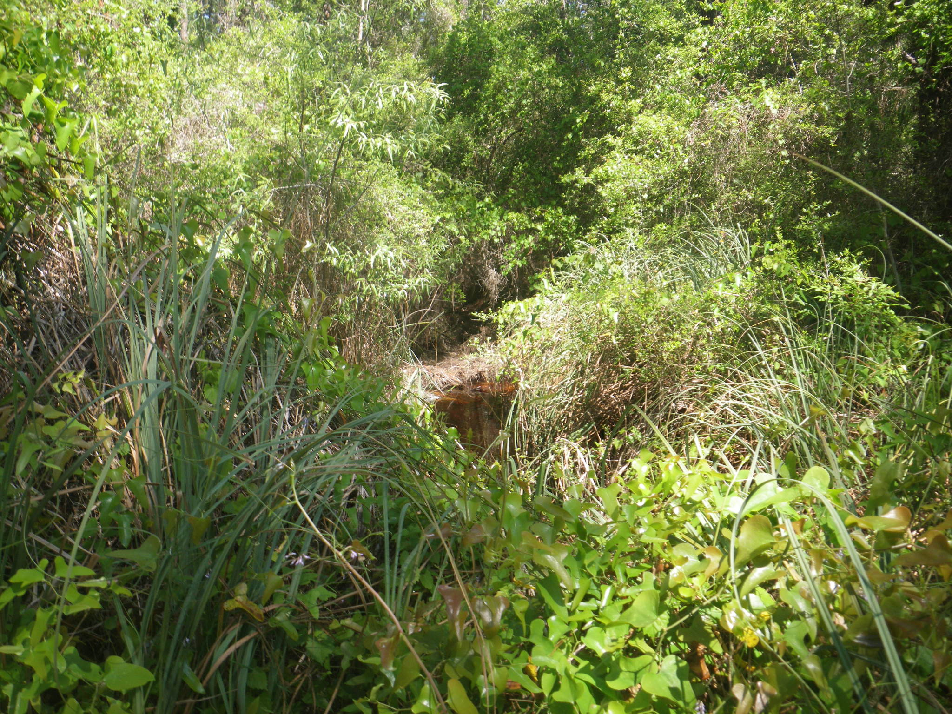
2.2.1 Soil Structure
Organic matter and vegetation increase permeability and water holding capacity and decrease erosion

Slide 10
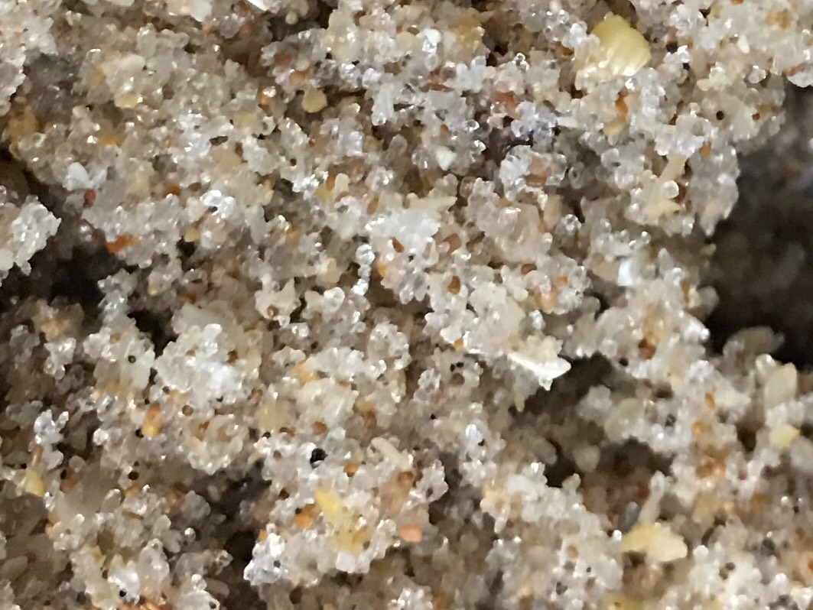
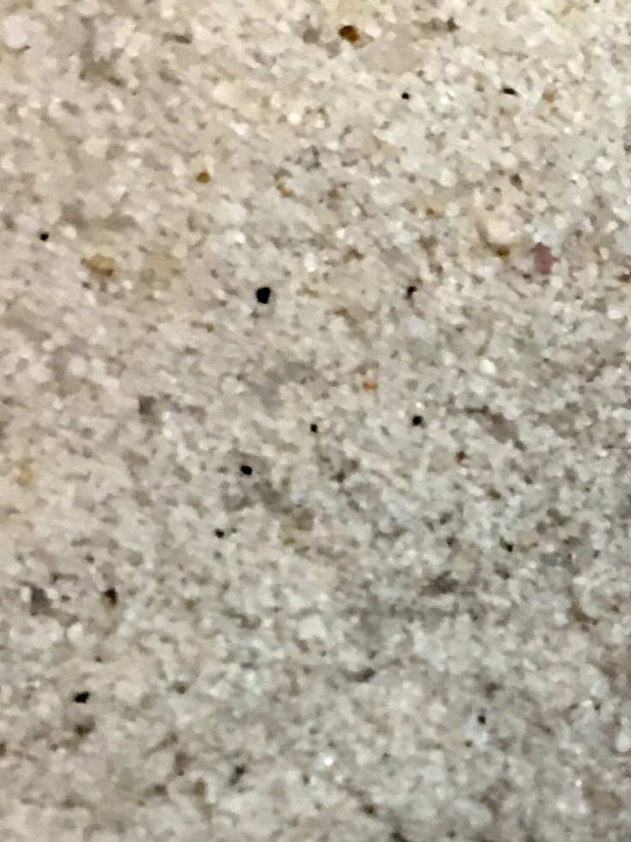
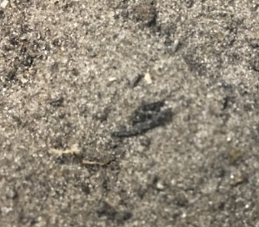

2.2.1 Soil Hydrologic Group
Hydrologic Groups Reflect Infiltration and Runoff Potential
A- Soils having high infiltration rates even when thoroughly wetted (low runoff potential)
B- Soils having moderate infiltration rates when thoroughly wetted
C- Soil having slow infiltration rates when thoroughly wetted
D- Soils having very slow infiltration rates when thoroughly wetted (hi runoff potential)

Slide 11
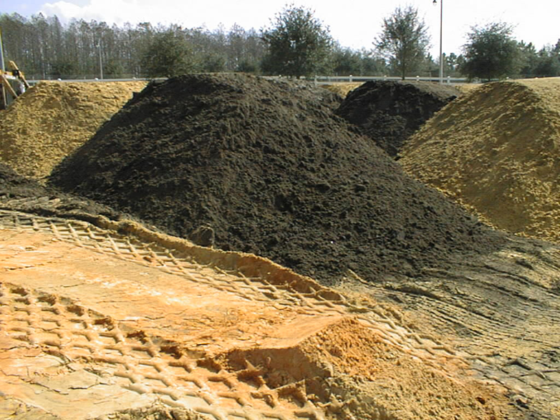
2.2.2 Soil Properties
Erodibility
Slope
Shrink-Swell
Soil pH
Wetness
Depth to Bedrock
Flood Vulnerability (Flood Prone)
Notes:
A soil’s properties will affect its ability to support heavy loads, percolate rainwater, grow vegetation, etc. Erodibility is often referred to as the Factor K. The slope of the land will affect runoff potential, the longer and steeper the slope, the more potential for soil loss. The shrink-swell property of soil can play an important roll in determining what is constructed on top of that soil. For instance, soils with a high shrink-swell capability will shrink when dry and swell when wet. You probably do not want to build a building or other structure on top of this type of soil which is constantly changing. Flood hazard refers to the soils typically found in floodplain area, such as depressional areas, wetlands, etc. Soil pH doesn’t really have an effect on construction activities, but it can play an important role in post-construction landscaping. If a soil has too high or low pH, it may affect how well the planted landscape grows. Soil wetness refers to the seasonal water table. Some soils will have water tables that remain at the surface or pond above the surface for a few months out of the year. Depth to bedrock is an important property to know especially when you’re digging ponds. You also want to be aware of the depth to the clay layer or spodic horizon.

Slide 12
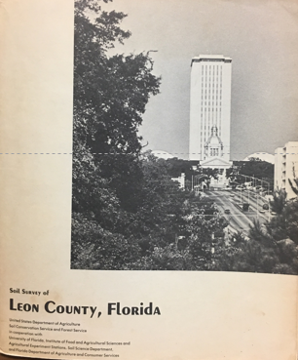
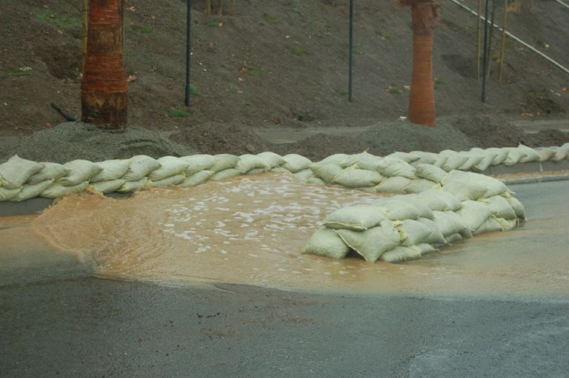
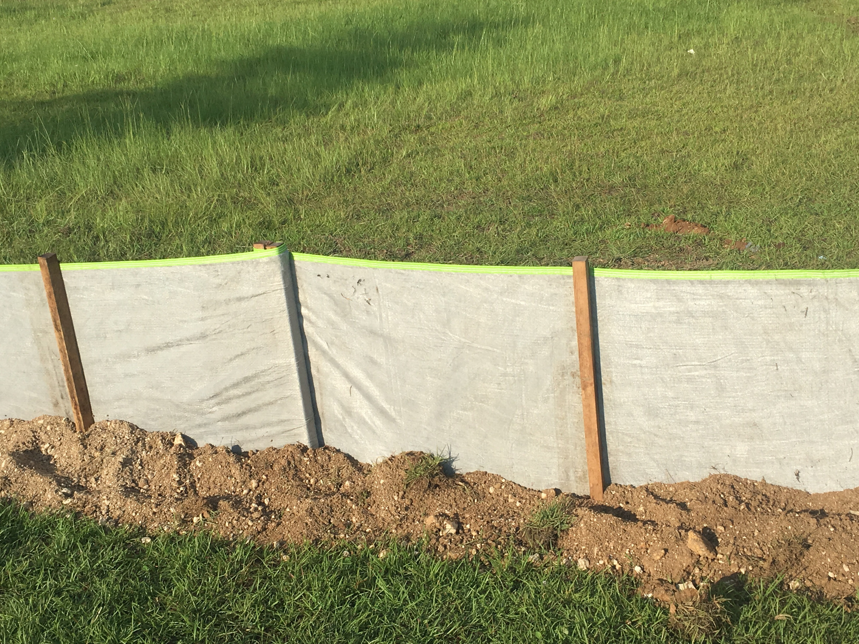
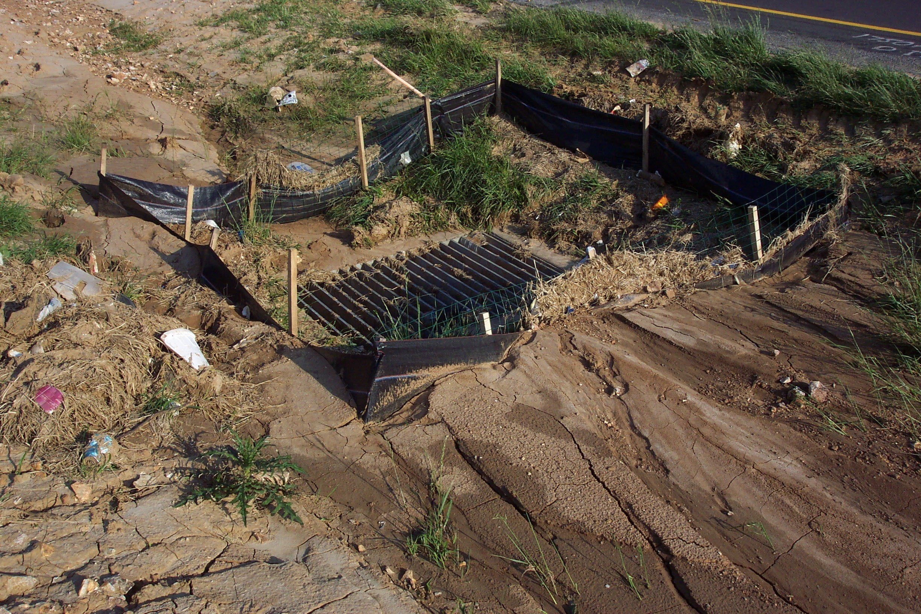
2.3 Soil Surveys
Map of soil types across a given area, usually county by county, most now digitized in GIS or other electronic format
Developed jointly by Natural Resources Conservation Service (NRCS), universities, local Soil and Water Conservation Districts
Initial fieldwork often dates back decades (40’s – 60’s), soils change slowly
Useful in determining soil conditions and planning proper BMPs and informing development

Slide 13
2.4 Predicting Soil Loss
THE REVISED UNIVERSAL SOIL LOSS EQUATION (RUSLE)
A = R x K x L x S x C x P
There are 6 major factors affecting soil loss according to the RUSLE:
A = Average annual soil loss (tons/acre)
R = Rainfall erosion index (100 ft. tons/acre-in/hour)
K= Soil erodibility factor (soil survey data)
L = Slope length factor (dimensionless)
S = Slope gradient factor (dimensionless)
C = Vegetative cover factor (dimensionless)
P = Erosion control practices factor (contractor)

Slide 14
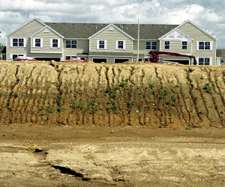
2.4 Predicting Soil Loss
A - The Soil Loss Factor
This is an estimated annual average of the soil eroded from the site in an average year.

Slide 15
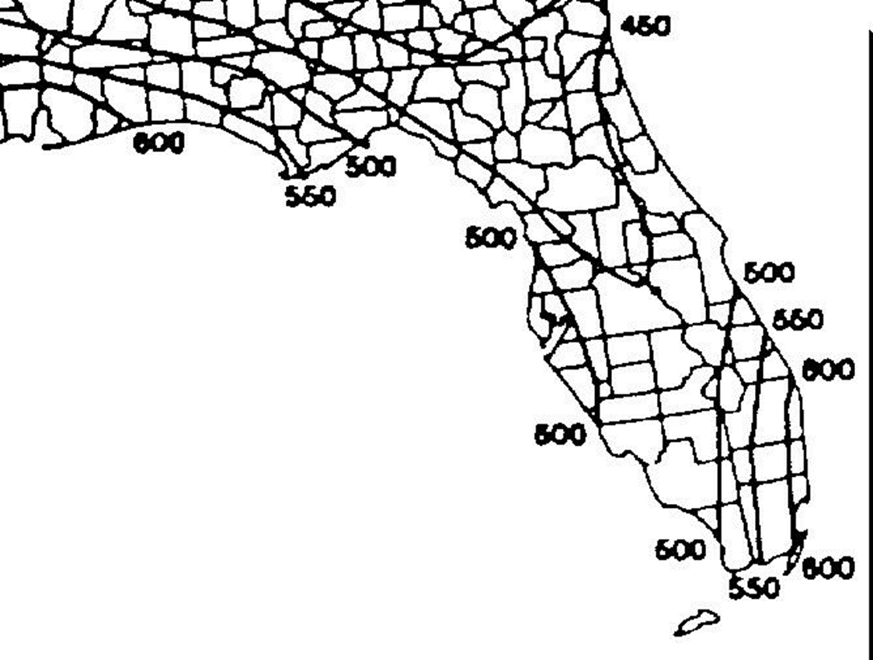
2.4 Predicting Soil Loss
R - The Rainfall Erosion Index
This is a measure of erosive force/intensity of rain in a normal year.
*Isoerodent Map (EPA2001)

Slide 16
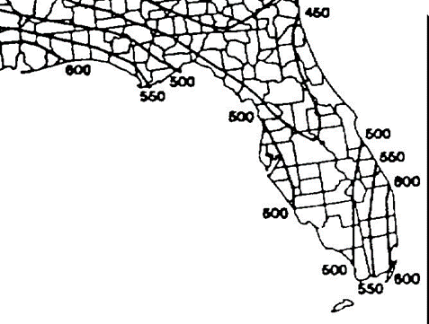

2.4 Predicting Soil Loss
Comparing Rainfall Factors Universal Soil Loss Equation
PACIFIC
NORTHWEST
FLORIDA
R = 340
R= 500-600
Although the Olympian Rain Forest receives twice the annual rainfall of Florida, the R Factors in Florida are much greater.
Due to rain drop geometry and rainfall intensity Florida has a climate with very erosive conditions (high R Factors).

Slide 17
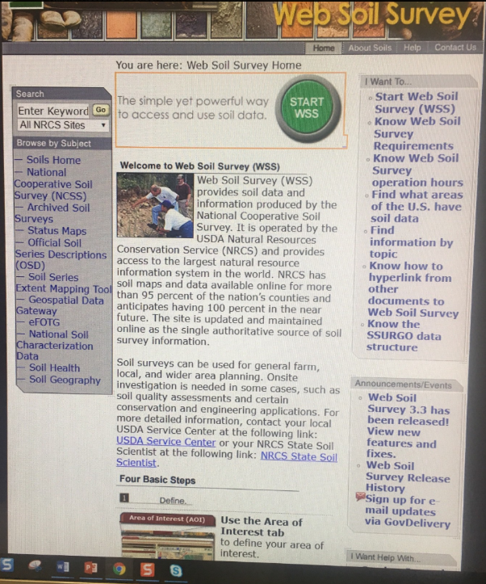
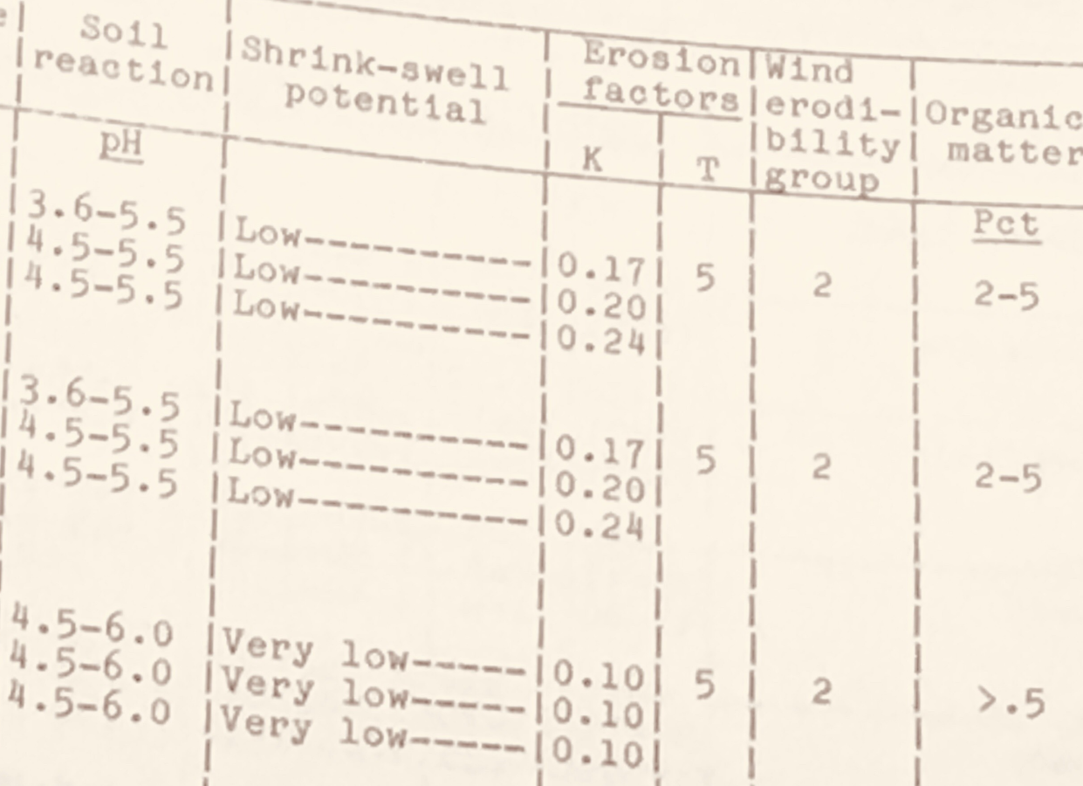
2.4 Predicting Soil Loss
K - The Soil Erodibility Factor
A measure of the soil’s susceptibility to detachment and transport by rainfall and runoff.
http://websoilsurvey.nrcs.usda.gov

Slide 18
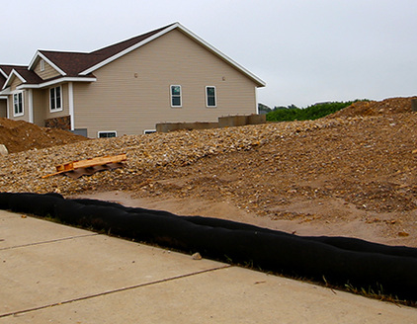
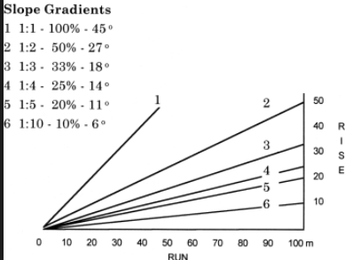
2.4 Predicting Soil Loss
L and S - The Slope Length and the Gradient (Steepness) Factors
This is described by the combined effect of slope length and slope gradient.

Slide 19
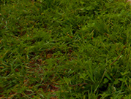
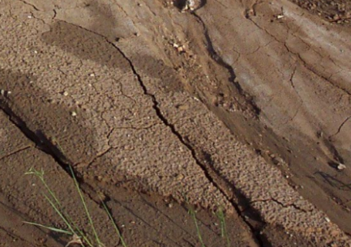
2.4 Predicting Soil Loss
C – The Vegetative Cover Factor
This is the ratio of soil loss from land under specified types of cover to the corresponding loss from tilled or disturbed bare soil.

Slide 20
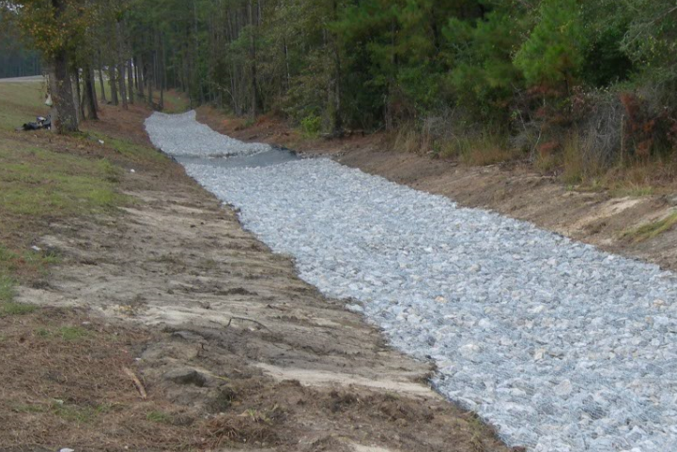
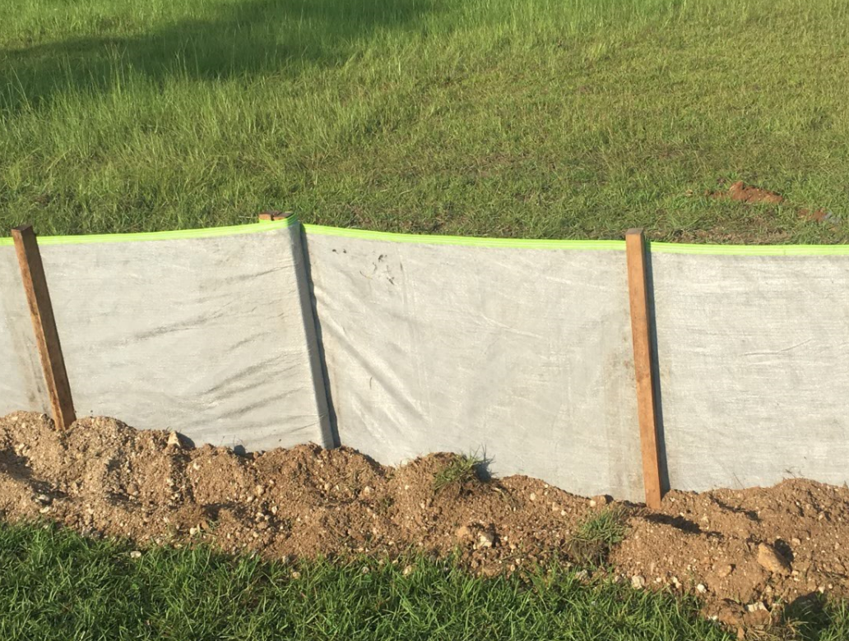
2.4 Predicting Soil Loss
P – The Erosion Control Practices Factor
This accounts for the selected erosion control practices of the contractor that reduce and control the erosion potential of the runoff by reducing the runoff velocity and the tendency of runoff to flow directly down slope.

Slide 21
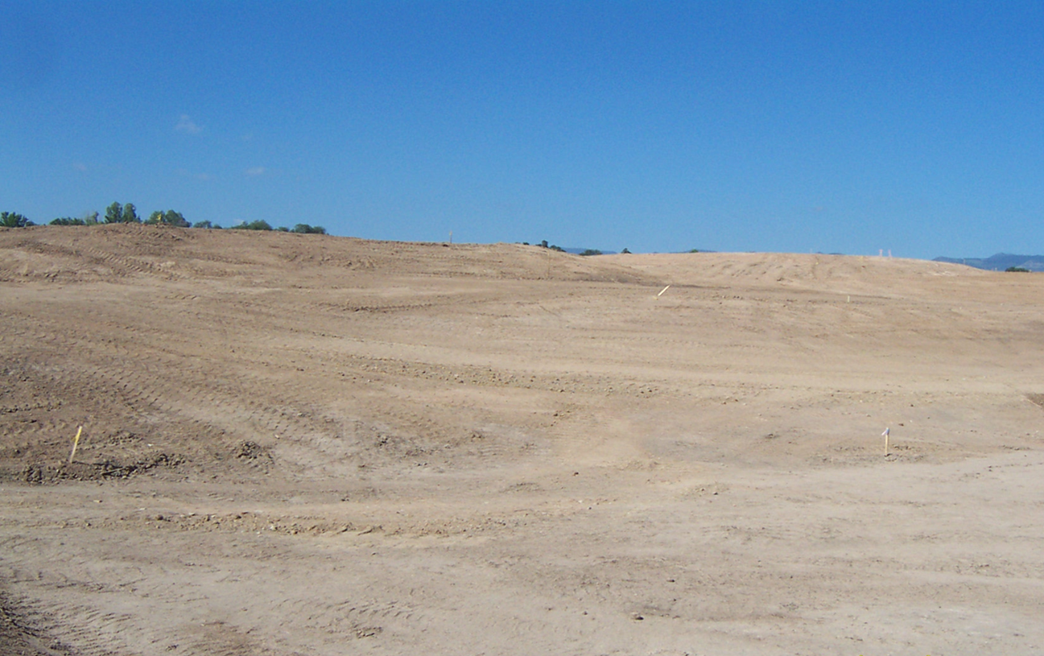
2.4 Predicting Soil Loss
Using the RUSLE for 5 acres with R = 600, L = 600 ft., 5% slope, K = 0.28 what is the difference if the only changes are to C (cover factor)?
A cover factor of 1 (bare soil) would result in annual soil loss of 66 cubic yards, the equivalent of 5 dump truck loads of soil.
A cover factor of 0.15 (well managed) would result in annual soil loss of only 4 cubic yards! Much more manageable

Slide 22
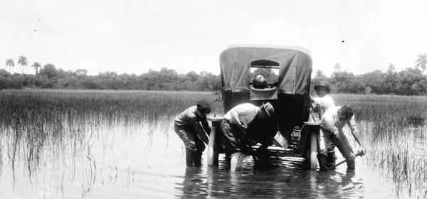
2.4 Predicting Soil Loss
Rainfall is the only factor not under your control!

Slide 23
2.4 Predicting Soil Loss
What can you do to minimize soil loss????
1. Protect soil from raindrop impacts
2. Minimize compaction when appropriate
3. Minimize slope length
4. Minimize slope gradient (steepness)
5. Minimize peak flow
Notes:
So now that you have the ability to calculate the amount of soil loss from your site, you can try to minimize that soil loss. Try to keep vegetation on the soil and try to clear only the area you’re working in. Minimize compaction which will help maintain the original soil structure thereby maximizing soil permeability. Minimize slope length and gradient, again these two factors are probably the most easily manipulated. Minimize the peak flow. Try to keep off-site runoff through your site to a minimum.
Unfortunately, we don’t always have a choice in the construction site we’re on, so we’re sometimes stuck with the soil conditions. Utilizing your basic knowledge of soils and soil loss you should be able to identify any potential problems and minimize soil loss from you site.

Slide 24
2.4 Predicting Soil Loss
In Summary
Be concerned about sediment yields
Don’t leave bare ground conditions for extended times
Large amounts of sediment can leave the site quickly – one large rain event can move tons!
Stabilize disturbed lands ASAP to save $$money$$

Slide 25
Chapter 2 Review
clay
Soil particles smaller than 0.002 mm are classified as _______ and along with _______are the two soil types that cause the most erosion/turbidity problems in Florida and the World.
Soils in the Type A hydrologic group have ____infiltration rates and _____ runoff potential even when thoroughly wetted.
Soils in the Type D hydrologic group have very _____ infiltration rates and _____ runoff potential when thoroughly wetted.
muck
high
low
low
high

Slide 26

Chapter 2 Review
rainfall erosion index
The __________________ is the only factor in the Universal Soil Loss Equation which is beyond the developer's control.
Slope________________, and ______________ are the two factors most easily manipulated by the developer.
The RUSLE is used on our construction sites to predict ___________ .
Stabilize disturbed lands immediately to save ____________
Who can you contact for a soil survey information? FDOT, FDEP, Water Management District, Mayor’s Office, or NRCS.
length & gradient
vegetative cover
Soil Loss
$ MONEY!!!

Slide 27
Chapter 2 Review
What are the soil forming factors?
Climate
Topography
Organisms
Parent material
Time

Slide 28
Fun Fact
Did You Know?
If you get a rainstorm that drops one inch of rain on your half acre lot with house, you just received over 13,000 gallons of water! That’s equivalent to a 24-foot diameter above ground swimming pool!

