Slide 1
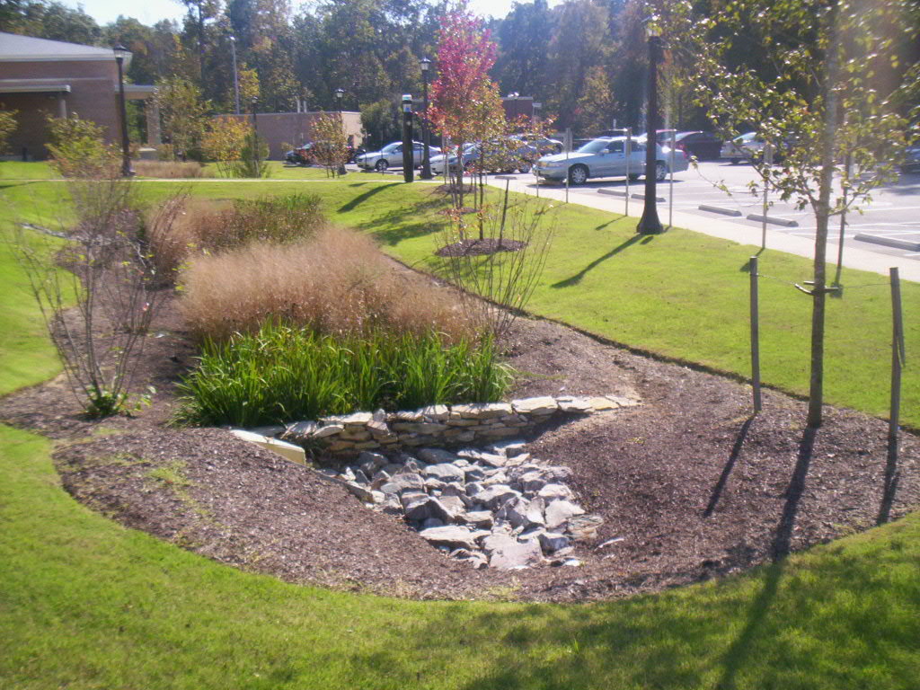
Chapter 4
Vegetation for Erosion Control
Chapter 4
BMPs – Vegetation for Erosion Control

Slide 2
Vegetation for Erosion Control
Introduction
The most cost-effective form of erosion control is vegetation.
Success depends on the proper:
Application
Installation
Maintenance of vegetative BMPs.

Slide 3
4.2 Surface Roughening
Definition: Providing a rough soil surface by creating horizontal depressions
Purpose:
To aid in establishment of vegetation
To reduce velocity and increase infiltration
To reduce erosion and provide minor sediment trapping
Condition where practice applies:
Slopes to be stabilized with vegetation
Temporary slopes roughened & loosened prior to seeding
Graded areas, that will not be stabilized immediately may be roughened to reduce velocity until seeding takes place.

Slide 4
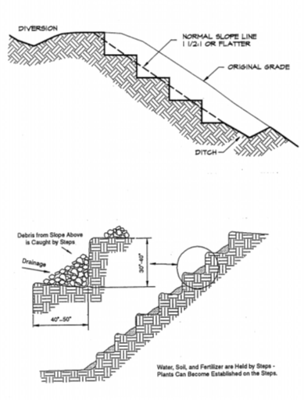
4.2 Surface Roughening
Stair Stepping
Large steps cut with dozer blade; 40 - 50” horizontal, 30 - 40” vertical, angled back from slope
Most slopes greater than 3:1 can’t be mowed; stair stepping helps natural or planted vegetation take hold

Slide 5
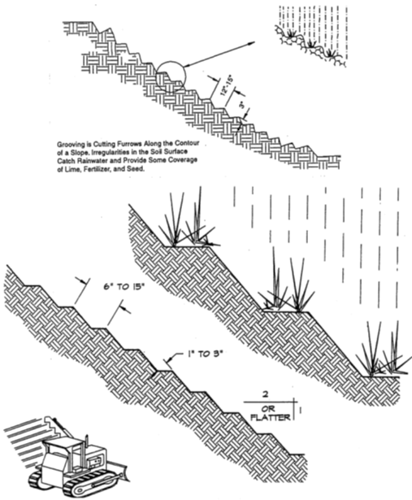
4.2 Surface Roughening
Grooving
Smaller cuts done w/ side attachment; 1 - 3” deep, 6 - 15” on center
Should be recut as steps fill in on active slopes, otherwise planted immediately

Slide 6
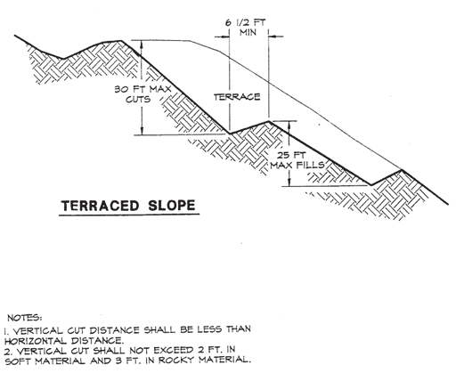
4.2 Surface Roughening
Terracing
Largest cut type; 6 - 7’ bench, 25 -30’ vertical separation
Often part of final landscaping design
Allows for planting of larger shrubs and trees

Slide 7
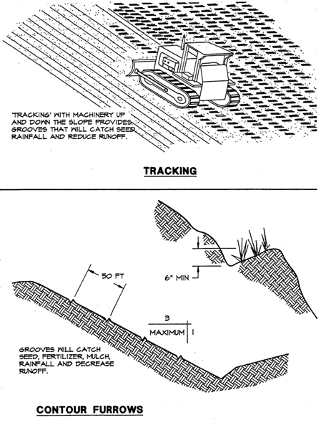
4.2 Surface Roughening
Tracking
Slope driven over by tracked equipment to create small furrows; up & down, not sideways
Only for actively worked slopes, otherwise temporary seed should be added
Rework daily
Notes:
REPLACED SCREEN SHOT with clearer picture

Slide 8
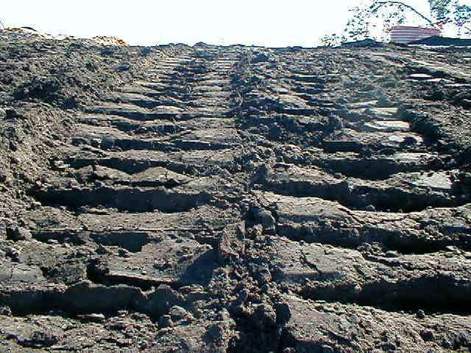
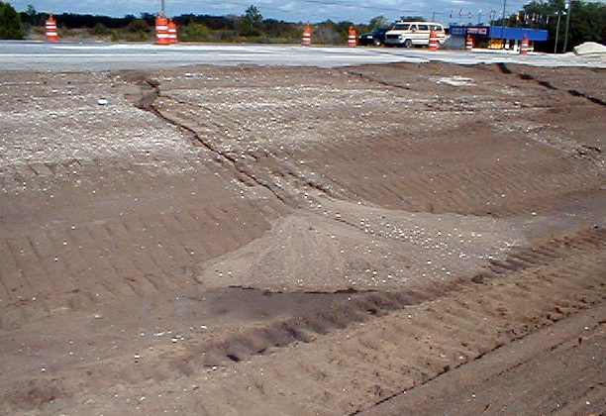
4.2 Surface Roughening
Track Up↑ and Down↓ - Not Round and Round!
Notes:
REPLACED SCREEN SHOT WITH CLEAR PICTURES

Slide 9
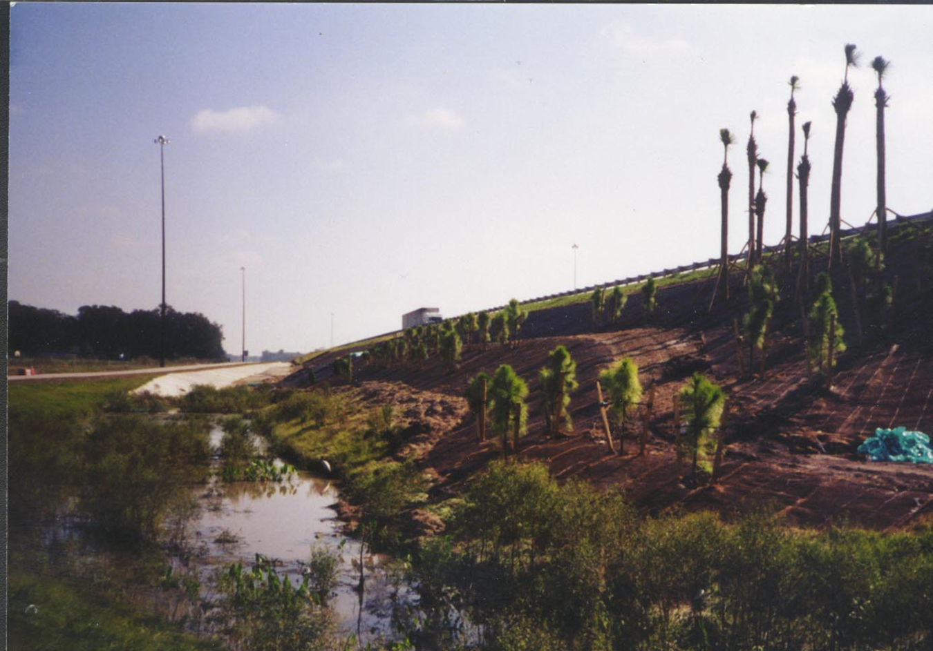
4.2 Surface Roughening
Example of Combining Techniques

Slide 10
4.3 Topsoiling
Definition: Methods of preserving and using topsoil to enhance final stabilization with vegetation
Purpose: To provide a suitable growth medium for final site stabilization with vegetation
Condition where practice applies: Where establishment of vegetation such as, trees, ornamental plants, and high-quality turf is desirable for final stabilization. Reduces need for fertilizers.

Slide 11
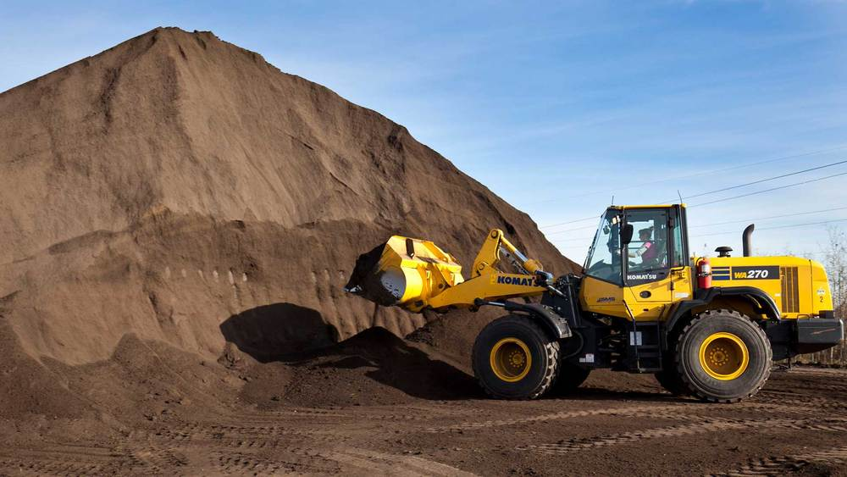
4.3 Topsoiling
Stripping - usually top 4-6”, check soil report or permit condition

Slide 12
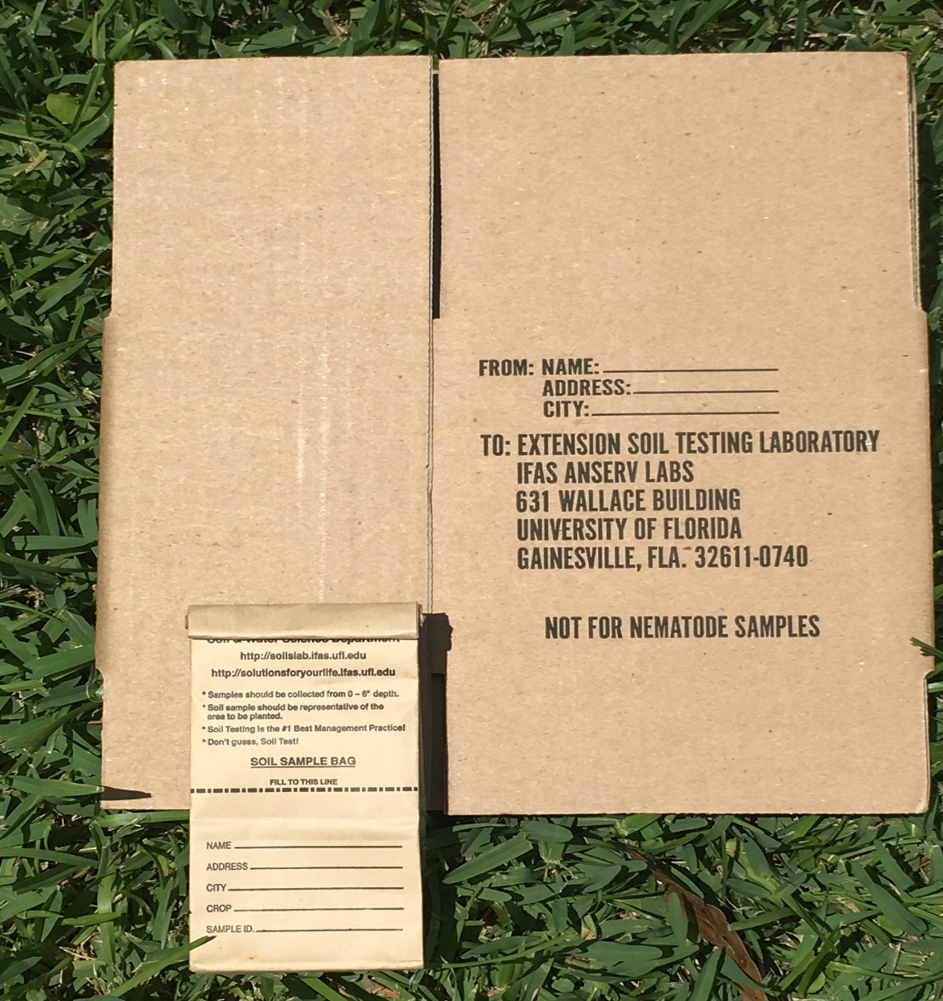
4.3 Topsoiling
Procedure:
Strip top 4 - 6” of soil
Stockpile using perimeter barrier, temporary cover w/ seed or plastic
Test topsoil for needed conditioners & amendments
Finish plan to specified grade
Disc or scarify top 2” of subsoil to loosen
Apply topsoil 2” deep @ < 3:1 slope; 4” deep @ > 3:1 slope

Slide 13
4.4 Temporary Seeding
Definition: The establishment of temporary vegetative cover on disturbed areas.
Purpose: To reduce wind and water erosion, and sedimentation by stabilizing all disturbed areas that will not be brought to final grade within seven days or longer.
*See CGP, Part 5.4: “You must initiate stabilization measures within 7 calendar days after construction activities have temporarily or permanently ceased for any portion of the site.”
Condition where practice applies: Where exposed soil will not be fine graded for 7 days or more.

Slide 14
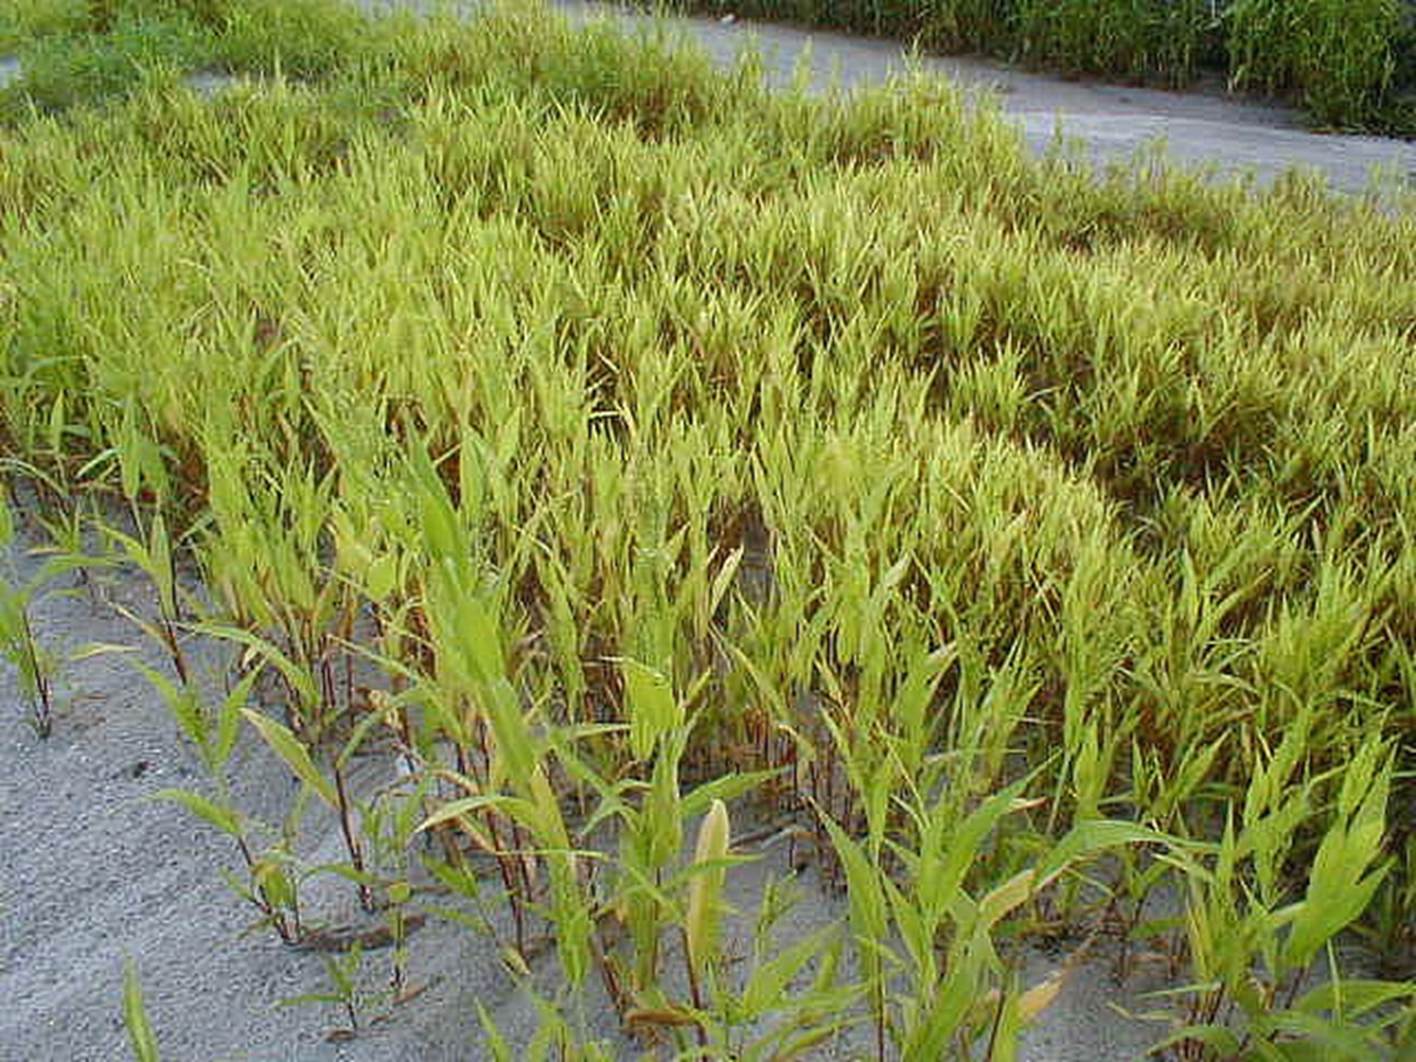
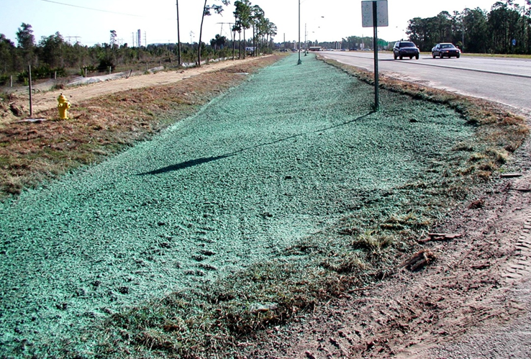
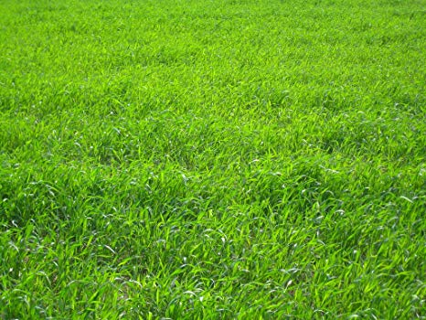
4.4 Temporary Seeding
Specifications:
Seedbed preparation: surface roughening, fertilizer, lime
Plant selected seed (appropriate for soil type, climate conditions, and time of year)
Seed application & rate
Mulching
Hydroseeding
Brown Top Millet
Hydroseed
Winter Rye

Slide 15
4.5 Permanent Seeding
Definitions: The establishment of perennial vegetative cover by planting seeds.
Purpose: To permanently stabilize soil in an economical, attractive, maintainable manner.
Condition where practice applies: Where permanent vegetative cover is required to stabilize soil; cleared areas which will not be developed sooner than 12 months.
Notes:
PIC

Slide 16
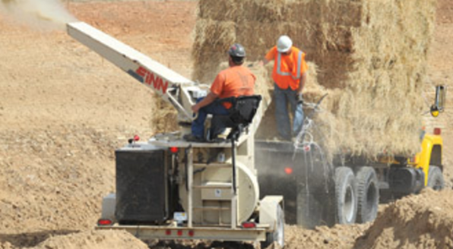
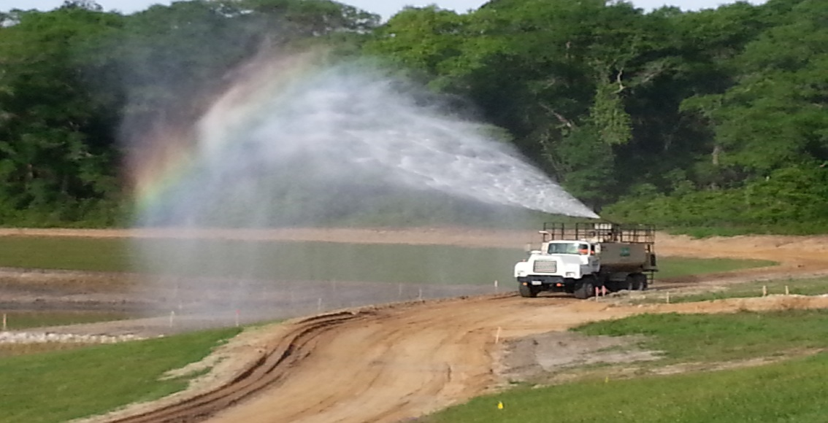
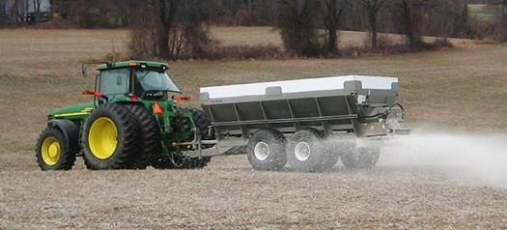
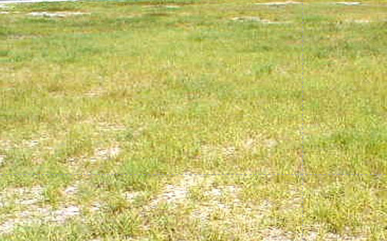
4.5 Permanent Seeding
Protect seed by applying blown straw or mulch.
Daily watering is very important to establish grass seed.
Proper application rate and mixer of fertilizer
Grass Must Survive For 1 Year To Be Considered Viable & Established!

Slide 17
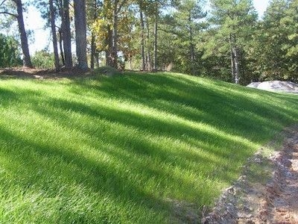
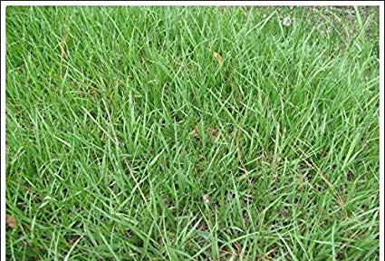
4.5 Permanent Seeding
Specifications:
Plant selection
Seedbed preparation: surface roughening, topsoil, soil conditioners & amendments
Seeding
Mulching
Maintenance: irrigation, regular fertilization, and repairs
Bermuda Grass
Photo Credit: Seed Ranch
Bahia Grass
Photo Credit: Seed Ranch
Notes:
PIC

Slide 18

4.5 Soil Conditioners
Definition: Substances used to modify the texture, structure, or drainage characteristics of a soil.
Examples: peat, sand, vermiculite, rotted manure, composted sawdust, treated sewage sludge.
Notes:
PIC

Slide 19
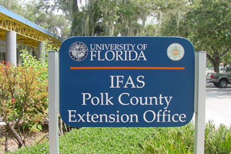
4.5 Soil Amendments
Definition: Materials that add missing ingredients to enhance growth.
Examples: lime and fertilizer.
Lime and fertilizer needs should be determined by soil tests. Soil samples should be collected and sent to the UF–IFAS Soil Testing Laboratory, or a private soil laboratory, so it can perform the appropriate soil analysis.
*SPECIAL NOTE: Please check with the local municipality for specific fertilizer ordinances that may limit the type and timing of fertilizer applied.
Information on the Soil Testing Laboratory, and sampling is available from county Agricultural Extension Service agents of your local county.

Slide 20
4.6 Sodding
Definition: The establishment of perennial vegetative cover by installing sod.
Purpose:
To establish turf immediately
To prevent erosion and damage from sediment and runoff by stabilizing the soil surface
To reduce the production of fugitive dust and mud associated with bare soil surfaces
To stabilize stormwater management systems where concentrated overland flow will occur
Condition where practice applies: Disturbed areas that require immediate vegetative cover or where sodding is preferred such as stormwater management system.

Slide 21
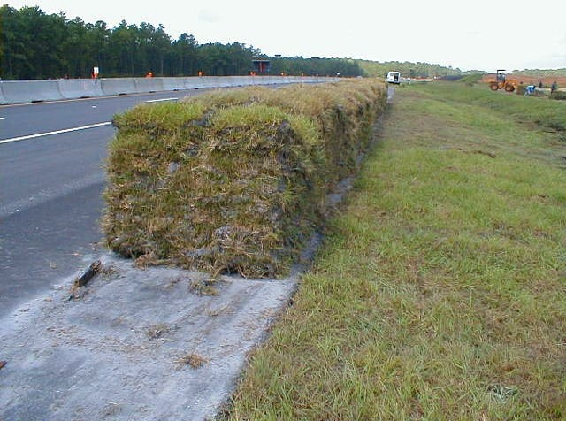
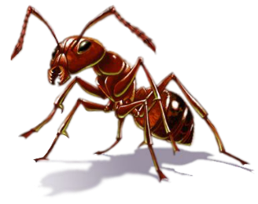
4.6 Sodding
Pallet of Sod in Squares
Fire ants are always present, try wearing a long sleeve shirt and gloves.
This Photo by Unknown Author is licensed under CC BY-NC

Slide 22
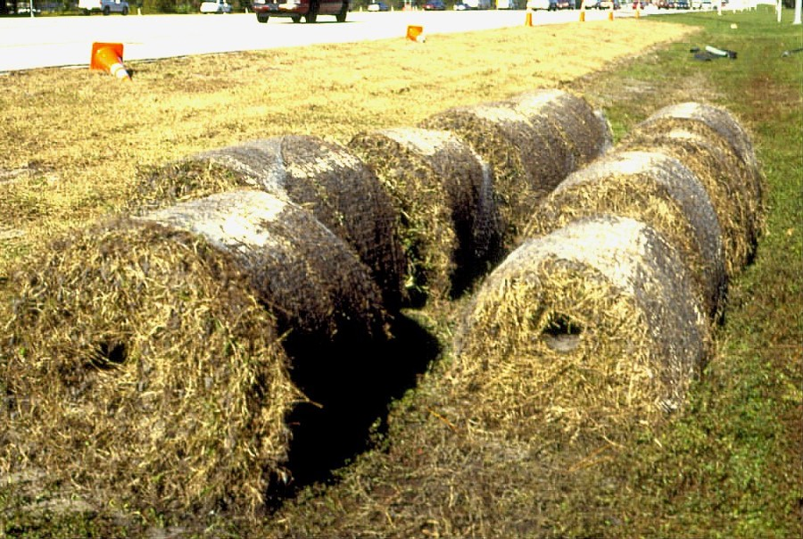
4.6 Sodding
Roll Sod
Installed with a Skid Steer

Slide 23
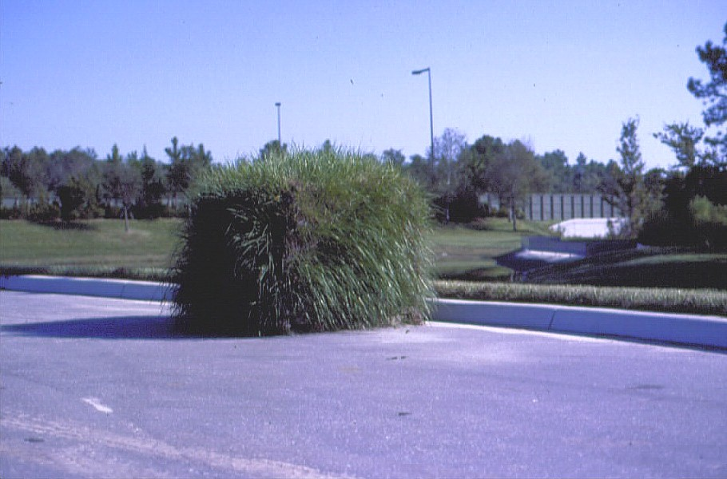


4.6 Sodding
If you leave your sod pallet out too long, you get - Chia Sod!

Slide 24
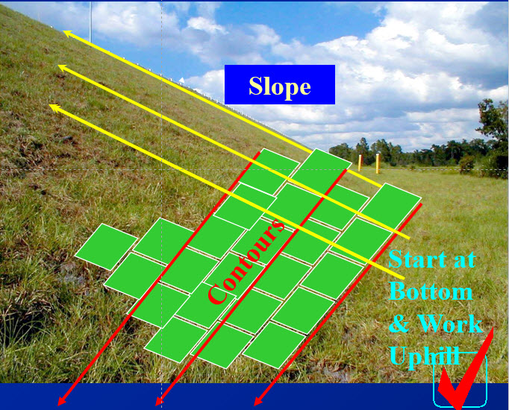
4.6 Sodding
Sod Laying Applications
SLOPES:
Lay strips along / parallel to the contours and across / perpendicular to the slope
Stagger lateral joints
Use sod pins, pegs, or hooks
Netting for critical areas

Slide 25
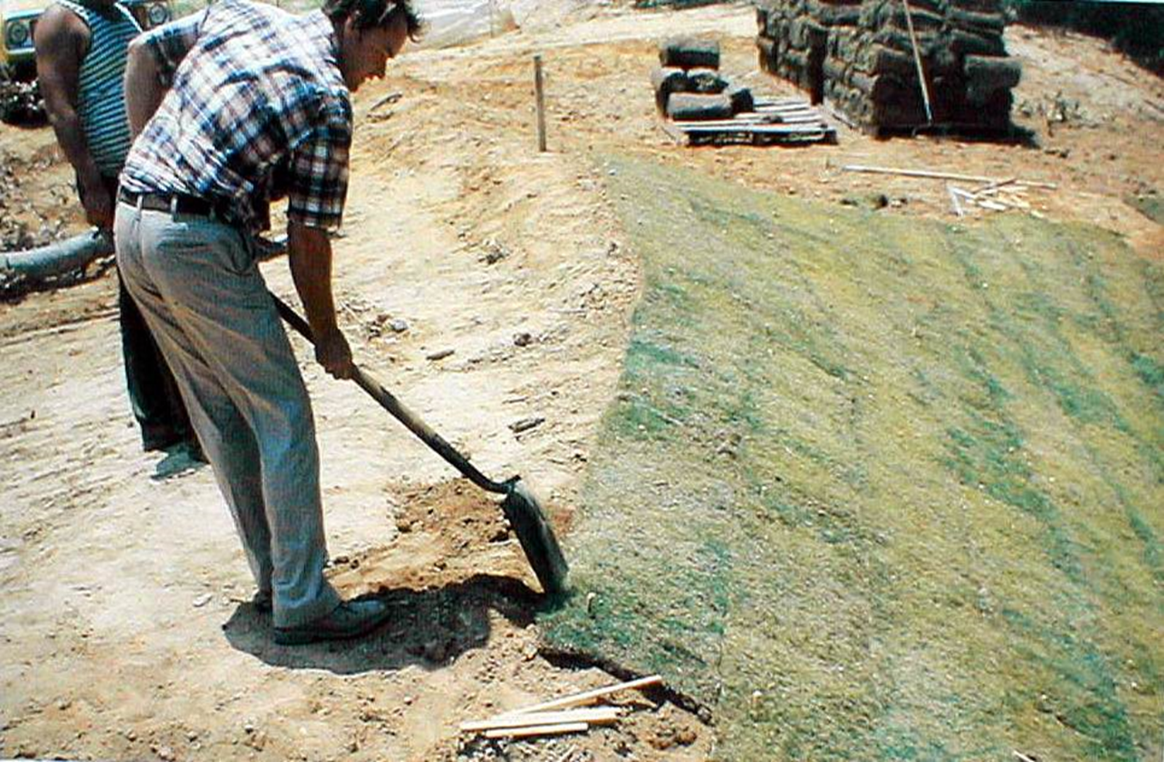
4.6 Sodding
Sod Laying Applications - Slopes

Slide 26
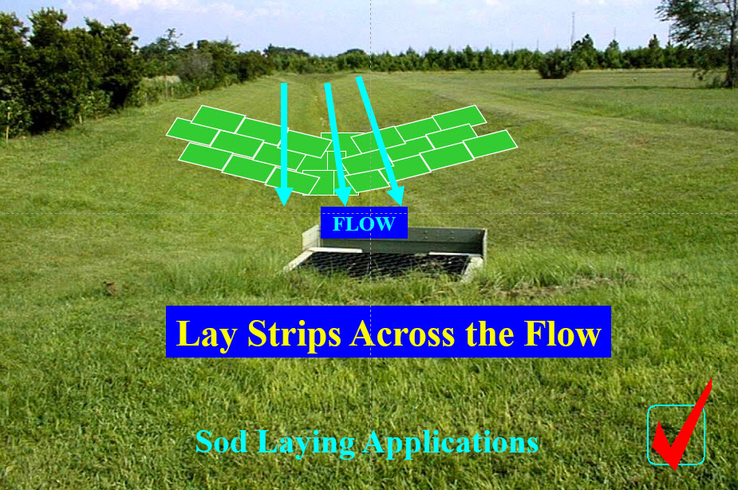
4.6 Sodding
Waterways and Channels (Stormwater Management Systems)

Slide 27
4.6 Sodding
Specifications:
Soil preparation: 2 - 4” topsoil, lime, fertilizer, etc.; raked smooth, no roots or rocks
Sod types: strips, rolls, squares
Sod installation: solid, strip, spot; use w/ staples & nets
Sod application: ponds, slopes, waterways
Notes:
PIC

Slide 28
4.7 Mulching
Definition: The application of plant residues or other suitable materials to soil surface areas.
Purpose:
To protect the soil surface from raindrop impacts such as splash and rill erosion and to reduce the velocity of overland flow
To improve soil conditions for plant growth by increasing the available moisture and providing insulation against extreme heat or cold
Condition where practice applies:
Areas after seeding,
When season prevents seed establishment
Around plantings of trees, shrubs, or certain ground covers that do not provide adequate soil stabilization by themselves
In conjunction with a temporary seeding operation
If in an area of concentrated flows or inundation mulch shall be properly anchored to prevent floating away

Slide 29
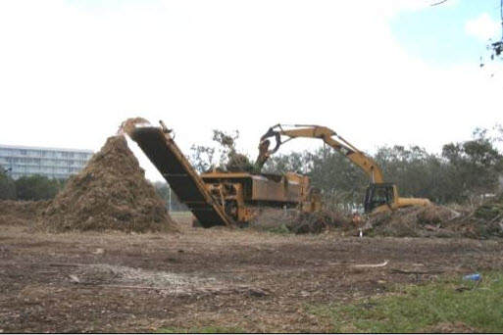
4.7 Mulching
Types of organic mulch: straw, wood chips, bark, pine straw, etc.
Mulch secured with:
Rolled Products; Nets, mats, blankets
Liquid mulch binders and tackifiers
Cut / punched / anchored mechanically
A GREEN NOTE! A Tub Grinder can be used to create a resource of mulch from your construction land clearing operations. Avoid landfilling or burning tree/vegetation debris, if possible. Please repurpose and reuse.

Slide 30
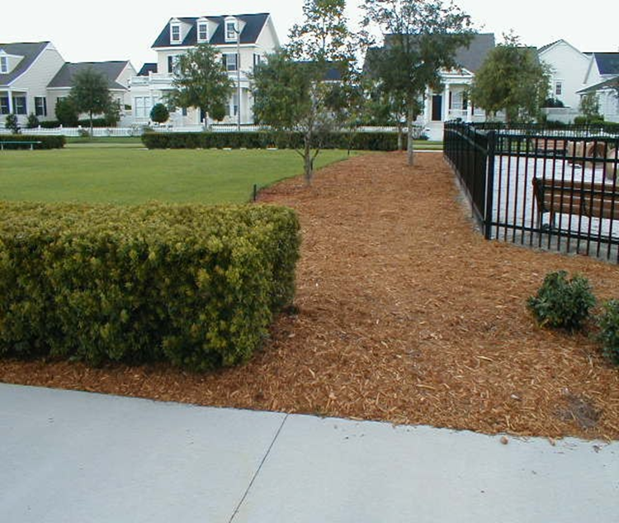
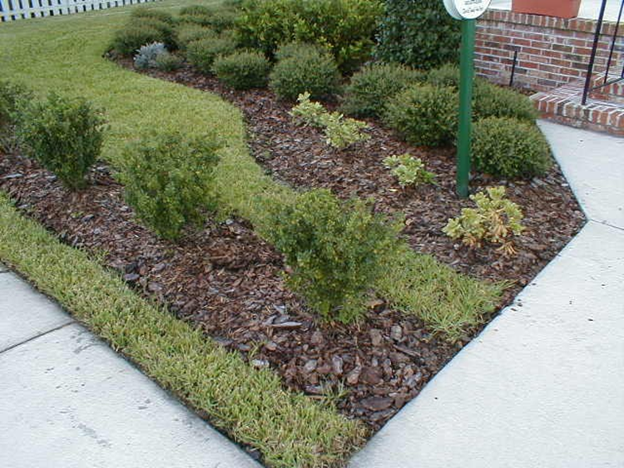
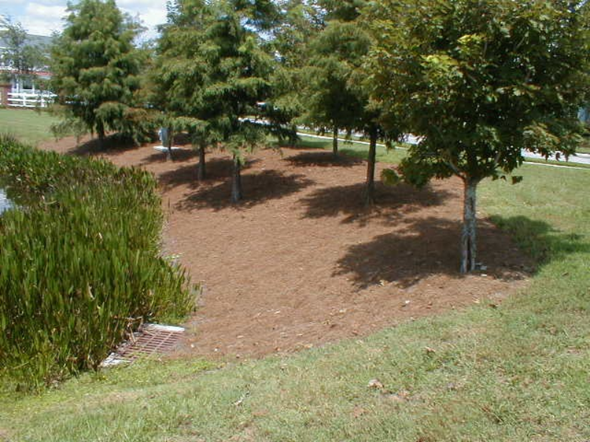
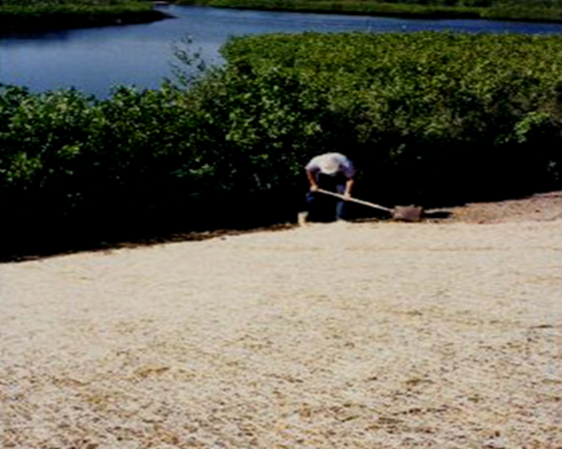
4.7 Mulching
Caution,
I float too!
Cypress mulch
Pine Bark
Pine Straw
Blanket or RECP

Slide 31
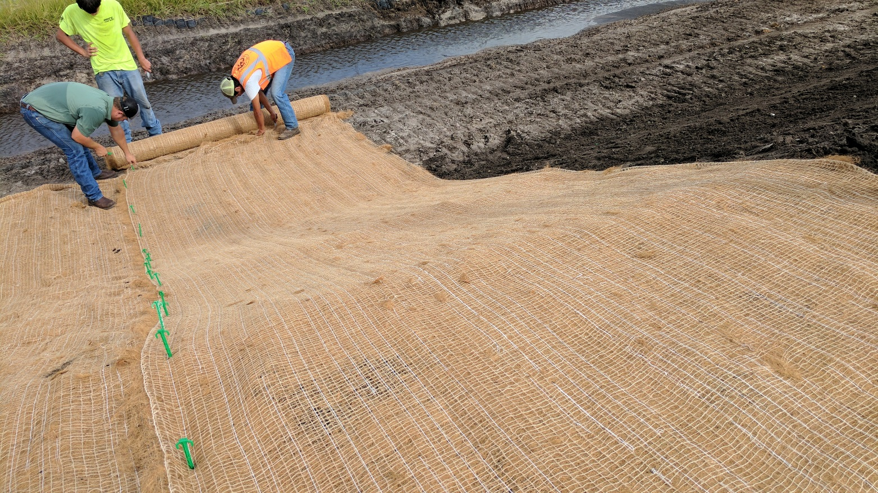
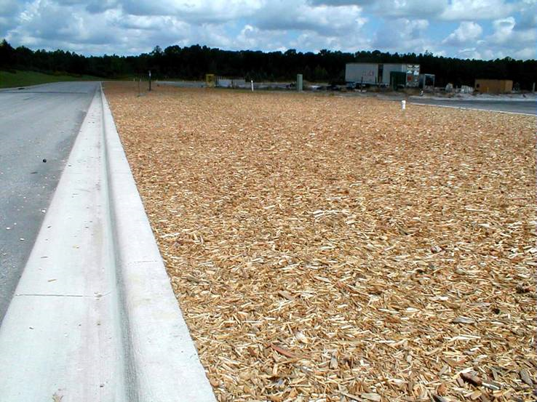
4.7 Mulching
RECP or
Rolled Erosion Control Product
Temporary Mulch
Notes:
REPLACE PIC ON LEFT

Slide 32

4.7 Mulching
Apply @ 2.0 Tons/Acre
(2 Bales / 1000 Sq. Ft.)
Straw

Slide 33
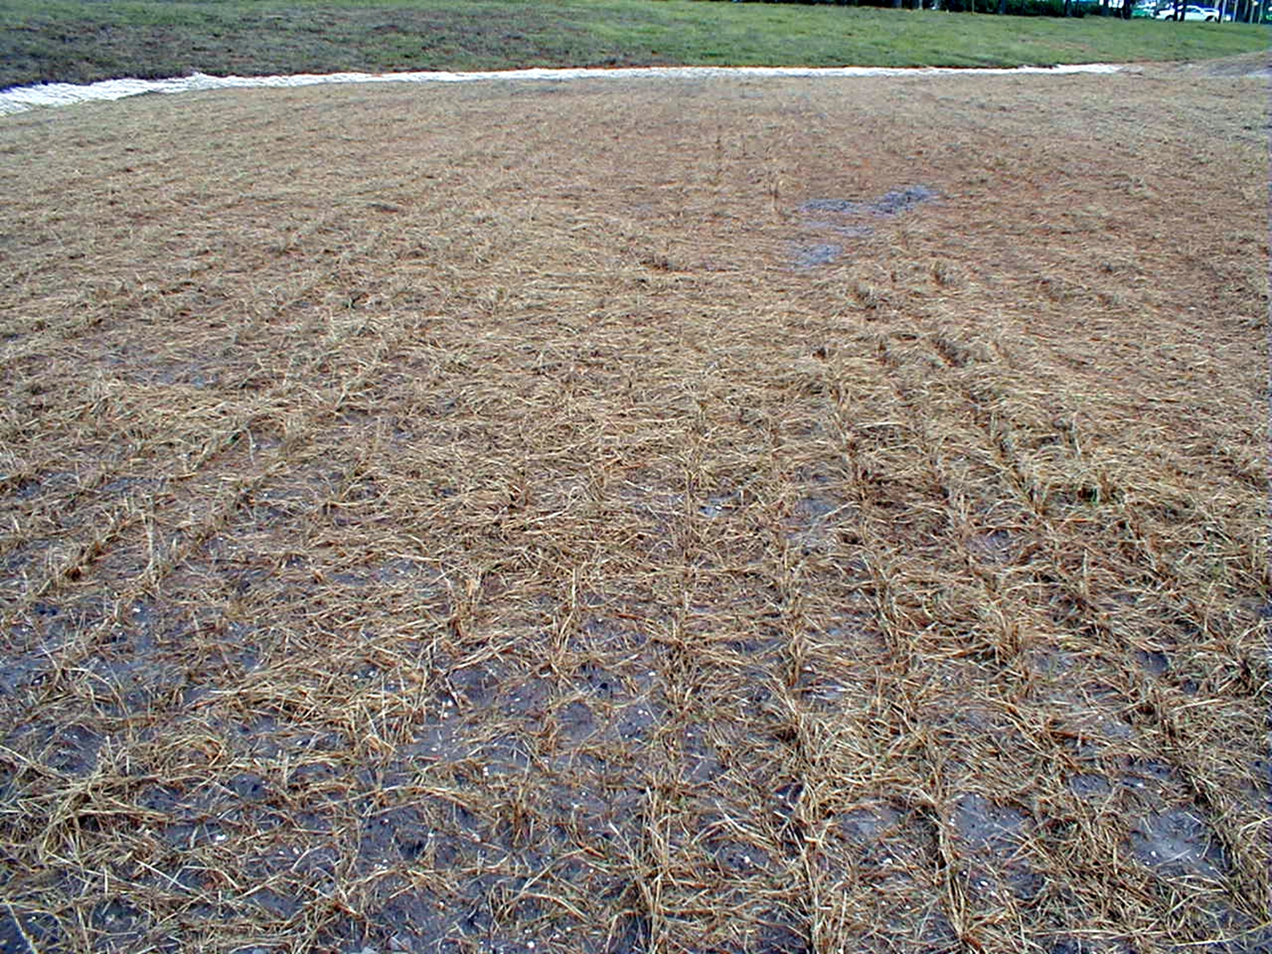
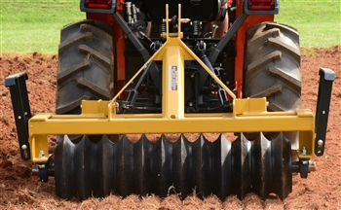
4.7 Mulching
Straw will hold in moisture, provide protection from birds, and provide organic materials to cut down on erosion.
Cultipacker disc
Always use a cultipacker or tines to cut straw in shortly after applying with a hay blower. You must secure the straw, or the wind will blow it away.

Slide 34
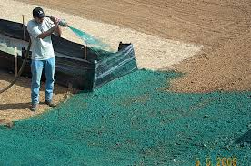
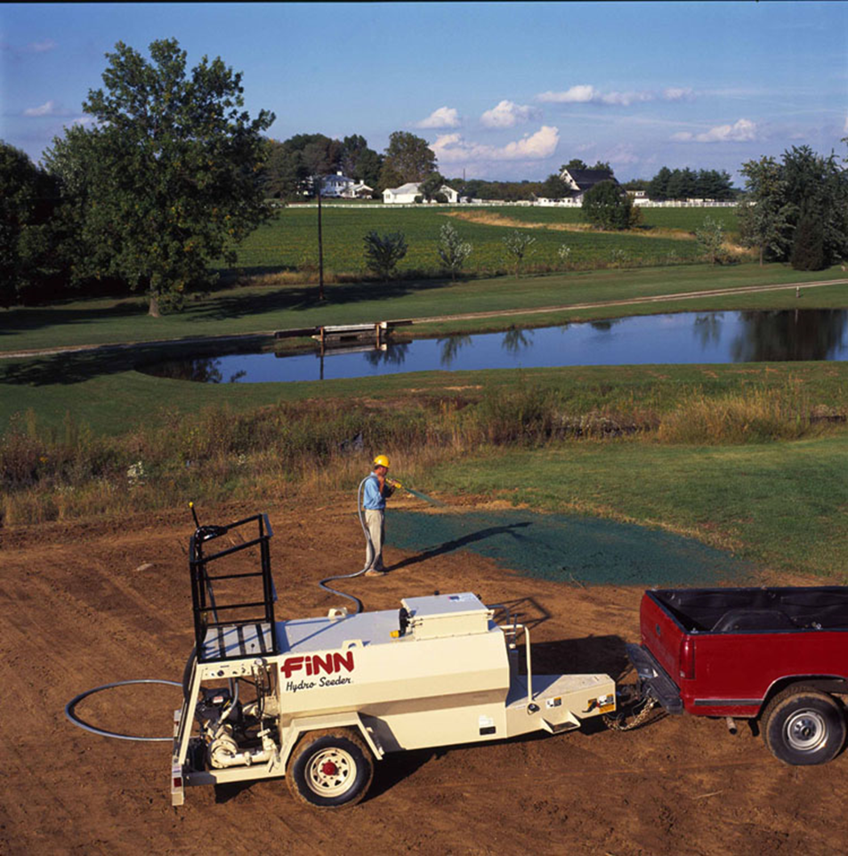
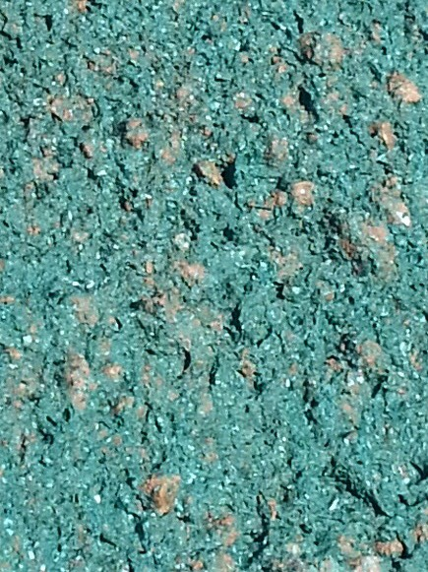
4.7 Mulching
Hydro-Mulching
Closeup of the bonded fiber matrix

Slide 35
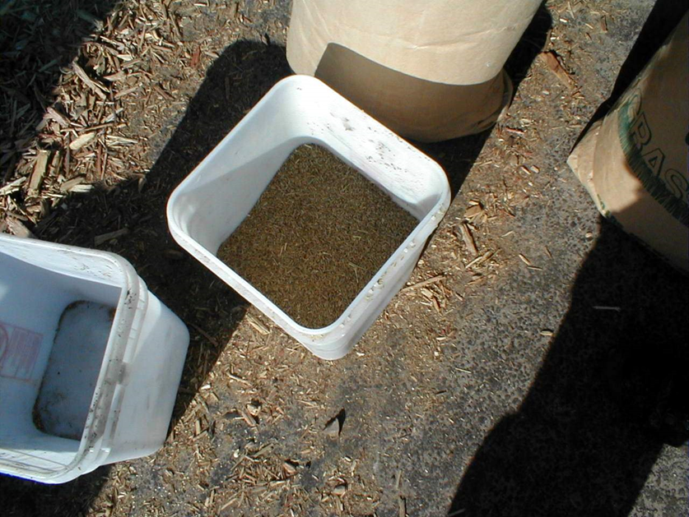
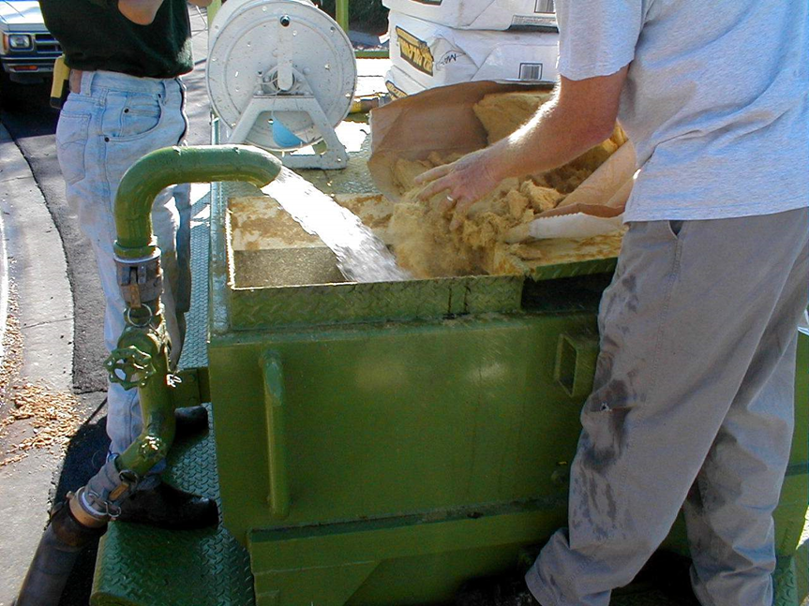
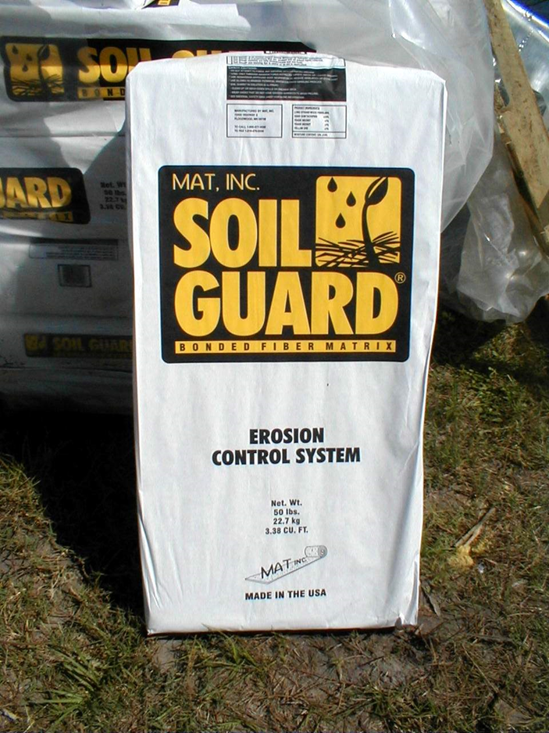
4.7 Mulching
Hydro-Mulching
Mix the seed, fertilizer, tackifier, other soil amendments and fiber mulch in a mixing tank to apply as a wet slurry of hydromulch or bonded fiber matrix.
Follow supplier/manufacturer instructions.

Slide 36
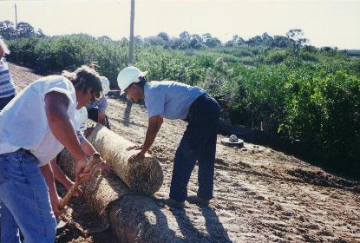
4.7 Mulching
Installing nets, mats, & blankets
Start at top of slope or channel & work down
Do not stretch
Secure: staples, top anchor trench (like installing silt fences), staple bottom on level ground, joining strips, check slots
Roll to insure contact w/ soil
Notes:
PIC

Slide 37
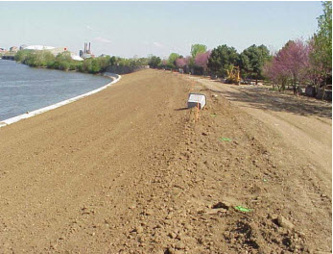
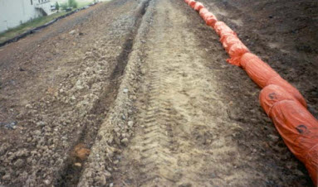
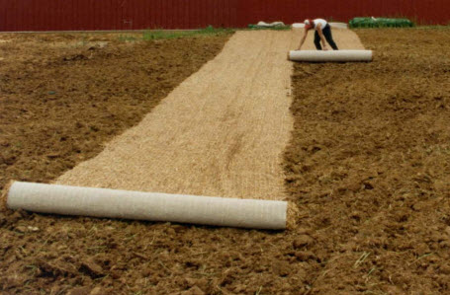
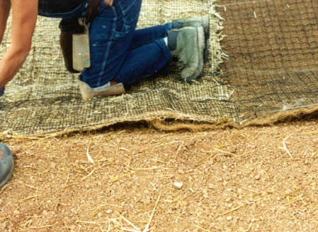
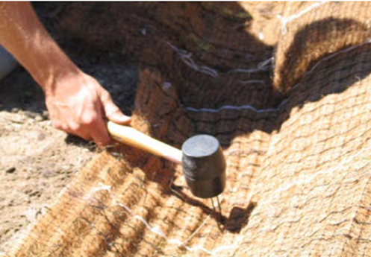
4.7 Mulching
Rolled Erosion Control Products(RECP) Typical Installation
Step 1: Smooth out soil Step 2: Anchoring Trench Step 3: Secure RECP
Step 4: Roll Out –Do not Pull Step 5: Anchor per Specifications Step 6: Anchor Bottom
Notes:
REPLACE DUPLICATE PIC

Slide 38
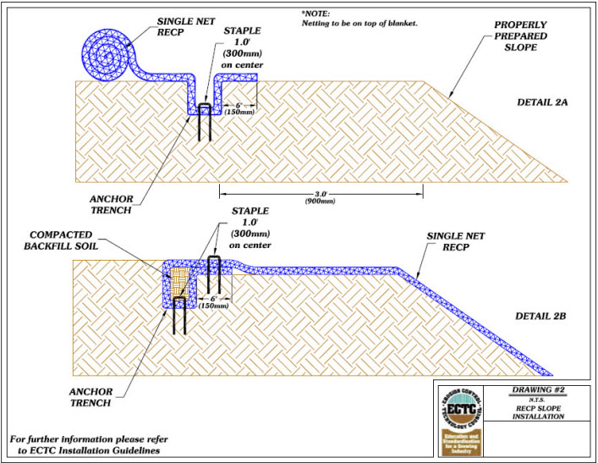
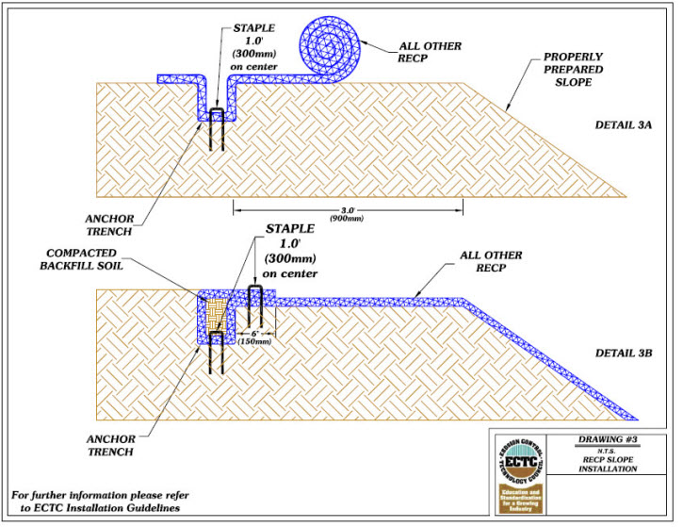
4.7 Mulching
Rolled Erosion Control Products (RECP) Trenching
Two types of top of slope trenching techniques

Slide 39





4.7 Mulching
Rolled Erosion Control Products (RECP)
and Turf Reinforcement Mats (TRMs)
Staple
Grasses growing through a TRM
RECPs are used widely on slopes
TRMs are used in hi-velocity areas

Slide 40

4.7 Mulching
Rolled Erosion Control Product (RECP)
Make sure to follow manufacturer’s specifications – unlike below!

Slide 41

4.7 Mulching
RECP – Post Stabilization

Slide 42
4.8 Trees, Shrubs, Vines & Ground Cover
Trees, Shrubs, Vines, and Ground Covers
Definition: Stabilize disturbed areas by establishing permanent vegetative cover by planting trees, shrubs, vines, and ground covers.
Purpose:
To provide food and shelter for wildlife where wildlife habitat is desirable.
Provide temperature modification.
Provide a sound and/or visual buffer as required by the local municipal or county Land Develop Codes or Regulations
Notes:
Pics???

Slide 43
4.8 Trees, Shrubs, Vines & Ground Cover
Trees, Shrubs, Vines, and Ground Cover
Conditions where practice applies:
Where turf maintenance is difficult, such as shady, steep, or rocky slopes, where mowing is not feasible but vegetative stabilized surface areas are required.
Where ornamental landscape materials are desired for landscaping aesthetic purposes *(See Site Landscape Plans)
Where woody plants are desirable for soil conservation.
As a traffic-control (traffic calming) devices to direct pedestrians, vehicles and equipment to or from an area, or to control access to an area

Slide 44
4.8 Trees, Shrubs, Vines & Ground Cover
Trees, Shrubs, Vines, and Ground Cover
Types of Tree Plantings:
Bare-rooted seedlings – to be handled only while dormant in the winter, after leaf fall in autumn, with January being the optimum planting month.
Transplants (balled-and burlapped or container-grown trees or shrubs) planting from fall to winter is preferred (November to February)

Slide 45

4.8 Trees, Shrubs, Vines & Ground Cover
Trees, Shrubs, Vines, and Ground Cover
Tree Planting -
Tree preparation: protect roots, foliage
Site preparation: hole – 2 times as wide as root ball, same depth, discard subsoil
Setting the tree: set to as near to the original depth, backfill 1/2 w/ soil, water (daily schedule or irrigate), finish backfill, and create a watering basin
Supports: Use stakes and flexible straps or struts as required by Landscape Plan
Maintenance: mulching, daily watering, fertilizer, and pruning dead roots or limbs

Slide 46






4.8 Trees, Shrubs, Vines & Ground Cover
Supporting a Tree
Strut and Stake System
Two Lodge Pole System
No Support!
Wood Support System
Wood Frame Below Ground

Slide 47

4.9 Tree Protection & Preservation
Do Not Nail Supports Into the Tree!
Introduces rot, insects, and pathogens
How much do you pay for a palm tree these days? $$$$$

Slide 48


4.9 Tree Protection & Preservation
Watering is essential for tree survival after transplant. Trees are an expensive investment – protect them!

Slide 49
4.9 Tree Protection & Preservation
Definition: Protection of desirable trees from mechanical and other injury during land-disturbing activities and construction activities.
Purpose:
To ensure survival of desirable trees where they will be effective for erosion and sediment control.
For watershed protection (green belt or conservation area).
Desirable for landscape or protected under the Land Development Regulations or Codes (LDR or LDC) of your local City or County Land Use Office or Planning Office – be sure to contact for further information regarding local regulations for tree preservation and protection.
Dust and pollution control, noise reduction and buffer zone
Shade and other environmental benefits - temperature reduction
Condition where practice applies: Where trees are near construction and land-disturbing activities.

Slide 50
4.9 Tree Protection & Preservation
Specifications:
Determine trees to be preserved and cleared up front:
Identify Limits of Disturbance
Identify Critical Root Zone (CRZ)
Only save trees with less than 1/3 CRZ disturbance
Marking: physically mark trees for removal, use signs and fencing to protect trees to be saved
No equipment, materials, etc. in CRZ
Discuss tree protection at pre-construction meeting
Use alternative construction techniques near trees where possible: boring/tunneling, light equipment
Use preservation techniques for trees with some CRZ impacts:
root pruning, irrigation, mulch
Use caution with grade changes: wells, walls, fill on roots
Use an arborist to prune damaged trees

Slide 51

4.9 Tree Protection & Preservation
Critical Root Zone (CRZ) = 1-foot radius from base of tree for every inch of Diameter at Breast Height (DBH)

Slide 52

4.9 Tree Protection & Preservation
Notes:
Change pic

Slide 53



4.9 Tree Protection & Preservation
Tree Protection and Preservation
Ideally placed outside Critical Root Zone (CRZ) but encroaching no more than 1/3 into the CRZ. 8-foot minimum from trunk for any tree.

Slide 54



4.9 Tree Protection & Preservation
Retaining Wall For Grade Changes
FILL ON ROOTS

Slide 55
4.10 Vegetative Streambank Stabilization
Definition: The use of vegetation in protecting and stabilizing stream banks.
Purpose: To protect stream banks from the erosive forces of flowing water.
Condition where practice applies:
Along creeks, streams, rivers
Bank-full flow velocity < 5 ft. / sec. & soils are erosion resistant
Above 5 ft. / sec. , structures are required
This practice does not apply where tidal conditions are present

Slide 56


4.10 Vegetative Streambank Stabilization
Vegetative Streambank Stabilization
1. Aquatic plant zone - always flooded
2. Herbaceous zone - flooded 1/2 year
3. Shrub zone - yearly occasional flooding
4. Tree zone - floods less than yearly
mean high water
mean water level
mean low water
Notes:
REPLACE SCREEN SHOT

Slide 57




4.10 Vegetative Streambank Stabilization
Establishing zone 2 (herbaceous):
planting clumps
shoots, rhizomes, stem slips
wattles or reed rolls
Seeding
w/ riprap, cellular block, grid confinement systems
Filtrexx Living Wall
Reed Wattle Installed
Reed Wattle - Vegetated
Flexamat

Slide 58
4.10 Vegetative Streambank Stabilization

Slide 59

4.10 Vegetative Streambank Stabilization
Establishing zone 3 (shrubs):
seeding & sodding: staples, blankets, nets
cuttings & seedlings
Work with the seasons, and plant during low flow!

Slide 60

Chapter 4 Review

Slide 61
Chapter 4 Review
The three purposes of soil roughening are:
1) Aid in establishment of vegetative cover
2) Reduce runoff velocity & increase infiltration
3) Reduce erosion and provide for sediment trapping
topsoiling
The purpose of _________ is to provide a suitable growth medium for final site stabilization with vegetation
The subgrade should be prepared by _______ or _________ to insure bonding of the topsoil with the subsoil.
discing
scarifying
temporary
Areas that are at rough grade for 7 days or more should receive _________ seeding immediately.

Slide 62
Chapter 4 Review
List three soil conditioners:
Name two soil amendments often required prior to permanent seeding: ______________.
A stand of vegetation is considered fully established after ___ year.
When sodding a slope, strips should be laid _____ the contour. Joints should be ________. Start from the ______ and work toward the ___.
peat
sand
vermiculite
rotted manure
sawdust
treated sewage sludge (biosolids)
fertilizer and lime
one
along
staggered
bottom top

Slide 63
Chapter 4 Review
List (at least) three beneficial functions of mulch:
1) Protects soil from raindrop erosion
2) Moderates soil temperature
3) Moderates soil moisture
4) Reduces velocity of overland flow
5) Improves soil texture and nutrients
6) Control/reduce weeds
Straw mulch should be applied at a rate of ______ lbs. per 1000 sq. ft.; ______ bales per 1000 sq. ft.; or _______ tons per acre.
70-90
1.5 -2
1.5 - 2
When installing erosion control nets or blankets, work from the ______ towards the ______.
top
bottom

Slide 64
Chapter 4 Review
Effective tree protection should be installed no closer than 8 feet or the ____________________ of the tree.
Critical root zone (CRZ)
A good place for material storage, parking, and portable toilets is inside the tree protection zone. (True / False)
False

