Slide 1

Chapter 5:
Best Management Practices for Dewatering

Slide 2
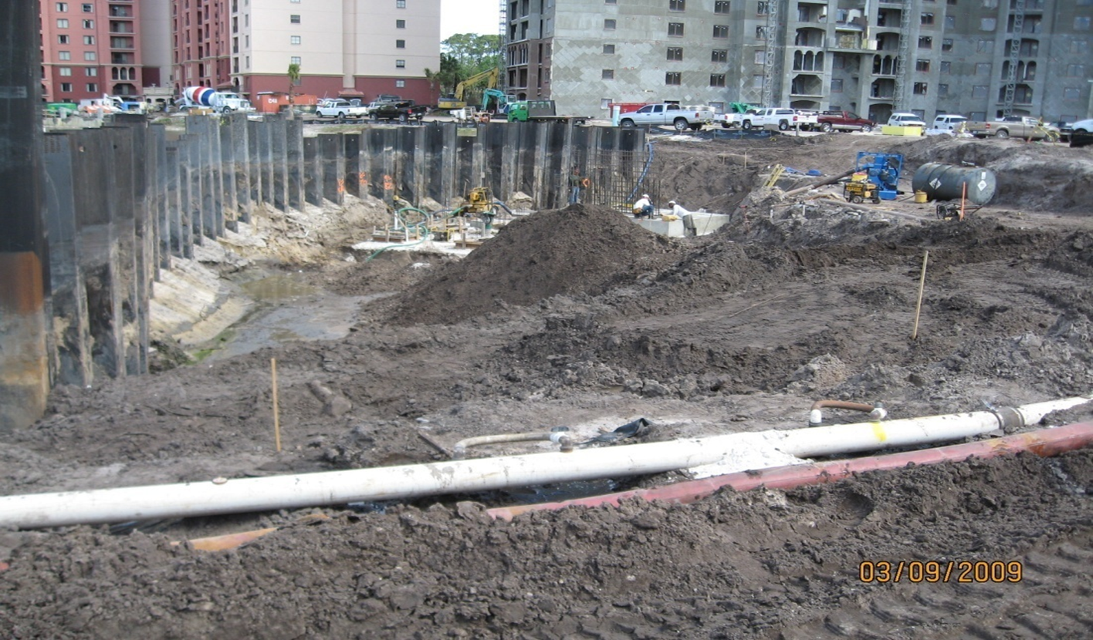
BMPs for Dewatering
Introduction
Dewatering Operations are practices that manage the discharge of pollutants when water (other than stormwater) must be removed from the work location so that construction may be carried out.

Slide 3
BMPs for Dewatering
Key Considerations for choosing a specific dewatering control method:
Sediment particle size
Limitations for receiving waters (turbidity, nutrients, pollutants)
Discharge rate
Area available for control technique

Slide 4
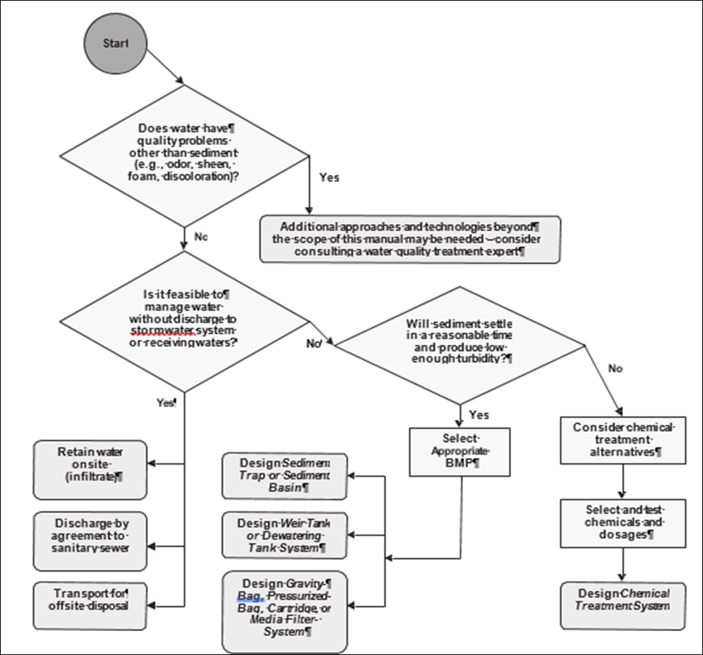
BMPs for Dewatering
This Chapter will discuss four types of control technologies:
Sediment Traps
Weir Tanks
Filters
Chemical Treatment
Dewatering Operations Flow Chart

Slide 5

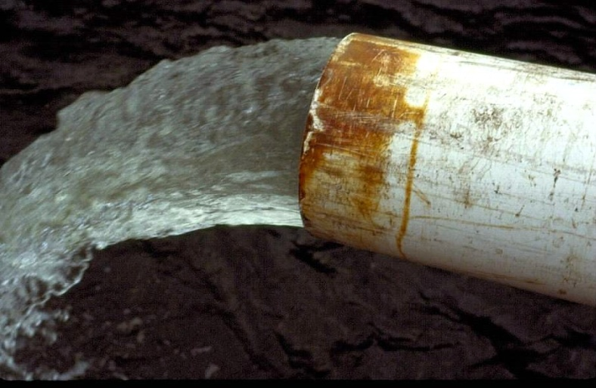
BMPs for Dewatering
Typical Pumping Methods:
Rim Ditch (Sump)
Sock System (Horizontal Well)
Well Point System (Vertical Well)

Slide 6
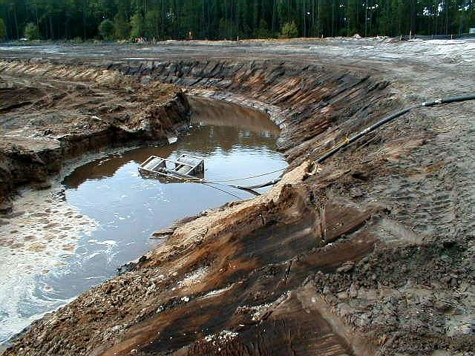
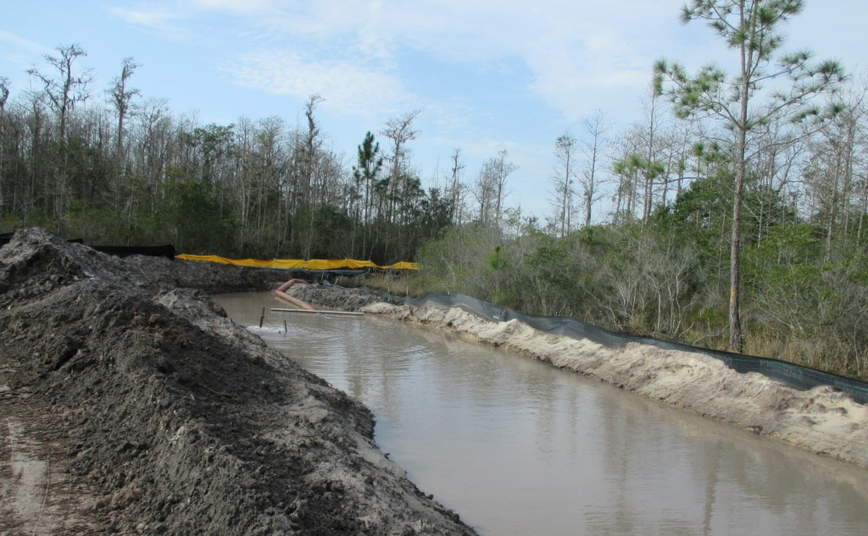
BMPs for Dewatering
Rim Ditch Systems
Ditch surrounds work area and draws down groundwater
Poorest water quality (high turbidity, NTUs)!
Direct discharge usually does not meet WQ standards
Often results in compliance action by agencies
Initially cheapest for contractor
Most expensive to clean up
Can be used as part of “treatment train”

Slide 7
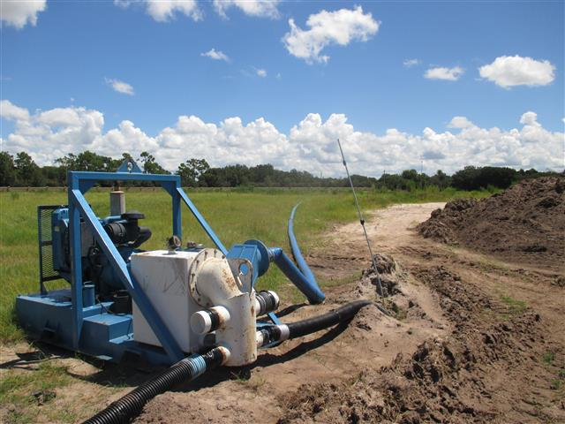
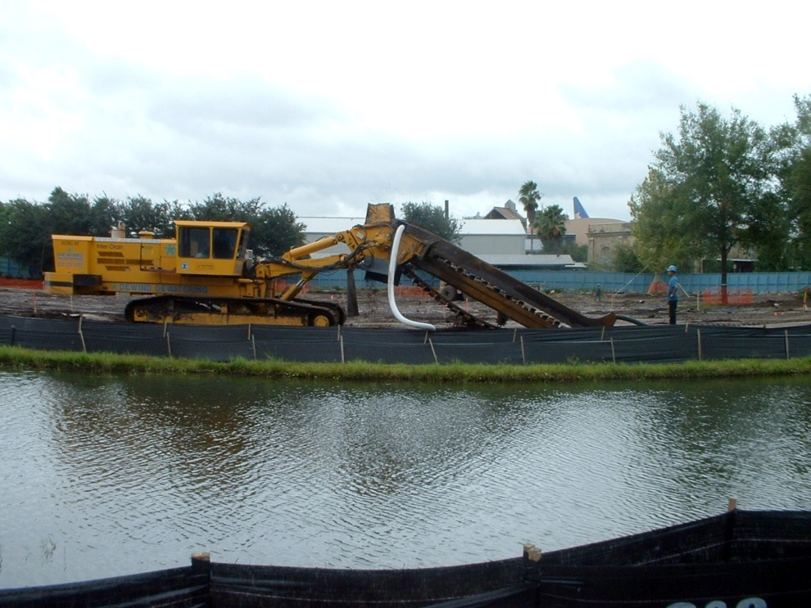
BMPs for Dewatering
Sock Systems
Generally, produces clean discharge water
Requires some sandy soils to function (does not work well in clay soils)
Placed along perimeter of project
Can be expensive to install

Slide 8
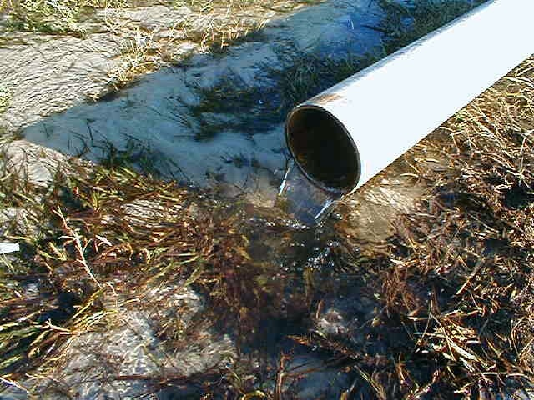
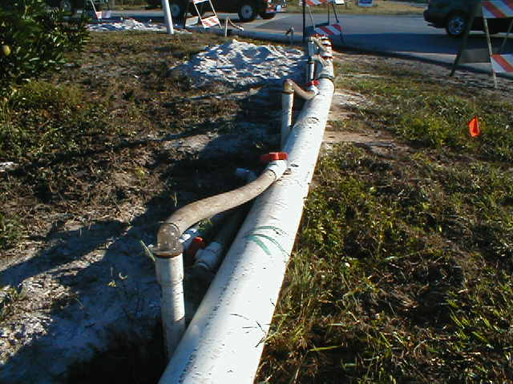
BMPs for Dewatering
Well Point Systems
Produces cleanest water
Requires some sandy soils to function
Usually placed along excavation in terrace fashion (can also be linear)
Can be expensive to install
Often reduces downtime in wet weather, as it keeps the site dry

Slide 9
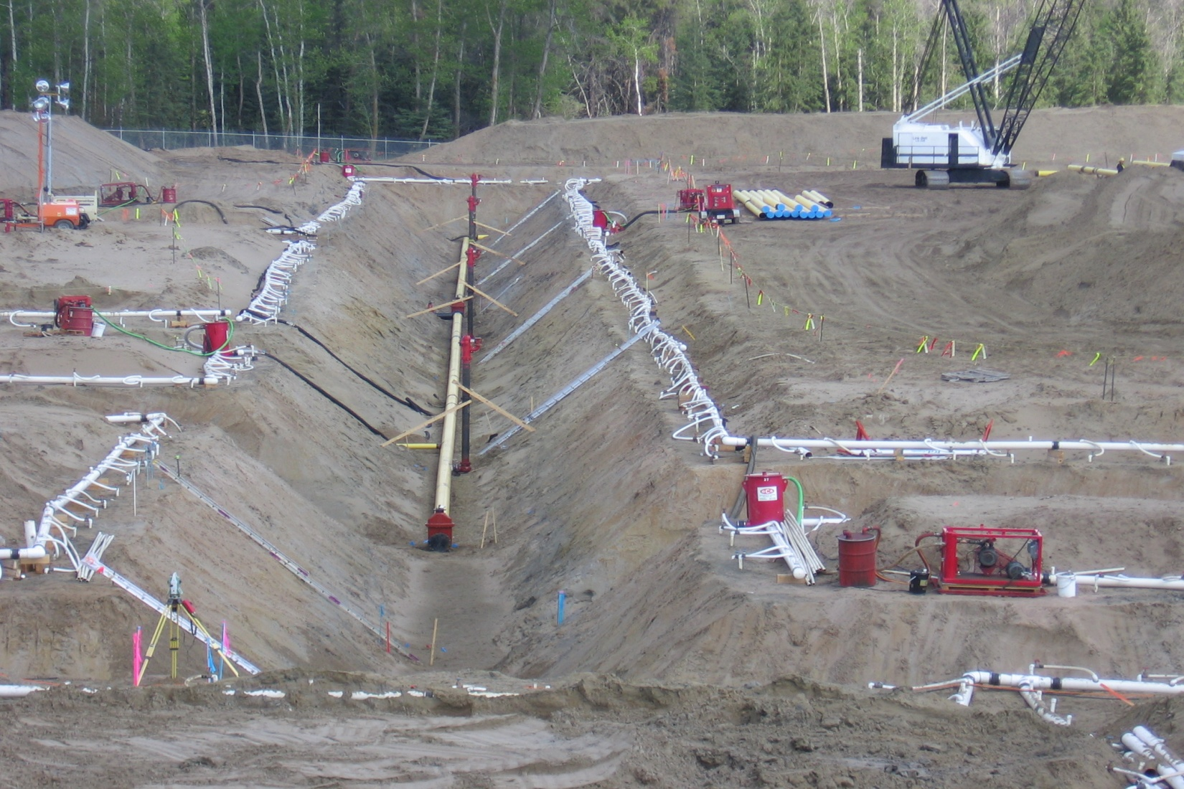
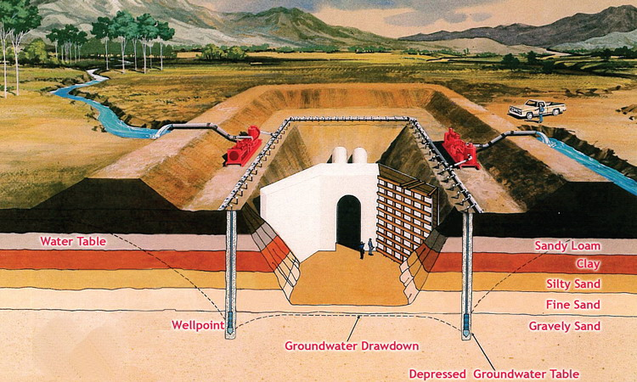
BMPs for Dewatering
Well Point Systems

Slide 10
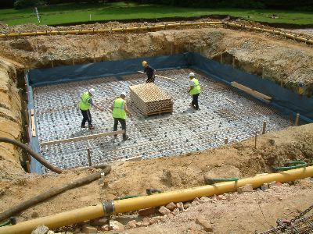
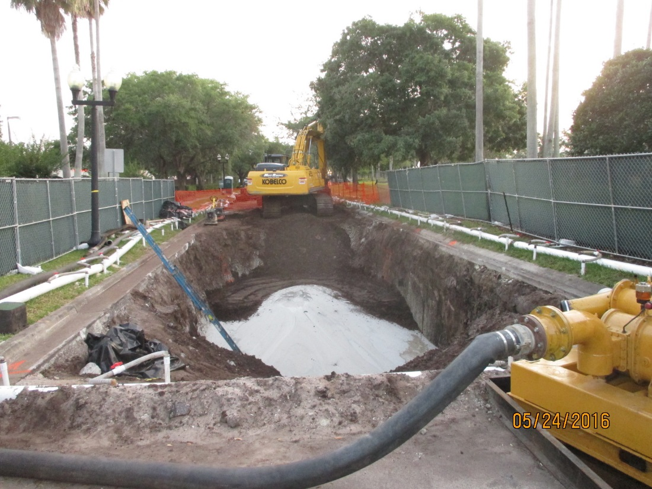
BMPs for Dewatering
Well Point Systems

Slide 11
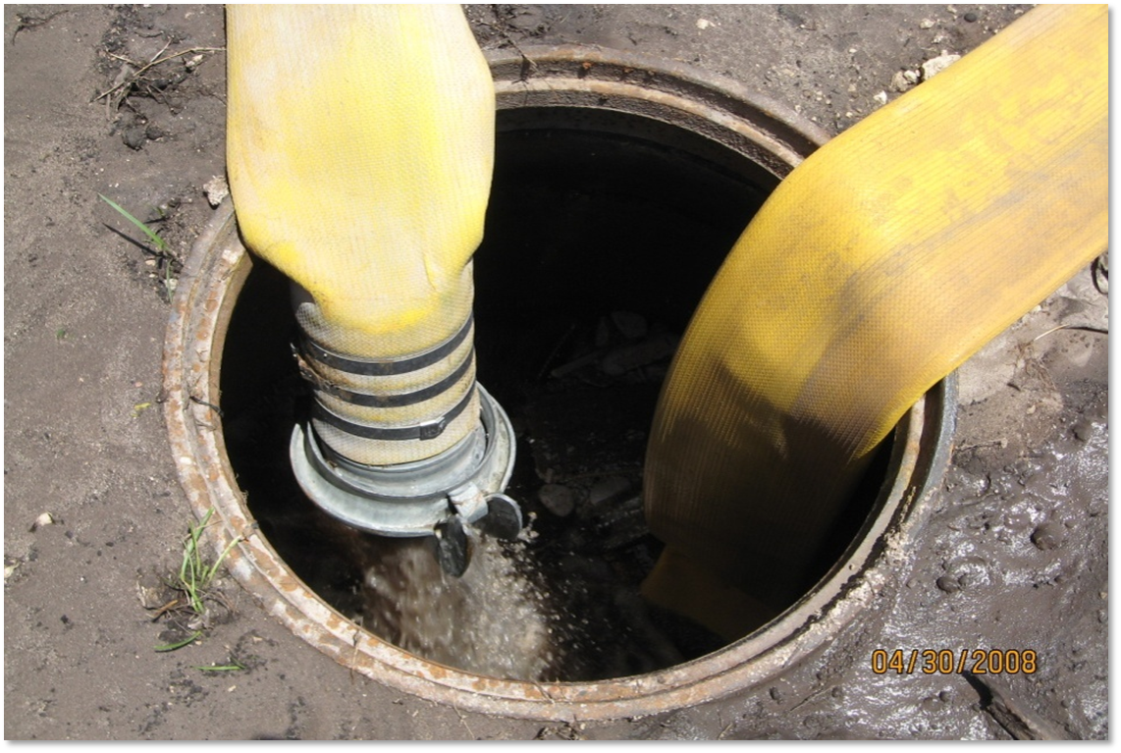
BMPs for Dewatering
WHERE IS THIS DISCHARGE GOING?

Slide 12
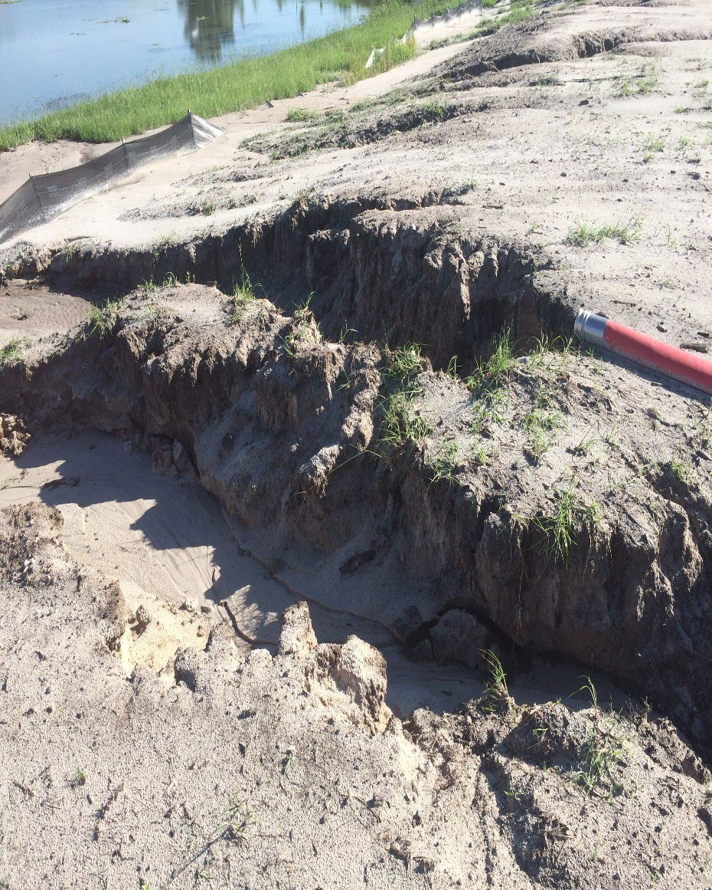
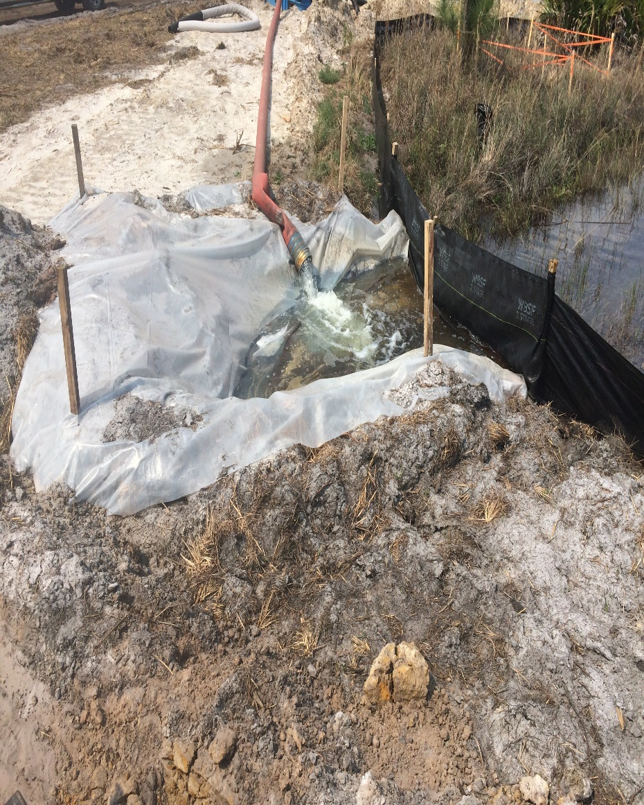
BMPs for Dewatering
Without Discharge Protection
With Discharge Protection

Slide 13
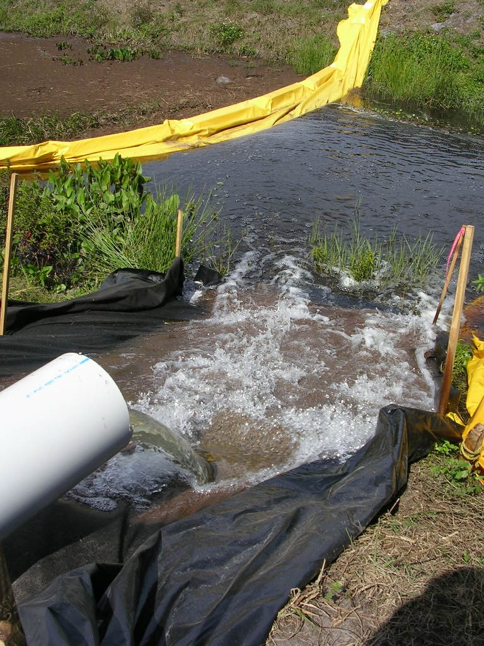
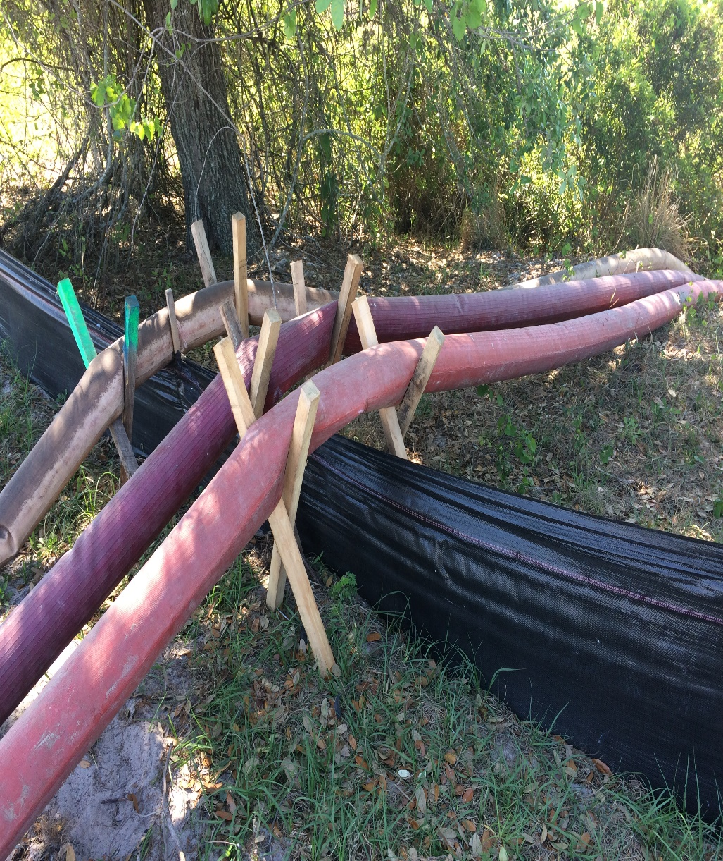
BMPs for Dewatering

Slide 14
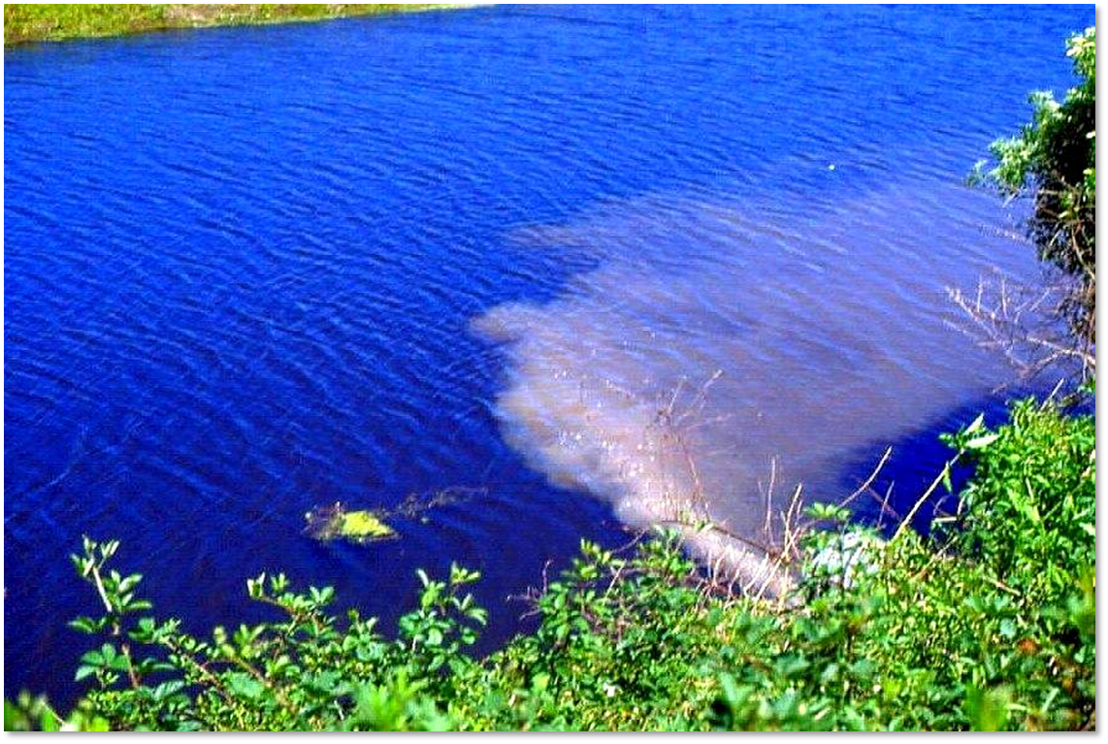
BMPs for Dewatering

Slide 15
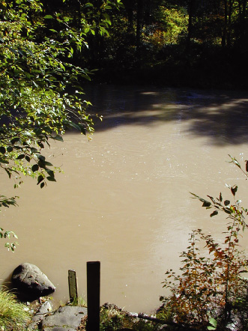
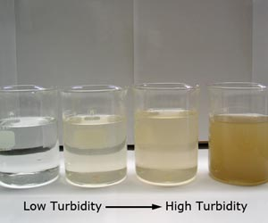
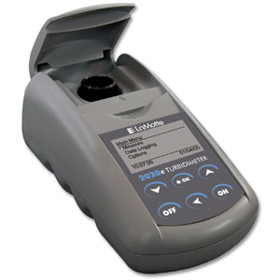
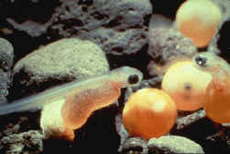
BMPs for Dewatering
Challenges

Slide 16
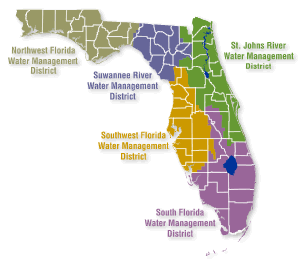
BMPs for Dewatering
5.2 Limitations
Discharges of produced groundwater from a non-contaminated site, require an FDEP Generic Permit for compliance with the NPDES program.
  This can now be obtained as part of the CGP NOI.
  Effective February 10, 2015
Contaminated sites need to contact FDEP before dewatering.
Additional information: http://www.dep.state.fl.us/water/wastewater/iw/genperm.htm
Water Management District Permits
Local governments should also be contacted regarding compliance requirements for dewatering.

Slide 17
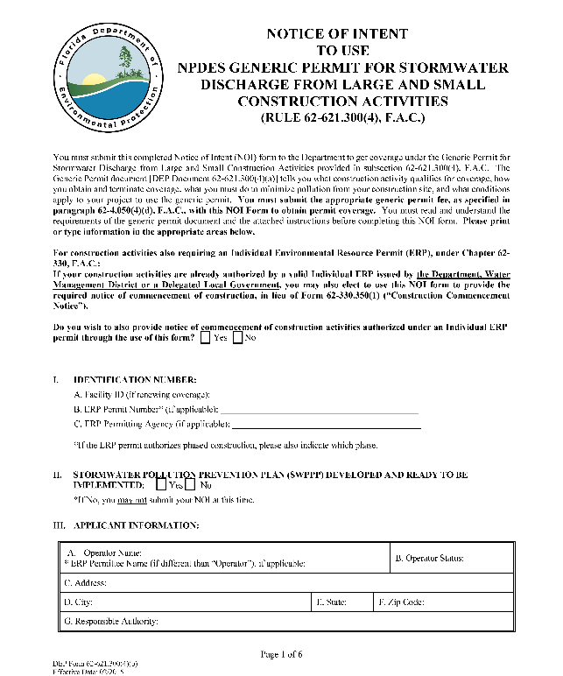
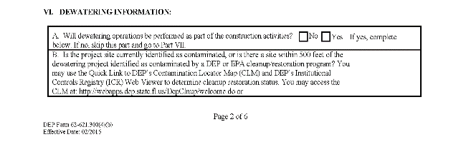
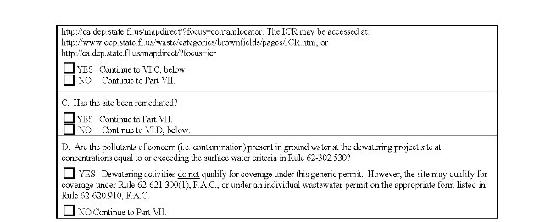
BMPs for Dewatering
5.2 Limitations
FDEP Generic Permit for Dewatering from Non-Contaminated Sites
  Greater than 500’ from known contamination areas
  File Notice of Intent (NOI) (select dewatering option)
  100$ Fee
  Coverage for 5 years
  File Notice of Termination (NOT)
  Can Obtain with CGP (Sites > 1 acre)
Individual Permits
  Required for Contaminated Sites
  Contamination status can be checked through FDEP’s “Contamination Locator Map” website or FDEP’s Map Direct with Institutional Controls Registry data layer
  Must Coordinate with FDEP

Slide 18
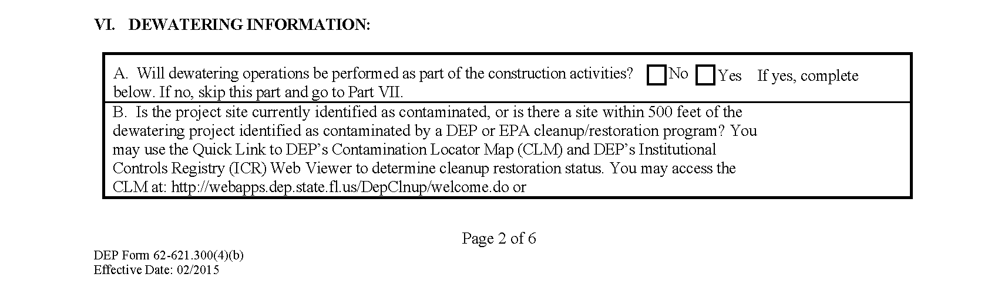
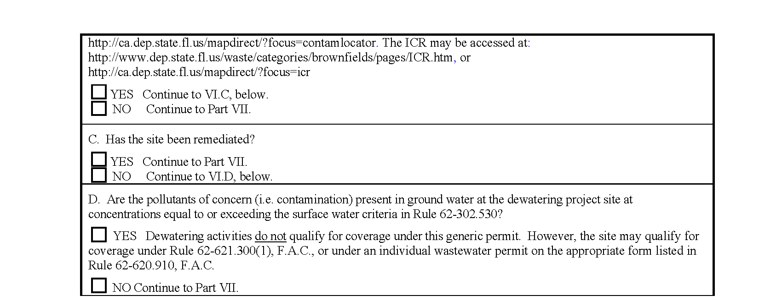
BMPs for Dewatering
5.2 Limitations

Slide 19
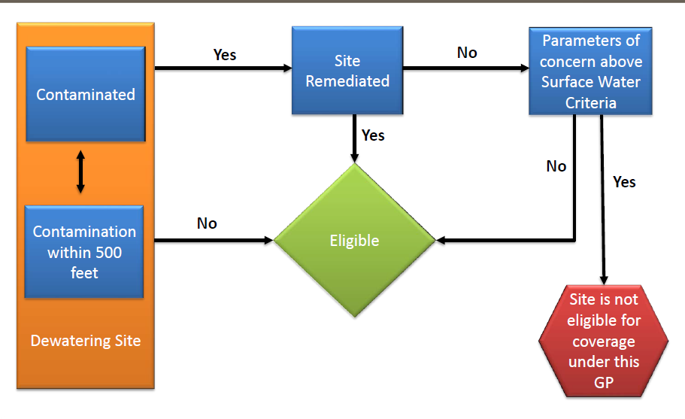
BMPs for Dewatering
5.2 Limitations

Slide 20
BMPs for Dewatering
5.2 Limitations
Tools applicant can use to determine cleanup restoration status.
Contamination Locator Map (CLM)
http://prodenv.dep.state.fl.us/DepClnup/welcome.do
Institutional Controls Registry (ICR)
https://floridadep.gov/waste/waste/content/institutional-controls-registry-guidance
Applicants may use other sources to determine whether contamination is present.
Remember - You can always contact your local DEP district office for advice!

Slide 21
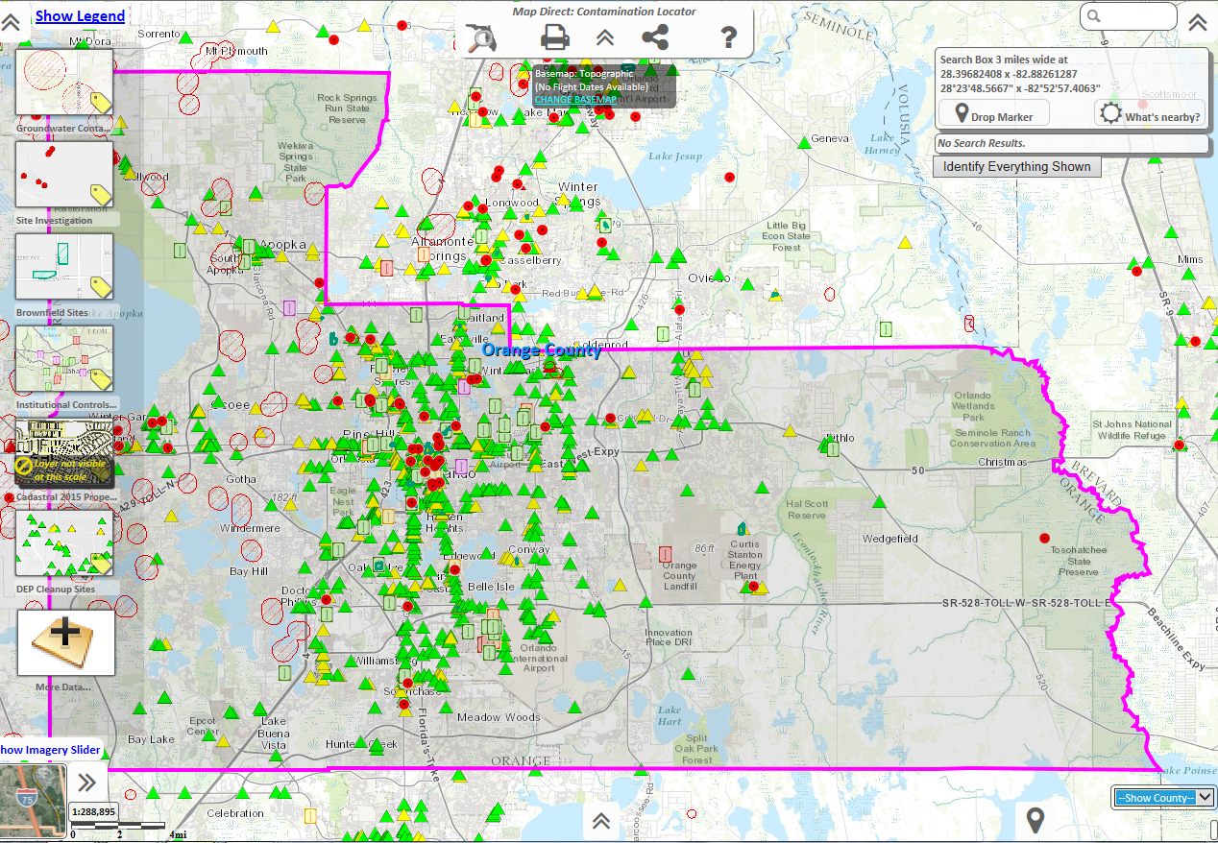
BMPs for Dewatering
5.2 Limitations
Map Direct with Institutional Controls Registry (ICR)
https://ca.dep.state.fl.us/mapdirect/

Slide 22
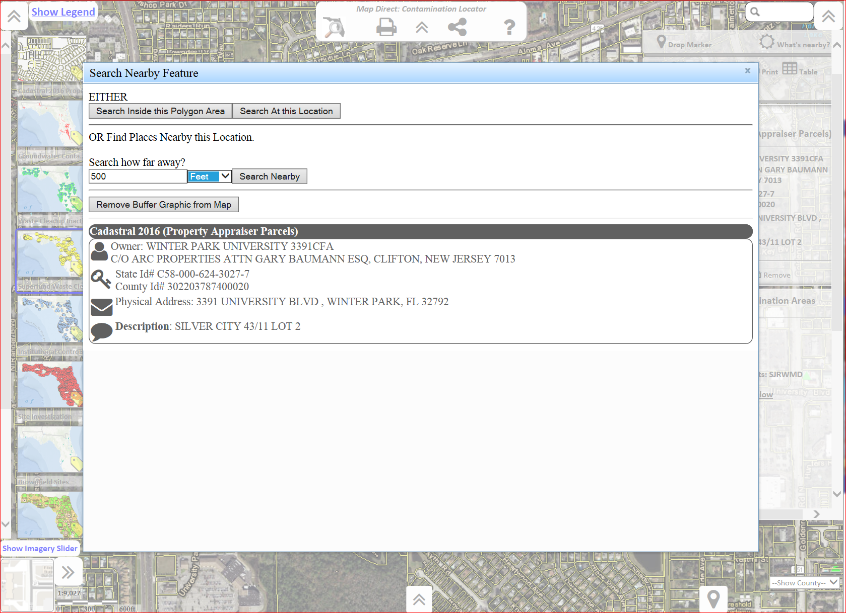
BMPs for Dewatering
5.2 Limitations
Running a buffer search with 500’ radius around a chosen point or address

Slide 23
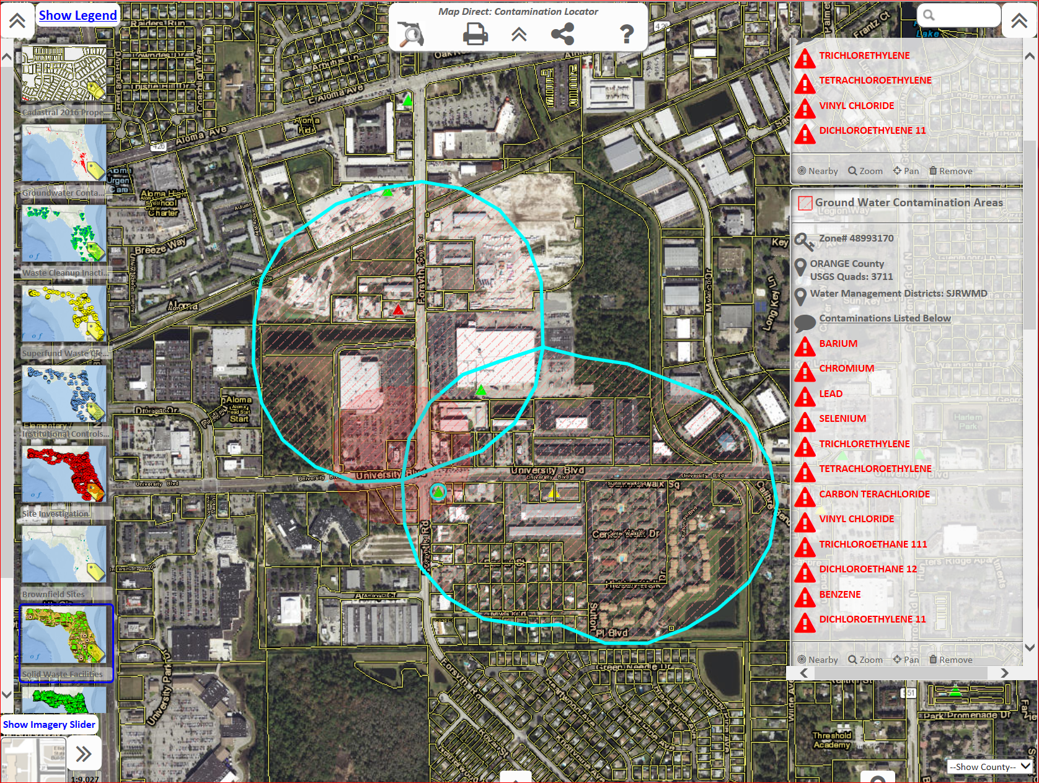
BMPs for Dewatering
5.2 Limitations
Buffer search radius result showing contaminated sites within 500’ of the project site

Slide 24

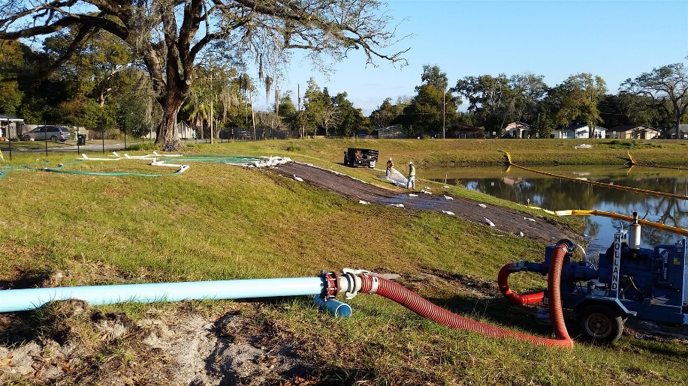
BMPs for Dewatering
5.3 Implementation
FDEP Dewatering Permit Requirements
Log & Monitor Flow Rates; sample weekly, possibly daily
Develop & Implement Site Specific BMPs
Weekly inspection & maintenance
Maintain Records On-Site
  Flow Rates & Sampling
  Permit, NOI, Approval Letter
  Weekly Inspections
  Maintenance Records
  Records of Chemicals Used
Keep Records 3 years

Slide 25
BMPs for Dewatering
5.3 Implementation
FDEP Dewatering Permit Requirements
“The Permittee shall report any characteristic in the effluent that could indicate the presence of a pollutant or pollutants not previously identified or anticipated (e.g. sheen, odor), and the occurrence, or new knowledge of, and spills, leaks or contamination in the vicinity of the project that could impact the water quality of the effluent.”
Cease operations & Contact DEP
24 Hour Reporting – State Warning Point - 1-800-320-0519
  Report “unauthorized releases or spills of untreated groundwater from dewatering operations” >1000 gal where effluent limitations are exceeded, or
  Where information indicates public health or the environment will be endangered
All permits and approvals must be secured (getting one does not ensure others)
Don’t assume you are permitted unless you can see it and review it!

Slide 26
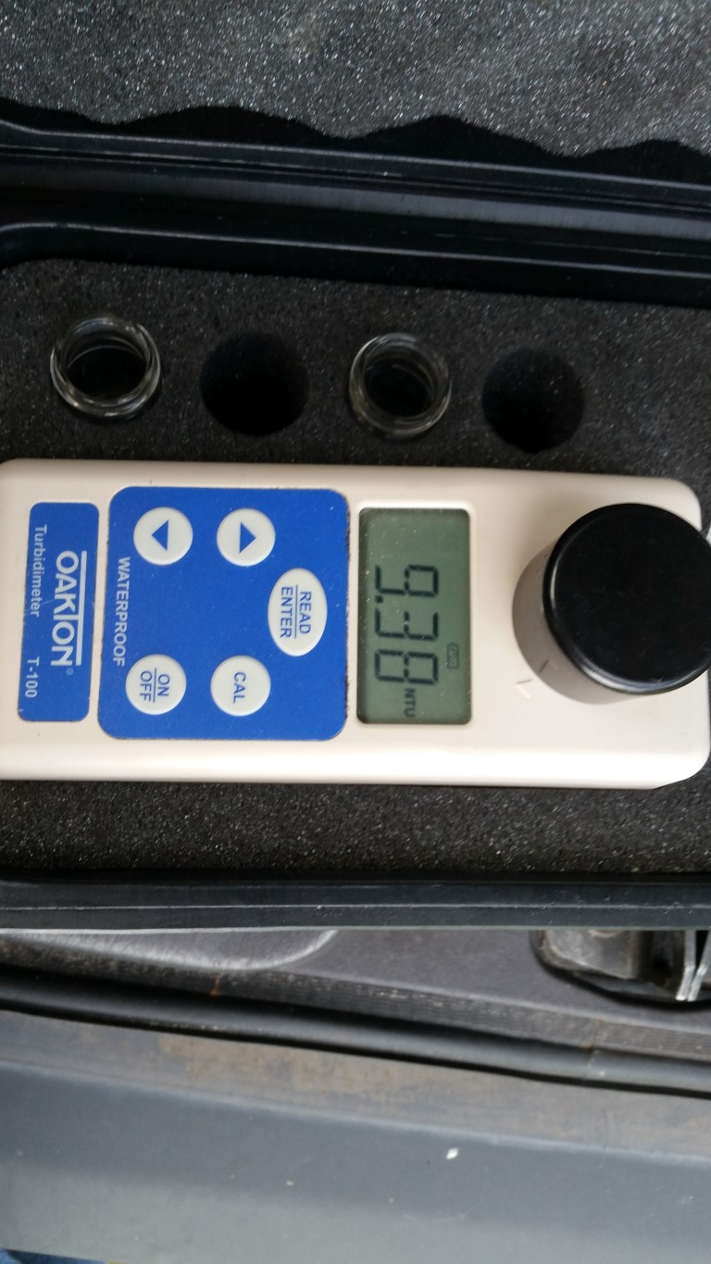
BMPs for Dewatering
5.4 Inspection & Maintenance
Inspect & verify that BMP’s are in place and functional before dewatering activities.
Monitor BMP’s throughout dewatering and after rain events
Remove accumulated sediment to ensure BMP effectiveness
Logbook of daily turbidity readings
Flow Rates

Slide 27
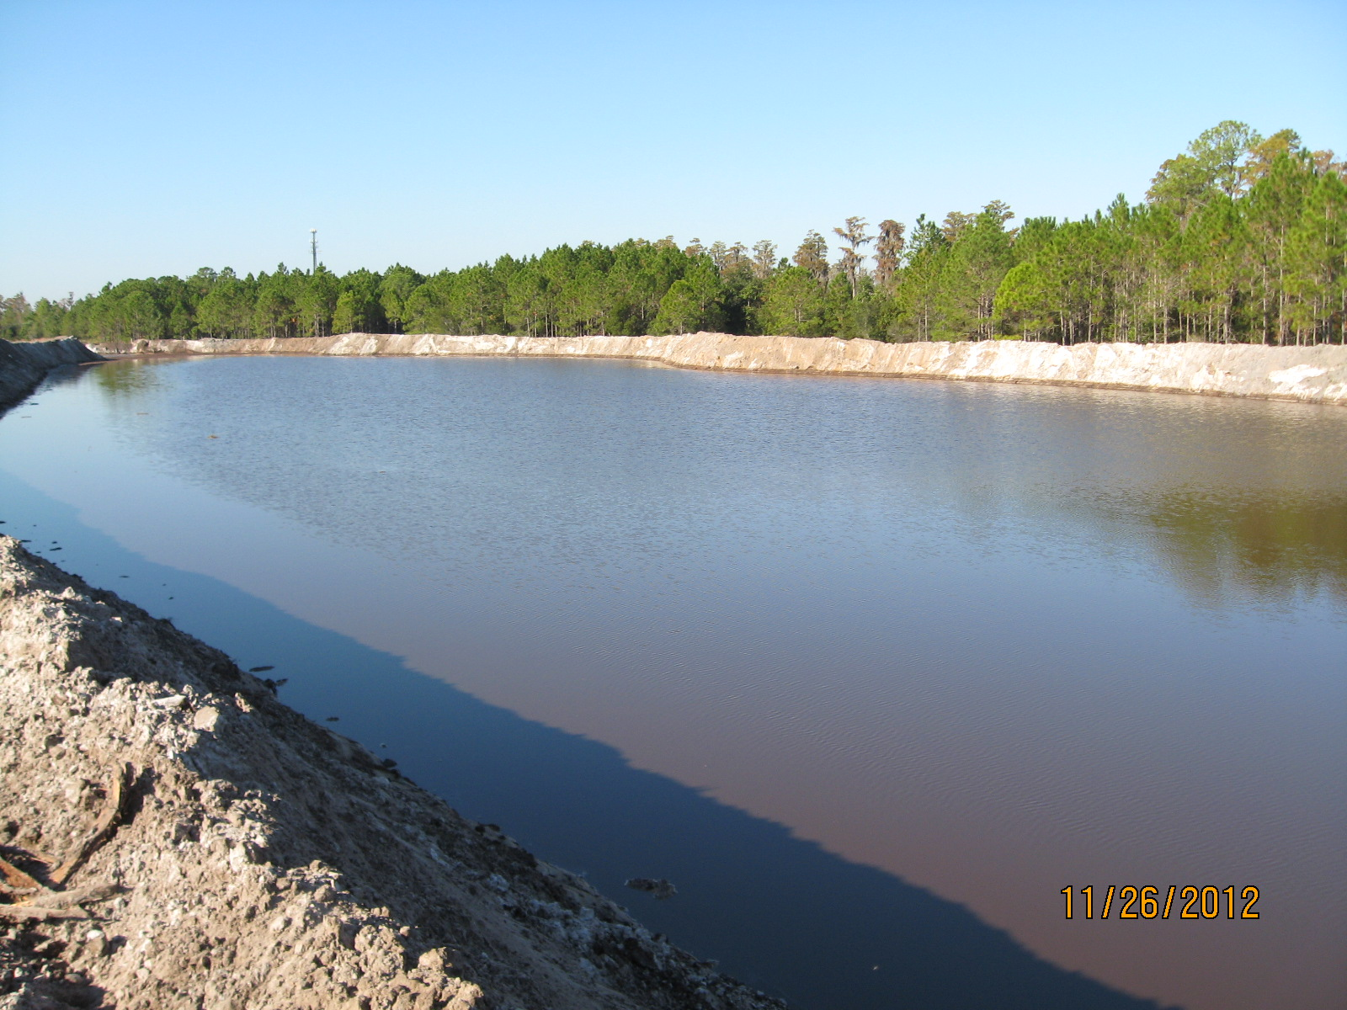

BMPs for Dewatering
5.5.1 Temporary Sediment Traps and Sediment Basins
A temporary basin created to detain sediment-laden runoff and allow sediment to settle out before discharging

Slide 28
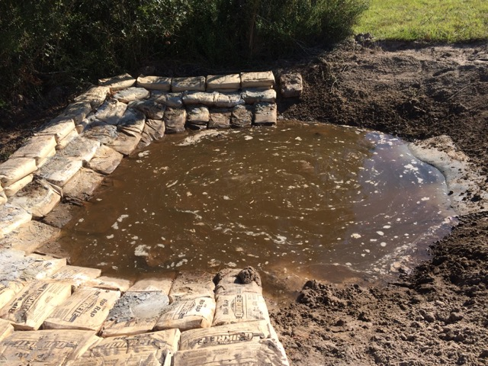
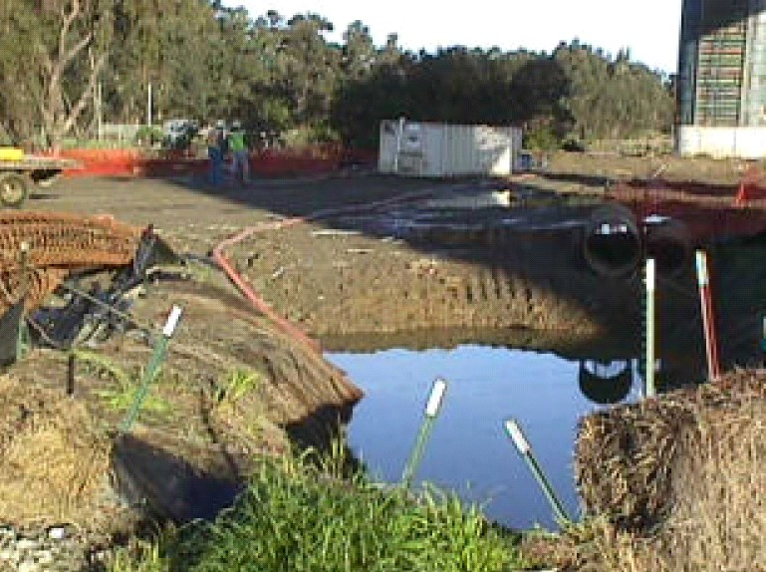
BMPs for Dewatering
5.5.1 Temporary Sediment Traps and Sediment Basins
Purpose:
The removal of large and medium particles and some metals that settle out with sediment.

Slide 29
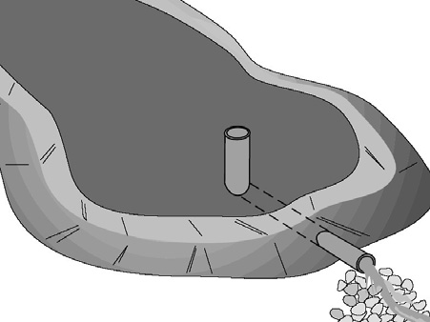
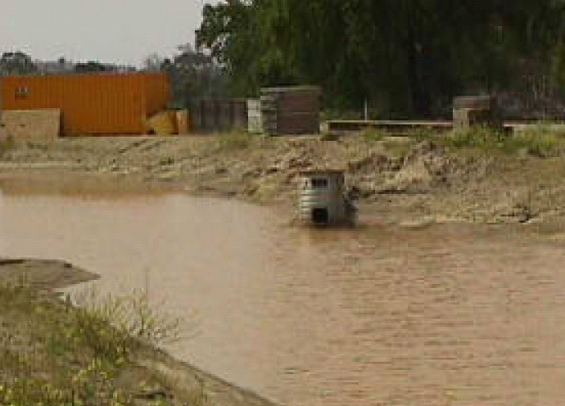
BMPs for Dewatering
5.5.1 Sediment Basin
Purpose:
Effective for the removal of sand, silt, and some metals that settle out with sediment.

Slide 30
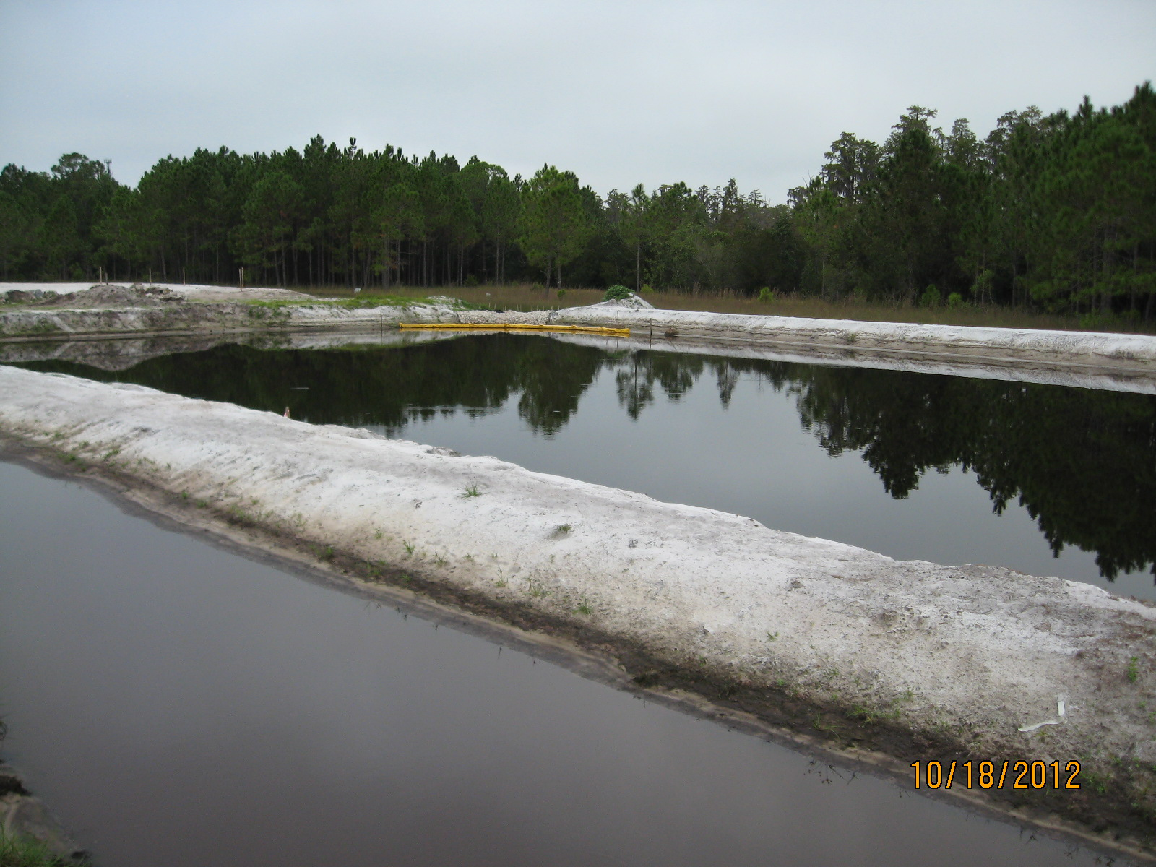
BMPs for Dewatering
Where & How Are Sediment Traps/Basins Commonly Used?
Tips:
The inflow pipe should be located as far from the outfall as possible - increases time for settling
Outfall should be stabilized with rock or non-erosive material
Notes:
The inflow pipe should be located as far from the outfall structure as possible. This increases the amount of time the water is in the basin and allows more time for the sediment to settle out.
The outfall should be stabilized with rock or vegetation or other non-erosive material.
An offsite discharge sampling location should be identified and used, as needed or required by dewatering plan/permit.

Slide 31
BMPs for Dewatering
5.5.1 Sediment Trap & Basin
Maintenance:
Daily inspections are recommended to prevent washouts, scouring and embankment blowouts.
Remove sediments when 1/2 full, or sooner.
Ensure banks are stabilized.

Slide 32
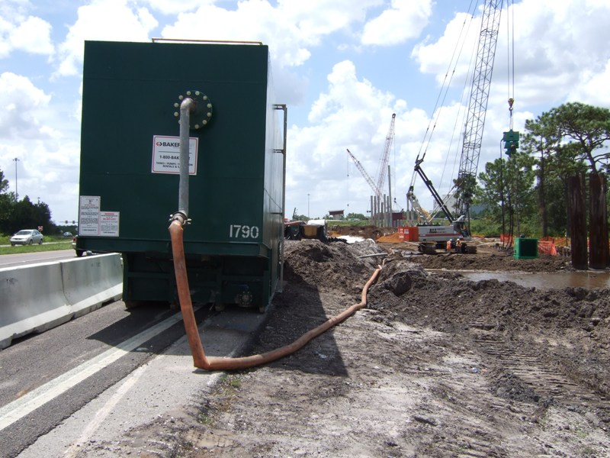
BMPs for Dewatering
5.5.2 Weir Tanks & Dewatering Tanks
Weir tanks and dewatering tanks separate water and waste (sediment, oil & grease, trash) by using weirs, baffles, and/or filter cloth.

Slide 33
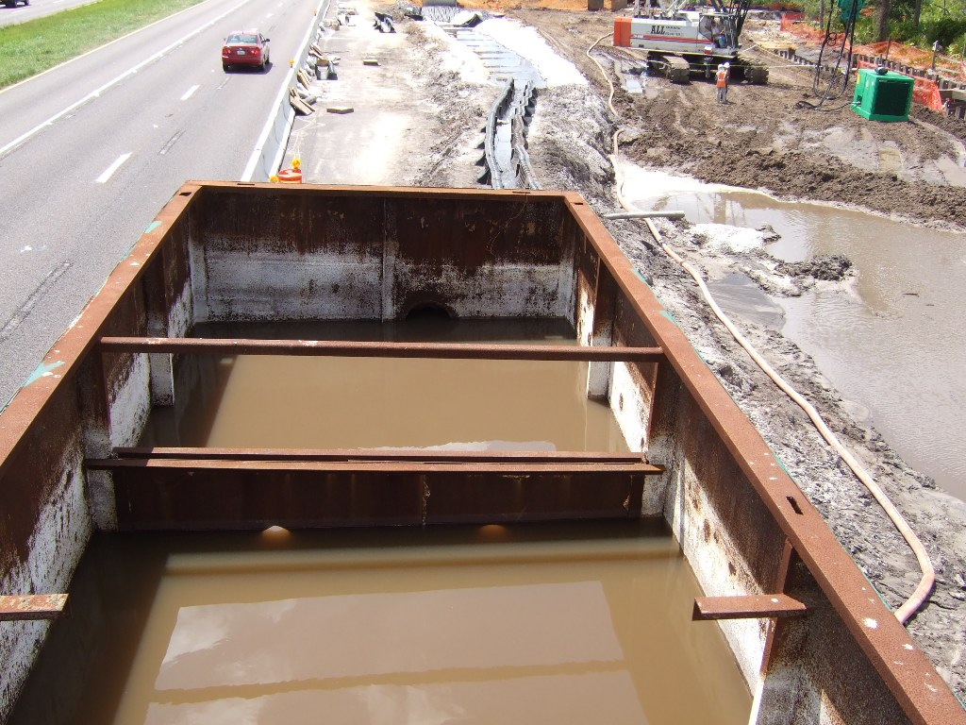
BMPs for Dewatering
5.5.2 Weir Tanks & Dewatering Tanks
Purpose: to separate sediment and other materials from water in dewatering operations.

Slide 34
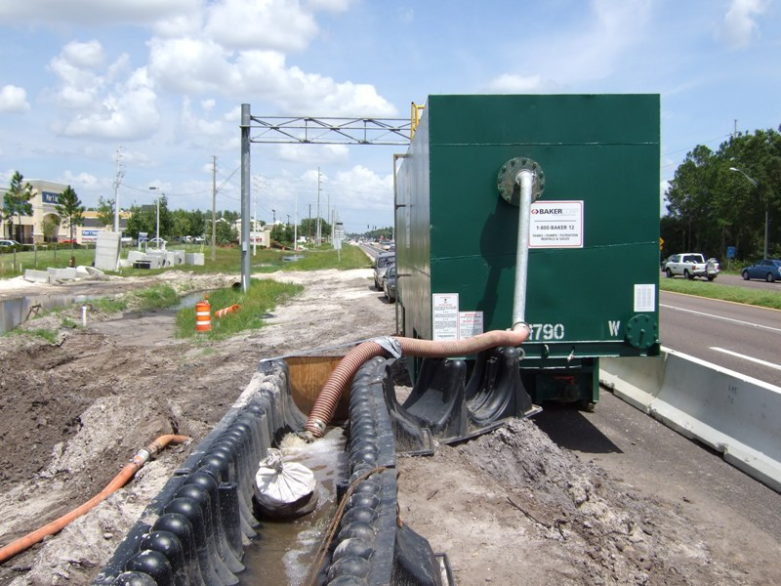
BMPs for Dewatering
Weir tanks are used in the treatment train to reduce turbidity in highway dewatering operation prior to discharge.
Notes:
The tanks are generally delivered to the site by a vendor who also provides assistance with the set up and operation of the dewatering operation. Tank size depends on site conditions.
High levels of flows may require the use of multiple tanks used in parallel or in series to provide pre-treatment for other treatment methods.

Slide 35
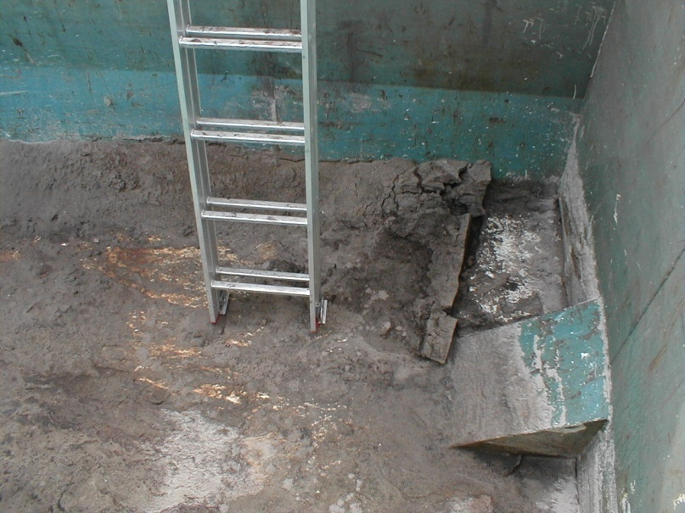
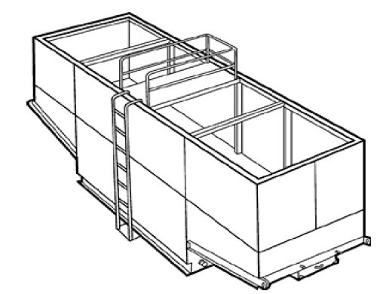
BMPs for Dewatering
5.5.2 Weir Tanks & Dewatering Tanks
Maintenance:
Inspect for and remove sediment accumulation
Oil & grease disposal by a licensed company

Slide 36
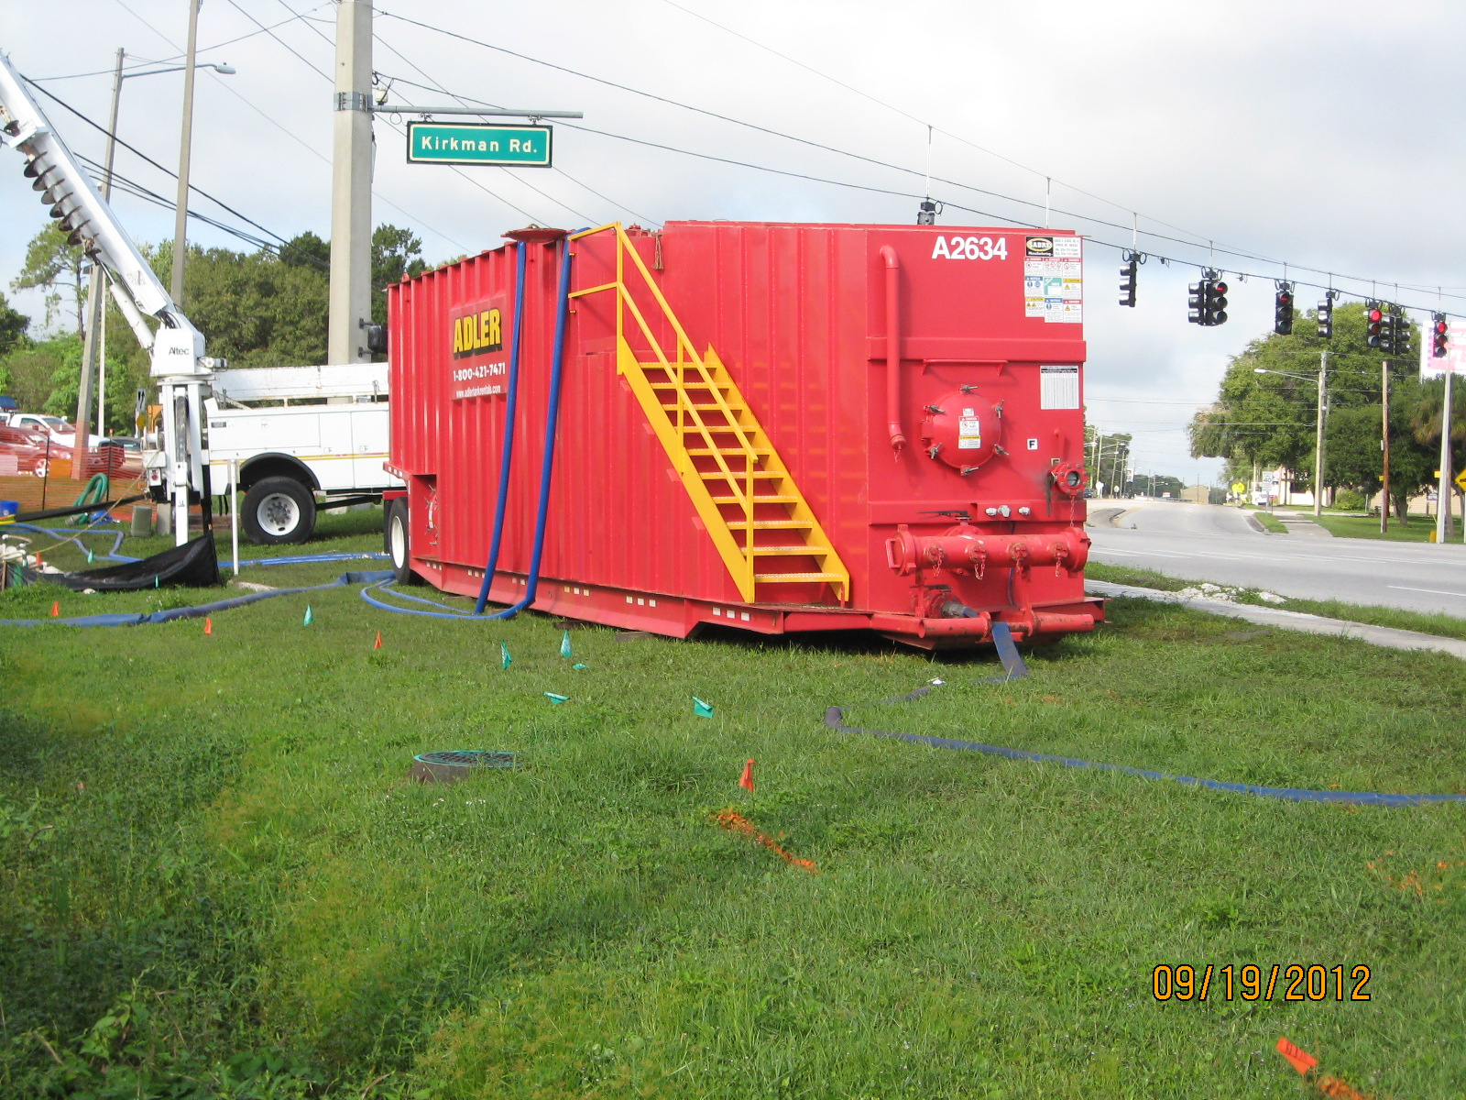
BMPs for Dewatering
5.5.2 Weir Tanks & Dewatering Tanks
A dewatering tank removes debris & sediment.
Flow enters through the top, passes through a filter, and discharges through the bottom of the tank.

Slide 37
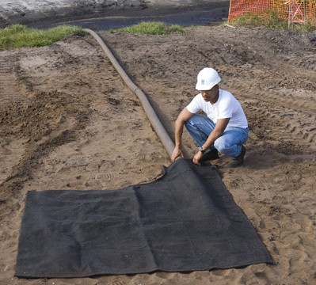
BMPs for Dewatering
5.5.3 Gravity Bag Filter
A nonwoven geotextile fabric bag that collects sand, silt, and fine particles.
Notes:
A gravity bag filter, or dewatering bag is a square or rectangular bag made of nonwoven geotextile fabric that collects sand, silt and some fines inside as water is pumped through it.

Slide 38
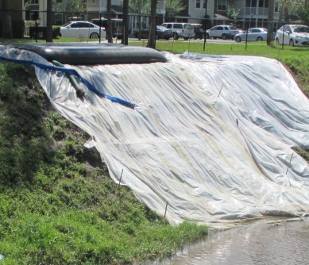
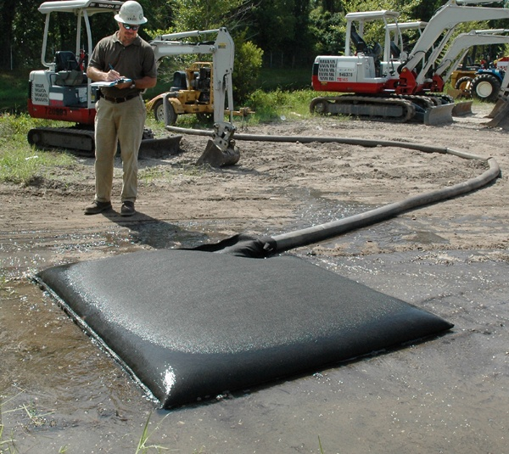
BMPs for Dewatering
5.5.3 Gravity Bag Filter
Purpose: The removal of larger particles and some metals in dewatering operations.

Slide 39

BMPs for Dewatering
Where & How is a Gravity Bag Filter Commonly Used?
Water is pumped through the bag and seeps through the bottom and sides of the bag and onto the ground.
The ground should be stabilized or protected so that turbid conditions are not created by the bag.

Slide 40

BMPs for Dewatering
5.5.3 Gravity Bag Filter
Maintenance:
Inspect bag regularly during use for:
  flow conditions
  bag conditions
  bag capacity
  secondary barrier, if applicable
Replace bag when it no longer functions
Dispose of offsite

Slide 41

BMPs for Dewatering
5.5.3 Gravity Bag Filter
Maintenance: If full, or no longer passes water, replace

Slide 42

BMPs for Dewatering
5.5.3 Gravity Bag Filter
Maintenance: Secondary stabilization often required

Slide 43

BMPs for Dewatering
5.5.3 Sand Media Filter
Water is treated by passing it though canisters filled with sand media.

Slide 44


BMPs for Dewatering
5.5.3 Pressurized Bag & Cartridge Filters
These water filtering units consist of filter bags and/or cartridge filters to clean water.
Pressurized Bag Filter
(Source: http://www.dot.ca.gov)
Cartridge Filter
(Source: http://www.dot.ca.gov)

Slide 45
BMPs for Dewatering
5.5.3 Pressurized Bag & Cartridge Filters
Purpose: Effective for the removal trash, gravel, sand, silt, some metals, as well as the reduction of turbidity
Maintenance:
Inspect regularly
Replace Filter Bags
Replace Cartridges

Slide 46


BMPs for Dewatering
5.5.4 Chemical Treatment
Reducing turbidity by applying a flocculant:
Polyacrylamide (PAM)
Aluminum Sulfate (Alum)

Slide 47


BMPs for Dewatering
5.5.4 Chemical Treatment
Reducing turbidity by applying a flocculant:
Polyacrylamide (PAM) Aluminum Sulfate (Alum)
PAM and Alum are both Anionic molecules and considered by the State of Florida to be non-toxic when used per manufacturer’s specifications
Cationic flocculants must have testing and approval before use (usually contain a toxic heavy metal)

Slide 48

BMPs for Dewatering
5.5.4 Chemical Treatment
Purpose:
Chemical treatment is used to significantly reduce turbid conditions on a site. This should be considered where turbid discharges to sensitive waters cannot be avoided using available BMPs.

Slide 49


BMPs for Dewatering
5.5.4 Chemical Treatment
Manifold System combining dewatering pumps with in-line flocculant blocks

Slide 50
BMPs for Dewatering
5.5.4 Chemical Treatment
Considerations for Use
Chemicals used must have toxicity testing results and FDEP approval
Any discharge from chemically treated dewatering operations must be nontoxic to aquatic organisms.
The discharge must meet all water quality standards for turbidity: < 29 NTUs above background or < background for OFWs. pH must be similar to receiving water.
Lab tests & field monitoring required. Sample and test the pH and turbidity frequently or during each batch release of chemically treated water.

Slide 51


BMPs for Dewatering
Where & How is Chemical Treatment Commonly Used?
Laboratory jar test
Certified applicator
The right chemical at the right dosage!

Slide 52


BMPs for Dewatering
Where & How is Chemical Treatment Commonly Used?
Alum application from boat
Check turbidity after application and record – compare to already known background for that waterbody

Slide 53


BMPs for Dewatering
Where & How is Chemical Treatment Commonly Used?
Check pH!!
Completed application☹

Slide 54

BMPs for Dewatering
Alum Treatment with Sediment Basin

Slide 55
BMPs for Dewatering
This is not an approved treatment system!
The right chemical at the right dosage!

Slide 56

BMPs for Dewatering
CTS-1 Continuous Treatment
Purpose: a designed flow-through system to provide continuous treatment of turbid water.

Slide 57
BMPs for Dewatering
Continuous Flow Through Alum Treatment System
Pumps
Alum tanks
Inflow cell 1
Cell 2
Cell 3
Cell 4
Discharge

Slide 58

BMPs for Dewatering
Polyacrylamide (PAM) - Floc Log Technology

Slide 59

BMPs for Dewatering

Slide 60

BMPs for Dewatering
Baffle Grid System
Grit Pit For Heavy Sediment

Slide 61

BMPs for Dewatering

Slide 62

BMPs for Dewatering

Slide 63

BMPs for Dewatering

Slide 64

BMPs for Dewatering

Slide 65

BMPs for Dewatering

Slide 66




BMPs for Dewatering
Water Clarification: Treatment Ditches using Baffle Grid and Mixing Trough with PAM

Slide 67


BMPs for Dewatering
Additional Treatment Systems

Slide 68

BMPs for Dewatering
CTS-2 Batch Treatment
Purpose: chemical treatment of turbid water using ponds or portable, trailer-mounted tanks.

Slide 69

BMPs for Dewatering
CTS-2 Batch Treatment
Turbid Input
Dual Channel System Allows For Continuous Discharge During Maintenance
Final (clean) Discharge
Pump
One channel is online while the other is down for maintenance
Long-term Operational System

Slide 70

BMPs for Dewatering
CTS-2 Batch Treatment

Slide 71

BMPs for Dewatering
CTS-2 Batch Treatment

Slide 72

BMPs for Dewatering
CTS-2 Batch Treatment

Slide 73

BMPs for Dewatering
CTS-2 Batch Treatment

Slide 74

BMPs for Dewatering
CTS-2 Batch Treatment

Slide 75

BMPs for Dewatering
CTS-2 Batch Treatment

Slide 76

BMPs for Dewatering
CTS-2 Batch Treatment

Slide 77

BMPs for Dewatering
5.4 Inspection & Maintenance
Monitor turbidity and pH levels
Inspect, clean, repair all flocculants and sediment collection devices
Ensure effectiveness not impacted by rain events

Slide 78

BMPs for Dewatering
Reminder: Obtain all Proper Approvals
Federal
State
  FDEP
  Water Management Districts (WMD)
Local
  County
  City

Slide 79



BMPs for Dewatering
Reminder: Obtain All Proper Approvals

Slide 80

BMPs for Dewatering
Reminder: Maintain Adequate BMPs and Replace/Repair as Needed!

Slide 81

BMPs for Dewatering
What is Wrong With this?

Slide 82

BMPs for Dewatering
What 35,000 NTUs Looks Like

Slide 83
BMPs for Dewatering
Chapter 5 REVIEW
What are the types of dewatering systems that generally produce the clearest and non-turbid discharge from groundwater?
Well-Point and Horizontal Sock (Sock/Horizontal Pumps).
What kind of water quality does a rim ditch system produce?
The poorest water quality with the highest turbidity NTU levels.
What must a well-point and horizontal pump system have in order to function properly?
Primarily sandy soil.
What methods are used to manage (treat) nonstormwater discharges & remove sediment from construction pumping?
Sediment traps and basins, weir and dewatering tanks, and chemical treatment.

Slide 84
BMPs for Dewatering
Chapter 5 REVIEW
FDEP General Permit for Dewatering requires that you be how many feet from a “known contamination source?”
500 feet or greater.
What tools can be used by the permit applicant to determine the cleanup and restoration status of a known contamination site?
The Contamination Locator Map (CLM) and the Institutional Controls Registry Web Viewer.
What must the permittee do if they observe the presence of a pollutant or pollutants such as a sheen, or odor while dewatering?
Cease operations immediately, contact their DEP District Ground Water Section for guidance, and contact the 24 Hour Reporting – State Warning Point.

Slide 85
BMPs for Dewatering
Chapter 5 REVIEW
When using chemical treatment systems, what should you remember?
“The right chemical at the right dosage.”
What two are the most common and approved flocculant chemicals utilized to control turbidity on a job site to reduce turbidity?
Anionic Polyacrylamide (PAM) and Aluminum Sulfate (Alum).
Before discharging chemically treated water, what should you test for?
pH and turbidity limits.

