Slide 1

Chapter 6:
Regulatory and Statutory Requirements

Slide 2
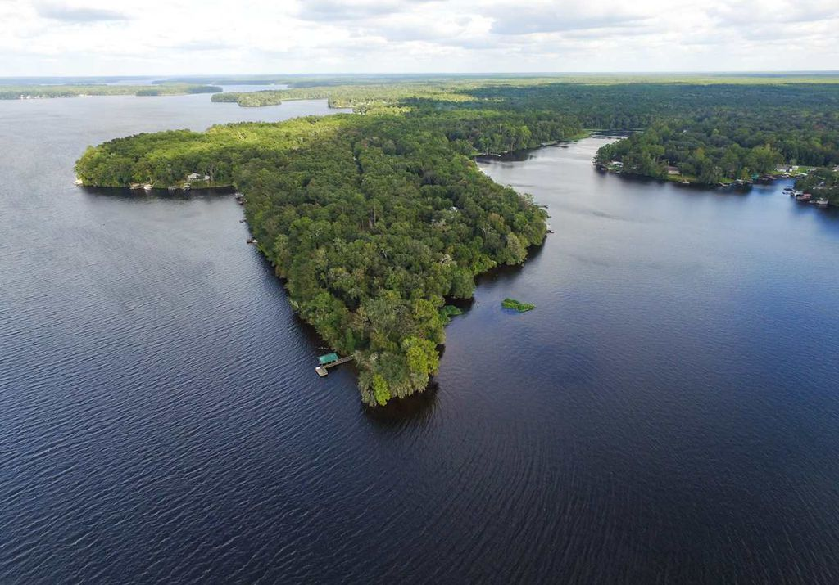
6.1 Introduction
Today we have two types of stormwater permits in Florida:
Environmental Resource Permit (ERP)
Construction Generic Permit (CGP)

Slide 3
6.1 Introduction
Florida – First state in the country to require stormwater treatment from all new development
State Stormwater Rule implemented in 1982
Goal was to Minimize the adverse impacts of runoff
This “Technology-Based” rule included:
  A goal (the performance standard)
  Design criteria for different types of stormwater treatment BMPs; i.e., retention and detention ponds

Slide 4

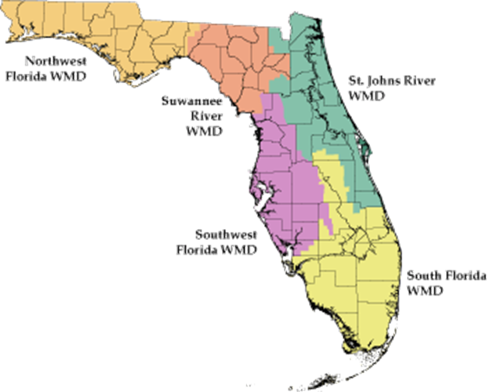
6.1 Introduction
ERP integrates stormwater quantity and wetland protection requirements into a single permit.
ERP regulates:
  Dredging and Filling in Wetlands
  Stormwater Treatment Systems
  Construction of Dams or Reservoirs
  Other Activities affecting the Waters of the State of Florida
Note: NPDES is separate from the ERP process, but you may need both!
NOTE: NPDES is separate from the ERP Process

Slide 5
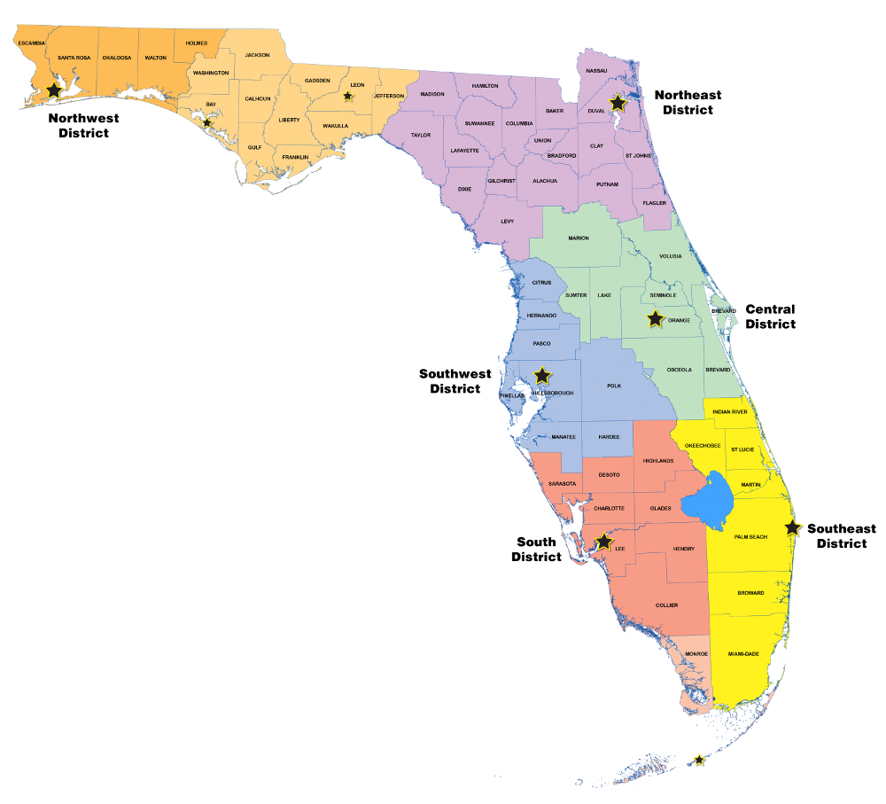
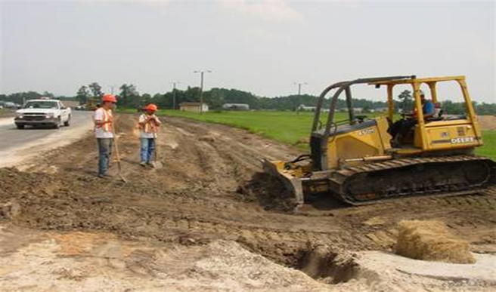
6.1 Introduction
In 2000, USEPA authorized the State of Florida DEP to implement the NPDES Stormwater Program
NPDES Stormwater Program is separate from the State’s ERP program authorized by Part IV, Chapter 373, F.S.
NPDES does not establish additional regulations for construction/design features of permanent stormwater management systems
Separate stormwater discharge permits may also be needed from the local county or municipality

Slide 6
6.2 NPDES Regulatory and Statutory Requirements
Clean Water Act – 1972
To maintain the chemical, physical, and biological integrity of the Nation’s waters
To eliminate discharge of pollutants
To achieve water quality
National Pollutant Discharge Elimination System (NPDES) 40 CFR 122.26 - 1987
Three Types of NPDES Permit:
Construction Generic Permit (CGP)
Multi-Sector Generic Permit (MSGP) or No Exposure Exclusion
Municipal Separate Storm Sewer Systems (MS4)

Slide 7
6.2 NPDES Regulatory and Statutory Requirements
DEP’s History with NPDES Stormwater
USEPA Implementation 1990-2000
DEP received delegation in October 2000
DEP outsourced inspections & permit processing to private contractor from 2001 to 2009

Slide 8
6.2 NPDES Regulatory and Statutory Requirements
DEP’s History with NPDES Stormwater, cont.
Permits and inspections managed by Tallahassee 2009-2013
Inspections delegated to District CAP programs in October 2013
CAP (Compliance Assurance Program) cross-training initiatives for NPDES Stormwater
Current Program
With DEP cross-training all DEP CAP staff are qualified to perform NPDES inspections = More inspectors doing more enforcement, not just one per office anymore!

Slide 9
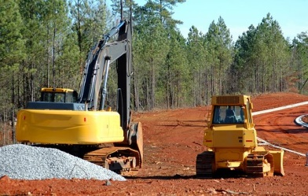
6.2.1 Construction Activities
CGP Definition 8.2 “Construction Activity”:
  Act or process of developing or improving land, including demolition and renovation activity, which involves the disturbance of soils not limited to, clearing, grading, and excavation.”
  This is a broadly defined category, on purpose!

Slide 10
6.2.1 Construction Activities
NPDES Stormwater Program regulates construction activities that disturb one or more acres of land and discharges stormwater to surface waters of the state or into an MS4.
What is an MS4 (Municipal Separate Storm Sewer System)?
  Defined in Chapter 62-624.200, F.A.C.; “A conveyance or system of conveyances like roads with stormwater systems, municipal streets, catch basins, curbs, gutters, ditches, constructed channels, or storm drains.”
  MS4’s are publicly-owned and maintained, take care because we share
Be aware of illicit discharges of stormwater to an MS4, which is anything from your site containing sediment, fuel, oil, paint, solvent, concrete wash water, hazardous chemicals, septic waste, and others. Discharge clean!
MS4 permit holders (public entities) monitor and enforce violations against construction where illicit discharges reach their conveyance systems.

Slide 11
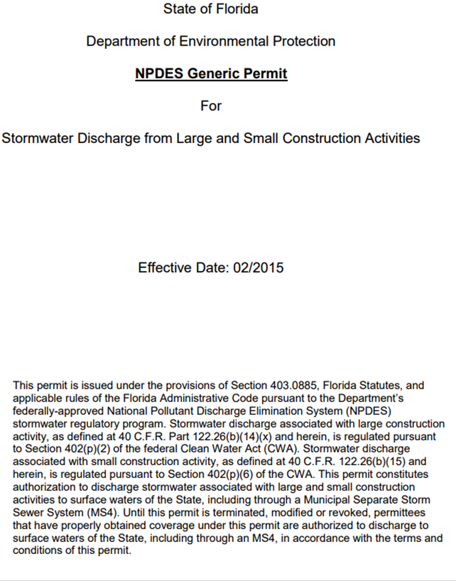
6.2.2 Large Construction Activities
Generic Permit for Stormwater Discharge from Large Projects:
  “Construction activity that results in the disturbance of five or more acres of total land area.
  Large construction activity also includes the disturbance of less than five acres of total land area that is part of a larger common plan of development or sale that will cumulatively disturb five acres or more.
Current CGP Adopted by State of Florida in 2015

Slide 12
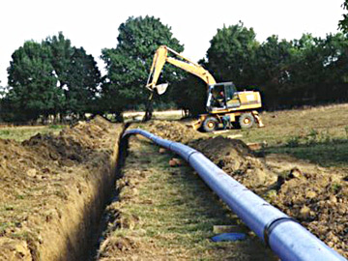
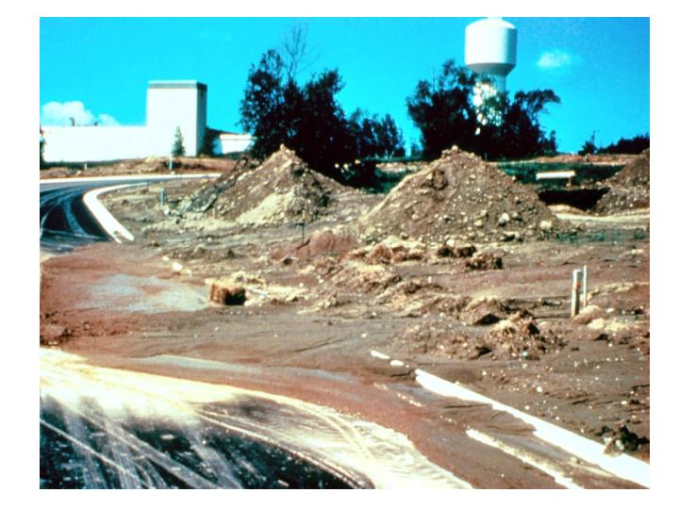
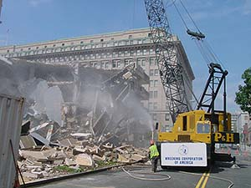
6.2.2 Large Construction Activities
Phased projects and projects with multiple lots, even if the separate phases or lots will be constructed under a separate contract or by separate owners (e.g., a development where lots are sold to separate builders)
Development that may be phased over multiple years
Projects in a contiguous area
Linear projects such as roads, pipelines, or utilities including demolition and renovation activity.

Slide 13

6.2.2 Small Construction Activities
Any construction activity greater than one acre, but less than 5, requires a CGP for Small Construction Activities
Small Construction Activities also includes projects with multiple separate lots
So, for example, a developer wants to build on three ½ acre lots. Would a CGP be required?
Yes!

Slide 14


6.2.2 Small Construction Activities
Example: Adding a shed to an existing house. Disturbing less than an acre. Subdivision has been complete years ago. Will a CGP permit be required?
No!

Slide 15
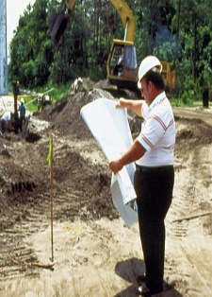
6.2.3 CGP Permits
Responsibilities of the Operator
CGP definition 8.20 “Operator”: Person, firm, contractor, public organization, or other legal entity that owns or operates the construction activity and that has authority to control those activities at the project to ensure compliance with the terms and conditions of this permit.”
Ultimately the “Operator” is responsible for:
  Obtaining permit coverage
  Implementing BMPs to minimize erosion and sedimentation from their site’s stormwater
  Having sufficient authority to ensure compliance with the CGP
  Having operational control over project

Slide 16
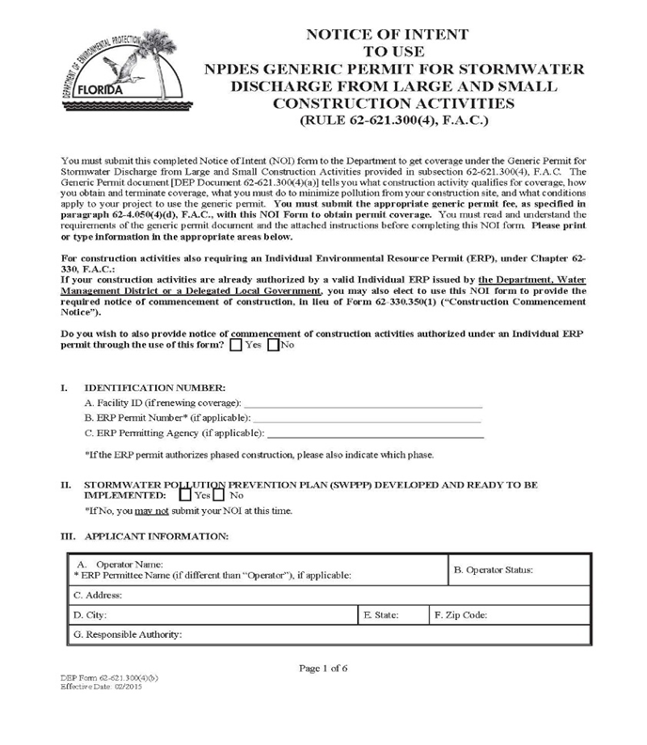
6.2.3 CGP Permits
Obtaining CGP Coverage
File a Notice of Intent (NOI)
Use DEP Form 62-621.300(4)(a)
Ask these additional questions:
  Do I already have my SWPPP developed? (answer must be yes!)
  Will I need dewatering?
  Do I have or need a separate ERP Permit?

Slide 17
6.2.3 CGP Permits
Where to File NOI?
NPDES Stormwater Notices Center, MS #3585
Florida Department of Environmental Protection
2600 Blair Stone Road
Tallahassee, FL 32399-2400
For questions call the Notice Center: (866) 336-6312 (toll-free)
Interactive Online Application: Notice of Intent (iNOI)
Go to: http://www.fldepportal.com/go/
The iNOI is the quick, easy and preferred method!

Slide 18
6.2.3 CGP Permits
Obtaining CGP Coverage
DEP Business Portal: http://www.fldepportal.com/go/
Follow Step by Step Guidance on how to apply:
Obtain and carefully read the CGP document
Develop a site-specific Stormwater Pollution Prevention Plan (SWPPP) before submitting NOI
Operator can submit an iNOI electronically after setting up a pin and an account to pay fees
Complete the application online or NOI DEP Form 62-621.300 [4][b]
Submit the NOI with correct fee to the Stormwater Notice Center
Do not send construction plans or Storm Water Pollution Prevention Plan (SWPPP)
If your project discharges stormwater to an MS4, you must send a copy of the NOI or the Acknowledgement Letter within seven calendar days of receipt to the operator of the MS4
Notice: The CGP Permit Coverage is effective starting 2 days (48 hours) after the date of submittal with correct fee applied. Permit coverage is good for 5 years.
*Remember to post a copy of the NOI or the Acknowledge Letter on the construction site.

Slide 19
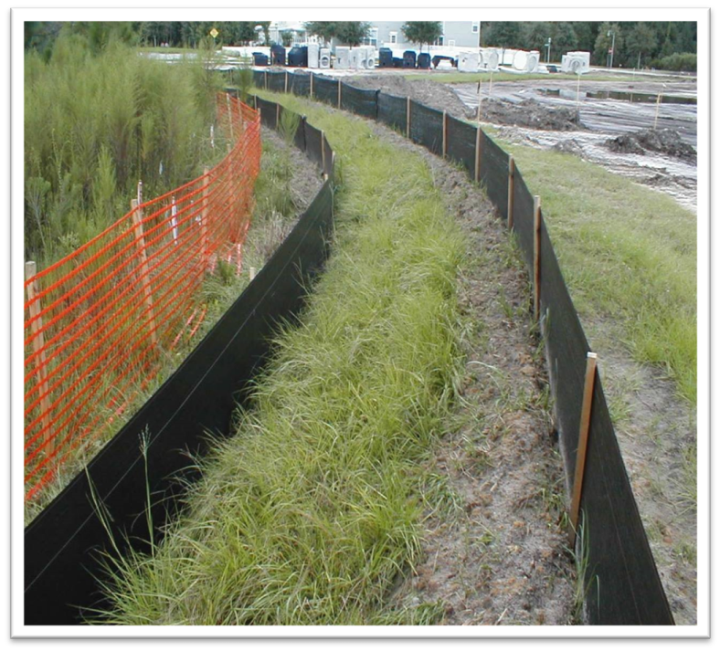
6.2.3 CGP Permits
Construction Activity Fees
Coverage is required for activities that ultimately disturb an acre or more.
Small CGP = 1 to 4.99 acres = $250
Large CGP = 5 acres or more = $400

Slide 20

6.2.3 CGP Permits
Submit a complete NOI and permit fee at least TWO calendar days before commencement of construction and land clearing activities.
The generic permit (CGP) is effective for FIVE YEARS and it is non-transferrable.
2022
2027

Slide 21
6.3 Key CGP Requirements
Develop and implement a SWPPP
Post a copy of the NOI or the Acknowledgement Letter onsite
Conduct inspections every seven calendar days (not working days) and after every half inch or greater rain event within 24 hours
Keep all records at the construction site or at an appropriate alternate location as specified in the NOI – but this must be clear!
Must maintain a site log (notebook or electronic computer file folder)
  Containing copies of the NOI, the Acknowledgement Letter, SWPPP, all inspections, records, and all notifications to or from DEP
Retain records for three years from the date the Notice of Termination (NOT) is submitted
Submit a NOT only when the site has reached final stabilization of 70% or better (or after a new Operator obtains coverage).

Slide 22
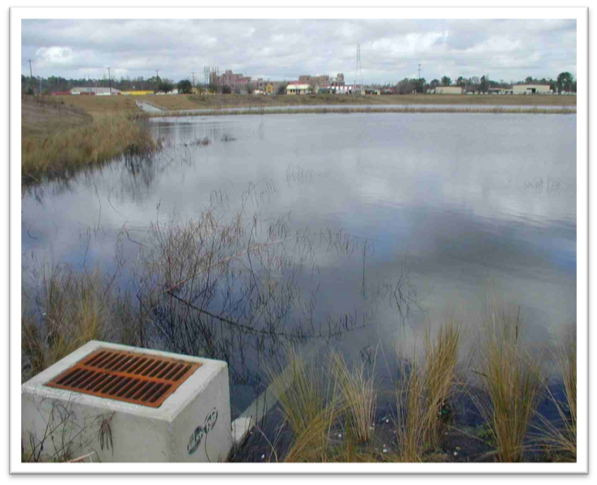
6.3 Key CGP Requirements
Permit specifically does not allow you to:
Cause or contribute to a violation of surface water quality standards (CGP 1.5.1)
Discharge stormwater mixed with non-stormwater sources (CGP 1.5.4)

Slide 23
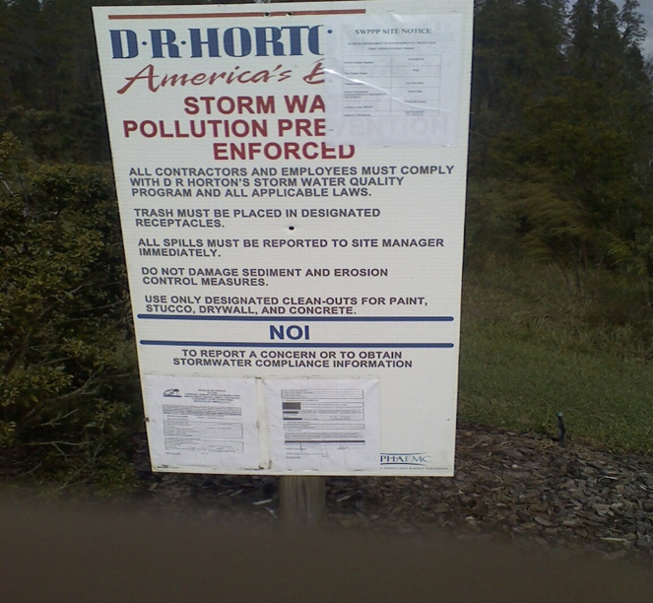
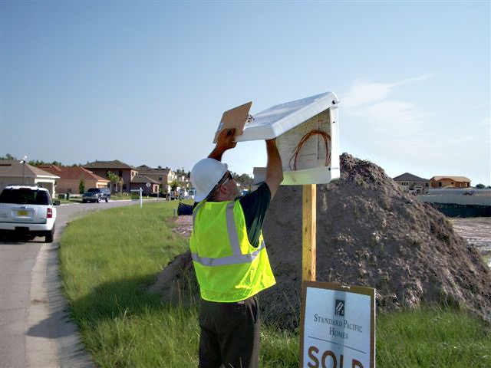
6.3 Key CGP Requirements
You must post a copy of the NOI or acknowledgment letter at the construction site in a prominent place for public viewing such as alongside a building permit.

Slide 24
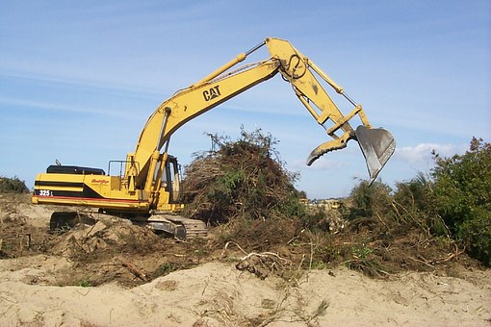
6.3 Key CGP Requirements
Allowable Non-Stormwater Discharges:
  Waters without detergents used to spray off loose solids from vehicles.
  Waters used to control dust.
  Non-contaminated groundwater associated with dewatering.
  Remember, these discharges must also be turbidity / pollutant free before leaving a site!

Slide 25
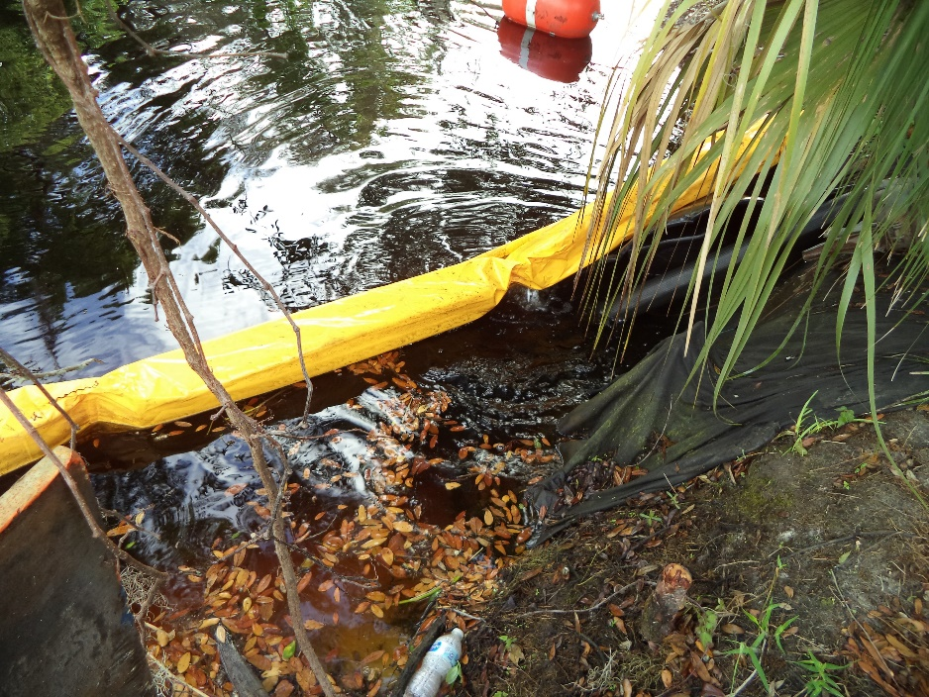
6.3 Key CGP Requirements
Groundwater Dewatering is Covered Under Your CGP:
  CGP authorizes the discharge of uncontaminated ground water.
  An uncontaminated site must meet the following conditions:
    Not a contaminated site and no identified contaminated site within 500 feet.
    Contaminated site, but DEP documentation confirms remediated.

Slide 26
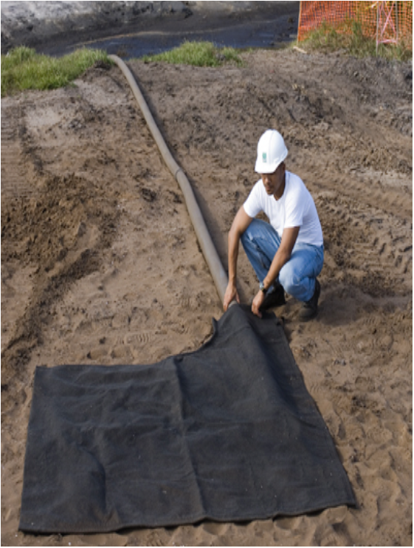
6.3 Key CGP Requirements
Groundwater Dewatering is Covered Under Your CGP:
  Appropriate dewatering BMPs shall be implemented to ensure that discharges from dewatering operations do not cause or contribute to violations of water quality standards.
  BMPs must be included in the Dewatering Section of the SWPPP.

Slide 27
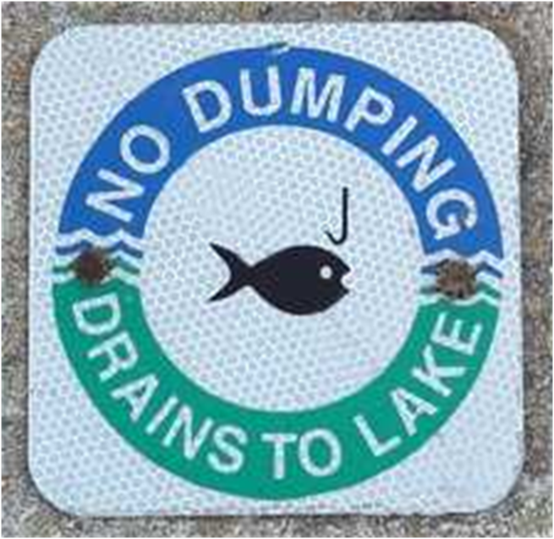
6.3 Key CGP Requirements
Prohibited Non-Stormwater Discharges
Wastewater from concrete washout
Wastewater from washout or cleanout of stucco, paint, form releasing oils, curing compounds, and other construction materials
Fuels, oils, or other pollutants from vehicle and equipment operation and maintenance.
Soaps, detergents, solvents or other cleaners
Hazardous substances or oil
Solid materials, including building materials
Any other non-stormwater discharge not specifically allowed by Part 3.2 of the CGP

Slide 28

NPDES Program Contact Information
Michelle Bull – Program Administrator
Michelle.Bull@dep.state.fl.us
(850) 245-7561
NPDES Stormwater Notices Center
Florida Department of Environmental Protection
2600 Blair Stone Road, MS #3585
Tallahassee, FL 32399-2400
Phone: (866) 336-6312 (toll-free))

Slide 29
Chapter 6
The US EPA authorized Florida to implement the NPDES program in what year: 1972 / 1999 / 2000 / 2007?
The NPDES Generic Permit for Florida Phase II implemented was effective on this year:
1979 / 2001 / 2005 / 2015?
A Large Construction activity results in the disturbance of ____ acres or more total land area.
Which of these is a construction activity? Building a Lego city / building a garden shed behind your house / clearing pine trees and burning them / replacing windows and doors in your home
5

Slide 30
Chapter 6
A road is a type of linear project? True or False
Obtaining permit coverage is the responsibility of the: engineering firm/FDOT/ subcontractor/ the Operator.
The person, firm, contractor, public organization, or other legal entity responsible for construction is known as the:
boss/ operator/ serve party/ improvement board
What should be the Operator’s first step? Submit the NOI/ develop the perimeter fencing around the area to be disturbed/ develop the SWPPP?
You can complete and submit the NOI application and fee electronically? True or False.

Slide 31
Chapter 6
After submitting the NOI you can start clearing land immediately?
True or False
What do you do with the NOI once you get it from the Notice Center? You can file it / send a copy to the inspector / post on the job board / put it in the garbage can
The CGP permit will allow you to do the following:
perform construction activities / fill a wetland / dump construction debris/ cause a water quality violation
- Must wait 48 hours!

