Slide 1
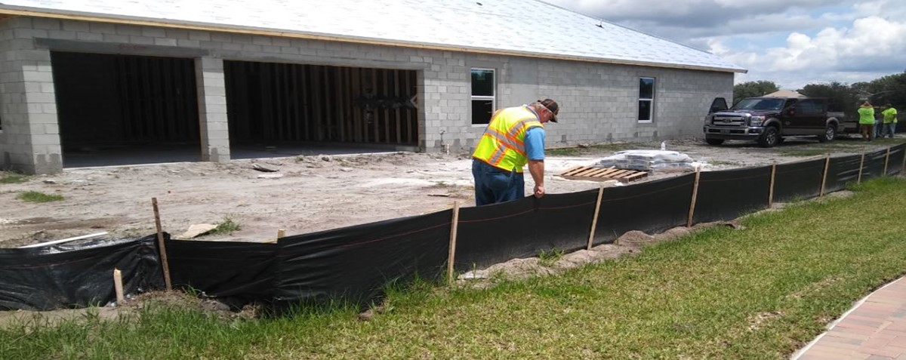
Chapter 9
Inspection and Enforcement

Slide 2
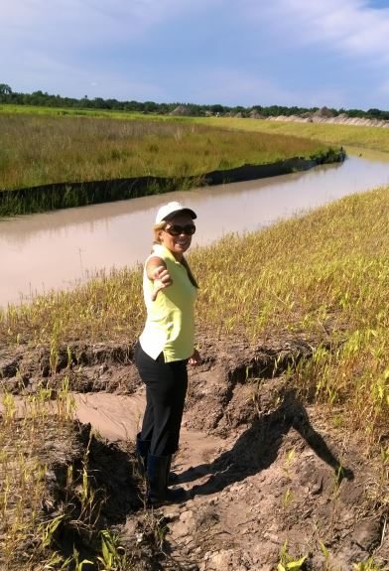
9.1 Introduction
Specific duties and responsibilities of an inspector depend on the employing agency:
Public: city, county, state, federal, etc.
Private: engineering inspection company, construction company, other consultant company, non-profit group, etc.
There are many forms of training:
DEP class you are now taking (FSESCI), Envirocert through CPESC, Stormwater One, etc., plus large company specific training like Walmart and Home Depot.
However, there is no substitute for on-the-job training from experienced inspectors and instructors.
Supplement your understanding and knowledge of associated environmental issues by joining industry groups, subscribing to magazines and websites for BMP info

Slide 3

9.2 The Role of the Inspector
Conduct
Compliance
Handling violations
Documentation

Slide 4

9.2.1 Conduct
An inspector must conduct themselves with:
Integrity
Fairness
Commitment

Slide 5
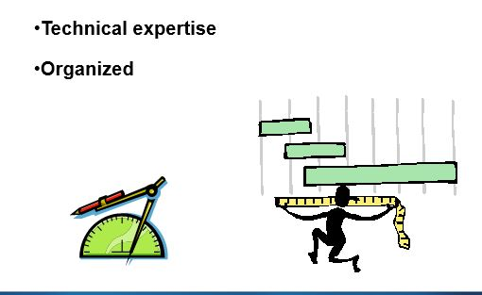
9.2.1 Conduct
An inspector must have the necessary technical expertise and be:
Organized
Unbiased and consistent
Professional and courteous

Slide 6
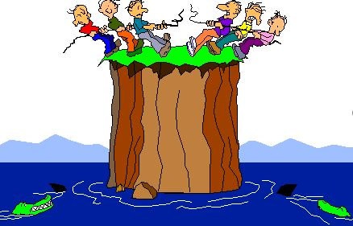
9.2.1 Conduct
PROMOTE TEAMWORK!
Construction and inspection should be working towards the same goal
Collaborate and seek shared solutions – be willing to revise or change if something isn’t working

Slide 7
9.2.1 Conduct
As an inspector – be the person that people come to first with issues or BMP failures because they know you are fair and a good partner towards achieving compliance
Build Partnerships

Slide 8
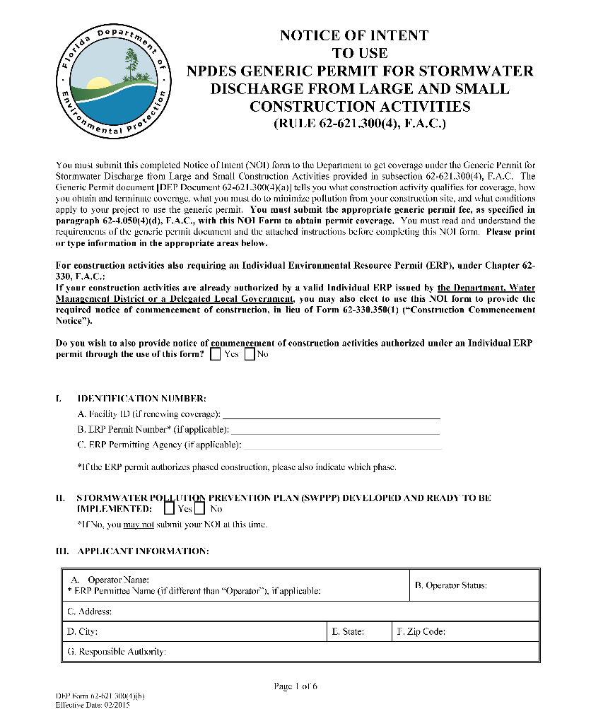
9.2.2 Compliance
Compliance
Site permitted, all BMPs installed per plan & maintained
Performance oriented
No off-site impacts
Doesn’t matter if it should work, does it actually work?
Make sure you have the proper permits, such as:
CGP NOI Permit (FDEP NPDES) – remember to have your SWPPP before, right?
ERP for stormwater and wetland impacts (FDEP/WMD/ACOE/local)
County and city permits
Other specific permits (Air quality? Hazardous materials? Contaminated site? Etc.)

Slide 9
9.2.2 Compliance
Inspection duties
Project permitted.
BMPs properly installed and maintained.
Erosion is controlled.
Off-site sedimentation is prevented.
Off-site turbidity is prevented.
Paperwork up-to-date

Slide 10
9.2.3 Handling Violations
Documentation
Write report onsite or as soon as possible after inspection for every site and every inspection.
Pictures, pictures, pictures!
Legible, concise, thorough and neat.

Slide 11

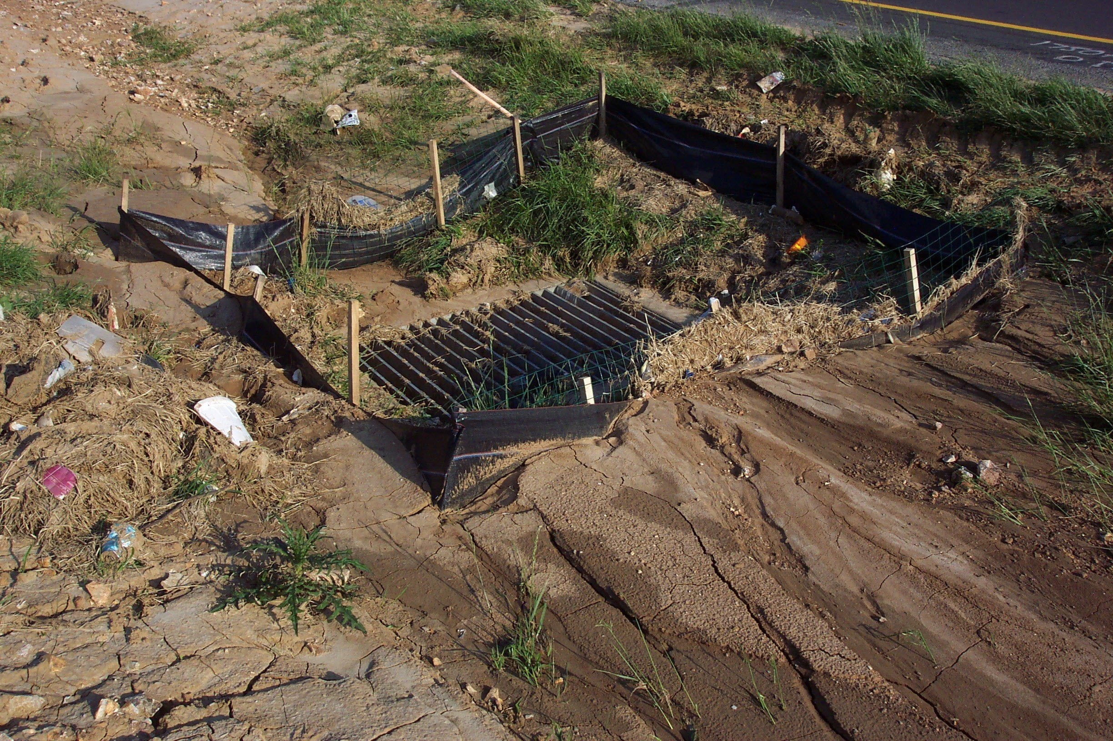
9.2.3 Handling Violations
Are all BMPs installed correctly and maintained ?

Slide 12

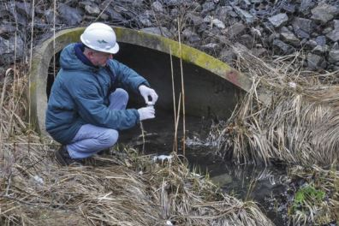
9.2.3 Handling Violations
Is off-site sedimentation and/or turbidity being controlled?

Slide 13

9.2.3 Handling Violations
If “YES” to all, the site is in compliance.
If “NO” to any, then the site is in violation.

Slide 14

9.3.1 The Inspection
Ask yourself these basic questions before and after each inspection
Is the project permitted?
Are all BMPs properly installed and maintained?
Is on-site erosion being controlled?
Is off-site sedimentation and/or turbidity being controlled?
Is paperwork complete and up-to-date?
If “YES” to all, the site is in compliance
If “NO” to any, the site is in violation

Slide 15

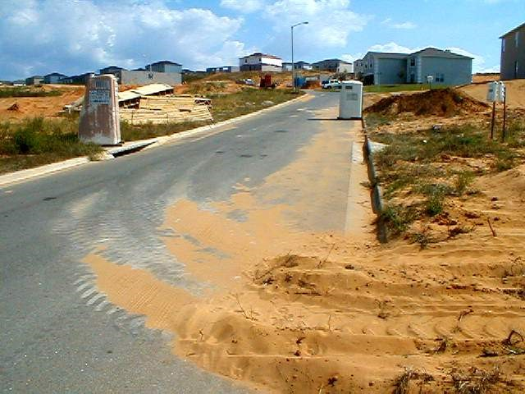
9.3.1 The Inspection
Is on-site erosion being controlled?

Slide 16
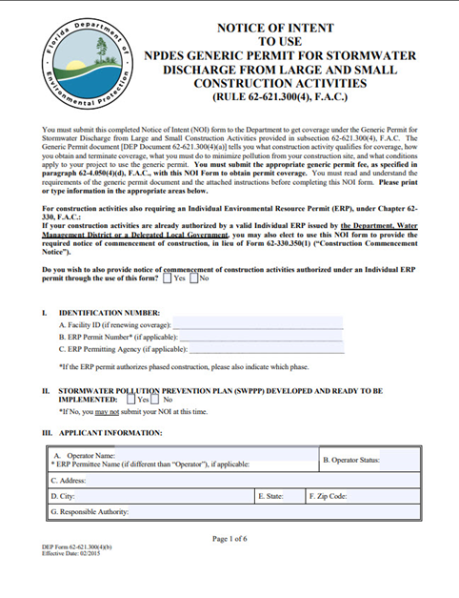
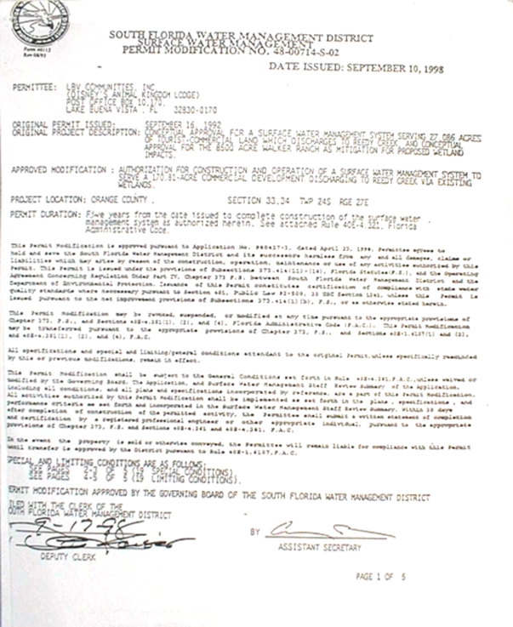
9.3.1 The Inspection
Is the project permitted?

Slide 17
9.3.2 Tolerances
Be Reasonable
The rules are performance based - allow innovative thinking, BMP combinations
Understand the function of BMPs = know the tolerances, consequences of failure.
Listen with an open mind - make the contractor your partner in problem solving.

Slide 18
9.3.3 Preparing for an Inspection
Study Plans, Maps, Photos, Permit Files
Sensitive areas: wetlands, waterbodies, natural drainage system, severe grades, erodible soils
Critical erosion areas: cuts, fills, waterways, streambanks, outlets
Construction plans: Stormwater management, utilities, buildings, roads
Schedule: phases, BMP installation, temporary seeding

Slide 19
9.3.3 Preparing for an Inspection
Perimeter: Off-site runoff, on-site runoff
Inspection and maintenance - Who? When?
Access to BMPs – stored onsite or off
Note stockpiles, borrow pits, haul roads, waste storage
Existing noncompliance, existing nonconforming land uses
Hi-lite plans, make lists

Slide 20
9.3.3 Preparing for an Inspection
Communication: Inspector, contractor, owner
Contact person: Name, address, 24-hour phone number
Responsibility: Schedule, performance, plan changes, maintenance, contingencies
Inspection Schedule:
  Must be upheld – it’s a permit condition!
  Erosion control and stormwater management FIRST
  No construction while noncompliant discharge is left ignored

Slide 21
9.3.4 Preconstruction Conference
Plan changes: Thresholds, procedures
Critical areas identified – subcontractors informed
Contractor understands how and when perimeter and internal BMPs are installed.
Maintenance of BMPs: Who, when; supplies stockpiled for severe storms.
Affirmation: Provide copies of plans/permits to everyone; confirm understanding of plans, schedule, responsibilities. MUST sign and date.

Slide 22
9.3.5 Before You Leave the Office
Before your inspection
Be familiar with the plans, details, schedule, and file history for each site.
Organize your route if you are inspecting several sites.
Always take the plans, file, and reporting forms.
Take measuring or surveying equipment.
Take photo or video equipment.
Personal protection: Boots, sun and insect protection, 2-way radio or cell phone.

Slide 23
9.3.6 Inspecting the Site
Take plans and file on-site.
Check in at contractor’s field office.
Take orderly, thorough, legible notes.
Walk the perimeter - from low to high.
Check internal BMPs - from low to high.
BMPs sized and installed OK, contributing area OK.
Ask questions and poke around; you’re an inspector!

Slide 24
9.3.7 Causes of Noncompliance
Causes of Non-Compliance
Little or no effort to comply.
Inadequate design or changes in site conditions.
Faulty installation and/or poor maintenance.
Failure to plan for severe weather

Slide 25
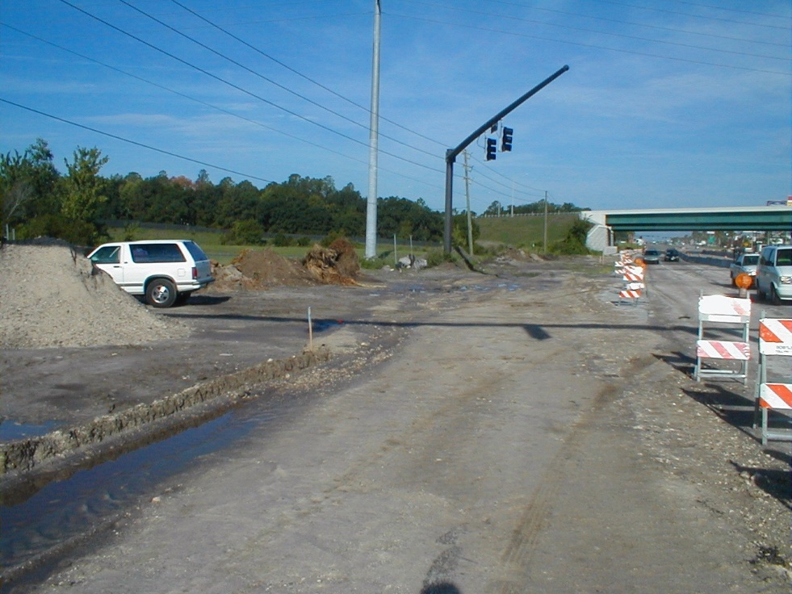
9.3.7 Causes of Noncompliance
Little or no effort to comply:
Not submitting a plan or applying for a permit.
Failure to follow approved plan.

Slide 26
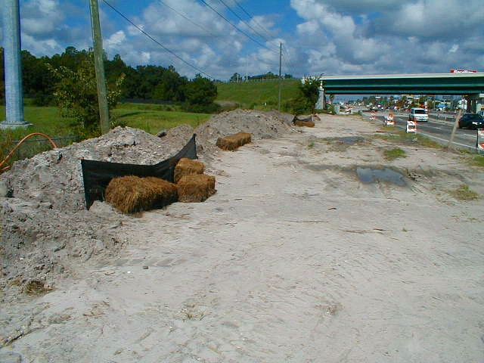
9.3.7 Causes of Noncompliance
Inadequate design or changes in site conditions:
Structural BMPs ineffective.
Ground cover failing due to slope or excessive runoff velocity and/or volume.
Contributing areas changed, additional BMPs required.
Maintenance overload.

Slide 27
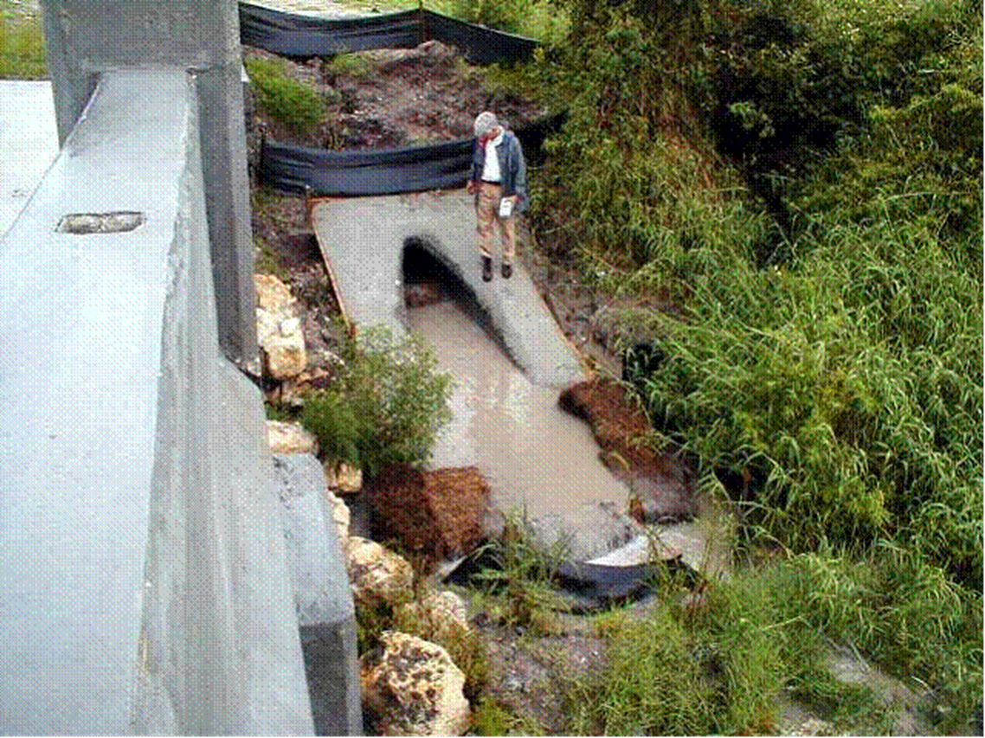
9.3.7 Causes of Noncompliance

Slide 28
9.3.7 Causes of Noncompliance
Faulty installation and/or poor maintenance:
This is the MOST COMMON REASON in Florida.
This is the reason why YOU ARE HERE.

Slide 29
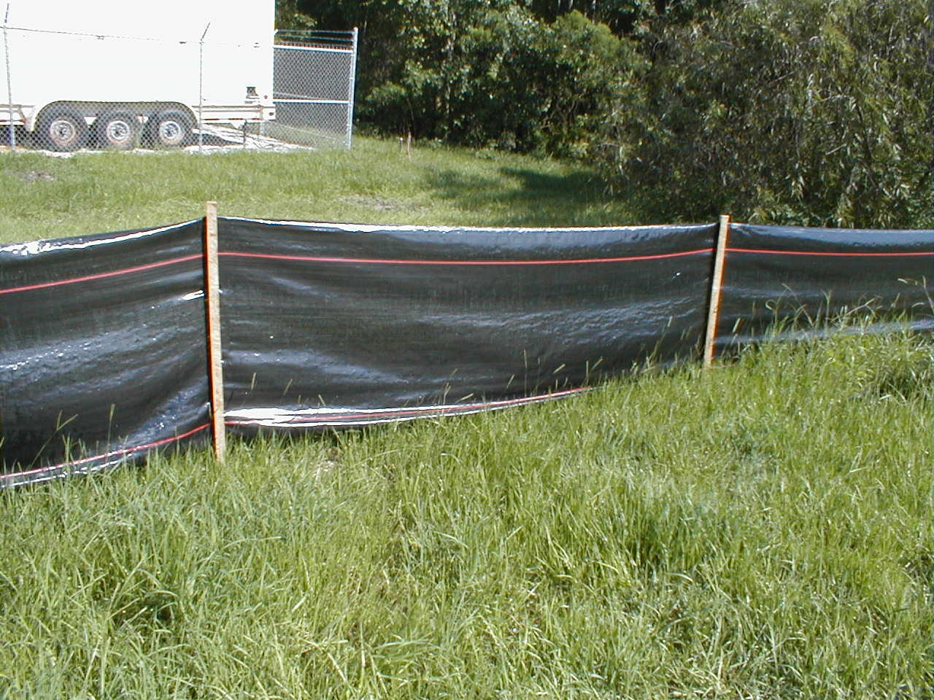
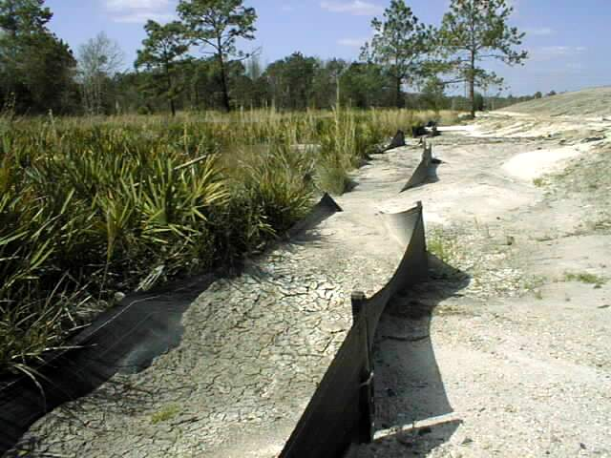
9.3.7 Causes of Noncompliance
Faulty installation
“Air fence”
Don’t just add another row after first is covered!
and/or poor maintenance

Slide 30
9.3.8 Inspection Reports
Document all findings:
  Correct form(s)?
  BMPs maintained?
  Ready for next storm?
Subcontractors informed/complying?
Schedule compliance.
Notes/comments
Date and type of inspection
Fill out report on site, report to contractor - ok or not
Finalize report and digitize back at office – if needed

Slide 31
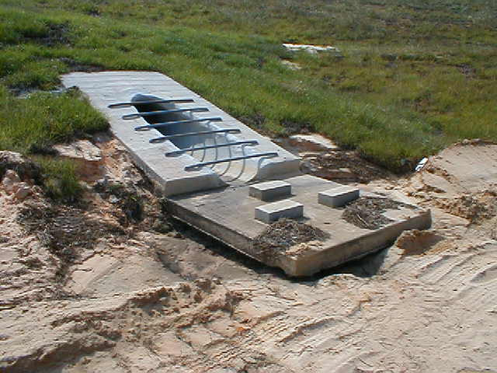
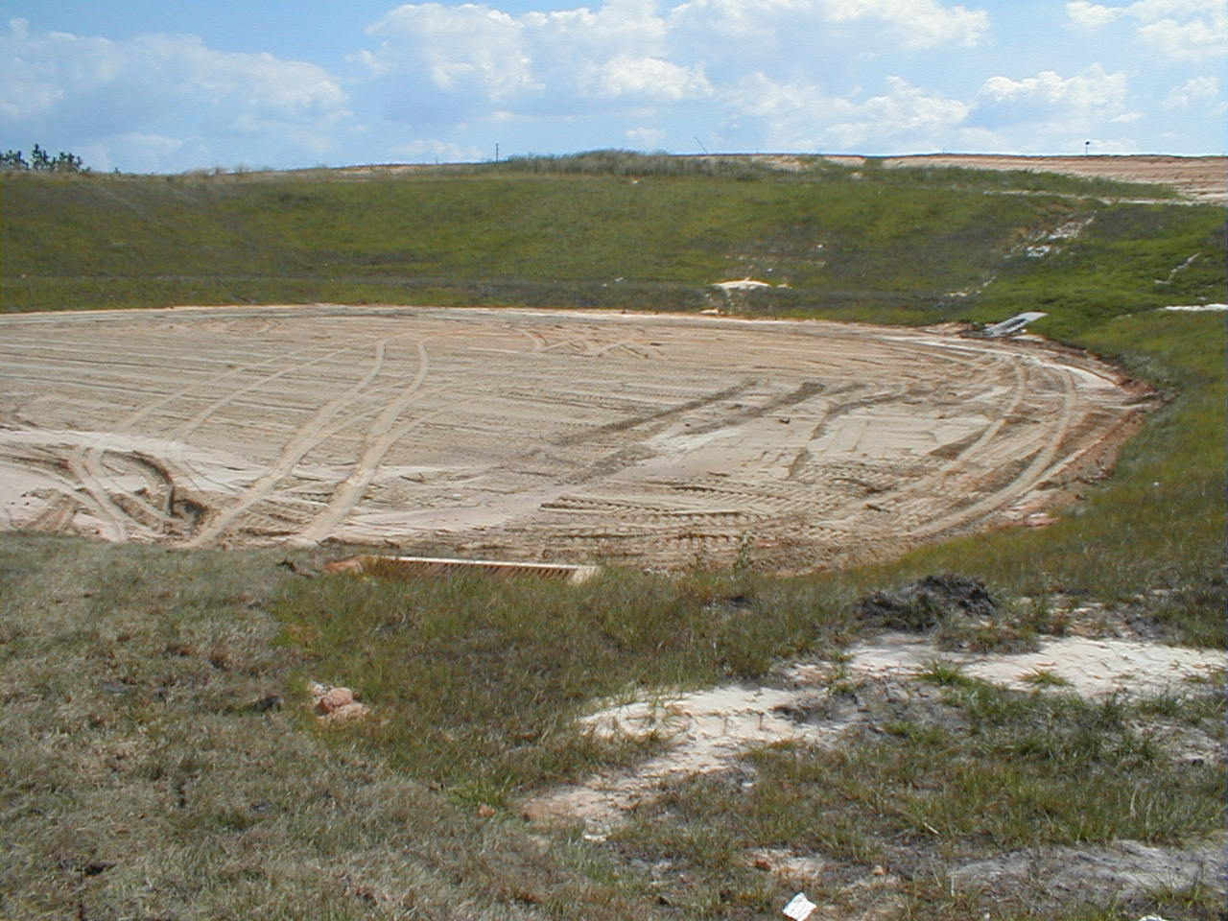
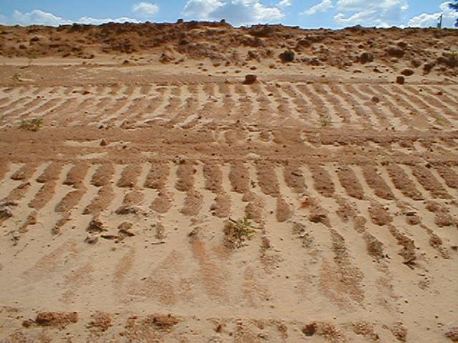
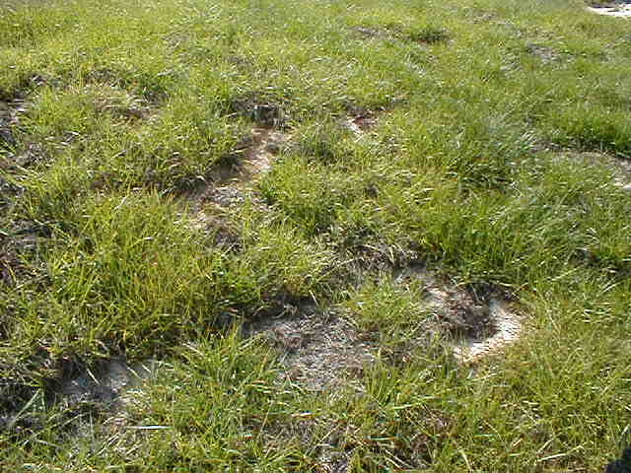
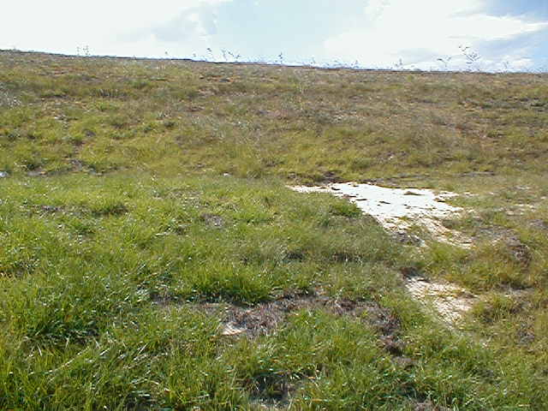
9.3.8 Inspection Reports
1
Inspect from low to high
4
2
3

Slide 32
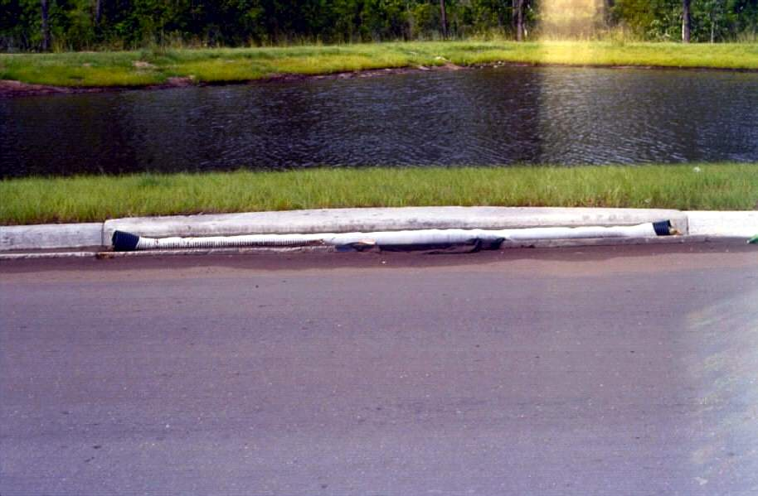
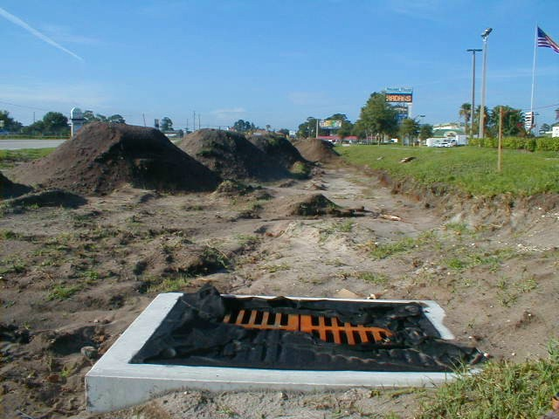
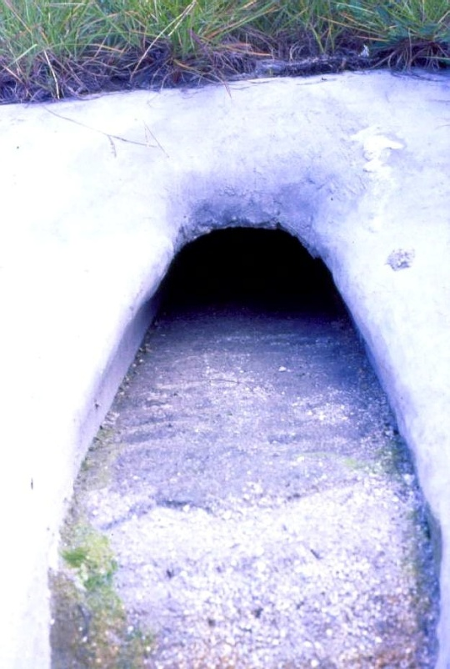
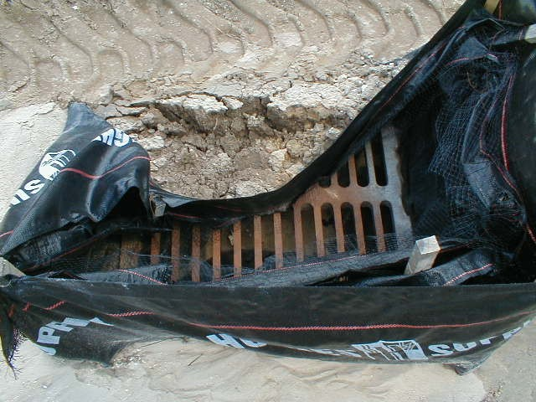
9.3.8 Inspection Reports
Correct BMP for inlet type?
Materials storage problems?
Discharging clean?
BMP installed correctly?

Slide 33
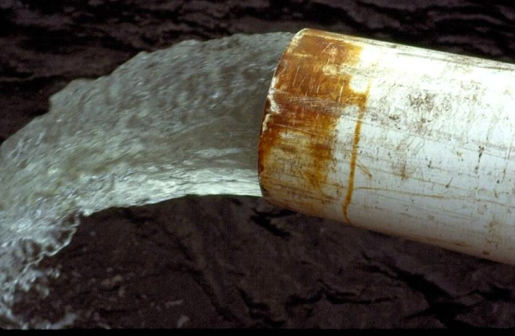
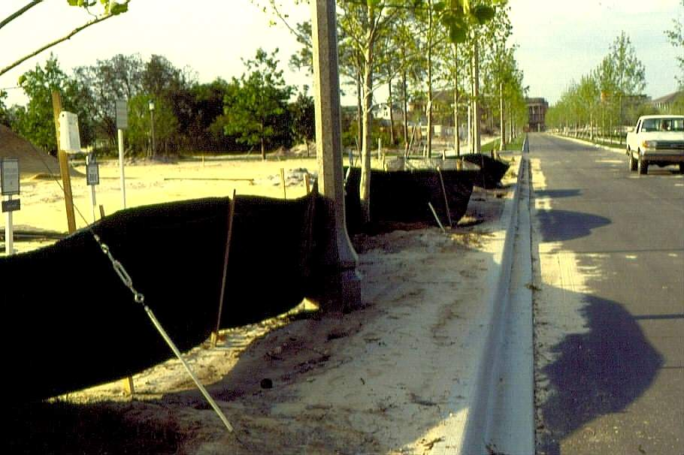
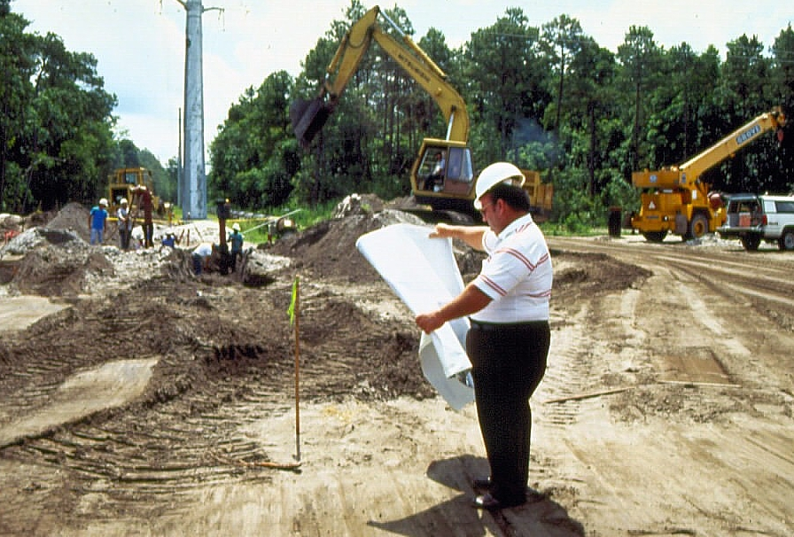

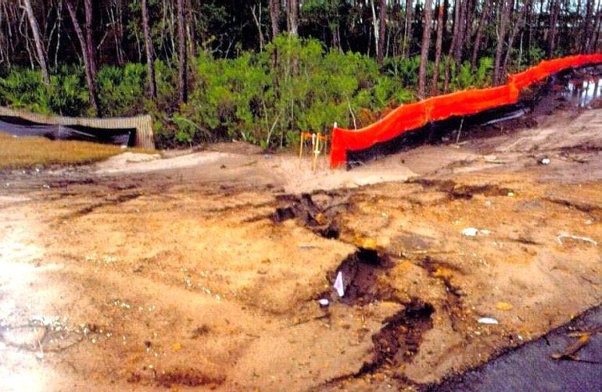
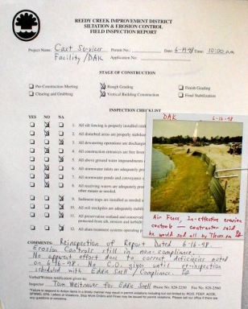
9.3.8 Inspection Reports
Dewatering?
BMPs?
Ready for next storm?
Off-site impacts?
Report

Slide 34
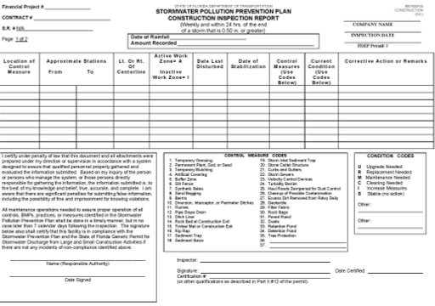
9.3.8 Inspection Reports – Your Turn!

Slide 35
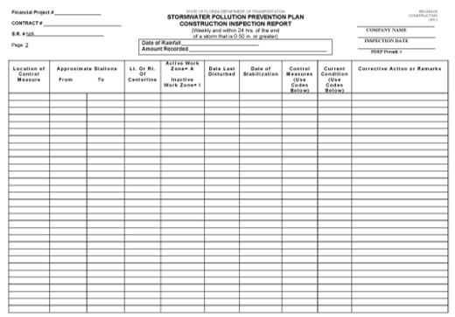
9.3.8 Inspection Reports – Your Turn!

Slide 36
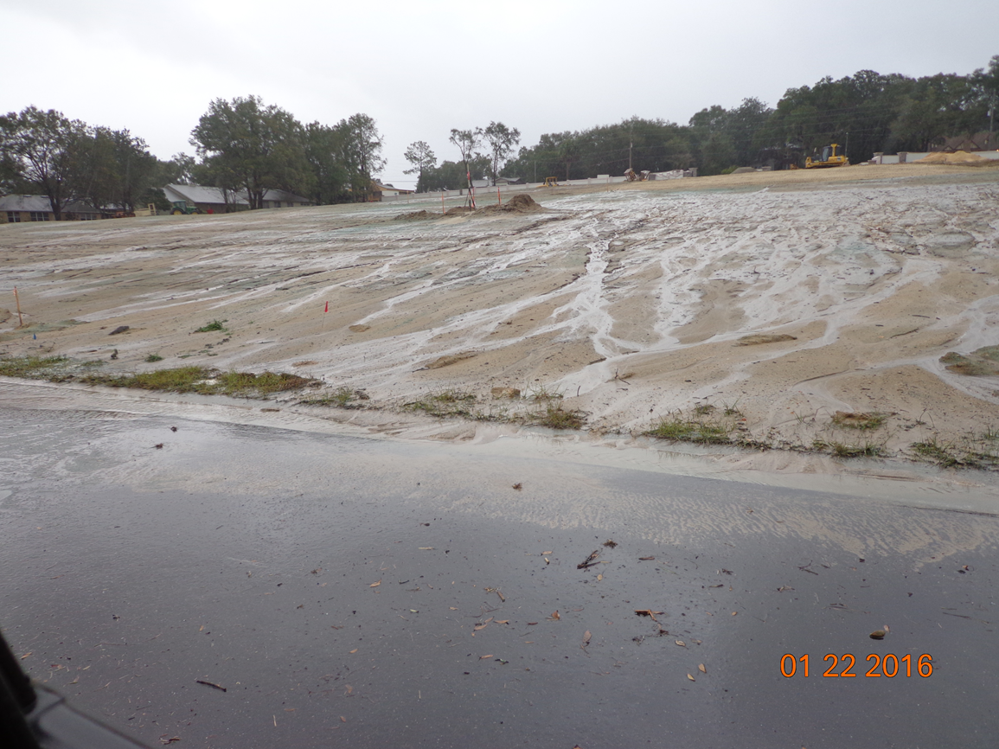
9.3.8 Inspection Reports – Your Turn!
You are inspecting now!
What should you say in your inspection report about this site?

Slide 37
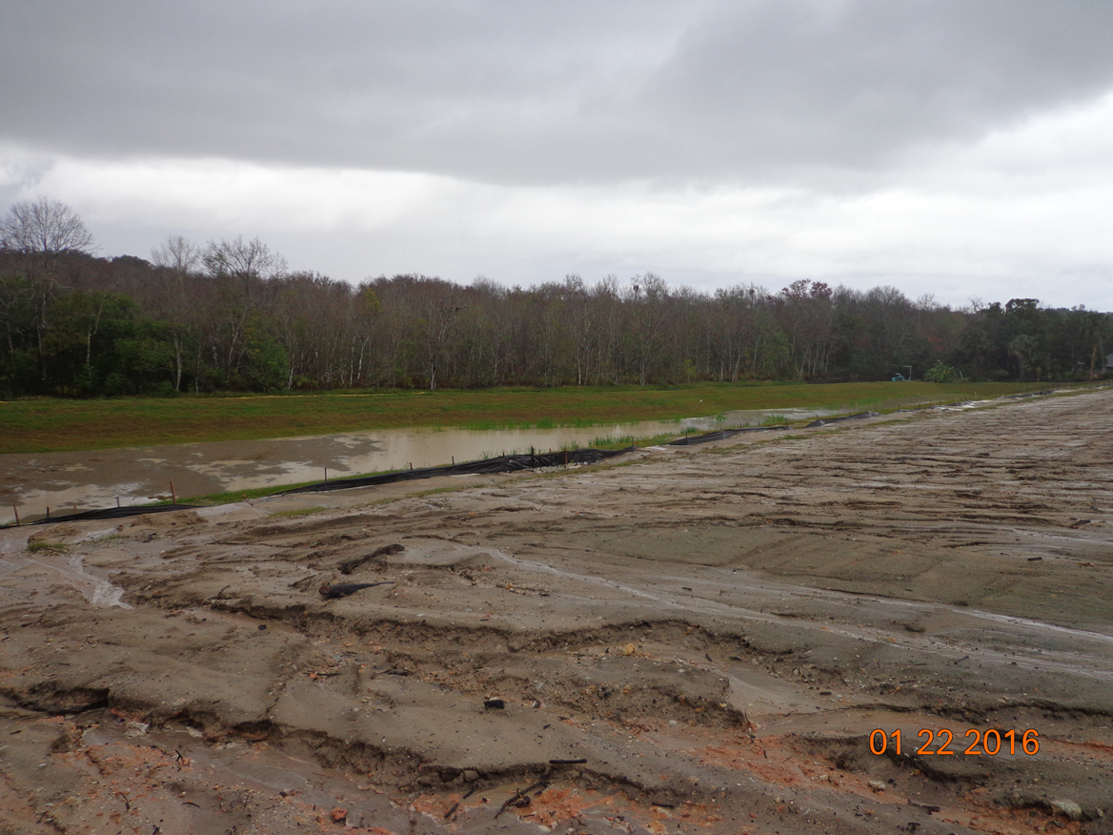
9.3.8 Inspection Reports – Your Turn!
You are inspecting ……
What should you say in your inspection report about this site?

Slide 38
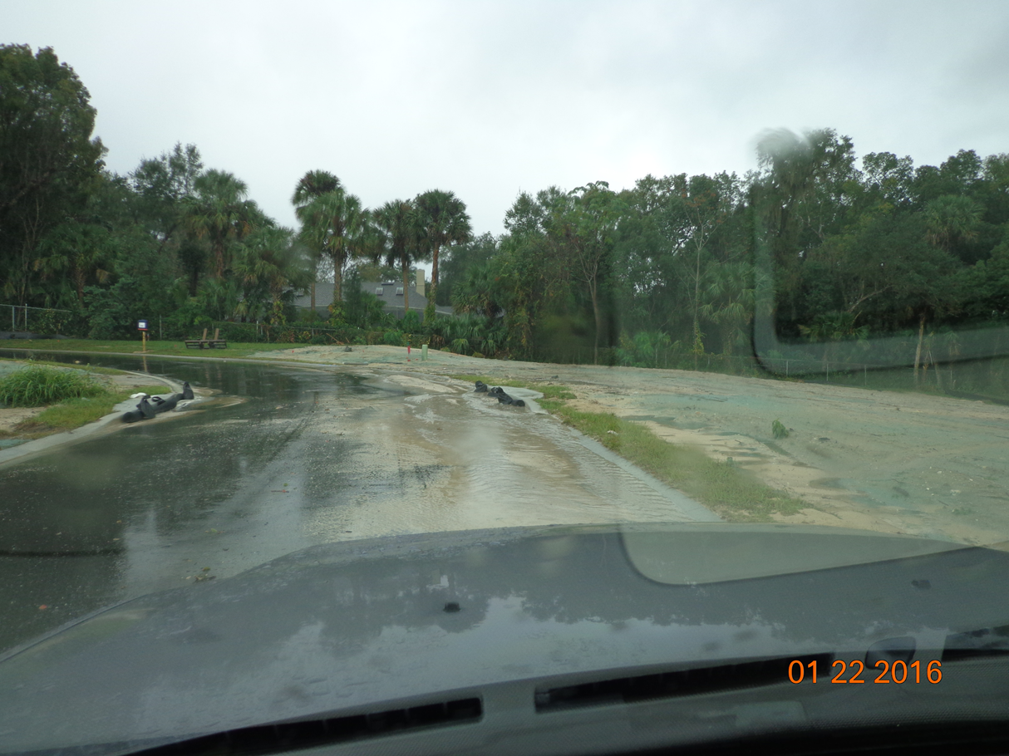
9.3.8 Inspection Reports – Your Turn!
You are inspecting ……
What should you say in your inspection report about this site?

Slide 39
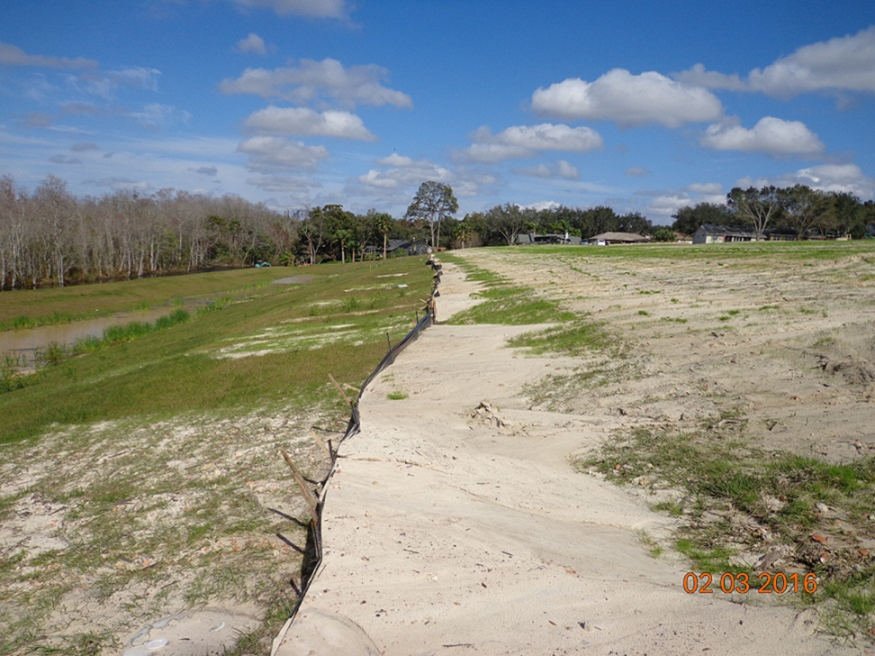
9.3.8 Inspection Reports – Your Turn!
You are inspecting ……
What should you say in your inspection report about this site?

Slide 40
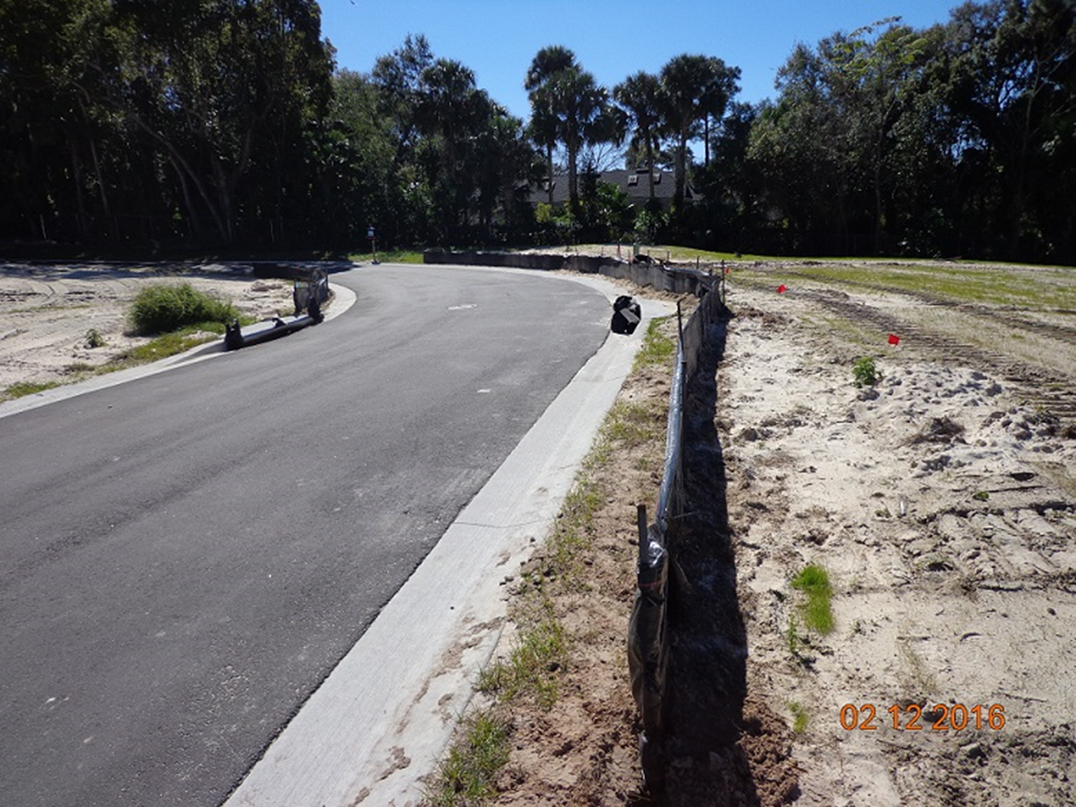
9.3.8 Inspection Reports – Your Turn!
You are inspecting ……
What should you say in your inspection report about this site?

Slide 41
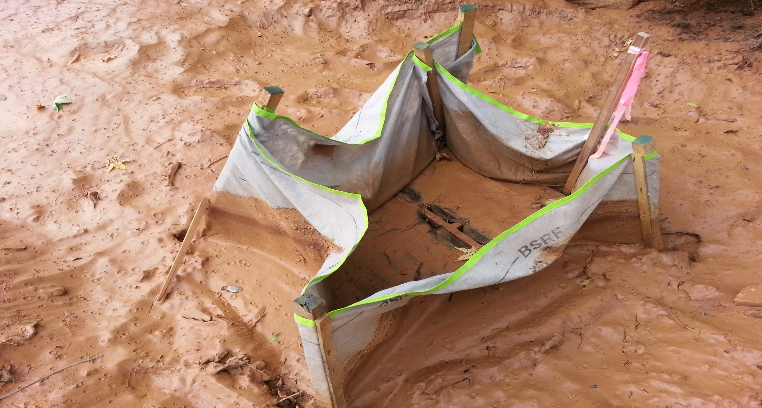
9.3.8 Inspection Reports – Your Turn!
You are inspecting ……
What should you say in your inspection report about this site?

Slide 42
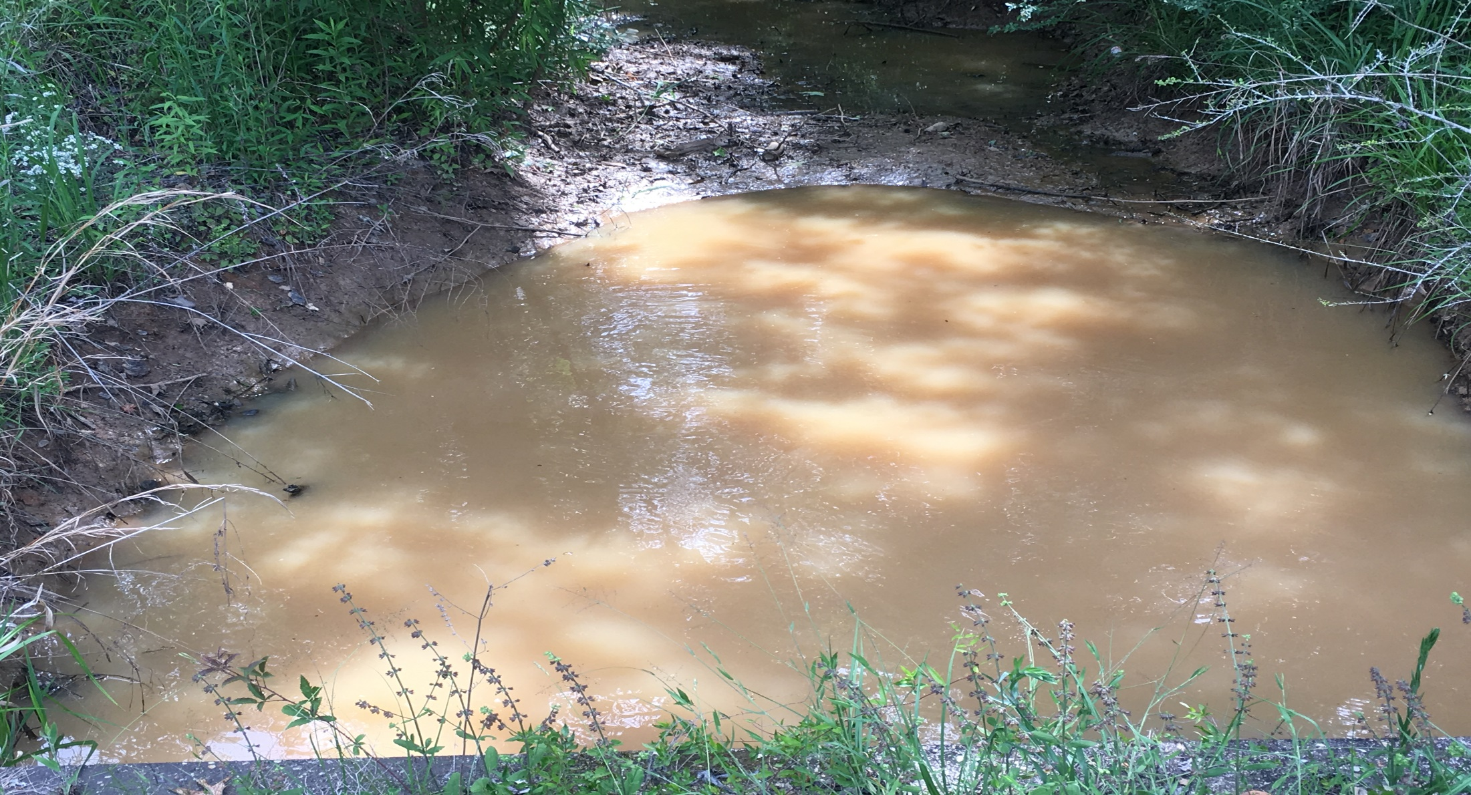
9.3.8 Inspection Reports – Your Turn!
You are inspecting ……
What should you say in your inspection report about this site?

Slide 43

9.3.8 Inspection Reports – Your Turn!
You are done… but time for the crew to fix the violations.
Only when you get the report to the maintenance or repair crew; ASAP!
They have seven calendar days to complete repair or replace after your report.

Slide 44





9.4 Regulatory Agencies

Slide 45

9.4 Regulatory Agencies
U.S. Environmental Protection Agency (EPA) – Oversees the federal wetlands program and the NPDES Stormwater Program.
U.S. Army Corps of Engineers (USACE) – Has jurisdiction over the permitting of the federal wetlands program, Section 404 of the federal Clean Water Act, and Section 10 of the federal River and Harbors Act.
Florida Department of Environmental Protection (DEP) – Has oversight of Florida’s wetlands programs and acts as the permitting authority for the state's NPDES Stormwater Program, dewatering activities, the Construction Generic Permit (CGP), and some aspects of Section 404 of the federal Clean Water Act.

Slide 46

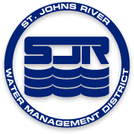


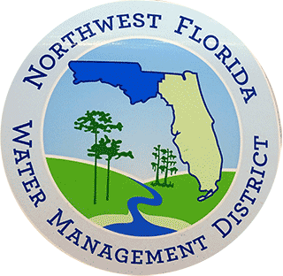
9.4 Regulatory Agencies
Water Management Districts – There are five water management districts in the state: Northwest Florida, Suwannee River, St. Johns River, Southwest Florida, and South Florida. These regional agencies implement the state's wetlands permitting program for most larger types of projects, as well as consumptive use and Environmental Resource Permitting (ERP) along with DEP.
Counties/Cities/Community Development Districts/Other Special Districts – These governmental entities have responsibilities for the MS4 under their jurisdiction, a multitude of local ordinances (Land Development Codes) that can be more restrictive than those of the federal, state, and regional governmental programs.

Slide 47

Chapter 9 Review

Slide 48
Chapter 9 Review
In addition to technical knowledge, the inspector must be able to effectively deal with ______.
In dealing with the public, it is most important to follow proper procedures, and to always be __________ and ____.
The erosion and sediment control rules are __________________. This means that the BMPs must be ________ in controlling erosion and preventing off-site sedimentation for the site to be in compliance.
Off-site sedimentation is excusable only if all BMPs have been installed per an approved plan (True/ False).
Inspector's job is to find out if:
a) an erosion and sediment control plan has been approved (permitted).
b) all BMPs are properly installed and maintained per plan.
c) off-site sedimentation is being prevented.
d) turbidity is being prevented.
e) All of the above
people
courteous
fair
performance based
effective

Slide 49
Chapter 9 Review
Inspection reports should be written (at end of week/in your spare time/at the end of the day/first thing in the morning/while you are on the job site).
The first step in inspecting a project is to ______ plans and drawings (if available).
When reviewing plans, locate the project with respect to the watershed and determine how water ______ and ______ the site.
Which of the following should you bring with you for a site inspection?
Copy of the approved plan / Project file / Reporting forms / Camera / All the above
First thing to do after you arrive on the job site is to: Hide and spy for a while / Start inspecting the perimeter first / Check in with the superintendent / Start inspecting the interior drainage first.
review
enters leaves

