Slide 1
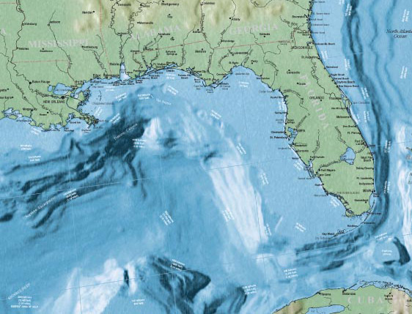
Estuary and Coastal Waters
Numeric Nutrient Criteria
Workshop Introduction

Slide 2
Contacts and Other Information
System | Lead DEP Contact | E-mail | Phone
Biscayne Bay | Ken Weaver | Kenneth.weaver@dep.state.fl.us | 850-245-8414
Florida Bay | Chandra McGee | Chandra.McGee@dep.state.fl.us | 850-245-8069
Florida Keys | Ken Weaver | Kenneth.weaver@dep.state.fl.us | 850-245-8414
Southeast Florida coral reef tract | Janet Klemm | Janet.Klemm@dep.state.fl.us | 850-245-8427
Website: http://www.dep.state.fl.us/water/wqssp/nutrients/estuarine.htm
Estuarine and Coastal Waters numeric nutrient plan
Agendas
Presentations
Meeting Summaries

Slide 3
Introduction
Meeting call to order
Welcome and introductions
Ground rules for meeting
  Scientific and technical discussion
  Expert input is primary purpose
  Public comment accepted after the technical discussion has concluded

Slide 4
Background
EPA has made a formal determination that numeric nutrient criteria are “necessary” for estuarine and coastal waters
Criteria will be proposed by EPA on January 14, 2011 and promulgated by October 15, 2011
  Unless the state submits and EPA approves numeric nutrient criteria prior to these dates
EPA also proposed “placeholder” Estuary targets on January 14, 2010, which could be promulgated on October 15, 2010.
DEP launched a collaborative effort to develop scientifically defensible and protective criteria values for marine waters
  Provide information to EPA
  Support potential state rule-making efforts

Slide 5
DEP Objectives
Engage local organizations, stakeholders, and experts around the State to generate discussion and exploration of appropriate numeric nutrient criteria.
Compile data and scientific support for recommended numeric nutrient criteria where such information is generated and available.
Ensure that such information is accessible to both FDEP and EPA for consideration when moving forward with proposed numeric nutrient criteria.

Slide 6
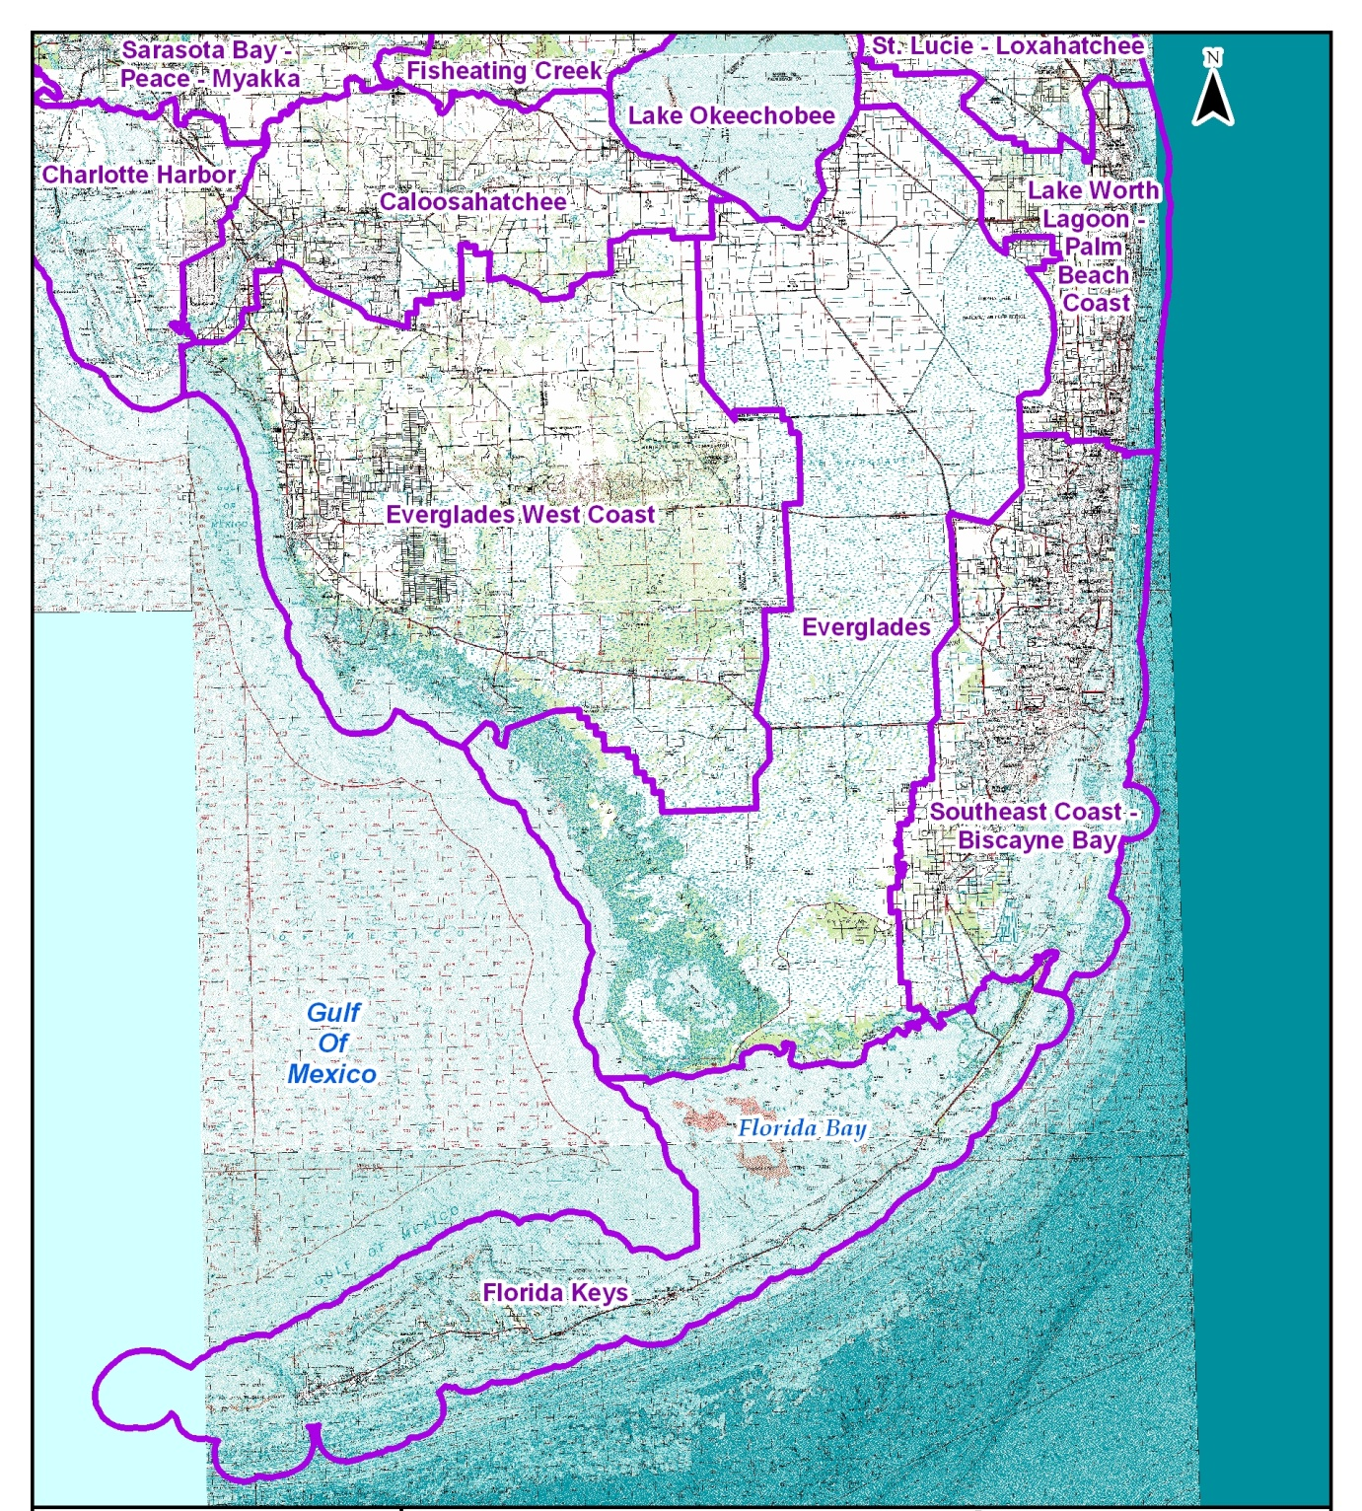

Slide 7
Data Gathering Approach
Regionalize waterbodies into relatively homogeneous units
Describe physical/chemical factors, including causal parameters (nutrients) and supporting variables (hydrodynamics, water residence time, transparency, salinity, DO, etc.)
Describe biological response variables. The type, quality, community structure, and areal extent of valued ecological attributes will be documented, emphasizing those shown to respond to anthropogenic nutrient enrichment

Slide 8
Data Gathering Approach (cont.)
Determine the sources and fates of nutrients, including assimilative capacity of the system
Summarize scientific evidence quantifying the relationship between anthropogenic nutrient inputs and adverse effects on biological communities
Identify existing regional nutrient loading models
Other ideas?

Slide 9
Water Quality Standards
(see 40 CFR 131.3)
Provisions of State/Tribal (or Federal) Law
  Designated Uses (Waterbody Goals)
  Criteria to protect those uses
  Antidegradation policy
Water Quality Standards are to:
  Protect public health or welfare
  Enhance the quality of the water
  Serve the purposes of the Clean Water Act (provide a regulatory basis for source control and waterbody assessment)

Slide 10
Designated Uses
CLASS I Potable Water Supplies
CLASS II Shellfish Propagation or Harvesting
CLASS III Recreation, Propagation and Maintenance of a Healthy, Well-Balanced Population of Fish and Wildlife

Slide 11
Water Quality Criteria
40 CFR 131.3
A concentration, level or narrative statement
  Loading or concentration may be acceptable for nutrients
  Florida’s existing narrative: “In no case shall nutrient concentrations of a body of water be altered so as to cause an imbalance in natural populations of aquatic flora or fauna.”
Represent a level of water quality that supports a particular use
When criteria are met, water quality will protect the designated use

Slide 12
Water Quality Criteria
Requirements
40 CFR 131.11
States/Tribes Must adopt criteria that protect the designated use
  Based on a sound, scientific rationale
  Sufficient parameters to protect the
  designated use
  Must support the most sensitive use
  (for waters with multiple use designations)

Slide 13
Downstream Waters Protection
Required by the Clean Water Act
40 CFR 131.10(b): In designating uses of a water body and the appropriate criteria for those uses, the State shall take into consideration the water quality standards of downstream waters and shall ensure that its water quality standards provide for the attainment and maintenance of the water quality standards of downstream waters.

Slide 14
Downstream Waters Protection
(continued)
Critical importance when establishing numeric nutrient criteria
EPA has proposed Downstream Protection Values (DPV) to be applied in upstream waters to be protect of downstream estuarine and coastal waters
  Protective TN loading targets were computed by reducing the current load by one half of the anthropogenic contribution.
  Loads were estimated using the USGS SPARROW (Spatially Referenced Regression on Watershed Attributes ).
  EPA did not develop TN targets for: Caloosahatchee, St. Lucie, Biscayne Bay, Florida Bay, Ten Thousand Islands, and Rookery Bay.

Slide 15
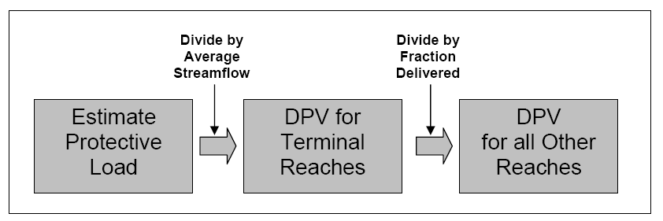
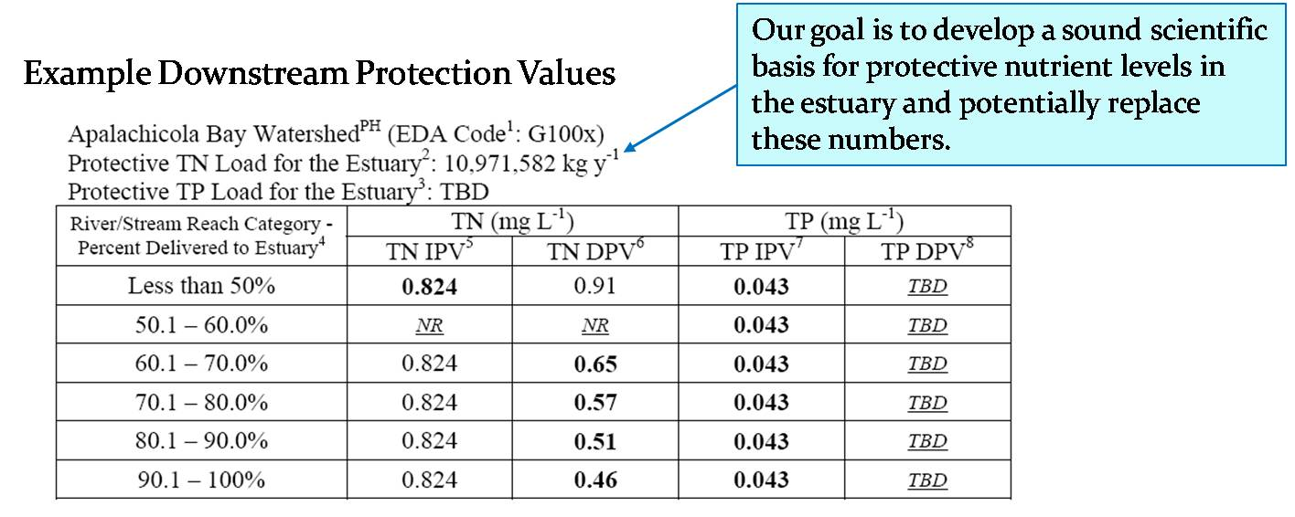
Downstream Protection Values

Slide 16
Numeric Nutrient Criteria
Considerations
Protective of the most sensitive use; that is, prevent imbalances in natural populations of flora and fauna
Nutrients exist naturally in the environment
  Nutrients are chemical elements and compounds found in the environment that plants and animals need to grow and survive
  Nutrients are not typically toxic
Biological responses are highly site specific

Slide 17
Defining a Healthy, Well Balanced Aquatic Community as Basis For a Water Quality Standards Endpoint
Attributes of community structure and function must be considered
Healthy, well balanced communities are not restricted to those described as “pristine” or “100% natural”
It is acceptable to have modest changes in biological community structure (compared to background) as long as :
  there are reproducing populations of sensitive taxa;
  an overall balanced distribution of all expected major groups is maintained; and
  ecosystem functions are largely intact due to redundant system attributes.

Slide 18
Dealing with Uncertainty/Variability
All scientific measurements, and therefore, conclusions based on those measurements, contain a degree of uncertainty (known as statistical error).
Lack of knowledge also introduces uncertainty.
All biological systems, and often the associated water quality conditions, are naturally variable in space and time.
Acknowledge uncertainty and variability when making decisions and provide a means for addressing them.

Slide 19
Conceptual Model for Relating Nutrient Enrichment to Designated Uses

Slide 20
Quantification of Adverse Effects of
Nutrients on Biological Communities
(Response Variables)
Scientific evidence describing the relationship between anthropogenic nutrient inputs and adverse effects on biological communities
  Any variety of statistical treatment, such as correlation, regression, conditional probability analysis, deterministic model, etc.

Slide 21
Potential Nutrient Criteria for
Ecosystem Protection
(Causal Variables)
Numeric targets needed for system protection or restoration
Demonstrate the bases for these targets
If nutrient target is achieved (assuming nutrients are the major source of stress), what level of response in the biology would be expected (complete or partial recovery)?

Slide 22
Objectives of Today’s Meeting
Gather relevant data and information:
  Sensitive biological resources
  Response metrics
  Relevant stressors (nitrogen and phosphorus)
  Loading or concentration
  Technical approaches
  Ideally, come out with potential site-specific criteria
Receive feedback on path forward

Slide 23
Objectives of Today’s Meeting
Discuss potential numeric targets (loading or concentration) needed for protecting or restoring the system, including a demonstration of the scientific bases for the nutrient targets.
Discuss connection of potential numeric targets to designated use protection (healthy, well balanced biology)
Identify core individuals willing to assist DEP with the scientific exploration and documentation

Slide 24
