Slide 1
Numeric Nutrient Criteria for the Florida Keys National Marine Sanctuary & Dry Tortugas National Park
Joseph N. Boyer, Director
Southeast Environmental Research Center
Florida International University
Miami, FL 33199

Slide 2
Outline of Presentation
Brief Description of System
Nutrient Regime
Targeted Biological Resources
Quantification of Adverse Effects of Nutrients on Biological Communities
Linking Degree of Effects to the Biological Community
Potential Nutrient Criteria for Ecosystem Protection

Slide 3
Background
Location (map)
Drainage Basin Size/ Open Water Size
Quantity and Nature of Freshwater Inputs
Typical Salinity, Temperature, pH, and Dissolved Oxygen Regime
Other Critical Information for This Discussion

Slide 4
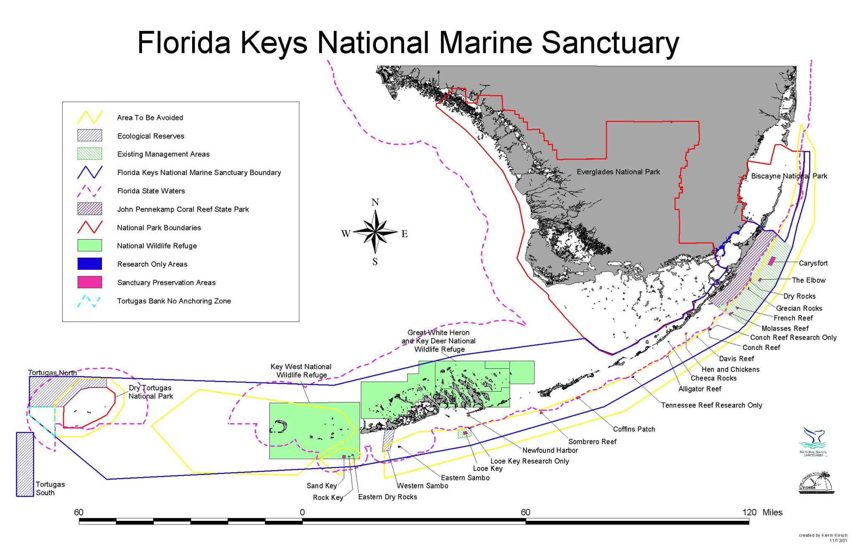
3,801-square miles of island archipelago

Slide 5
Background
Location (map)
Drainage Basin Size/ Open Water Size
Quantity and Nature of Freshwater Inputs
Typical Salinity, Temperature, pH, and Dissolved Oxygen Regime
Other Critical Information for This Discussion

Slide 6
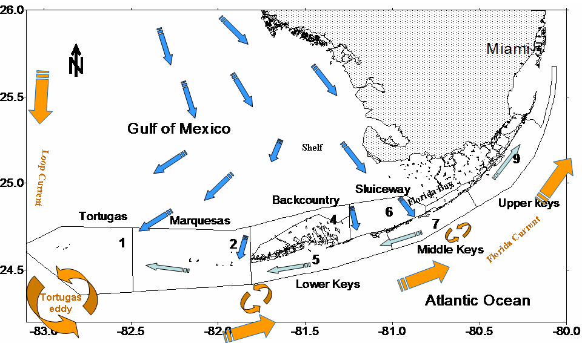
Regional Circulation

Slide 7
Background
Location (map)
Drainage Basin Size/ Open Water Size
Quantity and Nature of Freshwater Inputs
Typical Salinity, Temperature, pH, and Dissolved Oxygen Regime
Other Critical Information for This Discussion

Slide 11
Background
Location (map)
Drainage Basin Size/ Open Water Size
Quantity and Nature of Freshwater Inputs
Typical Salinity, Temperature, pH, and Dissolved Oxygen Regime
Other Critical Information for This Discussion

Slide 12
HABITATS
Coral Reefs
Hardbottom
Mangrove Fringed Shorelines & Islands
Sand Flats
Seagrass Meadows
SPECIES
Brain & Star Coral (some endangered)
Sponge Communities
Tropical Reef Fish
Spiny Lobster
Bottlenose Dolphin
Snapper/Grouper/Trout…

Slide 13
PEOPLE
Tourism
  Fishing
  Diving
  Partying
Development
In 2000-01, all uses of the reefs of the FKNMS generated over $504 million in Sales/Output. This generated $140 million in income in Monroe County, which supported almost 10,000 full and part-time jobs.
The total economic value of fishing in Florida is valued at ~$9 billion, much of it driven by the fisheries in Florida Bay and the FKNMS

Slide 14
Nutrient Regime
Sources and Fates of Nutrients in System
Concentration and Loading of P and N
Established Hydrodynamic or Nutrient Water Quality Models?
Other Nutrient Information

Slide 15
Nutrient Sources
Septic System Leaching
Shallow Well Injection - Groundwater
Stormwater
Canal Exchange
Ocean Upwelling
Gulf of Mexico – SW Shelf Advection

Slide 16
Nutrient Regime
Sources and Fates of Nutrients in System
Concentration and Loading of P and N
Established Hydrodynamic or Nutrient Water Quality Models?
Other Nutrient Information

Slide 17
Nitrogen Loading
Gibson et al. 2008

Slide 18
Phosphorus Loading
Gibson et al. 2008

Slide 19
Nutrient Regime
Sources and Fates of Nutrients in System
Concentration and Loading of P and N
Established Hydrodynamic or Nutrient Water Quality Models?
Other Nutrient Information

Slide 20
Models
HYCOM – hydrodynamic
EFDC – hydrodynamic w/ potential nutrients
Madden – FATHOM/seagrass/nutrients
Reasonable Assurance Document (in lieu of TMDL)

Slide 21
Nutrient Regime
Sources and Fates of Nutrients in System
Concentration and Loading of P and N
Established Hydrodynamic or Nutrient Water Quality Models?
Other Nutrient Information

Slide 22
WQ Monitoring
Quarterly grab sampling at 150-155 sites in FKNMS since 1995
-Semi-continuous CTD profile of water column for: salinity, temp., density, DO, PAR (calc. K_{d}), turbidity, and CHLA fluorescence
Surface and bottom water collected and analyzed for: NO₃⁻, NO₂⁻, NH₄⁺, TON, TP, SRP, SiO₂, TOC, and CHLA

Slide 24
Nutrients: Not The Only Problem
Light field effects are strong drivers of coral heath.
Chlorophyll a is tiny component of light extinction. Major contributor is turbidity with DOM a far second.

Slide 25
RAD Presentation by
Scott McClelland

Slide 26
Valued Biological Resources
Type, Quality, Community Structure, Areal Extent, etc. of Biological Communities, Emphasizing Those Shown to Respond to Anthropogenic Nutrient Enrichment:
  Phytoplankton/ chlorophyll (Yes)
  Zooplankton (No data)
  Coral (Yes)
  Submerged Aquatic Vegetation (Yes)
  Benthic Invertebrates (No data)
  Fish and Other Wildlife (little data)

Slide 27
Quantification of Adverse Effects of Nutrients on Biological Communities
Scientific Evidence Describing the Relationship Between Anthropogenic Nutrient Inputs and Adverse Effects on Biological Communities
  Any Variety of Statistical Treatment, such as Correlation, Regression, Conditional Probability Analysis, Deterministic Model, etc.
  How do the adverse effects relate to designated use (maintenance and propagation of a health, well-balanced population of fish and wildlife)? Use the conceptual model on the following slide to frame your discussion

Slide 28
Line of Evidence: Chlorophyll a
Bell et al. 1987 Eutrophication Threshold Model w/ Nutrient Threshold Conc. (NTC)
Empirical approach
CHLA <0.5 ug/l (since mod. to <0.3 ug/l)
DIN <1.0 uM
SRP < 0.1-0.2 uM

Slide 29
Line of Evidence: Chlorophyll a
Boyer et al. 2009. CHLA indicator for Florida Bay
Approach can be taken for FKNMS

Slide 30
Line of Evidence: Coral Effects
Fabricius 2005, Cooper, Gilmour, & Fabricius 2009
Extensive review of water quality – coral effects
Suggest monitoring suite of coral-specific bioindicators tied to nutrients, light, etc.

Slide 31
Line of Evidence: Coral Effects
Bruno et al. 2003.
“Experimentally increasing nutrient concentrations by 2-5x nearly doubled host tissue loss caused by yellow band disease.”
Nitrate 1.0-6.4 uM
Ammonium 1.0-11.0 uM
Phosphate 0.9-4.6 uM

Slide 32
Line of Evidence: Coral Effects
Voss & Richardson 2006.
“nutrient-dosed black band disease infections migrated on average twice as quickly as controls”
Nitrate up to 3 uM

Slide 33
Line of Evidence: Coral Effects
Wooldridge & Done 2009.
Conceptual model for the warm water breakdown (bleaching) of the coral-algae symbiosis
“reduced DIN…could directly benefit corals by enhancing their resistance to heat stress”
No threshold given

Slide 34
Line of Evidence: Coral Effects
Kline et al. 2006 and Hass et al. 2009
Dissolved organic matter implicated in coral mortality
Both used glucose, which is cheating as it’s not typical component of DOM
No DIN or P effects

Slide 35
Line of Evidence: Coral
Szmant 2002, Miller & Hay 1999, ENCORE 2001, Sotka & Hay 2009, etc.
No nutrient effect

Slide 36
Line of Evidence: Seagrass
Jim Fourqurean’s data from FKNMS monitoring program

Slide 37
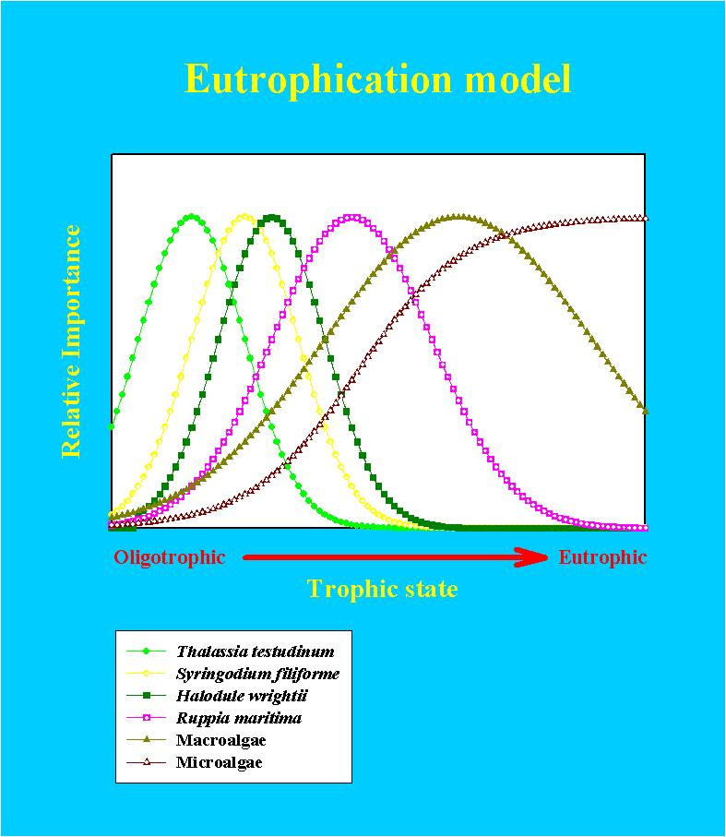
Explicit model of ecosystem behavior #1
Nutrient pollution will lead to changes in relative abundances of primary producers in a predictable way.

Slide 38
Explicit model of ecosystem behavior #2
Nutrient pollution will shift N:P ratios of primary producers towards a taxon-specific “Redfield ratio”

Slide 39
Changes in N:P of primary producers #1:
There is a spatial pattern in the relative availability of N and P
Fourqurean et al Estuaries 2005

Slide 40
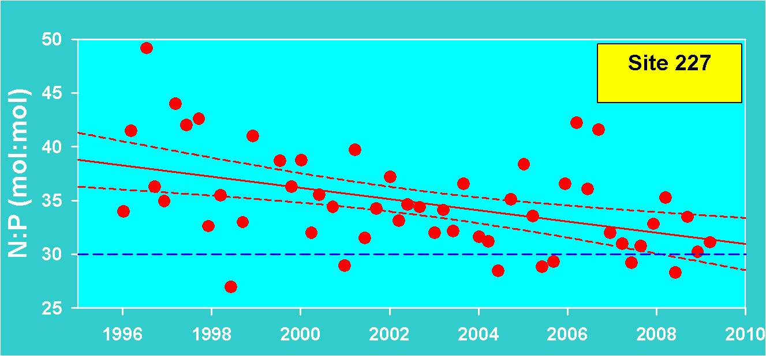
Changes in N:P of primary producers #2:
At 10 of 30 sites, N:P is trending towards “seagrass Redfield ratio”
(5 of 30 last year)

Slide 41
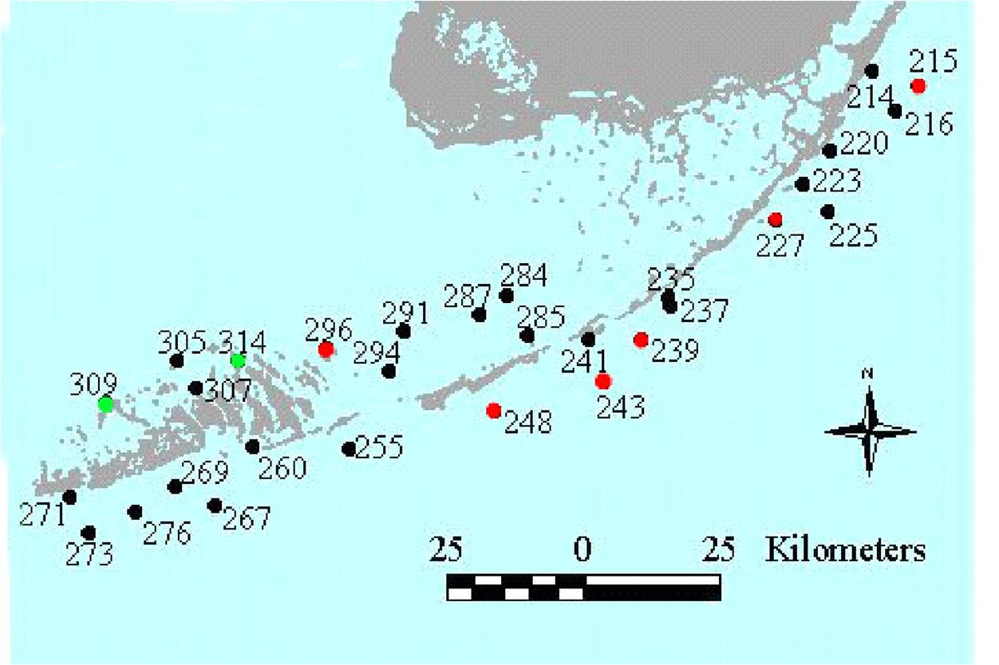
Changes in N:P of primary producers #3:
Green: shift away from RR
Red: shift towards RR

Slide 42
Summary
Rapid population increases adjacent to oligotrophic marine ecosystems in south Florida may have deleterious effects on those ecosystems
Changes are occurring in south Florida seagrass beds that are
consistent with increased nutrient availability in the system – but few increases have been observed in the water column
These changes are relatively subtle, we have not witnessed loss of seagrass beds in this regional and decadal scale program. There is time to act!
Many different factors can influence our indicators that are independent of the main management concern – anthropogenic nutrient enrichment
Congruence of patterns among independent indicators increases confidence in the observations

Slide 43
Potential Nutrient Criteria for Ecosystem Protection
Numeric Targets Needed for System Protection or Restoration
Demonstrate the Bases for These Targets
If Nutrient Target is Achieved (Assuming Nutrients are the Major Source of Stress), what level of response in the biology would be expected (complete or partial recovery)?

Slide 44
EPA Strategic Targets
(75th Percentile Approach)
Through 2011, beginning in 2008, annually maintain the overall water quality of the near shore and coastal waters of the FKNMS (1995-2005 baseline). Targets were set using a EPA 75th percentile method (Nutrient Criteria Technical Guidance Manual: Estuarine and Coastal Marine Waters, EPA-822-B-01-003, October 2001) from 1995-2005 data.
Targets for reef sites include chlorophyll a less than or equal to 0.35 micro grams/l and vertical attenuation coefficient for downward irradiance (Kd, i.e., light attenuation) less than or equal to 0.20 per meter. Targets for all sites in FKNMS include dissolved inorganic nitrogen (DIN) less than or equal to 0.75 micromolar and total phosphorus (TP) less than or equal to 0.25 micromolar.

Slide 45
Exceedances were calculated as percent of those exceeding targets divided by total number of samples. Values in green are those years with % exceedances less than 1995-2005 baseline. Values in yellow are those years with % exceedances greater than 1995-2005 baseline.

Slide 46
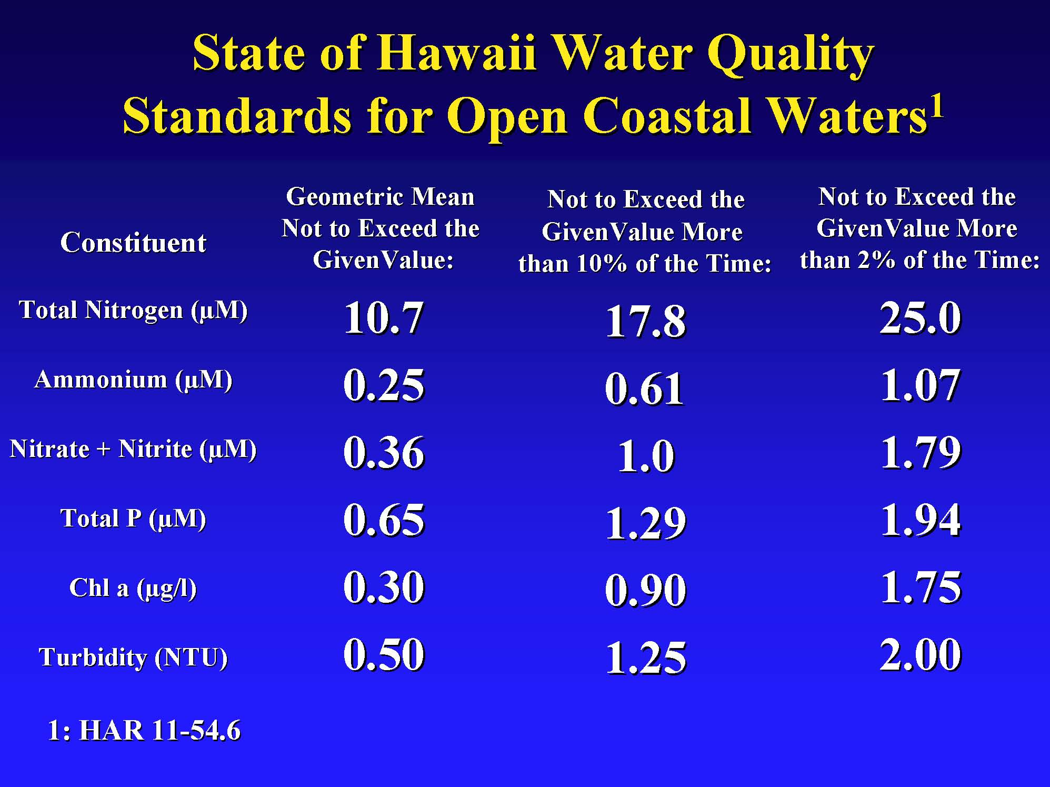
Courtesy Brian Lapointe

Slide 47
Nutrient Criteria Comparison
Parameter | Bell 1987 | EPA Target | Hawaii
CHLA (ug m⁻¹) | <0.5 | <0.35 | <0.30
TN (uM) |  |  | <10.7 (0.15 ppm)
NH₄⁺ (uM) |  |  | <0.25 (0.003 ppm)
NO_{x}⁻ (uM) |  |  | <0.36 (0.005 ppm)
DIN (uM) | <1.0 (0.014 ppm) | <0.75 (0.01 ppm) | <0.61 (0.008 ppm)
TP (uM) |  | <0.25 (0.008 ppm) | <0.65 (0.02 ppm)
SRP (uM) | <0.1-0.2 (0.003-6 ppm)
Turbidity (NTU) |  |  | <0.50
K_{d} (m⁻¹) |  | <0.20

Slide 48
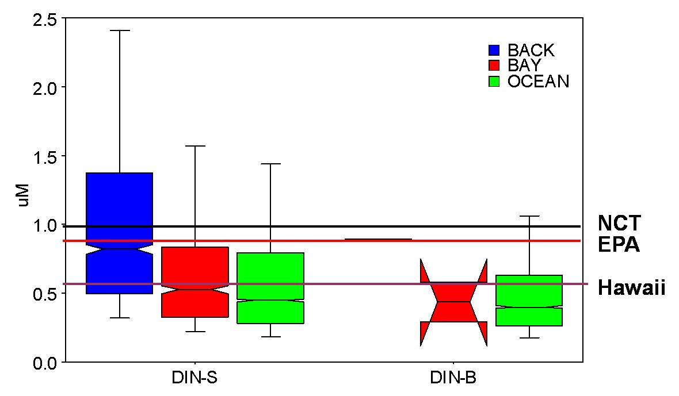

Slide 50
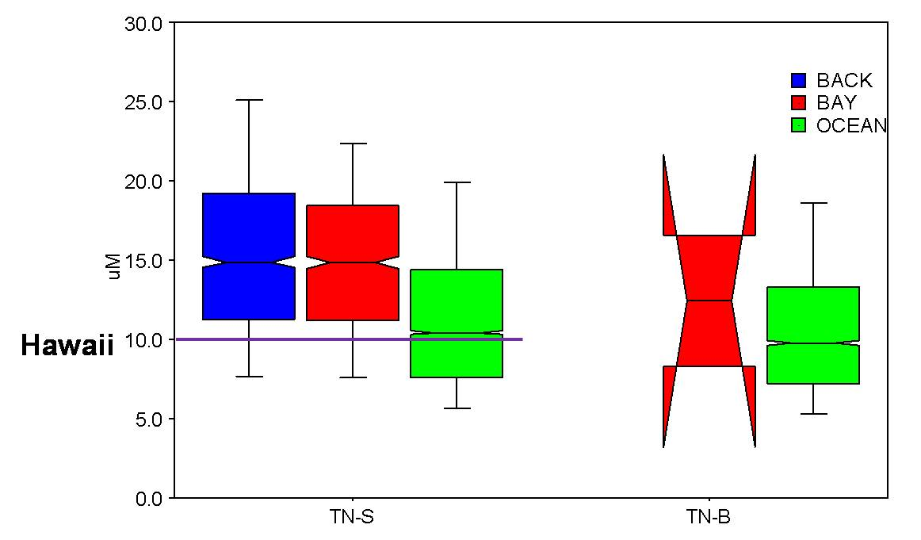

Slide 51
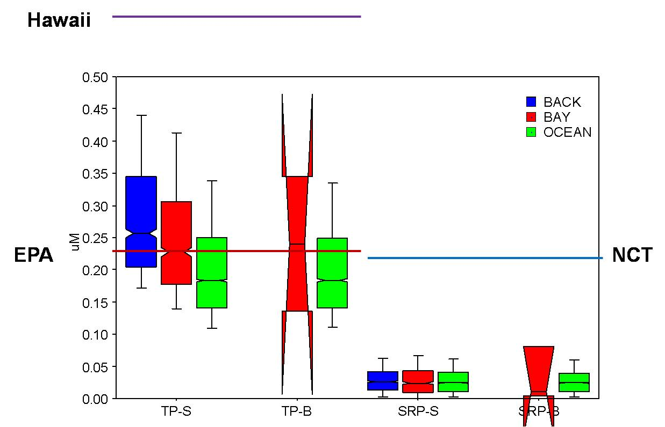

Slide 52
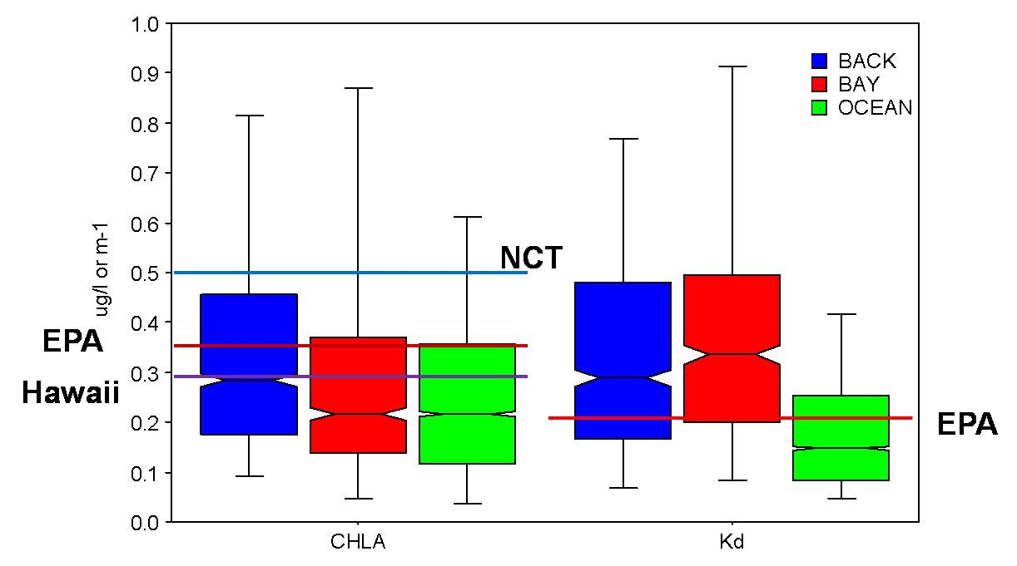

Slide 53
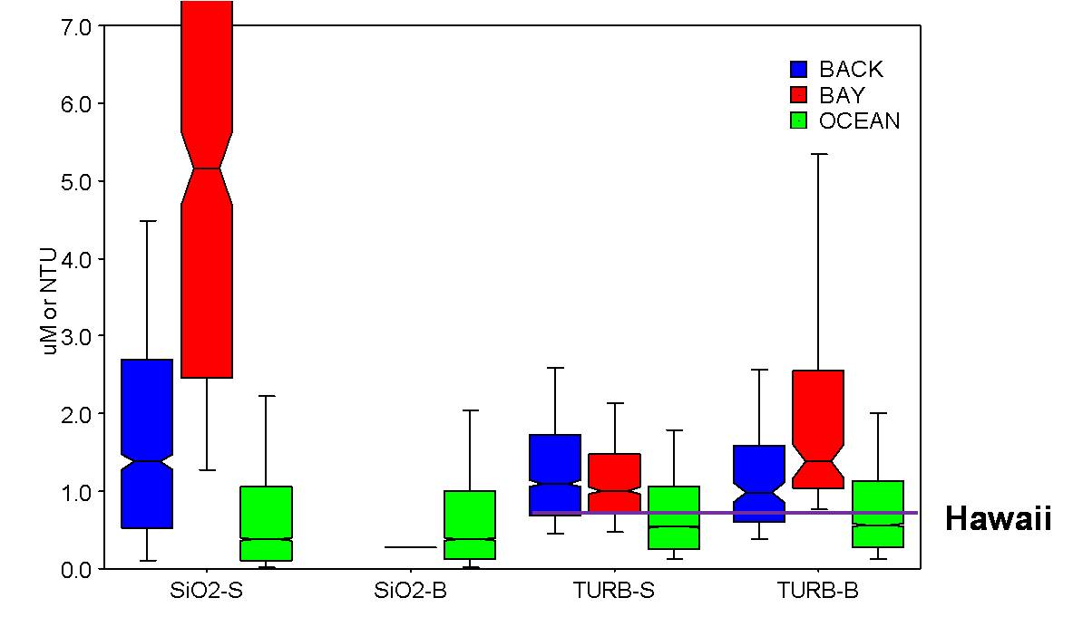

Slide 54
Nutrient Criteria Comparison
Parameter | Bell 1987 | EPA Target | Hawaii
CHLA (ug m⁻¹) | <0.5 | <0.35 | <0.30
TN (uM) |  |  | <10.7 (0.15 ppm)
NH₄⁺ (uM) |  |  | <0.25 (0.003 ppm)
NO_{x}⁻ (uM) |  |  | <0.36 (0.005 ppm)
DIN (uM) | <1.0 (0.014 ppm) | <0.75 (0.01 ppm) | <0.61 (0.008 ppm)
TP (uM) |  | <0.25 (0.008 ppm) | <0.65 (0.02 ppm)
SRP (uM) | <0.1-0.2 (0.003-6 ppm)
Turbidity (NTU) |  |  | <0.50
K_{d} (m⁻¹) |  | <0.20

