Slide 1
Nutrient Numeric Criteria Development for the Keys
Ken Weaver
Standards and Assessment Section
Florida Department of Environmental Protection

Slide 2
Presentation outline
Background on schedule and deadlines
DEP’ Marine Waters Initiative
Geographical and physical description
Sources and fates of nutrients
  Nutrient sources and loading estimates
  Assimilative capacity and productivity
Biological summary
  Seagrass: FKNMS Benthic Habitat and Seagrass Monitoring
  Coral: FKNMS Coral Reef Evaluation and Monitoring Project
  Mangroves
  Other biological resources
Water quality studies
  FKNMS Water Quality Monitoring Project
Waters on the 303(d) list
Numeric nutrient criteria recommendations
  FK RAD-HALO zone (<500 m)
  Magnitude, Frequency, and Duration-Can we get support for expression of the criteria as a annual average and long-term average; is this even the right group for such discussion?
  Existing condition-beyond Halo zone

Slide 3
Background
FDEP started developing numeric nutrient criteria in 2001
EarthJustice filed suit against EPA in August of 2008, kicking off litigation
EPA entered into a settlement agreement containing implementation dates
  Estuary proposal – November 14, 2011
  Final Estuary, south Florida flowing waters, and DPV rule – August 15, 2012

Slide 4
Science Advisor Board Review
Special Panel of SAB will review approaches
  Estuarine and coastal waters
  South Florida flowing waters (canals)
  Downstream Protection Values (DPVs) to protect estuaries
EPA accepting nominations until July 12, 2010
EPA/DEP technical document to be publically available October 1, 2010
  SAB review
  Public may submit comments to SAB
SAB workshop November 1-3, 2010

Slide 5
DEP Marine Waters Initiative
DEP launched a collaborative effort to develop scientifically defensible and protective criteria values for marine waters
  Provide information to EPA
  Support potential state rule-making efforts
Objectives
  Engage local organizations, stakeholders, and experts around the State to generate discussion and exploration of appropriate numeric nutrient criteria.
  Compile data and scientific support for recommended numeric nutrient criteria where such information is generated and available.
  Ensure that such information is accessible to both FDEP and EPA for consideration when moving forward with proposed numeric nutrient criteria.

Slide 6
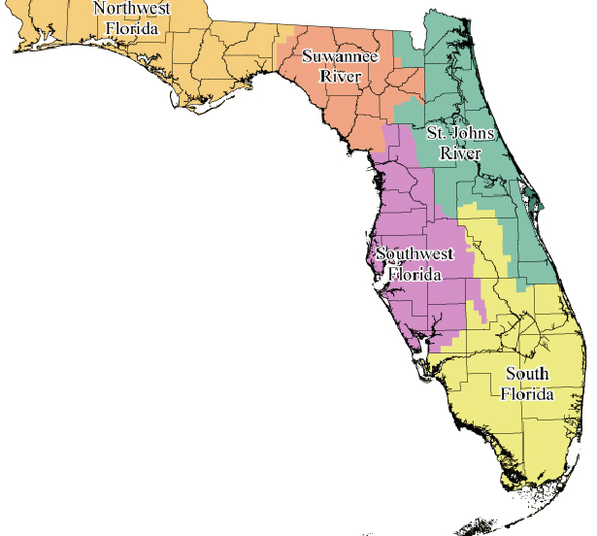
Perdido
Nassau/ St. Marys
Pensacola
St. Johns
Choctawhatchee
St. Andrews
Ochlockonee
Guana/Tolomato/Matanzas
Emerald
Coast
St. Joe
Apalachee
Apalachicola
Suwannee/
Waccasassa/
Withlacoochee
Alligator Harbor
Halifax
Springs Coast
Indian River Lagoon
St. Joseph/Clearwater
Systems Were Logically Defined To Reflect
Geography and Resources
Tampa NEP
Loxahatchee/St. Lucie
Sarasota NEP
Charlotte Harbor NEP
Lake Worth
SE Reef Tract
Rookery Bay
Biscayne
10,000 Islands
Florida Bay
Keys

Slide 7
Water Quality Criteria
40 CFR 131.3
A concentration, level or narrative statement
  Loading or concentration may be acceptable for nutrients
  Florida’s existing narrative: “In no case shall nutrient concentrations of a body of water be altered so as to cause an imbalance in natural populations of aquatic flora or fauna.”
Represent a level of water quality that supports a particular use
When criteria are met, water quality will protect the designated use
Based on a sound, scientific rationale

Slide 8
Numeric Nutrient Criteria
Considerations
Protective of the most sensitive use; that is, prevent imbalances in natural populations of flora and fauna
Nutrients exist naturally in the environment
  Nutrients are chemical elements and compounds found in the environment that plants and animals need to grow and survive
  Nutrients are not typically toxic
Biological responses are highly site specific

Slide 9
Defining a Healthy, Well Balanced Aquatic Community as Basis For a Water Quality Standards Endpoint
Attributes of community structure and function must be considered
Healthy, well balanced communities are not restricted to those described as “pristine” or “100% natural”
It is acceptable to have modest changes in biological community structure (compared to background) as long as :
  there are reproducing populations of sensitive taxa;
  an overall balanced distribution of all expected major groups is maintained; and
  ecosystem functions are largely intact due to redundant system attributes.

Slide 10
Geographical and physical description

Slide 11
External sources of nutrients
  Florida Current
  Gulf of Mexico
  SW Florida Shelf
  Everglades runoff
  Tidal exchange with Florida and Biscayne Bay
  Atmospheric deposition
Gibson et al. 2008

Slide 12
Local sources of nutrients
  Stormwater
  Wastewater
  Submarine groundwater discharge
Region | Estimated Annual Wastewater and Stormwater Load (MT year⁻¹)
 | Total Nitrogen | Total Phosphorus
Northern Keys | 163.5 | 40.9
Central Keys | 74.7 | 18.4
South-Central Keys | 91 | 21.2
Southern Keys | 108.8 | 31.3
FDEP 2008

Slide 13
Biological summary
  Results from the long term (15+ year) monitoring in FKNMS and published research and reports provide the background on the condition of biological resources in the Keys
    Seagrass - FKNMS Benthic Habitat and Seagrass Monitoring
      FKNMS uses the EI (elemental indicator) which measures changes in the N:P ratio of seagrass tissues, and the SCI (species composition indicator) which measures changes in seagrass community composition, to evaluate status and trends in the seagrass communities
    Coral - FKNMS Coral Reef Evaluation and Monitoring Project
    Mangroves
    Other biological resources (i.e. fisheries)

Slide 14
Symptoms of eutrophication
We looked for common symptoms of eutrophication in the biological communities of the Keys
We then evaluated whether or not any changes in biology could be attributed to nutrients or if the changes occurred for other reasons
We also considered if were additional environmental factors masking the expression of eutrophication

Slide 15
Symptoms of eutrophication checklist
Response variable | Observed ? | Explanation | Source
Low DO (hypoxia/anoxia) | Yes | Low DO concentrations have been observed in canals in the Keys and were observed at several nearshore stations during sampling in 1985 for the OFW designation. | FDEP (2008)
Reduced clarity | Yes | Turbidity declines with distance from shore. | Boyer and Jones (2002)
Increased chlorophyll a concentrations | No | There are no trends with chlorophyll a and distance from land and median concentrations are low. | Boyer and Briceño (2009)
Phytoplankton blooms (nuisance or toxic) | Yes | Periodic algae blooms originate on the gulf side of the Keys in Florida Bay or along the southwest Shelf. The Blackwater event in 2002 was a non-toxic bloom that was carried south through the Keys. More recently, in 2005 and 2006, blooms in northeastern Florida Bay and southern Biscayne Bay, were associated with highway development and hurricane activity.
Problematic epiphyte growth | No | Epiphyte growth is highly seasonal and recent studies have not found correlations with nutrients, but this may be due to the activity of grazers. | e.g. Fourqurean et al. (in press)

Slide 16
Symptoms of eutrophication checklist
Response variable | Observed ? | Explanation | Source
Problematic macroalgal growth | Yes | Abundance of macroalgae in the FKNMS has increased over time. Sites closest to land and with the highest N concentrations have the highest abundance. Some sites with increased macroalgal growth also have seagrass loss. | e.g. Lapointe et al. (2004), Collado-Vides et al. (2005) and (2007), Fourqurean et al. (in press)
SAV community changes or loss | Yes | Data from the FKNMS monitoring program’s permanent stations has not shown statistically significant sanctuary wide changes in either seagrass tissue N:P ratios or seagrass community composition using the FKNMS indicator criteria EI and SCI, but there have been site specific changes consistent with eutrophication models. | e.g. Fourqurean and Escorcia (2009)
Coral/hardbottom community changes or loss | Yes | Coral cover has declined and there have been outbreaks of disease such as black band and other disease conditions in the Keys. Overall mean percent stony coral cover has been stable since 1999, although Monastraea annularis has continued to decline in abundance. | Donahue et al. (2008), Callahan et al. (2007)
Fish kills | Yes | There are periodic fish kills attributed to low DO, red tide, algal blooms, cold, and other factors. | FWRI fish kill database

Slide 17
Additional environmental factors
Factors | Observed? | Explanation | Source
Increased nutrient loading or concentrations from historic levels? | Yes | Elevated DIN in nearshore region | Boyer and Briceño 2006
Mitigating factors that could prevent nutrient expression | No
Other significant stressors to biological communities | Yes | Coral diseases, over fishing, climate change | CREMP
Natural episodic events contributing to nutrient regime | Yes | Hurricanes, upwelling

Slide 18
Biological summary
Across the FKNMS the indicators of eutrophication in seagrasses, EI and SCI, do not show statistically significant change for the years 2006-2008 as compared to 1995-2005 long term averages.
However, there are biological symptoms of eutrophication at specific sites (i.e. seagrass loss and increased abundance of macroalgae).

Slide 19
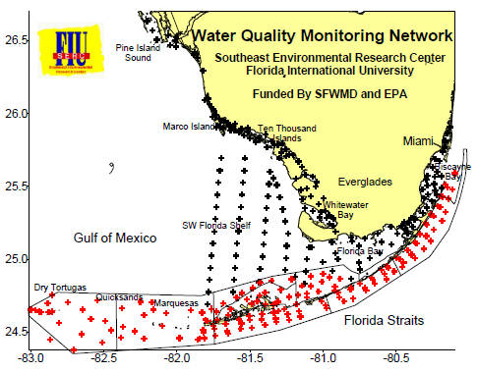
Water quality studies
The water quality monitoring project for the FKNMS water quality protection plan
  1995-present
Other sources of data:
  Storet
  IWR database

Slide 20
Waters on the 303(d) list
Halo zone waters: up to 500 meters offshore
Nearshore waters up to 12,100 meters offshore
  Classified as Class III (Recreation, Propagation and Maintenance of a Healthy, Well Balanced Population of Fish and Wildlife) and Outstanding Florida Waters (OFW).
Many of the halo Zone WBIDs are listed on the 1998 303(d) list as impaired for nutrients

Slide 21
Numeric Nutrient Criteria Options
FK RAD (2008) Water Quality targets
1985 Outstanding Florida Waters Baseline
Existing Condition Distributional Approaches
  Evaluating segmentation proposed by Boyer and Briceno
  Establish to maintain existing condition
    Water quality collected by FIU SERC
    Validate with IWR data set
Some combination of above three options
  Nearshore (≤ 500 m)
  Offshore (> 500 m)

Slide 22
Reasonable Assurance Document Nutrient Targets
Insignificant-Increase Targets: Concentration Increase above Natural Condition Within 500 Meters
  10 µg/l Increase Above Natural TN Concentration
  2 µg/l Increase Above Natural TP Concentration

Slide 23
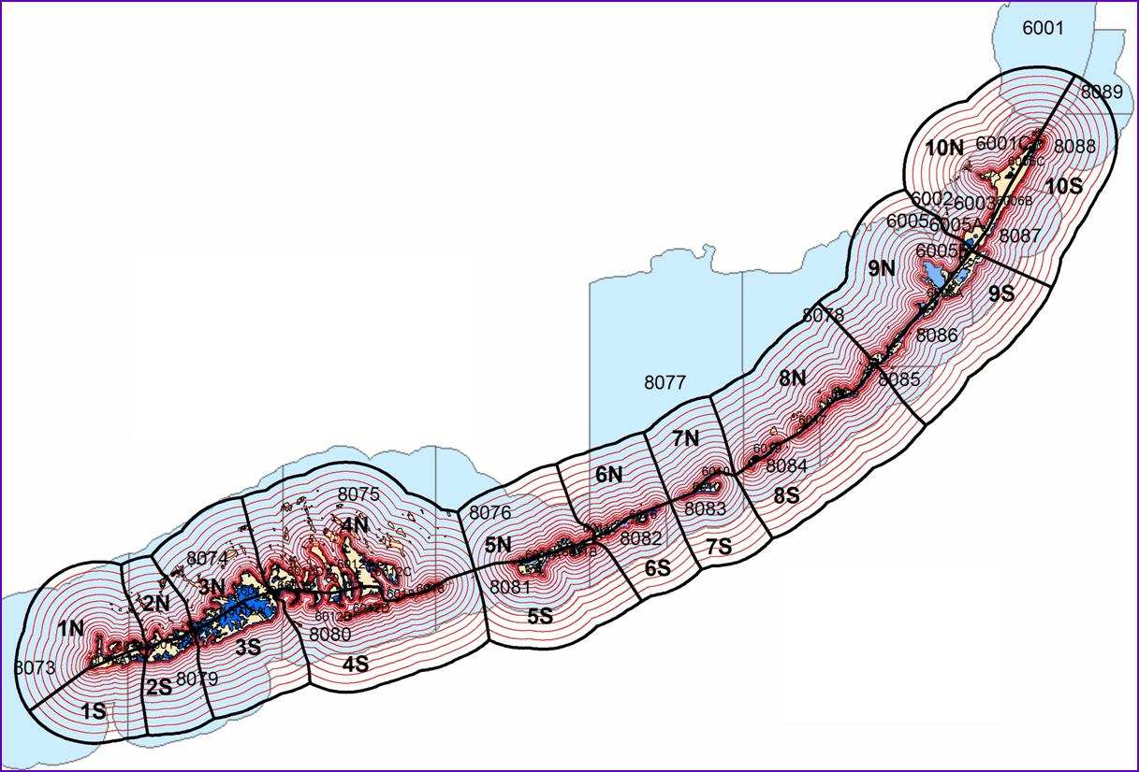
WBID Models in the Keys
20 Individual Models
Variable Model Sizes
Involved Spreadsheet Models (FKCCS)
Range: 100 to 12,100 meters off the Shoreline

Slide 24
Northern Keys RAD

Slide 25
OFW

Slide 26
Offshore Criteria
(insert picture)

Slide 27
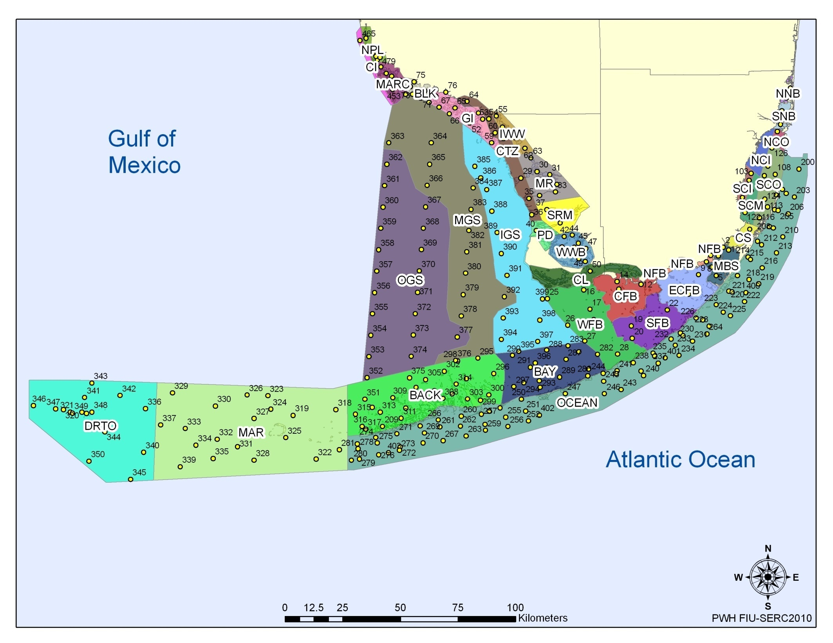
Proposed subdivision

Slide 28
Use Distributional Statistics to Describe the Range of Nutrients Associated with Designated Use Support (e.g., Reference Condition)
Predicated on the premise that maintenance of the frequency distribution associated with designated use support will protect those uses into the future
Describe:
  Central tendency associated with use support
  Variability around that central tendency
Goal: Develop magnitude, frequency, and duration components that will test whether the distribution has shifted upwards

Slide 29
Magnitude, Frequency and Duration Concept
The magnitude can be interpreted as the central tendency of the baseline distribution plus an insignificant increase (10%)
Frequency and duration components: assessment test of whether the distribution has shifted upward from the long-term average
  Consider natural variability, climatic cycles, and assessment cycles
Set a second assessment threshold at a higher level
  90% confident that if you exceed that value more than 2 times in a five year period than the waterbody has exceeded the long-term average

Slide 30
Potential Offshore NNC-TP
Insert TP time series

Slide 31
Potential Offshore NNC-TN
Insert TN time series

Slide 32
DEP Plans
TSD
Public workshops
SAB

Slide 33
Conclusions

