Slide 1
Nutrient criteria technical support document outline
Geographical and physical description
Sources and fates of nutrients
  Nutrient sources and loading estimates
  Assimilative capacity and productivity
Biological summary
  Seagrass: FKNMS Benthic Habitat and Seagrass Monitoring
  Coral: FKNMS Coral Reef Evaluation and Monitoring Project
  Mangroves
  Other biological resources
Water quality studies
  FKNMS Water Quality Monitoring Project
Waters on the 303(d) list
Numeric nutrient criteria recommendations

Slide 2
Geographical and physical description

Slide 3
External sources of nutrients
  Florida Current
  Gulf of Mexico
  SW Florida Shelf
  Everglades runoff
  Tidal exchange with Florida and Biscayne Bay
  Atmospheric deposition
Gibson et al. 2008

Slide 4
Local sources of nutrients
  Stormwater
  Wastewater
  Submarine groundwater discharge
Region | Estimated Annual Wastewater and Stormwater Load (MT year⁻¹)
 | Total Nitrogen | Total Phosphorus
Northern Keys | 163.5 | 40.9
Central Keys | 74.7 | 18.4
South-Central Keys | 91 | 21.2
Southern Keys | 108.8 | 31.3
FDEP 2008

Slide 5
Biological summary
  Results from the long term (15+ year) monitoring in FKNMS and published research and reports provide the background on the condition of biological resources in the Keys
  Seagrass
    FKNMS Benthic Habitat and Seagrass Monitoring
  Coral
    FKNMS Coral Reef Evaluation and Monitoring Project
  Mangroves
  Other biological resources (i.e. fisheries)

Slide 6
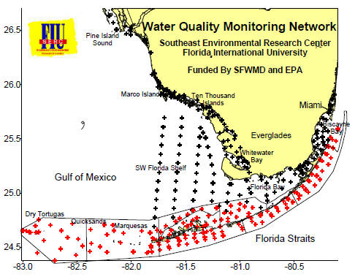
Water quality studies
The water quality monitoring project for the FKNMS water quality protection plan
  1995-present
Other sources of data?

Slide 7
Waters on the 303(d) list
Halo zone waters: up to 500 meters offshore
Nearshore waters up to 12,100 meters offshore
  Classified as Class III (Recreation, Propagation and Maintenance of a Healthy, Well Balanced Population of Fish and Wildlife) and Outstanding Florida Waters (OFW).
Many of the halo Zone WBIDs are listed on the 1998 303(d) list as impaired for nutrients

