Slide 1
Florida Bay Salinity and Water Quality Models
Estuary and Coastal Numeric Nutrient Criteria Development Meetings
March 2, 2010
Frank Marshall
Cetacean Logic Foundation, Inc.
www.cetaceanlogic.org

Slide 2
Background
Information on salinity models taken from draft RECOVER model status report (Marshall and Nuttle, 2010, draft)
Information on water quality models is new
Models group regionally
  Florida Bay
  Biscayne Bay
  Gulf coast estuaries

Slide 3
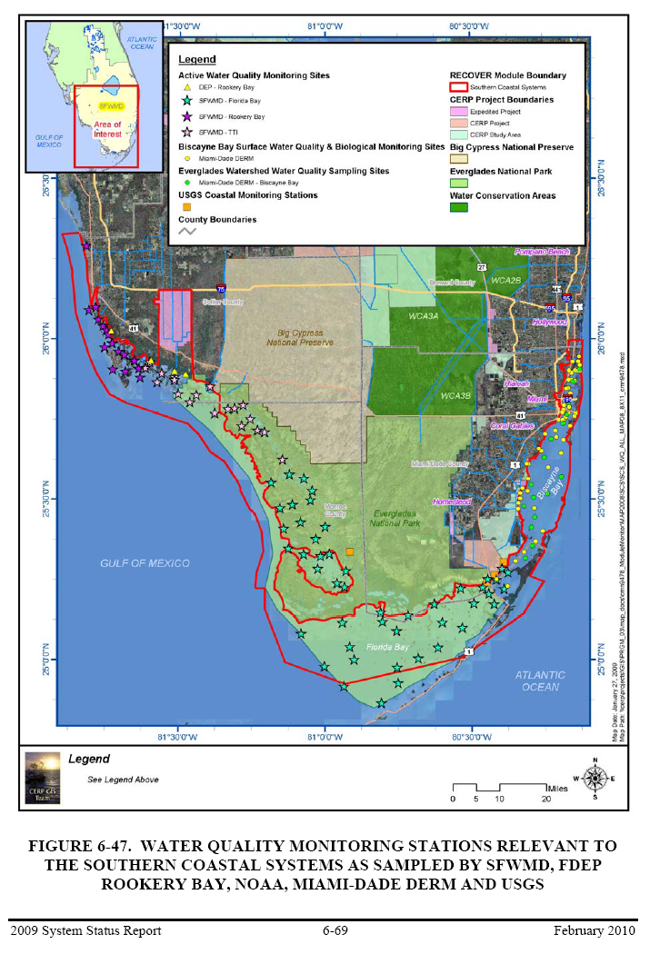
WATER QUALITY DATA
From 2009 RECOVER
System Status Report

Slide 4
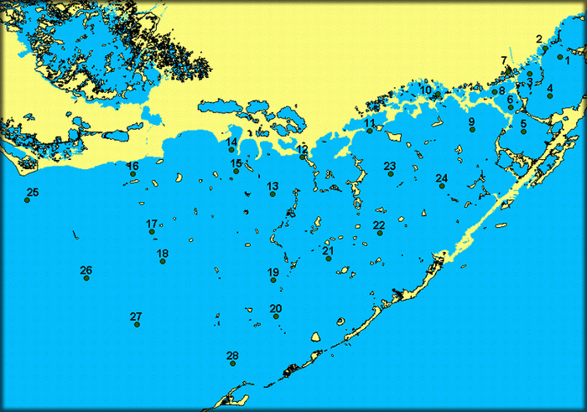
SERC/FIU Water Quality Data

Slide 5
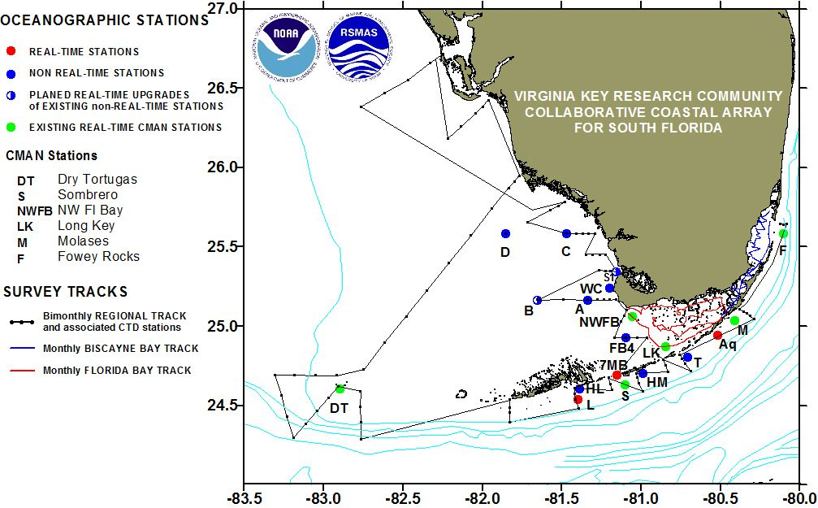
NOAA Cruise Data

Slide 6
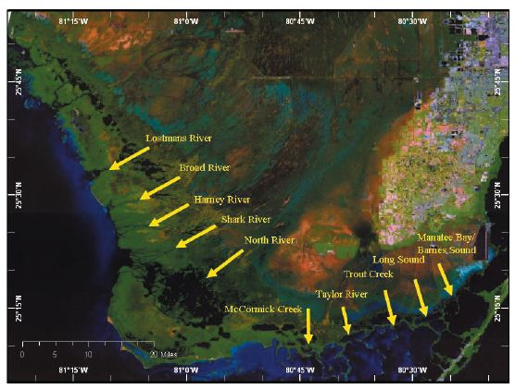
Loads – USGS Creek Data

Slide 7
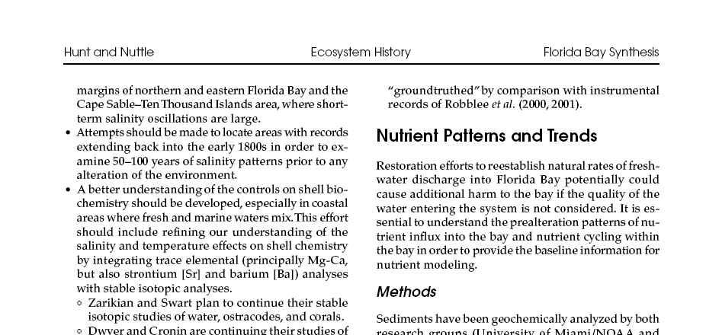
Paleo Information

Slide 8
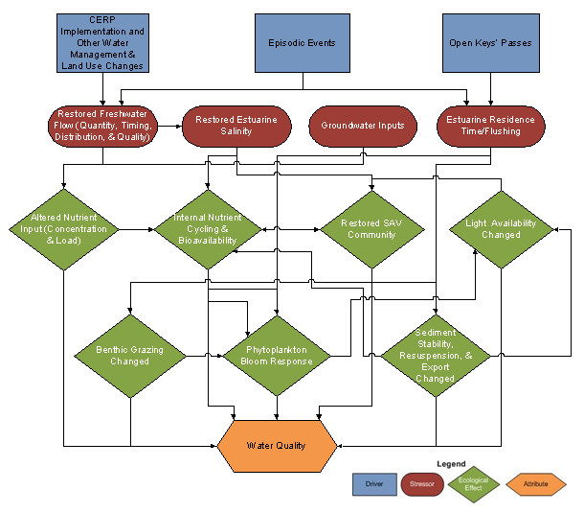
Water Quality CEM (from 2009 SSR)

Slide 9
Estuarine Model Types
Statistical models – regression, linear and non-linear; proven salinity models; largely unproven in south Florida for water quality
Mass balance models – static (budget), dynamic (exchange); useful in most estuaries
Numeric – physics-based, conservation of mass and momentum, 1/2/3-D hydrodynamics, can be coupled w/water quality models; water quality simulations rarely as good as salinity

Slide 10
Model Name | Parameter Modeled | type | Agency
MIKE SHE | groundwater, surface water | hydrologic | private
MIKE 11 | channel flow | hydraulic | private
CH3D | estuarine salinity | hydrodynamic | private
SFWMM | groundwater, surface water | hydrologic | SFWMD
HEC-RAS | channel flow | hydraulic | public domain
SWMM | channel flow | hydraulic | public domain
WASH123D | groundwater, surface water | hydrologic | USACOE
RSM | groundwater, surface water | hydrologic | SFWMD
RAS-MODFLOW | groundwater, surface water | hydrologic | public domain
RMA2/RMA4 | surface water | hydrologic | USACOE
SICS/TIME | groundwater, surface water, and salinity | hydrologic, hydrodynamic | USGS
HYSIM | surface water | hydrologic
DAFLOW | channel flow | hydraulic | USGS
BRANCH | channel flow | hydraulic | USGS
UNET | channel flow | hydraulic | USACOE
MODFLOW | groundwater | groundwater | public domain
FRAC3DVS | groundwater | groundwater | private
VS2D | groundwater | groundwater | USGS
MODBRANCH | groundwater, surface water | hydrologic | public domain
FEFLOW | groundwater | groundwater | USGS
SEAWAT | groundwater | groundwater | USGS
FTLOADDS | groundwater, surface water | hydrologic | USGS
PHAST | surface water | box | private
MLR | estuarine salinity | Statistical | public domain
Four Box⁴ | estuarine salinity | Mass Balance | private
FATHOM⁵ | estuarine salinity | Mass Balance, hydraulic | private
EFDC⁶ | estuarine salinity, circulation | hydrodynamic | public domain
SoFLA-HYCOM⁸ | oceanic salinity | hydrodynamic | private
Biscayne Bay Box Model | estuarine salinity | Mass Balance | private
BISECT | groundwater, surface water, and salinity | hydrologic, hydrodynamic | USGS
Wang Biscayne Bay Model | salinity | hydrodynamic | private
Ten Thousand Islands (TTI) | groundwater, surface water, and salinity | hydrologic, hydrodynamic | USGS
Biscayne Bay TABS- MDS | groundwater, surface water, and salinity | hydrologic, hydrodynamic | USACOE
Summary of Hydrology and Salinity Models
For South Florida

Slide 11
Florida Bay Salinity Models
Statistical Models
  Multivariate linear regression (MLR) models
Mass Balance Models
  Nuttle Four Box Model
  FATHOM
Numeric Models
  FTLOADDS TIME – limited coverage – near shore embayments
  EFDC – no longer being developed or supported

Slide 12
Florida Bay Water Quality Models
FATHOM nutrient module
EFDC - no longer being developed

Slide 13
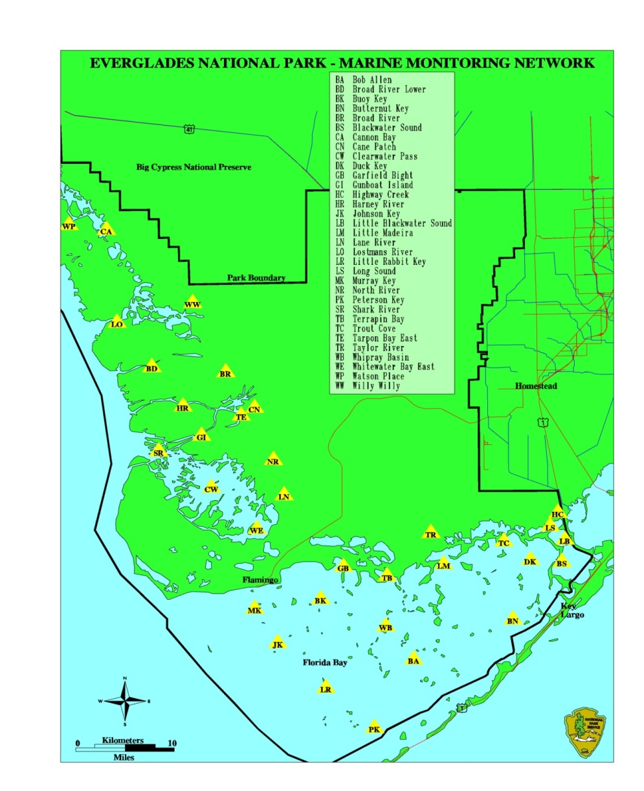
Domain of Florida Bay Statistical Salinity Models

Slide 14
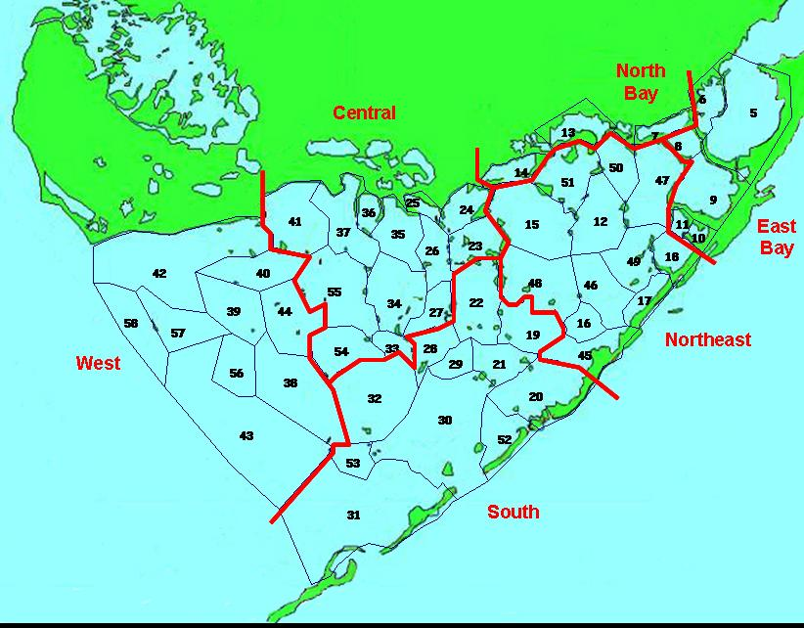
Domain of FATHOM

Slide 15
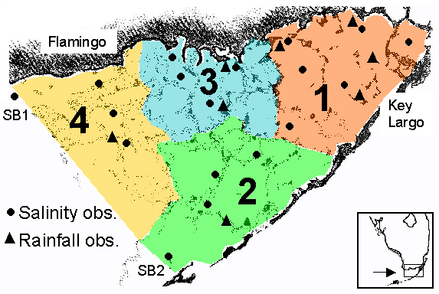
Nuttle Four Box Model

Slide 16
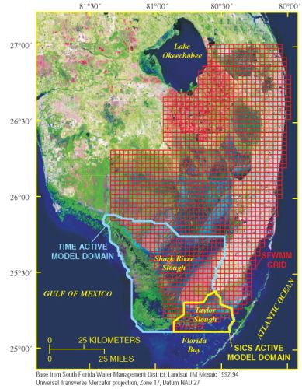
FTLOADDS TIME

Slide 17
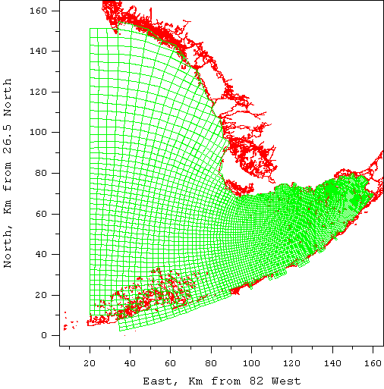
EFDC

Slide 18
Florida Bay Water Quality Models
EFDC – never fully developed, no longer supported
FATHOM Nutrient Modules
  Initial development 2008-9
  ENP CESI funded
  Workshop on nutrient transformation in Florida Bay – 6/2008 – led to identification of similar regions
  Results promising
  Work still needed

Slide 19
FATHOM
Mass balance model
Dynamic
  Time varying exchange between basins based on Manning’s empirical relationship
  Tide-driven
Assumes well-mixed basins
Assumes monthly grab sample data are monthly average
Monthly output
Not calibrated in numeric-modeling sense

Slide 20
FATHOM History in Florida Bay
Flux Accounting Tidal Hydrology Model: Cosby, Nuttle, Fourqurean (1999)
Florida Bay Minimum Flows and Levels (MFL), SFWMD: Cosby, Nuttle, Marshall (2005)
CESI Basin Update: Cosby, Marshall (2007)
FATHOM Paleoecology Application: Cosby, Marshall, Wingard (2007)
FATHOM Nutrient Workshop: Host of Characters (2008)

Slide 21
FATHOM Nutrient Capabilities
FATHOM
  Residence time estimates by region
  NO₃
  NH₄
  PO₄
  TOC
  TOP
  TON
  DIN (=NO3+NH4)
  TN (=TON+DIN)
  TP (=TOP+PO4).

Slide 22
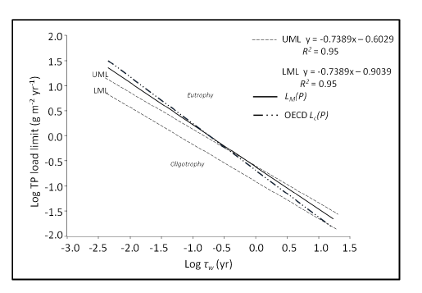
Residence time / load relationship
Steward and Lowe,
Estuaries and Coasts (2009)

Slide 23
Existing Salinity Model Linkages to Ecological Models
FATHOM salinity and:
  SFWMD seagrass model
  Fourqurean seagrass model
MLR salinity models and pink shrimp model

Slide 24
Florida Bay Model Summary
A number of salinity models are available
Only active water quality model is FATHOM
Statistical models for water quality have not been investigated
EFDC numeric model was used for preliminary water quality modeling, no longer supported
FTLOADDS TIME numeric model was not developed with intent of expanding to water quality
Oligotrophic conditions may be difficult to simulate

Slide 25
Thanks!

