Slide 1
Development of Numeric Nutrient Criteria for South Florida Estuaries and Coastal Waters
Prepared by: Florida Department of Environmental Protection, Division of Environmental Assessment and Restoration

Slide 2
Overview of Presentation
Purpose
What have we done so far?
National Estuary Program systems
  Methods and criteria
South Florida systems
  Statistical methods
  Biological overviews and criteria
What’s next?

Slide 3
Why Now?
FDEP Started Developing Numeric Criteria in 2001
Litigation began in 2008
EPA is under a consent decree to expeditiously promulgate marine nutrient criteria for Florida
Recently revised EPA schedule:
  Propose by March 15, 2012 and finalize by November 15, 2012
Notes:
Prior to timeline – DEP originally initiated rulemaking for numeric nutrient criteria in 2001.
Aug, 2008 - EarthJustice filed suit to compel EPA to establish criteria: Suit included Florida Wildlife Federation, ….???? Terry Cole was granted a motion to intervene (representing??)
Aug, 2009 – EPA prepared consent order containing implementation dates. Both EPA & EarthJustice signed consent order but the judge has not yet signed the order. Many different parties sued to stay the consent order.
9/09-10/09 - Many different parties includes: Terry Cole (opposition), Florida Department of Agriculture and Consumer Services (Commissioner Bronson) (opposition), Florida Water Environment Association Utility Council, Inc. (opposition), Florida Minerals and Chemistry Council (opposition), Florida Pulp & Paper (opposition), Florida Farm Bureau (opposition), Southeast Milk, (opposition), Florida Citrus Mutual, Inc. (opposition), Florida Fruit and Vegetable Association, (opposition), American Farm Bureau Federation (opposition), Stormwater Association (opposition), Florida Cattleman’s Association (opposition), Florida Engineering Society (opposition) and the South Florida Water Management District (support)
If DEP adopts by rule numeric nutrient criteria they may submit it to EPA for approval at any time in this process. The Clean Water Act requires EPA to approve any changes that the department makes to the water quality standards. EPA has reviewed the department’s current draft rule and raised issues.

Slide 4
Overall Estuary Approach
Develop estuary-specific nutrient criteria
  Rather than generic criteria that apply to all
Work with local scientists and EPA to reach consensus on methods and resultant criteria
Derive criteria that protect/restore designated uses (healthy, well-balanced biology)
Promulgate criteria that are scientifically sound, and can be adopted by EPA and/or DEP

Slide 5
What have we done so far?
Held a series of 8 public meetings in spring/fall of 2010 to solicit information from stakeholders/scientists
Drafted Reports for ~30 Estuarine Systems
  Summarized available water quality data
    Nutrients and Chlorophyll a
  Summarized available biological data
    Identified key biological resources
    Determined current biological health
  Selected approach for NNC development
    Presented draft criteria, where available

Slide 6
What have we done so far?
(continued)
Drafted separate document that summarizes three main approaches to develop criteria
  TMDL or response based – criteria based on cause-effect relationships established between biological indictors and nutrients
  Historic conditions - criteria based on a historic period associated with biologically healthy conditions (prior to subsequent nutrient enrichment and biological imbalances)
  Maintain healthy existing conditions - criteria based on current nutrient regime in a system determined to be biologically healthy from the standpoint of nutrient enrichment

Slide 7
What have we done so far?
(continued)
Held two meetings with DEP’s Marine Technical Advisory Committee in 2010
  Received constructive input/consensus on approaches
Submitted DEP approaches to EPA Science Advisory Board
  EPA agrees that the South Florida marine systems presented today are healthy, well balanced systems and that maintaining existing nutrient conditions is appropriate strategy for NNC

Slide 8
What have we done so far?
(continued)
  Reviewed technical reports submitted by Sarasota, Tampa Bay, and Charlotte Harbor National Estuary Programs (NEPs)
    These NNC are primarily based on cause-effect relationship between nutrients, chlorophyll a, transparency, and seagrass protection and maintain existing healthy conditions
    NEPs (Janicki) will present options on expression of criteria, DEP is seeking your input

Slide 9
National Estuary Program Criteria
Tampa Bay, Sarasota Bay, Charlotte Harbor and adjacent systems

Slide 10
TP Criteria for St. Joseph Sound/Clearwater
St. Joseph Sound (W1) | 0.044 mg/L
Clearwater North (W2) | 0.048 mg/L
Clearwater South (W3) | 0.061 mg/L

Slide 11
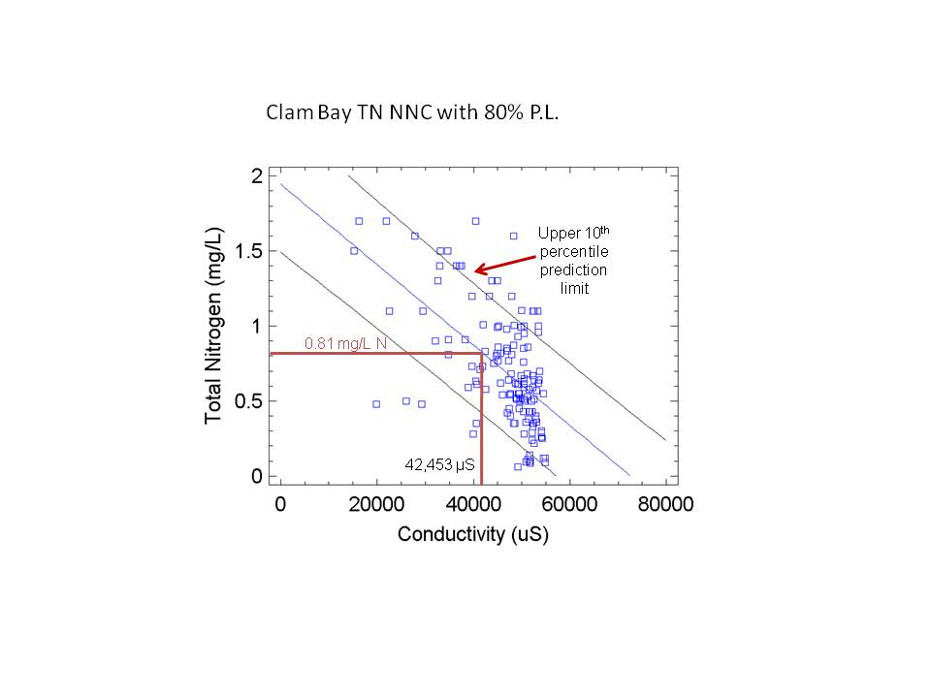
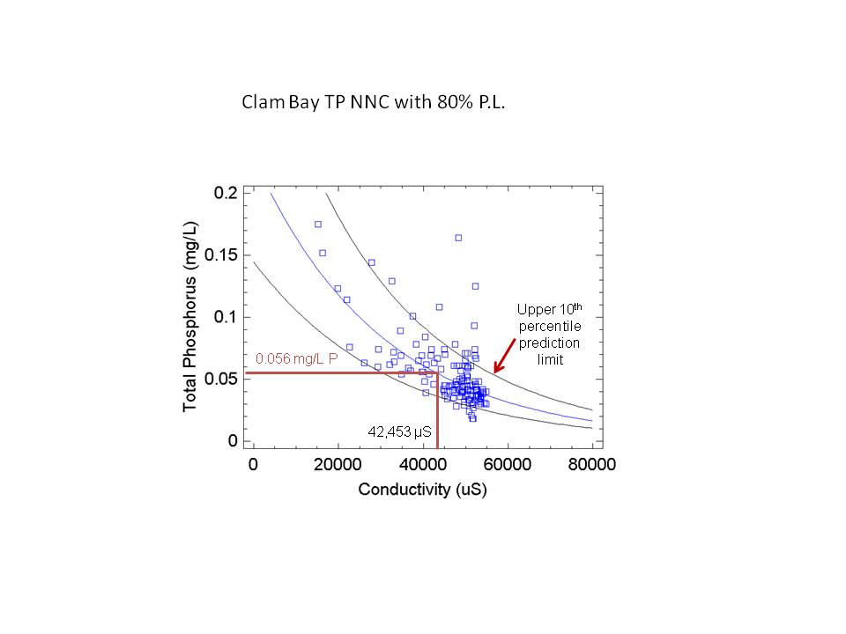
Clam Bay (Collier County)
Collier County (Gary McAlpin and Dave Tomasko) developed salinity dependent TN and TP criteria, which are based on exceeding the upper 10th percentile prediction interval.

Slide 12
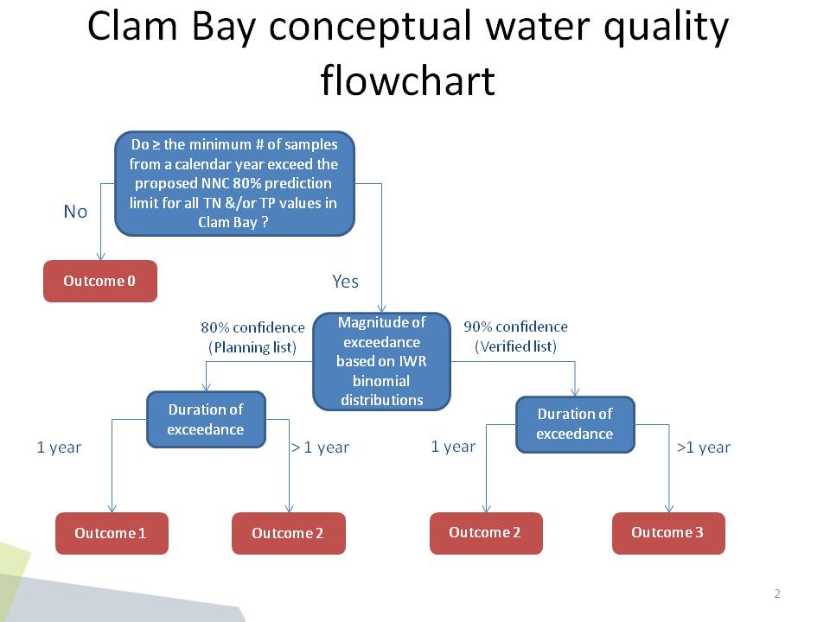
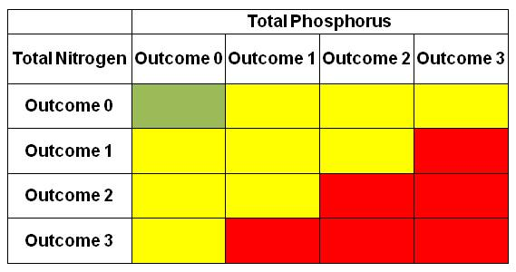
Clam Bay (Collier County)

Slide 13
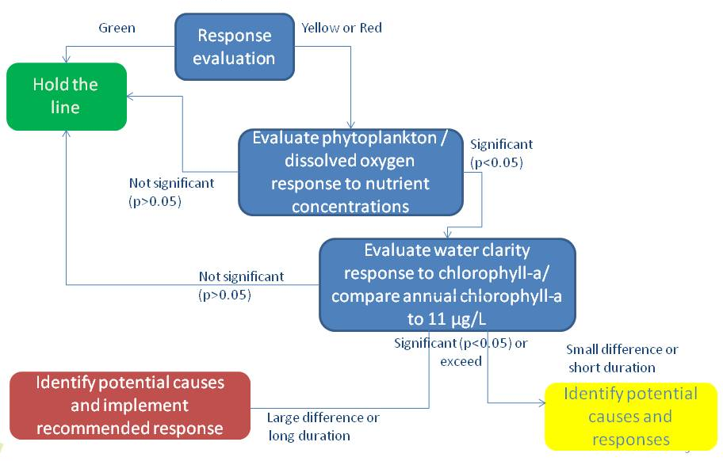
Clam Bay (Collier County)

Slide 14
DEP Statistical Approaches for Maintaining Healthy Nutrient Conditions
Florida Department of Environmental Protection, Division of Environmental Assessment and Restoration

Slide 15
Healthy Existing Conditions Approach
Each estuary that is documented to be healthy is used to describe its own reference condition
Nutrient distribution of a “baseline period,” (when the waterbody achieved its designated use) is determined and criteria are established to maintain that distribution into the future

Slide 16
Expressing Criteria (M-D-F)
Magnitude is a measure of how much of a pollutant may be present in the water without an unacceptable adverse effect
Duration is a measure of how long a pollutant may be above the magnitude
Frequency relates to how often the magnitude may be exceeded without adverse effects

Slide 17
DEP’s Approach
DEP is proposing to maintain the existing data distribution, while accounting for natural variability
Any additional assimilative capacity for nutrients would be determined in the future, on a site specific basis

Slide 18
DEP’s Approach (cont.)
Through the use of prediction limits, DEP proposes to control the Type I error rate at 10% and establish magnitude as:
An annual geometric mean, not to be exceeded more than once over a five- year period; and
A long-term geometric mean of the distribution, expressed as a five-year geometric mean, never to be exceeded

Slide 19
Describing Data Distributions
DEP has historically used a geometric mean and log-normal statistics to describe nutrient distributions and calculate upper percentiles
This method requires knowing or estimating the long-term mean (μ) and standard deviation (σ)
  Mean is set to the long-term network geometric mean
  Standard deviation is based on the variability observed within the baseline dataset

Slide 20
Lognormal Distribution (from Dr. Niu, FSU)
Nutrient data typically approximate a lognormal distribution (can only be verified with large data sets ~200 data points).
It is acceptable to assume a lognormal distribution, even if deviations occur at the tails , as long as the fit is very good at the 75th percentile.
Finding the best approximation of the distribution is an acceptable practice

Slide 21
Use of Long Term Mean
Relationship between nutrients and chlorophyll a, in Florida’s healthy estuaries, suggests that a long-term duration is in fact appropriate for the purposes of establishing numeric nutrient criteria

Slide 22
Type I Error and Natural Variability
The Type I error is the rate of incorrectly identifying waters as nutrient impaired, based simply on an exceedance of the statistically derived threshold, when in fact the system is biologically healthy
Achievement of target error rate must acknowledge inherent natural and analytical variability of the dataset that represents the current condition

Slide 23
Targeting the Type I Error
A 10% Type I error rate is achieved at the point where the cumulative probability of exceedance (probability of X or fewer exceedances) intersects 0.9
This is the point where there is only a 10% probability of observing greater than X exceedances in n trials.

Slide 24

Calculating Exceedance Frequency
A binomial distribution can be used to estimate the frequency of exceeding a threshold given a specific number of trials.
Where,
p= probability of selecting at random a member of the category (i.e., probability of exceedance), and
q= the probability of selecting a member of the second category (i.e., probability of nonexceedance) =1-p.

Slide 25
Development of an Annual Limit
To maintain an existing data distribution, use the frequency and duration components, in conjunction with magnitude, to assess whether the distribution has shifted upward
May be derived statistically when given the stated management goal of no more than a 10% Type I error rate

Slide 26
Choosing the Annual Excursion Frequency
Should account for inter-annual nutrient patterns and be established at a frequency that allows for effective and timely nutrient control
DEP believes that a rapid assessment period, to more quickly implement corrective action , is appropriate
1 out of 5 year excursion rate is DEP’s recommendation

Slide 27
Benefits of Using a 5 Year Duration Period
Better control for Type II error than shorter periods
More fully captures climatic cycles
Consistent with both the state’s 5-year 303(d) assessment and National Pollutant Discharge Elimination System (NPDES) permit renewal cycles

Slide 28
Excursion Frequency (cont.)
10% Type I error can be achieved by setting the allowable excursion frequency in a 5 year period:
Excursion Frequency | Annual Criterion Magnitude
0 | 98th
1 | 90th
2 | 75th
3 | 58th
4 | 37th

Slide 29
Use of Found Data and Variance Estimates
“Found data” are collected for a variety of purposes
  Varying spatial and temporal scales, range of sampling frequencies
Unlikely that future compliance data will be wholly consistent with the baseline data
True long-term variance in the system will therefore be greater than would be calculated based on a straight calculation of inter-annual variance

Slide 30
Calculating Variance Via ANOVA
The full range of variability or true inter-annual variance is composed of annual, spatial, and within-year (sampling) effects, such that the annual average concentration on the log scale is given as:
Ln (annual geometric mean concentration) = mean + year effect + site effect + within year effect + error.

Slide 31

True Inter-annual Standard Deviation for a Network of Stations
σ_{tyr} = true inter-annual standard deviation
σ²_{yr} = the year to year variance (year effect)
σ²_{s} = variance among stations (site effect)
σ²_{sd} = within year variance for a station (date effect)
n = average number of stations within the network
k = average number of annual samples collected at a station

Slide 32
Use of Prediction Interval
Prediction intervals are used to estimate the range of future data, such that 100 (1-α)% of the future data will fall within the prediction interval and 100 (α)% will fall outside the interval
Helsel and Hirsch (2002) provide an equation to calculate an asymmetric (log-normal) prediction interval.

Slide 33

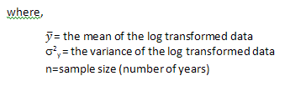
Calculation of Upper Prediction Interval

Slide 34
Criteria Based on Prediction Interval
DEP calculated upper 90 percent prediction limits on annual geometric mean nutrient concentrations for Florida’s estuaries
These limits are expected to be exceeded in only 10 percent of the future years, given variability measured during the baseline
For annual limit variance, 5-year geometric mean was approximated as one-fifth the annual variance (σ²_{tyr}/5).

Slide 35
Long Term Limit: 5 Year Geometric Mean
The 5-year geometric mean cannot simply be derived as the geometric mean of the baseline dataset (long-term error rate of would be 50%)
The 5-year limit must control for Type I error and account for present and future variability
Therefore, 5-year limit was calculated using an upper 90% prediction limit for a 5-year geometric mean

Slide 36
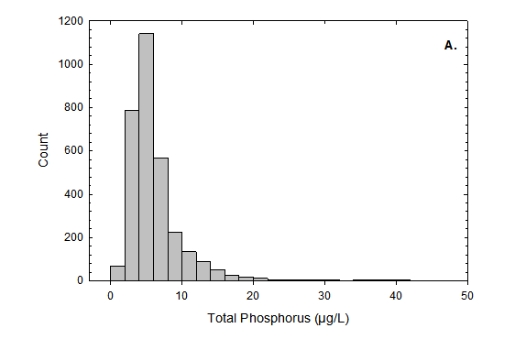
Biscayne Bay TP Example
Objective is to maintain the long-term average concentration
Exceedances would mean that TP had increased above the baseline distribution
Five-year geometric mean is intended to preserve the baseline central tendency
Annual limit accounts for natural variability above the central tendency.
Geometric Mean = 5.4 µg/L

Slide 37
Biscayne Bay (South Central Outer Bay) Example
In the absence of human influences this pattern of variability among individual samples is most likely caused by short-term fluctuations in climatic, hydrologic, and biological conditions, as well as sampling and analytical errors.
Variance Source | Percent
Station | 2.3%
Year | 1.8%
Within group (variance within sites and years) | 95.9%

Slide 38
Variance components, long-term average and upper prediction limits for South Central Outer Bay
Component | TP (mg/L) | TN (mg/L) | Chlorophyll a (mg/L)
Spatial variance (σ²_{s}) | 0.0053 | 0.02 | 0.118
Interannual variance(σ²_{yr}) | 0.0504 | 0.0645 | 0.0409
Within-year standard variance (σ²_{sd}) | 0.2136 | 0.1668 | 0.3235
Average number of stations within the network (n) | 8.1 | 8.1 | 8.1
Average number of annual samples collected at a station (k) | 11 | 11 | 11
Average network Ln | -5.259 | -1.659 | -1.576
Spatially averaged geometric mean (mg/L) | 0.0052 | 0.190 | 0.207
True interannual standard deviation (σ_{tyr}) | 0.231 | 0.262 | 0.243
N | 14 | 14 | 14
Upper 90% prediction limit (1:5 years) | 0.007 | 0.275 | 0.290

Slide 39
South Central Outer Bay
 | TP (mg/L) | TN (mg/L) | CHLA (mg/L)
Long-term Average network Ln | -5.259 | -1.659 | -1.576
Long-term Geometric Mean (µg/L) | 0.0052 | 0.190 | 0.207
True inter-annual standard derivation | 0.231 | 0.262 | 0.243
True long-term variance (σ²_{tyr}) | 0.053 | 0.069 | 0.059
5-Year variance (σ²_{tyr}/5) | 0.0107 | 0.0138 | 0.0118
t | 1.2816
Upper 90 Percent Prediction Interval (5-year geometric mean) | 0.0061 | 0.227 | 0.243
1:5 Years Limit (from Table 6) | 0.007 | 0.275 | 0.290
Summary variance components, long-term average concentrations, and t values used to calculate 5-year geometric mean limits for TP, TN, and chlorophyll a SCO, FL.

Slide 40
Example TP Criteria for South Central Outer Bay
To maintain the existing geometric mean TP of 5.2 µg/L, the criteria would be:
The five-year geometric mean shall not surpass 6.1 µg/L, and
The annual geometric mean TP shall not surpass 7.0 µg/L more than once year in a five-year period

Slide 41
Evaluation of Error Rates (SCO)
10% Type II error
(6.9 µg/L)*
*Difference from baseline, not imbalance threshold
Existing Condition
(5.2 µg/L)

Slide 42
Summary: Criteria Expression
Five-year geometric mean limit (upper 90th prediction limit) of the five-year, spatially averaged geometric means : not to be exceeded ; and
Annual geometric mean limit (upper 90th prediction limit) of the spatially averaged annual geometric means : no more than one exceedance in a five-year period

Slide 43
South Florida Estuaries:
Biological Description and Nutrient Criteria
Rookery Bay/10,000 Islands, Florida Bay, Florida Keys, Biscayne Bay

Slide 44
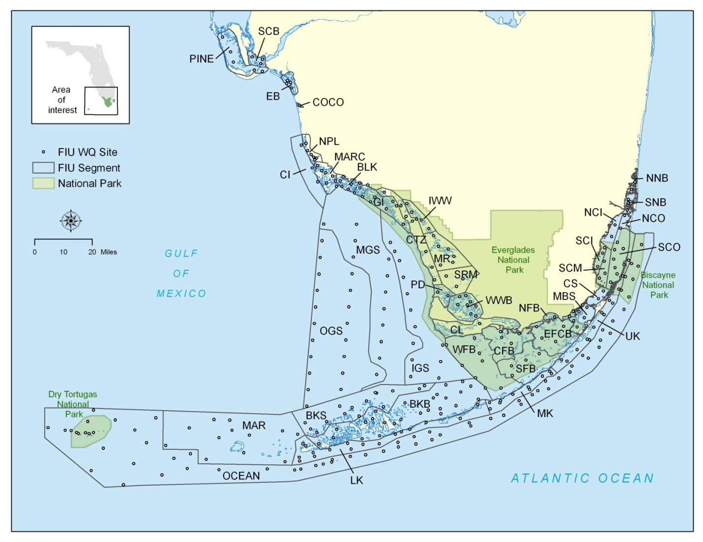
South Florida Estuary Segmentation (Boyer and Briceno)

Slide 45
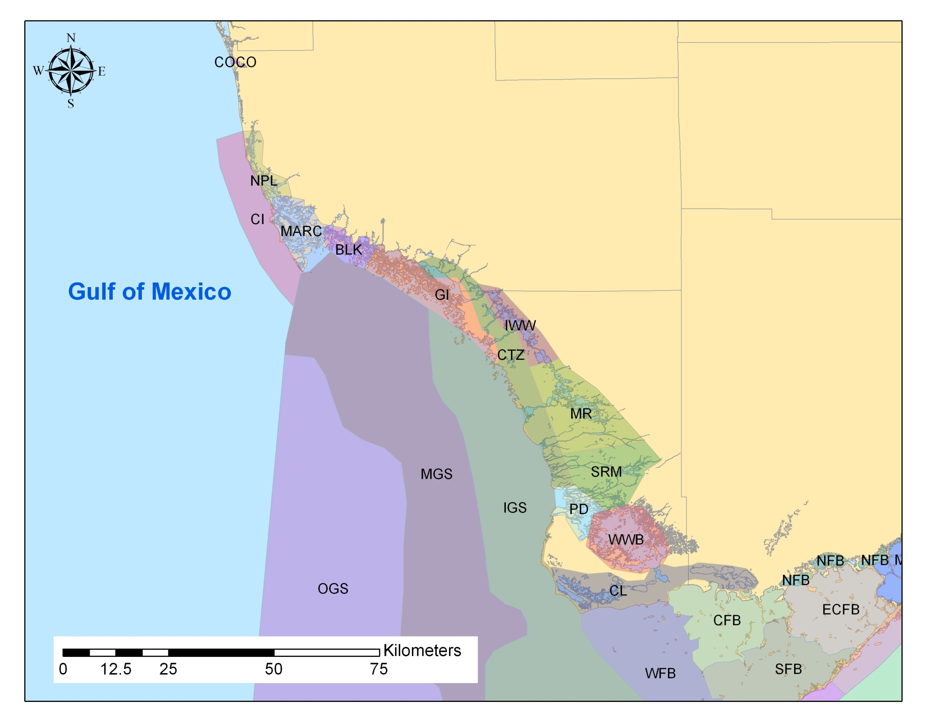
Southwest Coast

Slide 46
Naples Bay
1953 1999
Northern portions of the system (e.g., Naples bay) impacted by drainage, channelization, and urban development
  Highly urbanized around the Bay
  Construction of extensive series of dead-end canals

Slide 47
SW Description
Southern areas remain largely undisturbed with large percentage of conservation land in the basin
Largest undisturbed mangrove forests in the state

Slide 48
SW Biological Summary- Naples
Naples Bay has lost 90% of its seagrass beds, 80% of its oyster reefs, and 70% of its mangrove fringe since 1950
  Extensive areas of mangroves and salt marsh have been replaced by vertical seawalls and bulkheads
  Inappropriate fresh water deliveries from the inland canal system have altered the salinity regime, and stressed the biota of the estuary
  Hydrological restoration underway

Slide 49
SW Biological Summary- Southern Areas
Biological communities in Southern areas are largely intact
  Large percentage (>80%) of basins undisturbed (conservation lands)
  Biological communities stressed to varying degrees by altered hydrology and salinity regime resulting from inland canal system
Nutrient levels don’t appear to be a major stressor to the biological communities in most areas
  Most studies have focused on the effects of the altered hydrology and salinity regime

Slide 50
Response variable | Observed historically or currently? | Explanation | Source
Low DO (hypoxia/anoxia) | Yes | Localized naturally low DO conditions common due to stratification and inputs of large amount of organic material from natural mangrove forests. | Boyer (2008)
Reduced clarity | Yes | Reduced clarity (turbidity) can be an issue in Naples Bay where a large portion of the mangrove fringe has been replaced with vertical seawalls and in areas where seagrass has been lost due to changes in the salinity regime, not due to chlorophyll a. | Thomas and Rumbold (2006)
Increased chlorophyll a concentrations | No | No long-term increasing trends observed. | Boyer and Briceño (2008)
Phytoplankton blooms (nuisance or toxic) | Yes | Primarily episodic Karenia brevis blooms originating offshore, not locally | FWRI http://research.myfwc.com/features/category_main.asp?id=2309
Problematic epiphyte growth | No | Significant epiphyte growth on seagrasses reported in small areas. | RBNERR

Slide 51
Response variable | Observed historically or currently? | Explanation | Source
Problematic macroalgal growth | No | Drift algae occurs in some areas, but does not adversely affect the bay proper. | O’Donnell unpublished data
SAV community changes or loss | Yes | SAV has been lost in some areas due to the altered hydrology and salinity regimes, not from nutrient enrichment. | RB Management Plan (2010)
Emergent or shoreline vegetation community changes or loss | Yes | In Naples Bay, most of the mangrove fringe has been replaced with vertical seawalls or have been decreased due to changes in freshwater inputs and salinity regime. | Woithe and Brandt-Williams (2006)
Coral/hardbottom community changes or loss | No | None Reported
Impacts to benthic community | No | None reported.
Fish kills | Yes | Fish kills of generally limited extent and severity have occurred from low DO, cold, red tide, fishing violations and other unknown causes. | Fish and Wildlife Research Institute (FWRI 2010)

Slide 52
Naples Bay Nutrients
Although stressed by habitat and hydrological alterations, analysis shows that nutrient and chlorophyll a values in Naples Bay are similar to adjacent, minimally disturbed areas (Blackwater River/Coastal Transition Zone)
Therefore, as physical restoration progresses, maintaining existing nutrients is appropriate

Slide 53
SW Coast – Southern Areas
Most of the watershed consists of natural, protected areas
Nutrients are low, not identified as a stressor
  No increasing trends in nutrients or chlorophyll over time
  Healthy, well-balanced populations of flora and fauna where habitat and hydrology OK
EPA agrees that maintaining existing nutrient conditions is appropriately protective

Slide 54
Southwest NNC Comparison
 |  | DEP 1 in 5 year |  | DEP 5 Year Mean |  | EPA 1 in 3 Year
Parameter | Region | Inshore | Offshore | Inshore | Offshore | Inshore | Offshore
TP | SW Coast | 0.024 - 0.058 | 0.014 - 0.02 | 0.02 - 0.051 | 0.013 - 0.017 | 0.025 – 0.056 | 0.021
TN | SW Coast | 0.321 - 0.95 | 0.255 - 0.333 | 0.292 - 0.764 | 0.206 - 0.268 | 0.30 – 1.13 | 0.39
Chl-a | SW Coast | 2.6 - 5.84 | 1.15 - 1.9 | 2.14 - 4.97 | 0.96 - 1.54 | 2.47 – 5.86 | 2.84
a. Tidal Imperial River to Tidal Cocohatchee River | Option 1: 0.062 mg/L Option 2: 0.055 mg/L Option 3: 0.059 mg/L | Option 1: 0.53 mg/L Option 2: 0.44 mg/L Option 3: 0.54 mg/L | Option 1: 6.81 µg/L Option 2: 5.39 µg/L Option 3: 6.25 ug/L

Slide 55
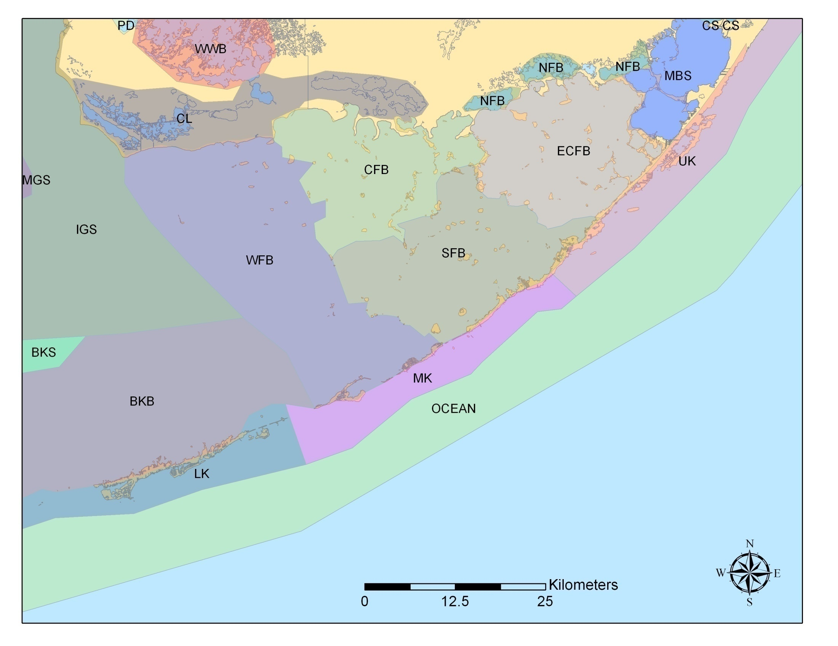
Florida Bay

Slide 56
Florida Bay
Major habitats consist of seagrass, hardbottom, and mangroves
Seagrasses have been increasing since the 1990s and continue to be the dominant biological community (90% coverage)
Although Florida Bay has changed since 1700s, no current evidence of imbalances in the ecological structure or function of biological communities

Slide 57
Florida Bay
Relatively low nutrient and chlorophyll a levels
No increasing trends in nutrient and chlorophyll a concentrations
Large amount of natural conservation lands in the basin (Everglades National Park, Water Conservation Areas)

Slide 58
Response variable | Observed ? | Explanation
Low dissolved oxygen (DO) | Yes | Usually occurs in the Snake Bight area of Everglades National Park (ENP) and is related to shallow water, poor circulation, high summer temperatures and high respiration, not due to nutrient enrichment.
Reduced clarity | Yes | Followed seagrass die-off in early 1990s; marl sediment-derived turbidity (inorganic particulates) increased significantly in the central and western bay after 1991. Seasonally occurring, with maximum in the winter/spring when winds are highest.
Increased chlorophyll a | Yes | Increased in the central bay in the early 1990s and then declined to previous concentrations; small increase occurred in the western bay where levels are seasonally highest in winter/spring. Chlorophyll a has declined and remains low in the eastern bay.
Phytoplankton blooms (nuisance or toxic) | Yes | Episodic nuisance blooms occur in specific areas; large cyanobacterial blooms have commonly occurred annually in summer/fall in central Florida Bay since 1992. Diatom-dominated blooms are common in western Florida Bay, mainly limited by N, and are associated with enhanced output from the Shark River.
Problematic epiphyte growth | No | Epiphyte distributions in Florida Bay follow spatial and temporal gradients. Higher epiphyte loads are associated with areas of high seagrass productivity.
Sources: Browder (2007), Boyer and Keller (2007), Boyer et al. (1999), Hitchcock et al. (2007), Durako et al. 2007

Slide 59
Response variable | Observed | Explanation
Problematic macroalgal growth | No | Macroalgae may have increased from historic levels but do not appear to have negatively affected ecosystem components.
SAV community changes or loss | Yes | Large die-off of T. testudinum occurred in late 1980s and continued to mid-1990s; from the mid- to late 1990s, abundance remained stable; abundance has increased from late 1990s to present
Vegetation community changes or loss | Yes | Changes in the mangrove community are related to hydrology and salinity,
Coral/hardbottom community changes or loss | N/A | N/A
Impacts to benthic community | Yes | Cascading effects from seagrass die-off, including declines of sponges and spiny lobsters; community has been slow to recover.
Fish kills | Yes | Due to low DO, these usually occur in the Snake Bight area of ENP.
Sources: Durako et al. (2007), Wingard (2007), Zieman et al. (1989, 1999), Robblee et al. (1991), Davis et al. (2005), Butler et al. (1995), Browder (2007)

Slide 60
Florida Bay NNC Comparison
 |  | DEP 1 in 5 year |  | DEP 5 Year Mean |  | EPA 1 in 3 Year
Parameter | Region | Inshore | Offshore | Inshore | Offshore | Inshore | Offshore
TP | Florida Bay | 0.008 - 0.054 | N/A | 0.007 - 0.042 | N/A | 0.011 – 0.049 | N/A
TN | Florida Bay | 0.42 - 1.532 | N/A | 0.353 - 1.187 | N/A | 0.47 – 1.59 | N/A
Chl-a | Florida Bay | 0.43 - 11.84 | N/A | 0.35 - 8.68 | N/A | 0.68 – 10.06 | N/A

Slide 61
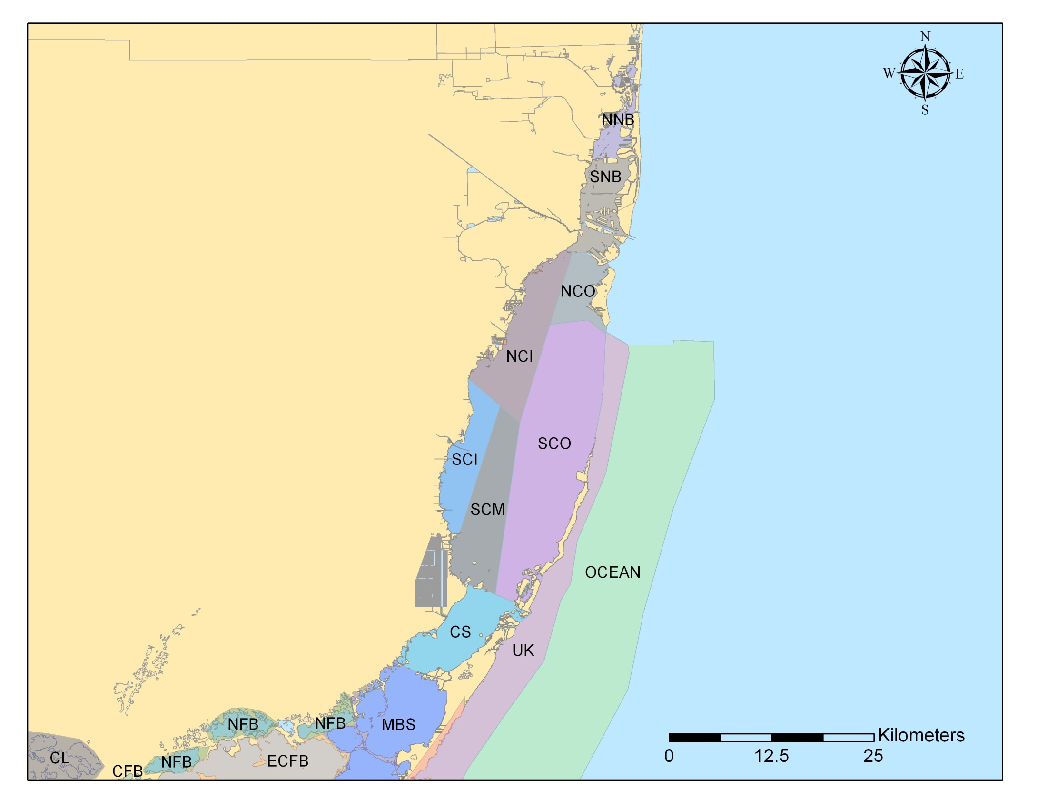
Biscayne Bay

Slide 62
Biscayne Bay
Seagrass Communities
  The predominant seagrass in Biscayne Bay is T. testudinum and other seagrasses include S. filiforme and H. wrightii
  Combined, these seagrasses cover approximately 65% of the bay. By area of bay:
    Central – 75% cover
    South – 50% cover
    North – 25% cover
  The lower percentage coverage in the Northern Bay is predominately due to the influence of dredge-and-fill activities and canal discharge

Slide 63
Response variable | Observed ? | Explanation
Low dissolved oxygen (DO) | Yes | Low DO is localized in the North Bay near canal inputs, where it is chronically low due to stratification, not due to nutrients.
Reduced clarity | Yes | Turbidity is an issue in parts of North Biscayne Bay near historical dredge-and-fill activities and near industrial complexes, such as the Port of Miami.
Increased chlorophyll a | Yes | Median chlorophyll a concentrations have increased in the North Bay, but chlorophyll a concentrations are still low, below 2 µg l^{-1 ,}as annual geometric mean.
Phytoplankton blooms (nuisance or toxic) | Yes | Historically (1925–76), the Miami River discharged nutrients into northern Biscayne Bay, leading to occasional blooms. In 2005–06, there was a bloom in Blackwater Sound (these data excluded from maintain existing conditions calculations).
Problematic epiphyte growth | No | None reported.
Sources: Caccia and Boyer (2005), Harlem (1979), Boyer and Briceñ0 (2008)

Slide 64
Response variable | Observed | Explanation
Problematic macroalgal growth | No | Drift algae is sometimes found near canal discharge sites but does not adversely affect the bay proper.
SAV community changes or loss | Yes | Although SAV is stable in most of Biscayne Bay, the abundance and community composition of seagrasses have changed near canal outputs, potentially due to freshwater inputs. SAV remains healthy throughout the interior of the bay.
Vegetation community changes or loss | Yes | Diversion of fresh water and development of shorelines have reduced mangrove habitat.
Coral/hardbottom community changes or loss | Yes | Coverage and species abundance have declined, but there is no indication that nutrients were responsible.
Impacts to benthic community | No | None reported.
Fish kills | Yes | Fish kills of generally limited extent and severity have occurred from low DO, cold, red tide, fishing violations, and other unknown causes.
Sources: Biber and Irlandi (2006), CERP (2010), Meeder and Boyer (2001), Browder et al. (2005), Robles et al. (2005), FWRI (2010)

Slide 65
Biscayne Bay NNC Comparison
 |  | DEP 1 in 5 year |  | DEP 5 Year Mean |  | EPA 1 in 3 Year
Parameter | Region | Inshore | Offshore | Inshore | Offshore | Inshore | Offshore
TP | Biscayne Bay | 0.008 - 0.013 | 0.007 - 0.008 | 0.007 - 0.011 | 0.006 - 0.006 | 0.007 - 0.012 | 0.007 - 0.008
TN | Biscayne Bay | 0.311 - 0.665 | 0.275 - 0.395 | 0.26 - 0.555 | 0.227 - 0.331 | 0.320 - 0.730 | 0.260 - 0.390
Chl-a | Biscayne Bay | 0.43 - 1.95 | 0.29 - 0.38 | 0.34 - 1.64 | 0.24 - 0.31 | 0.38 - 1.79 | 0.27 – 0.36

Slide 66
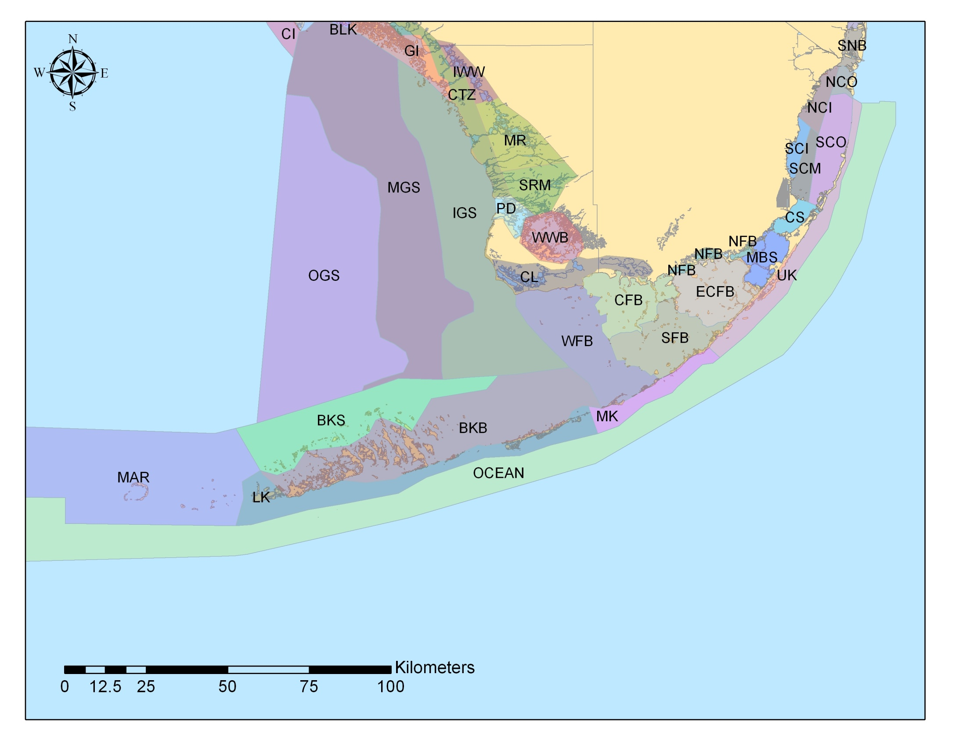
Florida Keys

Slide 67
Florida Keys
Seagrass Communities
  The Florida Keys National Marine Sanctuary (FKNMS) has been monitoring seagrasses since 1995
  Seagrasses are one of the dominant primary producers in the Keys and the seagrass beds are among the most extensive in the world.
  FKNMS seagrass monitoring has not found statistically significant changes in the community composition or N:P elemental ratios across the sanctuary for the period of record
  However, increased calcareous macroalgal growth has been observed at some sites close to shore

Slide 68
Response variable | Observed ? | Explanation
Low dissolved oxygen (DO) | Yes | Low DO concentrations have been observed in canals in the Keys and were observed at several nearshore stations during sampling in 1985 for the OFW designation. Diel low DO in SAV beds is a natural phenomenon resulting from SAV respiration.
Reduced clarity | Yes | There has been increased turbidity in nearshore areas, likely due to resuspension of sediments by wind and wave action. However, light penetration to SAV beds generally exceeds 40% of surface values, meaning light is not a limiting factor for SAV growth throughout the Keys.
Increased chlorophyll a | No | Chlorophyll a has not increased over time nor does it vary as a function of distance from land. Chlorophyll a median concentrations are extremely low (µg l⁻¹) for the monitoring period between 1995 and 2008.
Phytoplankton blooms (nuisance or toxic) | Yes | Periodic algae blooms originate on the Gulf side of the Keys in Florida Bay or along the southwest Shelf, and are not associated with human activities. The Blackwater event in 2002, resulting from natural tannic inputs into west Florida coastal waters, included a nontoxic algal bloom that was carried south through the Keys. More recently, in 2005 and 2006, blooms associated with highway development and hurricane activity were restricted to Barnes Sound and Lake Surprise.
Sources: FDEP (2008), Boyer and Jones (2002), Boyer and Briceño (2009)

Slide 69
Response variable | Observed ? | Explanation
Problematic epiphyte growth | No | Epiphyte growth is highly seasonal, and recent experimental studies have not found increased epiphytes associated with nutrient additions due to the activity of grazers.
Problematic macroalgal growth | No | Abundance of calcareous macroalgae in the FKNMS has increased over time, however, calcareous macroalgae is considered a viable benthic habitat. Sites closest to land and with the highest water column nitrogen (N) concentrations have the highest calcareous algae abundance.
SAV community changes or loss | No | Data from the FKNMS monitoring program’s permanent stations indicate no significant sanctuary-wide decrease in SAV coverage or adverse changes in community composition. Thallassia tissue nitrogen: phosphorus (N:P) ratios are being investigated to determine if this metric may be indicative of early signs of eutrophication. Results from the FKNMS monitoring show no clear spatial pattern that human activities have resulted in adverse eutrophication effects.
Sources: Fourqurean et al. (2010), Collado-Vides et al. (2005, 2007), Fourqurean and Escorcia (2009), Lapointe et al. (2004)

Slide 70
Response variable | Observed ? | Explanation
Emergent or shoreline vegetation community changes or loss | Yes | Shoreline vegetation has changed in many areas where human development has occurred due to physical (not nutrient) disturbance.
Coral/hardbottom community changes or loss | Yes | Coral cover has significantly declined, and there have been periodic outbreaks of coral diseases (black band and other diseases) in the Keys and throughout the Caribbean. Overall mean percent stony coral cover has been stable since 1999. Changes in coral health (cover and condition) has not been directly related to anthropogenic land-based sources of nutrients.
Impacts to benthic community | - | Covered above.
Fish kills | Yes | Periodic fish kills have been attributed to factors other than nutrient enrichment (e.g., low DO, red tide, cold, and other factors).
Sources: Donahue et al. (2008), Callahan et al. (2007), Lirman and Fong (2007), FWRI

Slide 71
Florida Keys NNC Comparison
 |  | DEP 1 in 5 year |  | DEP 5 Year Mean |  | EPA 1 in 3 Year
Parameter | Region | Inshore | Offshore | Inshore | Offshore | Inshore | Offshore
TP | Florida Keys | 0.008 - 0.01 | 0.008 - 0.012 | 0.006 - 0.009 | 0.007 - 0.011 | 0.007 – 0.009 | 0.008 – 0.011
TN | Florida Keys | 0.194 - 0.281 | 0.191 - 0.259 | 0.169 - 0.238 | 0.158 - 0.219 | 0.20 – 0.28 | 0.21 – 0.26
Chl-a | Florida Keys | 0.31 - 0.44 | 0.34 - 0.81 | 0.23 - 0.32 | 0.26 - 0.64 | 0.27 – 0.38 | 0.38 – 0.73

Slide 72
What’s Next?
DEP is proposing to include these estuarine criteria in Chapter 62-302, if rule-making moves forward
EPA will propose estuary criteria by March 15, 2012 and finalize by November 15, 2012
  Some EPA criteria appear similar to DEP’s

